Slide 1
Reaching 1.5ºC and 2.0ºC global surface temperatures targets
using stratospheric aerosol geoengineering
Simone Tilmes, Doug E. MacMartin, Jan Lenaerts, Leo van Kampenhout,
Laura Muntjewerf, Lili Xia, Cheryl S. Harrison, Kristen M. Krumhardt,
Mike M. Mills, Ben Kravitz, and Alan Robock
GLENS Meeting, November 4th, 2019

Slide 2
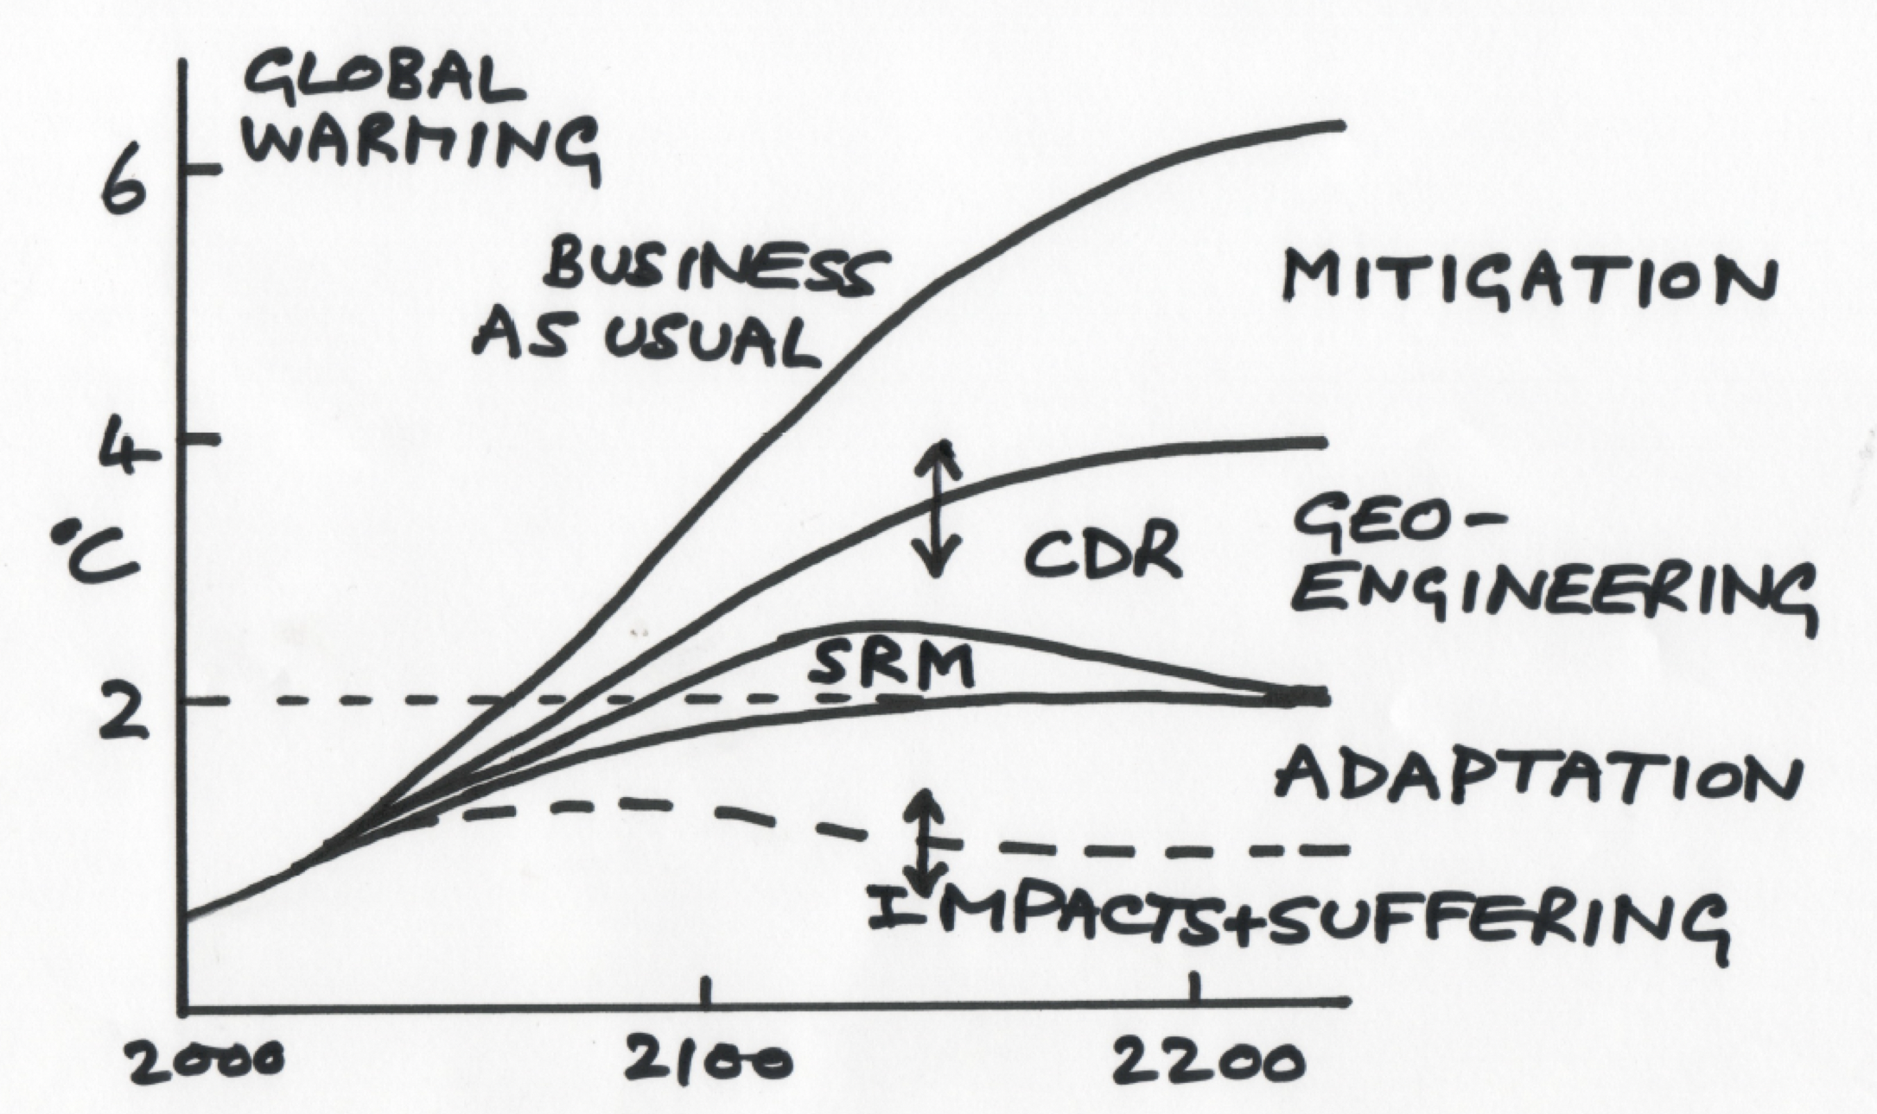
Motivation
What is a more realistic scenario for GeoMIP to explore impacts and side effects?
G1-G6:
Don’t aim towards reaching 1.5 or 2C temperature targets
Using solar dimming and/or stratospheric aerosol using EQ injections
GLENS:
Targets 3 temperature goals, but based on RCP8.5 (high forcing scenario)
Does not allow for a phase of of geoengineering after some time
G8: Overshot scenario
Napkin Diagram: Warming and Suffering
Jane Long and John Shepherd, 2014

Slide 3
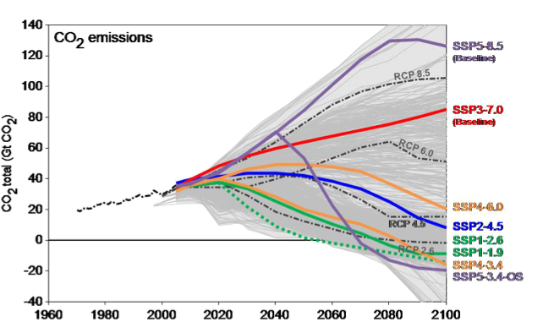
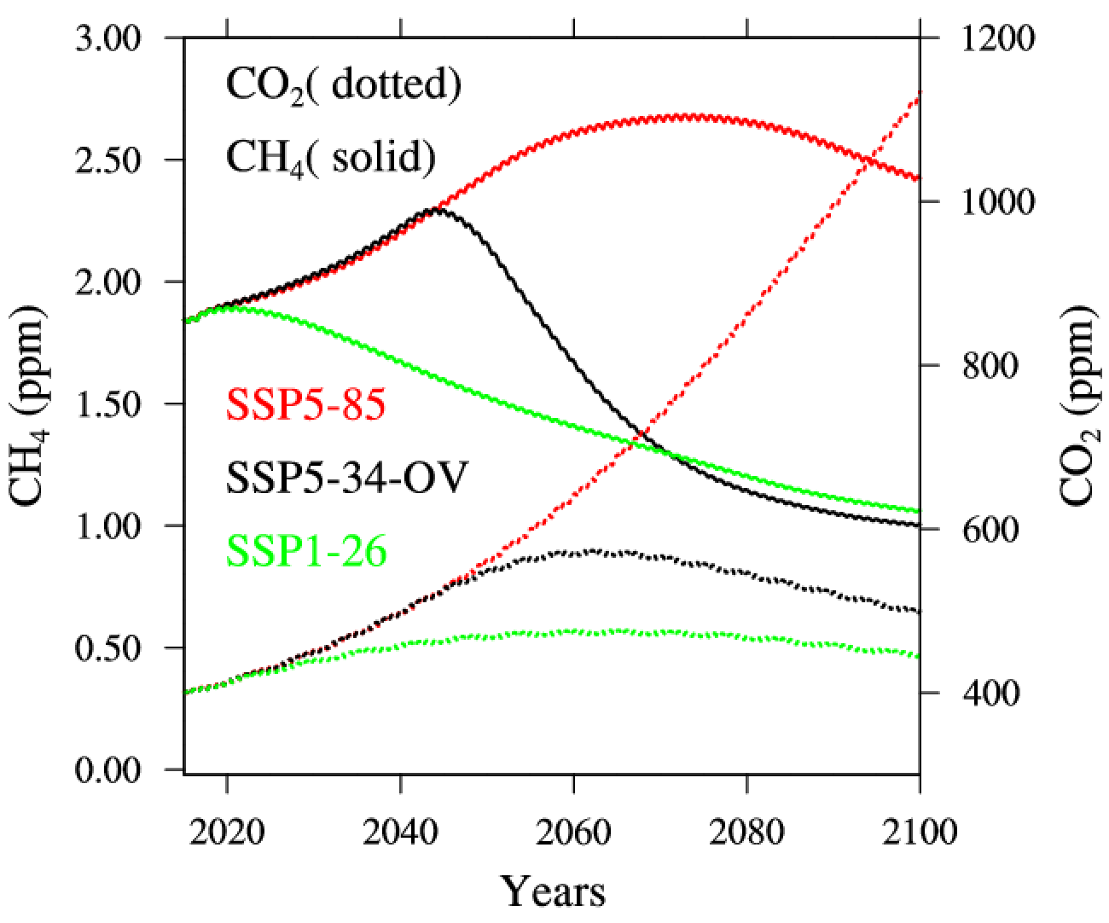
CMIP6 SSP5-85 and SSP-34-Overshoot Pathways
CO₂ emissions
Greenhouse Gas Concentrations
Overshoot
SSP5-85
SSP5-34-OS
SSP1-26
SSP5-85: High forcing scenario, continued increase in CO₂ concentration
Overshoot: Following the SSP5-85 pathway until 2040, strong decarbonization thereafter

Slide 4
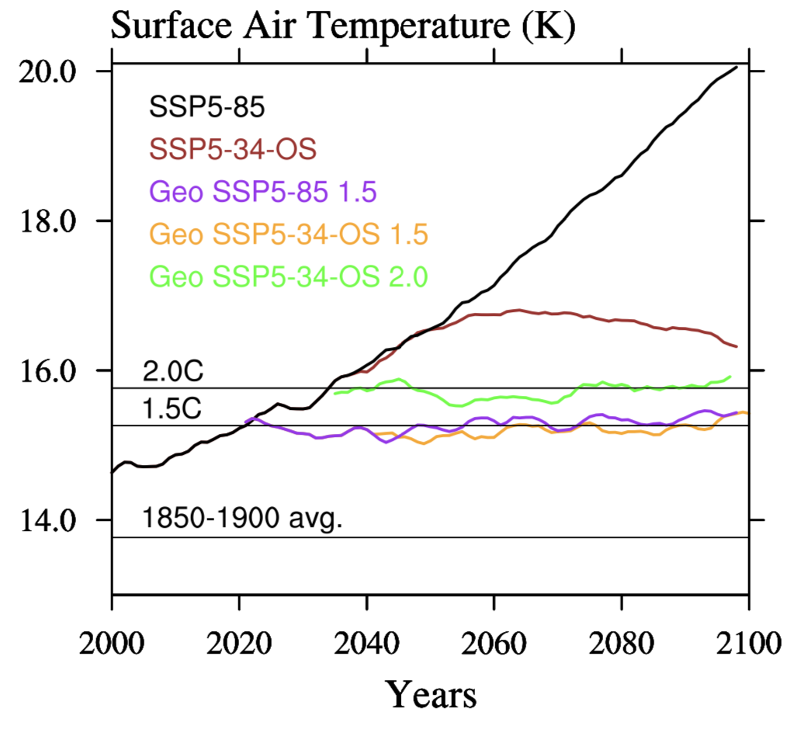
CMIP6 GeoMIP Experiments: Overshoot Experiment
Baseline1: SSP5-85
Baseline 2: SSP5-34-OS: Temperatures are increasing up to 3C degrees in WACCM6 compared to PI
Geoengineering: Keep temperatures from reaching above 1.5C and 2.C from 1850-1900 global average temperatures
Apply 4 injection locations and the feedback controller to reach surface temperature targets
T₀ = Global mean temperature
T₁ = Inter-hemispheric temperature gradient
T₂ = Equator-to-pole temperature gradient

Slide 5
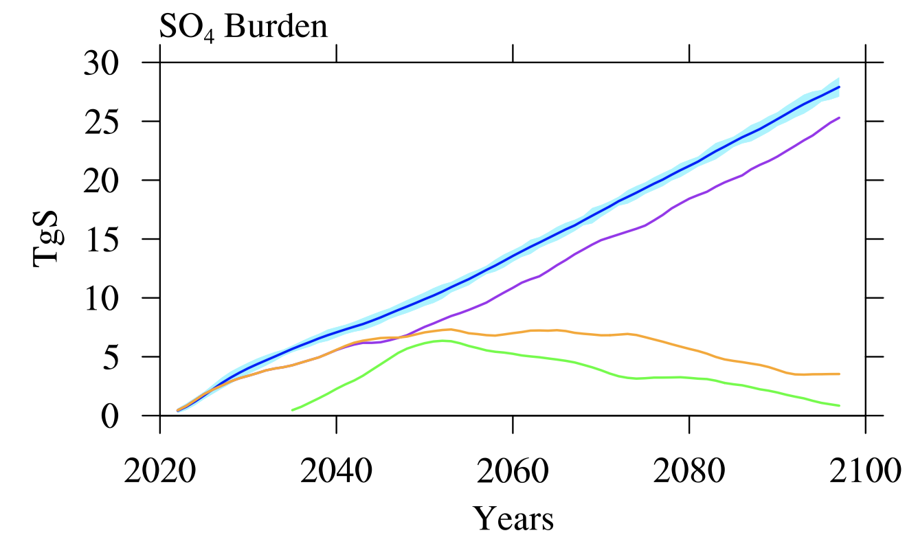
CMIP6 GeoMIP Experiments: Overshoot Experiment
GLENS
Geo SSP5-85 1.5
Geo SSP5-34-OS 1.5
Geo SSP5-34-OS 2.0
Accumulated Injection amount:
GLENS: 2056 Tg SO₂
SSP5-85: 1710 Tg SO₂
SSP5-34-OS-1.5: 605 Tg SO₂
SSP5-34-OS-2.0: 305 Tg SO₂

Slide 6
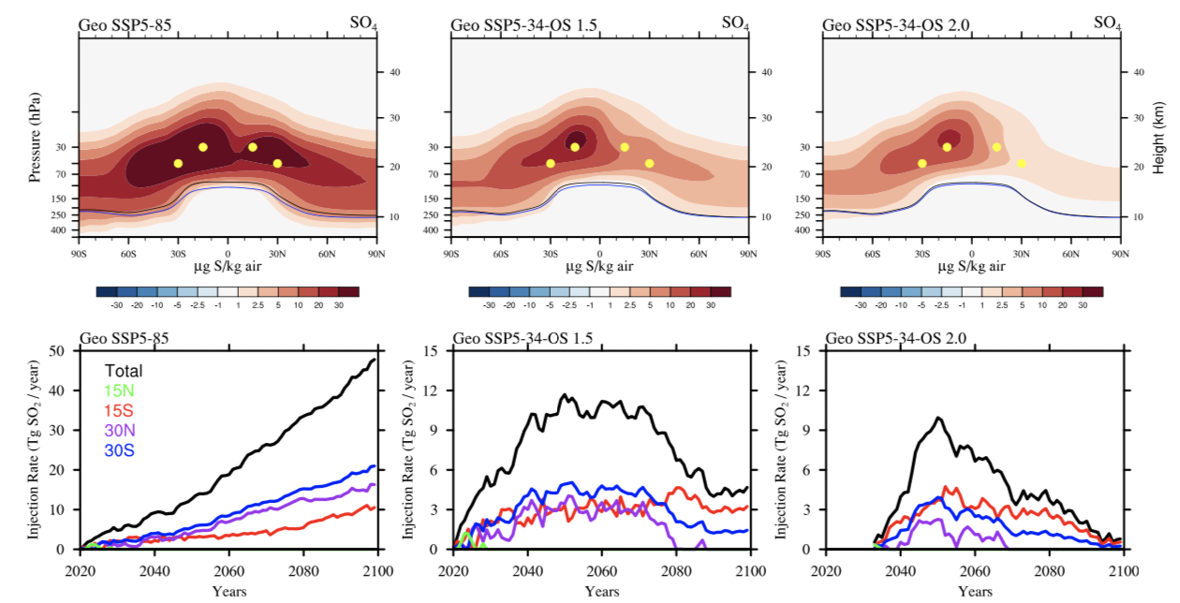
Sulfate Burden and Injection Amount (2060-69)
Geo SSP5-85 1.5
Geo SSP5-34-OS 1.5
Geo SSP5-34-OS 2.0

Slide 7
CMIP6 GeoMIP Experiments: Overshoot Experiment
Identify impacts based on:
Temperature Targets (1.5 vs 2.0C)
Injection amount
CO₂ content in the atmosphere
Discuss quantities that are more relevant for ecosystems and society

Slide 8
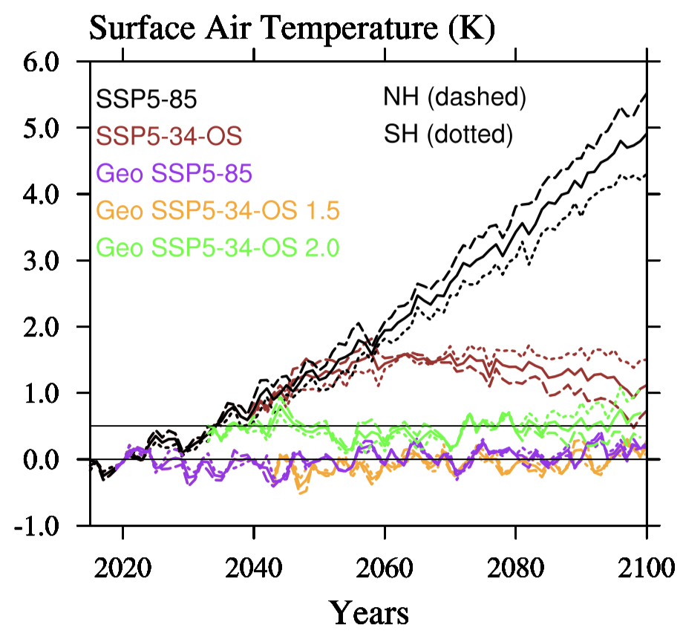
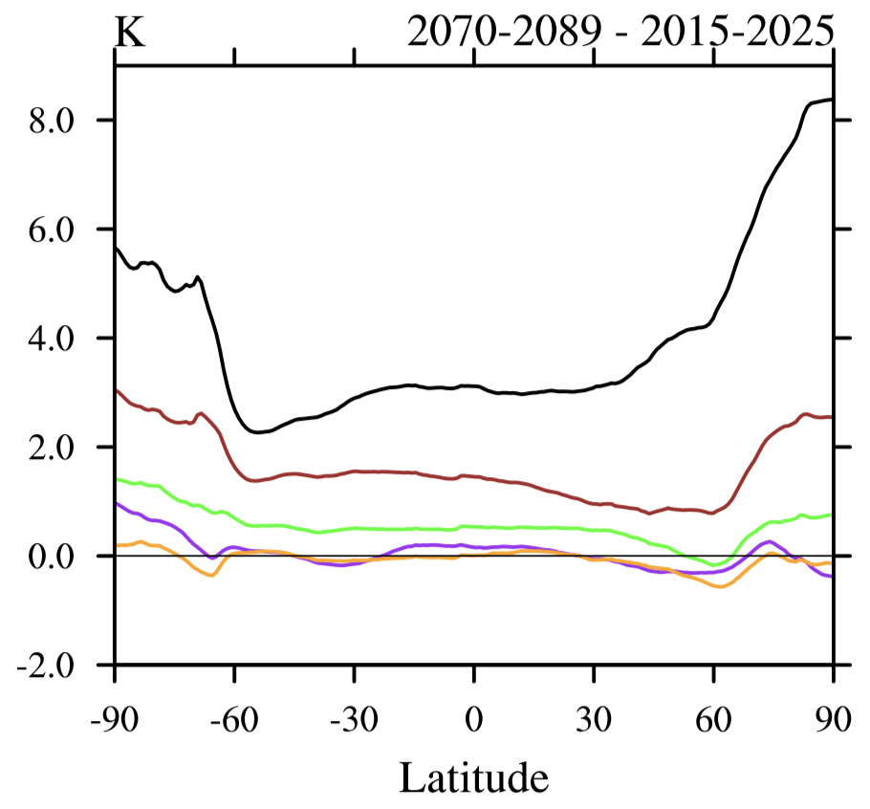
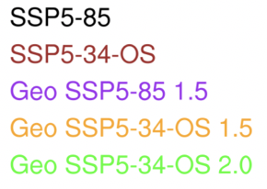
Reaching Surface Temperature Targets
Surface Air Temperature Change

Slide 9
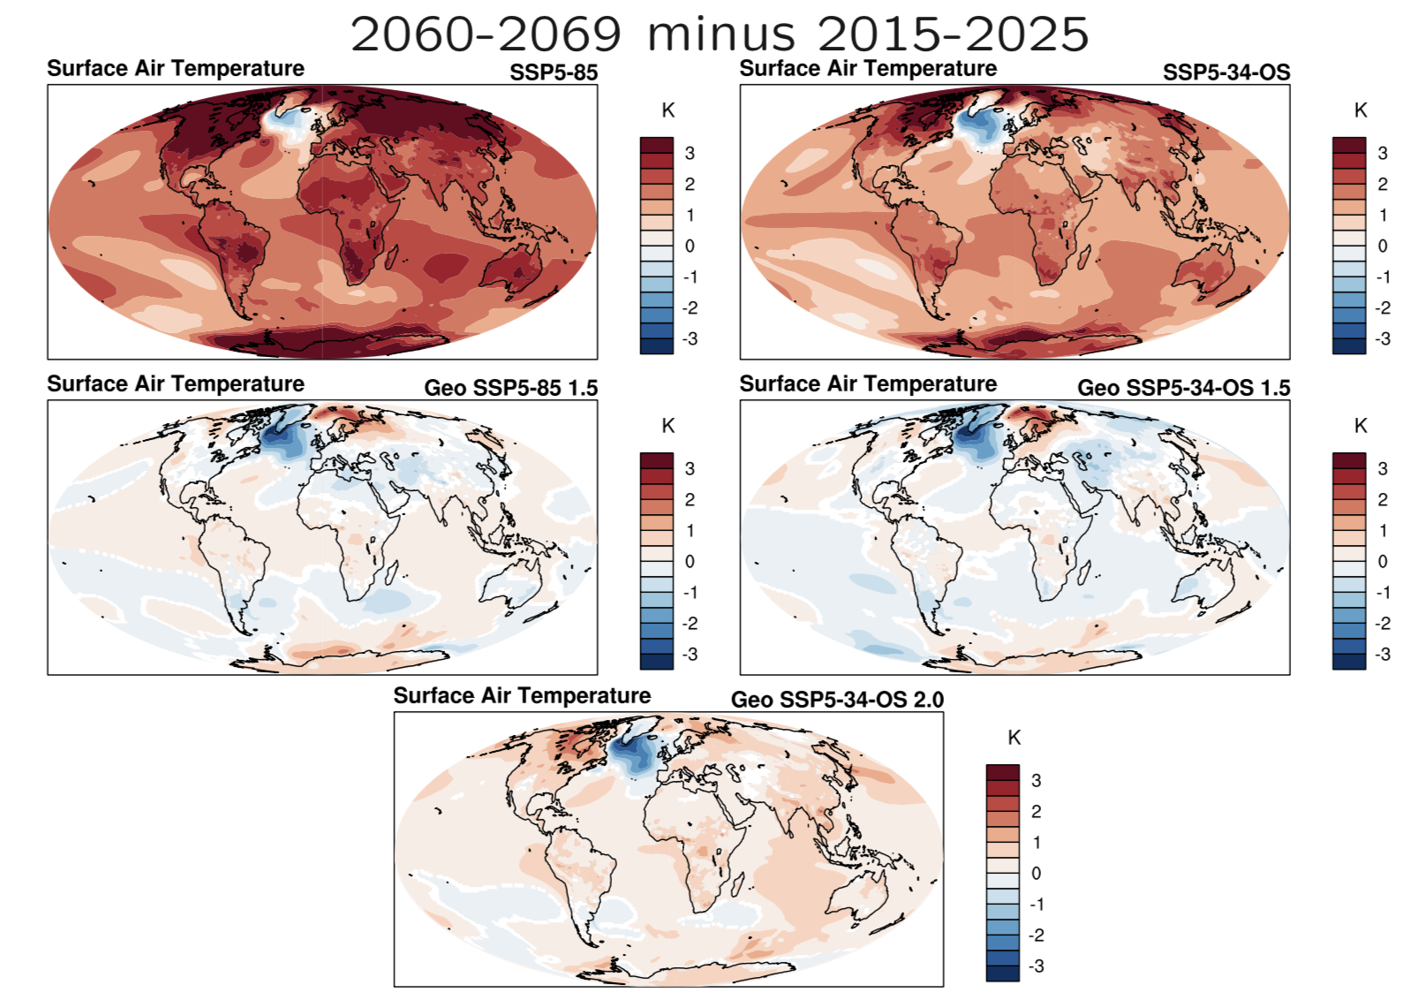
Surface Temperature and AMOC
Surface Air Temperature Change
Notes:
The AMOC index is defined as the maximum flux in the Atlantic Basin between 500m depth to the bottom, and between 28 - 90°N (Sverdrups).

Slide 10
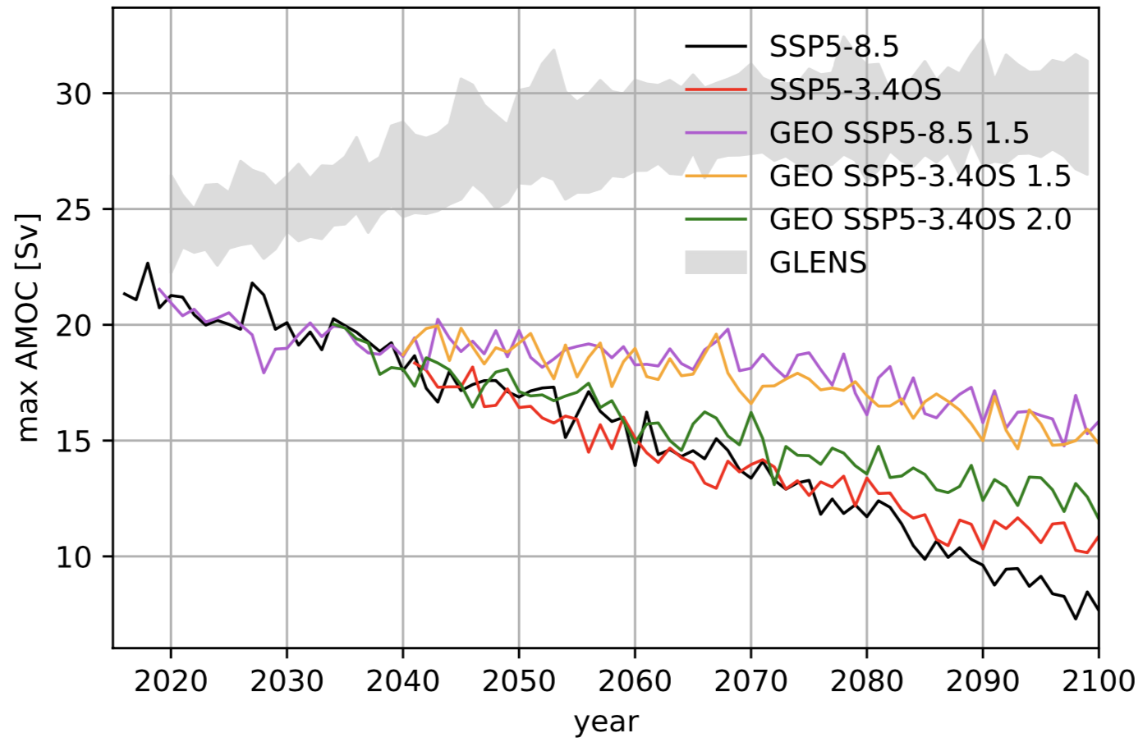
Surface Temperature and AMOC
Laura Muntjewerf
AMOC depends on surface temperature targets
Both Geo OS and Geo SSP-8.5 to 1.5C look very similar
However, Geo OS 2.0C is showing a stronger slowing
Notes:
The AMOC index is defined as the maximum flux in the Atlantic Basin between 500m depth to the bottom, and between 28 - 90°N (Sverdrups).

Slide 11
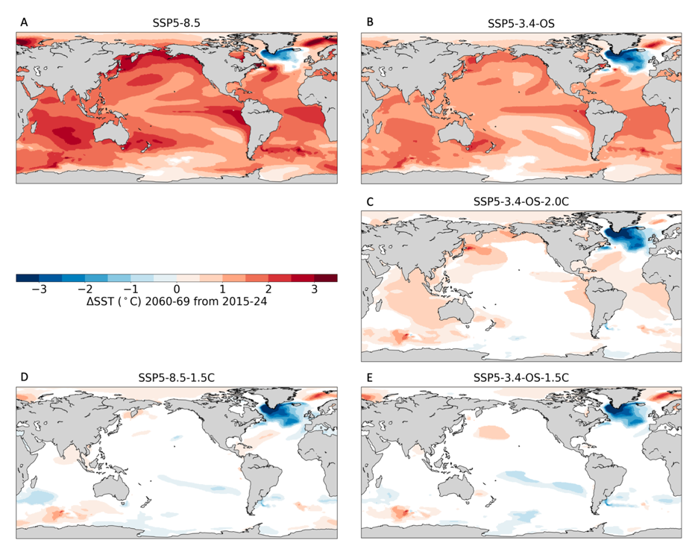
Sea Surface Temperatures
Ocean warming
Impact on fishery
Increase net primary productivity by phytoplankton
Ocean stratification -> reduces NPP
Changes in currents, sea-ice, river flow
Complicated response in different areas
-> 5% decline in fishery for every degree of warming (Lotze et al., 2019)
Anomalies outside the PI control level
(95% confidence interval)
Cheryl S. Harrison
Notes:
Setup difficult: albedo in that grid box will be set to α'=max⁡(1+δα,1.0), where δ is a constant
(radiative flux perturbation, changes of top of the atm. radiative forces of two fixed SST experiments)

Slide 12
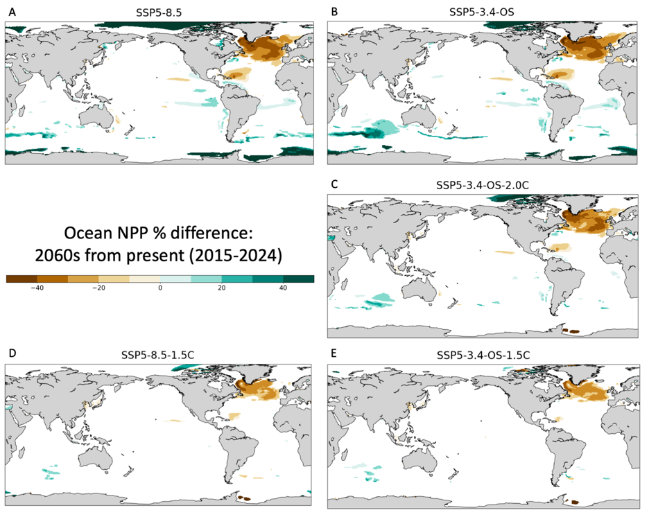
Ocean Ecosystem Impact, NPP
Anomalies outside the PI control level
(95% confidence interval)
NPP increase over the NH Polar
30-40% decline in NPP over the North Atlantic region (likely due to changes in nutrient supply)
Reduced effect 20-30% reduction for Geo SSP8.5 1.5C and OS 1.5C
Effects of ocean acidification not in the model (CO₂ dependent)
-> NPP changes are strongly dependent on the temperature target
Cheryl S. Harrison

Slide 13
Ice Sheet Mass Balance
Greenland
Antarctica
Jan Lenaerts, Leo van Kampenhout
1960-1990
1960-1990
Surface Mass Balance (SMB): snow fall and surface melt
Solid Ice Discharge (D) (dependent on ice flow and ice thickness)
Mass balance: MB = SMB – D, Tipping point: SMB = 0.
ISMB changes are strongly dependent on the temperature target
Notes:
Decline is driving by increased surface run off (partly offset by increased snowfall)

Slide 14
Ice Sheet Mass Balance
Greenland
Antarctica
Jan Lenaerts, Leo van Kampenhout
1960-1990
1960-1990
Surface Mass Balance (SMB): snow fall and surface melt
Solid Ice Discharge (D) (dependent on ice flow and ice thickness)
Mass balance: MB = SMB – D, Tipping point: SMB = 0.
Notes:
Decline is driving by increased surface run off (partly offset by increased snowfall)

Slide 15
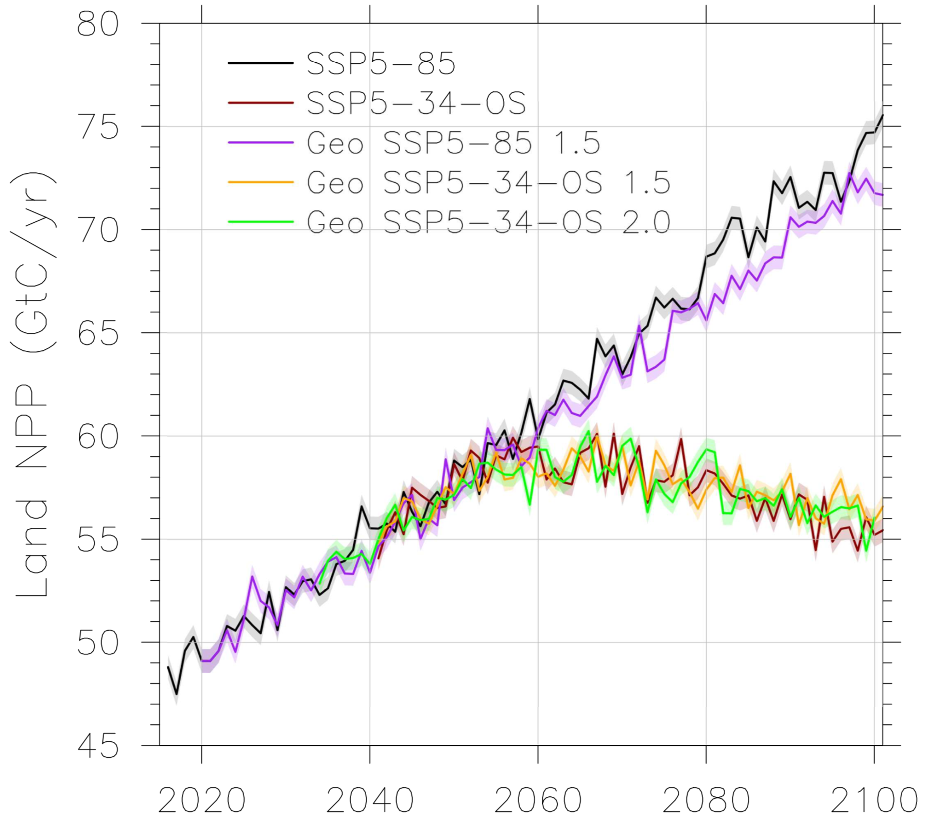
Land Primary Productivity, NPP
Land NPP strongly dependent on CO₂ content in the atmosphere.
Small reduction with geoengineering using SSP8.5 baseline.
Almost no differences with and without geoengineering using SSP5-34-OS
Lili Xia

Slide 16
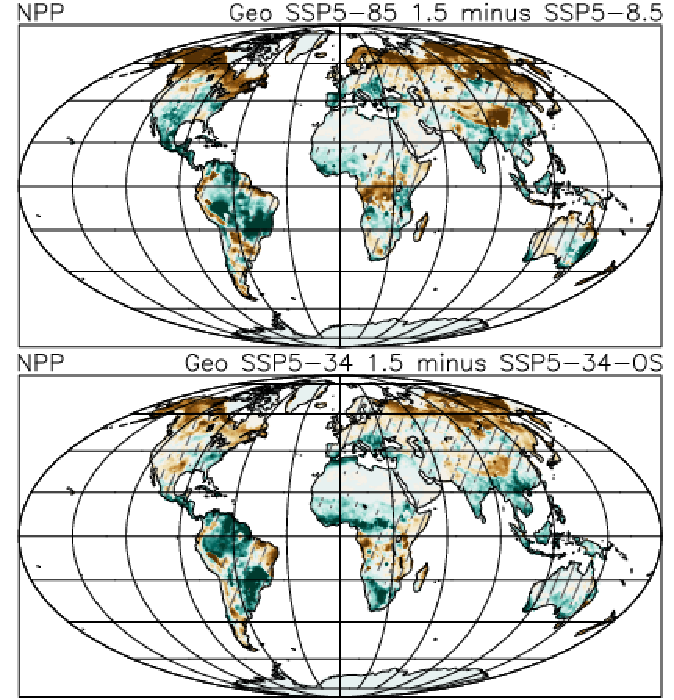
Land Primary Productivity, NPP
Lili Xia

Slide 17
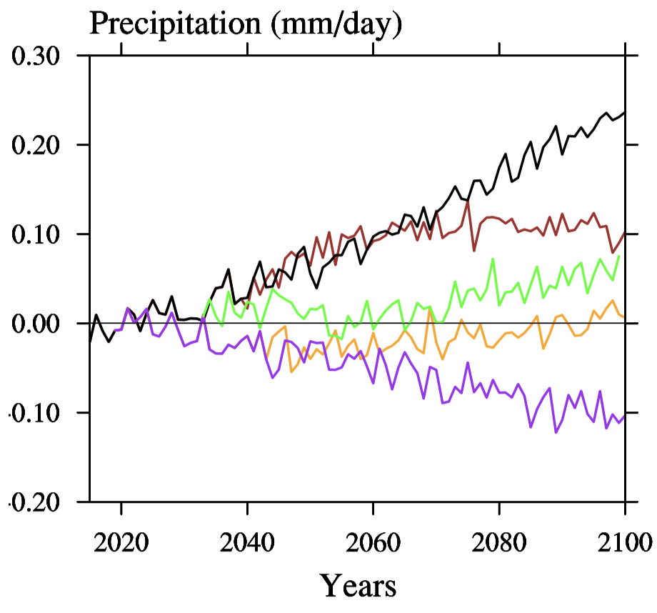
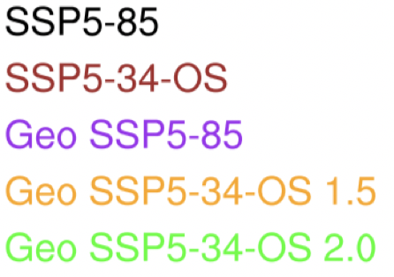
Global Precipitation Change
GLENS
Geo SSP5-85 1.5
Geo SSP5-34-OS 1.5
Geo SSP5-34-OS 2.0
Precipitation changes are strongly correlated to the amount of injection / stratospheric sulfate burden
Notes:
Shifts in precipitation are dependent on changes in the top of atmosphere imbalance in the baseline scenario.

Slide 18
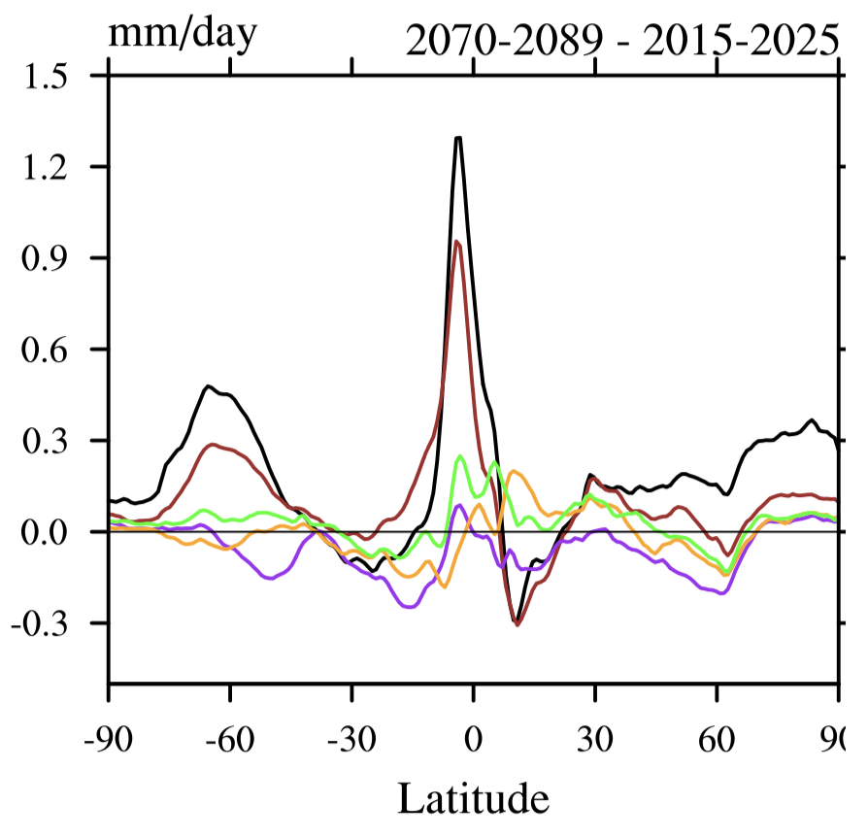
Global Precipitation Change
Notes:
Shifts in precipitation are dependent on changes in the top of atmosphere imbalance in the baseline scenario.

Slide 19
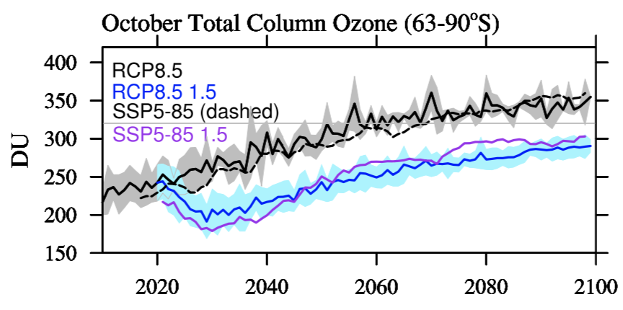
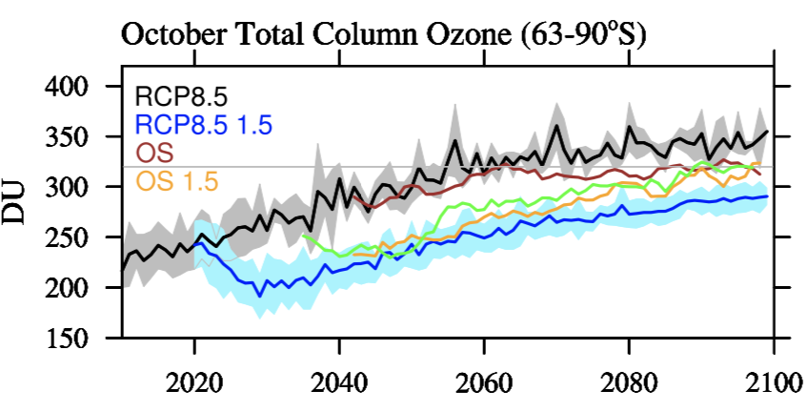
Effects on Stratospheric Ozone

Slide 20
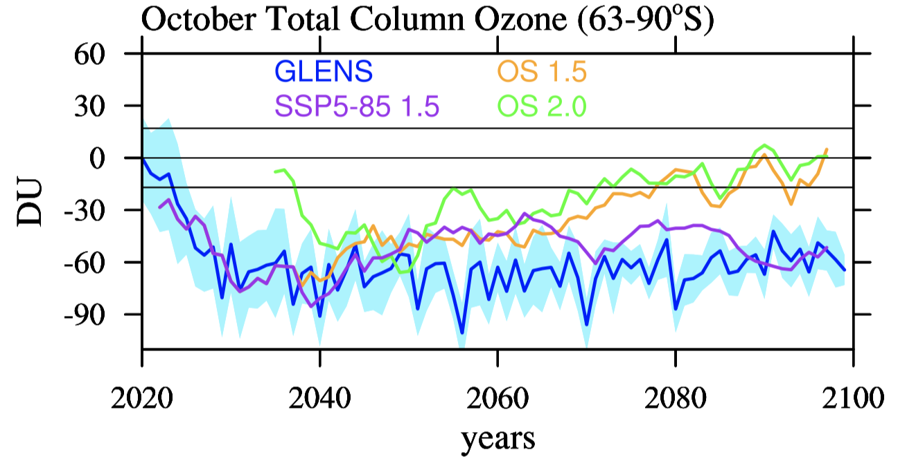
Effects on Stratospheric Ozone
Difference
from the Control
OS baseline results in reduced impact on ozone by the end of the century
Reduced injection amount in OS 2.0 still results in large ozone loss for some years

Slide 21
Summary

