Slide 1
Sensitivity of stratospheric ozone changes to stratospheric aerosol geoengineering”
Simone Tilmes
ACOM Project Scientist II
June 12, 2019

Slide 2
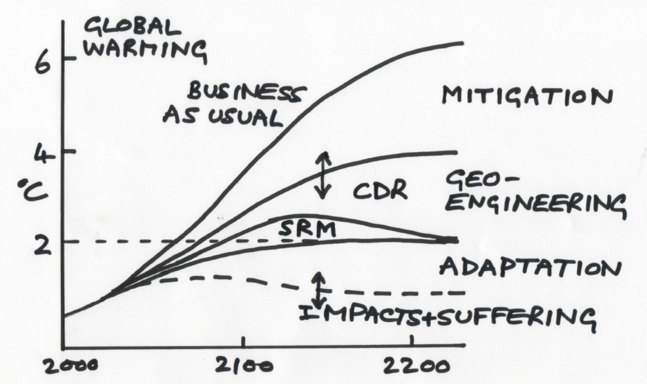
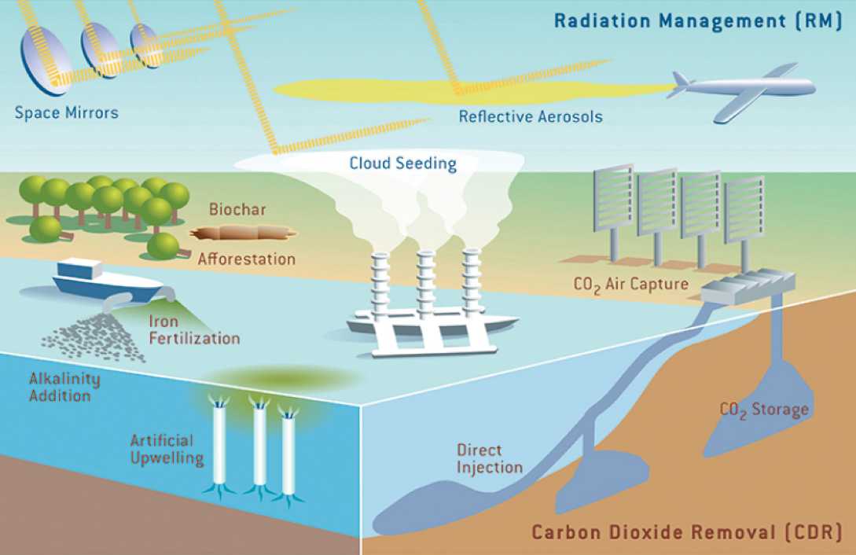
Motivation
Should Geoengineering be part of the mitigation portfolio?
Napkin Diagram: Warming and Suffering
What are the Risks?
Unintended consequences?
Limitations?
Jane Long and John Shepherd, 2014

Slide 3
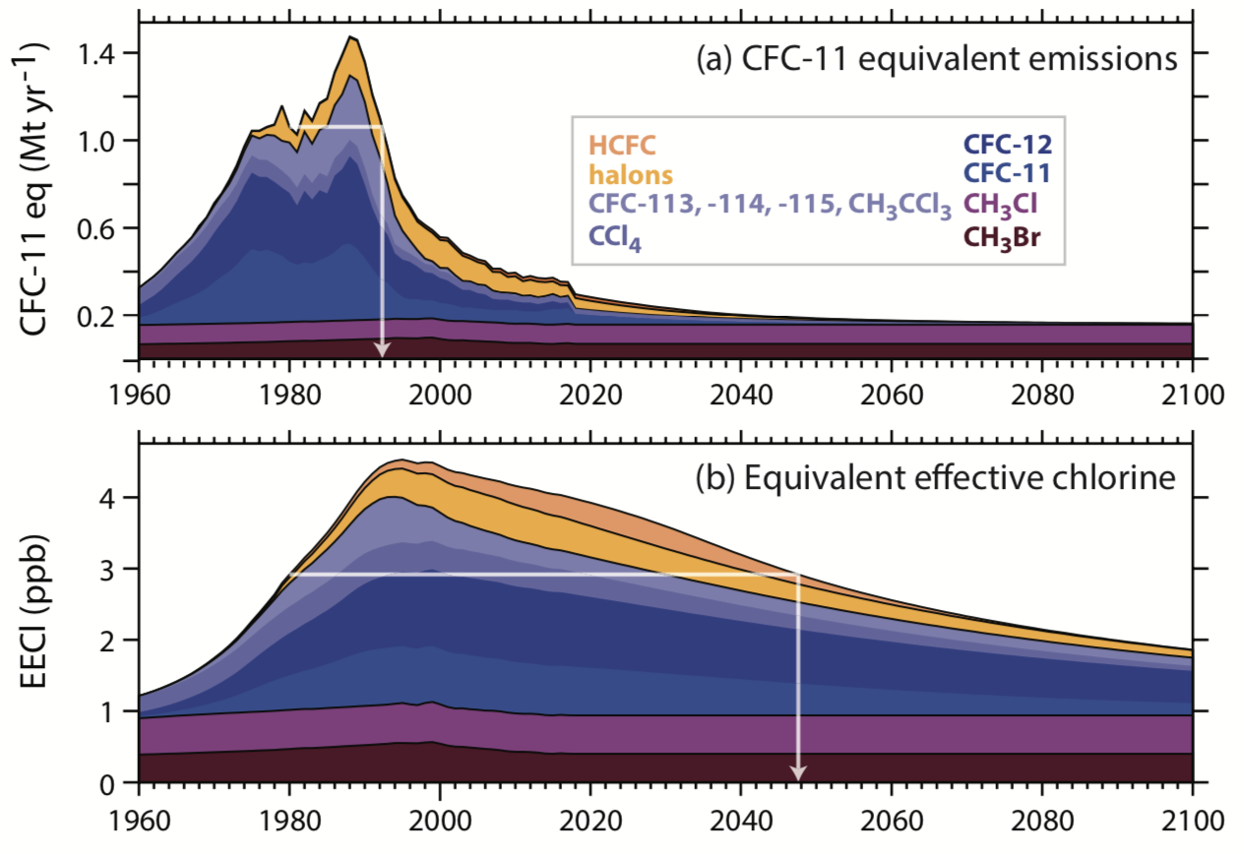
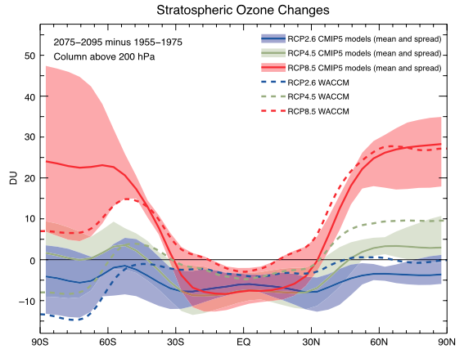
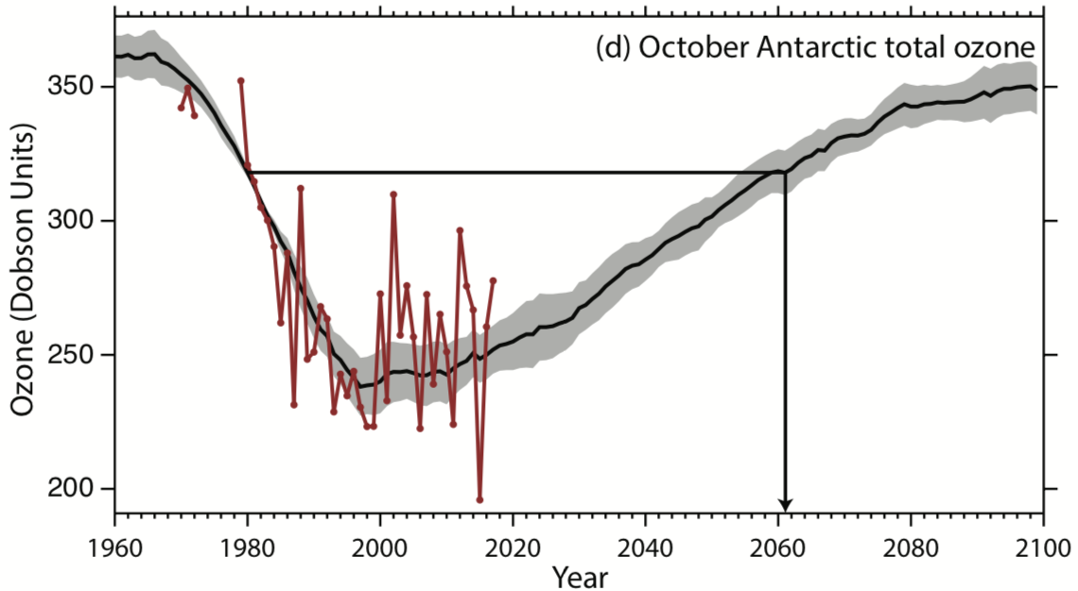
Future Stratospheric Ozone
Ozone Destroying Substances
Stratospheric Ozone Changes
2075-95 minus 1955-75
WMO 2018
RCP8.5
RCP4.5
RCP2.6
October Antarctic ozone hole
Butler et al, 2016
How is Stratospheric Aerosol Geoengineering effecting Ozone?

Slide 4
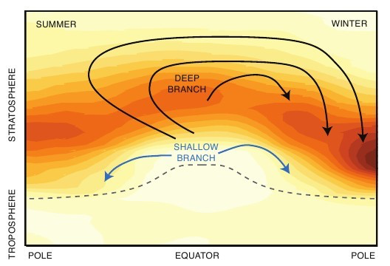
Effects of Geoengineering on Stratospheric Ozone
Stratospheric Ozone
Polar Regions (Ozone Hole)
50 km
CFC
Heterogeneous Reactions
reservoir
STS
STS
reactive
STS
STS
Catalytic cycles
HCl
NAT
STS
STS
STS
NAT
STS
NAT
STS
STS
ClONO₂
STS
STS
HOCl
25 km
STS
STS
STS
Ice clouds and
Sulfate particles
More ozone depletion
20 km
10 km
Tropics / Mid Stratosphere
Heterogeneous Reactions
Ozone Increase
60º
30º
30º
60º
H₂O
STS
STS
STS
STS
More Sulfate Aerosols:
Changes net chemical ozone production
Changes in temperatures and transport
STS
STS
STS
HNO₃
STS
STS
STS
N₂O₅
STS
STS
NO_{x}
STS
STS
STS
Sulfate particles (H₂SO₄)

Slide 5
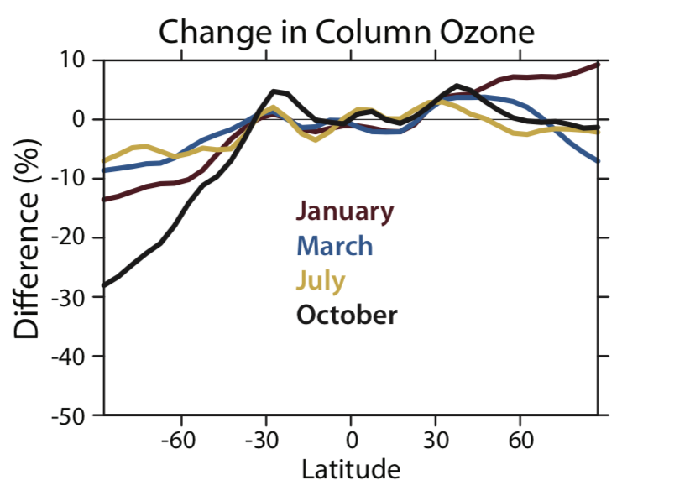
Effects of Geoengineering on Stratospheric Ozone
Stratospheric Ozone
50 km
25 km
20 km
10 km
60º
30º
30º
60º
More Sulfate Aerosols:
Changes net chemical ozone production
Changes in temperatures and transport
Chapter 6: Figure 6A-1

Slide 6

Effects of Geoengineering on Stratospheric Ozone
Intentional long-term geoengineering applications that substantially increase stratospheric aerosols to mitigate global warming by reflecting sunlight would alter stratospheric ozone. The estimated magnitudes and even the sign of ozone changes in some regions are uncertain because of the high sensitivity to variables such as the amount, altitude, geographic location and type of injection, and the halogen loading. An increase of stratospheric sulfate aerosol burden in amounts sufficient to substantially reduce global radiative forcing would delay the recovery of the Antarctic ozone hole. Much less is known about the effects on ozone from geoengineering solutions using non-sulfate aerosols.

Slide 7

Overview
Understanding the sensitivities of ozone changes to geoengineering
Geoengineering Large Ensemble (GLENS) simulations
Discuss changes in stratospheric ozone
Discuss the effects of using different geographic location
for SO₂ injections
Discuss the effects of using the 110L model version
Next steps:
Design CCMI-GeoMIP Modeling Testbed
New CMIP6 WACCM6 simulations
Tilmes et al., 2018

Slide 8
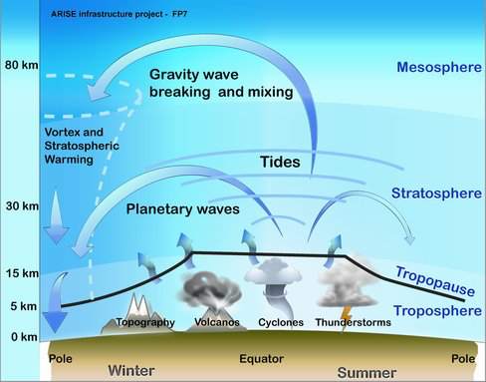
Whole Atmosphere Community Climate Model
CESM-WACCM (CAM5.4):
0.9x1.25º horizontal Res., 140km lid, 70 layer and 110 layer model
Prognostic volcanoes and aerosol microphysics, MAM3
Middle atmosphere chemistry
CLM4.5 (land), sea-ice, ocean
CESM2-WACCM6: CMIP6, GeoMIP
New shallow convection scheme (CLUBB)
Full tropospheric and stratospheric chemistry
New secondary organic aerosol approach (VBS approach), MAM4
CLM5 (land) with interactive, land ice, sea-ice, ocean bio-geo chemistry

Slide 9
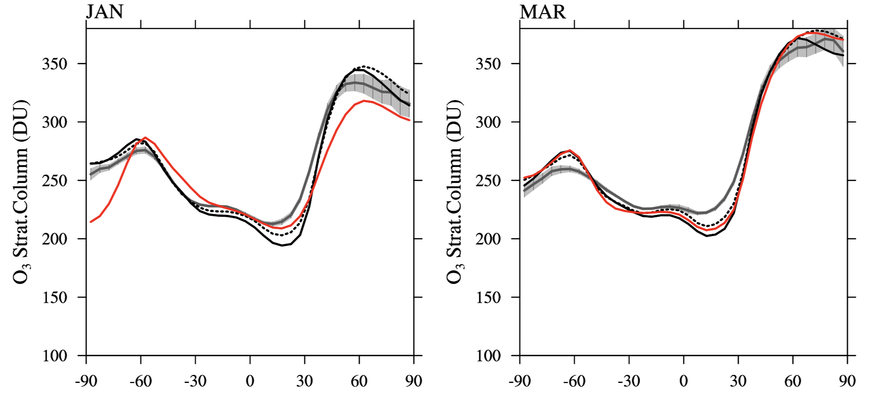
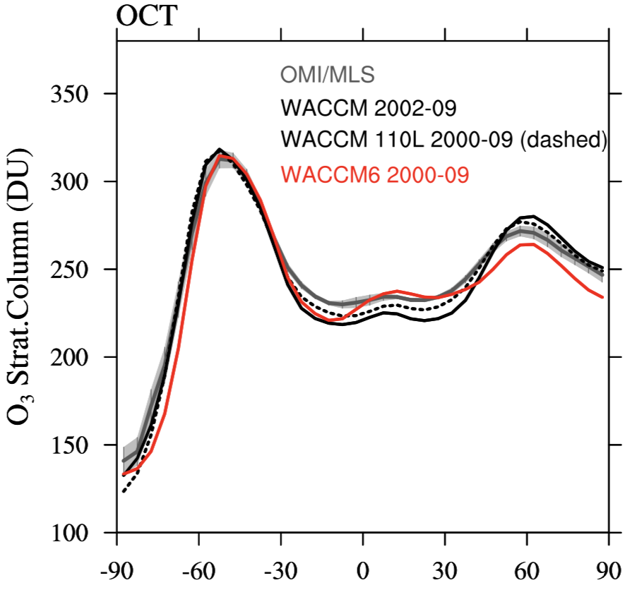
Evaluation WACCM: Stratospheric Ozone
OMI/MLS
WACCM5.4
WACCM5.4 110L (dashed)
WACCM6
Stratospheric Ozone Column 2002-2009
January
March
October

Slide 10
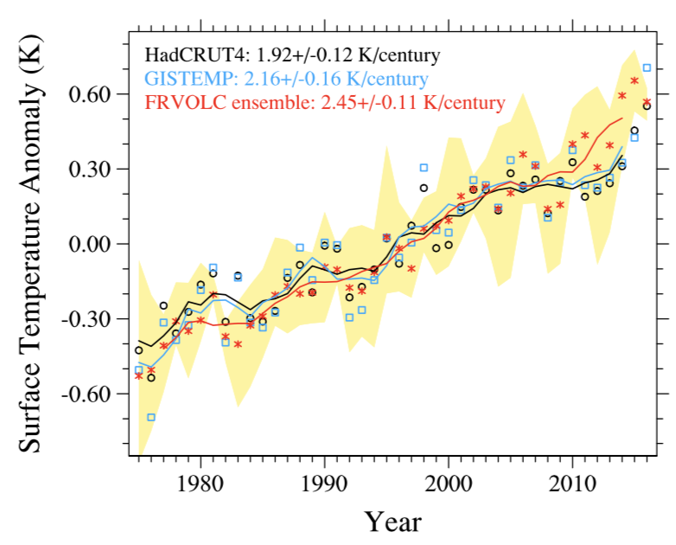
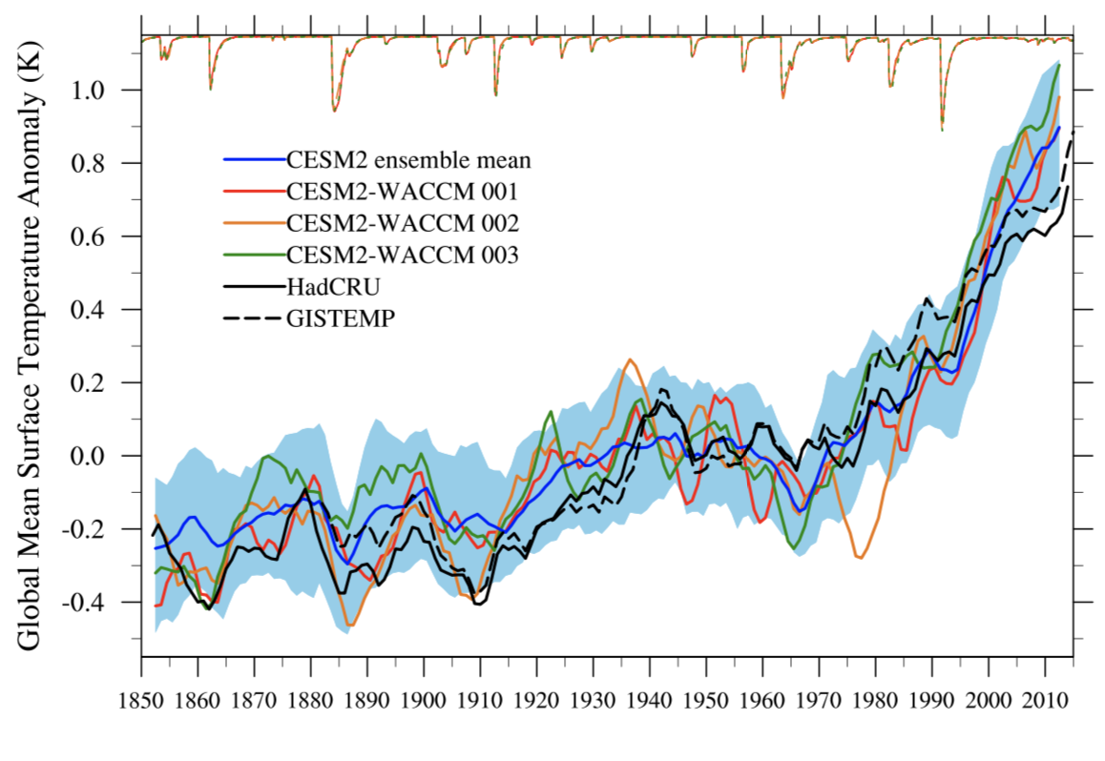
Evaluation WACCM: Surface Temperature
WACCM (CAM5.4)
WACCM6
Mills et al., 2017
Gettelman et al., submitted

Slide 11
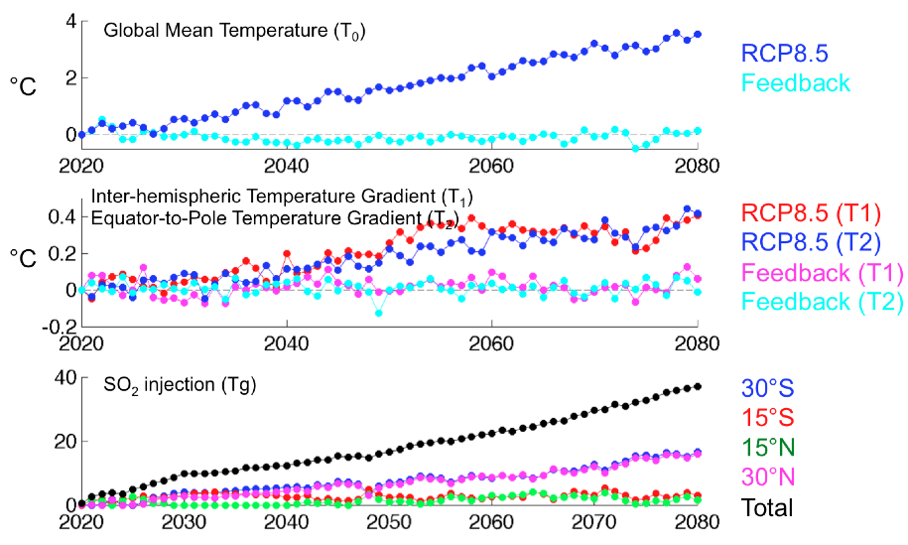
Geoengineering with Feedback Control
Climate Objectives (Surface Temperature):
T₀ = Global mean surface temperature
T₁ = Inter-hemispheric temperature gradient
T₂ = Equator-to-pole temperature gradient
Kravitz et al., 2014
Injections:
30N/30S, 15N/15S; 5 km above the tropopause
Control Period is 2010-2030

Slide 12
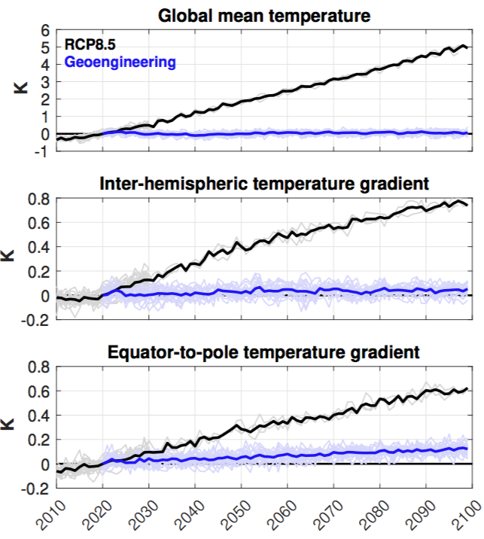
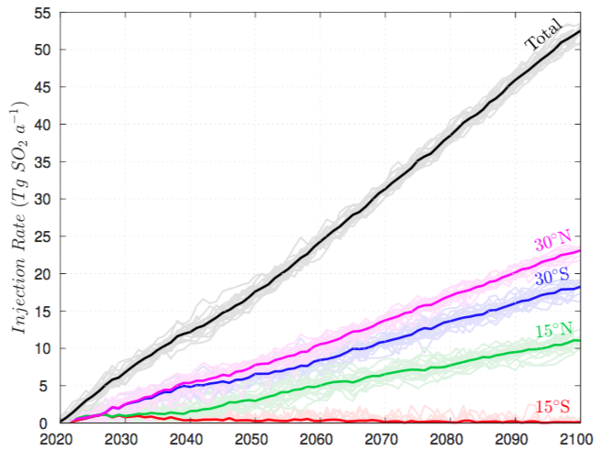
Geoengineering Large Ensemble Experiment
Injection Rate (Tg SO₂/yr)
55
45
35
25
15
5
Total
30ºN
30ºS
15ºN
15ºS
2020 2040 2060 2080 2100
Tilmes et al., 2018
c
Identify growing side effects and limitations of geoengineering
Control Period is 2010-2030

Slide 13
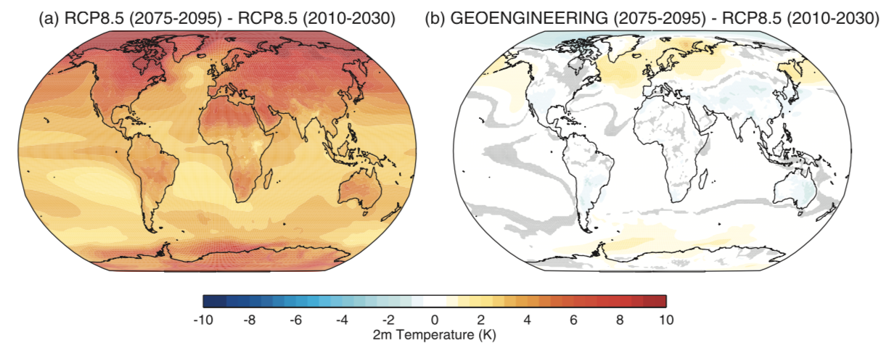
Geoengineering Large 20-Ensemble Experiment
Surface Temperature Change in 2075-2095 compared to 2010-2030
http://www.cesm.ucar.edu/experiments/cesm1.2/GLE/

Slide 14
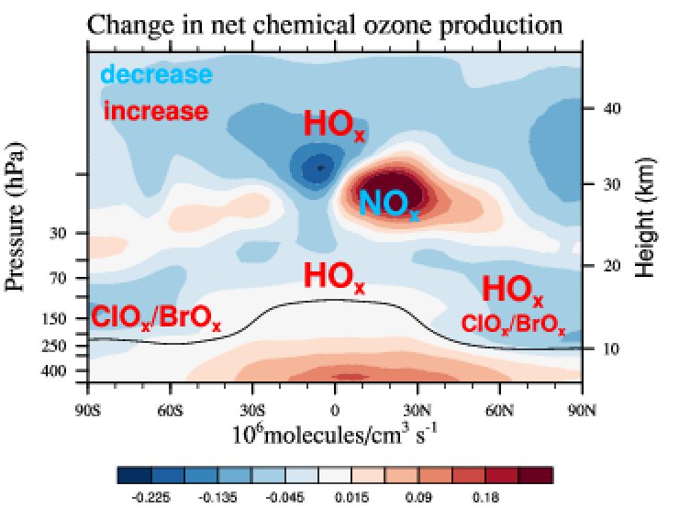
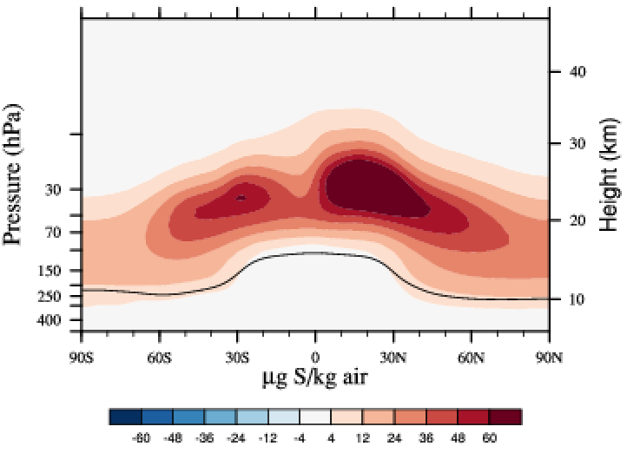
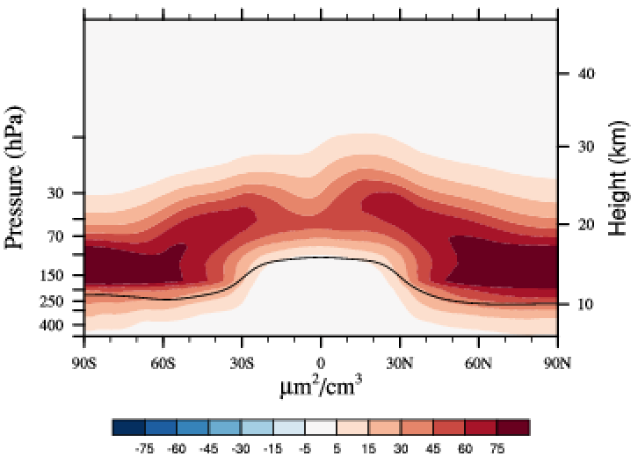
Impacts on Stratospheric Ozone (GLENS)
Geoengineering minus Control (2080-2089)
SO₄ Distribution 2080-89
Surface Area Density 2080-89
Net chem. ozone prod. 2080-89

Slide 15
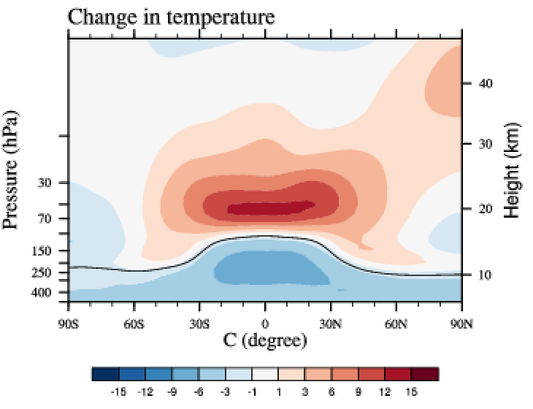
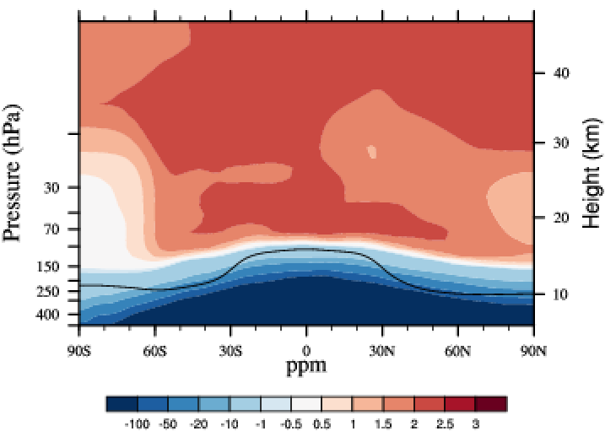
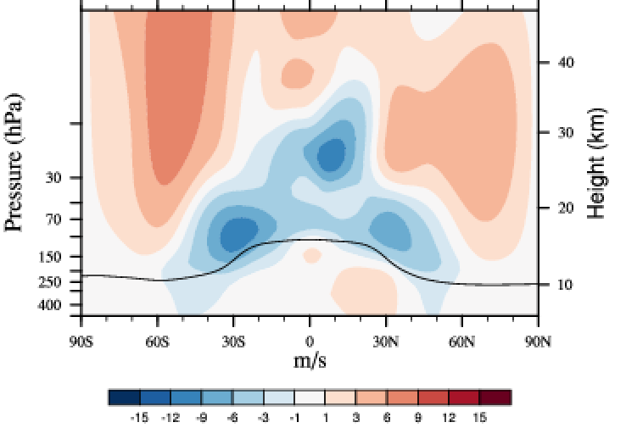
Impacts on Stratospheric Ozone (GLENS)
Geoengineering minus Control (2080-2089)
SO₄ Distribution 2080-89
Surface Area Density 2080-89
Net chem. ozone prod. 2080-89
Temperature change 2080-89
H₂O change 2080-89
Zonal wind change 2080-89

Slide 16
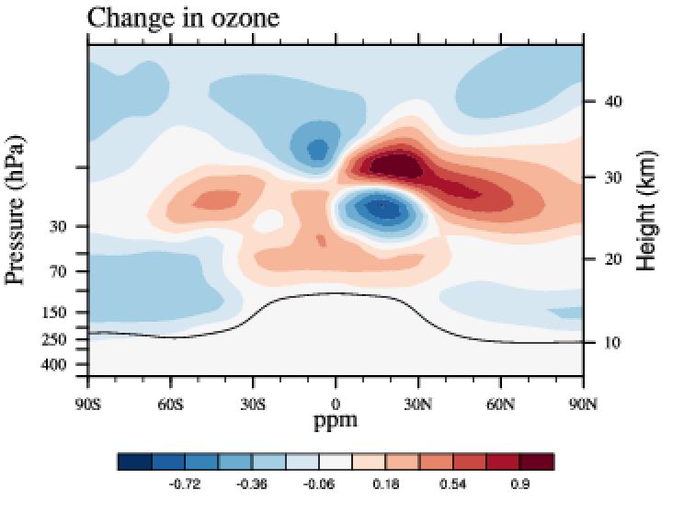
Impacts on Stratospheric Ozone (GLENS)
Geoengineering minus Control (2080-2089)
SO₄ Distribution 2080-89
Surface Area Density 2080-89
Net chem. ozone prod. 2080-89
Ozone change 2080-89
Temperature change 2080-89
H₂O change 2080-89
Zonal wind change 2080-89

Slide 17
Impacts on Stratospheric Ozone (GLENS)
Geoengineering minus Control (2080-2089)
SO₄ Distribution 2080-89
Surface Area Density 2080-89
Net chem. ozone prod. 2080-89
Ozone change 2080-89
Temperature change 2080-89
H₂O change 2080-89
Zonal wind change 2080-89
Mostly chemically controlled
Mostly dynamically controlled

Slide 18
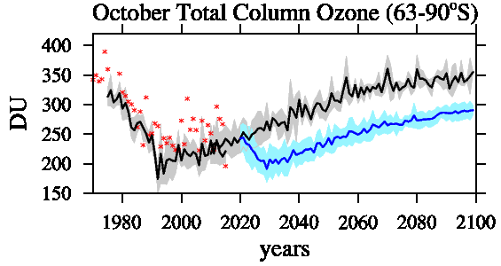
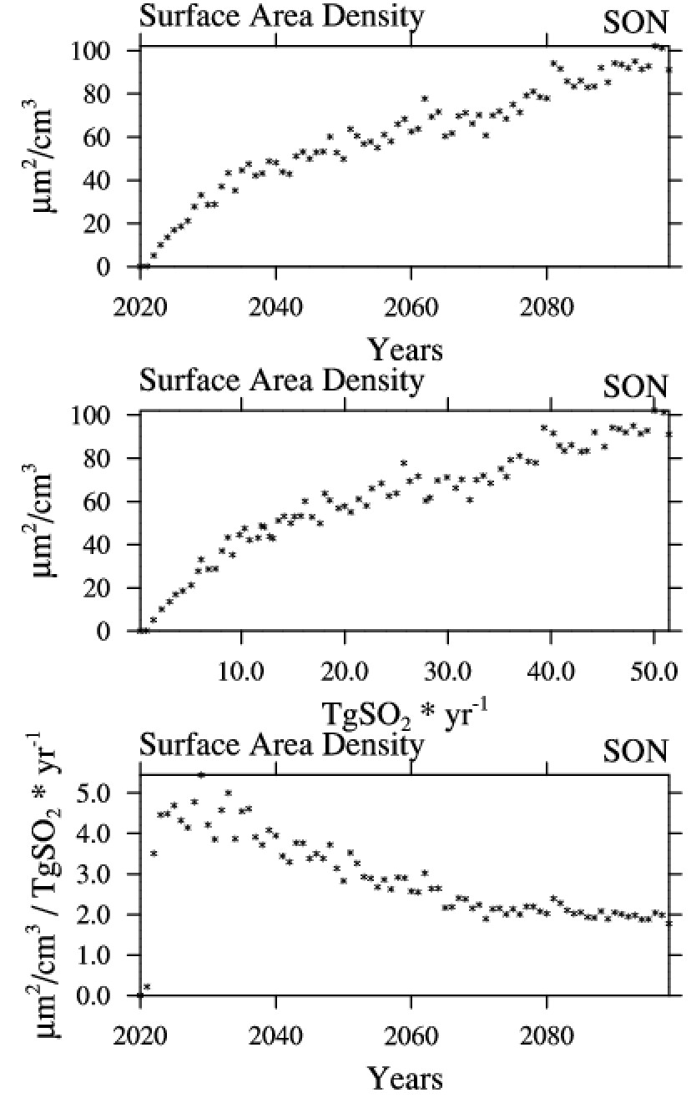
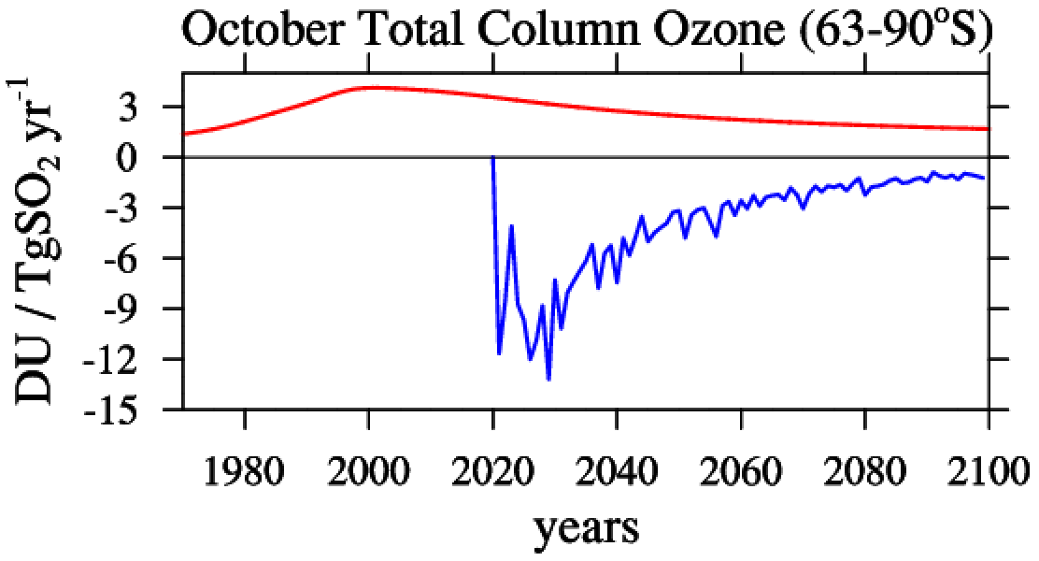
Total Column Ozone Change: SH Polar Region
Surface Area Density 63-90ºS
Surface Area Density
Ozone Sensitivity to
Equivalent Effective Stratospheric Chlorine (EESC)
Surface area density
Polar Temperatures
Horizontal Advection
Gradual start of geoengineering would still lead to a strong reduction in SH polar ozone
100-145hPa
Geoengineering
Surface Area Density per TgSO₂
EESC

Slide 19
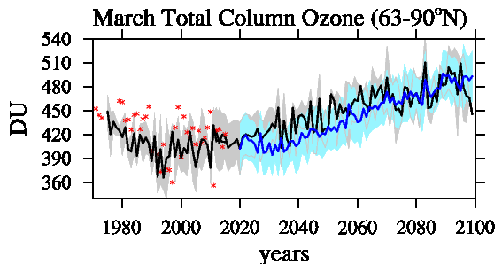
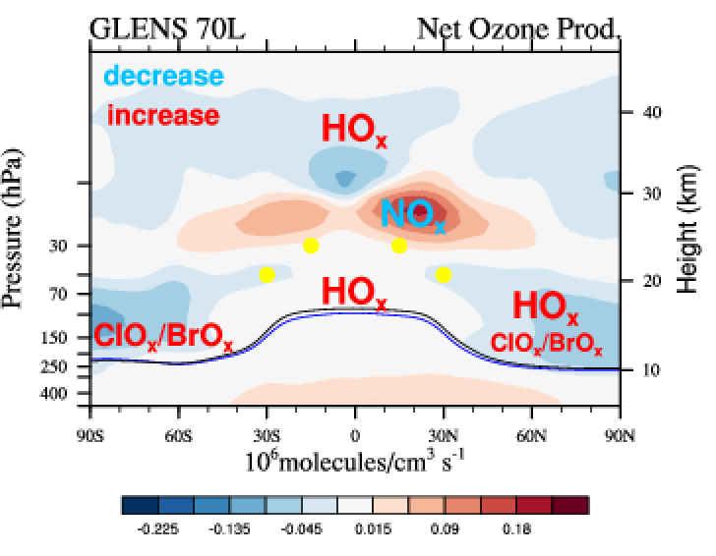
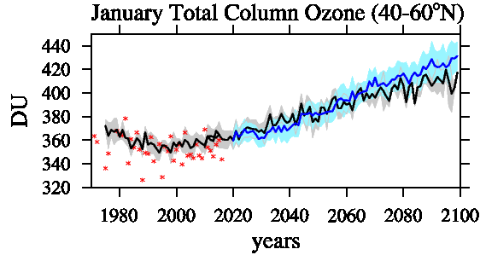
Total Column Ozone Change: NH
Net chem. ozone prod. 2040-49
Net chem. ozone prod. 2080-89
Geoengineering
NH Ozone stronger controlled by transport than chemical changes
EESC
Surface Area Density (chemical changes)
Horizontal Advection (mid/ high latitudes)

Slide 20
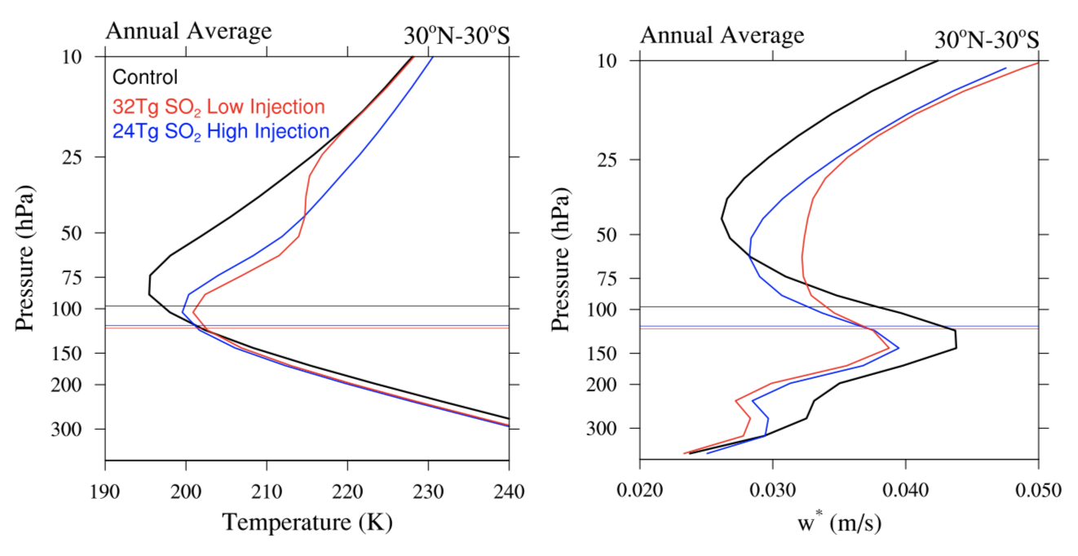
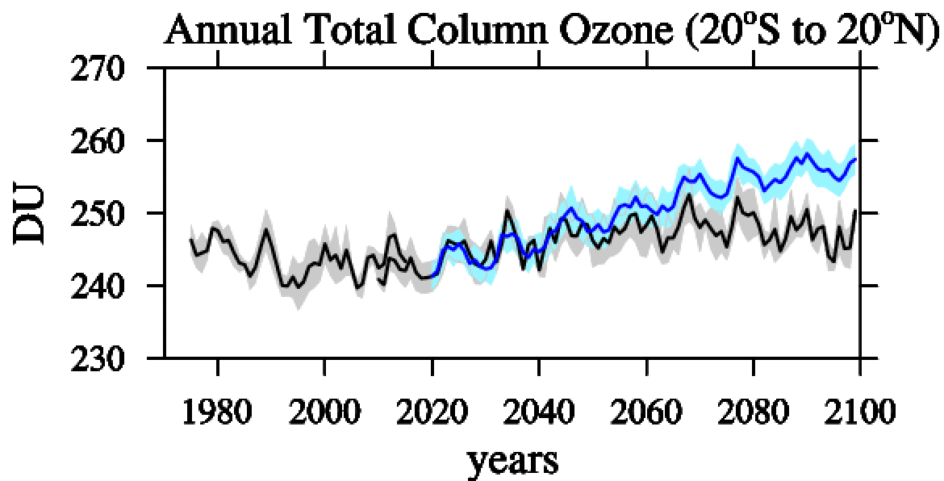
Total Column Ozone Change: Tropics
Temperature Changes w* Changes 30ºN-30ºS
Geoengineering
Geoengineering
Control
Geoengineering high
Geoengineering low
Ozone Sensitivity to
Changes in the NO_{x}/NO_{y} ratio -> net ozone production
Reduced upwelling below the injection location, increase upwelling above the injection location
Tilmes et al., 2018
c

Slide 21
WACCM5.4 SO₂ Injection Experiments
GLENS 20 members (yellow):
30N/30S, 15N/15S
5 km above the tropopause
GLENS EQ 3 members (orange)
EQ
5 km above the tropopause
GLENS Low 3 members (green)
30N/30S, 15N/15S
1 km above the tropopause
GLENS 110L (yellow)
30N/30S, 15N/15S
5 km above the tropopause

Slide 22
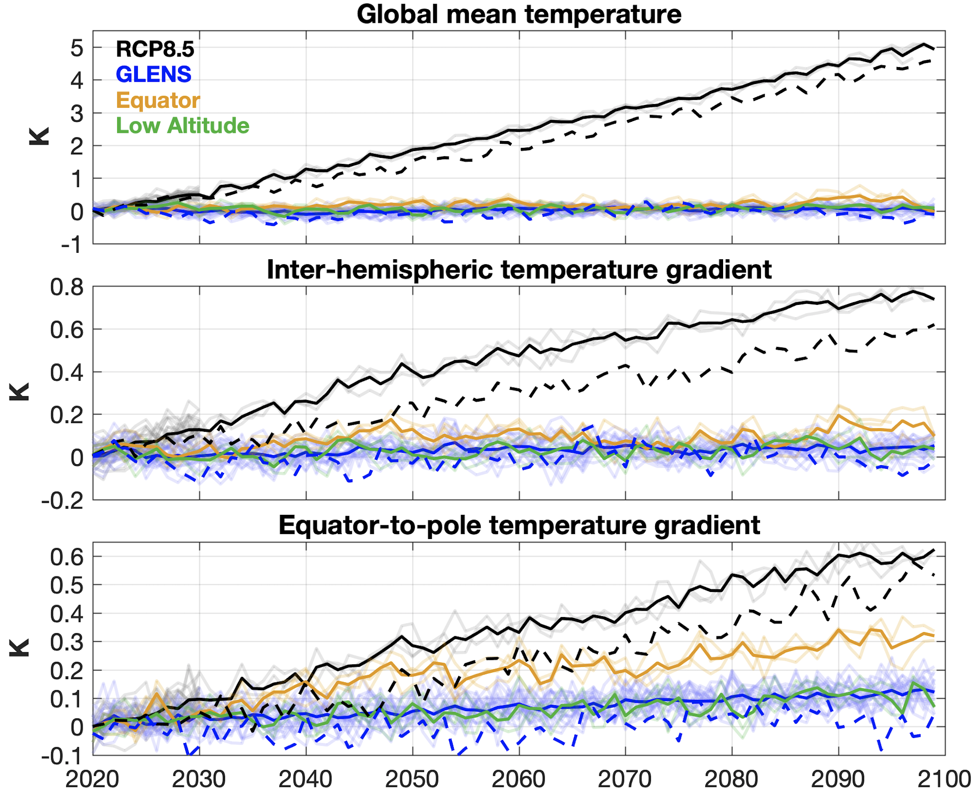
WACCM5.4 SO₂ Injection Experiments
110L (dashed)
GLENS 20 members (yellow):
30N/30S, 15N/15S
5 km above the tropopause
GLENS EQ 3 members (orange)
EQ
5 km above the tropopause
GLENS Low 3 members (green)
30N/30S, 15N/15S
1 km above the tropopause
GLENS 110L (yellow)
30N/30S, 15N/15S
5 km above the tropopause

Slide 23
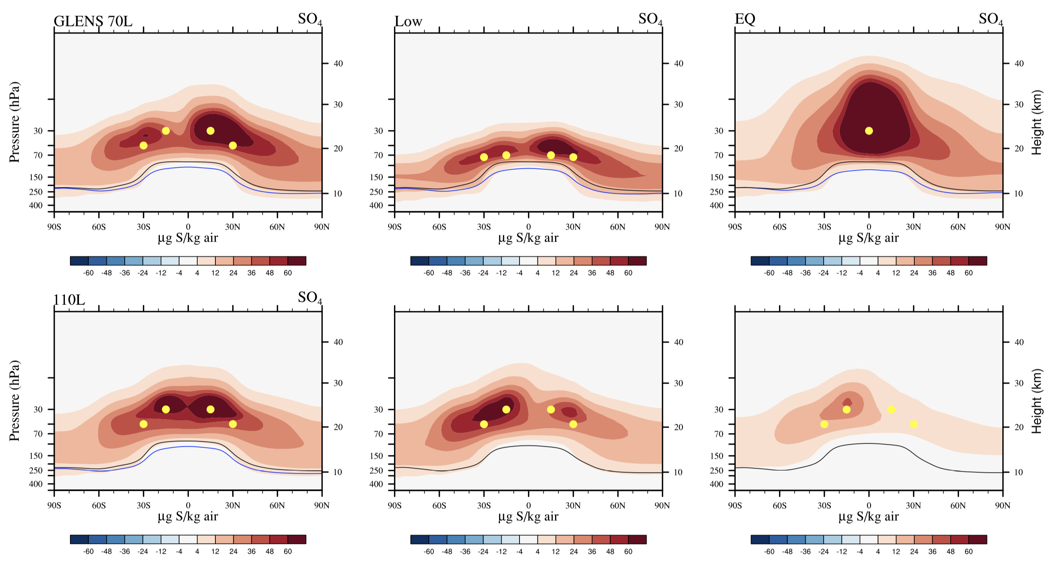
SO₄ Burden and Lifetime
GLENS (2080-89)
Low (2080-89)
Which cases will show the largest / smallest impact on Ozone?
110L (2080-89)
EQ (2080-89)
Notes:
GLENS Low: Largest Injections required for reaching temperature goals: smallest lifetime
GLENS EQ: Largest burden required for reaching temperature goals: largest lifetime, largest increase in H₂O
GLENS 110L: Least amount of injections required, second largest lifetime, less water vapor than others

Slide 24
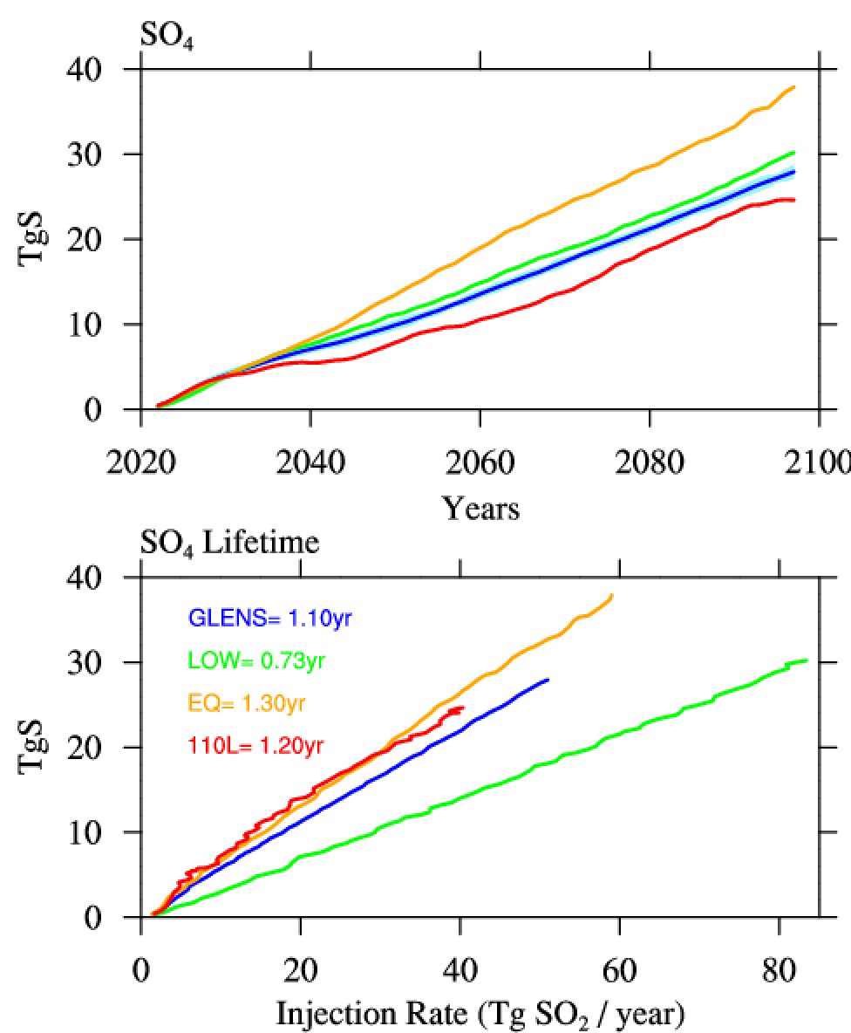
SO₄ Burden and Lifetime
GLENS (2080-89)
Low (2080-89)
SO₄ Burden
GLENS
EQ
Low
110L
110L (2080-89)
EQ (2080-89)
SO₄ Lifetime
1.10yr
1.30yr
0.73yr
1.20
Notes:
GLENS Low: Largest Injections required for reaching temperature goals: smallest lifetime
GLENS EQ: Largest burden required for reaching temperature goals: largest lifetime, largest increase in H₂O
GLENS 110L: Least amount of injections required, second largest lifetime, less water vapor than others

Slide 25
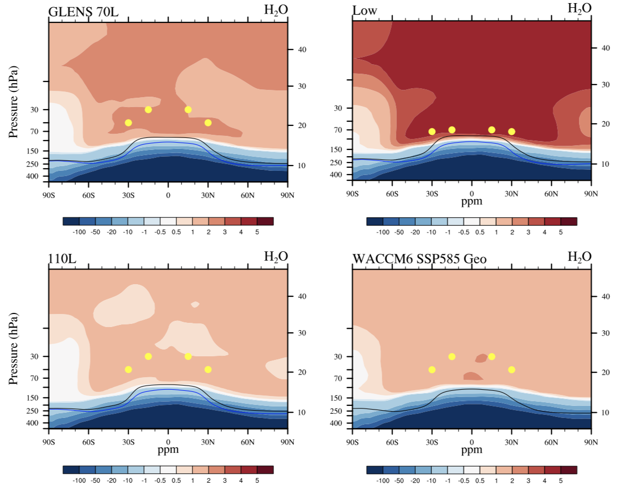
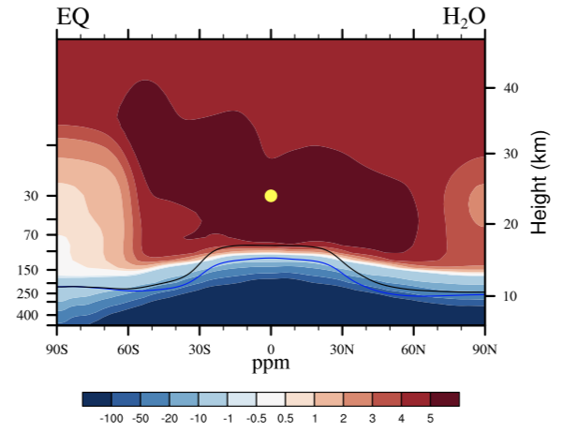
Water Vapor Changes, SO₄ Burden and Lifetime
GLENS (2080-89)
Low (2080-89)
SO₄ Burden
GLENS
EQ
Low
110L
110L (2080-89)
EQ (2080-89)
SO₄ Lifetime
1.10yr
1.30yr
0.73yr
1.20
Notes:
GLENS Low: Largest Injections required for reaching temperature goals: smallest lifetime , 50% more injection required
GLENS EQ: Largest burden required for reaching temperature goals: largest lifetime, largest increase in H₂O, 10% more injection, much larger burden
GLENS 110L: Least amount of injections required, second largest lifetime, less water vapor than others

Slide 26
Ozone changes: Low vs. High SO₂ Injections
SO₄ GLENS (2080-89)
SO₄ Low (2080-89)

Slide 27
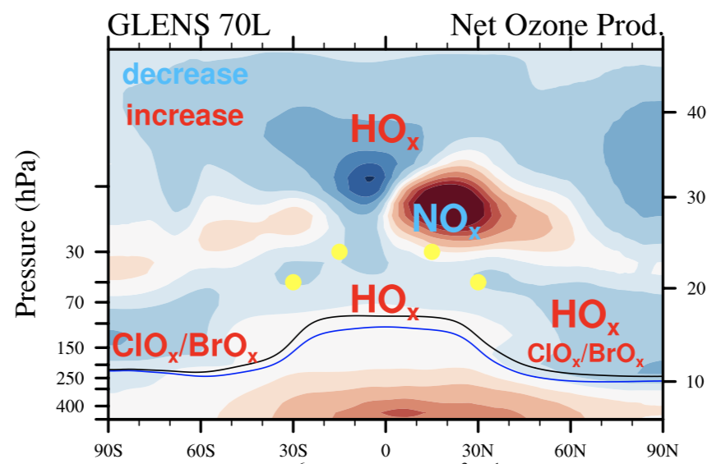
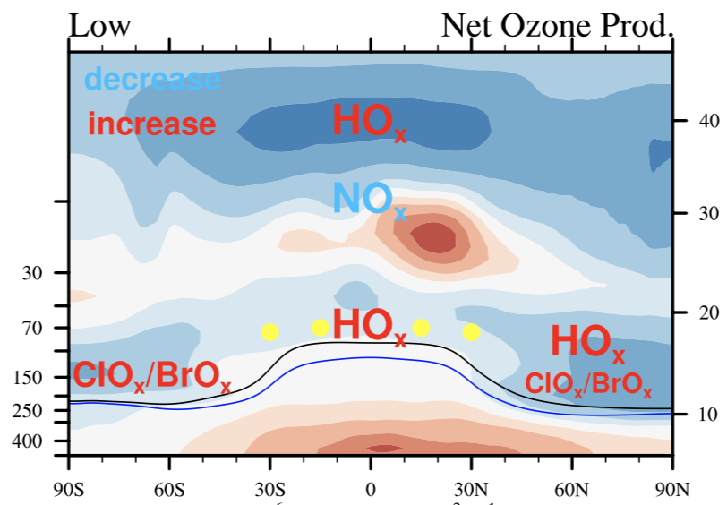
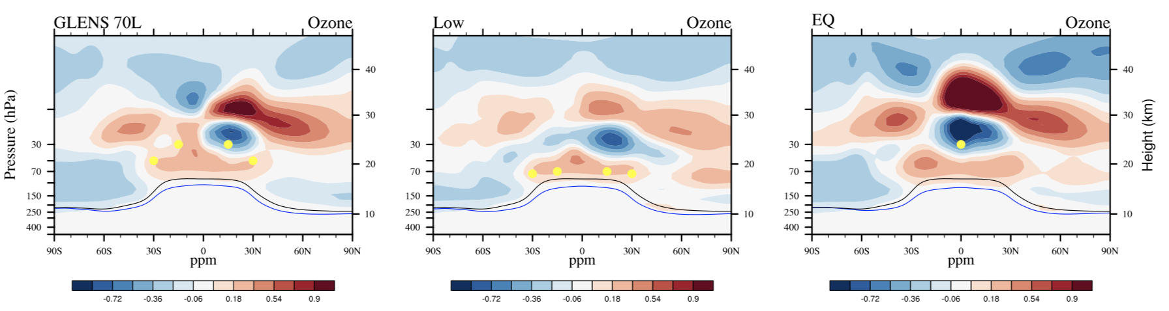
Ozone changes: Low vs. High SO₂ Injections
Geoengineering minus Control
GLENS (2080-89)
Net Ozone Prod
Low (2080-89)
Ozone changes low vs. high due to:
Less ozone in production the mid-stratosphere (reduce NO_{x})
Larger SAD in the lower stratosphere -> increased ozone loss
More loss from HO_{x} cycle (more water vapor)
Difference in upwelling due to difference in injection altitude
Weaker polar vortex
Increase in horizontal advection
Importance of changes in transport
Ozone

Slide 28
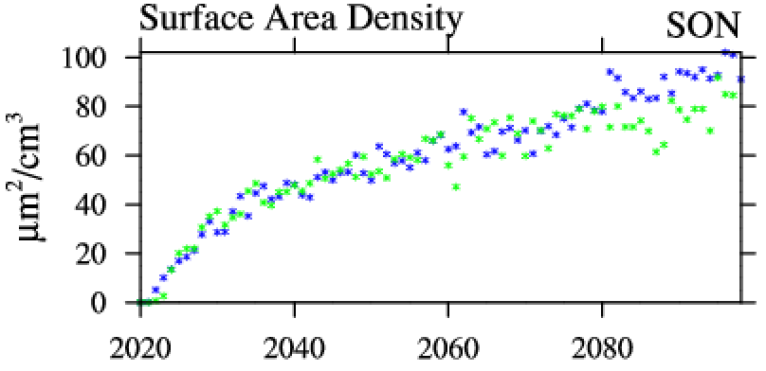
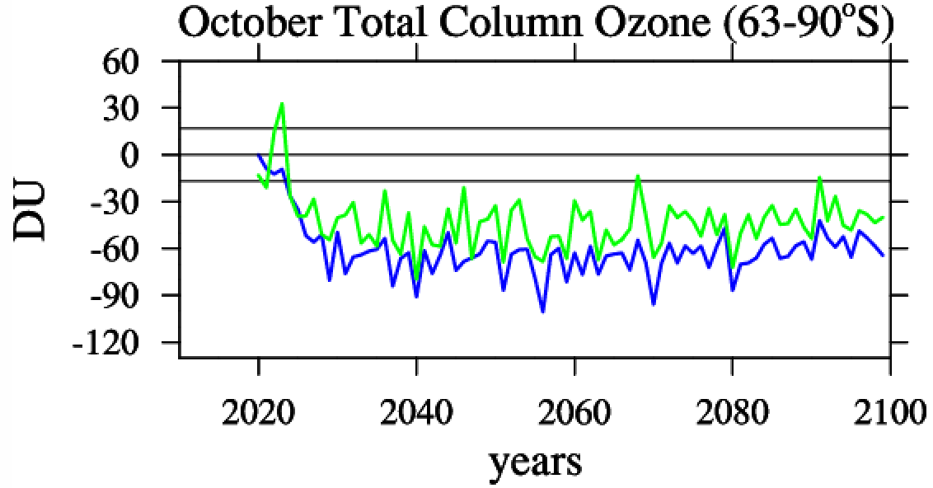
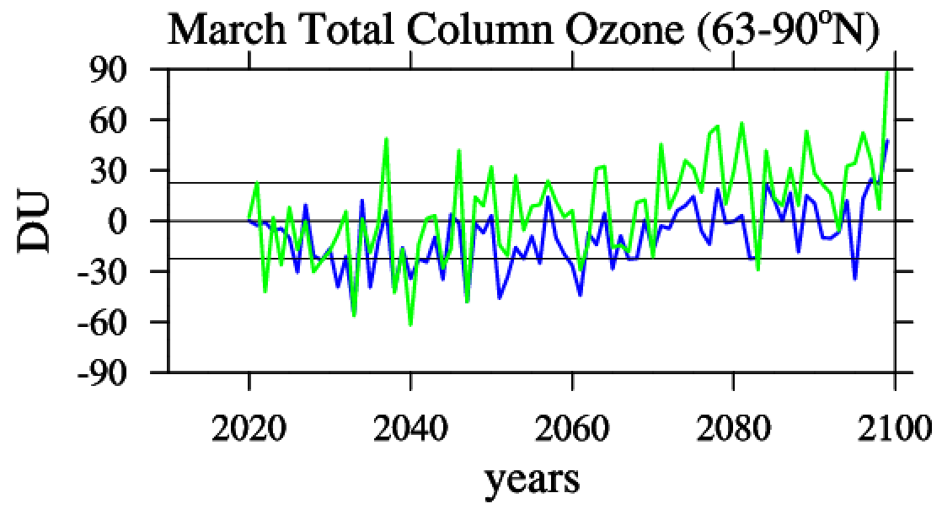
Polar Ozone changes: High vs. Low vs EQ
Polar Ozone changes: Low vs. High
Geoengineering minus Control
Surface Area Density 63-90ºS
100-145hPa
GLENS
Low
Low vs high
Same SAD, more transport towards high latitudes
-> less column ozone reduction in winter/spring high latitudes
Tropics: reduced effect on the NO_{x} cycle, less net chemical ozone production.

Slide 29
Summary: WACCM5.4 SO₂ injection cases
High vs. low Injection (towards the end of the century):
50% more injection required to reach similar burden, strong increase in water vapor, increase in the HO_{x}-cycle reduced NO_{x} cycling
Horizonal advection more pronounced: less ozone reduction in the SH polar vortex, increase in ozone in NH mid and high latitudes: dynamical changes more important

Slide 30
Ozone changes: EQ vs. 4 point SO₂ Injections
SO₄ GLENS (2080-89)
SO₄ EQ (2080-89)

Slide 31
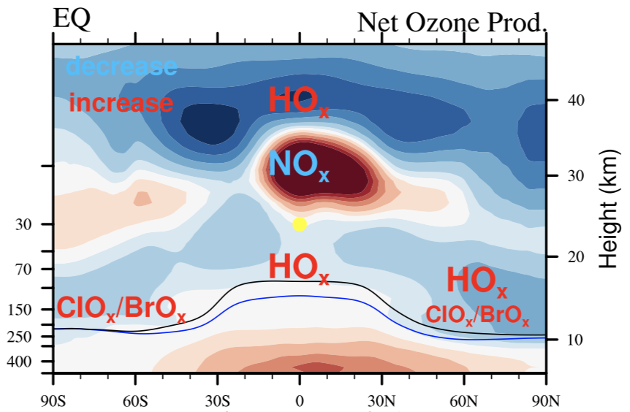
Ozone changes: EQ vs. 4 point SO₂ Injections
Geoengineering minus Control
Net Ozone Prod
EQ (2080-89)
GLENS (2080-89)
EQ (2080-89)
Ozone changes EQ vs 4 point due to:
More ozone production in the mid-stratosphere (reduced NO_{x})
More loss from HO_{x} cycle (more water vapor)
Difference in upwelling due to difference in injection altitude
Stronger polar vortex
Differences in residual wind velocity (w*) and removal of the QBO (Richter et al., 2017, Kravitz et al., 2019)
Importance of changes in transport
Ozone

Slide 32
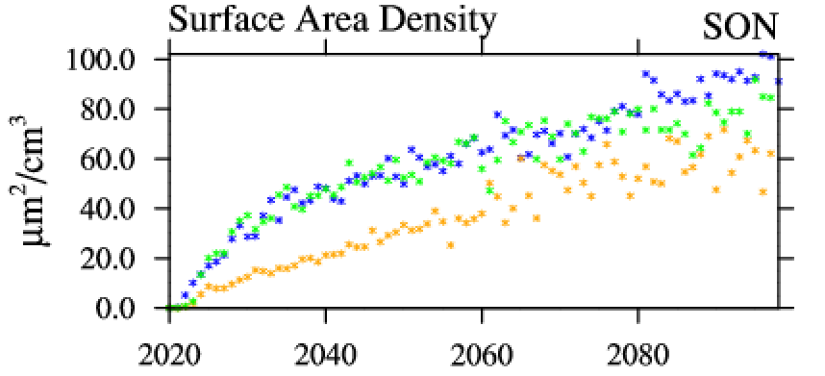
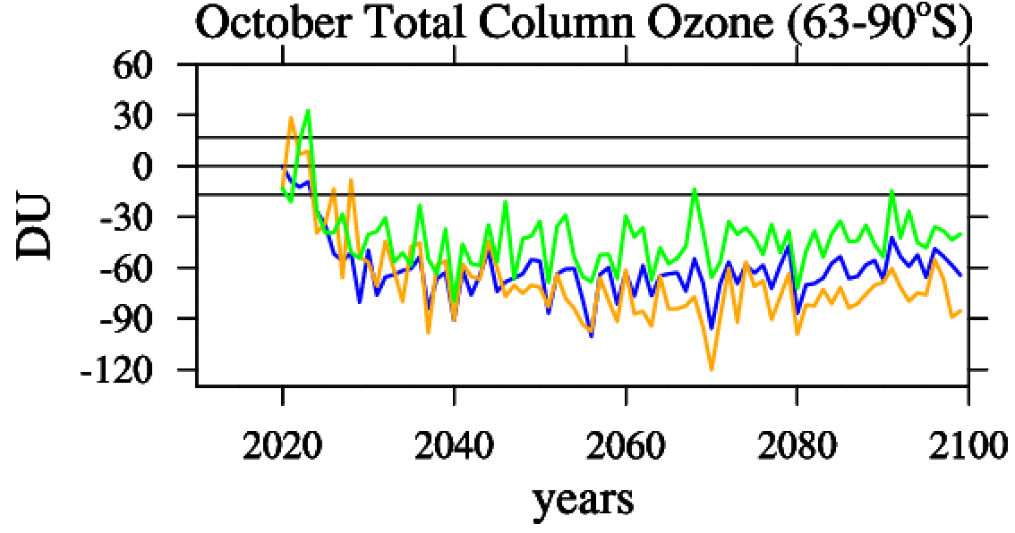
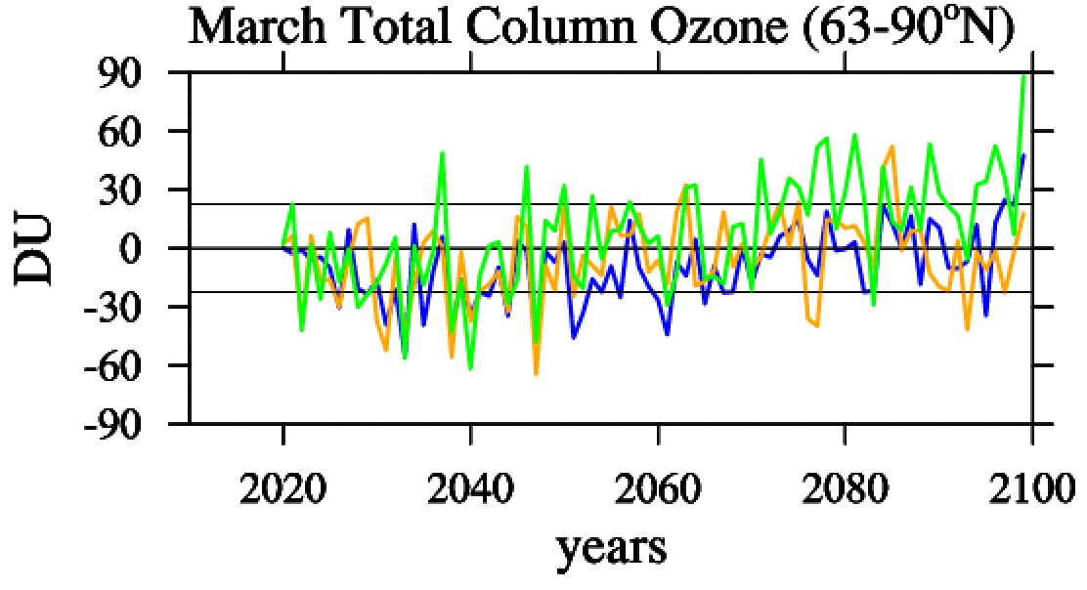
Polar Ozone changes: High vs. Low vs. EQ
Geoengineering minus Control
Surface Area Density 63-90ºS
100-145hPa
GLENS
EQ
Low
EQ vs 4 point injections
Less SAD, but stronger polar vortex, colder temperatures
-> more ozone reduction in the polar vortex

Slide 33
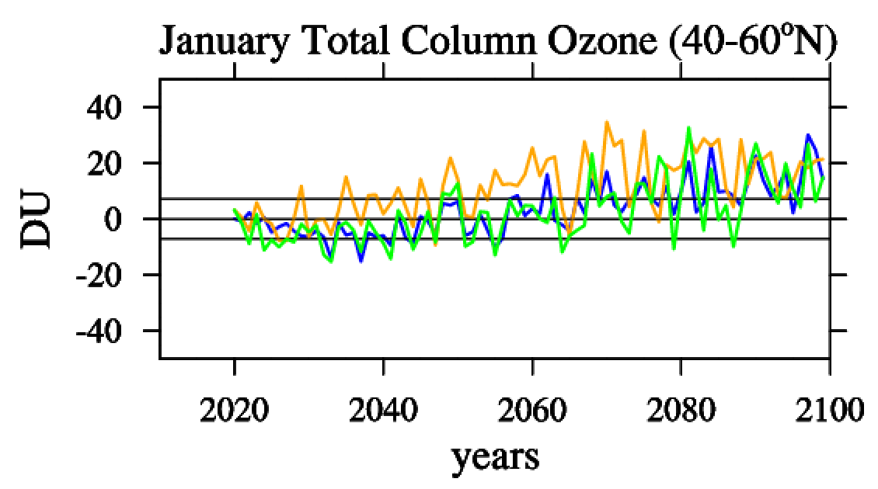
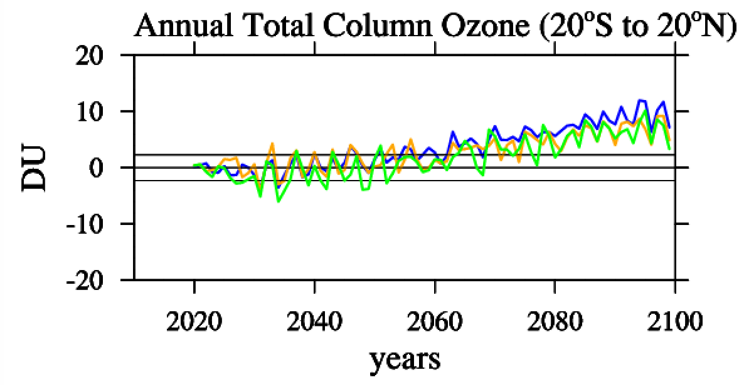
Mid-latitudes / Tropics
Geoengineering minus Control
EQ vs 4 point injections
More net chemical ozone production in the tropics
Changes in tropical upwelling
GLENS
EQ
Low

Slide 34
Summary: WACCM5.4 SO₂ injection cases
High vs. low Injection (towards the end of the century):
50% more injection required to reach similar burden, strong increase in water vapor, increase in the HO_{x}-cycle reduced NO_{x} cycling
Horizonal advection more pronounced: less ozone reduction in the SH polar vortex, increase in ozone in NH mid and high latitudes: dynamical changes more important
EQ v. 4 point Injection:
10% more injection required, larger burden needed to reach same surface temperature targets, aerosol burden more refined in the tropics, strong increase in water vapor
Stronger and colder polar vortex, shut-down of the QBO
More ozone loss in the polar vortex, strong increase of ozone over mid-latitudes in winter

Slide 35
110L vs. 70L WACCM
GLENS (2080-89)
SO₄ Distribution 2080
GLENS
EQ
Low
110L
110 layer model
More evenly distributed aerosol burden
Longer lifetime
Requires ~10% less injection (reduced water vapor)
Longer lifetime
Less Surface Area Density
Improved QBO
110L (2080-89)
SO₄ Lifetime
1.10yr
1.30yr
0.73yr
1.20

Slide 36
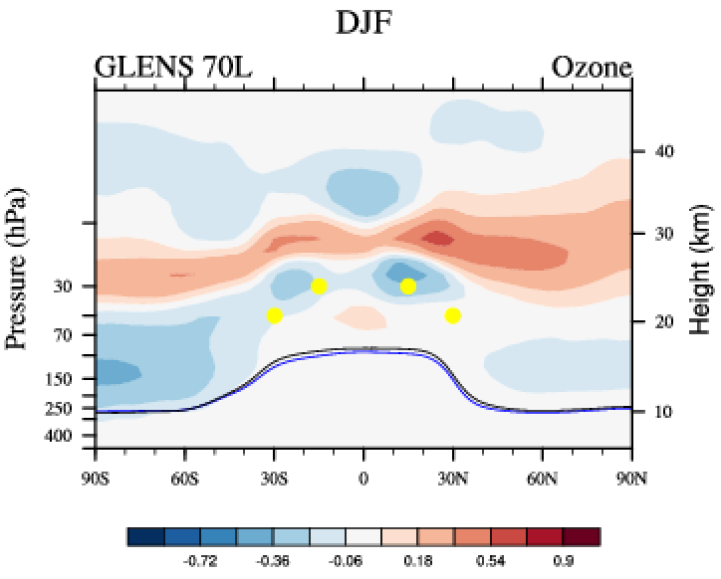
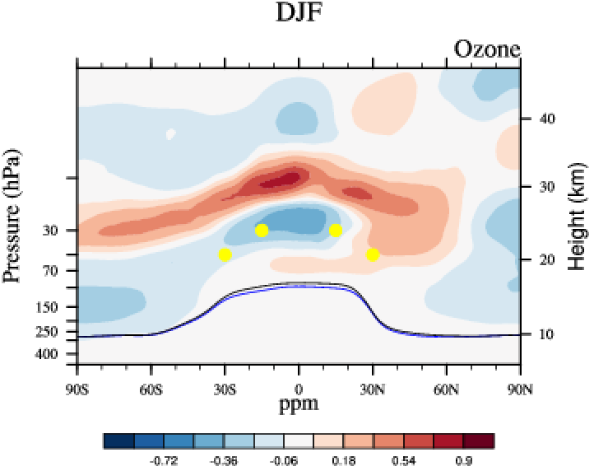


Ozone Changes: 110L vs. 70L WACCM
Geoengineering minus Control (2080-89)
Ozone
110L DJF
GLENS DJF
Aerosol distribution shifted to the NH (GLENS)
more horizonal advection towards the NH in DJF
more ozone reduction in the SH
Aerosol distribution more centered (110L)
more horizontal advection toward SH in DJF
more ozone reduction in the NH
GLENS SON
110L SON

Slide 37

Ozone Changes: 110L vs. 70L WACCM
Geoengineering minus Control (2080-89)
GLENS DJF
110L DJF
Range of all GLENS members
GLENS SON
110L SON
Range of all GLENS members

Slide 38
Summary: WACCM5.4 SO₂ injection cases
High vs. low Injection (towards the end of the century):
50% more injection required to reach similar burden, strong increase in water vapor, increase in the HO_{x}-cycle reduced NO_{x} cycling
Horizonal advection more pronounced: less ozone reduction in the SH polar vortex, increase in ozone in NH mid and high latitudes: dynamical changes more important
EQ v. 4 point Injection:
10% more injection required, larger burden needed to reach same surface temperature targets, aerosol burden more refined in the tropics, strong increase in water vapor
Stronger and colder polar vortex, shut-down of the QBO
More ozone loss in the polar vortex, strong increase of ozone over mid-latitudes in winter
110L Model:
~30% less injection required, reduced effects on water vapor
Shift in aerosol distribution-> more ozone loss in opposing hemisphere

Slide 39

Ozone changes between 2030-39
January
March
Results for 2030-39 (to keep temperatures at 2020 conditions):
Injections for all scenarios are ~10-15TgSO₂
SH Polar Region: Oct 24-38% reduction and 5-12% reduction for other seasons
NH Polar Region: Jul/Jan 3-8% reduction, Mar/Oct 0-8% reduction
Jan 40-60N: +3 to -5% change
Tropics: +3 to -3 % change
July
October
GLENS
EQ
Low
110L

Slide 40

Ozone changes between 2030-39 and 2080-89
January
March
January
March
July
October
GLENS
EQ
Low
110L
October
July

Slide 41
Summary
Factors influencing changes in ozone as the result of stratospheric aerosol geoengineering
Aerosol distribution dependent on: injection location / strategy, model, baseline scenario
Chemistry -> surface area density, aerosol microphysics, trop/strat. exchanges
Radiation / Dynamics -> temperatures, water vapor, transport
Early applications of SO₂ injections would result in significant reductions of column ozone in mid- and high latitudes between 2030-39 -> delay of the ozone recovery
Large injections by the end of the century to counter a business as usual scenario result in an increase in column ozone in Tropics / Mid-latitudes
-> further reduces UV radiation in addition to the super recovery of ozone
-> Need to identify range of changes in other models
-> Need to investigate more realistic scenarios
-> Need to investigate other proposed injection material

Slide 42
Next Steps
Opportunity for the CCMI: Design CCMI-GeoMIP Modeling Testbed with prescribed aerosol distributions
Identify changes in stratospheric dynamics and chemistry based on the same aerosol distribution (changing halogen loading and greenhouse gases) for example: 2020-2099 SSP5-85
Identify changes in stratospheric dynamics and chemistry based on different aerosol loadings: High vs Low injections, centric vs shifted distributions (10 year experiments)
Identify changes in stratospheric dynamics and chemistry depending on the SSP scenario. Same aerosol loading but different SSP scenarios are used, e.g., SSP2-45, SSP1-26.

Slide 43


Next Steps: WACCM6 SO₂ Injection Experiments
CO₂ emission scenarios
WACCM6 SSP5-8.5
WACCM6 SSP5-3.4-OS
1.5ºC
1850-1900
O’Neill et al., 2016

Slide 44


Next Steps: WACCM6 SO₂ Injection Experiments
Surface Air Temperature
SO₄ Burden
WACCM6 SSP5-8.5
GLENS
SSP5-85-Geo
SSP5-34-OS-Geo
WACCM6 SSP5-3.4-OS
SSP5-85 Geo
SSP5-34-OS Geo
SO₄ Lifetime
1.10yr
1.08yr
0.24yr
WACCM6: Slightly smaller burden required compared to WACCM5.4
Overshoot: Increase in aerosol lifetime after reaching injection peak

Slide 45

Questions?

Slide 46

WACCM6 SO₂ Injection Experiments
WACCM6 SSP5-8.5
WACCM6 SSP5-3.4-OS 2080-2089

Slide 47


Effects of Geoengineering on UV
Madronich et al., 2018
UV reduction in 2080 compared 2020 due to sulfate scattering and ozone recovery
DNA-weighted irradiance (blue), UV-index (UVI)(red), photosynthetically activation (PAR) (green)

Slide 48
Geoengineering SO₂ Injection Experiments
GLENS 70L
Low
EQ
110L
WACCM6 SSP5-8.5
WACCM6 SSP5-3.4

Slide 49


Geoengineering SO₂ Injection Experiments

Slide 50



WACCM5.4 SO₂ Injection Experiments
Kravitz et al., in revision.

