Slide 1
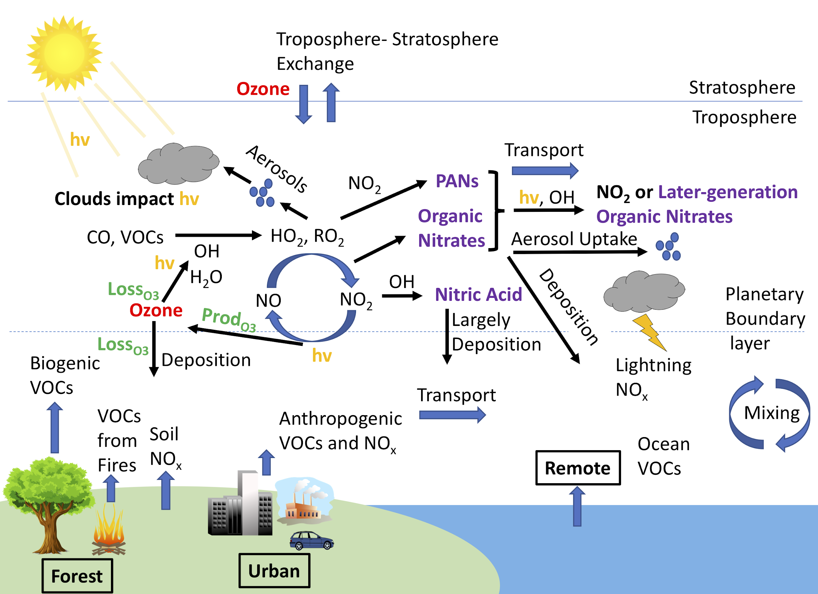
The NCAR Atmospheric Chemistry Observations & Modeling (ACOM) Laboratory
John J. Orlando
Deputy Director, ACOM
Gabriele Pfister
Deputy Director, ACOM
Figure: Rebecca Schwantes

Slide 2
Mission/Vision
Develop predictive capability for atmospheric composition through advances in understanding of chemistry and related processes
Chemical Climate Atmospheric chemistry in the Coupled Earth System
Chemical weather
Air Quality
Figure Courtesy U.S. Climate Change Science Program.

Slide 3
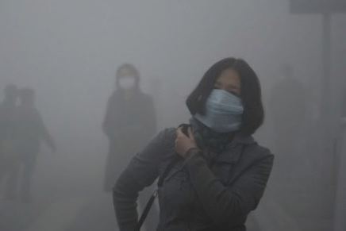
Chemical Weather
Poor air quality is the source of significant human premature mortality and ecosystem damage, and is thus an issue of major societal concern on a global scale
Research priorities:
Observing, modeling and predicting composition in the developed and developing world
Understanding the interactions between natural and anthropogenic emissions
Quantifying impacts of extreme events such as heat waves and wildfires
Exposure to air pollution:
100,000 premature mortalities per year in U.S.
Crop damage > $1B per year

Slide 4
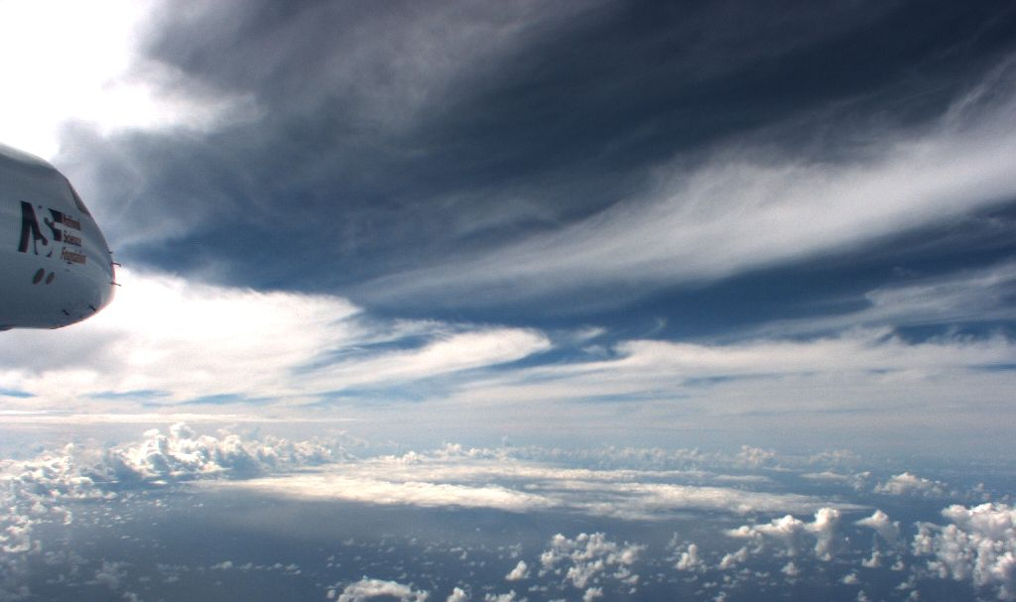
Chemical Climate
Quantifying the anthropogenic radiative forcing underlying climate change depends on an understanding of the chemical and physical processes determining the lifetimes and distributions of both short and long-lived gaseous and aerosol agents and their interactions with meteorology
Research priorities:
Ozone and oxidants, SLCF
Production, properties and lifetimes of atmospheric aerosols
The influence of the whole atmosphere on tropospheric predictability

Slide 5
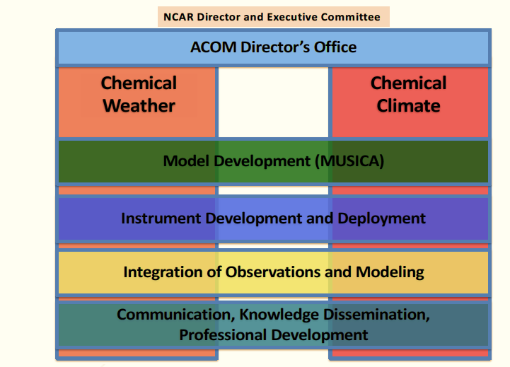
Organizational Structure

Slide 6
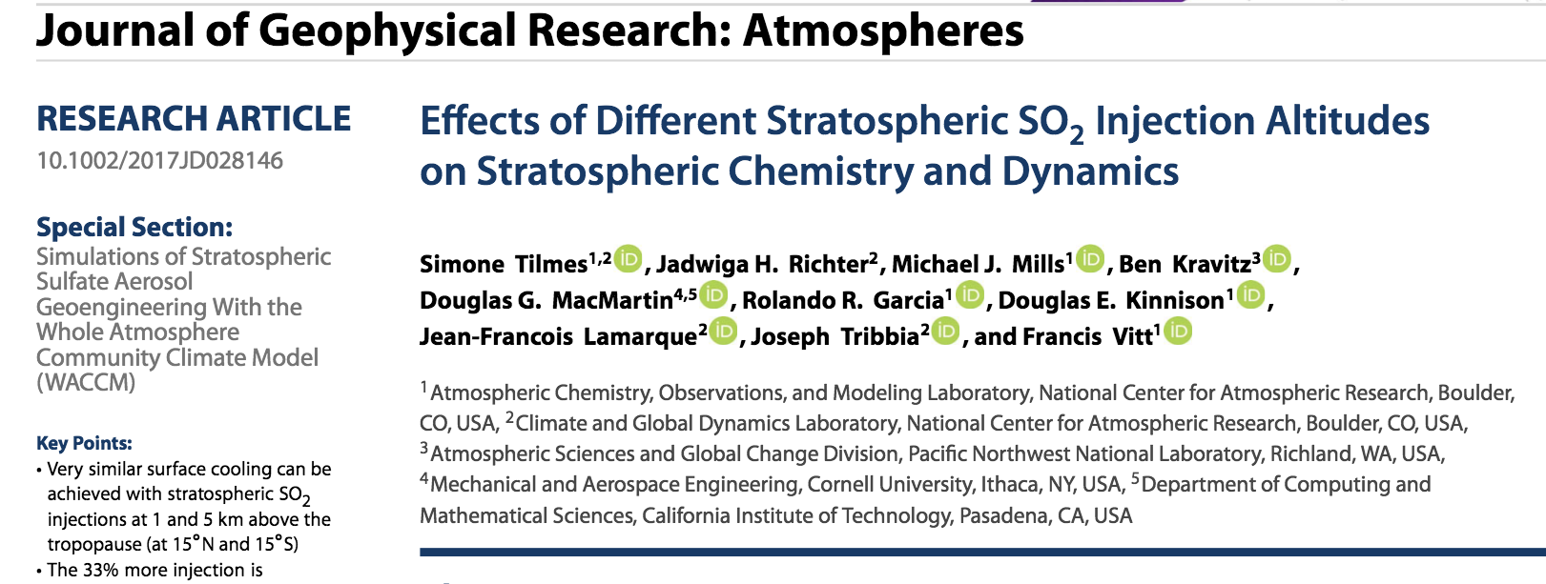
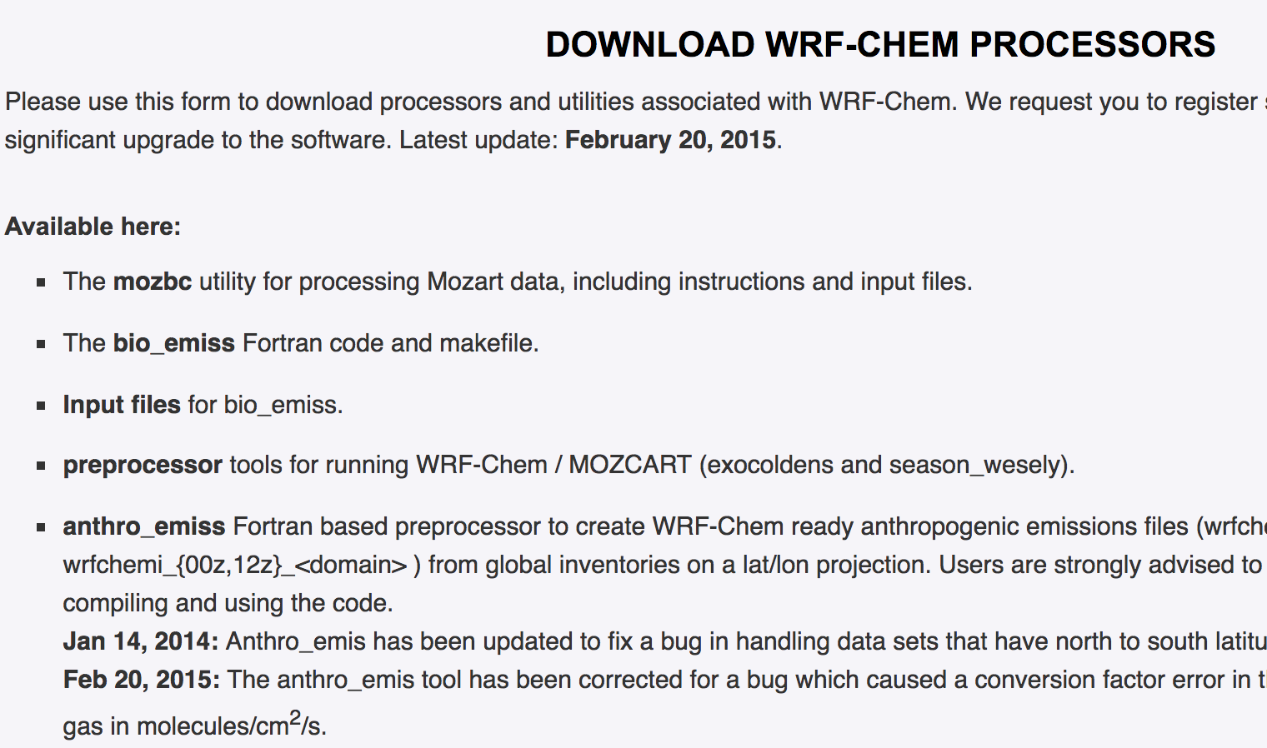
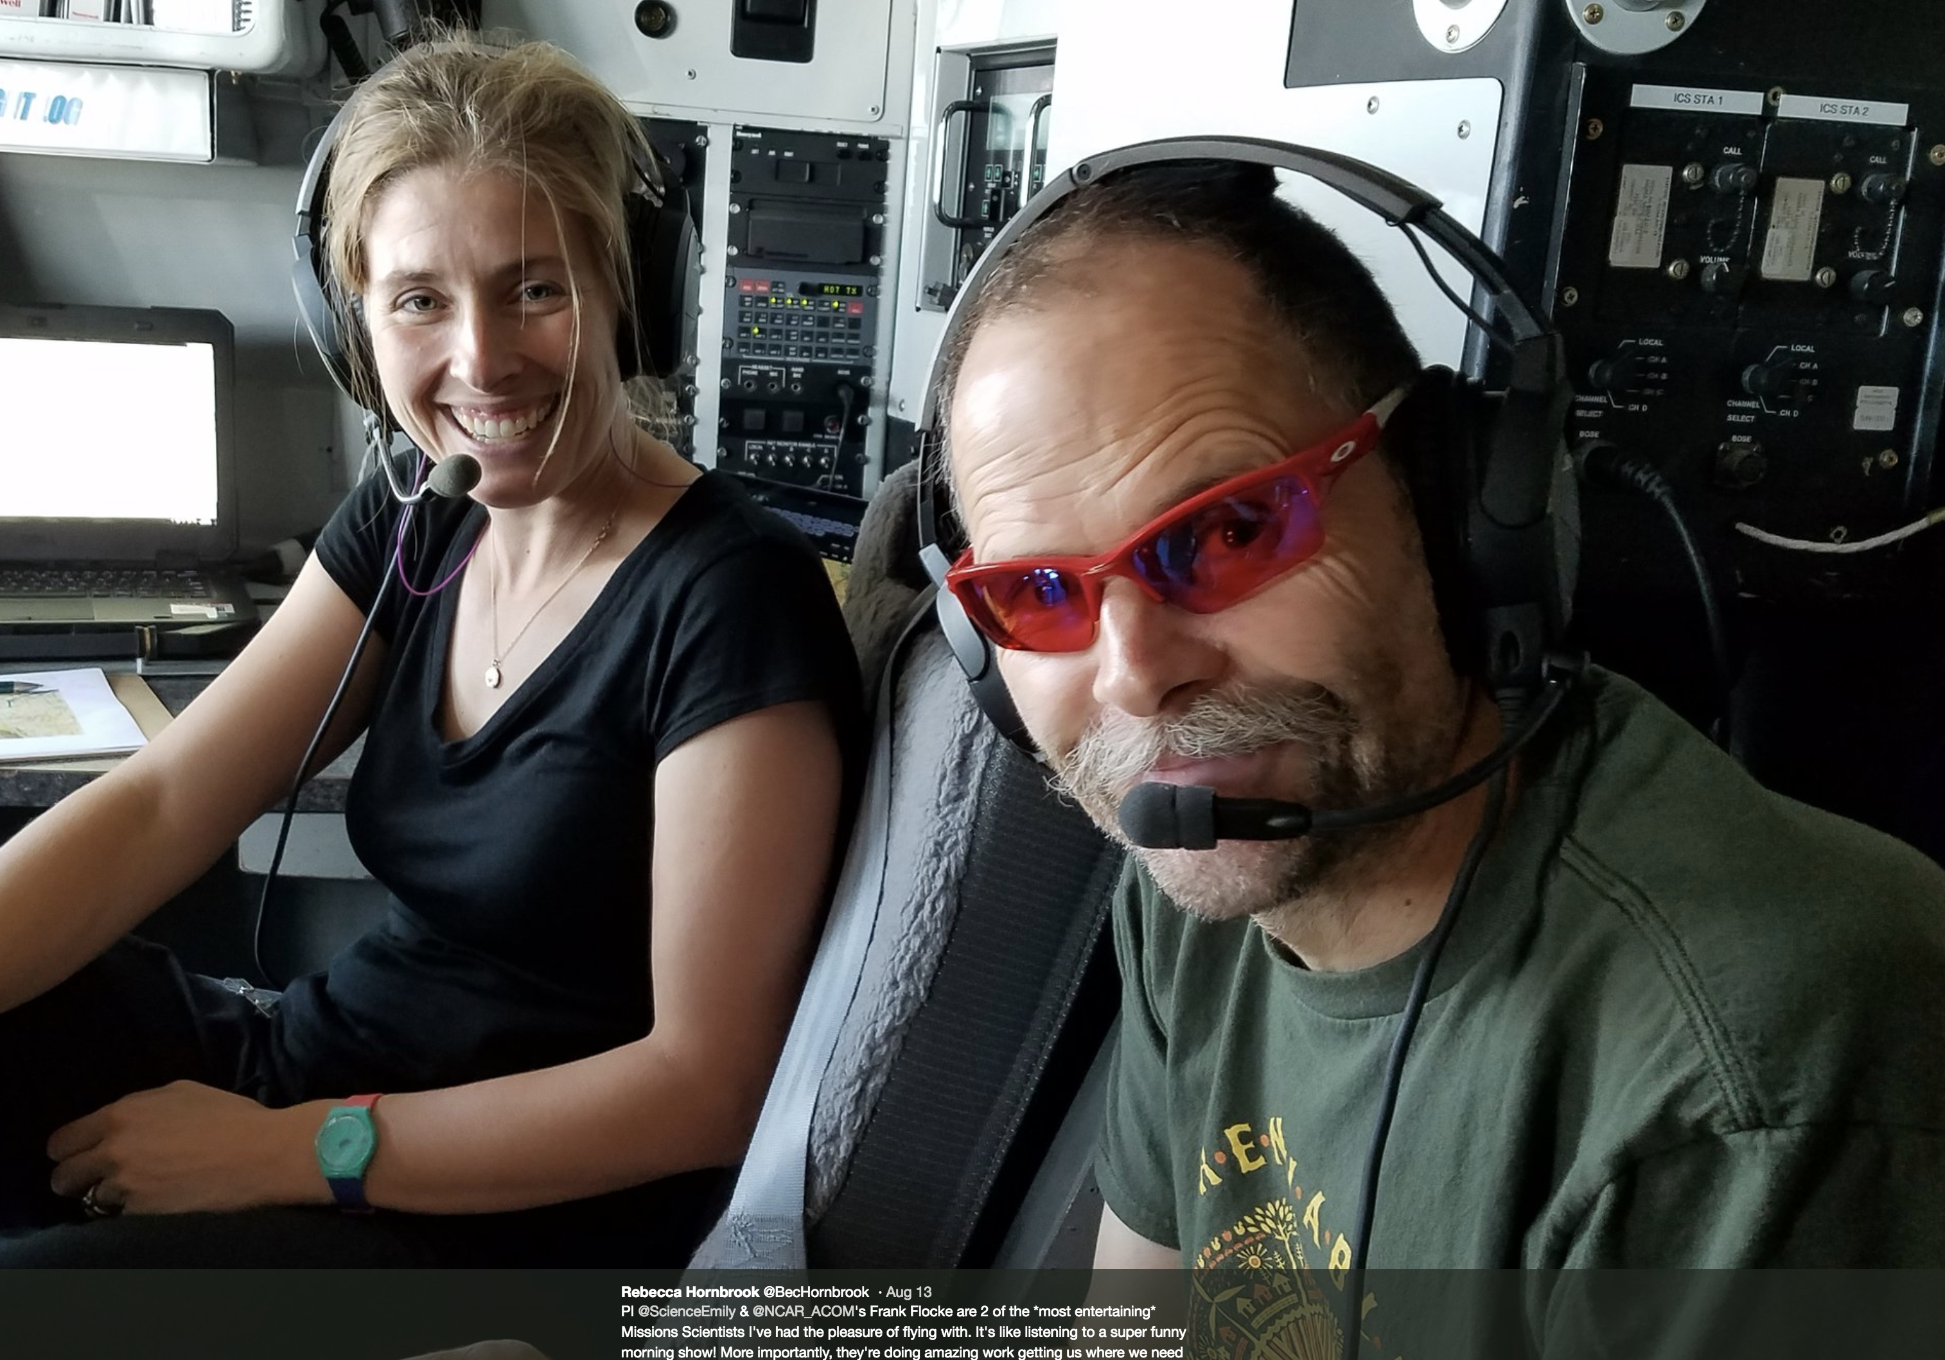
ACOM Community
ACOM scientists work closely with the national and international research community, providing intellectual leadership and facility support for measurement capabilities, laboratory and field experiments, and atmospheric chemistry models
Many metrics to demonstrate leadership and support (≈2014-2018):
Publications: ≈150 per year
Field Campaigns: ≈ 3-4 per year
Deployments of requestable instruments: ≈ 6/year
Additional instrument community deployments: 4-5/yr.
1000’s of downloads of models, tools and model output / yr. & User Support

Slide 7
ACOM Community
ACOM workshop on Fundamentals in Atmospheric Chemistry and Aerosol Modeling 2018
NSF-ATC-ACOM workshop 2018

Slide 8
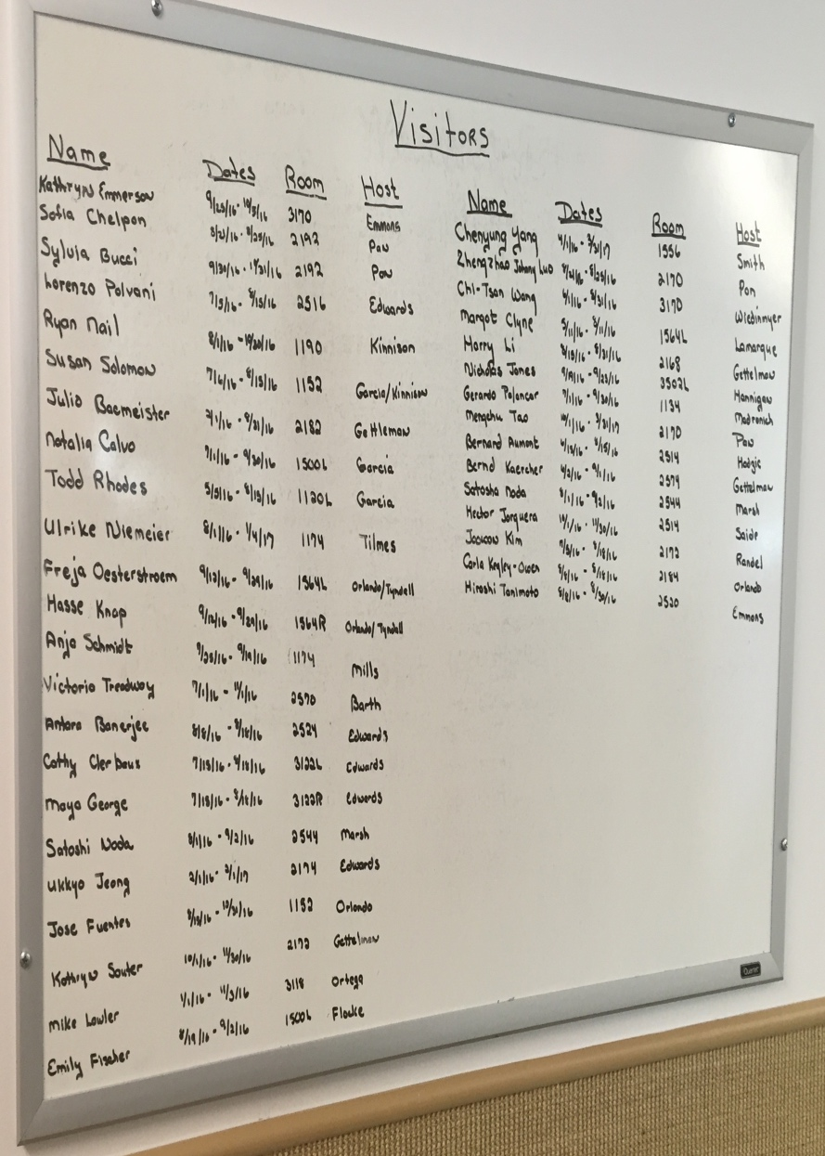





ACOM Visitors
Nicola Blake, UC Irvine working with the TOGA and modeling groups on analysis of VOC field campaign data.
ACOM staff are the reason for thriving collaborations across national and international Earth system research, and the draw for ACOM’s large and popular visitor program
Typically > 100 visitors/year, ≈ half for a duration of 1 month or more
ACOM provides a meeting ground for atmospheric chemistry endeavor hosting conferences and workshops
E&O is a priority with a commitment to developing a diverse workforce through mentoring graduate and post-graduate students and support of both ASP and UCAR SOARS
Cathy Clerbaux LATMOS (France), working with David Edwards on remote sensing data analysis.
Lorenzo Polvani Columbia University, working with Dan Marsh on WACCM
Alfonso Saiz-Lopez, Instituto de Química Física Rocasolano (Spain), working with J.-F. Lamarque on halogen chemistry in models.
Randall Chiu, University of Colorado, PhD work with Geoff Tyndall on hydrocarbon chemistry
Valeria Donets University of Miami, working with Laura Pan on analysis of CONTRAST data

Slide 9
Key Activities: Lab Studies
Advance fundamental understanding of chemical processes:
Understand the oxidation mechanisms of organic compounds in the atmosphere.
Study the reactions and cycling of atmospheric free radicals (HOx, NOx, halogens).
Development, calibration and characterization of field instruments
Inform development of chemical schemes for models

Slide 10
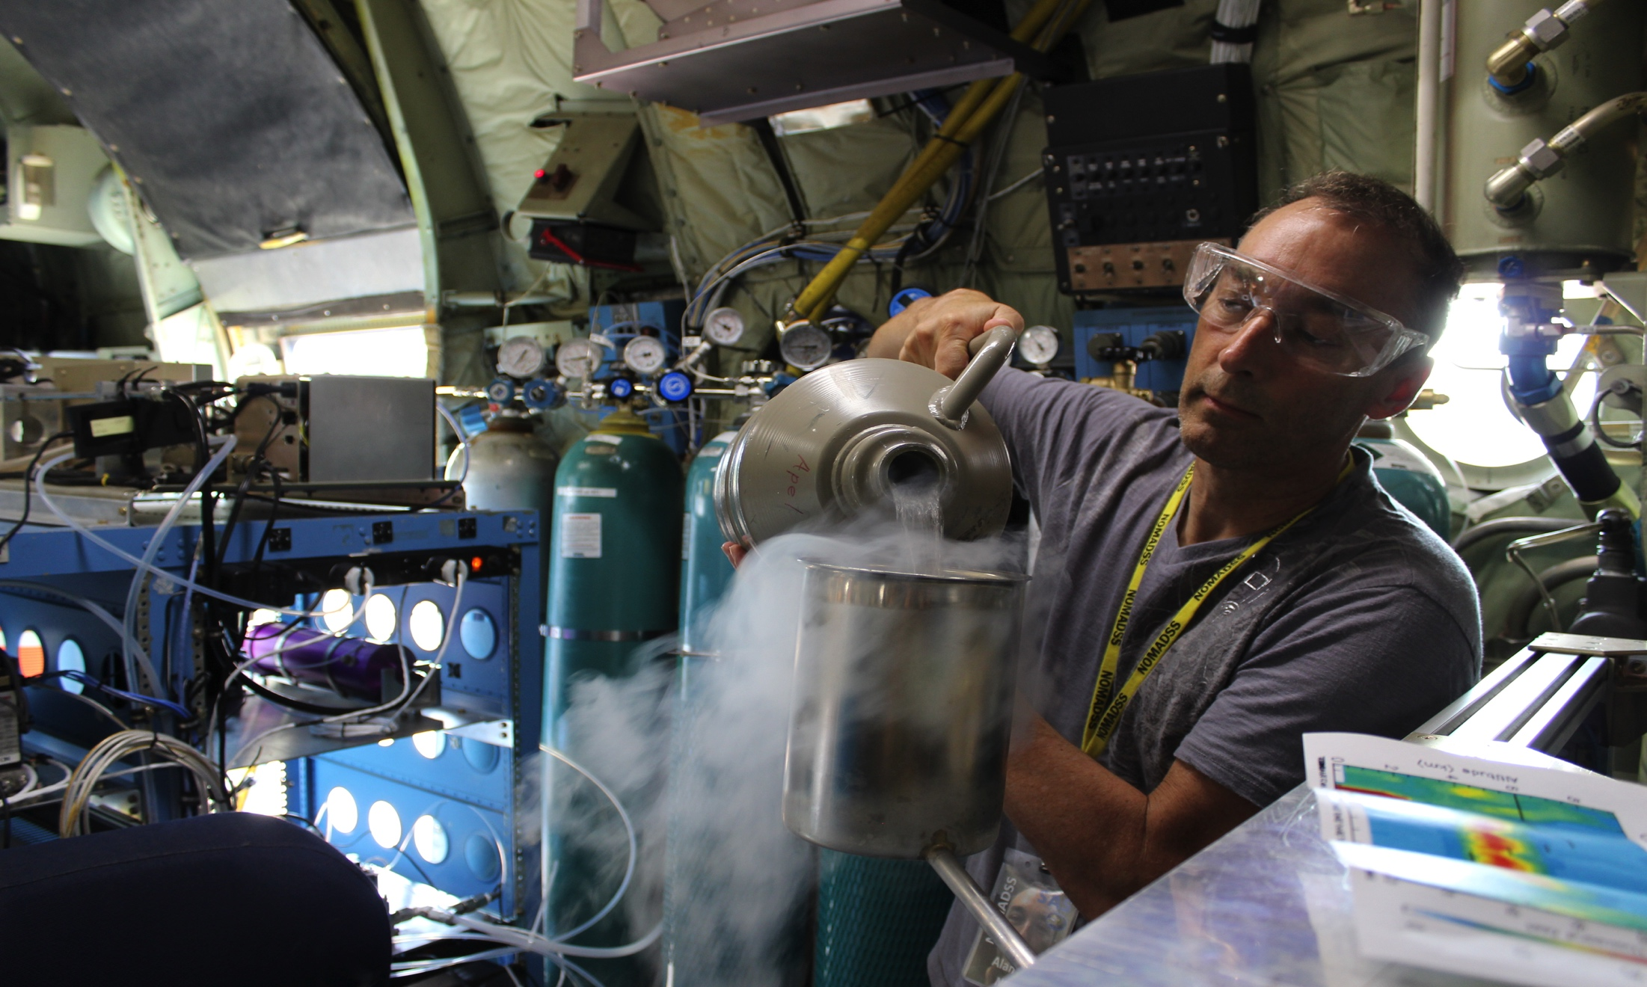
Key Activities: In-situ Measurements
Measurements of trace gases, radiation and aerosol properties
Laboratory studies
Focus on understanding chemical processes
Instrument development
Leadership of field campaigns
Inform model development

Slide 11
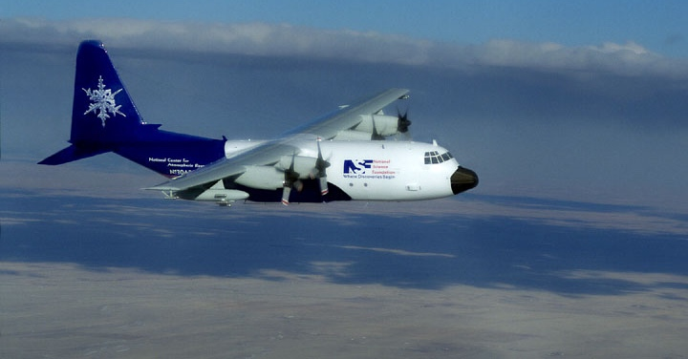
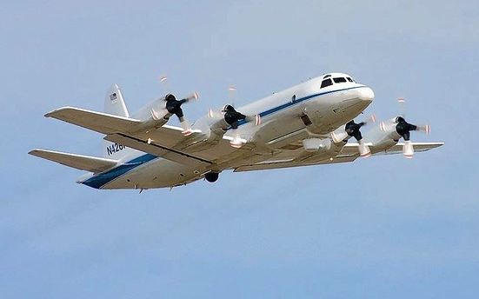
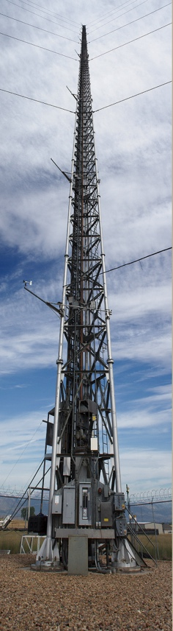
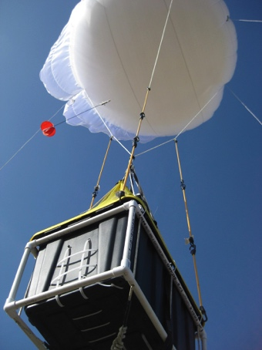
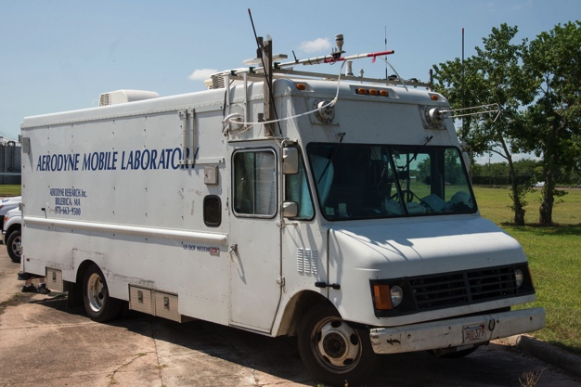
Key Activities: Field Campaigns
FRAPPÉ/DISCOVER-AQ 2014 Funded by NSF, State of Colorado and NASA
Provided a comprehensive look at air quality in the Colorado Front Range, an ozone non-attainment area
Involved many partners across government agencies, universities and private companies

Slide 12
Key Activities: Field Campaigns
Other recent or upcoming campaigns:
ATOM (NASA-led; 2016-2017), global atm. Composition
KORUS-AQ (NASA-led; 2016), air quality in S. Korea
WE-CAN (NSF; CSU-led), wildfires in Western USA – 2018
FIREX-AQ (NASA, NOAA; 2019), U.S. wildfires
ACCLIP (NSF ACOM-led), Japan, impact of Asian monsoon on atm. composition – planned for 2020

Slide 13
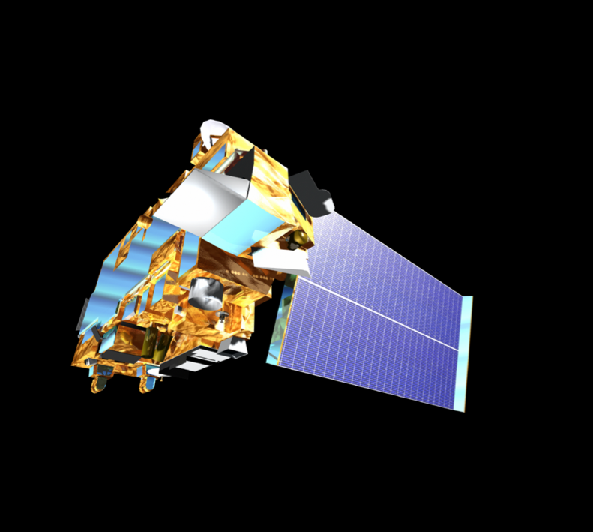
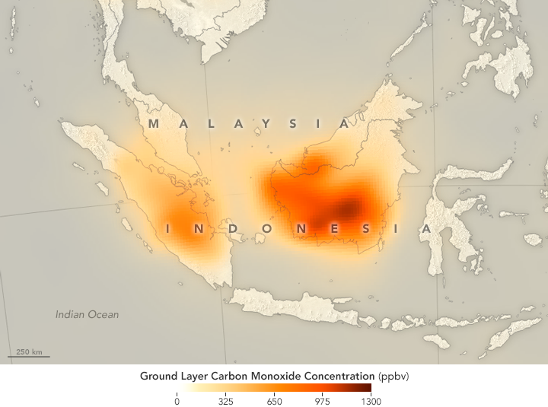

Key Activities: Remote Sensing & Data Analysis
ACOM has a long history of partnering with space agencies, either leading or contributing to satellite missions
Connecting satellite observations, in-situ measurements and chemistry modeling to improve model simulations of atmospheric composition in the troposphere and lower stratosphere
Operation of long-term ground-based spectrometer measurements at Thule, Greenland and Mauna Loa, HI (Chile to be added)
NASA Terra/MOPITT observations of extreme carbon monoxide pollution from large fires driven by El Nino conditions, September, 2015

Slide 14
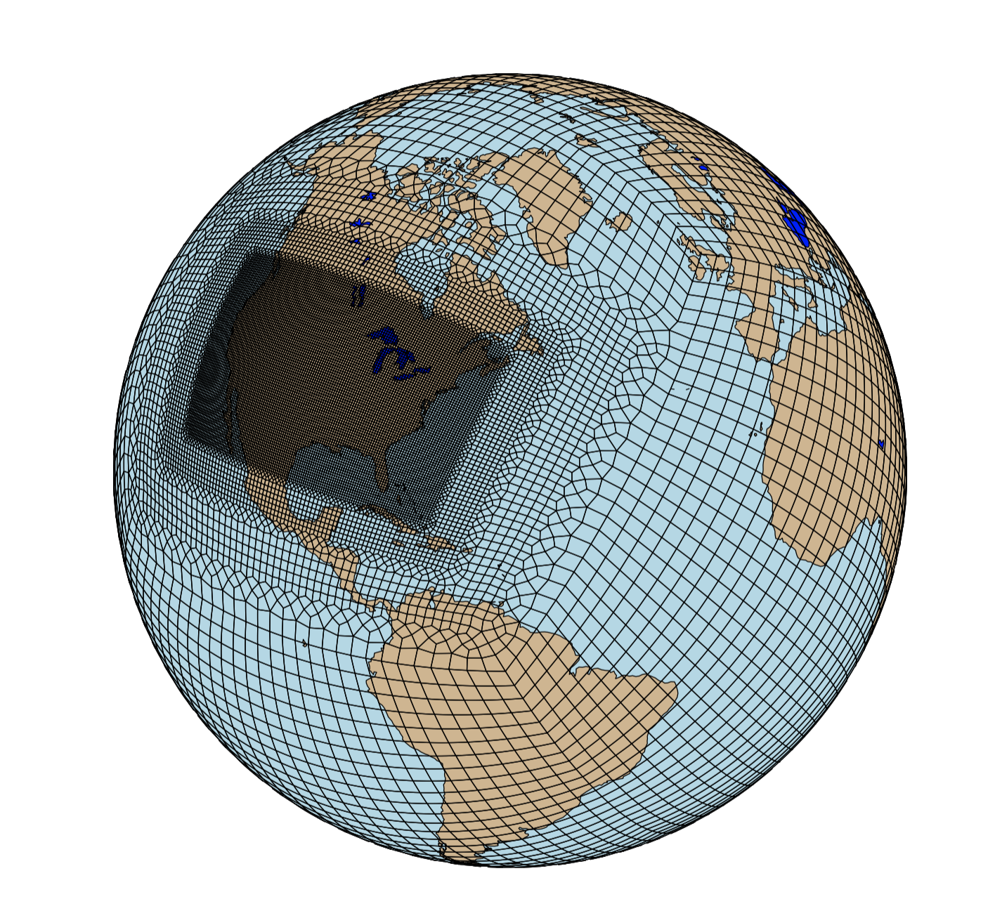
Key Activities: Modeling
ACOM develops, evaluates and applies process, regional-scale and global-scale models that represent our understanding of the couplings between atmospheric chemistry and the different Earth system components
Evaluated through comparison and integration with observations and community intercomparisons
Lab Kinetics
Emissions models
Process models
WACCM
CAM-chem
WRF-Chem
Field Campaigns
Global models: CAM-Chem and WACCM, successors to MOZART and implemented in CESM
Regional model: WRF-Chem
Box-model: BOXMOX
Process models: GECKO, FINN, TUV, Master Mechanism
MUSICA

Slide 15
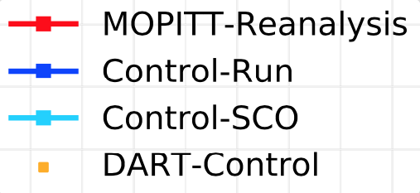
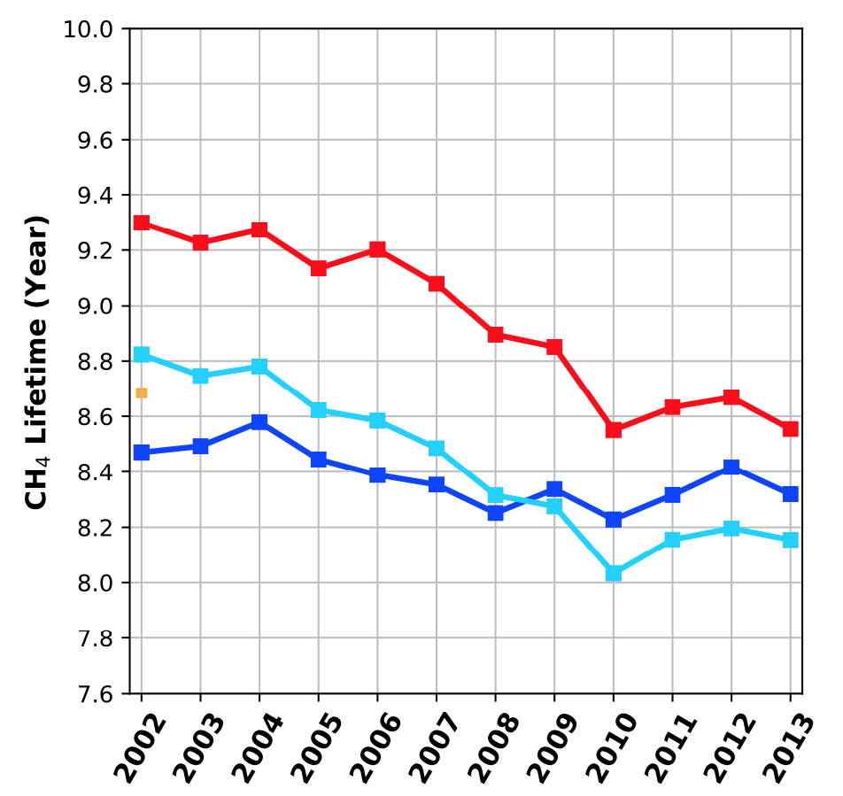
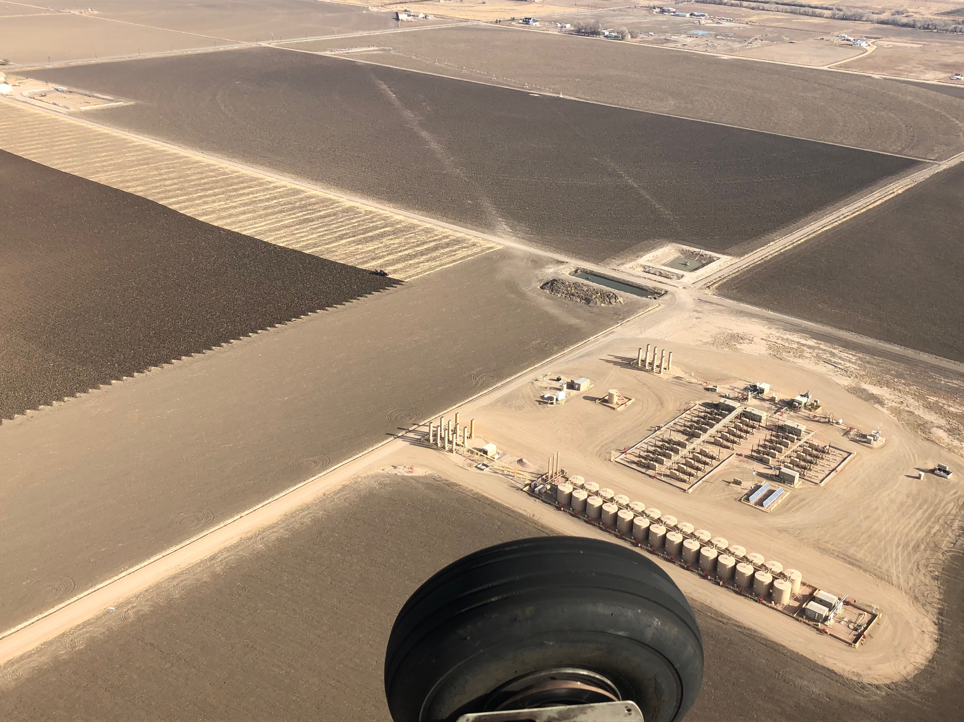

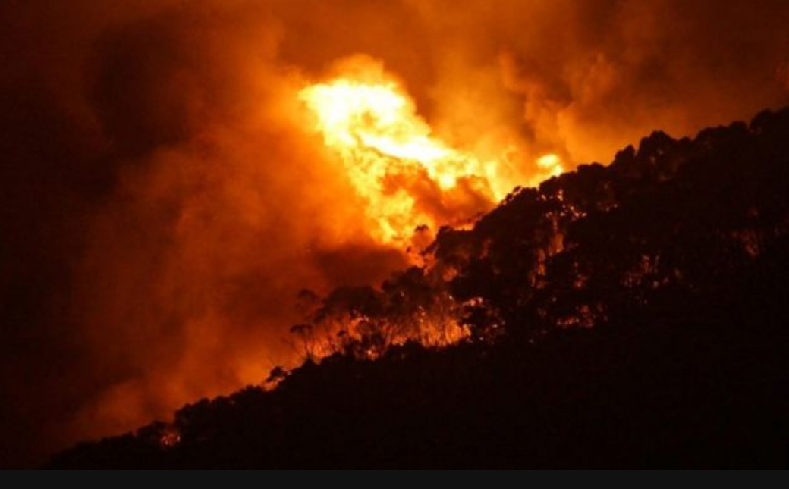
Recent Accomplishments – Satellite Data
MOPITT CO used in studies to estimate changes in methane lifetime and to explain conflicting trends in observed methane trend
After assimilating MOPITT data, CAM-Chem results show that decreasing concentrations of CO over the last decade (from decreases in both anthropogenic and biomass burning emissions) correspond to an 8% decrease in methane lifetime through interactions with OH. (Gaubert et al., GRL 2017)
Methane emissions from fires, identified using MOPITT, have been decreasing since the early 2000s due to a global decrease in tropical fires. (Worden et al., 2018)
Fossil fuel CH₄ estimated increase
~17 Tg/yr
> 25 Tg/yr
observed
CH₄ increase
+
New finding: Biomass burning CH₄ decrease ~4 Tg/year
Wetlands CH₄ increase
~12 Tg/yr

Slide 16
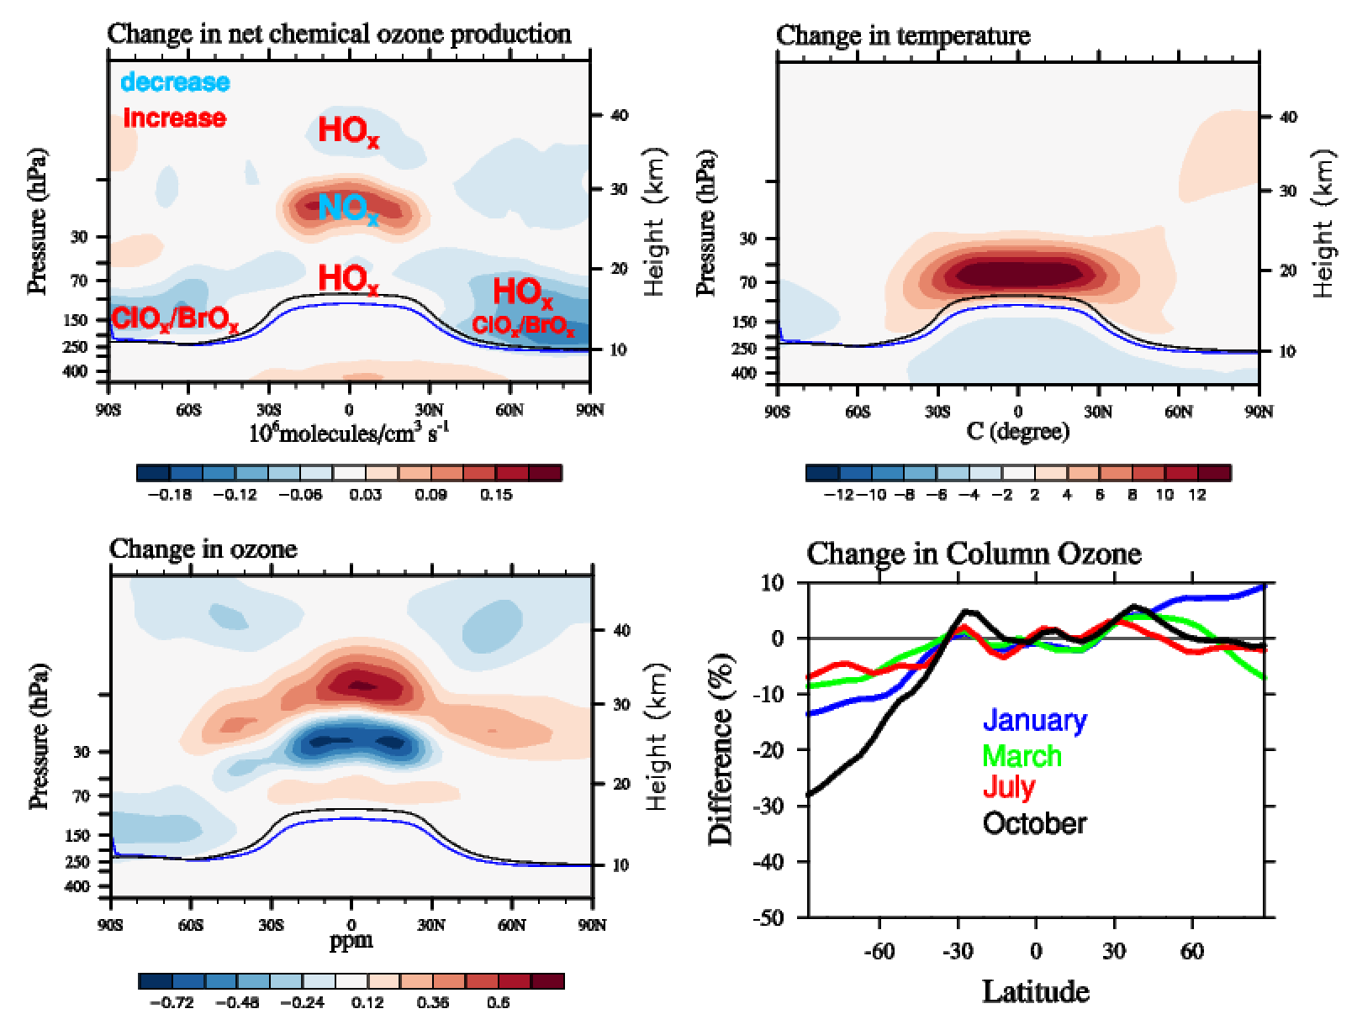
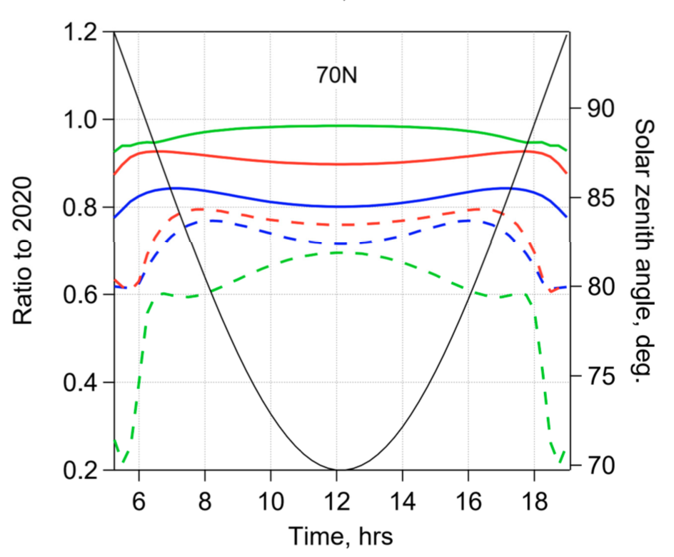
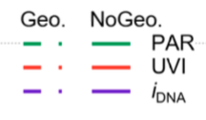
Recent Accomplishments – Example Geo-engineering
Potential geoengineering impact in 2040-2050
Impact on biological active radiation (DNA damage, UV Index, Photosynthesis) at the surface
Year 2080
Madronich et al, 2018
Geoengineering Large Ensemble Project (GLENS)
(BAMS paper: Tilmes et al., 2018b)
Addresses needs to identify side effects and risks of geoengineering
Supports DECIMALS project: looking at impacts of Geoengineering in developing countries
Various research projects are in progress or have been completed based on this dataset
WMO 2018 Ozone Assessment, Chapter 6, Figure 6-A1
(based on Tilmes et al., 2018a)
Notes:
How will stratospheric aerosol geoengineering impact atmospheric composition and ozone. An important contribution on this topic was provided for the WMO 2018 assessment. Geoengineering will change column ozone and depending on the approach may decrease or even increase ozone, a much better understanding on this question is still needed.
ACOM is addressing impacts and risks of geoengineering, including impacts on air quality and climate. We have also looked at changes in biological active radiation: DNA damage, the UV Index, and Photosynthetically Active Radiation (PAR) using the TUV model.
The geoengineering large ensemble simulations has been performed: results have been distributed to the community, biweekly meetings are held to exchange information on ongoing research using the GLENS dataset.
GLENS supports research on geoengineering in developing countries.

Slide 17
Recent Accomplishments – Example Wildfires
Early results
Vastly different NOx but similar VOCs in the two fire plumes.
Ozone production in Taylor Creek fire plume more efficient due to the availability of initial NOx (~10 x higher).
Further studies will shed detail into the chemical processing.
New (e.g. TROPOMI) and planned (e.g. TEMPO) satellite NO₂ products could dramatically improve modeling of ozone from wildfires.
F. Flocke et al., work in progress
Elapsed Time Since Emission

Slide 18
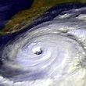
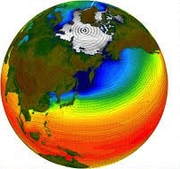

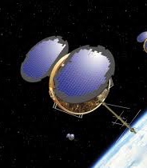
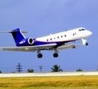
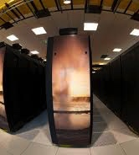
Research Activities with other NCAR Labs

Slide 19
Thank you!
ACOM Real-time Global Atmospheric Composition Forecasts

Slide 21
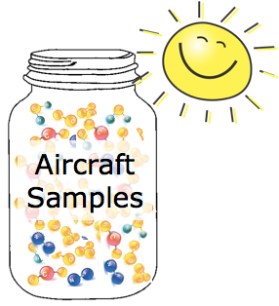
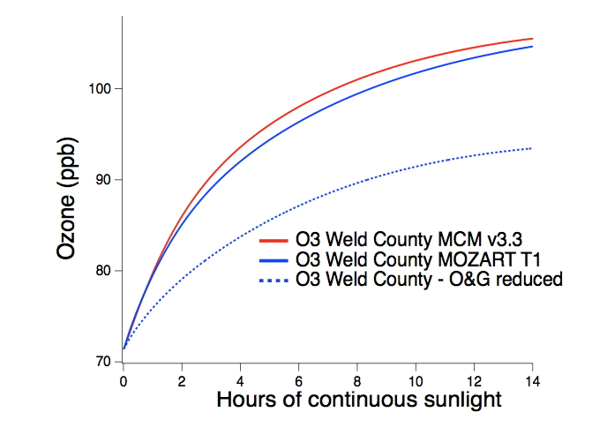
Recent Accomplishments – Example Air Quality
FRAPPÉ: Ozone source contributions in the CO Front Range
WRF/CMAQ constrained by field observations: 3 August 2014
Chemical Box model driven by aircraft Observations
Oil &Gas Contribution
Mobile Contribution
Ft Collins
Ft Collins
Greeley
Greeley
Boulder
Boulder
Denver
Denver
-
Analysis of FRAPPÉ Observations and Modeling show:
Underestimation of reported mobile and oil and gas emissions.
On average, over 2/3 of ozone produced in the Front Range is attributable to oil and gas and mobile sources.
Oil and gas emissions primarily impact ozone formation in the Northern Front Range
Mobile emissions (and to some extent) industrial emissions impact the Southern Front Range

Slide 22
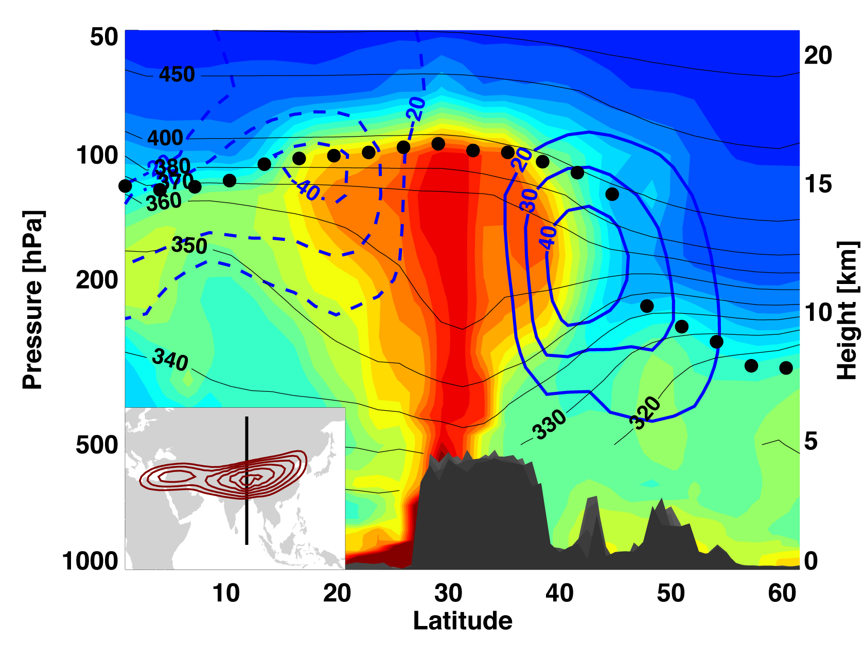
Recent Major Accomplishments
Chemistry & climate impacts of the Asian Monsoon
WACCM simulation of convective transport by Asian monsoon
Satellite observations reveal a large persistent layer of pollutants and aerosols in the lower stratosphere over Asia during the summer monsoon season
NCAR WACCM model identifies the formation mechanism, revealing the role of monsoon deep convection in coupling the most polluted boundary layer in the world to the stratosphere

