Slide 1
Langley Mobile Ozone Lidar (LMOL) Results during the DISCOVER-AQ Denver, CO Air Quality Campaign
Russell De Young
Science Directorate
NASA Langley Research Center
Hampton, VA 23681
Russell.j.deyoung@nasa.gov
William Carrion
Coherent Applications Inc.
Hampton, VA 23681
Denis Pliutau and Rene Ganoe
Science Systems and Applications Inc.
Hampton, VA 23681

Slide 2
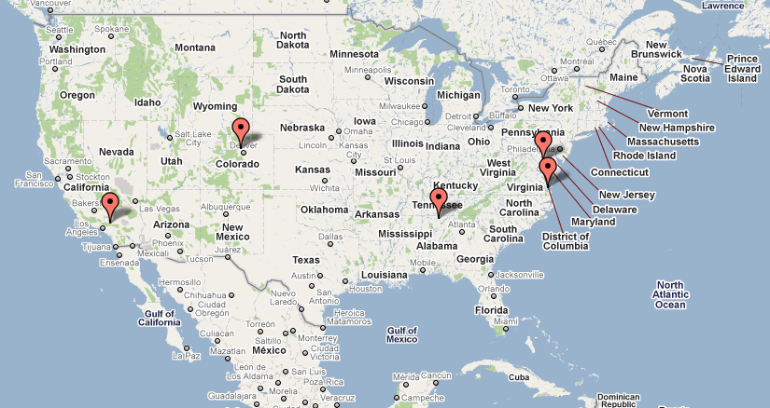
Langley Mobile Lidar is part of the Tropospheric Ozone Lidar Network
(TOLNet)
NOAA/ESRL
NASA/GSFC
NASA/LaRC
UAH
JPL/TMF

Slide 3
Colorado Population Density

Slide 4
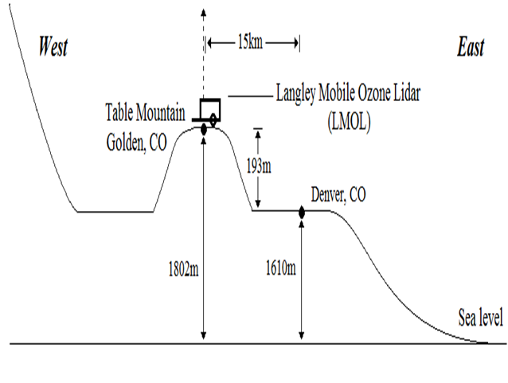
LMOL Location at Table Mountain, Golden, CO

Slide 5
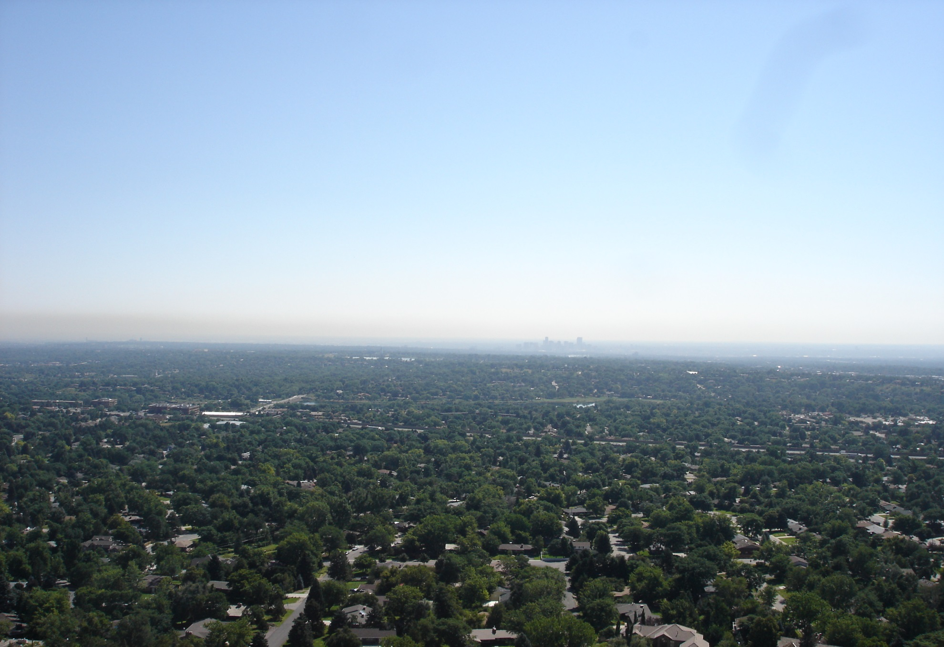
Denver Brown Cloud from Table Mountain, Golden, CO

Slide 6
Lidar System
Characteristics

Slide 7
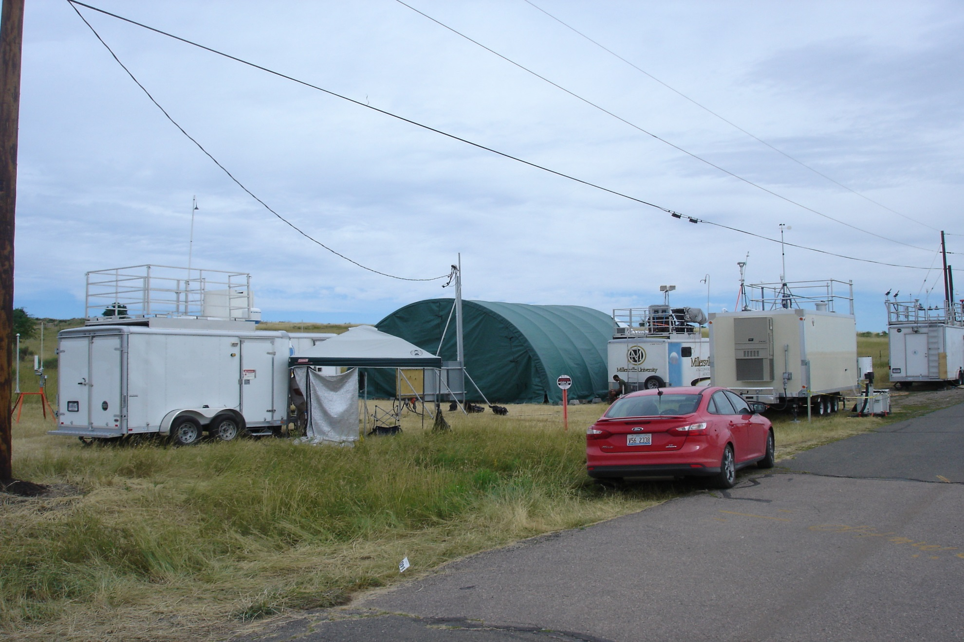
LMOL at South Table Mountain, Golden, CO

Slide 8
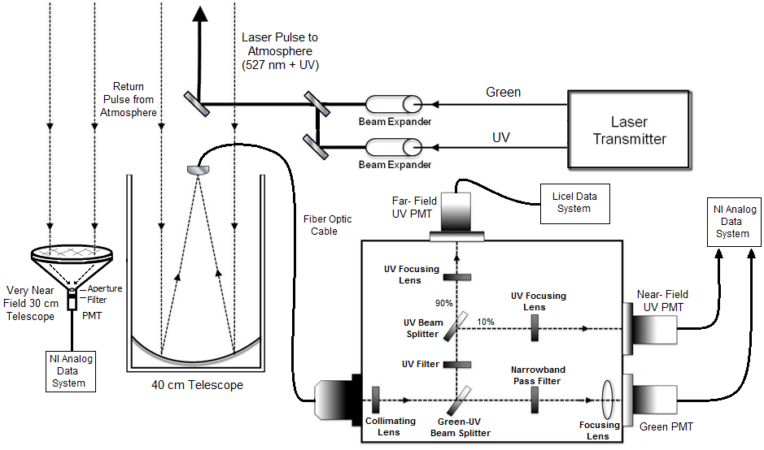
Langley Mobile Ozone Lidar Schematic

Slide 9
Atmospheric Ozone Results
Boulder Atmospheric Observatory, Erie, CO and
South Table Mountain, Golden, CO

Slide 10
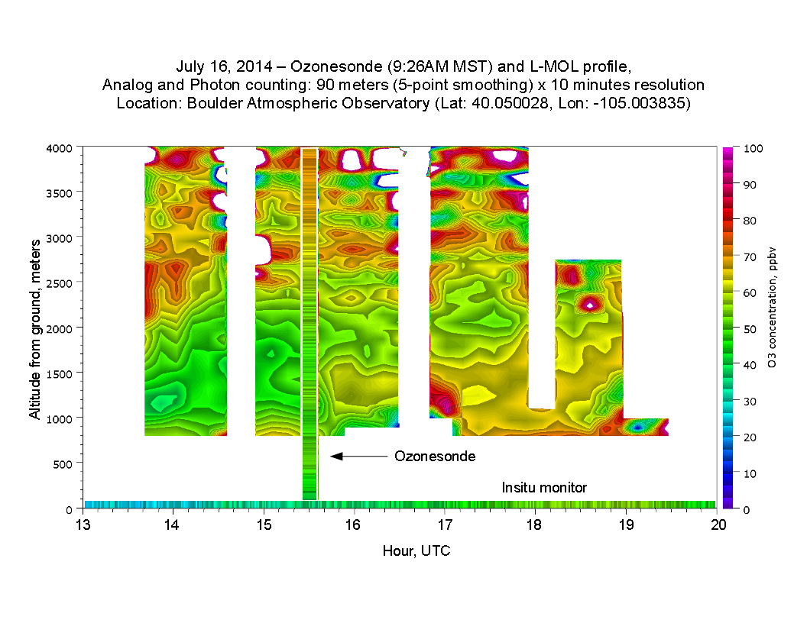

Slide 11


Slide 12
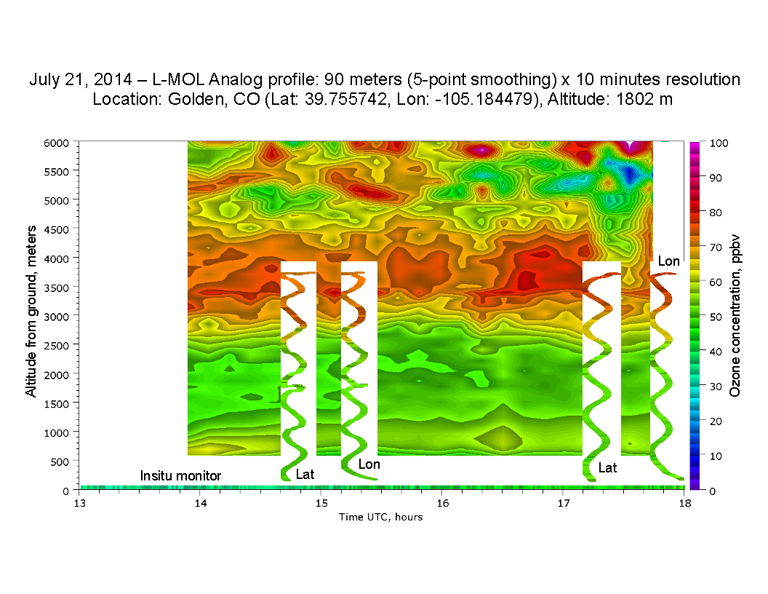

Slide 13
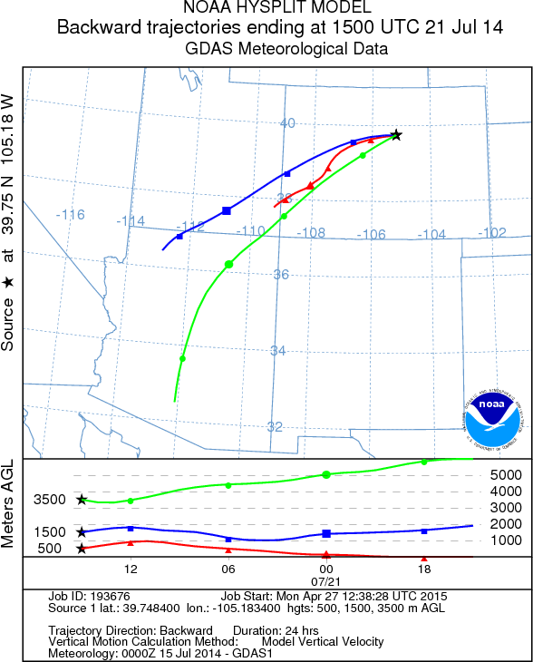
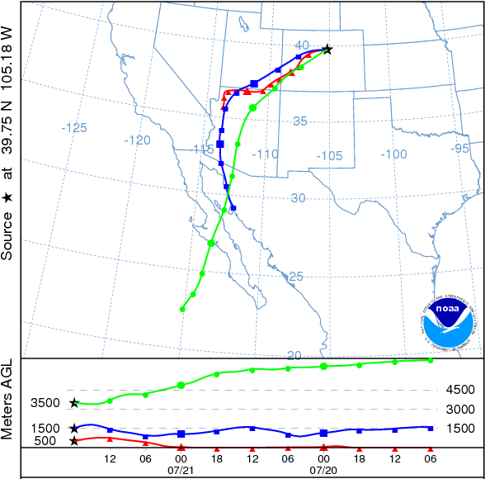
Background Ozone = 45 ppbv

Slide 14
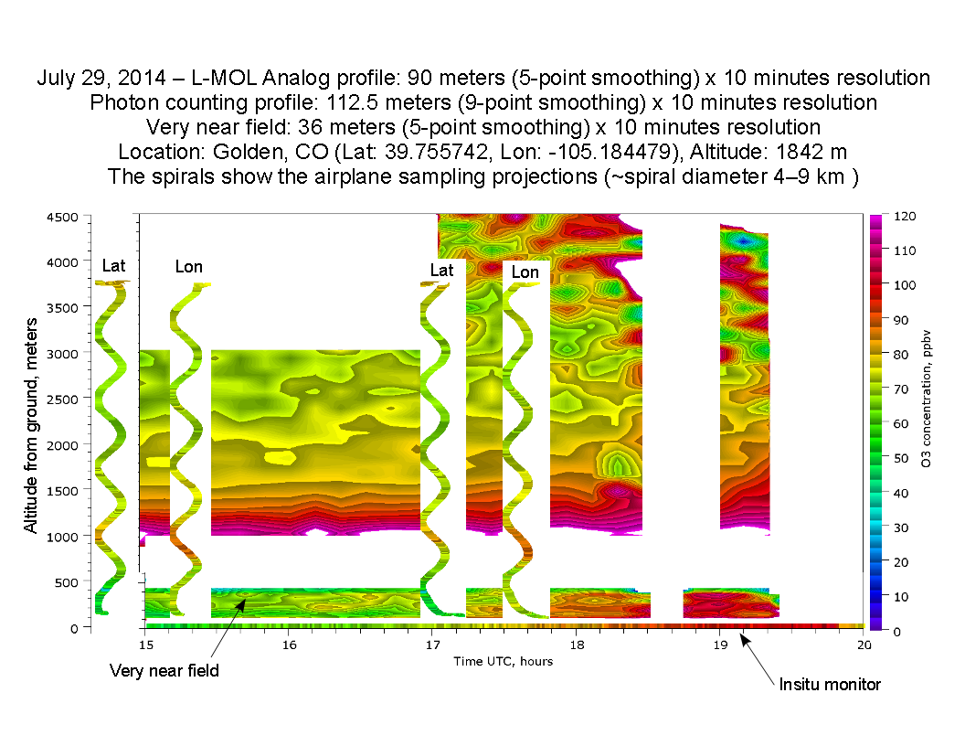
In-situ aircraft ozone

Slide 15
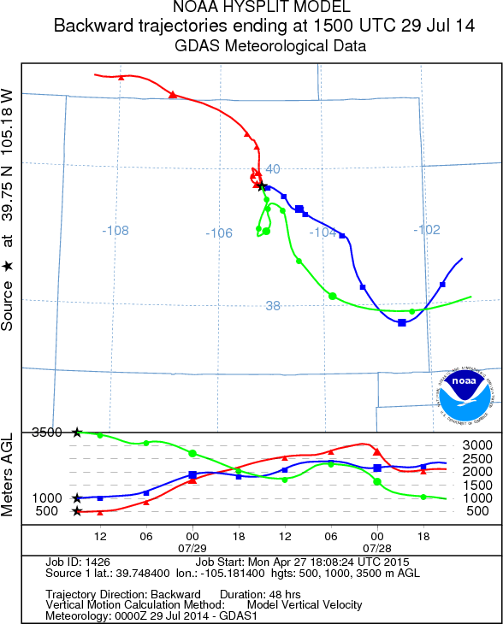
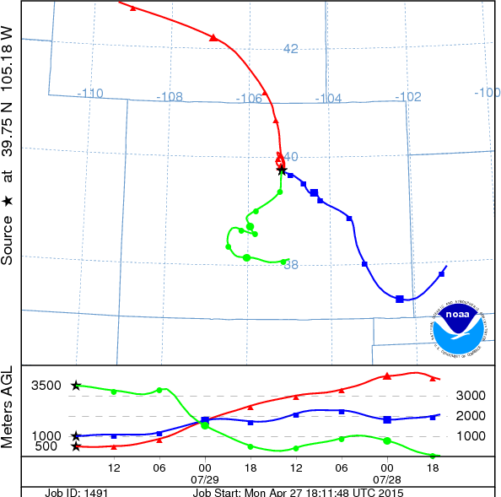
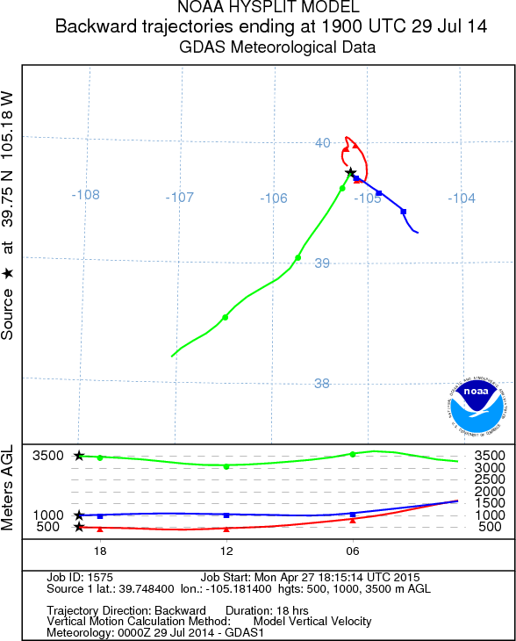


Slide 17
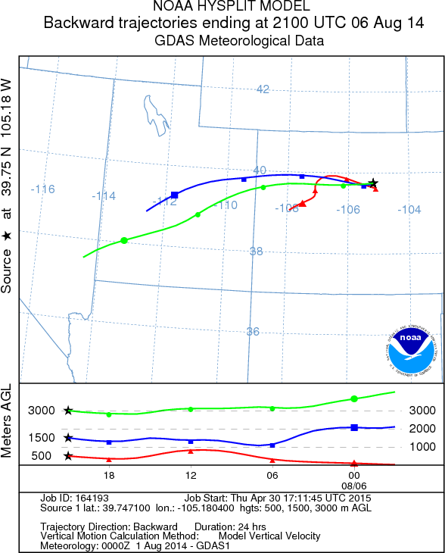

Slide 18
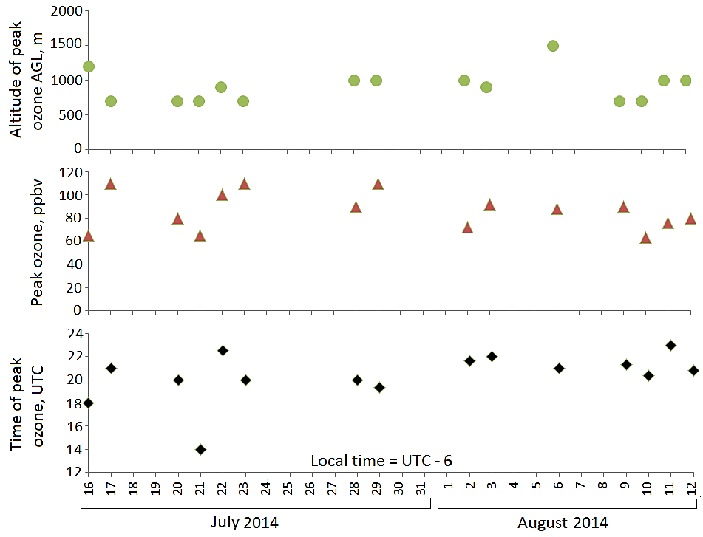
Peak Ozone Lidar Trends from South Table Mountain, Golden, CO
(July 16, 17 at Boulder Atmospheric Observatory, Erie, CO)
Background ozone 45 ppbv

Slide 20
Backup slides

Slide 21
Ozone Lidar Specifications
PUMP LASER
Green output of Nd:YLF laser | 12 mJ/pulse, 527 nm (max)
UV output for pumping Ce:LiCAF laser | 2.8 mJ/pulse, 263 nm (max)
Repetition rate | 1 kHz
LIDAR TRANSMITTER
Ce:LiCAF laser energy | 0.1-0.6 mJ/pulse 500 Hz each
Wavelength tuning range | 285-310 nm
Typical ozone wavelengths | 285.7 and 291.4 nm
Laser line width | 0.2 nm
Laser beam diameter, divergence | ~ 0.8 cm, 0.13 mrad
Transmitted green, divergence | 4 mJ/pulse, 527 nm (max); 0.85 mrad
LIDAR RECEIVER
Near Field Telescope | 40 cm dia. Newtonian (62% efficiency)
Fused silica optical fiber | 1 mm dia., NA=0.28
Field of view | 1.4 mrad
UV channel, λ_{c} 285-300 nm, T = 60% | PMT – analog + photon counting
Green channel , λ_{c} 527 nm, ∆λ = 0.3 nm, T = 43% | PMT – analog
Very near field telescope | 30 cm dia. Newtonian
POWER REQUIREMENTS
Laser + control system Chiller | 1 KW 1 KW

Slide 22
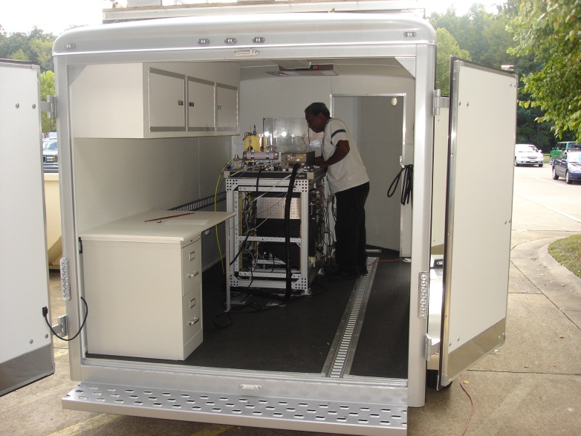
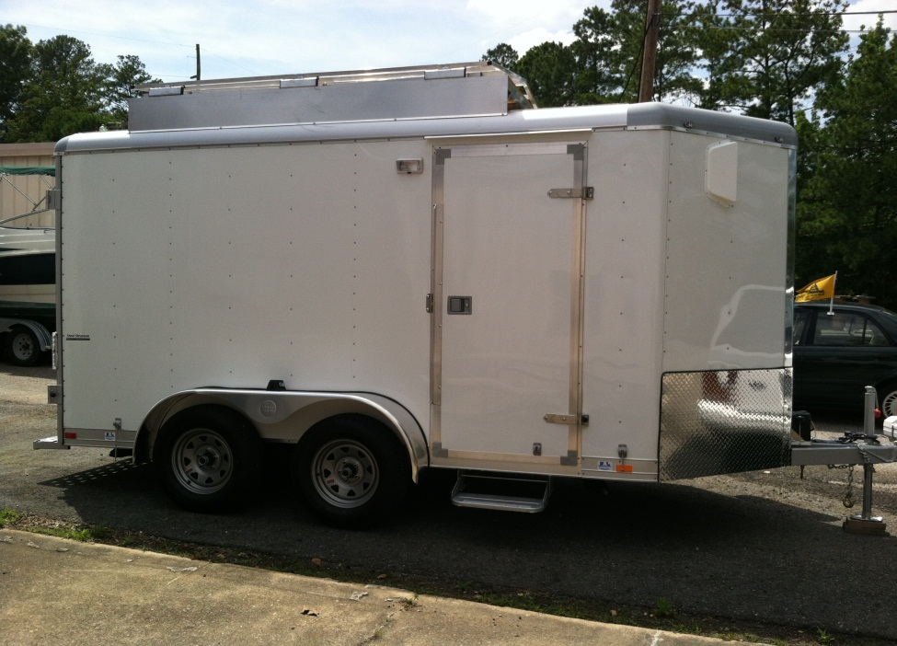
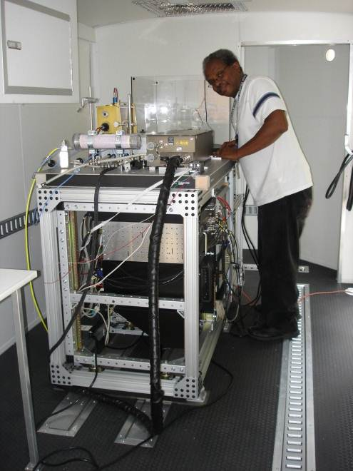
Lidar System Mobility
The system has been configured to enable mobile operation from an environmentally controlled trailer, which is towed to sites equipped with power.
This mobility will allow the system to be set up at remote sites to support major air quality field campaigns.

Slide 23
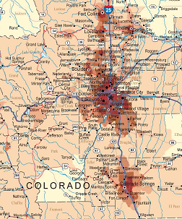

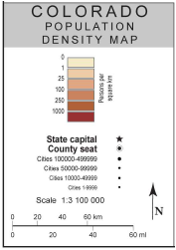

Slide 24
Science Investigations Addressed by the Langley Mobile Ozone Lidar
Provide high spatio-temporal profiles of Planetary Boundary Layer (PBL) and Free Troposphere (FT) ozone and aerosols to study the atmospheric structure that GEO-CAPE will observe and assess the fidelity with which a geo instrument can measure that structure.
Discover new structures and processes at the PBL/FT boundary, especially in the diurnal variation of that interface.
Help improve air-quality forecast models. Field an ozone lidar that would be suitable to populate a network to address the needs of NASA/EPA/NOAA air-quality scientists and managers who increasingly express a desire for ozone profiles.
Participate in Denver DISCOVER AQ campaign July 2014.
Improve understanding of ozone and aerosols aloft and surface ozone and PM values. Advance our understanding of processes controlling regional background atmospheric composition and their effect on surface air quality to prepare for the GEO-CAPE era.

Slide 25
August 2, 2014
Denver, CO sounding of temperature and relative humidity at 12Z 2 Aug¹
¹ University of Wyoming, Department of Atmospheric Science, http://weather.uwyo.edu/upperair/sounding.html

Slide 26
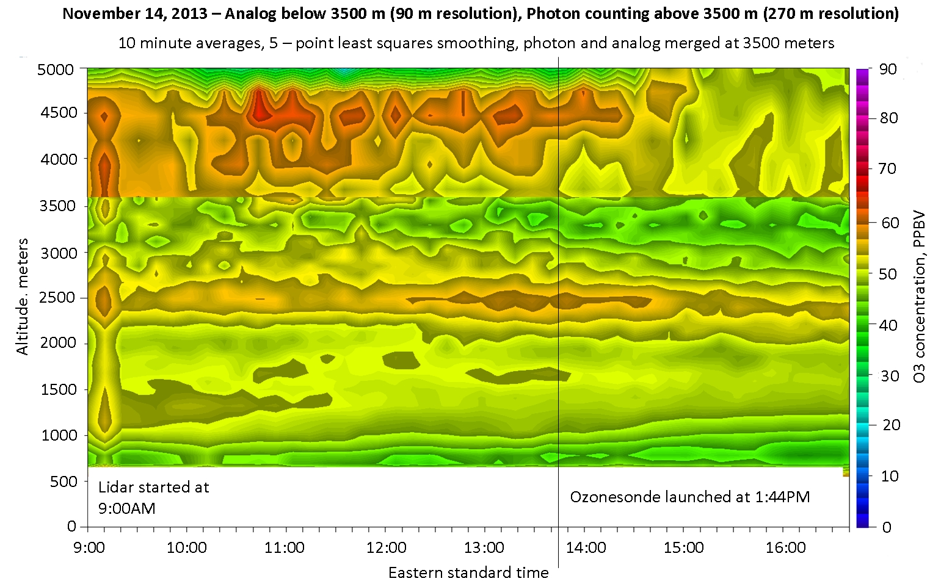
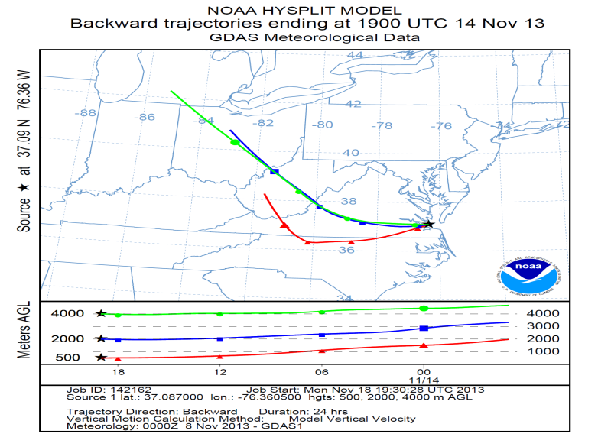
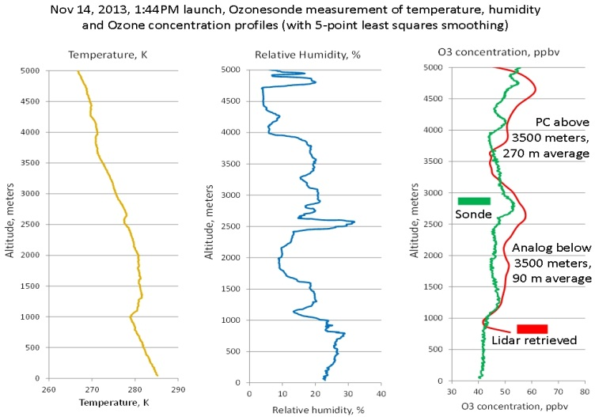
Hampton Roads Ozone profile: Example of Extended Range with Low Ozone and Little Transport

Slide 27
Hampton Roads Ozone Profile: Example of Low Ozone Generation with Little Transport

Slide 28
Hampton Roads Ozone Profile: Example of Ozone Transport and Local Ozone Generation

Slide 29
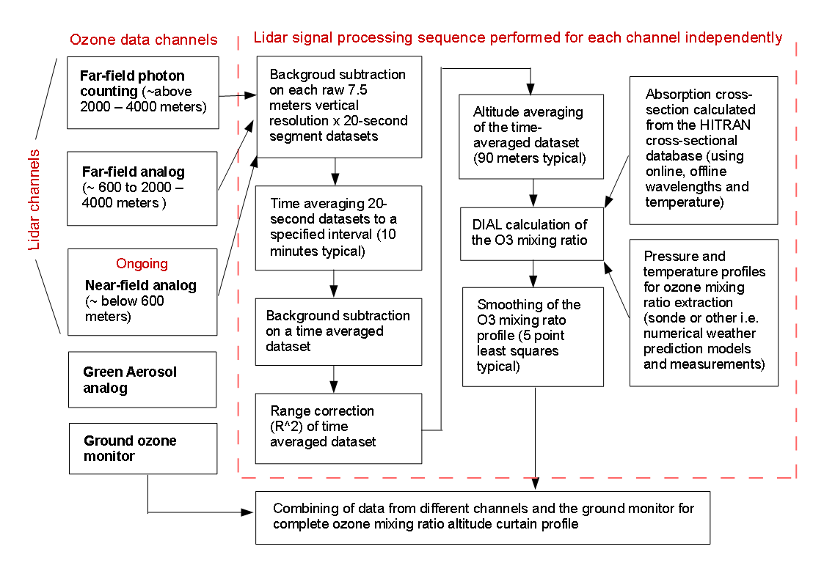
Ozone Profile Extraction Routine

