Slide 1


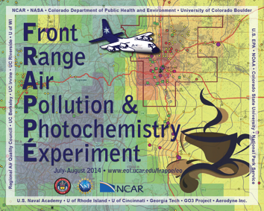
Front Range Air Pollution and Photochemistry Éxperiment
PIs: Gabriele Pfister and Frank Flocke
National Center for Atmospheric Research (NCAR)
Funded by State of Colorado & National Science Foundation
National Center for Atmospheric Research (NCAR), NASA Airborne Science Program
Colorado Department for Health and Environment (CDPHE), Colorado State University (CSU),
University of Colorado Boulder, Environmental Protection Agency (EPA) Region 8,
National Oceanic and Atmospheric Administration (NOAA), National Park Service (NPS),
Regional Air Quality Council (RAQC), UC Berkeley, UC Irvine, UC Riverside, US Naval Academy,
U of Wisconsin, U of Rhode Island, U of Cincinnati, Georgia Tech, GO3 Project, Aerodyne Inc., and others
Jointly with NASA DISCOVER-AQ
PI: James Crawford
Northern Front Range Metro Area (NFRMA)
July 15 - August 18, 2014
http://www2.acd.ucar.edu/frappe

Slide 2
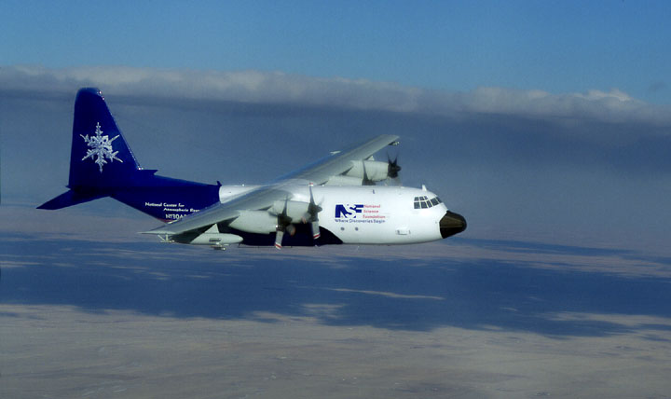
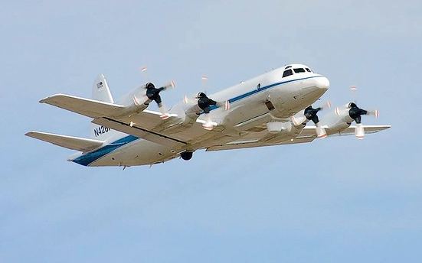
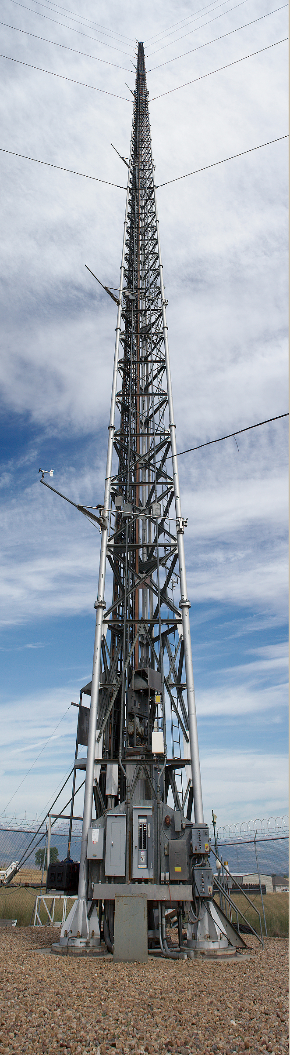
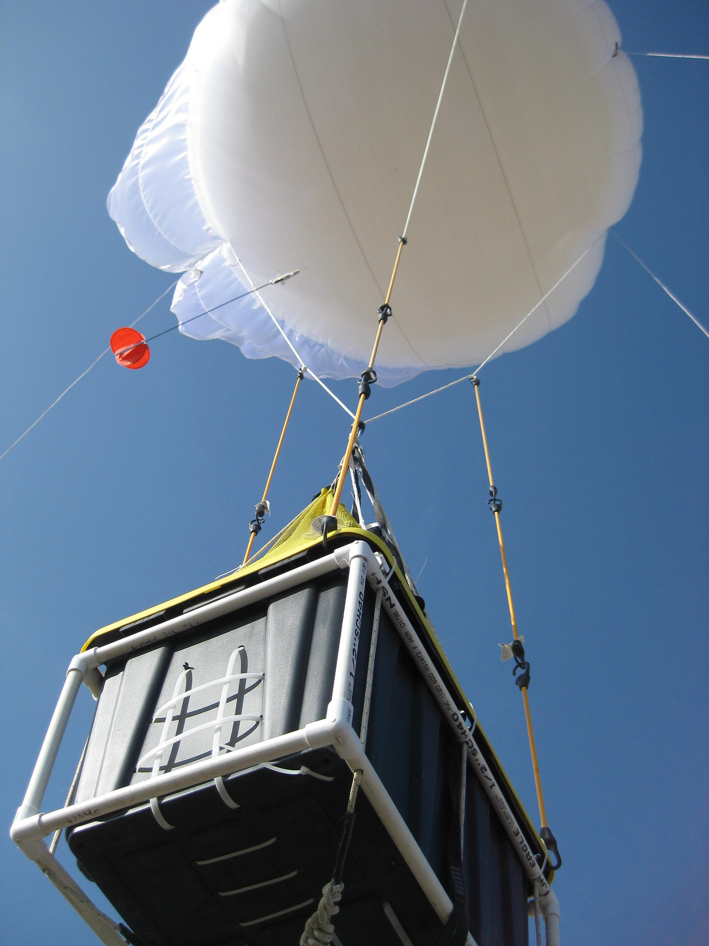

FRAPPÉ and DISCOVER-AQ
Merging of two major field campaigns
to provide a most comprehensive look at
air quality in the Colorado Front Range
Improve development & evaluation of emission control strategies
Allow better modeling of present and future air quality for decision making
Identify optimal locations for surface monitoring sites making the network more efficient and more representative
Refine and verify satellite data for air quality planning in the Front Range.

Slide 3
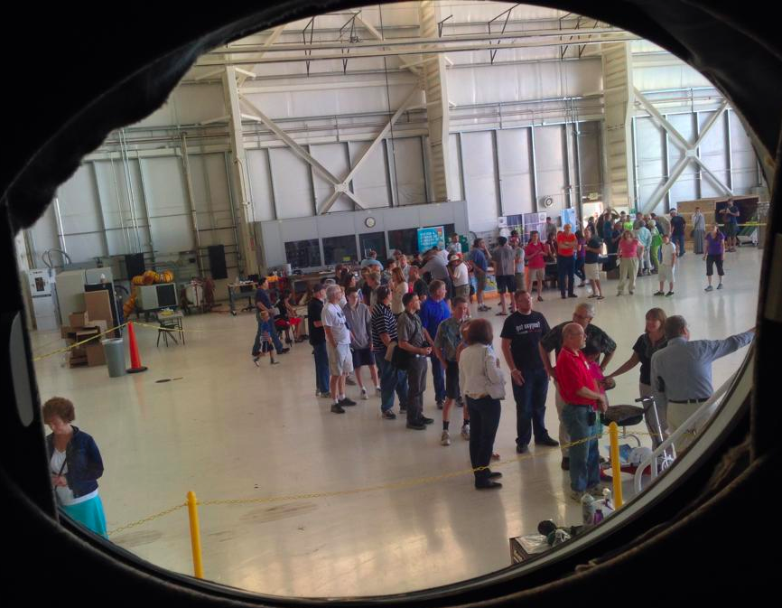
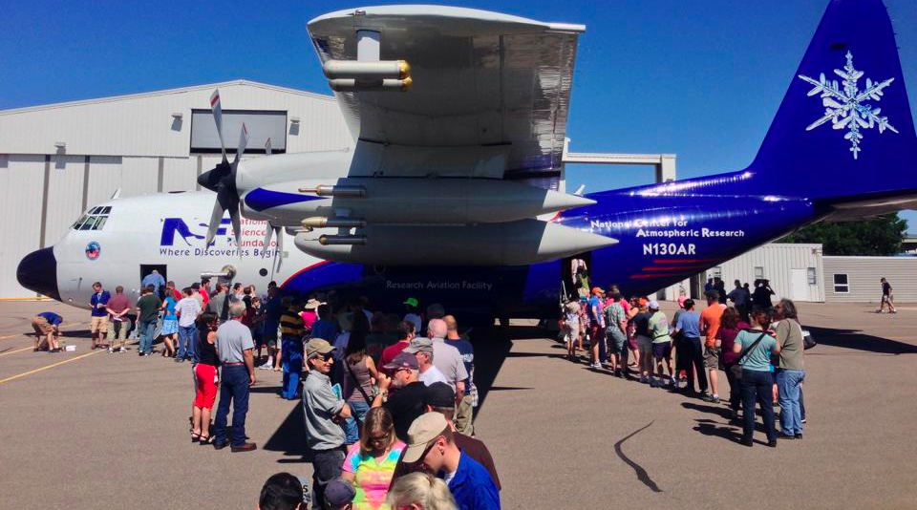
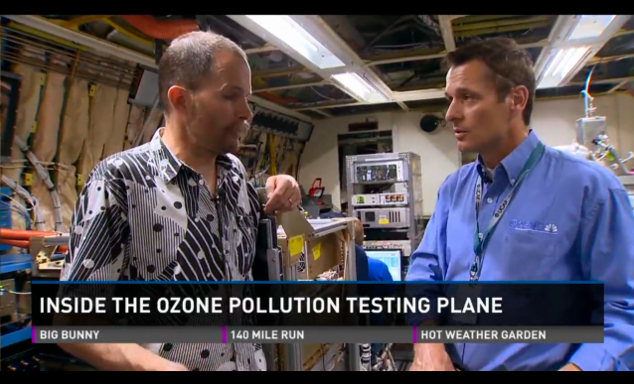
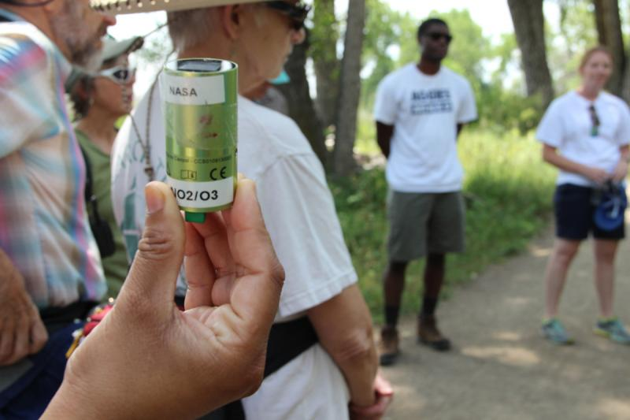

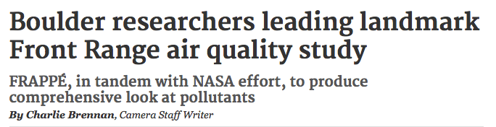
FRAPPÉ E&O
Open House (2 August) and Media Day (15 July) at RAF
Outreach oriented webpages
Student and teacher involvement
2-day educator workshop
Videos, flyers, brochures, stickers
Public presentations and displays
Public involvement (AQ hikes, personal
exposure monitors, ... )
Media and Press

Slide 4

Mission Summary and Preliminary Findings
Joint FRAPPÉ and DISCOVER-AQ Science Team Meeting
4-8 May 2015
Picture: Samuel Hall (NCAR)

Slide 5

MEASUREMENTS
Data Archive
http://www-air.larc.nasa.gov/missions/discover-aq

Slide 6
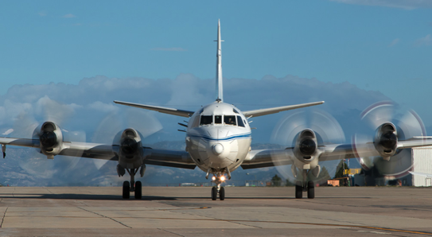
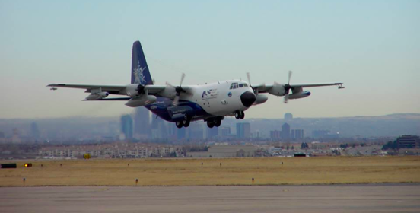
Aircraft
NASA P3
15 Flights
NASA B200
16 Flights
FRAPPÉ and
DISCOVER-AQ Flights
NASA Falcon
10 Flights
NCAR C130
17 Flights (2TF)
NASA Aircraft pictures by Paul Filmer, NCAR C130 picture by Sam Hall

Slide 7
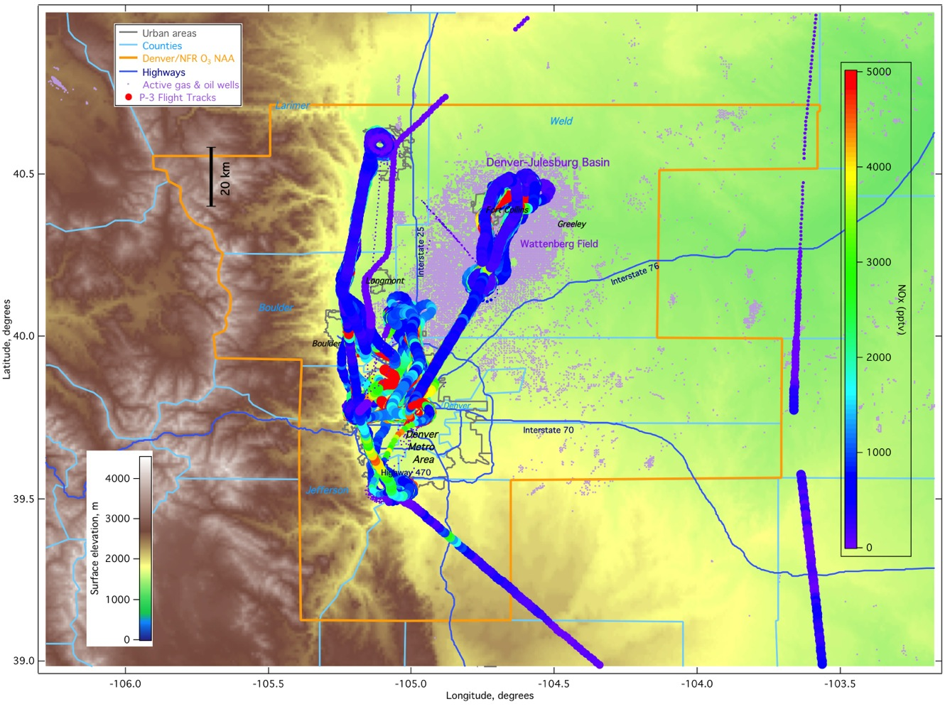
NASA P-3 Flight Tracks - NO_{x}
Repetitive flightpattern

Slide 8
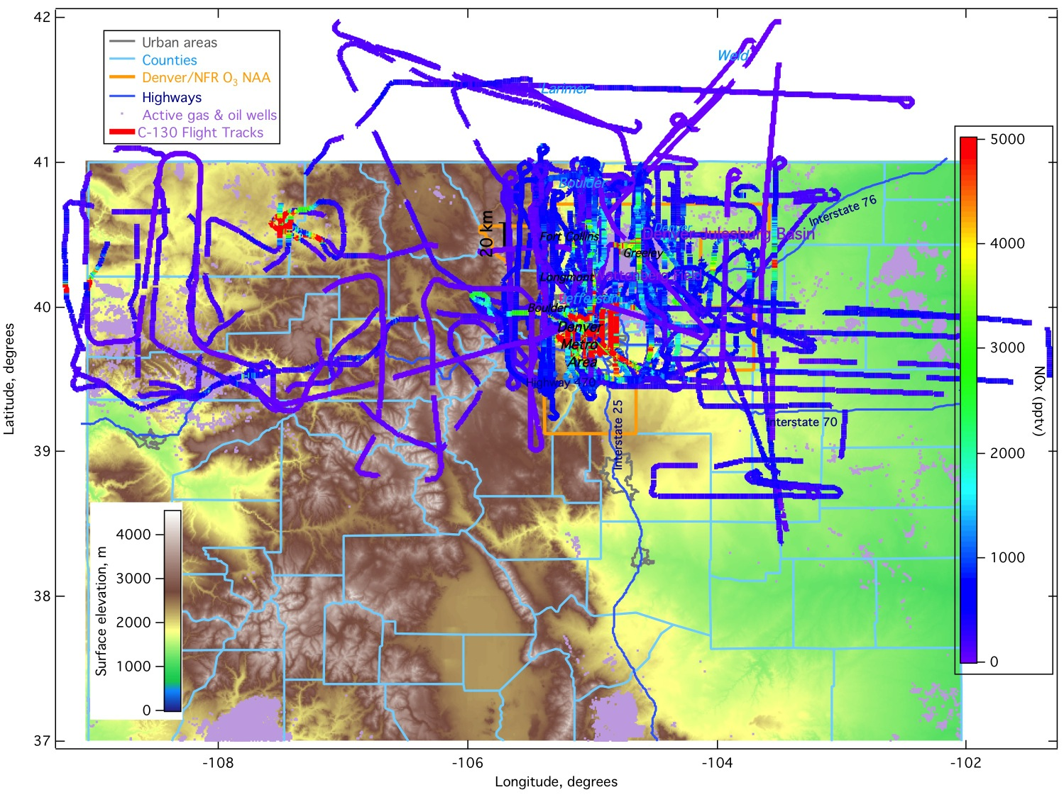
NCAR/NSF C-130 Flight Tracks - NO_{x}
Targeted, regional flights

Slide 9
FRAPPÉ Flight Objectives
Date | Objective
0726 (RF01) | Front Range emissions
0727 (RF02) | Front Range emissions & Denver Cyclone
0728 (RF03) | Front Range emissions & Denver Cyclone & Transport to NW out of Fort Collins
0729 (RF04) | Large scale pollution over NW Colorado and S WY & Jay’s CAFO & Pawnee PP
0731 (RF05) | Mountain-valley (not well developed)
0802 (RF06) | Mountain-valley
0803 (RF07) | Mountain-valley
0806 (RF08) | Piceance and Uintah Basin & Hayden and Craig PP
0807 (RF09) | Front Range Emissions
0808 (RF10) | P-3 Intercomparison & Platte River valley flow
0811 (RF11) | Mountain-valley
0812 (RF12) | Mountain-valley
0815 (RF13) | Inflow from WY (not found) & Hayden, Craig, Ute PP, Rifle OG & SE outflow
0816 (RF14) | SE Outflow & TES overpass – 2 spirals
0817 (RF15) | Front Range emissions & Piceance Basin emission to Front Range & Upslope

Slide 10
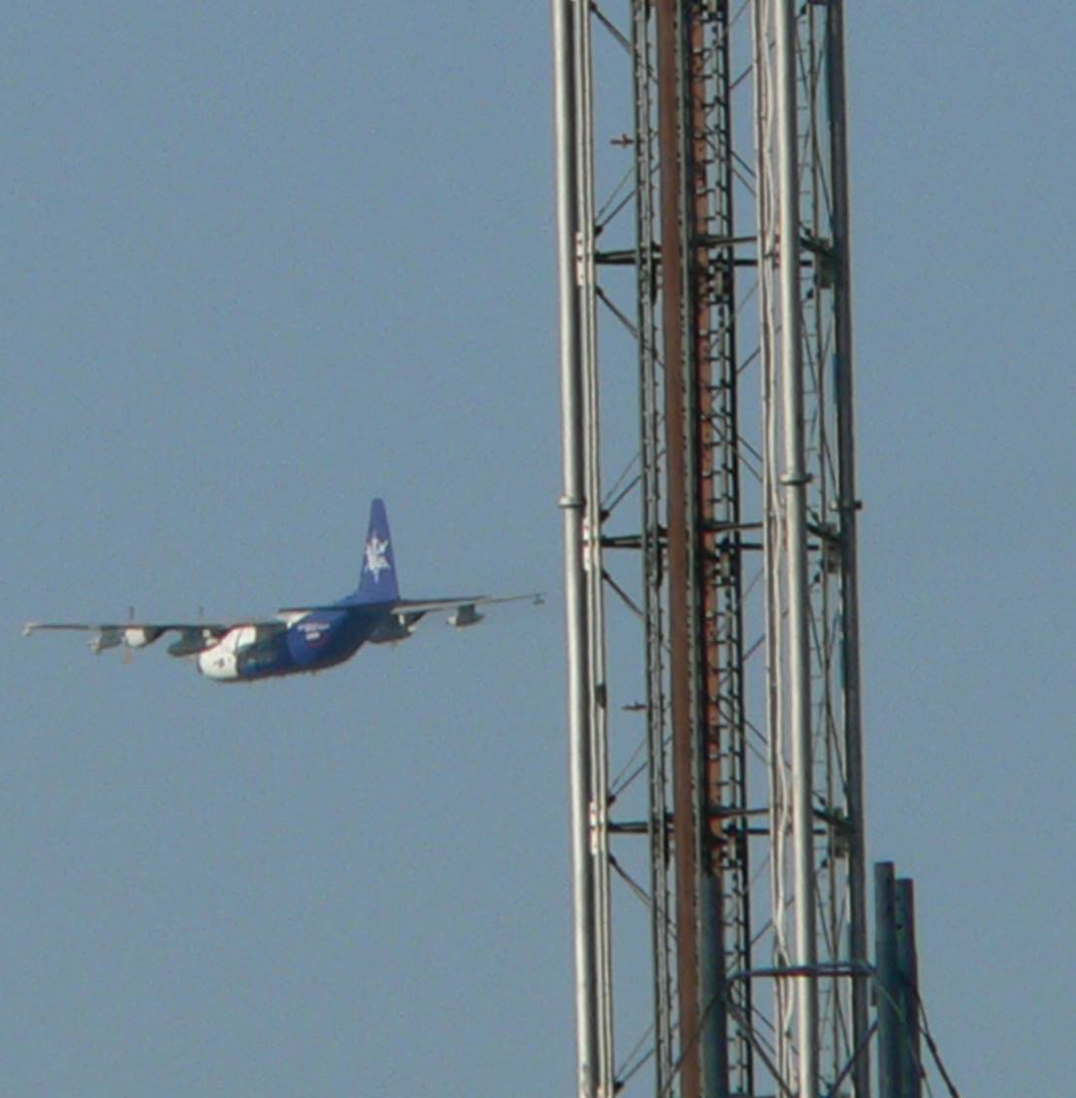
Ground Measurements
Six ground sites at P-3 spiral locations
Erie/BAO, Platteville, Fort Collins, Downtown Denver, Chatfield, Golden/NREL
In-situ instruments, tethered balloons, LIDARs, ozone sondes, vertical profiles up to 1000 feet.
Ground monitors set up by EPA / CDPHE specifically for the campaign
  In addition to existing ground network
Ozone and VOC sampling on E-W gradient
  Along ~40N, between Erie and the Continental Divide
6 Mobile labs
  Operating from Eastern Plains to Continental Divide
  Sampling of oil and gas facilities, CAFOs,
  Commerce City, Metro Area & Foothills
Tethered balloons
  Ft Collins, Downtown, Chatfield
Small monitors, PANDORA spectrometers, etc.
Picture by Andy Langford

Slide 11
Surface Monitors

Slide 12
Surface Monitors
Notes:
The orange circles show the major ground sites with more than ozone, Pandora and maybe NOx.

Slide 13
Mobile Units

Slide 14
Mobile Units

Slide 15
Mobile Units

Slide 16
Mobile Units

Slide 17
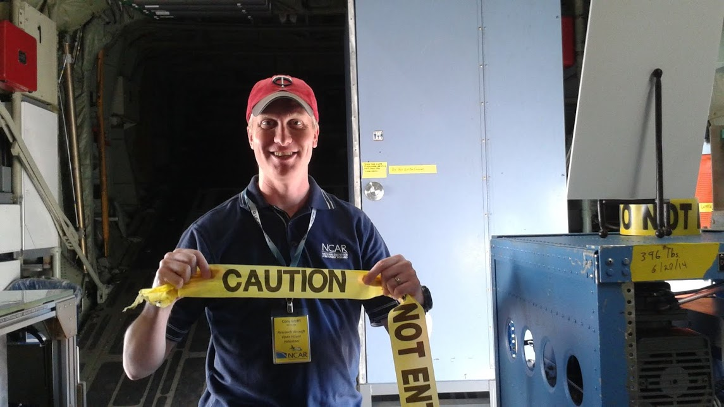
Some First Results
SOURCES
PRELIMINARY Analysis !
Cory Wolff, NCAR/RAF

Slide 18
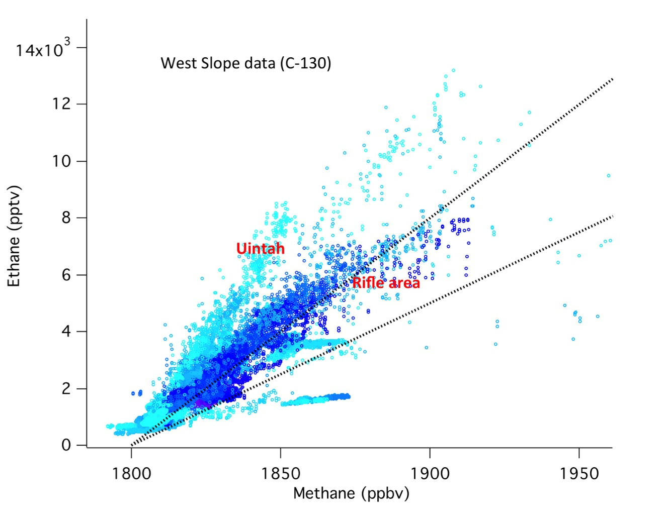
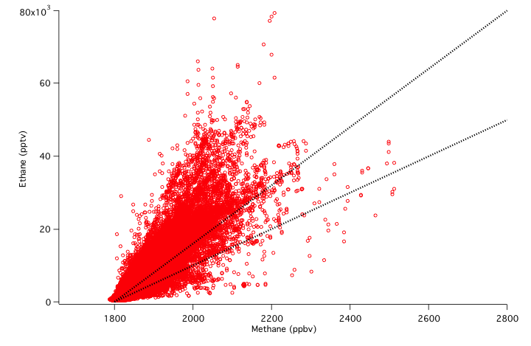
O&G: Ethane to Methane Ratio
8% Ethane*
5% Ethane*
Western Slope (C-130)
8% Ethane*
Wattenberg (C-130)
5% Ethane*
*Composition of Natural Gas
as provided by Xcel Energy

Slide 19
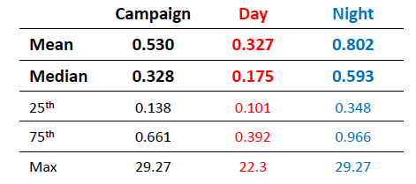
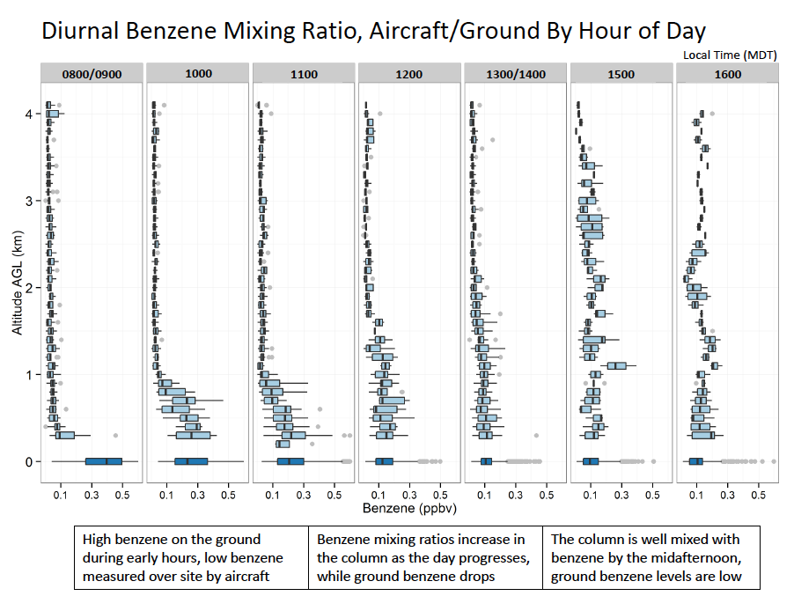
O&G: Benzene @ Platteville
Hannah Halliday, Penn State University
Surface PTRMS & P-3

Slide 20
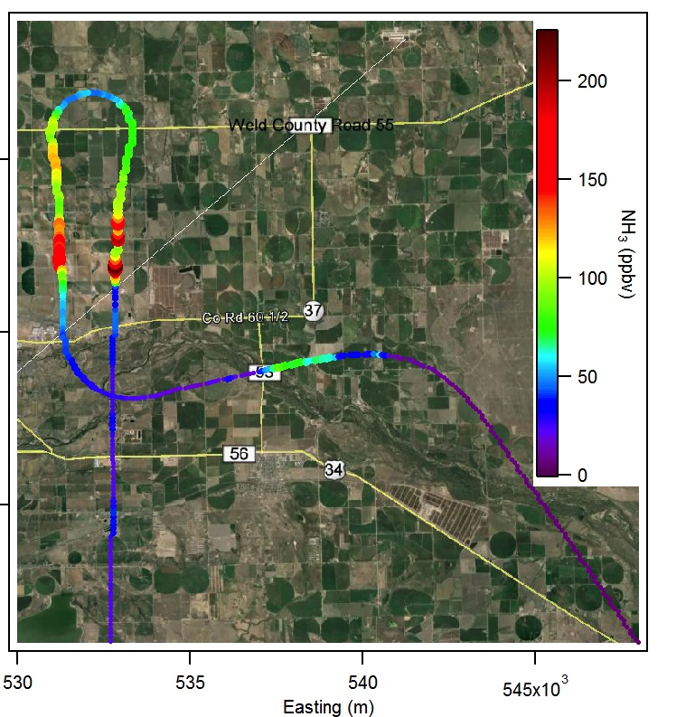
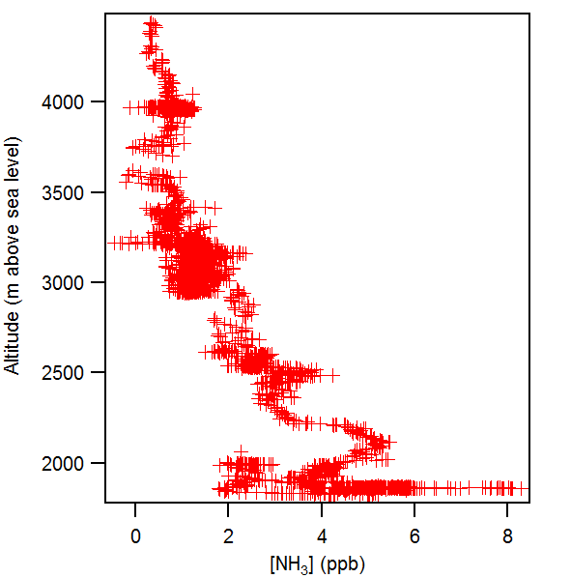
Agriculture:
Ammonia as a Tracer
Downwind of feedlots
C-130

Slide 21
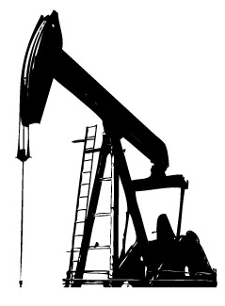

Fingerprinting Methane
Tracer – tracer correlations
(e.g. Methane vs Ammonia and Ethane)
Methane isotope analysis
?
δ²H signature ~-202‰
δ²H signature ~-290‰
δ²H signature ~-290‰
Platteville: δ²H signature ~-250‰
-> ~ equal contribution of O&G and agricultural sources
Amy Townsend-Small, U Cincinnati

Slide 22
Power Plants – C-130 NO_{x} and SO₂
NO_{x}
SO₂
Hayden
Bonanza
Craig
Valmont

Slide 23
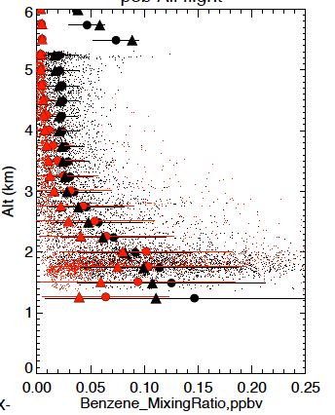
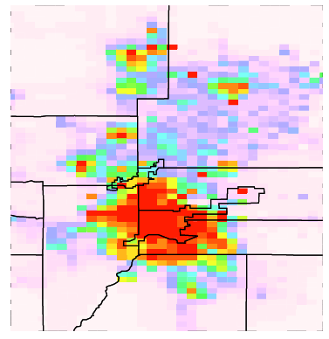
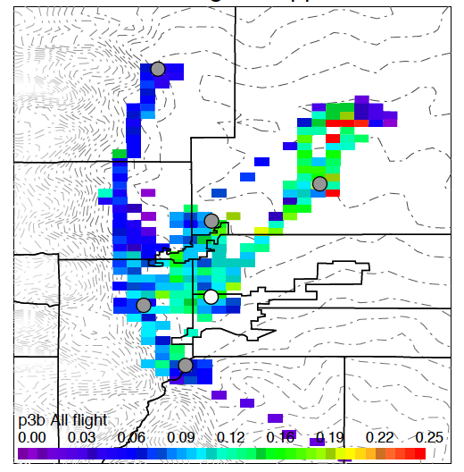
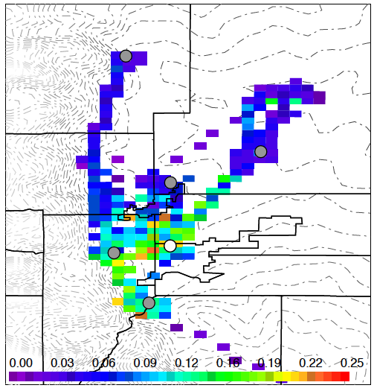
WRF-Chem Analysis with NEI 2011
P-3
WRF-Chem
Currently available: NEI 2011 (provided by Stu McKeen),
WESTAR (2011, upon request), Other?
Need region specific emissions & speciation & year specific
Update emissions based on observations
Form Front Range emission and modeling working groups
(proposed by K. Briggs, CDPHE)
For modeling we need better anthropogenic emissions!
• Mean ⏏ Median
Benzene too low, NEI 2011 has mostly urban sources
NEI 2011 Benzene
P-3 Benzene (<3km)
WRF-Chem Benzene (<3km)
Data: Wisthaler
Notes:
Nox, CO too high
VOCs all over the board

Slide 24
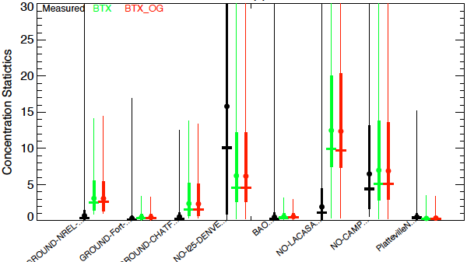
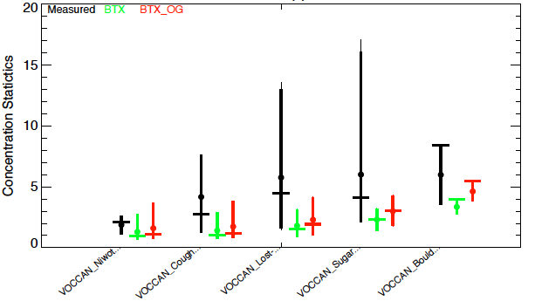
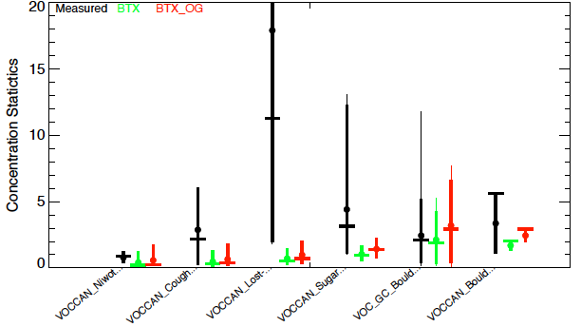
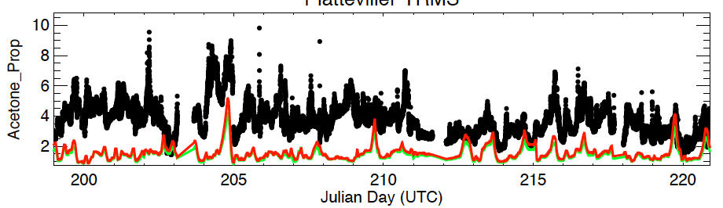
WRF-Chem Analysis with NEI 2011
Comparison to surface measurements
NO, ppb
Evaluations show the model is:
Too high for urban NOx, CO, SO2
Too low for many VOCs, NH3
Off in spatial distribution for some tracers
Incorrect in tracer ratios
Various
C2H6, ppb
C3H8, ppb
Cans, Helmig
Cans, Helmig
Acetone, Platteville
Measured
WRF-Chem
WRF-Chem (+50% OG Emis.)
PTRMS, Wisthaler

Slide 25
Some First Results
VOC/Nox Sensitivity
PRELIMINARY Analysis !
Cory Wolff, NCAR/RAF

Slide 26
NO_{X} sink partitioning
RH + OH → RO₂ + H₂O
RO₂ + NO → RONO₂
NO₂ + OH → HNO₃
Rural
Urban
Fractional NO_{X} Loss
HNO₃
RONO₂
log NO_{X}
"NO_{X} Oxidation Products and their Relationship to Ozone Production Across Colorado's Front Range"
Tamara Sparks, UC Berkeley
Notes:
If look at how ozone produced, NOx and VOC emissions fuel coupled NOx and HOx cycles which spit out ozones.
This cycling ends with termination, including formation of NOx sinks alkyl nitrates and nitric acid
As part of understanding ozone production, I will be focusing on these NOx sinks
Which NOx sinks are formed depends on these reactions
If VOC reacts with OH, it produces RO2, then RONO2
If NO2 reacts with OH, is make HNO3
So at high NOx, HNO3 dominates
At low NOx, VOC more likely to react with OH so RONO2 dominates
So if we look back at this picture, we can think of this urban line as where we used to be*

Slide 27
NO_{X} sink partitioning
RH + OH → RO₂ + H₂O
RO₂ + NO → RONO₂
NO₂ + OH → HNO₃
Rural
Urban
Fractional NO_{X} Loss
Time
VOCR
HNO₃
RONO₂
log NO_{X}
"NO_{X} Oxidation Products and their Relationship to Ozone Production Across Colorado's Front Range"
Tamara Sparks, UC Berkeley
Notes:
But as time goes forward and NOx decreases, urban areas are moving to the left, toward more AN production. But this isn’t a fixed picture that depends only on NOx*
Alkyl nitrate formation also depends on the VOCs going making the RO2 radicals, so VOC reactivity can shift this picture too

Slide 28
NO_{X} sink partitioning
RH + OH → RO₂ + H₂O
RO₂ + NO → RONO₂
NO₂ + OH → HNO₃
P-3 Aug 3
SOAS
Mexico City
Fractional NO_{X} Loss
HNO₃
RONO₂
1.5ppb
log NO_{X}
"NO_{X} Oxidation Products and their Relationship to Ozone Production Across Colorado's Front Range"
Tamara Sparks, UC Berkeley
Notes:
So where does this day fall on partitioning plot?
*Right in between, still to right of crossover, but in a region with high gradient where can change quickly with small changes in NOx
This occurs at an average of about 1 ppb
As was mentioned previously, August 3 and July 22 were the ozone exceedance days during the campaign, and I noticed that both of those days had a high fraction of ANs. As I showed before, Aug 3’s calculated production ratio was 32% for ANs, which is among the highest we saw for production. July 22 C130 wasn’t flying, so don’t have a plot of production, but the concentration was 42%, which was the highest of any day based on concentrations. If the greater AN loss from Aug 3 holds on July 22 as well, the production percentage would be even higher, maybe even crossing the 50% mark. So we see a correlation between high ozone and high alkyl nitrate production
Ozone exceedance days had high alkyl nitrates

Slide 29
Some First Results
Denver Cyclone
PRELIMINARY Analysis !
Cory Wolff, NCAR/RAF

Slide 30
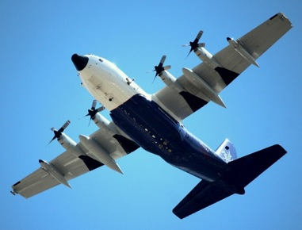
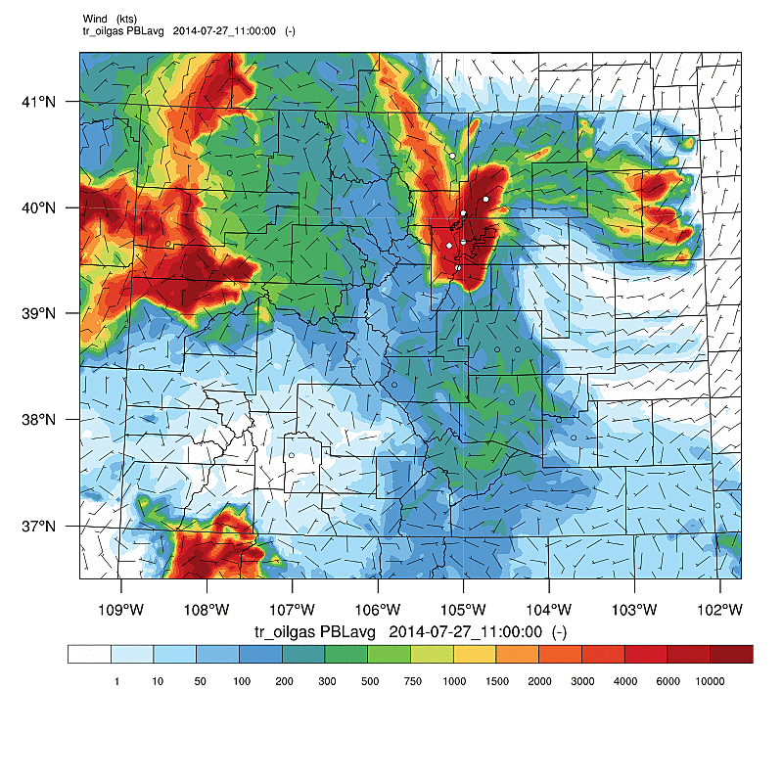
The “Denver Cyclone”
What the WRF Tracer Model predicted
What the C-130 saw
Notes:
DCVZ conditions form when a low-level moist, southeasterly flowing air mass meets the Palmer Divide, a ridge that extends east of the Colorado Front Range. If the moist air lifts over the ridge and meets northwesterly winds originating in the Rocky Mountain foothills, winds may converge to create enhanced cyclonic vorticity.^{[2]}

Slide 31
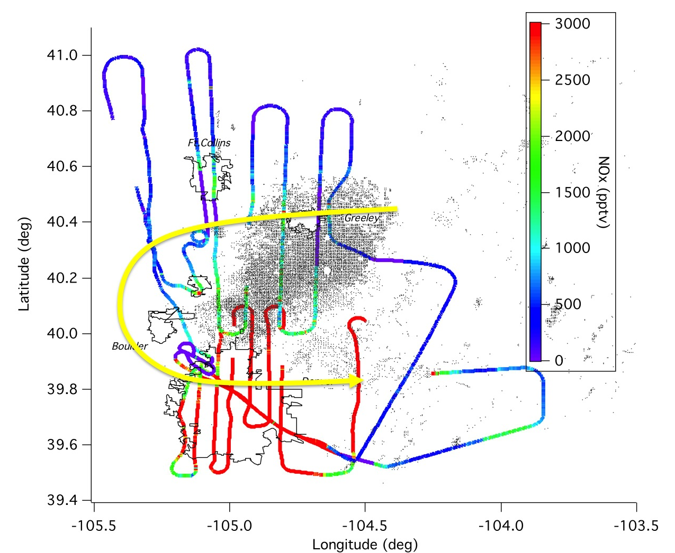
Local Emissions - Separation and Mixing
NOx (C-130)

Slide 32
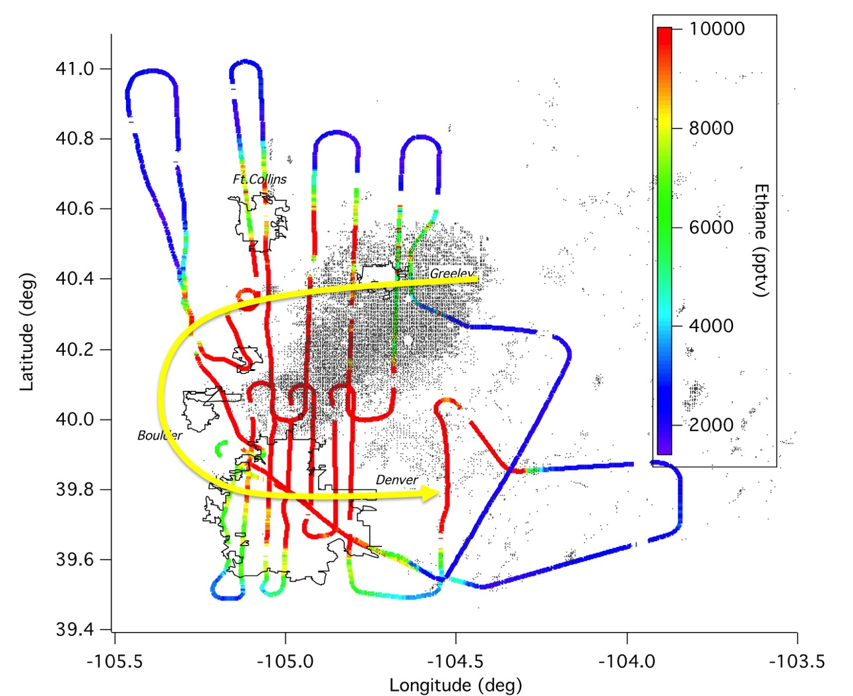
Local Emissions - Separation and Mixing
Ethane (C-130)

Slide 33
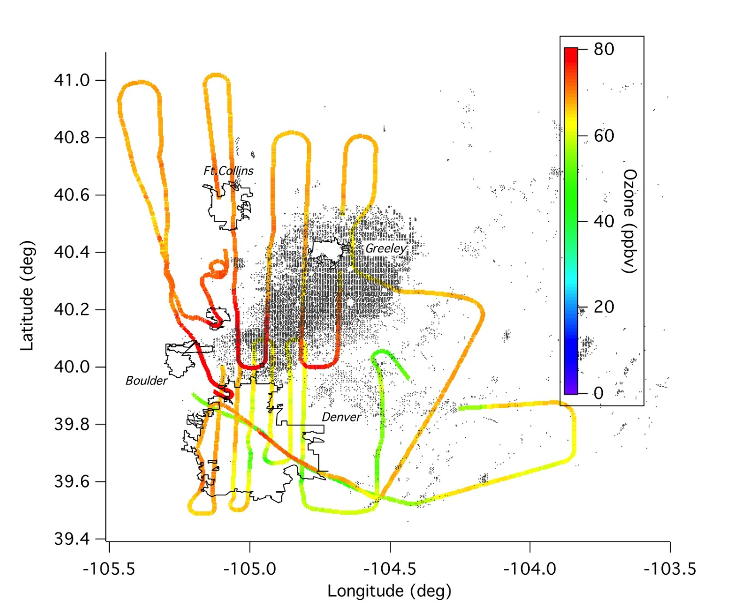
Local Emissions - Separation and Mixing
Ozone (C-130)

Slide 34
Some First Results
Residual Layer and Recirculation
PRELIMINARY Analysis !
Cory Wolff, NCAR/RAF

Slide 35
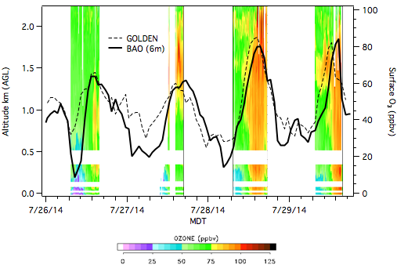
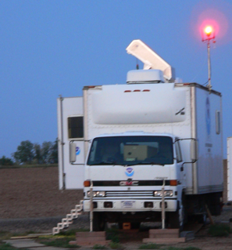
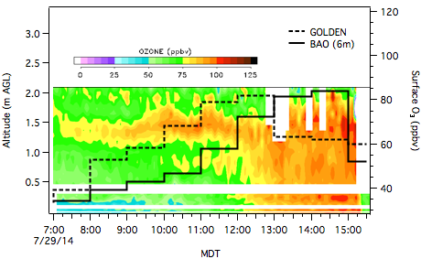
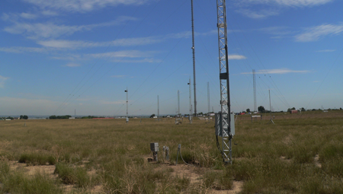
Case Study: Denver Cyclone Episode of July 26-29
Andy Langford, NOAA
8-h O₃ of 73 ppbv at Golden on July 28 and 1-h O₃ of 84 ppbv at BAO on July 29
July 26-29
TOPAZ ozone lidar
Polluted layer aloft
High O₃ in residual layer
9:39 MDT Aug 8
July 29
What is the origin and fate of the high ozone in the nocturnal residual layer?

Slide 36
Some First Results
Mountain-Valley Flow
PRELIMINARY Analysis !
Cory Wolff, NCAR/RAF

Slide 37
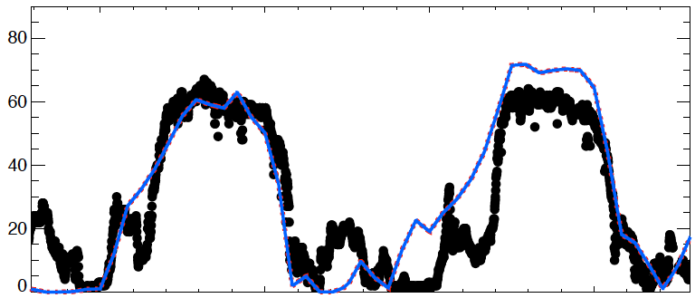
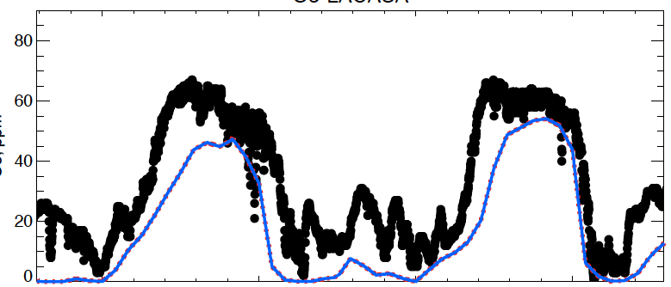
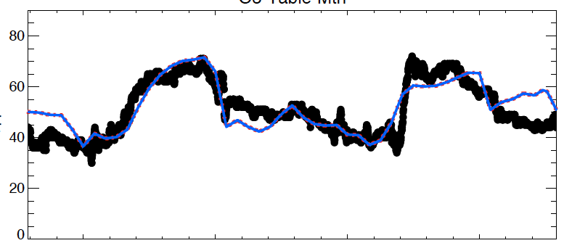
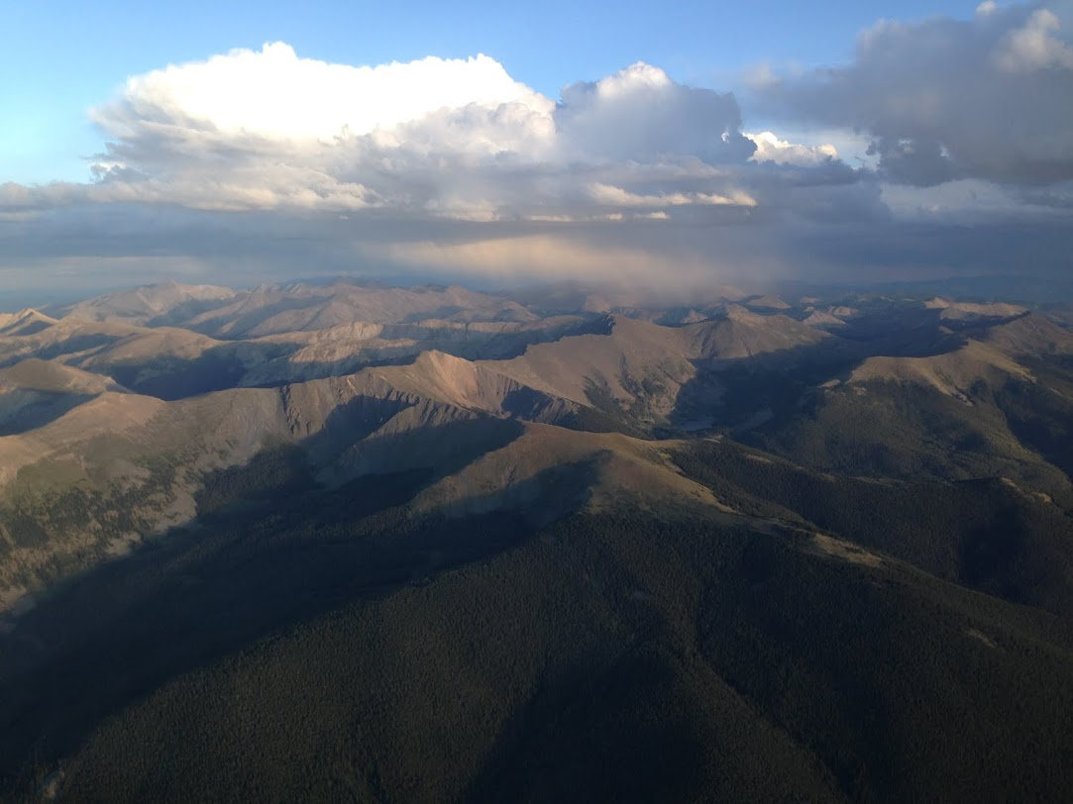
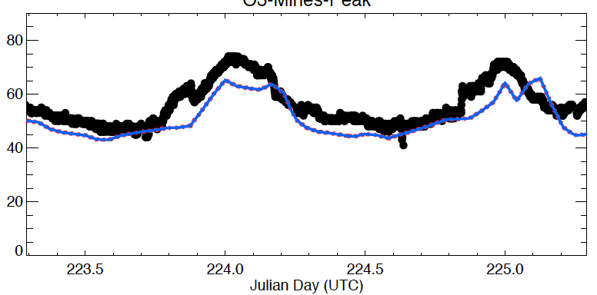
Surface Monitoring (CDPHE)
WRF-Chem
Ozone Transport
into the Mountains
Welby
Denver Downtown
Golden
Mines Peak
Evolution of Surface Ozone for
11 & 12 August 2014 Upslope Events
Surface Ozone (ppb)
4pm LT
4pm LT
Day of Year (UTC)

Slide 38
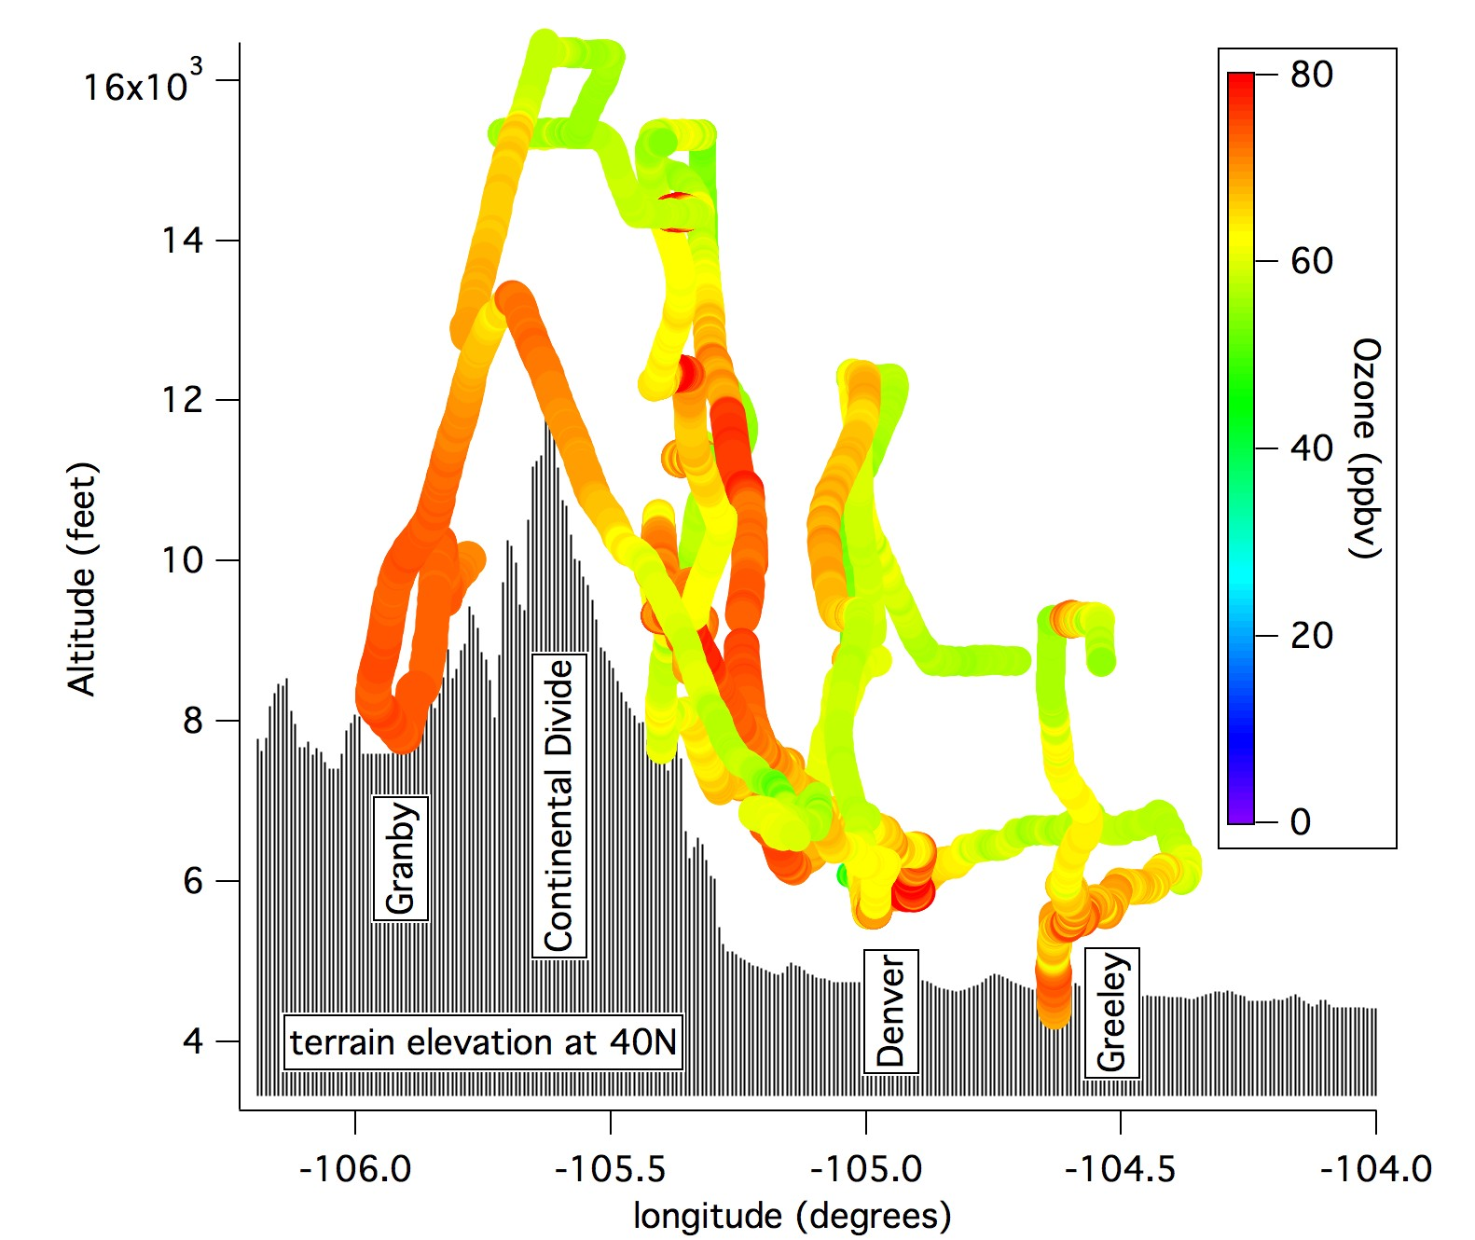
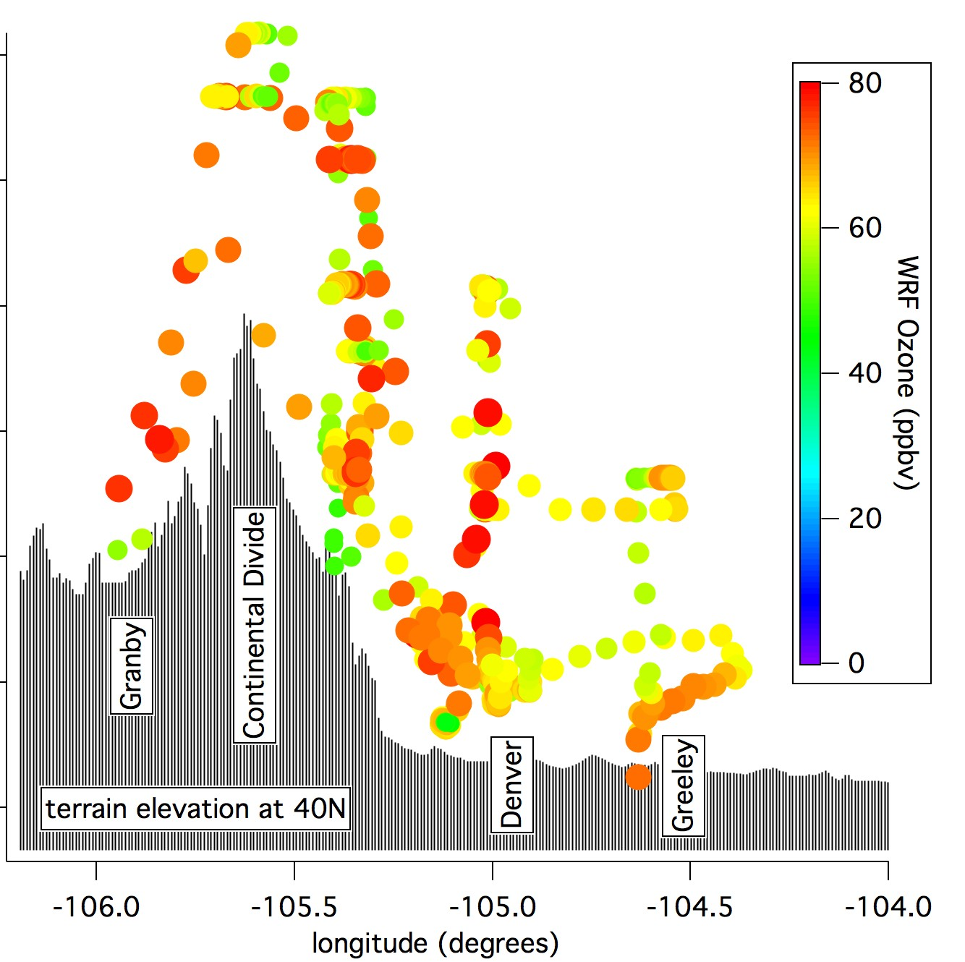
Ozone Transport into the Mountains
Background
(50 ppb)
C-130
Modeled
Evening
spillover
Upslope flow
The Figures highlight the transport event for ozone - produced over the Front Range and being pushed westward into the mountains by thermally driven upslope.
This demonstrates how Front Range ozone can impact remote areas up to the divide and into the adjacent valleys on the west side of the divide.
12 August 2014

Slide 39
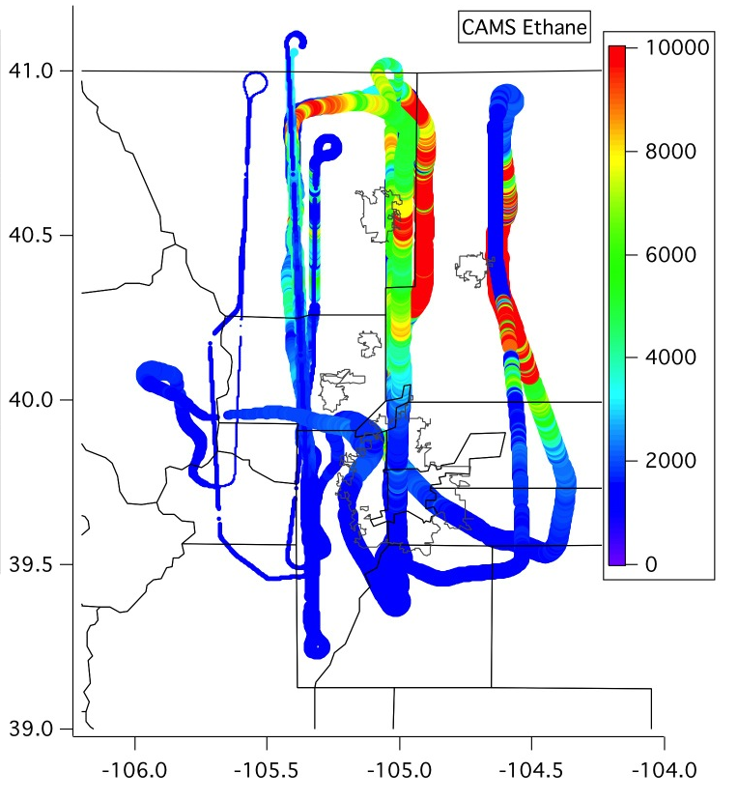
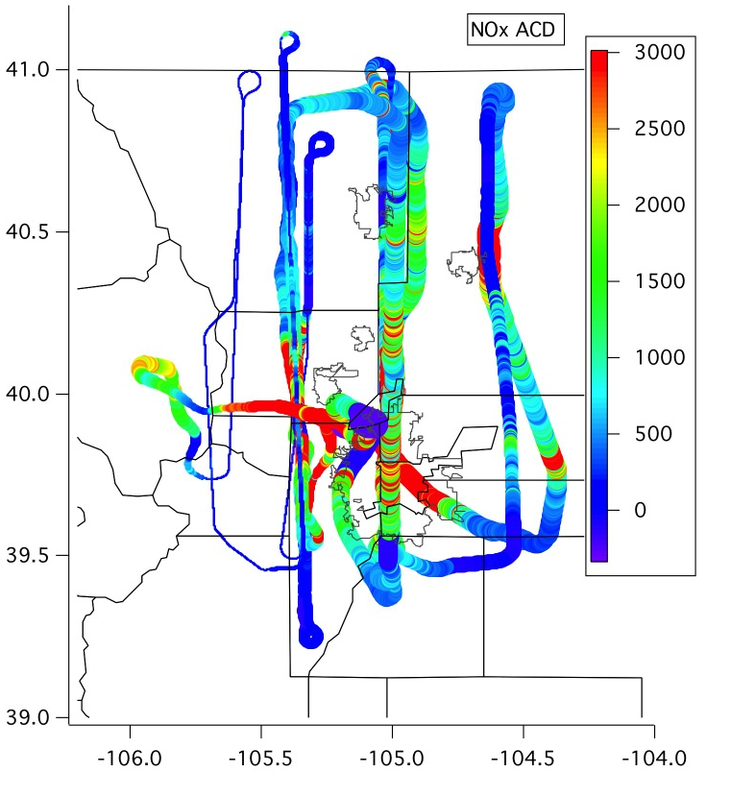
Ozone Transport into the Mountains
C-130 Ethane
C-130 NO_{x}
12 August 2014

Slide 40
Some First Results
AerosoLS
PRELIMINARY Analysis !
Cory Wolff, NCAR/RAF

Slide 41
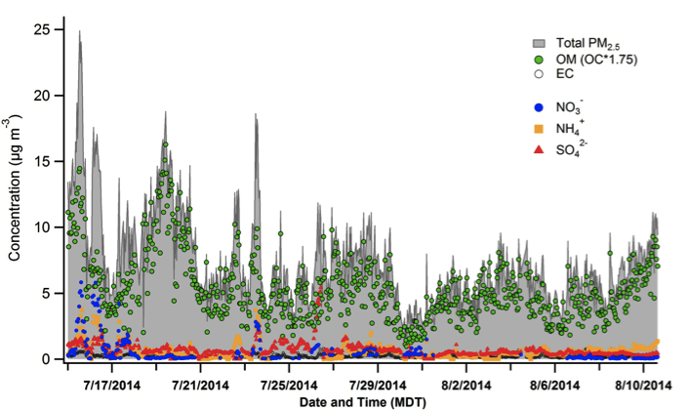
Predominance of organic aerosol species (Average = 75% of fine aerosol mass)
Chrisopher Hennigan
University of Maryland
Sunset Labs OCEC Field Analyzer andParticle-into-Liquid Sampler with dual Ion Chromatographs (PILS-IC)
@ Golden Site
Aerosol composition in Golden was dominated by organics: most of this OA was secondary
Corroborated by AMS measurements on C-130 (Bahreini Group)
Most of the PM was regional (~70%), but a strong local signature was evident most days (~30% of PM) – sources of the local PM (OM, NH₄NO₃, EC) need to be investigated

Slide 42
PRELIMINARY Findings
Clearly identified and characterized all emission sources in the Front Range and Western Slopes slope
  Northern Front Range / Greeley / DJ Basin dominated by oil & gas and agricultural emission signatures
  Denver / Boulder urban centers usually dominated by traffic and industrial emissions
Ozone (and secondary organic aerosols) efficiently formed across the region
In the absence of wildfires, this summer’s Front Range air quality was mainly controlled by local emissions.
Air Quality in eastern foothills and to the Continental Divide dominated by Front Range emissions
Elevated regional ozone background
Influence of Western Slope sources on Front Range are small
Transport of front range air pollution into mountains and adjacent valleys was seen regularly.
Outflow from Front Range into Eastern Plains can be significant
Identified potential new / better monitoring locations
Need for improved emission information for AQ modeling

Slide 43
EXTRAS

Slide 44
Some First Results
Regional POllution
PRELIMINARY Analysis !
Cory Wolff, NCAR/RAF

Slide 45
Inflow from the West?

Slide 46
Regional Ozone Distribution
C-130 All altitudes

Slide 47
FRAPPÉ and DISCOVER-AQ Measurement Suite
Full chemistry payload on NCAR/NSF C-130
(almost) Full chemistry payload on NASA P3
Roughly equivalent # of measurements at BAO, NREL, Platteville; plus LIDARs
Many important pollutants on six mobile vans
Enhanced CDPHE*( ground network (EPA monitors)
Remote sensing / atmospheric column measurements on two aircraft and at 16 ground locations
Tethered Balloons and Ozone Sondes
Personal Pollution Monitoring
& Comprehensive Modeling Efforts
* Colorado Department of Public Health and the Environment

Slide 48
C-130 NO_{x}

Slide 49

C-130 Ethane

Slide 50
P-3 NO_{x}

Slide 51

P-3 Ethane

Slide 52

Benzene Correlations
Canister Benzene correlates better with heavier alkanes, not well with CH4 or ethane
or even propane
C130 Aircraft Benzene also correlates better with heavier alkanes
(TOGA data from 7/28/14 flight)

Slide 53

Ammonia to Methane Ratio
Color-coded by Ethane

Slide 54

Ammonia to Methane Ratio
C-130 Flights 12-15 for Front Range

Slide 55
Power Plants – C-130 NO_{x} and SO₂
Hayden, Craig
Valmont
Bonanza

Slide 56
Commerce City – C-130 NO_{x} and So2
Typical coal fired
PP plumes
NO_{x} enhancements of 30-45 ppb
converted boilers Cherokee EGU ?

Slide 57

Front Range Outflow (C-130 Ethane)

Slide 58


All data NASA P3
Benzene
Alt (km)
0.5
Longitude (deg)
Instead of this one we
could use a slide from Halliday
(see next)
25
Platteville

Slide 59

H. Halliday, Penn State

