Slide 1
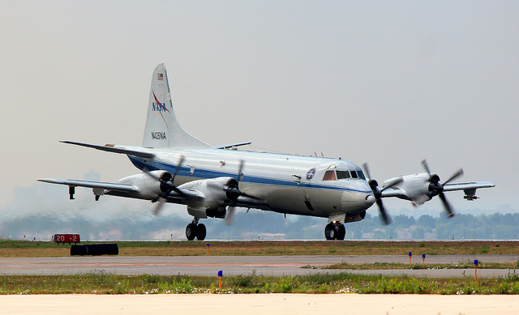
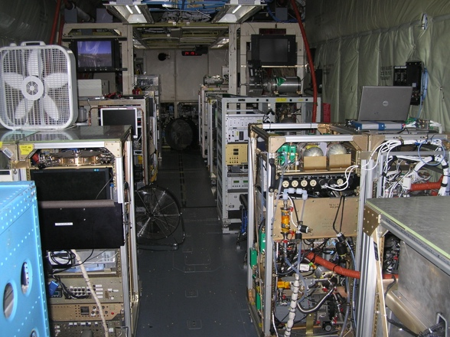
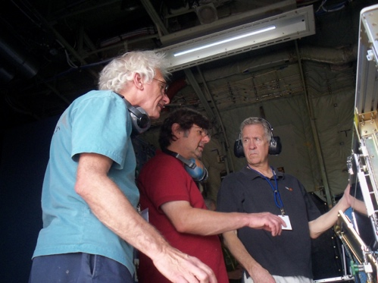
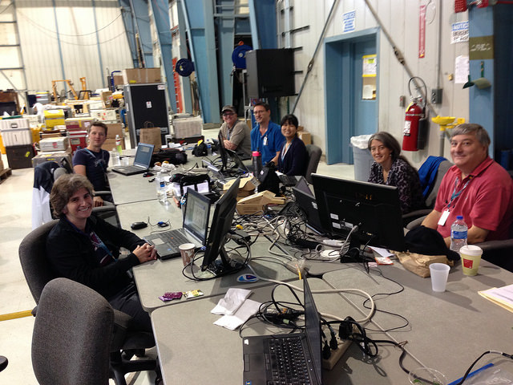
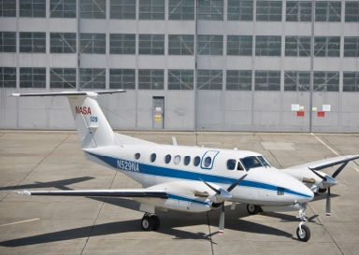

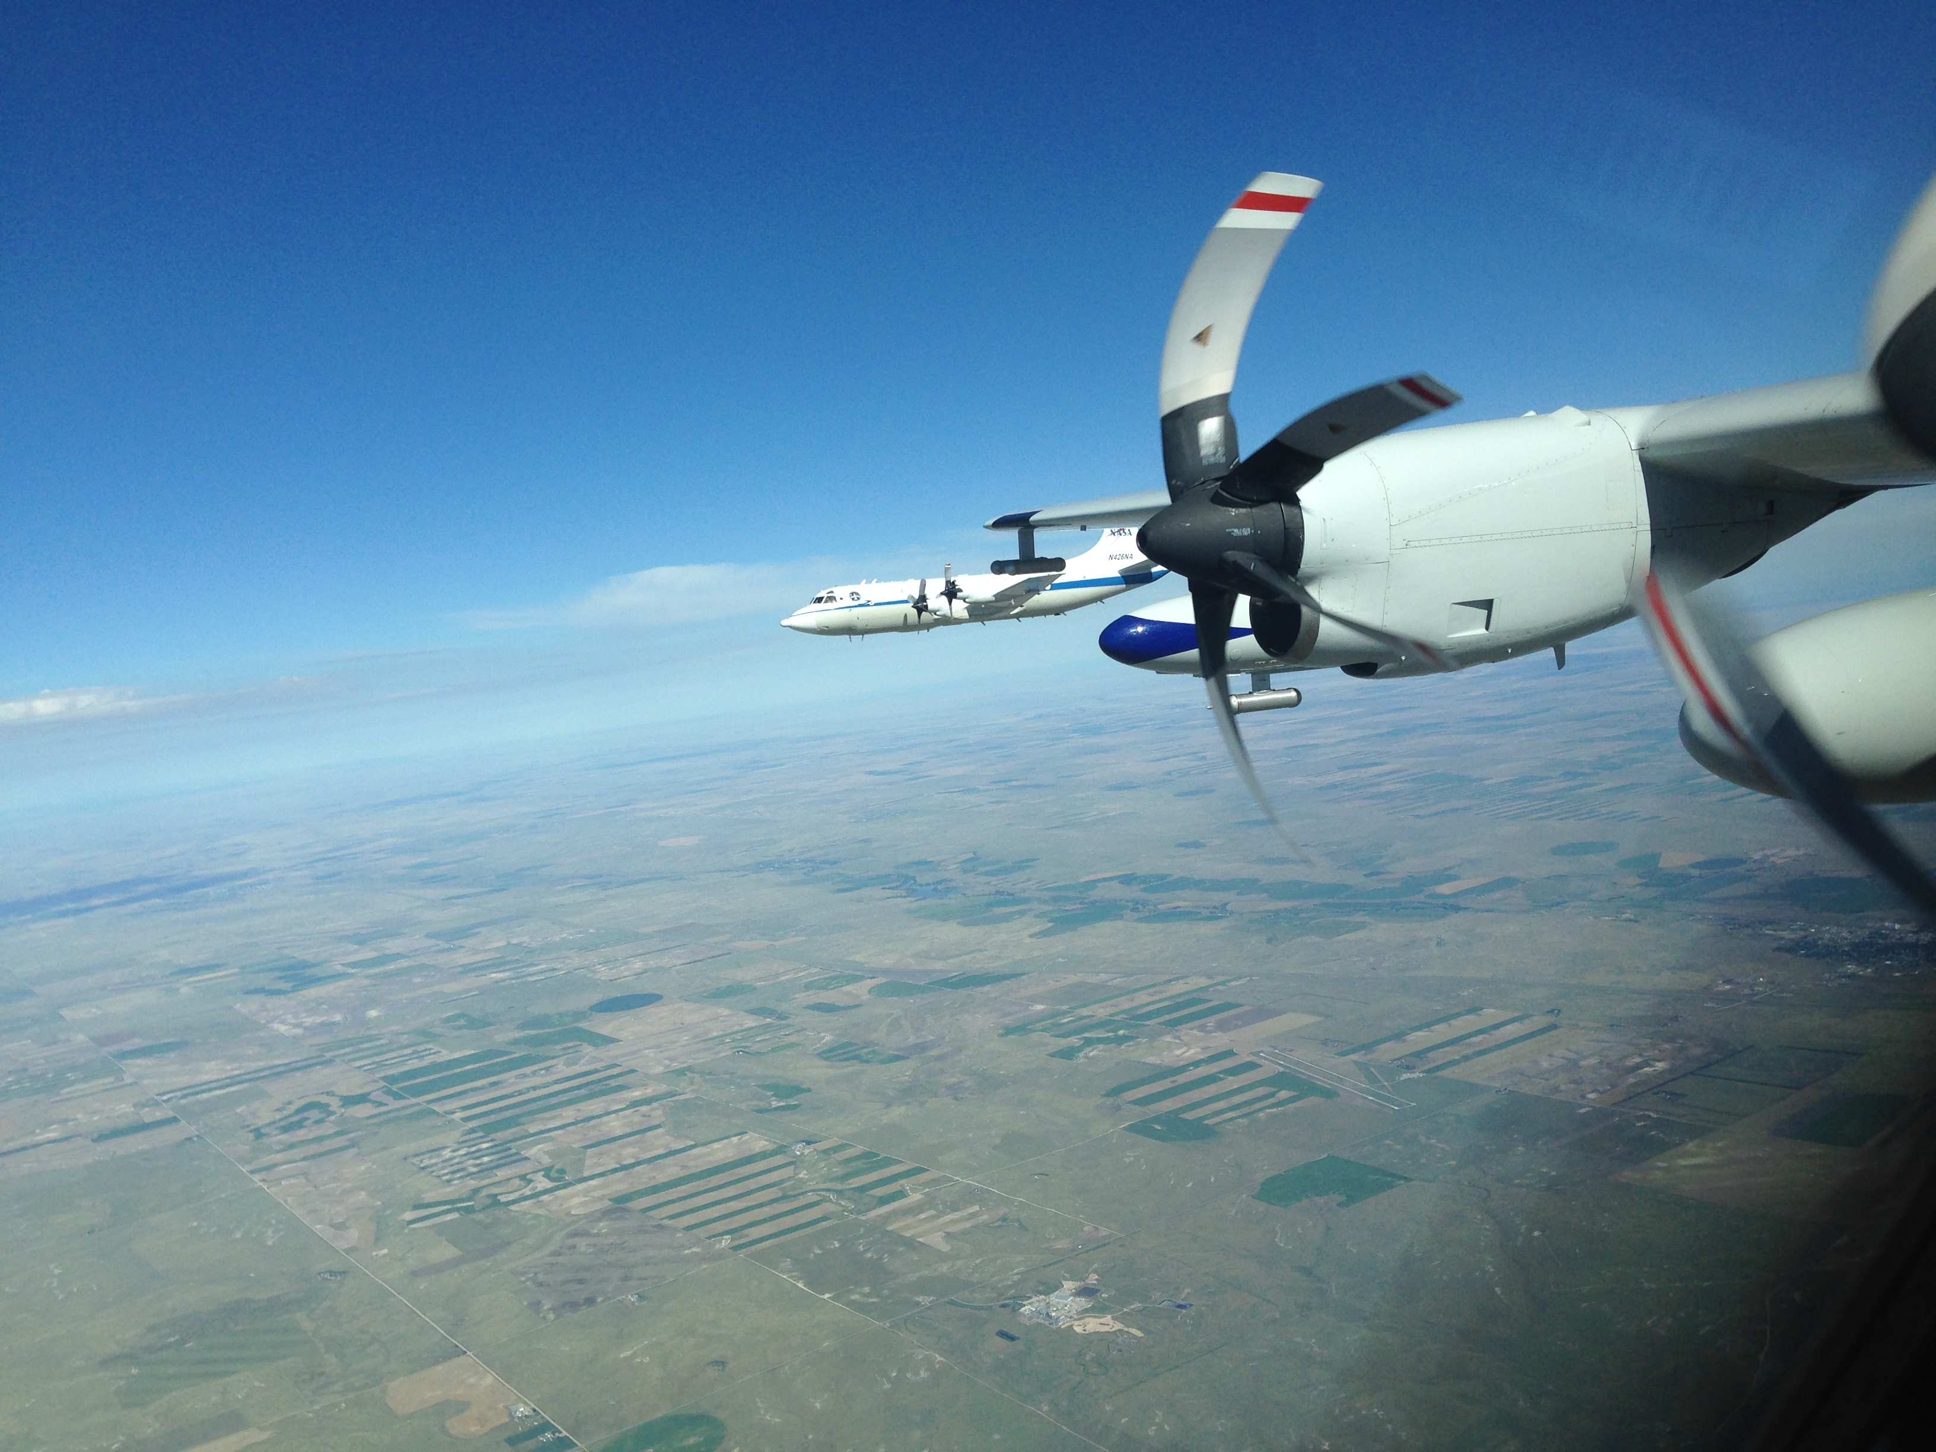
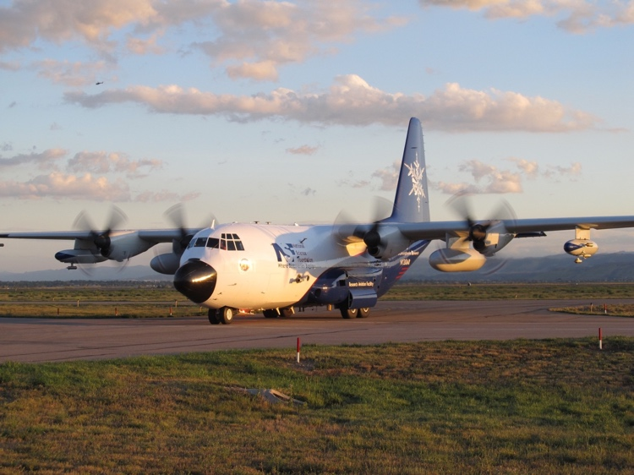
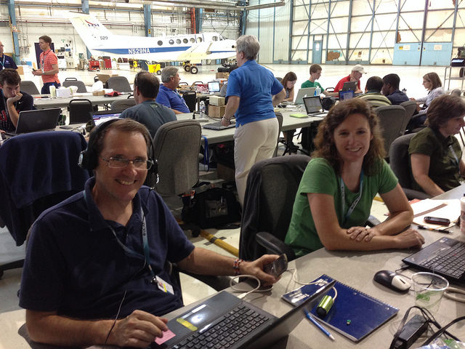
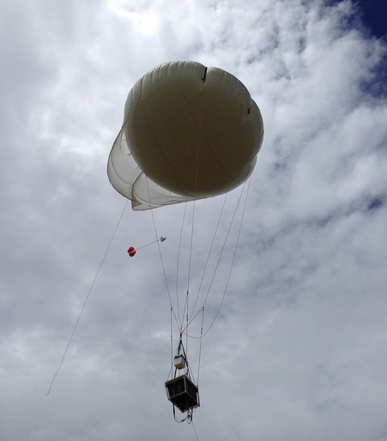
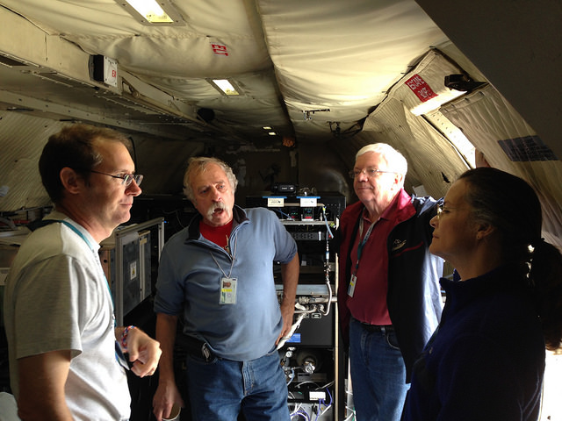
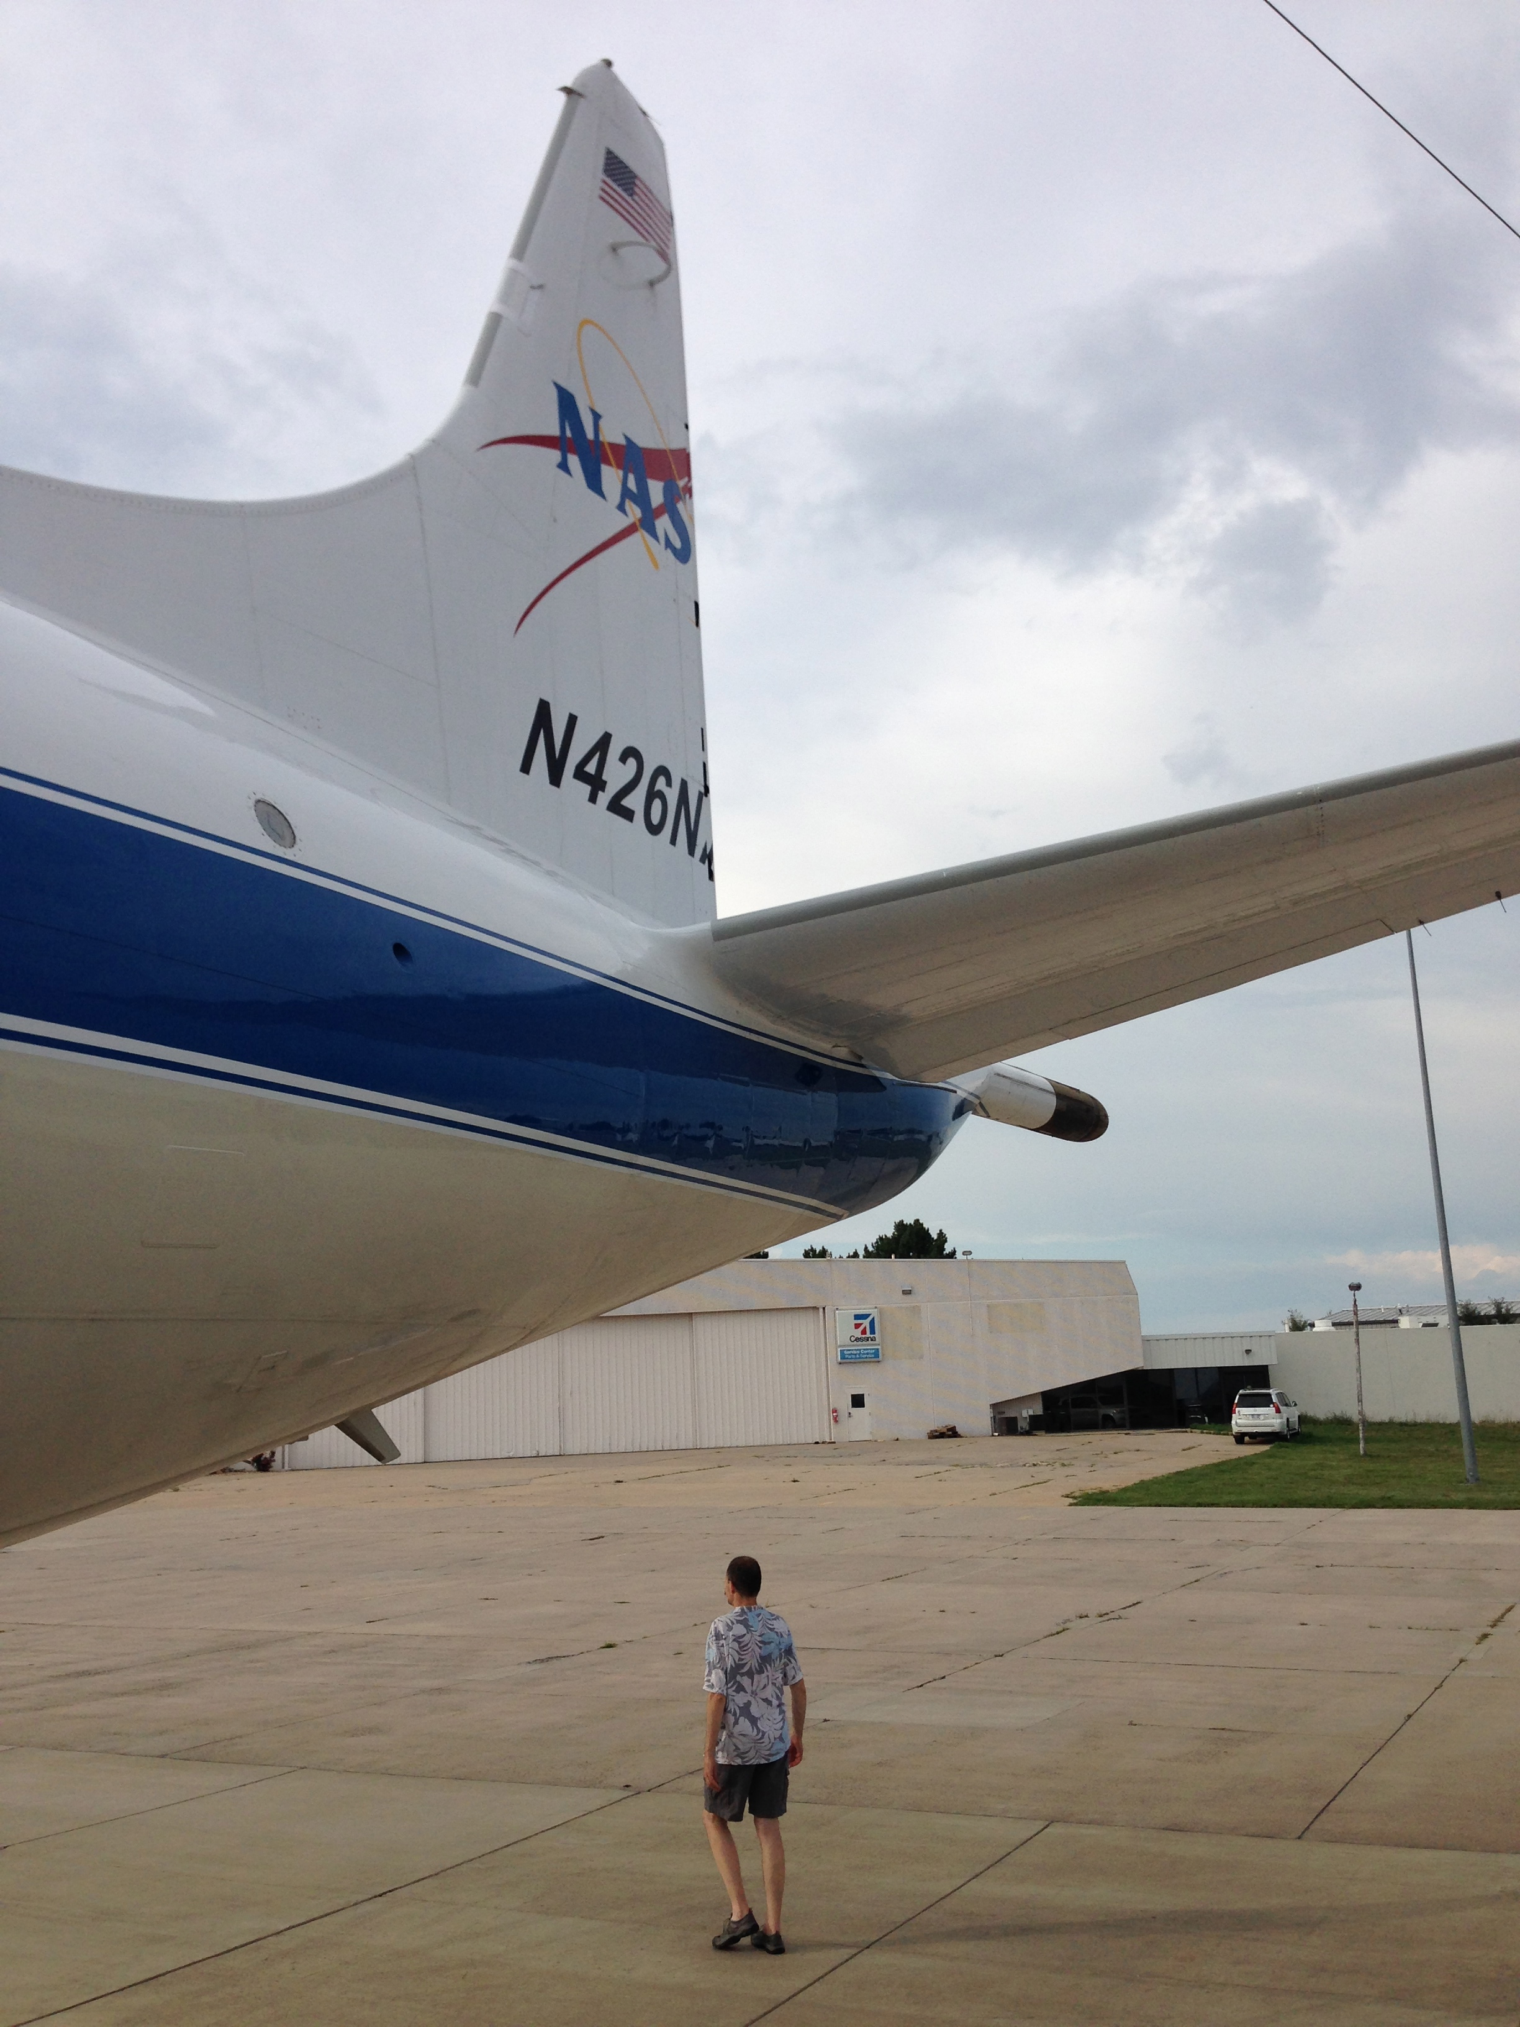
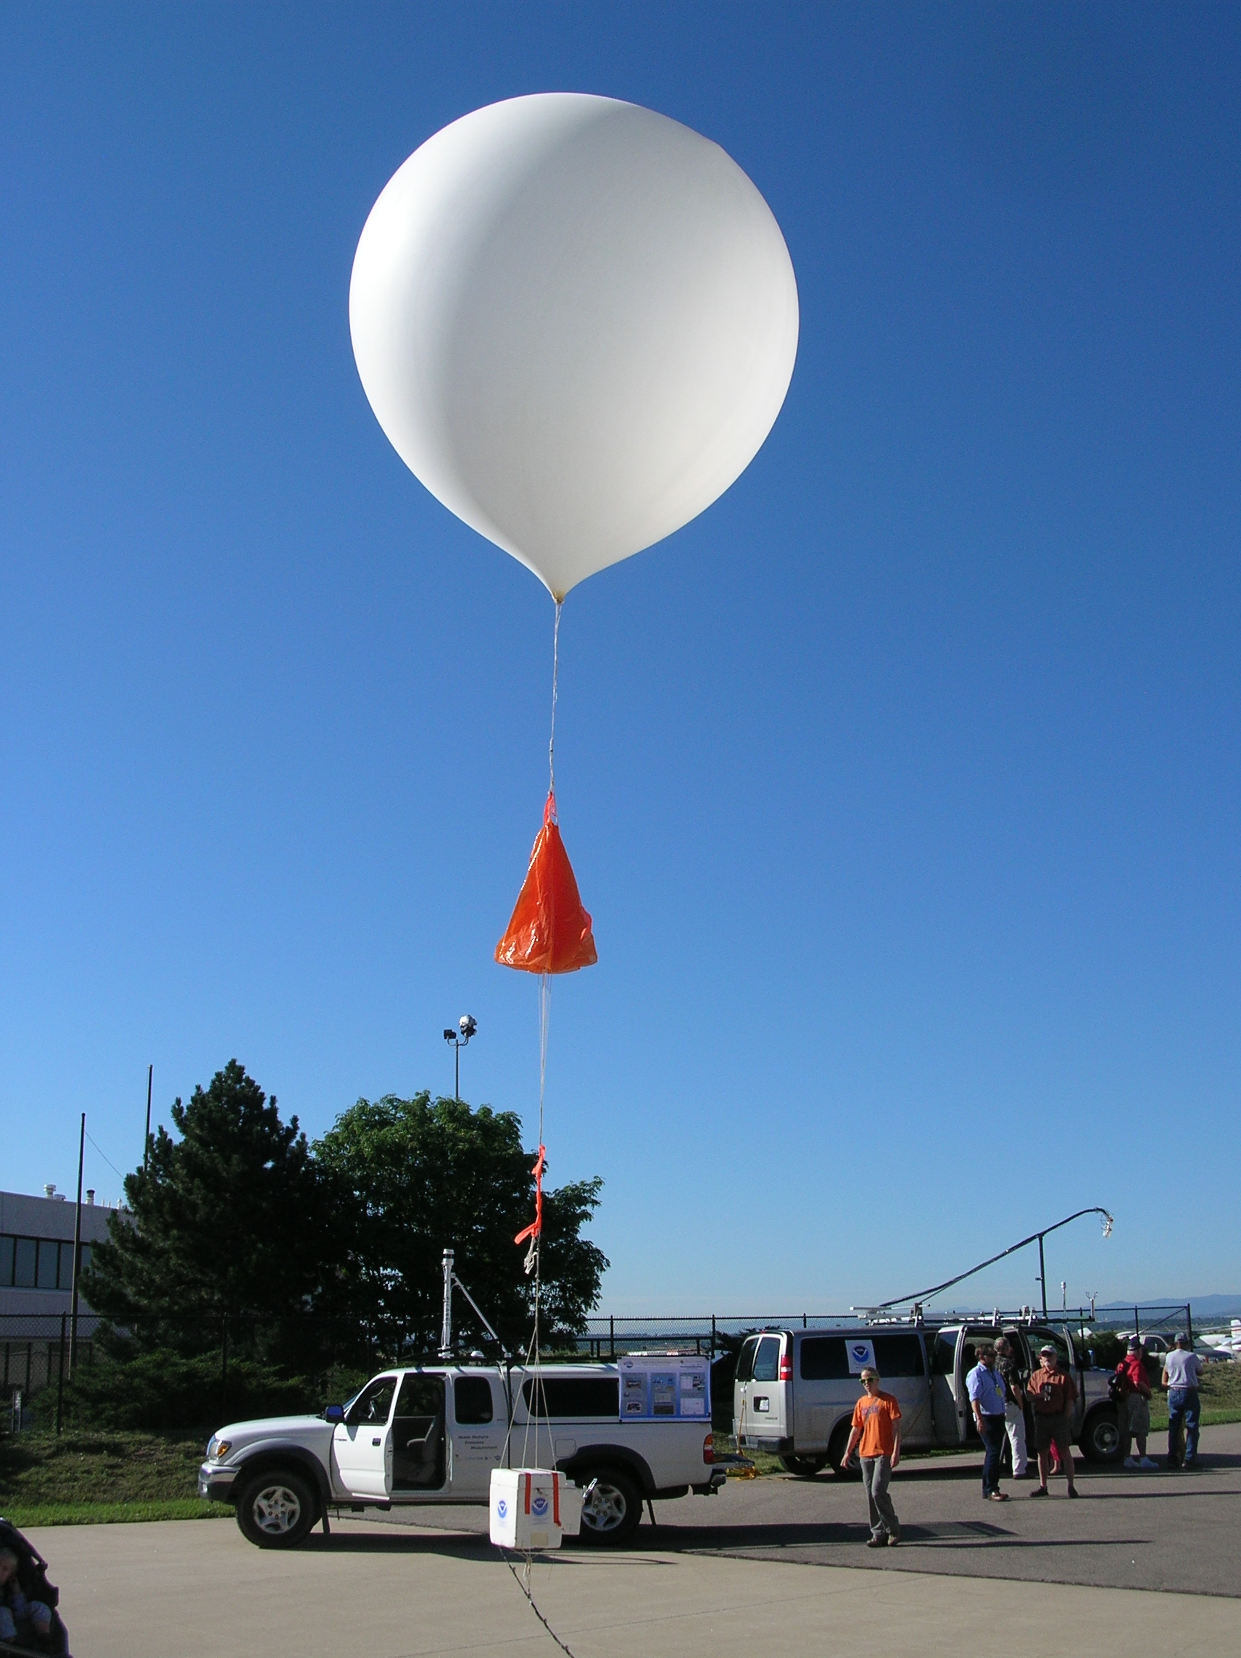
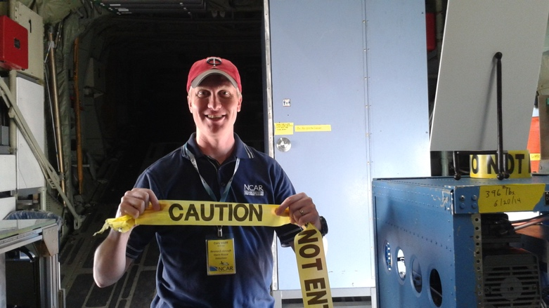
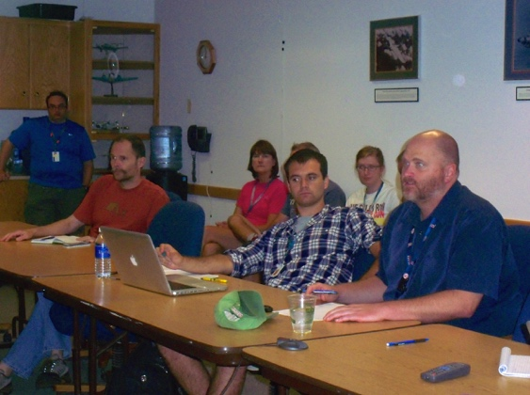
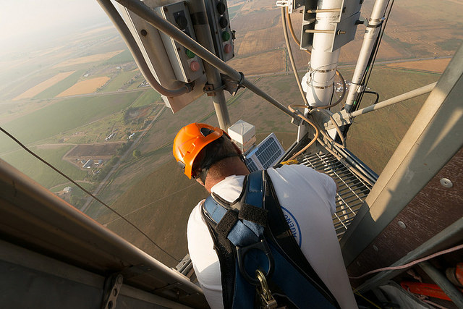
FRAPPÉ and DISCOVER-AQ
Joint FRAPPÉ and DISCOVER-AQ
Science Team Meeting
May 2-3, 2017

Slide 2
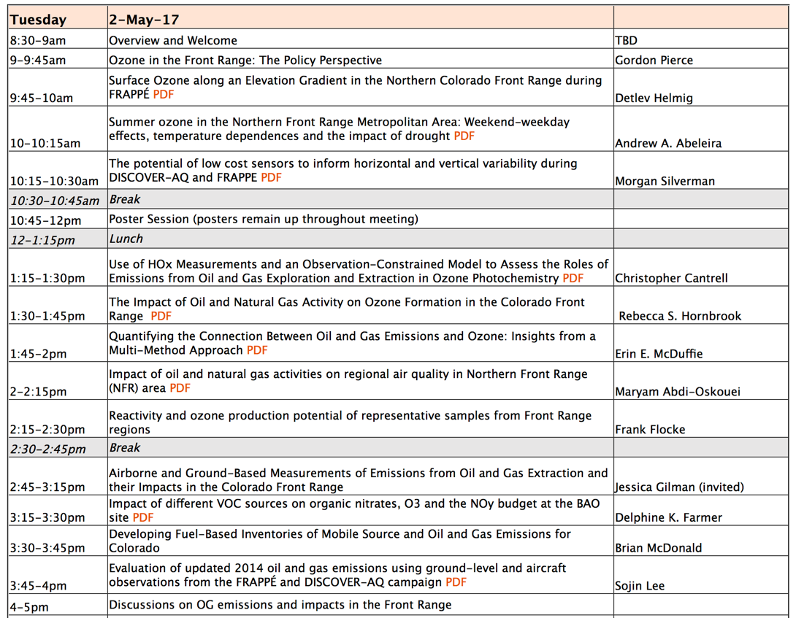
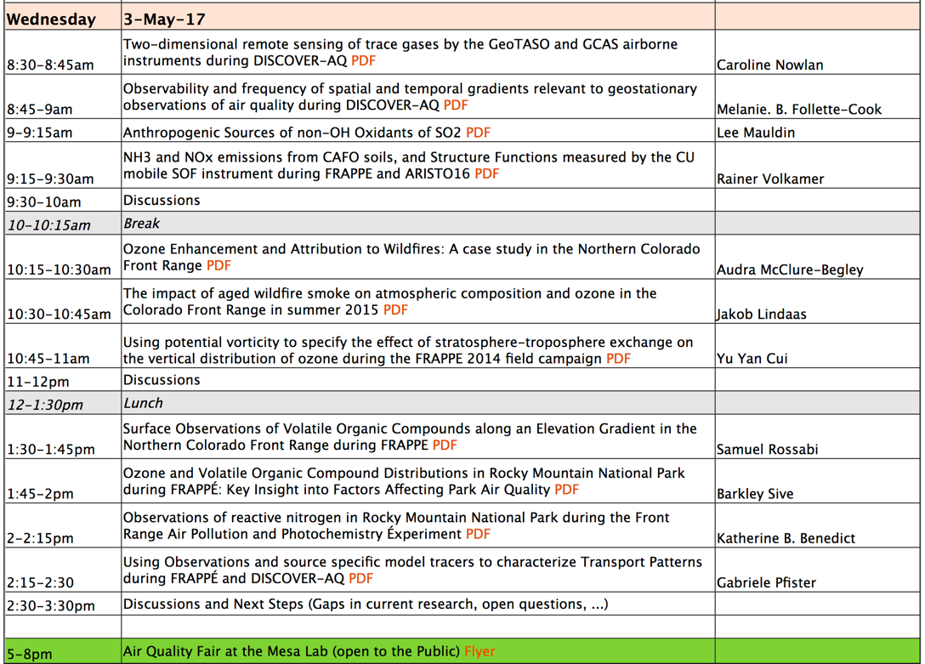

Joint FRAPPÉ and DISCOVER-AQ Science Team Meeting
We plan on putting the presentations on the website (password protected).
Please let us know if you do NOT want your presentation posted.

Slide 3
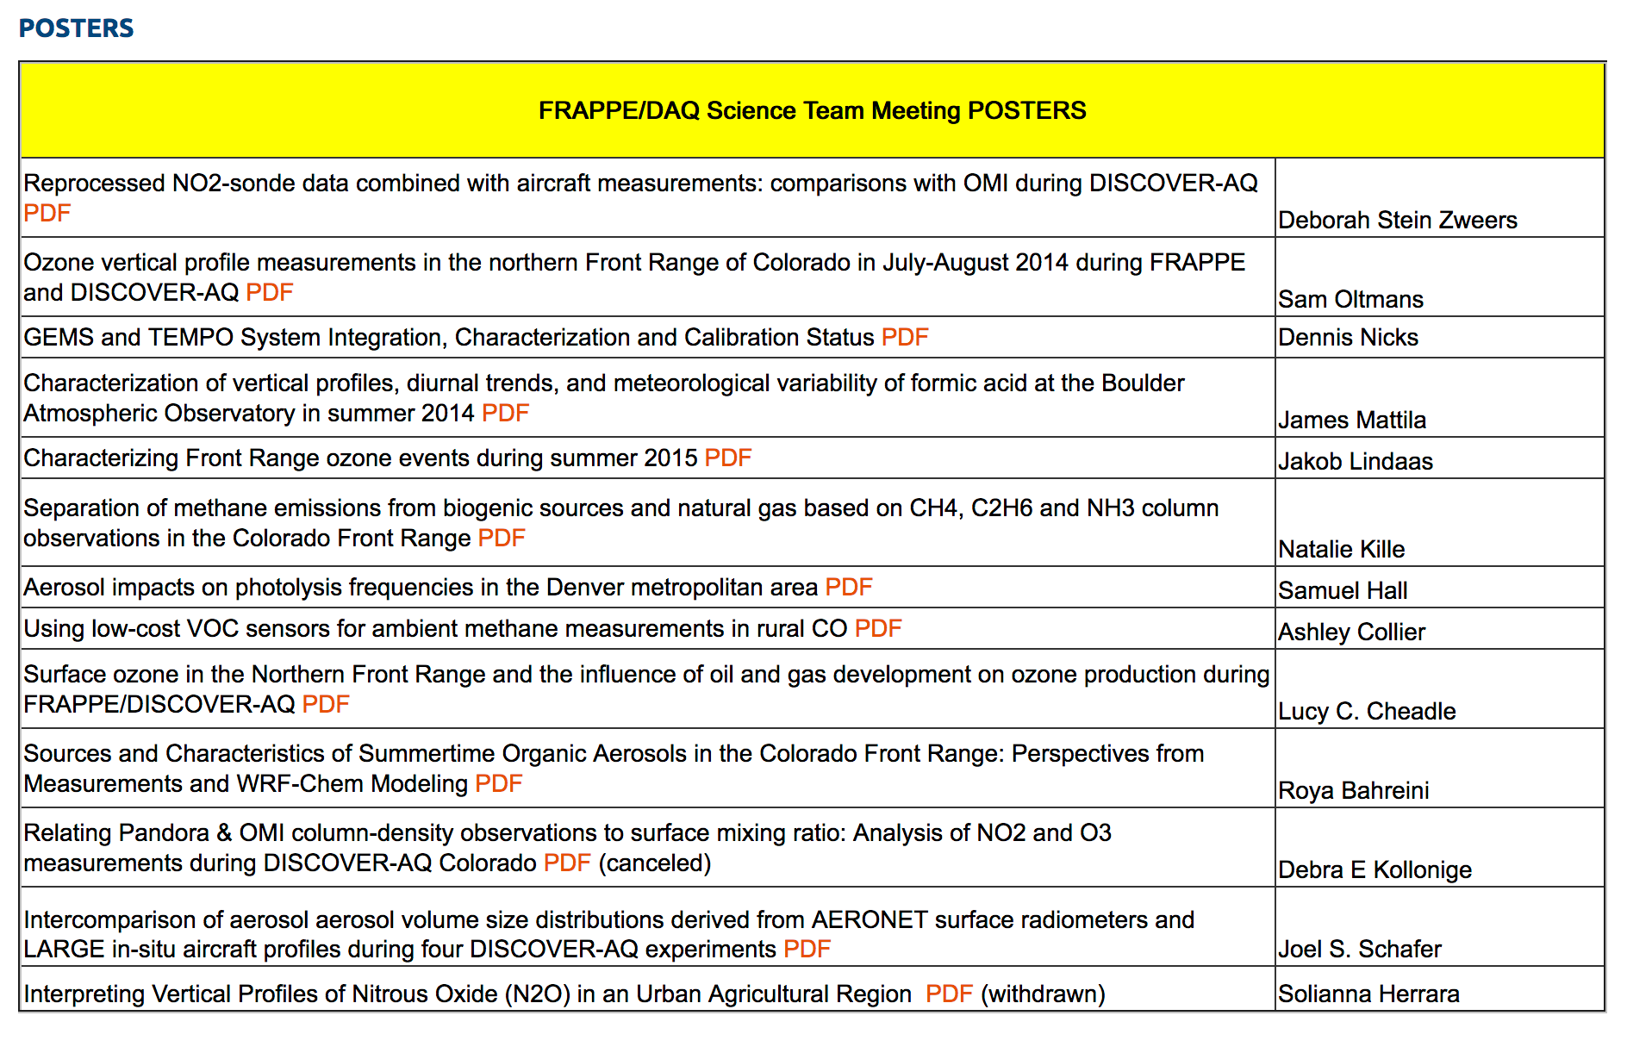
Joint FRAPPÉ and DISCOVER-AQ Science Team Meeting
Today starting 10:45am
canceled
canceled
We plan on putting the presentations on the website (password protected).
Please let us know if you do NOT want your presentation posted.
Please send us a PDF of your poster.

Slide 4
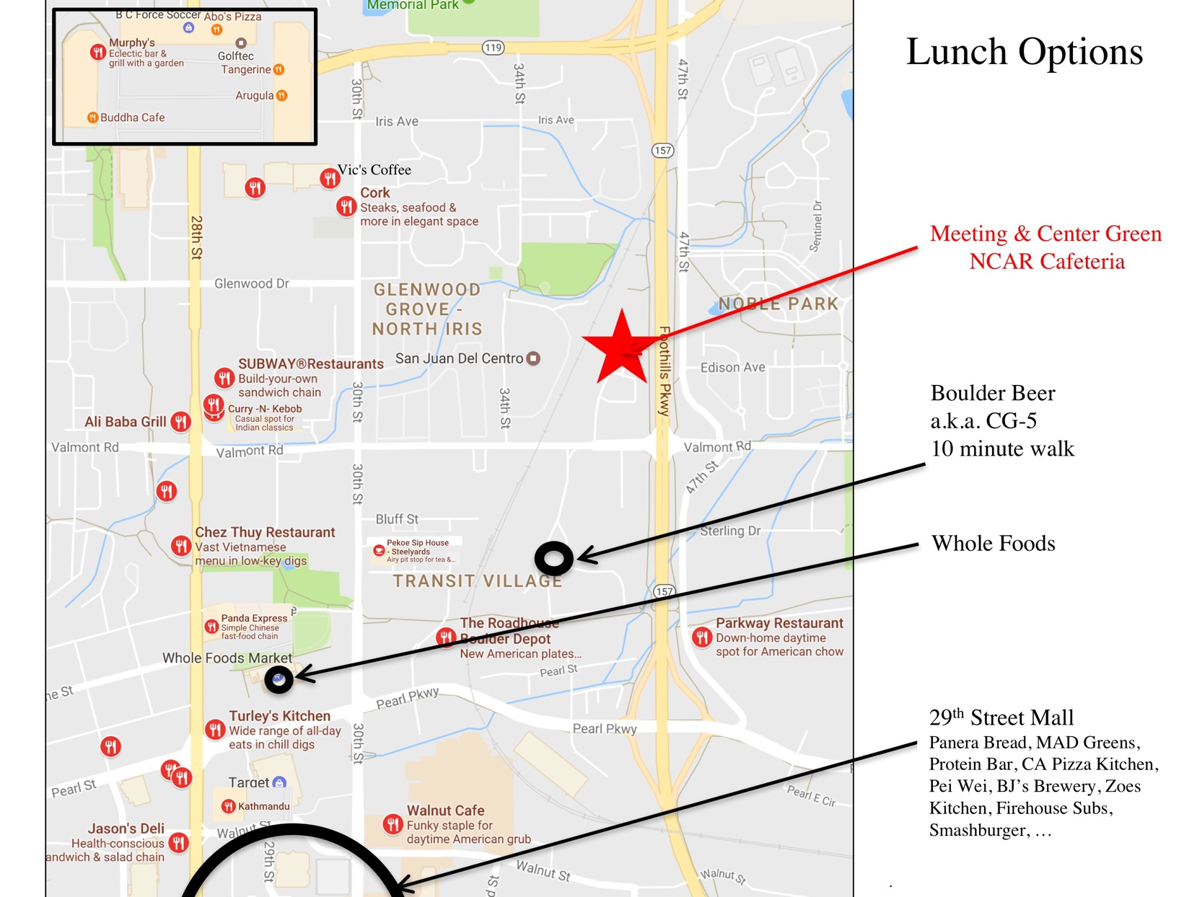
Nearby restaurants

Slide 5
Wireless Internet and password
UCAR Guest
yecyomisic

Slide 6
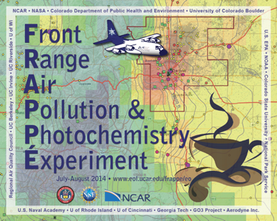









FRAPPÉ & DISCOVER-AQ
15 July - 18 August 2014, Colorado Front Range
PI: James Crawford
NASA Langley
PIs: Gabriele Pfister and Frank Flocke
National Center for Atmospheric Research (NCAR)
Funding Sources
FRAPPÉ: State of Colorado / CDPHE
National Science Foundation (NSF)
DISCOVER-AQ: NASA
Others: NOAA, GO₃ Project, NPS, EPA

Slide 7
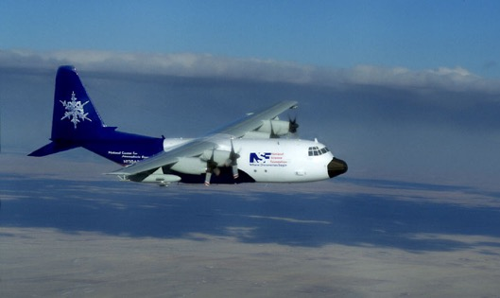
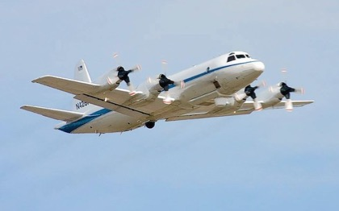
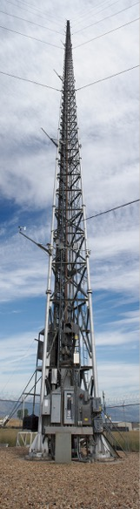
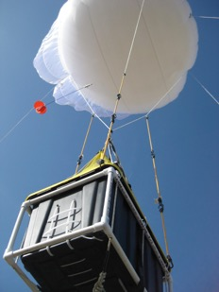
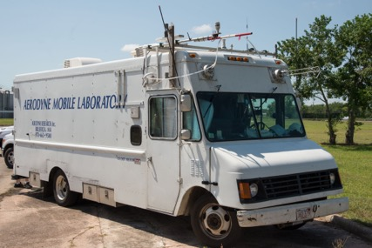
FRAPPÉ and DISCOVER-AQ
Merging of two major field campaigns
Comprehensive look at air quality in the Northern Colorado Front Range
4 aircraft
6 mobile vans
6 enhanced ground sites
Tethered balloons and daily ozone sondes
Enhanced CDPHE network

Slide 8
FRAPPÉ Data Archive
Latest Aircraft Merges: P-3 Revision R1 (April 2015)
C-130 Revision R2 (May 2016)
Updates to Surface Data:
Timestamp error in all "MATTSON.ERICK" files (CDPHE Ground Sites) submitted before August 2016. All data points are off by 1 hour.
Add 3600 seconds to each timestamp.
GSFC Dial/Fort Collins West: The "Latitude" coordinate in the files' header was listed incorrectly. The actual value should be "40.5927" instead.
Please let us know of any errors or problems you find in the data!

Slide 9
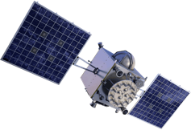


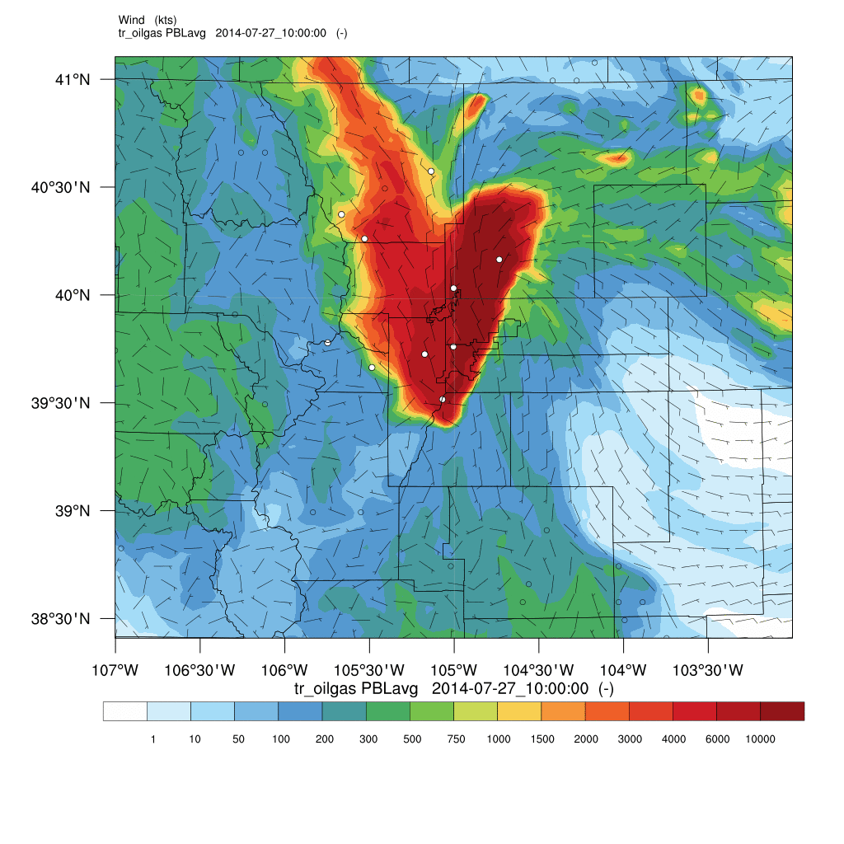







FRAPPÉ (Field Campaign) Study Approach
refine
Observations
Processes
Integration of different platforms and observation strategies
compare
evaluate
refine
evaluate
Model
Emissions

Slide 10
The Questions
Ozone Pollution
  What and where are the relevant sources?
  How do these emissions get transported?
  How do they get chemically processed?
  How much pollution comes into Colorado?
  Which are the best ways to improve air quality?
Methane
  How much is emitted? Cows versus oil and gas?
Air Toxics
  What are the concentrations of air toxics and which are the major sources?
Nitrogen Deposition
  What and where are the relevant sources and how much gets deposited in remote areas?
Meteorology and Transport
  How well can our models represent the physical processes in NFRMA?
❑ ❑ ❑ ❑ ❑ ❑ ❑ ❑ …..

Slide 11
Ozone in 2014
2014 was not a super-high ozone year ……
Linear regression with confidence limits of annual fourth maximum ozone versus mean June through August 500 mb heights
Source: Colorado SIP, released December 2016; Correction Method (Reddy and Pfister, 2016)
http://raqc.org/technical-support-documents-for-the-moderate-area-2008-8-hour-ozone-standard-state-implementation-plan/
Notes:
blue-green line is the LOESS curve

Slide 12
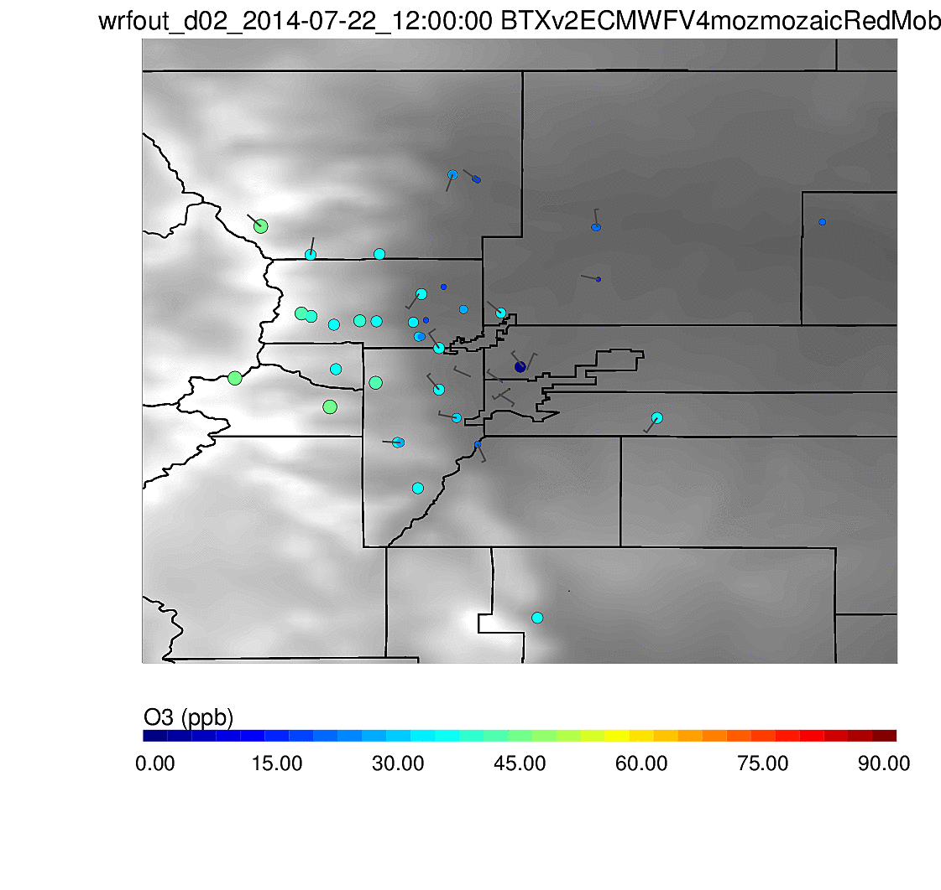
22 July 2014
… but we had some pretty ”good” days.
UTC:
Surface Ozone (ppb)
22 July 2014 6-24 LT
Notes:
Other days with 8-hour O3 < 70: 28 July (NREL,RF), 2 Aug (NREL, FCW), 3 Aug(multiple), 4 Aug (AE), 13 Aug (FCW)

Slide 13
Science Topics
Ozone
  Various studies for ozone production,
  but mostly focused on O&G
Methane source attribution
  O&G vs. Agriculture/Livestock
  Total O&G emissions
Ammonia emissions
  Measurements vs inventory
Particulates
  Role of ammonia, sulfate, nitrates, organics
Meteorology
  Model performance, assimilation methods
Models, emissions, regulatory implications
  Work done in ACOM. Others?
  Ground samples?

Slide 14
Methane emissions from O&G & agriculture
Franco et al., 2016 [~5%]
XCEL Energy 2014 Jul/Aug
Fraction in Distr. NG [7%]
Methane: Picarro 2311 (RAF/ACOM)
Ethane: CAMS (A. Fried, CU)
C-130 flights E of 105.2W and N of 39.8N
Notes:
Franco: Sharp rises in the atmospheric abundance of ethane (C₂H₆) have been detected from 2009 onwards in the Northern Hemisphere as a result of the unprecedented growth in the exploitation of shale gas and tight oil reservoirs in North America. Using time series of C₂H₆ total columns derived from ground-based Fourier transform infrared (FTIR) observations made at five selected Network for the Detection of Atmospheric Composition Change sites, we characterize the recent C₂H₆ evolution and determine growth rates of ~5% yr⁻¹ at mid-latitudes and of ~3% yr⁻¹ at remote sites. Results from CAM-chem simulations with the Hemispheric Transport of Air Pollutants, Phase II bottom-up inventory for anthropogenic emissions are found to greatly underestimate the current C₂H₆ abundances. Doubling global emissions is required to reconcile the simulations and the observations prior to 2009. We further estimate that North American anthropogenic C₂H₆ emissions have increased from 1.6 Tg yr⁻¹ in 2008 to 2.8 Tg yr⁻¹ in 2014, i.e. by 75% over these six years. We also completed a second simulation with new top-down emissions of C₂H₆ from North American oil and gas activities, biofuel consumption and biomass burning, inferred from space-borne observations of methane (CH₄) from Greenhouse Gases Observing SATellite. In this simulation, GEOS-Chem is able to reproduce FTIR measurements at the mid-latitudinal sites, underscoring the impact of the North American oil and gas development on the current C₂H₆ abundance. Finally we estimate that the North American oil and gas emissions of CH₄, a major greenhouse gas, grew from 20 to 35 Tg yr⁻¹ over the period 2008–2014, in association with the recent C₂H₆ rise.
Evaporation? From transporting gas. Now maybe better because more pipelines?

Slide 15
Methane emissions from O&G & agriculture
USDA inventory for CAFOs (JEQ, 2010)
Methane: Picarro 2311 (RAF/ACOM)
Ammonia:TILDAS(Aerodyne)
C-130 flights E of 105.2W and N of 39.8N
Notes:
Not quite in line with Amy. This would suggest more methane from OG than 50%. Or 85% as for entire RF05.
Though this plot is for all C130 Front Range flights E of .... – so the different coverage could explain some of differences.
Bottom line – the verdict is still out on it and there might be more than one answer dependent on the region we are looking at. Or the time of the day. Not time to get into transport and recirculation patterns in the NFRMA but these are highly complex and for us modelers a pure nightmare.

Slide 16
Methane emissions from O&G & agriculture
USDA inventory for CAFOs (JEQ, 2010)
Methane: Picarro 2311 (RAF/ACOM)
Ammonia:TILDAS(Aerodyne)
C-130 flights E of 105.2W and N of 39.8N
Notes:
Not quite in line with Amy. This would suggest more methane from OG than 50%. Or 85% as for entire RF05.
Though this plot is for all C130 Front Range flights E of .... – so the different coverage could explain some of differences.
Bottom line – the verdict is still out on it and there might be more than one answer dependent on the region we are looking at. Or the time of the day. Not time to get into transport and recirculation patterns in the NFRMA but these are highly complex and for us modelers a pure nightmare.

Slide 17
Mobile Ground Sample (Weld County)
Alkanes:
Propane 150 ppb
Butane 425 ppb
Pentanes 700 ppb
Hexanes 900 ppb
Benzene 65 ppb
“strong smell”
Whole Air Sampler (WAS), UC Irvine

Slide 18
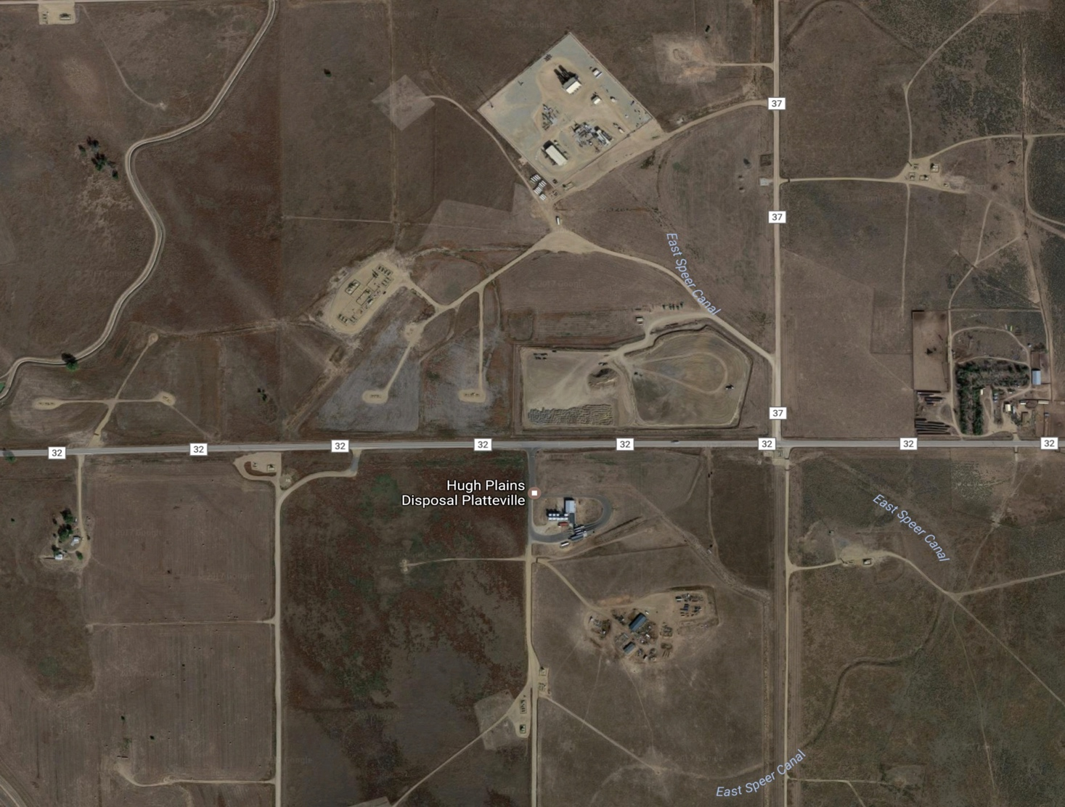
Mobile Ground Sample (Weld County)
Benzene 120 ppb Alkanes: Propane 55 ppb
Methane 1.9 ppm Butanes 300 ppb
Pentanes 600 ppb
Whole Air Sampler (WAS), UC Irvine

Slide 19

NH₃ C-130 (Aerodyne Group)
HIGH
Greeley
Longs Peak
Denver
LOW
- Non-Attainment Area
● Oil/Gas Wells

Slide 20
NH₄⁻ PILS (Brechtel / CSU)
HIGH
Greeley
Longs Peak
Denver
LOW
- Non-Attainment Area
● Oil/Gas Wells

Slide 21
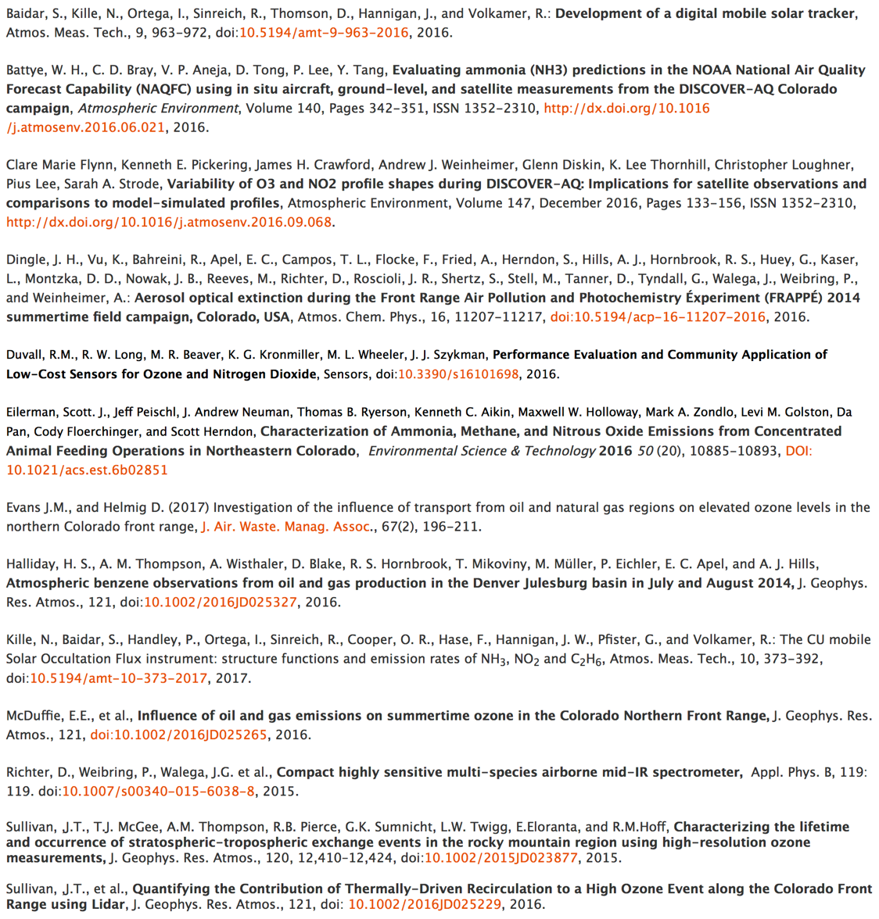
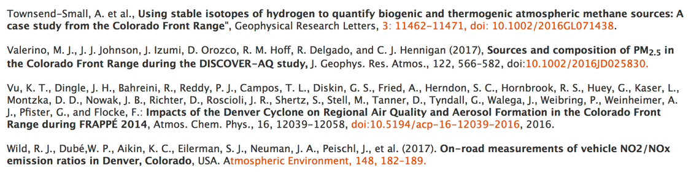
Publications
Please inform us about
any published papers.
If you are using the data,
please do not forget to at least acknowledge the campaigns!

