Slide 1


Quantifying the Connection Between Oil and Gas Emissions and Ozone:
Insights from a Multi-Method Approach
Erin E. McDuffie^{1,2,3}, Steven S. Brown^{1,3}, Jessica B. Gilman^{2,3}, Brian M. Lerner^{2,3}, Peter M. Edwards⁴, William P. Dubé^{2,3}, Michael Trainer³, Greg Yarwood⁵, Wayne M. Angevine^{2,3}, Stuart McKeen^{2,3}, Daniel E. Wolfe⁶, Alex G. Tevlin⁷, Jennifer Murphy⁷, Emily V. Fischer⁸, Jeff Peischl^{2,3}, Andrew O. Langford^{2,3}, Christoph J. Senff^{2,3}, John S. Holloway^{2,3}, Eric J. Williams³, Joost deGouw^{1,2,3}, Thomas B. Ryerson³, Kenneth Aiken^{2,3}, Samuel Hall⁹, Kirk Ullmann⁹, Kathy O. Lantz¹⁰
¹Department of Chemistry, University of Colorado, ²Cooperative Institute for Research in Environmental Sciences, University of Colorado, ³NOAA, Chemical Sciences Division, ⁴Department of Chemistry, University of York, United Kingdom, ⁵Ramboll Environ, ⁶NOAA, Physical Sciences Division, ⁷Department of Chemistry, University of Toronto, Canada, ⁸Department of Atmospheric Science, Colorado State University, ⁹Atmosperic Chemistry Observations and Modeling Laboratory, NCAR, ¹⁰NOAA, Global Monitoring Division
Project Goal:
Quantify O&G Emissions Impact on Front Range Ozone
Publication:
McDuffie, E. E., et al. (2016), J. Geophys. Res. Atmos., 121(14)
FRAPPE/DISCOVER-AQ Science Meeting
May 2nd, 2016

Slide 2
Tropospheric Ozone: Photochemistry
VOC Emissions
VOC
O₃
NO_{x} Emissions
OH
NO
NO₂
NO_{z}
Sunlight, O₂
O₃

Slide 3
Tropospheric Ozone: Photochemistry
VOC Emissions
OH
VOC
RO₂•
RO•
O₂
NO_{x} Emissions
OH
NO
NO₂
NO_{z}
Sunlight, O₂
O₃

Slide 4
Tropospheric Ozone: Photochemistry
VOC Emissions
OH
VOC
RO₂•
RO•
O₂
NO_{x} Emissions
OH
NO
NO₂
NO_{z}
Sunlight, O₂
Local/Regional Emission Sectors
O₃

Slide 5
Tropospheric Ozone: Photochemistry
VOC Emissions
OH
Organic nitrate
VOC
RO₂•
O₂
NO_{x} Emissions
OH
NO
NO₂
NO_{z}
Sunlight, O₂
Local/Regional Emission Sectors
O₃

Slide 6
Tropospheric Ozone: Photochemistry
Radical Recycling
=
More Efficient O₃ Production
VOC Emissions
O₂
OH
VOC
RO₂•
RO•
O₂
NO_{x} Emissions
OH
NO
NO₂
NO_{z}
Sunlight, O₂
Local/Regional Emission Sectors
O₃

Slide 7
Field Measurements
VOC Mass
OH Reactivity
O₃ Production Efficiency
Box-Model
Radical Recycling
=
More Efficient O₃ Production
VOC Emissions
O₂
OH
VOC
RO₂•
RO•
O₂
NO_{x} Emissions
OH
NO
NO₂
NO_{z}
Sunlight, O₂
Local/Regional Emission Sectors
O₃

Slide 8
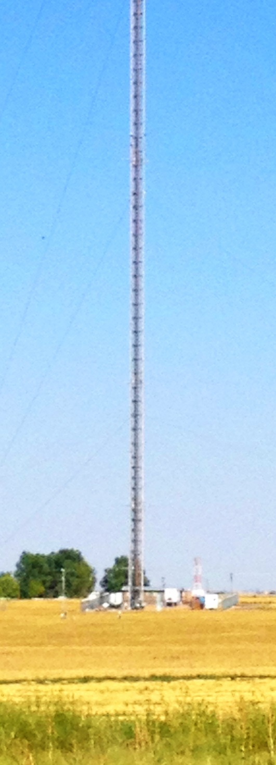
Field Measurements
VOC Mass
OH Reactivity
O₃ Production Efficiency
Box-Model
Colorado
Colorado Northern Front Range (NFR)
300m Tower

Slide 9
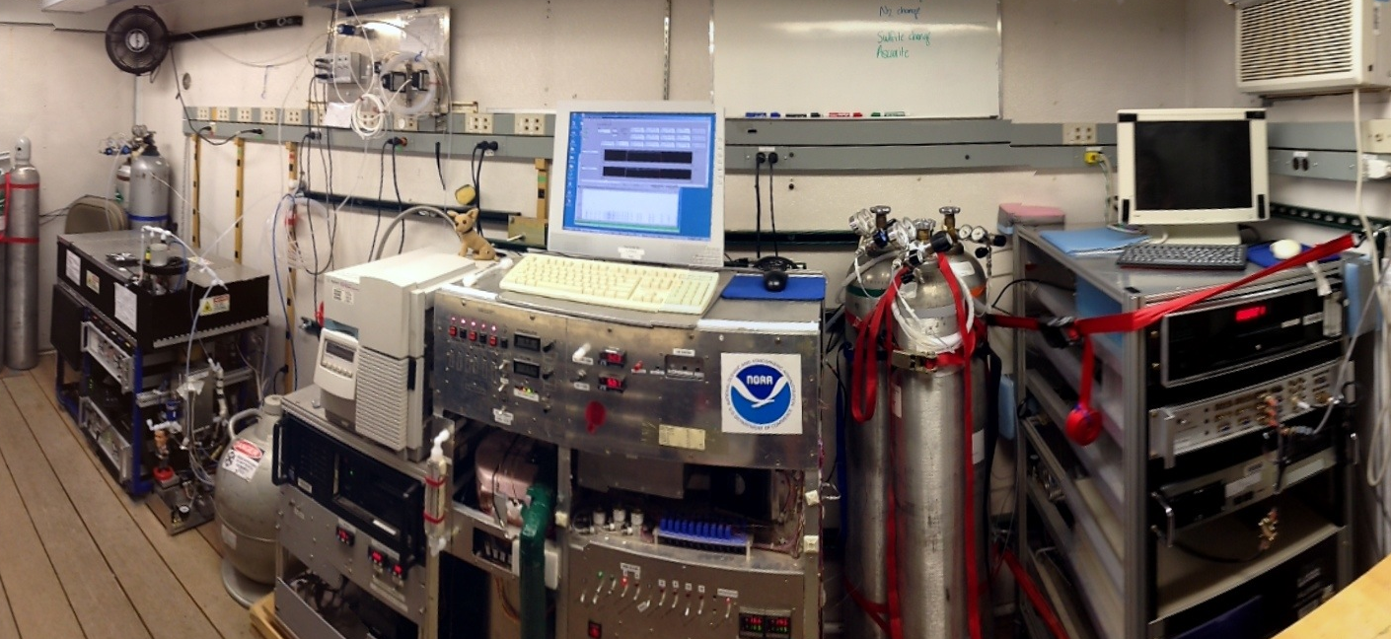
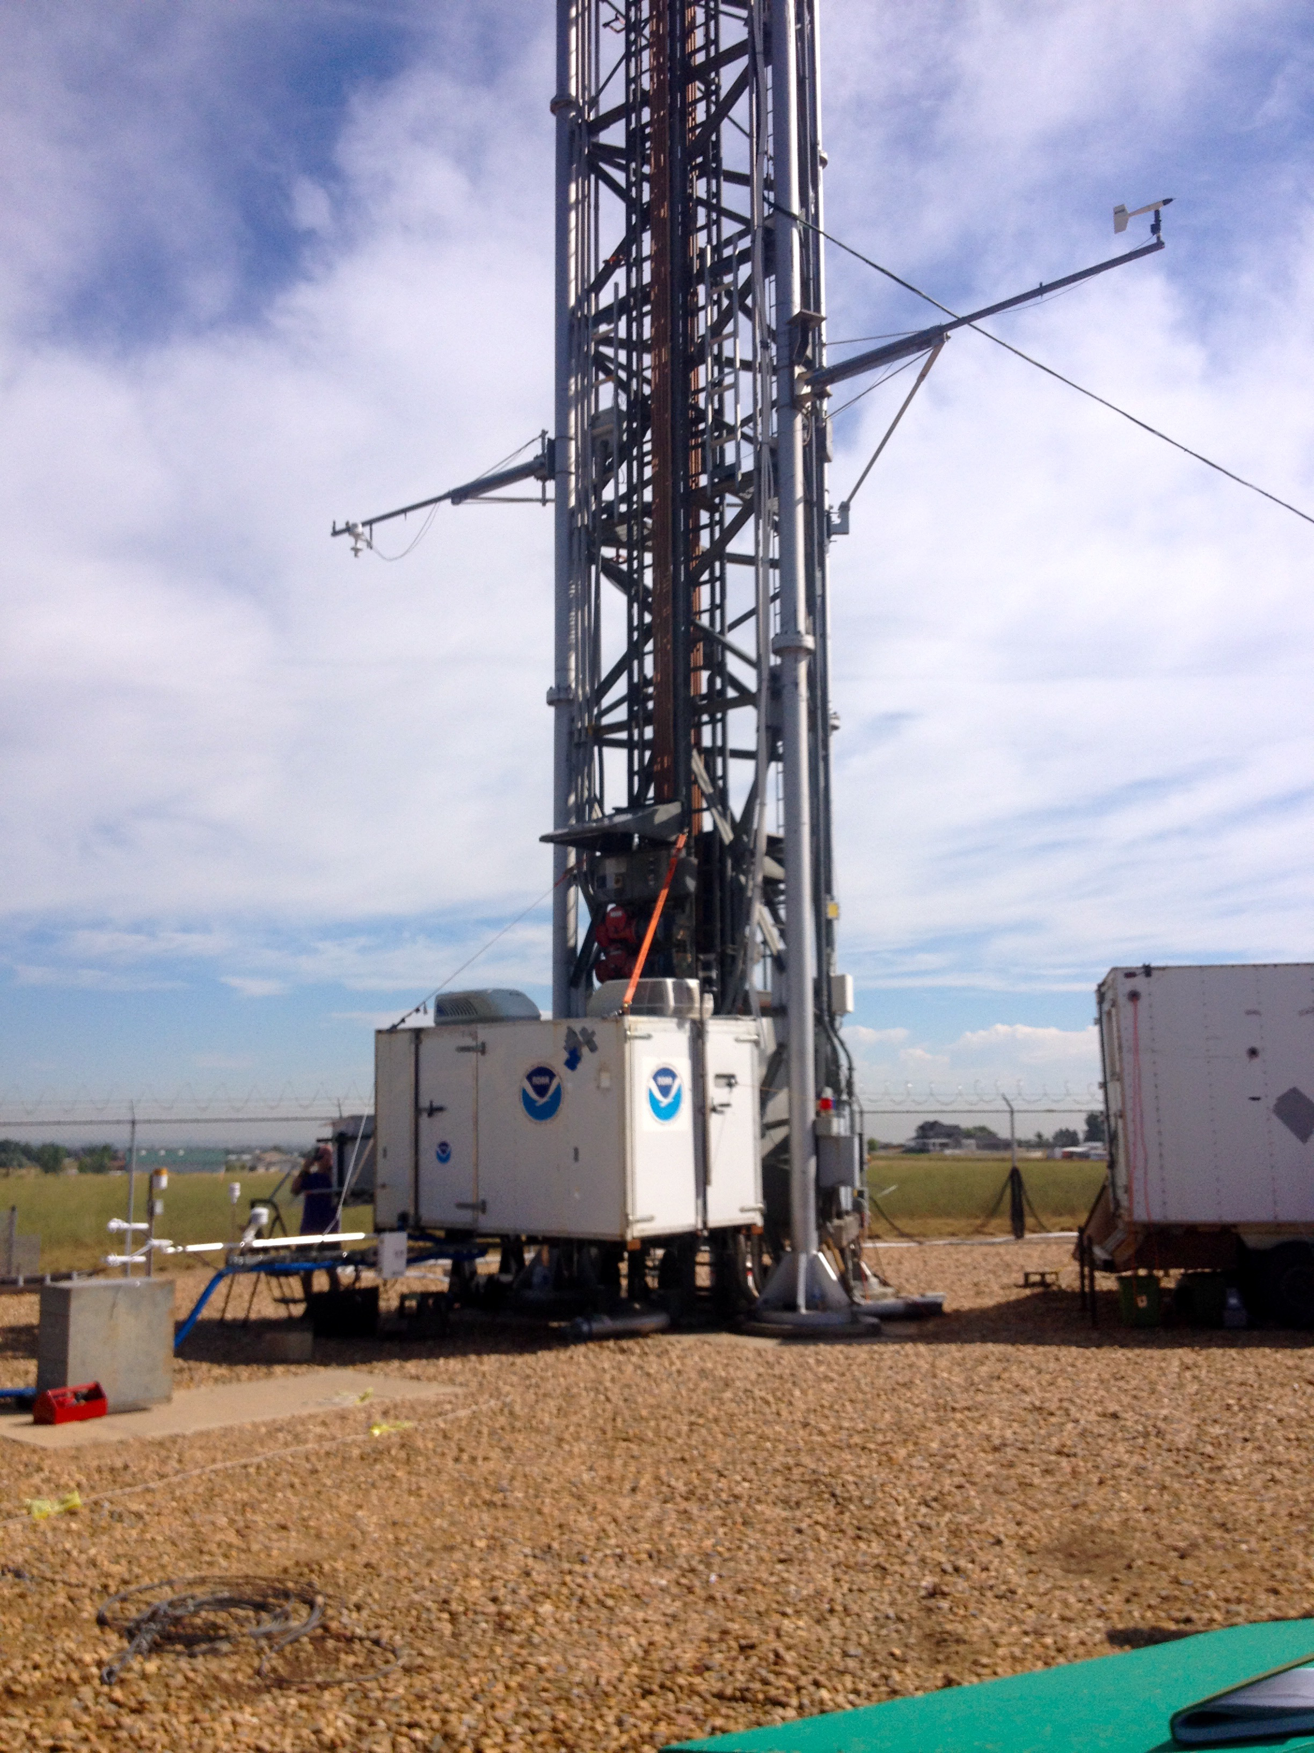
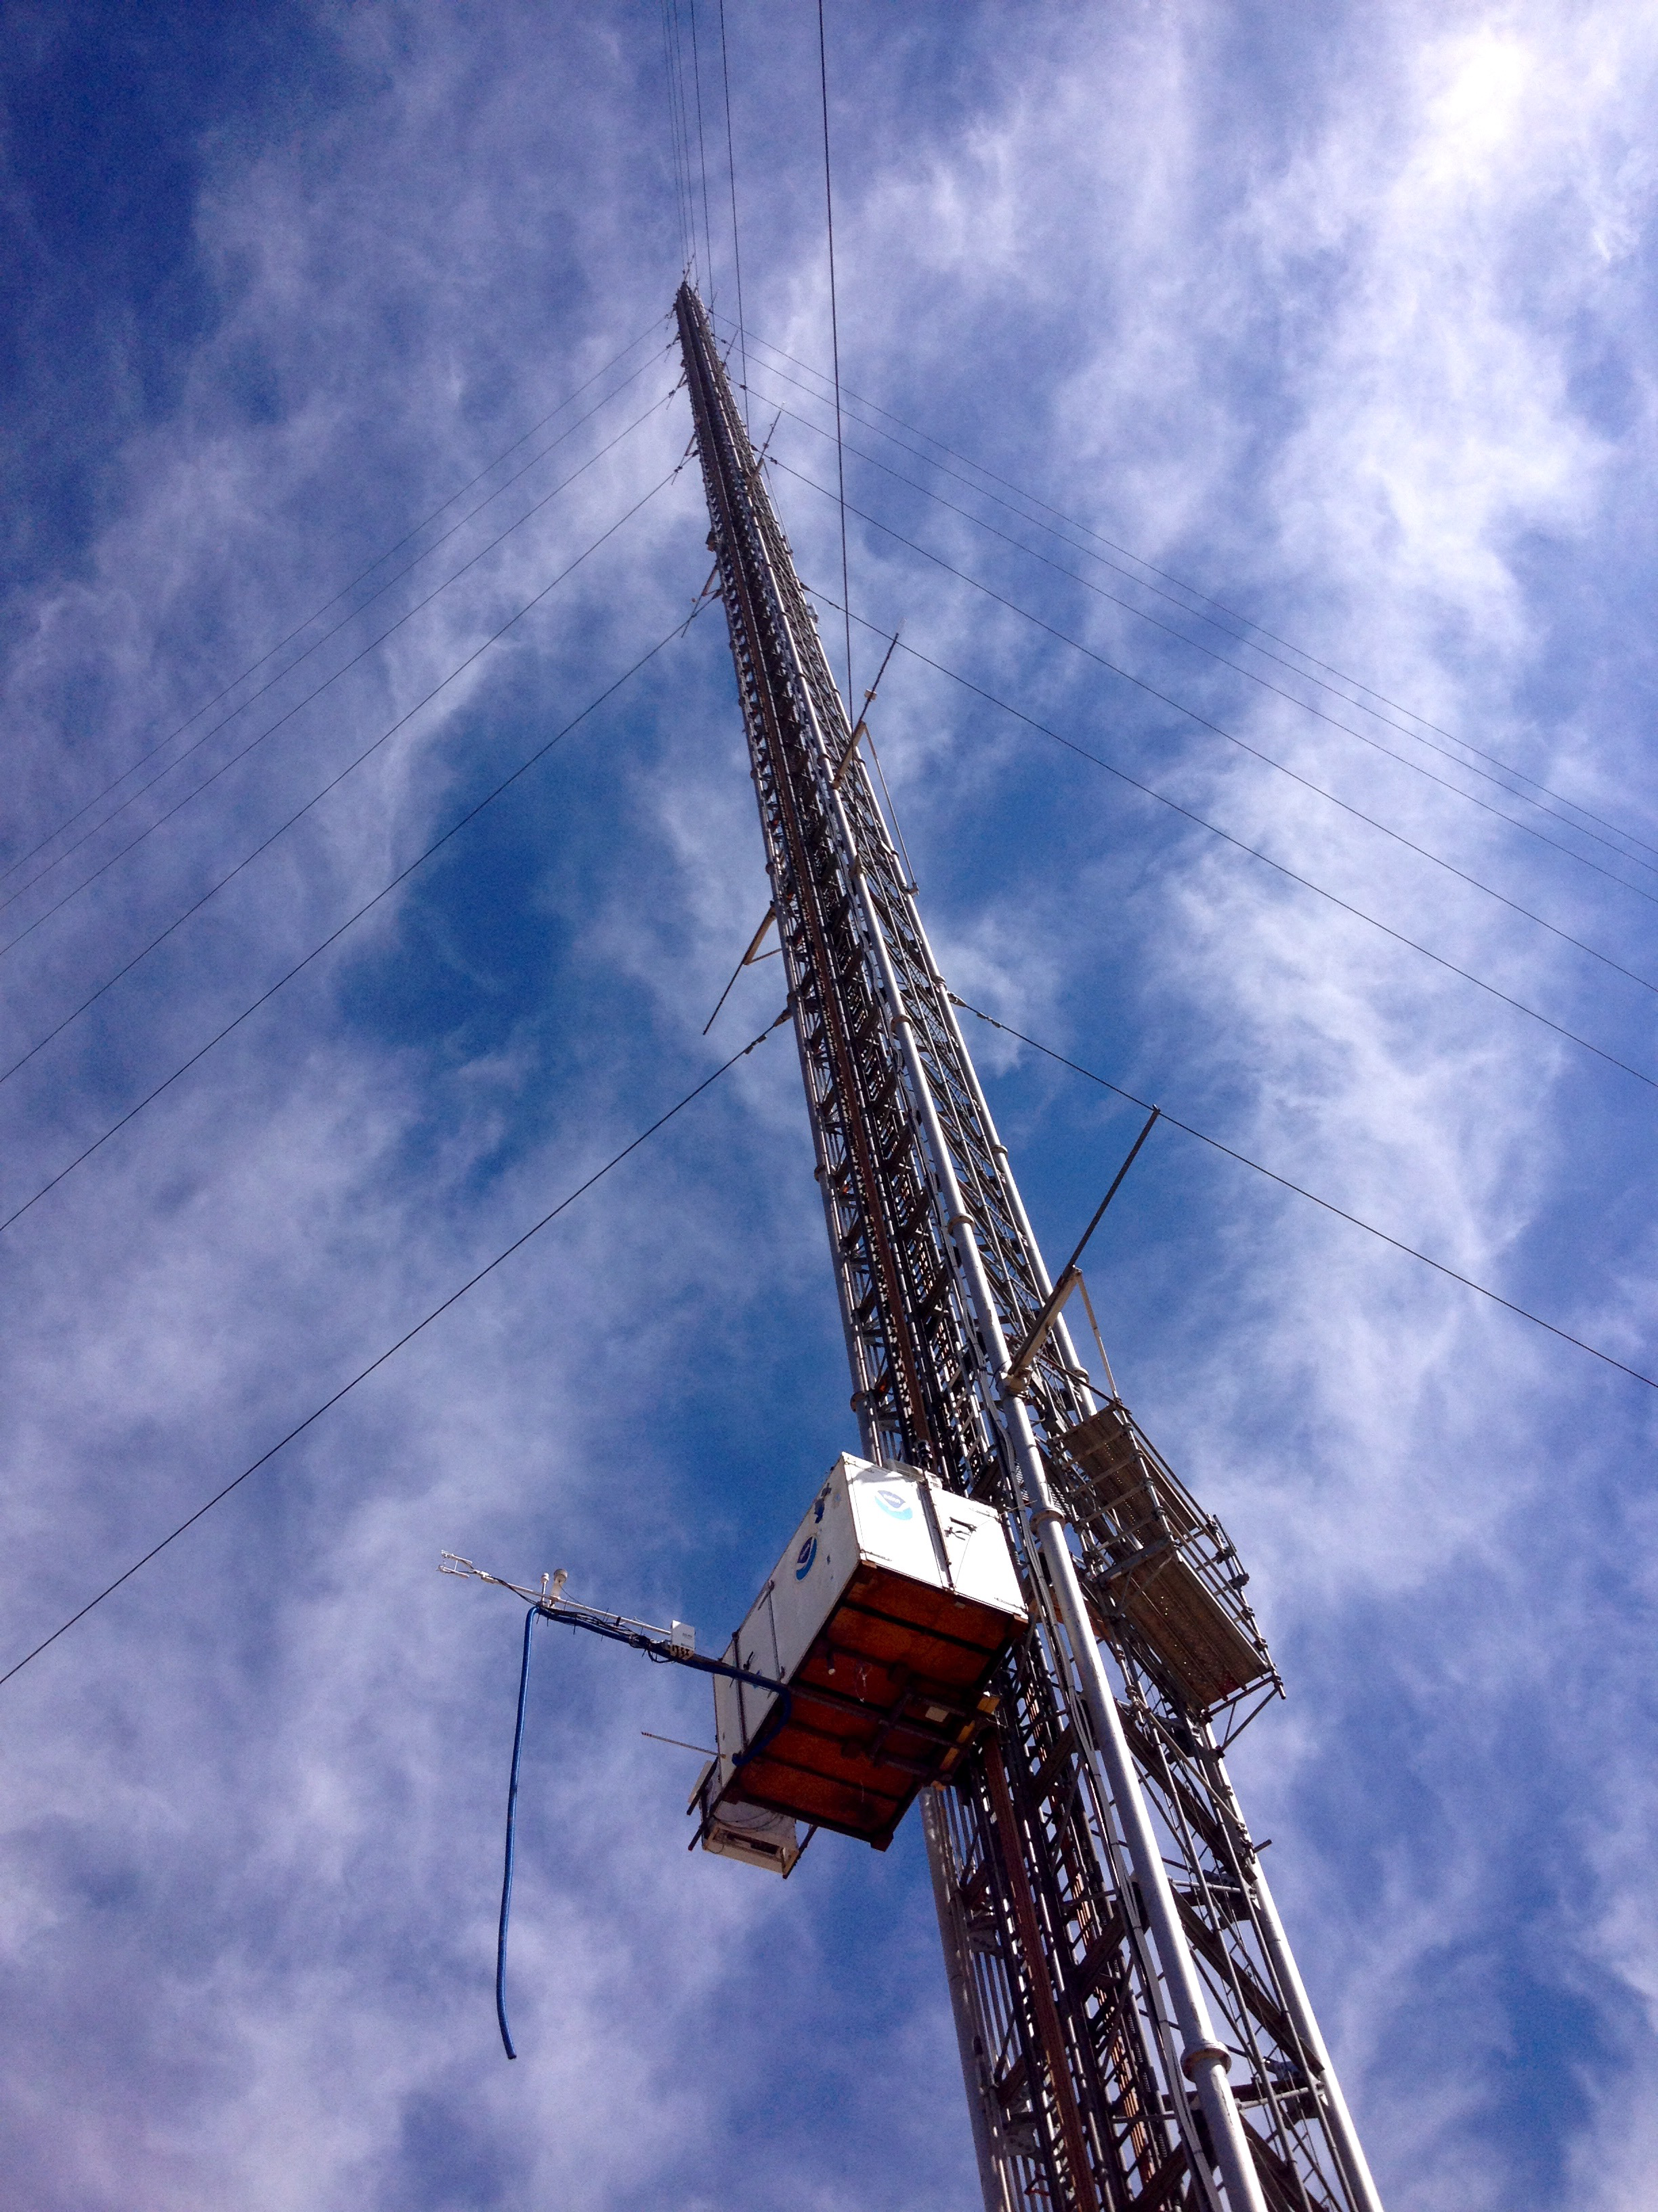
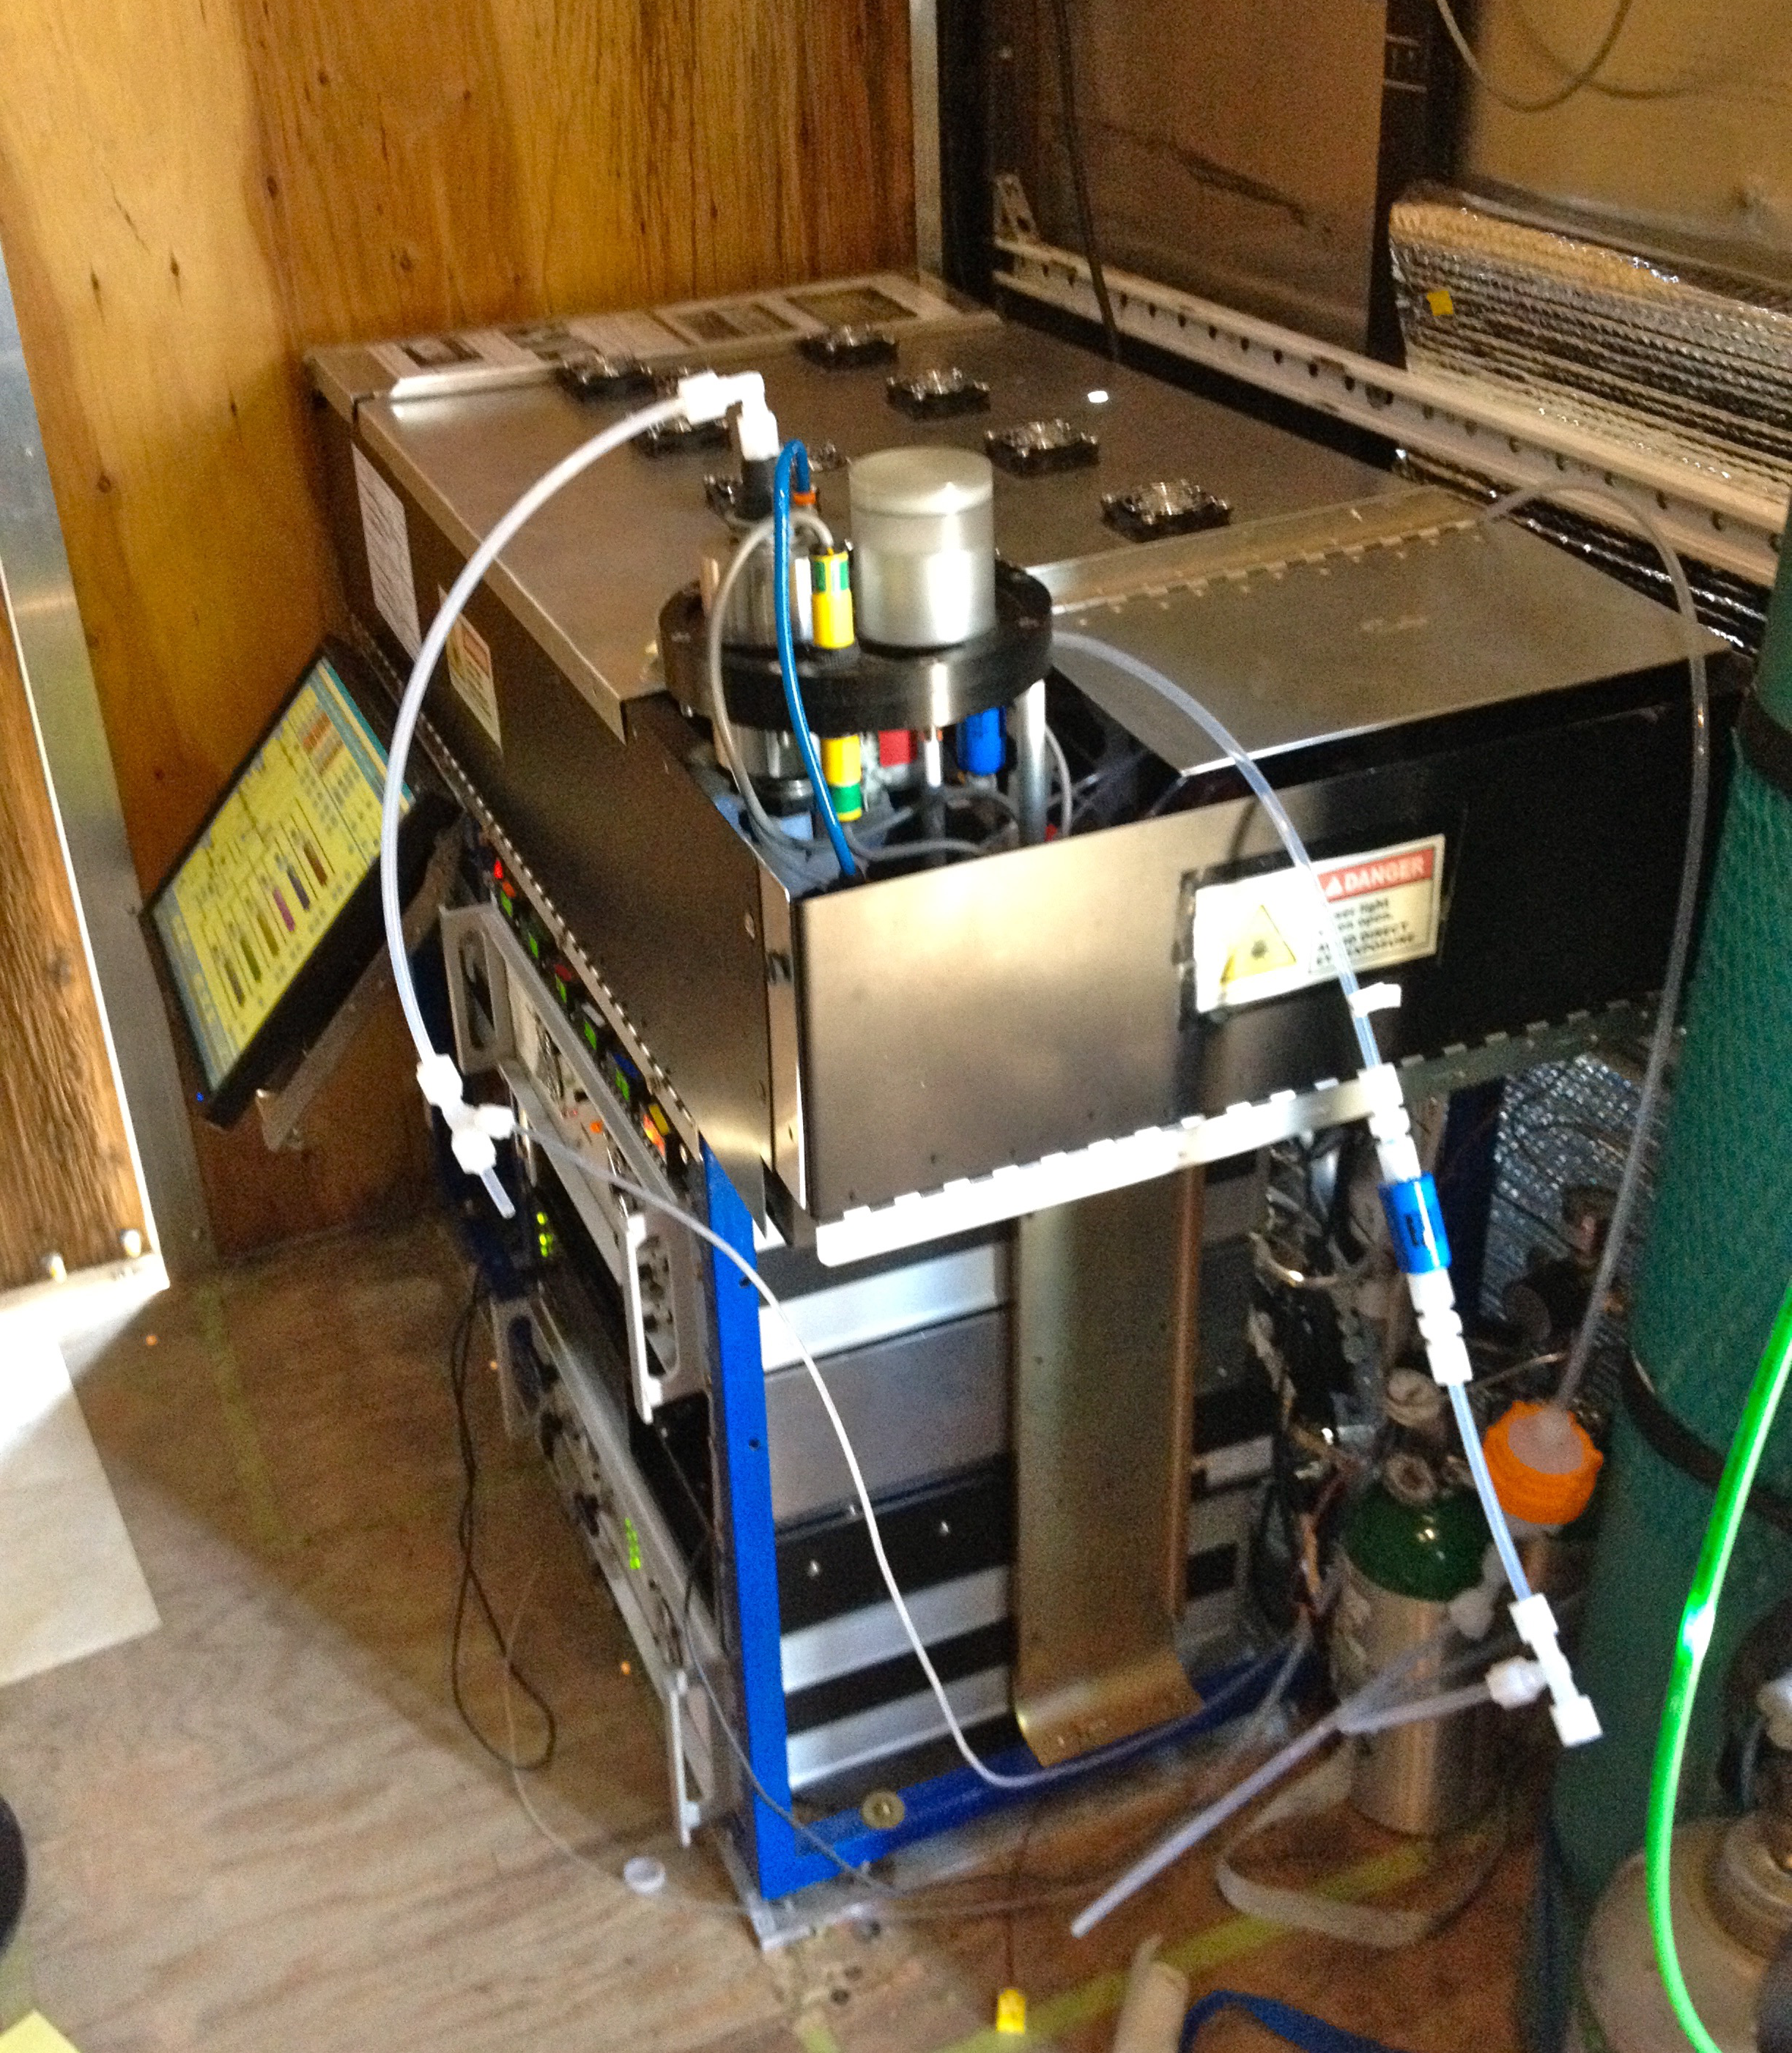
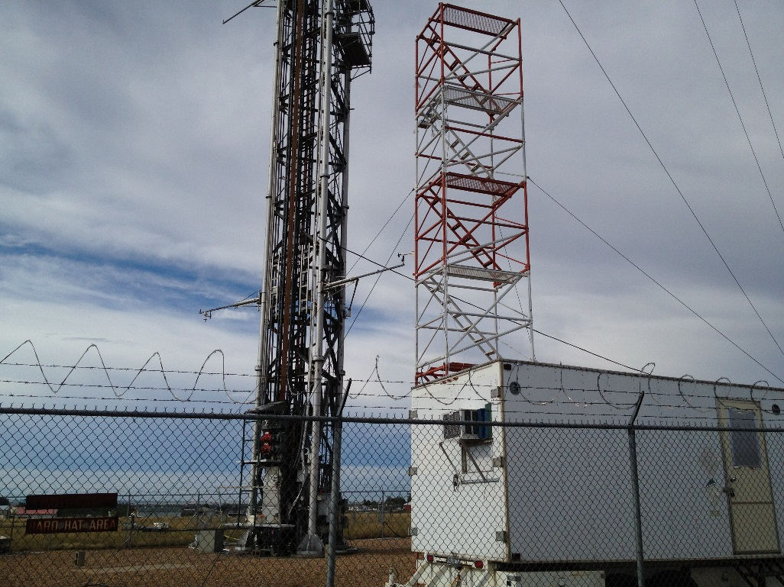
Field Measurements
VOC Mass
OH Reactivity
O₃ Production Efficiency
Box-Model
Data: NO_{x}, NO_{y}, O₃, Speciated VOCs, CH₄, CO, NH₃, j(NO₂), albedo, meteorological data
2014
FRAPPE/DISCOVER-AQ
(NO_{y,} no speciated VOCs)
2012 – SONNE (Speciated VOCs, no NO_{y})
300m
10m

Slide 10
Field Measurements
VOC Mass
OH Reactivity
O₃ Production Efficiency
Box-Model
Colorado
Colorado Northern Front Range (NFR)

Slide 11
Field Measurements
VOC Mass
OH Reactivity
O₃ Production Efficiency
Box-Model
Colorado
Colorado Northern Front Range (NFR)
> 27,000 Active Oil and Natural Gas Wells

Slide 12
Field Measurements
VOC Mass
OH Reactivity
O₃ Production Efficiency
Box-Model
Colorado
Colorado Northern Front Range (NFR)
> 27,000 Active Oil and Natural Gas Wells
Urban NO_{x} + VOC

Slide 13
Field Measurements
VOC Mass
OH Reactivity
O₃ Production Efficiency
Box-Model
BAO Composition is characteristic of both Urban and O&NG Emission Sectors

Slide 14
Field Measurements
VOC Mass
OH Reactivity
O₃ Production Efficiency
Box-Model
BAO Composition is characteristic of both Urban and O&NG Emission Sectors
2014 Chemical Tracers
Oil and Natural Gas: Enhanced CH₄
Average
90th, 10th Percentiles
75th, 25th Percentiles
Urban: NO_{x} and Enhanced CO

Slide 15
Field Measurements
VOC Mass
OH Reactivity
O₃ Production Efficiency
Box-Model
Carbon Mixing Ratio (ppbC):
2012 VOCs
Bar Height: Mean Carbon Mixing Ratio
Alkanes
Alkenes/Alkynes
Aromatics
Aldehydes/Ketones
Alcohols
Biogenic VOC

Slide 16
Field Measurements
VOC Mass
OH Reactivity
O₃ Production Efficiency
Box-Model
Carbon Mixing Ratio (ppbC):
2012 VOCs
Bar Height: Mean Carbon Mixing Ratio
Alkanes
Alkenes/Alkynes
Aromatics
Aldehydes/Ketones
Alcohols
Biogenic VOC
Average Fractional Contribution
7%
1%
6%
3%
1%
Alkanes
82%

Slide 17
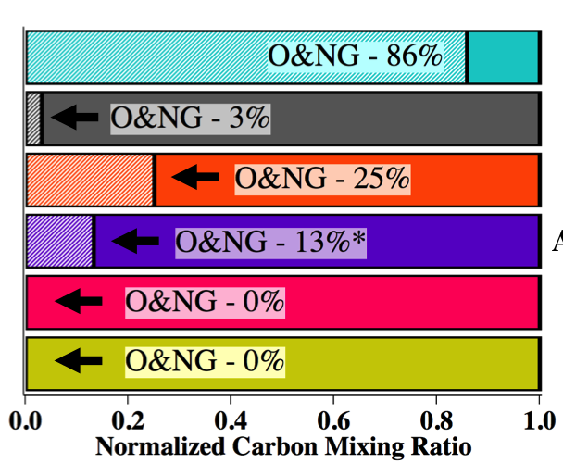
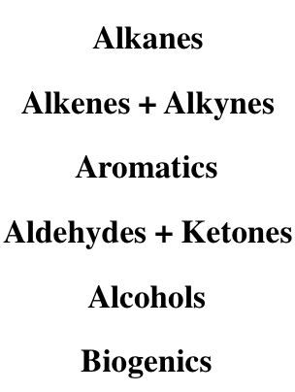
Field Measurements
VOC Mass
OH Reactivity
O₃ Production Efficiency
Box-Model
Carbon Mixing Ratio (ppbC):
2012 VOCs
Bar Height: Mean Carbon Mixing Ratio
Alkanes
Alkenes/Alkynes
Aromatics
Aldehydes/Ketones
Alcohols
Biogenic VOC
Average Fractional Contribution
O&NG VOC Contribution
7%
1%
Gilman, J.B. et al. Environ Sci Technol, 2013, 43(3), 1297
6%
3%
1%
Alkanes
82%

Slide 18
Field Measurements
VOC Mass
OH Reactivity
O₃ Production Efficiency
Box-Model
Carbon Mixing Ratio (ppbC):
2012 VOCs
Bar Height: Mean Carbon Mixing Ratio
Alkanes
Alkenes/Alkynes
Aromatics
Aldehydes/Ketones
Alcohols
Biogenic VOC
O&NG VOCs contribute ~ 80% to Observed Carbon Mass
Average Fractional Contribution
O&NG VOC Contribution
7%
1%
Gilman, J.B. et al. Environ Sci Technol, 2013, 43(3), 1297
6%
3%
1%
Alkanes
82%

Slide 19
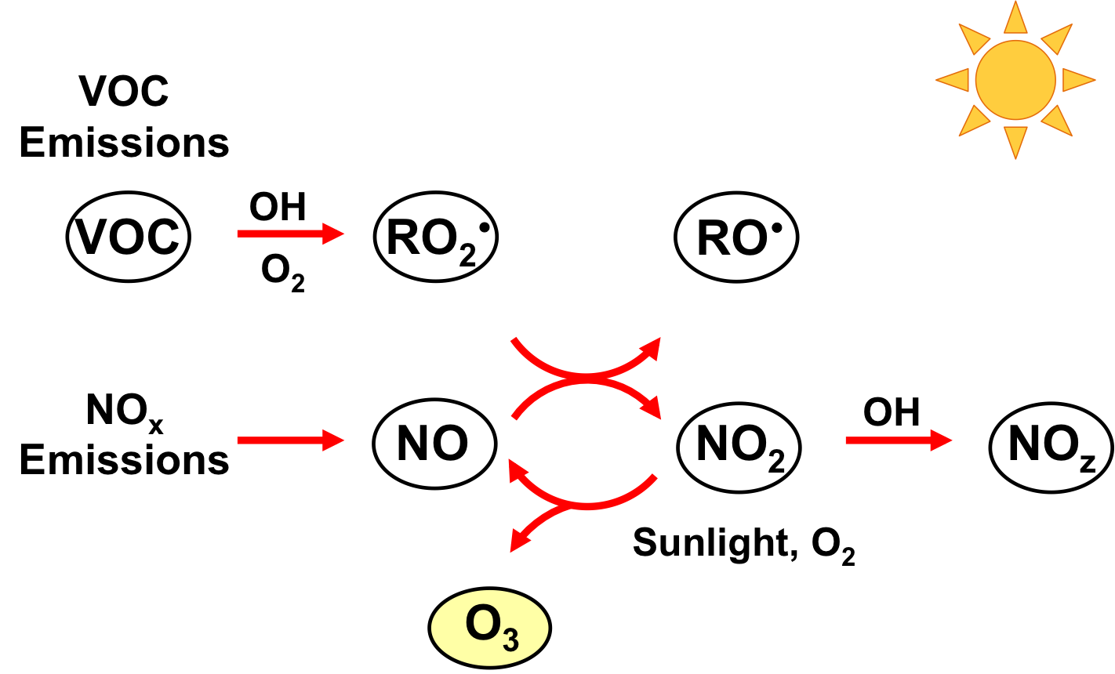
Field Measurements
VOC Mass
OH Reactivity
O₃ Production Efficiency
Box-Model
OH Reactivity (OHR):
Σ(k_{OH+VOC}*[VOC])
Previously used in O&NG focused O₃ studies

Slide 20
Field Measurements
VOC Mass
OH Reactivity
O₃ Production Efficiency
Box-Model
OH Reactivity (OHR):
Σ(k_{OH+VOC}*[VOC])
Previously used in O&NG focused O₃ studies

Slide 21
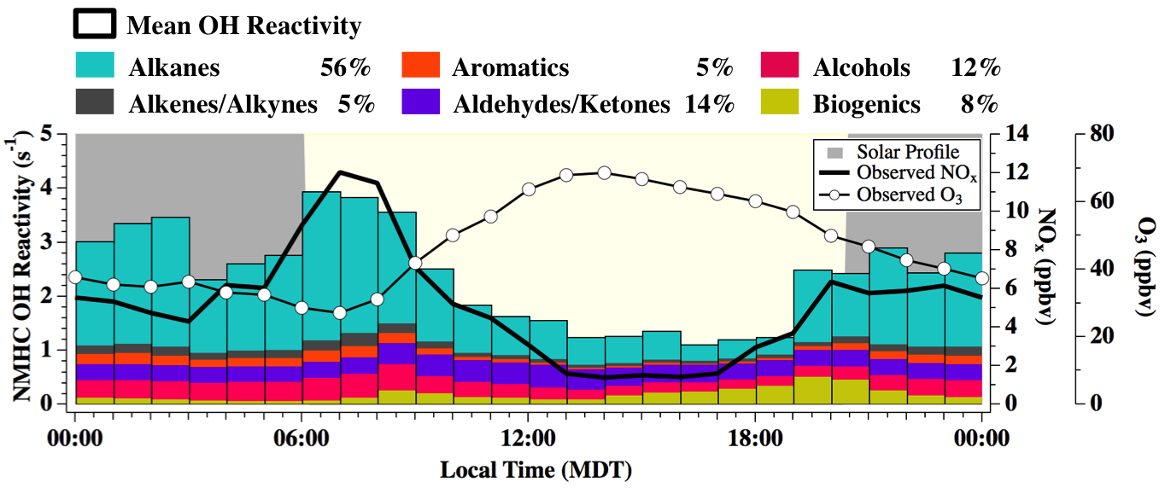
Field Measurements
VOC Mass
OH Reactivity
O₃ Production Efficiency
Box-Model
OH Reactivity (OHR):

Slide 22
Field Measurements
VOC Mass
OH Reactivity
O₃ Production Efficiency
Box-Model
OH Reactivity (OHR):
O&NG VOCs contribute ~ 50% to OH Reactivity

Slide 23
Field Measurements
VOC Mass
OH Reactivity
O₃ Production Efficiency
Box-Model
OH Reactivity (OHR):
O&NG VOCs contribute ~ 50% to OH Reactivity
Comparison to other US O&NG Basins:
Barnett Basin, TX
O&NG: 13-20%
Biogenic: 70%
Marcellus Basin, PA
O&NG: 7%
Biogenic: 47%
Rutter, A. P., et al. Atmospheric Environment, 2015, 120, 89
Swarthout, R. F., et al. Environ. Sci. Technol., 2015, 49(5), 3175

Slide 24
Field Measurements
VOC Mass
OH Reactivity
O₃ Production Efficiency
Box-Model
OPE: Slope of O_{x} ( = O₃ + NO₂) against NO_{z} (= NO_{y}- NO_{x} ) as a measure of the number of O₃ molecules produced per NO_{x} molecules oxidized
NOT previously used in O&NG focused O₃ studies

Slide 25
Field Measurements
VOC Mass
OH Reactivity
O₃ Production Efficiency
Box-Model
OPE: Slope of O_{x} ( = O₃ + NO₂) against NO_{z} (= NO_{y}- NO_{x} ) as a measure of the number of O₃ molecules produced per NO_{x} molecules oxidized
Local/Regional Emission Sectors
NOT previously used in O&NG focused O₃ studies

Slide 26
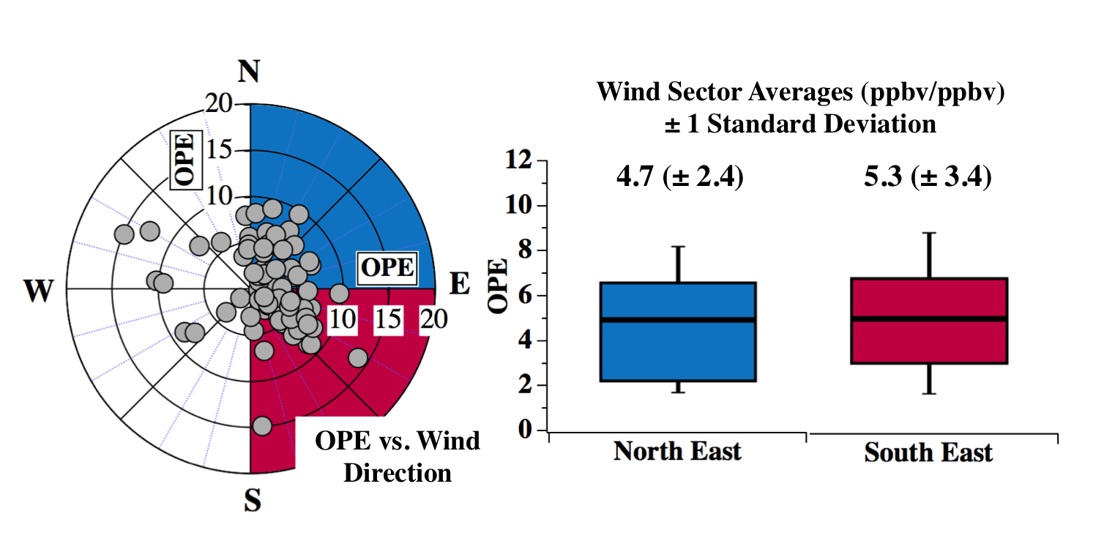
Field Measurements
VOC Mass
OH Reactivity
O₃ Production Efficiency
Box-Model
Individual OPEs:
16 July – 15 August, 2014:
12pm-6pm (MDT) – 15-Minute Intervals

Slide 27
Field Measurements
VOC Mass
OH Reactivity
O₃ Production Efficiency
Box-Model
Individual OPEs:
16 July – 15 August, 2014:
12pm-6pm (MDT) – 15-Minute Intervals
Urban and O&NG OPEs not distinguished by
wind direction or chemical tracers

Slide 28
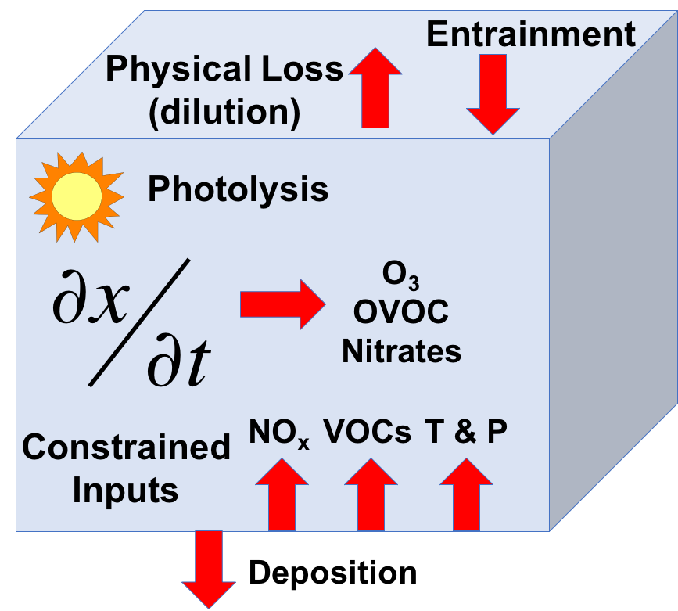
Field Measurements
VOC Mass
OH Reactivity
O₃ Production Efficiency
Box-Model
Photochemical Box-Model: Dynamically Simple Model of Atmospheric Chemical Complexity (DSMACC) - Emmerson, K. M., Evans, M. J., Atmos. Chem. Phys., 2009
Model Details (24-hours, Initialized at 8am):

Slide 29
Field Measurements
VOC Mass
OH Reactivity
O₃ Production Efficiency
Box-Model
Photochemical Box-Model: Dynamically Simple Model of Atmospheric Chemical Complexity (DSMACC) - Emmerson, K. M., Evans, M. J., Atmos. Chem. Phys., 2009
Model Details (24-hours, Initialized at 8am):
Chemistry – Master Chemical Mechanism (MCMv3.3.1) → 4002 species, 15555 reactions

Slide 30
Field Measurements
VOC Mass
OH Reactivity
O₃ Production Efficiency
Box-Model
Photochemical Box-Model: Dynamically Simple Model of Atmospheric Chemical Complexity (DSMACC) - Emmerson, K. M., Evans, M. J., Atmos. Chem. Phys., 2009
Model Details (24-hours, Initialized at 8am):
Chemistry – Master Chemical Mechanism (MCMv3.3.1) → 4002 species, 15555 reactions
Photolysis – NCAR’s TUV → Scaled to diel j(NO₂)/j(O¹D) observations

Slide 31
Field Measurements
VOC Mass
OH Reactivity
O₃ Production Efficiency
Box-Model
Photochemical Box-Model: Dynamically Simple Model of Atmospheric Chemical Complexity (DSMACC) - Emmerson, K. M., Evans, M. J., Atmos. Chem. Phys., 2009
Model Details (24-hours, Initialized at 8am):
Chemistry – Master Chemical Mechanism (MCMv3.3.1) → 4002 species, 15555 reactions
Photolysis – NCAR’s TUV → Scaled to diel j(NO₂)/j(O¹D) observations
Dilution/Entrainment Rate – Fit to best reproduce 10-secondary products

Slide 32
Field Measurements
VOC Mass
OH Reactivity
O₃ Production Efficiency
Box-Model
Photochemical Box-Model: Dynamically Simple Model of Atmospheric Chemical Complexity (DSMACC) - Emmerson, K. M., Evans, M. J., Atmos. Chem. Phys., 2009
Model Details (24-hours, Initialized at 8am):
Chemistry – Master Chemical Mechanism (MCMv3.3.1) → 4002 species, 15555 reactions
Photolysis – NCAR’s TUV → Scaled to diel j(NO₂)/j(O¹D) observations
Dilution/Entrainment Rate – Fit to best reproduce 10-secondary products
Inputs – Diel Observations of 8am: VOCs, NO_{x}, Pressure, Temperature, H₂O Vapor
Constraints – every 30 minutes

Slide 33
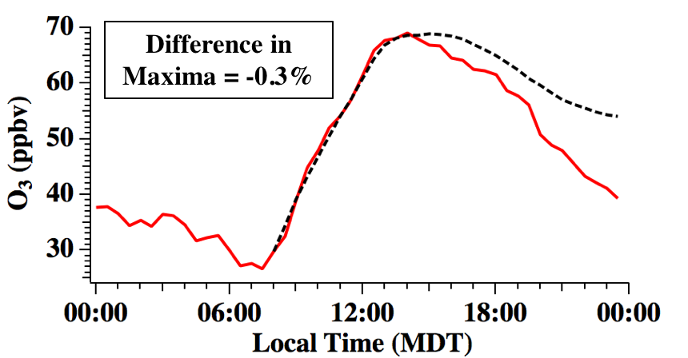
Field Measurements
VOC Mass
OH Reactivity
O₃ Production Efficiency
Box-Model
Photochemical Box-Model: Dynamically Simple Model of Atmospheric Chemical Complexity (DSMACC) - Emmerson, K. M., Evans, M. J., Atmos. Chem. Phys., 2009
Model Details (24-hours, Initialized at 8am):
Chemistry – Master Chemical Mechanism (MCMv3.3.1) → 4002 species, 15555 reactions
Photolysis – NCAR’s TUV → Scaled to diel j(NO₂)/j(O¹D) observations
Dilution/Entrainment Rate – Fit to best reproduce 10-secondary products
Inputs – Diel Observations of 8am: VOCs, NO_{x}, Pressure, Temperature, H₂O Vapor
Constraints – every 30 minutes
Base Case Simulated O₃
Model
Observations

Slide 34
Field Measurements
VOC Mass
OH Reactivity
O₃ Production Efficiency
Box-Model
Photochemical Box-Model: Dynamically Simple Model of Atmospheric Chemical Complexity (DSMACC) - Emmerson, K. M., Evans, M. J., Atmos. Chem. Phys., 2009
Model Details (24-hours, Initialized at 8am):
Chemistry – Master Chemical Mechanism (MCMv3.3.1) → 4002 species, 15555 reactions
Photolysis – NCAR’s TUV → Scaled to diel j(NO₂)/j(O¹D) observations
Dilution/Entrainment Rate – Fit to best reproduce 10-secondary products
Inputs – Diel Observations of 8am: VOCs, NO_{x}, Pressure, Temperature, H₂O Vapor
Constraints – every 30 minutes
Box-Model Limitations
Single location in heterogeneous region
Modeling O₃ for average data, not events

Slide 35
Field Measurements
VOC Mass
OH Reactivity
O₃ Production Efficiency
Box-Model
Photochemical Box-Model: Dynamically Simple Model of Atmospheric Chemical Complexity (DSMACC) - Emmerson, K. M., Evans, M. J., Atmos. Chem. Phys., 2009
Model Details (24-hours, Initialized at 8am):
Chemistry – Master Chemical Mechanism (MCMv3.3.1) → 4002 species, 15555 reactions
Photolysis – NCAR’s TUV → Scaled to diel j(NO₂)/j(O¹D) observations
Dilution/Entrainment Rate – Fit to best reproduce 10-secondary products
Inputs – Diel Observations of 8am: VOCs, NO_{x}, Pressure, Temperature, H₂O Vapor
Constraints – every 30 minutes
Box-Model Limitations
Single location in heterogeneous region
Modeling O₃ for average data, not events
Box-Model Advantages
Explicit Chemistry
Representative of average conditions
Tool to assess O₃ sensitivity to NO_{x} and VOCs

Slide 36
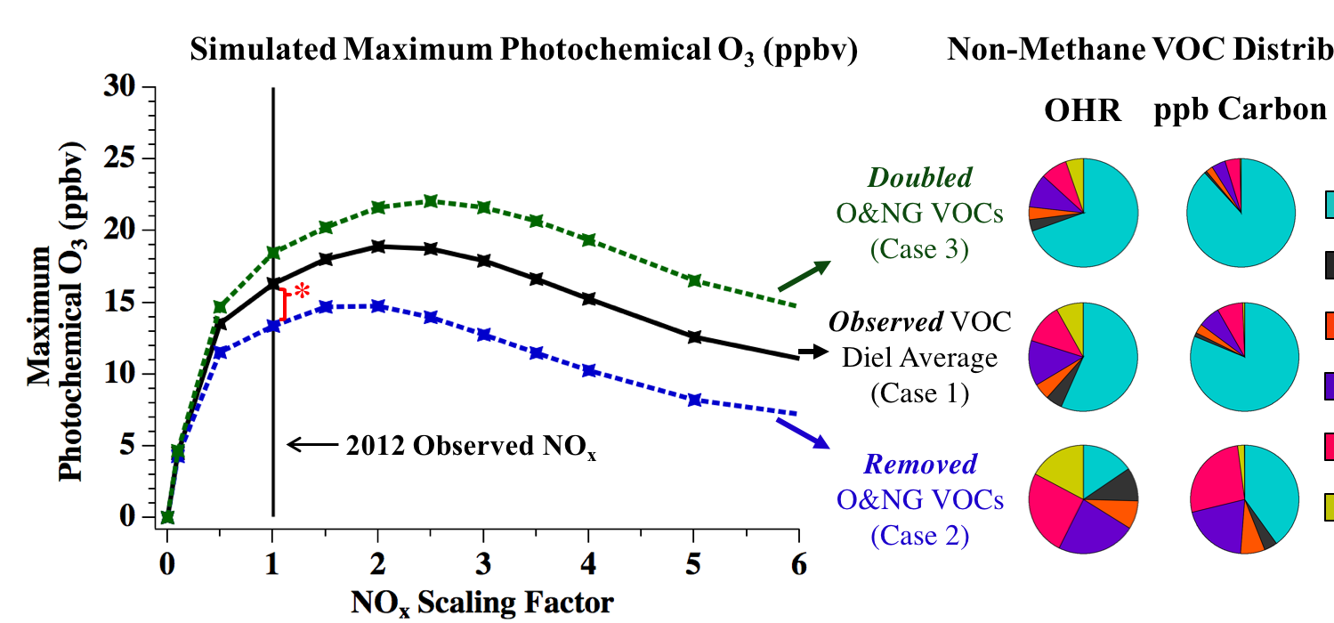
Field Measurements
VOC Mass
OH Reactivity
O₃ Production Efficiency
Box-Model
On Average, Oil and Natural Gas (O&NG) VOC Emissions Contribute ~18% or 3ppbv* to Maximum O₃ Photochemically Produced at BAO
VOC Distributions
Alkanes
Alkenes/Alkynes
Aromatics
Aldehydes/Ketones
Alcohols
Biogenic VOC
The Northern Front Range of Colorado is in a NO_{x} Sensitive Regime

Slide 37
Field Measurements
VOC Mass
OH Reactivity
O₃ Production Efficiency
Box-Model
CB6r3 vs MCM Mechanisms:
“Carbon Bond” Mechanism - provided by Greg Yarwood (Ramboll Environ),
Implemented into DSMACC - Chemical Mechanism is the only change
323 Reactions and 94 Species

Slide 38
Field Measurements
VOC Mass
OH Reactivity
O₃ Production Efficiency
Box-Model
CB6r3 vs MCM Mechanisms:
“Carbon Bond” Mechanism - provided by Greg Yarwood (Ramboll Environ),
Implemented into DSMACC - Chemical Mechanism is the only change
323 Reactions and 94 Species
Obs. Max O₃: 69.0 ppbv
MCM = -0.3%
CB6r3 = + 0.7%

Slide 39
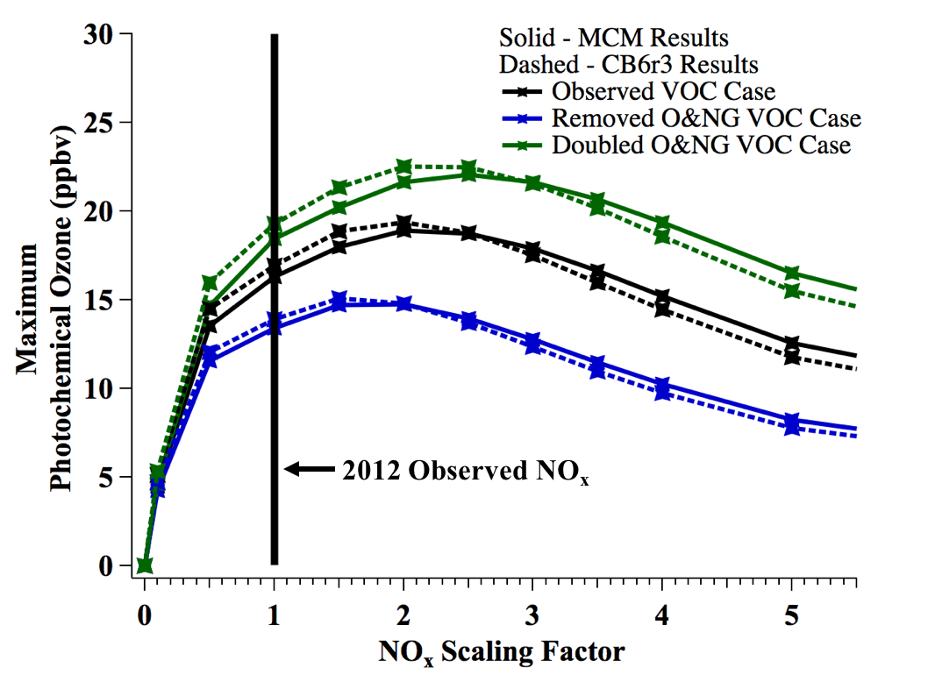
Field Measurements
VOC Mass
OH Reactivity
O₃ Production Efficiency
Box-Model
CB6r3 vs MCM Mechanisms:
“Carbon Bond” Mechanism - provided by Greg Yarwood (Ramboll Environ),
Implemented into DSMACC - Chemical Mechanism is the only change
323 Reactions and 94 Species
Obs. Max O₃: 69.0 ppbv
MCM = -0.3%
CB6r3 = + 0.7%
Solid - MCM
Dashed - CB6r3
With CB6r3 Mechanism:
BAO Remains NO_{x} sensitive
O&NG Contribution:
17.8% vs 17.8%

Slide 40
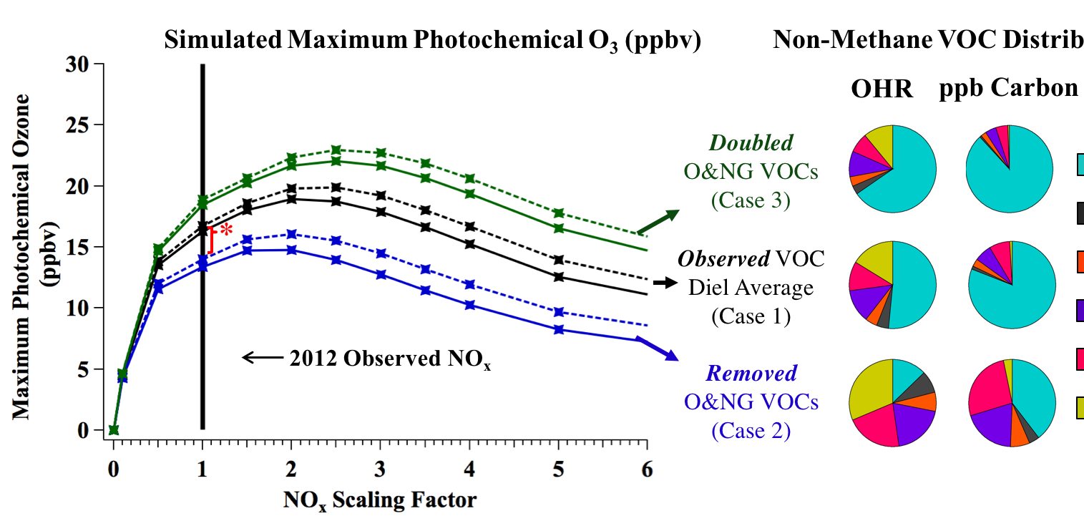
Field Measurements
VOC Mass
OH Reactivity
O₃ Production Efficiency
Box-Model
Influence of Isoprene:
Solid Lines: Original Simulations, Dashed Lines: 2012 Isoprene *3
O&G Influence: 16.1% or 2.8 ppbv vs original 17.8% or 3ppbv
VOC Distributions
Alkanes
Alkenes/Alkynes
Aromatics
Aldehydes/Ketones
Alcohols
Biogenic VOC

Slide 41
Summary and Conclusions
Regional O₃ photochemistry is dependent on local NO_{x} and VOC emission sources
BAO experiences both O&NG & urban emissions

Slide 42
Summary and Conclusions
Regional O₃ photochemistry is dependent on local NO_{x} and VOC emission sources
BAO experiences both O&NG & urban emissions
  O&NG Contribution:
VOC Mass
OH Reactivity
O₃ Production Efficiency
Box-Model

Slide 43
Summary and Conclusions
Regional O₃ photochemistry is dependent on local NO_{x} and VOC emission sources
BAO experiences both O&NG & urban emissions
  O&NG Contribution:
VOC Mass
OH Reactivity
O₃ Production Efficiency
Box-Model
  ~80%
7%
1%
6%
3%
1%
Alkanes
82%

Slide 44
Summary and Conclusions
Regional O₃ photochemistry is dependent on local NO_{x} and VOC emission sources
BAO experiences both O&NG & urban emissions
  O&NG Contribution:
VOC Mass
OH Reactivity
O₃ Production Efficiency
Box-Model
  ~80%
  ~50%
7%
1%
6%
3%
1%
Alkanes
82%

Slide 45
Summary and Conclusions
Regional O₃ photochemistry is dependent on local NO_{x} and VOC emission sources
BAO experiences both O&NG & urban emissions
  O&NG Contribution:
VOC Mass
OH Reactivity
O₃ Production Efficiency
Box-Model
  ~80%
  ~50%
  Indistinguishable
7%
1%
6%
3%
1%
Alkanes
82%

Slide 46
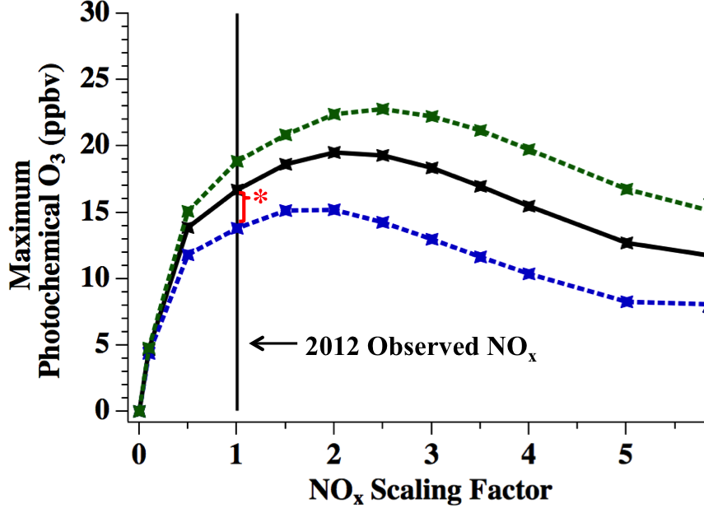
Summary and Conclusions
Regional O₃ photochemistry is dependent on local NO_{x} and VOC emission sources
BAO experiences both O&NG & urban emissions
  O&NG Contribution:
VOC Mass
OH Reactivity
O₃ Production Efficiency
Box-Model
  ~80%
  ~50%
  Indistinguishable
  ~18%
7%
1%
6%
3%
1%
Alkanes
82%

Slide 48
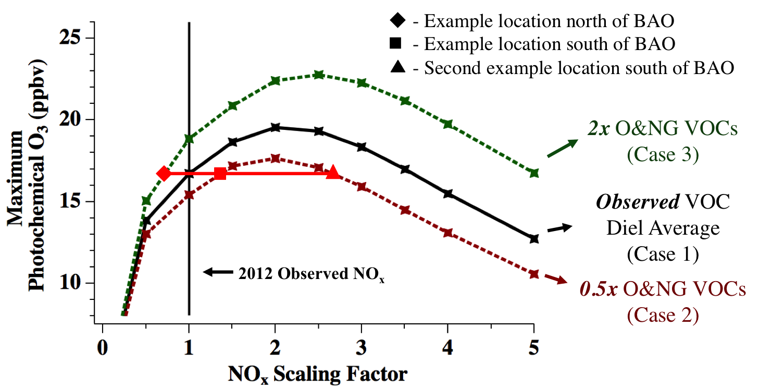
Regional O₃ Enhancements in different NO_{x}/VOC regimes

Slide 49
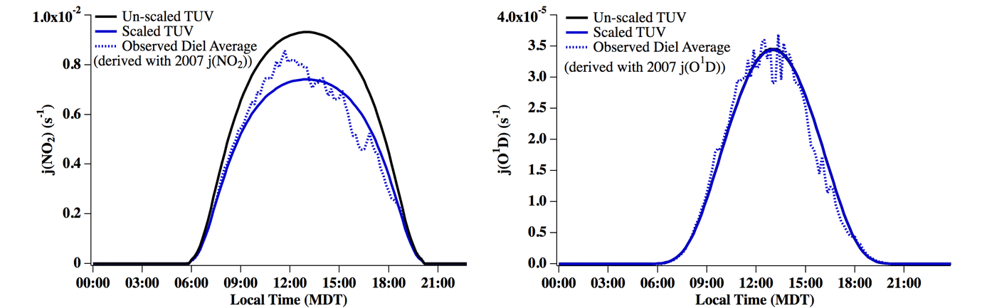
Field Measurements
VOC Mass
OH Reactivity
O₃ Production Efficiency
Box-Model
Photochemical Box-Model: Dynamically Simple Model of Atmospheric Chemical Complexity (DSMACC) - Emmerson, K. M., Evans, M. J., Atmos. Chem. Phys., 2009
Model Details (24-hours, Initialized at 8am):
Chemistry – Master Chemical Mechanism (MCMv3.3.1) → 4002 species, 15555 reactions
Photolysis – NCAR’s TUV → Scaled to diel j(NO₂)/j(O¹D) observations
Dilution/Entrainment Rate – Fit to best reproduce 10-secondary products
Background O₃ – Derived from LIDAR measurements
Inputs – Diel Observations of: VOCs, NO_{x}, Pressure, Temperature, H₂O Vapor
Constraints – every 30 minutes
Model
Observations
± 1 std dev.

Slide 50
Field Measurements
VOC Mass
OH Reactivity
O₃ Production Efficiency
Box-Model
OPE: Slope of O_{x} ( = O₃ + NO₂) against NO_{z} (= NO_{y}- NO_{x} ) as a measure of the number of O₃ molecules produced per NO_{x} oxidized
2014: 12pm-6pm (MDT) 16 July-15 August
Average of 80 Individual OPEs = 5.3 ± 3.6 ppbv/ppbv

Slide 51
Photolysis

Slide 52
Entrainment
Physical Loss
(dilution)
Photolysis
O₃
OVOC
Nitrates
Constrained
Inputs
NO_{x}
VOCs
T & P
Deposition

