Slide 1
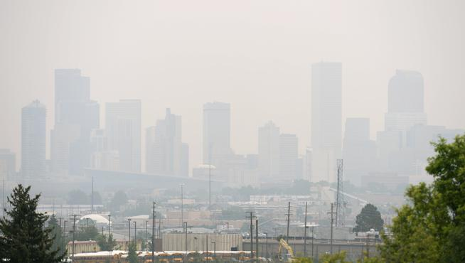

Wildfire smoke, atmospheric composition, and ozone in the Colorado Front Range during summer 2015
Jakob Lindaas¹, Delphine K. Farmer², Ilana B. Pollack^{1,2}, Andrew Abeleira², Frank Flocke³, Rob Roscioli⁴, Scott Herndon⁴, and Emily V. Fischer¹
¹ Colorado State University, Department of Atmospheric Science, Fort Collins, CO, USA
² Colorado State University, Department of Chemistry, Fort Collins, CO, USA
³ National Center for Atmospheric Research, Boulder, CO, USA
⁴ Aerodyne Research Inc, Billerica, MA, USA
FRAPPE Team Meeting
May 3th, 2017
Funding from NOAA grant NA14OAR4310148 and the AMS Graduate Fellowship
The Denver Post, Aug. 20th, 2015

Slide 2
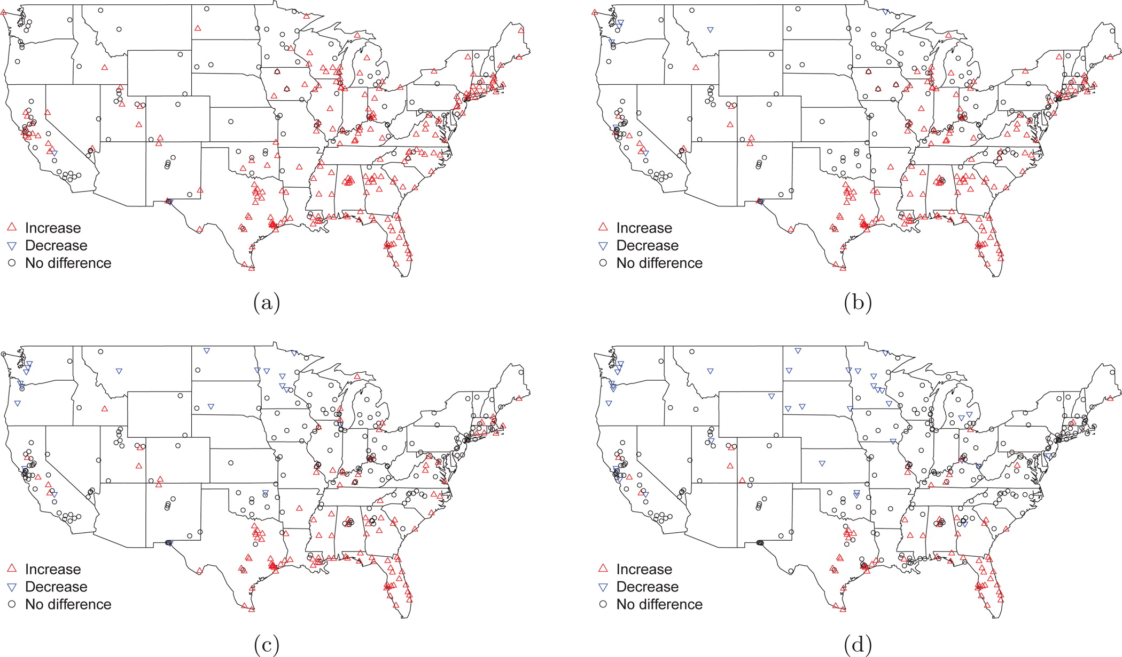
The presence of smoke is correlated with higher surface O₃ across much of the U.S.
Brey and Fischer, 2016

Slide 3
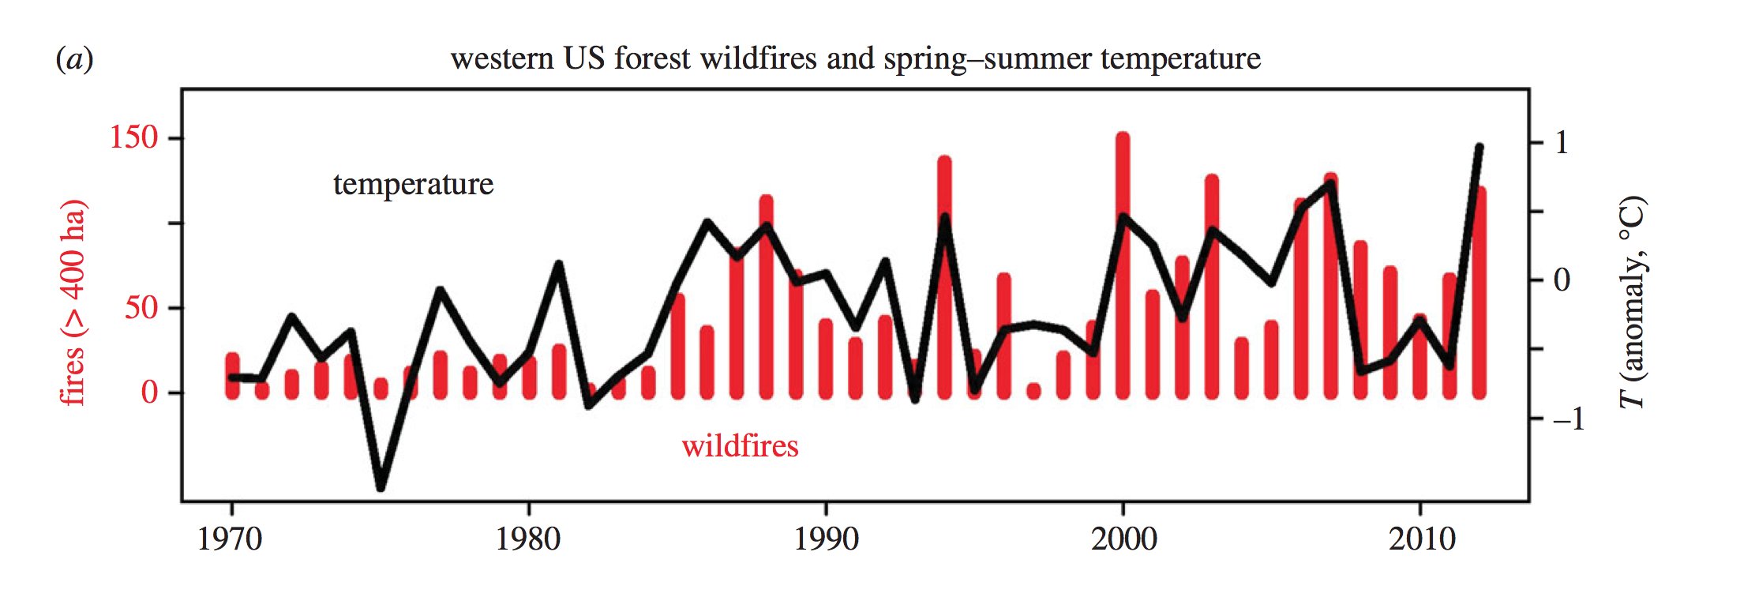
Wildfires are increasing in frequency and intensity due to climate change and human activity
Westerling, 2016

Slide 4
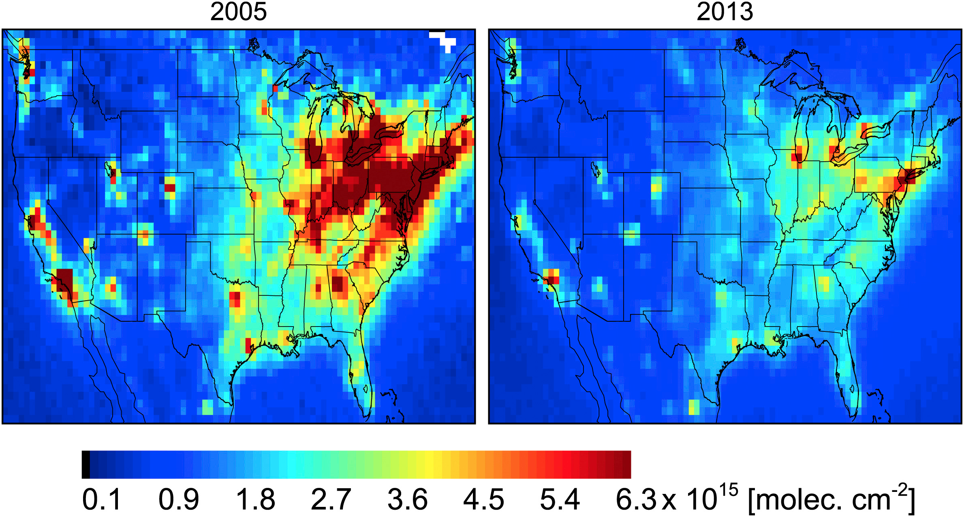
While emissions of ozone precursors are generally going down
Annual average OMI NO₂
vertical column density
Lamsal et al., 2015

Slide 5


Thus wildfire smoke will become more important for U.S. air quality in the future
August 20th, 2015
Average day
Denver County Courthouse

Slide 6
How does wildfire smoke affect atmospheric composition and surface O₃ in the Colorado Front Range?
Two months of in situ measurements
made at the Boulder Atmospheric Observatory
near Erie, CO
CSU
Via Collaborations

Slide 7
Overview
1) We will describe the two smoke periods at BAO during summer 2015: July 6 – 10 and August 16 - 30
2) Investigate the significant changes to atmospheric composition during the smoke periods
Analyze surface O₃ enhancements

Slide 8
Two distinct wildfire smoke-impacted periods at BAO:
July 6 - 10 and August 16 - 30
Notes:
Figure 1. Top panel: Timeseries of hourly PM_{2.5} concentrations for the CDPHE CAMP air quality monitoring site located in downtown Denver (39.75’, -104.98’). Bottom panel: Timeseries of hourly CO mixing ratios at the Boulder Atmospheric Observatory (BAO: 40.05’, -105.00’). Red shading denotes periods during which smoke is present at BAO.
http://www.colorado.gov/airquality/site_description.aspx

Slide 9
Smoke was transported over 2-3 days from the Pacific NW and Canada and covered large areas of the U.S.
HYSPLIT 5-day
back trajectories
MODIS fire locations
HMS smoke product
Notes:
Figure 2. Representative days during each smoke period observed at the Boulder Atmospheric Observatory (BAO: blue square). NOAA Hazard Mapping System smoke polygons are plotted in grey with MODIS fire locations from the previous day plotted as red triangles. The thin black lines show HYSPLIT back trajectories from the BAO site released at 1000m above ground level for each hour of the day plotted.

Slide 10
Many wildfire-emitted VOCs with lifetimes > 2 days were enhanced during the August smoke period
Notes:
Figure 3. Significant changes (two sided Student’s t-test, 90% confidence interval) in hourly averaged mixing ratios of a subset of species measured at the Boulder Atmospheric Observatory (BAO) between smoke-free periods and the August 15 – 30 smoke period. Significant increases during smoke are shown in red, significant decreases are in blue, and missing data is plotted in grey.

Slide 11
High local abundances of some alkanes obscure expected enhancements
Notes:
Figure 3. Significant changes (two sided Student’s t-test, 90% confidence interval) in hourly averaged mixing ratios of a subset of species measured at the Boulder Atmospheric Observatory (BAO) between smoke-free periods and the August 15 – 30 smoke period. Significant increases during smoke are shown in red, significant decreases are in blue, and missing data is plotted in grey.

Slide 12
High local abundances of some alkanes obscure expected enhancements
Notes:
Figure 3. Significant changes (two sided Student’s t-test, 90% confidence interval) in hourly averaged mixing ratios of a subset of species measured at the Boulder Atmospheric Observatory (BAO) between smoke-free periods and the August 15 – 30 smoke period. Significant increases during smoke are shown in red, significant decreases are in blue, and missing data is plotted in grey.

Slide 13
Reductions in several alkenes with high OH-reactivities indicate possible increased oxidation capacity
Notes:
Figure 3. Significant changes (two sided Student’s t-test, 90% confidence interval) in hourly averaged mixing ratios of a subset of species measured at the Boulder Atmospheric Observatory (BAO) between smoke-free periods and the August 15 – 30 smoke period. Significant increases during smoke are shown in red, significant decreases are in blue, and missing data is plotted in grey.

Slide 14
Heptane isomers with similar OH-reactivity show opposite behavior – not sure why?
Notes:
Figure 3. Significant changes (two sided Student’s t-test, 90% confidence interval) in hourly averaged mixing ratios of a subset of species measured at the Boulder Atmospheric Observatory (BAO) between smoke-free periods and the August 15 – 30 smoke period. Significant increases during smoke are shown in red, significant decreases are in blue, and missing data is plotted in grey.

Slide 15
Increased morning and evening NO₂ observed – not clear if this is connected to the presence of smoke
Notes:
Figure 5. Average diurnal cycles of ozone and important nitrogen species involved in ozone photochemistry measured at the Boulder Atmospheric Observatory (BAO). Panels a), b), and c) compare average diurnal cycles from smoke-free time periods (black) to average diurnal cycles from the July smoke-impacted period (orange). Panels d) – h) show average diurnal cycles during the August smoke-impacted period (red) to the same average diurnal cycles from smoke-free periods (black). PAN and HNO₃ measurements were not available during the July smoke-impacted period.

Slide 16
Elevated average PAN mixing ratios – though small levels compared to those found in young smoke plumes
Notes:
Figure 5. Average diurnal cycles of ozone and important nitrogen species involved in ozone photochemistry measured at the Boulder Atmospheric Observatory (BAO). Panels a), b), and c) compare average diurnal cycles from smoke-free time periods (black) to average diurnal cycles from the July smoke-impacted period (orange). Panels d) – h) show average diurnal cycles during the August smoke-impacted period (red) to the same average diurnal cycles from smoke-free periods (black). PAN and HNO₃ measurements were not available during the July smoke-impacted period.

Slide 17
O₃ is enhanced by ~12 ppbv for any given temperature during the August smoke-impacted period
Notes:
Figure 6. Hourly O3 data from the Boulder Atmospheric Observatory (BAO) plotted against hourly temperature data show a positive correlation between temperature and O3 abundances for both smoke-free time periods in grey and the August smoke-impacted time period in red. Overplotted are barplots (5th, 25th, 50th, 75th, and 95th percentiles) for each 5 degree Celsius bin, showing a clear increase in O3 abundances for any given temperature. On the left normalized histograms of the hourly O3 data are plotted, with all smoke-free measurements in black, and all hourly measurements made during the August smoke-impacted period in red. The distribution of ozone concentrations shifts towards higher mixing ratios during the smoke-impacted August period. The mean of this distribution is significantly greater than the mean of the smoke-free distribution at a 99% confidence level according to a two-sample Student’s t-test.
Bottom plot is a kernel density plot
Using two-sample Student’s t-test I found that ozone is significantly increased during the August smoke period at the 95% confidence level. The result holds if you pick 99% as well. I used function is.sig.simple() that I wrote in R
----- Meeting Notes (6/23/16 16:01) -----
anova

Slide 18
30% of high O₃ days were influenced by smoke
Notes:
Figure 8. Maximum daily 8 hour average (MDA8) of ozone concentrations at the Boulder Atmospheric Observatory (BAO) plotted in black with maximum daily temperature at BAO in blue. Boxes denote days that exceed 70 and 75 ppbv, potentially in exceedance of the EPA NAAQs new and old standards for ozone.

Slide 19
We looked for evidence of O₃ enhancements at two NPS sites with less anthropogenic influence
Notes:
Figure 7. Hourly O3 vs. temperature scatterplots for a) the Boulder Atmospheric Observatory, b) the Rocky Mountain National Park long-term monitoring site, and c) the Arapahoe National Wildlife Refuge long-term monitoring site near Walden, CO. Plotted here are hourly afternoon data (12pm – 5pm MDT), with boxplots overplotted showing standard percentiles of 5 degree Celsius binned O3 data the same as was shown in Figure 7. We see similar increases in O3 mixing ratios at a given temperature across all three sites, along with the differences in average abundances due to location ( a) – c) follow roughly an urban to rural gradient).

Slide 20
Similar O₃ enhancements suggest some production of O₃ within the smoke plume as it was advected to BAO
Notes:
Figure 7. Hourly O3 vs. temperature scatterplots for a) the Boulder Atmospheric Observatory, b) the Rocky Mountain National Park long-term monitoring site, and c) the Arapahoe National Wildlife Refuge long-term monitoring site near Walden, CO. Plotted here are hourly afternoon data (12pm – 5pm MDT), with boxplots overplotted showing standard percentiles of 5 degree Celsius binned O3 data the same as was shown in Figure 7. We see similar increases in O3 mixing ratios at a given temperature across all three sites, along with the differences in average abundances due to location ( a) – c) follow roughly an urban to rural gradient).

Slide 21
Summary
1) BAO was impacted by two distinct smoke periods during summer 2015: July 6 – 10 and August 16 - 30
2) Enhancements observed in less reactive VOCs and reductions observed in many highly reactive VOCs
Significant increases in O₃ observed, independent of temperature or air mass origin (not shown here)

Slide 22
Questions?
jlindaas@rams.colostate.edu
Funding from NOAA grant NA14OAR4310148 and the AMS Graduate Fellowship
The Denver Post, Aug. 20th, 2015

Slide 23
Changes in composition are consistent across wind direction
Notes:
Figure 4. 95th percentiles plotted of a) Benzene and b) NO2 as a function of wind direction for all data during smoke-free periods (black) and for data from the August smoke period (red). Both plots show that changes in abundances are not due to differences in wind direction, but are instead related to the presence of smoke.

Slide 24
K-means cluster analysis of HYSPLIT back trajectories run every hour

Slide 25
Most smoke trajectories are in the C1 cluster, and show the same
enhanced O₃ pattern

