Slide 1
Surface Observations of Ozone Along an Elevation Gradient in the Northern Colorado Front Range During FRAPPE
Helmig D.¹, Bien T.¹, Hueber J.¹, Thompson C¹., Reed T.¹, Evans J.¹, McClure A.², Petropavloskikh I.², Oltmans, S.², and Pfister, G.³
¹Institute of Arctic and Alpine Research, University of Colorado, Boulder, CO 80305
² CIRES/NOAA, Global Monitoring Division, Boulder, CO 80303
³National Center for Atmospheric Research, Boulder, CO 80307

Slide 2
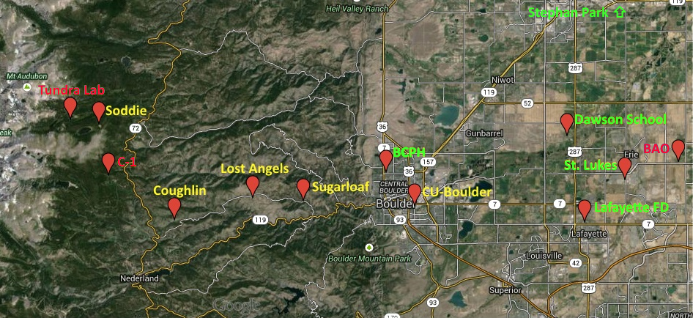
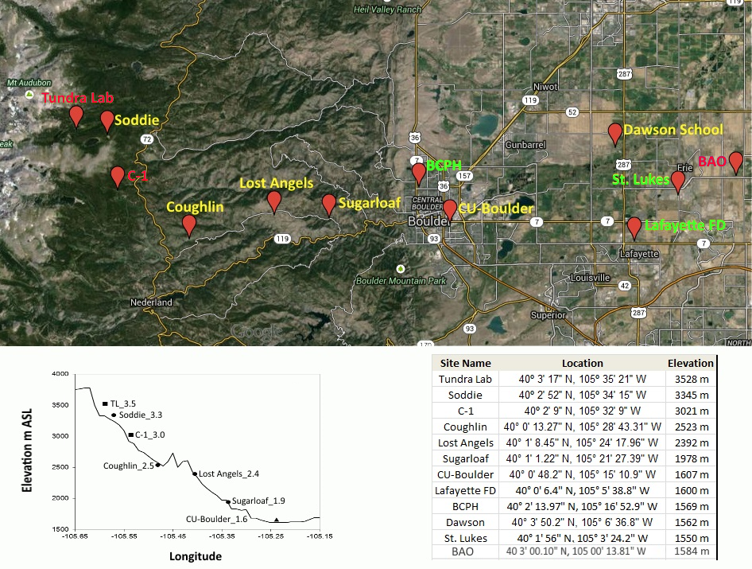
Title
FRAPPÉ/DISCOVER-AQ Science Team Meeting: Surface Observations of Ozone Along an Elevation Gradient in the Northern Colorado Front Range During FRAPPÉ Slide x of x

Slide 3
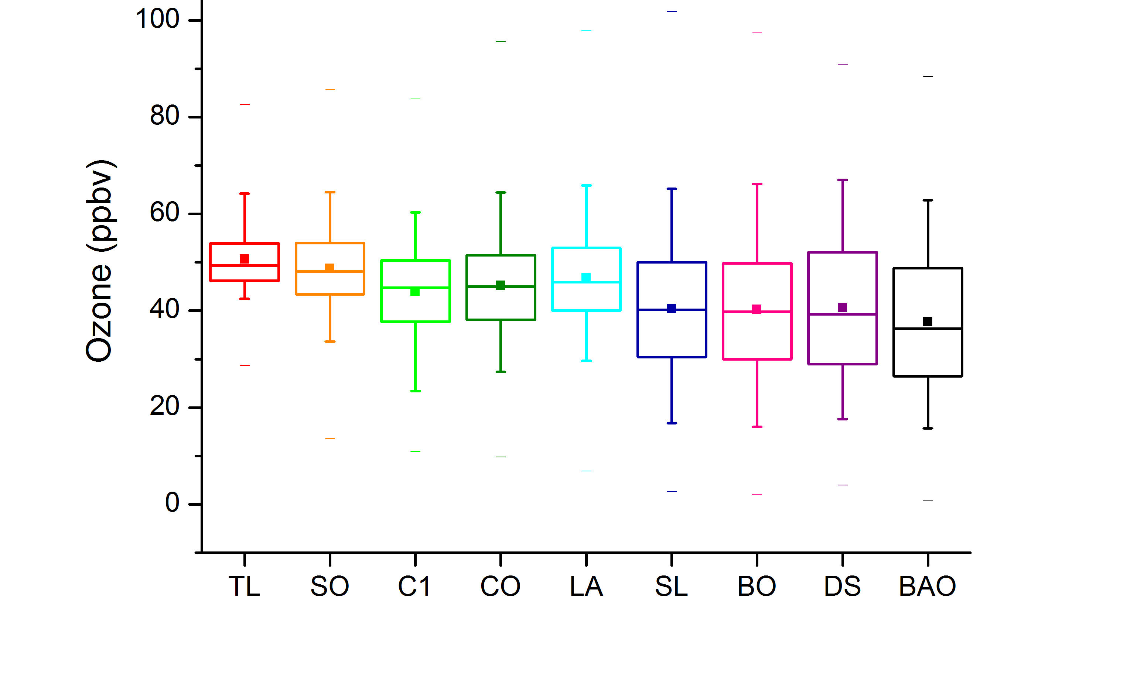
Ozone – Vertical Distribution June 1 – Aug. 31, 2014

Slide 4
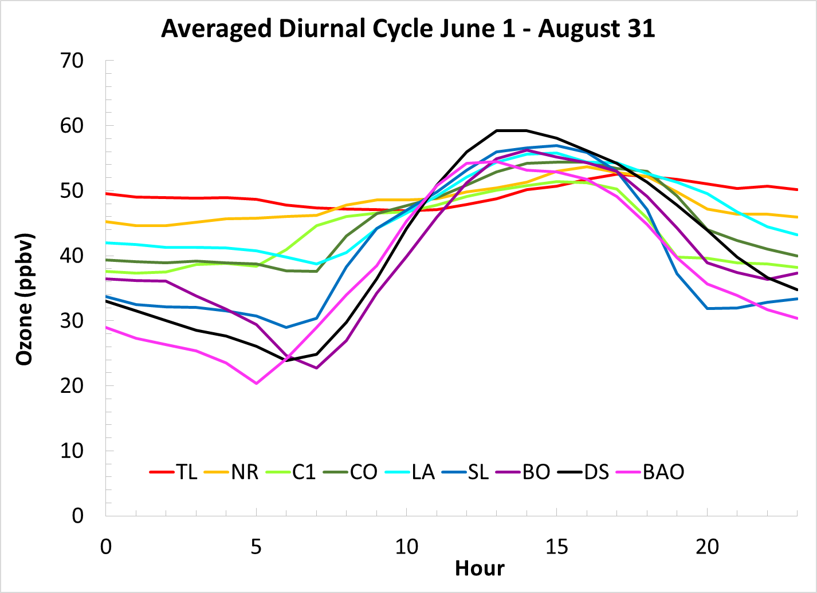

Slide 5
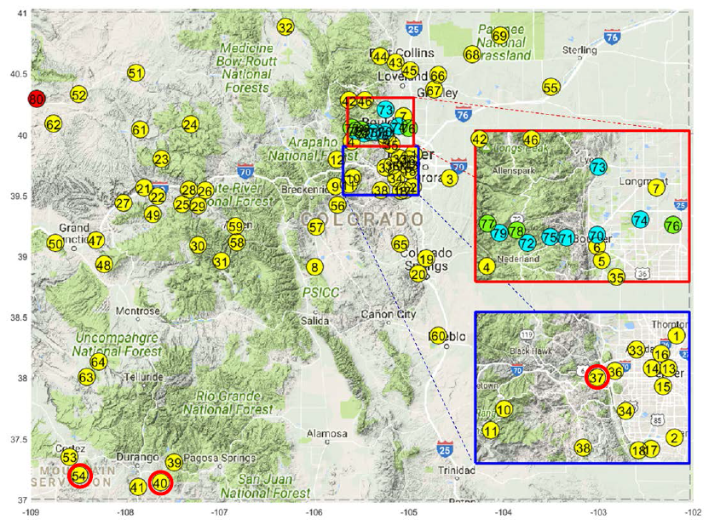
Extension of FRAPPE Ozone Data to all State of Colorado Sites
- 80 sites
- 2000-2015
- 21 for Trends

Slide 6
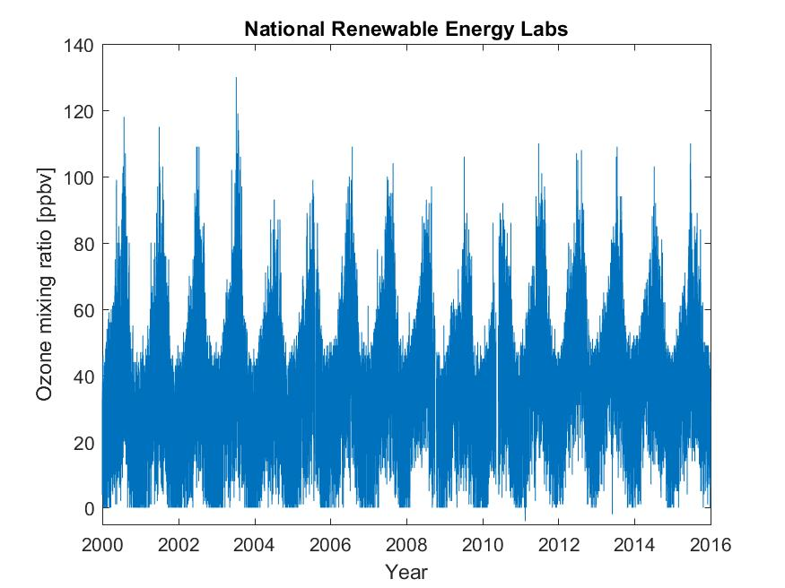
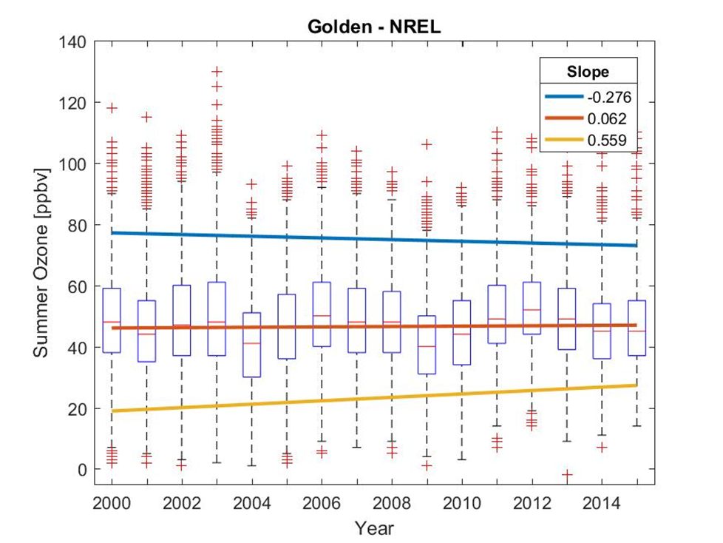
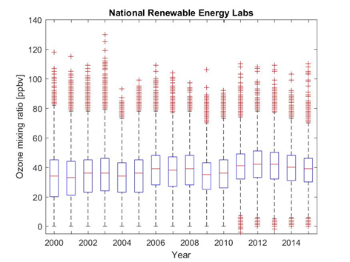
All Year
Summer
Statistical Analyses:
Box-Whisker Plots &
95th-percentile
50th-percentile (median)
5th-percentile

Slide 7
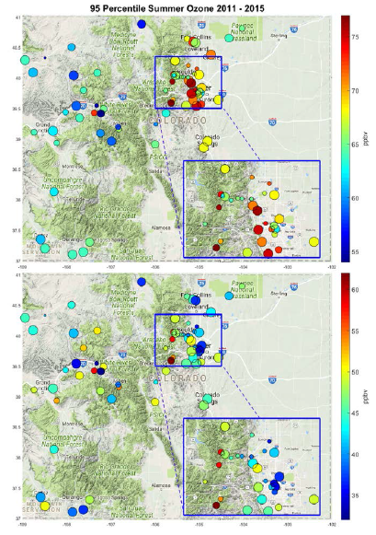
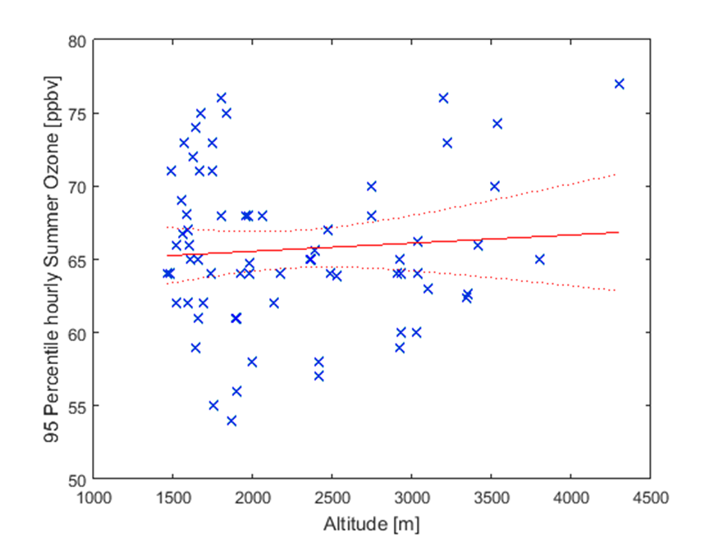
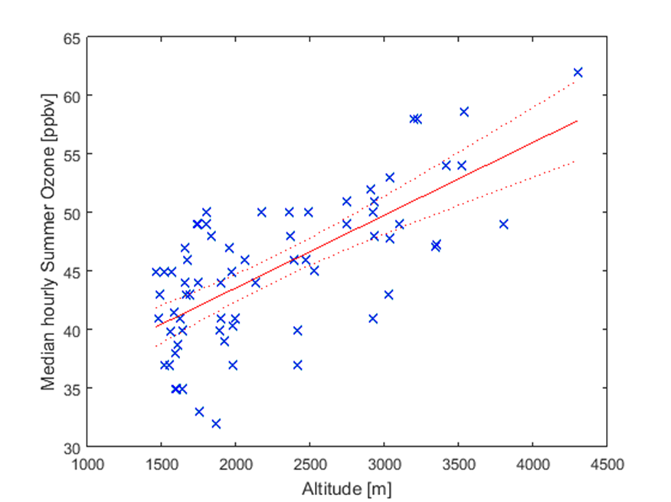
Summer (JJA) Ozone (ppb), 2010-2015
95th
%-ile
50th
%-ile
6.6 +/- 1.6 ppb km⁻¹
(Circle size scales with years of available data.)

Slide 8
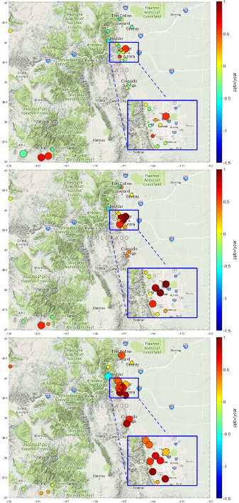
2000 – 2015 Summer 95/50/5 Percentile Ozone Changes/Trends
(ppb/year)
95th
%-ile
Stat. significant trend
Not stat. significant change
50th
%-ile
5th
%-ile

Slide 9
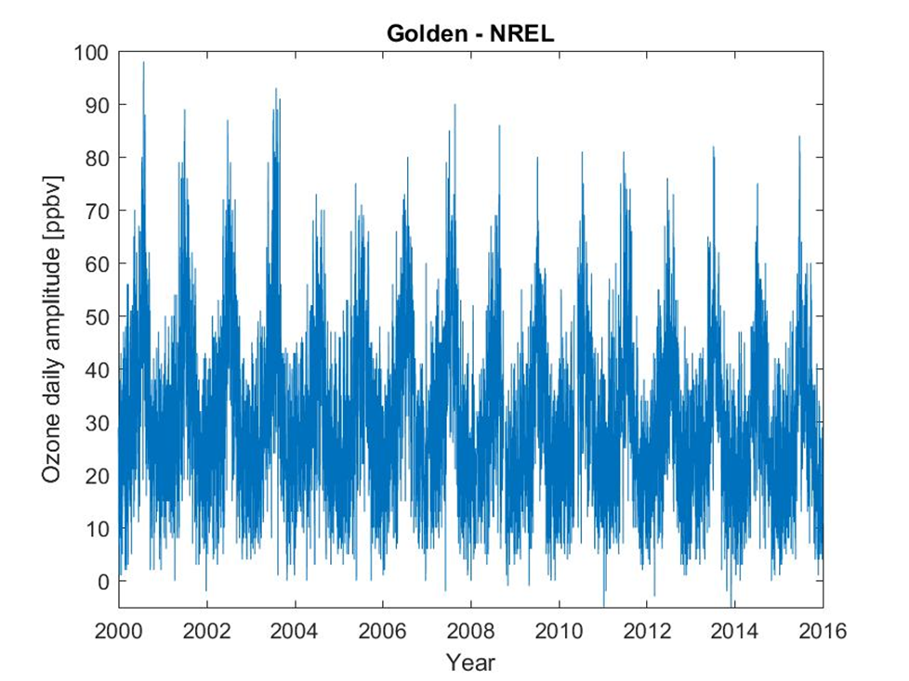
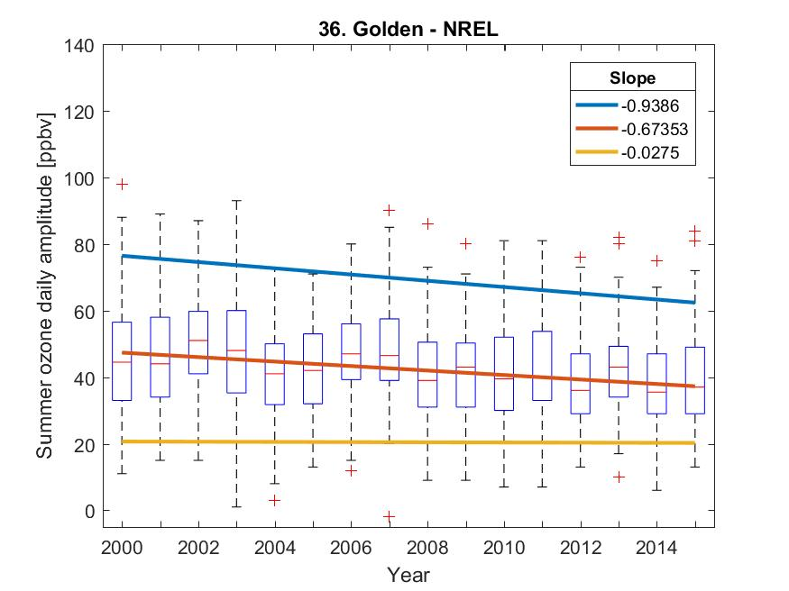
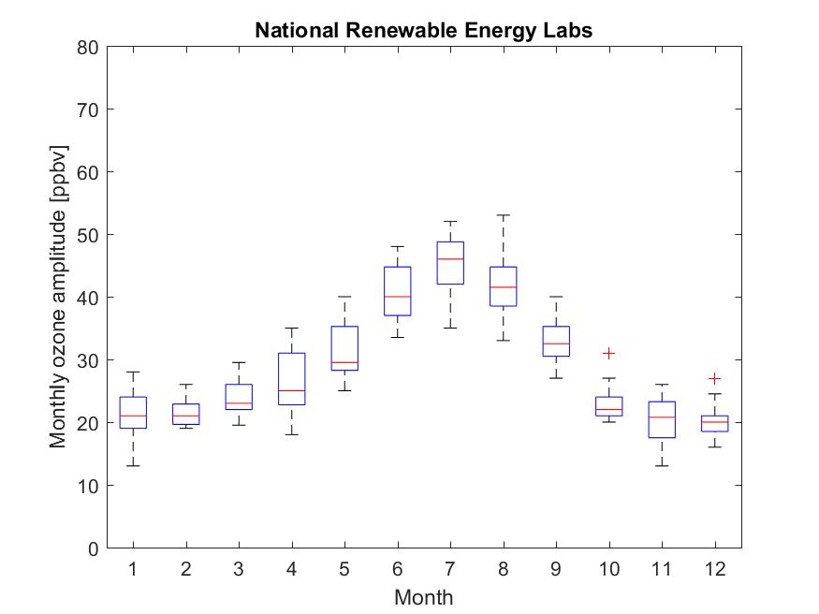
All Year
Summer
Seasonal Changes of Ozone Diurnal Amplitude
Denver Ozone Workshop, Mar 28-29, 2017 Slide 8 of 14

Slide 10
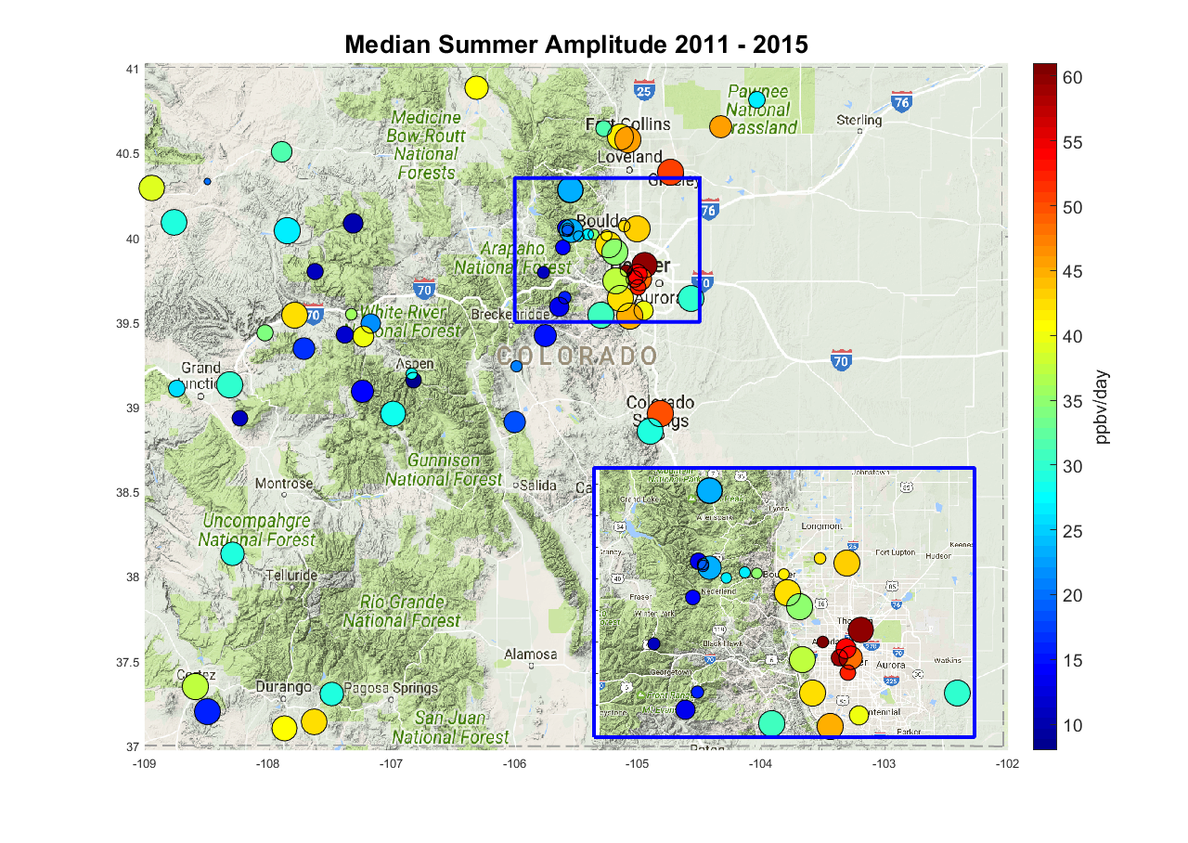
Medium Summer Ozone Diurnal Amplitude 2011 - 2015
(Circle size scales with years of available data.)

Slide 11
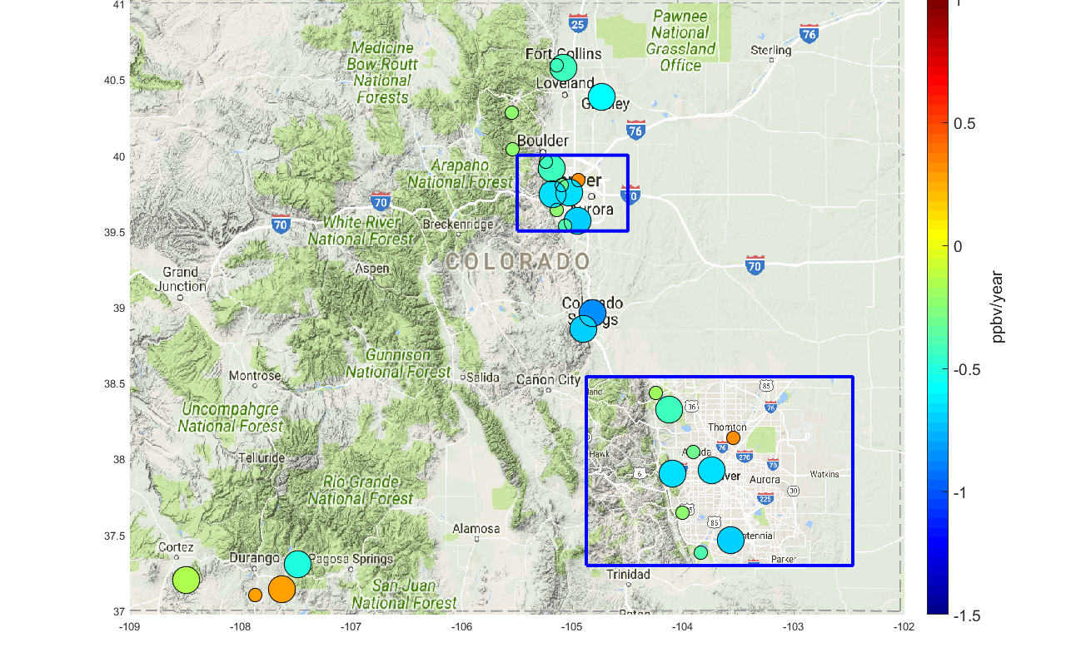
2000 – 2015 Medium Summer Ozone Diurnal Amplitude Changes
stat. significant trend
statistically not significant change

Slide 12
Summary (I)
Colorado Rural/Background/Reference Site Trends:
Neutral/slightly negative ozone trends
(similar to mid to eastern US)
Colorado High Elevation Site Trends:
95th-%ile: -0.48 ± 0.11 ppb yr⁻¹
Median: -0.33 ± 0.28 ppb yr⁻¹
(compare with + 0.41 ± 0.27 ppbv yr⁻¹ between 1995-2011 (spring) at Western US (Cooper et al., 2012)

Slide 13
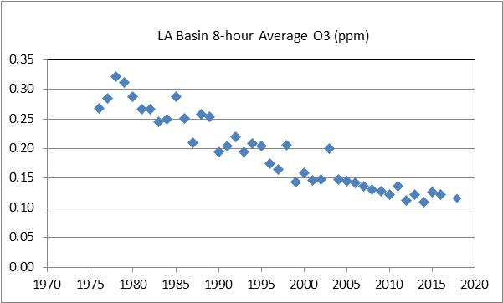
Summary (II)
Denver Metro Area Site Ozone Trends:
- Clear evidence for NOx reductions (positive lower percentile ozone trends, reduction in diurnal ozone amplitudes)
Ozone Trends: 95th-%ile: -0.01 ± 0.34 ppb yr⁻¹
Median: 0.29 ± 0.41 ppb yr⁻¹
(compare with –2.8% in LA/Southern Cal.; similar in Baton Rouge, Houston, El Paso,, and Dallas-Fort Worth )
-> No obvious reduction in high end ozone/Design Value/NAAQS Exceedance
Oil and Natural Gas Influence:
- Very clear indication that sites in/near oil and gas development areas are deviating from rural/high elevation/DMA sites: experiencing increasing ozone, increasing diurnal production

Slide 15
Changes in ozone vary substantially by site location in Colorado
Summer 5/50/95%-ile ozone increases seen at most sites
BUT decreases seen in diurnal ozone amplitudes
Sign for reductions in NOx, consistent with inventories and NOx observations
SW CO sites and Welby in developing oil and natural gas basins deviate from urban sites, showing increasing upper percentile ozone and diurnal amplitudes, indicative of increasing ozone production
-> see next slide
Ozone chemistry is changing, but not yielding much improvement in summer high percentile ozone values (Design Value)
How successful have NOx reductions been for lowering ozone?
Are gains in NOx outpaced by increases in VOC?
What are changes in ozone transport (probably not much, most trends seem to be driven by local emission changes)?

Slide 16
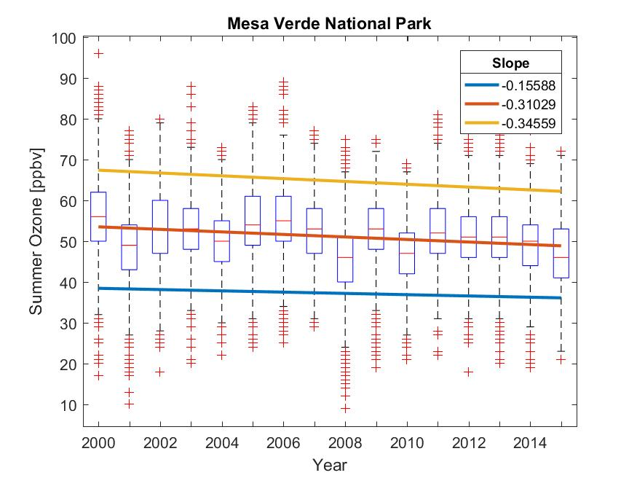
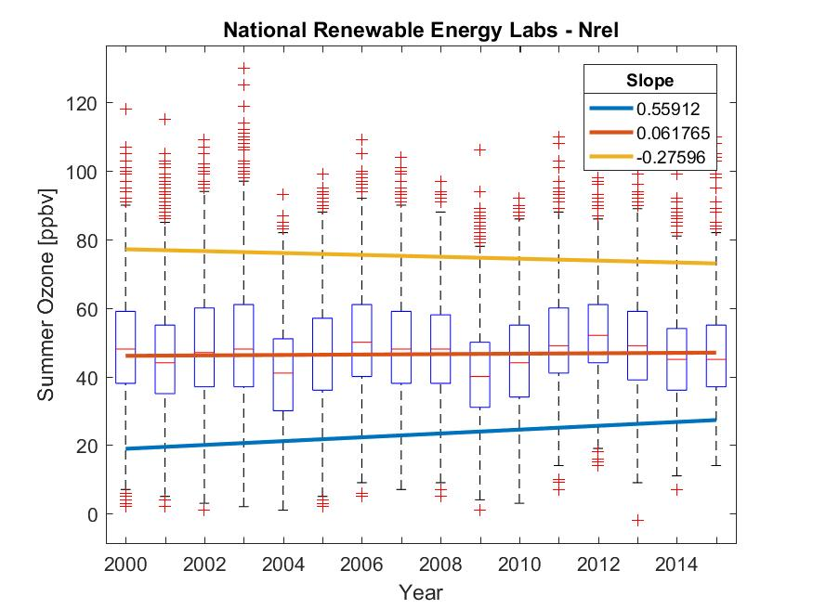
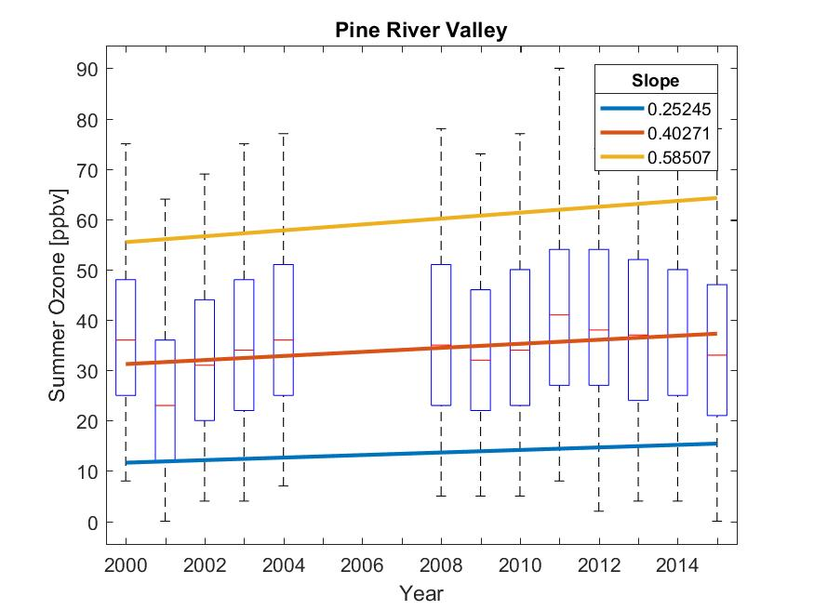
Case Study Sites Summer Months (JJA) Ozone 5/50/95 Percentile Trends
Background Ozone Workshop, Mar 28-29, 2017 Slide 6 of 14

Slide 17
Extra Slides

Slide 18
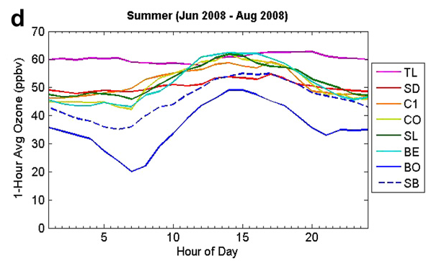
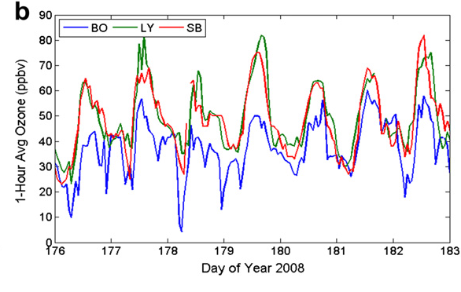
Comparison with 2008 Study
Brodin M., Helmig D., and Oltmans S.J. (2010) Seasonal ozone behavior along an elevation gradient in the Colorado Front Range Mountains. Atmos. Environ., 44, 5304-5315.
FRAPPÉ/DISCOVER-AQ Science Team Meeting: Surface Observations of Ozone Along an Elevation Gradient in the Northern Colorado Front Range During FRAPPÉ Slide 14 of 15

Slide 19
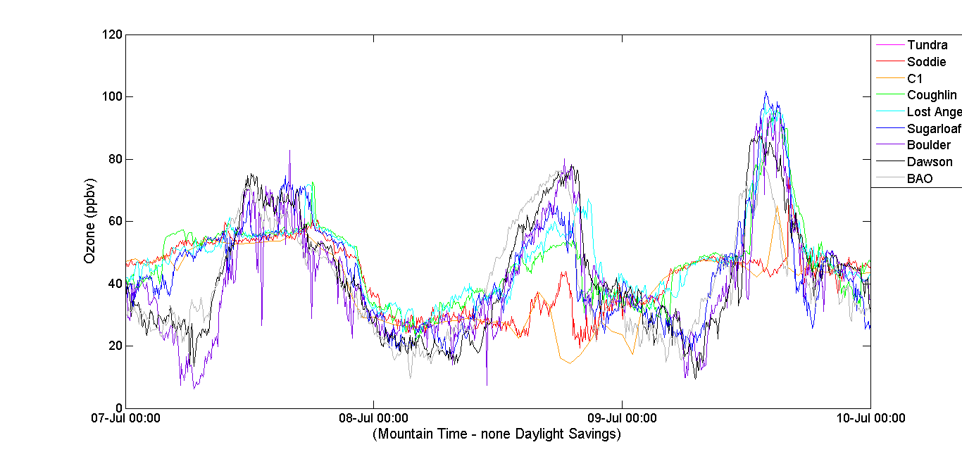
July 7 - 10
*
FRAPPÉ/DISCOVER-AQ Science Team Meeting: Surface Observations of Ozone Along an Elevation Gradient in the Northern Colorado Front Range During FRAPPÉ Slide 8 of 15

Slide 20
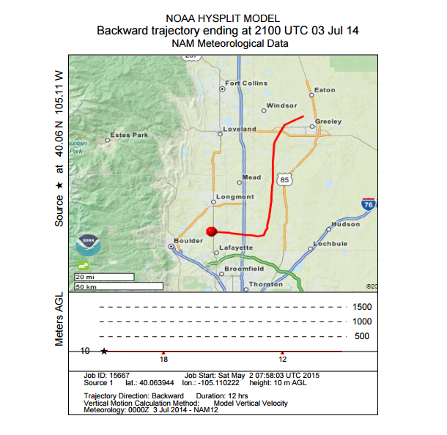
FRAPPÉ/DISCOVER-AQ Science Team Meeting: Surface Observations of Ozone Along an Elevation Gradient in the Northern Colorado Front Range During FRAPPÉ Slide 7 of 15

Slide 21
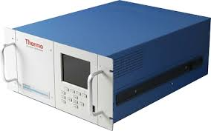
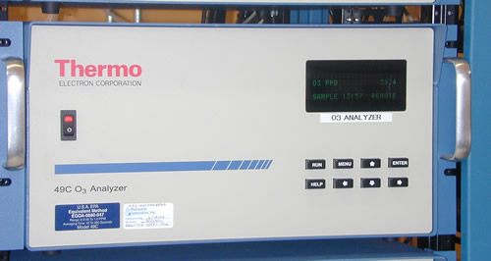
Ozone Monitoring and Data Quality Control
Continuous monitoring using UV absorption instruments (TEI 49C, TEI 49i)
All instruments calibrated before field deployment against NOAA GMD standard
One site calibration check with TEI 49i transfer standard
All instruments checked in the lab after experiments
Drifts/Changes < 1%
1-min data acquisition, logged at 5 min
Uncertainty of 5 min data estimated at ≤ 1.5 ppbv
FRAPPÉ/DISCOVER-AQ Science Team Meeting: Surface Observations of Ozone Along an Elevation Gradient in the Northern Colorado Front Range During FRAPPÉ Slide 4 of 15

Slide 22
Comparison with 2008 Study
Brodin M., Helmig D., and Oltmans S.J. (2010) Seasonal ozone behavior along an elevation gradient in the Colorado Front Range Mountains. Atmos. Environ., 44, 5304-5315.
FRAPPÉ/DISCOVER-AQ Science Team Meeting: Surface Observations of Ozone Along an Elevation Gradient in the Northern Colorado Front Range During FRAPPÉ Slide 15 of 15

Slide 23
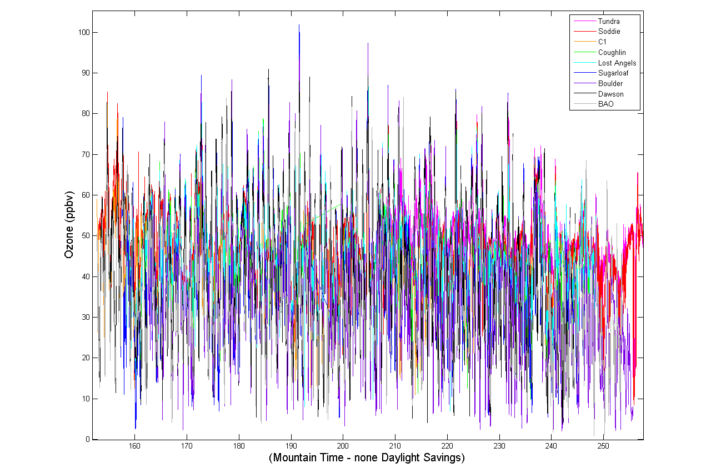
FRAPPE Surface Ozone All Sites
FRAPPÉ/DISCOVER-AQ Science Team Meeting: Surface Observations of Ozone Along an Elevation Gradient in the Northern Colorado Front Range During FRAPPÉ Slide 5 of 15

Slide 24
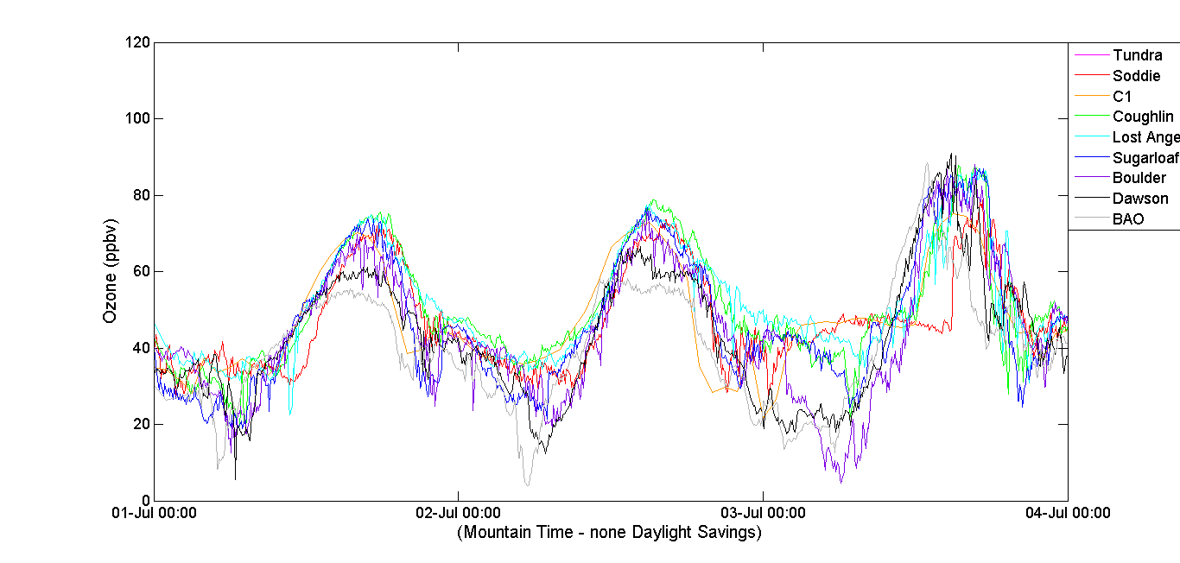
July 1 - 4
*
FRAPPÉ/DISCOVER-AQ Science Team Meeting: Surface Observations of Ozone Along an Elevation Gradient in the Northern Colorado Front Range During FRAPPÉ Slide 6 of 15

Slide 25
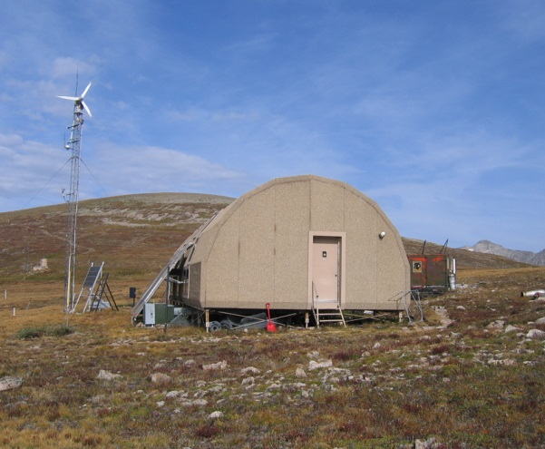
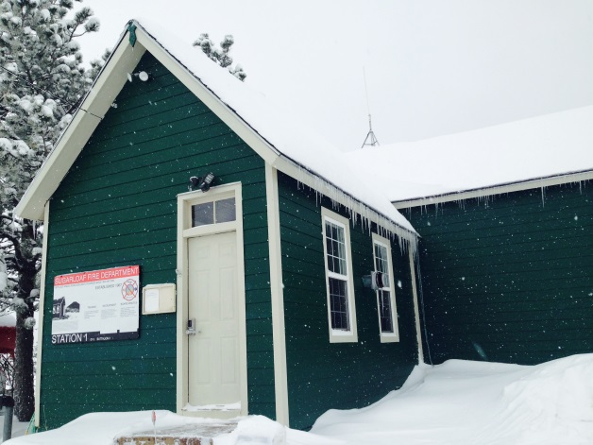
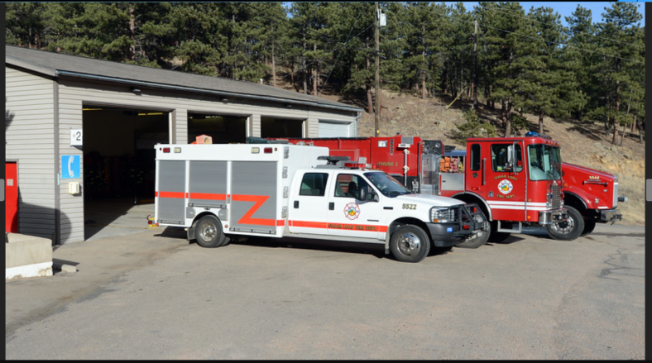
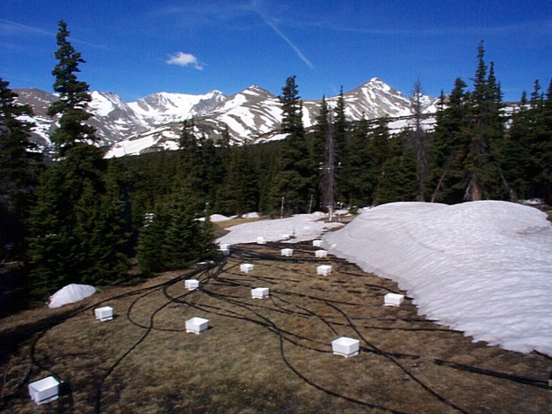
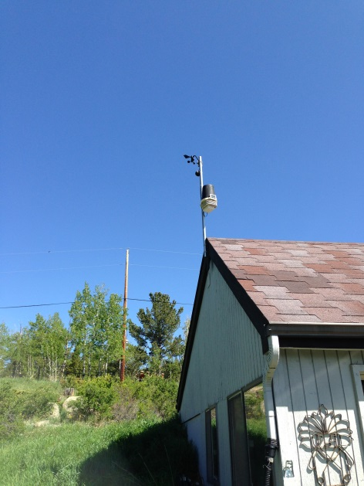
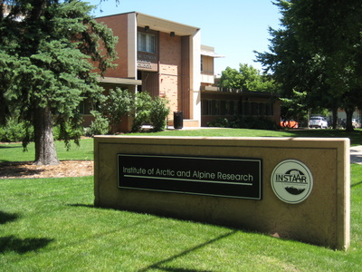
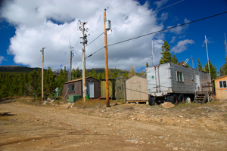
Title
Tundra Lab
Lost Angels
Sugarloaf Fire St.
Soddie
C-1
Coughlin
INSTAAR
FRAPPÉ/DISCOVER-AQ Science Team Meeting: Surface Observations of Ozone Along an Elevation Gradient in the Northern Colorado Front Range During FRAPPÉ Slide 3 of 15

Slide 26
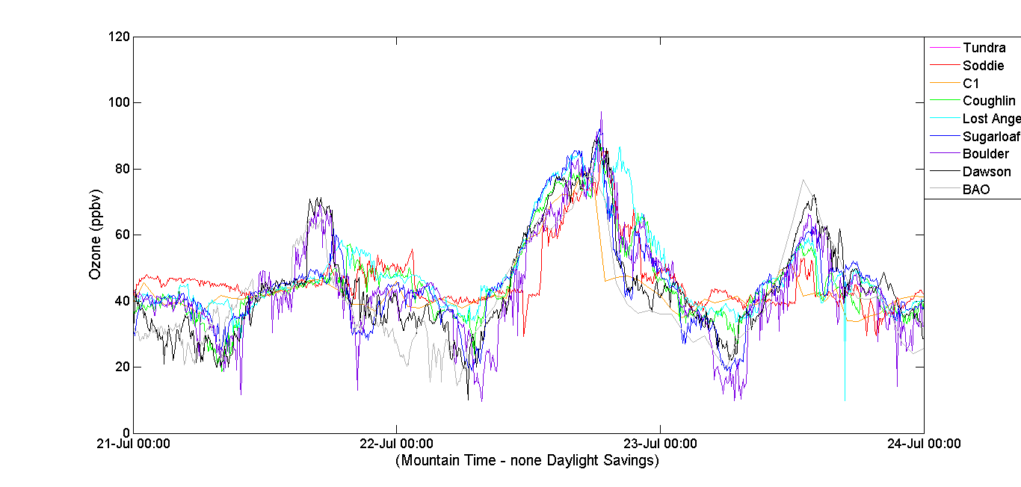
July 21 - 24
*
FRAPPÉ/DISCOVER-AQ Science Team Meeting: Surface Observations of Ozone Along an Elevation Gradient in the Northern Colorado Front Range During FRAPPÉ Slide 10 of 15

Slide 27
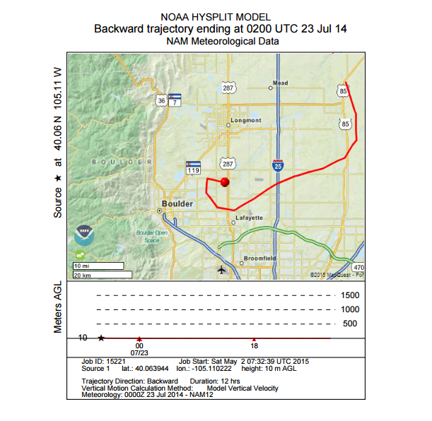
FRAPPÉ/DISCOVER-AQ Science Team Meeting: Surface Observations of Ozone Along an Elevation Gradient in the Northern Colorado Front Range During FRAPPÉ Slide 11 of 15

Slide 28
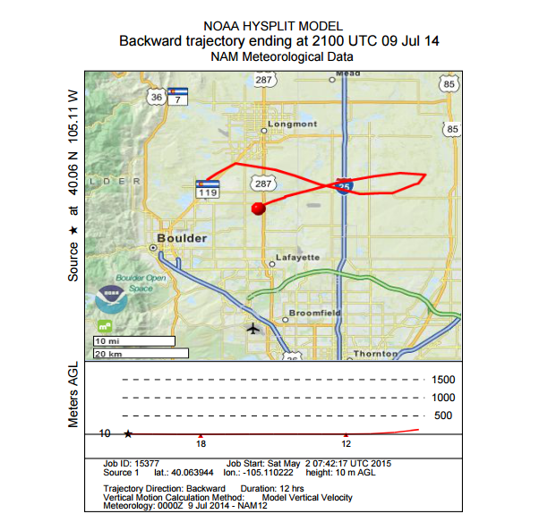
FRAPPÉ/DISCOVER-AQ Science Team Meeting: Surface Observations of Ozone Along an Elevation Gradient in the Northern Colorado Front Range During FRAPPÉ Slide 9 of 15

