Slide 1
Frequency of spatial and temporal gradients during DISCOVER-AQ:
Relevance to geostationary observations of air quality
Melanie Follette-Cook (Morgan State University/NASA GSFC), K. Pickering (U. of Maryland), J. Crawford (NASA LARC), W. Appel (EPA), G. Diskin (NASA LARC), A. Fried (U. of Colorado), C. Loughner (ESSIC/NOAA ARL), G. Pfister (NCAR),
A. Weinheimer (NCAR)
DISCOVER-AQ Science Team Meeting
May 3, 2017

Slide 2
Motivation
The Tropospheric Emissions: Monitoring of Pollution (TEMPO) instrument will be the first NASA mission to make atmospheric composition observations from geostationary orbit
We want to quantify the variability that a geostationary instrument like TEMPO would observe.
Is the resolvable variability sufficient to answer the relevant science questions for this proposed geostationary instrument?

Slide 3
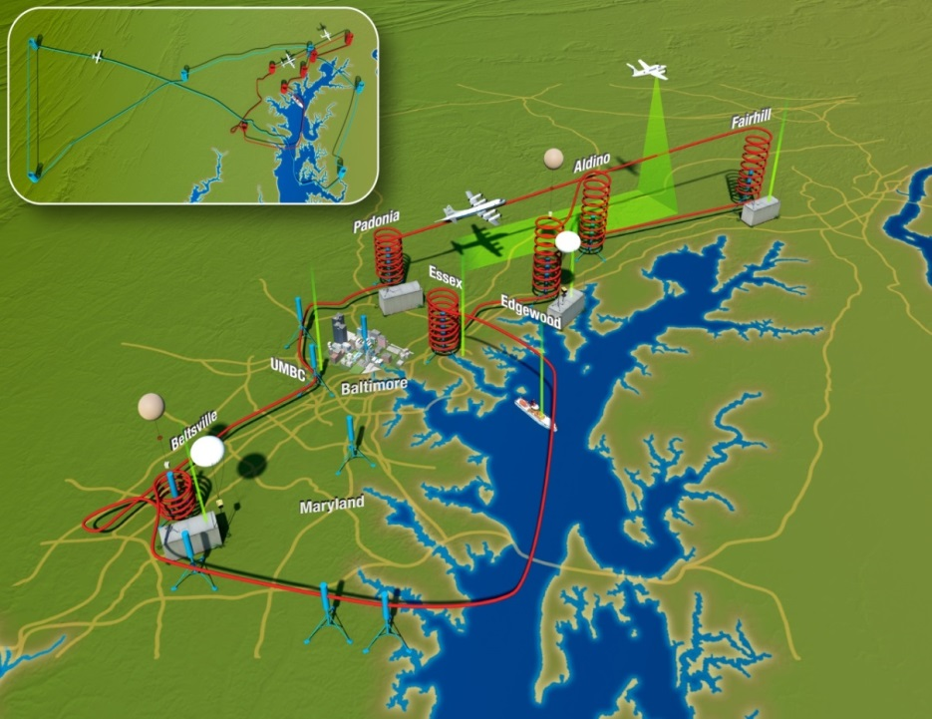
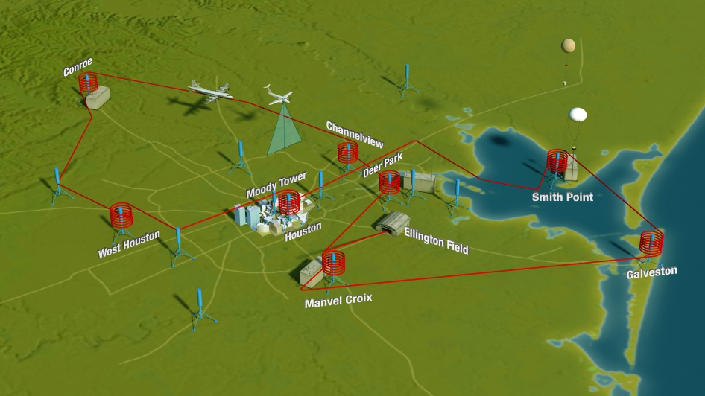
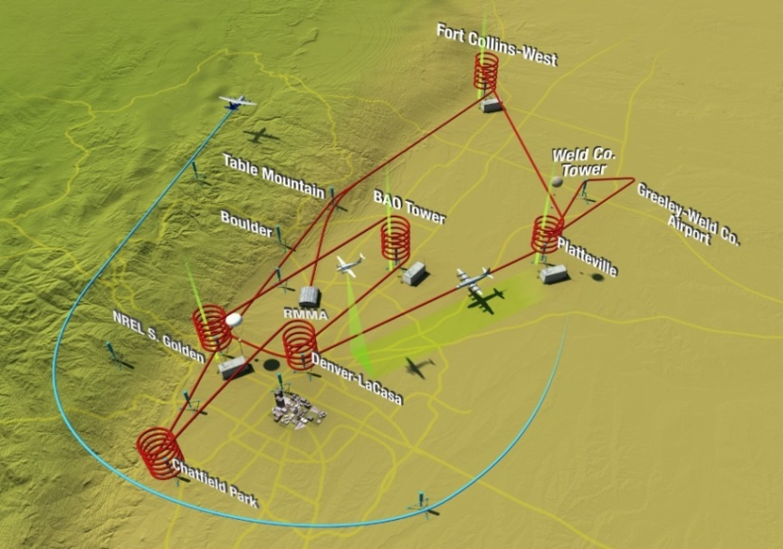
DISCOVER-AQ observations and simulations
Maryland
WRF/Chem - 4km
Follette-Cook et al. 2015
California
WRF/CMAQ - 4km
W. Appel
Texas
WRF/CMAQ - 4km
C. Loughner
Colorado
WRF/Chem - 3km
G. Pfister

Slide 4
Structure Functions
ƒ(Z, y)≡<⏐Z(x + y) - Z(x)⏐^{q}>
< > = the average of data pairs separated by distance or time y
Z = variable of interest at given location x
q = scaling exponent (here q =1)
We calculated structure functions for in-situ aircraft observations taken during each of the four DISCOVER-AQ campaigns, as well as for collocated simulation output
Though the structure function yields a mean by definition, we analyze the distributions of the trace gas differences at several separation distances

Slide 5
Do the simulations reproduce the observed variability?
O₃
Spatial
P-3B Aircraft (0 – 2 km)
Temporal
Surface observations
MD
CA
MD
CA
Simulation – Obs (ppbv)
TX
CO
TX
CO
Distance (km)
Time (hr)
25th 50th 75th 85th 95th Mean
These plots show the (simulated-observed) difference between corresponding percentiles of the simulated and observed distributions calculated using the structure function equation

Slide 6
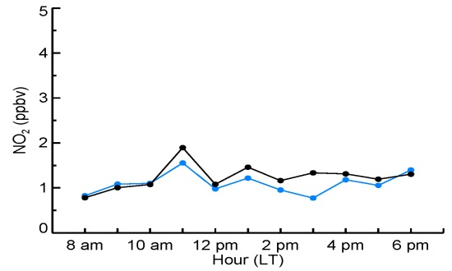
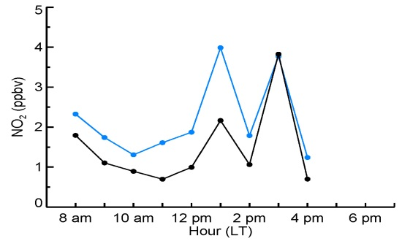
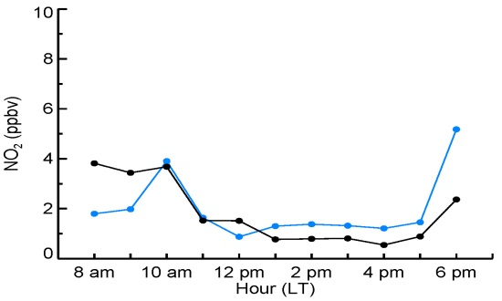
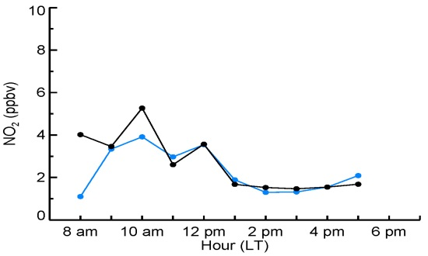
Do the simulations reproduce the observed variability?
NO₂
Spatial
Temporal
MD
CA
MD
CA
Simulation – Obs (ppbv)
NO₂ (ppbv)
CO
TX
CO
TX
Distance (km)
Hour (local time)
25th 50th 75th 85th 95th Mean
P-3B Model
Spatial: Models overestimate the spatial variability in NO₂ in MD and CO, and underestimate in TX.
Temporal: In absence of continuous true-NO₂ surface obs, we examine the simulated diurnal variability of NO₂. Diurnal changes appear to be well captured by the models.

Slide 7
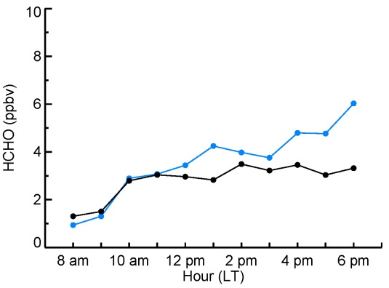
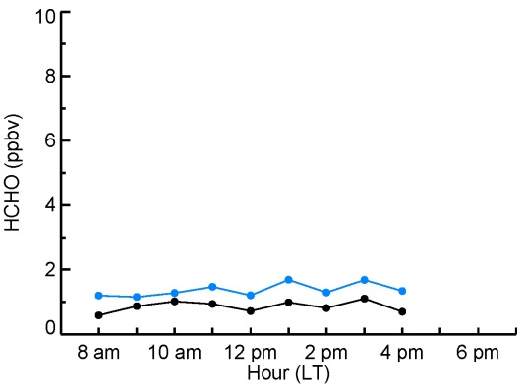
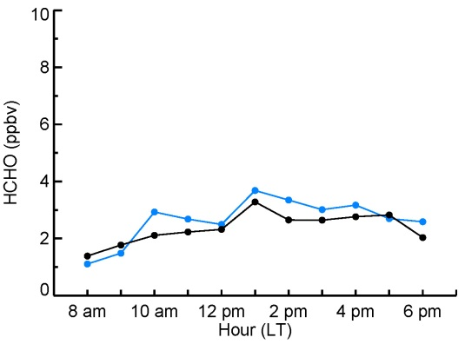
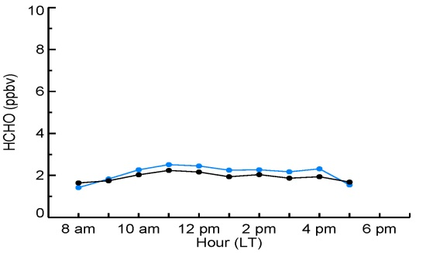
Do the simulations reproduce the observed variability?
HCHO
Spatial
Temporal
MD
CA
MD
CA
Simulation – Obs (ppbv)
HCHO (ppbv)
CO
TX
CO
TX
Distance (km)
Hour (local time)
25th 50th 75th 85th 95th Mean
P-3B Model
Spatial: All models underestimate HCHO variability during each campaign
(~ < 2 ppbv)
Temporal: All models capture observed diurnal variability in HCHO. MD simulation shows an underestimation in HCHO in the afternoon

Slide 8
Frequency of observable gradients
How often and over what spatial and temporal scales were simulated point to point differences larger than the TEMPO precision requirements?
Precision Requirements (PR) for TEMPO
Species | Altitude range | STM Precision |  | Temporal Revisit
O₃ | 0-2 km | 10 ppbv | 1.7 DU* | 2 hr
O₃ | Tropospheric column | 10 ppbv | 6.2 DU* | 1 hr
NO₂ | Tropospheric column | 1x10¹⁵ molec/cm² | 1 ppbv** | 1 hr
HCHO | Tropospheric column | 1x10¹⁶ molec/cm² |  | 3 hr
* calculated quantity
** Lok Lamsal, personal communication
TEMPO spatial resolution: 8 x 4.5 km²

Slide 9
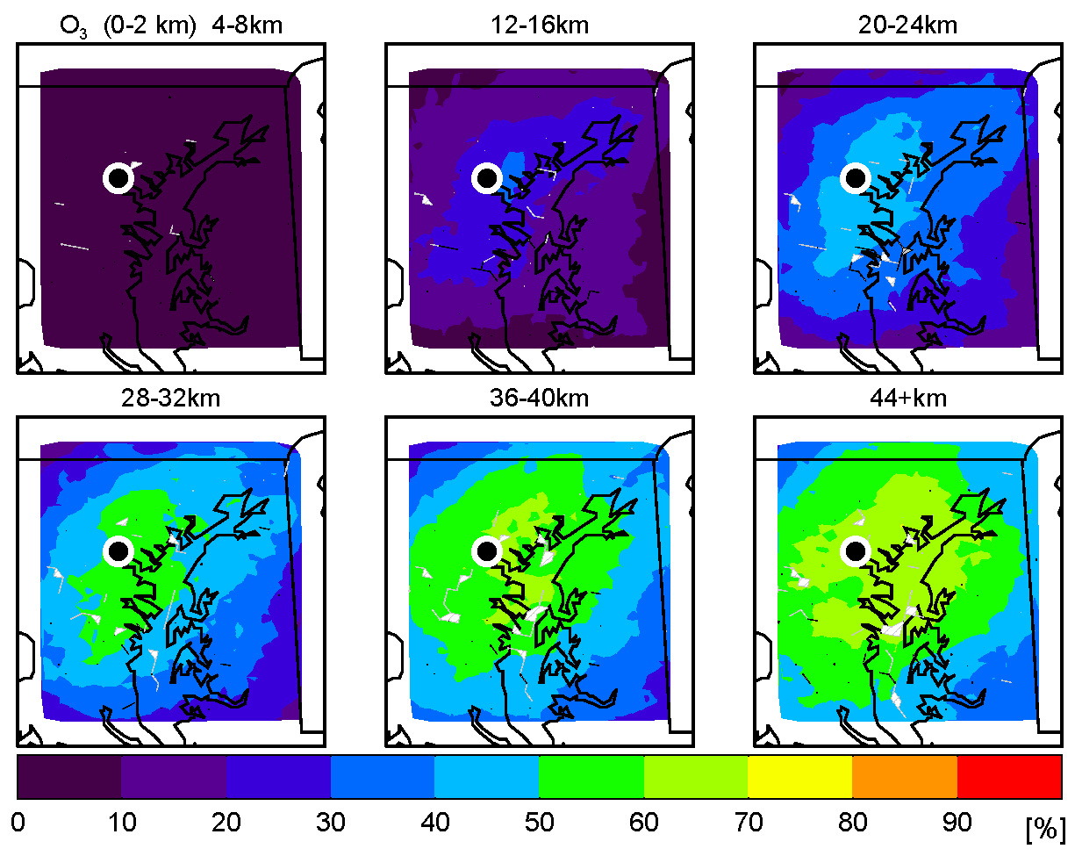
Frequency of observable spatial gradients
O₃
Maryland
Urban-to-suburban scales (12-24 km) show percentages that are likely associated with air quality events (20-40%). On urban-to-rural (40+ km) scales, percentages increase to roughly 60% of the time
Spatial gradients largest in the afternoon (after 2 pm LT) (not shown)
Baltimore

Slide 10
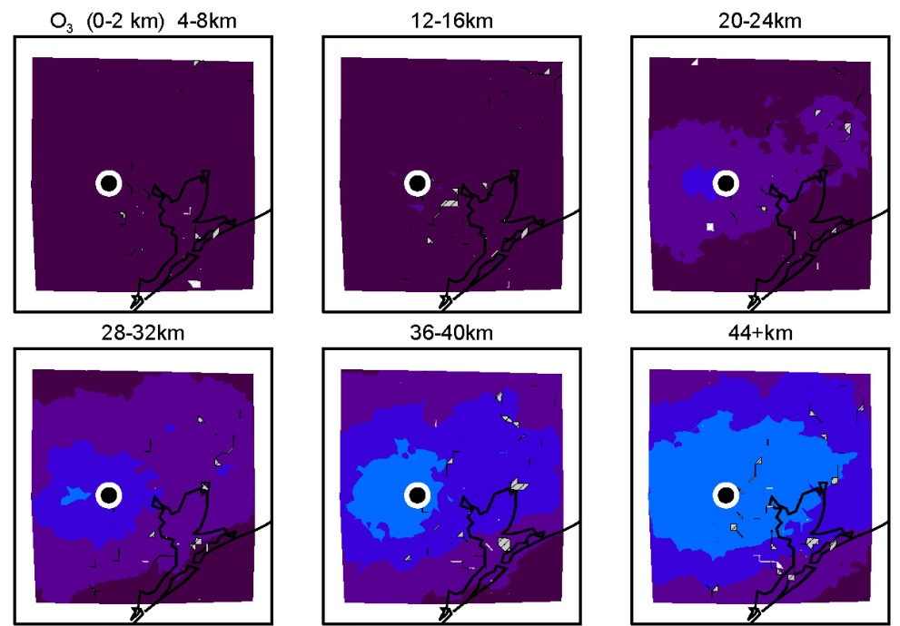
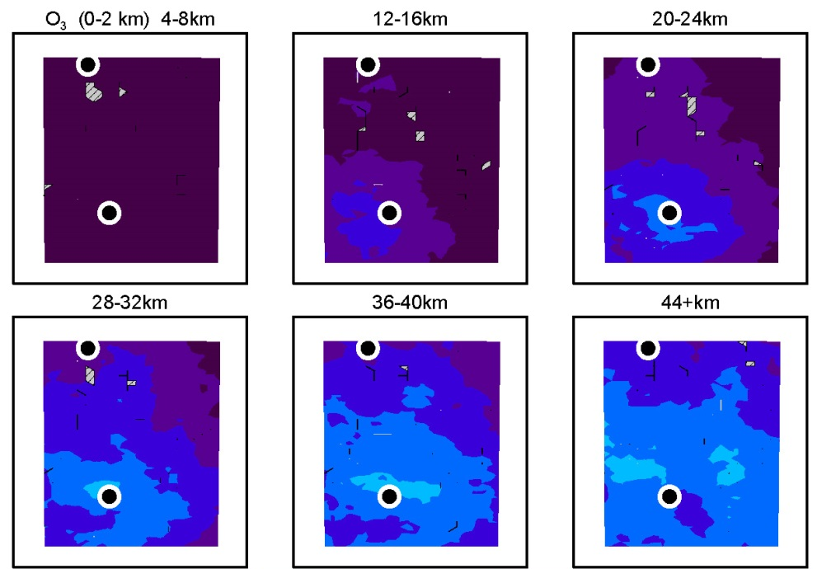
Frequency of observable spatial gradients
O₃
Texas
Colorado
Ft. Collins
Houston
Denver
TX and CO show less spatial variability than MD
Lower percentages are likely due to the relatively few air quality events observed during the two campaigns

Slide 11
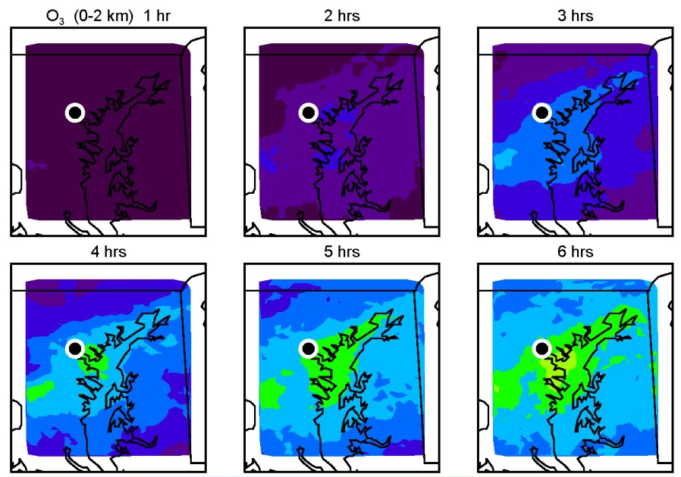
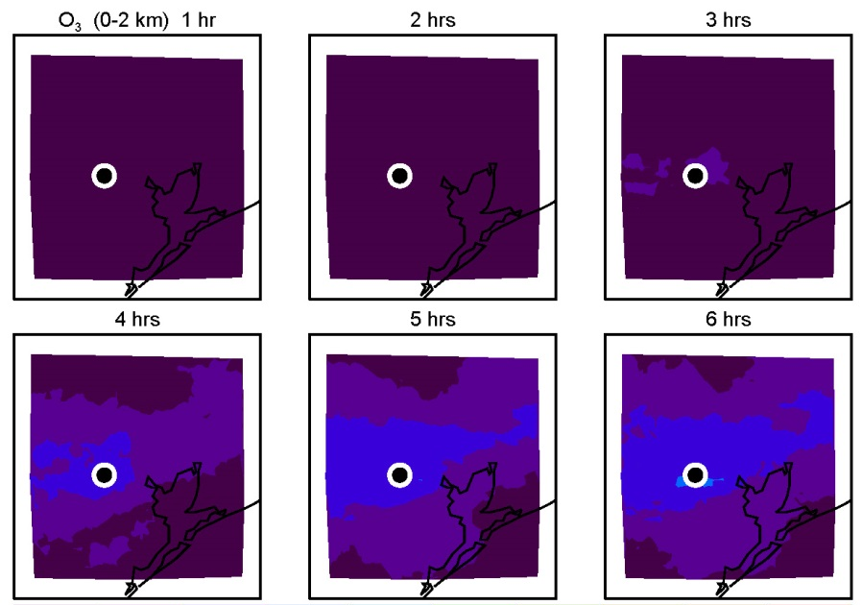
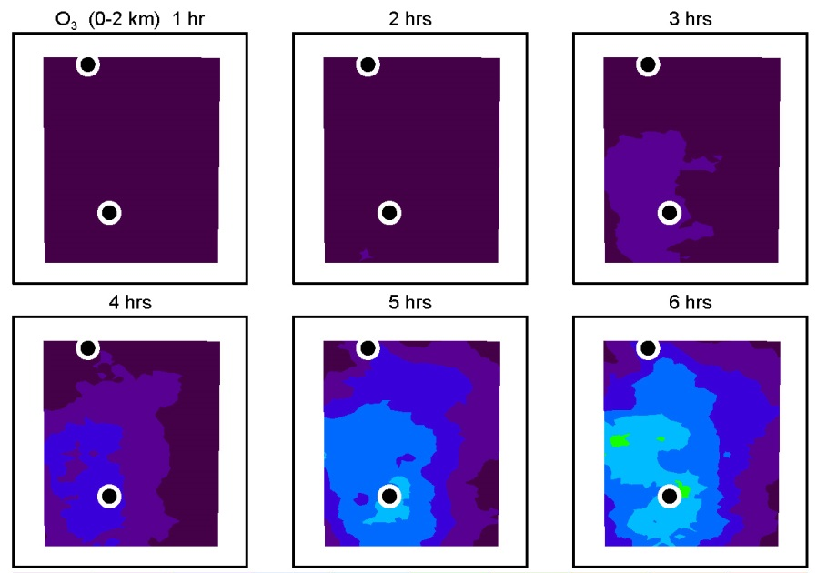
Frequency of observable temporal gradients
O₃
Maryland
Texas
Colorado
Temporal differences in O₃ are largest 6 h apart, consistent with the production of O₃ throughout the day

Slide 12
Frequency of observable spatial gradients
NO₂
Maryland
California
Fresno
Visalia
Bakersfield
Texas
Colorado
Spatial gradients over urban areas are larger than the TEMPO PR
>90% of the time
Overall, NO₂ variability appears to be well captured by the proposed precision requirement

Slide 13
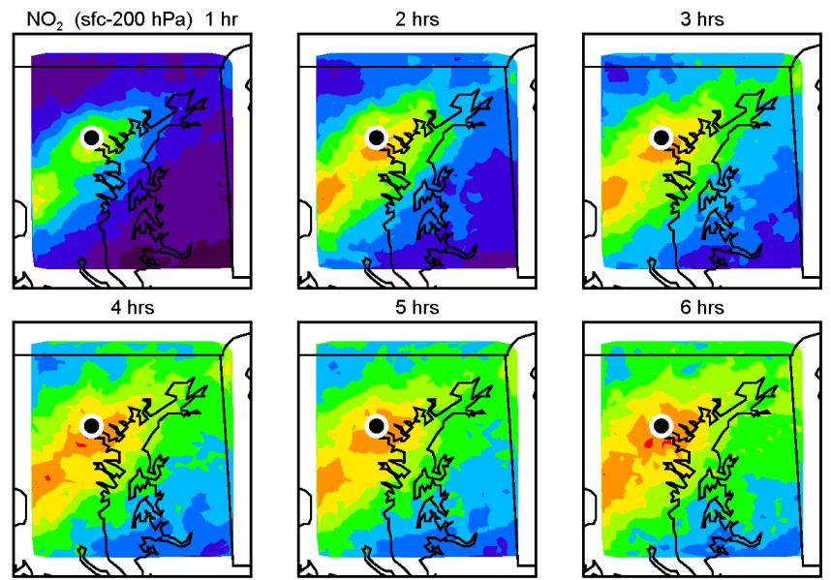
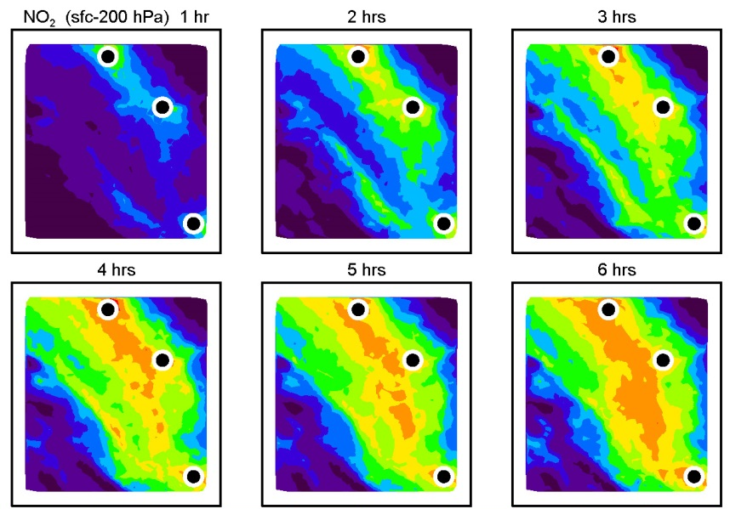
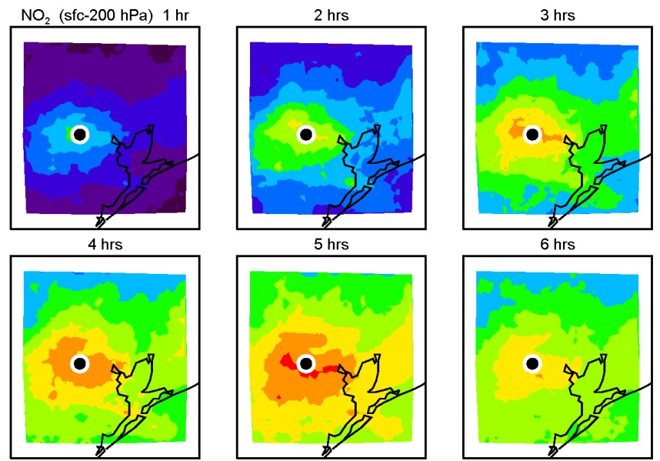
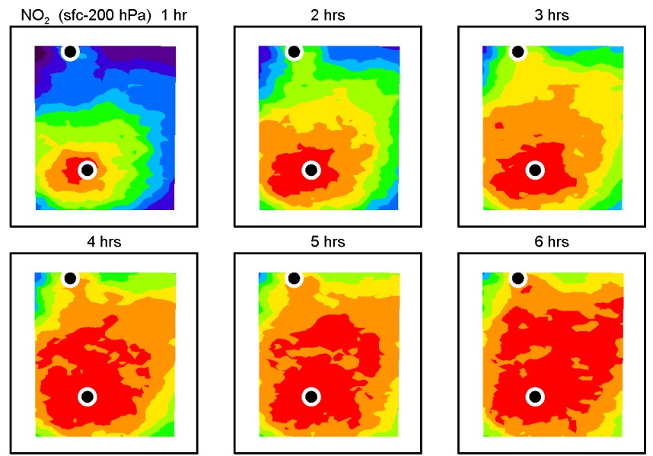
Frequency of observable temporal gradients
NO₂
Maryland
California
Texas
Colorado

Slide 14
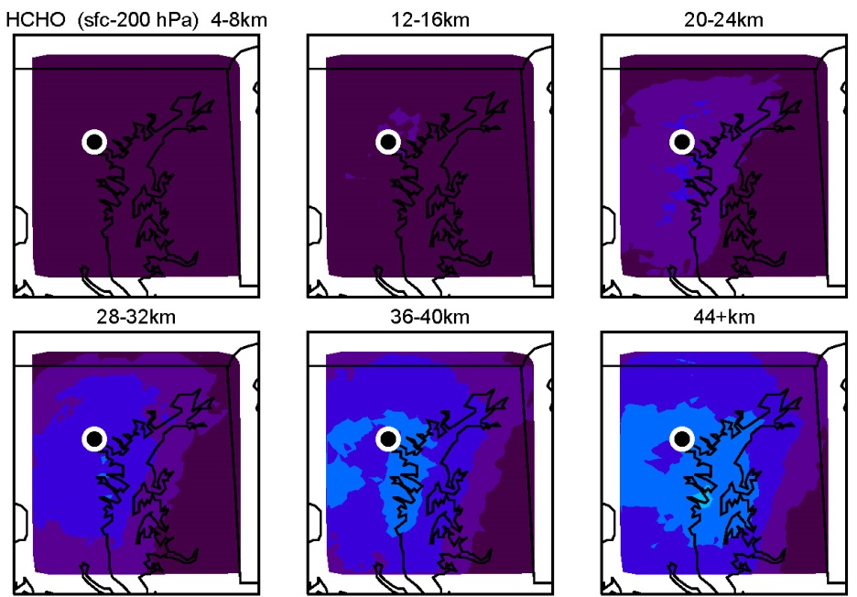
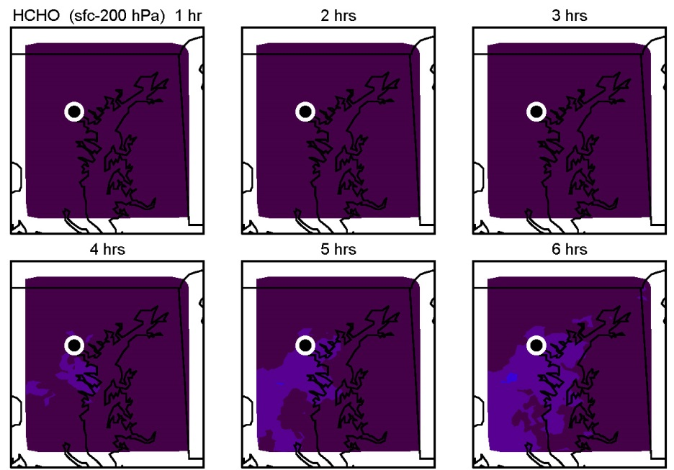
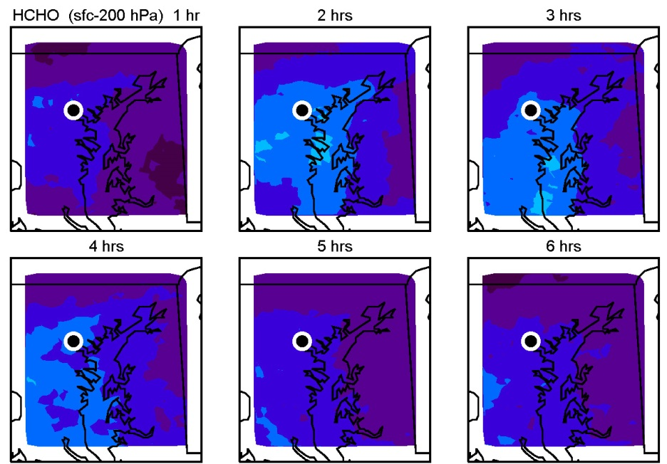
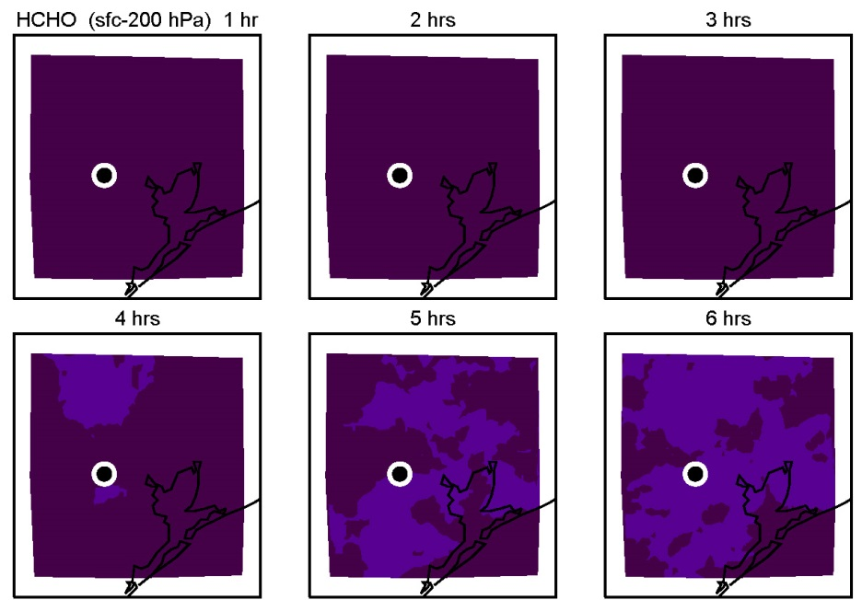
Frequency of observable spatial and temporal gradients
HCHO
Maryland
Texas
Maryland – Spatial
Maryland – Temporal
HCHO 1 day
2 days
3 days
HCHO 1 day
2 days
3 days
4 days
5 days
6 days
4 days
5 days
6 days

Slide 15
Conclusions
O₃ (0–2 km):
In MD, spatial gradients were detectable ~60% of the time for urban-to-rural scales and 20-40% of the time for urban-to-suburban
Spatial gradients in TX and CO were not as large, but both campaigns had fewer AQ events
Temporal differences in O₃ were largest 6 h apart, consistent with the production of O₃ throughout the day
NO₂ (tropospheric column):
Spatial gradients in NO₂ were visible > 90% of the time for substantial portions of each region
One-hour temporal differences in NO₂ were detectable at least 50% of the time, increasing to at least 90% for 4-5 hour differences
Overall, NO₂ variability appears to be well captured by the proposed precision requirement
HCHO (tropospheric column):
All percentages were <10% for all distances and times for the CA, TX, and CO campaigns
Each model simulation underestimated the spatial variability in HCHO, so these results should be considered a minimum with respect to observable spatial gradients in HCHO

Slide 16
Thank you!

