Slide 1
Urban Photochemistry during FRAPPE
Christopher Cantrell, Lee Mauldin, FRAPPE Science Team
University of Colorado, Boulder

Slide 2
FRAPPE/DISCOVER-AQ Collaborators
C-130: Lee Mauldin, Anondo Mukherjee, Frank Flocke, Gabriele Pfister, Eric Apel, Roya Bahreini, Donald Blake, Nicola Blake, Teresa Campos, Ronald Cohen, Delphine Farmer, Alan Fried, Alex Guenther, Samuel Hall, Brian Heikes, Scott Herndon, Rebecca Hornbrook, Greg Huey, Thomas Karl, Lisa Kaser, John Nowak, John Ortega, Daniel O'Sullivan, Dirk Richter, James Smith, David Tanner, Amy Townsend-Small, Kirk Ullmann, James Walega, Petter Weibring, Andrew Weinheimer
P-3B: Jim Crawford, Bruce Anderson, John Barrick, Ronald Cohen, Glenn Diskin, Alan Fried, Charles Gatebe, David Van Gilst, Andrew Weinheimer, Armin Wisthaler, Tara Yacovitch, Melissa Yang
Ground: Steve Brown, Edwin Eloranta, Delphine Farmer, Emily Fischer, Sam Hall, Jay Herman, Travis Knepp, Kathleen Lantz, Audra McClure-Begley, Erin McDuffie, Christoph Senff, James Smith, Nadia Smith, Anne Thompson, James Hannigan, Rainer Volkamer, Mark Zondlo, Jeff Collett, Owen Cooper, Barkley Sive
Models/Merges: Gao Chen, Louisa Emmons, Gabriele Pfister, RaJesh Kumar, Brad Pierce, Lee Thornhill

Slide 3
Topics
Analysis of FRAPPE airborne observations
Constrained steady state model and MCM model for comparison
Contributions of sources and types of VOCs to photochemistry
Effects of oil and gas exploration and extraction (O&GEE) on HO_{x} and O₃ amounts and production

Slide 4
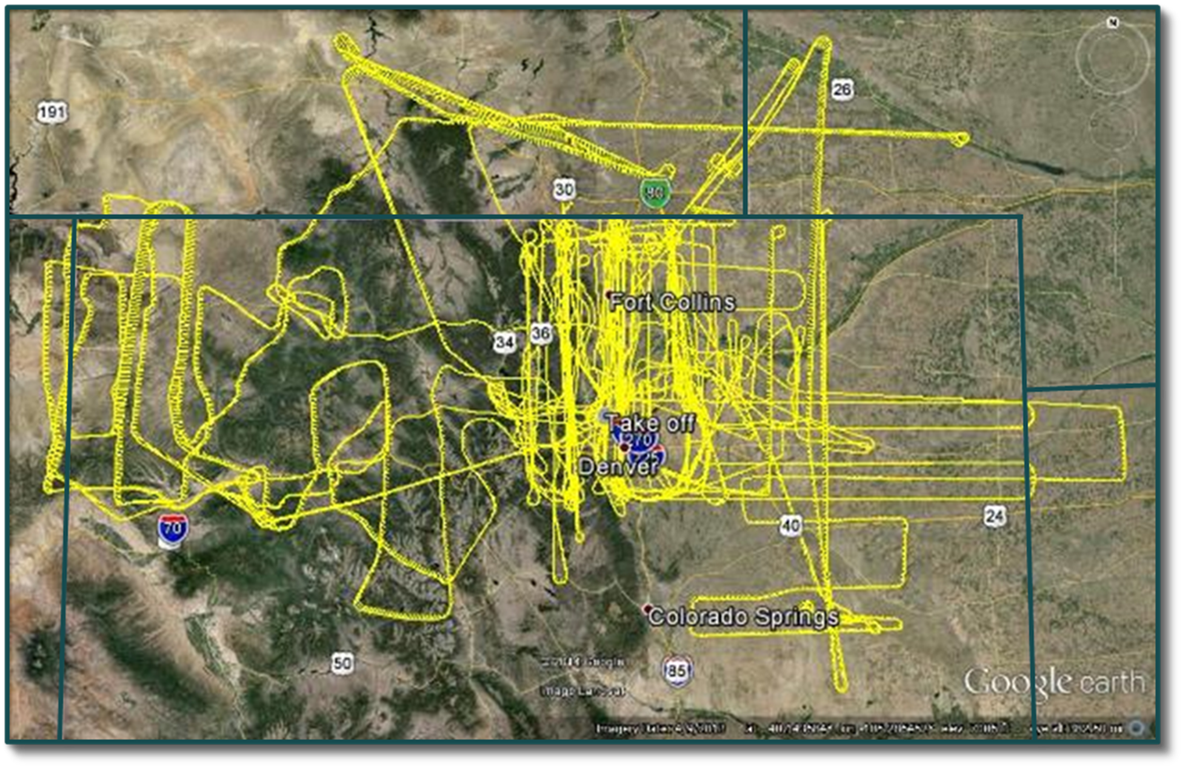
C-130 Flight Tracks - FRAPPE
NSF/NCAR C-130 Flight Tracks during FRAPPE
26 July – 18 August 2014, Broomfield, CO

Slide 5
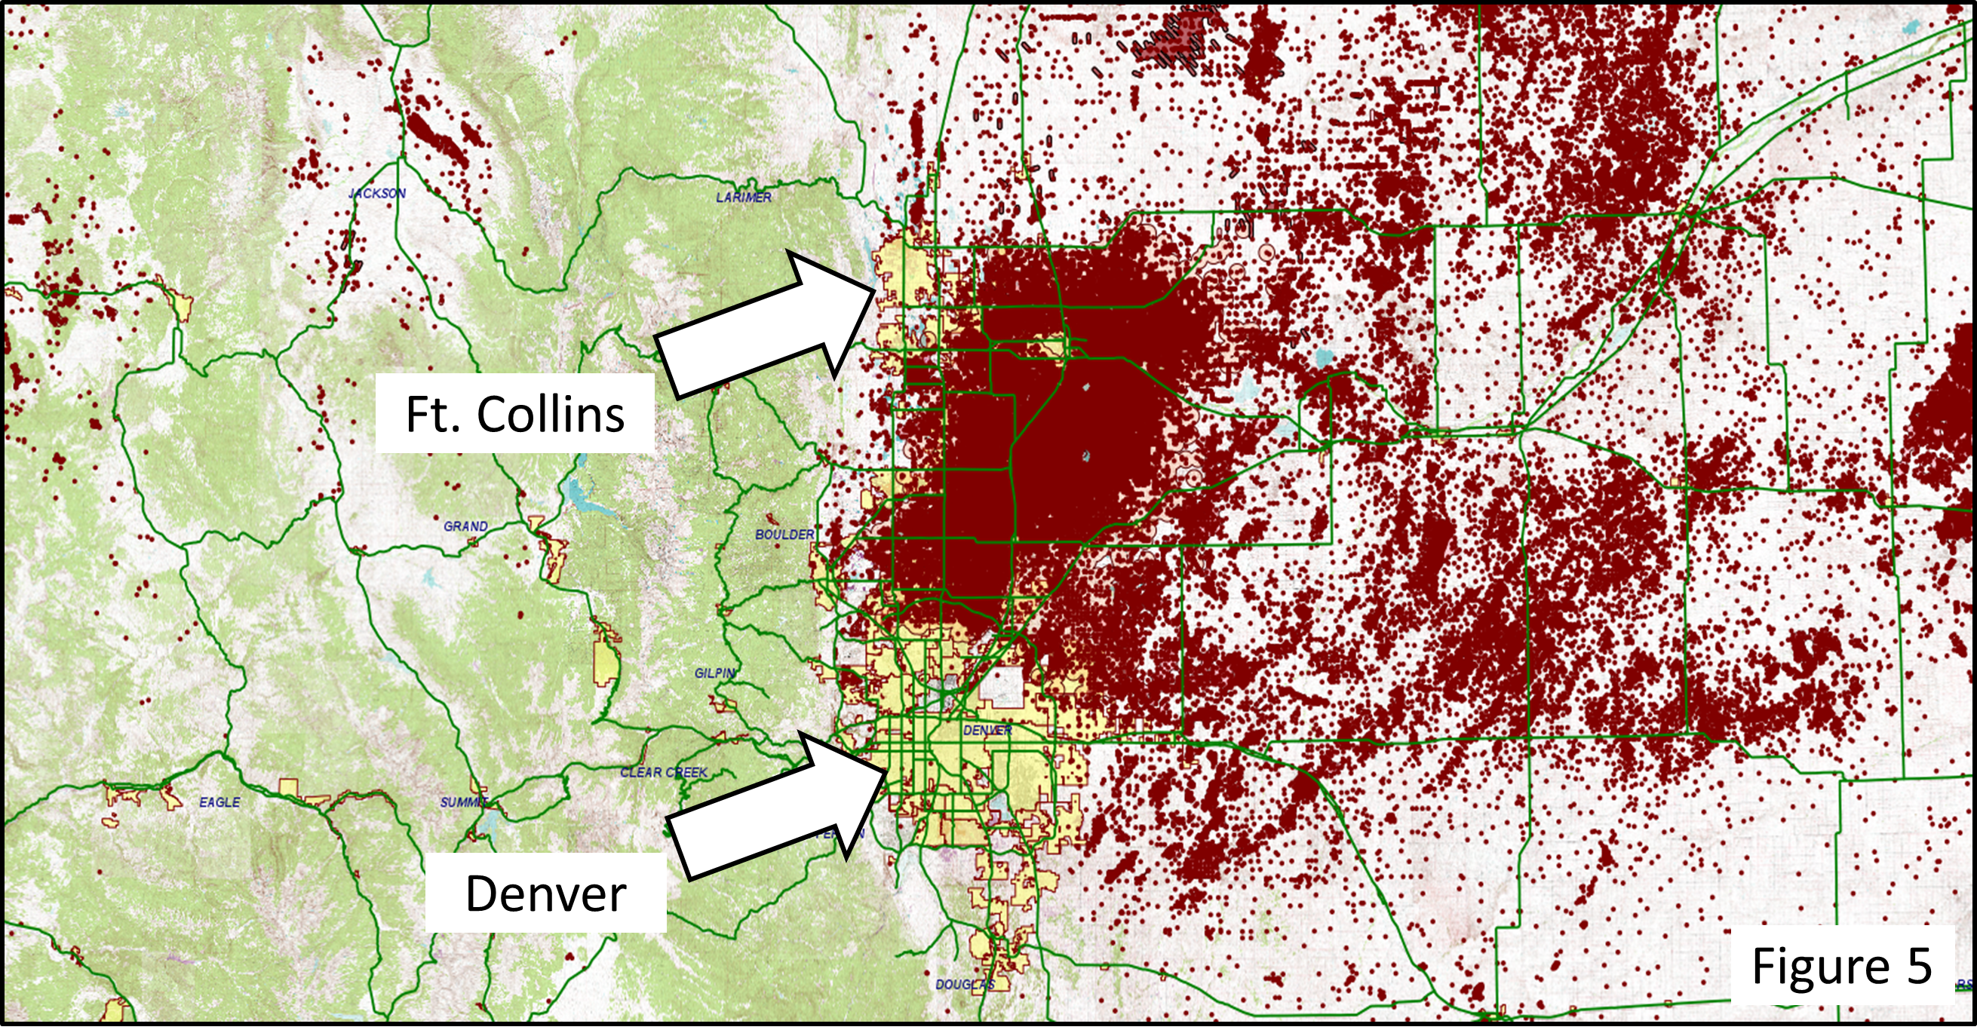
Oil & Gas Wells in Northeast Colorado

Slide 6
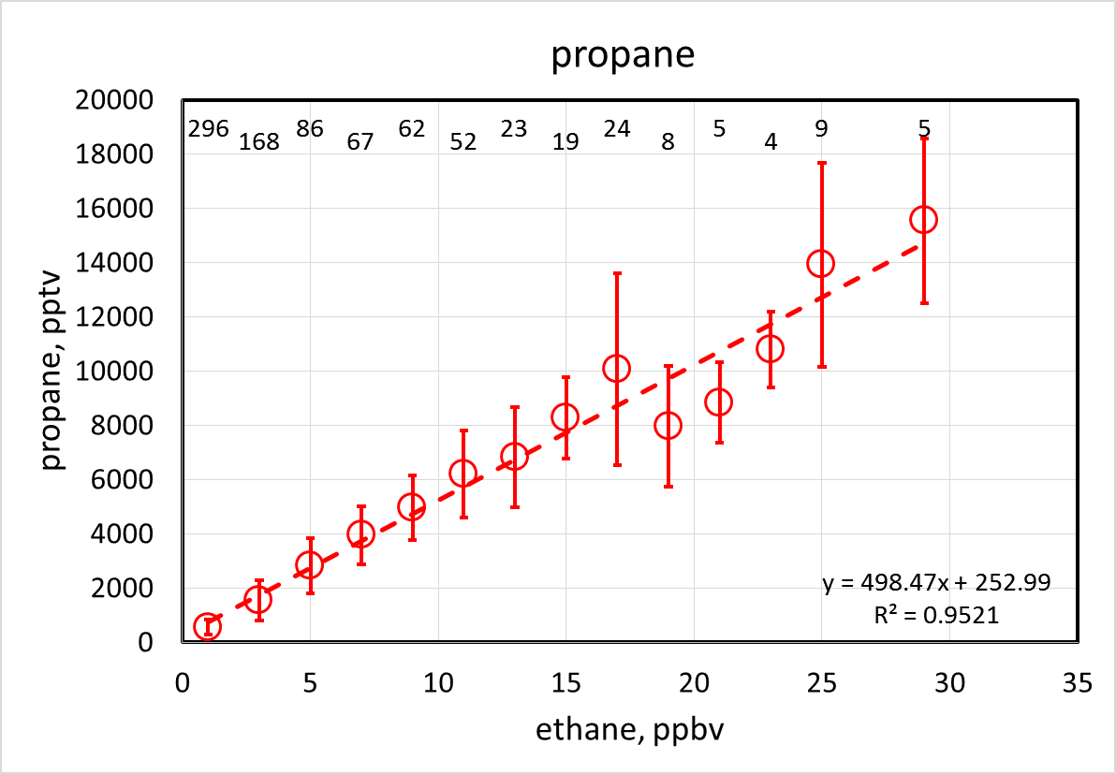
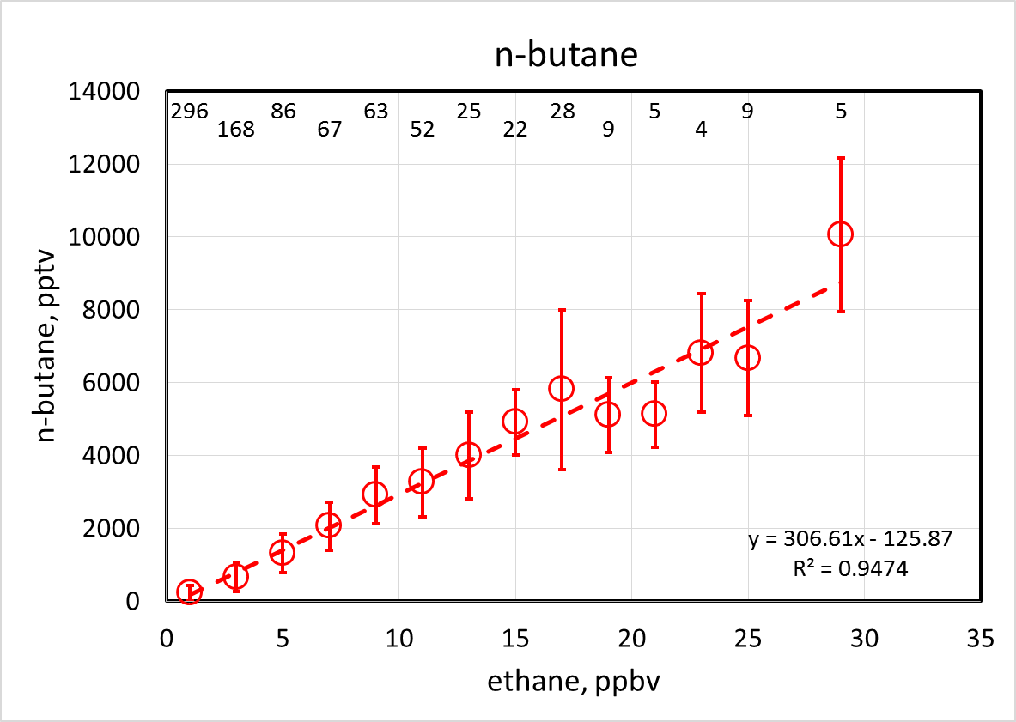
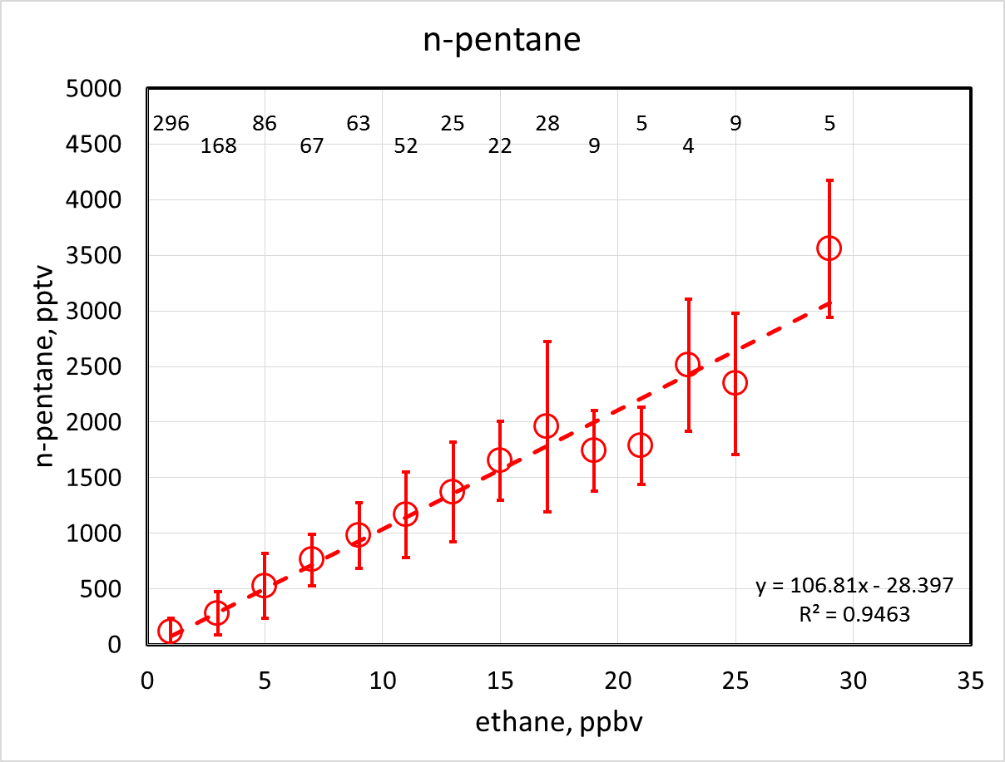
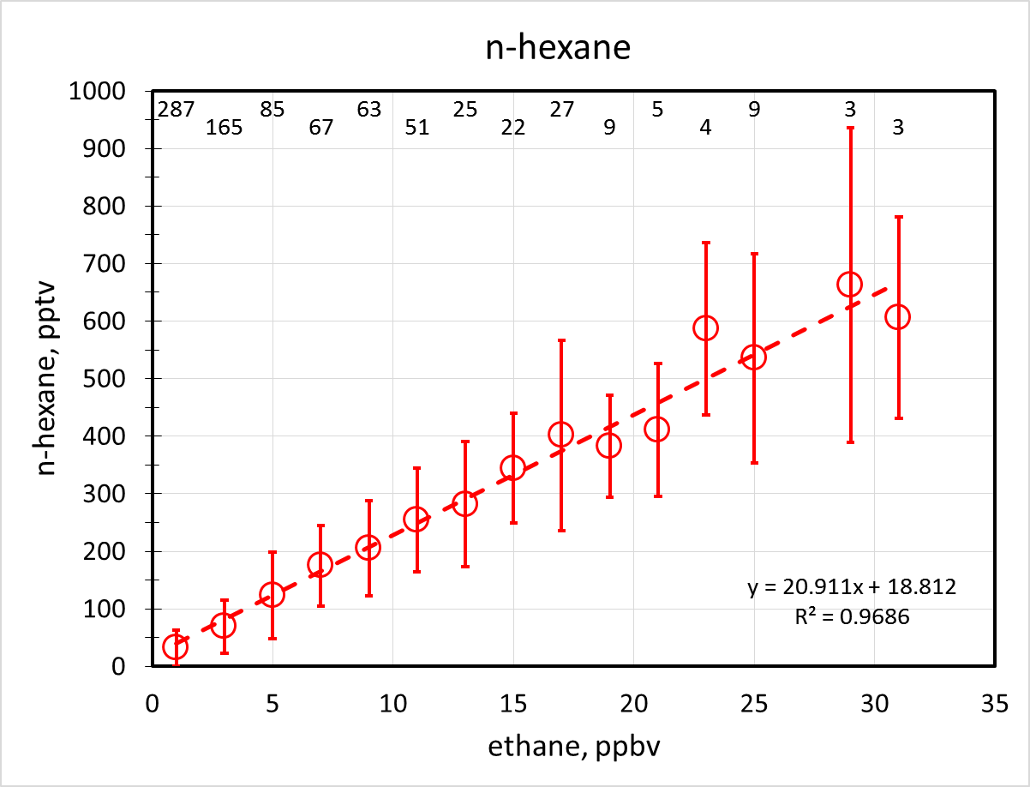
C₃-C₆ alkanes vs ethane (urban box)

Slide 7
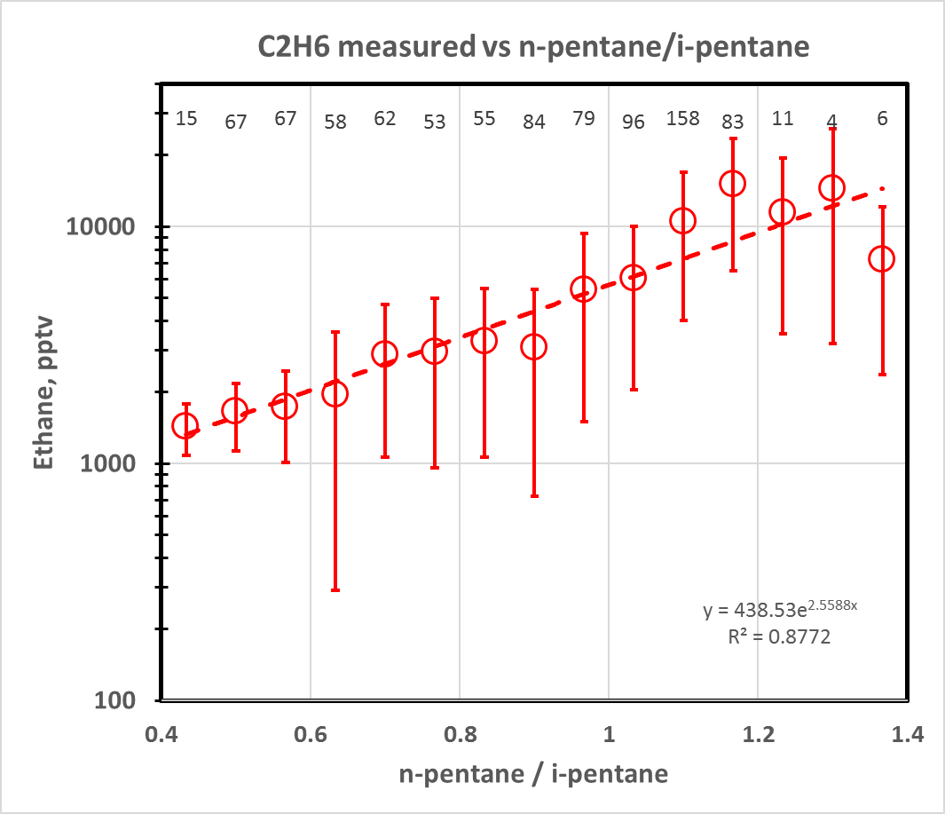
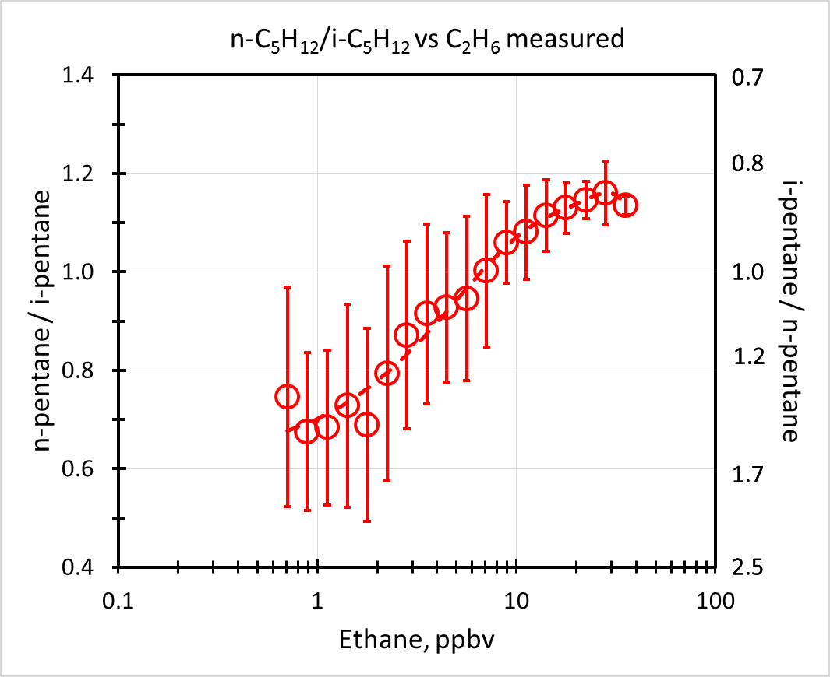
n-pentane / i-pentane vs ethane
Vehicles/Urban
O&GEE
Raw natural gas
Urban Box
Raw natural gas
O&GEE
Vehicles/Urban

Slide 8
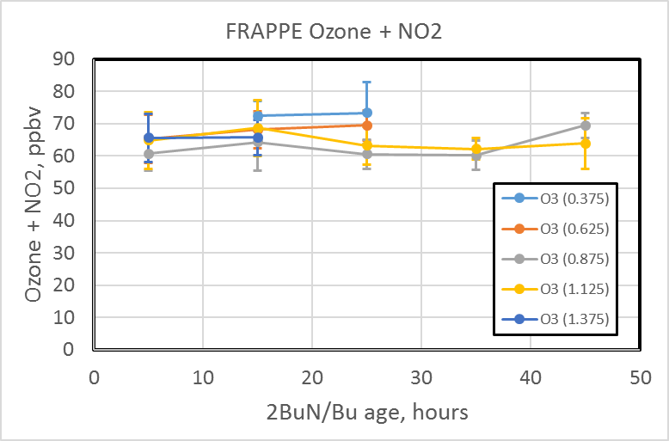
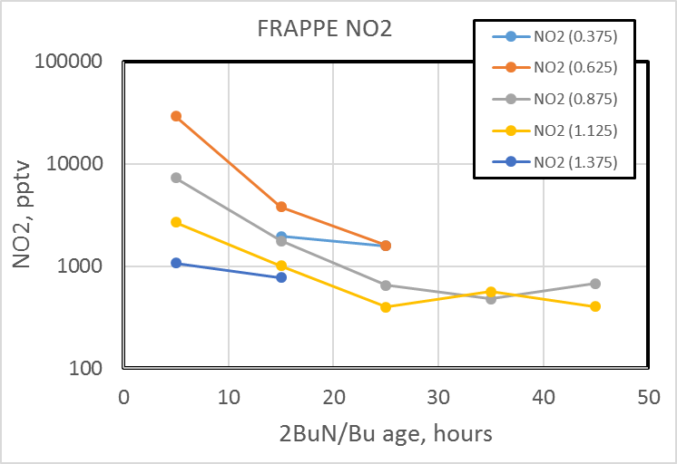
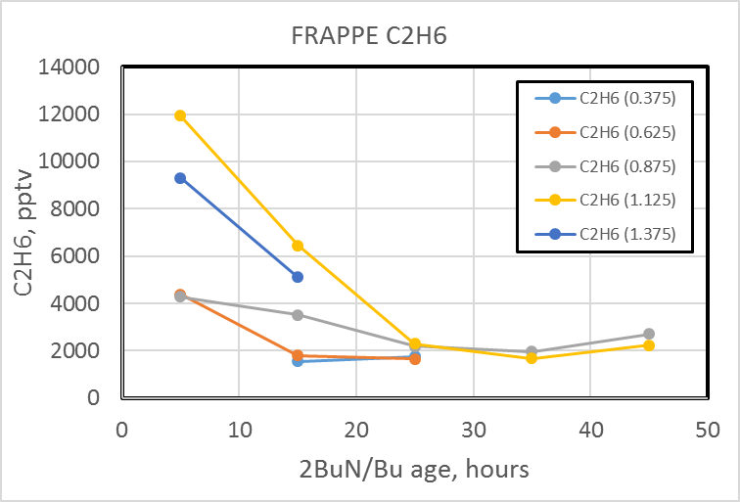
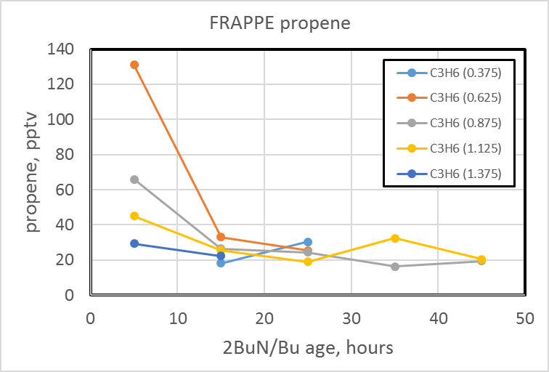
Observed Trace Gas Levels Binned

Slide 9
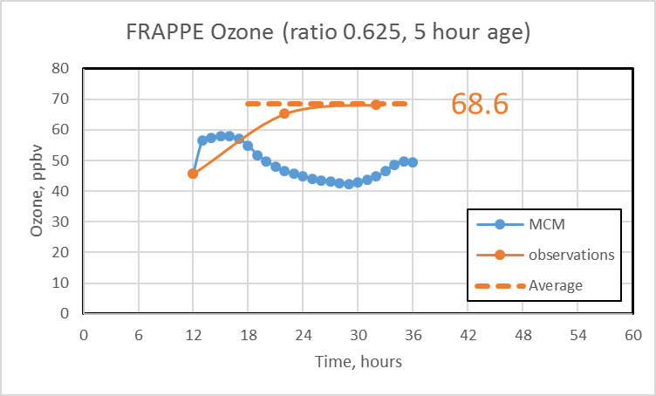
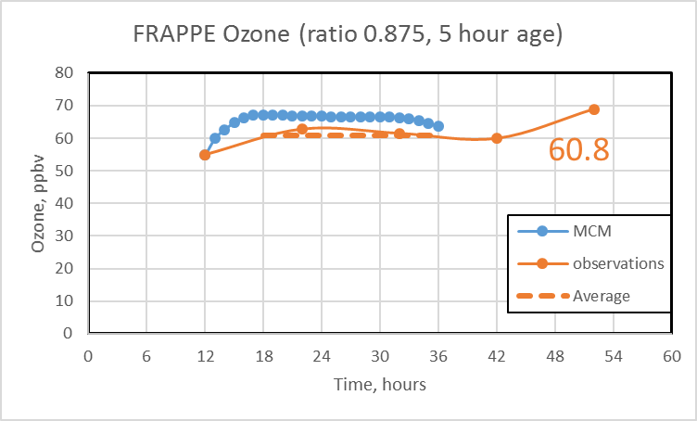
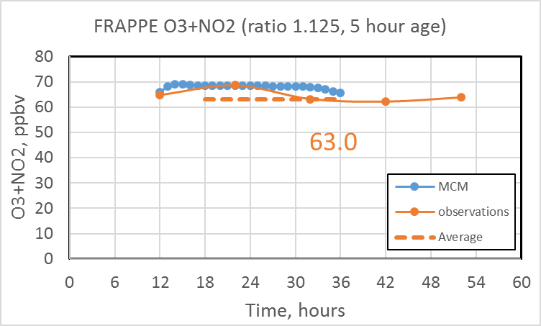
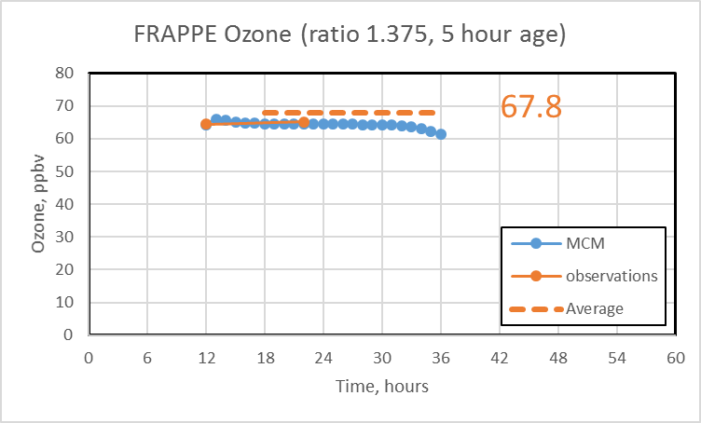
Ozone Observations & MCM Model

Slide 10
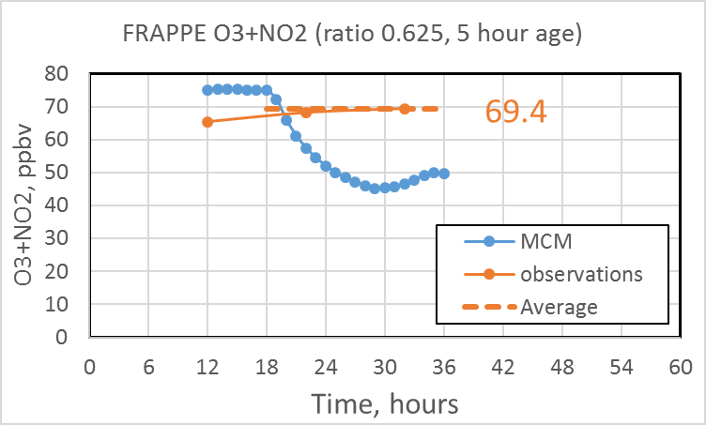
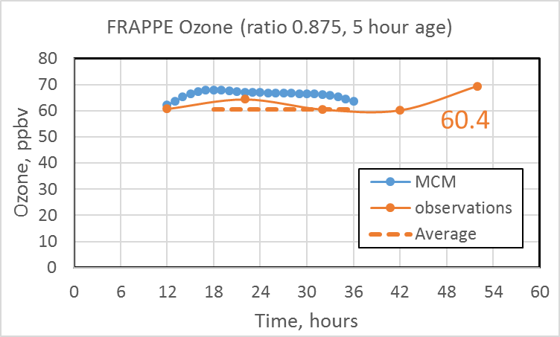
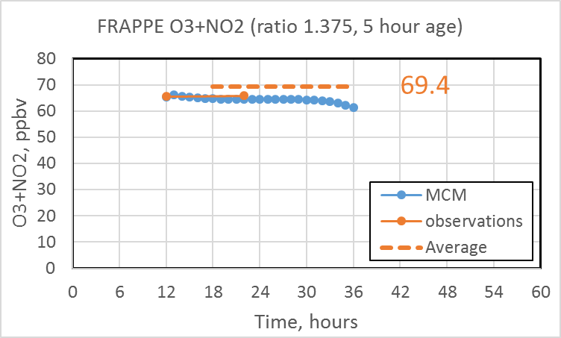
O₃+NO₂ Observations & MCM Model

Slide 11
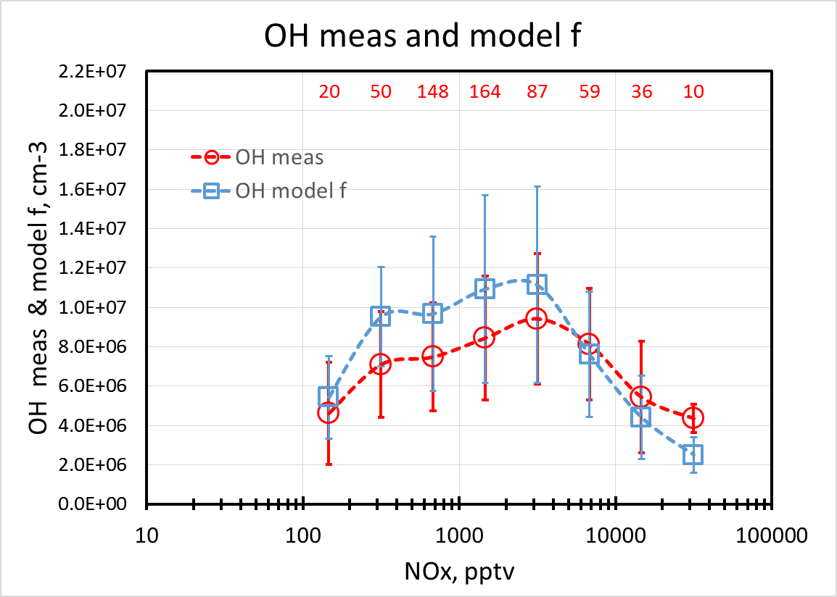
OH vs NO_{x}
Urban Box

Slide 12
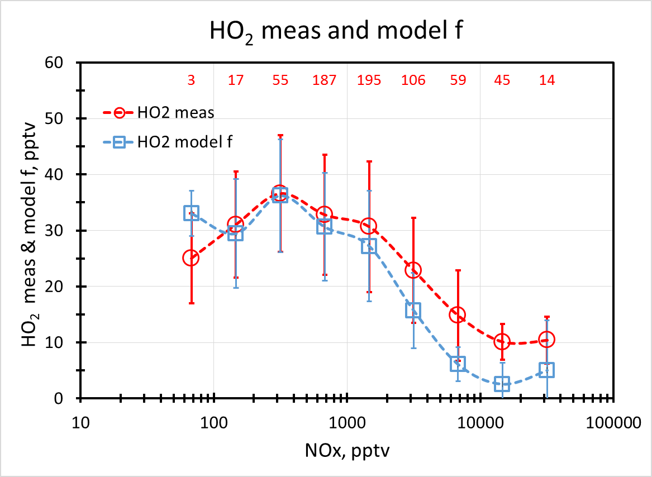
HO₂ vs NO_{x}
Urban Box

Slide 13
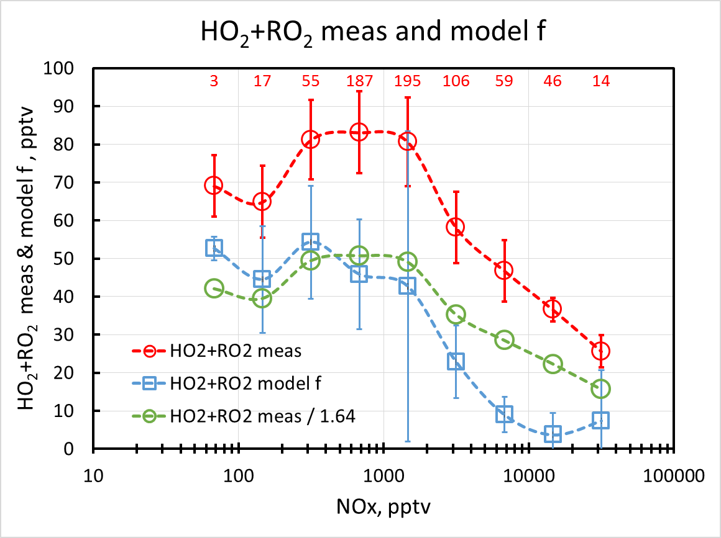
HO₂+RO₂ vs NO_{x}

Slide 14
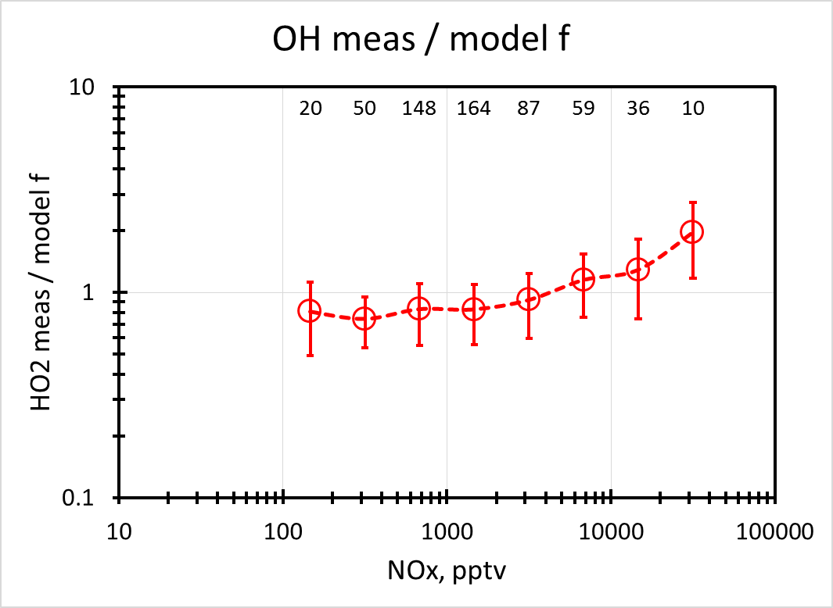
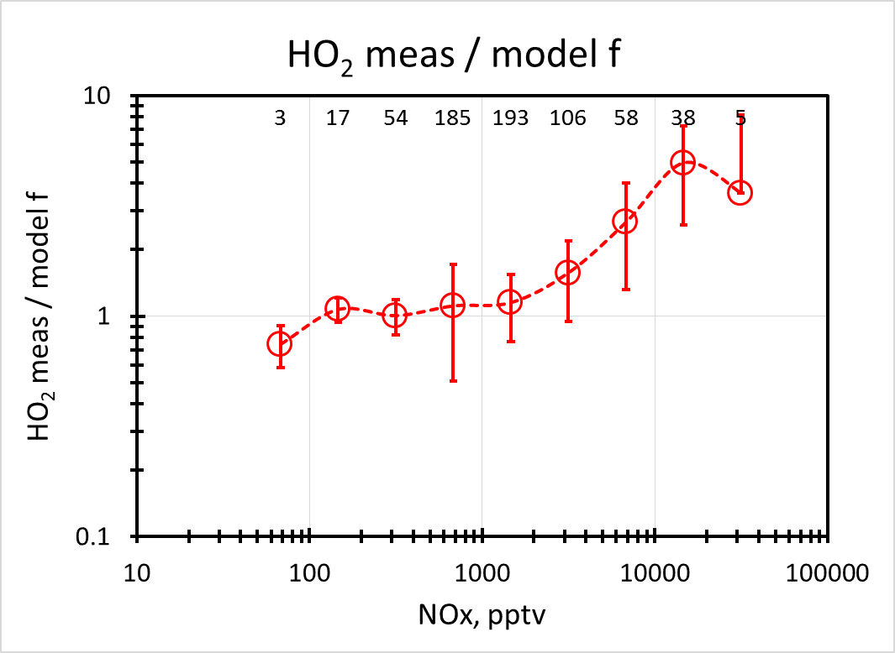
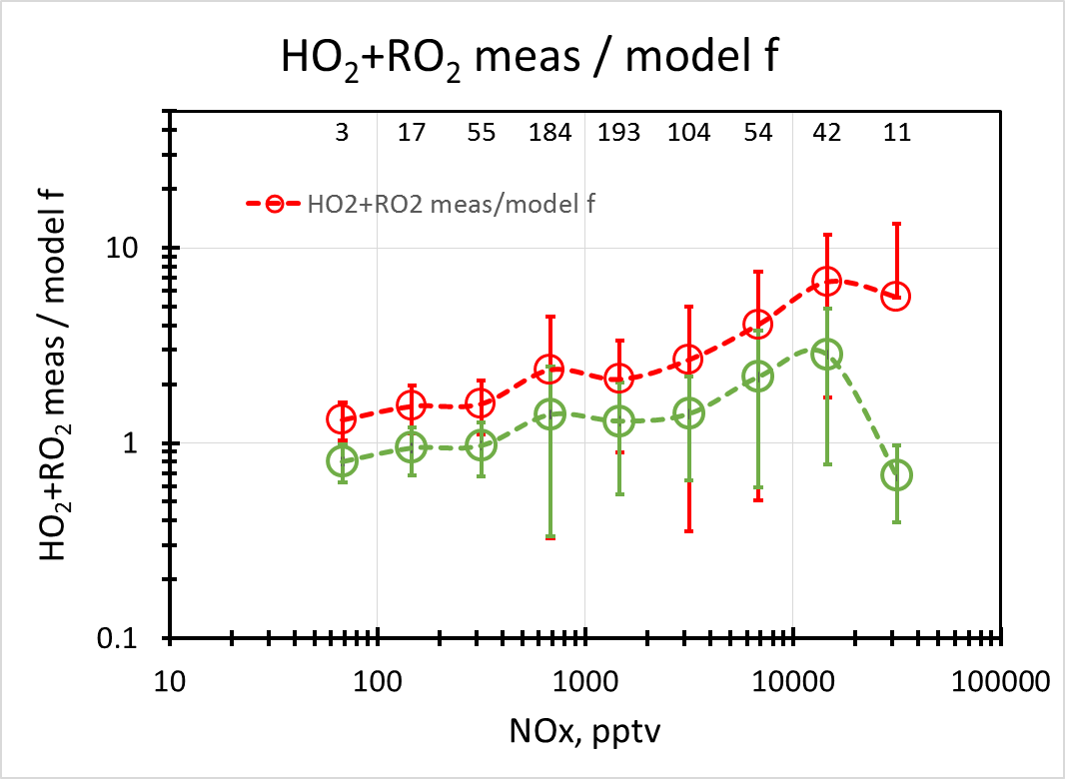
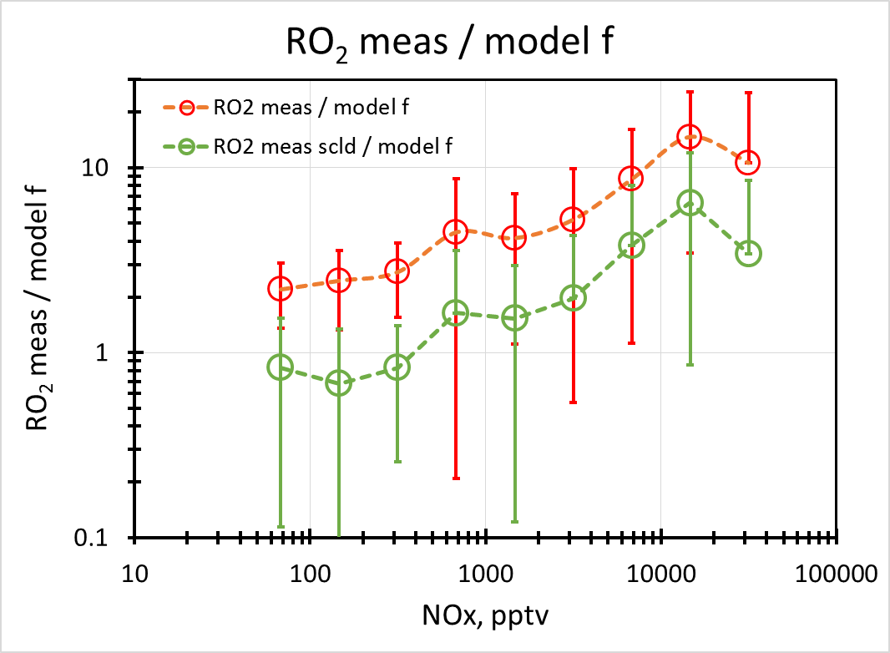
HO_{x} measured / model vs NO_{x}
Urban Box
OH

Slide 15
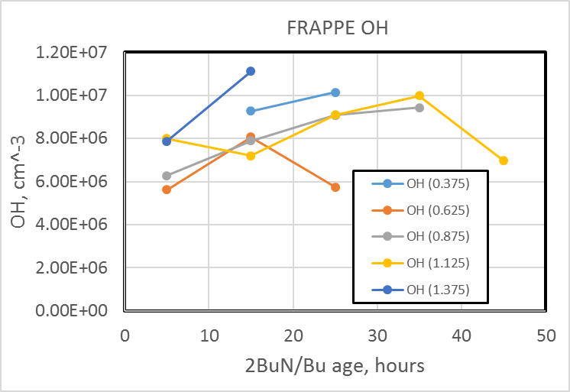
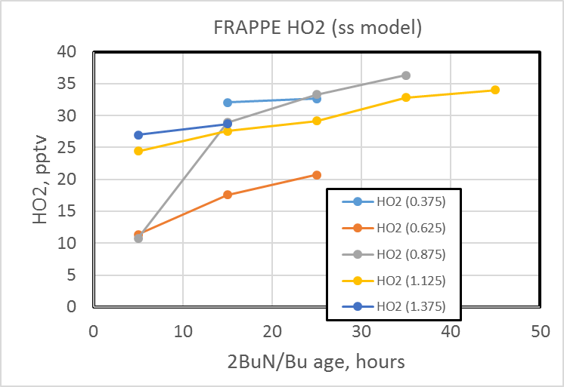
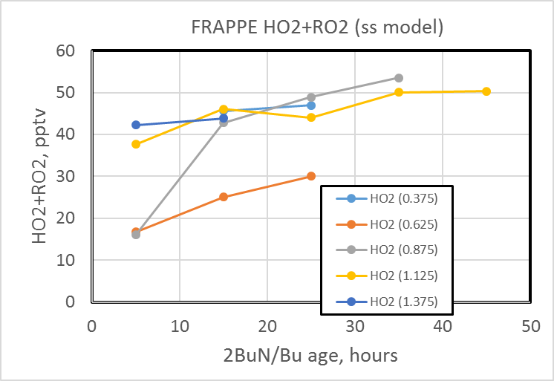
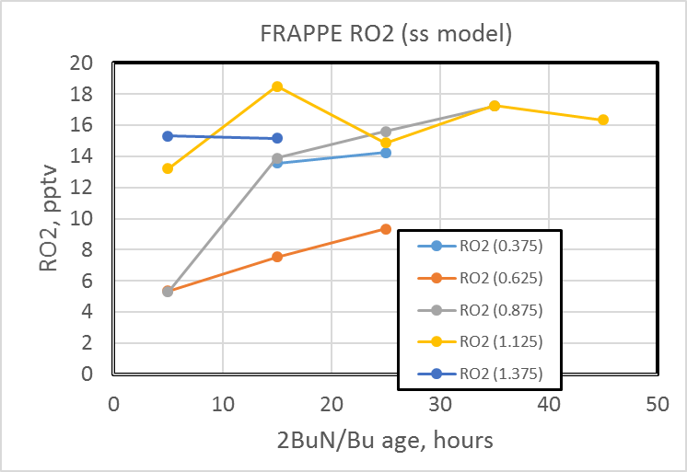
HO_{x} measured vs n-pentane/i-pentane

Slide 16
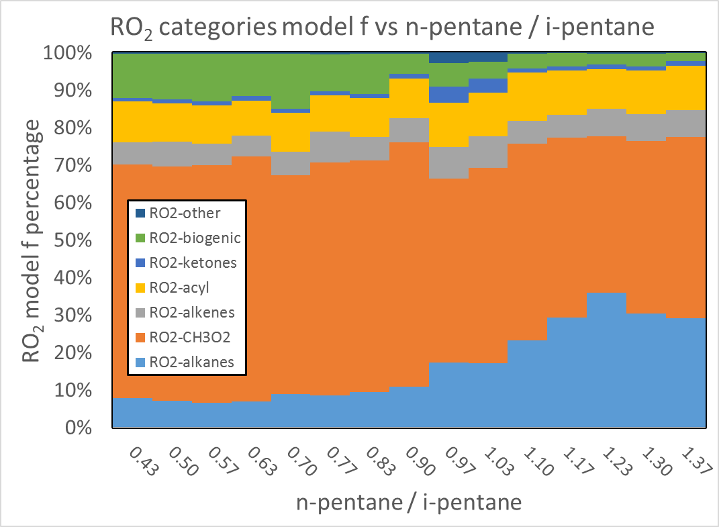
RO₂ Categories vs n-pent / i-pent

Slide 17
Impact of O&GEE on P(O₃)
P(O₃) net | n-pentane / i-pentane
Method | 0.4 – 0.6 | 0.6 – 0.8 | 0.8 – 1.0 | 1.0 – 1.4
Meas HO_{x} | 1.78 | 1.56 | 1.31 | 1.49
Model f HO_{x} | 0.89 | 0.95 | 0.74 | 0.90
Model g HO_{x} | 0.88 | 0.90 | 0.72 | 0.82
Ratio | n-pentane / i-pentane
Method | 0.4 – 0.6 | 0.6 – 0.8 | 0.8 – 1.0 | 1.0 – 1.4
Meas HO_{x} | 1.00 | 0.88 | 0.74 | 0.83
Model f HO_{x} | 1.00 | 1.07 | 0.83 | 1.02
Model g HO_{x} | 1.00 | 1.01 | 0.82 | 0.93
Model f/g | 1.00 | 1.06 | 1.01 | 1.08

Slide 18
Impact of O&GEE on O₃ and NO₂
DO₃, ppbv | n-pentane / i-pentane
Age, hrs | 0.375 | 0.625 | 0.875 | 1.125 | 1.375
5 |  | 45.7 | 54.9 | 62.9 | 64.5
15 | 70.9 | 65.2 | 62.8 | 67.8 | 65.2
25 | 72.1 | 68.2 | 61.4 | 62.6
DO₃ + NO₂, pptv | n-pentane / i-pentane
Age, hrs | 0.375 | 0.625 | 0.875 | 1.125 | 1.375
5 |  | 65.4 | 60.7 | 64.8 | 65.6
15 | 72.4 | 68.2 | 64.4 | 68.6 | 65.8
25 | 73.3 | 69.4 | 60.5 | 63.2

Slide 19
Summary
n-pentane / i-pentane appears to be a useful measure of O&GEE influence
HO_{x} measurements systematically greater than ss model at high NO_{x} (>2 ppbv); also P(O₃)
O&GEE influences P(O₃) net by +3% to +4% (model) and -16% (measurements) (urban)
Average values of P(O₃) net are 0.95 ppbv/hr (model) and 1.8 ppbv/hr (measurements) (urban)
O_{x} averages 0.2 to 13 ppbv lower in O&GEE influenced air masses

Slide 20
Acknowledgements
Colorado Department of Public Health and Environment
National Science Foundation – Atmospheric Chemistry
National Aeronautics and Space Administration
National Oceanic and Atmospheric Administration
National Center for Atmospheric Research – Atmospheric Chemistry & Research Aviation Facility
National Park Service
Regional Air Quality Council
Global Ozone Project
Western Regional Air Partnership
Environmental Protection Agency

Slide 21
Extra Slides

Slide 23
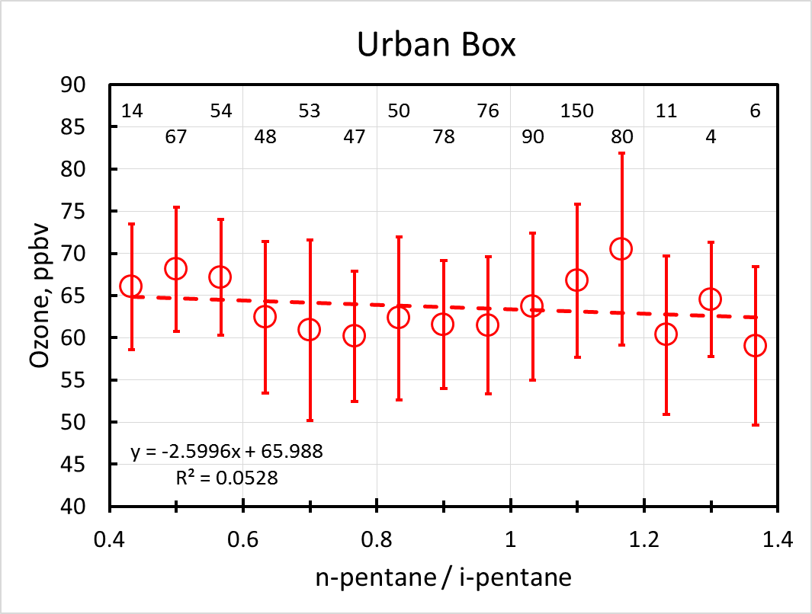
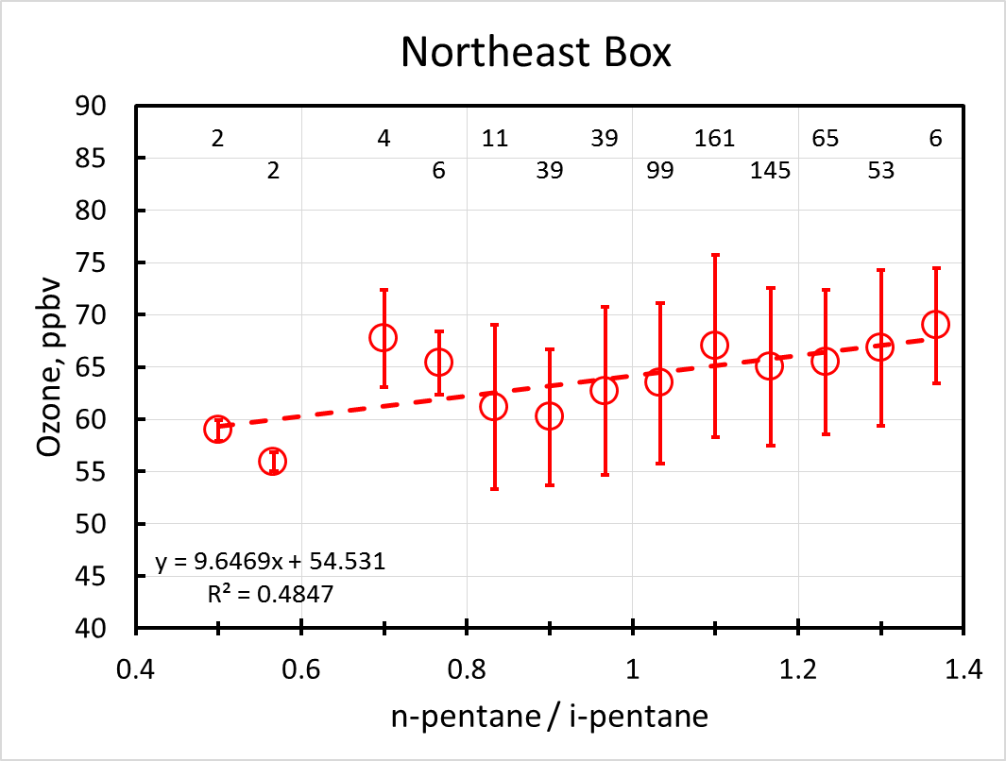
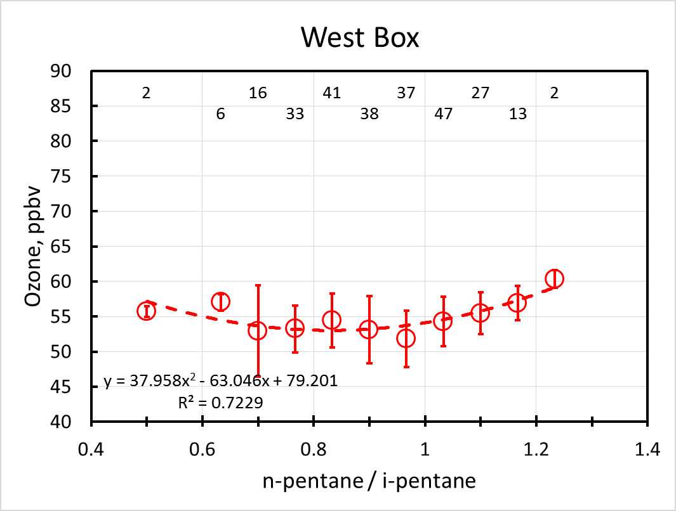
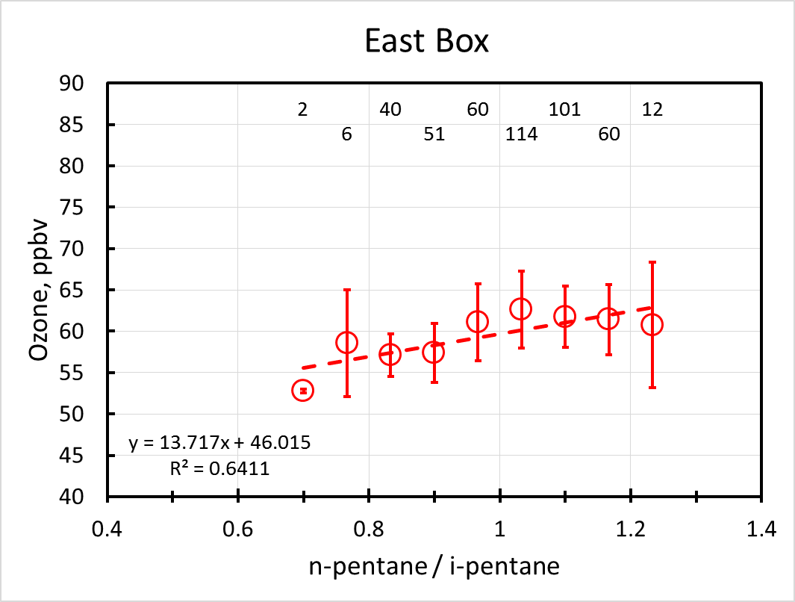
Ozone
Δ=+0.49
+1.2
+0.41
+2.3

Slide 24
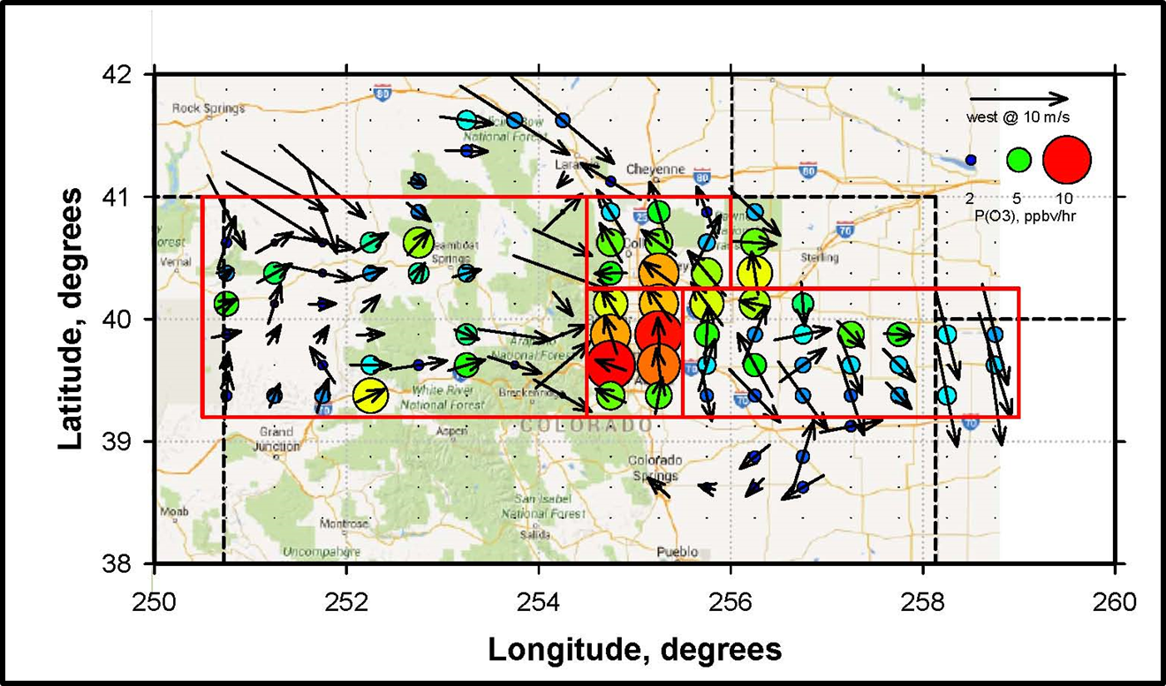
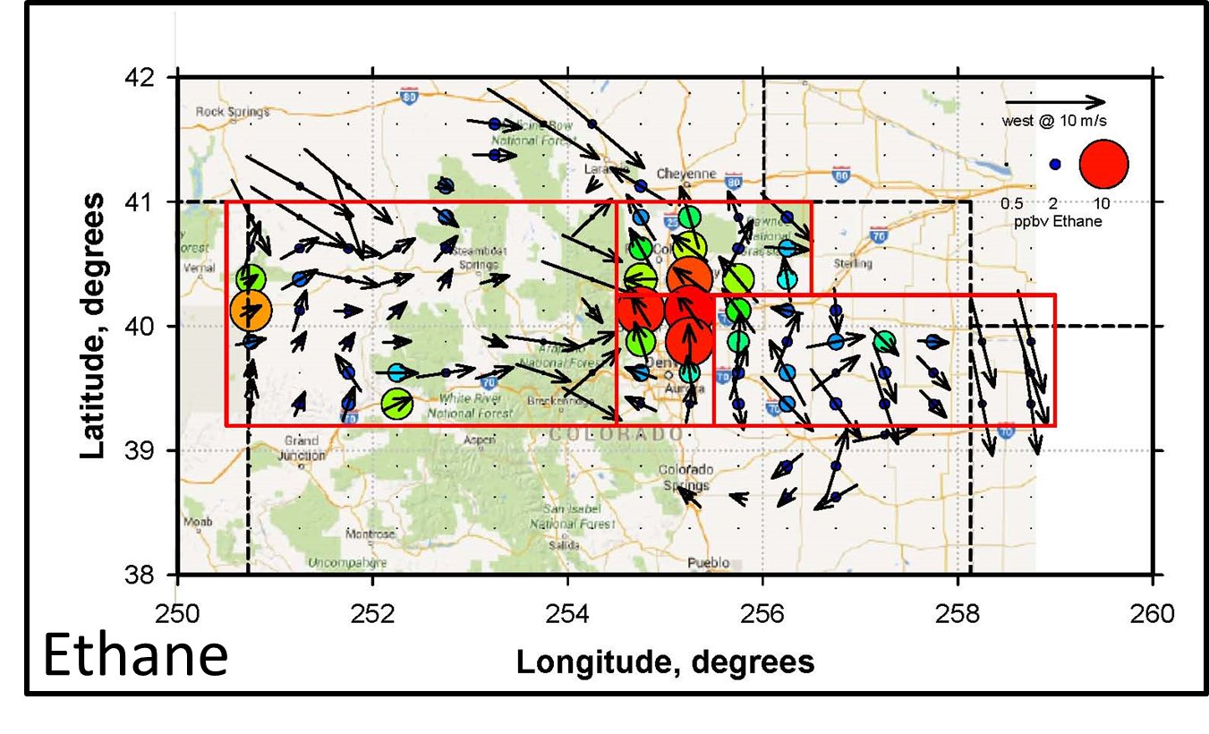
FRAPPE Data
Weinheimer et al - NCAR
Fried et al – University of Colorado

Slide 25
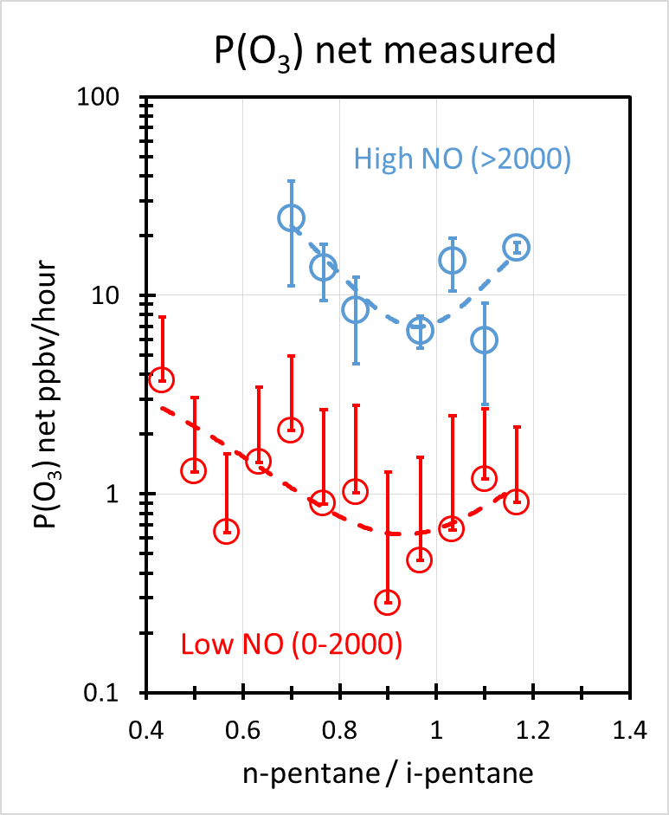
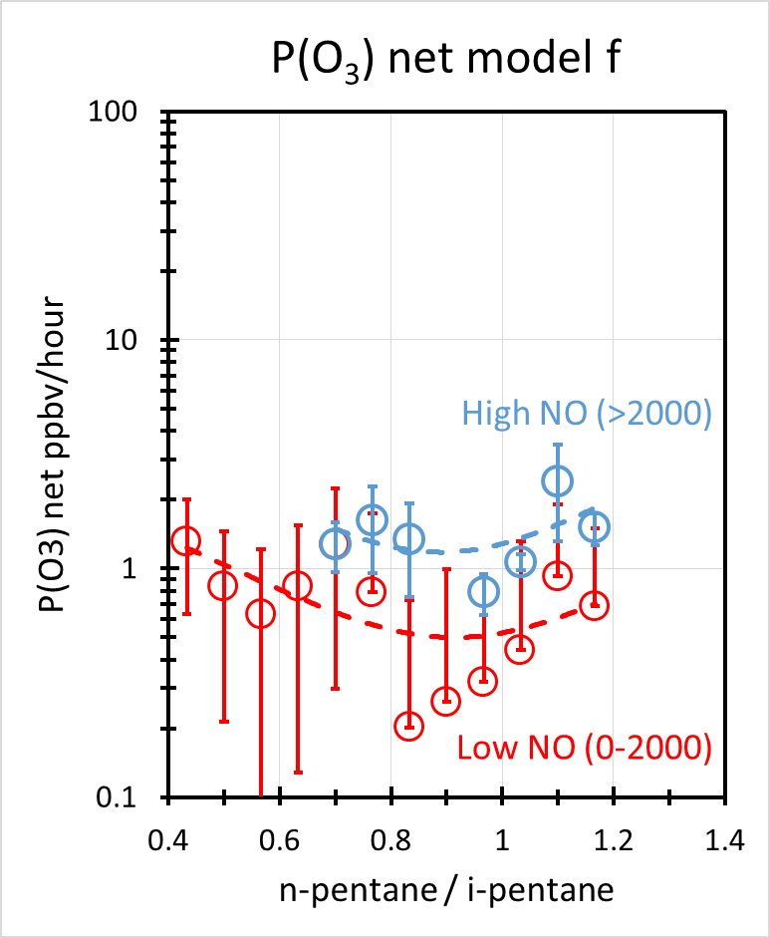
P(O₃) net vs n-pentane / i-pentane

Slide 26
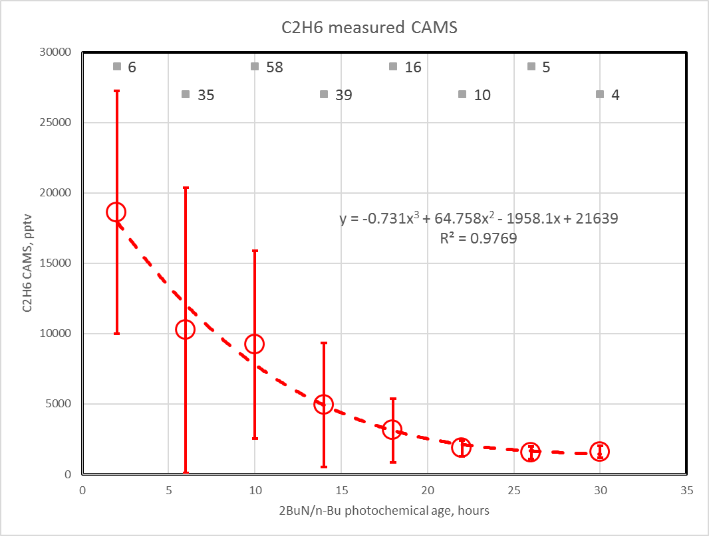
Chemical Coordinates – Photochemical Processing Time

Slide 27
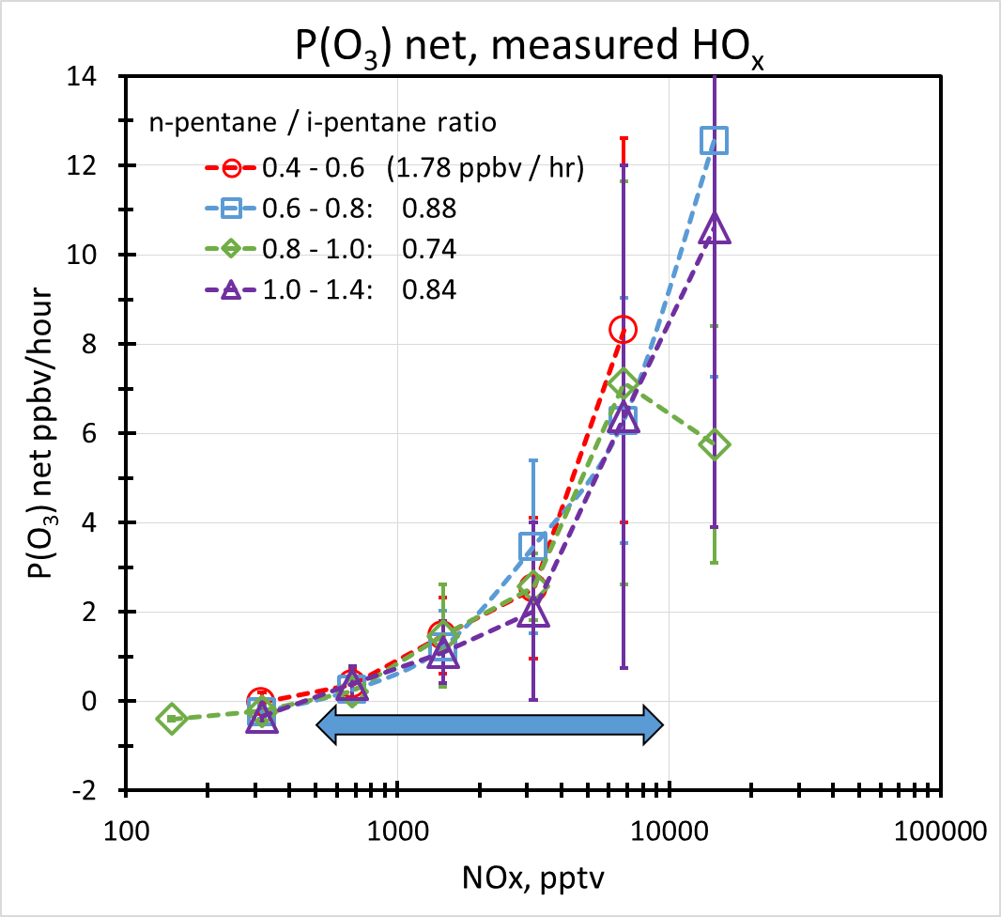
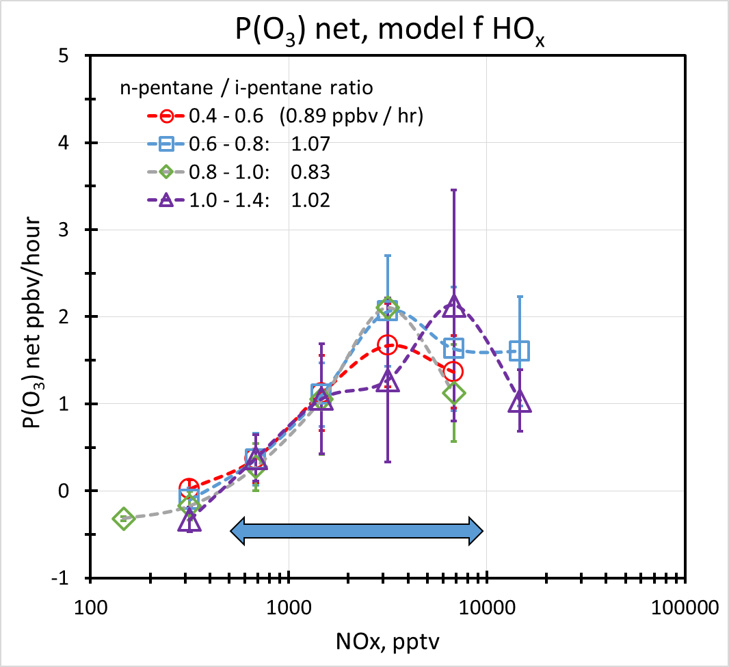
P(O₃) net vs NO_{x} & n-pent / i-pent
Weighted average P(O₃) net:
measured: 1.8 ppbv/hr
model f: 0.95 ppbv/hr
meas/mdl ratio: 1.84

Slide 28
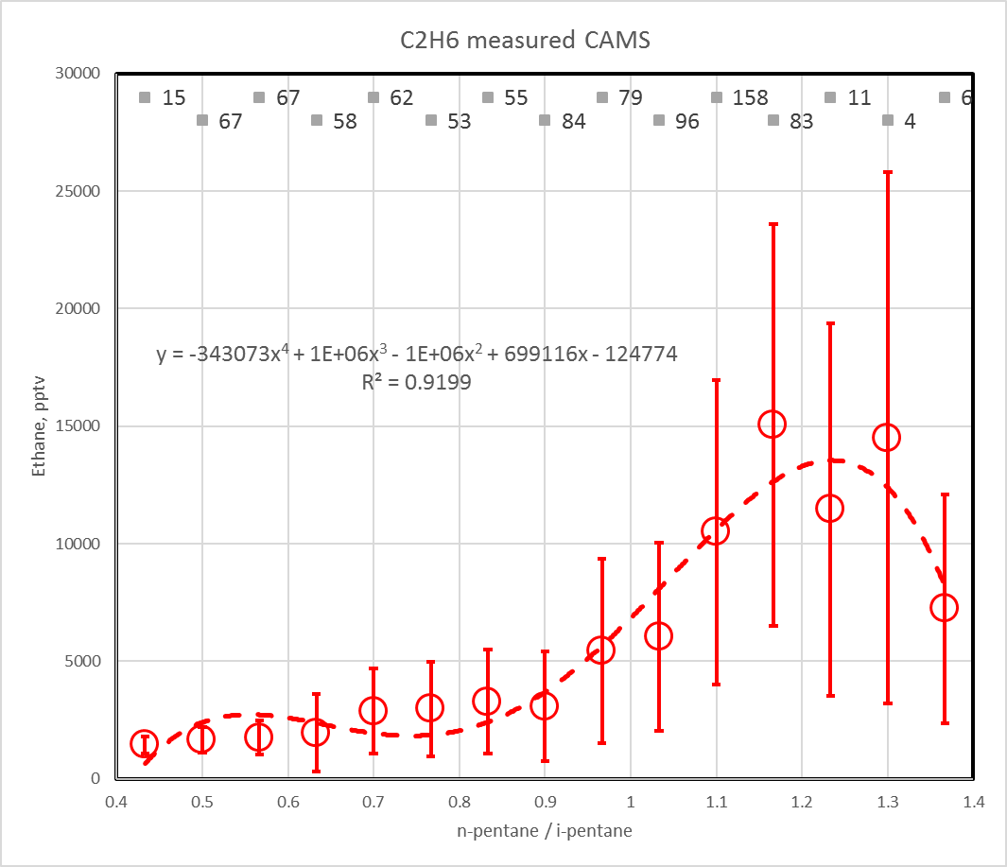
Chemical Coordinates – Oil and Gas Exploration & Extraction
Urban
O&GEE

Slide 29
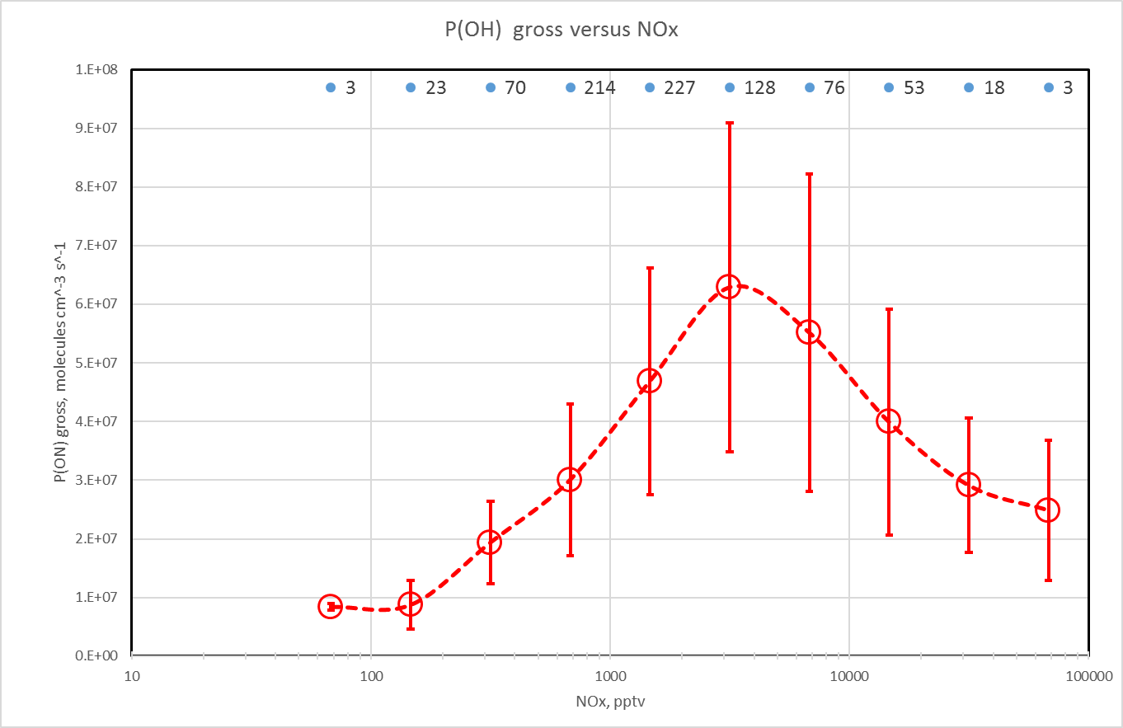
Chemical Coordinates - NOx

Slide 30
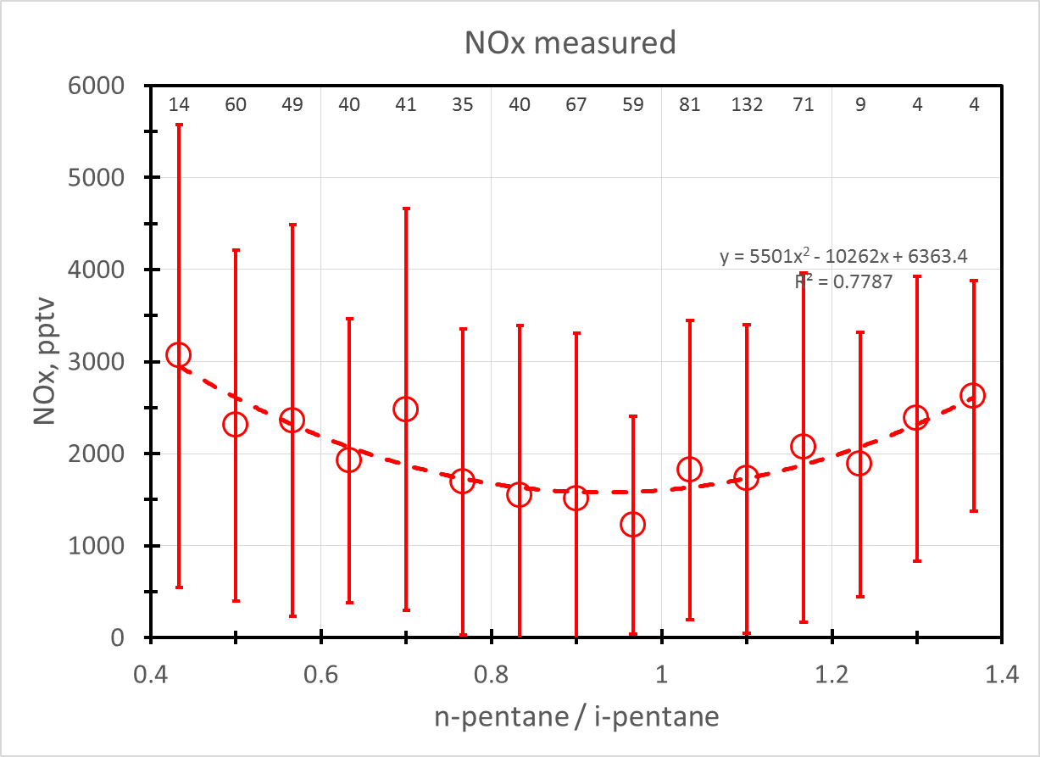
Measured NOx vs n-pent/i-pent

Slide 31
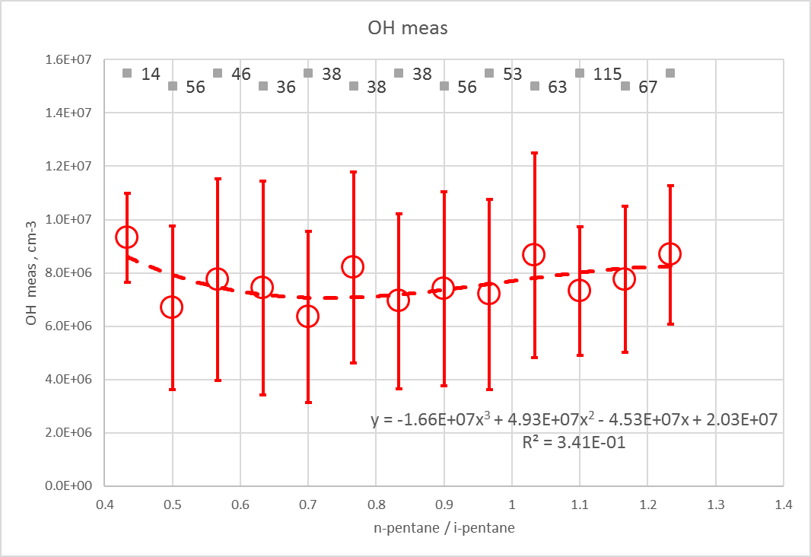
OH vs n-pentane / i-pentane
Urban Box

Slide 32
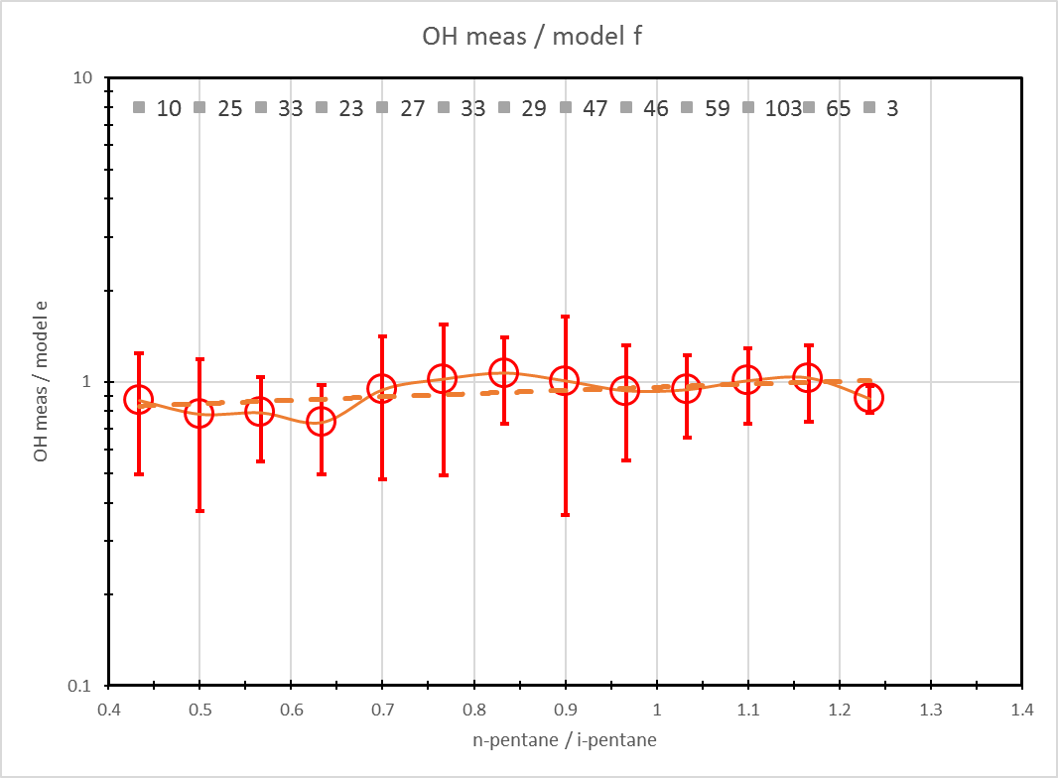
OH measured / model ratio vs n-pentane / i-pentane
Urban Box

Slide 33
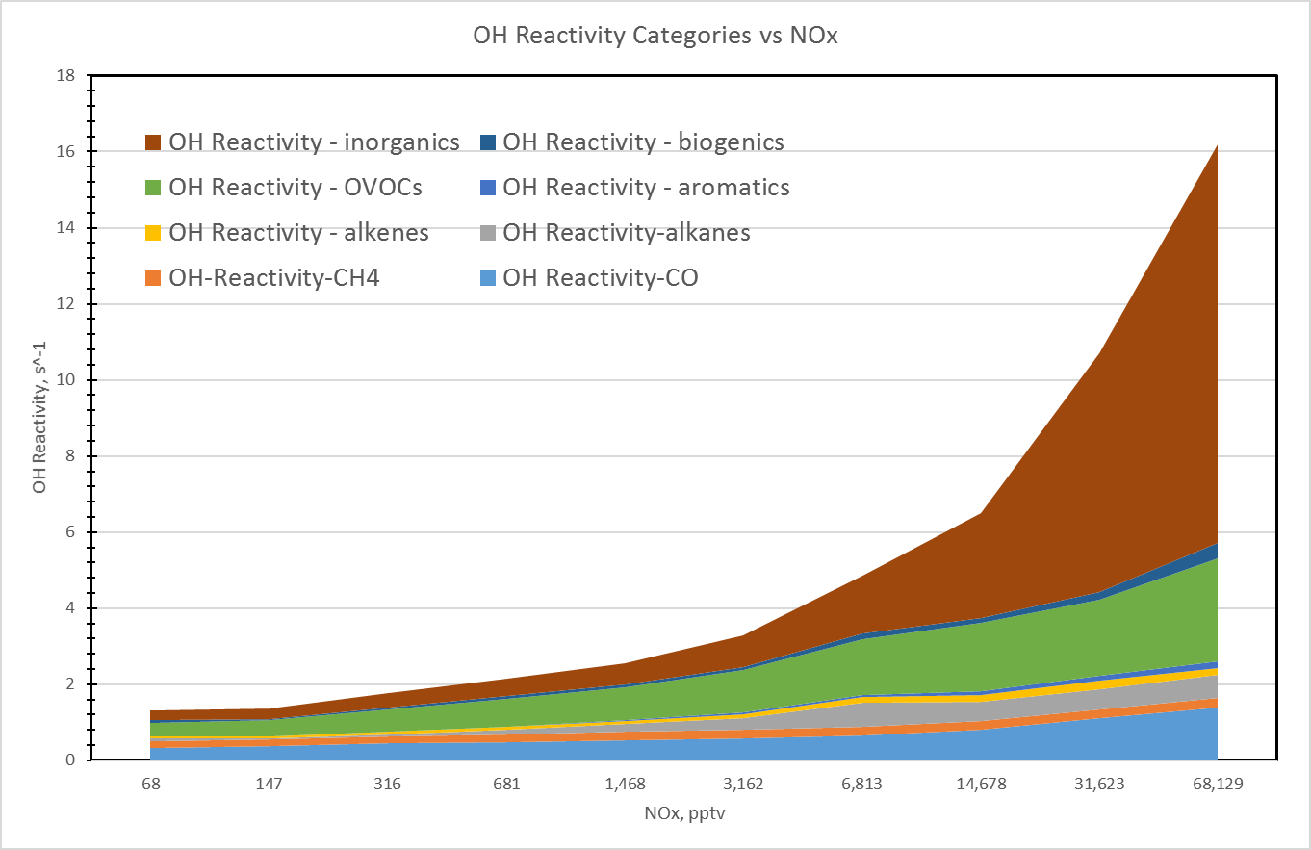
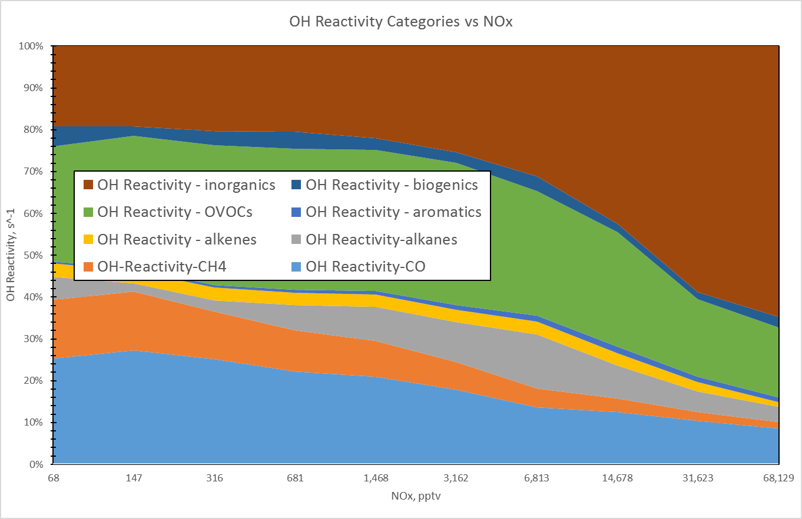
OH Reactivity vs NOx
Urban Box

Slide 34
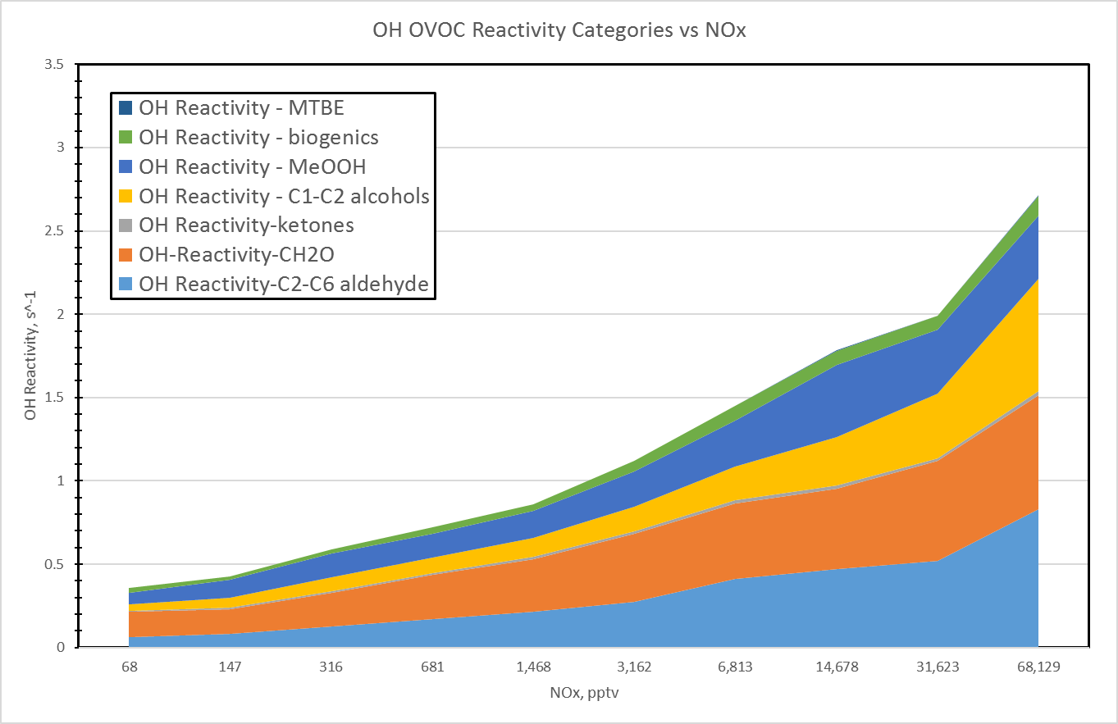
OH OVOC Reactivity

Slide 35
OH Reactivity vs n-pentane / i-pentane
Notes:
Inorganics: HO2, O3, H2O2, H2, SO2, HNO3, NO, HNO4

Slide 36
OH Reactivity vs Alkane Reactivity

Slide 37
P(OH) vs NOx
Urban Box

Slide 38
O3 measured vs Photochemical Age
n-pent / i-pent
Urban Box

Slide 39
O3 vs Photochemical Age
Urban Box
Northeast Box
West Box
Downwind Box

Slide 40
P(O3) net vs Photochemical Age

Slide 41
Measured vs Photochemical Age

Slide 42
MILAGRO

Slide 43
Data Collections - MILAGRO
C-130 Flights DC-8 Flights

Slide 44
Mexico City Outflow

Slide 45
MILAGRO Measured CO

Slide 46
MILAGRO Meas & Model HCHO

Slide 47
MILAGRO Meas & Model OH

Slide 48
MILAGRO Meas & Model HO2

Slide 49
MILAGRO Unmeasured VOCs with Major Influence on Photochemistry

Slide 50
MILAGRO Summary
CH₂O and HO₂ measurements systematically greater than constrained steady state model
OH measurements systematically lower than model
Measure-model differences appear to be explained by presence of unmeasured (on the C-130 & DC-8) oxygenated VOCs

