Slide 1

Ozone in the North Front Range and Policies
FRAPPÉ Science Team Meeting
5/2/2017

Slide 2

What will be covered?
Ozone levels and trends across Colorado
Precursor monitoring
Complaint response
PAMS site
Oil and gas regulations
Ozone bump-up SIP
Current and future work

Slide 3
CDPHE Focus
Ozone has been the dominant focus for criteria air pollutants
North Front Range is non-attainment
2008 NAAQS = 75 ppb as the 3-year average of the 4th maximum 8-hour values
  NFR just bumped up from marginal to moderate
  May get bumped to serious, depending on 2017
2015 NAAQS = 70 ppb as the 3-year average of the 4th maximum 8-hour values
  NFR proposed to be designated as marginal
  Implementation may get delayed to 2025
Oil and gas development has been primary target of VOC reductions
EGU’s have been the target for NOx reductions

Slide 4
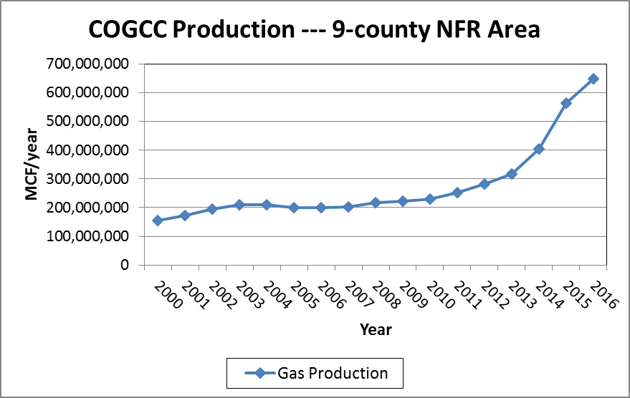
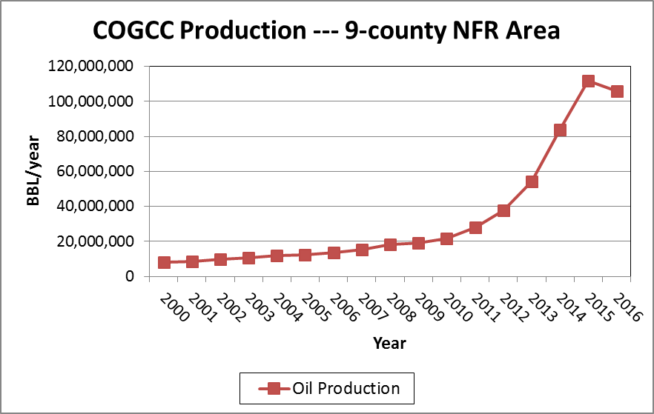
Gas and Oil Production
(COGCC, March 2017)
(2016 incomplete)

Slide 5
Ozone levels and trends across Colorado

Slide 6
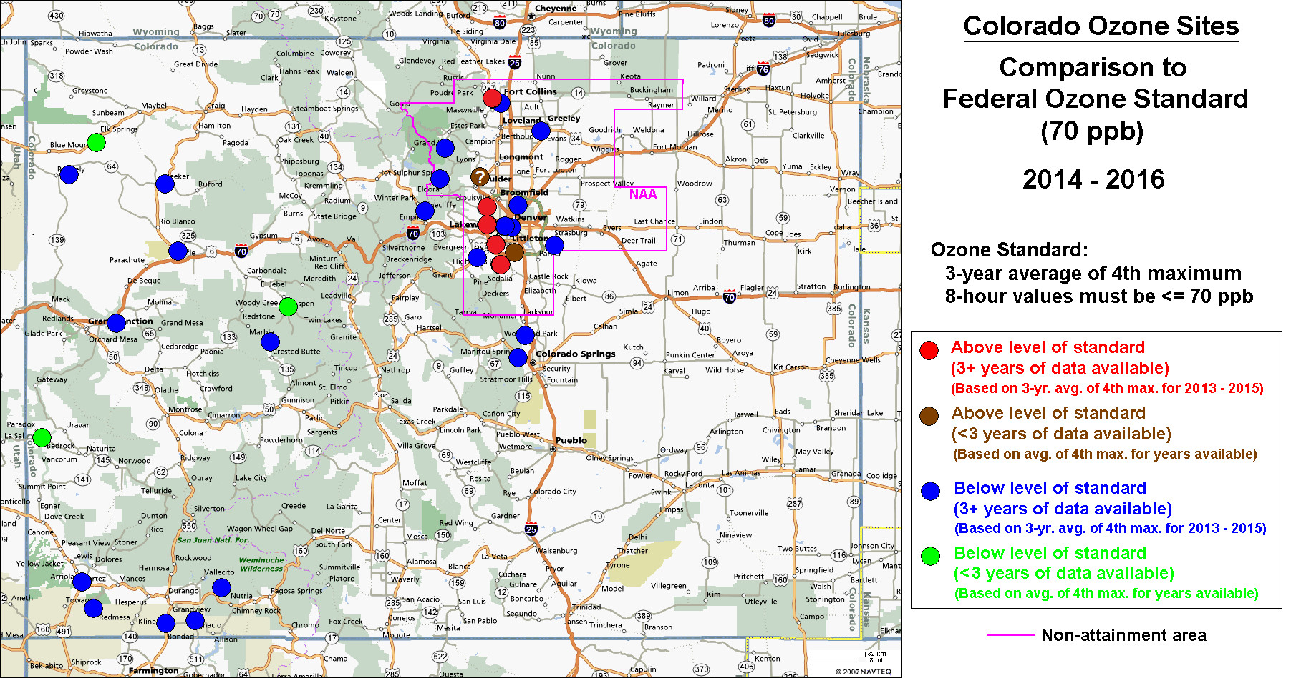
The Current 70 ppb Standard
Notes:
The DMA/NFR violates the current NAAQS, but good news for rest of state.
Rangely not exceeding through 10/2016.
New Boulder site showing levels somewhat similar to Rocky Flats.
New Paradox site
New Elk Springs site (re-location of Lay Peak)
NOAA BAO site gone…relocating ozone to their Table Mtn site N of Boulder?
Note sites on west slope and SW….many are not APCD sites.

Slide 7
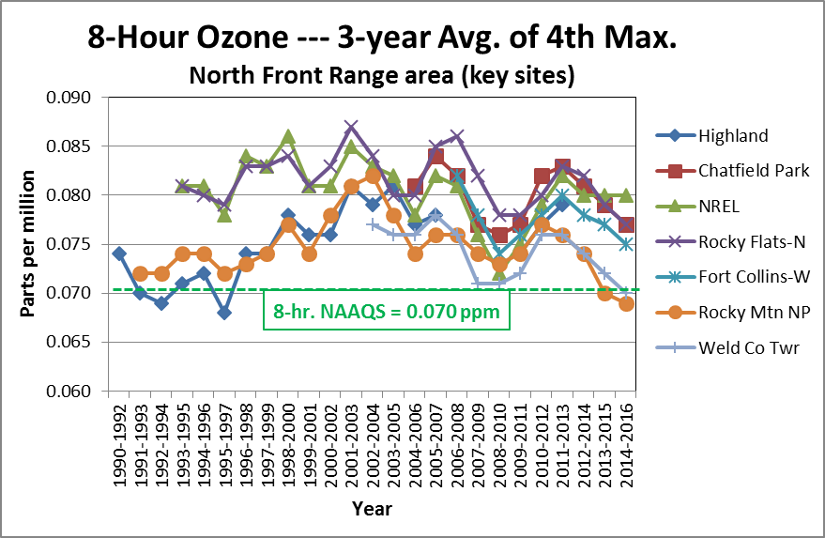
North Front Range
Ozone Trends
Notes:
Note the cyclic nature due to meteorology….Need many years to see a trend.
Slight decreasing trend.
Overall, the high peaks tend to be decreasing.
Keep in mind, population and industry have increased significantly over this period.

Slide 8
South Front Range
Ozone Trends
Notes:
Note the cyclic nature due to meteorology….Need many years to see a trend.
Slight decreasing trend.
Keep in mind, population and industry have increased significantly over this period.

Slide 9
Western Slope
Ozone Trends
Gothic site indicative of background?
Notes:
No cyclic nature.
Need many years to see a trend.
Decreasing trend.
Rangely no longer exceeding.
Keep in mind, population and industry have increased significantly over this period.

Slide 10
Southwest area
Ozone Trends
Notes:
No cyclic nature due to meteorology….Need many years to see a trend.
Slight decreasing trend in recent years.
Keep in mind, population and industry have increased significantly over this period.

Slide 11
CDPHE precursor monitoring

Slide 12
CDPHE Ozone Precursor Studies
All in North Front Range
2003
  July – September 2003
  2 primary sites, 3-hour AM & PM samples
  3 secondary sites, 3-hour AM & PM samples
2006
  June – July 2006
  4 primary sites, 3-hour AM samples
  2 secondary sites, 3-hour PM samples
2012 – present (CAMP, Platteville)
  December 2011 - present
  2 primary sites, 3-hour AM samples

Slide 13
CDPHE sampling overview
All sampling done for 3-hours, every 6th day
  Most 6:00 a.m. – 9:00 a.m. ➔ un-reacted mix
  Some limited 1:00 p.m. – 4:00 p.m. ➔ reacted mix
Non-methane organic compounds (NMOCs)
  EPA Method TO-12 + speciation
  Whole air canisters
Carbonyls
  EPA Method TO-11a
  DNPH cartridges with ozone pre-scrubber
Methane (started in 2012)
  Whole air canisters

Slide 14
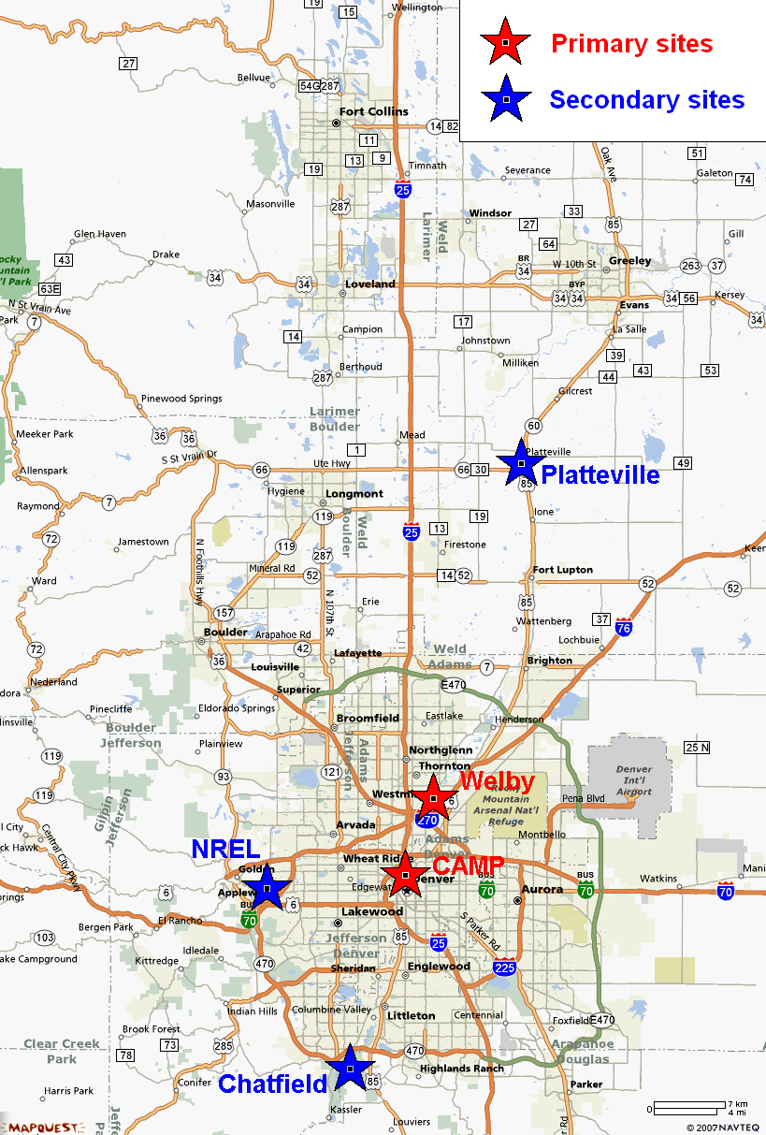
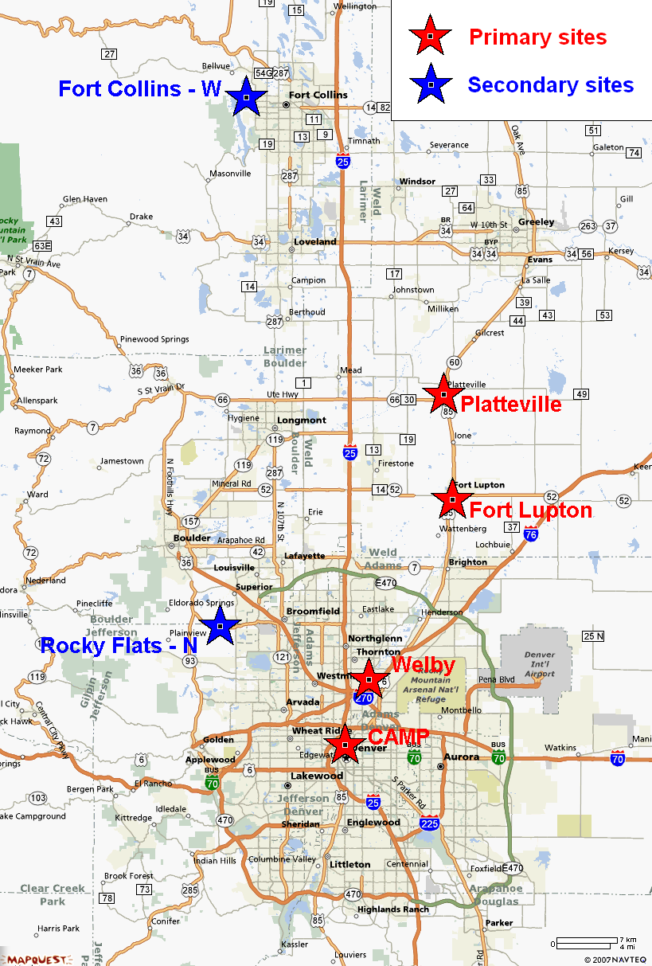
Ozone Precursor Monitoring
2003 2006/2012-2016
Notes:
Urban and oil/gas rural areas.
Some overlap in sites between 2003 and 2006.

Slide 15
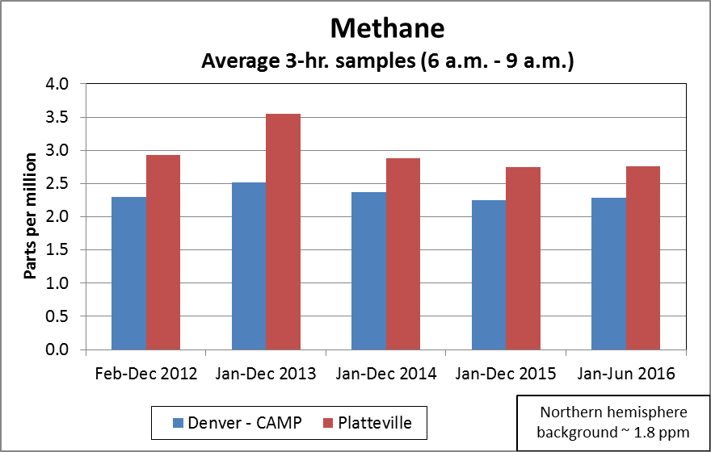
Methane
Downward trend since 2013

Slide 16
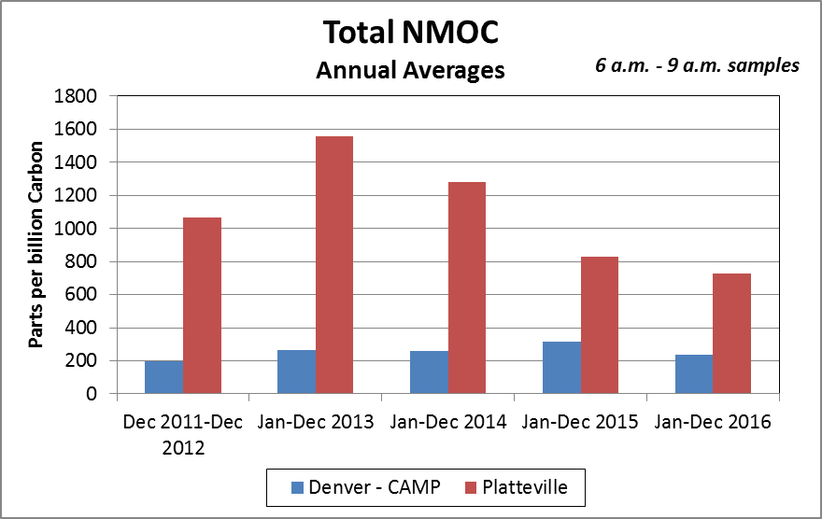
Total NMOC
Significant downward trend since 2013

Slide 17
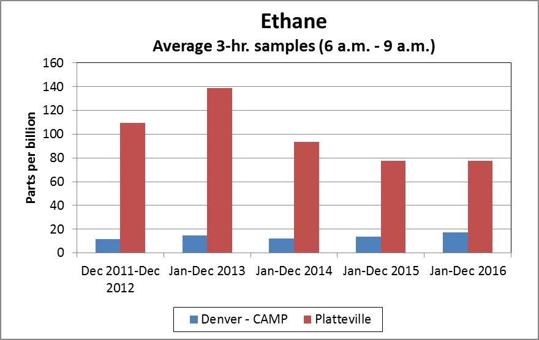
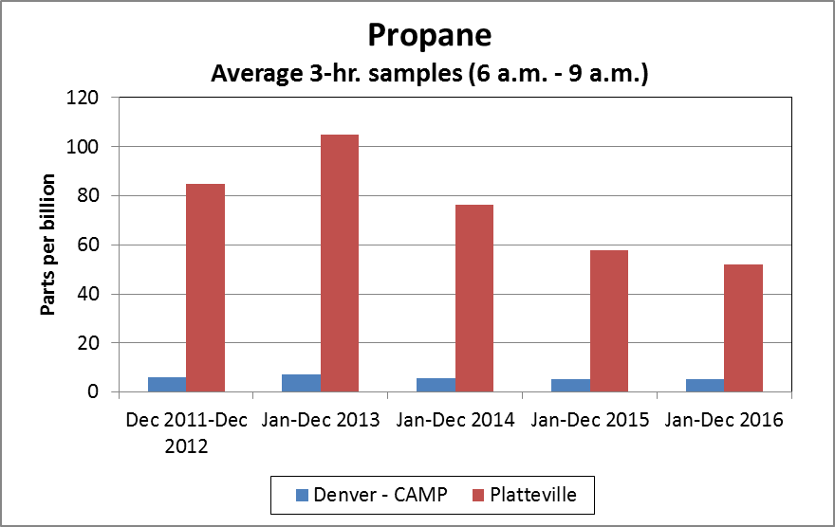
Oil and gas related compounds
Higher in oil and gas development area versus urban area

Slide 18
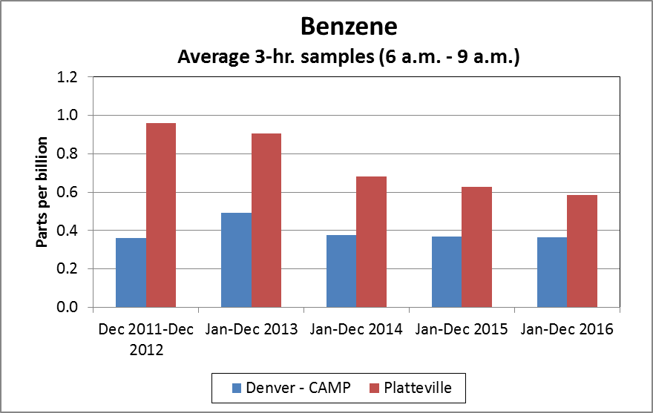
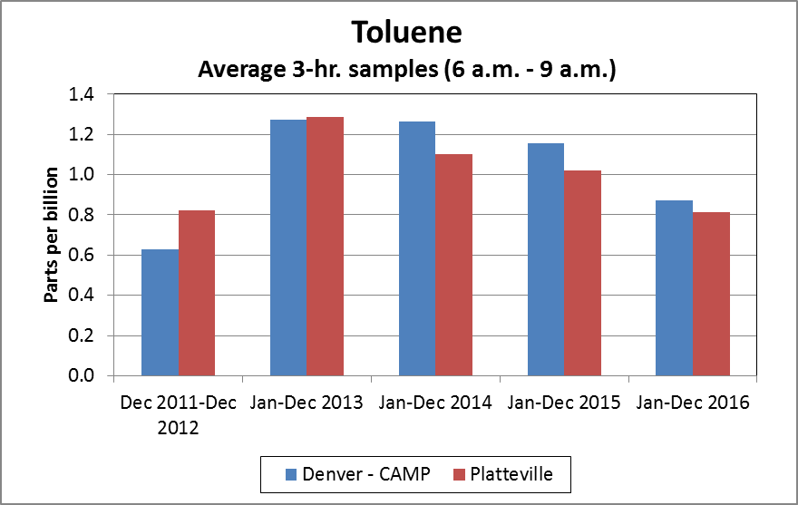
Urban / oil and gas related compounds
Higher or similar in oil and gas development area versus urban area, but whole area is somewhat urbanized

Slide 19
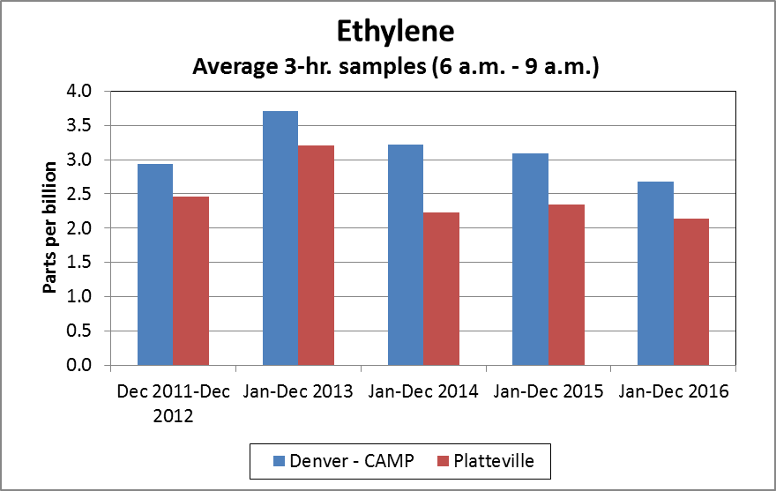
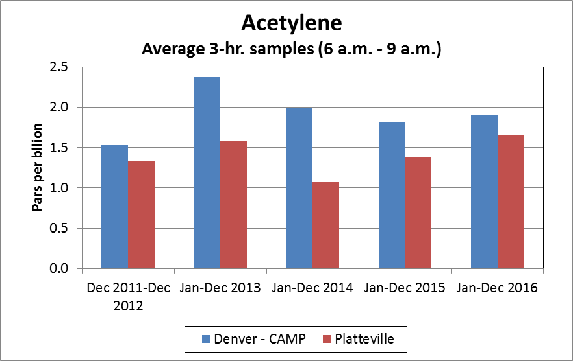
Urban related compounds
Higher in urban area versus oil and gas development area

Slide 20
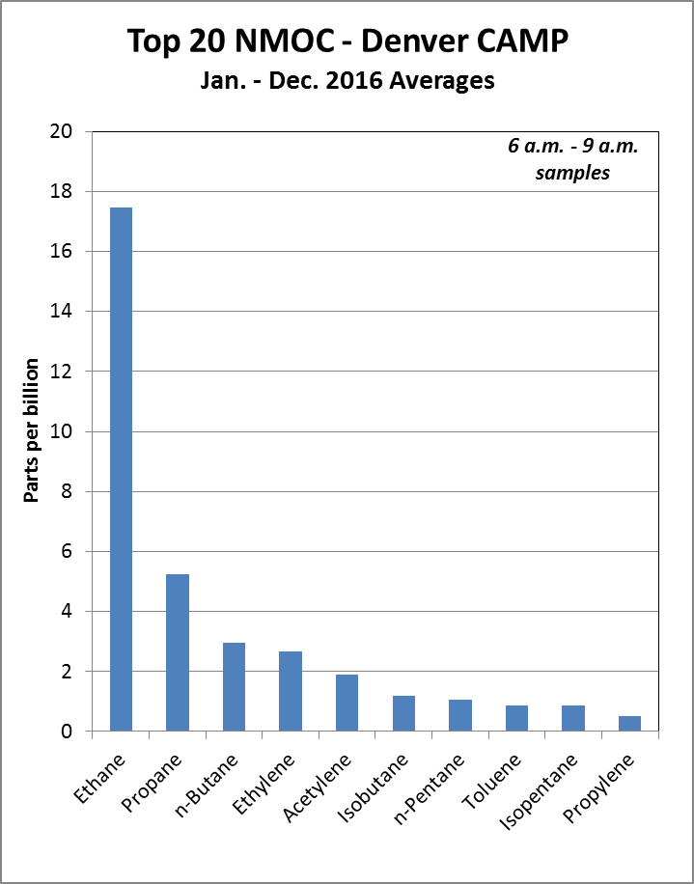
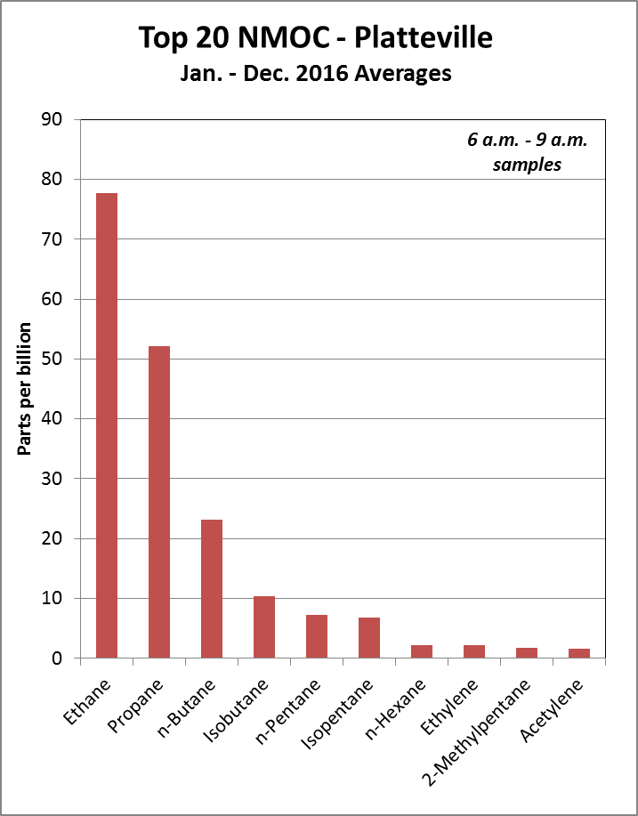
Top 20 compounds --- 2016
Alkanes dominate in oil and gas development areas
Alkenes and alkanes in urban areas

Slide 21
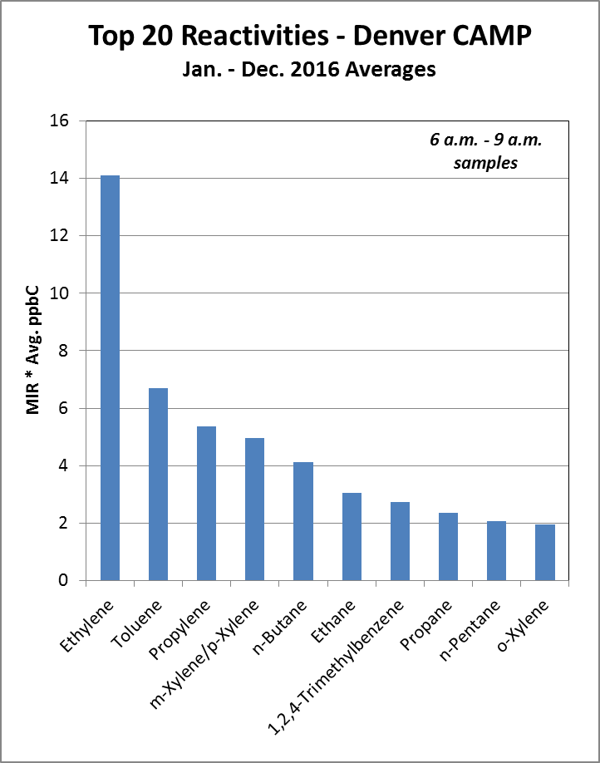
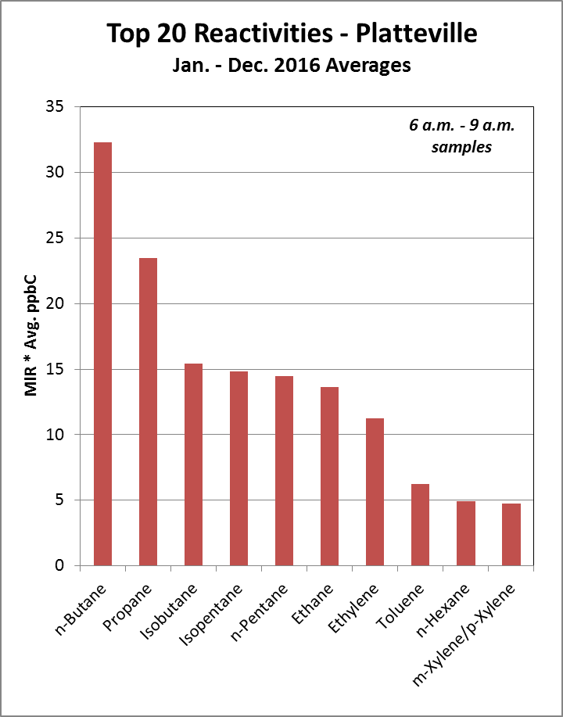
Top 20 ozone reactivities --- 2016
Alkanes dominate in oil and gas development areas
Alkenes and aromatics dominate in urban areas

Slide 22
Complaint response / mobile response trailer

Slide 23
Oil and gas complaint response
As-needed
Historically limited
On-site visual and odor investigation
Canister sampling in odor plumes by residents
Governor’s Oil and Gas Task Force
  Established by Executive Order B 2014-005
  Examine the many facets of the issues surrounding oil and gas operations and provide recommendations for policy or legislation on how best to achieve goals
  Identify and strive to reach agreement on recommendations for policy or legislation to harmonize state and local regulatory structures as to activities associated with oil and gas operations
  Recommendation #31b

Slide 24
CDPHE Mobile Response Trailer
Funding authorized by legislature based on 2015 Governor’s Oil and Gas Task Force recommendation #31b
1. CDPHE convert five temporary FTEs to permanent status so that the Department can continue its air monitoring and leak detection activities.
2. CDPHE establish a health complaint and information line.
3. Encourages CDPHE to seek funding from the General Assembly and other sources to conduct a human health risk assessment.
4. Encourages CDPHE to seek authorization and funding and urges the General Assembly to consider providing support for a mobile air quality monitoring unit and associated staffing. A mobile air monitoring unit could be used in responding to Tier II complaints and could be dispatched to defined locations to monitor ambient air quality and to help determine potential sources.

Slide 25
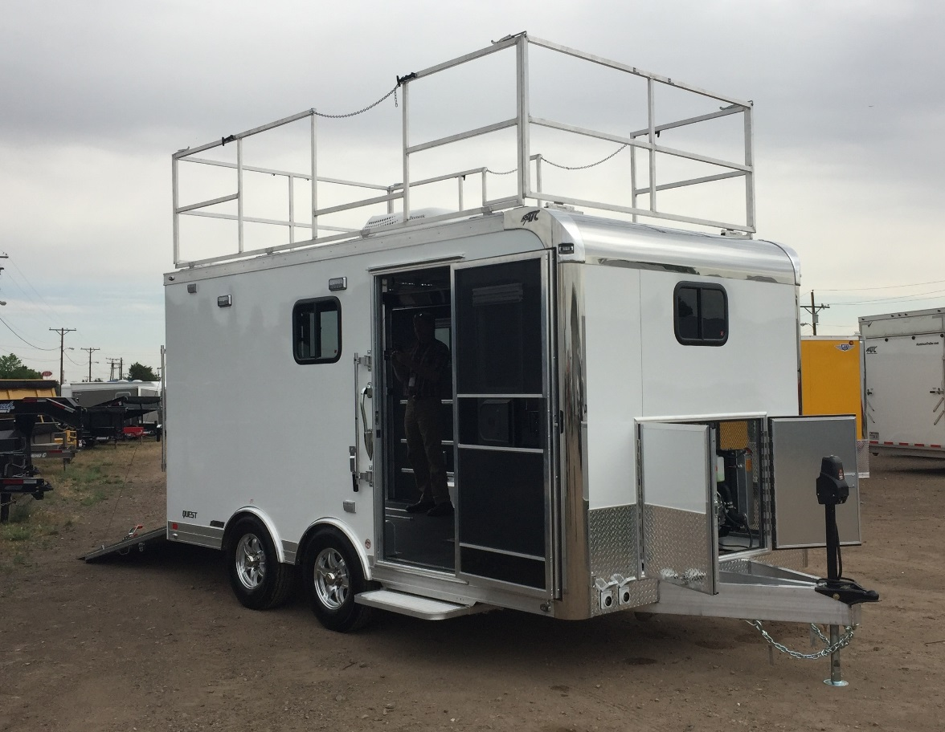
Capabilities
NMOC’s/VOC’s via GC/FID/MS
Methane
Ozone
NOx
CO₂
Ammonia
Hydrogen sulfide
Particulates
Meteorology
Sorbent tube analysis
Operate 24 hours unattended
  Remote instrument controls
Line power, onboard diesel and batteries

Slide 26
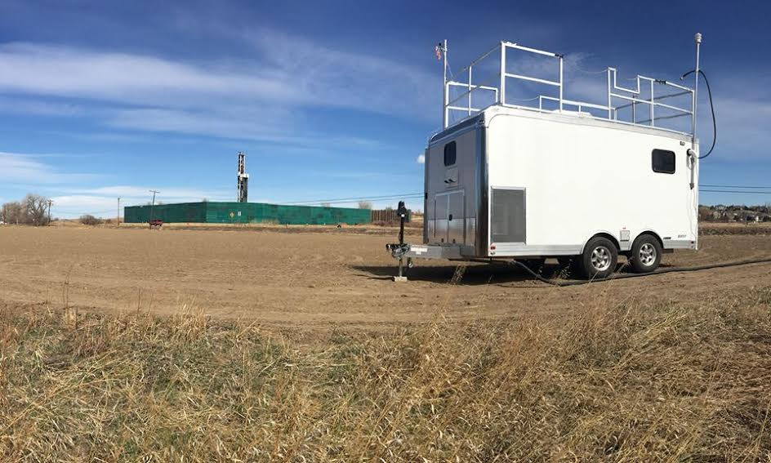
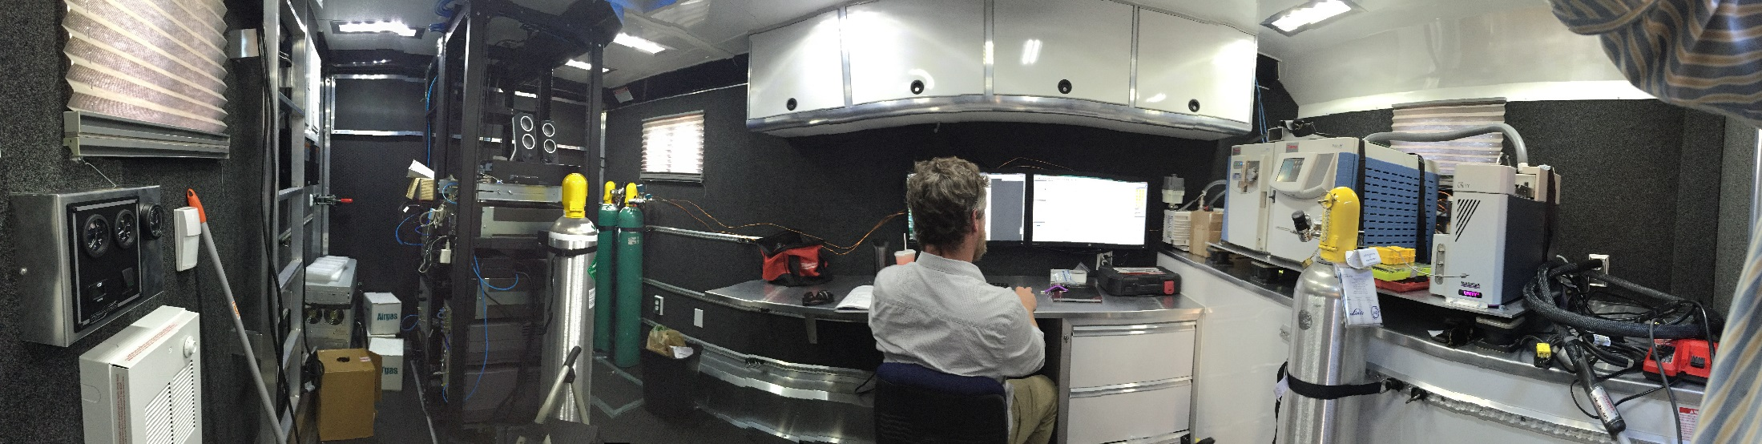
Status
Calibration and field testing in January 2017
Deployed in March 2017 to drilling site near Erie
Data being evaluated
Additional deployments planned for Greeley and Broomfield

Slide 27
Photochemical air monitoring stations

Slide 28
Photochemical Air Monitoring Stations (PAMS)
Part of 2015 ozone rule
  Required at each NCore site in a CBSA with a population of 1,000,000 or more by 6/1/2019
  3-month summer monitoring
  43 sites nationwide
  Moderate or higher areas need to develop an Enhanced Monitoring Plan by 10/1/2019
1 required for Colorado, plus enhanced monitoring
Required equipment
  Auto GC for NMOCs
  Carbonyls
  NOy and true NO₂
  Meteorology
  Mixing height (using ceilometer)
Work in progress on a waiver for PAMS site location

Slide 29
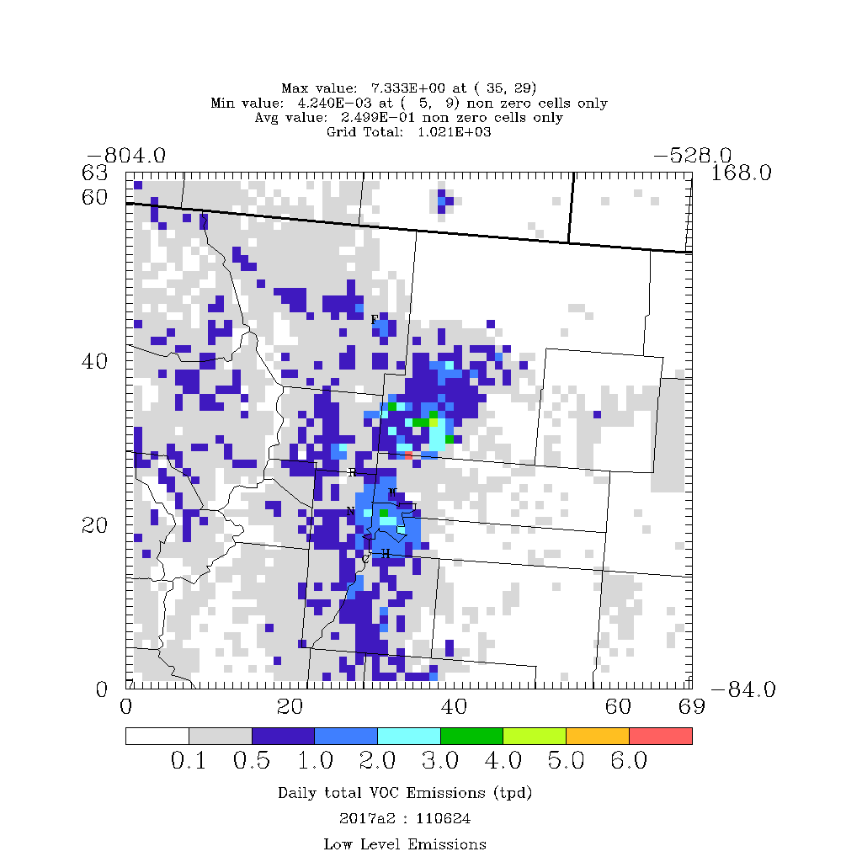
PAMS
Daily total VOC emissions
Concentrated in O&G area

Slide 30
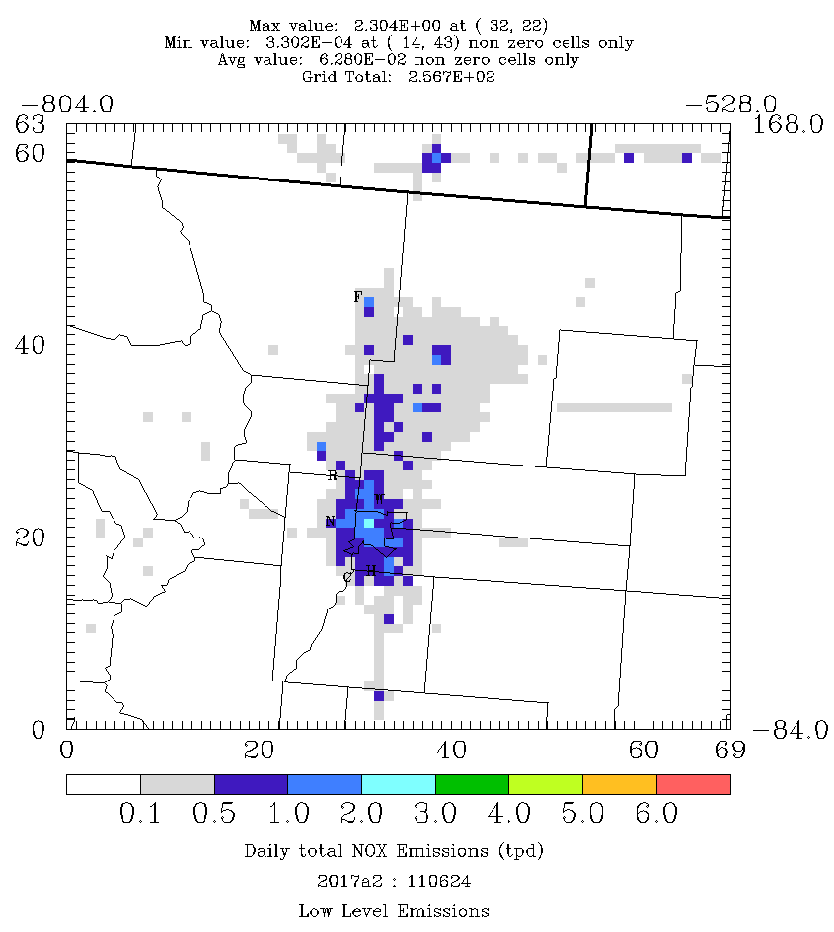
PAMS
Daily total NOx emissions
Concentrated in urban area

Slide 31
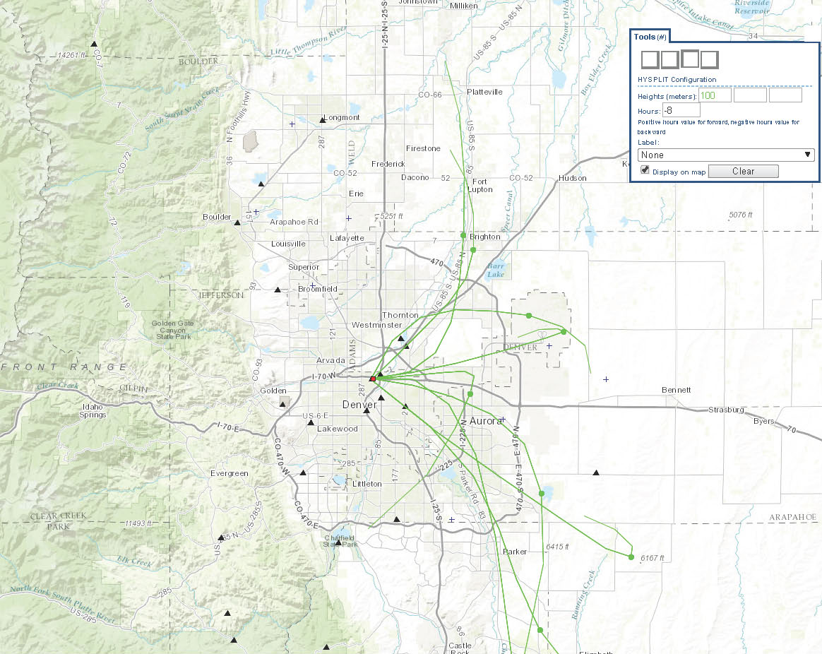
PAMS
8 hr - Back Trajectories for the 10 Highest RFN Ozone Days in 2016 at La Casa Beginning at 14:00
La Casa gets overlapping influences from urban and oil/gas development

Slide 32
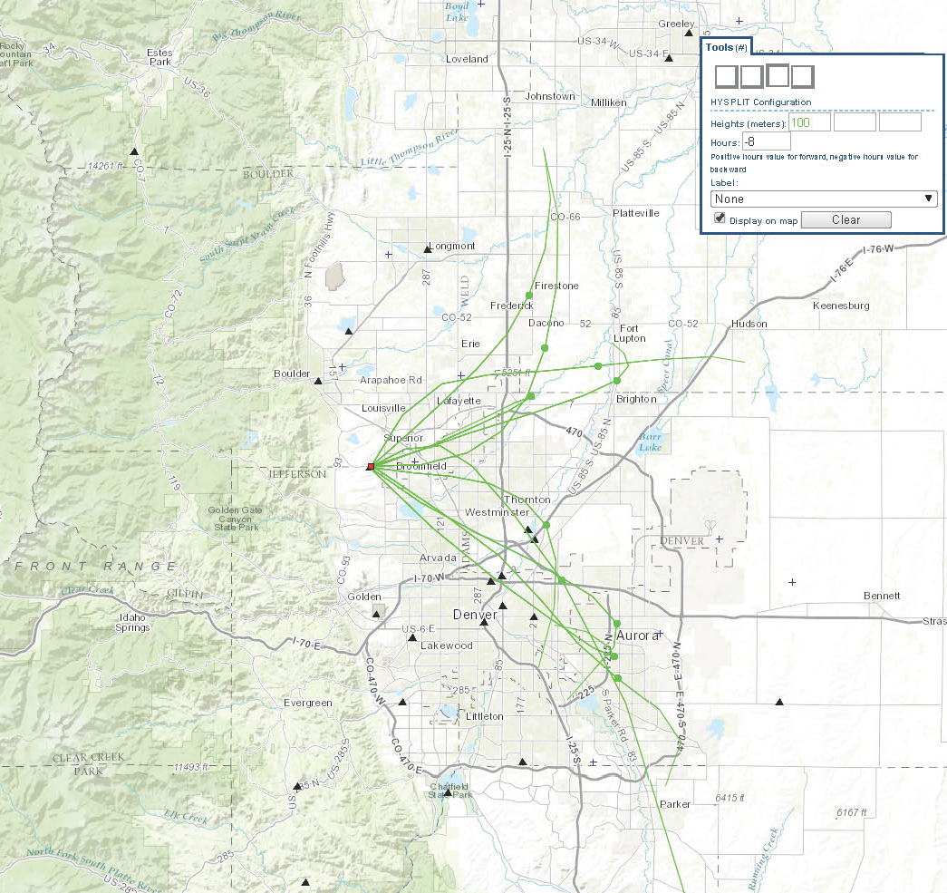
PAMS
8 hr - Back Trajectories for the 10 highest ozone days in 2016 at Rocky Flats-North beginning at 14:00
RFN gets separated influences from urban and oil/gas development
→ Better scenario

Slide 33
Colorado oil and gas regulations

Slide 34
Oil and Gas Regulations
(Reg. #7) - Background
Colorado has been a national leader in regulating air emissions from the oil and gas production sector
2004 rulemaking to reduce VOC emissions from O&G sources in the Denver Metro/North Front Range as part of Ozone Early Action Compact
2006 update to rules and adoption of new requirements with statewide applicability
2008 Ozone Action Plan to address non-compliance with the Federal ozone standard
2014 rulemaking to address VOC and methane emissions, inspections
  Now fully implemented
Notes:
4 significant rulemaking in past decade.
Some driven in large measure by O3
O&g measures one in a suite of complementary strategies. Power plants. Vehicles.
Re: power plants, CACJA. Have significant NG in CO. Promoting clean burning natural gas. Minimizing leakage of the at gas is one of ways ensure envt’l benefits are fully realized, and that the valuable resources enjoys maximum beneficial use

Slide 35
Rationale for
2014 Oil and Gas Rules
Directive from Governor Hickenlooper to find ways to reduce leakage from natural gas production
  Responsible development
  Reduce waste
  Maximize climate change benefits of natural gas usage
Ensure benefits from existing rules for petroleum storage tanks
Proactively address non-compliance with the ozone National Ambient Air Quality Standard while also reducing methane emissions which contribute to global climate change

Slide 36
2014 Rulemaking Effort Goals
Identify and implement strategies that improve the effectiveness and efficiency of Colorado’s air quality program
Address the growth in oil and gas development through the adoption of reasonable emission reduction strategies
Find ways to reduce permitting burdens for both the Division and the regulated community without impacting environmental benefits from the permitting program
Lay the groundwork for ongoing efforts to reduce oil and gas emissions while minimizing burdens that don’t provide environmental value

Slide 37
Overview of Adopted Strategies
Establishes leak detection and repair requirements for compressor stations and well production facilities
Expands control requirements for storage tanks
Improves capture of emissions at controlled tanks
Expands control requirements for glycol dehydrators
Establishes requirements to minimize emissions during well maintenance and liquids unloading
Expands pneumatic controller requirements statewide
Requires auto-igniters on all combustion devices

Slide 38
Federal New Source Performance Standards, Subpart OOOO
Primary NSPS OOOO Elements
  Gas well completion requirements
  Compressors – centrifugal (wet seals) and reciprocating (rod packing)
  Pneumatic devices – tracks with State requirements (6 scf/hr)
  Hydrocarbon storage tanks – many elements track State requirements
  Fugitive emissions – also similar to State approach
Colorado Perspective/Efforts
  Colorado and EPA rules very similar by design
  Compliance evaluations done on a case by case approach

Slide 39
Ozone bump-up SIP

Slide 40
2008 8-Hour Ozone Standard
Marginal Nonattainment Area
  Designation – July 2012
  Attainment deadline – July 2015
    Based on 2012-2014 monitoring data → did not attain
Moderate Nonattainment Area
  Bump-up to next highest classification – Published in FR May 2016
  Attainment deadline – July 2018
    Based on 2015-2017 monitoring data
  Required SIP revision that meets Moderate area obligations per:
    Clean Air Act – Sec. 182(b)
    EPA’s SIP Requirements Rule for the 2008 Ozone Standard (March 2015)

Slide 41
Ozone bump-up SIP
SIP is the result of a 16-month planning process
Significant level of technical, strategy and regulatory analysis
  Detailed base year and future year emission inventories
  Photochemical dispersion modeling and weight of evidence analysis
  Emission reduction measures evaluations
  Establishment of motor vehicle emission budgets
  Proposed regulation revisions
RAQC/APCD had over 40 public meetings and numerous presentations/discussions with other organizations
RAQC Subcommittees considered and evaluated a wide range of strategies for implementation and future evaluation
  Stationary/Area Sources Subcommittee
  Mobile Sources/Fuels Subcommittee
  Transportation/Land Use/Outreach Subcommittee

Slide 42
Rulemaking process
Development by RAQC
  Modeling shows attainment by 2017
Approval by AQCC (Nov. 2016)
  Air Quality Standards: Revise vehicle emission budgets
  Regulation 11: Put current state-only NFR I/M area into SIP
  Regulation 7: Bump-up SIP measures include oil & gas requirements, RACT
Other “SIP fixes” unrelated to bump-up SIP
Legislative review (→current status)
Transmittal to EPA

Slide 43
Required SIP elements
2011 Base Year Emissions Inventory
Reasonable Further Progress (RFP) Demonstration
  15% reduction in VOC emissions by 2017
Attainment Demonstration And Weight of Evidence Analysis
Reasonably Available Control Measures (RACM) Analysis
  Technologically and economically feasible measures
  Qualify if quantifiable, enforceable, permanent or surplus
Stationary Source Control Programs
  Reasonably Available Control Technology (RACT) for existing sources
    The lowest emissions limit a particular source can meet by applying technology that is reasonably available, considering both technological and economic feasibility
  Nonattainment New Source Review (NSR) for new sources
Motor Vehicle Inspection and Maintenance (IM) Program
Contingency Measures Plan
Motor Vehicle Emissions Budgets (MVEB)
Notes:
EPA defines RACT as the lowest emissions limit a particular source can meet by applying technology that is reasonably available, considering both technological and economic feasibility.

Slide 44
Control measures in SIP
Federal On-Road and Non-Road Mobile Source Standards/Regulations
  Light-duty vehicle and fuel standards
  Heavy-duty vehicle and fuel standards
  Non-road engine standards
Inspection and Maintenance Program
  AQCC Regulation No. 11 – Including requirement for Larimer and Weld
Oil and Gas Regulations
  AQCC Regulation No. 7 – Current and proposed provisions in Sec. XII
7.8 Reid Vapor Pressure (RVP) with 1 PSI Ethanol Waiver (8.8 RVP)
Stage I Vapor Recovery at Gas Stations
Power Plant Emissions Reductions – Clean Air Clean Jobs & Regional Haze
  AQCC Regulation No. 3
Other Stationary Source Regulations
  AQCC Regulation No. 3, No. 6, and No. 7

Slide 45
Current State-Only Ozone Strategies (not in SIP)
Stationary sources
  Oil & gas leak detection
  Energy efficiency and renewables
Mobile sources
  Electric vehicles
  Diesel retrofits
  Alternative fuels
Lawn mower exchanges
Education and outreach
Transportation planning

Slide 46
Current and Future Plans

Slide 47
Monitoring and data analysis plans
Continue ozone precursor sampling
Continue work with Garfield County
Continue to monitor and evaluate nitrogen deposition in RMNP
Possibly add NOx monitors in NFR in oil and gas development area
Full FRAPPÉ and DISCOVER-AQ analysis by NCAR, due by 6/30/2017
  Information to be used in SIP and regulation development

Slide 48
Current and future policy work
Ozone State Implementation Plan (SIP)
  NOx and VOC reductions critical
  Emissions inventory improvements
  Modeling improvements needed to capture complex and changing industry, topography, circulation, etc.
  Possible bump-up SIP to “serious”
CTG’s
RACT/RACM
Regional Haze
Nitrogen Deposition

Slide 49
2015 Ozone Standard Implementation
2016
2017
2018
2019
2020
2021
2022
2023
2024
2014
2015
①
②
③
④
⑤
⑥
① 70 ppb standard finalized – Oct. 2015
② State designation recommendations due Oct. 2016; EPA proposed implementation rule for 70 ppb standard
③ EPA finalizes designations & classifications Oct. 2017
  - Effective Jan. 2018
④ Marginal Area attainment date – Jan. 2021
⑤ Moderate Area SIP revisions due Jan. 2021
⑥ Moderate Area attainment date – Jan. 2024

Slide 50
Inventory Assessment
Big Inventory Questions
  Inventory quality for Criteria Pollutants + Ozone precursors
  Needs for source apportionment
    Source apportionment modeling currently ongoing
  Studies suggest most emissions come from “fat tail” effects
  Need to know if we are missing anything
  Emission factors need work
VOCs
  Source Speciation Profiles needed
  Can we distinguish things like fuel evaporation, mobile, etc.
NOx
  How does the State inventory compare with observations?
SO2, PM, etc.
Notes:
Speciated inventories will vary in quality as VOCs are reported generally as a lump sum of >C3 hydrocarbons
CDPHE does track HAPs, though there a many minor sources below reporting thresholds that could add up—this needs to be evaluated

Slide 51
Potential ozone reduction strategies
Reasonably Available Control Technologies (RACT) for stationary major sources
  Existing and new sources
  Requested RACT analyses from ~50 major sources
  Engines, boilers, turbines, breweries, others
  Analyses due December 2017
  Determine RACT in 2018-2019
Evaluating additional oil and gas reductions
  October 2016 Control Techniques Guidelines trigger RACT
  Considering intermittent pneumatic controllers
  Other reductions possible
Study of gasoline fuel specifications
Low-VOC architectural coatings
Lawn and garden equipment
Volkswagen settlement projects
  Charging stations
  Vehicle replacement/repowering

Slide 52
Control Techniques Guidelines
Control Techniques Guidelines (CTGs)
  Issued by EPA on October 20, 2016
  For reducing smog-forming volatile organic compound (VOC) emissions from existing oil and natural gas equipment and processes in certain states and areas with smog problems
CTGs are designed to assist states that are required to address VOC emissions from covered oil and gas sources as part of their state plans for meeting the ozone NAAQS
Affected areas and states will have to address the sources covered in the guidelines as part of state plans for meeting the ozone standards
The RACT recommendations in the oil and gas CTGs include technologies and approaches, such as replacing high-bleed pneumatic controllers with low-bleed controllers and replacing rod packing on a regular recommended schedule, that are widely available at a reasonable cost to reduce the amount of natural gas – and the VOCs that come with it -- that is vented to the air
Stakeholder meetings currently being held

Slide 53
Challenges with ozone
Background and transported ozone
Natural events
  Wildfires
  Stratospheric intrusions
Meteorology
Elevation
Population and economic growth increases emissions
NOTE: New Federal policies may change regulations and implementation schedules

Slide 54
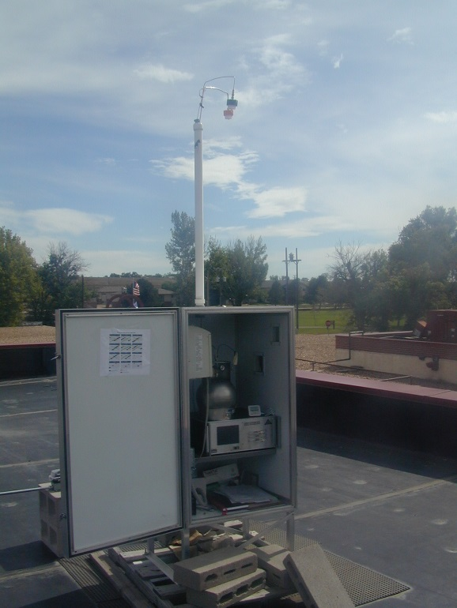
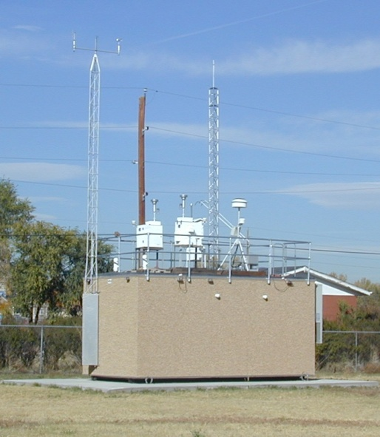
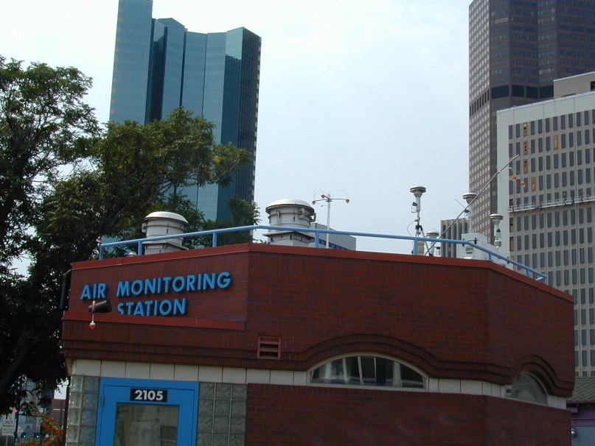
Questions?
Gordon Pierce
gordon.pierce@state.co.us
303-692-3238

