Slide 1
Volkamer Group Research

Slide 2
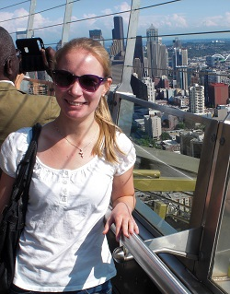
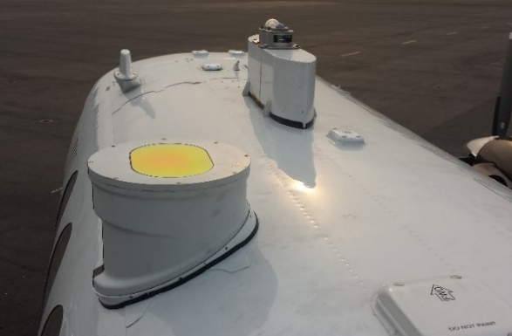
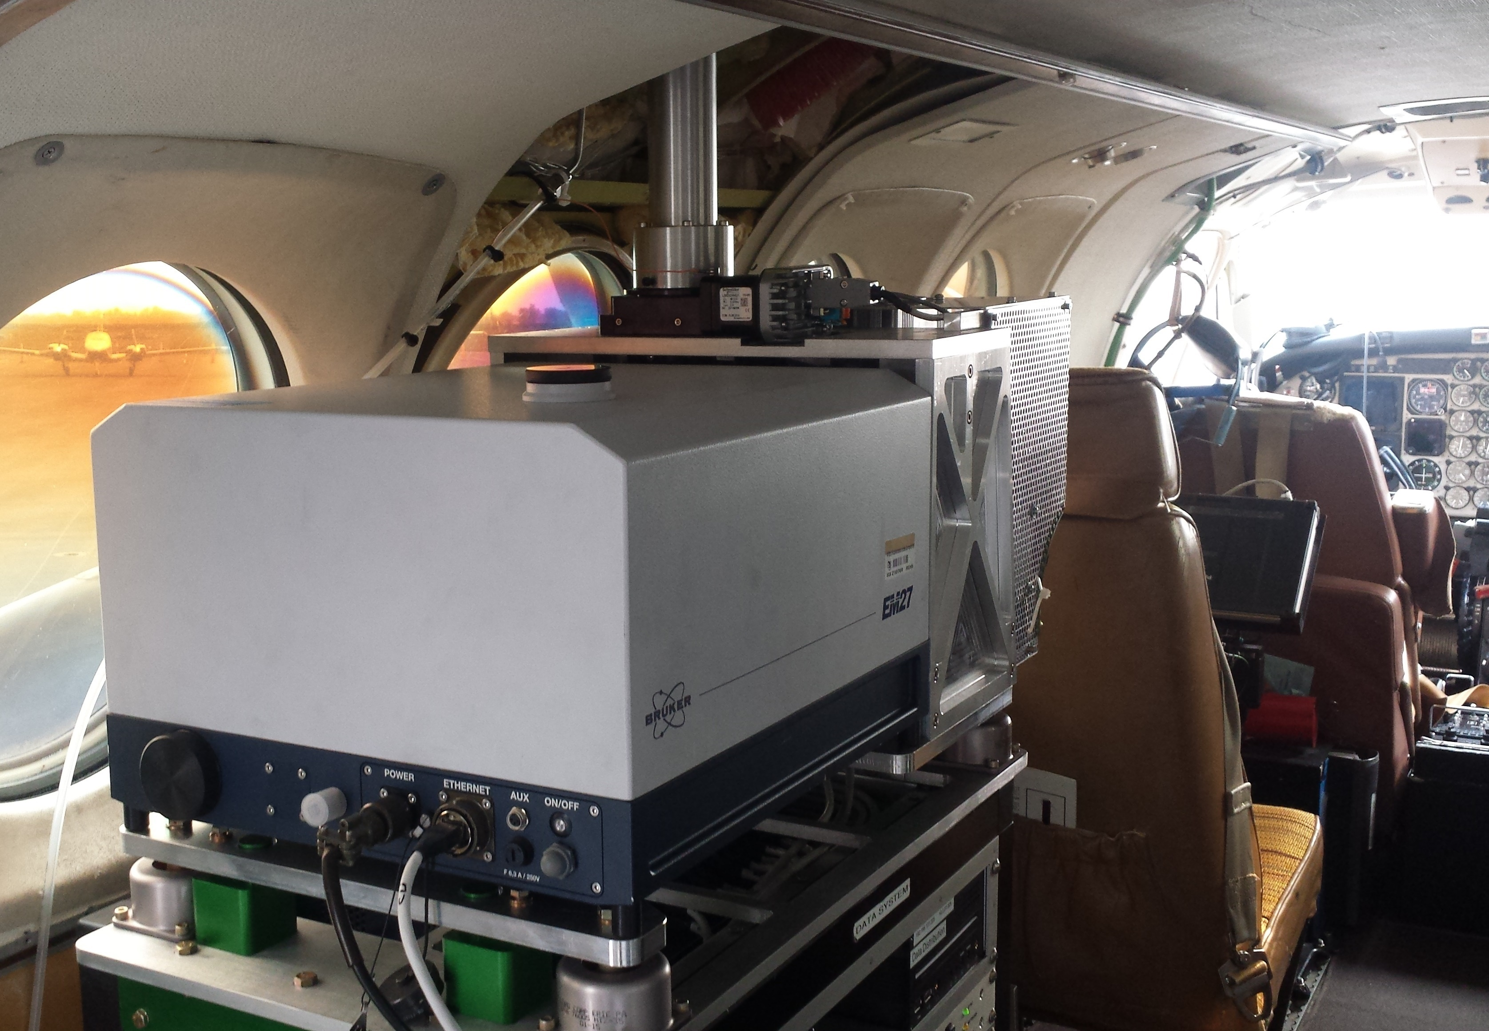
Solar Occultation Flux (SOF)
Digital solar tracker coupled to a Fourier transform infrared spectrometer (FTIR)
Using EM27 (0.5 cm⁻¹ resolution), 2 second spectra
ZnSe window
Species | Interfering species | Wavenumber range
NH₃ | O₃, H₂O, CO₂, C₂H₄ | 950 – 980 cm⁻¹
CO | H₂O, CH₄ | 4270 – 4303 cm⁻¹
C₂H₆ | CH₄, H₂O, O₃, C₂H₄, H₂CO, HCl | 2970 – 3000 cm⁻¹
C₂H₄ | H₂O, NH₃, O₃, CO₂ | 940 – 1000 cm⁻¹
CH₃OH | CO₂, O₃, H₂O, NH₃ | 980 – 1040 cm⁻¹
HCOOH | O₃, H₂O, NH₃, CO₂, CH₄ | 1090 – 1120 cm⁻¹
…
Kille et al., 2017, AMT
Notes:
No inlets
Columns average over inhomogeneity within a plume

Slide 3
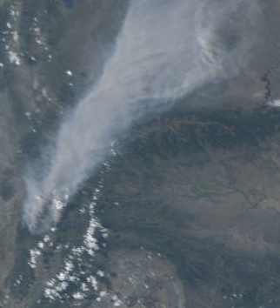
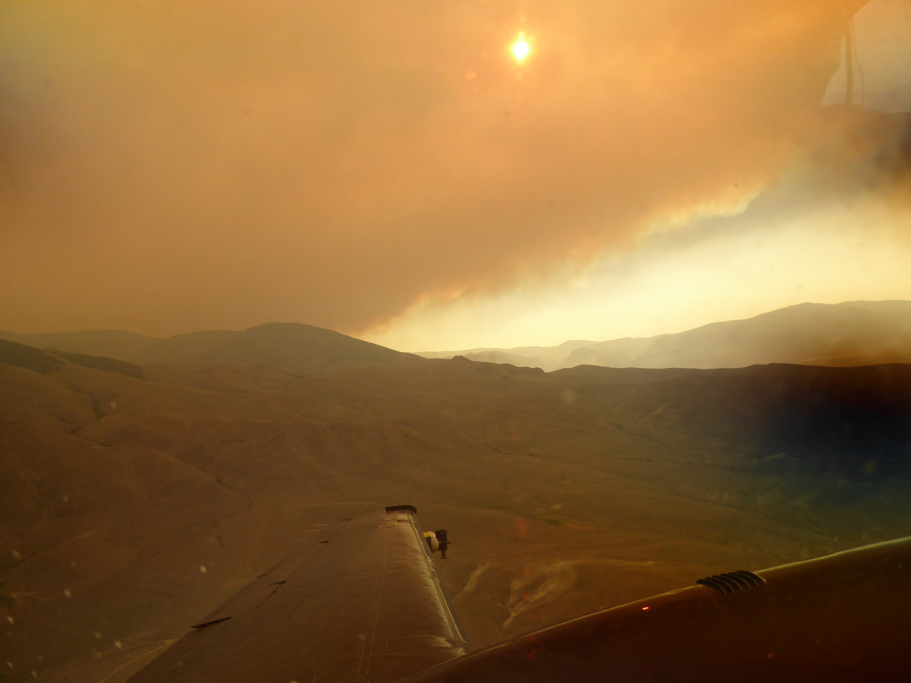
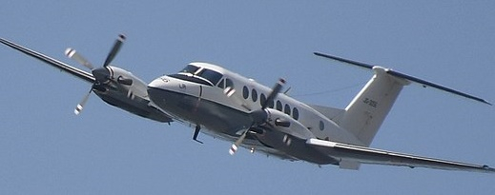
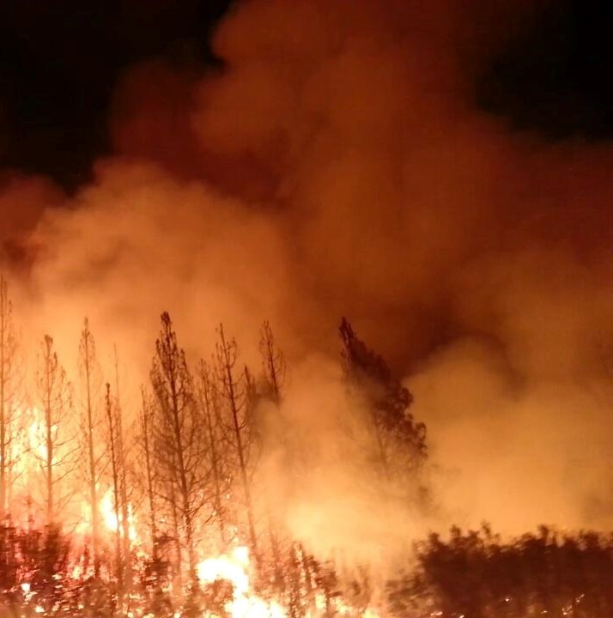
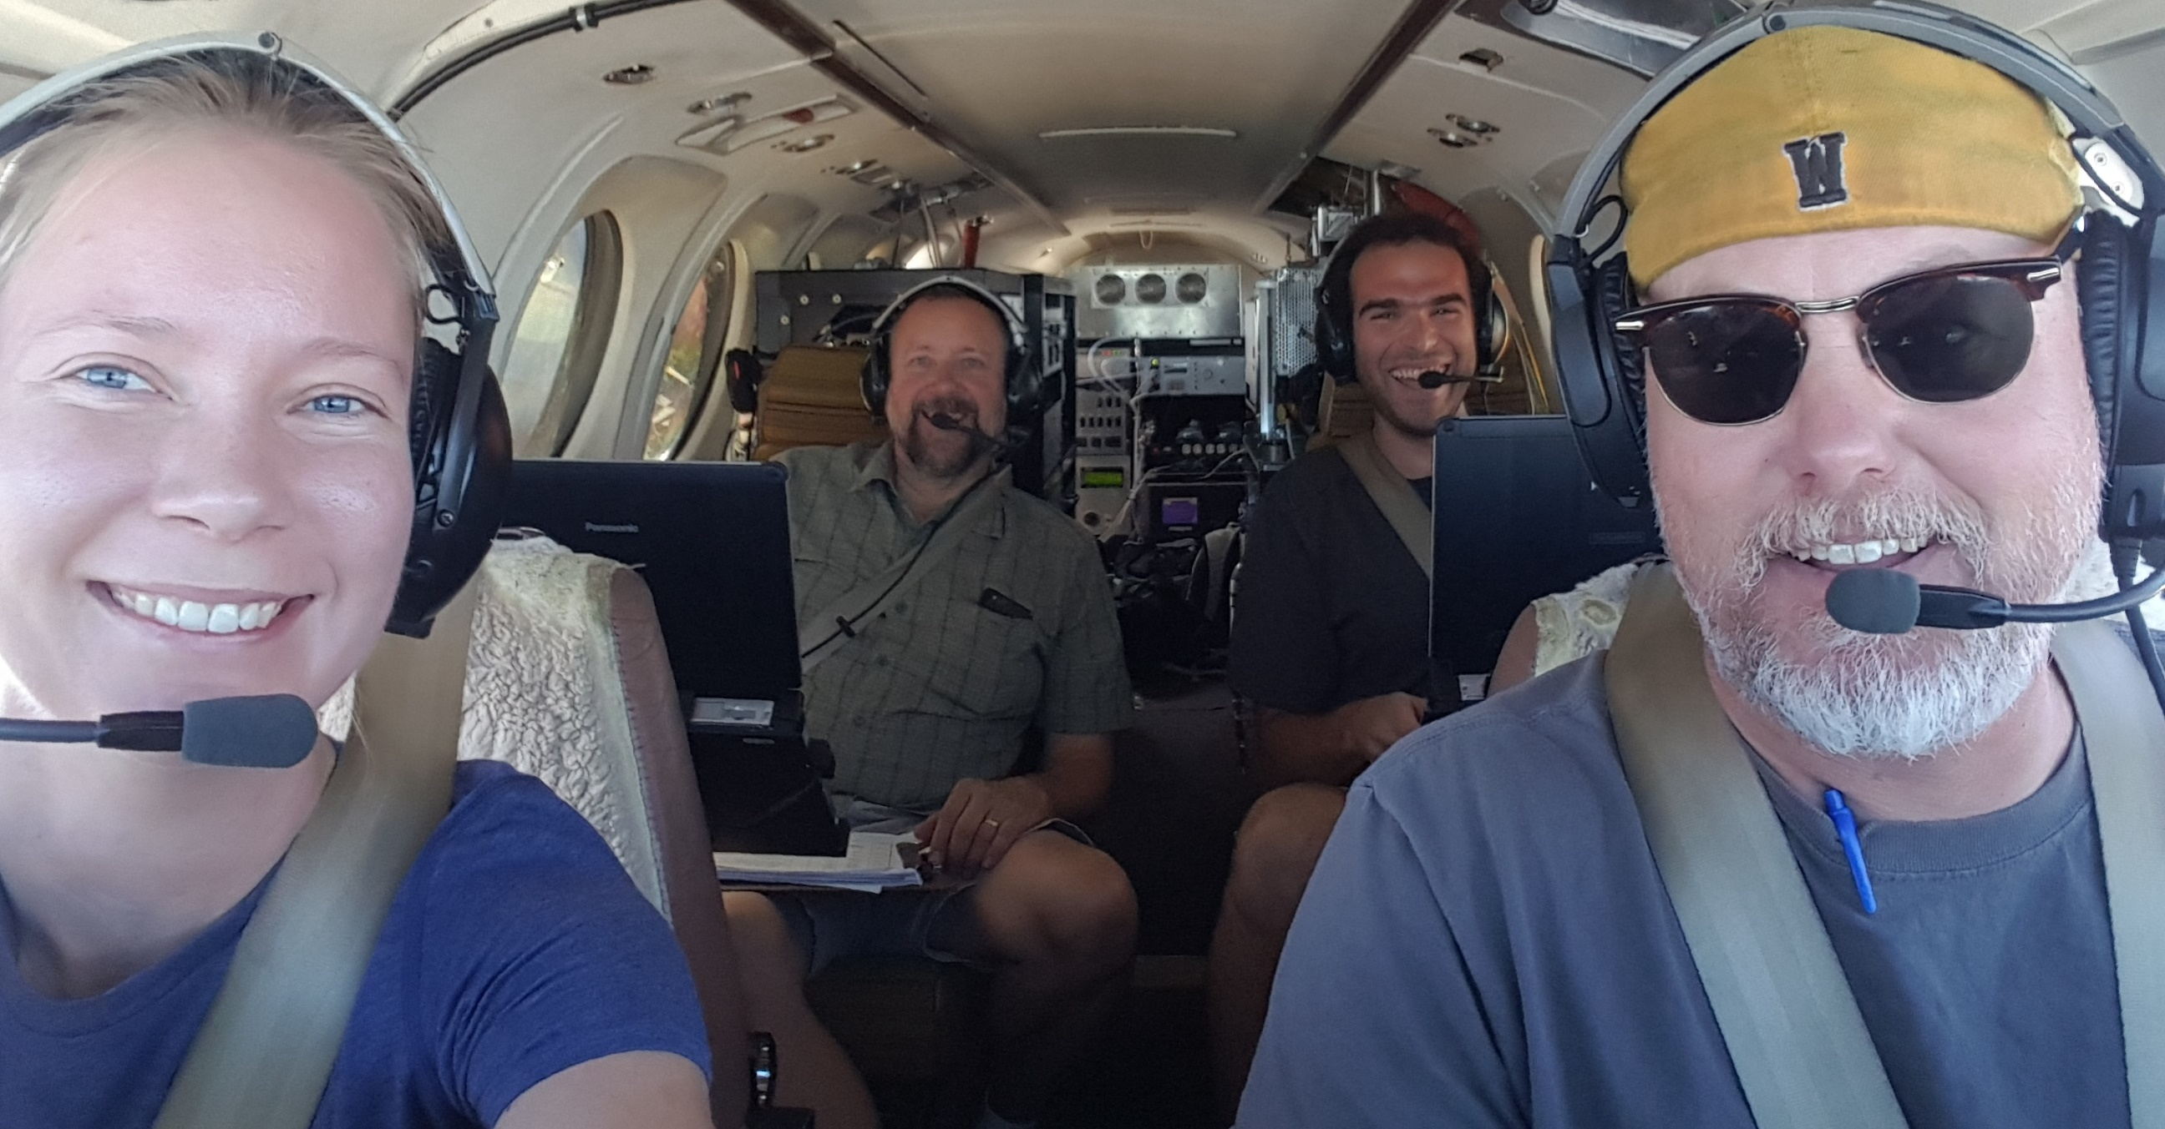
Quantifying fluxes in the field
Wind
Measure concentration, wind speed and direction Calculate flux
Fly under the plume and measure the changes in the solar spectrum in and out of plumes
Column measurement integrates over vertical inhomogeneities

Slide 4
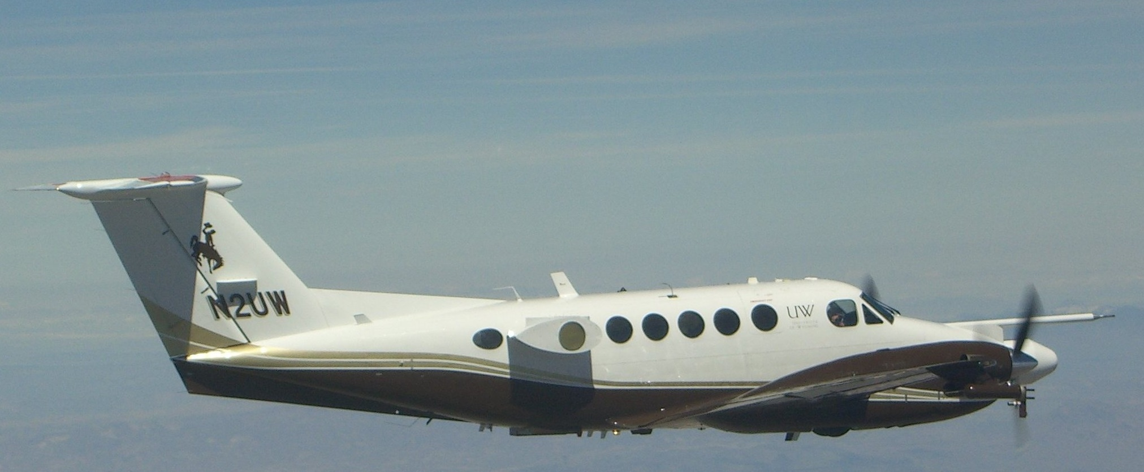
2018 BB-FLUX payload
CU SOF
Wyoming Cloud Lidar
Zenith Sky DOAS (ZS-DOAS) - CU
Direct Sun DOAS (DS-DOAS) - CU
In situ aerosol sizer/counter
DOAS and SOF to measure columns/quantify fluxes
Lidar to measure plume heights
In situ aerosol and trace gas (O₃, CO₂, CO), wind sensors for in plume measurements

Slide 5
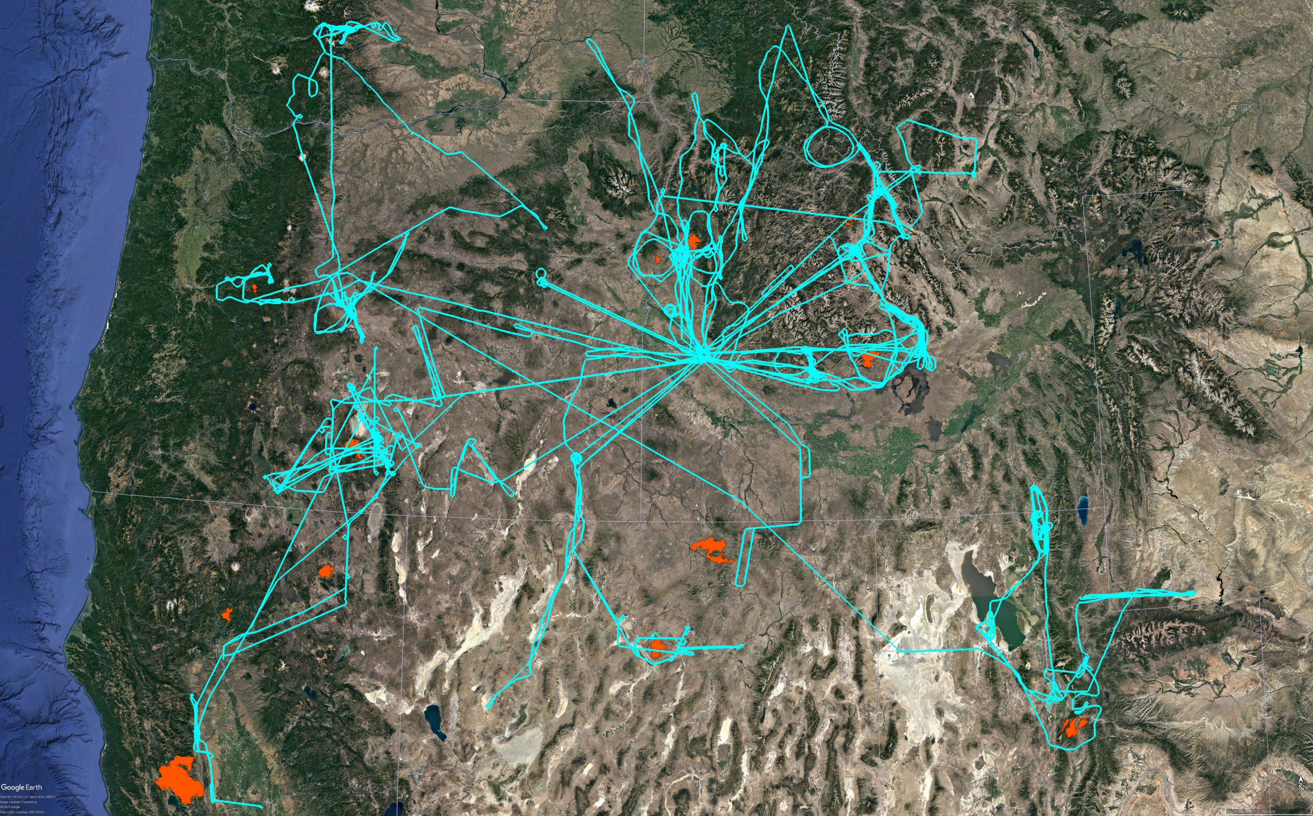
BB-FLUX- July to September 2018
37 RFs to 18 fires (60+ profiles & 125+ plume underpasses)
Miriam
Reynolds Lake
Rattlesnake Creek
Terwilliger
Keithly
Mesa
Rabbit Foot
Tepee
Sharps
Stewart Creek
Watson Creek
South Sugarloaf
Hirz
Stone
Sheep Creek
Pole Creek/
Bald Mountain
Mendocino
Notes:
Mention that did multiple passes for each RF to probe temporal variability during one day
Did repeats to probe variability over multiple days
Transition to next slide using the equation

Slide 6
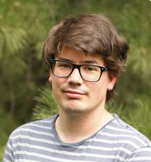
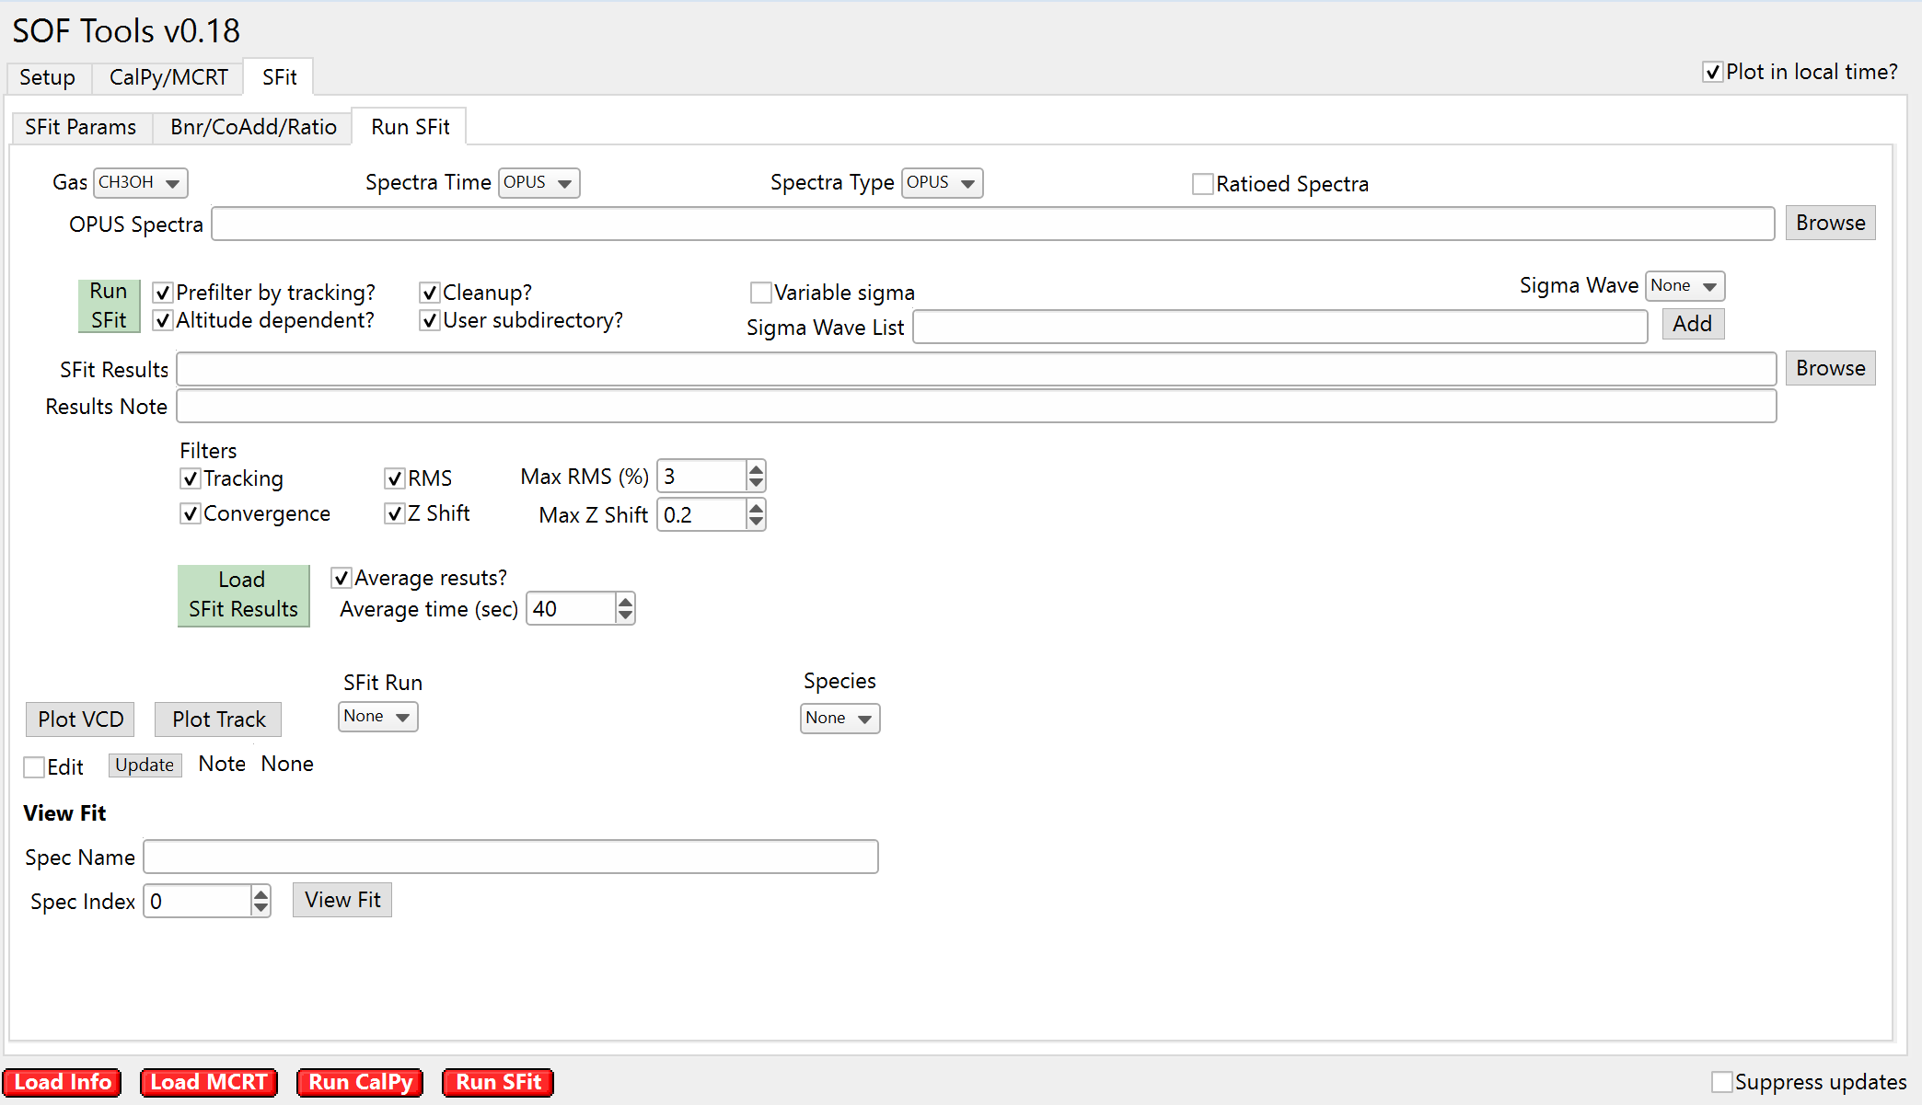
V Group SFit
Running on Windows 10 using Windows Subsystem for Linux (instructions available)
Using Python 2.7, will test 3 shortly
Igor runs batch files to call Python to call SFit

