Slide 1
Introduction
SFIT Retrieval Workshop
J Hannigan
NCAR, Boulder, CO
November 2019

Slide 2
Outline
Past SFIT /Retrieval / Error Analysis Workshops
What we hope to do here
Structure of SFIT vs Batch processing
Outline of this workshop

Slide 3
Previous SFIT2 / SFIT4 / Retrieval IRWG Workshops 1/3
SFIT2 Workshop
May 2000 BIRA, Brussels, Belgium, hosted by M. De Maziere
Attendees:
Nicolas Jones, Steve Wood, Curtis Rinsland, Clive Rodgers, Nikita Pougatchev, Frank Hase, Yongjing Zhao, Justus Notholt, Claude Camy-Peyret, Sebastien Payan, Johan Mellqvist, William Bell, Emmanuel Mahieu, Philippe Demoulin, Francine Melen, Rudy Zander, Ralf Sussmann, Wolfgang Wimmer, Merritt Deeter, Leonid Yourganov
“Participants who have some sfit2 experience are requested to bring along one or two transparencies to briefly say something about what they have learned in the context of their local conditions.”
“The biggest need is for a new document advising on “good practice” points for use with SFIT2.”
Marked the beginning of wide use of profile retrievals for IRWG type high resolution solar spectra
  Quick reference on basic formulae.doc
  Averaging Kernels and errors.doc

Slide 4
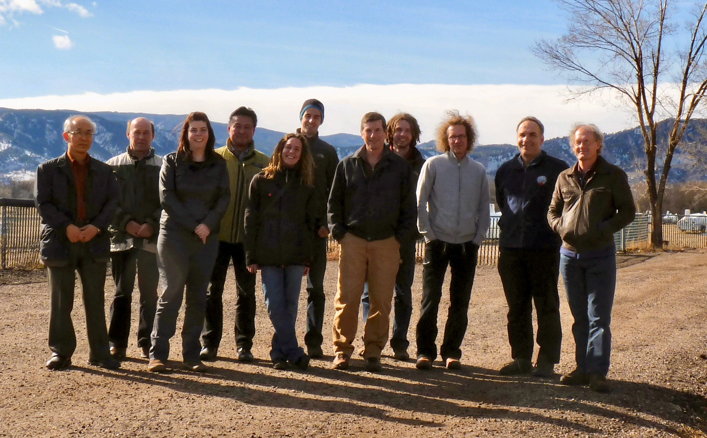
Previous SFIT2 / SFIT4 / Retrieval IRWG Workshops 2/3
IRWG – NORS Retrieval & Error Analysis Workshop
January 2013 NCAR, Boulder, CO hosted by J Hannigan
Shortly after the adoption of the standard retrieval parameters for all 10 NDACC species
Move to SFIT4
Beginning of OE error estimation
  How would we do this efficiently?
Definition of batch processing
  Collected batch processing techniques from many goups to optimize a set of procedures that would be acceptable / useful to all groups

Slide 5
Nested Scripts for Calling Spectra Process & Fitting Codes
Raytrace for one atmosphere/sza
Create fastcode & sfit2 inputs for one spectrum/gas/sza
fastc.k
Checks input
Calls fastcode
Calls fastconvert
Re-Names output
fastcode
Fit many years/gases
Fit one year/many gases
fastcnvert
fitalot
Send multiple slists to fitbn
fitbn
Gathers spectra
Gets binput template
Gets atmos. model
Writes fitone.inp
Calls fitn.k
Saves output
fitn.k
Edits input files
Calls fastc.k
Calls sfit2.k
Make T15 & fit one spectra/gas/sza
specasc6
sfit2.k
Expects all files
Calls specasc6
Calls sfit2
sfit2
flist
rlist
Slist.YY
fitone.inp

Slide 6
Previous SFIT2 / SFIT4 / Retrieval IRWG Workshops 2/3
Interconnect diagram for requirements of the SFIT4 batching processing.

Slide 7
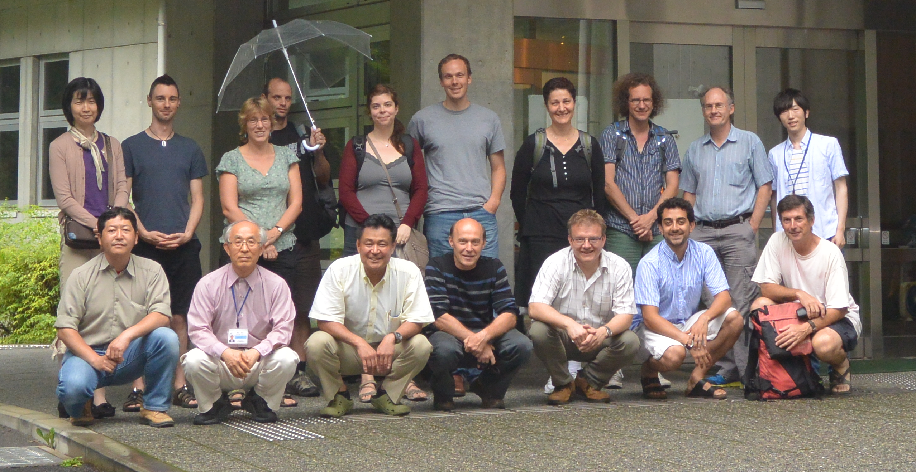
Previous SFIT2 / SFIT4 / Retrieval IRWG Workshops 3/3
SFIT4 – Error Analysis Workshop
June 2013 NEIS, Tsukuba Japan, Hosted by Hideake Nakajima
Introduction of the SFIT Processing Environment
Refinement of Kb calculations
Bug fixes in SFIT4
Goals for the meeting:
a core group who are very familiar with a standard processing method, issues and tools,
a deeper understanding of error issues and limitations
further implementation of a general set of tools and documentation required to produce reasonable error estimates and create the IRWG HDF data that would be available to all IRWG/NORS members at the IRWG web site.
agreement on and a path toward ‘completing’ these tools
plans to implement these methods back at their home institute for testing, verification and operational use.

Slide 8
What we hope to do here
Less development, more teaching & learning on all sides
Answer your questions
Dig inside how sfit works how to make it work for you
Test latest version (wiki) V1.0pr & latest linelist including ATM2010910
A more savvy user community especially as we move towards external processing
Consolidate and complete documentation
  We envision 3 documents
    SFIT4 Theory, Input, Outputs (many pieces already exist…)
    SFIT4 Processing Environment (this generally exists: “Optical Techniques FTS Profile Retrieval Processing”)
    SFIT4 User Manual, Tips, Examples (some pieces exist…)

Slide 9
Outline of this workshop
    Mornings
    Presentations of components of SFIT4 and the processing Environment
    SFIT4 theory, Spectroscopy, forward model, Band, Retrieval parameters
    Including discussions of these
    Afternoons
    More open discussions
    Your questions and issues discussed
    Discussions of examples or of earlier presentations or ?

Slide 10
Structure of SFIT4 vs Batch processing 1/
    Much more detail to follow, and we all have thousands of spectra to process but to start at the beginning: SFIT4 fits one spectrum at a time. So when we talk about SFIT4 or talk about an issue with fitting a spectrum we are talking about just running SFIT4. A user should know what SFIT4 needs to run and what SFIT4 outputs for diagnostics. And this is very different than what the processing environment requires:
      This leads ease of diagnosing any issue
      Leads to more direct communication when asking about an issue: ie. What constitutes a ”testcase”
      The structure of SFIT4 and the Processing Environment was specifically designed to be modular & concentric.

Slide 11
Structure of SFIT4 vs Batch processing 2/
Flexibility – Exploratory analysis tool
Two foci of sfit4
Development
  S_{a} (S_{a}⁻¹) definition / direct input
  Background parameters (slope, curvature, zero)
  Shifts, by species, by fit
  Channeling
  SNR by region
  Multiple regions / SZA
  Fit gas by region
  Phase, ME
  Isotope separation
  Solar background /shift
  Levenberg-Marquardt non-linear iteration scheme
  Emission spectra
  Log(vmr) retrieval
  Line mixing (co2, ch4 soon…)
  SDV speed dependent Voigt lineshape
  Spectra output by layer / gas
  O2 CIA line data included
Process & I/O Speed –
NDACC operational processing
  Standard layering
  Binary HITRAN input
  Binary output for HDF ?

Slide 12
Structure of SFIT4 vs Batch processing 2/
These (mainly) constitute a fit

Slide 13
Structure of SFIT4 vs Batch processing 3/
map of Input & Output files
! --- SET DEFAULT FILENAMES
TFILE(08) = 'pbpfile'
! --- ISOTOPE SEPARATION FILE
TFILE(09) = 'isotope.input'
TFILE(15) = 't15asc'
TFILE(16) = sfit4.dtl'
! --- STATEVEC
TFILE(18) = 'statevec'
! --- SET MIXOUTPUT FILENAME AS STATE VECTOR FILENAME + .MXF
TFILE(17) = TRIM(TFILE(18))//'.mxf'
! --- SAVED SYNTHETIC SPECTRUM
TFILE(19) = 'synspec.out'
! --- SUMMARY
TFILE(20) = 'summary'
! --- EMPIRICAL MODULATION FUNCTION
TFILE(23) = 'ils.dat'
! --- EMPIRICAL PHASE FUNCTION
TFILE(24) = 'ils.dat'
! --- DEFAULT COMPLETE SA OUTPUT FILENAME
TFILE(63) = 'Sa.complete'
! --- DEFAULT K,SE,SA MATRICES OUTPUT FILENAME
TFILE(66) = 'K.out'
! --- SE OUTPUT
TFILE(67) = 'Se.out'
! --- DEFAULT K TRANSPOSED FILENAME
TFILE(68) = 'KT.out'
! --- LEVENBERG-MARQUARDT DETAILS
TFILE(70) = 'detail.opt'
! --- LAYERING SCHEME - OUTPUT FROM WACCM PROFILES
TFILE(71) = 'station.layers'
! --- REFERENCE VMR PROFILES
TFILE(72) = 'reference.prf'
! --- RAYTRACE DETAILED OUTPUT AKA TAPE6
TFILE(73) = 'raytrace.out'
TFILE(74) = 'raytrace.pt'
TFILE(75) = 'raytrace.ms'
TFILE(76) = 'raytrace.mix'
TFILE(77) = 'raytrace.sa'
TFILE(78) = 'raytrace.pnch'
! --- CHANNEL OUTPUT
TFILE(30) = 'chnspec.data1'
TFILE(40) = 'chnspec.data2'
! --- SET SHORT FILENAME AS SUMMARY FILENAME + .ST
TFILE(31) = TRIM(TFILE(20))//'.st'
! --- DEFAULT FIRST RETRIEVAL GAS SA OUTPUT FILENAME
! --- OUTPUT DEPENDS ON NAME SA .NORM, .VMR, .PCOL
TFILE(61) = 'Sa.norm'
! --- DEFAULT SAINV INPUT FILENAME
TFILE(62) = 'Sainv.input’
! --- RESERVED FOR GASOUT NAME CHANGES - SEE FRWDMDL.F90
!TFILE(80)
TFILE(80) = ”gas.<gas>.<band>.<scan>.<itr>”
TFILE(81) = 'AK.out'
TFILE(82) = 'SM.out'
TFILE(83) = 'SS.out'
TFILE(84) = 'A-S.out'
TFILE(85) = 'AEIGEN.out'
TFILE(88) = 'PRFS.out'
TFILE(89) = 'Parm.out'
TFILE(91) = 'Spec.out’
May 2014
NDACC IRWG / Jena, Germany
13

Slide 14
Structure of SFIT4 vs Batch processing 4/4 Testcase
required inputs
required output
sfit4.ctl
Retrieval specific params:
Region
Species
State vector
sit4.dtl (detail file)
Step-by-step of retrieval process
Verification of inputs
Summary of raytracing
Statevector on every iteration
t15asc4
Spectrum specific params:
Date/Time
Solar zenith angle
N spectra
sfit4
Raytracing
Forward Transmission / Emission Model
retrieval
spc.all.01.01.final (Spectra output file)
This file and others for individual specie plotting
pbpfile (Spectra output file)
Input, output difference spectra
stations.layers
Layering for each site
From WACCM
reference.prf
Z-p-T for reference profiles
Reference (apriori) chemical profiles
Binary (HITRAN) Line list file

Slide 15
The Rest of the Workshop
    Your feedback is important so we can
    Improve documentation and
    Future workshops
    Improve SFIT4 functionality and usability
    The workshop is informal and all presentations are open for discussion
    Visit: https://wiki.ucar.edu/display/sfit4/
    Enjoy the workshop!

Slide 16
end

