Slide 1
Wollongong Site Report 2023
Nicholas Jones, Nicholas Deutscher, Clare Murphy, Dave Griffith, Susan John, Justin Takacs
Overview:
a. A brief summary covering the period 2020 to date since no meetings were held and there were extraordinary covid related issues
b. Current status: instrument, site logistics, operational, funding,
c. Any losses sustained due to covid: personnel, data
d. Outlook 2023 & beyond

Slide 2
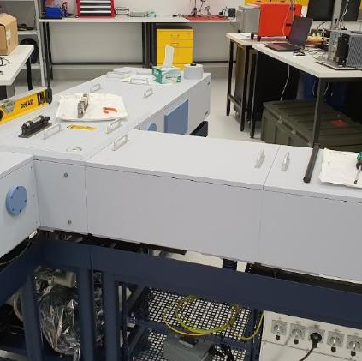
Wollongong site 2020 to June 2023
Australia went into lockdown March 2020. In the state of NSW, (where UoW is located) lockdowns occurred for various periods in 2020 and 2021. The University campus remained in online mode through this period, while transitioning to “blended” learning in 2022/2023.
The financial response of UoW to this situation impacted our (small) research group with the loss of 2 staff.
International students not supported by Australian Federal Govt.
TA new Bruker HR125 was planned and purchased in 2019/2020, arrived in January 2021 but the commissioning was delayed until July 2021.
The system was installed in a new building, whose commissioning was slow, so this also impacted the installation.
The existing HR125 NDACC/TCCON system was not impacted significantly as the measurements are largely automated.

Slide 3
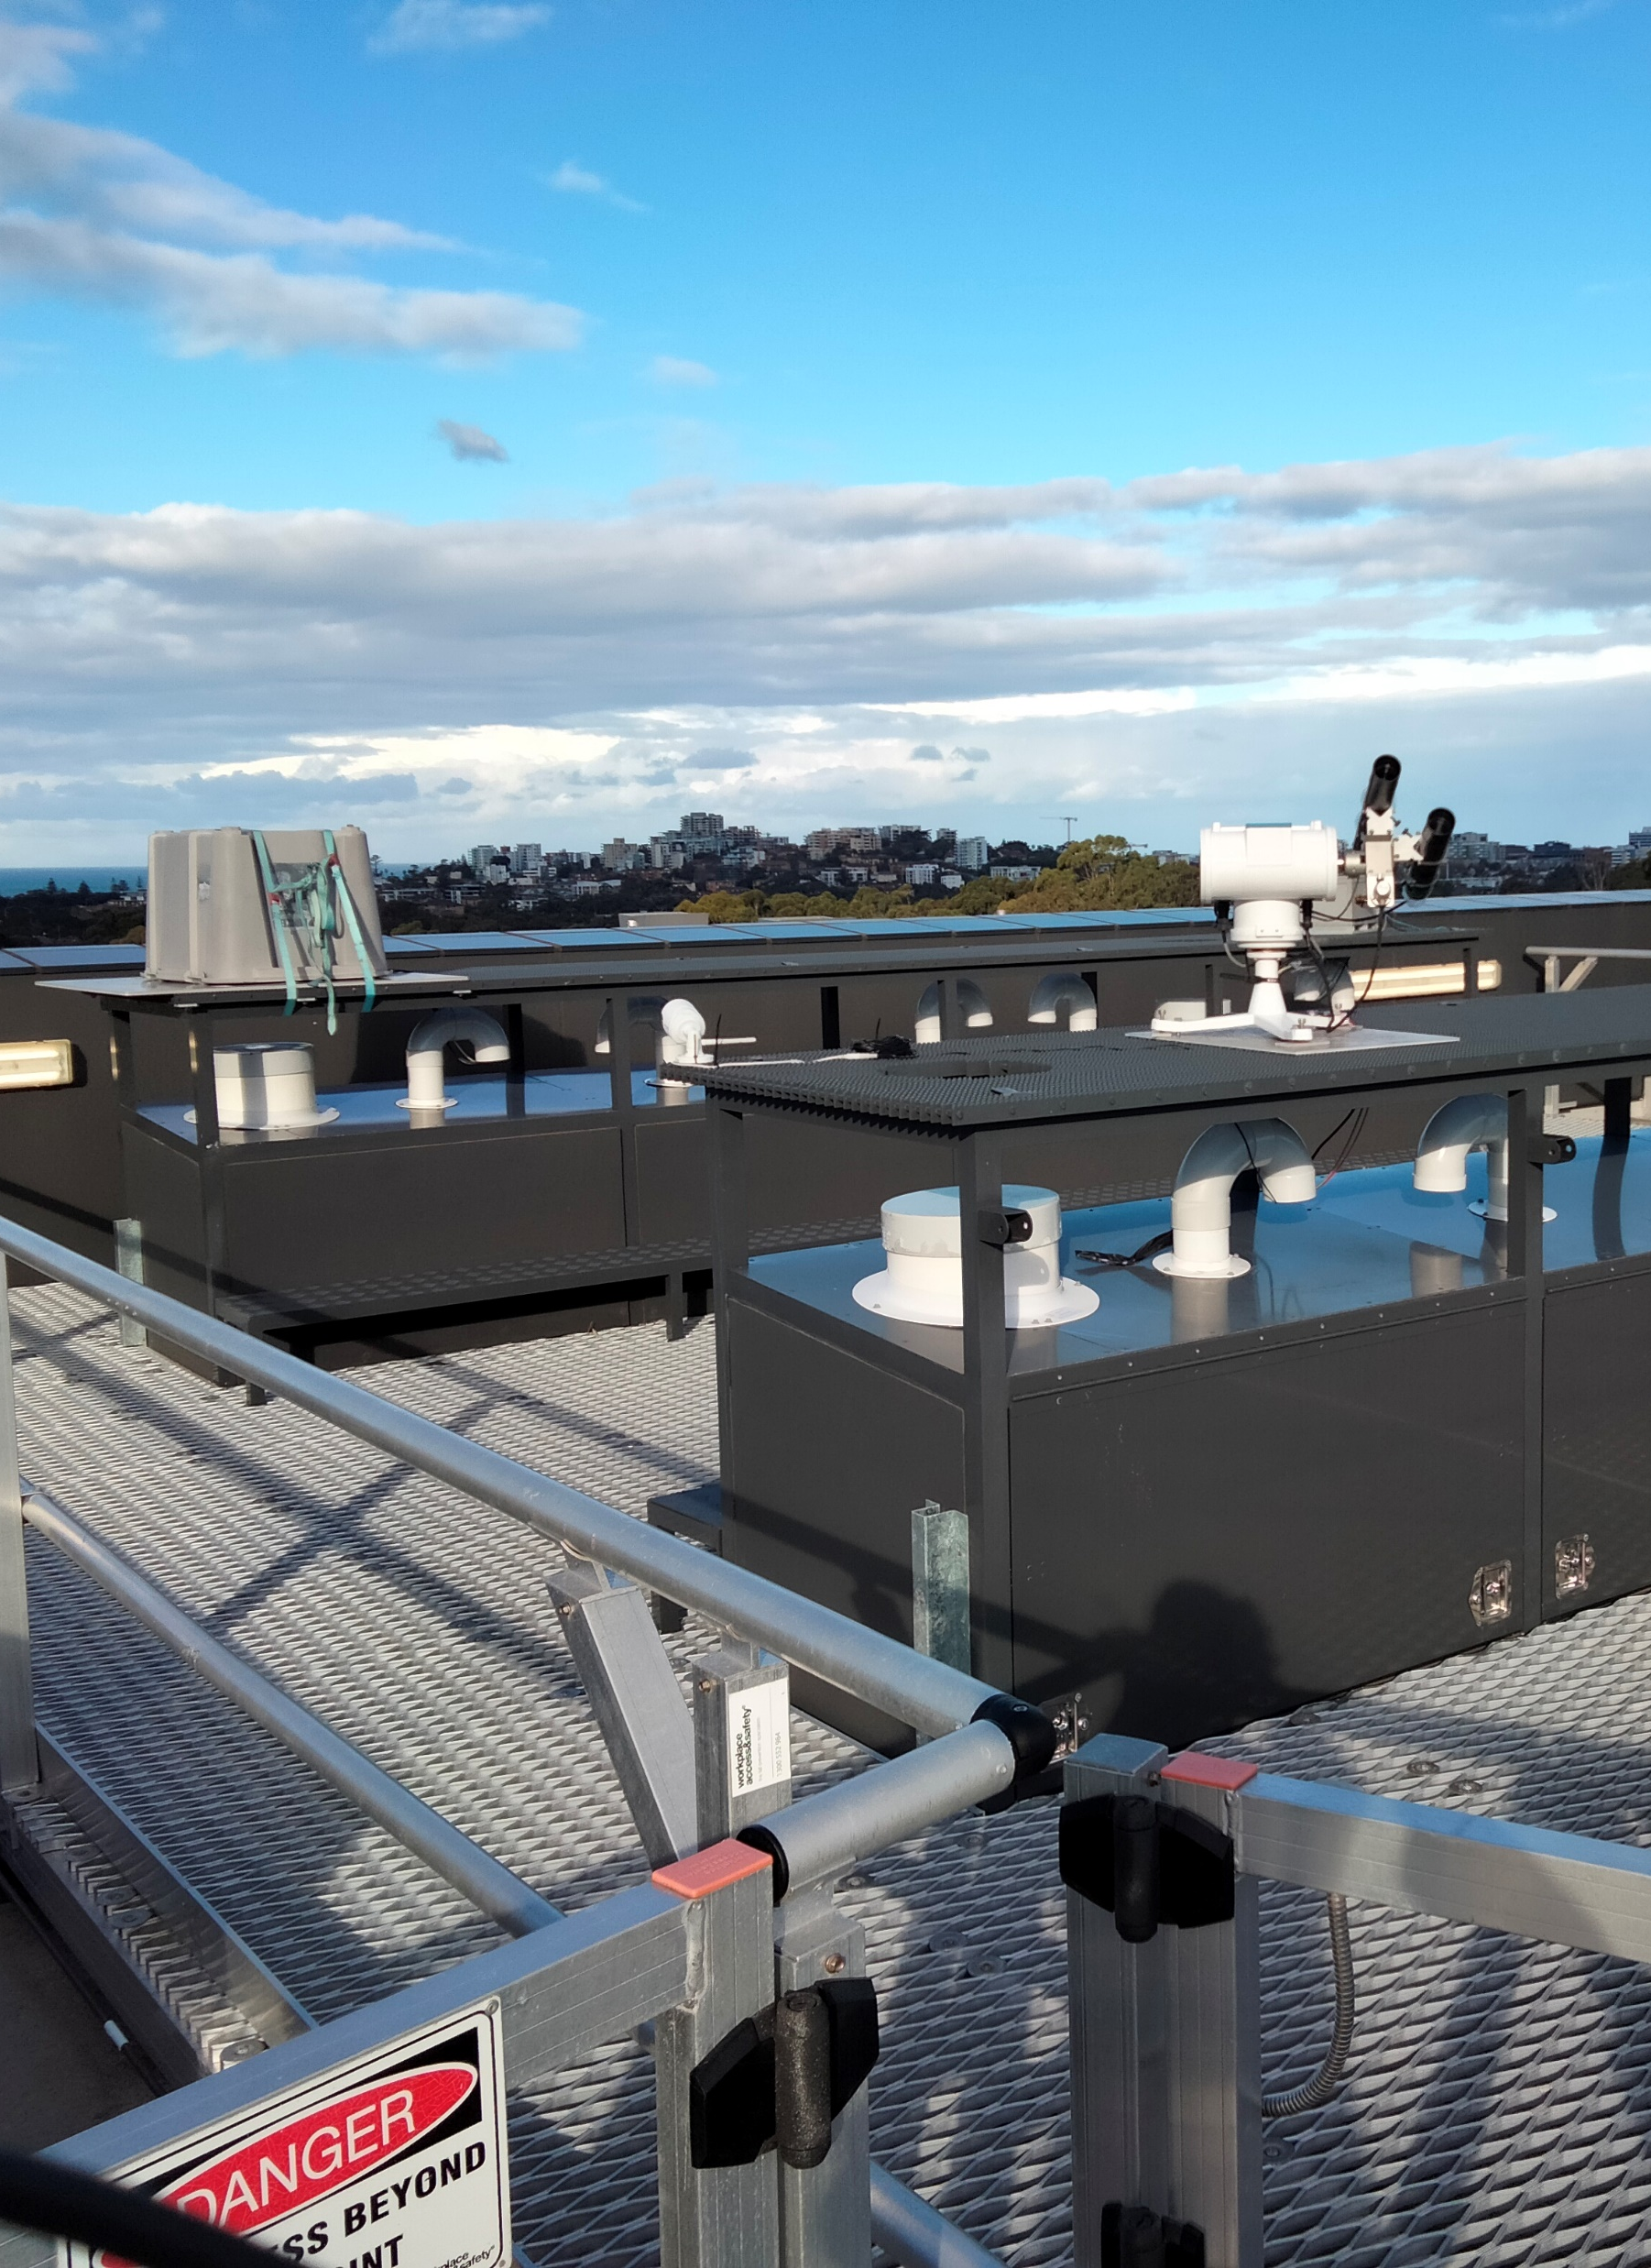
Current status June 2023
The “old” HR125 spectrometer continues to operate in an automatic fashion, but still requires staff/students to run the system as a whole
Previously, we had a full-time person responsible for running these systems – still plan to employ someone to do this in the future
The new HR125, is not fully operational due to the solar tracker weather proof housing not completed. Periods of co-measurements have occurred between the old and new HR125’s (analysis a work in progress).
Funding is a problem; no major grants in the last few years to sustain the two HR125 systems (other than internal support) but the group is working on this…
Last 12 months 290 measurement days.

Slide 4
Outlook for 2023 and beyond
Always looking for funding opportunities – need to employ a full-time person(s) to run TCCON/NDACC site(s), maintenance and data analysis, QA/QC, archiving.
External funding from CAMS27
Would like to expand the TCCON/NDACC measurements to another site in Australia, maybe Alice Springs.
PhD work of Justin Takacs on O3 trends in the SH

Slide 5
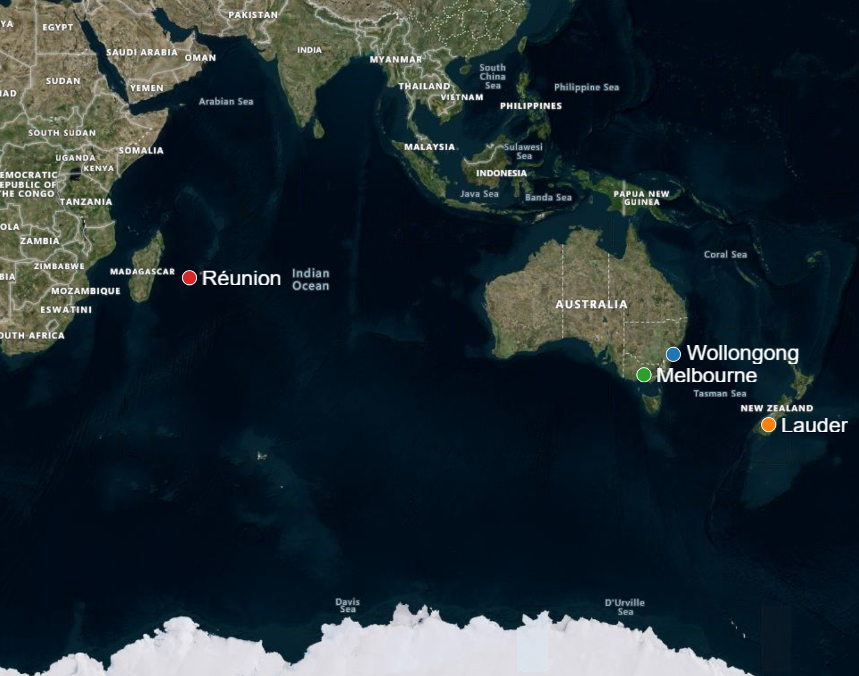
Justin Takacs: Intercomparison of Sites
NDACC FTIR observations at three sites – Wollongong, Lauder and La Réunion – compared to Microwave Limb Sounder retrievals and ozonesonde launches (for Lauder and La Réunion)
MLS, ozonesonde and GMI CTM ozone
profiles smoothed using FTIR averaging
kernels and a priori
Partial columns constructed between
261-10 hPa

Slide 6
Trend Analysis
Each data series was fit to a multiple linear regression model (based on Vigouroux et al. 2015) with parameters accounting for linear trend, seasonal variation and dependence on:
  Tropopause Pressure
  Solar radio flux
  Quasi-biennial Oscillation
  Antarctic Oscillation
  NOAA’s Multivariate ENSO Index
Vigouroux, C., Blumenstock, T., Coffey, M., Errera, Q., García, O., Jones, N. B., Hannigan, J. W., Hase, F., Liley, B., Mahieu, E., Mellqvist, J., Notholt, J., Palm, M., Persson, G., Schneider, M., Servais, C., Smale, D., Thölix, L., and De Mazière, M.: Trends of ozone total columns and vertical distribution from FTIR observations at eight NDACC stations around the globe, Atmos. Chem. Phys., 15, 2915–2933, https://doi.org/10.5194/acp-15-2915-2015, 2015

Slide 7
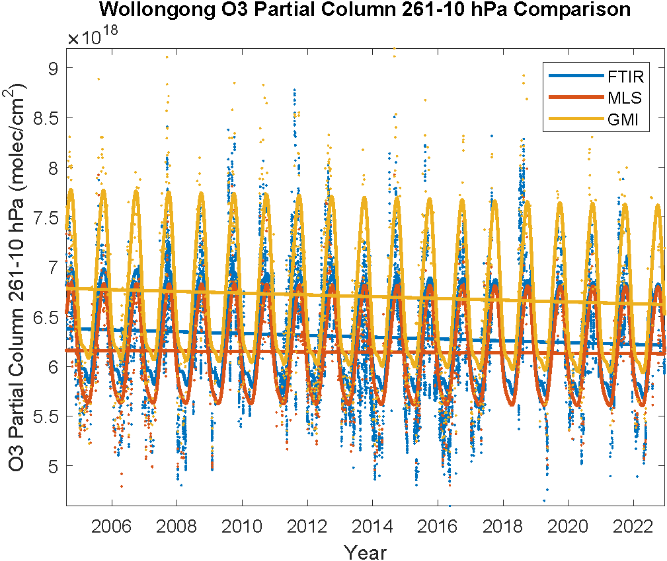
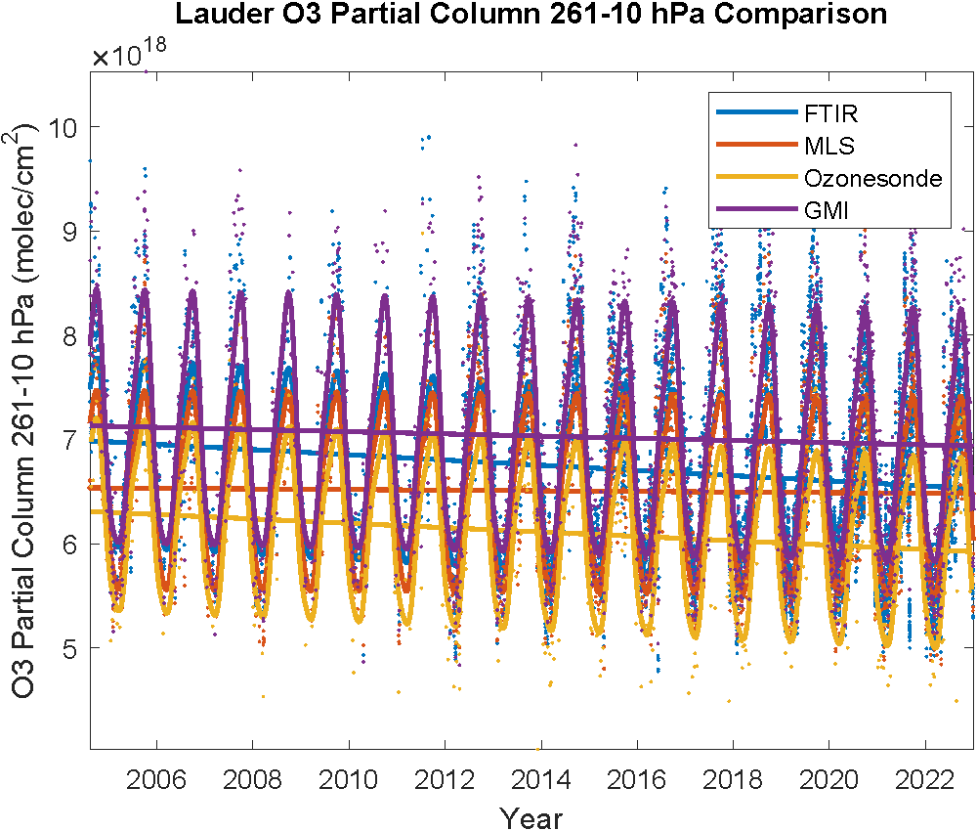
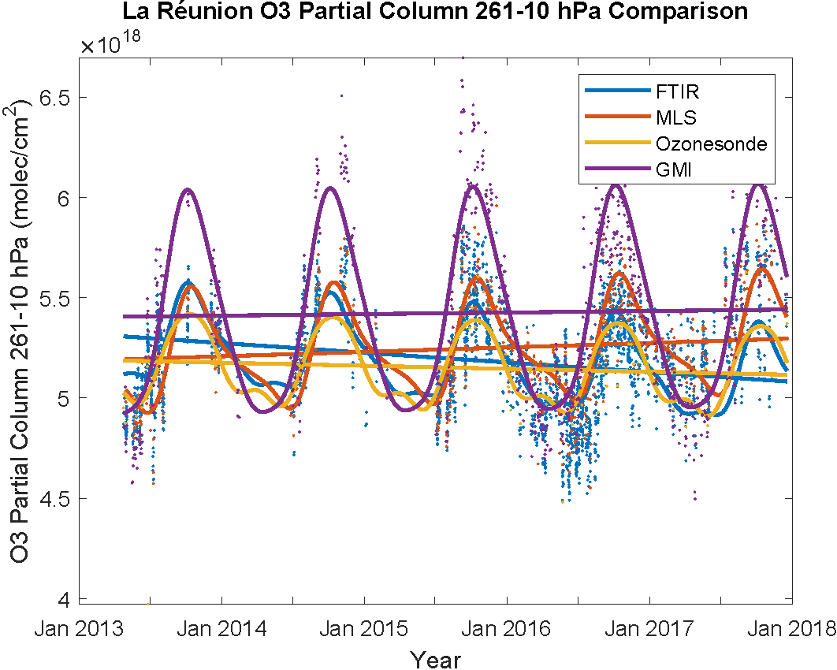
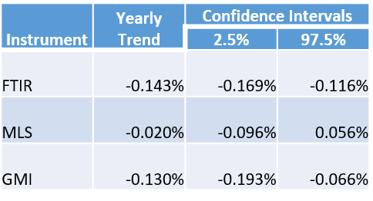
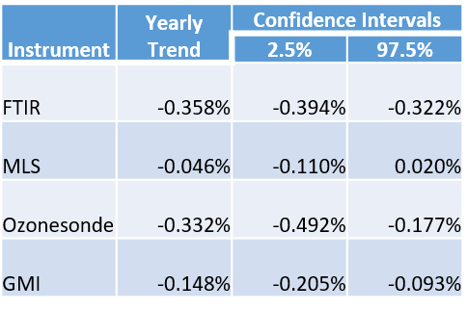
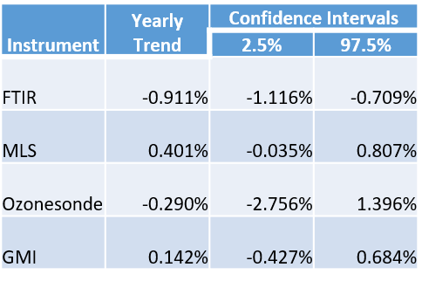
Wollongong – 2005-2022
Lauder – 2005-2022
Réunion – 2013-2017
(0.31+/- 0.27)
(-0.38+/- 0.41)

Slide 8
Contribution Fractions
Product of Standardised Regression Coefficient and Correlation Coefficient for each parameter
Sum of contribution fractions = R² of fit

