Slide 1


Sitereport Uni Bremen
Bremen, Ny Alesund,
Paramaribo (and Nicosia)
Justus Notholt and Mathias Palm
University
of Bremen

Slide 2
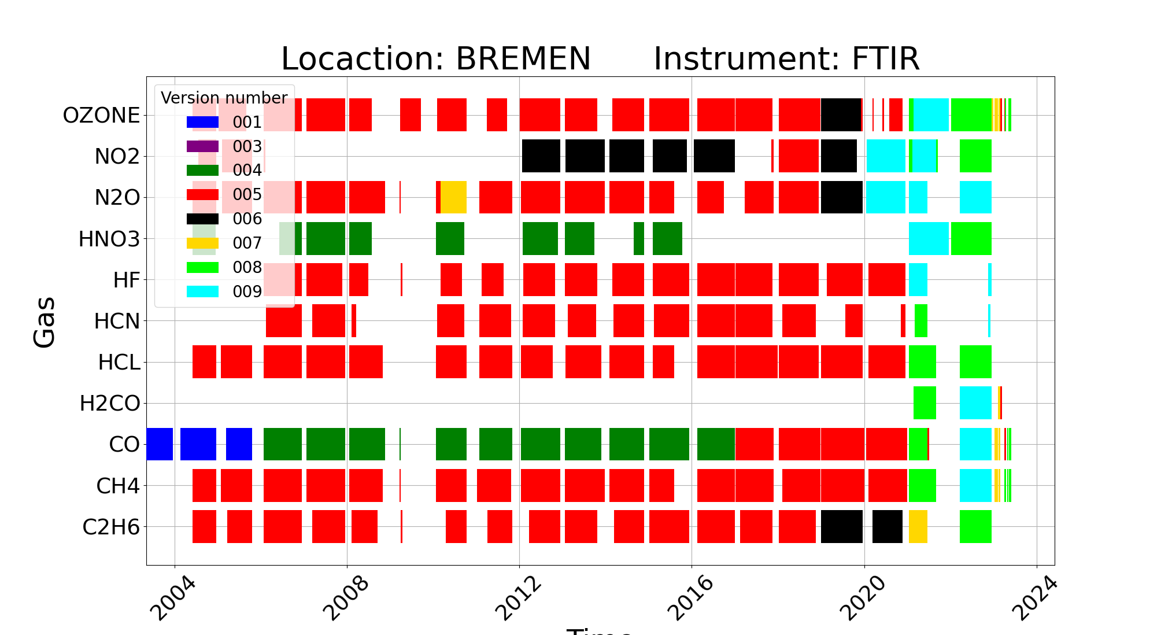
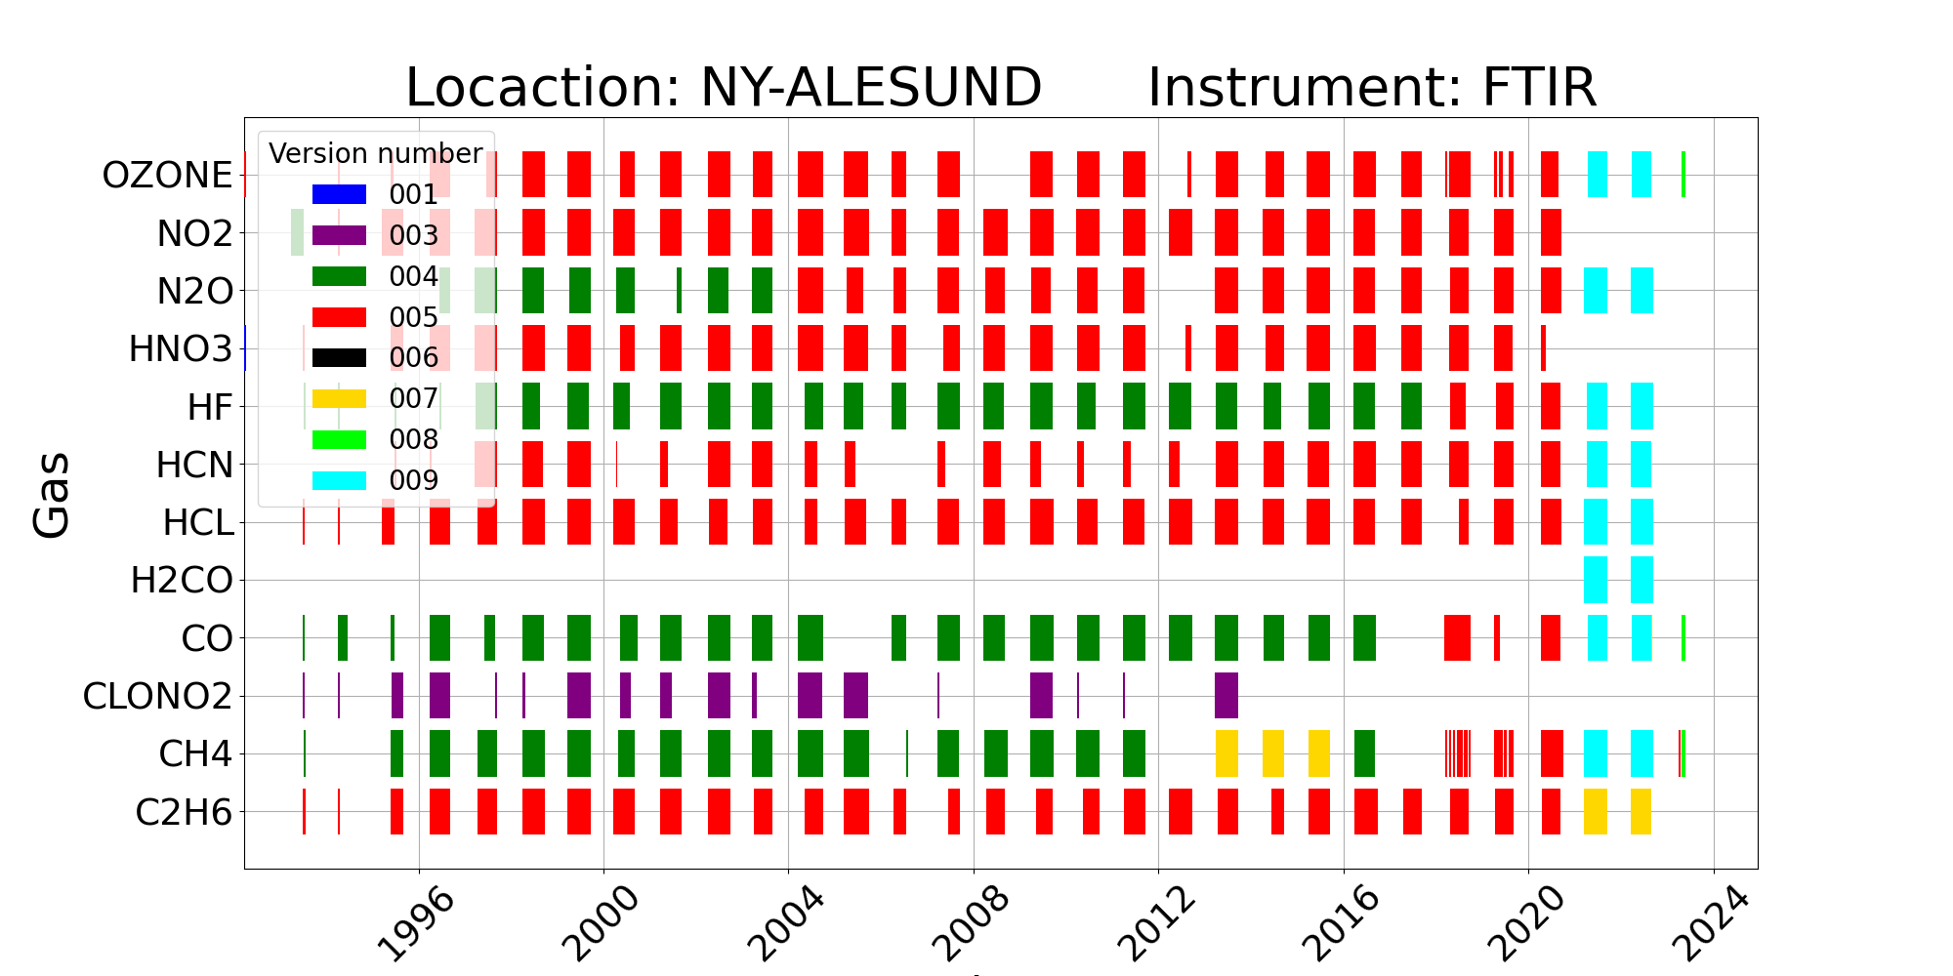
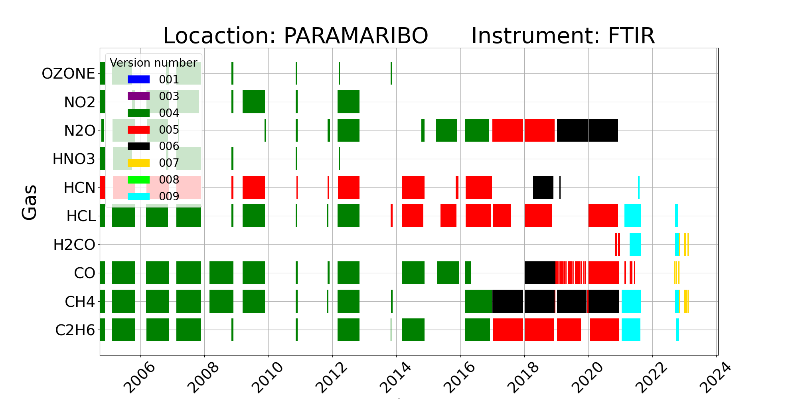
Same filenumbers are not allowed in repository
  - CAMS27 files are v8, newer final versions are v9 → confusing
MCT spectra in Ny-Ålesund are degrading, retrieval does not work properly
→ investigation ongoing
PMB was almost a year out of operation
→ laser failure followed by solartracker failure

Slide 3
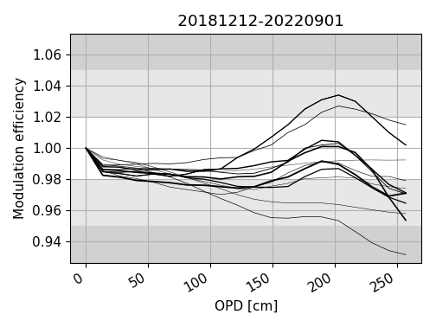
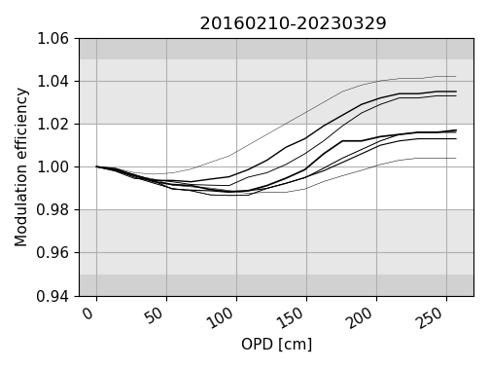
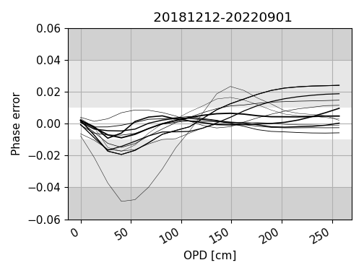
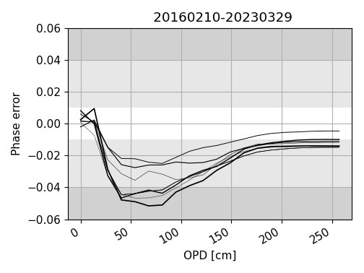
Bremen
Ny Alesund
Paramaribo
No regular ILS measurements because there have been no longer stays since 2017. Our local support does not perform cell measurements

Slide 4
Bremen
Operational
  Manual measurements by PhD students and technical staff
Funding: Internal, national projects, CAMS27, ACTRIS
Future plans
  Upgrading the Dome to enable automatic operation
Ny Alesund
Operational
  Semi automatic operation
  Use of extended Kbr (Poster of M. Buschmann & M. Palm) would be very beneficial
Paramaribo
Replacement in the framework of ACTRIS planned
  Construction started
  Container based station
  Automatic operation envisioned
  Relocation to French Guyana considered because French Guyana is European Union (Taxation)
Nicosia
First measurements
Not analysed yet

Slide 5
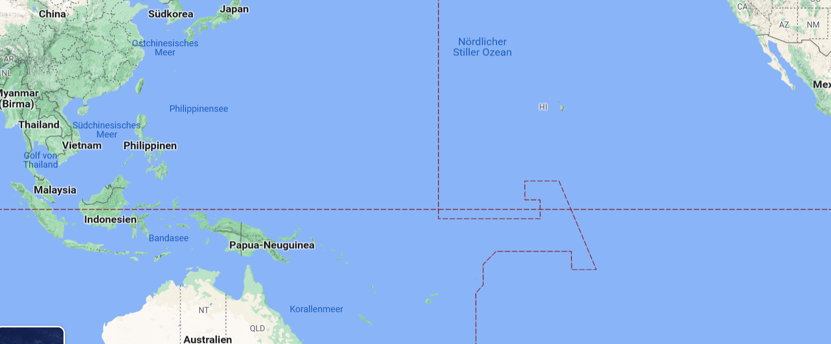
Site report Palau
Atmospheric observations in the Western Pacific on Palau
Justus Notholt¹, Mathias Palm¹, Xiaoyo Sun¹, Katrin Müller²
¹University of Bremen
²Alfred-Wegener-Institute for Polar and Marine Research, Potsdam
University
of Bremen
Institute of
Environmental Physics

Slide 6

Specifics of Palau (7.5°N, 134°E)
Ocean warmest wordwide
Very clean air
- air coming from east for 10.000 km
- no aerosols
- large droplets
- less lightning
- no NO_{x}, low O₃ and OH
- lifetime of molecules quite long
Pathway of air from the troposphere
into stratosphere
Tropospheric air around Palau determines
global composition of the stratosphere
Impact of monsoon
Good partners:
- Palau Community College
- Coral Reef Foundation
Stable politics
Stable electricity (failure once per week)

Slide 7
Specifics of Palau (7.5°N, 134°E)
(Rex et al., ACP, 2014)

Slide 8
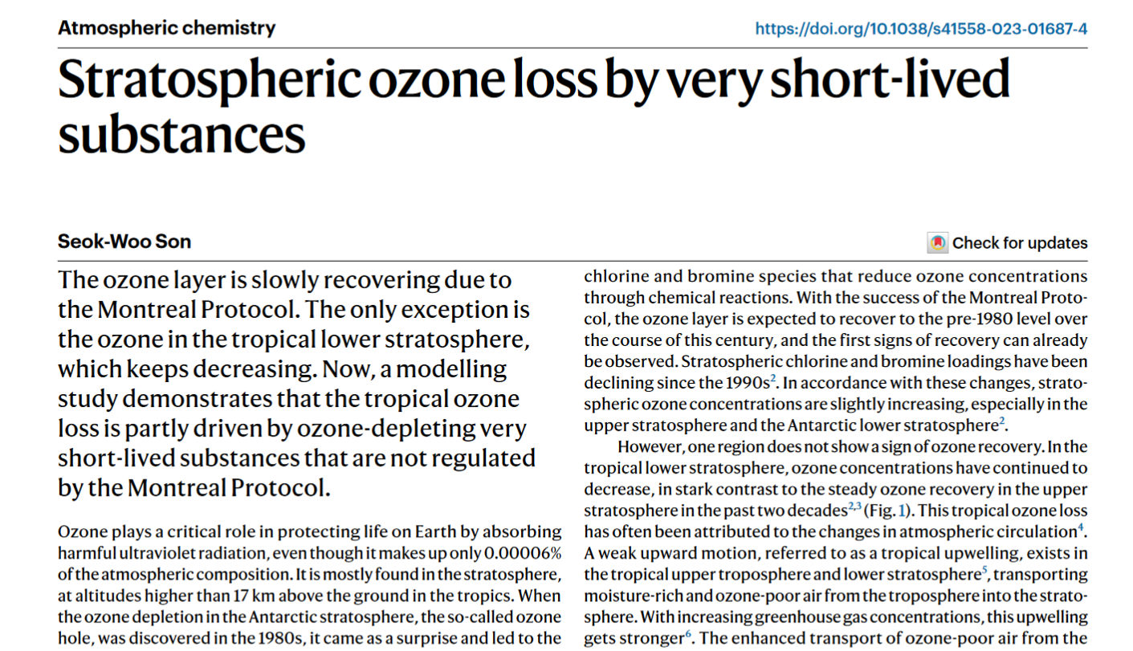
Nature, News & Views, June 2023

Slide 9
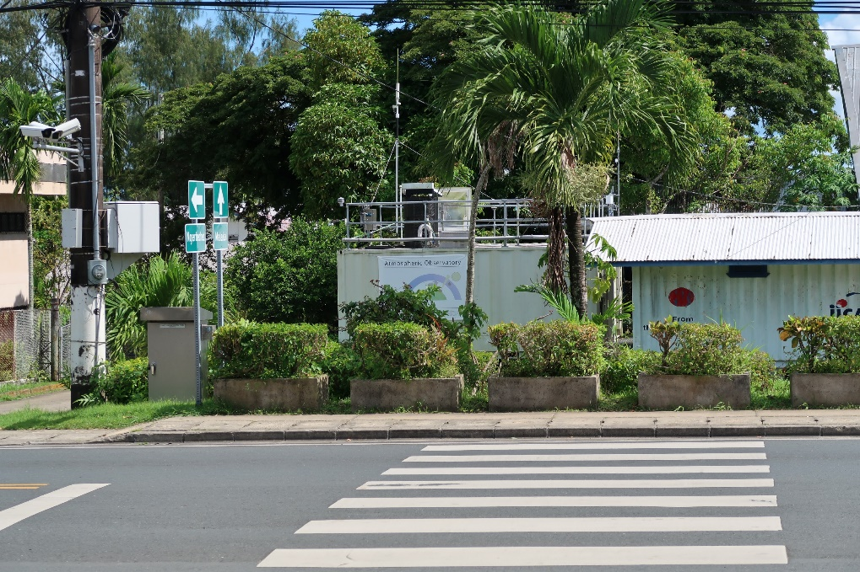
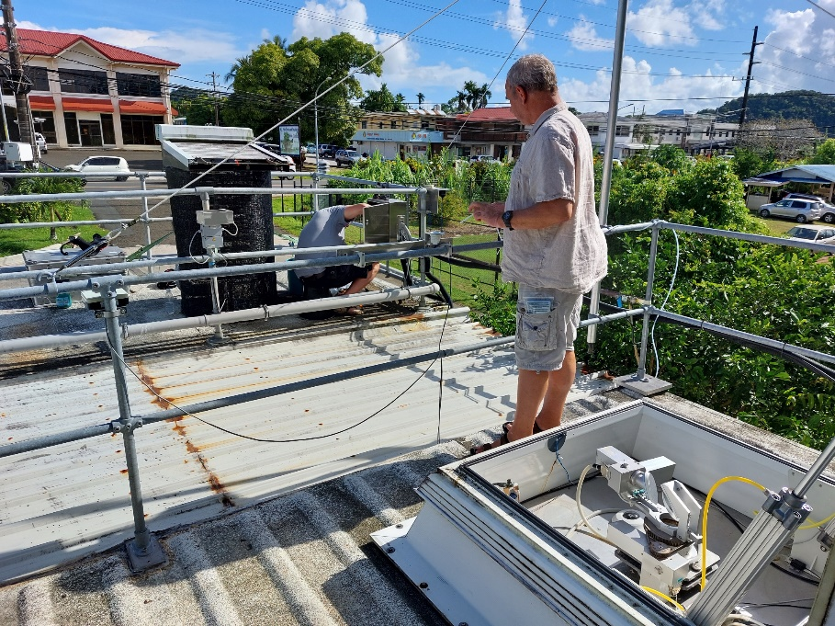
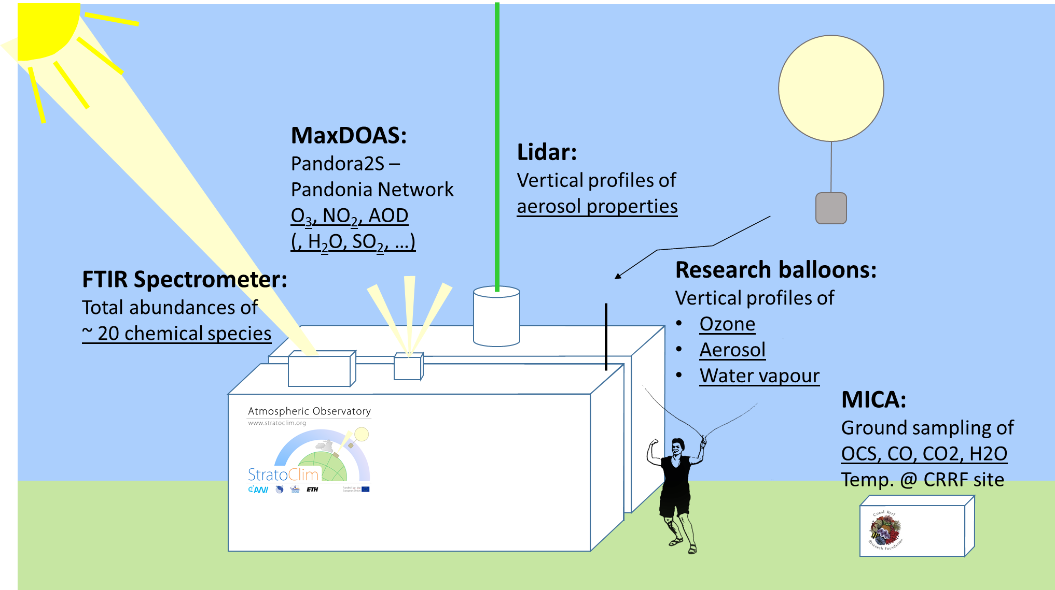
Atmospheric observations in Palau
- FTIR-spectrometer (since 2016)
- ComCAL (Compact Cloud and Aerosol LIDAR, since 2018:
- Research Balloons (O₃, aerosol, water)
- Pandora Max-DOAS spectrometer
- In-situ O₃ monitor (since 2022)
(Mueller et al., submitted)

Slide 10
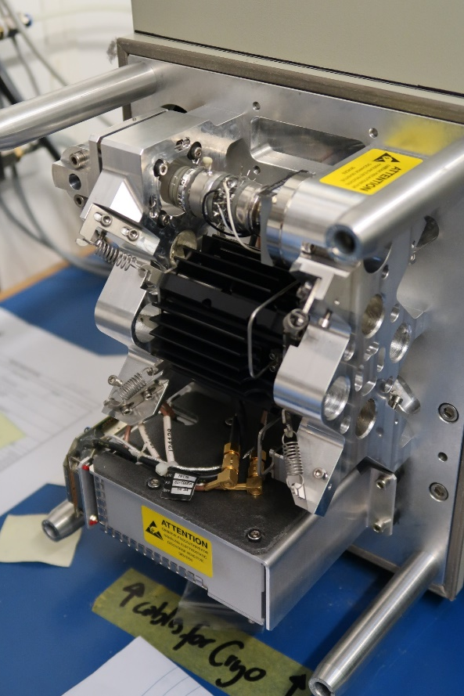
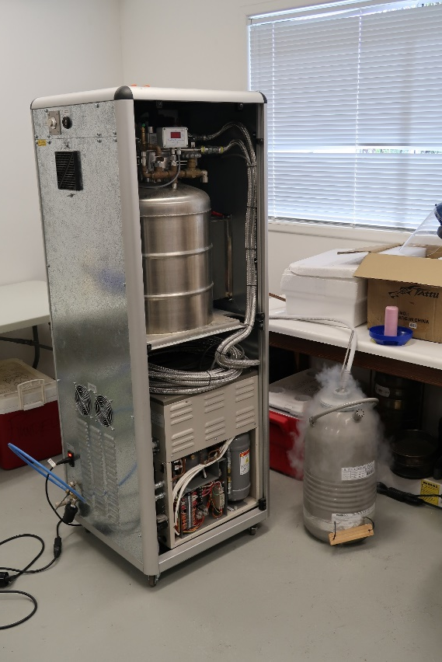
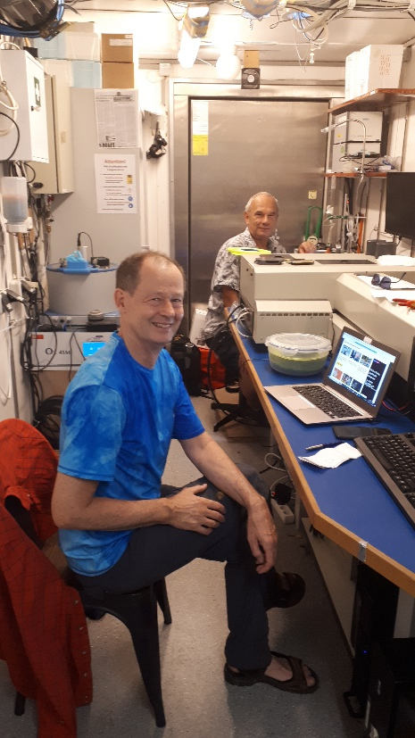
FTIR-observations
- Routine InSb-observations since 2018
- MCT-measurements on a campaign basis (August to October 2022)
Egon and Justus Sterling cooled InSb LN-machine at Coral Reef Foundation

Slide 11
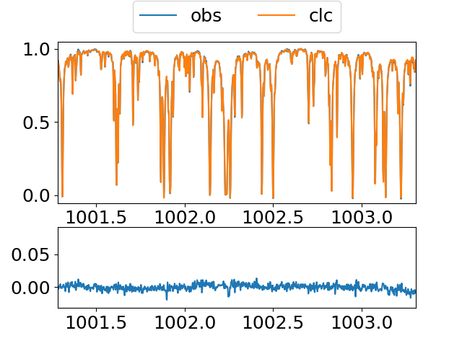
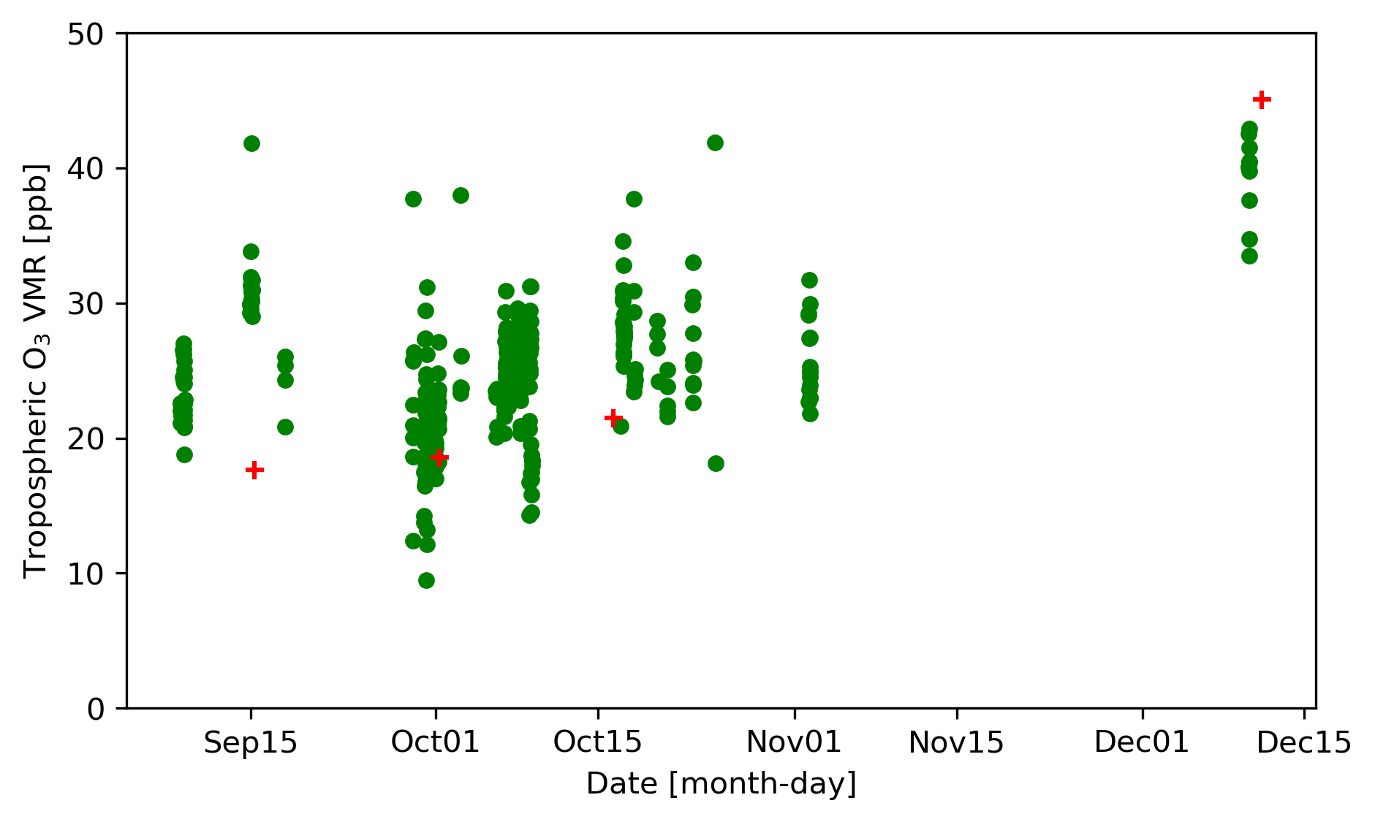
FTIR-observations
O₃(0-12km)
FTIR
sonde
wavenumber (cm⁻¹)

Slide 12
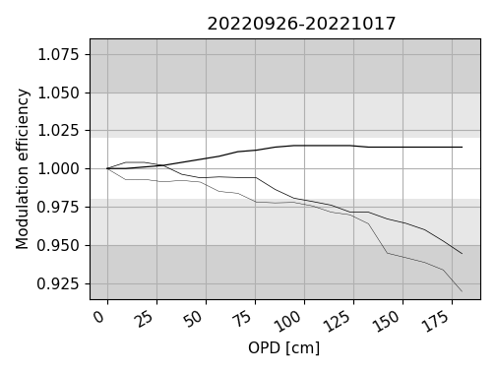
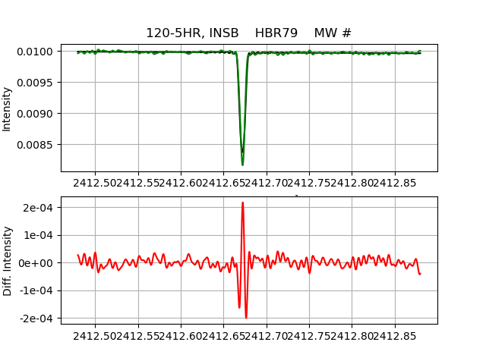
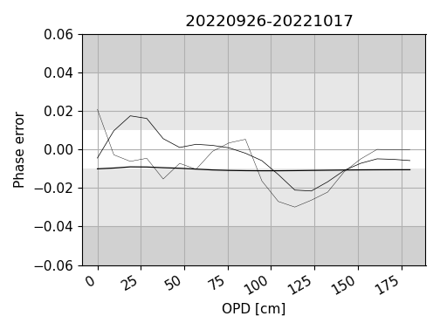
FTIR-observations

Slide 13
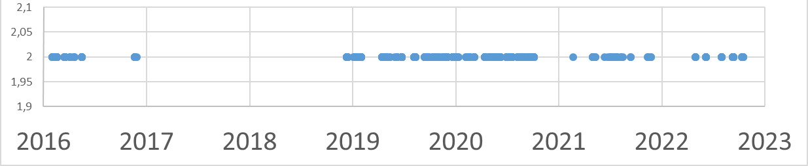
FTIR statistics in Palau
Measurement statistics
Funding
- Start in 2016 as part of EU-project StratoClim
- BMBF project 2019 - 2023
- Proposal submitted by Xiaoyu Sun in 2023
CH₄ data

Slide 14
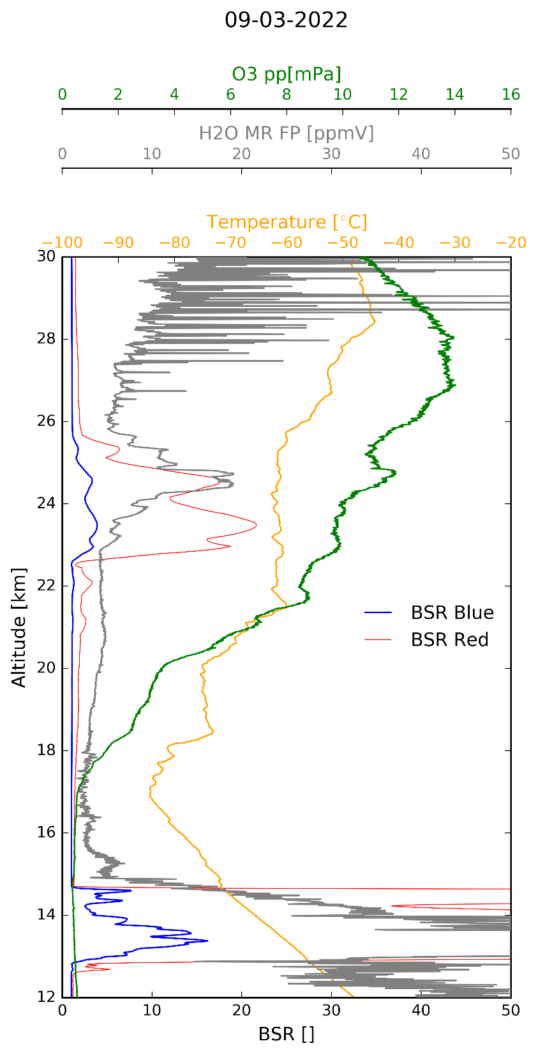
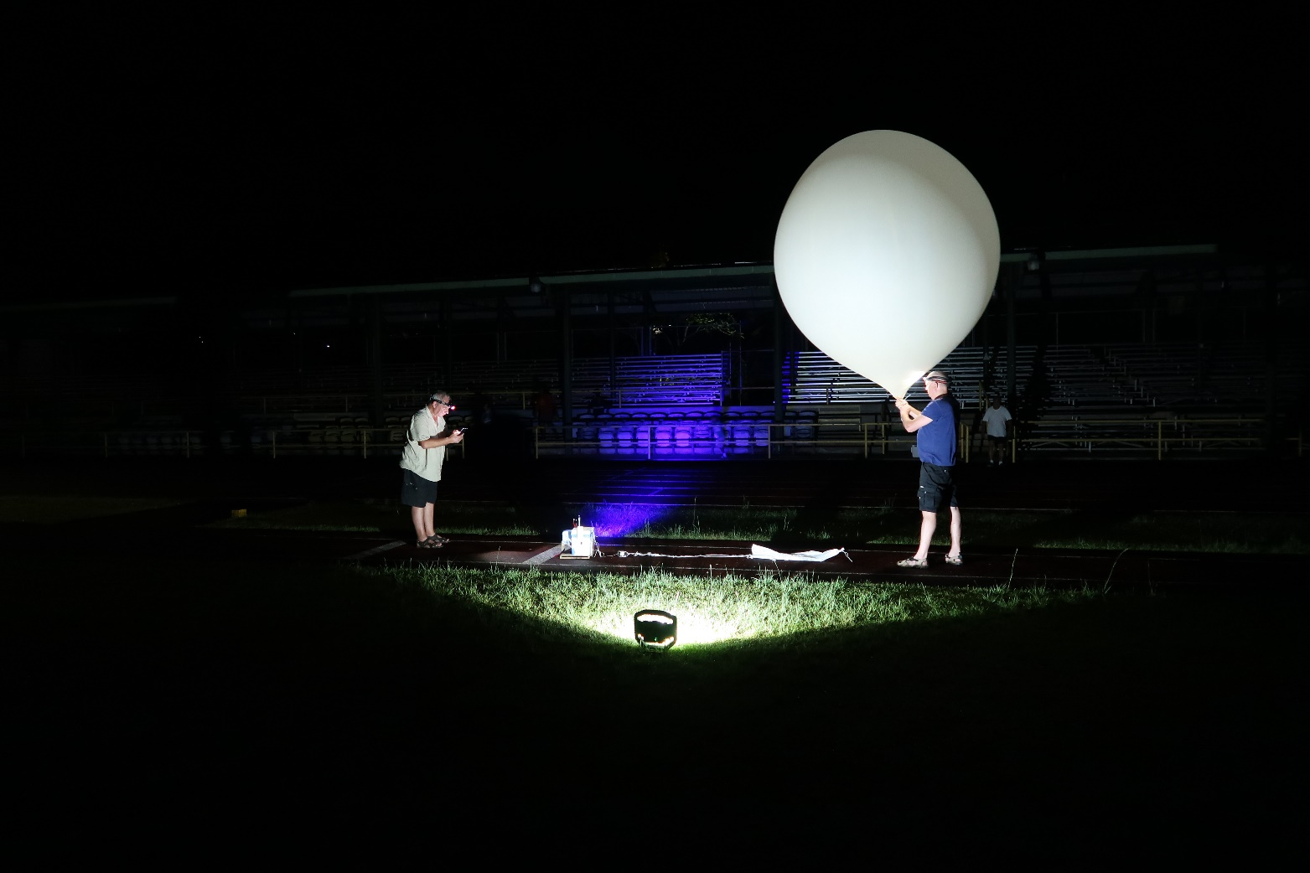
Cobald (aerosol backscatter) and CFH (water vapour) sondes
9 March 2022
(K. Mueller, AWI, unpublished)

Slide 15
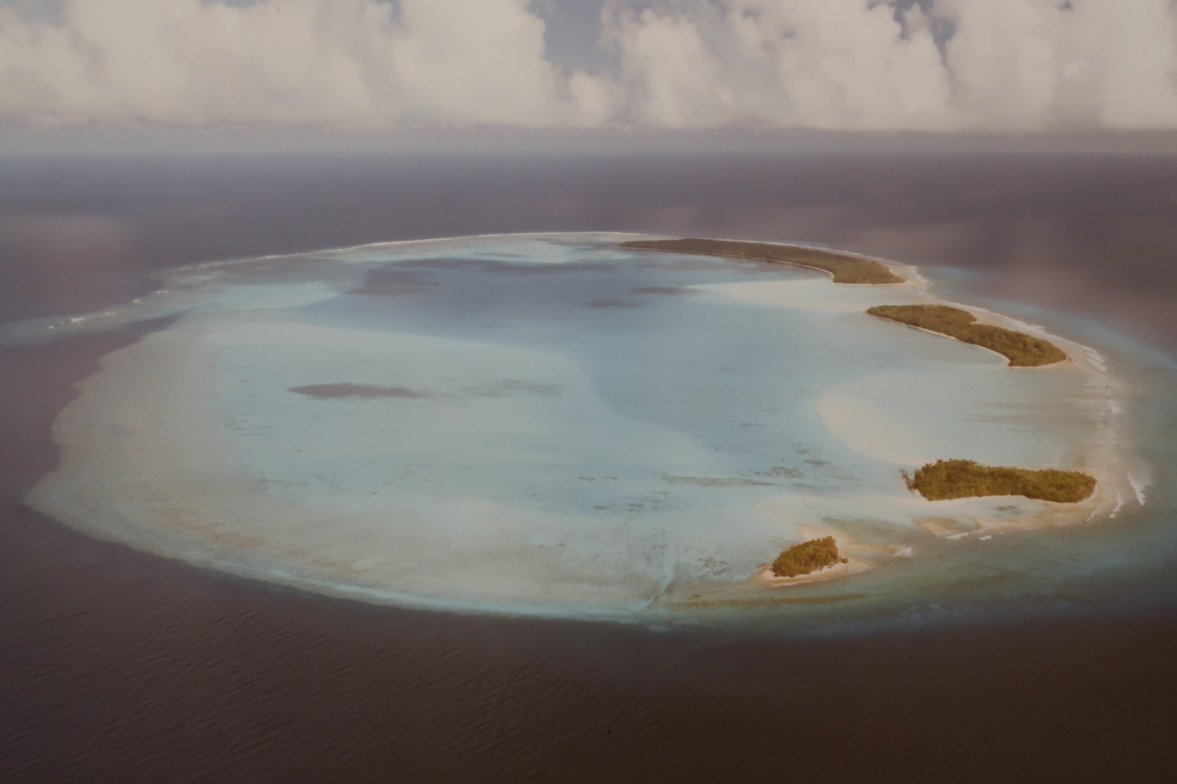
Impressions (Kayangel atoll)

Slide 16
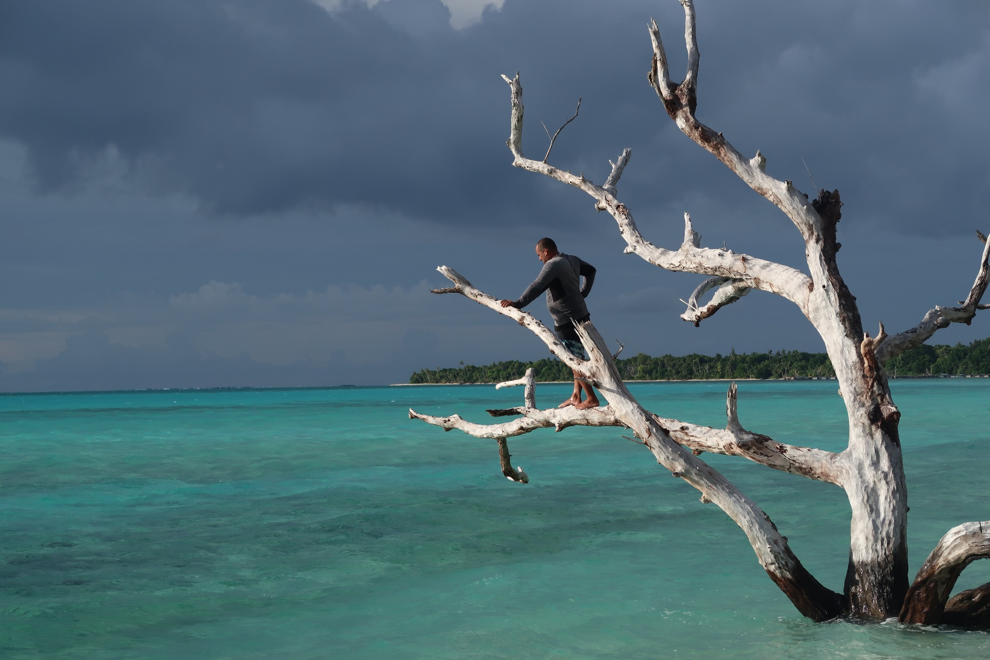
Impressions (Kayangel atoll)

Slide 17
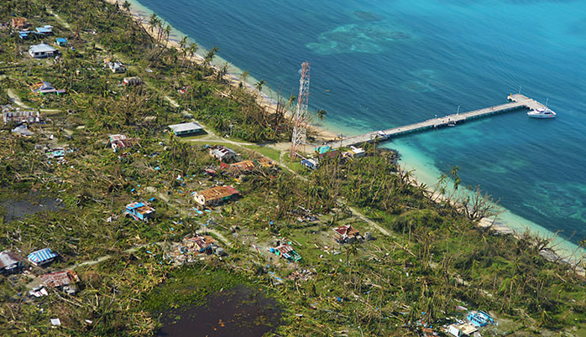
Impressions (Kayangel atoll after typhoon in 2013)

Slide 18
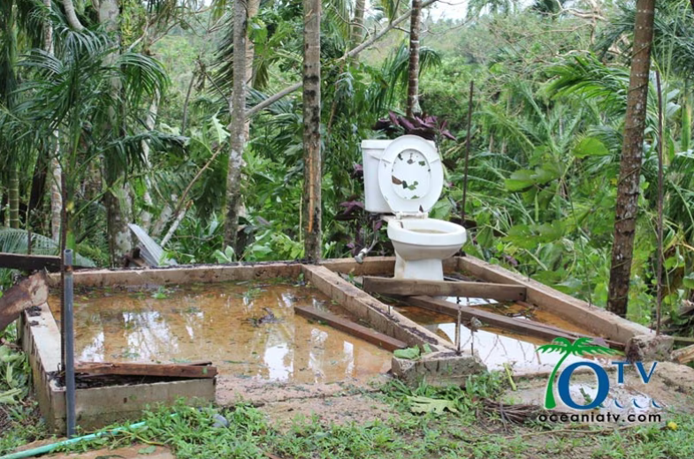
Impressions (Kayangel atoll after typhoon in 2013)

Slide 19
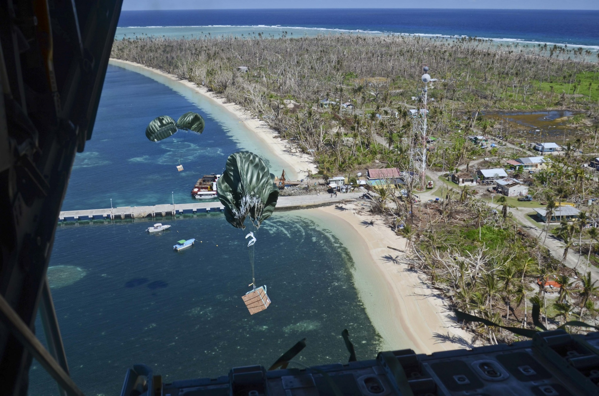
Impressions (Kayangel atoll after typhoon in 2013)

