Slide 1

Site Reports for NCAR: Thule, Mauna Loa, Boulder
2023 NDACC IRWG Meeting, Spa, Belgium
Jim Hannigan, Ivan Ortega
Notes:
NOTE: Background image can be used as is or changed for a particular presentation in the “Slide Master” button found under the “View” tab.

Slide 2
Outline
General Status of NCAR NDACC Program
Thule
Mauna Loa
Boulder
2023 NDACC IRWG Meeting, Spa, Belgium

Slide 3
Outline
General
Our NDACC operations are supported by a competitive 4 year NASA grant,
    Next recompete in summer 2024
    Archive up to date until end of 2022, additionally: NH₃, C₂H₂, and HCOOH
    13 publications 2022 – present
    2023 Calibration Cells near to ship.
Near real-time and long term data plots are here https://www2.acom.ucar.edu/optical-techniques/current-data
Long term data are also stored at UCAR/GDEX https://gdex.ucar.edu/dataset/ftir.html
Data license status CC0 – “No Rights Reserved”, following NASA guidance
2023 NDACC IRWG Meeting, Spa, Belgium

Slide 4
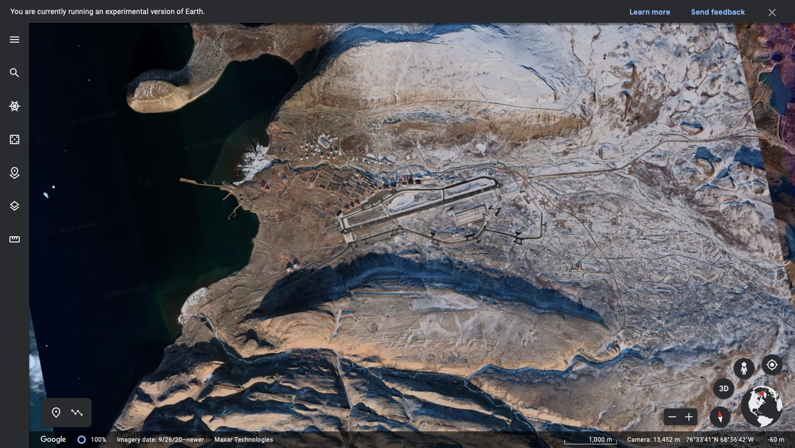
Publications 2022-present
Thule
Thule High Arctic Atmospheric Observatory
North Mountain
NSF Building #1971
South Mountain
2023 NDACC IRWG Meeting, Spa, Belgium

Slide 5
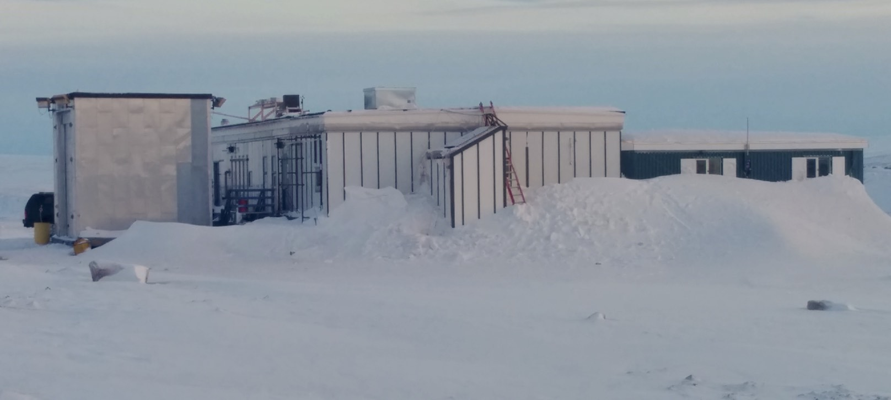
Publications 2022-present
Thule
Thule High Arctic Atmospheric Observatory
See THAAO website
https://www.thuleatmos-it.it/index.php
Solar tracker
AERONET/Radiometers
Lidar Hatch
Site Management :NSF
Primary Research Groups:
NCAR, Univ Rome, ENEA, INVG
Office
(now removed)
VESPA22 Annex
Main Lab
Balloon
Launch
Current Suite of measurements
FTIR
AERONET (solar, lunar AOD +)
Whole Sky Imager, Radiometers (IR, PAR, SW)
Lidar – Tropospheric-Stratospheric Aerosol, Temperature
GMBS Ground-Based Millimeter-wave Spectrometer – Stratospheric CO, HNO₃, N₂O, O₃
HATPRO microwave radiometer and Heitronics pyrometer –Tropospheric temperature profiles
The Vaisala DigiCora 2 sounding system - O₃ & H₂O sondes
Water Vapor Emission Spectrometer for Polar Atmospheres at 22 GHz (VESPA-22) – Strat-Mesosphere
2023 NDACC IRWG Meeting, Spa, Belgium

Slide 6
Thule, Greenland 76ºN, 68.5ºW, 225masl
Logistics News
  Thule Air Base now formally renamed Pituffik Air Base
    Base is now operated by the US Space Command (not USAF) in conjunction with the Danish Liaison Office.
    Logistics support is provided by Battelle ARO under contract by the US NSF
    Internet services will change hands in August 2023
      Was provided by Tusass, (TeleGreenland) (2Mb link)
      Will be provided be Battelle ARO with new installation of OneWeb satellite link for all NSF operations on base (possibly 10Mb link)
2023 NDACC IRWG Meeting, Spa, Belgium

Slide 7
Thule
Instrument
125 HR (new 2015 Thanks Gregor!) operating nominally
LN2 generator motor failed winter 2021-2022 lost ~2 months due to diagnostics & parts deliveries
    Replaced the SIOS laser with a refurbished frequency stabilized Spectra Physics 117A, 2022
      SIOS was repaired once and was not able to be repaired again, new SIOS cost prohibitive,
      OPUS/Laser communication disabled and shutter fixed in open position
    PC running our remote control software installed in 2015 began failing late spring 2023
      The replacement on-site failed to properly run ADIO software
      Instrument down since early May to present.
2023 NDACC IRWG Meeting, Spa, Belgium

Slide 8
Thule
Observation Density
Observations began Fall 1999
Recent Data Loss
Early spring 2022 due to LN2 generator failure
Late spring 2023 computer failure
2023 NDACC IRWG Meeting, Spa, Belgium

Slide 9
Thule
Recent LineFit / ILS
2023 NDACC IRWG Meeting, Spa, Belgium

Slide 10
Mauna Loa, HI, US 19.5ºN, 204.4ºE 3396masl
General
125HR (upgrade from 120HR 2011-2, Thanks Gregor!)
System was operating nominally until Mauna Loa eruption – power lost ~04:30 HST 29 Nov.
      We tentatively believe the site will be accessible in Fall 2023 & system will be back online at that time
      We *may* have lost the KBr beamsplitter to excessive humidity – after power was lost & the vacuum pump offline, ambient air leaked into the Bruker
      Returning the beamsplitter now for inspection
2019 issue w/ detector choose mirror some degradation in spectra
2019 minor pointing alignment adjustment
InSb detector failure late 2020 replace with existing 8h unit.
Replace Kashiyama roots pump Jan 2021 (9y old)
Replace InSb & MCT, new IR Assoc. 24h Bruker specification detectors mid-Feb. 2021
Replace laser Sep. 2021
2023 NDACC IRWG Meeting, Spa, Belgium

Slide 11
Mauna Loa, HI, US
Observation Density
Since operations began with 125HR upgrade in 2012 minimal downtime.
Power outages in April 2020 cased several issues: laser, detectors.
Early 2021 replace detectors, & vacuum pump, laser
2023 NDACC IRWG Meeting, Spa, Belgium

Slide 12
Mauna Loa, HI, US
Recent LineFit / ILS
    Proposed Update
    Replace CU dynamic tracker with camera tracker (e.g. in Thule)
    Move to new building (~2026)
2023 NDACC IRWG Meeting, Spa, Belgium

Slide 13
Boulder, CO, US 40.0ºN, 254.8ºE, 1616masl
General
125HR (upgrade from 120HR 2017-8, Thanks Gregor!) Operations nominal
  System to automate observations is in process (move to all python)
  Manual start, weather system attached, pointing solar cell near complete
  REO laser > 6years
Other instruments at the FL0 site
Pandora (also one at NOAA ~6km S)
AERONET
    Proposed Updates
    Replace CU dynamic tracker with camera tracker (e.g. in Thule)
    Install Ceilometer or MPLNet small pulse LIDAR for boundary layer height measurements
2023 NDACC IRWG Meeting, Spa, Belgium

Slide 14
Boulder, CO, US
Observation Density
Since operations began in 2008 observations intermittent and manual only.
With 125HR upgrade in 2018 minimal downtime & improved density.
Manual operations until 2022 then semi-manual to date.
2023 NDACC IRWG Meeting, Spa, Belgium

Slide 15
Boulder, CO, US
Recent LineFit / ILS
2023 NDACC IRWG Meeting, Spa, Belgium

Slide 16
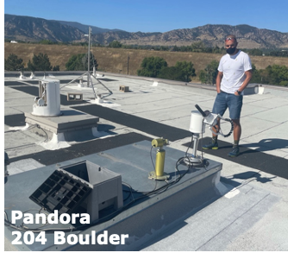
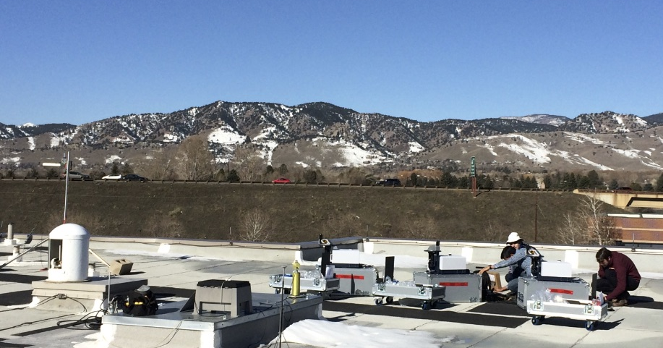
Boulder, CO, US
Addition of Pandora #204 in 2021
Max-DOAS & Direct sun observations
NO2, O3, H2CO
FL0 view west during early COCCON testing in 2015
2023 NDACC IRWG Meeting, Spa, Belgium

Slide 17
Publications 2022-present
I. Ortega, et. al., . “Anomalies of O3, CO, C2H2, H2CO, and C2H6 detected with multiple ground-based Fourier-transform infrared spectrometers and assessed with model simulation in 2020: COVID19 lockdowns versus natural variability”. In: Elementa: Science of the Anthropocene 11.1 (May 2023). 00015. doi: 10.1525/elementa. 2023.00015. eprint: https://online.ucpress.edu/elementa/article-pdf/11/1/00015/ 778700/elementa.2023.00015.pdf. url: https://doi.org/10.1525/elementa.2023. 00015.
H-A Kwon, et. al., “Validation of OMPS Suomi NPP and OMPS NOAA-20 Formaldehyde Total Columns With NDACC FTIR Observations”. In: Earth and Space Science 10.5 (May 2023), e2022EA002778. doi: https://doi.org/10.1029/2022EA002778. url: https://doi.org/10.1029/ 2022EA002778.
V. A. Flood, et. al., “Evaluating modelled atmospheric composition in the Arctic troposphere using ground-based remote sensing measurements”. In: Journal of Geophysical Research - Atmospheres - submitted (2023).
D. Smale, et. al., “Opportunistic observations of Mount Erebus volcanic plume HCl, HF and SO2 by high resolution solar oc- cultation mid infra-red spectroscopy”. In: Journal of Quantitative Spectroscopy and Radiative Transfer 307 (2023), p. 108665. doi: https://doi.org/10.1016/j.jqsrt.2023.108665. url: https://www.sciencedirect.com/science/article/pii/S0022407323001838.
N. Kille, et. al., “The CU Airborne Solar Occultation Flux Instrument: Performance Evaluation during BB-FLUX”. In: ACS Earth and Space Chemistry 6.3 (Mar. 2022), pp. 582–596. doi: 10.1021/acsearthspacechem.1c00281. url: https://doi.org/10.1021/acsearthspacechem.1c00281.
I. Albores, et. al., “Continental-scale Atmospheric Impacts of the 2020 Western U.S. Wildfires”. In: Atmospheric Environment (2022), p. 119436. doi: https://doi.org/10.1016/j. atmosenv.2022.119436. url: https://www.sciencedirect.com/science/article/pii/ S1352231022005015.
I. Pardo Cantos, et. al., “Determination and analysis of time series of CFC-11 (CCl3F) from FTIR solar spectra, in situ observations, and model data in the past 20 years above Jungfraujoch (46◦N), Lauder (45◦S), and Cape Grim (40◦S) stations”. In: Environ. Sci.: Atmos. 2 (6 2022), pp. 1487–1501. doi: 10.1039/ D2EA00060A. url: http://dx.doi.org/10.1039/D2EA00060A.
S. Bahramvash Shams, et. al., “Analyzing ozone variations and uncertainties at high latitudes during sudden stratospheric warming events using MERRA-2”. In: Atmospheric Chemistry and Physics 22.8 (2022), pp. 5435–5458. doi: 10.5194/acp-22-5435-2022. url: https://acp.copernicus.org/articles/22/5435/2022/.
2023 NDACC IRWG Meeting, Spa, Belgium

Slide 18
Publications 2022-present
S. B. Shams, et, al.,“Retrievals of Ozone in the Troposphere an Lower Stratosphere Using FTIR Observations over Greenland”. In: IEEE Transactions on Geoscience and Remote Sensing (2022). doi: 10.1109/TGRS.2022.3180626.
E. Lutsch, et. al., “Can the data assimilation of CO from MOPITT or IASI constrain high-latitude wildfire emissions? A Case Study of the 2017 Canadian Wild- fires”. In: Earth and Space Science Open Archive (2022), p. 44. doi: 10.1002/essoar. 10510875.1. url: https://doi.org/10.1002/essoar.10510875.1.
S. Vandenbussche, et al.,. “Nitrous Oxide Profiling from Infrared Radiances (NOPIR): Algorithm Description, Application to 10 Years of IASI Observations and Quality Assessment”. In: Remote Sensing 14.8 (2022). doi: 10.3390/rs14081810. url: https://www.mdpi.com/2072-4292/14/8/ 1810.
F. Cali Quaglia, et. al., “On the Radiative Impact of Biomass Burning Aerosols in the Arctic: The August 2017 Case Study”. In: Remote Sensing 14.2 (2022). doi: 10.3390/rs14020313. url: https://www.mdpi.com/2072- 4292/14/2/313.
J. W. Hannigan, et. al., “Global Atmospheric OCS Trend Analysis From 22 NDACC Stations”. In: Journal of Geophysical Research: Atmospheres 127.4 (2022). doi: https://doi.org/10.1029/ 2021JD035764.
2023 NDACC IRWG Meeting, Spa, Belgium

Slide 19
fin

