Slide 1
NDACC-IRWG-TCCON-COCCON annual meeting 2023 12 - 16 June, Spa, Belgium
Bruker Optics News
BRUKER OPTICS

Slide 2
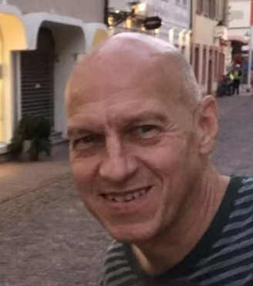
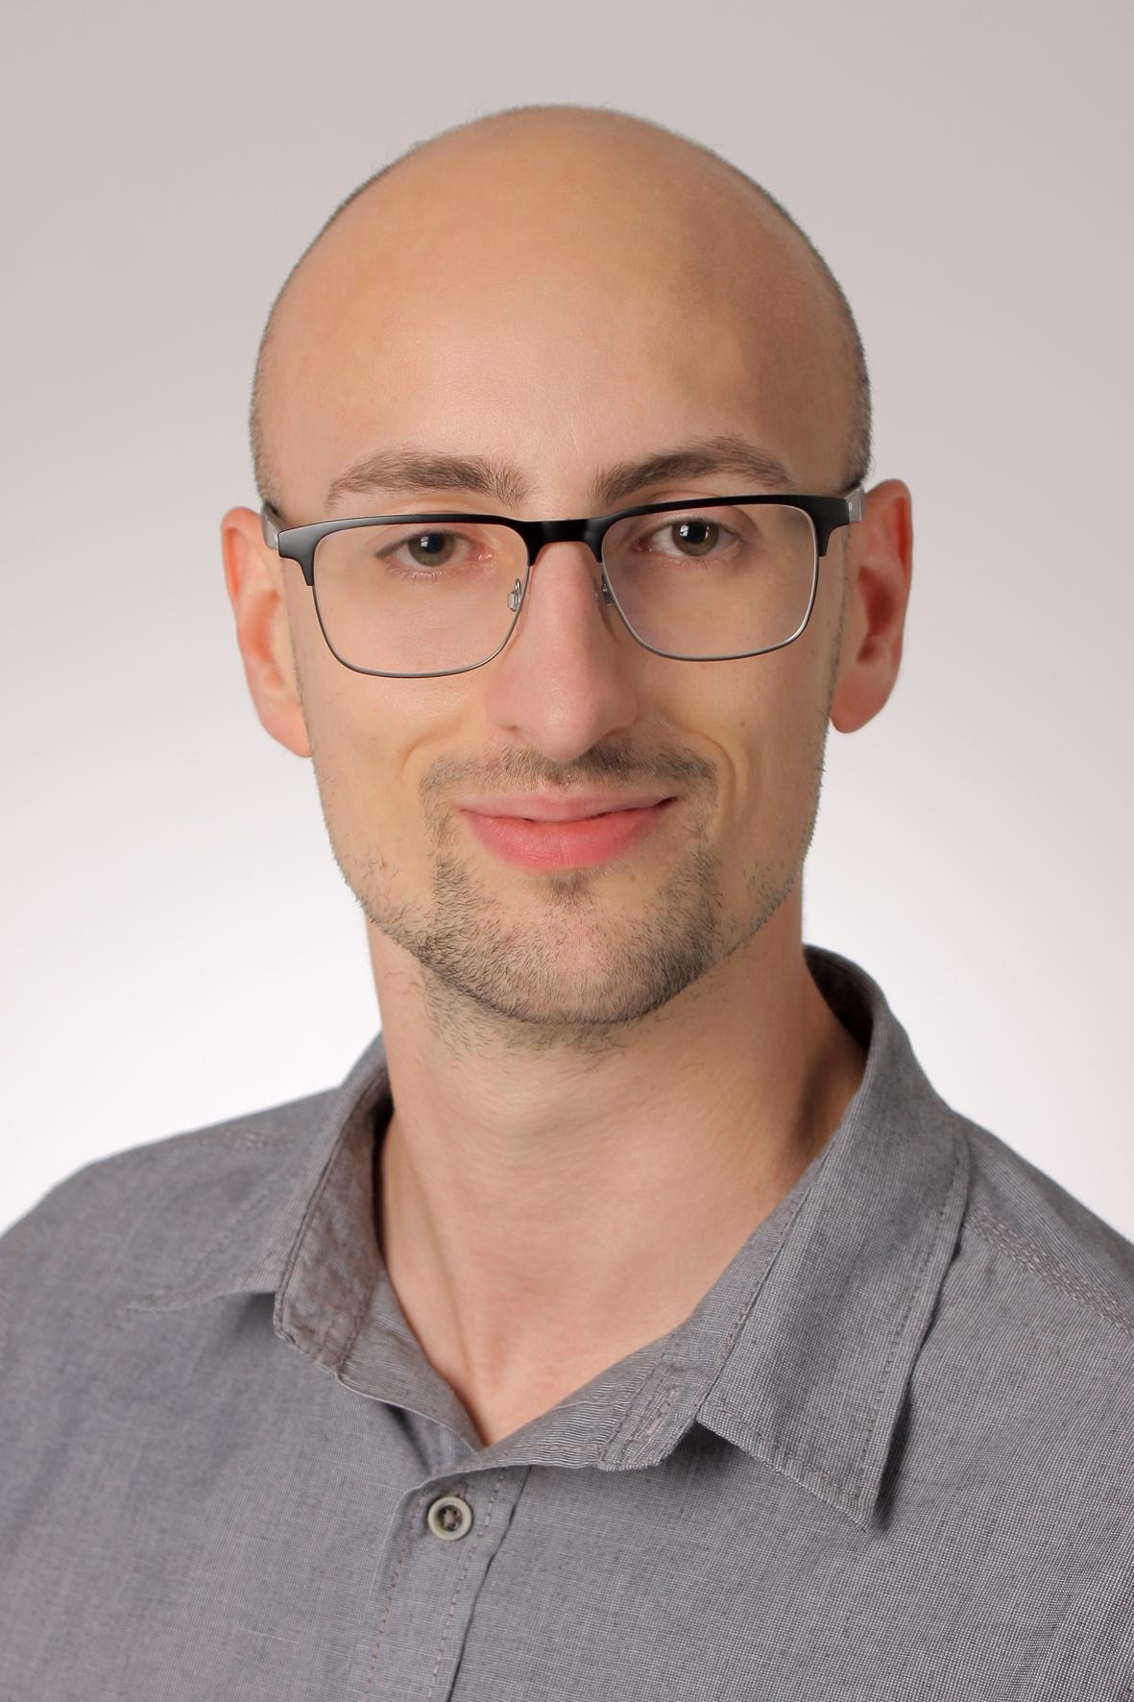
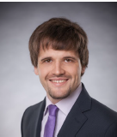
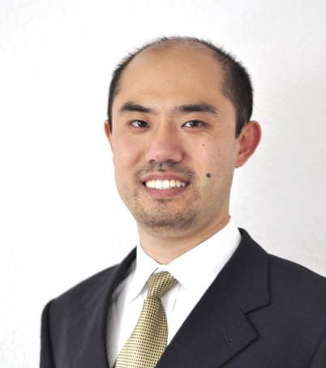
People at Bruker
NDACC-IRWG-TCCON-COCCON annual meeting 2023
Gregor Surawicz will stay responsible for final test and worldwide service at least until 2024
Kevin Loran joined Bruker in March 2022 and will assist Gregor
Most likely Kevin will take over final test and service after Gregor’s retirement
Both also do EM27/SUN service and final test
Denis Czurlok, responsible for the high resolution IFS125HR business at Bruker HQ
Xia Wu, responsible for EM27/SUN and other remote sensing systems such as hyperspectral imager HI 90 at Bruker HQ
In case you don’t know whom to address use the new e-mail address:
    ifs.service.BOPT.de@bruker.com

Slide 3
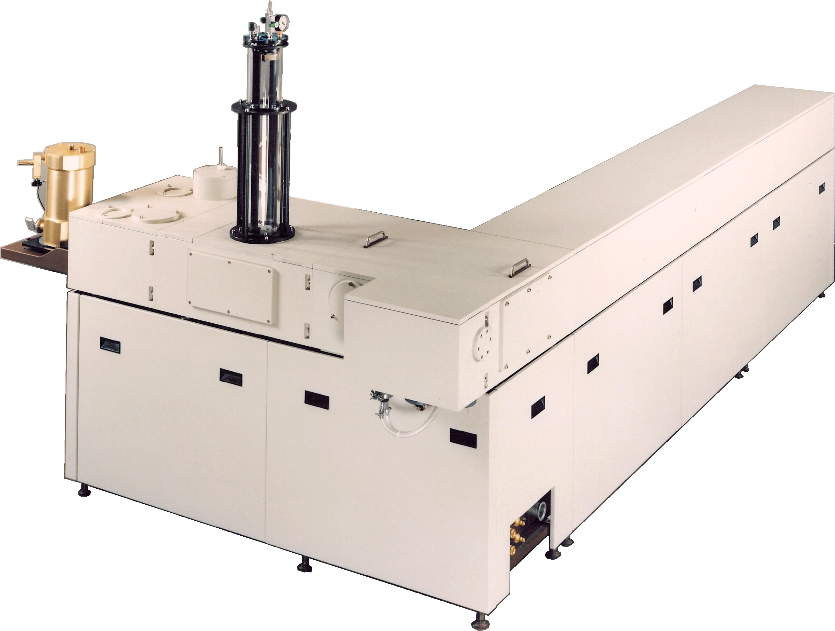
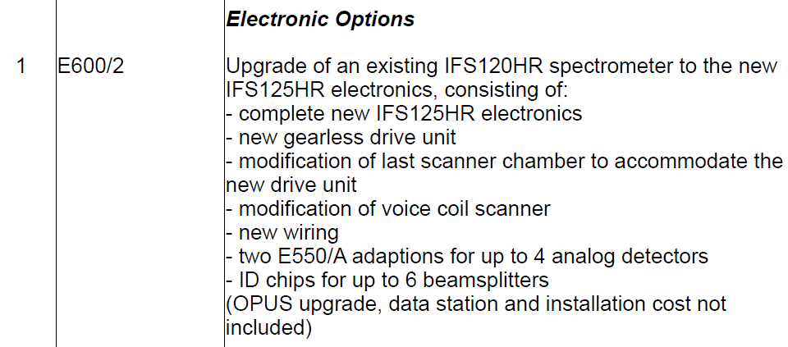
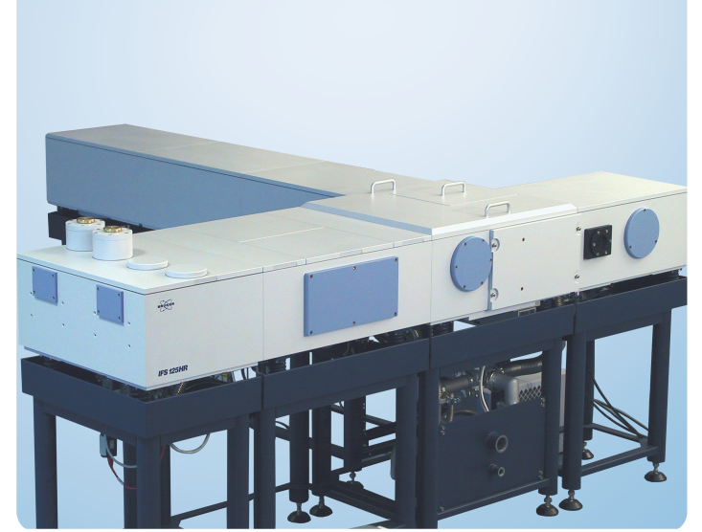
Important sales information
NDACC-IRWG-TCCON-COCCON annual meeting 2023
Upgrade possibility discontinued
Support of upgraded instruments until 2030 (for latest upgrades)
Update from M15 to M16 electronics (IFS125 HR) still possible via I24190
No more orders of E600/2 possible
IFS system upgrades
IFS120HR
Electronic upgrade to IFS125HR electronics: E600/2
M15 electronics
M16 electronics
I24190

Slide 4
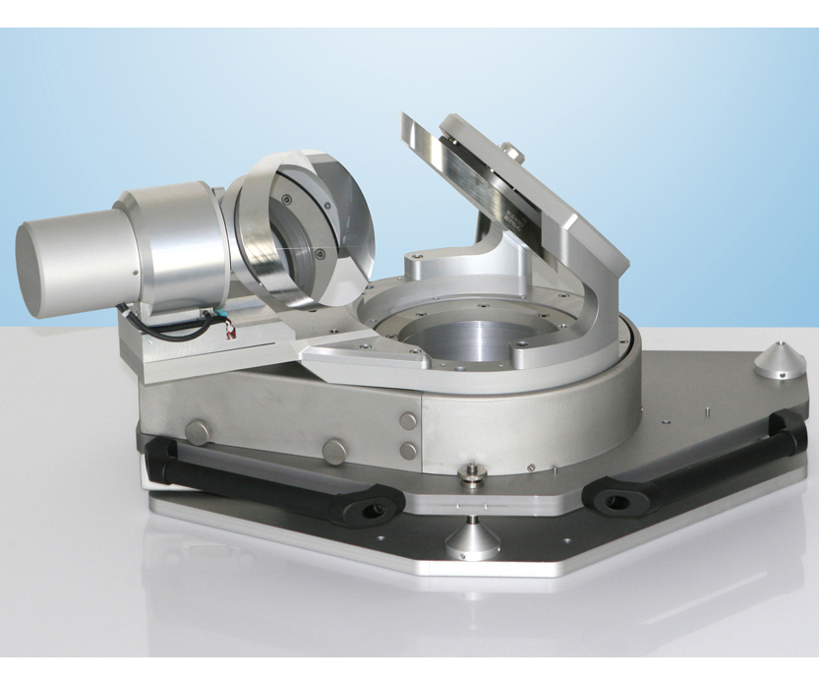
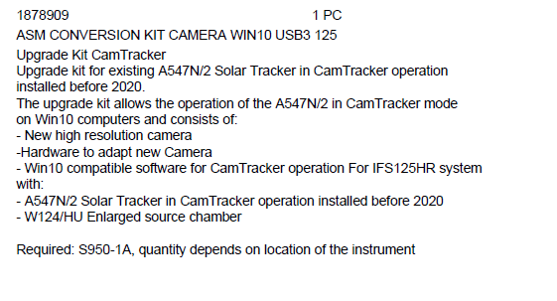
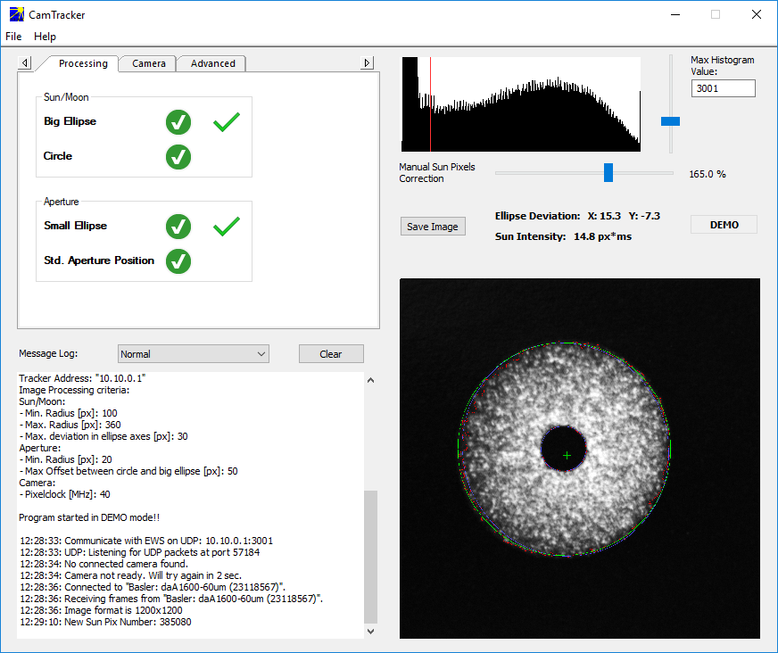
Important sales information
NDACC-IRWG-TCCON-COCCON annual meeting 2023
CamTracker operation is standard and included in Solar Tracker option
Optional: quadrant diode sensor optional
New camera model (USB3) and related software for CamTracker operation since 2020
Camera and software suitable for Windows10 operation
Upgrade package for existing Trackers available, service assistance might be required:
A547N/2
SolarTracker

Slide 5
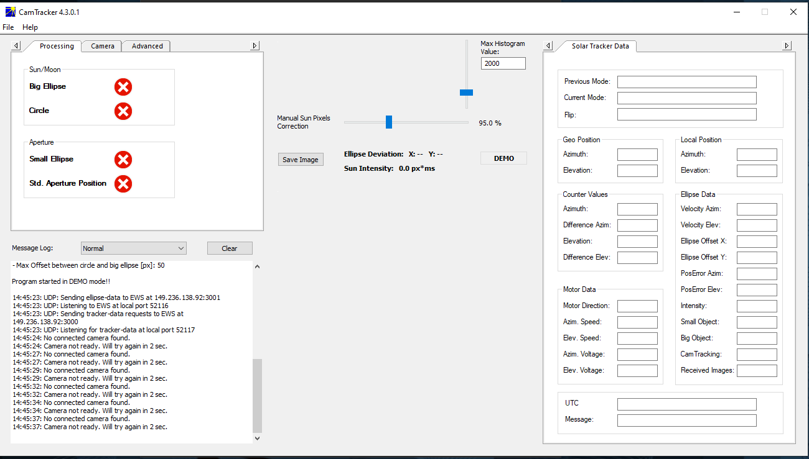
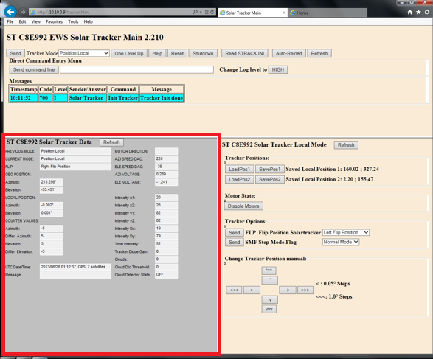
Important sales information
NDACC-IRWG-TCCON-COCCON annual meeting 2023
Last year: Problem for Browser-operation of SolarTracker found for newest Win10 upgrades
Reason: Internet Explorer is discontinued, operation requires JAVA Applet/Plug-in
Solution:
Transfer critical parts (red)
to new CamTracker software
Revised software version
since 2022 (ver 4.4.2.0)
New: No Browser use
in regular operation
New: Also usable for
quadrant diode operation
to avoid browser operations
A547N/2
SolarTracker

Slide 6
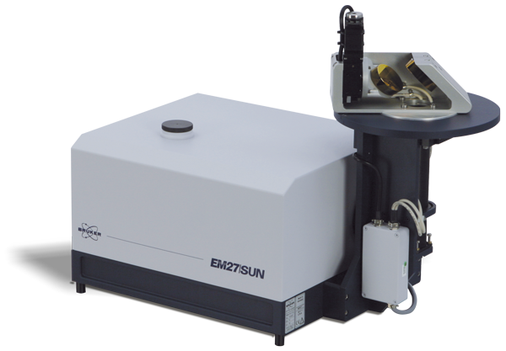
Important sales information
NDACC-IRWG-TCCON-COCCON annual meeting 2023
EM27/SUN
SolarTracker
New GigE vision camera
Only one Ethernet connection is needed
Updated software for Win 10 and Win 11 operation
Updated software cannot work with the old USB camera
Update the system to the new camera possible
New systems are equipped with the height adjustable feet
Emerging country-wide EM27/SUN networks

Slide 7
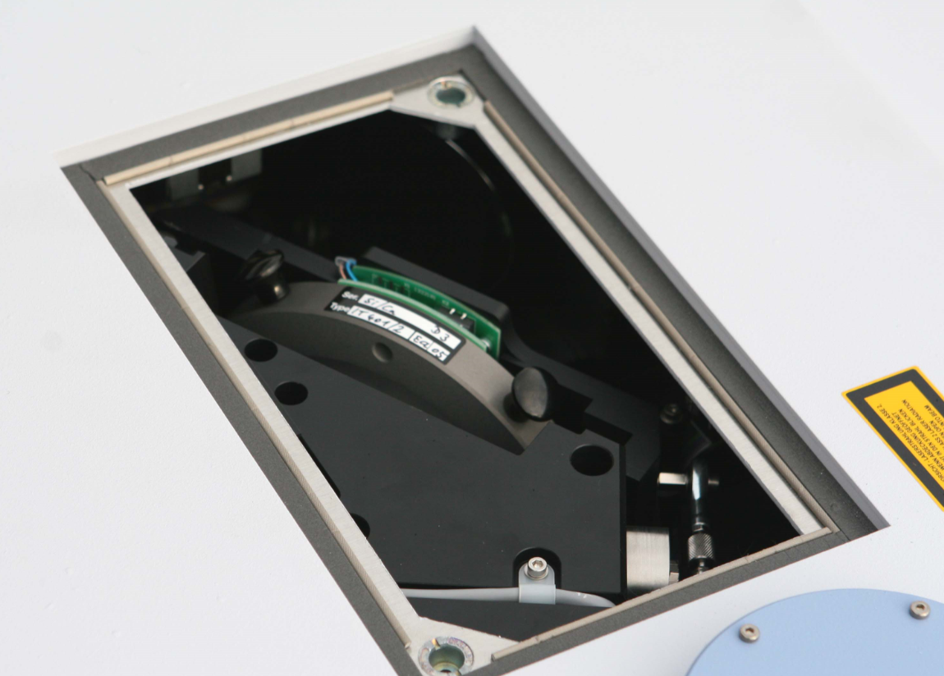
Important sales information
NDACC-IRWG-TCCON-COCCON annual meeting 2023
Maximum wedge angle to maintain compatibility to other beamsplitters: 0.8°
Maximum wedge angle that can be realized in current interferometer design: ~ 2°
Since end of 2020, 0.8° the new standard wedge angle for all beamsplitters
(same price, feedback appreciated)
Special KBr or CaF2 BMS with 2° wedge angle available (no batch order)
Increase of air-gap wedge
^{Interferograms}
^{Spectra}
0.5° 1.27° 2.2°

Slide 8
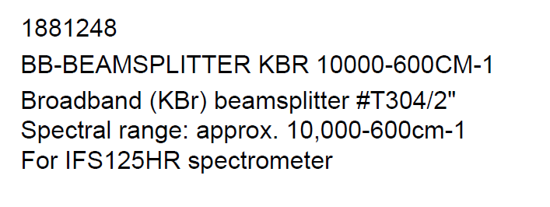
Important sales information
NDACC-IRWG-TCCON-COCCON annual meeting 2023
New part defined:
Available on request
At least 3 (or 5) orders, otherwise price unreasonable high
→ batch request required
3rd BMS delivered
Broad-band KBr beamsplitter

Slide 9
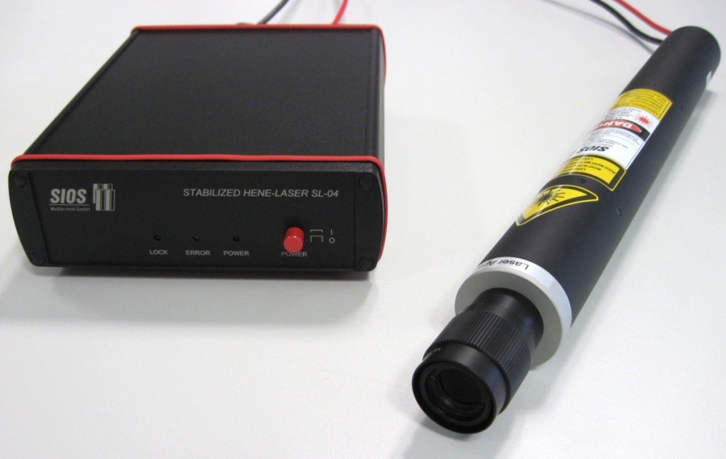
Important service information
Bruker IRWG/TCCON Online Meeting 2022
Q101/2
HeNeLaser
Bruker service issue
Direct contact between SIOS and user now possible again since 04/2022
→ For refurbishment, repairs,..
SIOS reports Bruker about repair cases
All repairs (worldwide) can/should be handled with SIOS directly
New Lasers can be ordered via Bruker
SIOS SL04/BRUK
stabilized HeNe-laser
→ IFS125 HR (M), IFS120 HR (M)

Slide 10
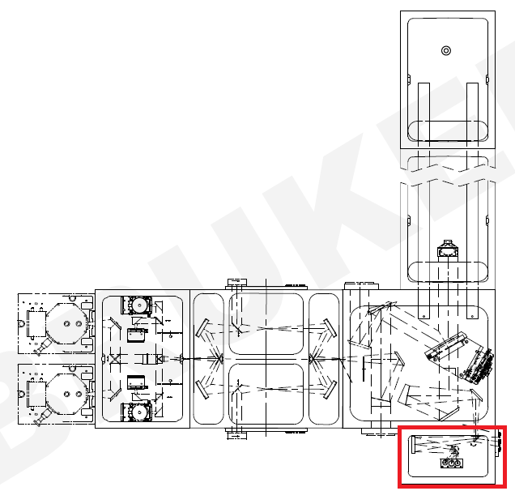
Important sales information
NDACC-IRWG-TCCON-COCCON annual meeting 2023
Standard: Small source chamber in line with scanner arm.Up to 3 internal sources. One focussed entrance port available.
→ never used by atmospheric researchers
IFS125 HR source chamber I

Slide 11
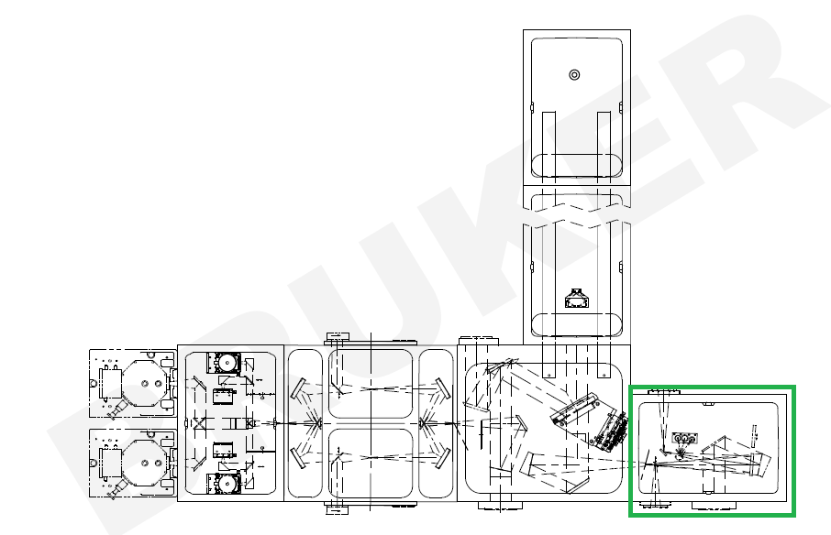
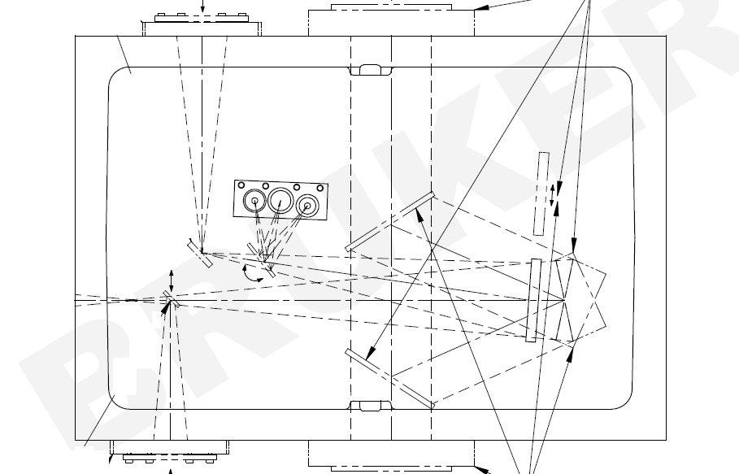
Important sales information
NDACC-IRWG-TCCON-COCCON annual meeting 2023
Large source chamber W124/HU: Large source chamber 90° with scanner arm.Up to 3 internal sources. Focussed entrance ports available. Possibility to activate one large parallel beam input for suntracker operation. Available from left or right side (W108/HR2 vs W108/HL2).
→ Frequently used
IFS125 HR source chamber II
W124/HU
W108/HR2
W124/HU
W108/HL2

Slide 12
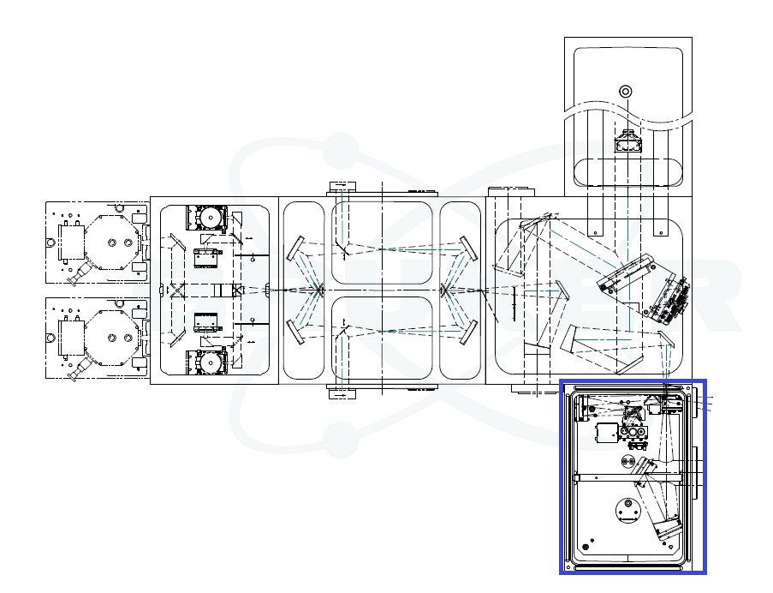
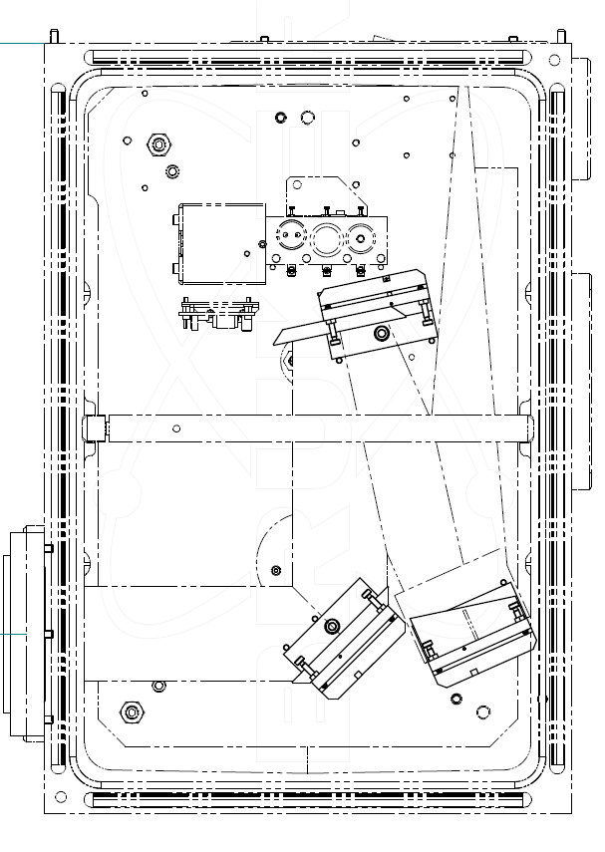
Important sales information
NDACC-IRWG-TCCON-COCCON annual meeting 2023
Large source chamber W124/HUL: Large source chamber in line with scanner arm.Up to 3 internal sources. Focussed entrance port available. Possibility to activate one large parallel beam input for suntracker operation. Available from left or right side (W108/HR5 vs W108/HL5).
→ not well known
IFS125 HR source chamber III
W124/HUL
W108/HR5
W108/HL5
(not in opposite
to W108/HR2!)
W124/HUL

Slide 13
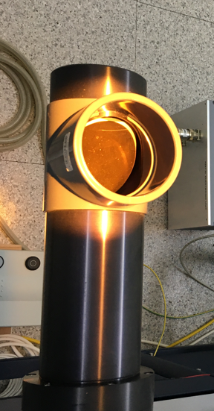
Important sales information
NDACC-IRWG-TCCON-COCCON annual meeting 2023
2 large source chambers for suntracker operation
Each having two input option for large parallel beam
→ 4 coupling option for suntracker tube
Each can be operated with CamTracker option
or with quadrant diode operation
Important for space requirement
IFS125 HR source chamber summary
2
3
4
1

Slide 14
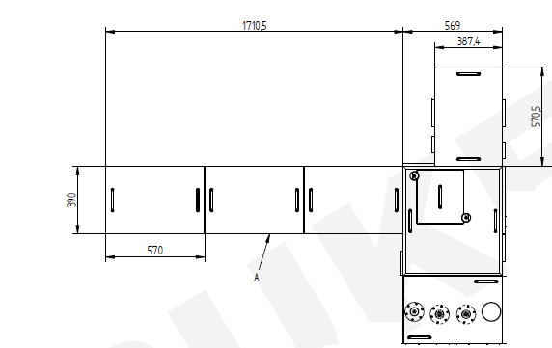
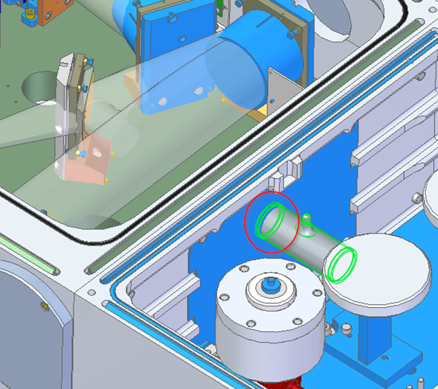

Important sales information
NDACC-IRWG-TCCON-COCCON annual meeting 2023
Often sample compartments are removed:
New official place for calibration gas cell between interferometer and detector compartment
Includes mount and refitting of back scattering protection plate
HCl cell TCCON

