Slide 1
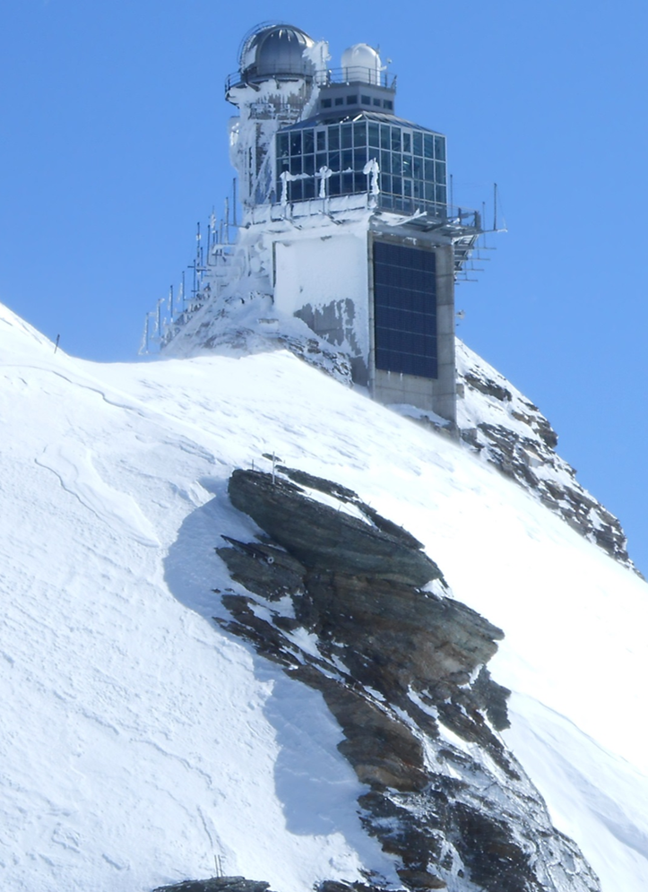



Jungfraujoch site report
[2020-2023]
emmanuel.mahieu@uliege.be
IRWG meeting // Spa // 14-Jun-2023

Slide 2
IR measurements @Jungfraujoch
Regular measurements of solar absorption infrared spectra ongoing since the mid-1970s:
  grating spectrometer over 1976-1989
  homemade FTIR over 1984-2008
  Bruker 120HR from 1991 onwards
Pioneering observations available for 1950-1951 (cfr Jamal’s talk)
Time series covering more than 45 years in the most favorable cases
More than 30 target species available (PAN is the latest addition), others are coming (see Irene’s talk on Thursday)
Overlap

Slide 3
Recent operation (covid-19) and… issues
Operation nominal until end of 2020
Failure of a device needed for remote operation
The shortage of electronic components substantially delayed the production and delivery of a new device
Delivered and implemented before the end of June 2021 (=> a gap of nearly six months)
Then the globar failed => no cell spectra…
Two new failures in 2022, gain control for the detectors (=> no interruption but noisier spectra), and of a board controlling the mirrors and flaps => both now fixed

Slide 4
Way forward
Replace the instrumentation: obvious ageing + not supported anymore! (a budget has recently been secured from MeteoSwiss)
The transition will likely occur during 2024 (with advice/support from Jim and Justus)
The plan is to support the transition with measurements performed with a Vertex instrument (Mathias P./UBremen)
The new instrumentation (125HR and new sun-tracker) should allow the certification by the ACTRIS EU research infrastructure
We still need to raise funds in order to reinforce the team and support the transition: the battle is ongoing

Slide 5
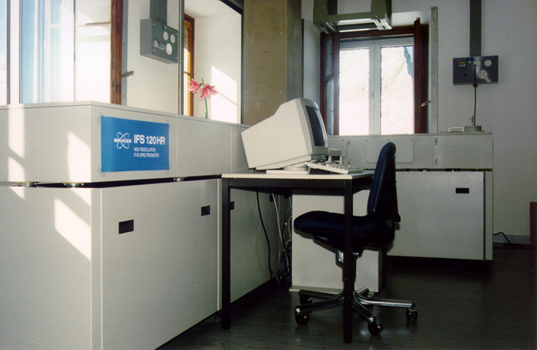
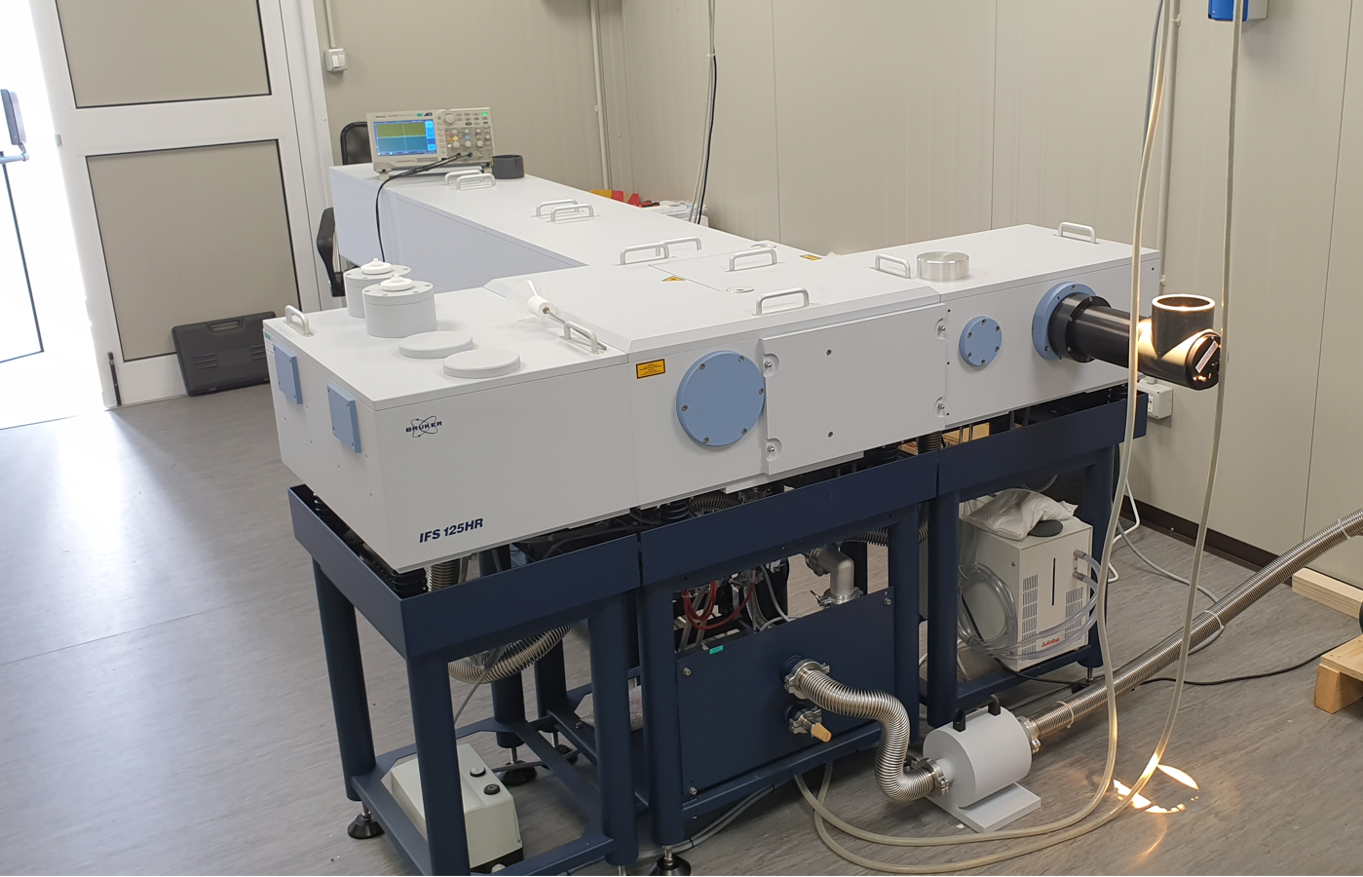
Summary
Bruker 120HR [1989]
Bruker 125HR [2024]

