Slide 1
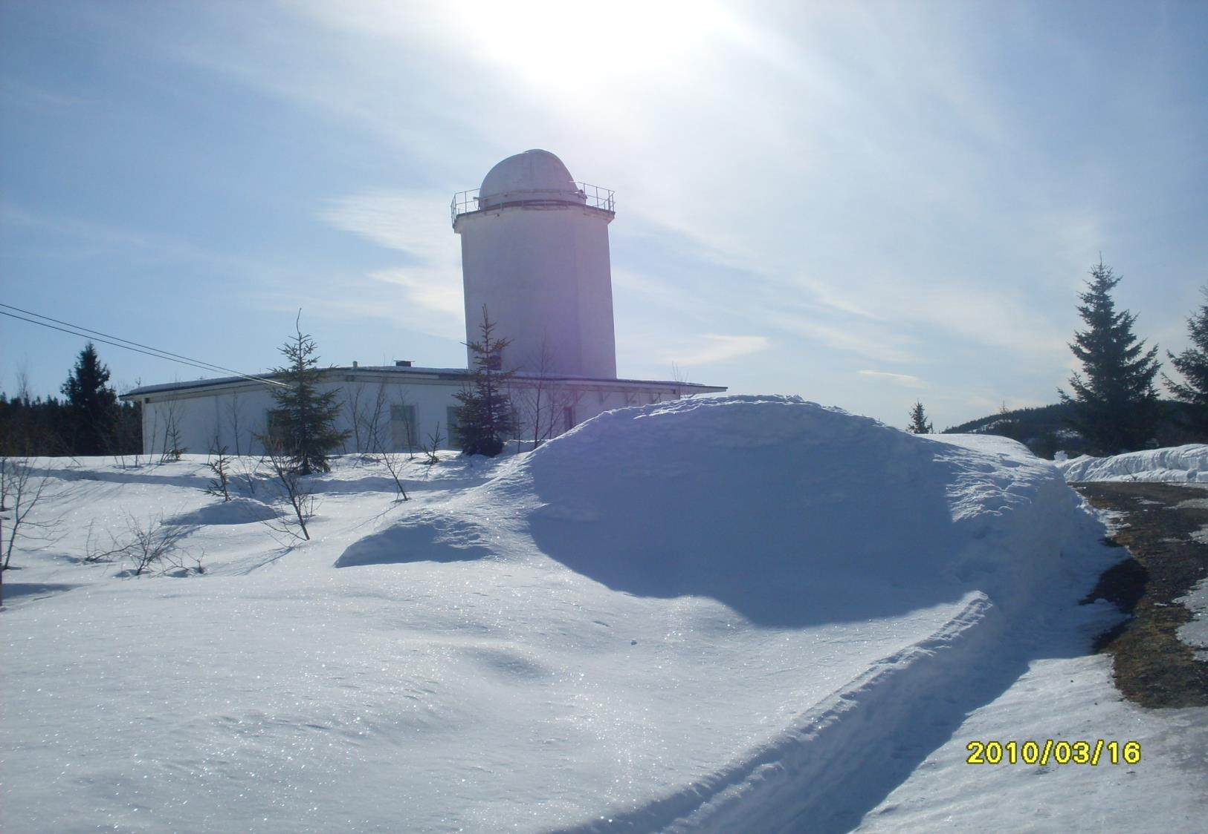
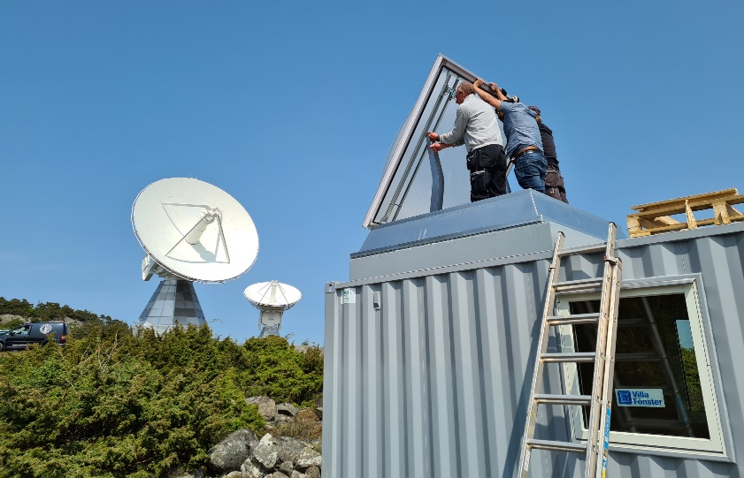
Site report - Harestua – 2023
And new Onsala site
60.2°N, 10.8°E, 596 m.a.s.l.
Johan Mellqvist, Glenn Persson, Maxime Prignon
Space, Earth and Environment
Chalmers University of technology
Göteborg, Sweden
johan.mellqvist@chalmers.se

Slide 2
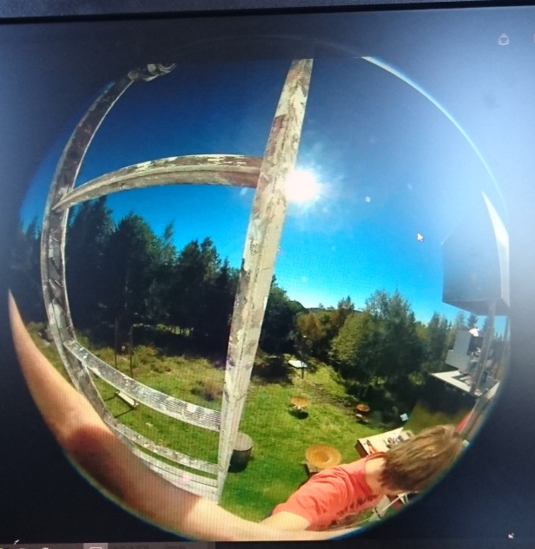
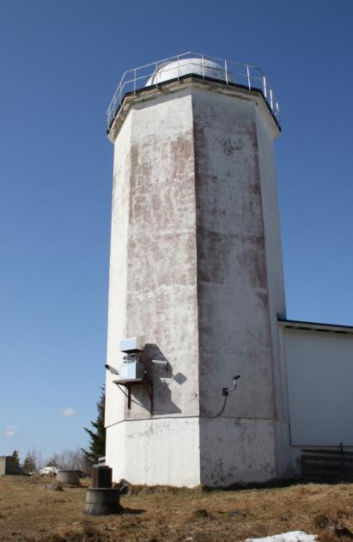
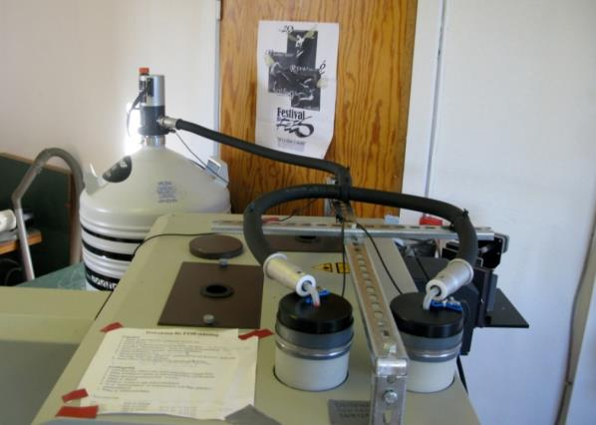
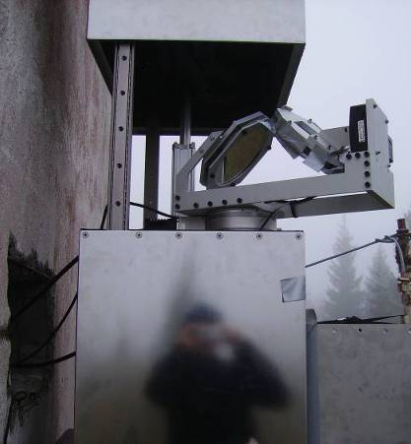
Bruker 125 M, remotely controlled through internet
Instrument installed in May 1994 (120 M) and upgraded in Aug. 2008 to 125 M (Brault aquisition );
Homemade solar tracker since 2006, before solar coelistat of solar observatory.
Remote LN2 filling and meteorogical parameters (p, T and RH), 2008
  New beamsplitter and laser and new aperture plate, Nov. 2009
  HBr cell #13, new since Aug 2016

Slide 3
Measurements at Harestua
1310 measurement days since Nov 1994 Until end of December 2022
38 measurement days in 2022 ( power problem)
HBR cell measurements shows in general stable measurements with reasonable quality for IFS 125 M (modulation efficiency 0.82)
Date retrieval and reporting
  Data in AMES format are reported to the NDACC archive up to the end of December 2021. The data has been retrieved with SFI2 and corresponds to C2H6, CCl2F2, CH4, ClONO2, CO, COF2, HCFC22, HCl, HF, HNO3, N2O, NO2 and O3. Data for 2022 will be reported end of June.
  HDF 4 Geoms reported for HCl, O3, CH4, and HF 2009-2020. 1994-2022 will be updated end of June.
Funding from Swedish EPA and some faculty funding .Part of the Swedish National monitoring program, ”Ozone depleting substances” . Funding for running cost , 50% position for engineer.

Slide 4
More about data retrieval
SFIT4 fully implemented
Retrieval strategies have been updated/improved (often motivated by IRWG efforts):
  HCl (linelist test)
  C₂H₆ (linelist test, Manu)
  F22 (Minq)
  F12 (Matt Rigby+Jim)
  HCHO (Corinne)
  NO₂ (Corinne)
  HNO₃
  CH₄
NDACC species to archive are currently in development or in QA/QC, most of it will be updated and uploaded this year
Planned to improve instrument line shape processing. Right now, LINEFIT output with 1 parameter (straight-line)

Slide 5
Obstacles
The foundation managing the observatory went bankrupt, leading to a loss of power from December to March.
A new entity took over at the end of March, at which point electricity was restored, allowing for the resumption of measurements.
There is a low laser signal since the restart, possibly due to issues with the laser, beamsplitter, and/or misalignment.
At the moment, we are limited to using a CaF2 beamsplitter and an InSb detector with filters 1-5.
Out of the 50 planned measurement days in 2023 , 16 have been completed.

Slide 6
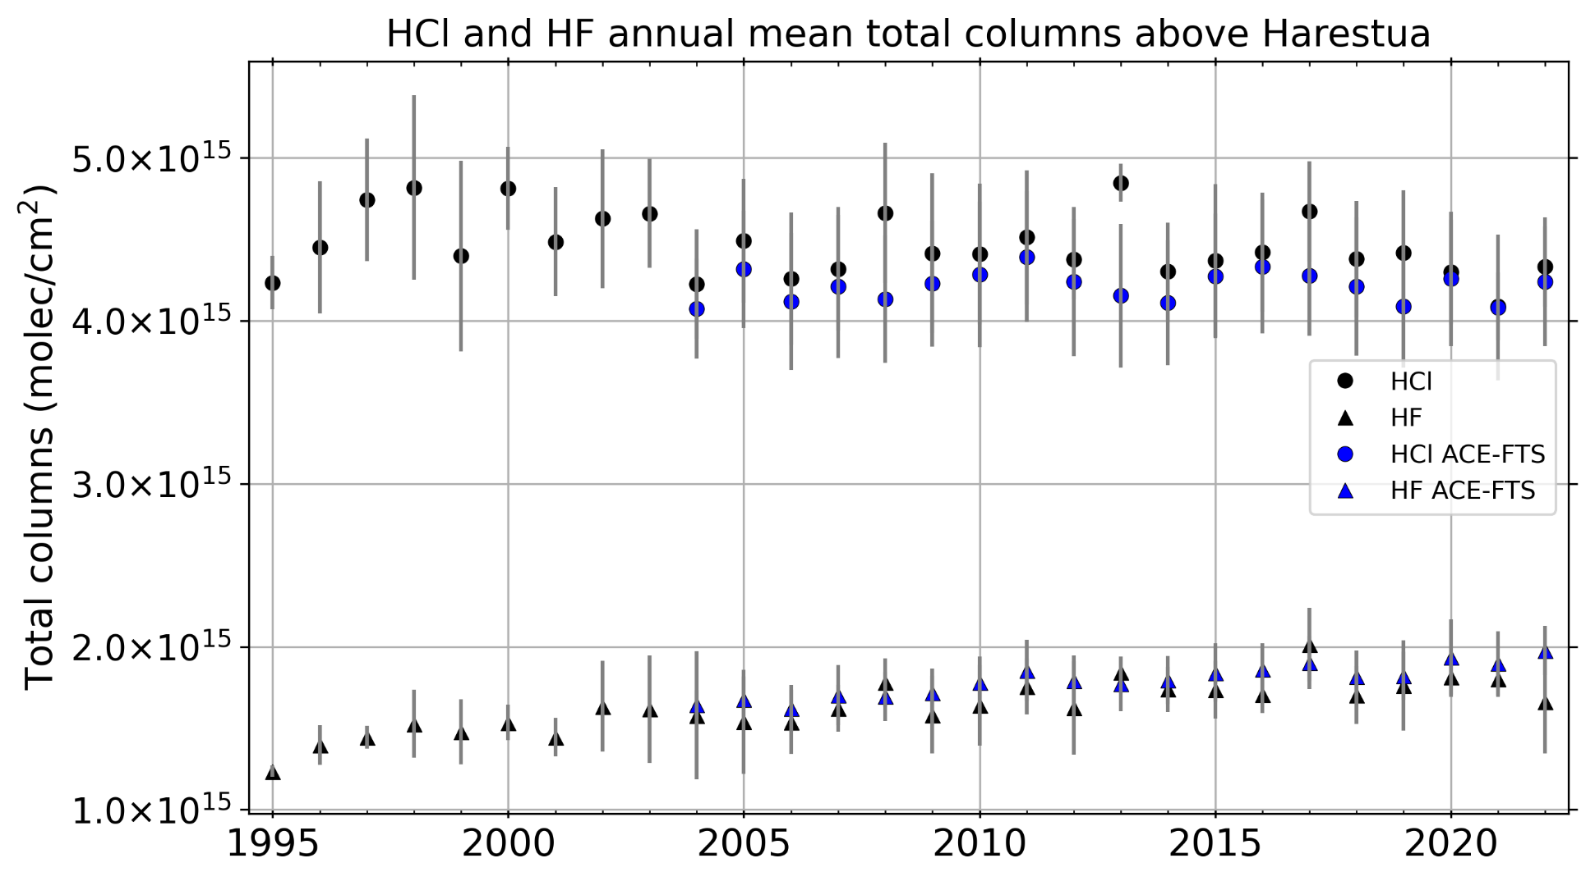
Some results

Slide 7
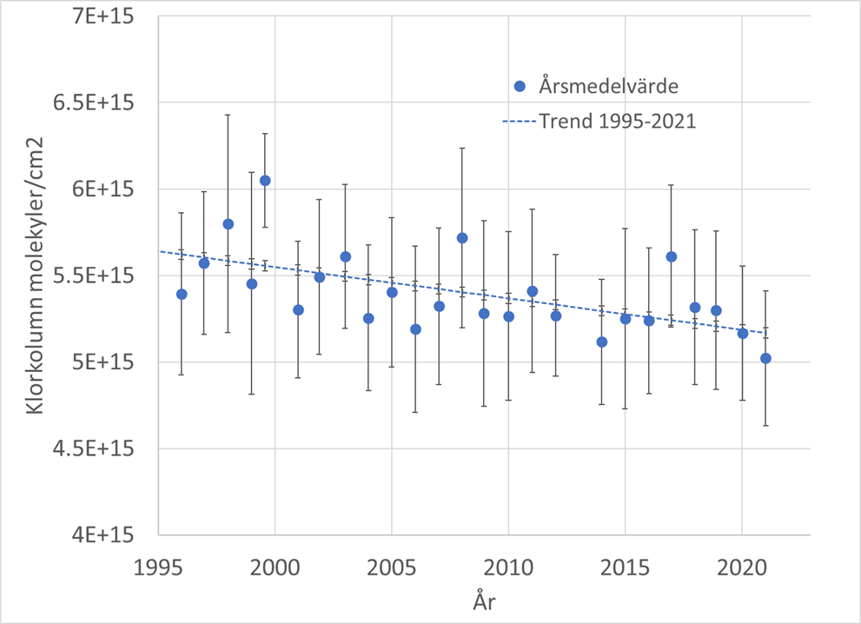
Chlorine HCl and ClONO2

Slide 8
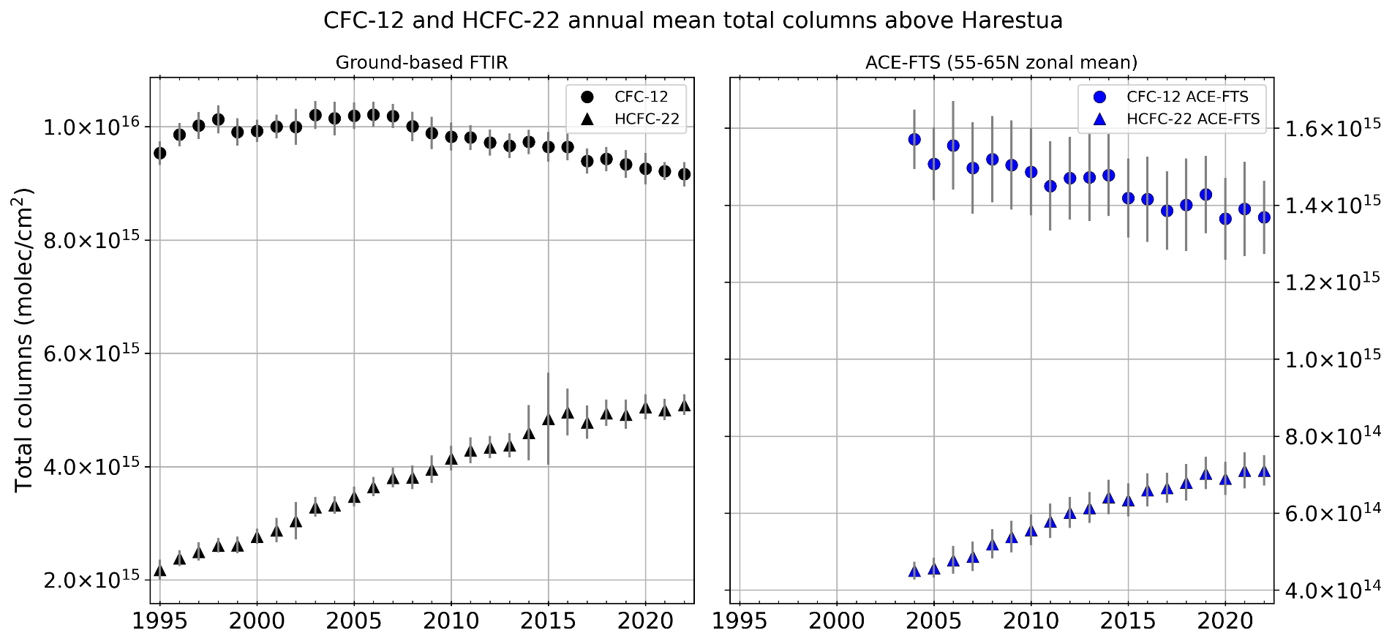
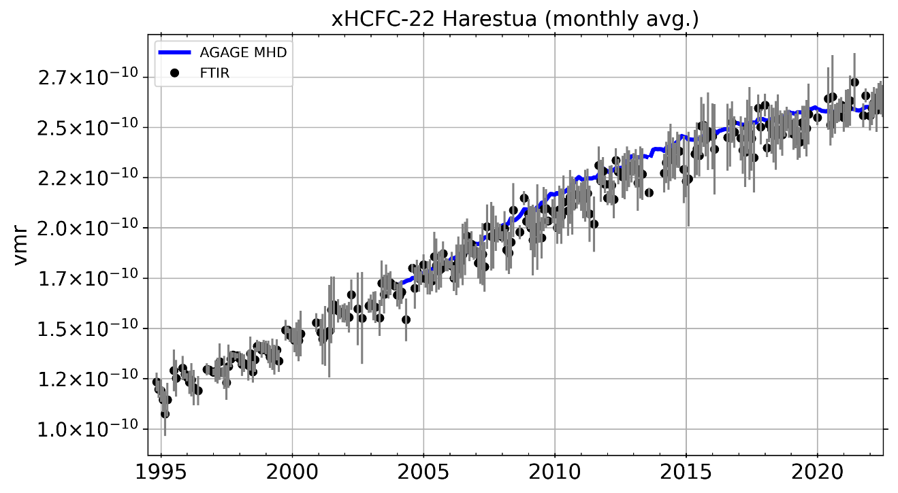
CFC
CFC12
FTIR
ACE-FTS
HCF22
AGAGE model

Slide 9
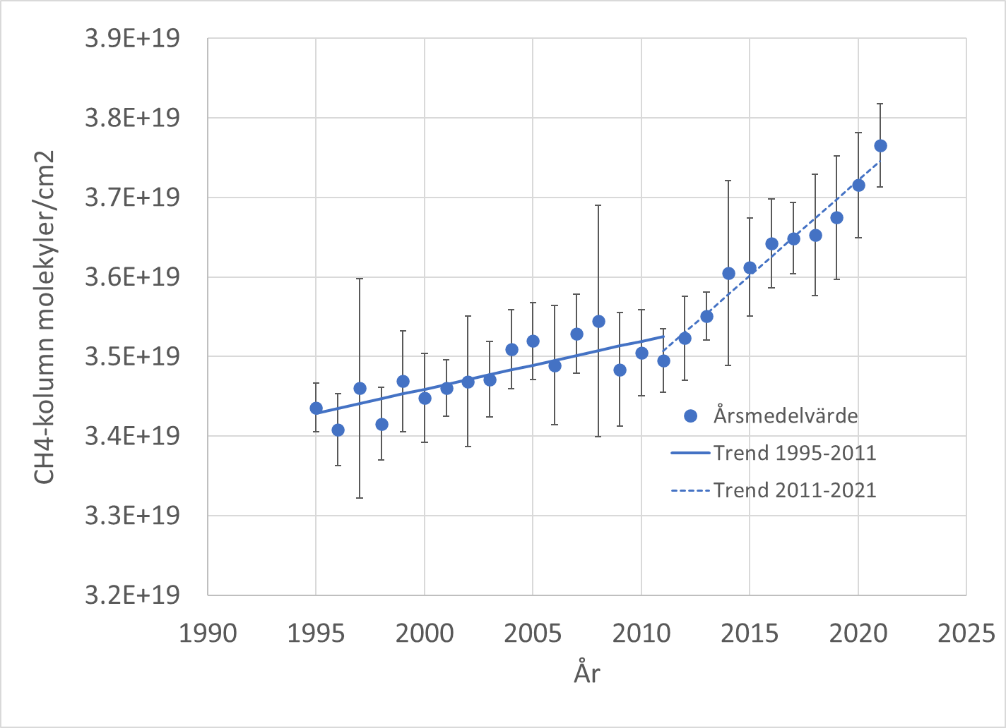
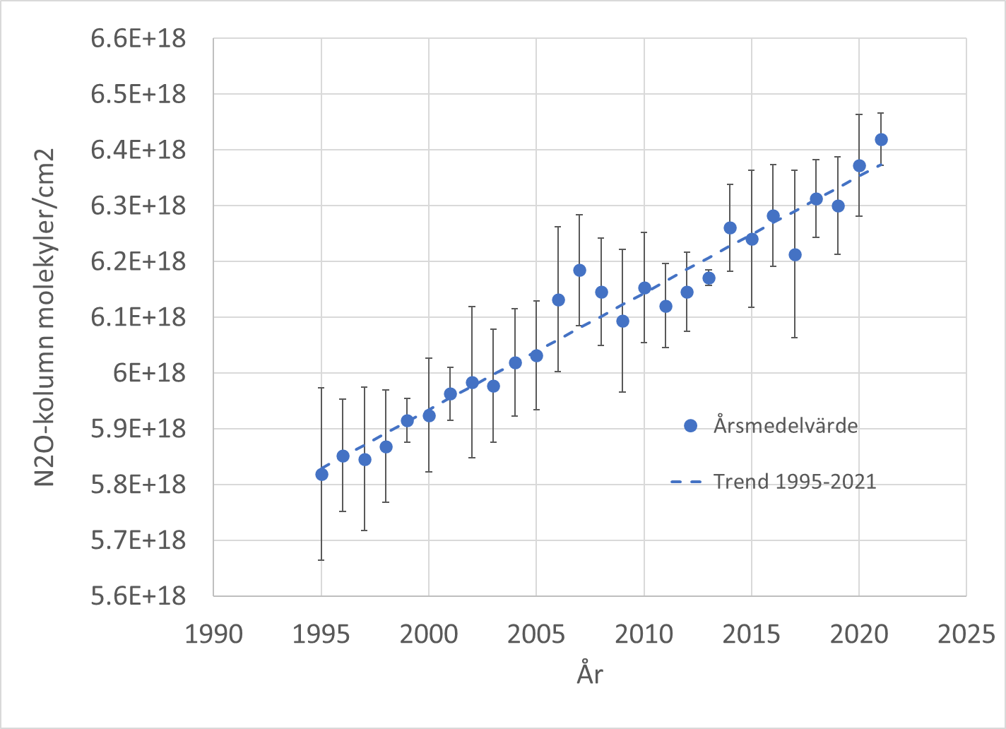
CH4 and N2O
CH4:
1995– 2011: 6 ∙10¹⁶ molekyler∙cm⁻² år⁻¹ (0.18 % rel 1995 )
2011-2021: 2.4∙10¹⁷ molekyler∙cm⁻² år⁻¹ (0.67 %/år rel 2011).
N2O
1995-2021 : 0.36 %/year rel 1995

Slide 10
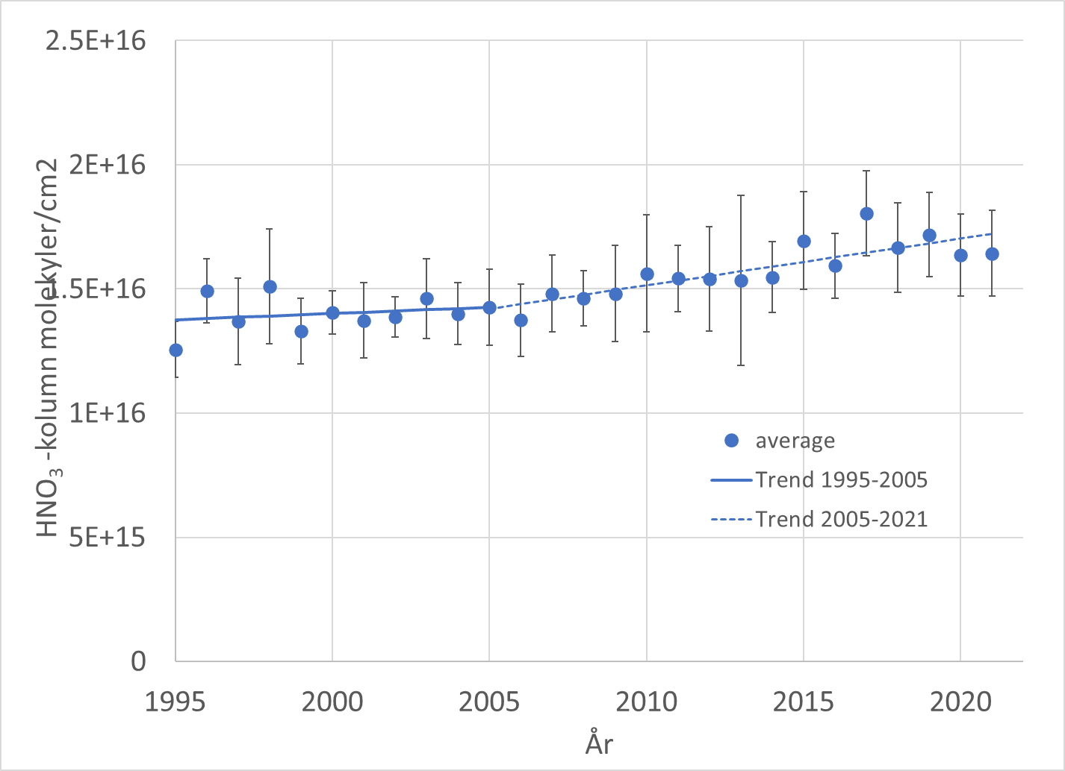
HNO3
Trend
1995-2011: 0.32 % rel 2011
trend 2011-2021: 1.22% rel 2011

Slide 11
S5P stratospheric NO2 validation using the FTIR network
One additional site (Harestua), in very good agreement with previous validation.

Slide 12
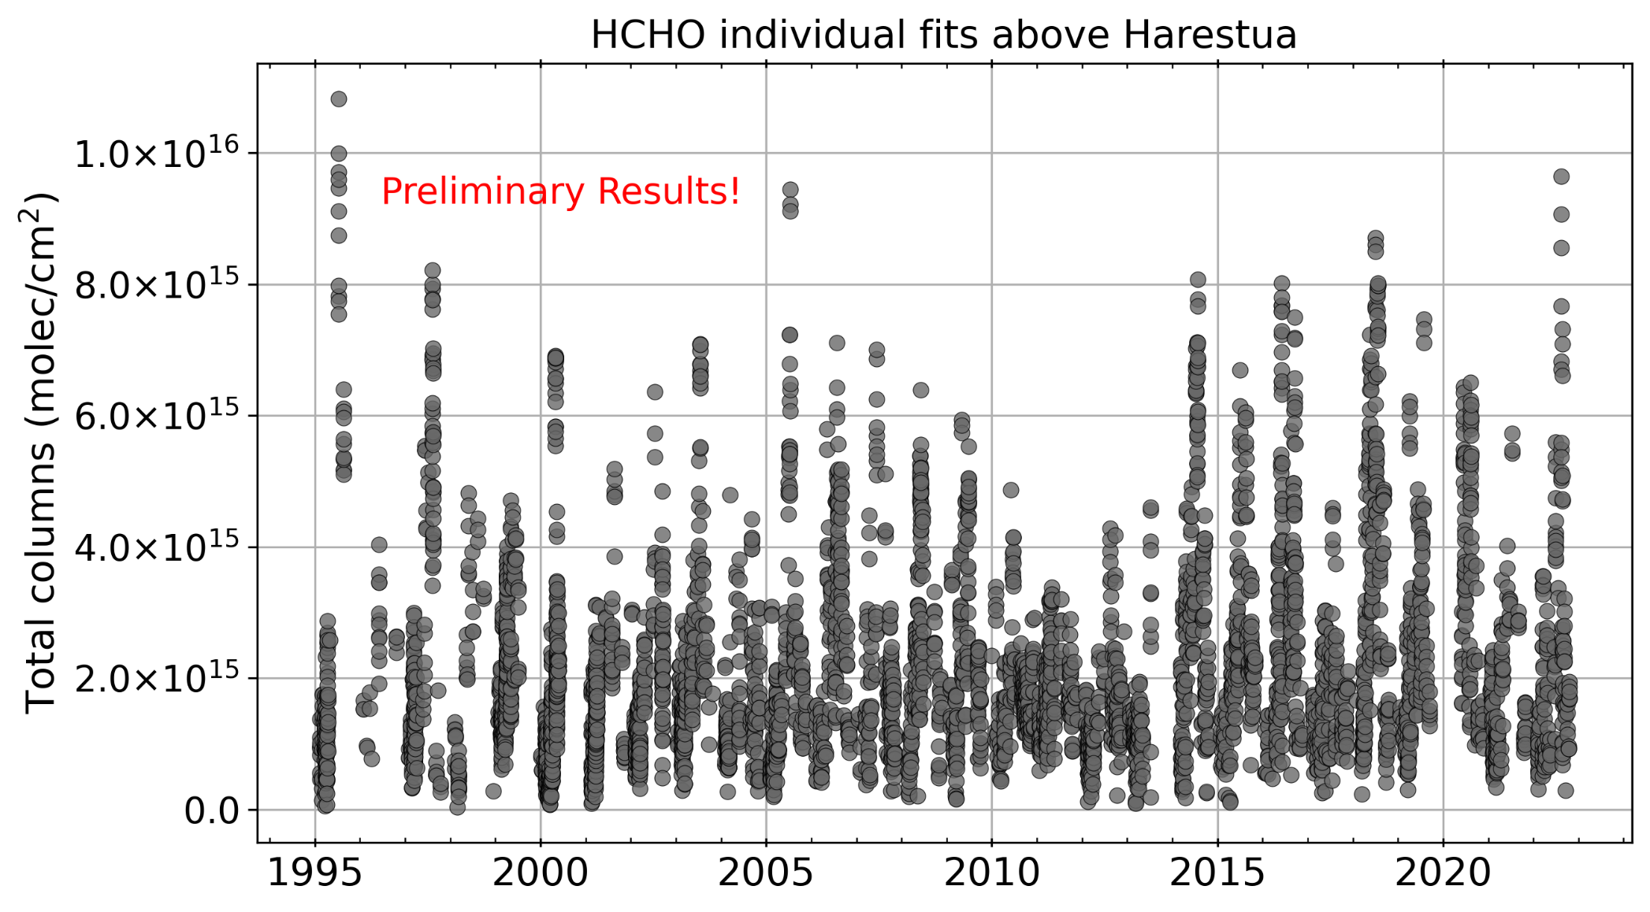
HCHO

Slide 13
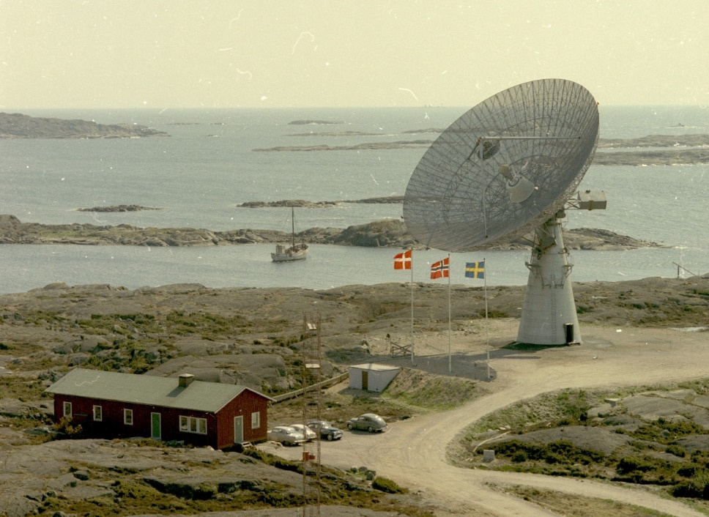
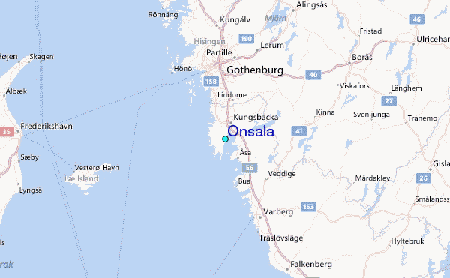
New instrument at Onsala space observatory
Full NDACC & TCCON FTIR and solar tracker has arrived and will be installed in the end of June
Latitude: 57° 23' 20.99" N Longitude: 11° 55' 2.39" E.
Already equipped with NDACC microwave radiometer

Slide 14
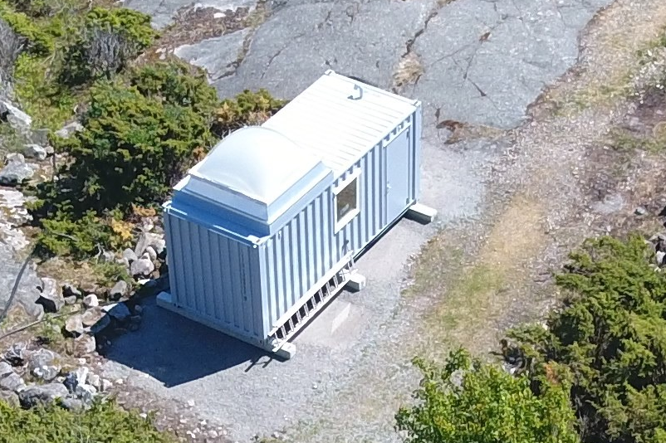
IFS 125 HR
Bruker solar tracker
Installed June 26 2023
NDACC:
BS: KBr
Det: InSb, MCT
Standard filters
TCCON
BS: CaF2,
Det: InGaAs and Si
Max DOAS, 200-700 nm
Picarro CRDS CO2, CH4, H2O
We will apply for associated
NDACC site IRWG and UV/VIS
TCCON site
(Potentially also ICOS and Actris)

Slide 15

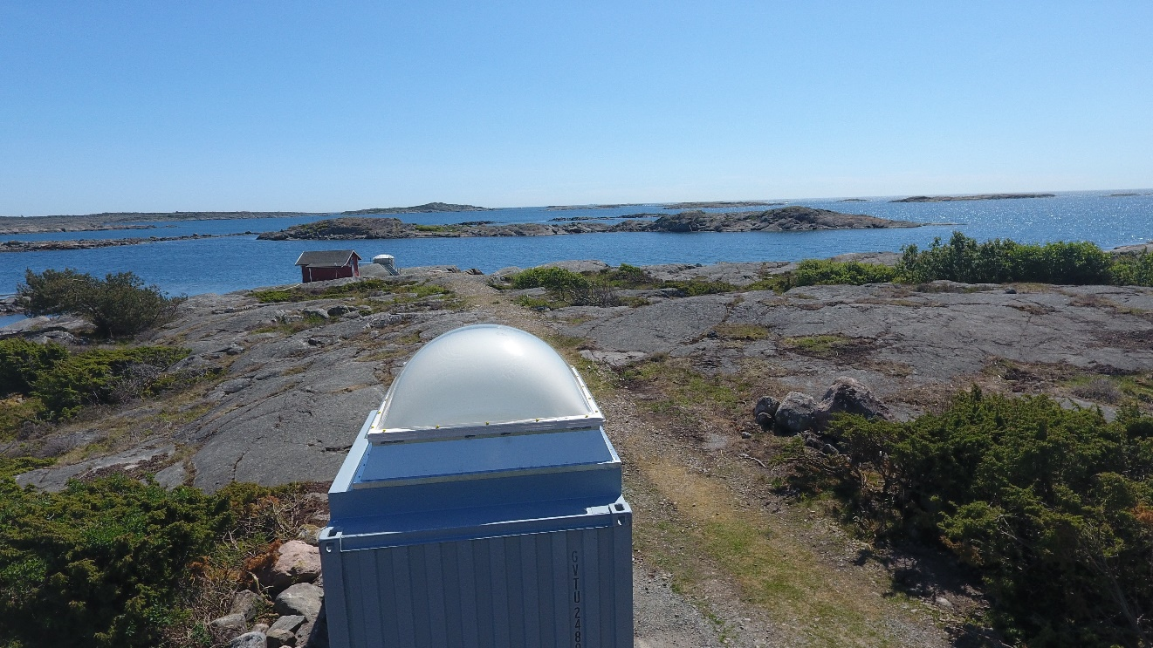
Refurbished and insulated container with a heat pump and a reinforced roof, with a hole for a solar tracker installed in May 2023
Astrodome,
(∼25 kEuros)

Slide 16
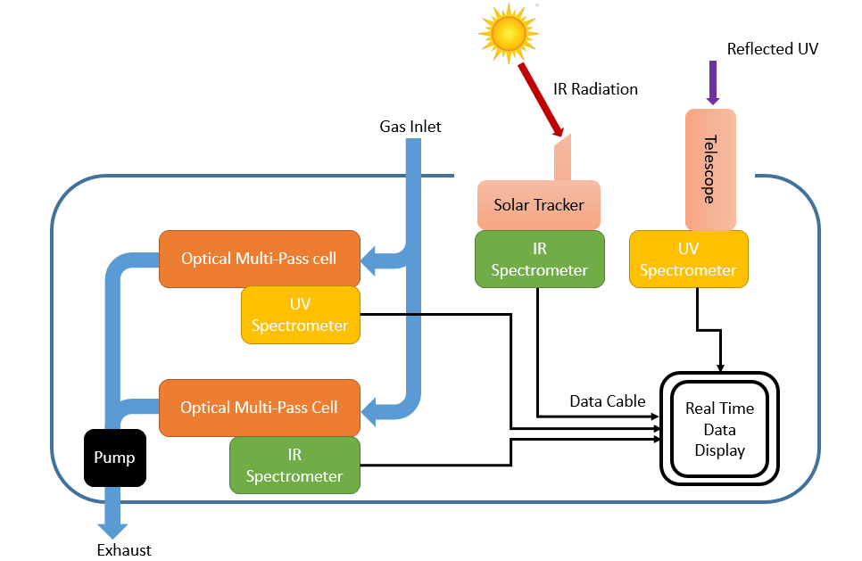
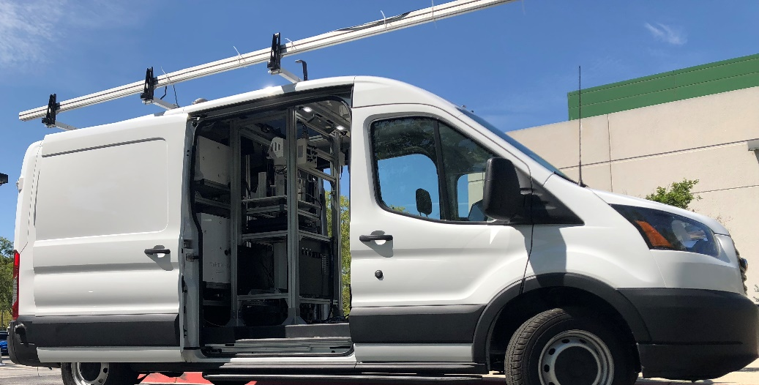
Mobile Solar FTIR
Nathalia T. Vechi, Johan Mellqvist, J. Samuelsson et al, Ammonia and methane emissions from dairy concentrated animal feeding operations in California, using mobile optical remote sensing, Atmospheric Environment, 2023
Johansson, (2014). Emission measurements of alkenes, alkanes, SO2, and NO2 from stationary sources in Southeast Texas over a 5 year period using SOF and mobile DOAS. JGT
Mellqvist, J (2014). Quantitative measurements and modeling of industrial formaldehyde emissions in the Greater Houston area during campaigns in 2009 and 2011. JGR

