Slide 1
Anthropogenic CO₂ emission estimates in the Tokyo Metropolitan Area
Matthias Max Frey, Hirofumi Ohyama, Isamu Morino, Kei Shiomi, Masahide Nishihashi, Tatsuya Miyauchi, Hiroko Yamada, Makoto Saito, Masanobu Wakasa, Thomas Blumenstock, Frank Hase

Slide 2
Outline
Measurement campaign overview
Modeling setup
Campaign results
Outlook

Slide 3
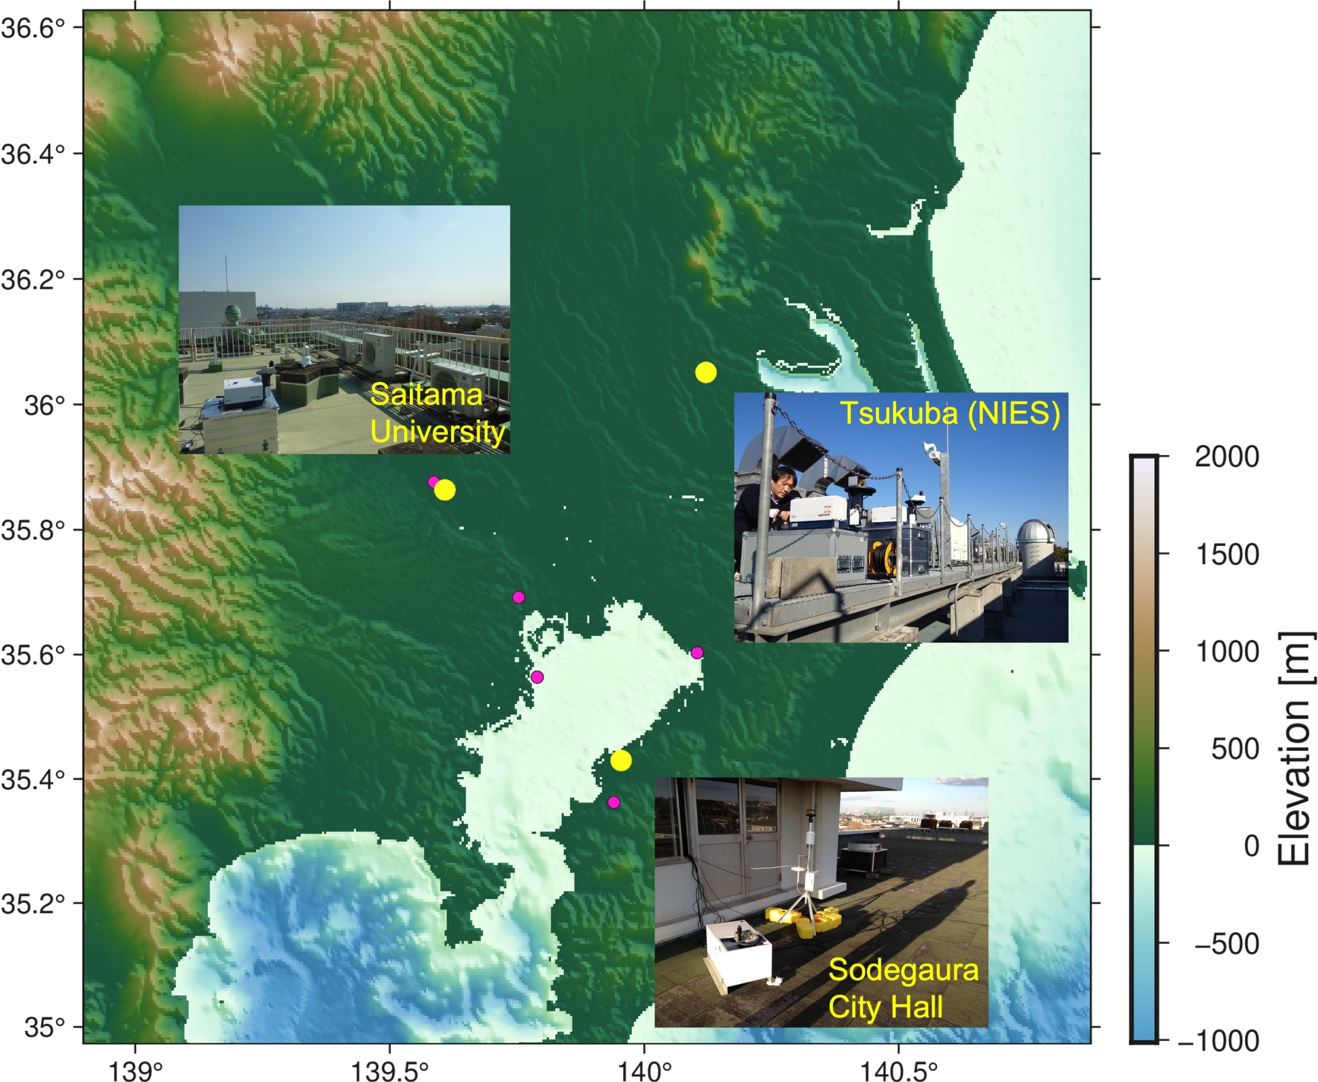





Measurement campaign overview
Campaign period: February – April 2016
  The COCCON Tsukuba instrument arrived March 2016
Objective: Estimate megacity (Tokyo) GHG emissions
Collaboration partners
  KIT
  JAXA
  NIES
  Additional support
    Saitama University
    Sodegaura city government
Ohyama and Frey et al., ACPD, 2023

Slide 4
Modeling setup

Slide 5
Lagrangian transport model
Meteorological fields from the WRF model
Horizontal resolution 1 km
Different PBL schemes tested w. r. t. AMeDAS observations
WRF drives STILT model
STILT calculates back trajectories from a receptor location, so called footprints
  1 km spatial resolution
  15 min temporal resolution
Footprints are multiplied with anthropogenic and biogenic fluxes to derive spatially resolved contributions of the emission sources
XCO₂ enhancement (ΔXCO2) at each observation site is sum of contributions over all cells

Slide 6
Anthropogenic CO₂ fluxes
Open-Source Data Inventory for Anthropogenic CO₂ (ODIAC)
  Global high-resolution (1 km) monthly fossil fuel CO₂ emissions database
Large point source (LPS) emission strengths and positions corrected
  Replace grid cells above threshold (>10⁴ tons of carbon per month) with averaged value of neighboring cells
  Add LPS emissions according to Ministry of Environment information
For the corrected inventory, LPS account for 37 % of total emissions

Slide 7
Additional model settings
Biogenic CO₂ fluxes: VISITc model downscaled to 1 km resolution using green vegetation fraction data from the VIIRS sensor onboard the Suomi NPP satellite
Background CO₂ concentrations from Tsukuba observations
Estimation of a posteriori CO₂ emissions utilizing a Bayesian inversion framework
  Scaling factor for large point source emissions
  3 km spatial resolution for nonpoint source emissions
  Biogenic fluxes not optimized

Slide 8
Results

Slide 9
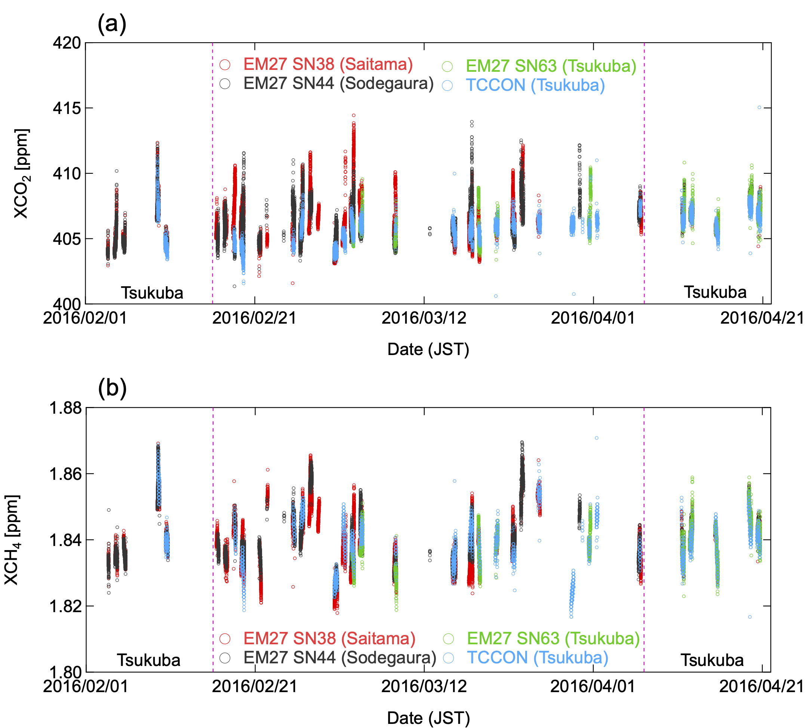
XCO₂ and XCH₄ measurement timeseries
XCO₂ (XCH₄) daily maxima show large variability with peaks up to 415 ppm (1.87 ppm)
XCO₂ daily minima 403 – 405 ppm
XCH₄ daily minima show large variability 1.82 – 1.85 ppm due to synoptic-scale events

Slide 10
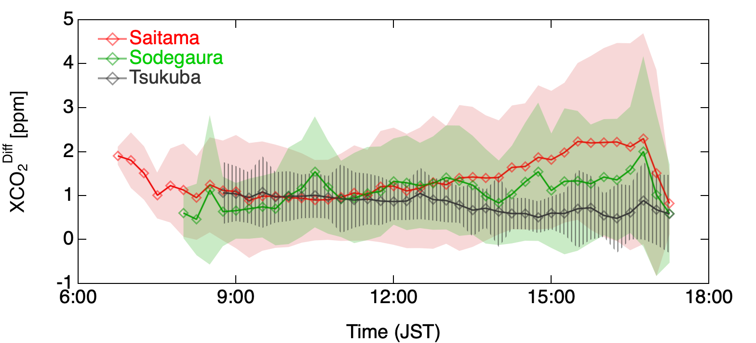
Diurnal XCO₂ differences
XCO₂^{Diff} defined as XCO2 differences from daily background values common to the three sites (5th percentile of Tsukuba measurements throughout each day)
Average XCO₂^{Diff} value per 15-min bin calculated for each site using the entire campaign dataset is shown below
Higher variability and XCO₂^{Diff} for urban sites
For Tsukuba XCO₂^{Diff} decreases during the day due to moderate effect of photosynthesis

Slide 11
XCO₂ simulations
XCO₂ enhancements at the three sites
Non-point source contributions dominate ΔXCO₂ in Saitama and Tsukuba
LPS and non-LPS ΔXCO₂ contributions are comparable in Sodegaura
For model-observation comparison, background XCO₂ values must be added to the simulated ΔXCO₂, calculated as the difference between observed Tsukuba XCO₂ values and simulated Tsukuba ΔXCO₂ values

Slide 12
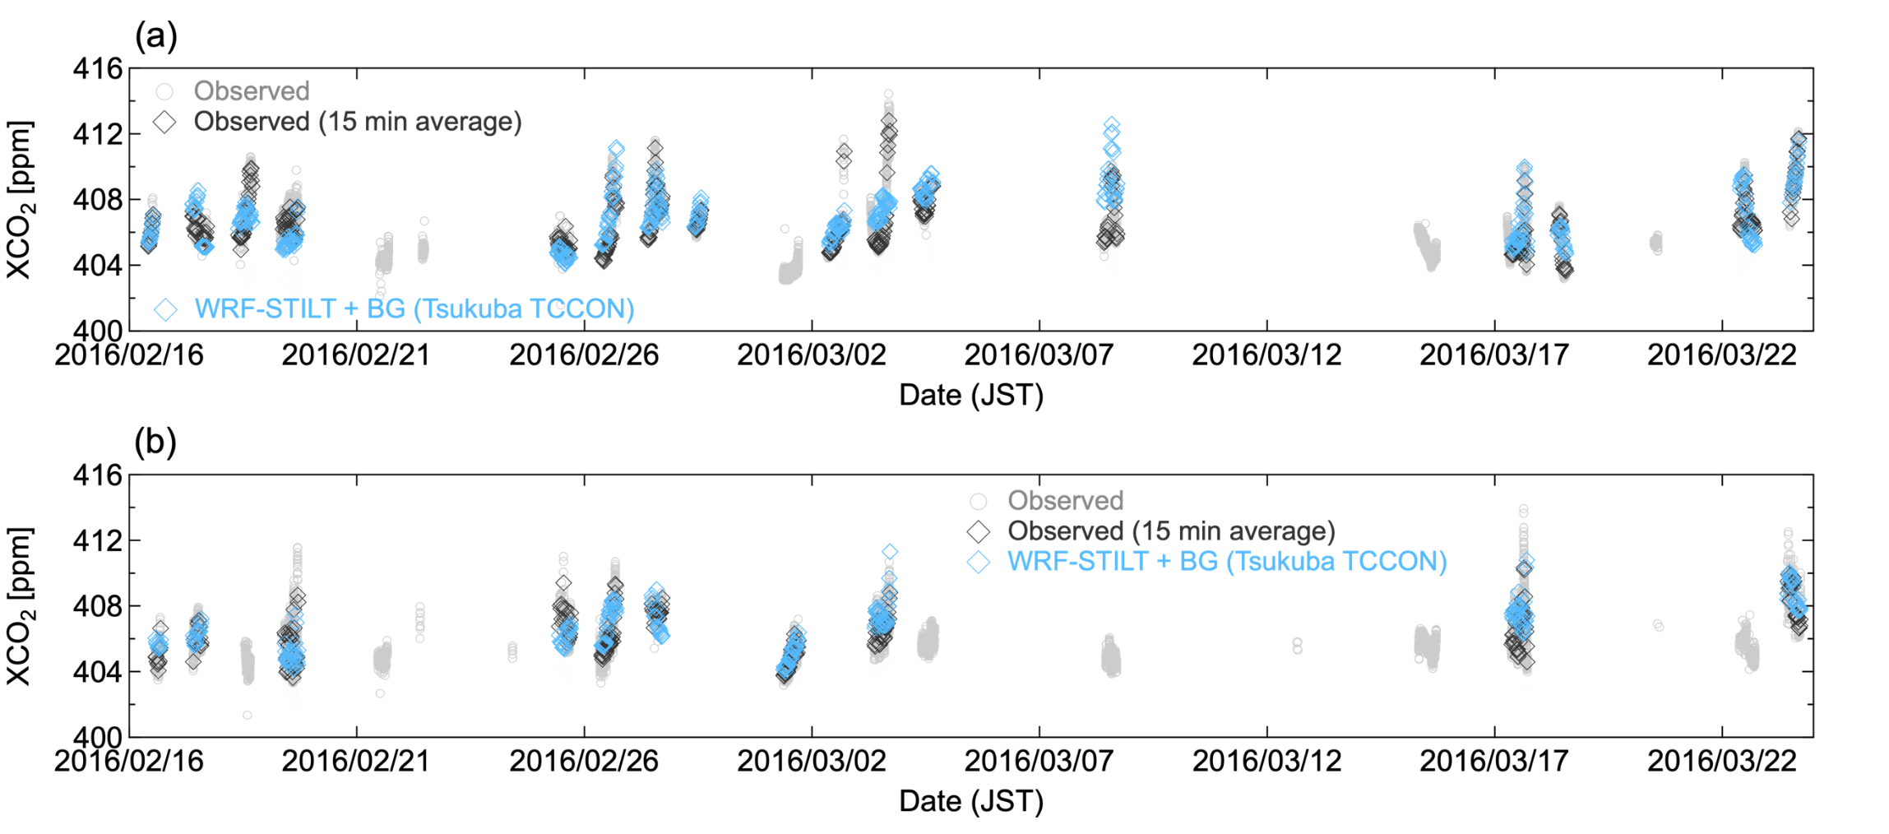
Observation and simulation comparison
Simulations were performed on days with over 2 h of observations and when the 15-min pooled data showed enhancements of at least 1 ppm between urban and rural site two or more times
Generally good agreement
Inversion significantly improves the comparison
XCO₂ timeseries at Saitama and Sodegaura
Example days

Slide 13
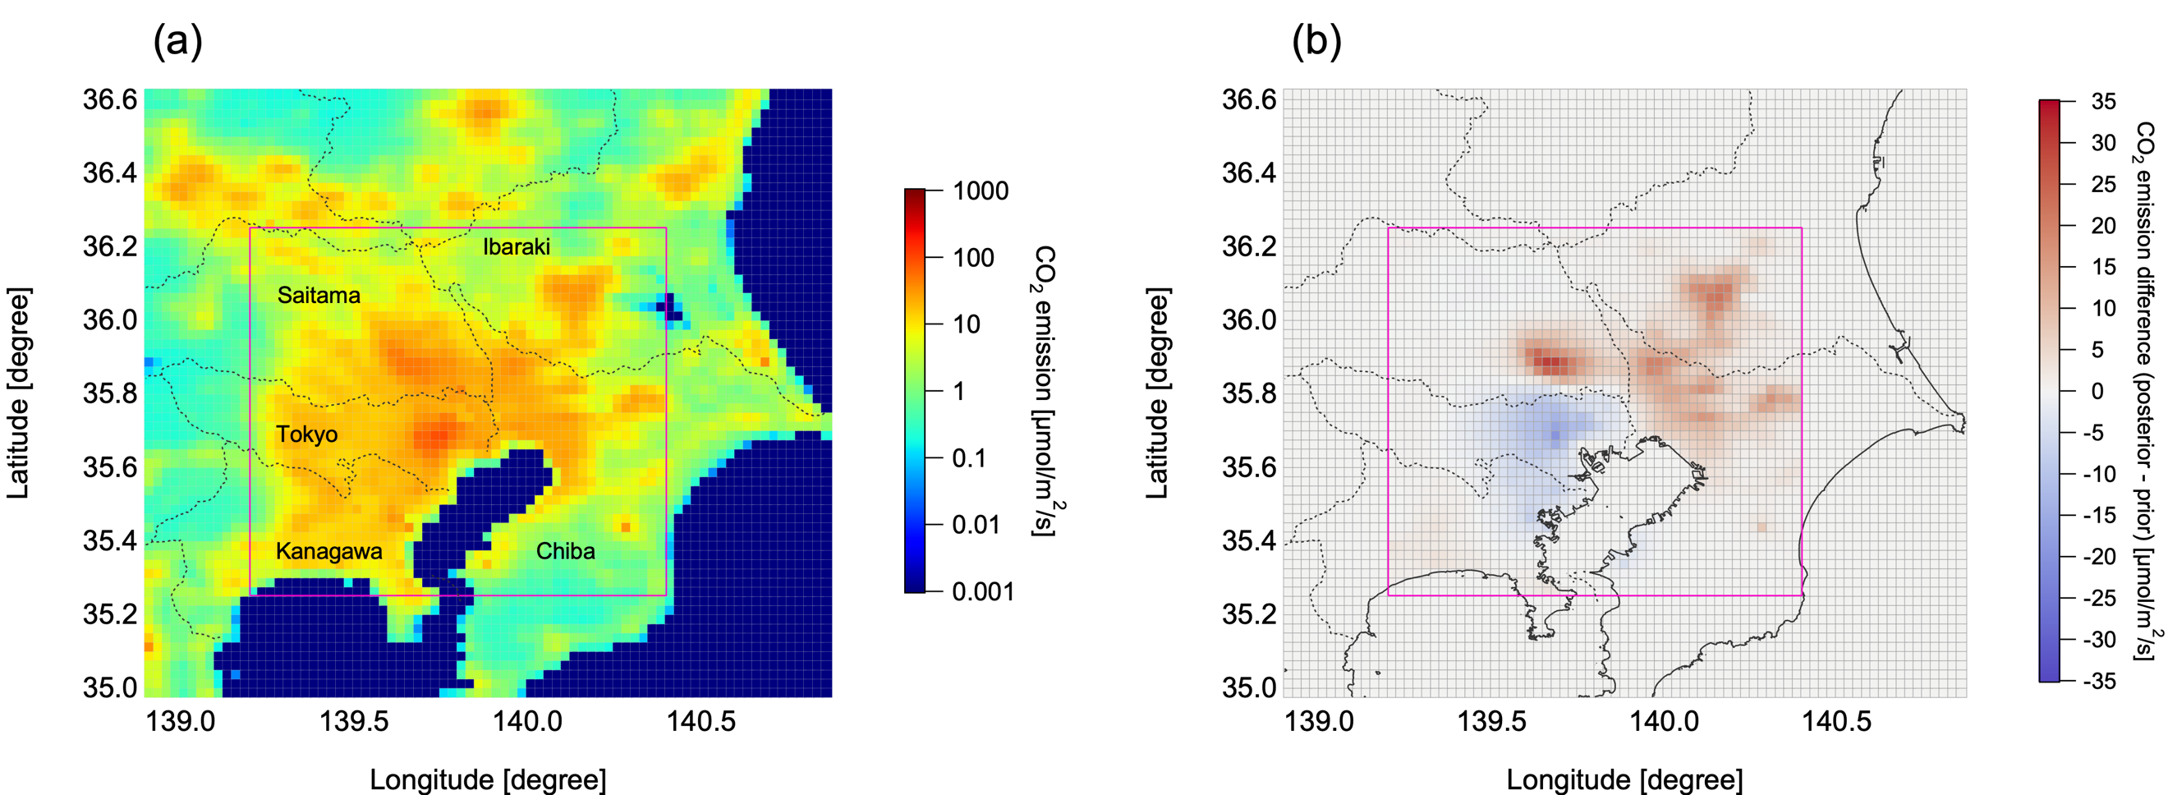
Emission estimation
Optimized spatial emission pattern still largely resembles the prior emissions
Spatial readjustments in part agree with national bottom-up emission inventory MOSAIC
Absolute difference between prior and posterior emissions 1 % (LPS -14 %, Non-LPS 10 %)
Inversion analysis reduced the uncertainty in the total emissions by a factor of ~2
Inversion optimized emissions 277.8 Mt CO₂ / y for Tokyo metropolitan area
Good agreement with administrative emission report (250.6 Mt CO₂ / y )

Slide 14
Summary and outlook
We conducted a measurement campaign in the Tokyo Metropolitan area February – April 2016
We developed an urban-scale inversion system to estimate CO₂ emissions at >3 km spatial resolution
Our EM27/SUN measurements can properly constrain CO₂ emissions in this urban setting
Future tasks:
  Operational megacity observation for more frequent emission estimates
  Investigation of methane emissions
  Integration of satellite data (GOSAT-GW, OCO-3)

Slide 15
Thank you for your attention!

Slide 16
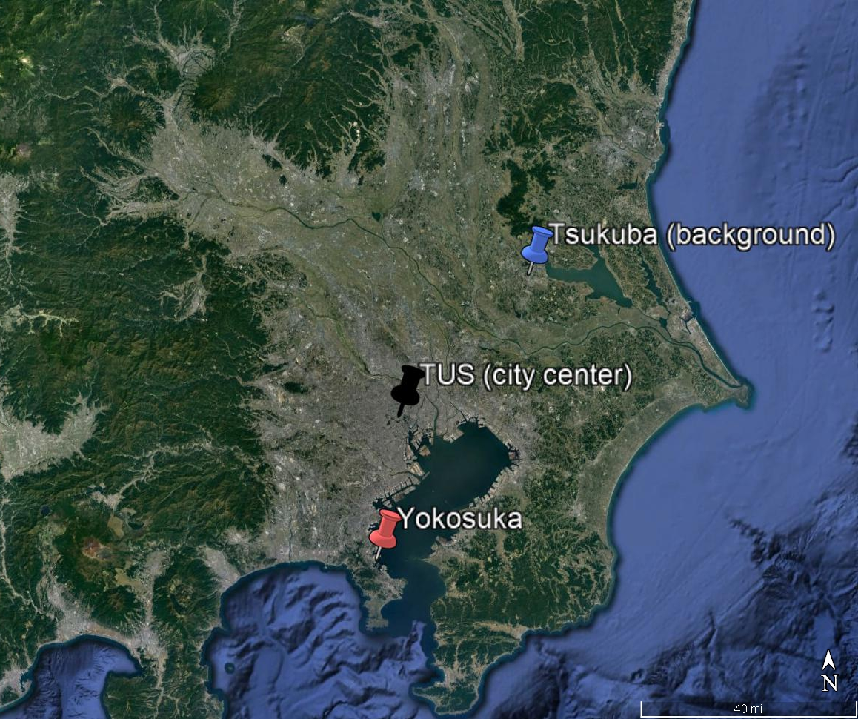
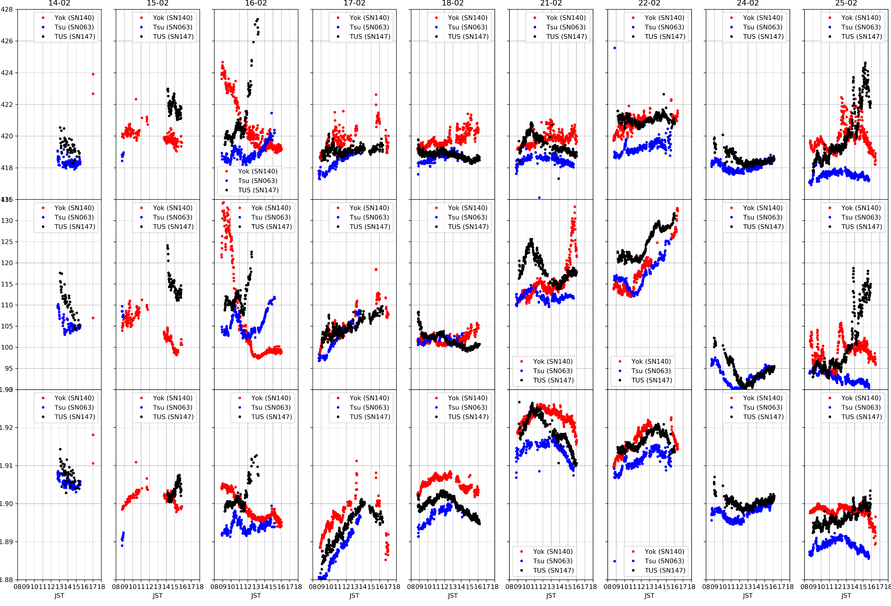
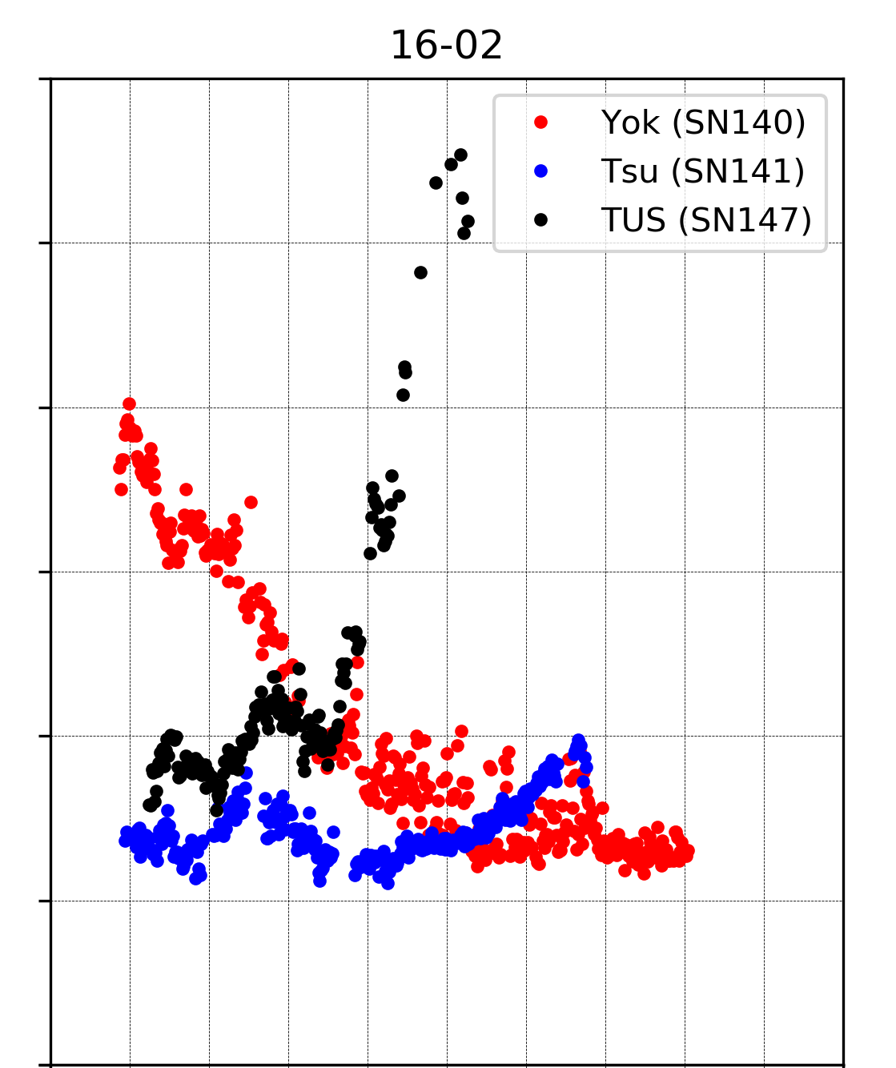
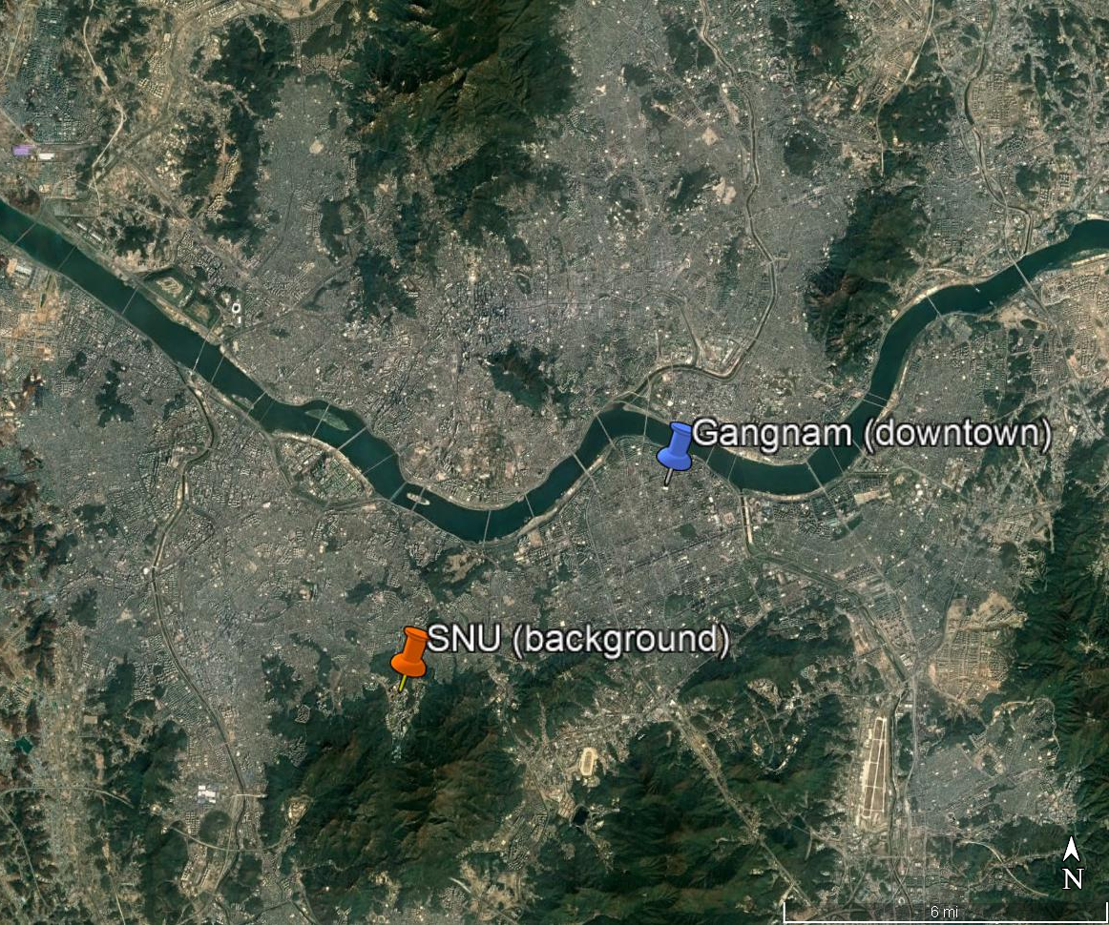
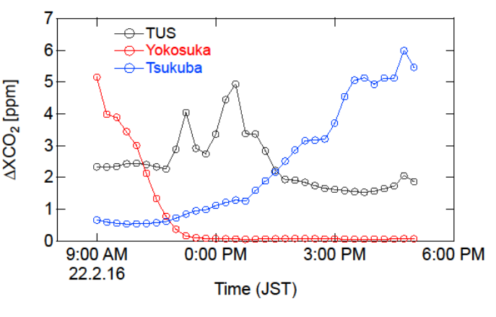
Tokyo-Seoul campaign #1, 14-25 Feb 2022
Objective: Monitoring changes of CO₂, CO, CH₄ in the urban atmosphere on different scales: now and in future; Test for the long-term validation of GOSAT-GW in central Tokyo and Seoul
XCO2
XCO₂ [ppm]
XCO
XCH4
ΔXCO₂ [ppm]
Timeseries of the EM27/SUN measurements in Kanto at the three stations Tsukuba, Tokyo, and Yokosuka
Comparison of observation and modelling results on February 16
Collaboration: NIES (Frey, Morino, Ohyama, Müller, Tanimoto), Seoul National Univ. (Sujong Jeong, Hayoung Park)

