Slide 1
EM27/SUN observations in the Atacama desert
Matthias Max Frey¹, Isamu Morino¹, Hirofumi Ohyama¹, Takashi Miyata², Yuzuru Yoshii²

Slide 2
Outline
Atacama geographical information
Tokyo Atacama Observatory (TAO)
Atacama desert campaign 2023

Slide 3
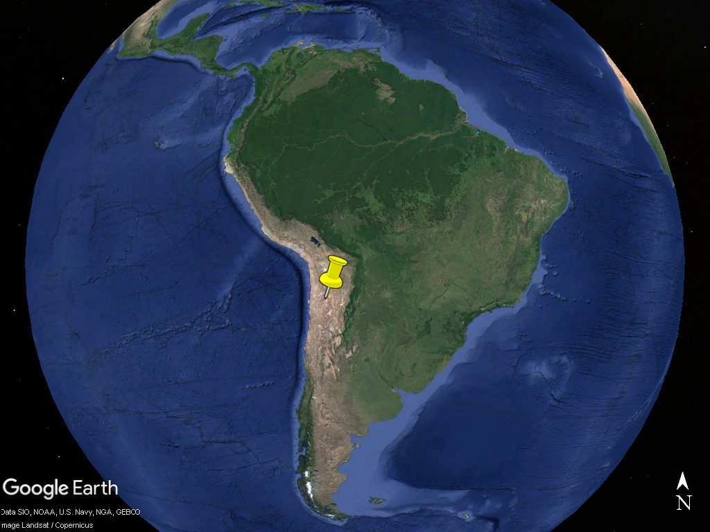
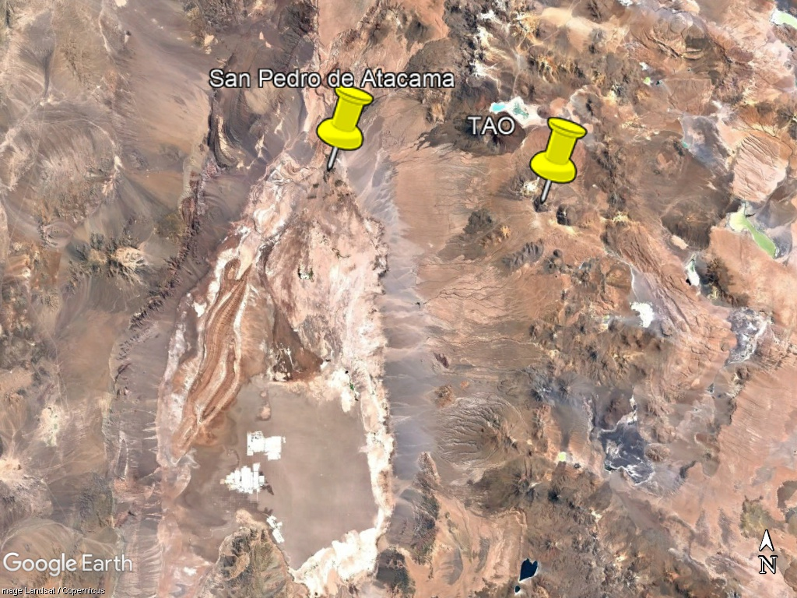
Chile, Atacama desert

Slide 4
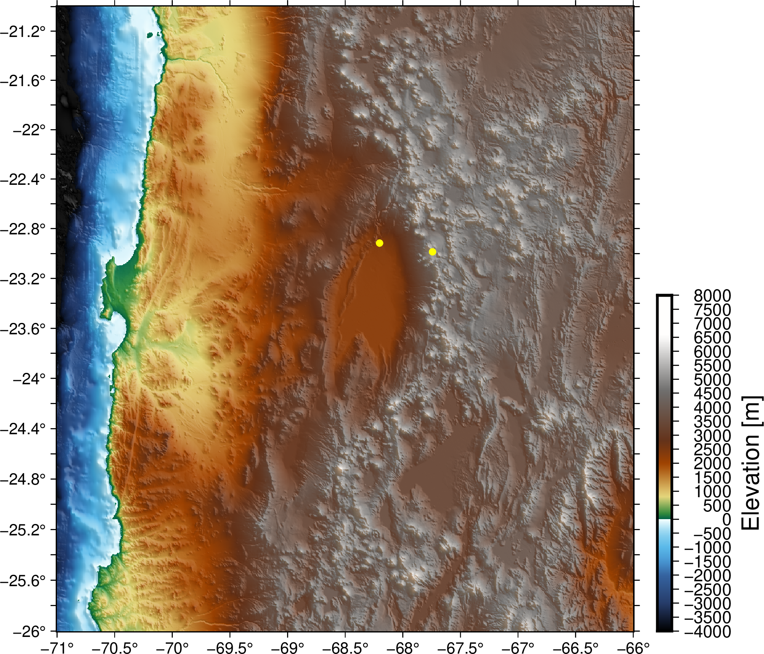
Atacama desert topography and reflectance
Atacama Desert/Plateau south of San Pedro de Atacama (~90 km x ~60 km)
Albedo of Atacama Desert in Jan: 0.25-0.35
San Pedro de Atacama
~90 km
Mt. Chajnantor
~60 km
SRTM15+
ADAM Surface Reflectance Database v4.0

Slide 5

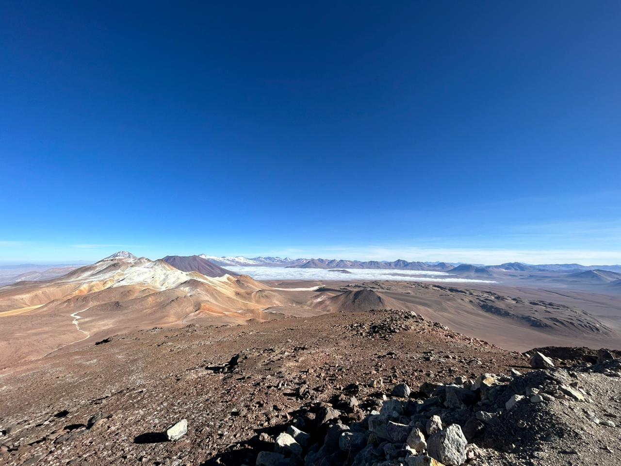
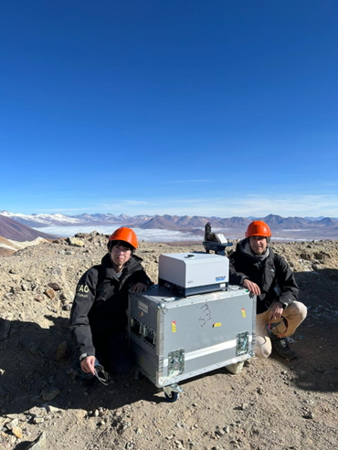
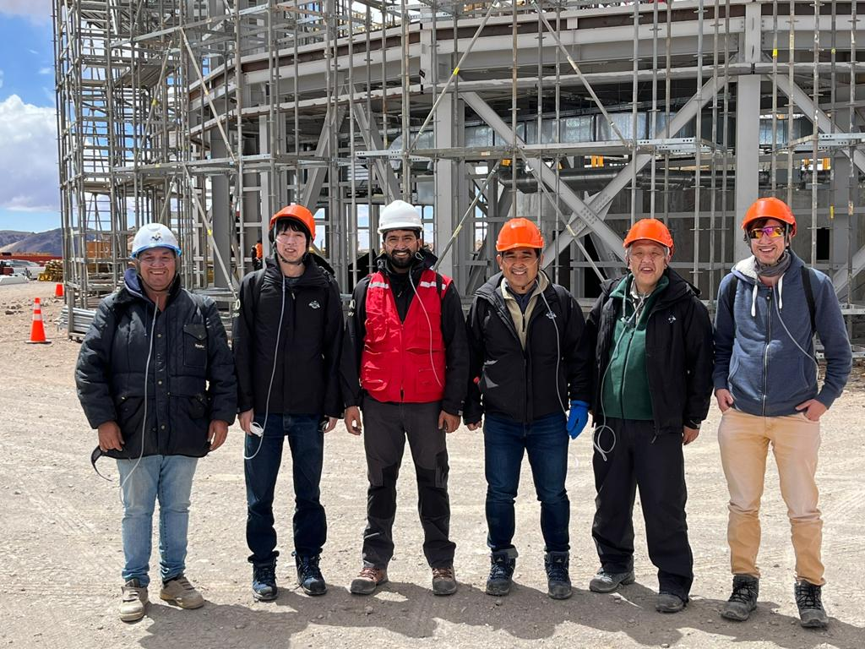
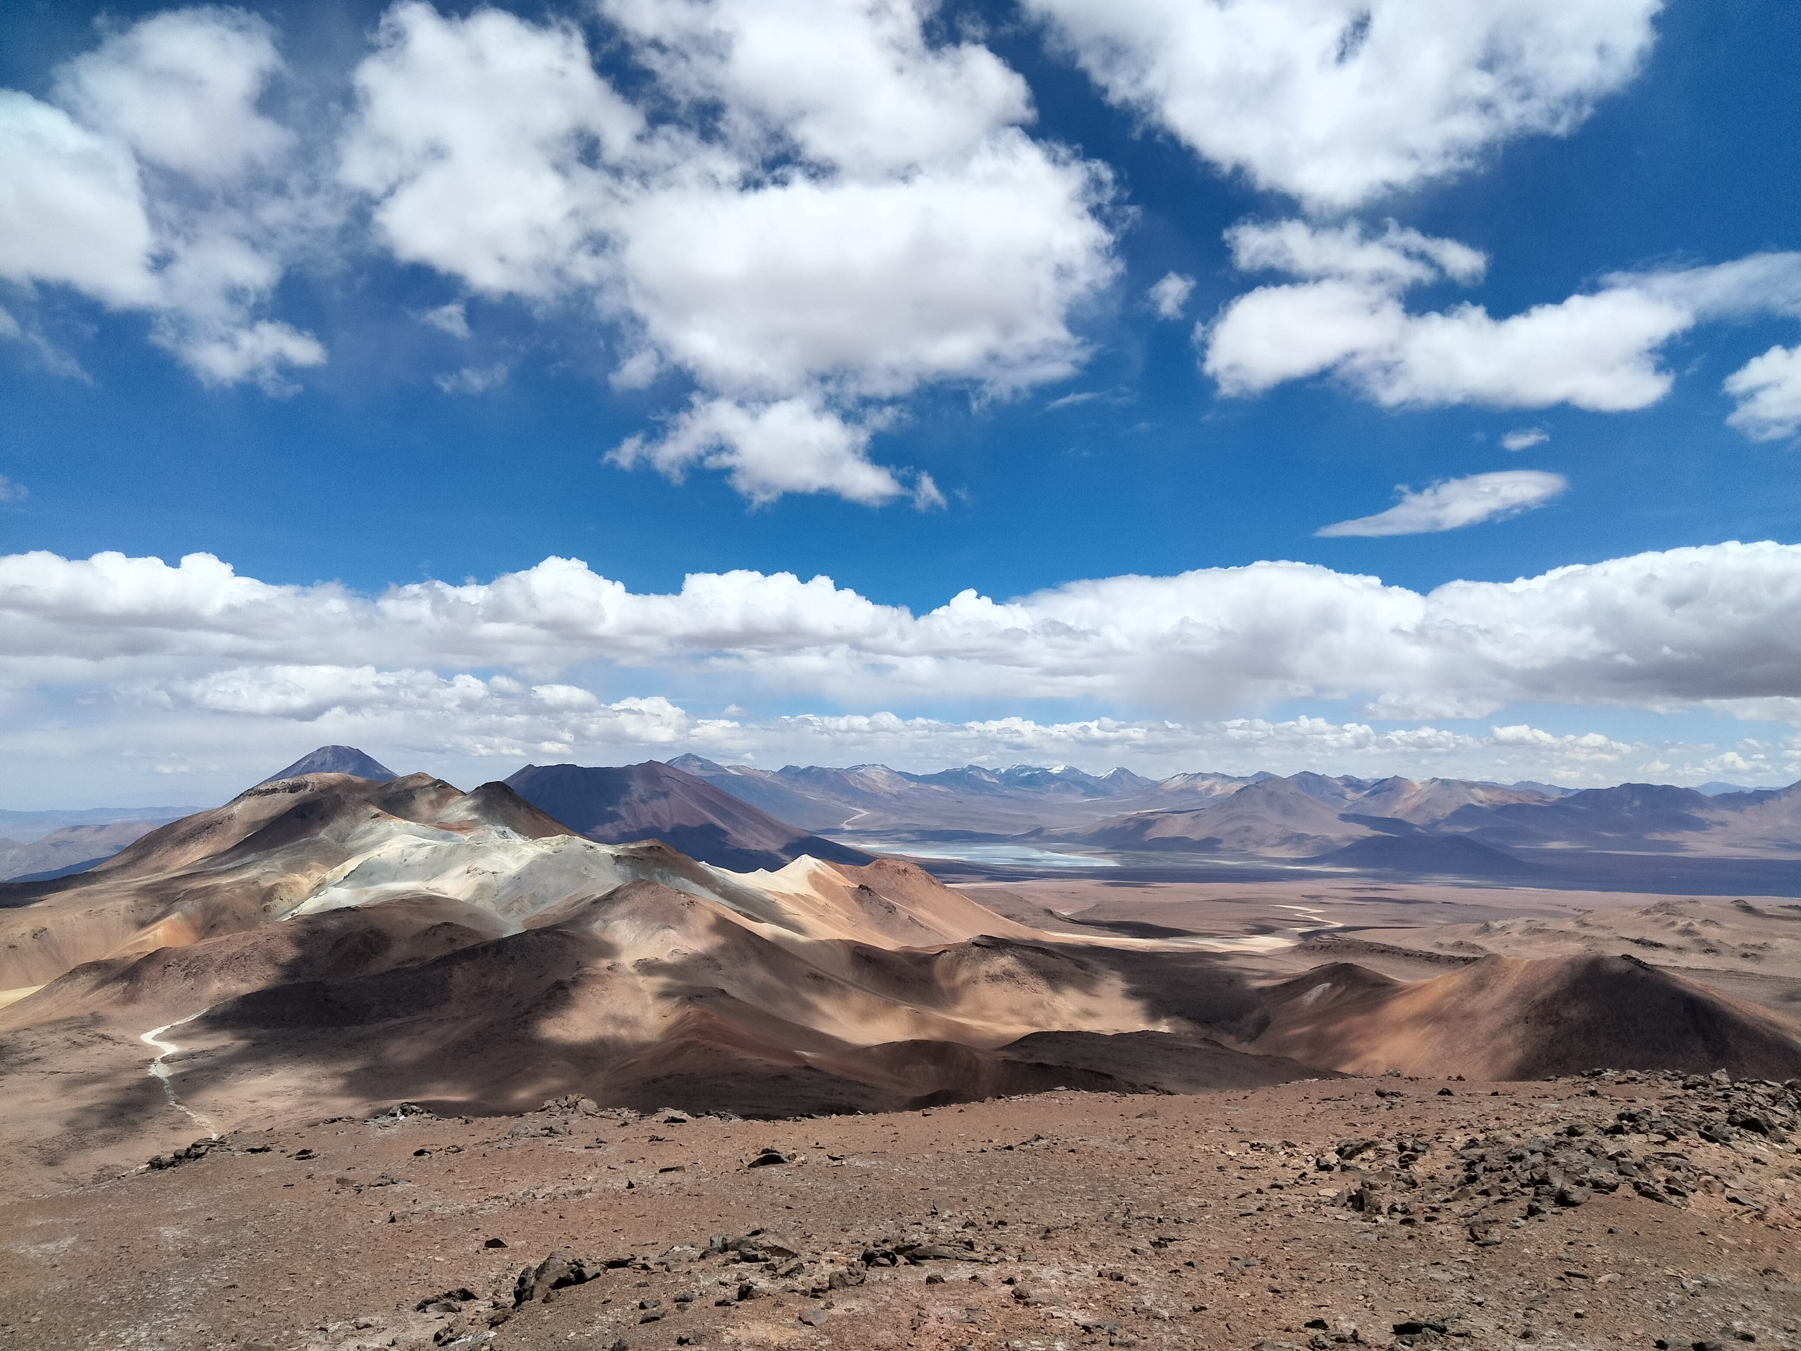
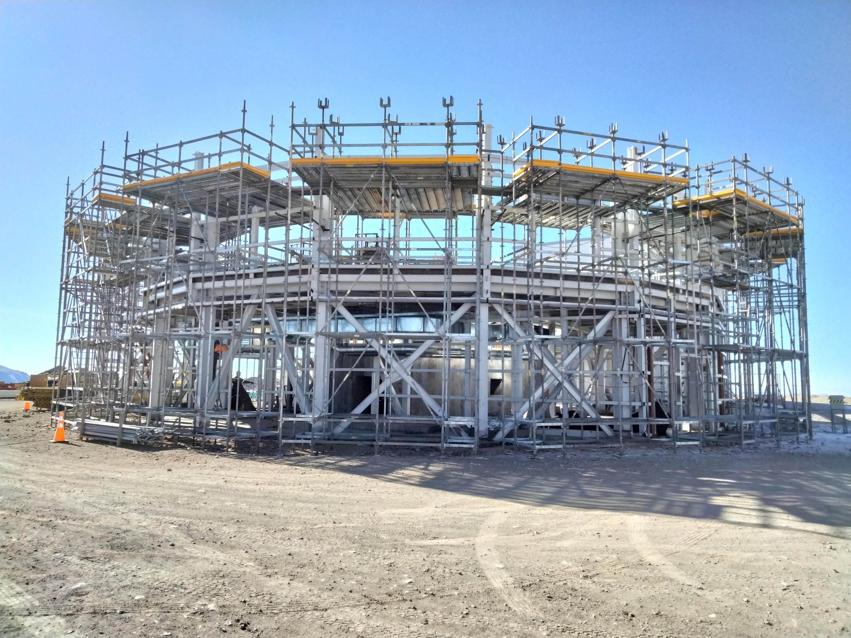

University of Tokyo Atacama Observatory (TAO)
Observatory at Mount Chajnantor at a height of 5640 m
Main purpose: Astronomical observatory (Optical-infrared telescope)
Base facility at San Pedro de Atacama (2400 m)
Additional oxygen supply mandatory at TAO

Slide 6
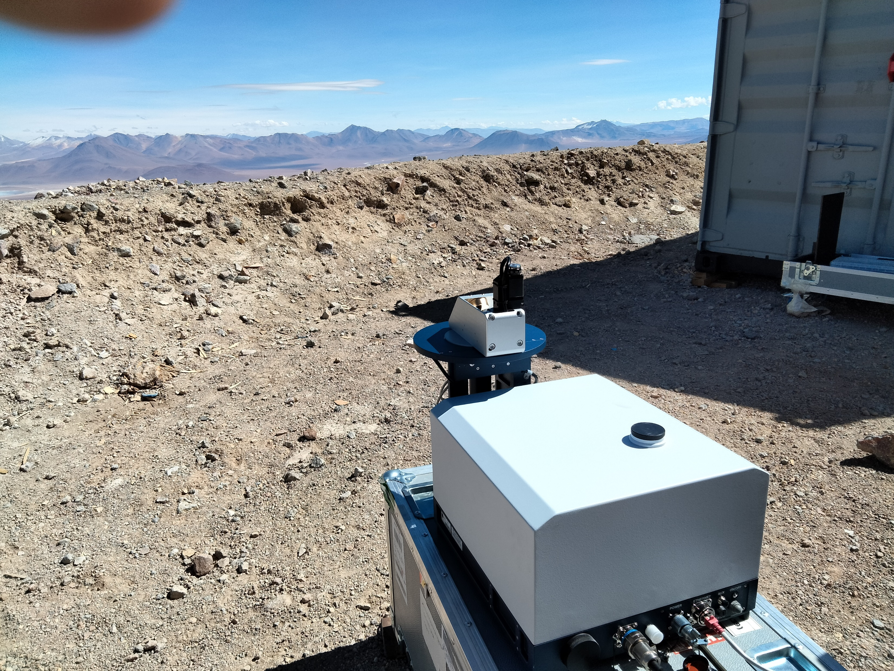
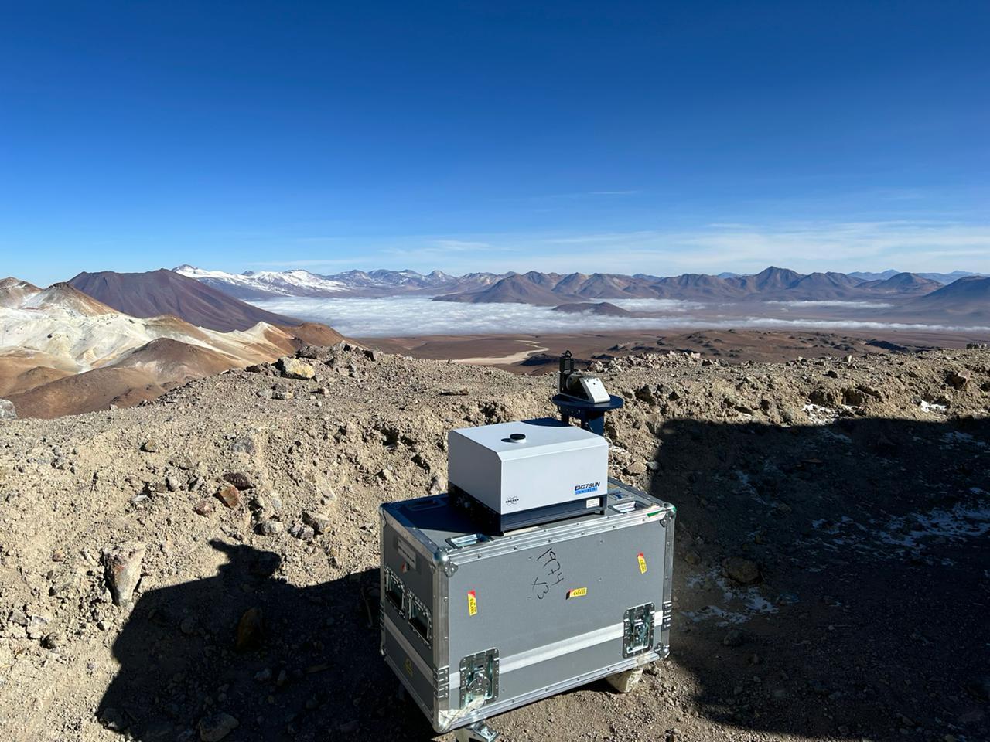
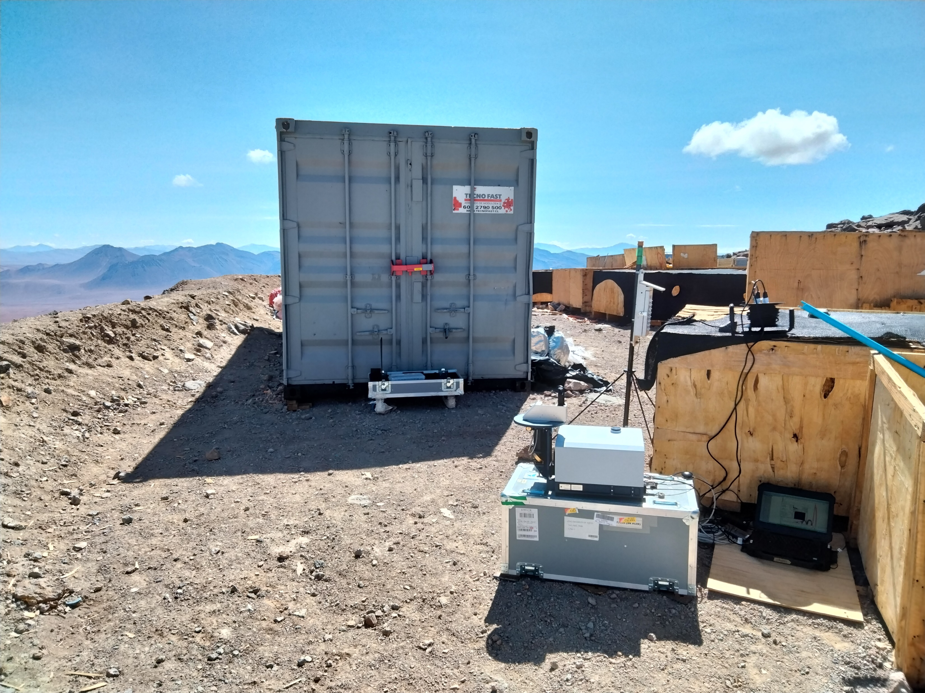
EM27/SUN observations January 2023
EM27/SUN observations at highest altitude ever performed (~0.5 atm)
Flawless performance of the instrument
Only 2 – 3 hours of observations on the mountaintop due to safety regulations
Additional observations at the base facility in San Pedro de Atacama in the afternoon

Slide 7
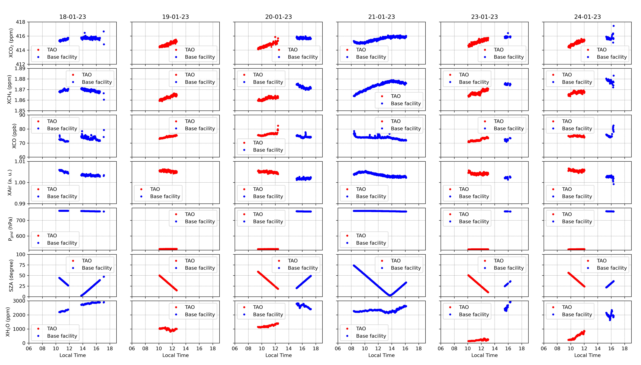
Preliminary analysis
Results look sensible!

Slide 8
Preliminary X_{luft}/X_{air} analysis
Results look sensible!
However, X_{luft}/X_{air} deviates from nominal by 0.5 – 1 % (both PROFFAST2.2 and GGG2020)
Possible reason: GEOS mod files doesn’t extend to the surface for San Pedro de Atacama (lowest layer ends at appr. 3000 m, surface is at 2400 m)
Alternative mod files created using NCEP reanalysis data
Changes more pronounced and systematic for GGG2020, for PROFFAST2.2 more variable

Slide 9
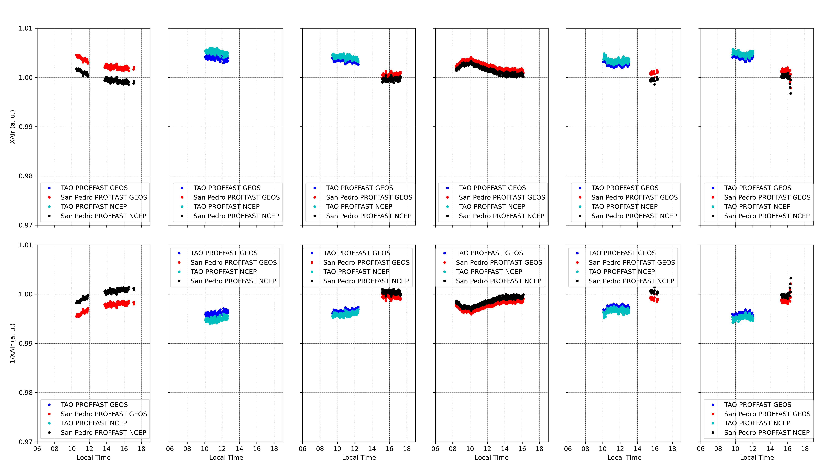
Preliminary X_{luft}/X_{air} analysis
PROFFAST2.2
GGG2020

Slide 10
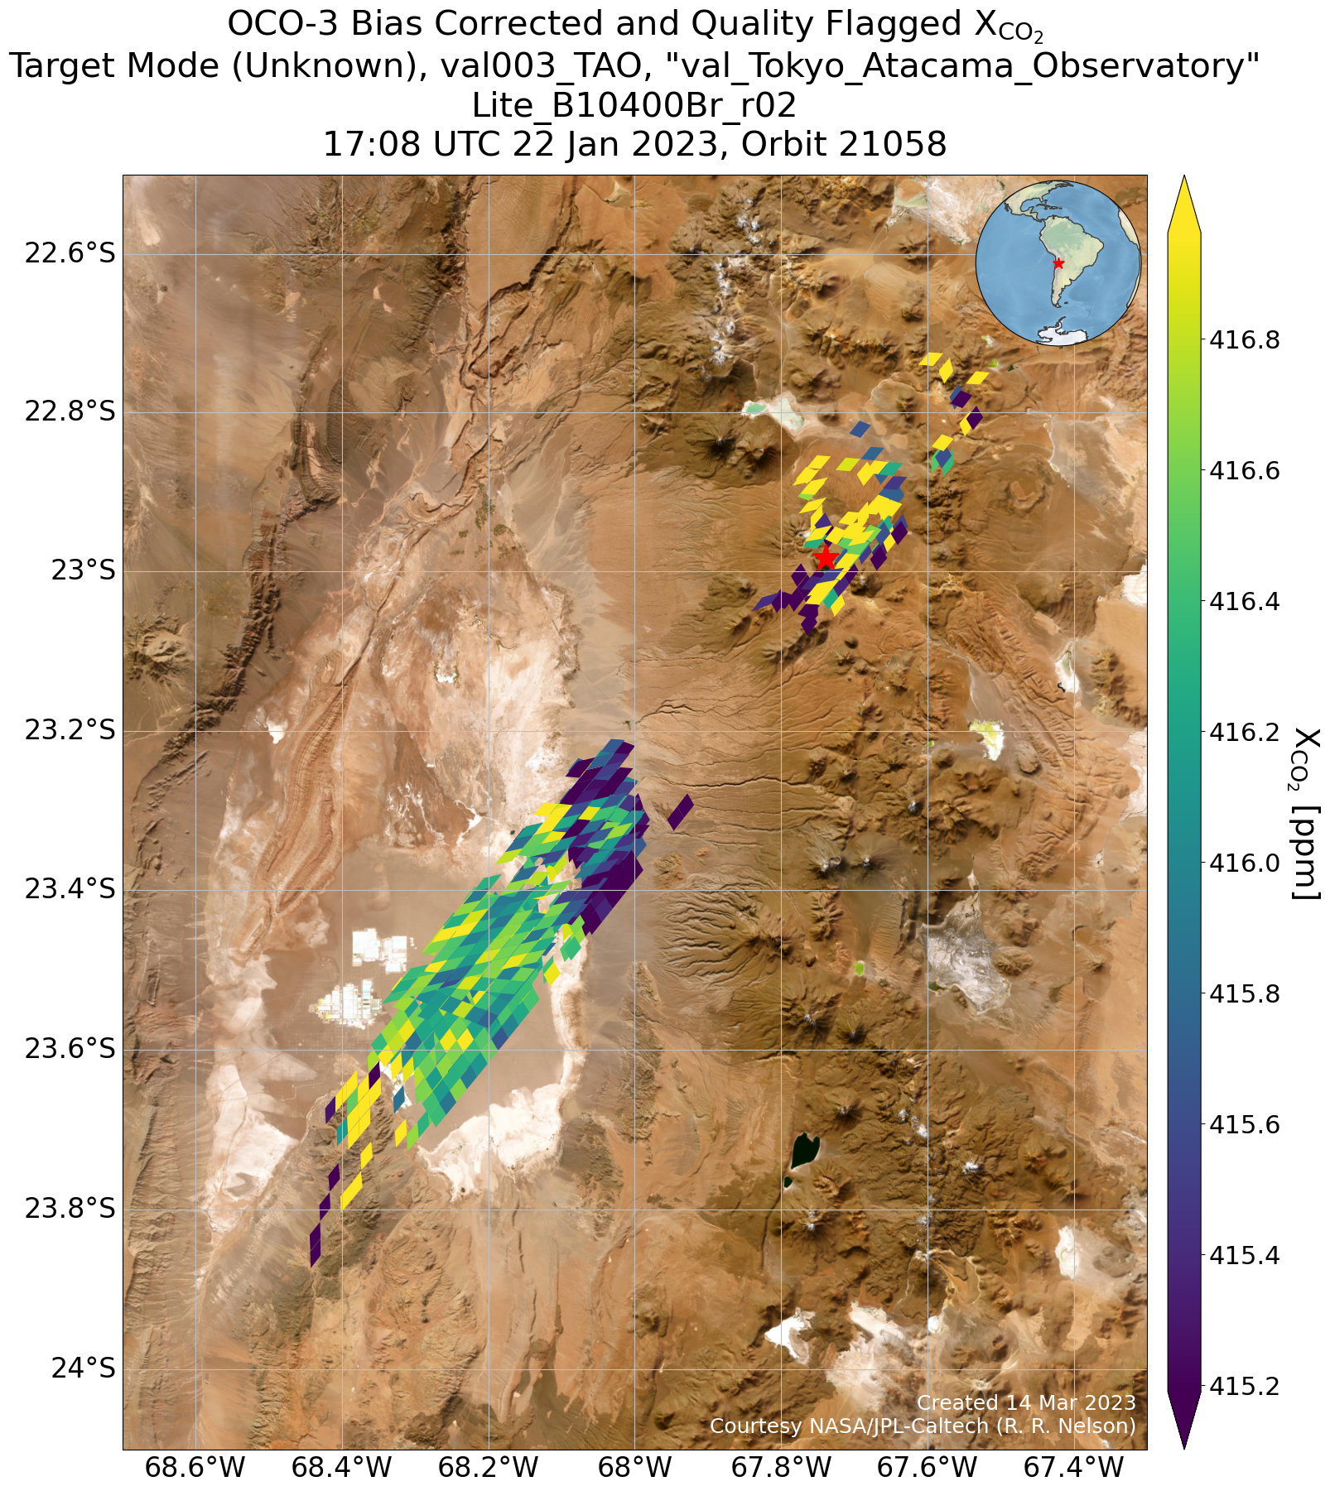
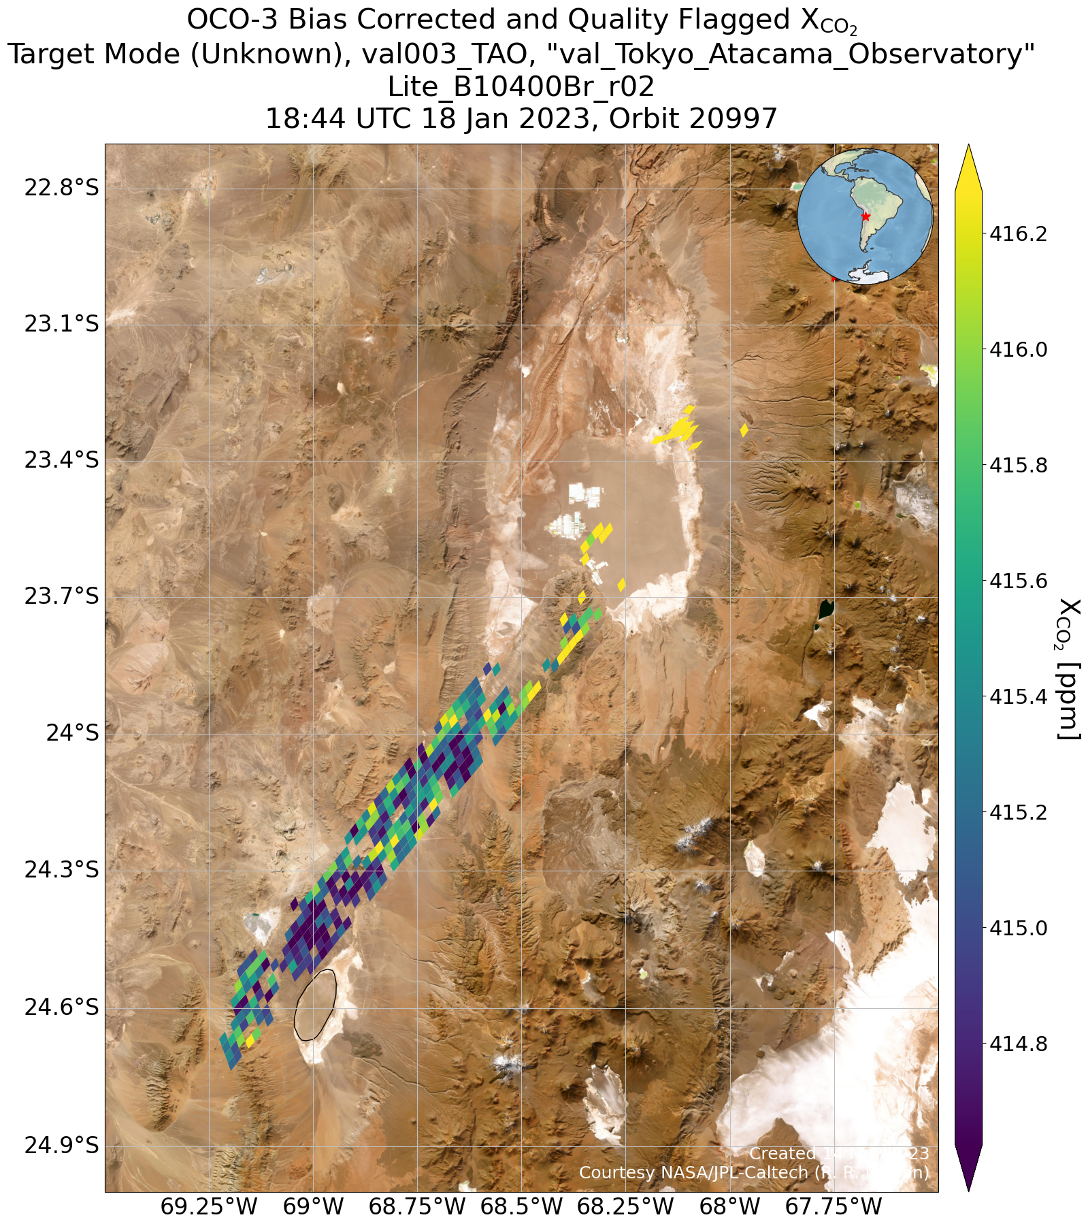
Coincident OCO-3 target mode
OCO-3 overpass January 22 (January 18, less valid data)
XCO₂ at the plateau 416.4 ppm (416.2 ppm)
EM27/SUN observations January 21 (at San Pedro de Atacama) and 23 (at TAO), but XCO₂ values at overpass time (415.9 ppm) and diurnal variability very similar on both days
For January 18, EM27/SUN XCO₂ 415.8 ppm
SAN PEDRO
TAO

