Slide 1








Total greenhouse gas column measurements in the Paris region
J. DOC¹, M. RAMONET¹, M. LOPEZ¹, F-M. BREON¹, B. MACQUART¹, S. LATCHABADY¹, P. JESECK², Y. TE²
1 : CEA-LSCE/CNRS/UVSQ, France
2 : LERMA, France
NDACC-IRWG-TCCON-COCCON annual meeting, June 12-16, 2023, Spa, Belgium

Slide 2




Contents
Project’s presentation
Measurements network and DCM
First results
Conclusion and outook

Slide 3
Project’s presentation

Slide 4
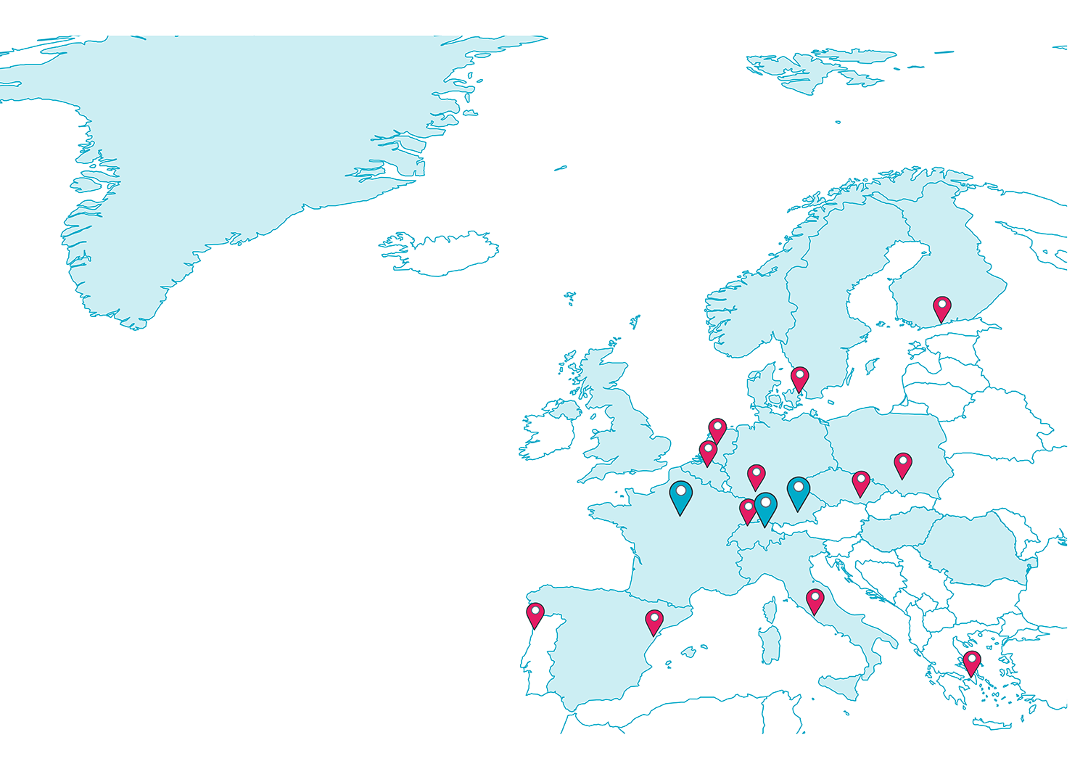

What is the ICOS Cities project about?
A European Green Deal project with 3 PILOT CITIES:
Paris, Munich and Zurich
develops systematic observations to monitor the level of greenhouse gas emissions in urban areas
creates useful tools and services for cities in support of their local climate action plans
provides data services that have societal impact

Slide 5
Focus on Paris
City-center: 2.16 million inhabitants (2019, source: INSEE)
Urban area: 12.21 million inhabitants (2019, source: EUROSTAT)
64.630 Mt CO₂eq in 2019 (source: AirParif)
Main sectors:
  Road trafic: 31.360 Mt CO₂eq, ~ 48.5%
  Airports: 7 Mt CO₂eq, ~ 10.8%
  Residential: 5.990 Mt CO2eq, ~ 9.3%
  Others (energy, industry, wastes, ...): 20.280 Mt CO2eq, ~ 31.4%

Slide 6
Network and method

Slide 7
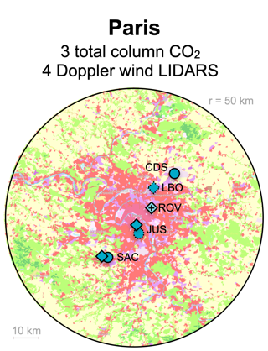
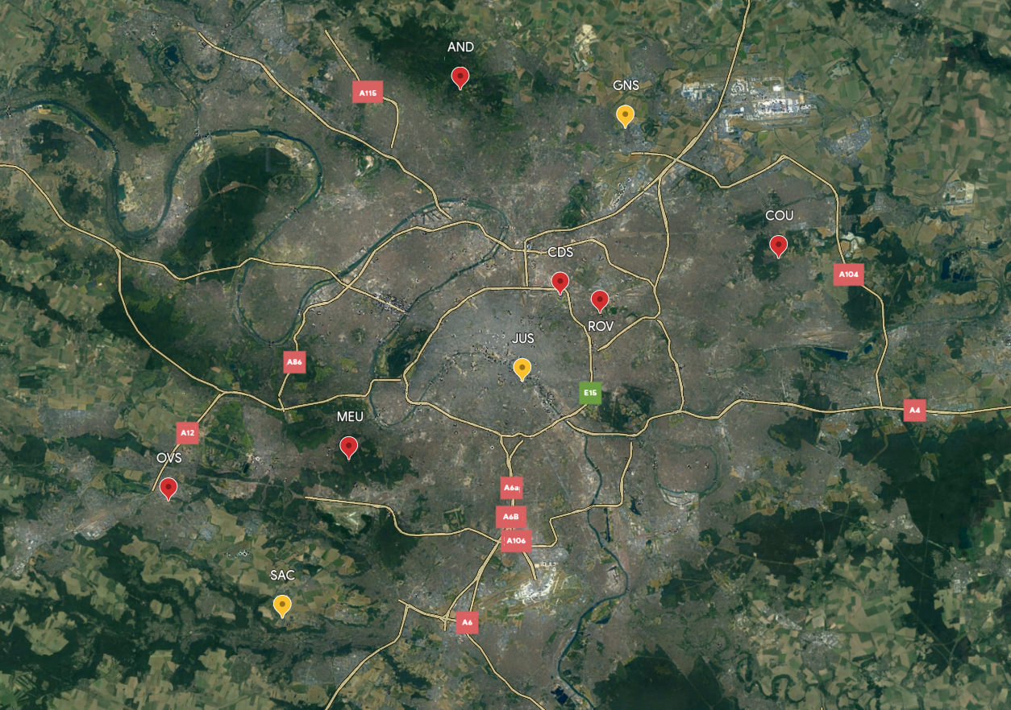
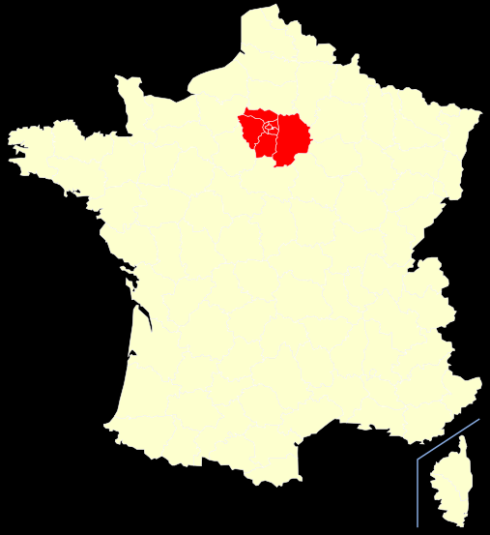

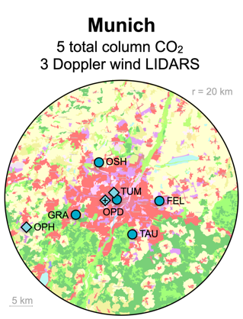
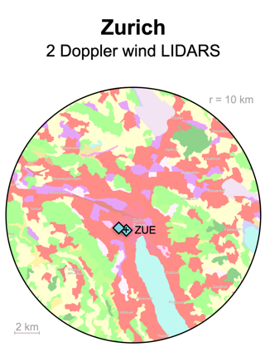
Network
Prevailing wind

Slide 8
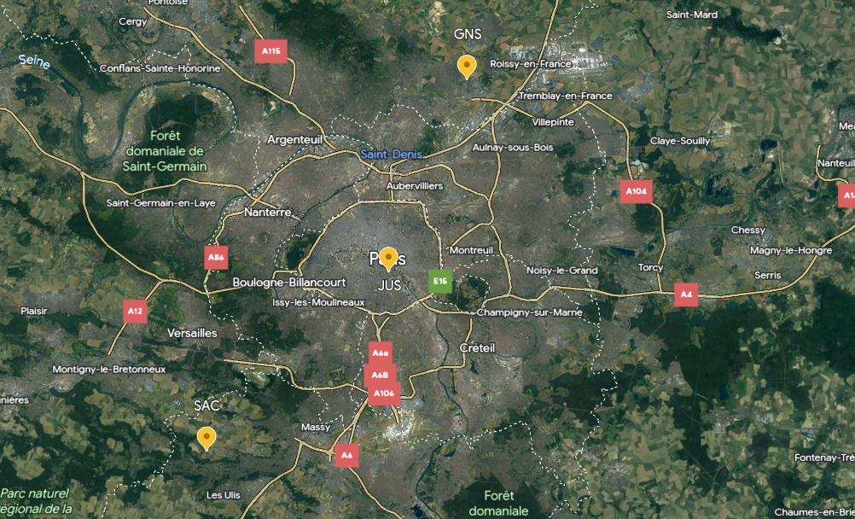
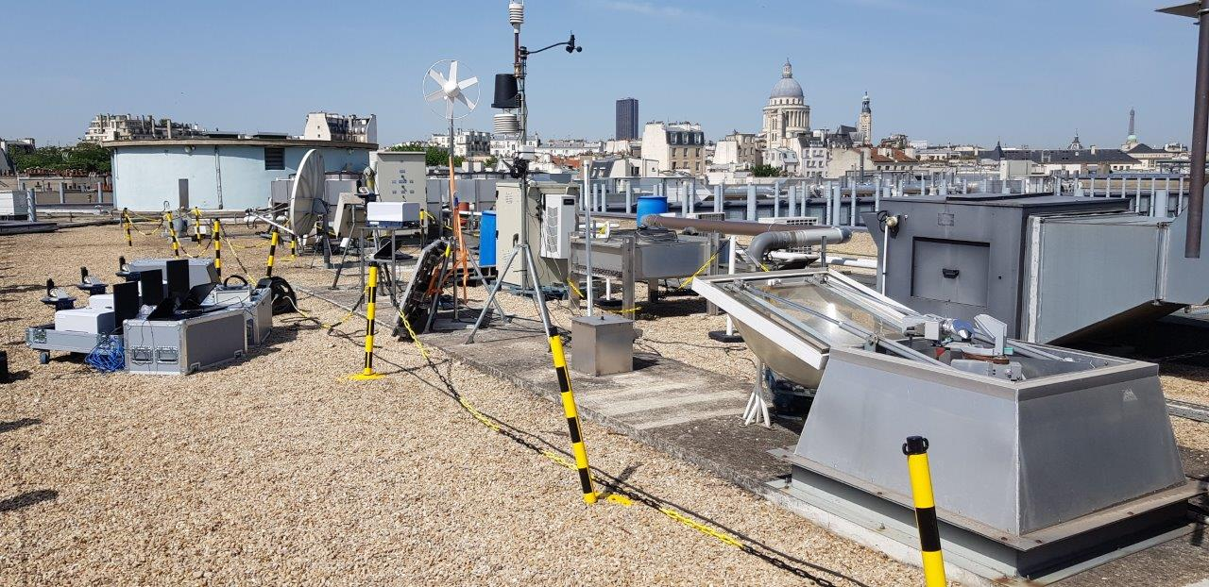
Network
Prevailing wind
Jussieu
Sorbonne-University
Paris’ city-center
TCCON (+ EM27)
site operated by LERMA
Co-located with an
in-situ ICOS station

Slide 9
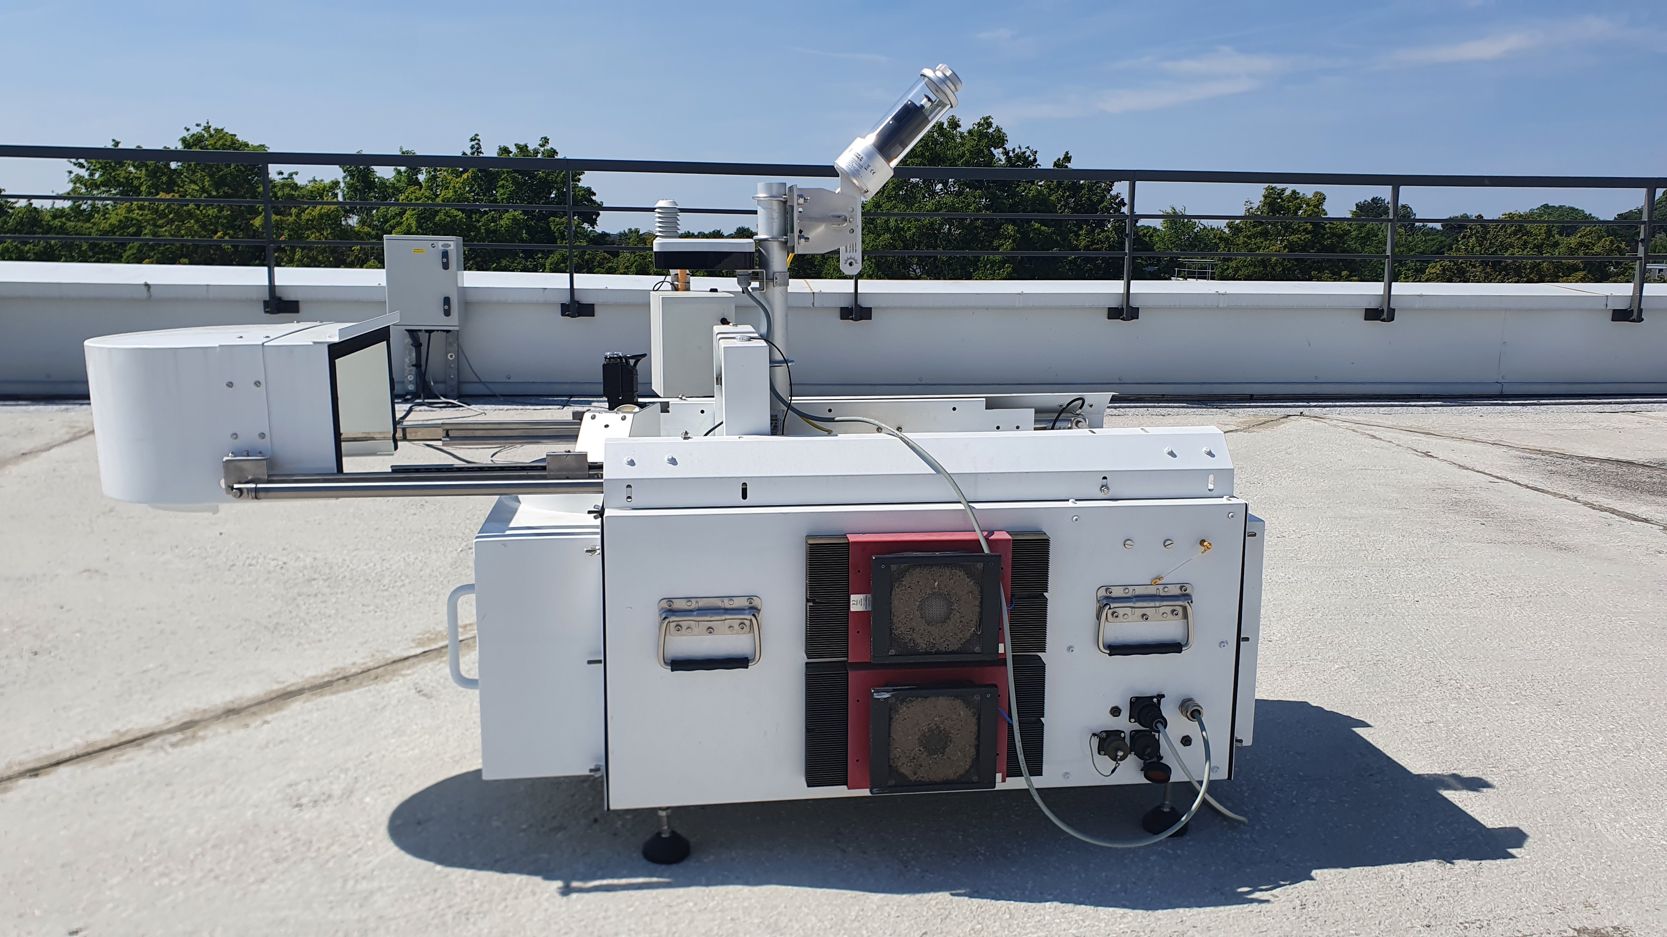
Network
Prevailing wind
Saclay
LSCE
21 km, SW of Paris
Operated by LSCE
Co-located with an
in-situ ICOS station
Works since 2021

Slide 10
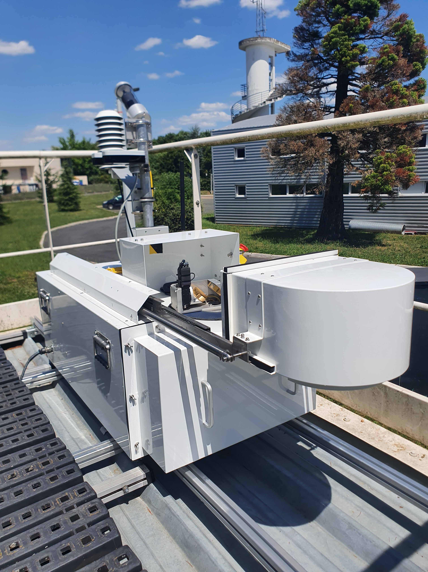
Network
Prevailing wind
Gonesse
Firefighters station
17 km, NE of Paris
Operated by LSCE
Near CDG (5 km,
East) and Le Bourget
airports (3 km, South)
Co-located with an
in-situ ICOS station
Works for one year

Slide 11
Automatic EM27/SUN enclosure system and NRT data processing chain
See also:
“Urban and tropical EM27/SUN network for satellite validation, observation and verification of greenhouse gas emissions”
M. Lopez, S. Latchabady, B. Macquart, M. Ramonet, J. Doc and C. Bes, Poster #19

Slide 12
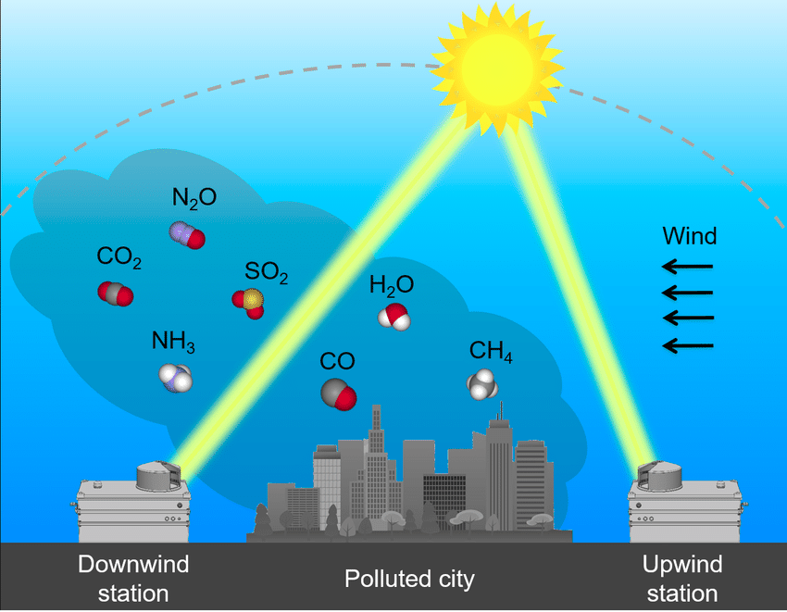
The Differential Column Measurements method (DCM)
Prevailing wind
Dietrich et al., 2021

Slide 13
Results

Slide 14
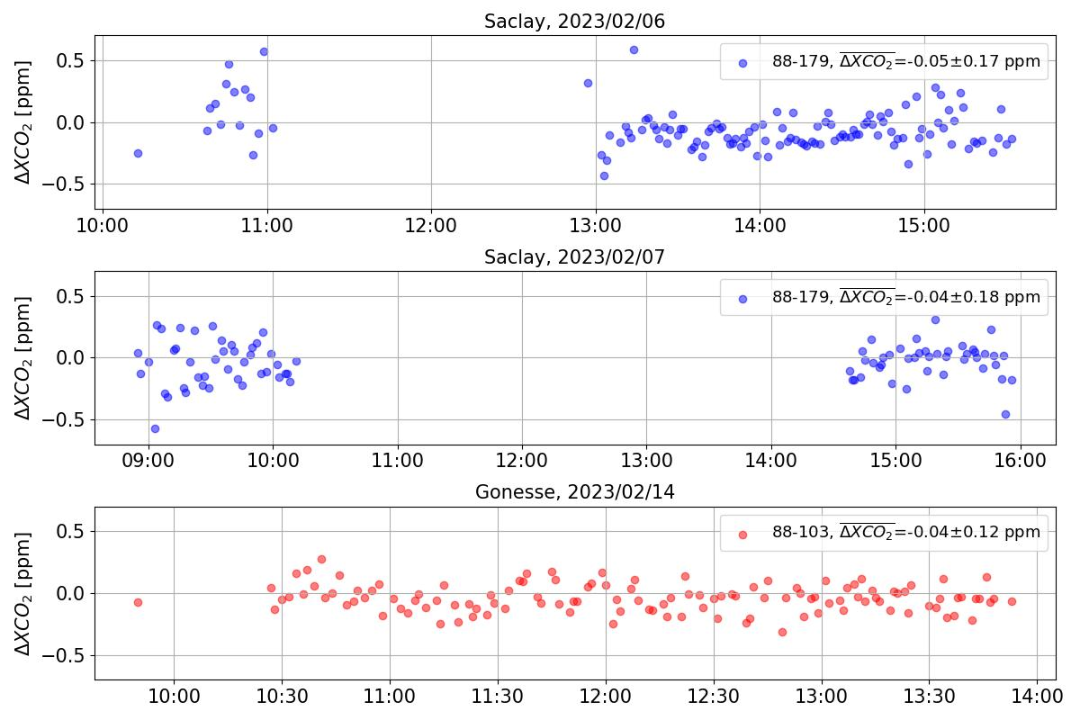
How to keep a good agreement between the instruments in the network?
A mobile instrument
travels from site to site
Inter-comparison at
least twice a year
Goal: 0.1~0.2 ppm
These instruments
are validated to work
together in the network

Slide 15
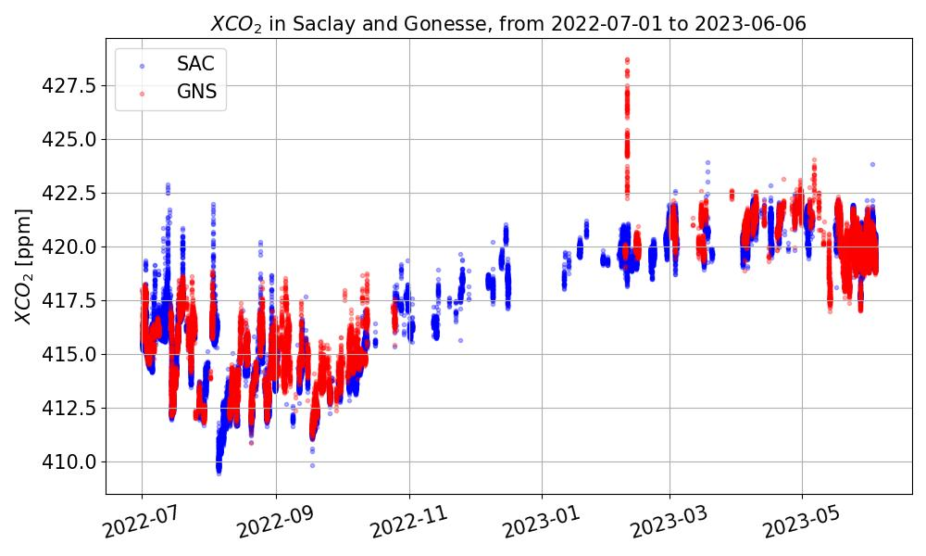
XCO₂ time series in SAC and GNS

Slide 16
Focus on 2023/02/09 XCO₂ peak
2023/02/09

Slide 17
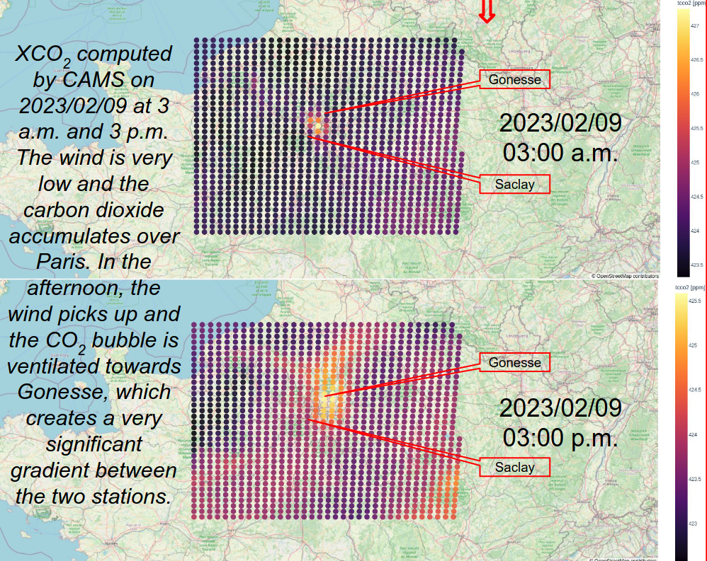
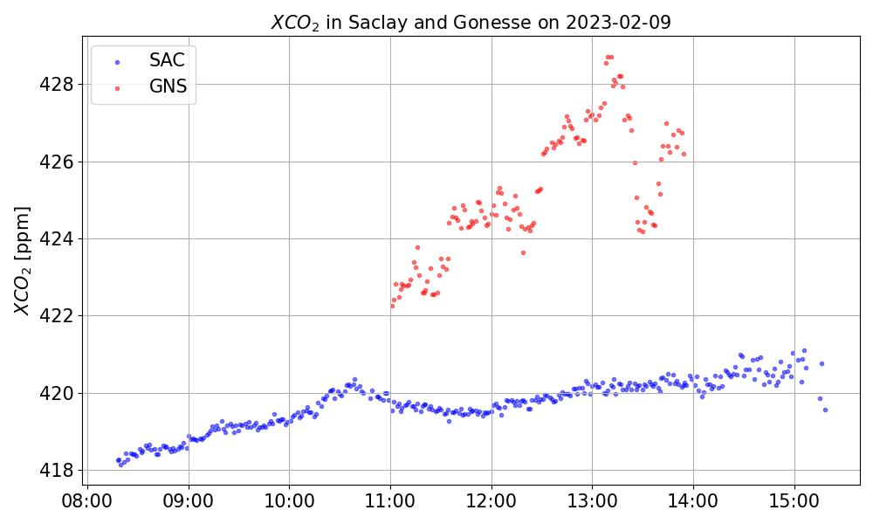
Focus on 2023/02/09 XCO₂ peak

Slide 18
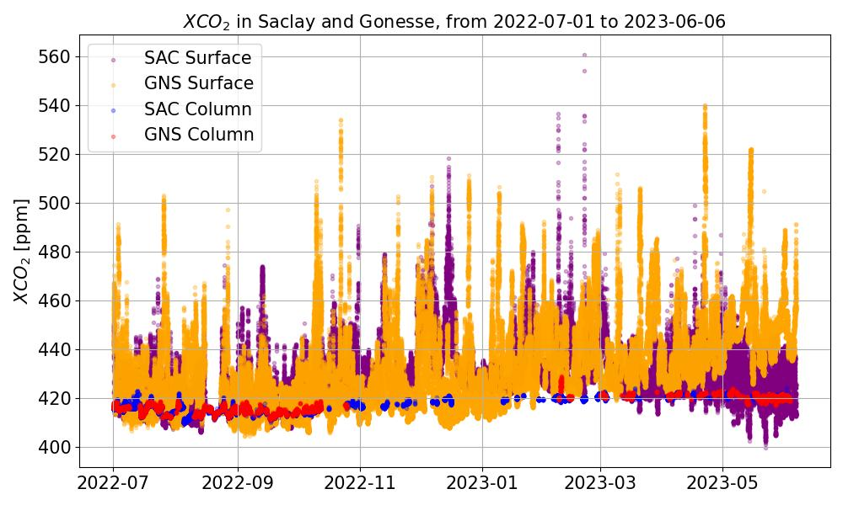
XCO₂ vs in-situ CO₂ time series
Less columns measurements than in-situ measurements
Daytime only
10 times smaller
variations
Less sensitive to local
sources

Slide 19
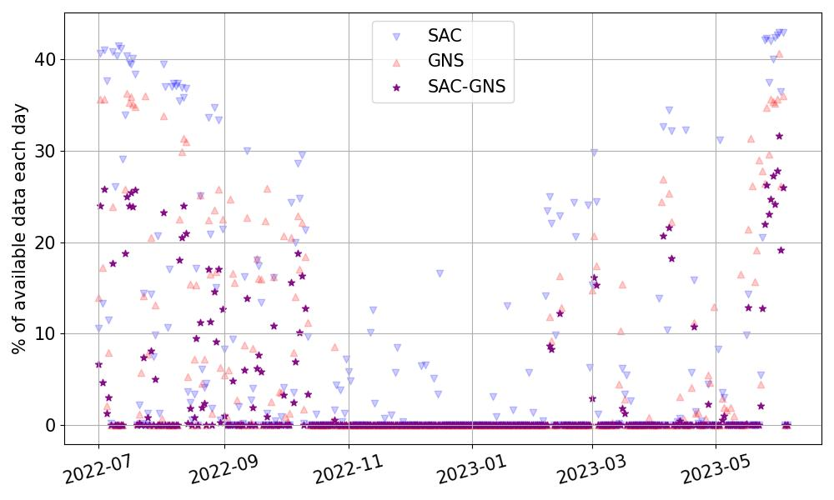
Data availability

Slide 20
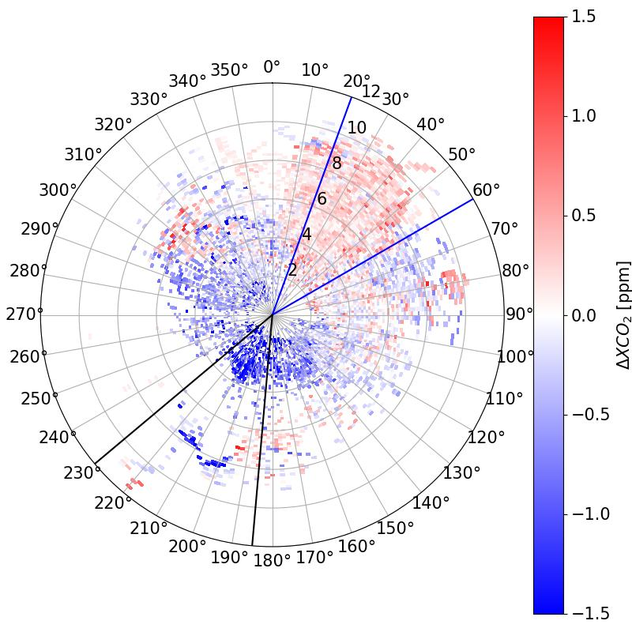
XCO₂ gradients (∆XCO₂)
∆XCO₂ = XCO_{2;SAC} – XCO_{2;GNS}
10 minutes averaged gradients
between Saclay and Gonesse
Period: 2022/07/01 - 2023/06/06

Slide 21
Conclusion

Slide 22
Conclusion and future work
ICOS-Cities network has been up and running for almost a year now
Automatic enclosure system and NRT data processing give us as much data as possible
Regular inter-comparison of instruments enables us to guarantee the quality of the data
Averaged ∆XCO₂: ~ 1 ppm, strong dependence to the wind direction but not to the wind speed
Perspectives:
Inverse modeling: comparison of the inversion using surface measurements
Goal: get a fast emission inventory and correct statistical ones

Slide 25
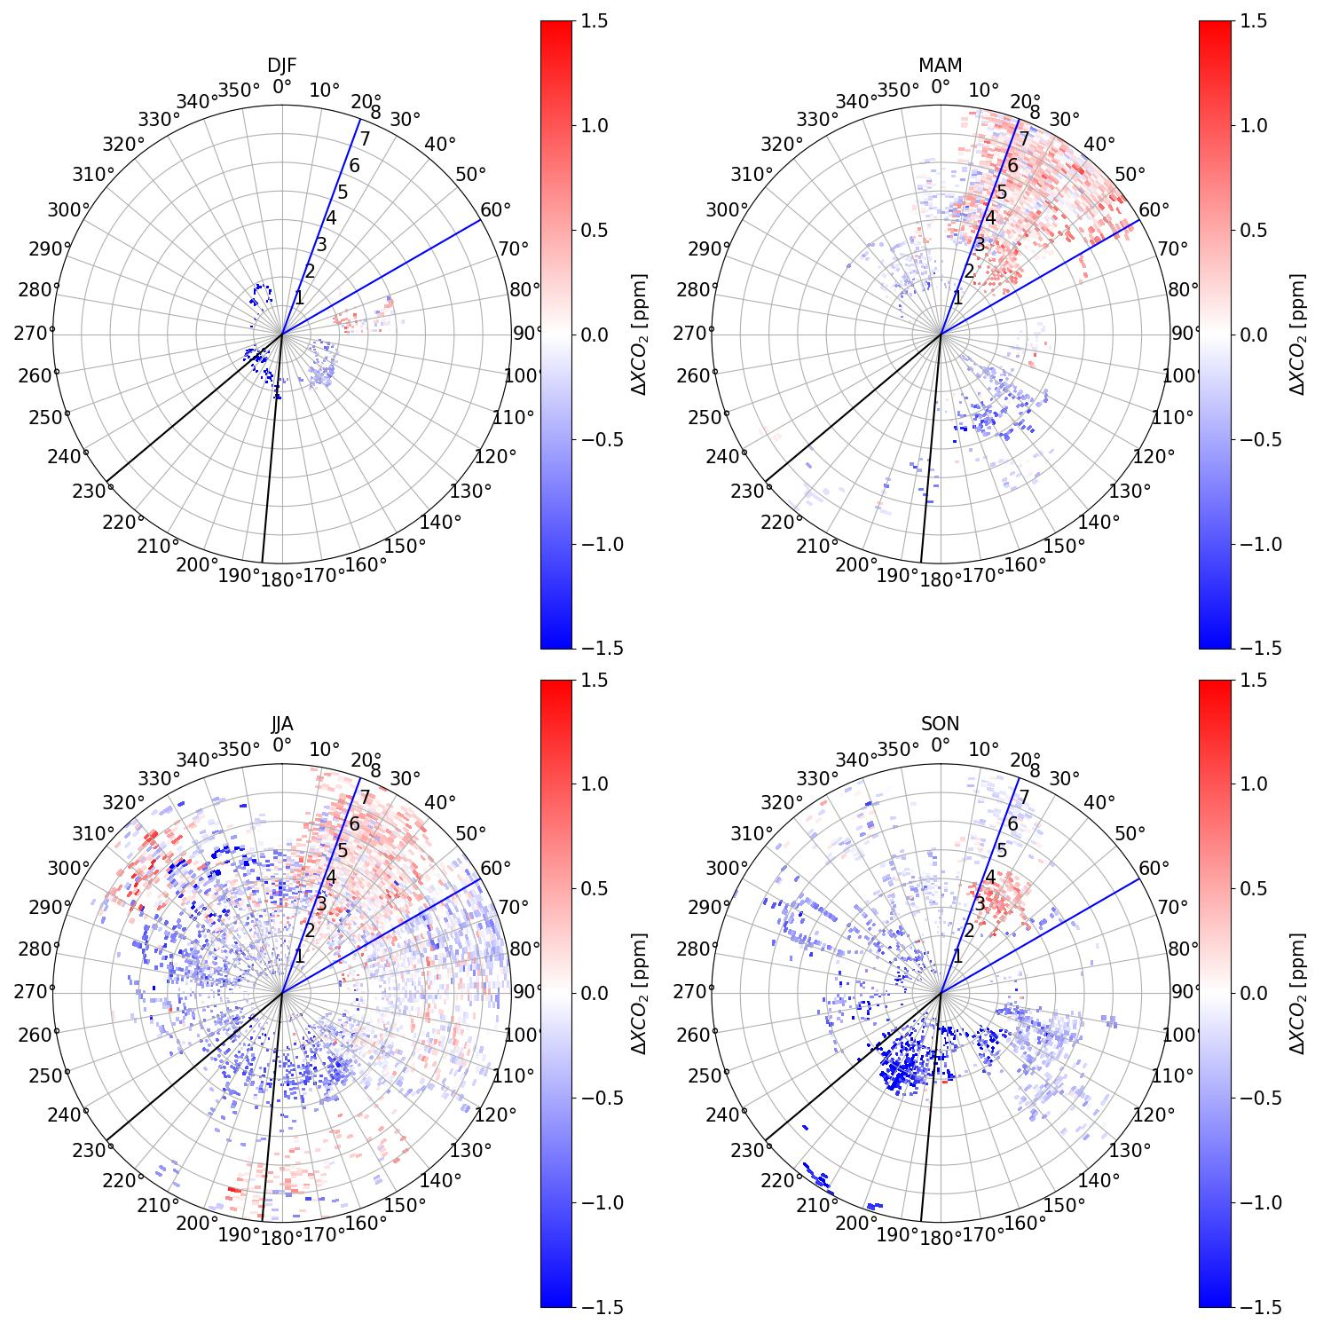
XCO₂ gradients (∆XCO₂)
∆XCO₂ = XCO_{2;SAC} – XCO_{2;GNS}
10 minutes averaged gradients
between Saclay and Gonesse
Period: 2022/07/01 - 2023/06/06

