Slide 1
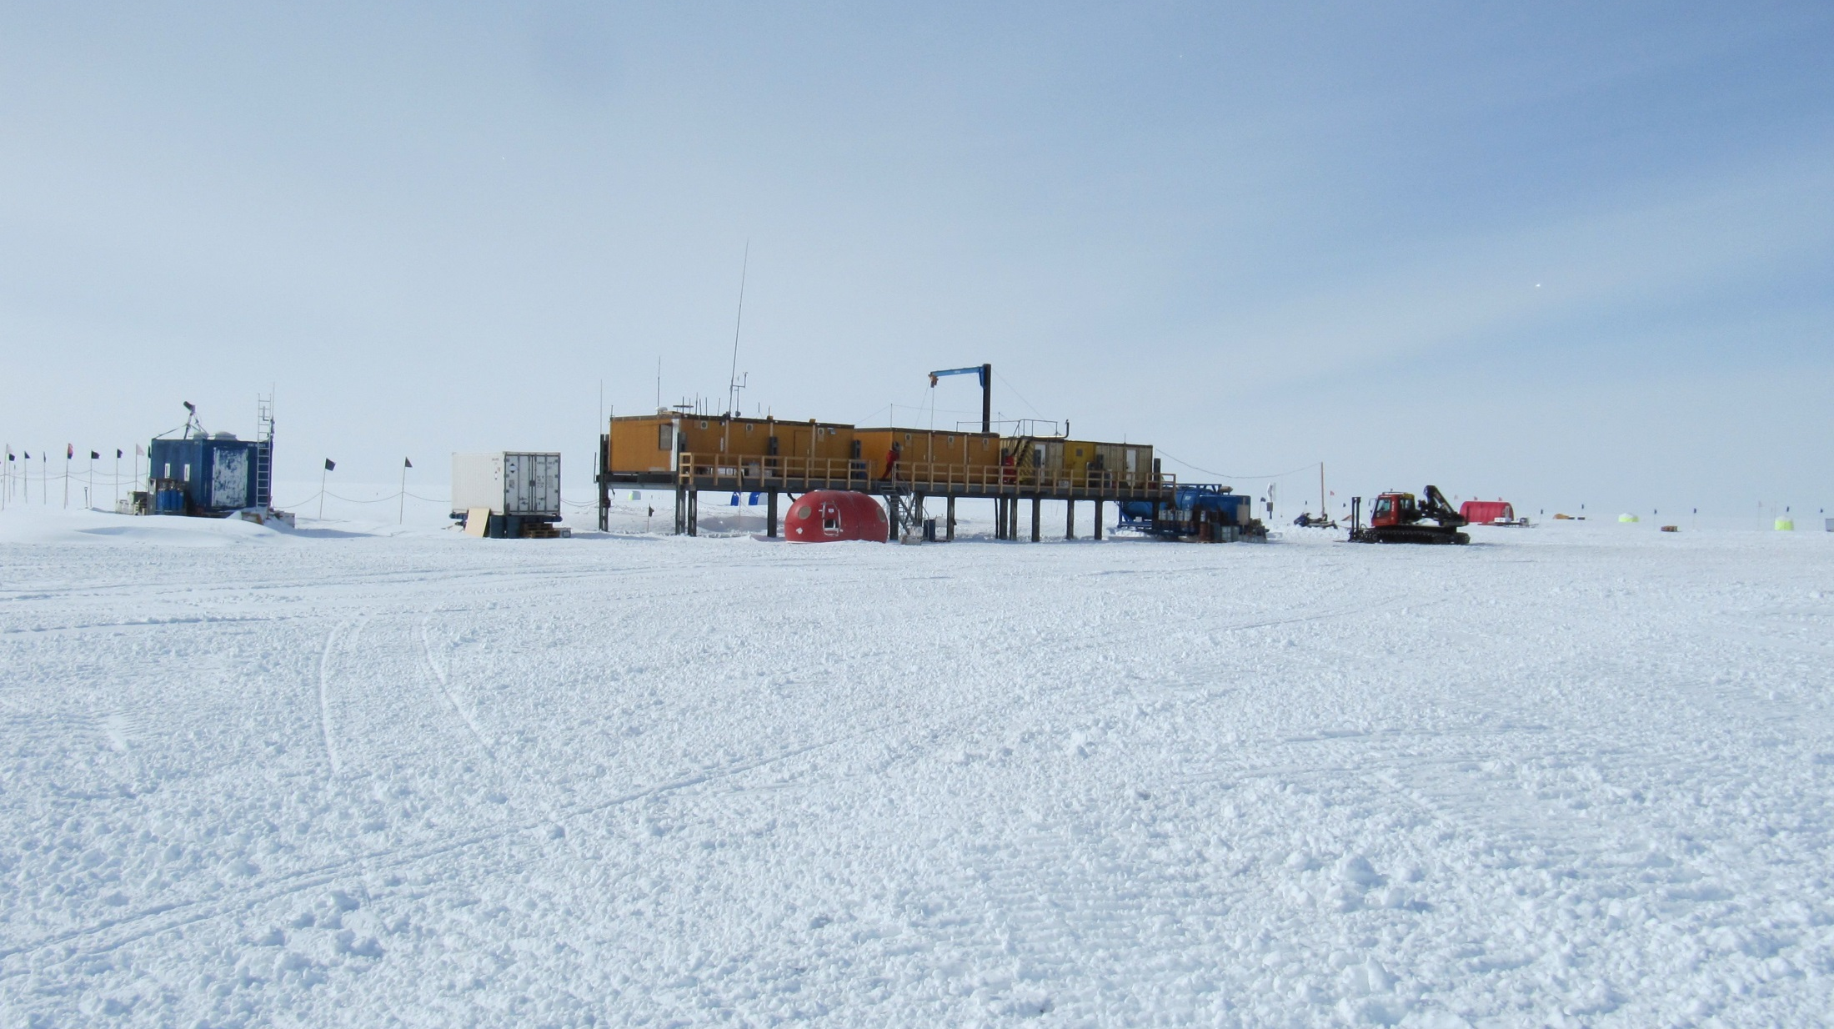

Beyond trace gas retrievals, what can be done with line-by-line codes:
Increasing CH₄ leads to a warming in the Antarctic troposphere
Justus Notholt¹, Matthias Buschmann¹, Holger Schmithuesen², Axel Kleidon³
¹University of Bremen
²Alfred-Wegener-Institute for Polar and Marine Research, Bremerhaven
³Max-Planck-Institute for Biogeochemistry, Jena
University
of Bremen
Institute of
Environmental Physics

Slide 2
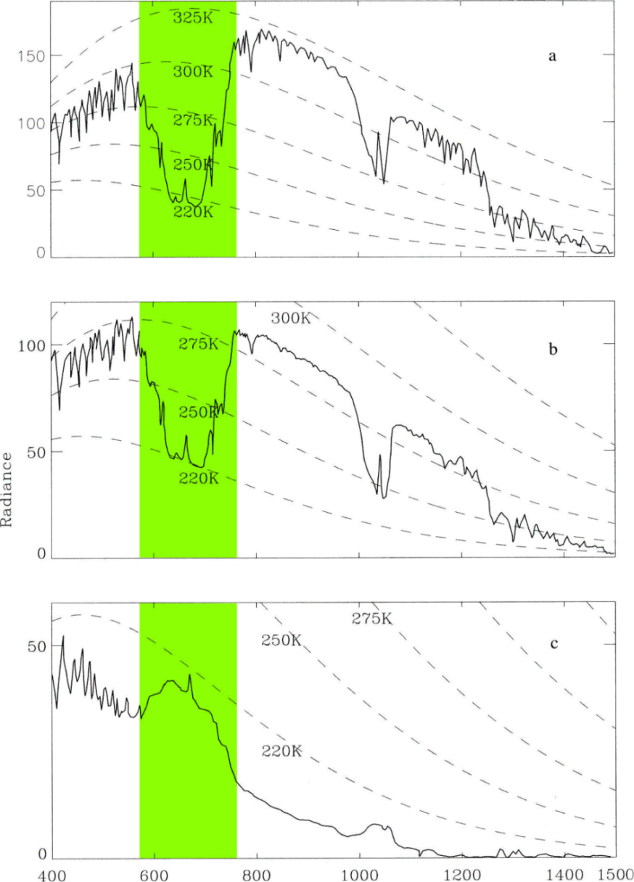
Emission spectra (Iris on Nimbus 4)
CO₂
Sahara region
O₃
Emission from top of atmosphere
is lower than emission from surface
H₂O
Mediterranean
Emission from top of atmosphere
is lower than emission from surface
Antarctica
Emission from top of atmosphere
is higher than emission from surface
wavenumber (cm⁻¹)
(Thomas and Stamnes, 1999)
Notes:
IR Emission Spectra, satellite 1970/ 45 Years ago
KLICK -> 3 Regions
KLICK -> Normal on top vs. Antarctic
KLICK -> Qualitative difference in CO2-band
Question: Can CO2 have oppostite effect?
->Key Questions

Slide 3
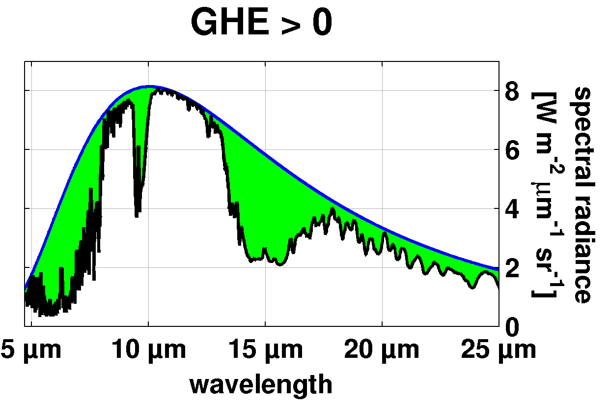
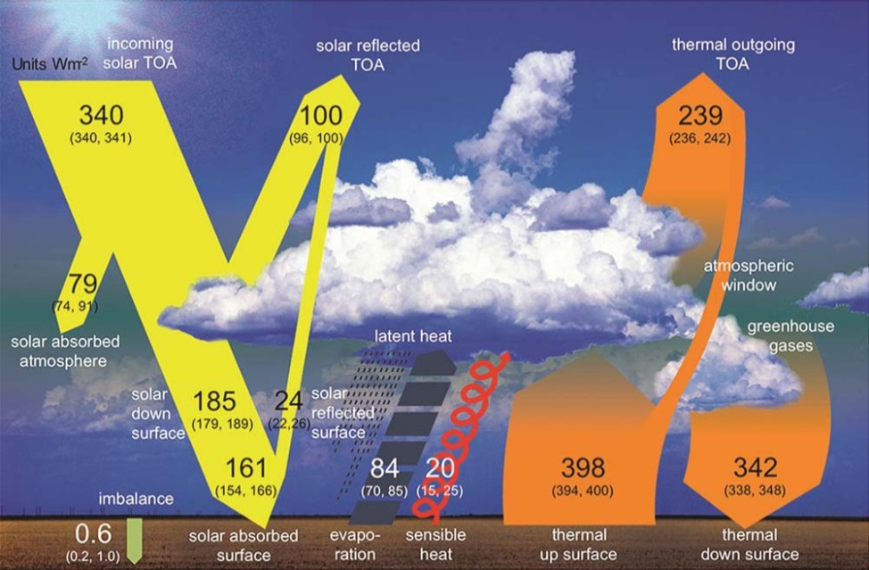
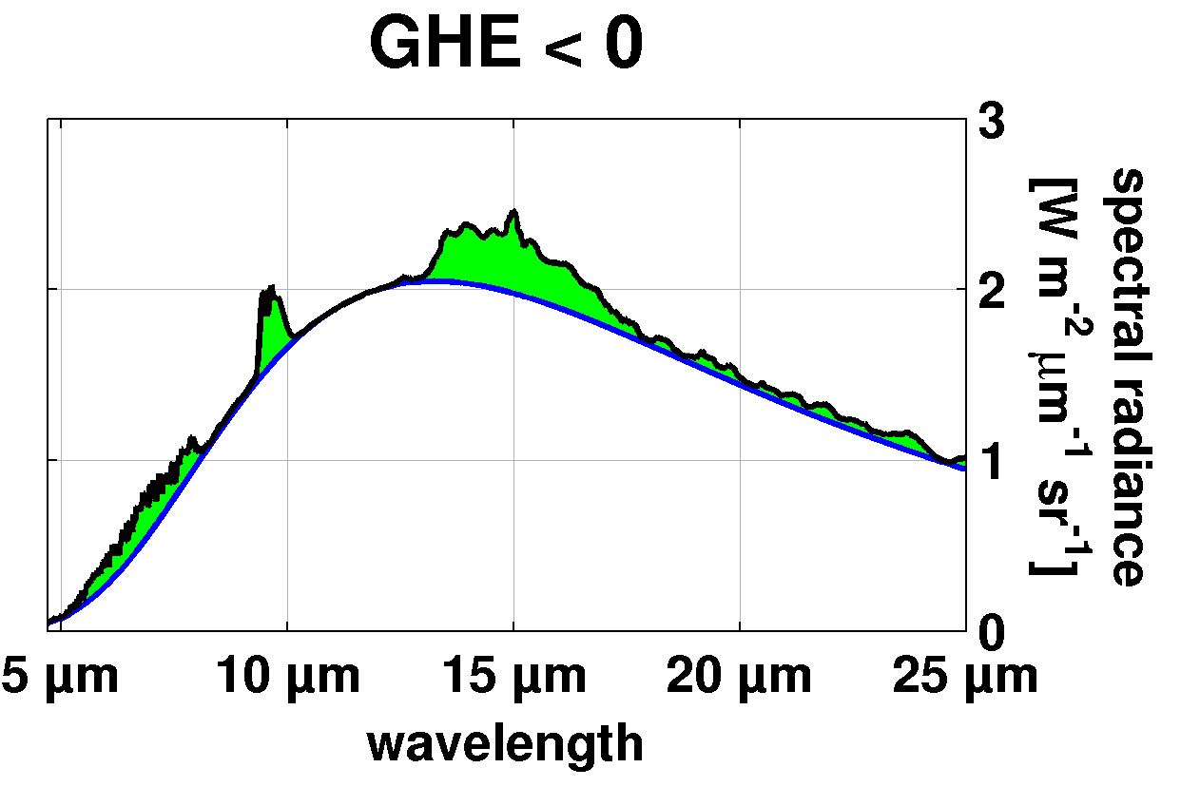
The Greenhouse Effect (GHE)
GHE = LWU_{surface} – F_{TOA}
Midlatitudes: GHE > 0
emission from TOA
lower than emission from surface
Antarctica: GHE < 0
emission from TOA
higher than emission from surface
Energy loss in atmosphere of Antarctica
(IPCC, 2013)
Notes:
To assess, whether TOA emission is below or above the surface emission: metric of GHE.
GHE > 0
GHE < 0
GHE of CO2

Slide 4
The Greenhouse Effect (GHE)
- Negative GHE for a few months in Antarctica
- Atmosphere looses energy
- Where does the cooling take place ?
(Schmithuesen et al., GRL, 2015)

Slide 5
The line-by-line model
Line-by-line radiative transfer calculations (Notholt et al., JQSRT, 2006)
Formerly ALFIP (Automatic Line Finding Program)
- ground-based and satellite
- transmission
- with external light source, absorption plus emission
- no scattering, no clouds
- up-looking, down-looking geometry
- HITRAN or ATMOS spectral data base, 0 – 120 km, 0.01 cm⁻¹
- Voigt profile via Humlicek (JQSRT, 1982)
Extension of GLBL
- H₂O continuum (Mlawer et al., 2012)
- upwelling, downwelling radiation in each layer
- heating and cooling of atmosphere (and surface) in each layer
- simulation only in the infrared 50 – 2000 cm⁻¹ (5 – 20 μm)
- no (vertical, horizontal) transport, no clouds

Slide 6
Extension of line-by-line model
T_{sky}
T_{Sky}
5
4
3
2
1
0
4
3
2
1
4
3
2
1
4
3
2
1
altitude
3-2
1-2
T_{Surf}
T_{Surf}
T radiation ΔQ ⇒ ΔT T_{new} = T_{old} + ΔT
Only contribution from infrared radiation

Slide 7
Inclusion of UV/Vis radiation, advection, clouds, ...
- Simulation for ‘current‘ atmospheric composition (ERA5 climatology, 1 x CO₂, 1 x CH₄, …)
- Comparison with ERA5 climatology T_{ERA5} (using ERA5 monthly averages)
T_{ERA5}(day 1)
T_{new,infrared} = T_{old} + ΔT_{infrared}
T_{new}=T_{new,infrared} + ΔT_{residual}
Comparison between T_{new} and T_{ERA5}(day 30)
Calculation of T_{surface} is different, unknown emission grade and heat capacity
- Iterative process to calculate ΔT_{residual}, three steps are sufficient (variability thoughout one month)
- T_{new} and T_{surface} include UV/Vis radiation, advection, convection, clouds, …
Radiation (warming/cooling) in IR for a 3 hour time step giving ΔT_{infrared}
ΔT_{residual} = T_{new,infrared} – T_{ERA5}(day 1 + 3 hours, interpolated)

Slide 8
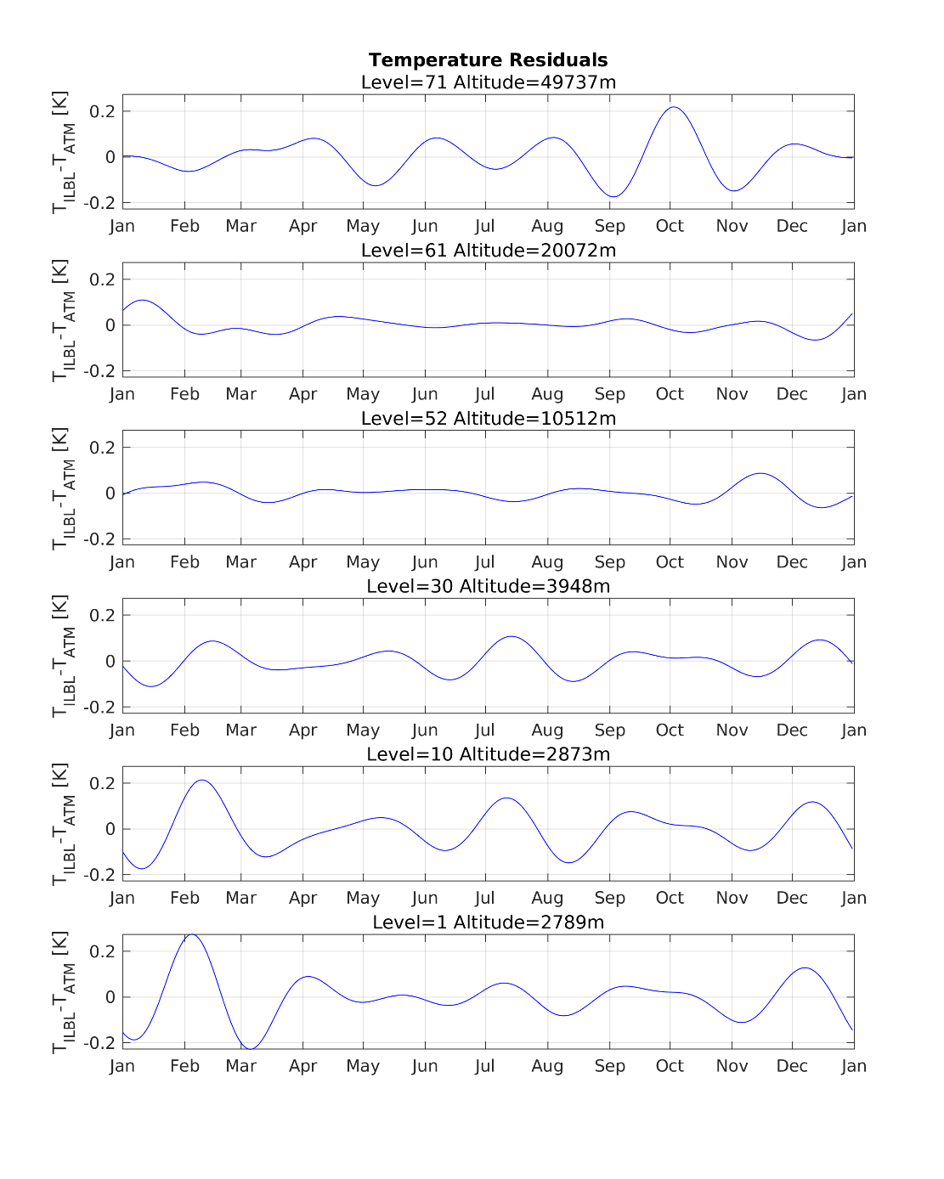
Accuracy of simulation (1xCO₂, 1xCH₄)
Antarctic (South Pole) at 2789 m
- Simulations started in January
- run for three years
- shown are results for third year.
- when averaging for 3 months, ΔT < ±0.05 K

Slide 9
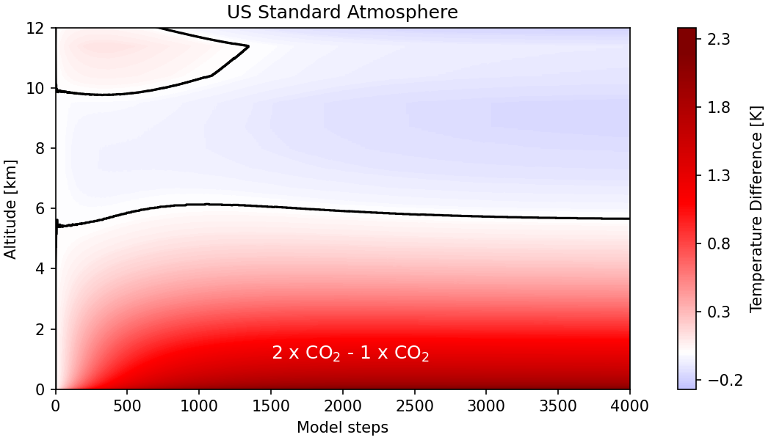
US-Standard atmosphere 2 x CO₂ – 1 x CO₂
Equilibrium in troposphere after about 2000 steps with 1.0 hour step size (approx. 3 months).

Slide 10
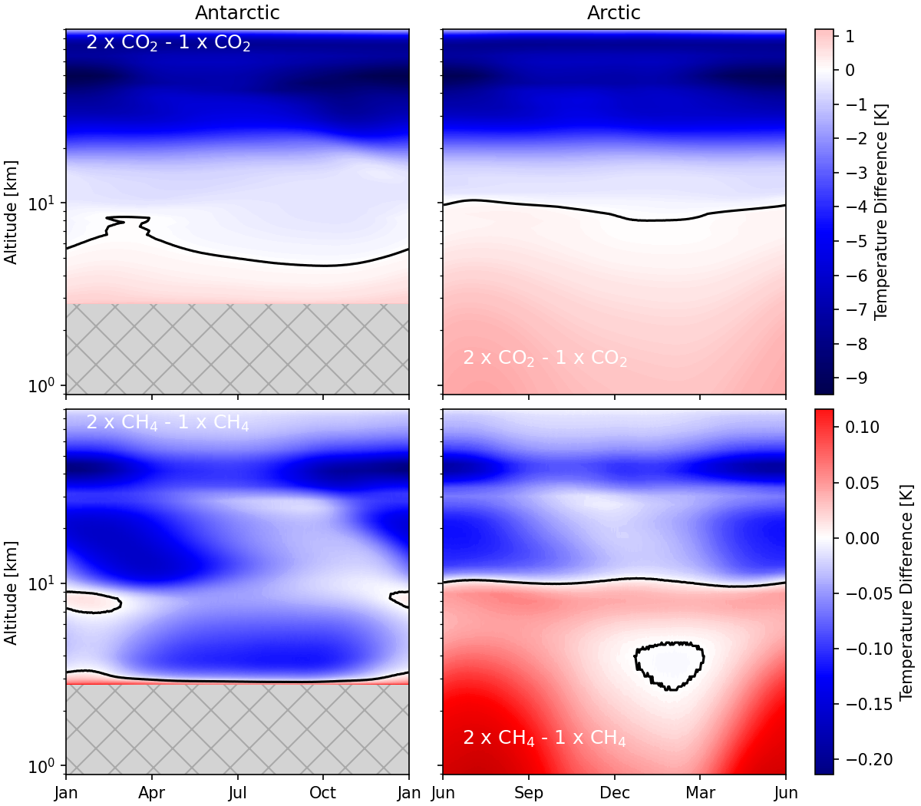
Antarctica and Arctic up to 90 km (log. scale)

Slide 11
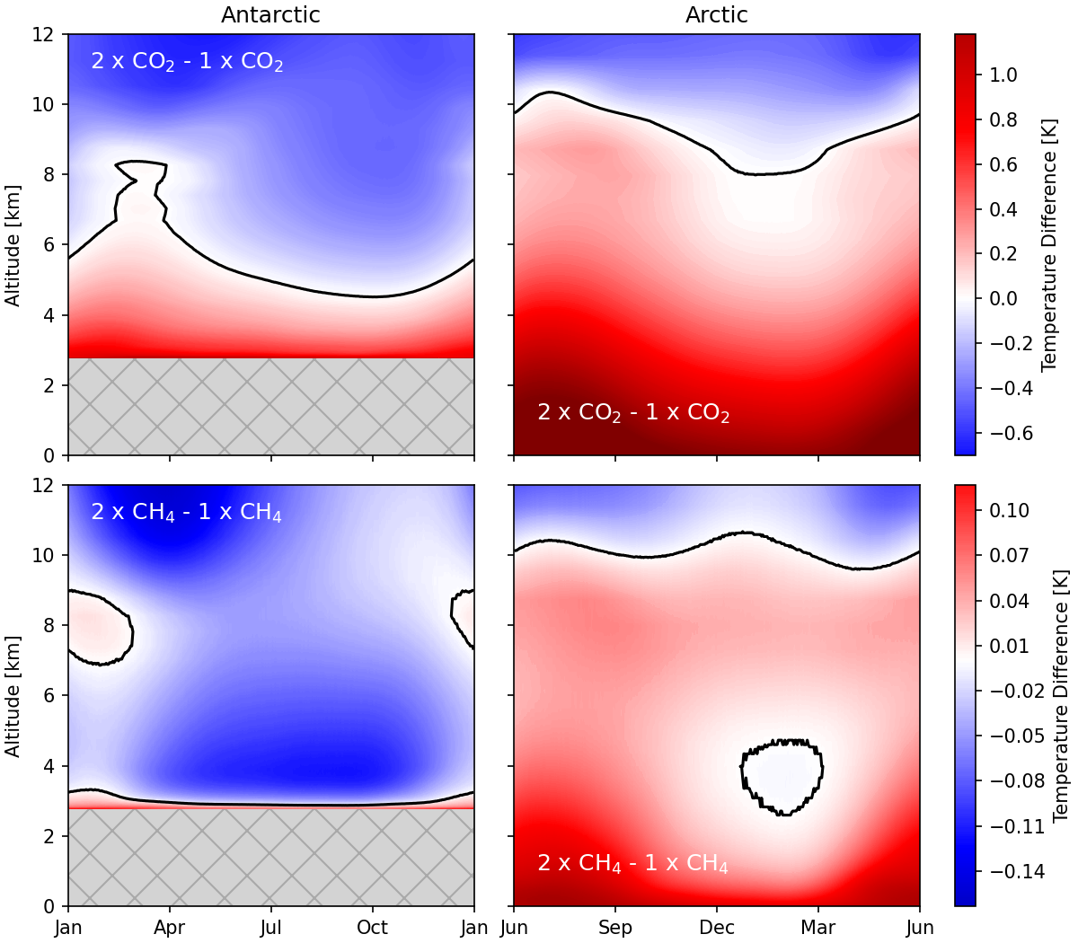
Antarctica and Arctic up to 12 km
CO₂:
Arctic: warming in troposphere
Antarctica: warming up to 5 - 6 km
CH₄:
Arctic: warming in troposphere
Antarctica: cooling in troposphere, except surface

Slide 12
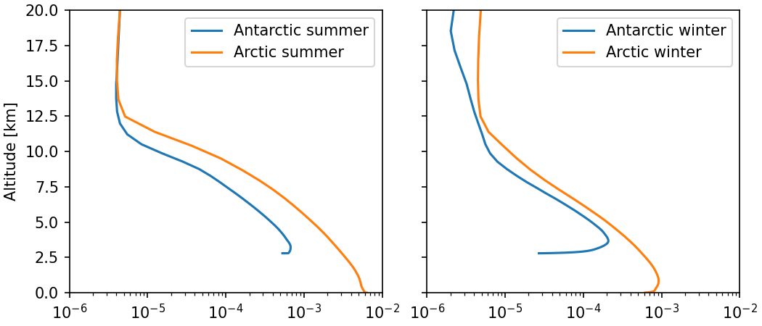
H₂O mixing ratio profiles
H₂O(Arctic) x 0.1 similar to H₂O(Antarctica)
H₂O(Antarctica) x 10 similar to H₂O(Arctic)

Slide 13
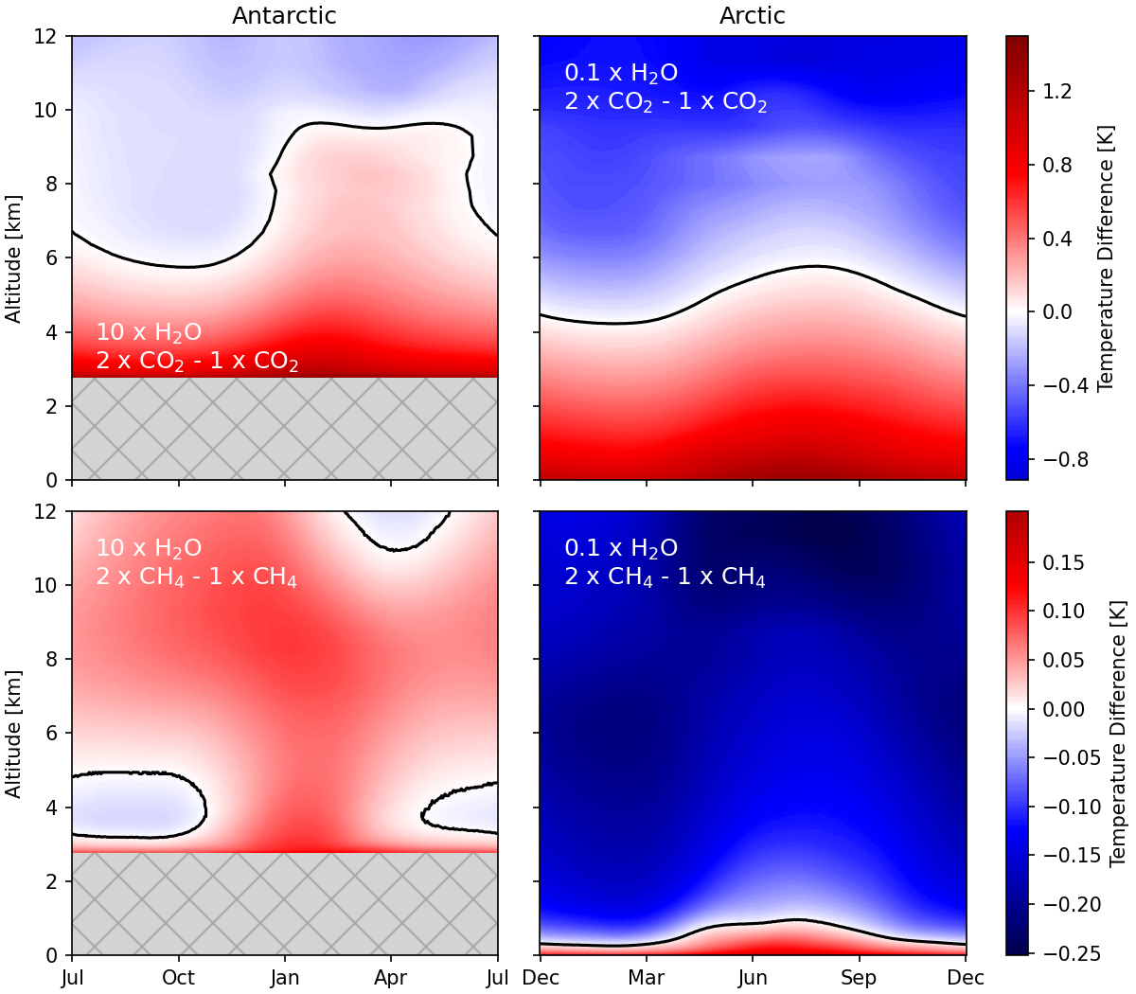
Test simulations for Antarctica and Arctic
Arctic: 0.1 x H₂O
Antarctica: 10 x H₂O
CO₂:
Arctic: warming up to 5 – 6 km
Antarctica: warming up to 6 - 10 km
CH₄:
Arctic: cooling in troposphere, except first 500 m
Antarctica: warming in nearly whole troposphere

Slide 14
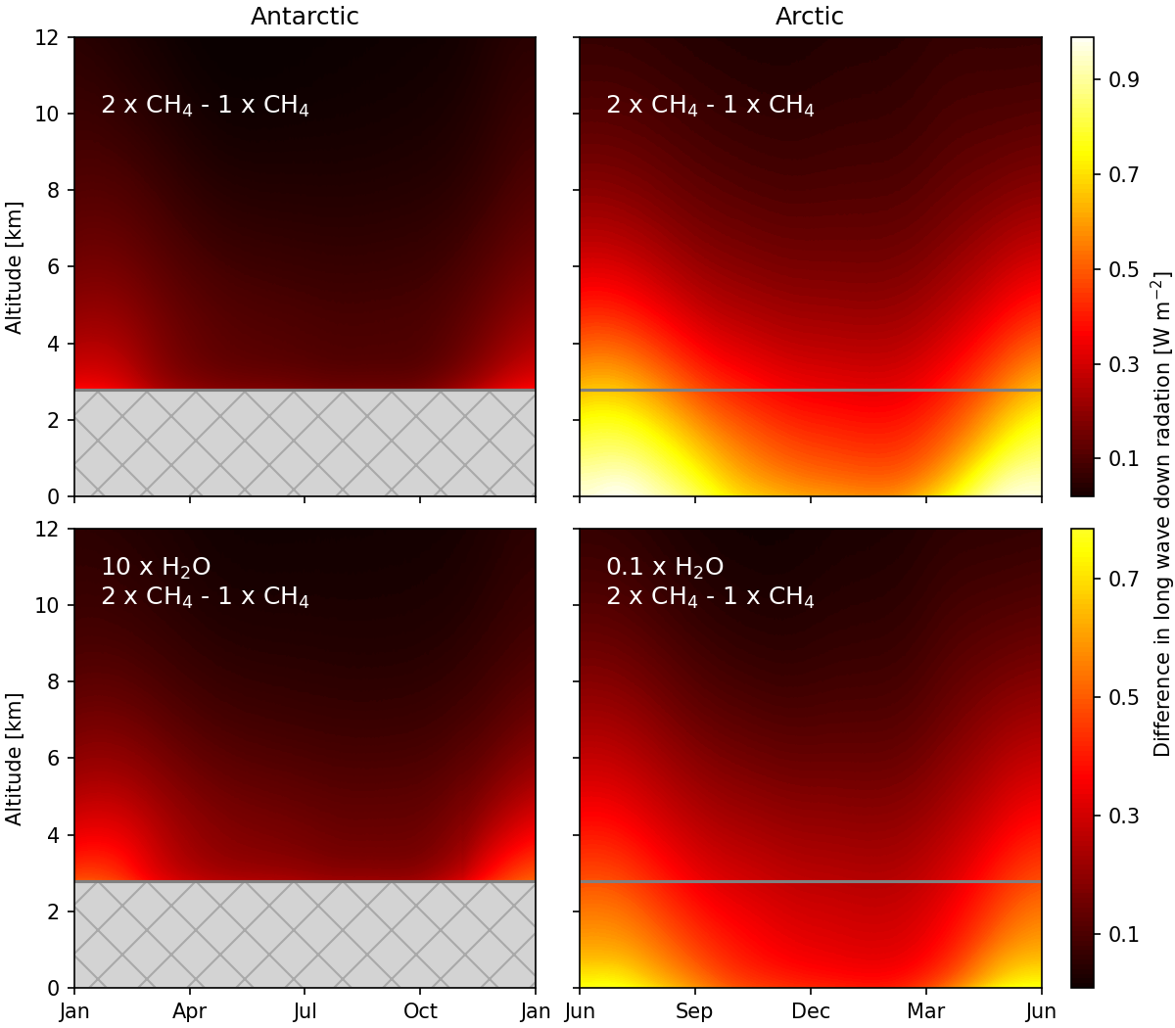
Difference in downwards radiation for CH₄
Heating in troposphere comes from downwards radiation
Antarctica with 10 x H₂O look similar as
Arctic with 1.0 x H₂O
Arctic with 0.1 x H₂O look similar as
Aantarctica with 1.0 x H₂O

Slide 15
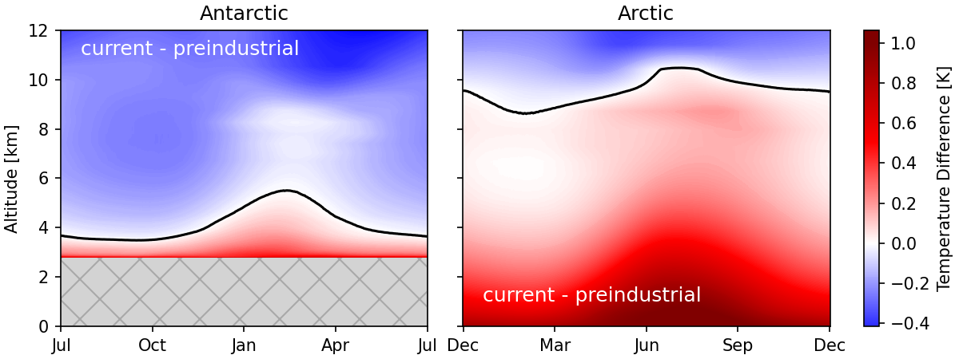
Current versus pre-industrial concentrations
400 ppm CO₂ and 1.85 ppm CH₄
versus
278 ppm CO₂ and 0.75 ppm CH₄
In Antarctica the surface is at 2.8 km altitude, in the Arctic at sea level.

Slide 16
Summary
- Increasing CH₄ cools the troposphere in Antarctica
- Warming in troposphere results from increased downwelling radiation in upper troposphere
- Interplay between H₂O and CO₂ or CH₄ gives a warming or cooling
Our studies could help to understand the lack of warming in Antarctica
For a further warming, with increased H₂O, the cooling by CH₄ might switch to a warming

