Slide 1
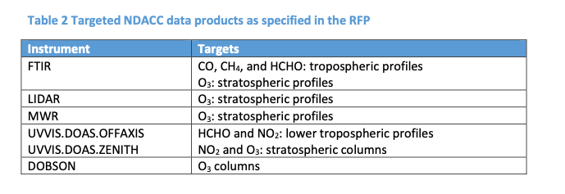
CAMS2-27: status update
follow-up contract is signed with ECMWF and ESA beginning of this year
continuation of service (only): WP0 and WP1 funding level is [10k€ , 40k€] /PI in the past contract ~4y
runs from Jan 2023 till April 2026: 40 months (extension is expected)
annual allowance will be covered by both ESA and ECMWF … total annual allowance is 129k€ for the entire NDACC group
allowances for 2022 are included (CAMS27 contract ended 2021): BIRA waits for ECMWF to send invoice to ECMWF … then we will send out order forms to the PIs

Slide 2
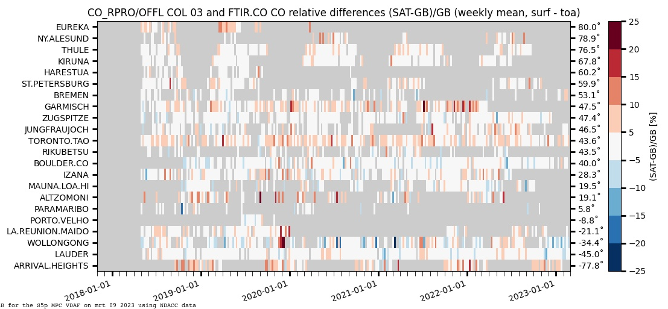
CAMS2-27: usage
https://atmosphere.copernicus.eu/eqa-reports-global-services > quarterly update for operational run > quarterly update for reanalysis run > periodic evaluation of upgrades to the operational runs > periodic on demand evaluation of ECMWF experiments (GHG models)
ESA/Copernicus Atmospheric Mission Performance Cluster ATM-MPC mpc-vdaf.tropomi.eu > quarterly update: IRWG used for CO, H2CO and CH4 … (and O3)

Slide 3
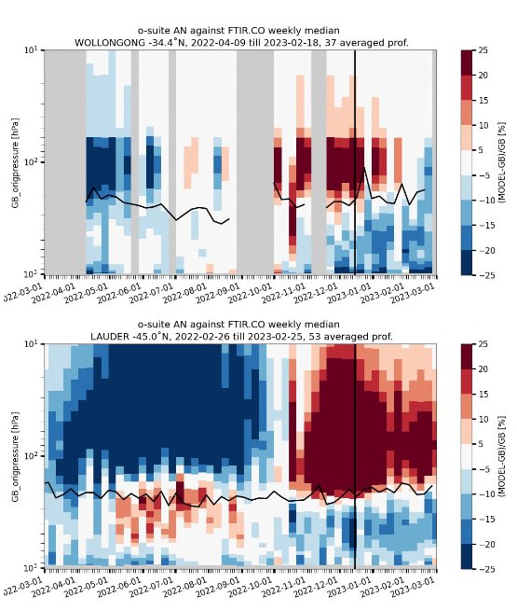
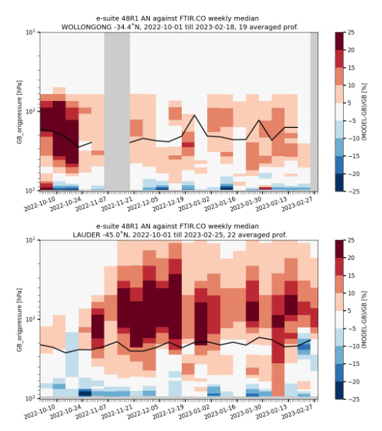
CAMS2-27: example of ECMWF experiments

Slide 4
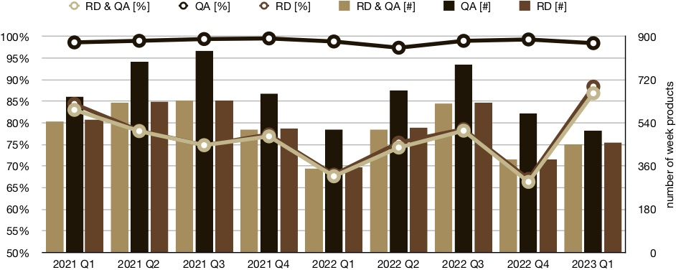
CAMS2-27: KPI
Statistics on “weeks with measurements”
Room for improvement on RD submissions: the target KPI is 95% for RD! >submit every month the recent data in weekly files
warning let me know when using extra GEOMS versioning!!

