Slide 1
Discussion topics
TCCON MEETING 2023

Slide 2
Coauthorships
One of the items within the ESSD Data Policy (https://www.earth-system-science-data.net/policies/data_policy.html) is about coercive/unethical usage agreements:
  data must not be tied to any additional coercive/unethical usage agreements (e.g. co-authorship requirements upon usage).
I asked Dr. Kristin Elger (editor of ESSD) about this and what it means. My question to her:
  Could you clarify what this means? It is typical within my field to request that the data providers are made aware of studies involving their data at an early stage, and that if the data are essential to the study, co-authorship may be appropriate. Does this constitute a coercive or unethical usage agreement according to ESSD?
Her response:
  What we mean is not that co-authorship must be avoided by all means, but that there cannot be a requirement to include the originating creators of the data to become co-author on any publication using their data.
  Data publications with DOI are fully citable in scholarly literature and the credit to the creators of the data is given via their citation - similar to getting credit for papers. An additional requirement to, e.g. send all publications to the creators of the data for their approval and to include them as co-authors (we had such cases before) is unethical given the changed opportunities of data citation. I truly believe that most researchers uphold the guidlines of good scientific practice and would probably ontact the creators of the data they used anyway asking for their advice (including the offer of co-authorship if the data creator contributes to the paper).
We need to discuss how we wish to proceed as a community.
Also, “policing” the literature is a time-consuming and difficult task. Is this something that the TCCON community wants the co-chairs and deputies to continue doing?

Slide 3
Nonlinearity
Rigel/Pauli/Frank’s FORTRAN code is available on GitHub
  Not all sites are able to use it, because it requires ifort, fwd/rev InGaAs/Si combined OPUS-style igms
  Some code changes can be made to run it, but it’s not always straightforward
  Needs more flexibility to handle slices, OPUS files of different types, more compilers (i.e., gfortran)
How should we proceed as a community to remove nonlinearity from our datasets?
Proposal: if your site has DIP<-0.5e-3, then you must attempt a correction, though everyone is welcome to attempt a correction. Debra, Rigel, Pauli, and Frank are available to help you work through the process.
  If your system collects “slices”, it will be more efficient (at the moment) to work with Debra (my Matlab code handles slices)
  For sites with DIP>0, we need more research to determine what to do. Ralf and Markus have been working hard on this.

Slide 4
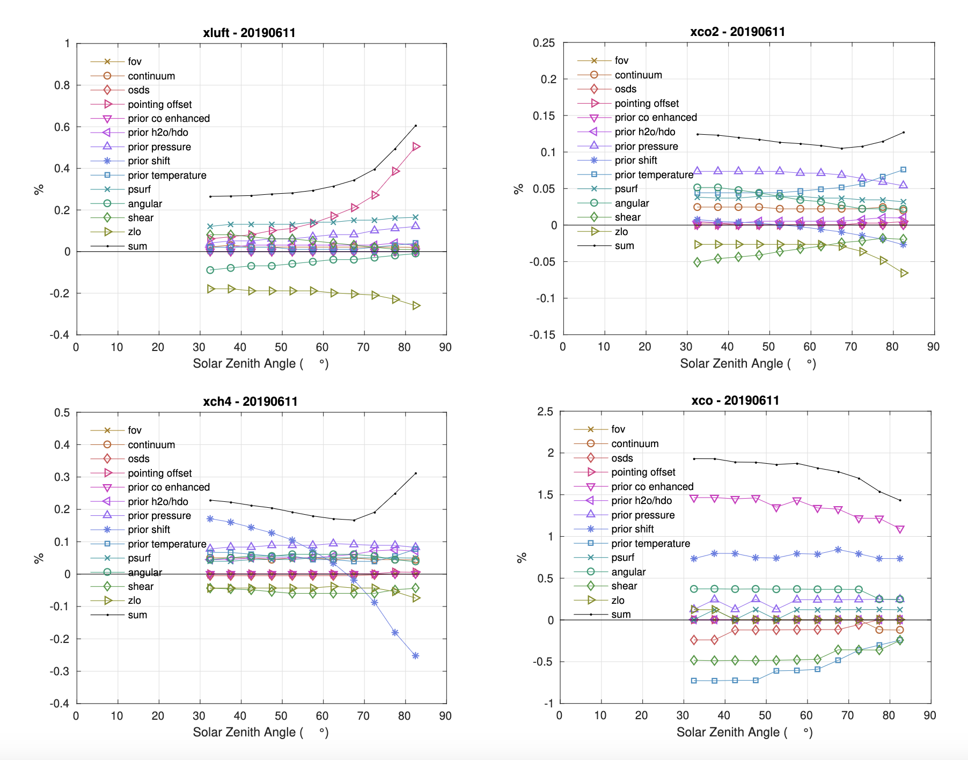
Surface pressure calibrations
What is the best way to organize this?
Who would like to take the lead on this?

Slide 5
Supporting new satellite missions
Faster data delivery
  1 month delivery – no need to change current processing but increased frequency of processing
  <1 week delivery – might need to change processing (faster prior generation, fast internet at all stations, no time for QAQC)
    Needs a “pre-QA/QC product” that is *not* “TCCON data”
    Would require automated processing that is currently not developed
  <1 day delivery – requires significant changes to processing (forecasts instead of reanalysis, fast internet at all stations or local processing facilities)
    This would constitute a new product that is not, and will never be “TCCON data” because the a priori profiles are inconsistent with the standard TCCON product

Slide 6
TCCON Funding
To support validation efforts across multiple satellites, provide long-term time records, and continuously improve our retrieval products, we require stable, predictable funding
There have been several attempts to secure long term TCCON funding
  ICOS RINGO document with personnel costs: https://www.icos-cp.eu/sites/default/files/2020-04/D1.5.%20Scientific-technical%20concept%20for%20the%20integration%20of%20European%20TCCON%20sites%20into%20ICOS%20and%20resulting%20costs.pdf
  A recent document circulated and presented to Bojan Bojkov (EUMETSAT/CO2M) on operational and upgrade hardware costs (i.e., not personnel costs)
What else should we try? Who should we approach?

Slide 7
Interferogram and Spectra backup systems
Issues with Ascension have highlighted the need for better and more accessible data backup systems
  i.e., if we are unable to access our processing data systems, is there a copy of our raw data accessible from anywhere?
How do people currently back up their raw data?
  I write my interferograms (slices/savesets) to archival tape through a Canadian academic shared supercomputing resource. Costs are a few hundred dollars per year, paid for by the supercomputing service provider. (There is a ~competitive proposal process.)
  Write multiple copies to hard drives
Dietrich would like to propose a torrent network for this purpose
  Amazon Deep Glacier another option

Slide 8
TCCON Internal Budget
Funding for Slack ($2USD/active user/month for an educational account)
  Current “free” version of Slack removes history after 90 days
Funding for Gather.Town platform for future virtual poster sessions
Funding to help students travel to TCCON meetings or collaborate with international PIs
How would we fund this? Everyone contributes a certain amount? Ask external agencies for funding? Continue with our current model?

Slide 9
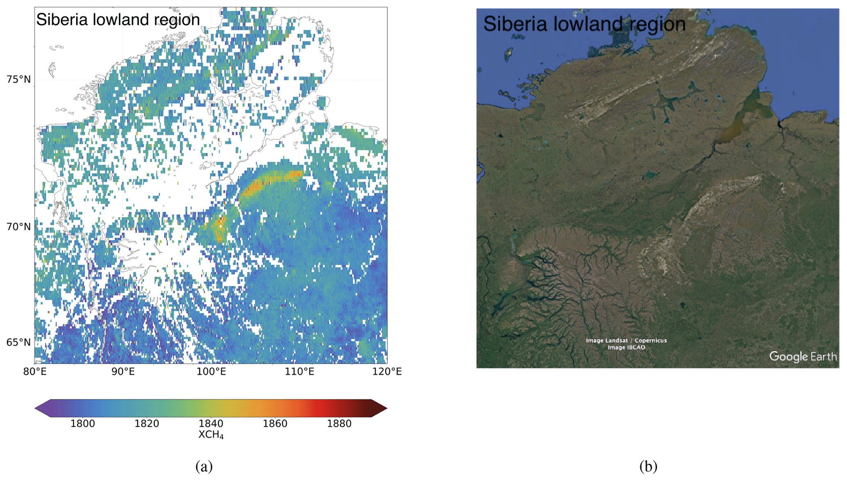
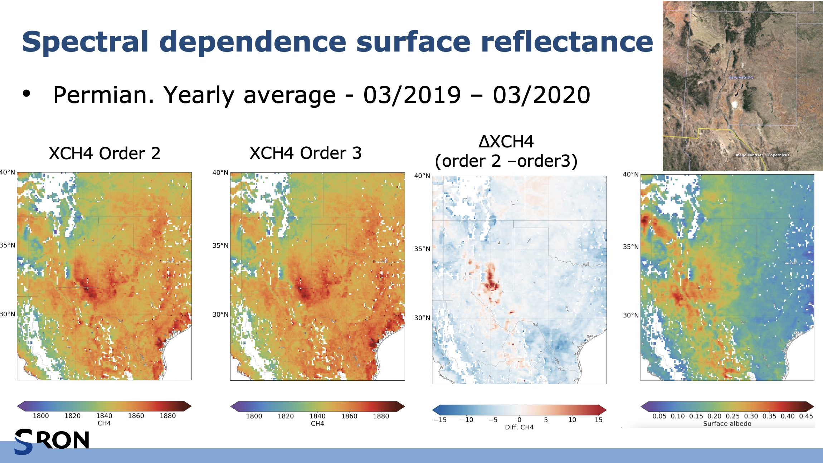
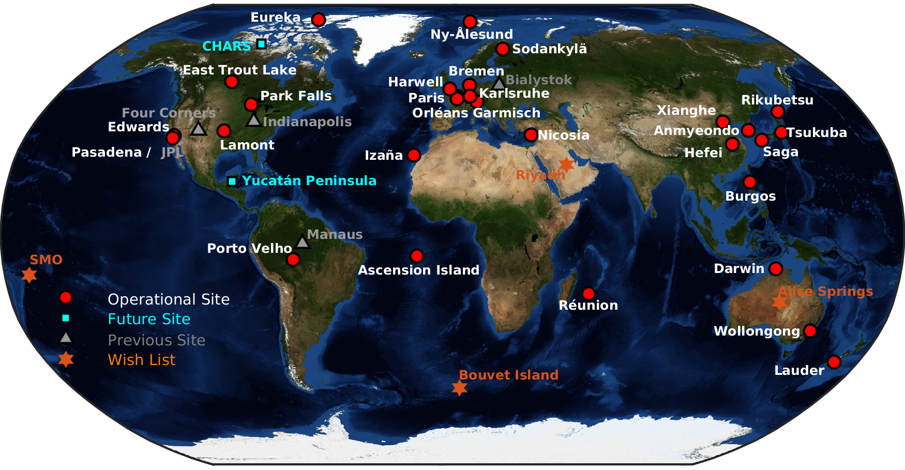
Expanding the TCCON
Recent papers* indicated that new TCCON stations are needed in locations with high albedo and with large surface reflectance spectral dependence
  High albedo: Sahara, central Australia, etc.
  Large surface reflectance spectral dependence: Permian Basin (Four Corners?)
Any thoughts on potential partners in these locations?
Lorente, A., Borsdorff, T., Martinez-Velarte, M. C., and Landgraf, J.: Accounting for surface reflectance spectral features in TROPOMI methane retrievals, Atmos. Meas. Tech., 16, 1597–1608, https://doi.org/10.5194/amt-16-1597-2023, 2023.
*one of which did not cite TCCON properly or offer co-authorship

Slide 10
InSb measurements
Who would like to upgrade to InGaAs/InSb? Do you require additional support?
Currently, InSb retrievals are put in the private netcdf files using insb_xxx variables.
InSb retrievals shown to be helpful for partial column CO retrievals (e.g., Parker, H. A. et al., Atmos. Meas. Tech. Discuss. [preprint], https://doi.org/10.5194/amt-2022-322, in review, 2022.)
  Similar analyses could be done for CH4
TEMPO will be interested in NO₂, H₂CO, O₃ from TCCON, available from the InSb detector
  Should look at some NDACC/TCCON intercomparisons to ensure that we can provide a consistent dataset to TEMPO
New KBr beamsplitter?

Slide 11
Formal PROFFAST-GGG comparison
To be held during the COCCON meeting discussions?

Slide 12
TCCON Elections

