Slide 1
Status on GOSAT and GOSAT-2 observations and validations 2023
TCCON/COCCON/NDACC Annual meeting, Spa, Belgium, 2023
Isamu Morino, Yukitomo Tsutsumi, Hirofumi Ohyama, Matthias M. Frey, Tomoaki Tanabe, Akihiro Hori, Yukio Yoshida, Yu Someya, Akihide Kamei, Makoto Saito, Hibiki M. Noda, Tsuneo Matsunaga
(National Institute for Environmental Studies, Japan)
and TCCON Partners

Slide 2
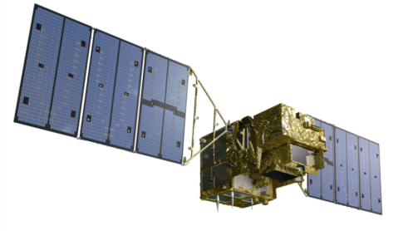
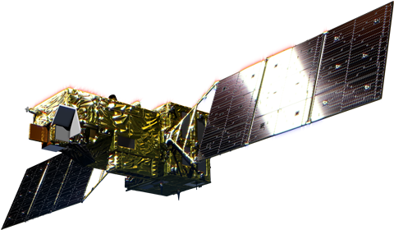
Contents
1. Introduction
Global maps from GOSAT and GOSAT-2 FTSs
TCCON data used in validation analyses
2. Validation of GOSAT FTS level 2 data (version 02.90/02.91)
3. Validation of GOSAT-2 FTS-2 Full Physics and PROXY level 2 data (version 02.00)
GOSAT (2009-)
More 14 years operation
5 years operation in next Oct 2023
GOSAT-2 (2018-)
Notes:
This is contents of my talk.
First, I will show observation results of the GOSAT and GOSAT-2 retrieved from FTS SWIR spectra.
Next, I will present validation results of GOSAT FTS L2 data, version 02.90/91. This version is released to the public, and updated version 03.00 will released be soon.
Then I would like show validation analysis for GOSAT-2 Full physics and Proxy retrievals version 02.00. These data for full physics are released to be the public and PROXY will be released to the public soon.

Slide 3
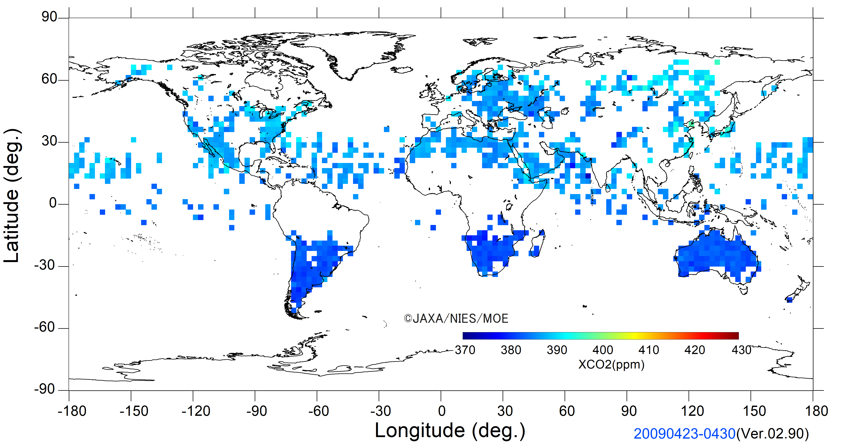
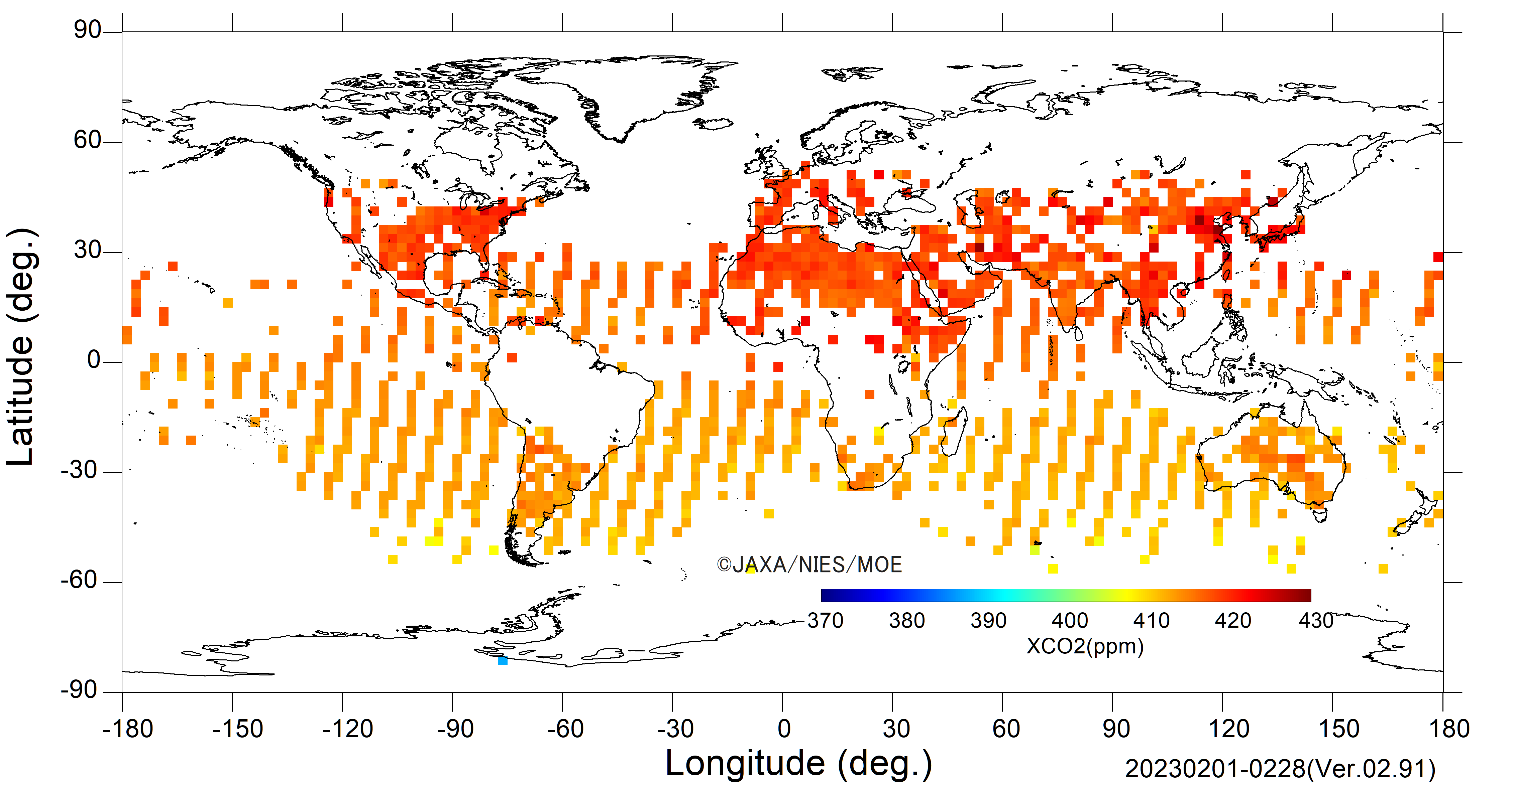
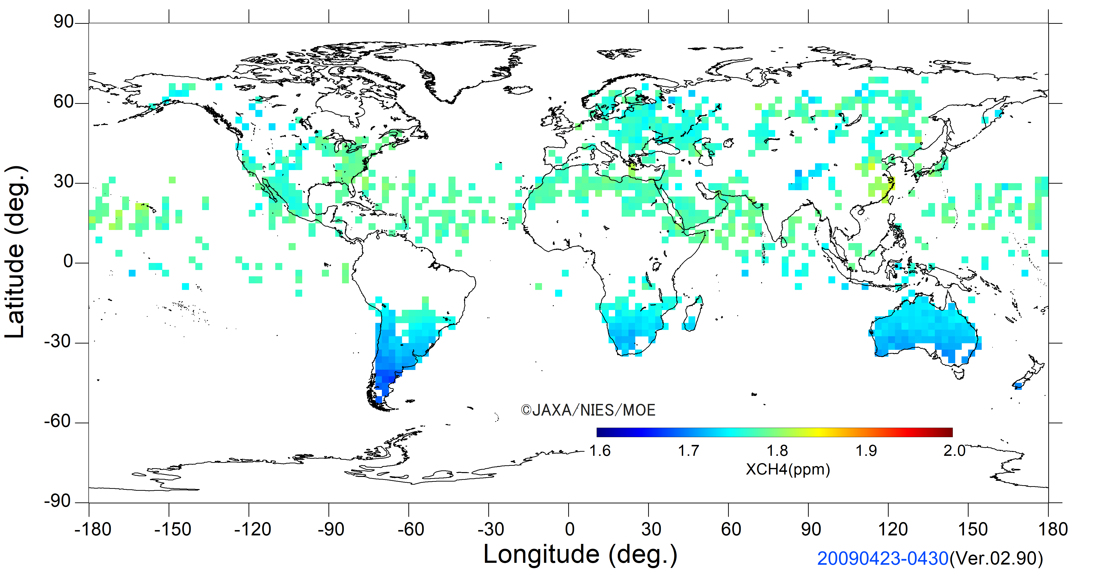
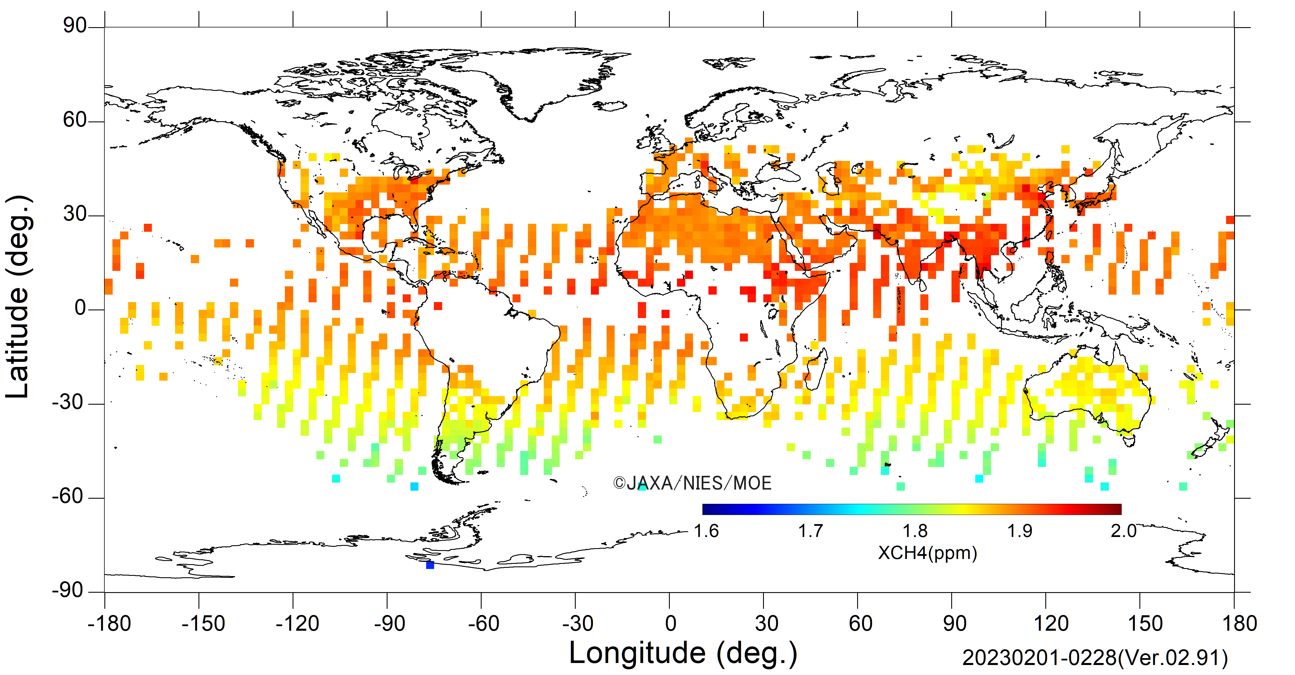
Global maps of GOSAT FTS Level 2 products
(ver. 02.90/91)
April 2009
February 2023
XCO₂
XCO₂
XCH₄
XCH₄
Monthly global map of the CO₂ and CH₄ column-averaged dry-air mole fractions (FTS SWIR L2 XCO₂ and XCH₄ ver. 02.90/91) averaged over ±2.5 degree boxes
Notes:
This slide shows global maps of GOSAT L2 products.
Top maps are (column averaged dry mole fraction of carbon dioxide,) XCO2 and bottom maps are (column averaged dry mole fraction of methane,) XCH4.
Lefts maps are observed in 2009, eleven years ago, launching year of the GOSAT. And left maps are recent observations made in this ferrauary.
For 14 years operation of GOSAT, XCO2 is increasing by more 30 ppm, and XCH4 is increasing by 135 ppb. Recent annual increasing rate is 2 ppm/ yr for XCO2 and 15 ppb /yr for XCH4.
Version of this products is 2.90/91, which is released to the pubic.

Slide 4
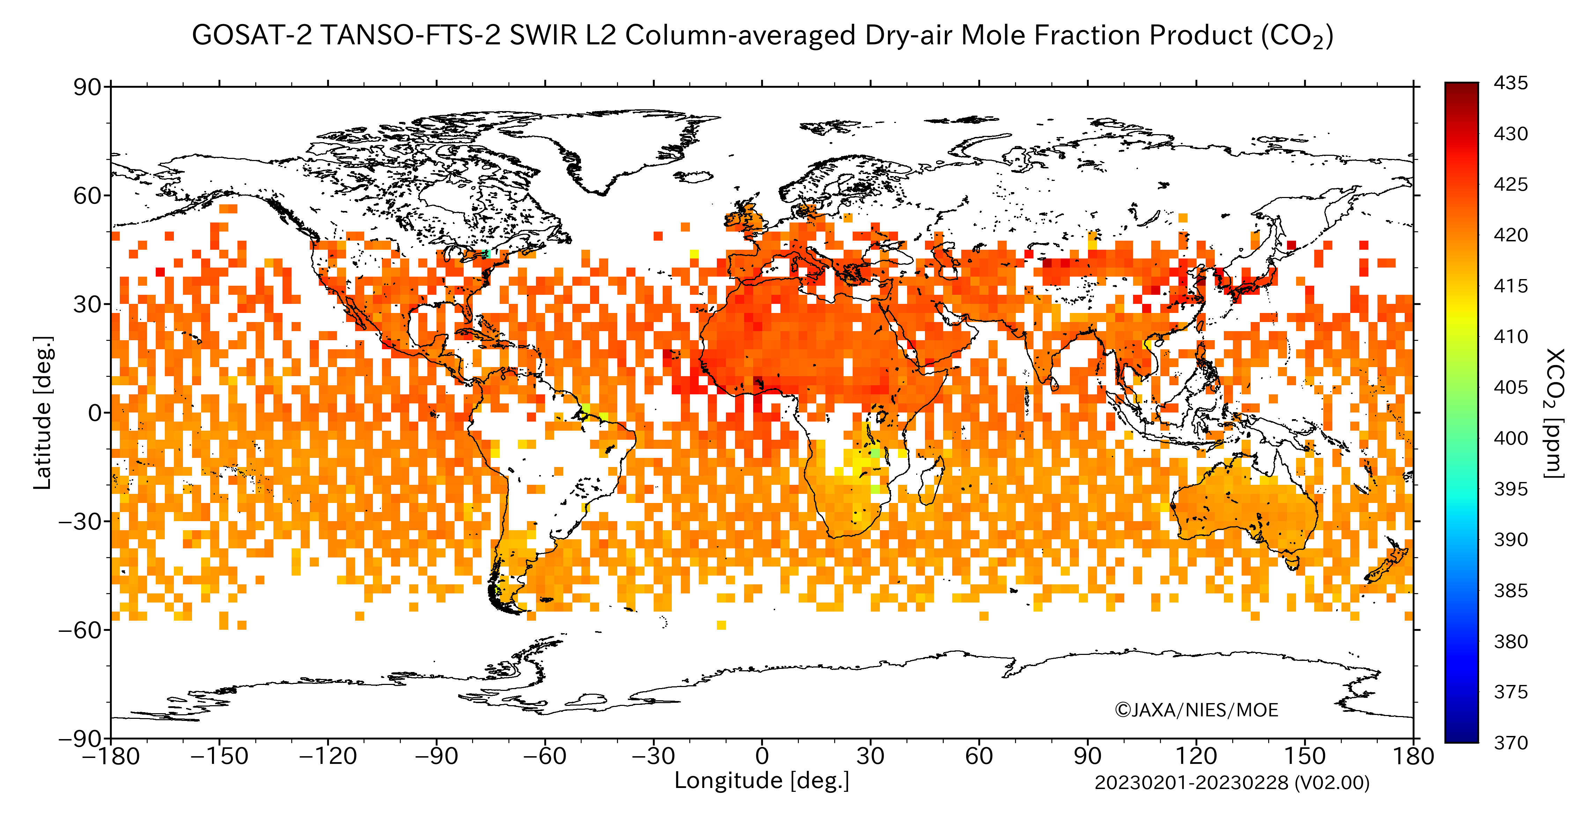
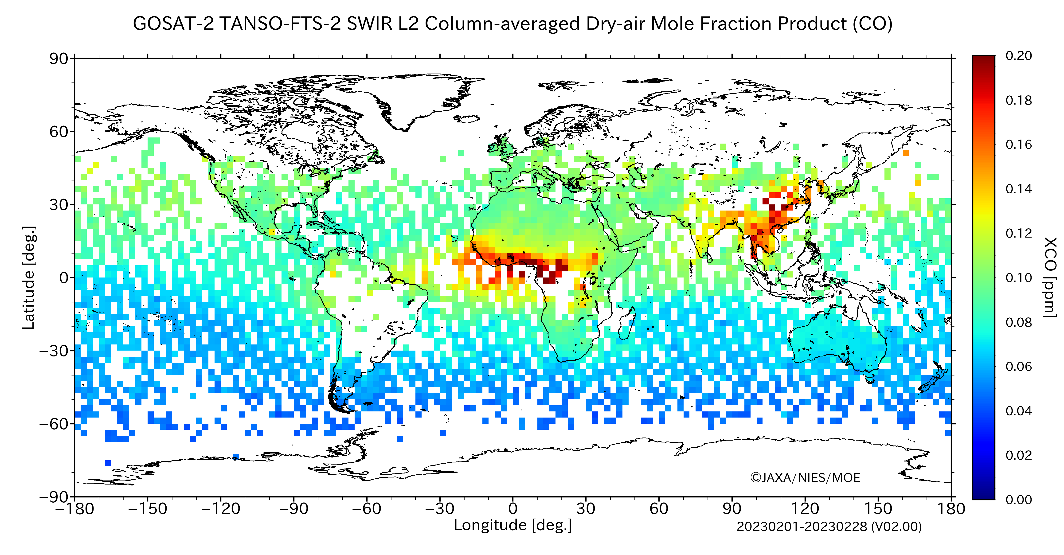
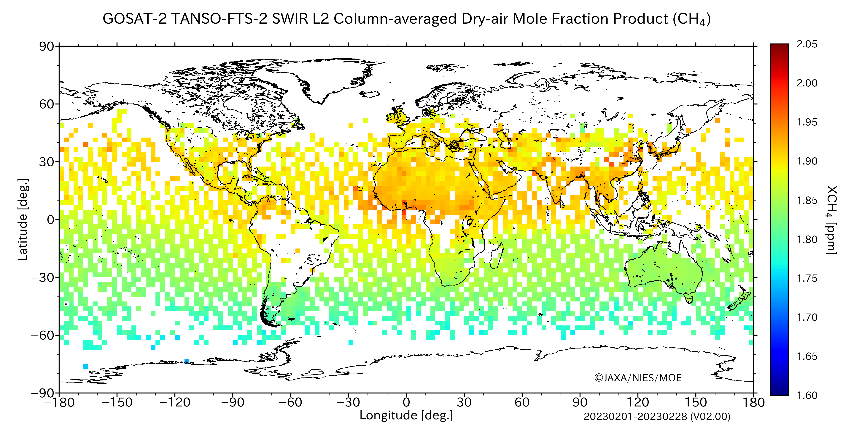
Global maps of GOSAT-2 FTS-2 Full Physics XCO₂, CH₄ and XCO (ver. 02.00)
XCO₂
XCO
XCH₄
GOSAT-2 full physics XCO₂ are larger than GOSAT and these are similar in comparison with the TCCON data.
Global distribution of carbon dioxide, methane and carbon monoxide column-averaged dry-air mole fractions (XCO₂, XCH₄, XCO) retrieved by the full physics-method from GOSAT-2. Data are averaged from Feb 1 to 28, 2023.
Notes:
This slide shows global maps of GOSAT-2 full physics retrievals in February 2023.
Top left map is XCO2, top right is XCO, and bottom map is XCH4.
For XCO, we can see clear enhancements over East and South Asia, and Central Africa.
GOSAT-2 full physics XCO₂ are larger than GOSAT and these are similar in comparison with the TCCON data.

Slide 5
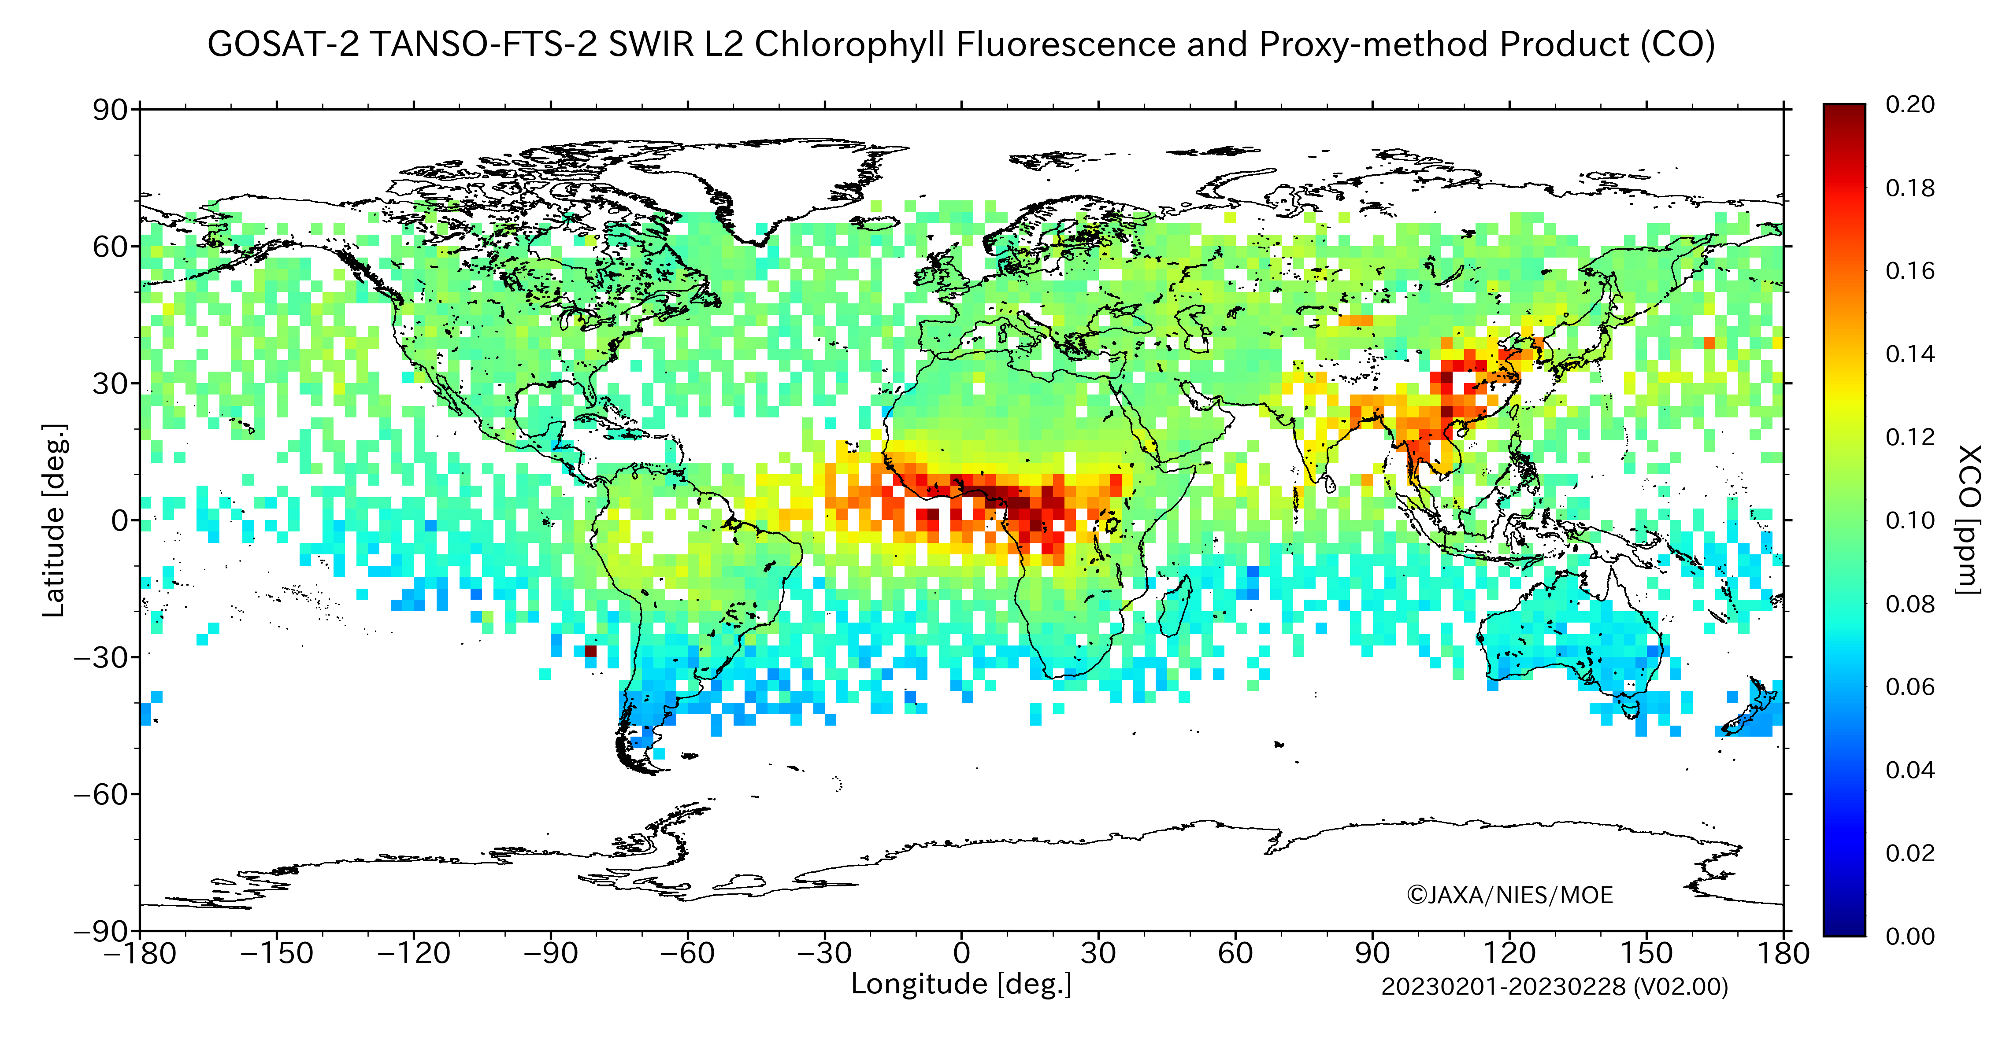
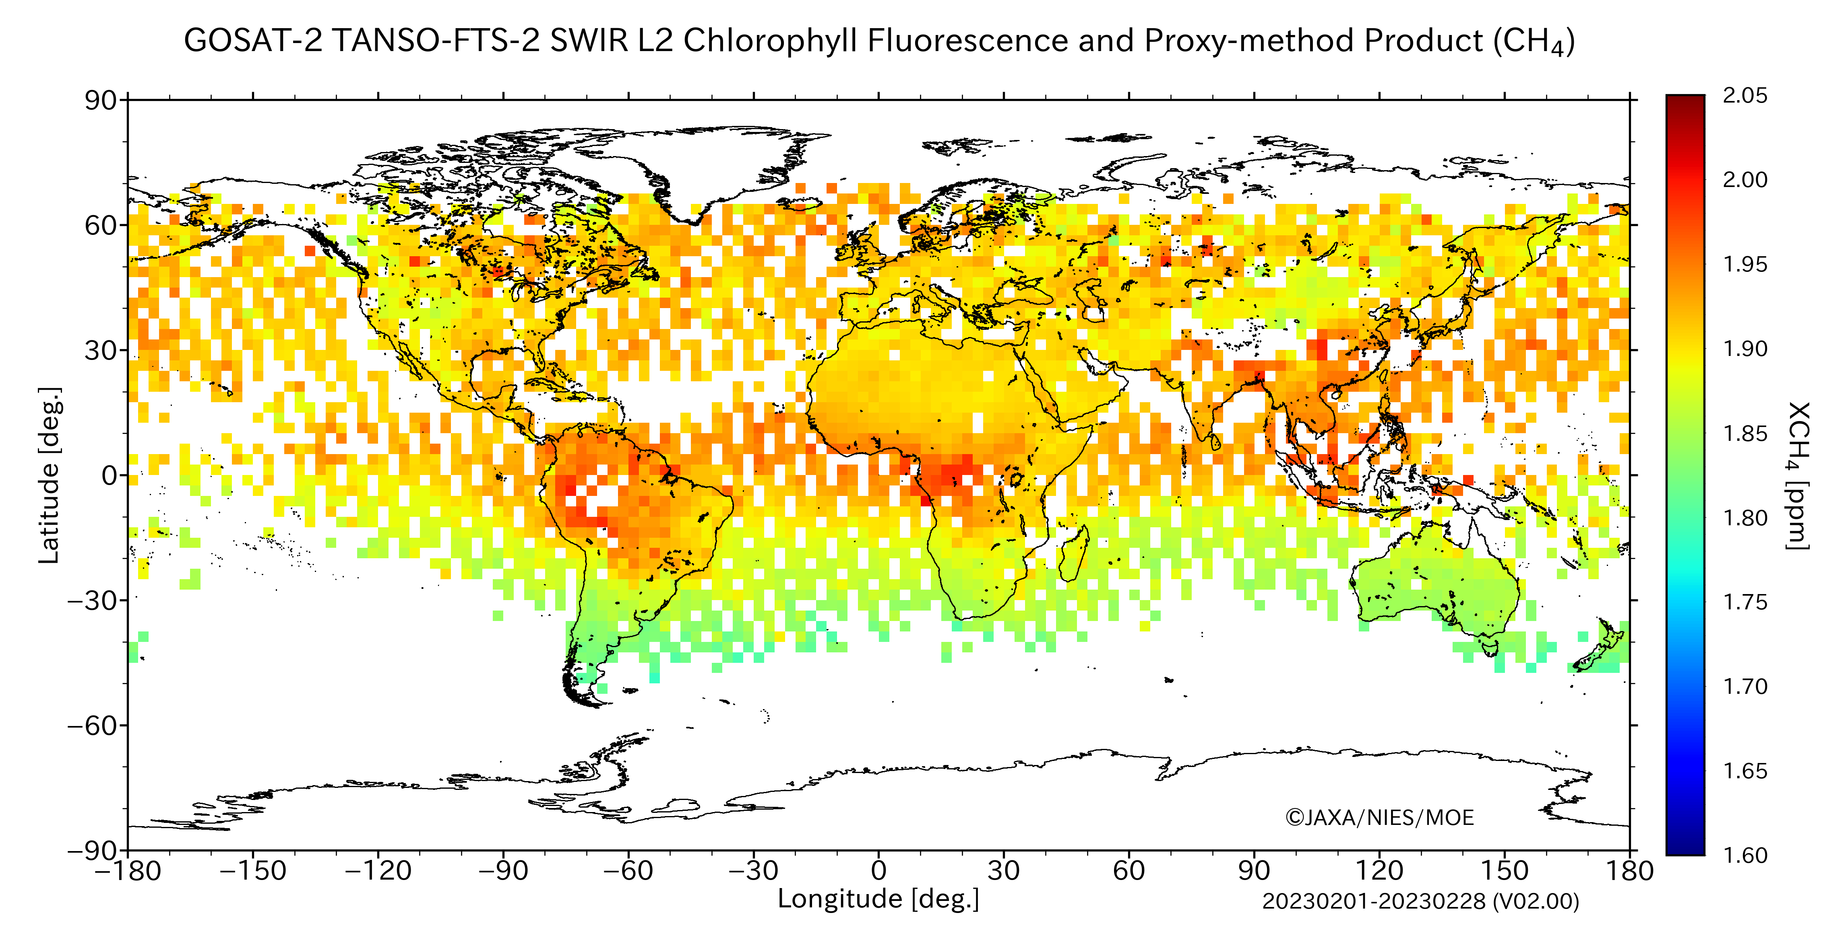
Global maps of GOSAT-2 FTS-2 Proxy XCH₄ and XCO (ver. 02.00)
XCO
GOSAT-2 PROXY XCH₄ are larger than GOSAT-2 full physics, and these are similar in comparison with the TCCON data.
XCH₄
GOSAT-2 PROXY XCO are same as GOSAT-2 full physics, and these are similar in comparison with the TCCON data.
Global distribution of methane and carbon monoxide column-averaged dry-air mole fractions (XCH₄ and XCO) retrieved by the proxy-method from GOSAT-2. Data are averaged from Feb 1 to 28, 2019.
Notes:
This slide shows global maps of proxy XCH4 and XCO in February 2019.
Also, we can see clear enhancements over East and South Asia, and Central Africa.
They, might be due to biomass burning or human activities.
GOSAT-2 PROXY XCH₄ are larger than GOSAT-2 full physics, and these are similar in comparison with the TCCON data.
GOSAT-2 PROXY XCO are same as GOSAT-2 full physics, and these are similar in comparison with the TCCON data.

Slide 6
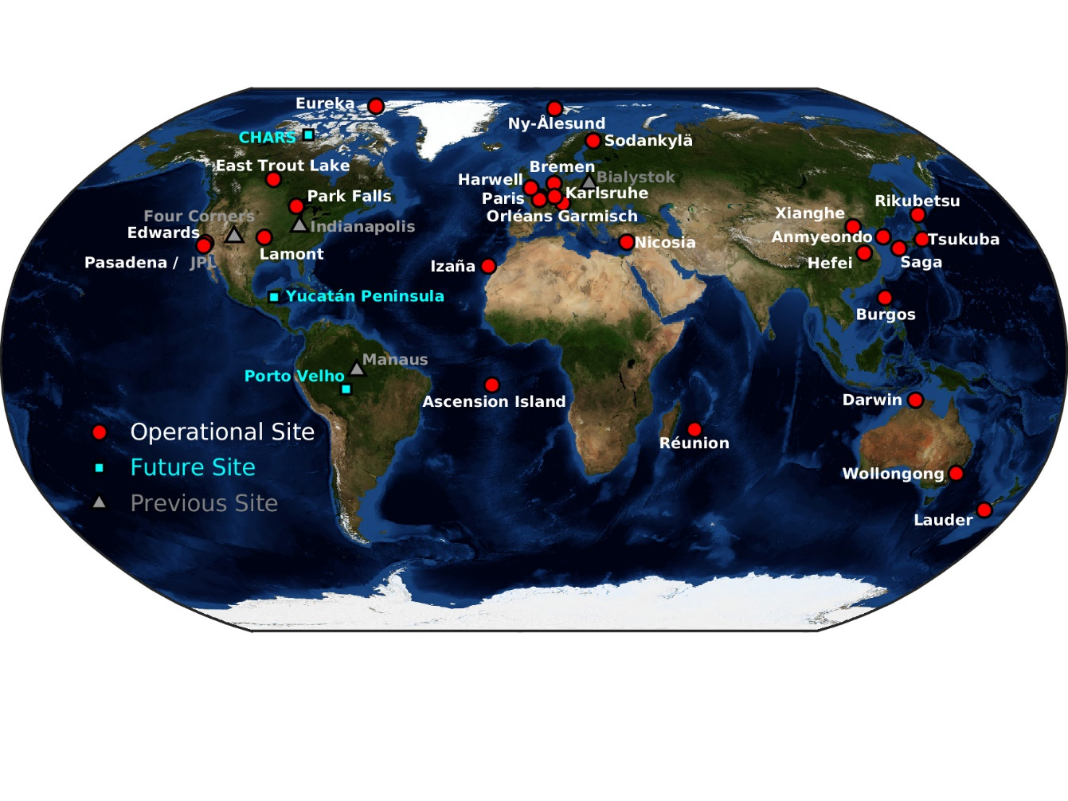
Total Carbon Column Observing Network (TCCON)
TCCON (Total Carbon Column Observing Network ) is a network of ground-based Fourier Transform Spectrometers recording direct solar spectra in the near infrared spectral region. From these spectra, accurate and precise column-averaged abundances of CO₂, CH₄, N₂O, HF, CO, H₂O, and HDO are retrieved by the algorithm GGG2020.
GGG2020 - GGG2014
ΔXCO₂: +0.03 ppm (median)
ΔXCH₄: - 5.70 ppb (median)
ΔXCO : +6.40 ppb (median)
J. L. Laughner et al., AGU Fall meeting, 2021.
The TCCON Data Archive (http://tccondata.org)
Notes:
In validation analysis using the TCCON data, we used version GGG2020.

Slide 7
Validation of GOSAT FTS SWIR L2 product
Data and conditions for comparisons
GOSAT FTS SWIR L2 products
Ver. 02.90 (April 23, 2009 – May 31, 2020) and Ver. 02.91 (June 1, 2020 – October 31, 2022) , standard (GU) products
Area definition: Land: 100% of a land fraction
Ocean: 0% of a land fraction
Gain: Land (gain H and M) and Ocean (gain H)
TCCON data
Obtained from the TCCON data archive (http://tccondata.org)
Retrieved by the algorithm GGG2020
Averaged over within ±30 min of GOSAT overpass time
Comparison of GOSAT products with TCCON data
Without consideration of column averaging kernels and prior profiles for the quick validation analysis.
Comparison area: ±0.1º, ±1º, ±2º, ±5º latitude / longitude box centered at the TCCON sites
Among the GOSAT products, those with a difference between the footprint altitude and the altitude of the TCCON site greater than 500 m are excluded from the comparison.

Slide 8
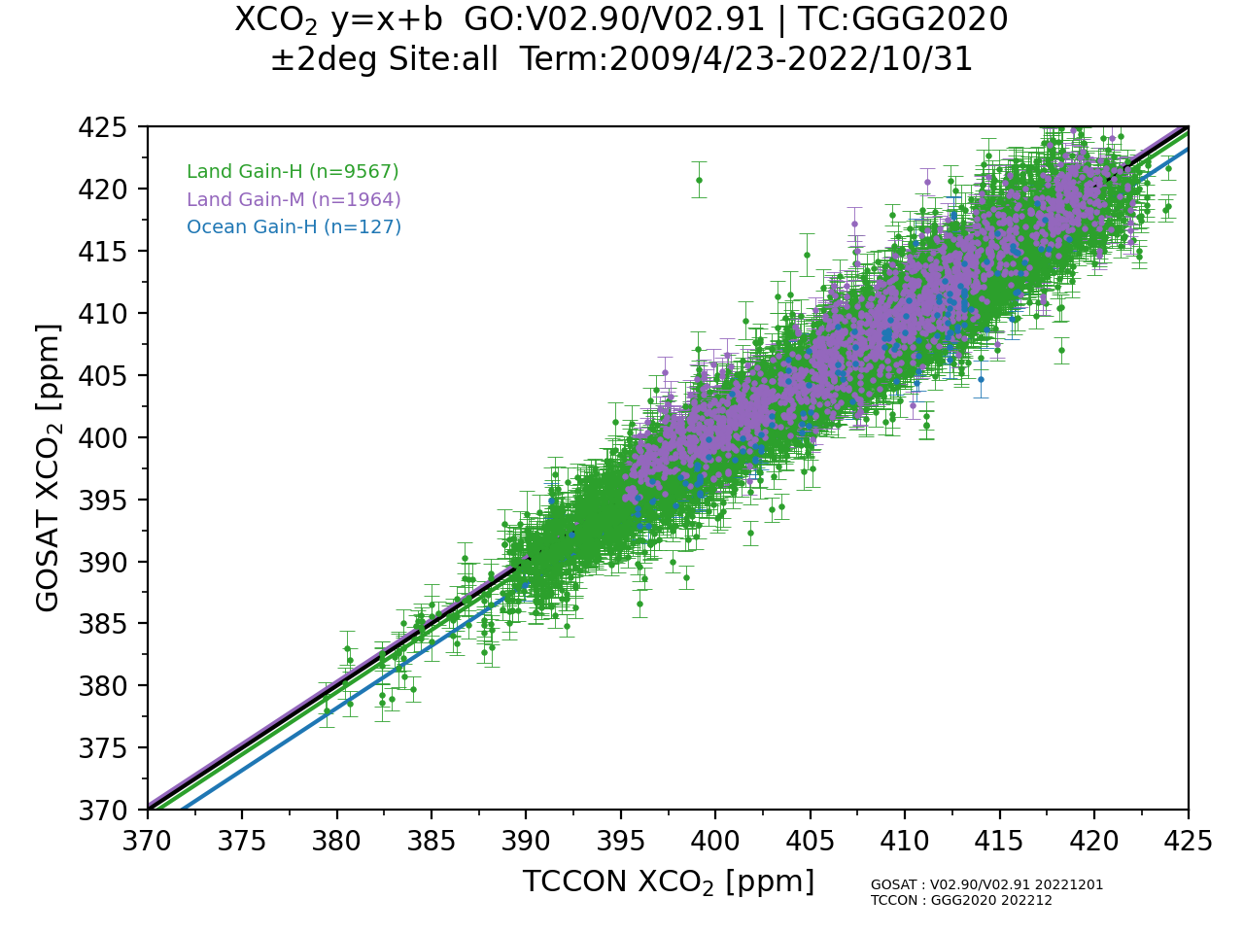
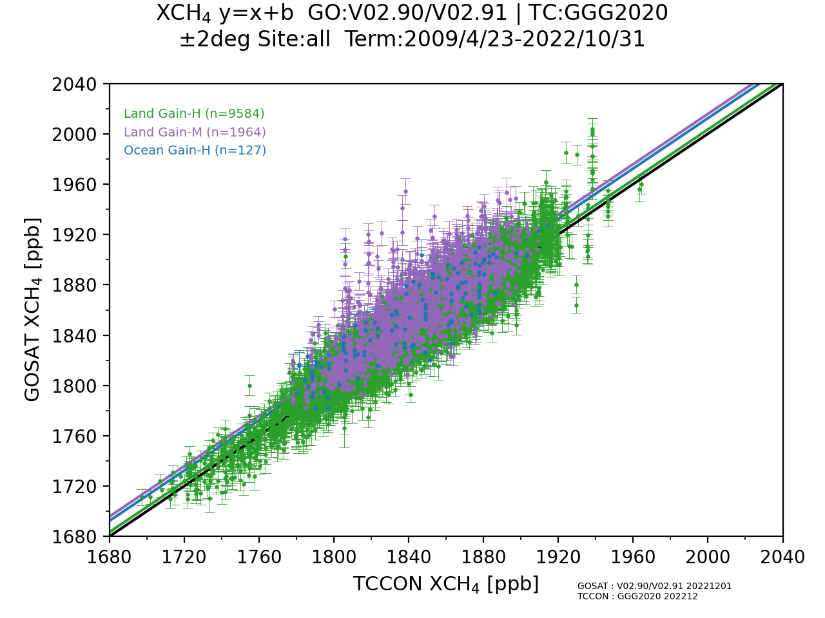
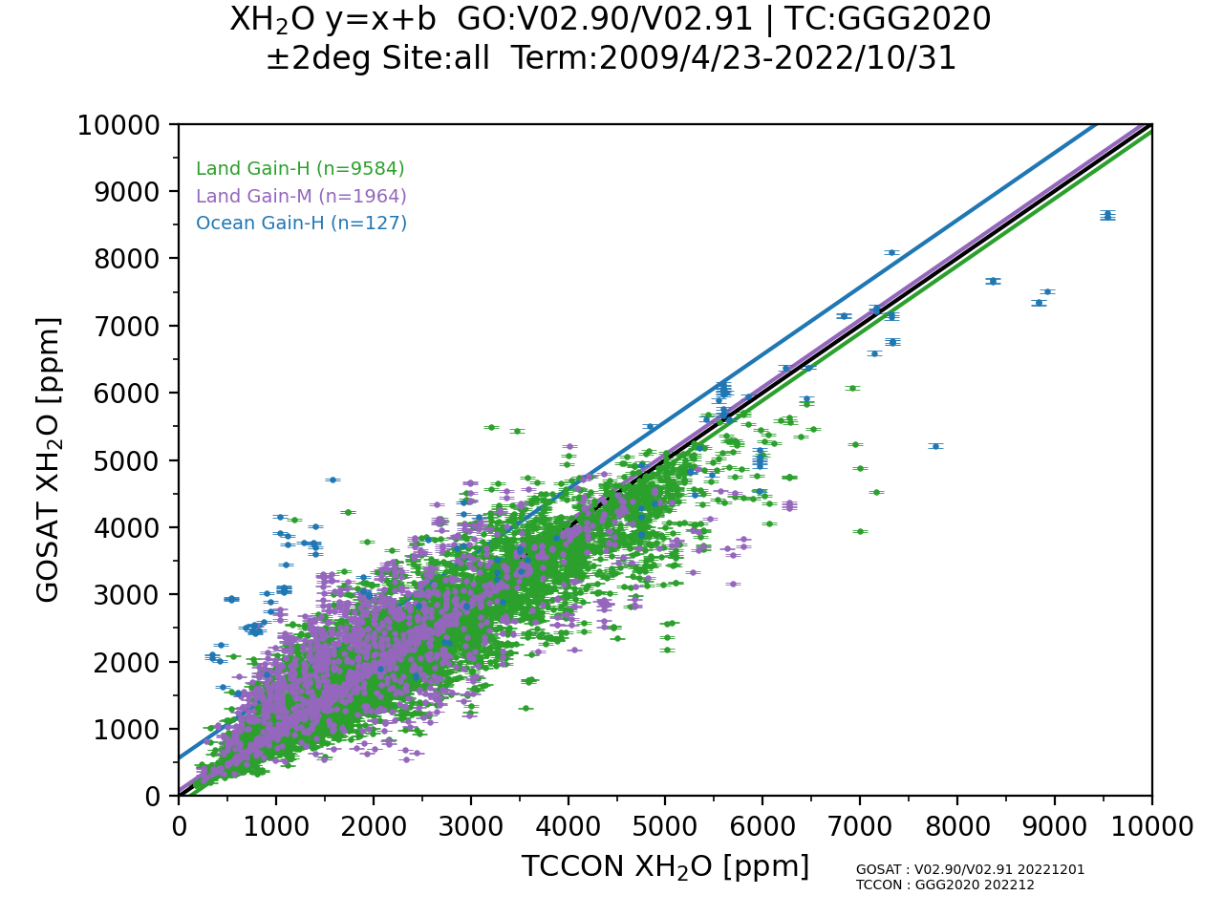
Scatter plots of GOSAT product against TCCON data (Ver. 02.9/91 ±2º, Apr 23, 2009 – Ocｔ 31, 2022)
XCO₂
XCH₄
Land Gain H N=9567 -0.52 ± 2.12 ppm (-0.13 ± 0.52%)
Land Gain M N=1964 0.31 ± 1.96 ppm ( 0.08 ± 0.48%)
Ocean Gain H N=127 -1.80 ± 2.27 ppm (-0.44 ± 0.55%)
Land Gain H N=9584 3.44 ± 12.19 ppb (0.19 ± 0.66%)
Land Gain M N=1964 15.84 ± 18.85 ppb (0.86 ± 1.02%)
Ocean Gain H N=127 12.37 ± 16.29 ppb (0.68 ± 0.89%)
XH₂O
Land Gain H N=9584 -112.9 ± 376.4 ppm ( -3.6 ± 19.3%)
Land Gain M N=1964 83.9 ± 589.2 ppm (11.1 ± 35.2%)
Ocean Gain H N=127 568.9 ±1210.5 ppm (80.4 ± 128.9%)

Slide 9
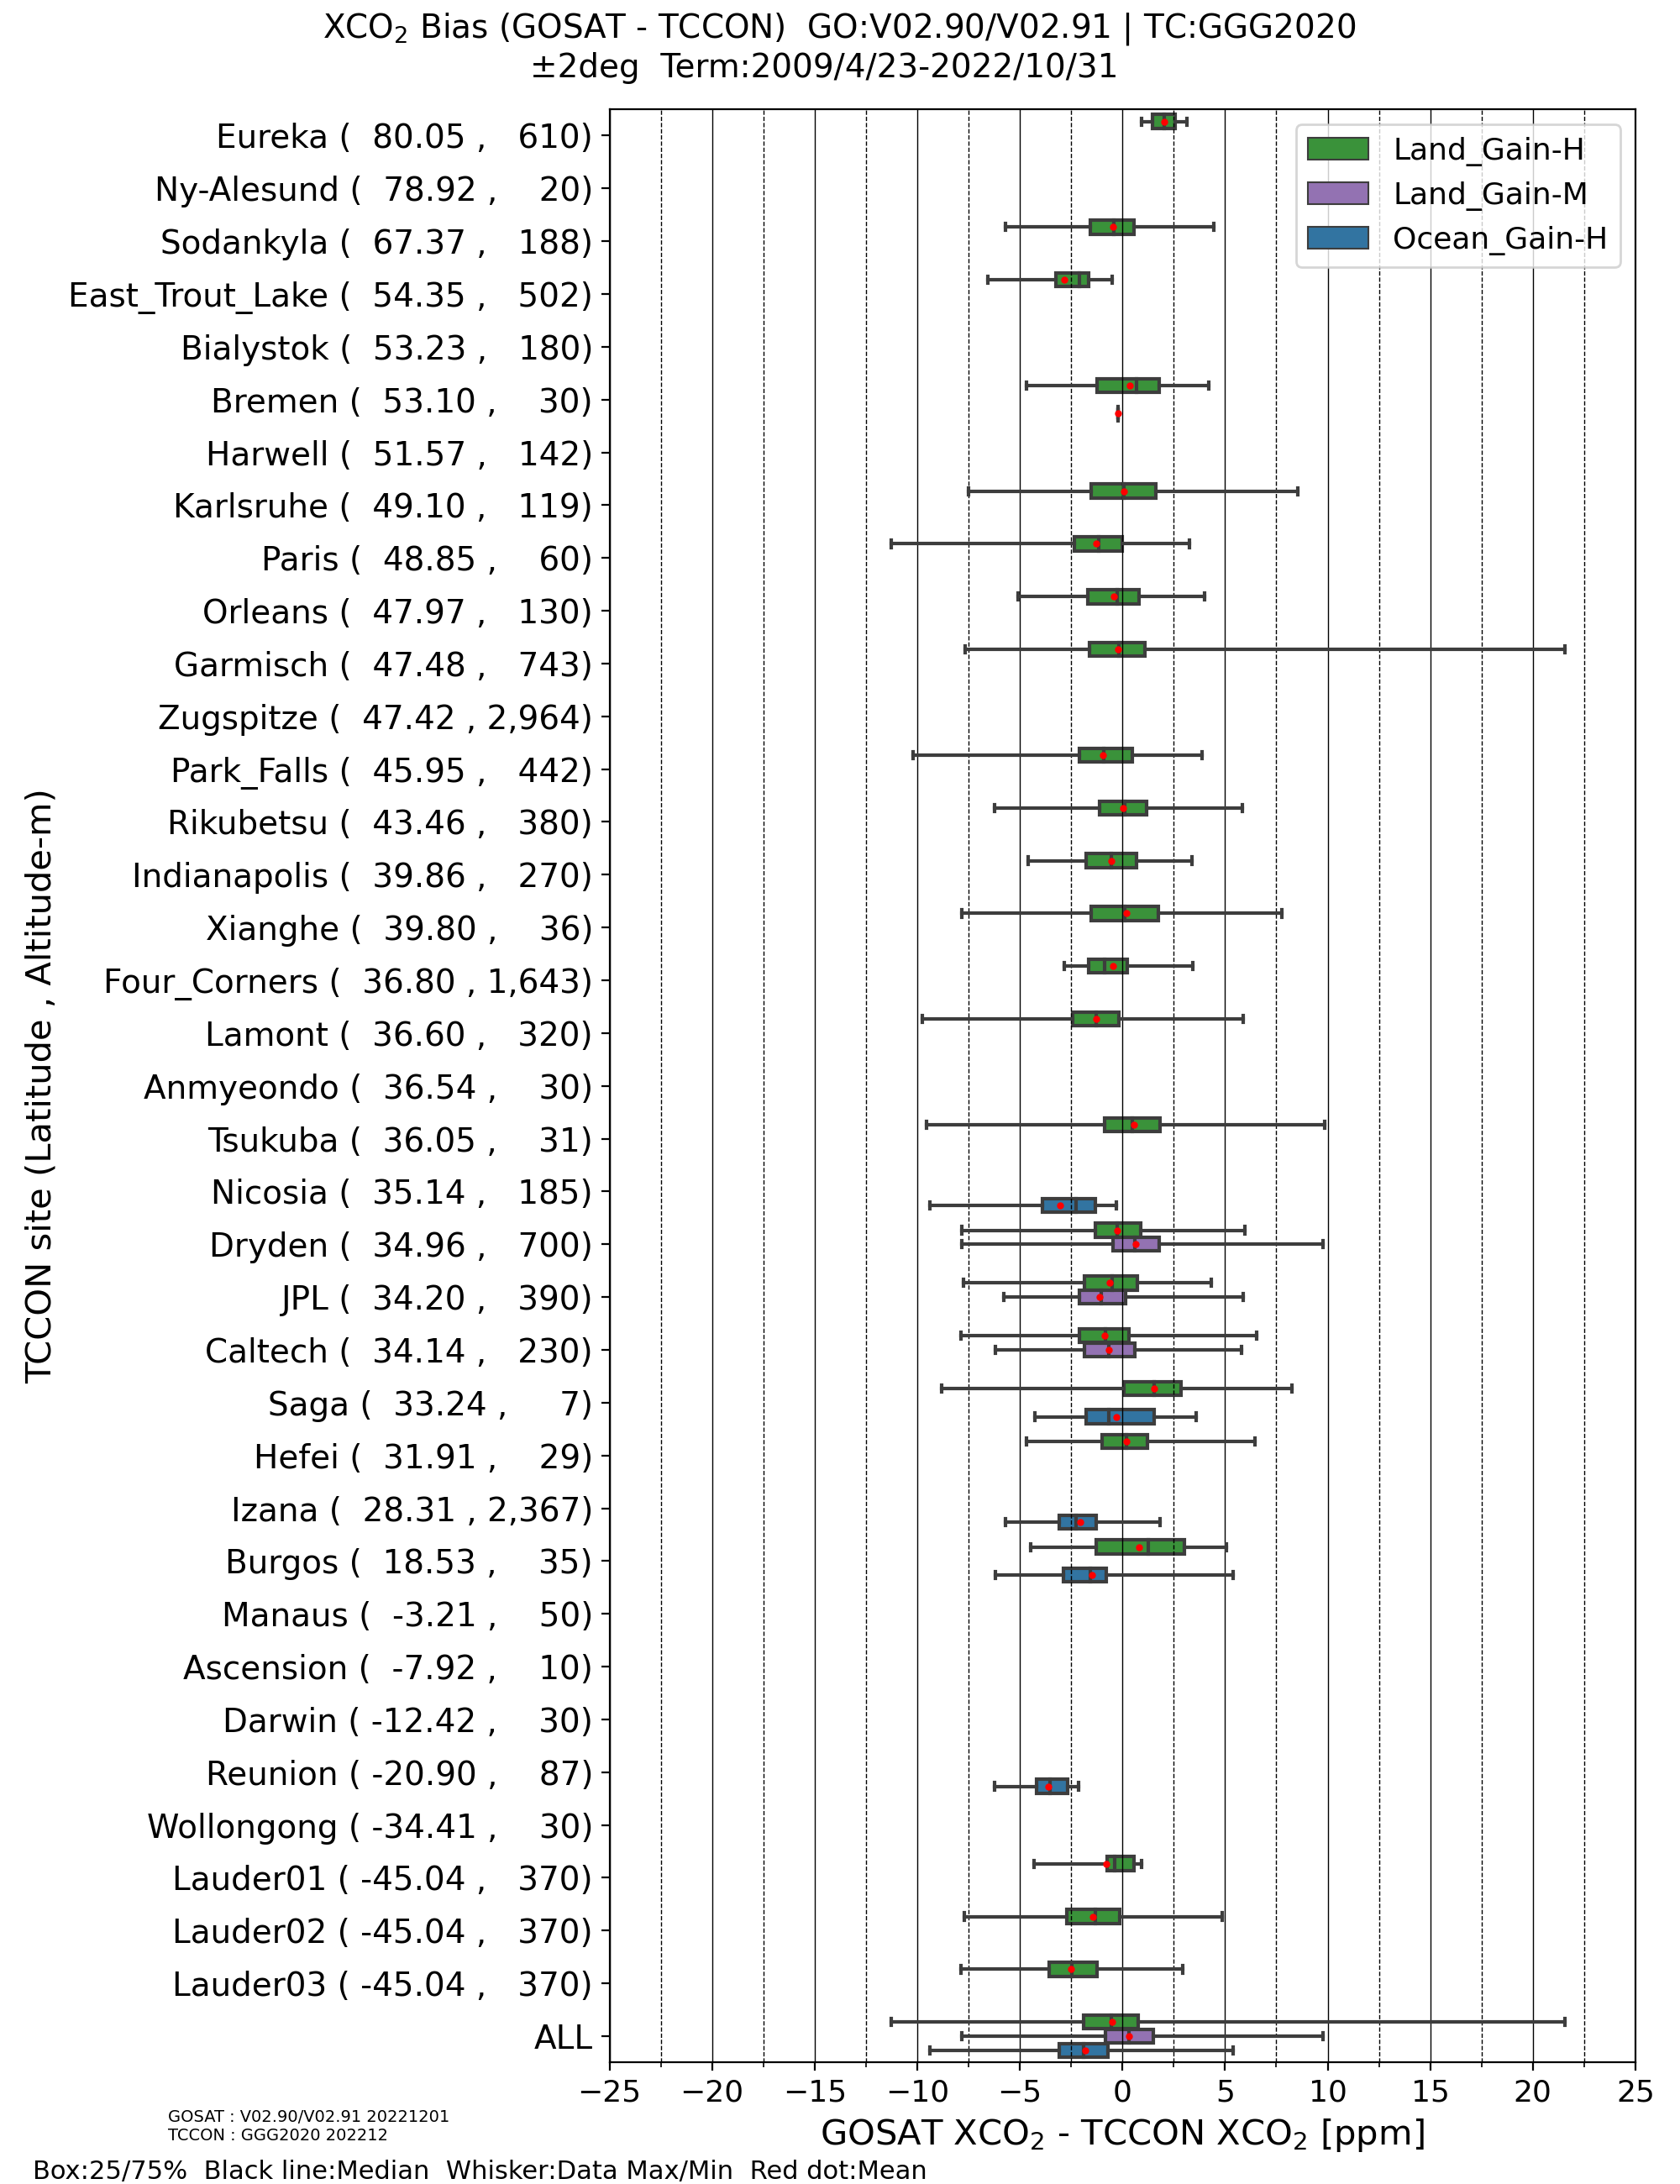
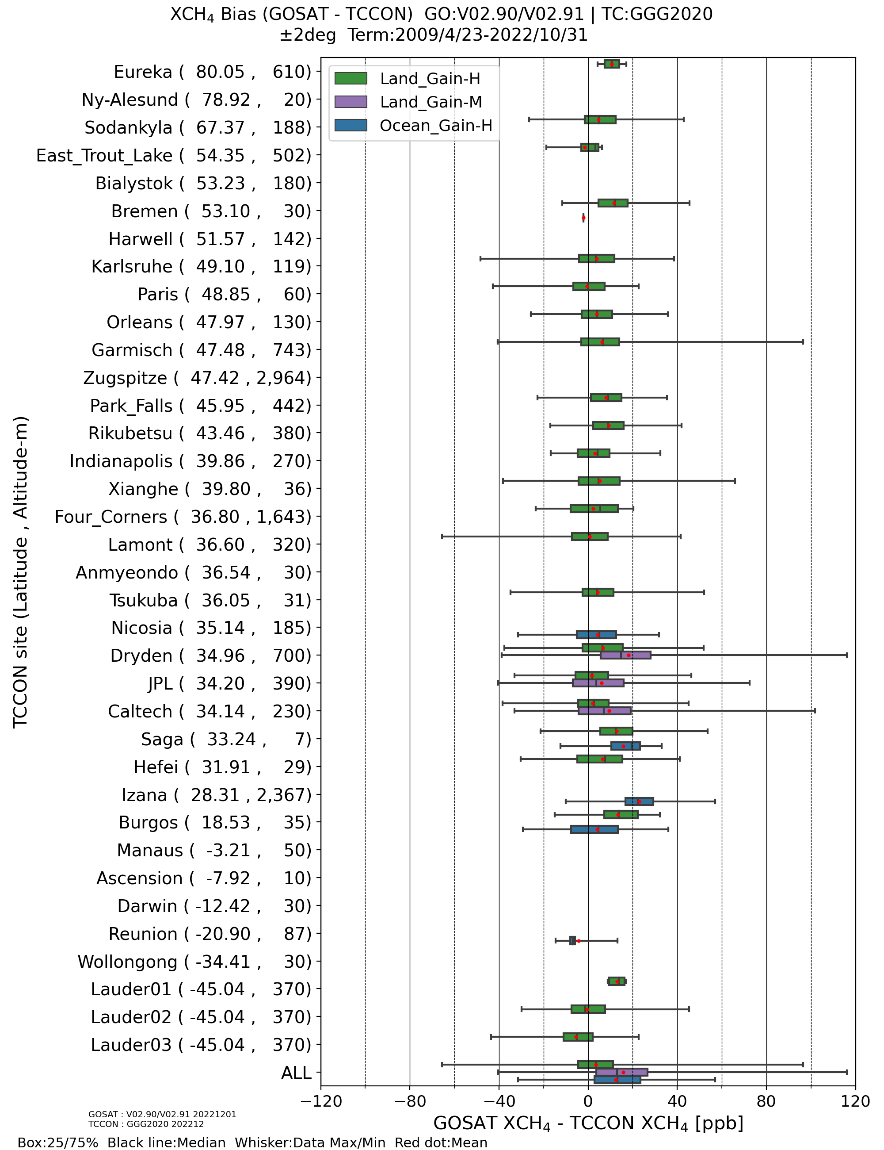
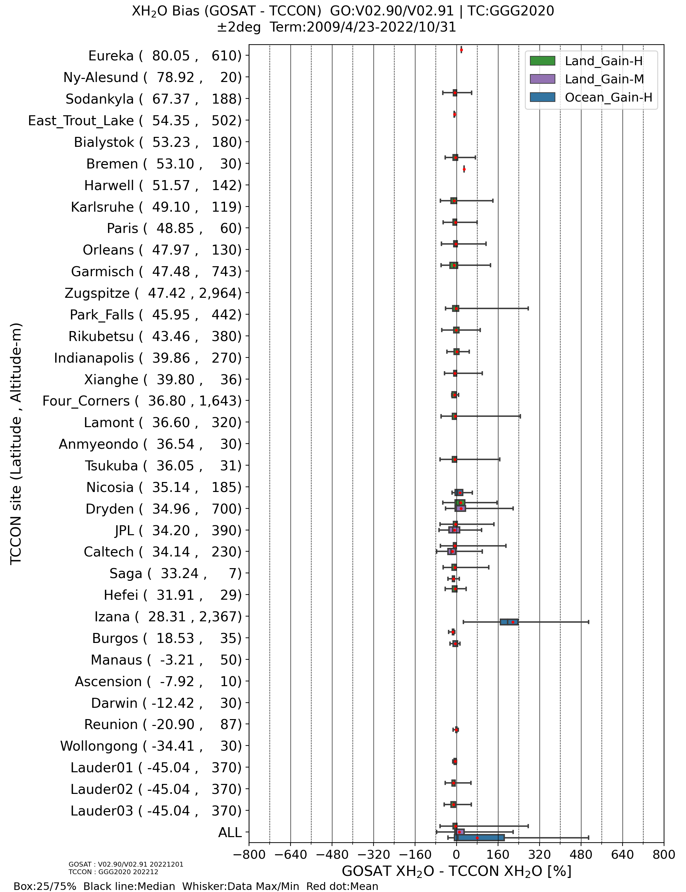
Biases for each TCCON site
(Ver. 02.90/02.91, ±2º : Apr. 23, 2009 – Ocｔ. 31, 2022)
XCO₂
XCH₄
XH₂O

Slide 10
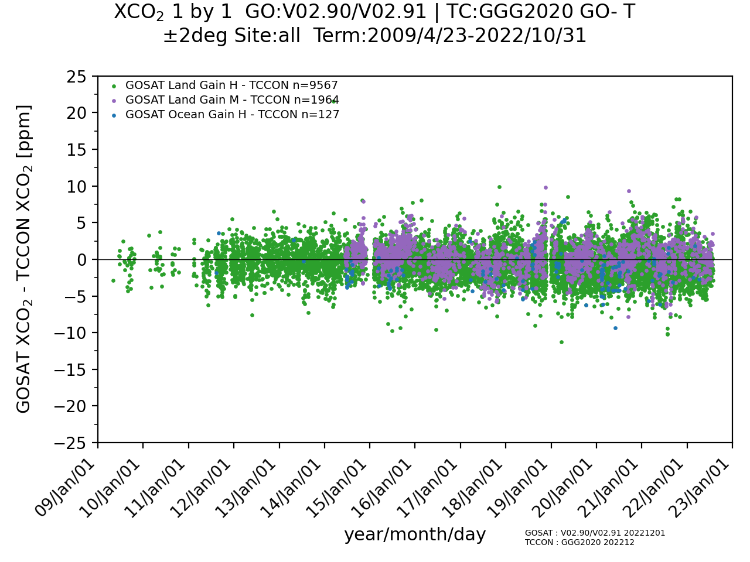
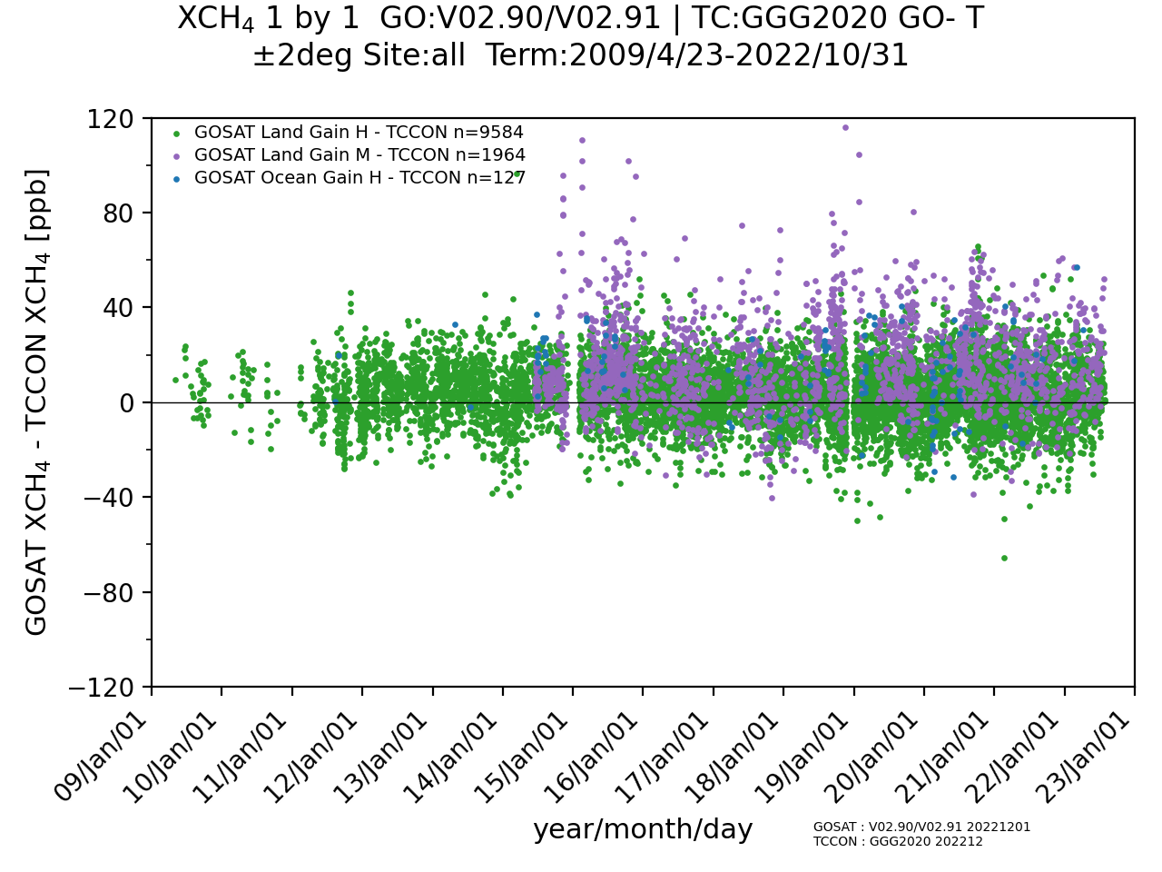
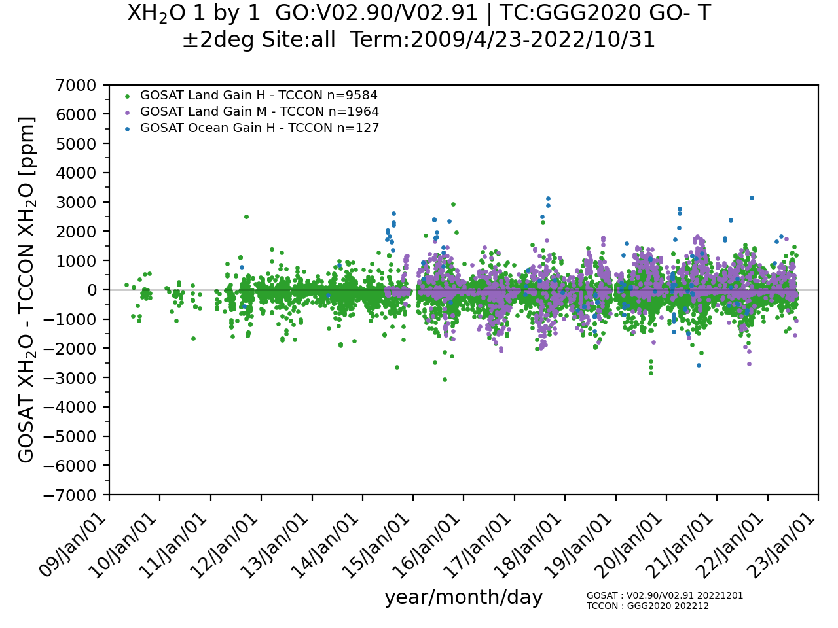
Temporal stability of biases in the GOSAT product (Ver 02.90/91, ±2º, Apr 23, 2009 – Ocｔ 31, 2022)
XCO₂
XCH₄
XCO₂
XCH₄
XH₂O
XH₂O

Slide 11
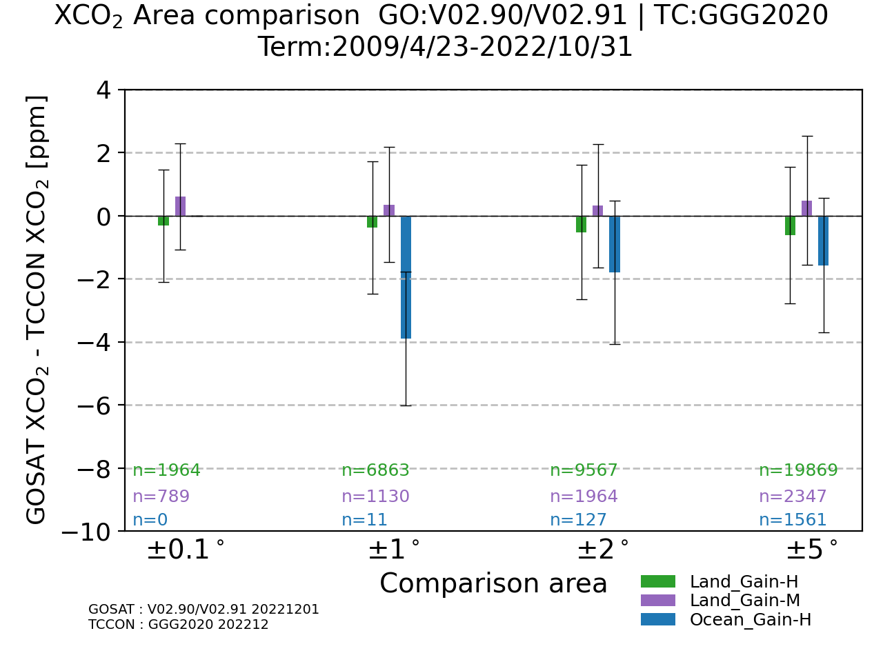
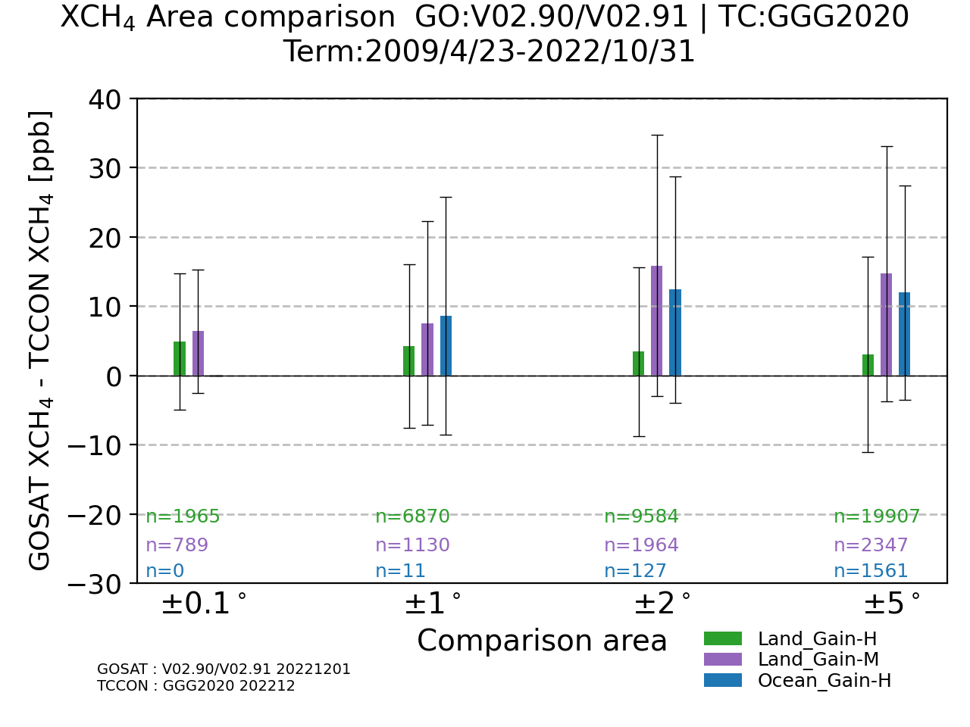
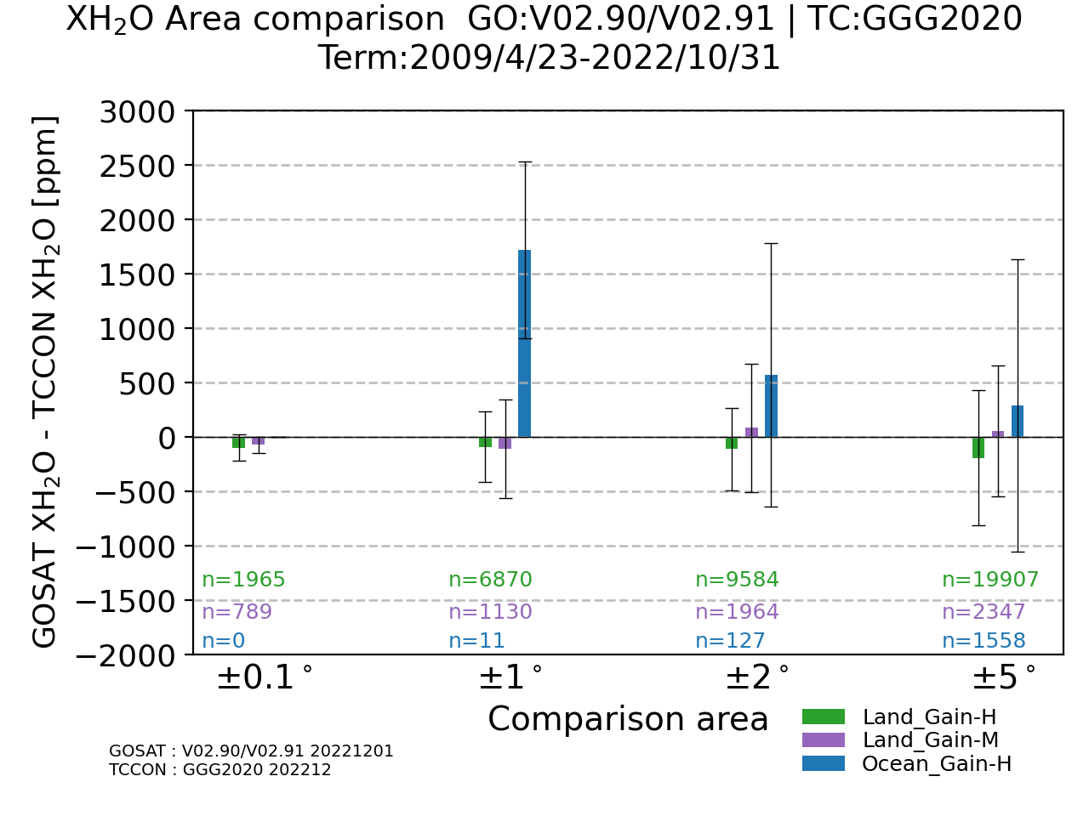
Variability of biases by comparison areas (Ver 02.90/91, Apr. 23, 2009 – Ocｔ. 31, 2022)
XCO₂
XCH₄
XH₂O

Slide 12
Validation of GOSAT-2 SWIR L2 product
Data and conditions for comparisons
GOSAT-2 FTS-2 SWIR L2 product
Full physics V02.00 (Aug 2019 ~ Jul 2022) and Proxy V02.00 (Mar 2019 ~ Feb 2023).
Area definition: Land: ≥ 10% of land fraction, Ocean: < 10% of land fraction.
Only data with the quality flag “Good” are used.
No distinction is made by gain in these analyses.
TCCON data
TCCON data are obtained from the TCCON data archive (http://tccondata.org/).
TCCON data are derived using the GGG2020 algorithm.
The TCCON data measured at each TCCON site within ±30 minutes from the GOSAT-2 overpass time are averaged for comparison.
Comparison conditions of GOSAT-2 FTS-2 SWIR L2 product with TCCON data
Without consideration of column averaging kernels and prior profiles for the quick validation analysis (Full physics only).
Comparison area: ±0.1º, ±1º, ±2º, ±5º latitude / longitude box centered at the TCCON sites.
Among data of GOSAT-2 FTS-2 L2 product, those with a difference between the footprint altitude and the altitude of the TCCON site greater than 500 m are excluded from the comparison.

Slide 13
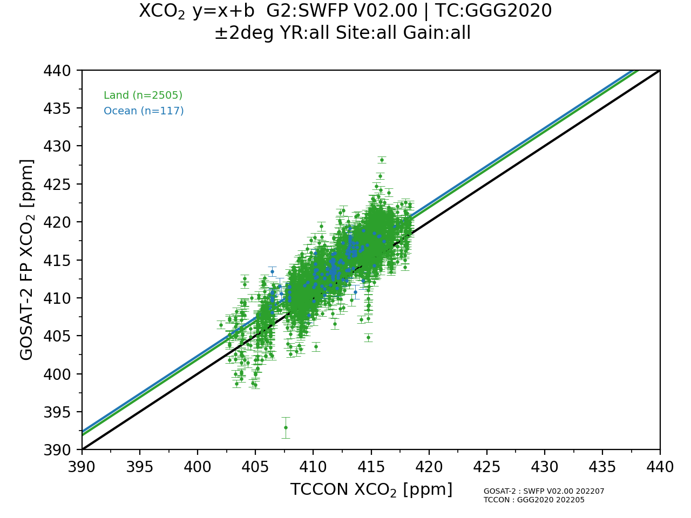
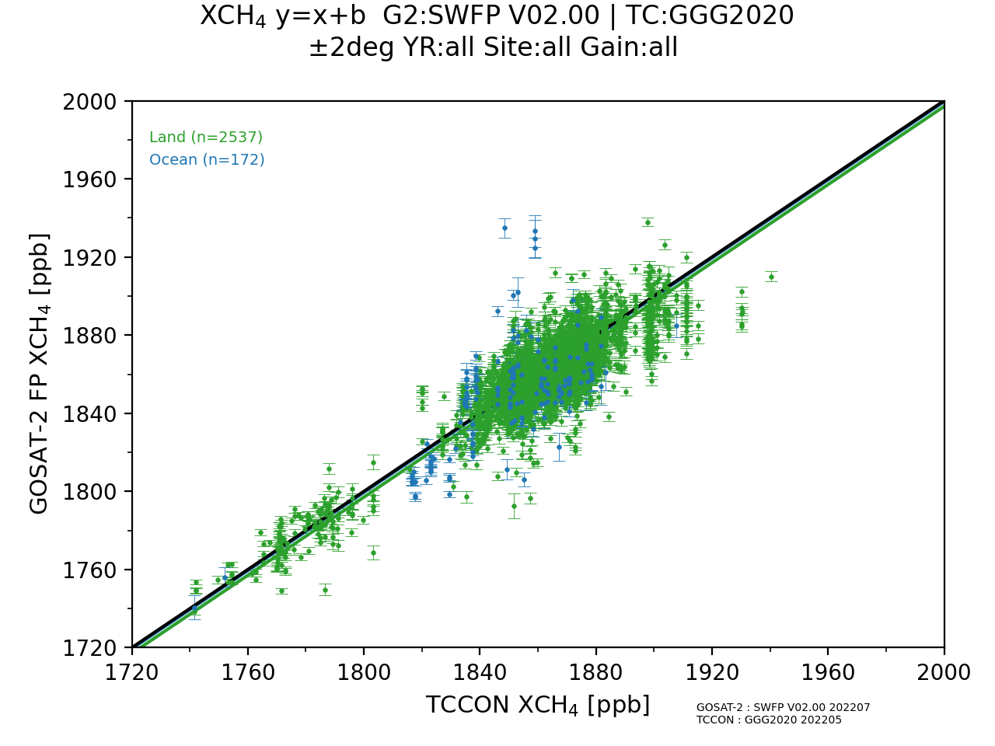
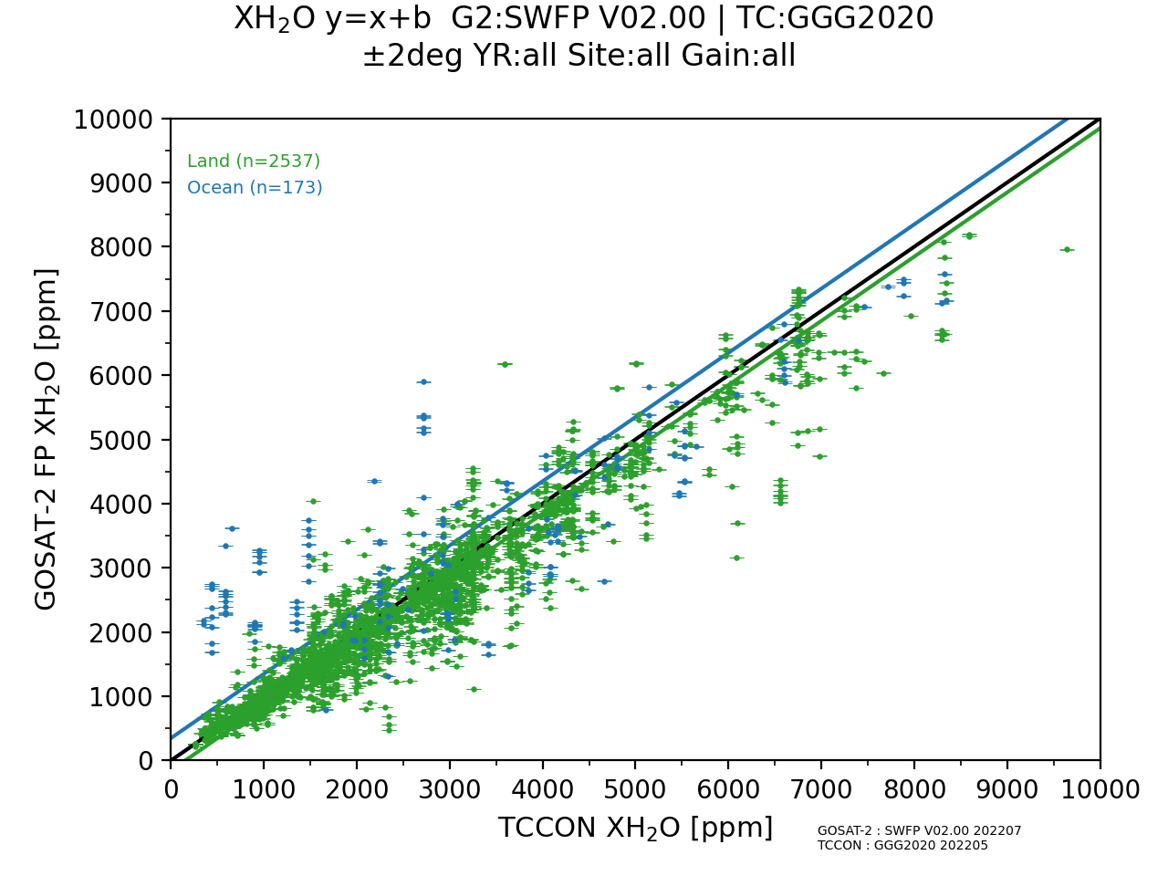
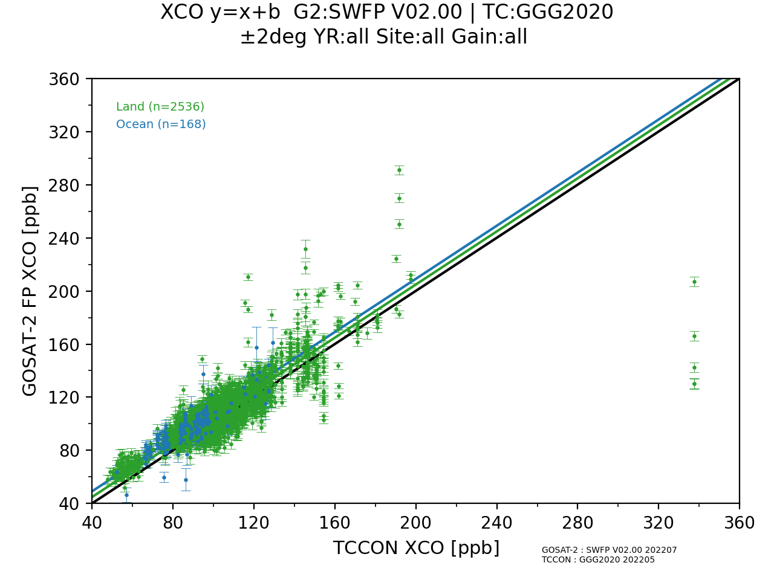
Scatter plot of GOSAT-2 product against TCCON data (Ver 02.00, ±2º, Full Physics)
XCO₂
XCH₄
Land N=2505 1.90 ± 2.21 ppm (0.46 ± 0.54%)
Ocean N= 117 2.35 ± 1.59 ppm (0.57 ± 0.39%)
Land N=2537 -2.96 ± 12.29 ppb (-0.16 ± 0.66%)
Ocean N= 172 -0.57 ± 20.44 ppb (-0.03 ± 1.10%)
XH₂O
XCO
Land N=2537 -154.1 ± 447.3 ppm ( -4.1 ± 18.2%)
Ocean N= 173 347.9 ± 1147.2 ppm (64.7 ± 135.3%)
Land N=2536 4.78 ± 13.65 ppb ( 5.51 ± 10.38%)
Ocean N= 168 9.07 ± 8.36 ppb (10.72 ± 9.68%)

Slide 14
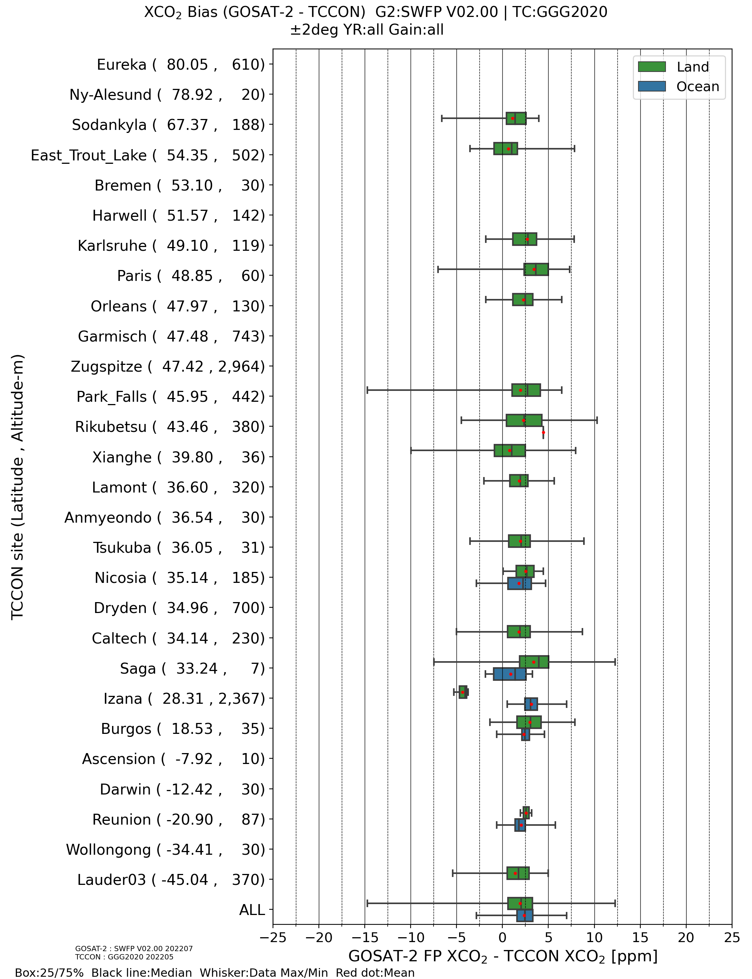
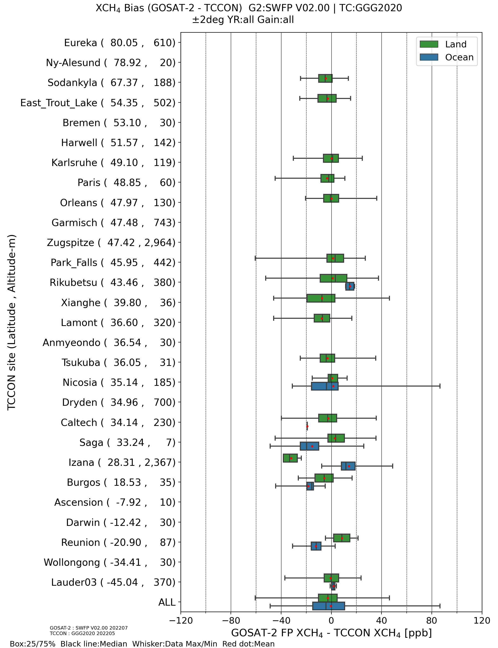
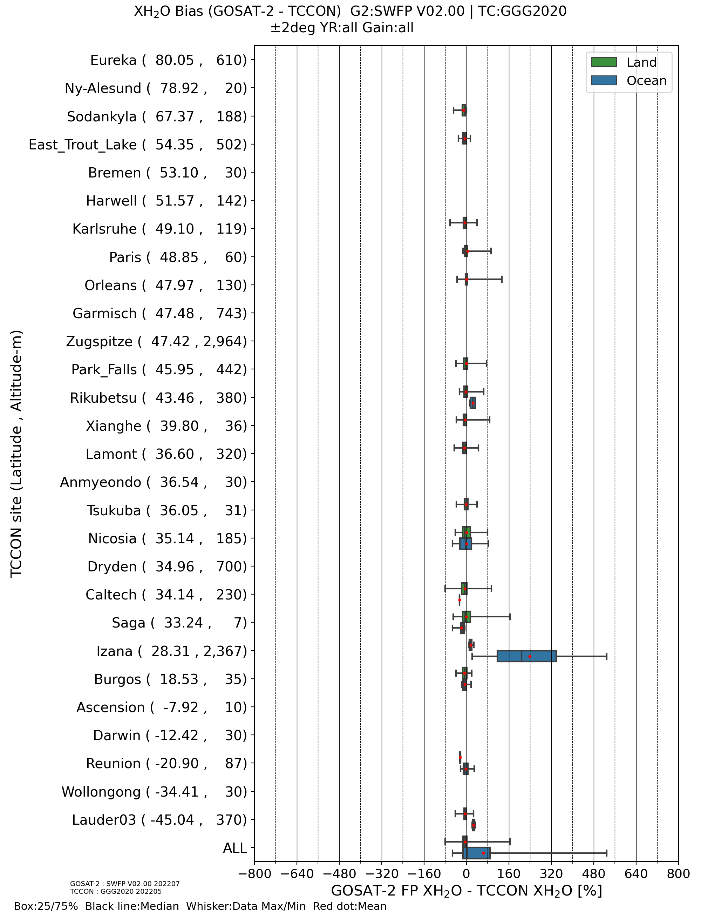
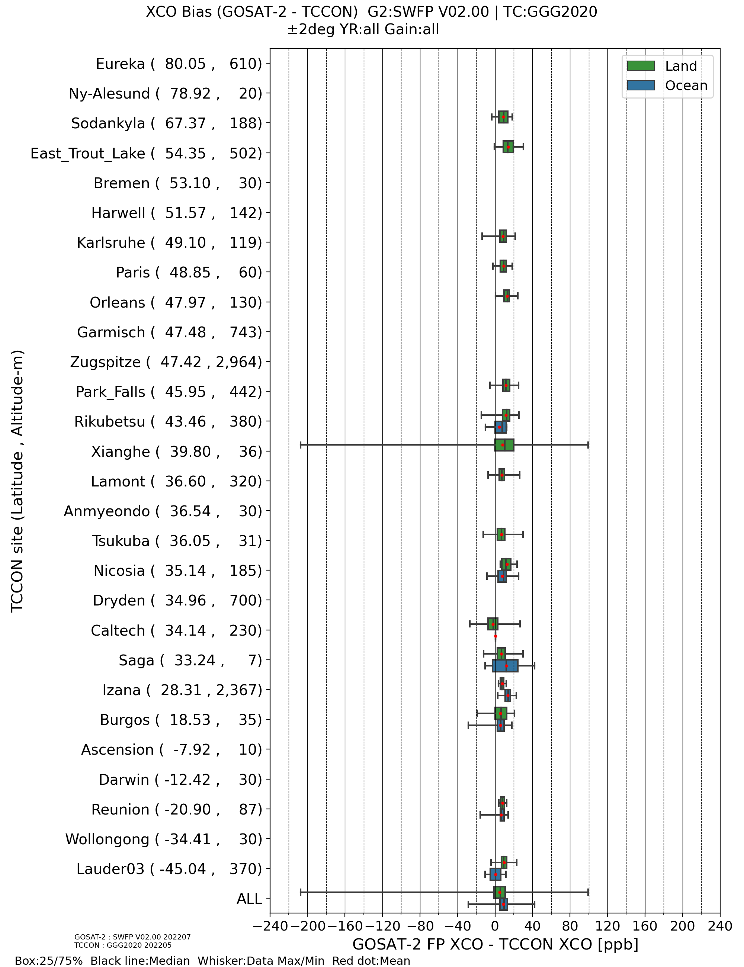
Bias of GOSAT-2 product for each TCCON site (Ver 02.00, ±2º, Full Physics)
XCO₂
XCH₄
XH₂O
XCO

Slide 15
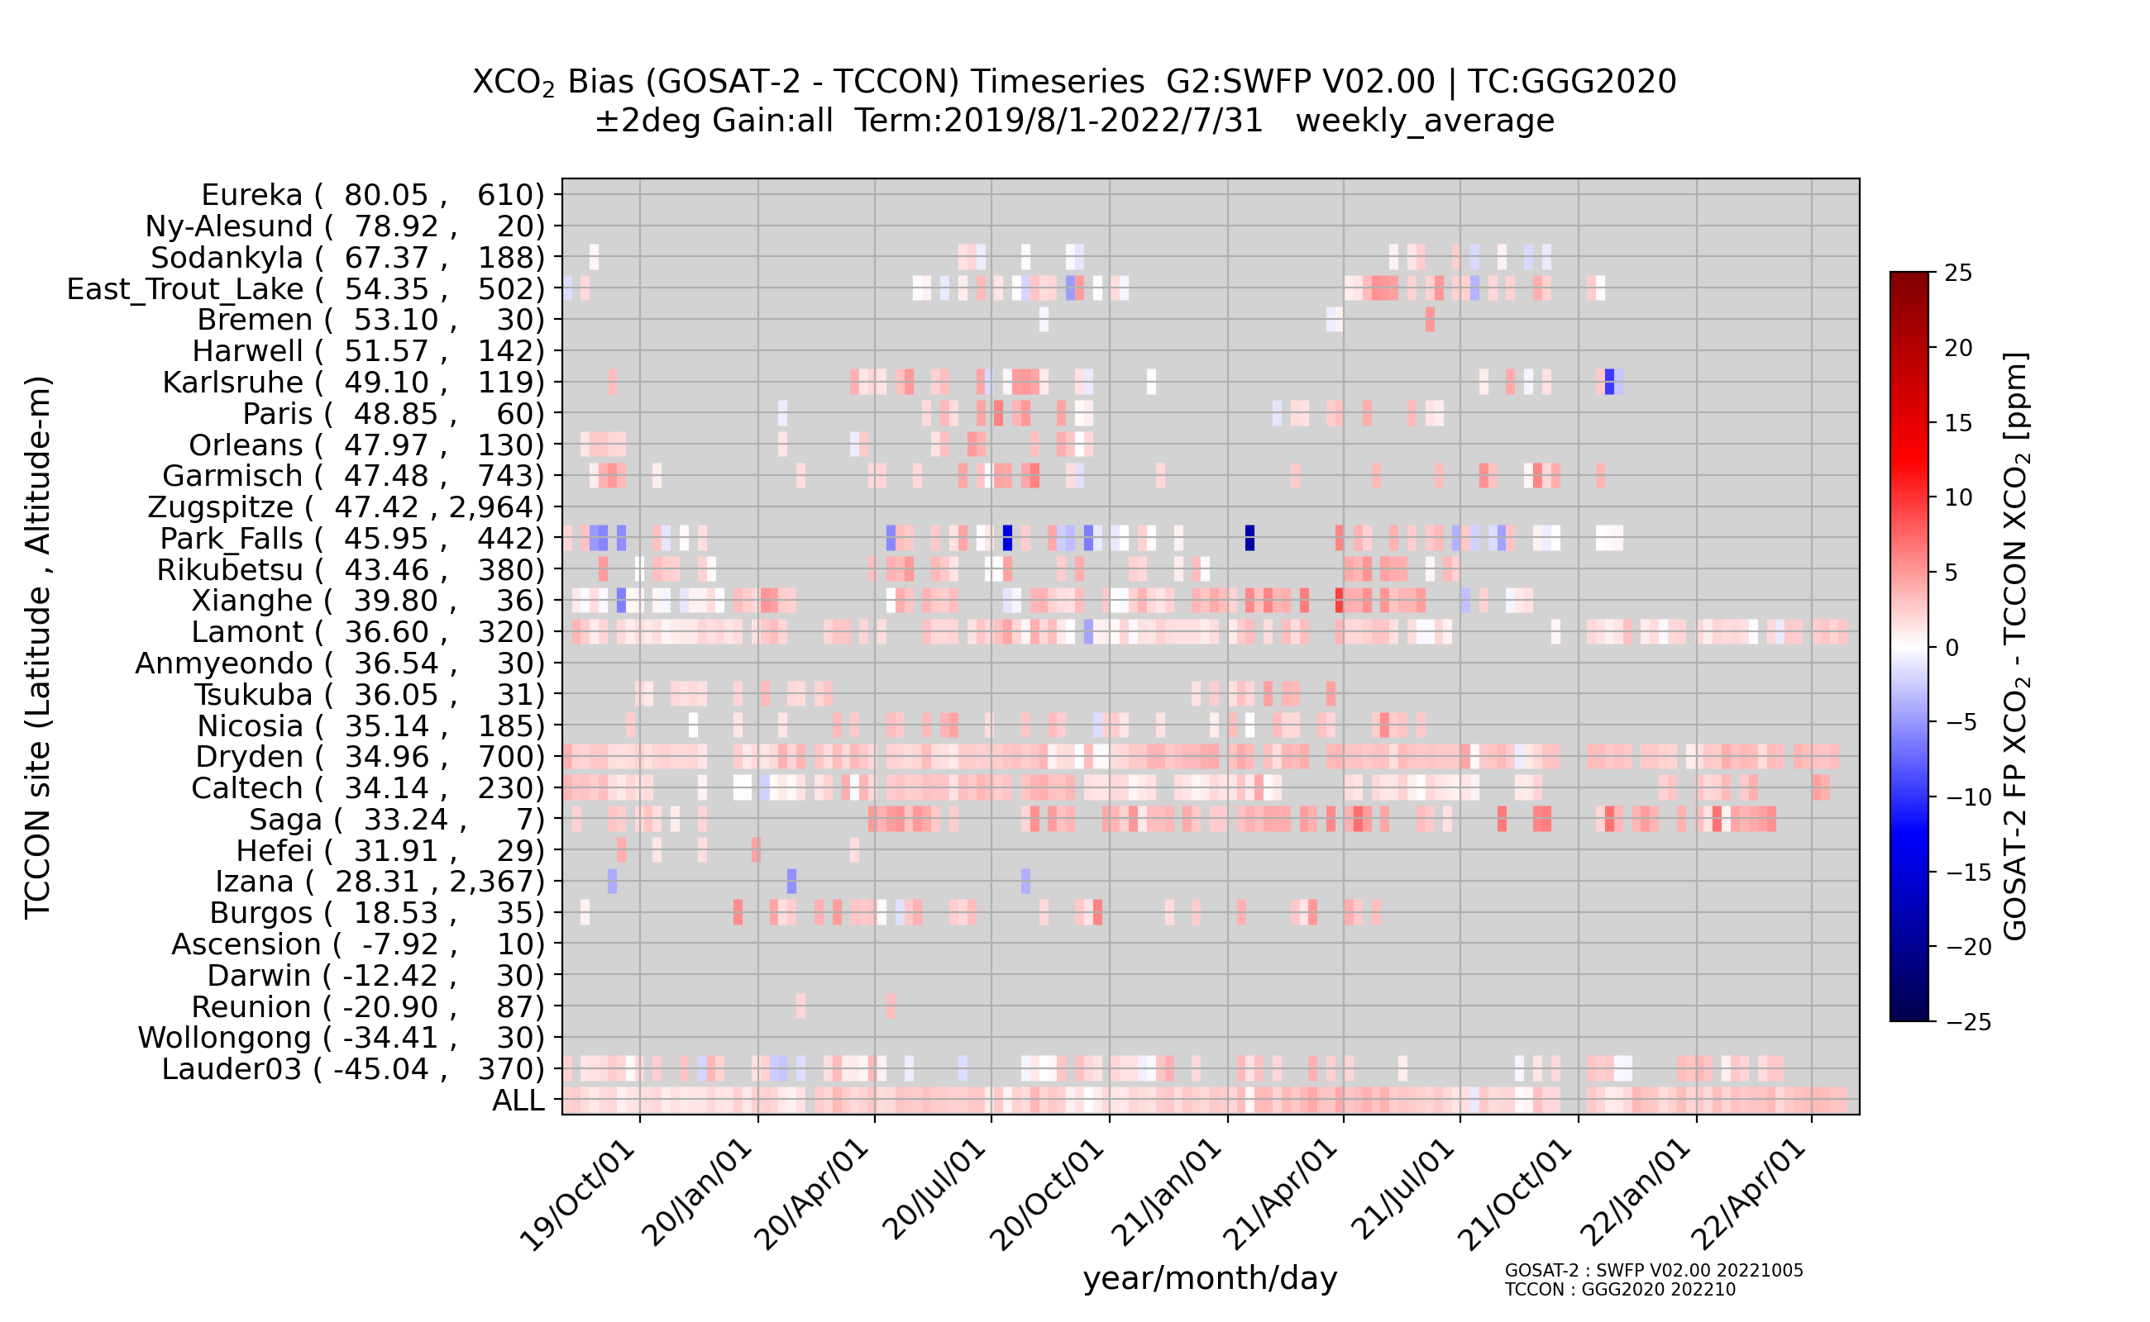
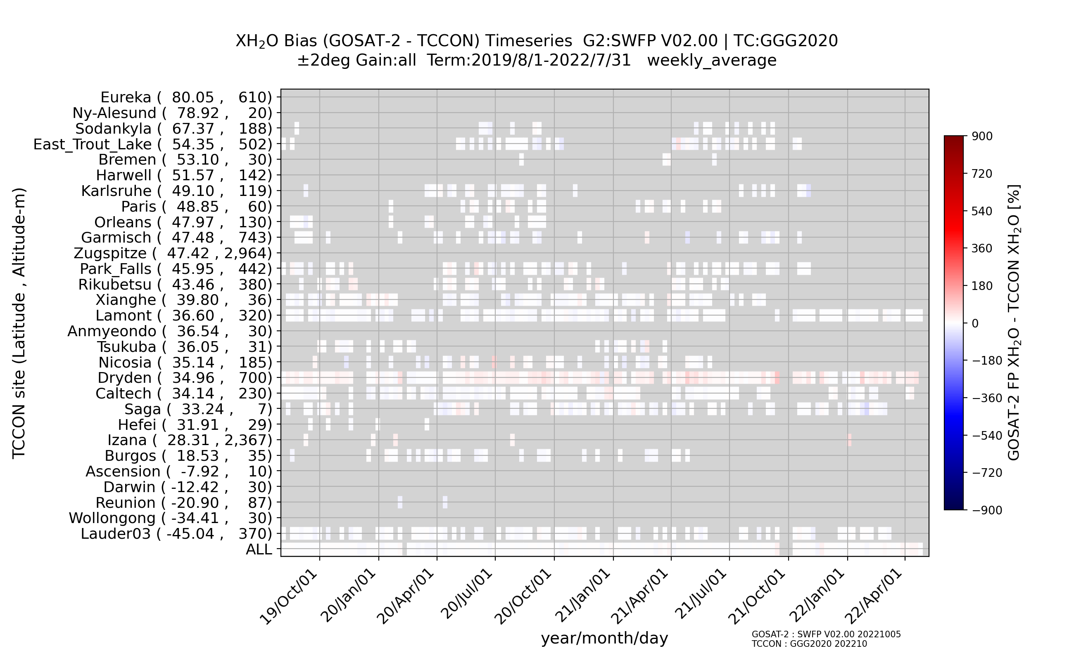
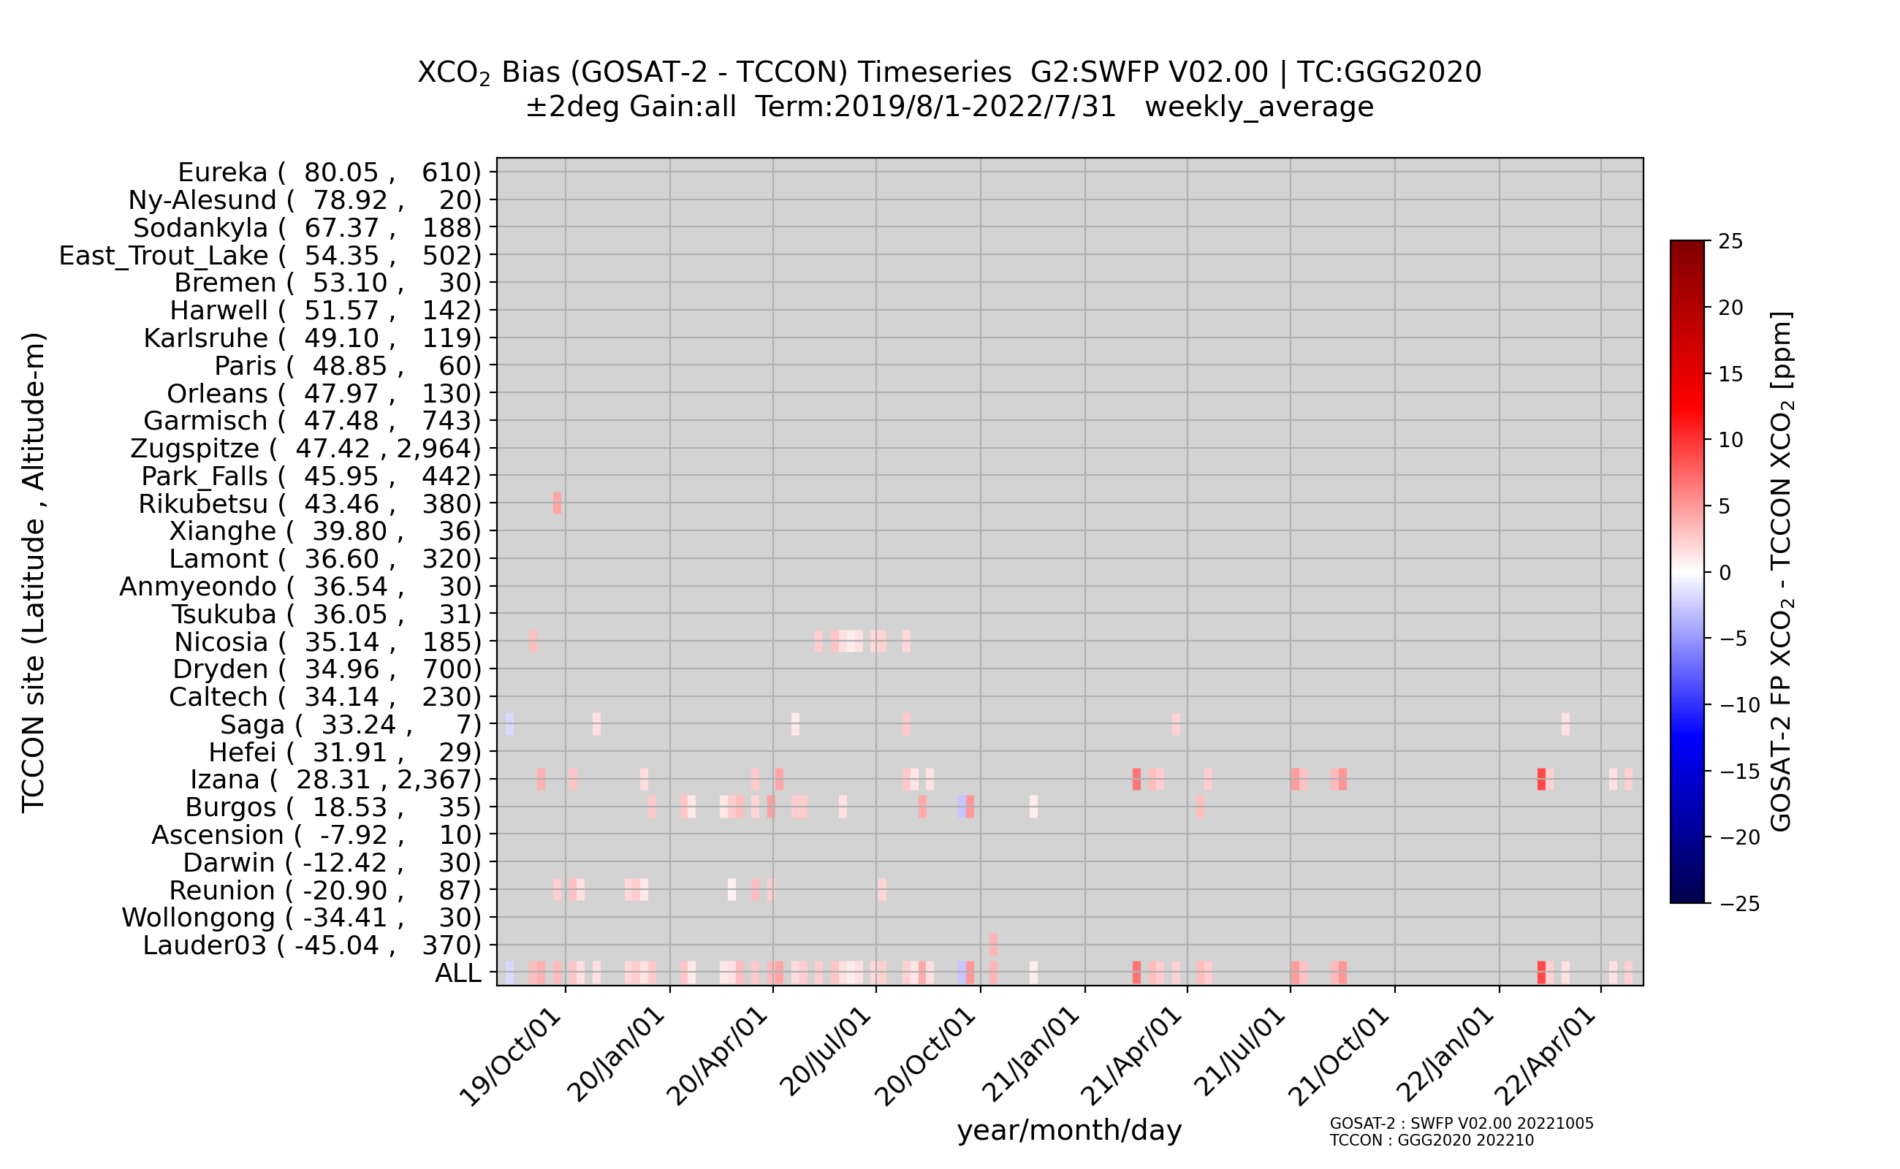
Temporal stability of weekly averaged biases of GOSAT-2 product (Ver. 02.00, ±2º, Full Physics)
XCO₂ Land
XH₂O Land
XCO₂ Ocean
XH₂O Ocean

Slide 16
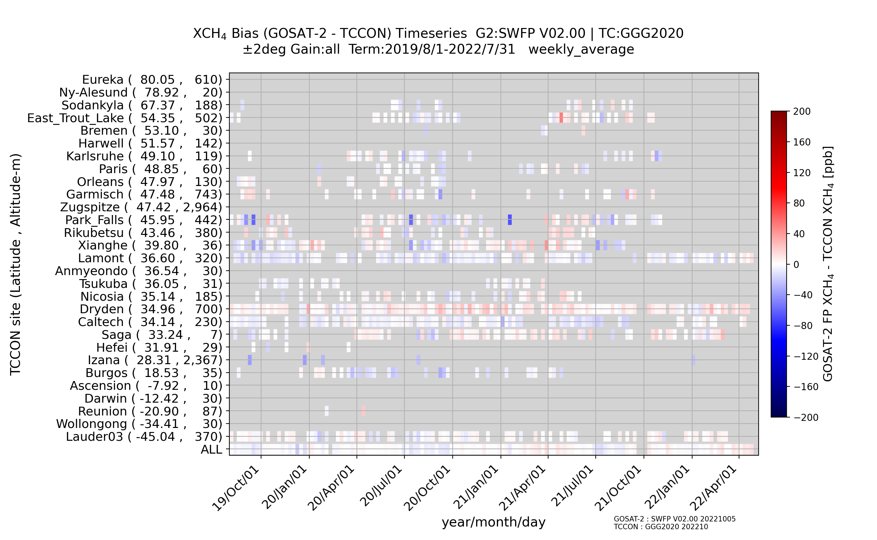
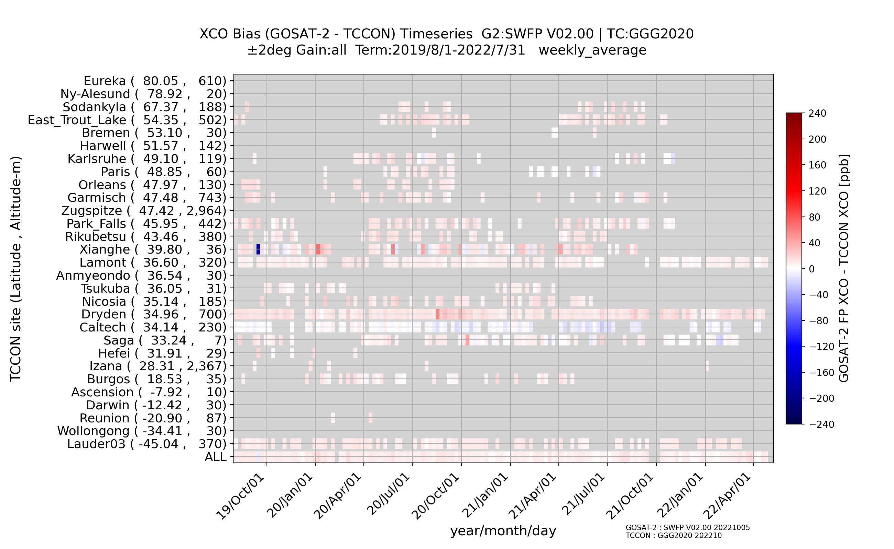
Temporal stability of weekly averaged biases of GOSAT-2 product (Ver. 02.00, ±2º, Full Physics)
XCH₄ Land
XCO Land
XCH₄ Ocean
XCO Ocean

Slide 17
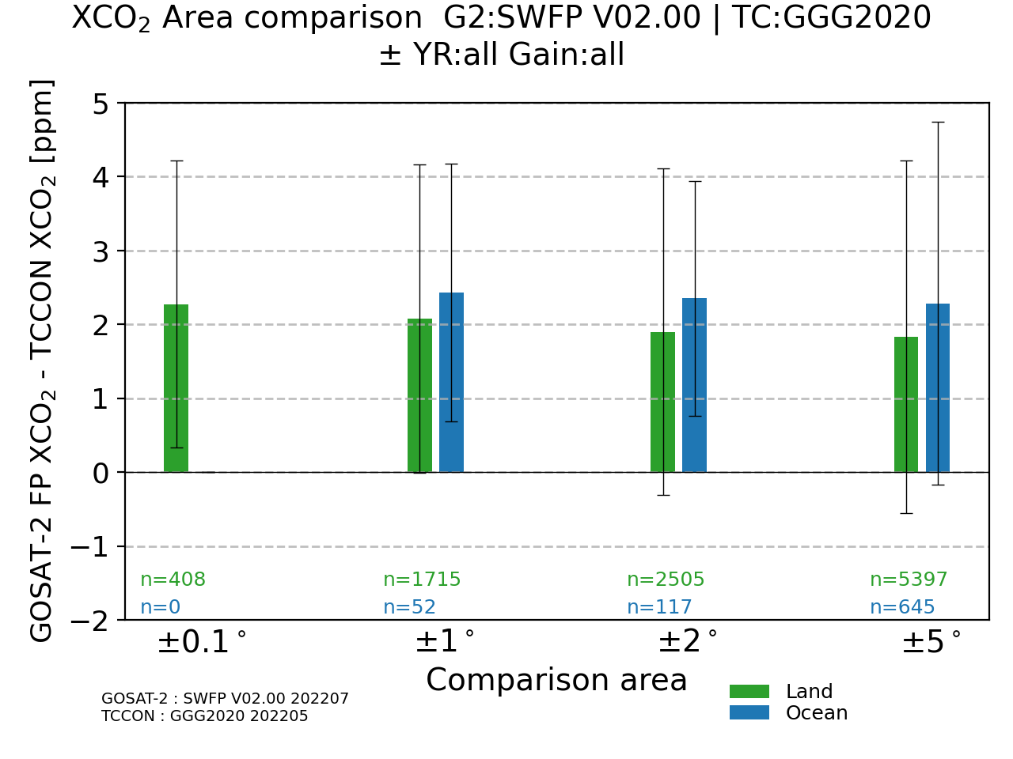
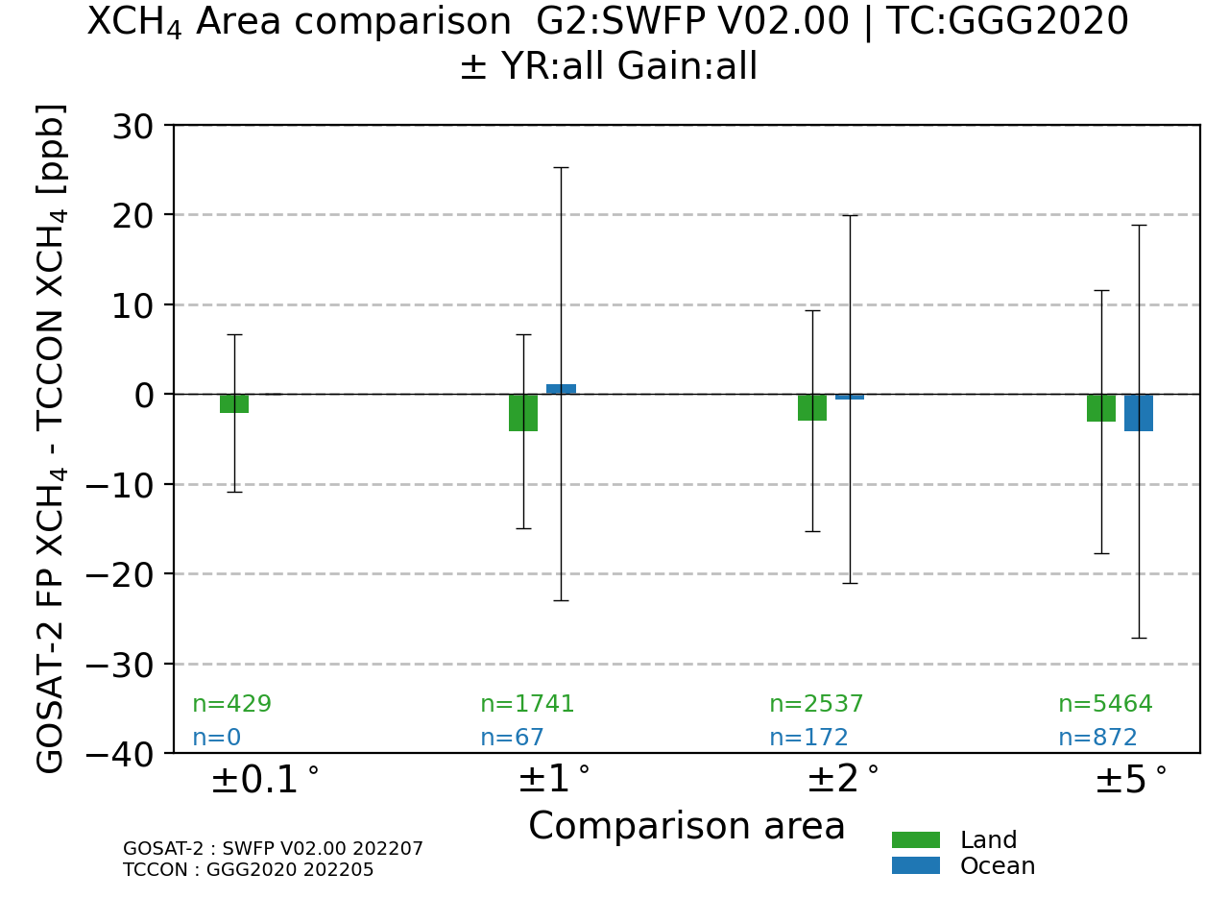
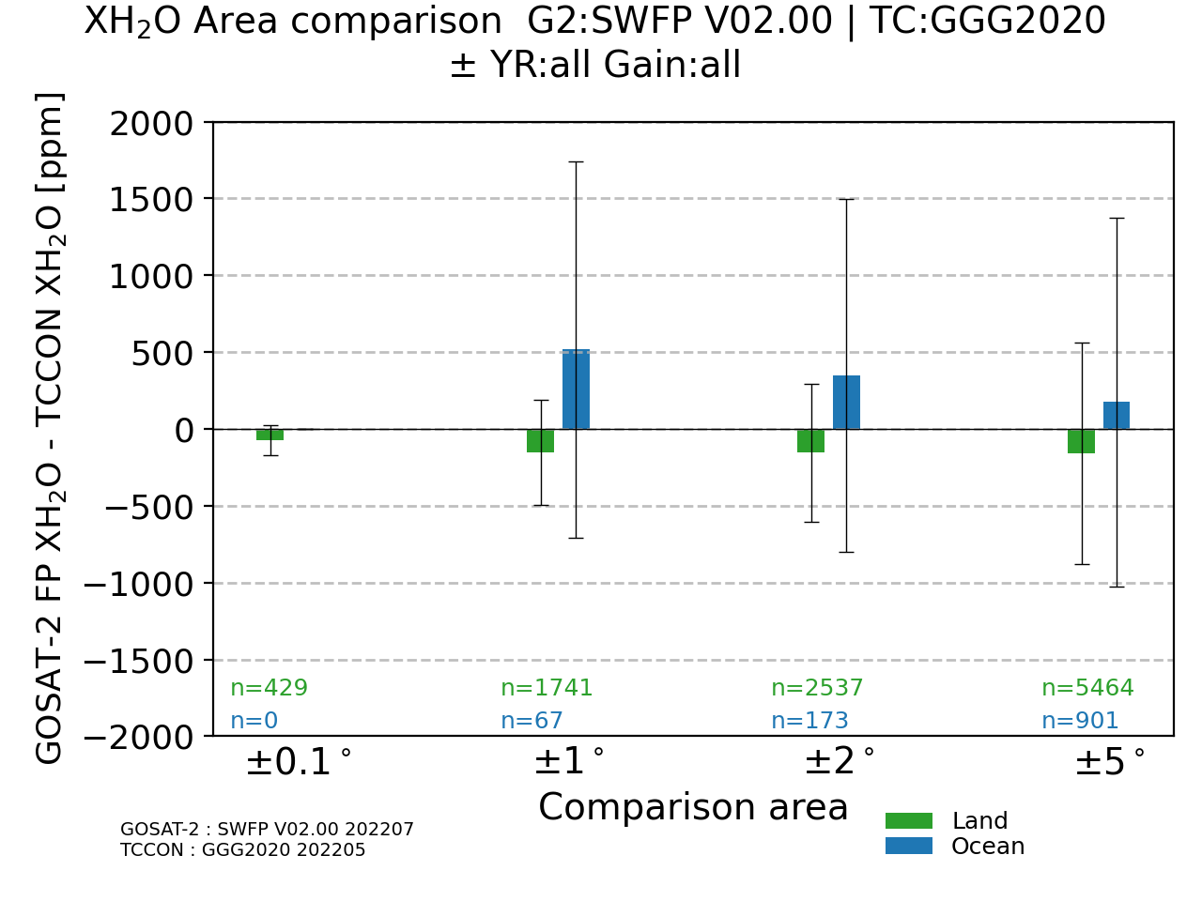
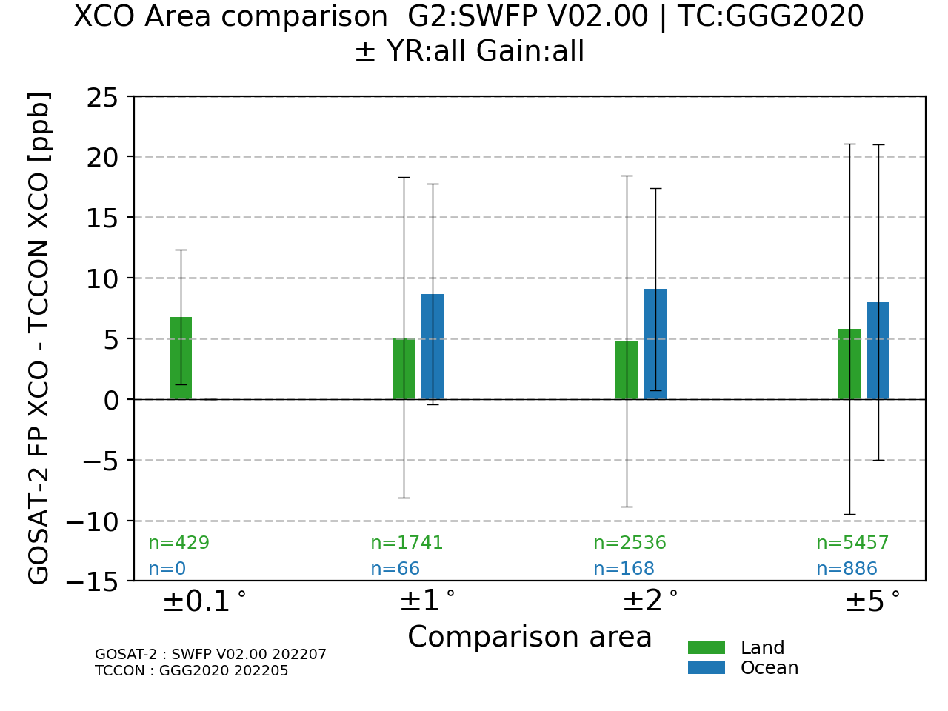
Variability of the mean biases by comparison areas (Ver. 02.00, Full Physics)
XCO₂
XCH₄
XH₂O
XCO

Slide 18
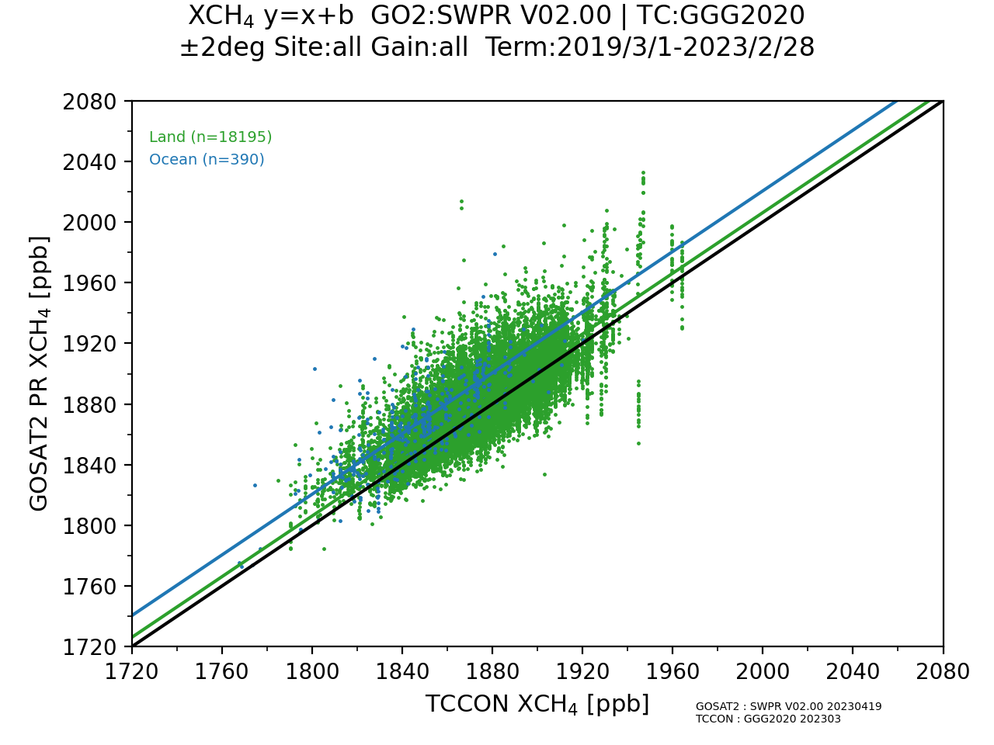
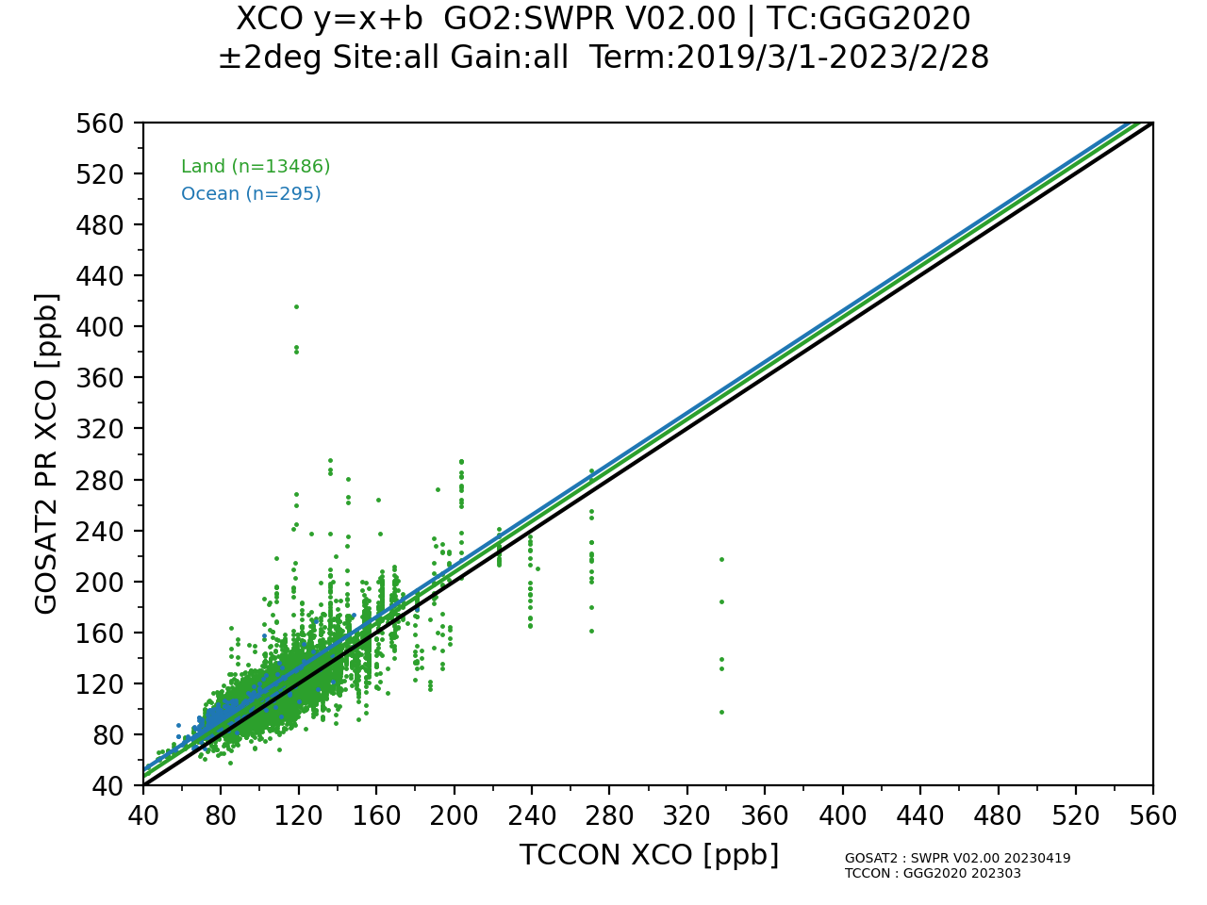
Scatter plot of GOSAT-2 product against TCCON data (Ver. 02.00, ±2º, PROXY)
XCH₄
XCO
Land N=18195 6.16 ± 17.27 ppb (0.33 ± 0.92%)
Ocean N=390 20.49 ± 18.58 ppb (1.11 ± 1.01%)
Land N=13486 7.18 ± 14.12 ppb (7.60 ± 12.06%)
Ocean N=295 12.19 ± 7.86 ppb (15.21 ± 9.59%)

Slide 19
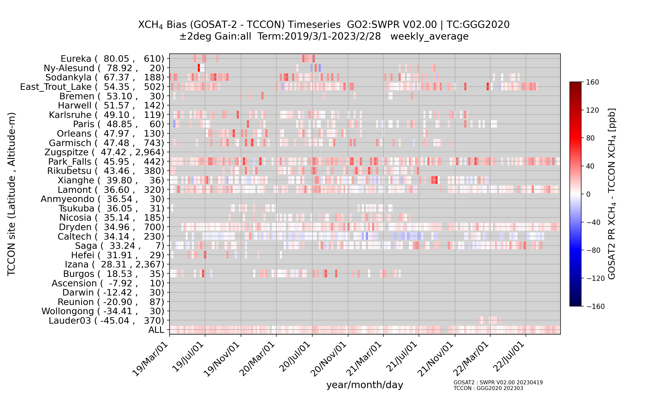
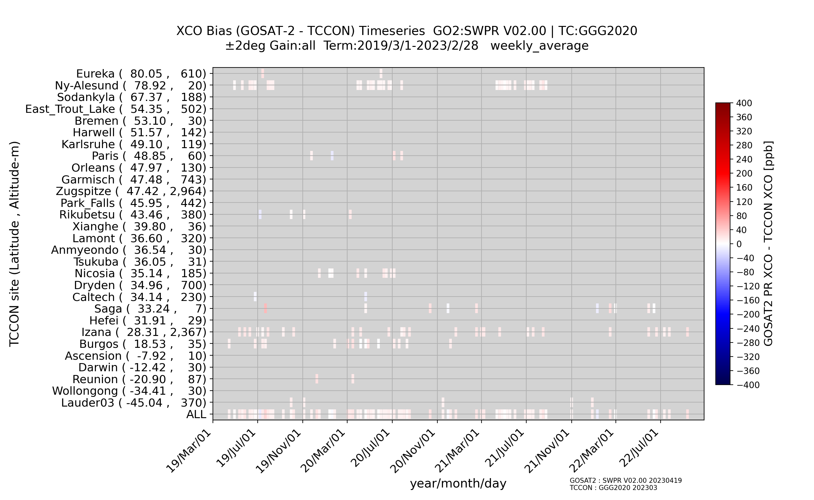
Temporal stability of weekly averaged biases GOSAT-2 product (Ver 02.00, ±2º, PROXY)
XCH₄ Land
XCO Land
XCH₄ Ocean
XCO Ocean

Slide 20
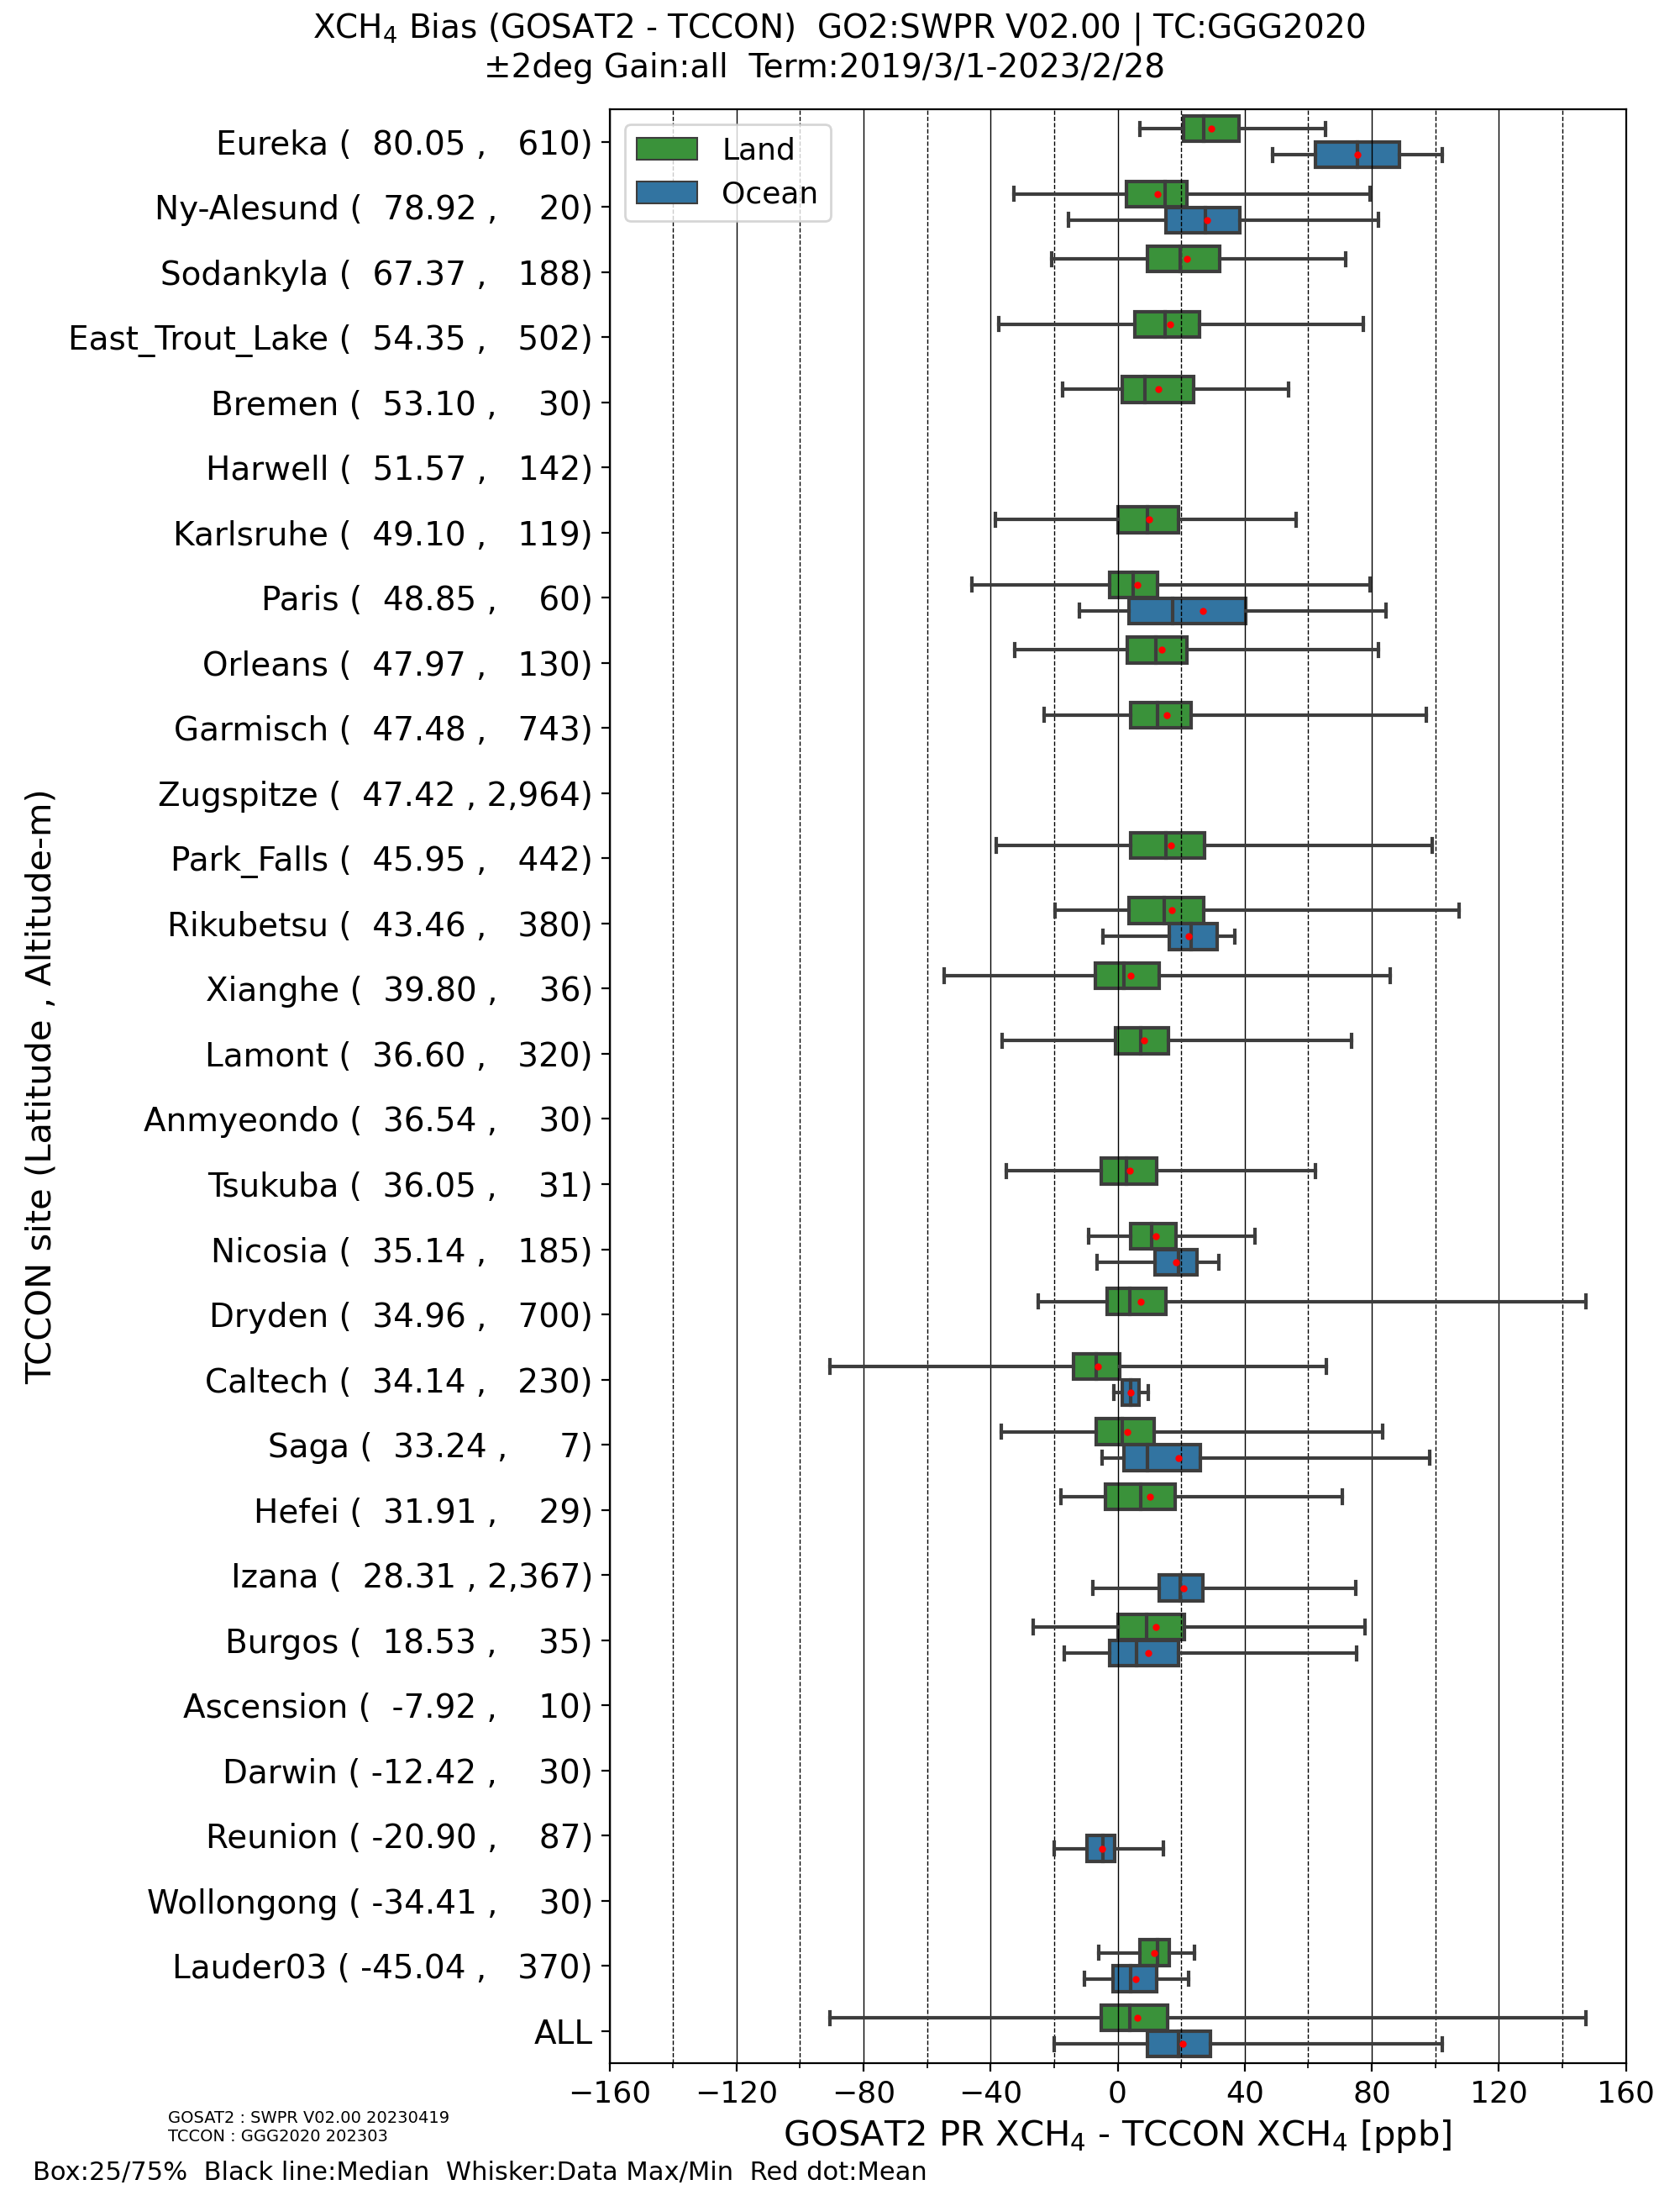
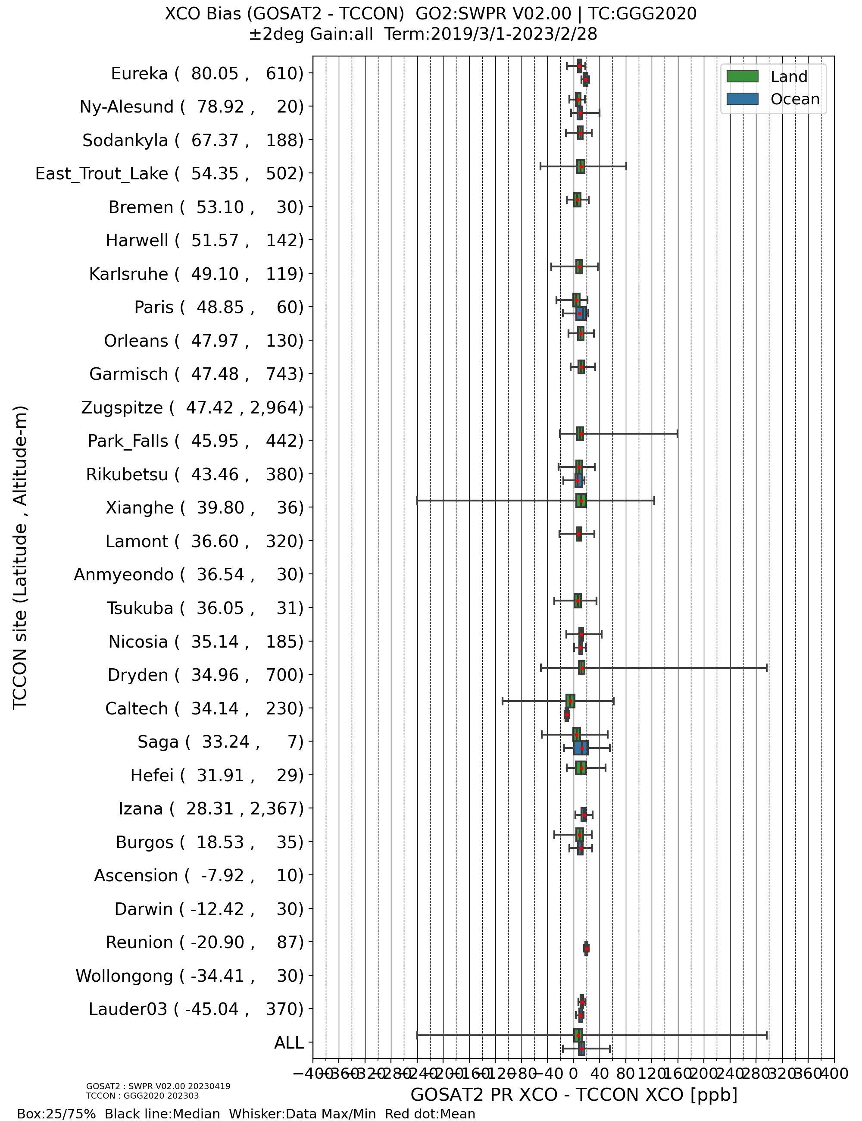
Biases of GOSAT-2 product for each TCCON site (Ver. 02.00, ±2º, PROXY)
XCH₄
XCO

Slide 21
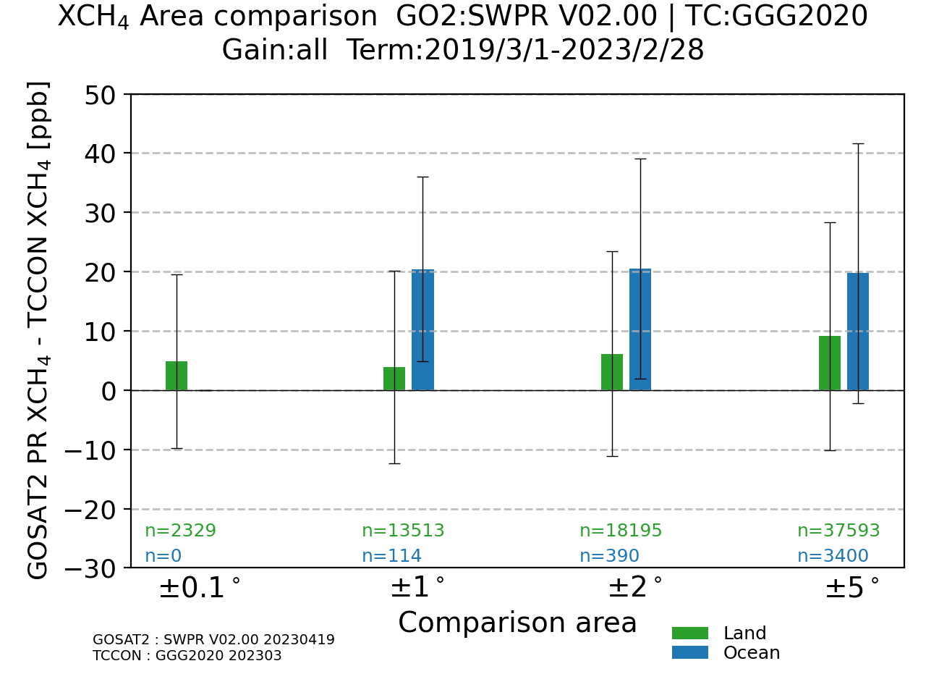
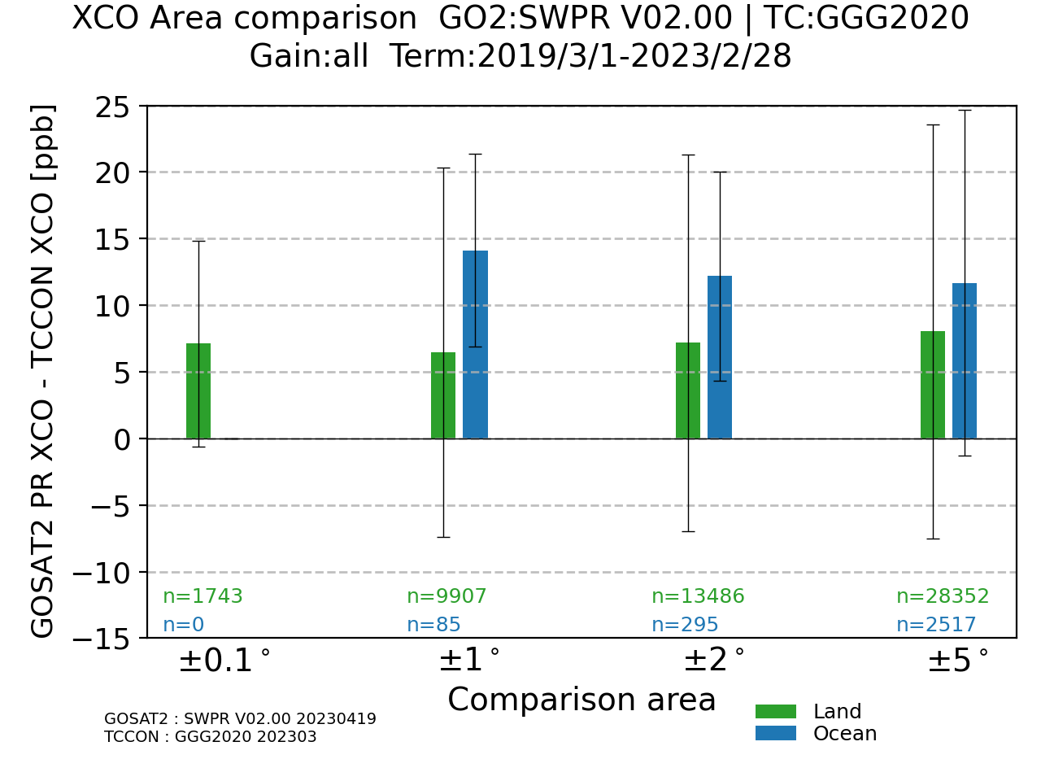
Variability of mean biases by the comparison areas (Ver. 02.00, PROXY)
XCH₄
XCO

Slide 22
Conclusions and outlook
GOSAT validation results: generally stable
Updated Ver. 03.00 has negative bias for gain H ocean soundings, therefore, the bias-corrected one as Ver.03.05 will be released together with Ver. 03.00. The biases are due to the fitting accuracy of the spectra and improvement of the algorithm will be continued through further analysis. Yu Someya et al., Update on the GOSAT TANSO–FTS SWIR Level 2 retrieval algorithm, AMT, 16, 1477–1501, 2023.
Laser power of interferometer is decreasing, but FTS is healthy, and I expect to continue operation for more than 5 years.
GOSAT-2 validation results: generally stable
Full physics XCO₂ Ver. 02.00 has positive bias of ~ 2 ppm
Some of the biases become relatively large, since GOSAT-2 and TCCON would observe different air masses at some sites with biomass burning, air pollution, aerosols etc. like Xianghe, Caltech, Dryden and these data should be excluded from the comparison. Biases and standard deviations are improved when these data are excluded.
Investigation of thin cirrus clouds and aerosols using lidar and sky radiometer is in progress. In case of GOSAT: Tran et al., Influences of aerosols and thin cirrus clouds on GOSAT XCO₂ and XCH₄ using Total Carbon Column Observing Network, sky radiometer, and lidar data, Int. J. Remote Sensing, 43(5), 1770-1799, 2022.
Review meeting after the GOSAT-2 nominal operation (5 years) will be held on 30 Oct 2023.
Comparison of GOSAT and GOSAT-2 data with the COCCON data will be made after releasing the COCCON data as much as possible, now they are not so many compared with the TCCON data.

Slide 23
Summary of validation analysis of GOSAT and GOSAT-2 SWIR L2 data using the TCCON data
±2º |  | GOSAT SWIR L2 Ver. 02.90/91 Apr 2009 – Oct 2022, gain H |  |  | GOSAT-2 full physics, Ver. 02.00 Aug 2019 – Jul 2022 |  |  | GOSAT-2 proxy, Ver. 02.00 Mar 2019 – Feb 2023
 |  | N | Bias | SD | N | Bias | SD | N | Bias | SD
XCO₂ | Land | 9567 | -0.52 ppm (-0.13%) | 2.12 ppm (0.52%) | 2505 | 1.90 ppm (0.46%) | 2.21 ppm (0.54%) | - | - | -
 | Ocean | 127 | -1.80 ppm (-0.44%) | 2.27 ppm (0.55%) | 117 | 2.35 ppm (0.57%) | 1.59 ppm (0.39%) | - | - | -
XCH₄ | Land | 9584 | 3.44 ppb (0.19%) | 12.19 ppb (0.66%) | 2537 | -2.96 ppb (-0.16%) | 12.29 ppb (0.66%) | 18195 | 6.16 ppb (0.33%) | 17.27 ppb (0.92%)
 | Ocean | 127 | 12.37 ppb (0.68%) | 16.29 ppb (0.89%) | 172 | -0.57 ppb (-0.03%) | 20.44 ppb (1.10%) | 390 | 20.49 ppb (1.11%) | 18.58 ppb (1.01%)
XCO | Land | - | - | - | 2536 | 4.78 ppb (5.51%) | 13.65 ppb (10.38%) | 13486 | 7.18 ppb (7.60%) | 14.12 ppb (12.06%)
 | Ocean | - | - | - | 168 | 9.07 ppb (10.72%) | 8.36 ppb (9.68%) | 295 | 12.19 ppb (15.21%) | 7.86 ppb (9.59%)
XH₂O | Land | 9584 | -112.9 ppm (-3.6%) | 376.4 ppm (19.3%) | 2537 | -154.1 ppm (-4.1%) | 447.3 ppm (18.2%) | - | - | -
 | Ocean | 127 | 568.9 ppm (80.4%) | 1210.5 ppm (128.9%) | 173 | 347.9 ppm (64.7%) | 1147.2 ppm (135.3%) | - | - | -
Notes:
spatial representativeness

Slide 24
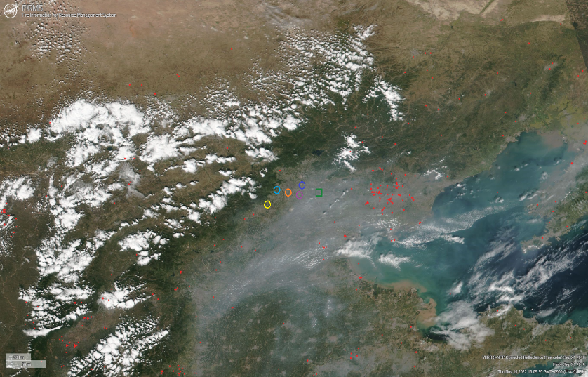
Outlier investigations near TCCON sites
In the validation analysis, there are large differences between GOSAT-2 and TCCON observations where one of them would detect airmass with biomass burning, air pollution, aerosols etc. We investigated these cases as thoroughly as possible for all TCCON sites. Finally, we set threshold values for ΔXCO₂, ΔXCH₄, ΔXCO as described in the validation analysis settings.
Below is an example for the Xianghe TCCON site on 21 Sep 2019.
Image from FIRMS VIIRAS S-NPP
Image from FIRMS VIIRAS S-NPP (expanded)

Slide 25
Outlier investigations near TCCON sites
ΔXCO₂
XCO₂
Image from FIRMS VIIRAS S-NPP
Image from FIRMS VIIRAS S-NPP (expanded)

Slide 26
Outlier investigations near TCCON sites
ΔXCH₄
XCH₄
Image from FIRMS VIIRAS S-NPP
Image from FIRMS VIIRAS S-NPP (expanded)

Slide 27
Outlier investigations near TCCON sites
ΔXCO
XCO
Image from FIRMS VIIRAS S-NPP
Image from FIRMS VIIRAS S-NPP (expanded)

Slide 28
Acknowledgements
TCCON data of the GGG2020 version were obtained from the TCCON Data Archive in the web of http://tccondata.org/
D. Wunch, G.C. Toon, J.-F.L. Blavier, R.A. Washenfelder, J. Notholt, B.J. Connor, D.W.T. Griffith, V. Sherlock, P.O. Wennberg,
The Total Carbon Column Observing Network. Phil. Trans. R. Soc. A (2011) 369, doi:10.1098/rsta.2010.0240
TCCON Partners

