Slide 1



FRM4GHG-2, an ESA project to measure greenhouse gases and beyond, also with low resolution spectrometer. Progress during phase II
¹J. Notholt, ²M. Kumar-Sha, ³T. Blumenstock, ⁴P. Castracane, ⁵H. Chen, ⁴A. Dehn,
²M. De-Maziere, ²F. Desmet, ⁶N. Deutscher, ⁶D. Griffith, ³F. Hase, ³B. Herkommer,
⁷P. Heikkinen, ⁶N. Jones, ⁷R. Kivi, ²N. Kumps, ⁸N. Macleod, ¹W. Markert. ¹C. Petri, ²C. Vigouroux, ⁸D. Weidmann, ²M. Zhou
¹Universty of Bremen, Germany
²Royal Belgian Institute for Space Aeronomy, Belgium
³Karlsruhe Institute of Technology, Germany
⁴European Space Agency, Italy
⁵University of Groningen, Netherlands
⁶University of Wollongong, Australia
⁷Finnish Meteorological Institute, Finland
⁸Rutherford Appleton Laboratory, United Kingdom
University
of Bremen
Institute of
Environmental Physics

Slide 2
Fiducial Reference Measurements
FRM4GHG-1
intercomparison between alternative instruments collocated with a TCCON station and additional independent observations.
contribution to the Agency’s commitment towards CEOS-WGCV
(Committee on Earth Observation Satellites - Working group for cal./val.)
establish a set of Fiducial Reference Measurements (FRM) for GHGs.
FRM4GHG-2
further improve the investigated low resolution instruments. Development of hardware and software, algorithms.
links to TCCON and complementary COllaborative Carbon Column Observing Network (COCCON).
Notes:
IR Emission Spectra, satellite 1970/ 45 Years ago
KLICK -> 3 Regions
KLICK -> Normal on top vs. Antarctic
KLICK -> Qualitative difference in CO2-band
Question: Can CO2 have oppostite effect?
->Key Questions

Slide 3
Instrumental improvments for low res. specs. (BIRA & Uni Bremen)
Develop a mobile stand-alone version of the
Bruker Vertex 70 or other small spectrometers
- thermally isolated
- Including solar tracker
- rain sensor
- automatically controlled cover
- test of TE-cooled MCT, InSb

Slide 4
Instrumental improvments for low res. specs. (BIRA & Uni Bremen)
Design

Slide 5
Instrumental improvments for low res. specs. (BIRA & Uni Bremen)
Current status

Slide 6
Instrumental improvments for low res. specs. (KIT)
dedicated shelter and additions for EM27-sun
- built by the TU Munich
- NEW! Built by KIT
- PLC controlling the measurement dome
- router designed for outdoor usage
- highly accurate pressure sensor “Vaisala PTB330”.

Slide 7
Instrumental improvments for low res. specs. (Uni Bremen)
Develop a cheap and simple solar tracker
- Gearbox (1:25) by 3 D printer
- 30 mm diameter
- Totally ∼ 200 €
By far not yet finished, but an interesting new idea

Slide 8
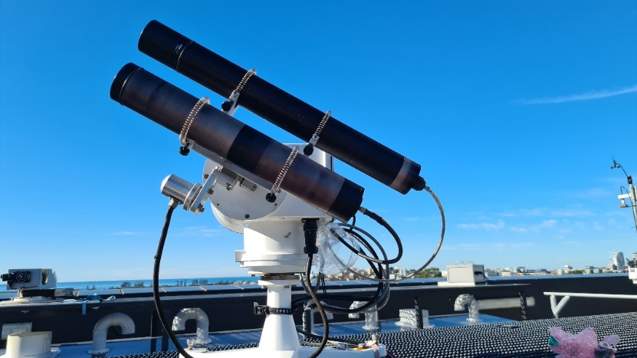
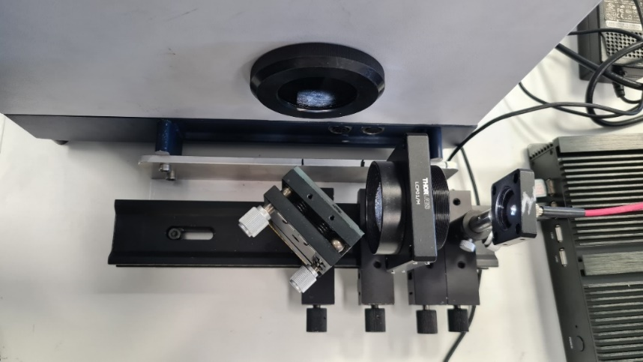
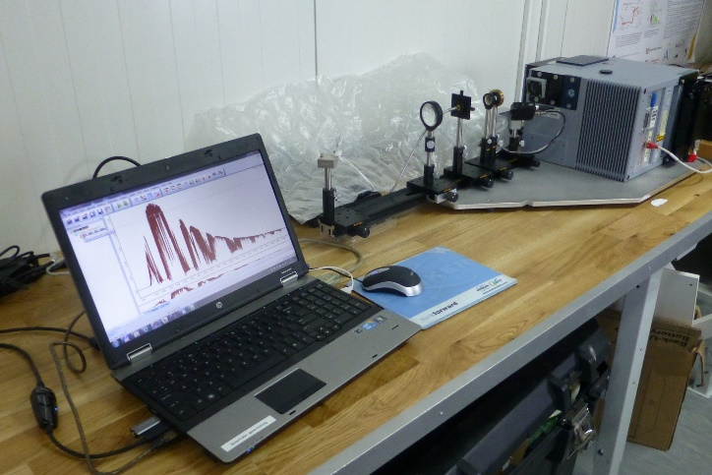
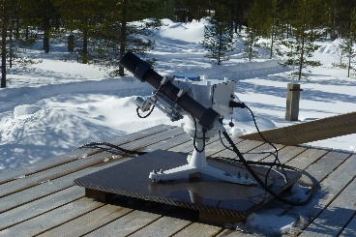
Instrumental improvments for low res. specs. (Uni Wollongong)
EM27 at UoW
fibre-optic coupling:
- Alternative solar tracker
- The sun is imaged into an optical fibre (FO) by a simple glass lens telescope
mounted on a commercially-available Aeronet-style tracker
- The FO brings the solar radiation into the lab
- The divergent FO exit beam is collimated into the FTS for spectrum
measurement
- We have successfully used the telescope-FO tracker system for several
years in the FRM4GHG project with a Bruker IRcube FTS
Details:
- Ekotracker: autonomous, active tracking <0.1°, self-parks at night.
- Robust, reliable, weatherproof
- Telescope: BK7 glass lens, Φ 50mm x FL 35 or 40 cm
- Glass fibre optics Φ500 or 800 μm, 20 m long, divergent exit beam ~ F/3
- IRcube 0.5 cm¹ resolution, single sided igm
- EM27 0.5 cm⁻¹ resolution, double sided igm
Pros:
- Tracker is autonomous, robust, reliable and
weatherproof
- FTS is housed indoors in protected environment
- Weatherproofing not required
- Continuous 24/7 measurements
- Comparable signal levels and SNR
Cons:
- Possible fibre spectral structures and
variability continuum shape, fringing
- Fibre/glass cutoff below 4500 cm⁻¹
- CO, N₂O bands not accessible

Slide 9
Solar fibre-optic coupling to portable EM27 and IRcube
Next steps …
- Optimise fibre optic for robustness and reproducibility
- Check for fibre spectral effects
  spectral structures, fringing
  Dependence on fibre bending and movement
  Not apparent so far
- Routine data collection and analysis (GGG, PROFFAST)
- Comparisons with co-located TCCON
- New HR125 at UoW
- Comparisons with co-located COCCON
Conclusions:
- Spectra via the telescope-FO and the Camtracker are so far very comparable
- Encourages further investigation to assess accuracy and variability

Slide 10
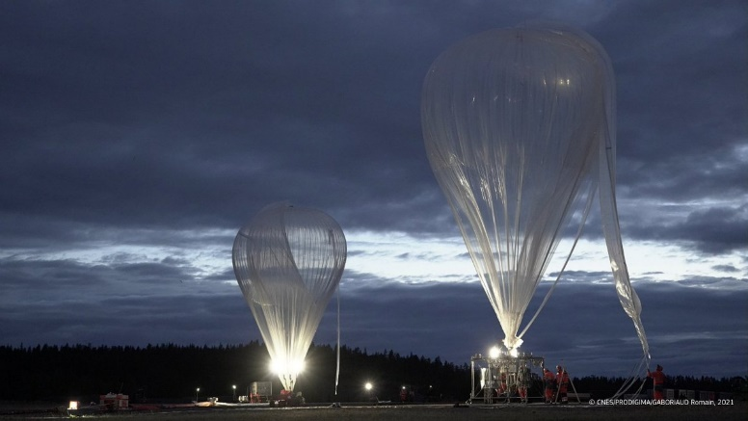
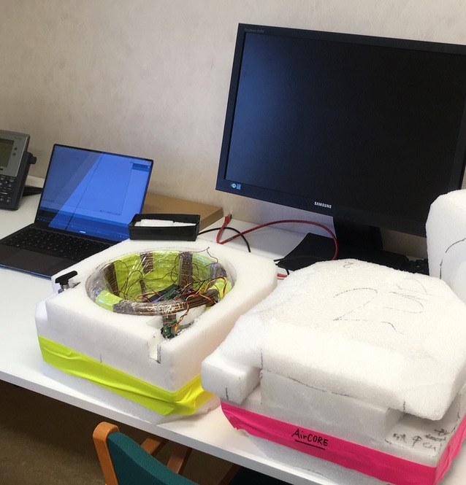
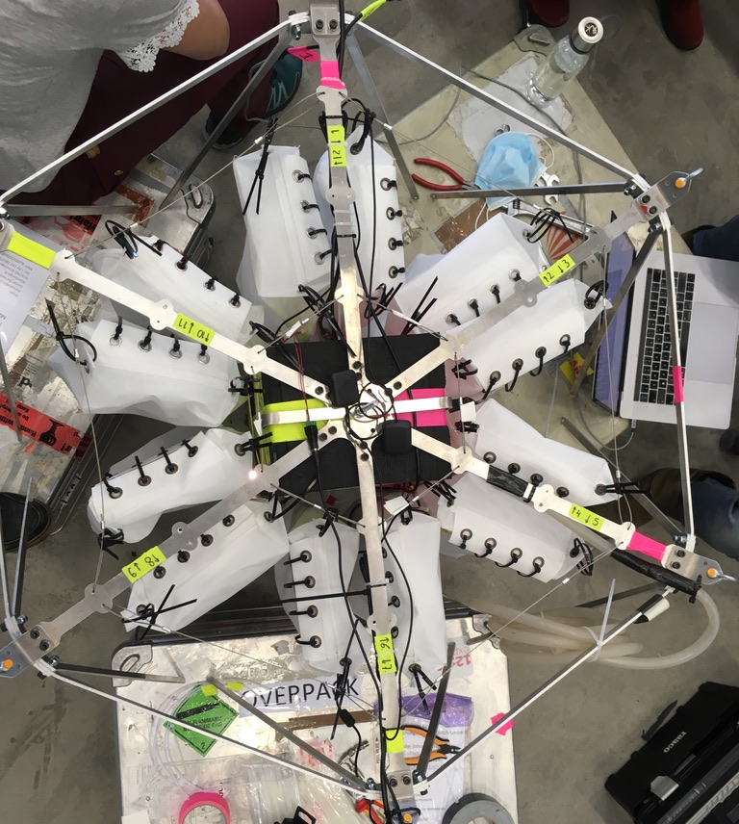
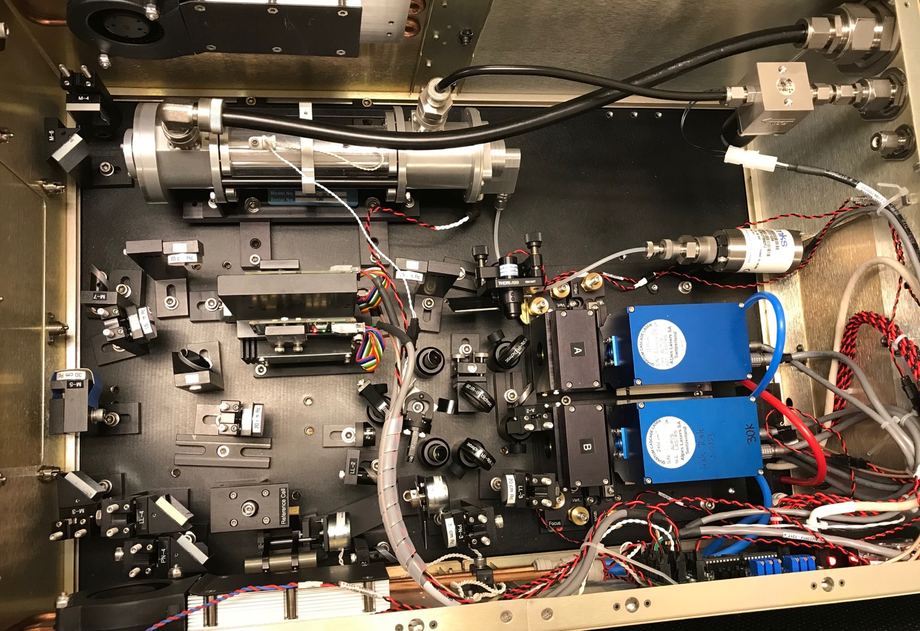
Aircore development as part of FRM4GHG (here Kiruna)
Uni Groningen participating in HEMERA, a large balloon flight in Kiruna, August 2021
Cryogenic samples
AirCores
bigLISA
Spectrometers
Balloon and auxiliary balloon being filled. Source: hemera-h2020.eu
RUG AirCore + bigLISA
Measurements of OCS/N₂O/CO₂/CH₄/CO during HEMERA
Cell volume | 150 mL
Optical Path length | 36 m
Pressure | 40 – 60 Torr
Effective Cell Volume at 50 Torr: ~ 10 mL
Species | COS (ppt) | N₂O (ppb) | CO₂ (ppm) | CH₄ (ppb) | CO (ppb) | H₂O (ppm)
1-sigma | ~ 12 | 0.1 | 0.08 | 0.45 | 0.65 | 7.2
Aerodyne Research Inc.

Slide 11
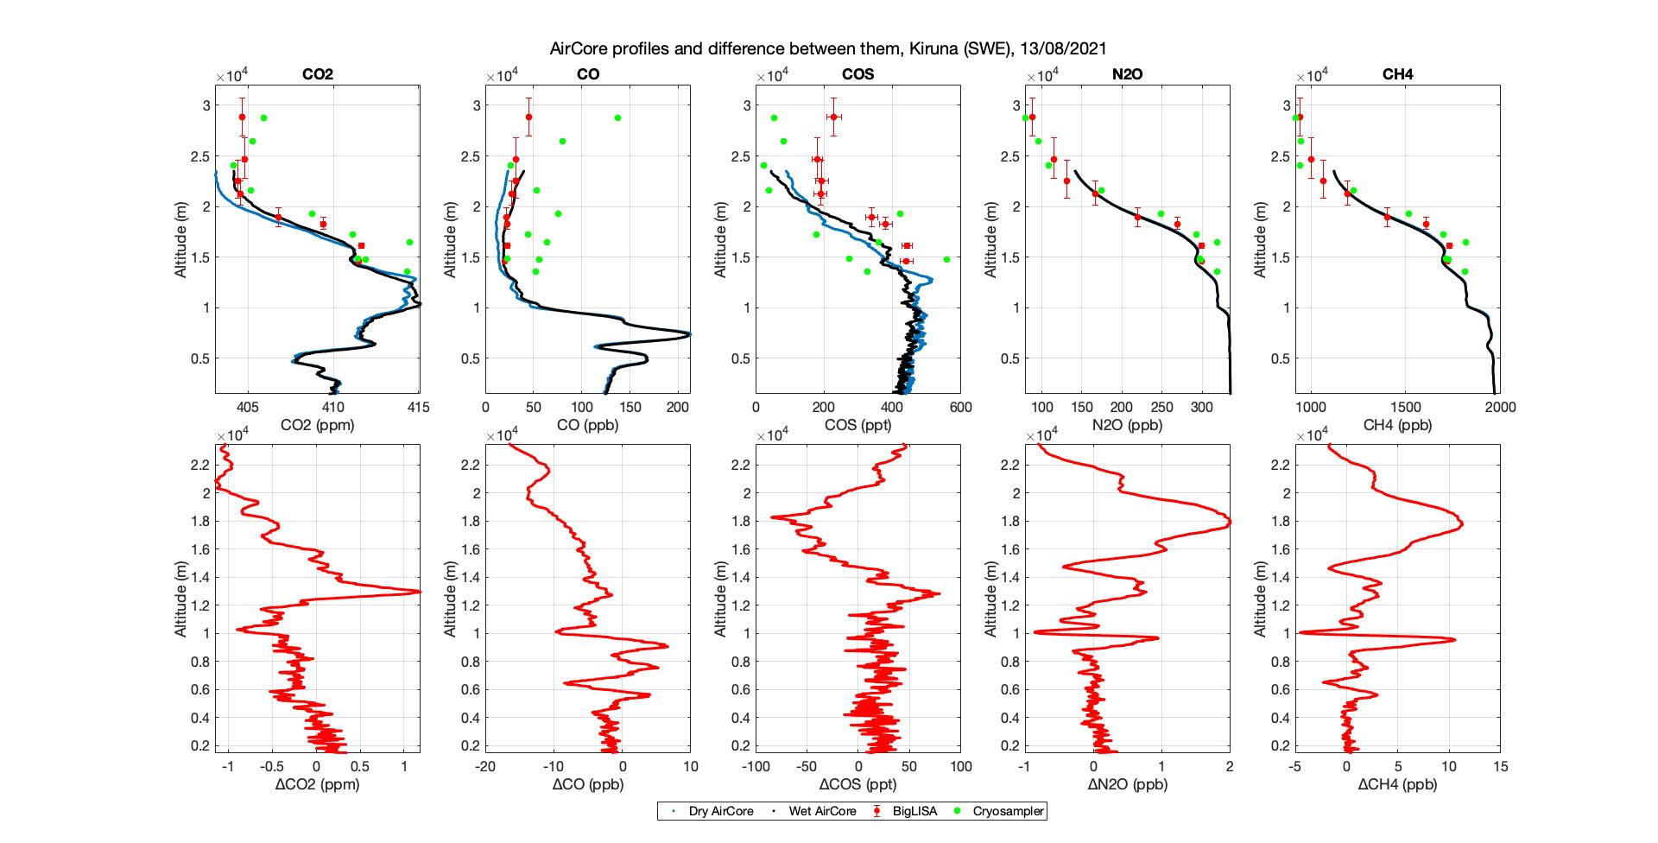
Aircore development as part of FRM4GHG (here Kiruna)
Upcoming campaign August 2023: LISA & AirCore for OCS and N₂O in Sodankylä

Slide 12
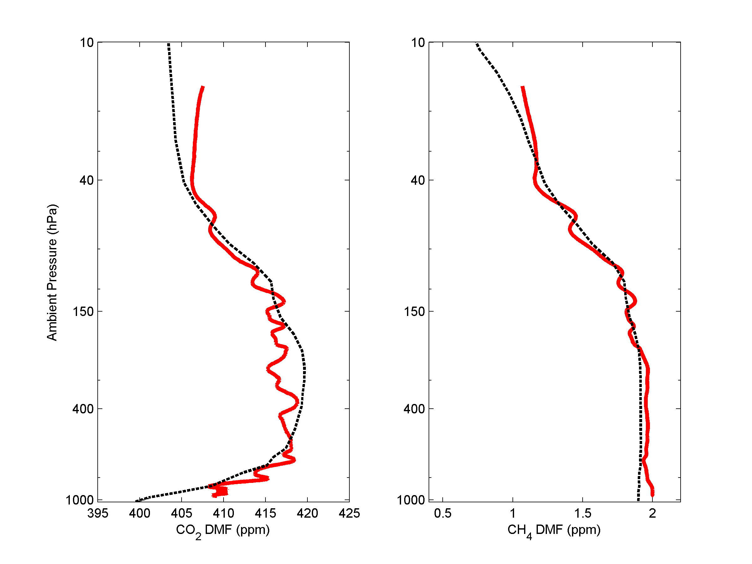
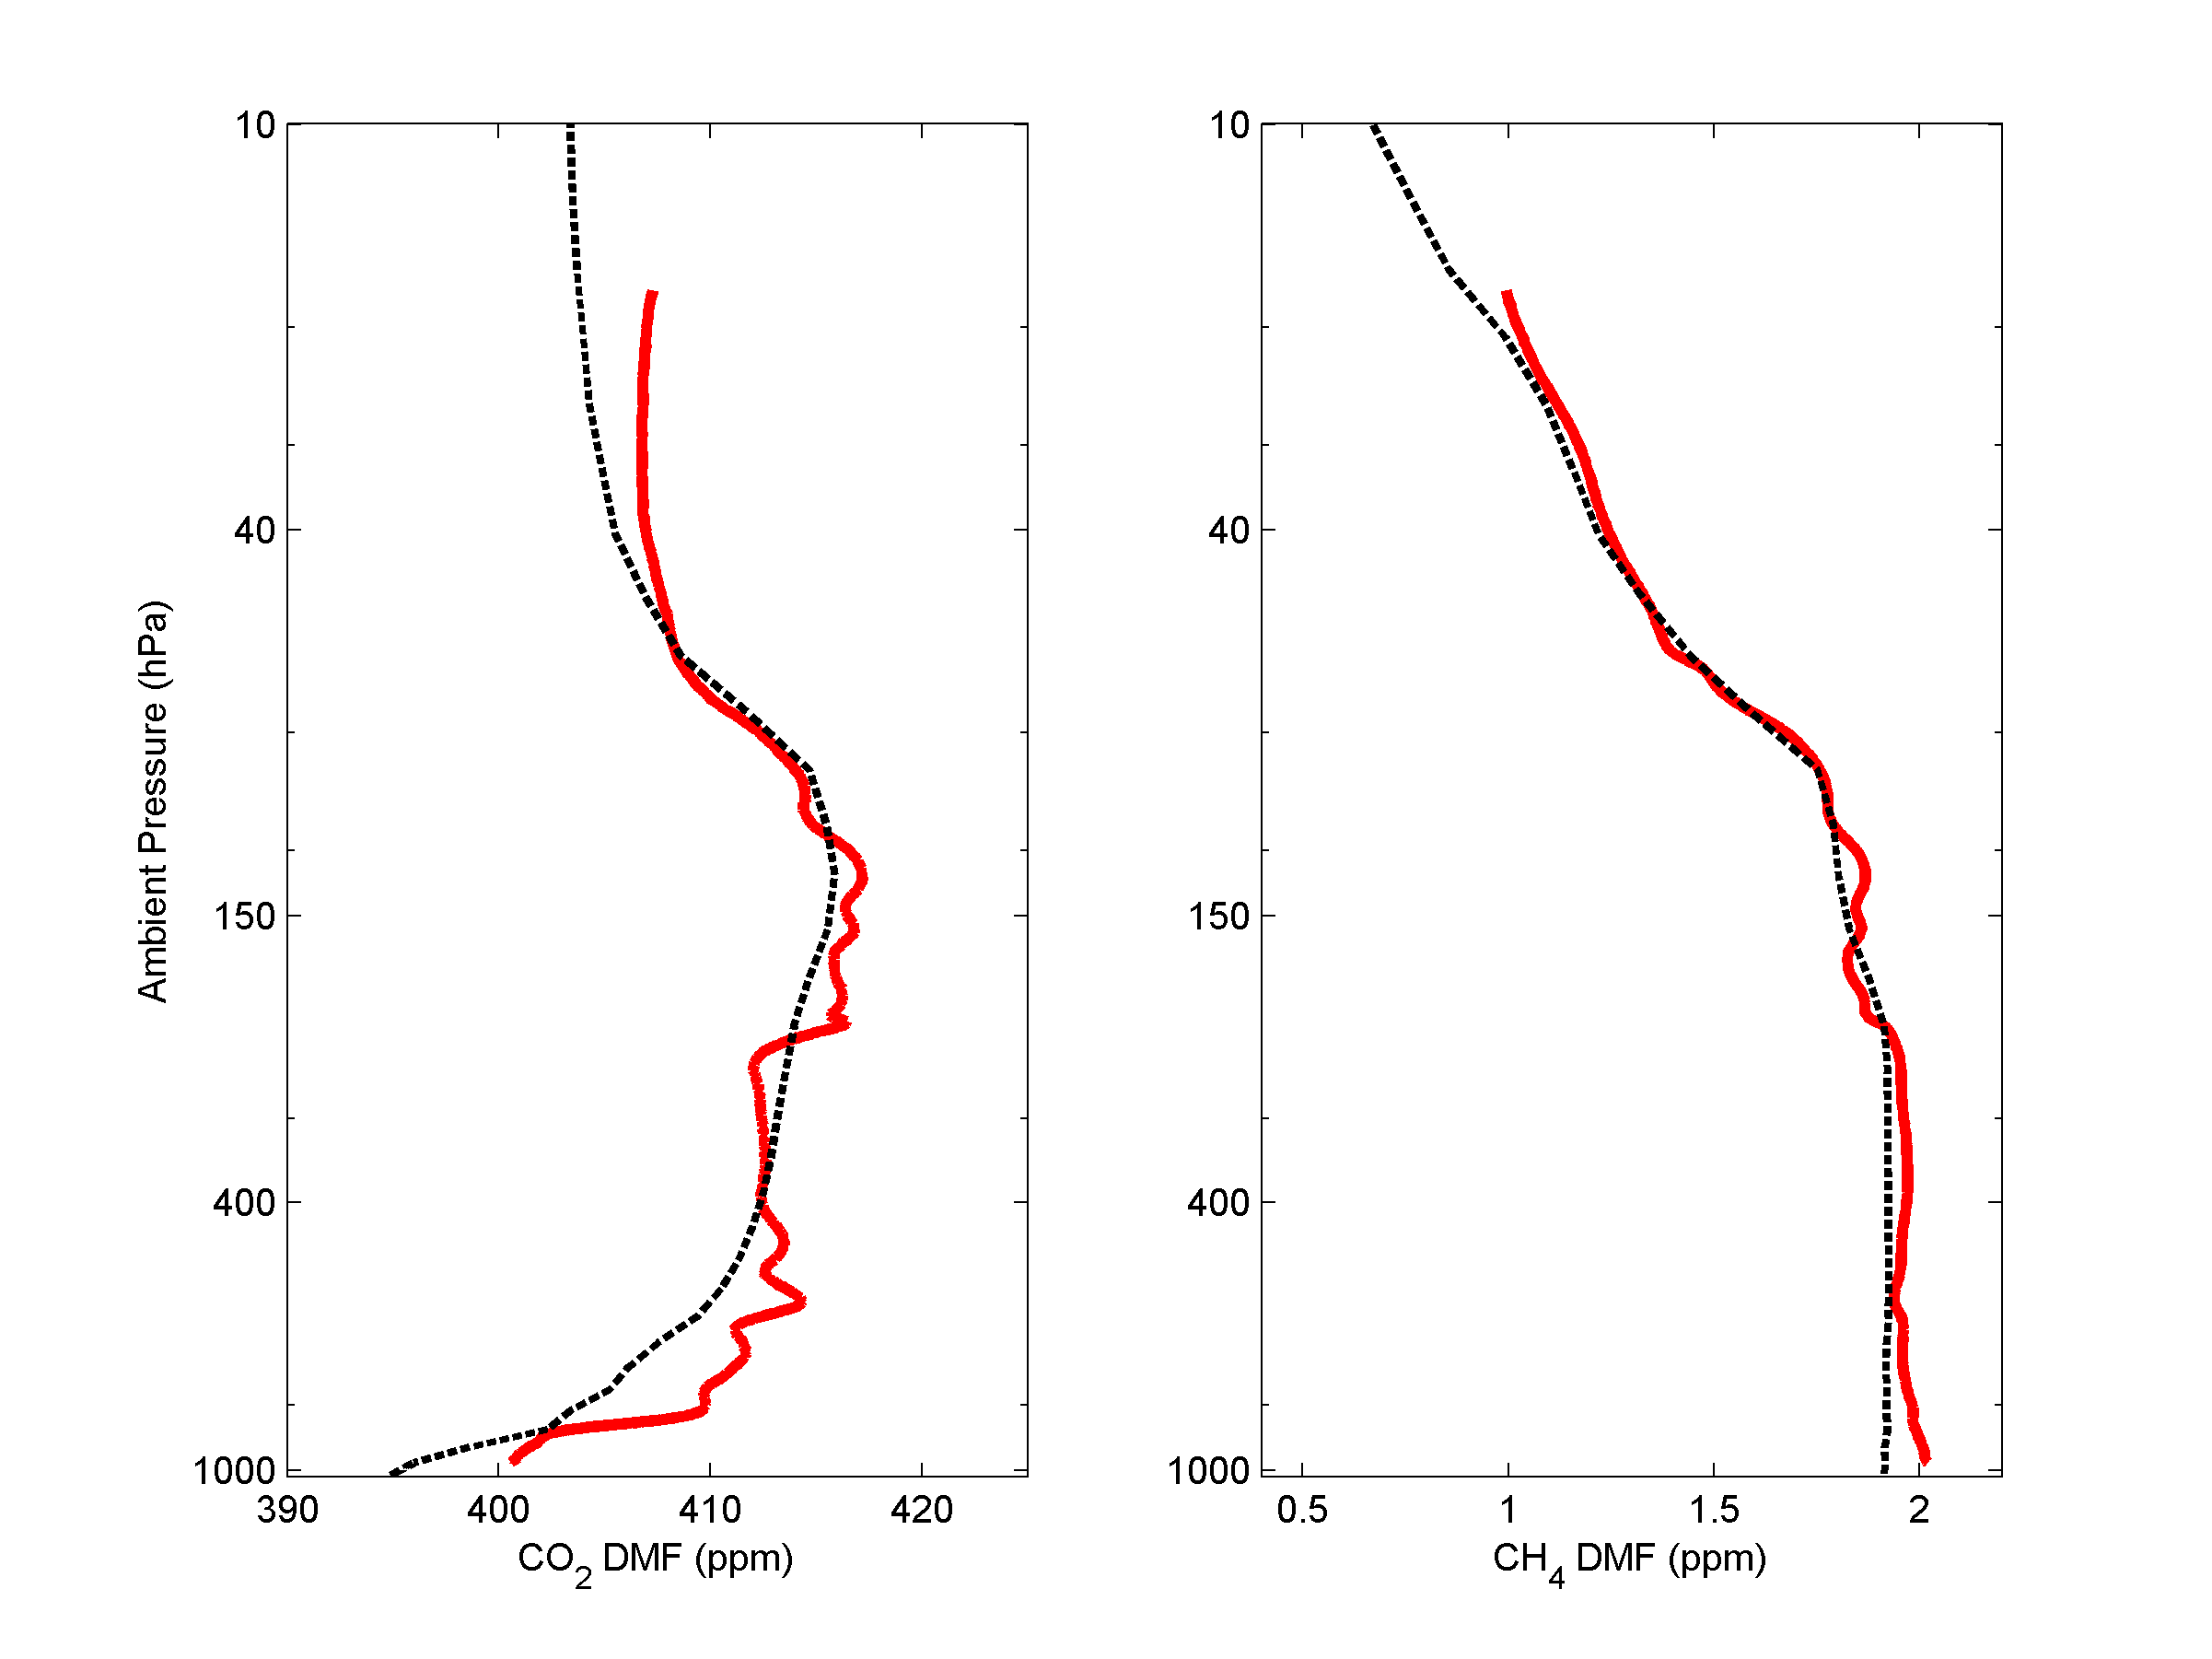
Aircore studies in Sodankyla
AirCore CO₂ and CH₄ profiles (red) and TCCON GGG2020 a priori (dashed line). Sodankylä 29 June 2022 08:09 UTC (left) and 25 August 2022 08:02 UTC (right).

Slide 13
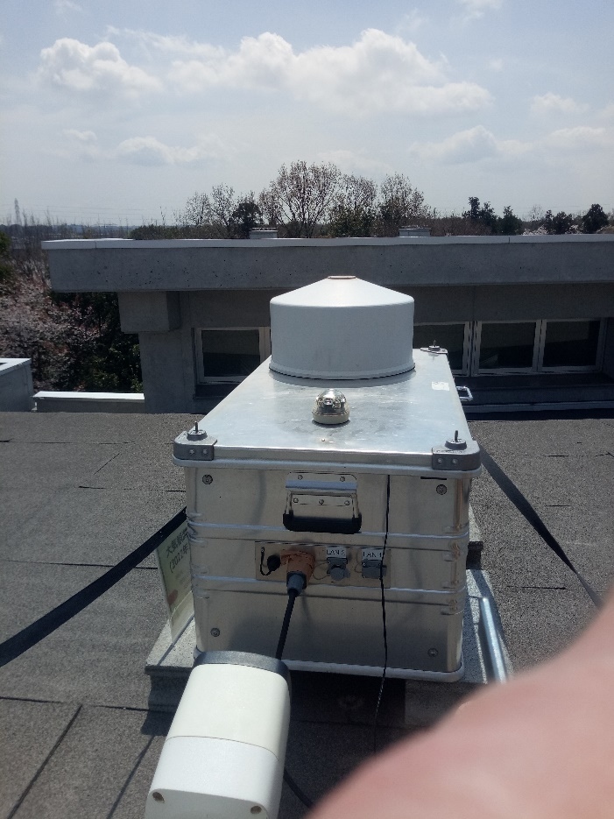
Calibration of a traveling standard instrumental EM27/SUN
Comparison EM27/SUN (Karlsruhe reference) to traveling standard instrument
- before and after trip to Japan
- before and after trip to Canada
- empirical SZA correction for XCO
Collaborators: J. Chen, P. Aigner (TUM, Germany)
D. Wunch, N. Pak (University of Toronto, Canada)
I. Morino, M. Frey (NIES, Japan)

Slide 14
Improvment of retrieval for GHG and additional species
Diurnal cycle
Larger scatter for Invenio (18% vs 9.5% for daily std)
Invenio biased high (about a factor 2 !)
-> Caused by use of one solar tracker for both instruments, shift during the day ?

Slide 15
Improvment of retrieval for GHG and additional species
Comparison HCHO for NDACC with TROPOMI.

Slide 16
Atmospheric N₂O and CH₄ retrieved from low and high resolution FTIR spectra
(Bruker Vertex 70) in the mid-infrared region (Sodankyla)
(Zhou et al. AMTD, 2022)

Slide 17
Atmospheric N₂O and CH₄ retrieved from low and high resolution FTIR spectra
(Bruker Vertex 70) in the mid-infrared region (Sodankyla)
(Zhou et al. AMTD, 2022)

