Slide 1
Roadmap for future GGG development
and
Application of machine learning to XCO₂ diurnal cycles
Joshua L. Laughner¹, Calla Marchetti^{1,2}, Geoffrey C. Toon¹, Debra Wunch³, and Paul Wennberg^{4,5}
¹ Jet Propulsion Laboratory, California Institute of Technology
² University of California, Los Angeles
³ Department of Physics, University of Toronto
⁴ Department of Geological and Planetary Sciences, California Institute of Technology
⁵ Department of Engineering and Applied Science, California Institute of Technology

Slide 2
GGG development roadmap

Slide 3
GGG versioning nomenclature
GGG2020
GGG2020.1, GGG2020.2
GGG202X or GGGv3
Current stable algorithm version
Minor (post processing-only) updates
Major update to GFIT and/or I2S
Post processing-only updates done at:
Caltech if change is straightforward to apply to the netCDF files, or
Individual sites if additional data from other files needed - save your run directories!
Major updates planned to be run by individual sites

Slide 4
GGG development overview
Upcoming milestones:
GGG2020
GEOS FP-IT to GEOS IT changeover
GGG2020.1
Xluft-based bias correction for XCO₂
GGG2020.2
Temperature-based biased correction for XN₂O and XCH₄
CO₂ & CO (TARDISS) and CH₄ partial columns
Improved post-processing mechanics
GGG202X
Non-linearity correction in I2S
Modeling non-ideal ILS in GFIT
Improved spectroscopy for N₂O, CH₄, and CO₂
Support for modern gfortran compilers

Slide 5
GGG (notional) development timeline
GGG2020
GGG2020.1, GGG2020.2
GGG202X
June 2023
Jul 2023
Oct 2023
Dec 2023
Aug 2024
Dec 2024
Mid- 2025
Late 2025
GGG2020.2 alg. complete
GGG202X ready for beta testing
GEOS IT support ready
GGG2020.2 data release
GGG2020.1 data release
GGG2020.1 bias corr. complete
Change to XCH₄ and XN₂O
Partial column products release
Change to XCO₂
Can be generated at Caltech
New products

Slide 6
GEOS FP-IT to GEOS IT changeover (GGG2020)
GGG2020 uses GEOS FP-IT for the meteorology and as input for the VMR priors
Goddard plans to end FP-IT production ~end 2023, switching to the new GEOS IT product
GEOS IT has the same variables as FP-IT, but is an updated assimilation system
Three main tasks:
Update CO priors to reflect changes in CO emissions between FP-IT and IT
Modify the automatic priors generation to handle the FP-IT to IT switch
Evaluate changes in Xgas products introduced by the new meteorology
There will be a hard changeover date after which the automatic priors will use GEOS IT data. We are coordinating this with OCO -2 and -3.
Priors before the changeover date will not be regenerated with GEOS IT except as needed for testing in task #3 above

Slide 7
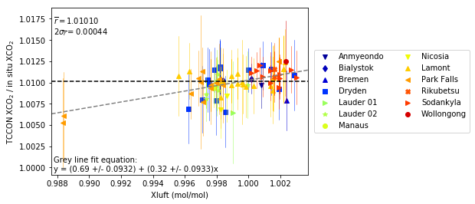
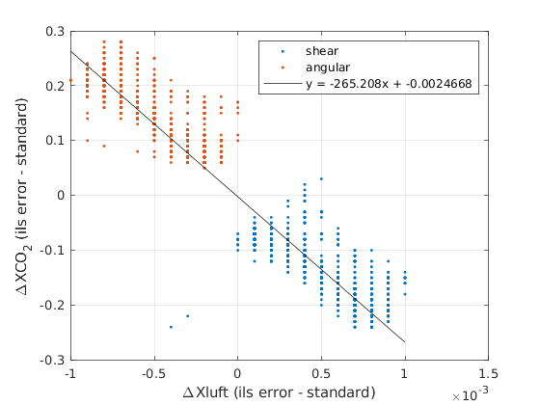
Xluft-based bias correction for XCO₂ (GGG2020.1)
Comparison with in situ profiles identified a bias in XCO₂ correlated with Xluft
Grey line at right is only fit to data in 0.996 ≤ Xluft ≤ 1.002, but predicts the two Park Falls points at Xluft ≈ 0.988 well
NB: Only Sodankylä has nonlinearity correction in this plot
This should be driven by factors such as misalignment, nonlinearity, and surface pressure errors
Still working to reproduce this behavior in tests with synthetically “bad” data

Slide 8
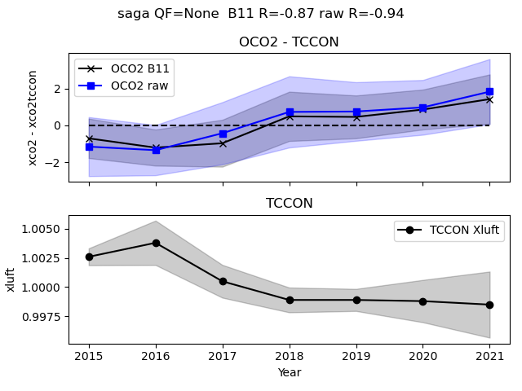
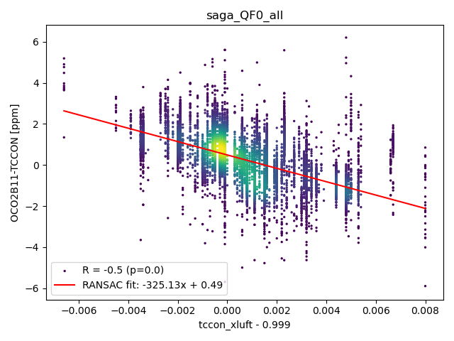
Xluft-based bias correction for XCO₂ (GGG2020.1)
Plots from Steffen Mauceri, JPL
This correction has become more urgent since a team working on machine learning-based filtering and bias correction for OCO-2 noticed time trends in OCO-2 vs. TCCON biases that correlate with Xluft (top)
We are working with them to determine how much of this bias is due to TCCON and how much to OCO-2 (most significant cases seem to be sites near ocean)
Still, we want to have a bias correction of our own in place ASAP
GGG2020
GGG2020 with AICF slope removed

Slide 9
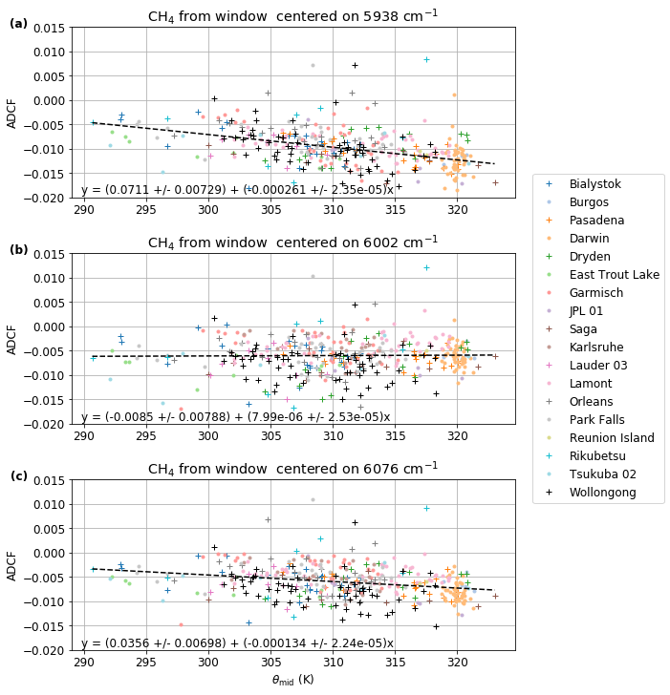
Temperature- or H₂O- based biased correction for XN₂O and XCH₄ (GGG2020.2)
XCH₄
Comparison of XN₂O with surface measurements provides compelling evidence of a temperature-or H₂O- dependent error
Likewise, analysis of the XCH₄ ADCFs suggests such errors in the 5938 and 6076 cm⁻¹ windows.
Plan to optimize the linelists based on these metrics, then develop a bias correction from retrievals with the improved spectroscopy
XN₂O

Slide 10
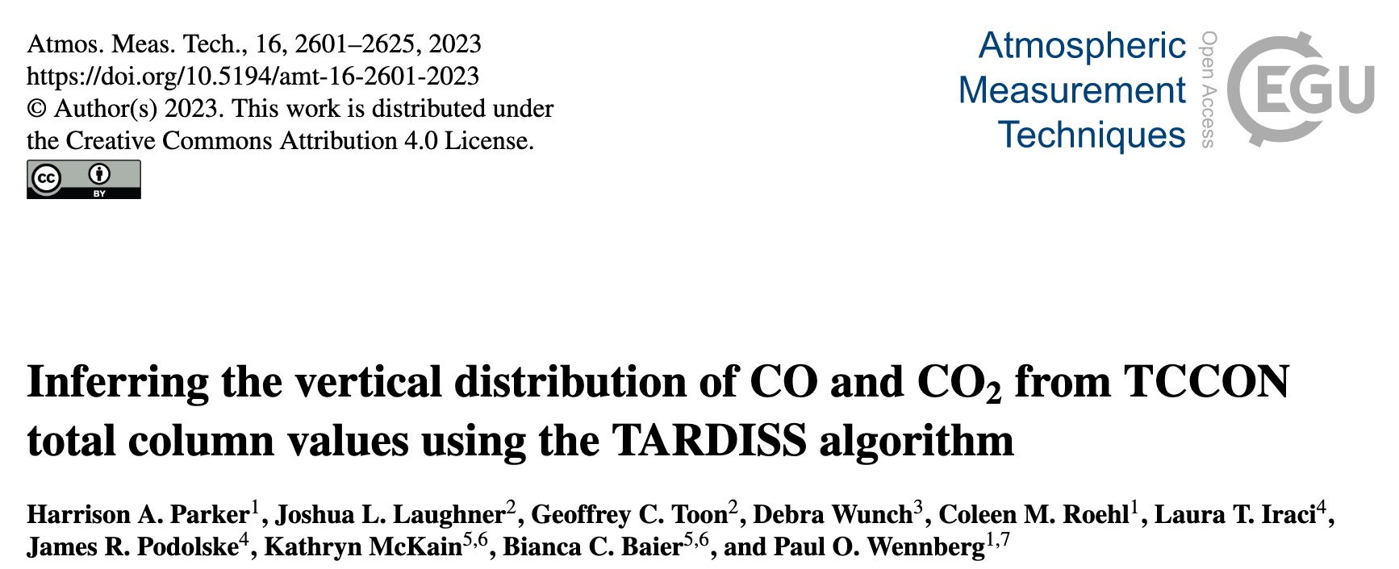
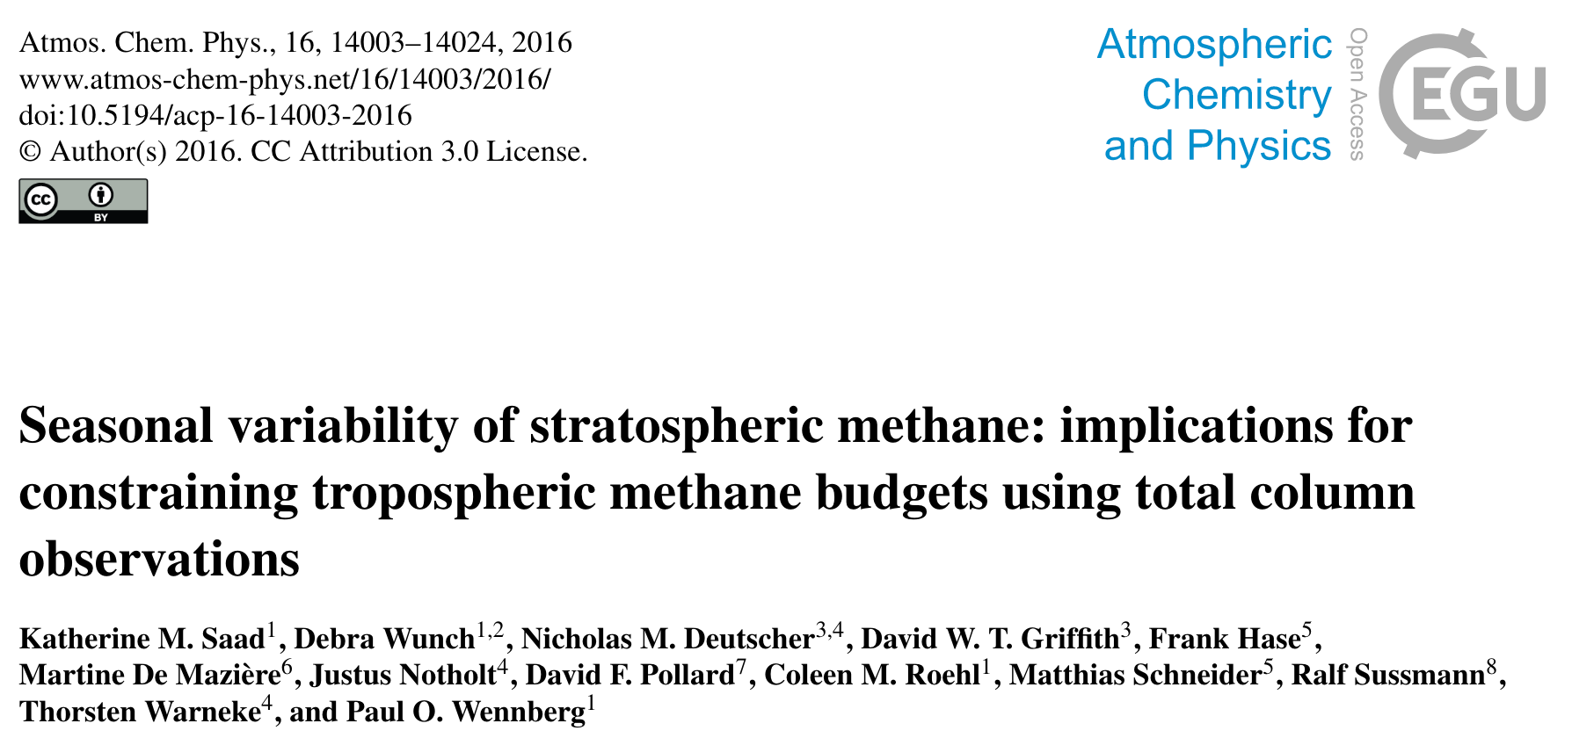
CO₂ & CO (TARDISS) and CH₄ partial columns (GGG2020.2)
TARDISS upper & lower XCO₂
We now have several algorithms to constrain partial columns from TCCON data
These will initially be done as separate algorithms run at Caltech, then incorporated into GGG post processing
Gas | Sub columns | Method | Applies to
CH₄ | Trop vs. strat | HF/N₂O correlation | All sites
CO₂ | PBL vs. remainder or PBL vs. free trop. vs. strat | TARDISS | All sites
CO | PBL vs. remainder | TARDISS | InSb-equipped sites

Slide 11
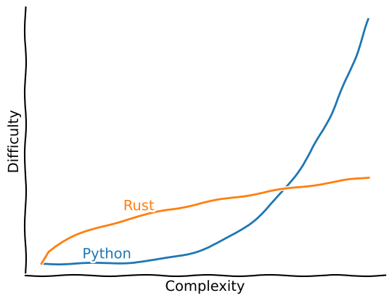
Improved post-processing mechanics (GGG2020.2)
There are some miscellaneous changes planned for the post-processing code
Improved multi-detector support
NetCDF writer cleanup
InGaAs
Si
InGaAs
Maintainability first, speed second
InGaAs
InSb
Transition from Python to Rust as second language
?
OH NO…!
Modified from No Boilerplate: https://youtu.be/2hXNd6x9sZs?t=491
Oh no…
I can handle this…
Notes:
Improved multi-detector support
Plan to add a mechanism to keep retrievals from InGaAs, Si, and InSb detectors separate during average_results
Workarounds exist currently via renaming windows, this needs standardized into the post-processing workflow
NetCDF writer cleanup
Incorporating the netCDF writer directly into post processing was a significant change that had to handle lots of complicated edge cases.
Now that those edge cases are known, this is ready to be refactored to improve long-term maintainability as well as error reporting to the user
Improving the speed will be explored, but is secondary to maintainability.
Transition from Python to Rust as second language
Python was a natural choice for the netCDF writer given its wide use in our community
However, it lacks strong compile-time guarantees (even with type hinting)
Managing Python environments also requires some tricky scripting to do automatically
Rust provides very strong compile-time guarantees and manages environments more cleanly
This trades longer development time for better maintainability
There is currently some drama with the Rust leadership. Will wait to see how that resolves before committing to this change.

Slide 12
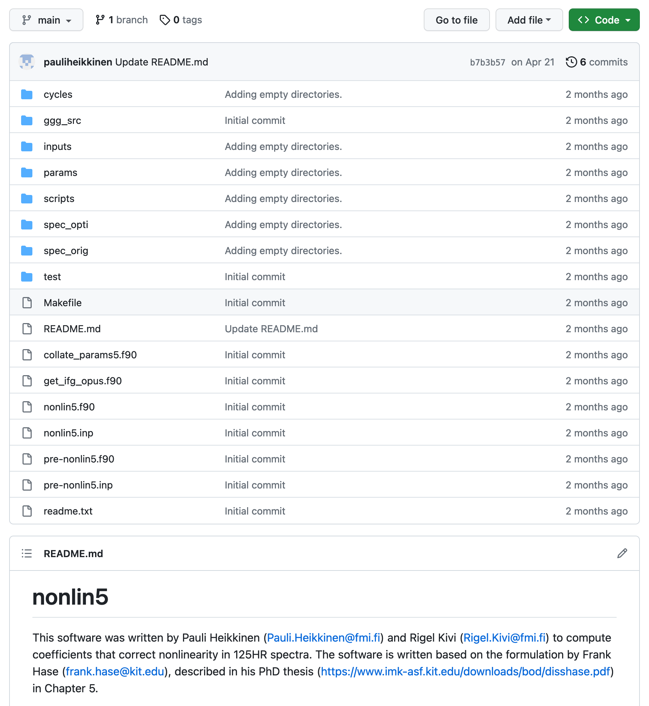
Non-linearity correction in I2S (GGG202X)
Thank you to Pauli and Rigel for making the nonlinearity fitting code available to the network.
Helping us modify this to work with InGaAs-only data (currently needs InGaAs + Si, haven’t tested with InGaAs + InSb)
Making this easier to use end-to-end is an important task
Since nonlinearity is more common in our data than we expected, incorporating the ability to correct this into I2S will be critical
The current method of hard-coding the correction into I2S is inconvenient, the intention is to make this a parameter in the I2S input file
If there is enough interest, we could potentially release an I2S2020 version with this functionality added
We would need some volunteers to test and confirm that such a version introduces no other changes in the spectra produced

Slide 13
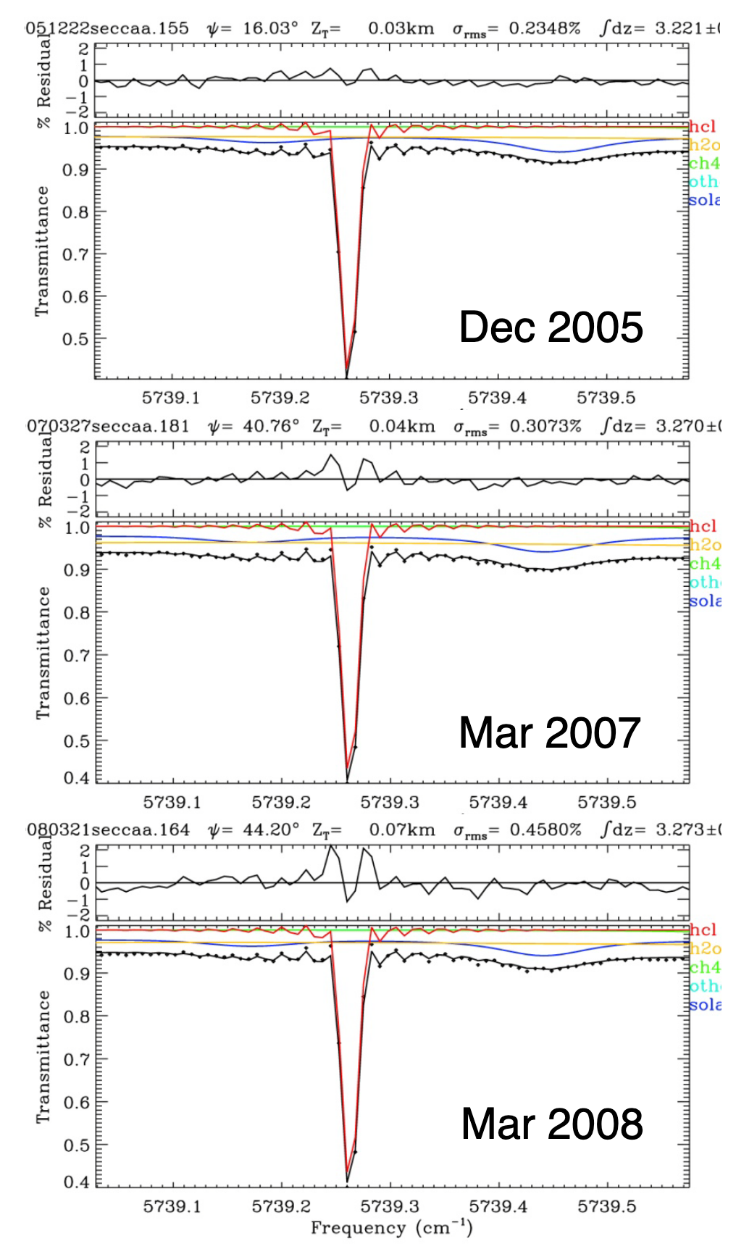
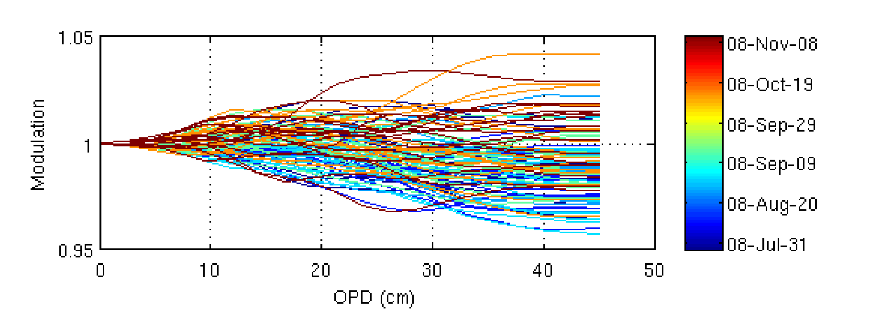
Modeling non-ideal ILS in GFIT (GGG202X)
Implementing variable ILSes in GFIT has been desired for some time.
This would allow the retrieval to better account for instrument errors, e.g. shear/angular misalignment
The current plan is to fit an ILS via an external program (e.g. LINEFIT) and feed that into GFIT via either the runlog or a new input file
Input via the runlog with parameters OPD, FOVI, AMAL, and a new “shear” parameter would be ideal for traceability, since these values can be stored in the .private.nc files
There remain technical details to work out in calculating these parameters from LINEFIT modulation efficiencies (MEs)
Testing will also be needed to quantify how well the runlog parameters capture the information contained in the LINEFIT ME output.
Plots from Geoff & Debra’s 2009 talk. Left = Darwin, above = Lamont.
See Geoff’s talk for details
https://tccon-wiki.caltech.edu/pub/Main/PresentationsandPostersGarmisch/Impact%20of%20Misalignment%20on%20ILS.pdf
Notes:
Some examples on https://tccon-wiki.caltech.edu/Main/GfitTreatmentofInstrumentLineShape, but not bad ones

Slide 14
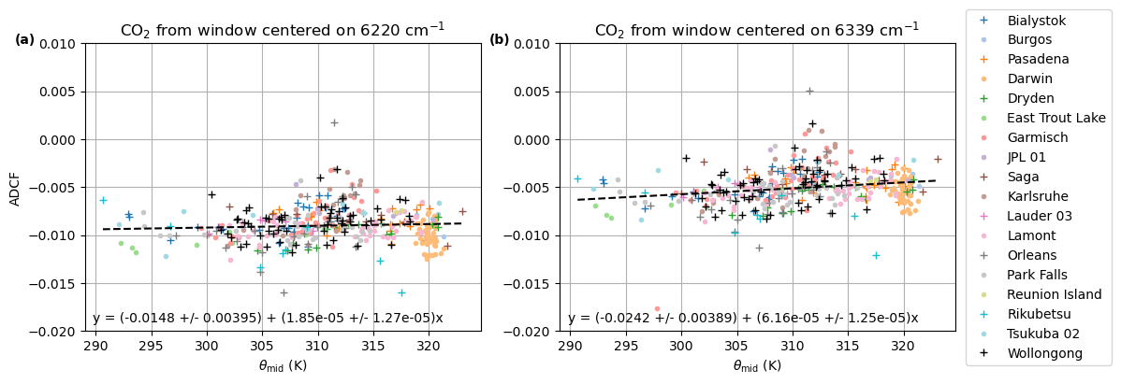
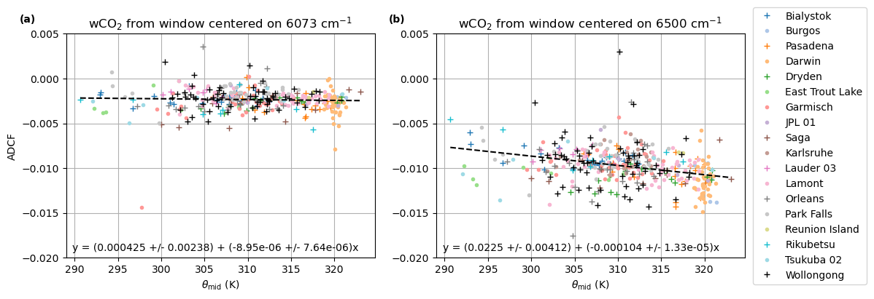
Improved spectroscopy for N₂O, CH₄, and CO₂ (GGG202X)
As mentioned in the “Temperature-based bias correction” task for GGG2020.2, we believe there are errors in the temperature-dependent broadening of N₂O and CH₄ lines.
There is also some possible temperature in CO₂ windows; one candidate wCO₂ window was removed from GGG2020 because of this.
The improvements we find in the spectroscopy from the GGG2020.2 bias correction will be incorporated into GGG202X.
6500 cm⁻¹ window not used in GGG2020

Slide 15
Support for modern gfortran compilers (GGG202X)
For GGG202X, our development compiler will be at least gfortran v8.5.0
We recognize that gfortran versions 10 and higher do not allow GGG2020 to compile successfully
Given long development times, we won’t be able to target the latest gfortran compiler at time of release
However, we will aim to get compilation at least working on gfortran 10/11/12, even if that is not the recommended compiler.
We have not yet isolated the NaN bug in non-Voigt windows on gfortran versions 7 to 9
We’re not able to reproduce this bug on our system even using v8.5
This suggests that it is either a machine-dependent problem with e.g. file access or a combination of that and the compiler version
To really track this down, we need assistance from someone who has encountered this problem

Slide 16
Using machine learning to extract diurnal cycles from temporally sparse data

Slide 17
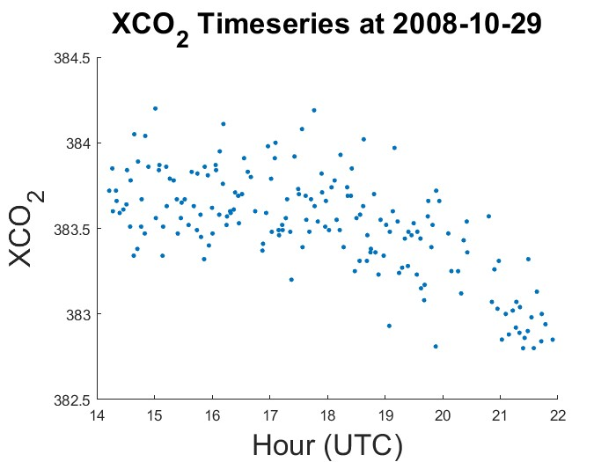
Introduction
Deriving XCO2 Diurnal Cycles from Space Based Column Measurements
XCO₂ Diurnal Cycles
XCO₂ diurnal cycles give information on regional CO₂ drawdown from photosynthesis
Diurnal cycles captured by TCCON reveal an afternoon drawdown in XCO₂ from increased photosynthetic activity
XCO₂ drawdown can be used to calculate Net Ecosystem Exchange (NEE)
G. Keppel-Aleks et al. Biogeosciences, 2012. doi: 10.5194/bg-9-875-2012

Slide 18
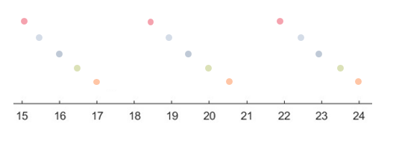
Methods
Deriving XCO2 Diurnal Cycles from Space Based Column Measurements
Machine Learning Model
Random Forest Model
Features:
Subsampled TCCON observations at a mimicked GeoCARB scanning pattern
3 observations 3.5 hours apart, with randomized start time
Source | Variable
TCCON | XCO₂, Solar Zenith, Azimuth, Temperature Delta XCO₂, Delta Solar Zenith
GOME/ SCIAMACHY | SIF (monthly averaged)
What should our models target variable be?

Slide 19
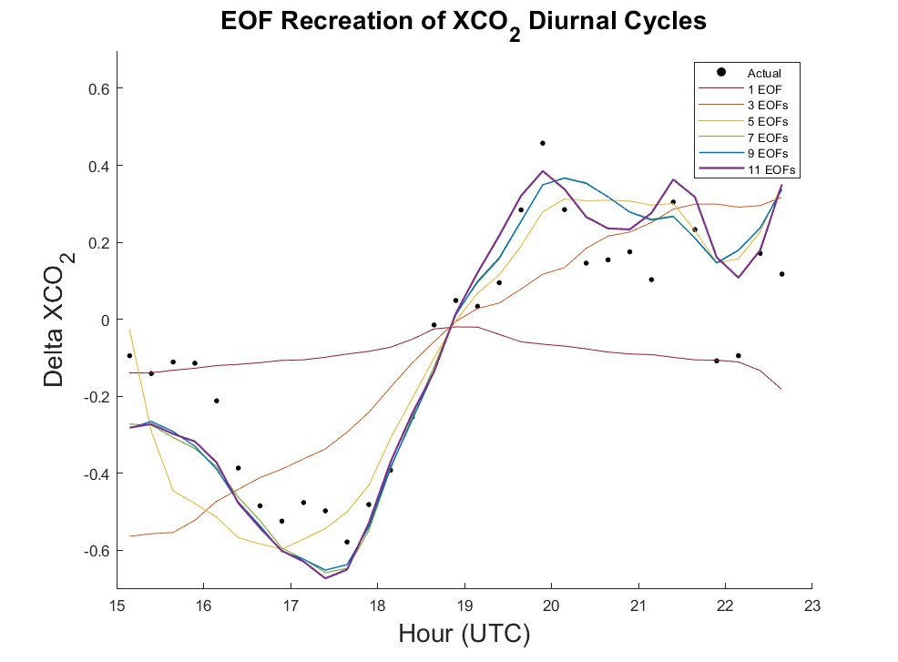
Methods
Deriving XCO2 Diurnal Cycles from Space Based Column Measurements
Empirical Orthogonal Functions (EOFs)
EOFs are a way of capturing patterns of variability in a data set, with each sequential EOF representing finer variation
For our data, we want to capture 95% variance, which takes 12 EOFs
Model output is the EOF principal components

Slide 20
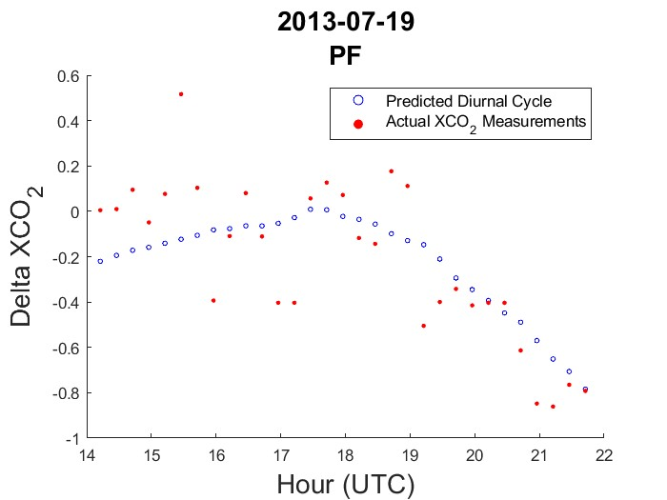
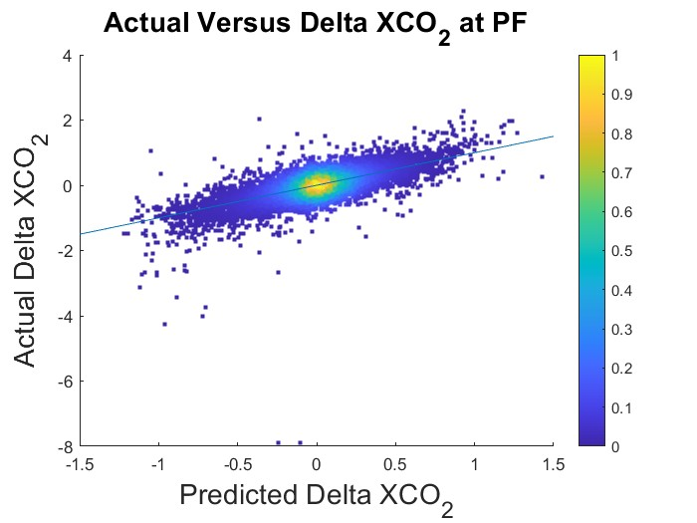
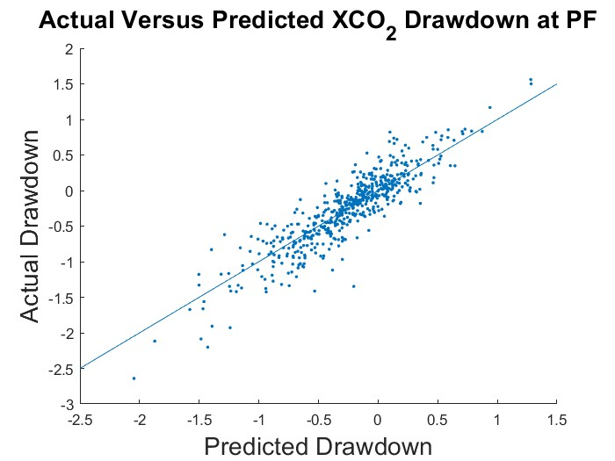
Results
Deriving XCO2 Diurnal Cycles from Space Based Column Measurements
XCO₂ Drawdown/ Net Ecosystem Exchange
From Diurnal Cycles we can calculate XCO₂ drawdown
Defined as the 6 hour difference in XCO₂ centered around solar noon
Better representation of our model’s accuracy
R2: 0.67
R2: 0.83
From drawdown, we can calculate net ecosystem exchange

Slide 21
To access additional layout options, on the Home tab, click the down arrow next to New Slide on the menu bar.
To obtain the appropriate marking and handling instructions for your information, visit the Marking and Handling Wizard at https://mh.jpl.nasa.gov and answer a few questions about the information's content. The Wizard complies with JPL’s Prime Contract requirements, and by implementing the marking and handling instructions provided by the Wizard, the document will be in compliance with JPL’s Marking and Handling requirements.
When you find your correct marking, copy it to your clipboard; then on the Insert tab, click Header & Footer, and paste it in the Footer box.

