Slide 1

GGG Updates and Plans 2022/23
Jet Propulsion Laboratory
California Institute of Technology
2023-06-12
Josh’s presentation will cover the models, priors and biases
This talk covers the other stuff including ILS progress
Future plans for the GGG software
Copyright 2023 California Institute of Technology. Government sponsorship acknowledged.

Slide 2
Progress with the GFIT ILS
GGG2014 and 2020 assume a perfect ILS based on the MOPD and FOVI parameters in the runlog and v₀ from .ggg file.
The third ILS parameter (AMAL) was implemented into my GFIT code in 2022, to correctly handle angular tilt misalignment, based on the equations of Kauppinen and Saarinen (1992). (Only took me 30 years to get around to implementing). This works well for double-passed instruments (e.g. MkIV) in which any shear is passively compensated and therefore negligible, as shown at 2022 virtual meeting.
So my current version of GFIT assumes an ILS characterized by 3 instrumental parameters read from runlog:
Max Optical Path Difference (MOPD)
Field of View Diameter (FOVI)
Tilt Mis-alignment (AMAL)
It also supports several apodization functions, e.g. Box-Car, Norton-Beer weak/medium/strong, triangular, ramps)
Tilt misalignment is a lateral displacement of the vertex of the moving HCCRR wrt the optical axis (defined by the detected radiation & fixed HCCRR) that increases linearly with OPD. This causes the center of the Haidinger fringe pattern to have an angular offset from the center of the field stop that is OPD-independent. Tilt misalignment results in self-apodization producing an asymmetrical contribution to the ILS.
But for instruments that also have significant shear (e.g. single-passed Brukers) the tilt misalignment capability won’t be a complete solution. We need a ILS method that will handle cases of shear and tilt misalignment.
Why not use LINEFIT?

Slide 3
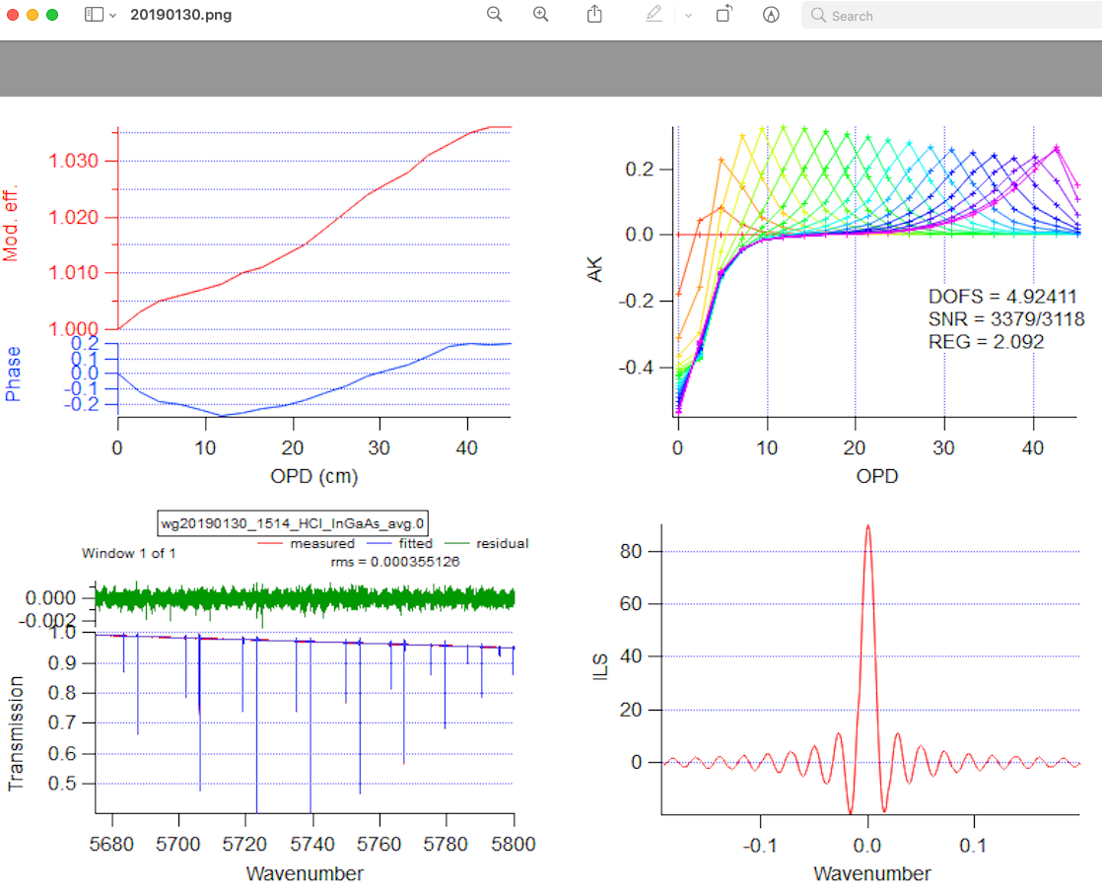
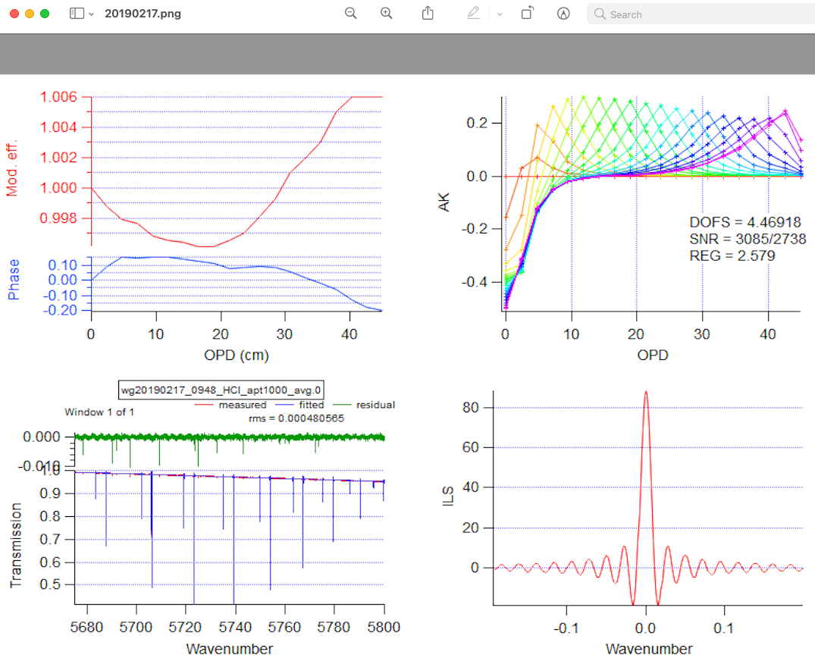
Griffith/Wollongong LINEFIT ILS Exercise
Plots from Dave’s LINEFIT analysis of Wollongong cell HCl spectra, before (left) and after (right) a realignment.
Left: Before realignment; ME reaches 1.035 Right: After realignment; ME is much closee to 1
GFIT cannot use the LINEFIT ILS directly because the dv grid is different to what GFIT wants and is only valid at 5700 cm-1. But GFIT could use the ME/ѱ produced by LINEFIT then compute ILS on the grid that it wants for any window.
Wrote subroutine MEPH2ILS to compute ILS for any FOVI and v₀, on any dv grid using ME/ѱ on any dx grid as imput.
Checked the ILS produced by MEPH2ILS and LINEFIT for the Wollongong cases.

Slide 4
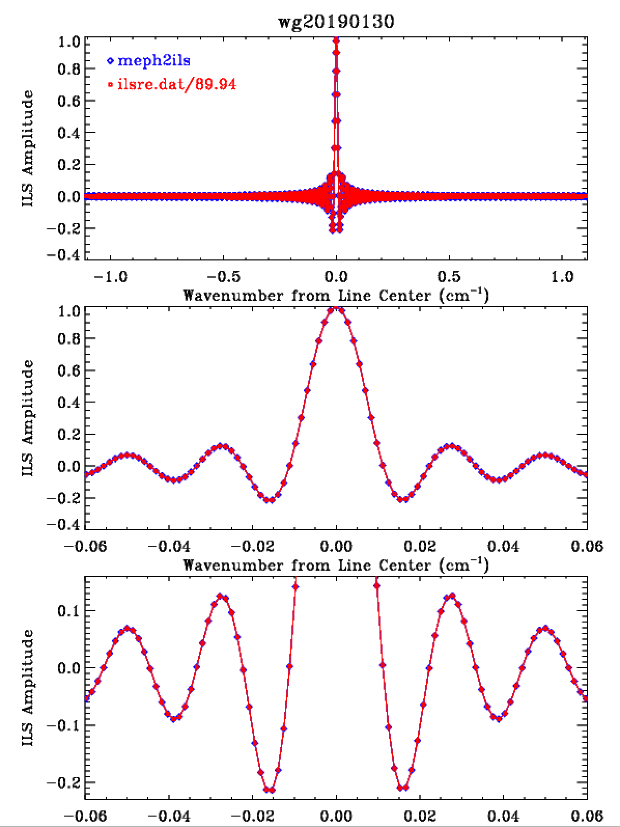
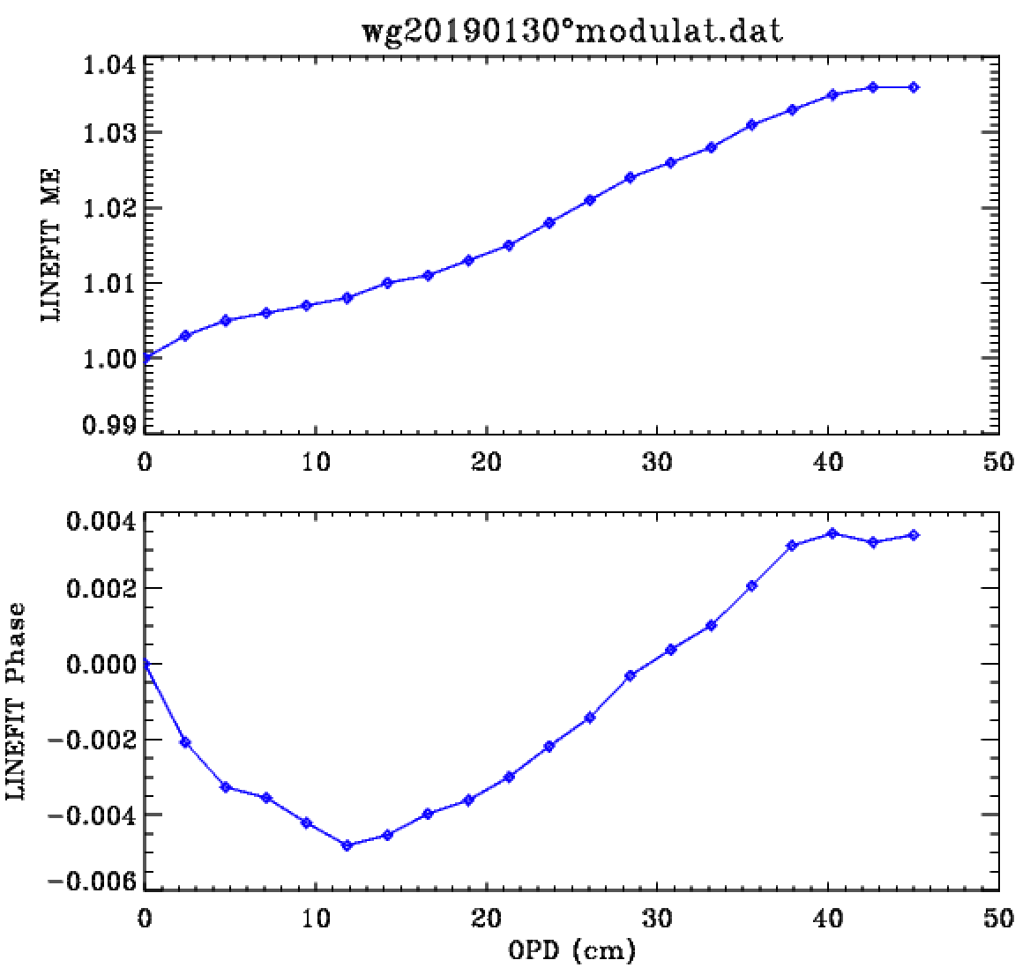
Wollongong ILS before re-alignment
Compared ILS produced by LINEFIT (ilsre.dat) with that produced by me2ils subroutine, which re-samples the ME and φ onto a different dx grid, to match the desired dv grid: dv.dx.NFFT=1 (NFFT=2¹³)
The smaller dx and the larger NFFT, the less spectral leakage.
Multiply ME by self-apodization = SINC(π v₀ MOPD f ²)
Converts ME/φ to a complex vector = ME(x).[sinφ(x) + i.cosφ(x)]
Zero-fills and perform a complex-to-real DFT.

Slide 5
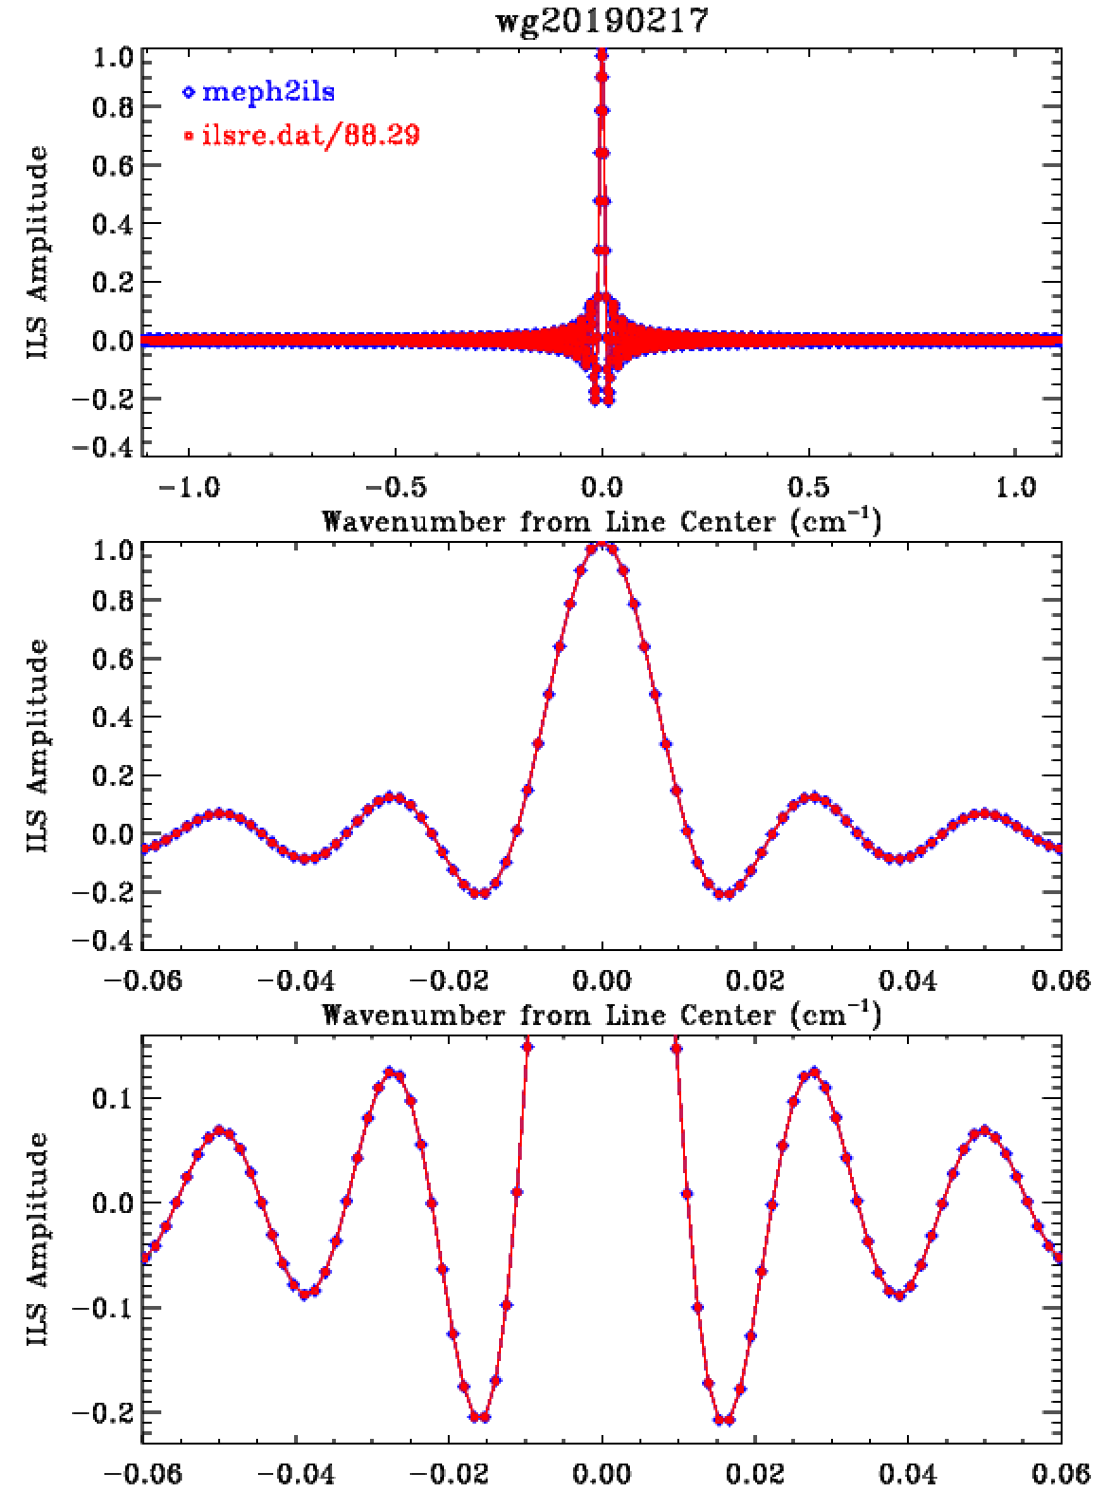
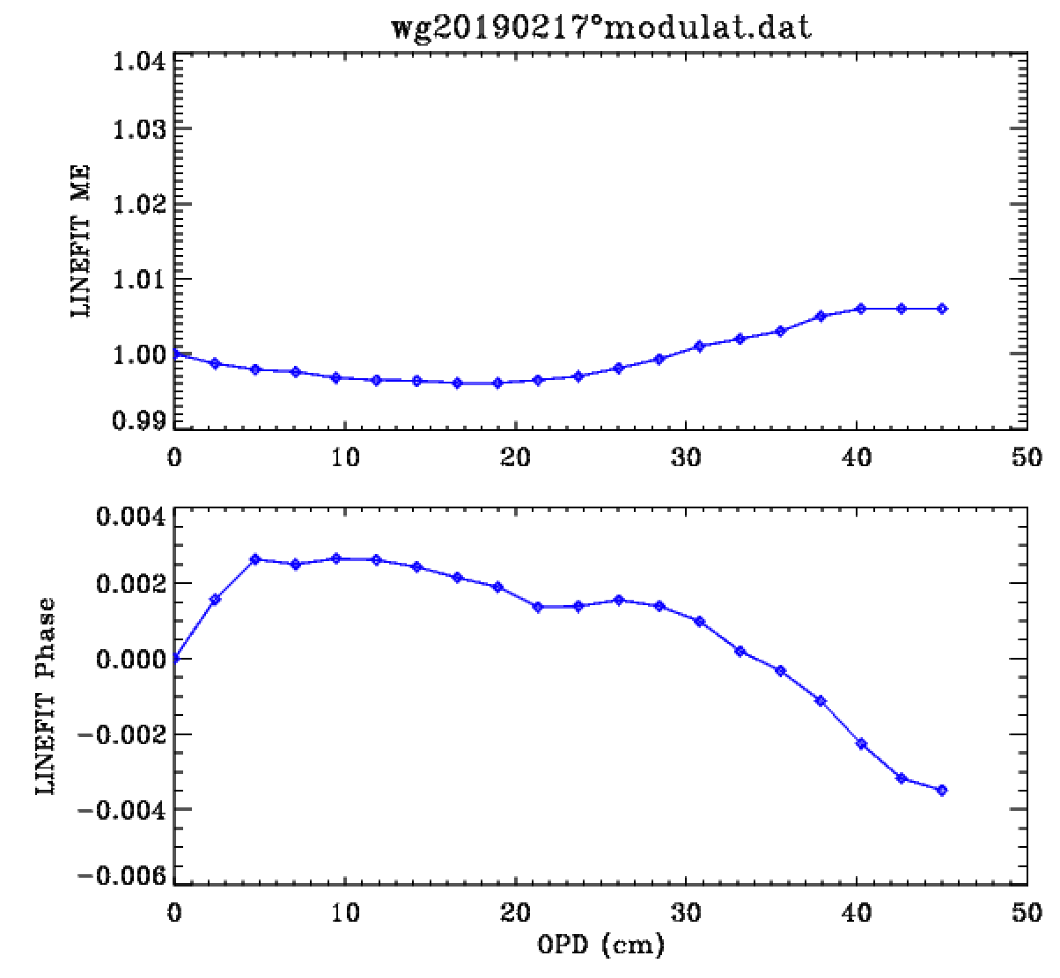
Wollongong ILS after re-alignment
ME is much improved (closer to 1). Phase is slightly better (closer to 0).
Very good agreement between LINEFIT and MEPH2ILS subroutine in both cases, so could use meph2ils inside GFIT.
The MEPH2ILS subroutine seems to correctly converts ME/ѱ into an ILS

Slide 6
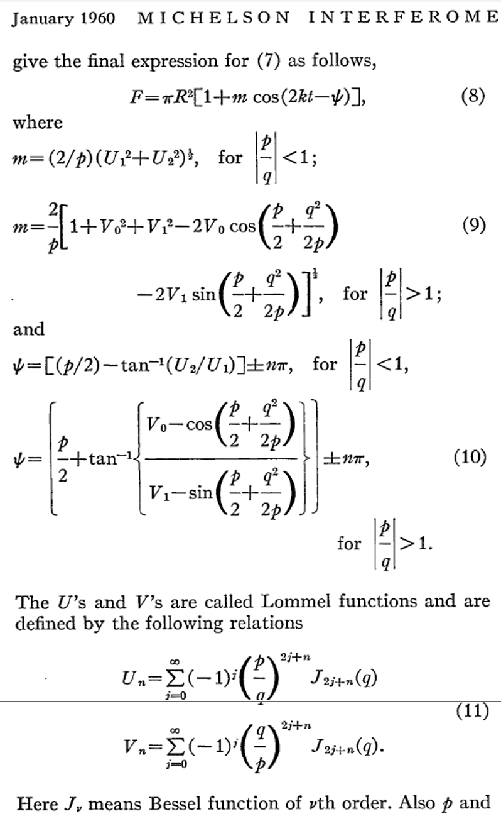

Tested Three Forward Models for Computing ILS from knowledge of OPD, FOVI, AMAL, SHEAR, v₀
from Murty (1960)
Have previously shown that the following 3 methods give consistent ILS results:
1) Numerical Integration: Perform 2D integration of the monochromatic (v₀) fringe pattern over the circular FOV. Do this for every OPD step, creating mono-chromatic igram. FFT creates ILS centered at v₀. Very slow.
2) Use Equations of Kauppinen and Saarinen (1992): In special case of tilt-misalignment (no shear), the ILS contribution from self-apodization can be written down directly as an inverse cosine function in spectrum space, without any integration over the FOV or Fourier Transform. Limited applicability single-passed FTS (e.g. IFS120HR), but useful check on the other methods.
3) Use Equations (9) and (10) of Murty (1960) (right) to calculate the ME (m) and Phase (ѱ) as a function of p and q which describe motion of the moving HCCRR.
p = 4 π v t f ² ≃ 2 π v OPD f ²
q = 4 π v e f
where f (=R) is the FOV radius (rads), t is the displacement of the MHCCRR along the optical axis, and e is its lateral displacement (shear) from this axis. So OPD ~ 2t. Create complex igram-values
I(t,e) = ME(t,e).[cosѱ(t,e) + i.sinѱ(t,e)]
truncate at max OPD, perform complex-to-real DFT to yield ILS centered at 0 cm⁻¹.
Assume, e.g., that e = e_{ZPD} + tilt*t that lateral displacement is linear in OPD

Slide 7
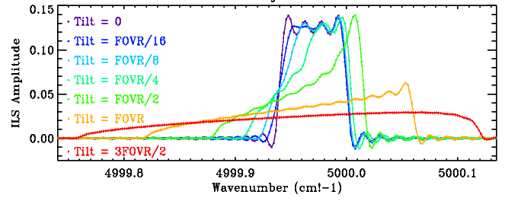
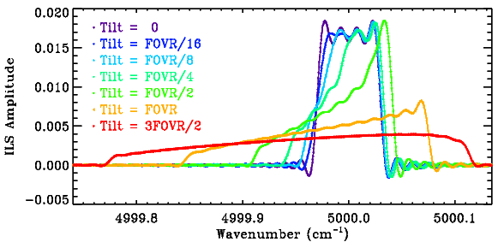
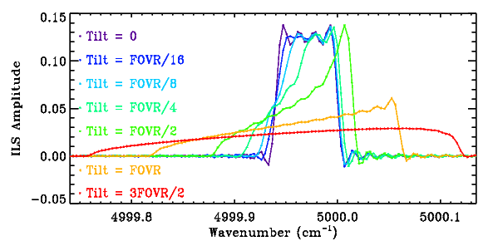
Comparing ILSs computed by the three different methods in tilt-only case
For the case v₀=5000, cm⁻¹, FOVR=4.9 mrad, Max OPD=66.7 cm, and AMAL/FOVR = 0.0 to 1.5
where FOVR is the FOV radius, which is half the FOVI diameter in the runlog. Such a large FOVR and OPD values were chosen to broaden and hence more clearly see the underlying self-apodization contribution beneath the SINC. This is not how a real FTS would be aligned, it is a test of the algorithms for the no-shear case in which the answer is known and simple.
Method 1: Numerical Integration + FFT
Method 2. Kauppinen & Saarinen equation implemented into compute_ils.f and convolved with SINC
These are not typical ILSs. These are extreme cases in which the self-apodization contribution to the ILS is much wider than the SINC, allowing the details of the self-apodization to be seen.
The comparison is not perfect – more work needed -- but it is very close.
Method 3. Murty’s Equation + FFT

Slide 8
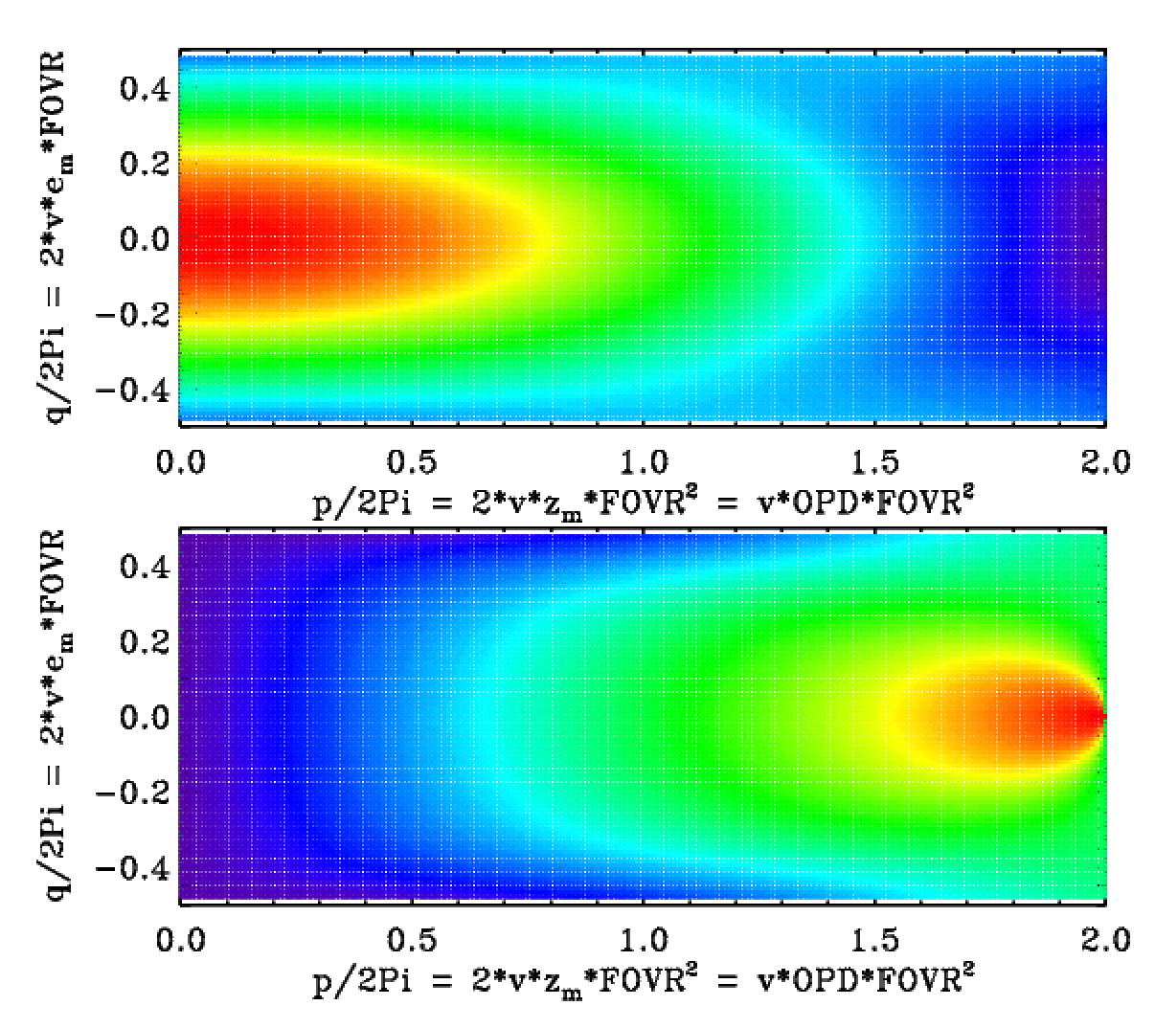
Modulation Depth and Phase computed from eqtns 9 & 10 of Murty (1960)
q=2.22
MD
Figures map the modulation depth (MD) and phase (ѱ) in Murty’s eqtn. 8 over conceivable ranges of p and q.
F = πf²[1 + MD.cos(4πvz-ѱ)]
The top panel is color-coded by MD: Red=1.0, Yellow=0.8; Green=0.55, Cyan 0.4, Blue=0.2, Purple=0.0
Bottom panel is color-coded by ѱ: Red=π, Yellow=0.8*π, Green=0.7*π, Cyan=0.5*π, Blue=0.2*π, Purple=0.0
Brault’s limit is that p/2π =1, so only the left halves of these panels are relevant to a correctly operated FTS.
|q/2π| should normally be < 0.25 or else the shear seriously attenuates the modulation at all OPDs as the fringes become narrower than the FOV/detector.
ME(t,e) = MD(t,e)/ME(t,0)
q=0.91 q=0.0
q=2.22
ѱ
q=0.91 q=0.0
The three horizontal colored lines represent Murty’s three cases: q=0.0; q=0.91; q=2.22.
White dashed lines represent the tilt-only case discussed earlier.
White dotted line represent a more general case of shear + tilt with the peak ME occurring at p/2π = 0.90

Slide 9
Progress and Plans for the ILS
A Fortran subroutine (meph2ils.f) has been written that converts the MOPD, FOVI and vectors of ME and Phase into an ILS, via complex-to-real DFT.
The ME and Phase vectors can come from LINEFIT, or be computed via Murty’s equations from the MOPD, FOVI, AMAL, SHEAR values.
The combination of tilt and shear can have a variety of affects on the ILS. If they reinforce each other, this will cause the ME to decline rapidly with OPD, broadening the ILS. If they cancel each other at a particular OPD the ME will be a maximum there. If this occurs near MOPD then the ILS will be narrower than nominal.
Perhaps for each spectrum GFIT could be modified to search for a valid LINEFIT file containing ME & ѱ versus OPD. If found, it would use this to compute the ILS. If not found, it would feed the OPD, FOVI, AMAL, & Shear values in the (new-format) runlog to Murty’s equations to compute the ME & ѱ versus OPD, and thence Fourier transform to get the ILS.
Where would the runlog values of AMAL and SHEAR come from? Need new programs to derive them directly from the HCl cell spectra or from the LINEFIT ME/ѱ output file.

Slide 10
Currently: GFIT 2022 reads MOPD, FOVI, AMAL from runlog
DUR
APT
APF
FOC
VEL
SSM
SSP
create_runlog
Bruker spectral header
GFIT
MOPD
FOVI
AMAL
Runlog
Runlog
Runlog
1
Currently, the GFIT ILS is computed in wavenumber space using the runlog values of MOPD, FOVI, and AMAL. SHEAR is not used – it isn’t even present in the runlog.
If AMAL = 0, the ILS is symmetrical: it is the convolution of a MOPD-defined sinc function with a FOVI-defined boxcar. So the FOVI broadens and red-shifts the ILS and reduces the ringing (self-apodization).
If AMAL > 0, the left-hand edge of the boxcar becomes a cos⁻¹ function and so the ILS becomes asymmetrical. Non-zero AMAL values must currently be entered by hand into runlog.

Slide 11
Proposed GFIT ILS Computation Scheme
IT
GFIT
ME + ѱ
at 20 OPDs from LINEFIT
Resample
& self-apo
2
v₀
FOVI
ME + ѱ on GFIT dx grid
MEPH2ILS
(FFT)
.ggg file
ILS on
GFIT grid
v₀
Runlog
Murty
Equation
v₀
MOPD
FOVI
AMAL
SHEAR
1
compute_ils
MOPD
FOVI
AMAL
0
GFIT will have three options for computing the ILS:
0: The existing method
1: Use the MOPD, FOVI, AMAL, & SHEAR values from the runlog then use Murty’s equation to compute ME and ѱ vs OPD
2: Use the LINEFIT output file containing ME and ѱ vs OPD directly (plus FOVI from the runlog and v₀ from .ggg file)
One strategy would be to search for a LINEFIT-generated ME+ѱ file. If it exists, use it. If not, compute the ILS from the runlog parameters. How are runlog parameters derived?

Slide 12
Option 2: LINEFIT pre-computes ME+ѱ for subsequent use by GFIT
Off-Line Processing
Lamp HCl Cell Spectra
ILS on
PROFFIT grid
Lamp HCl Cell Spectra
LINEFIT
ILS on
PROFFIT grid
Lamp HCl Cell Spectra
ILS on
PROFFIT grid
ME + Ph
at 20 OPDs
On-Line
Processing
ME + Ph
at 20 OPDs
ME + Ph
at 20 OPDs
2
Lamp HCl Cell Spectra
GFIT
Lamp HCl Cell Spectra
Atmospheric Spectra

Slide 13
Compute ILS from runlog: GFIT fits HCl cell spectra offline to derive runlog parameters
Y
Lamp HCl Cell Spectra
GFIT
Residuals
RES2AMSH
Converged (Y/N)?
Runlog
Lamp HCl Cell Spectra
N
𝛿AMAL
𝛿SHEAR
Lamp HCl Cell Spectra
MOPD
FOVI
AMAL
SHEAR
Use GFIT to fit HCl cell spectra. A new program (RES2AMSH) examines the residuals and computes what changes to AMAL and SHEAR would improve the fits. These updated values are written to the runlog, and the fitting is repeated. Iterate until convergence.
ILS is parameterized from 4 inputs: MOPD, FOVI, AMAL, SHEAR. MOPD and FOVI are known and held constant. AMAL and SHEAR are adjusted to optimize fits to HCl cell spectra. Would requires another column in the runlog (SHEAR).

Slide 14
Compute ILS from runlog: new program MEPH2AMSH to derive AMAL and SHEAR from LINEFIT ME/Ph output
Lamp HCl Cell Spectra
LINEFIT
ME + Ph
at 20 OPDs
MEPH2AMSH
(invert Murty)
Lamp HCl Cell Spectra
ME + Ph
at 20 OPDs
AMAL
SHEAR
Runlog
Lamp HCl Cell Spectra
ME + Ph
at 20 OPDs
LINEFIT extracts ILS information from the HCl cell spectra.
A new program (MEPH2AMSH) then reduces these 40 pieces of info (ME/ѱ vs OPD) into AMAL & SHEAR values. This process uses an iteration loop to invert Murty’s equations (adjust AMAL & SHEAR to best match ME & ѱ). This process inevitably loses of information (40 → 2), so the quality of spectral fits to the HCl cell spectra will be poorer. But 2 adjustable ILS parameters better than 0.
This approach would avoid having to write the RES2AMSH program to derive AMAL and SHEAR from the HCl spectra. Instead, we write the simpler MEPH2AMSH program.
The subsequent analysis of atmospheric spectra is consistently done using the runlog.

Slide 15
Upgrade from GFORTRAN V4 to V8.5 compiler – in progress
There have been reports of NaNs in the GFIT output files, especially if using more recent versions of the GFORTRAN. These occurred in windows that use the non-Voigt lineshape, suggesting problems with the DSDV code.
Couldn’t reproduce any NaNs with the gfortran V4 compiler, so I began using the V8.5 compiler on ccycle. Again, no NaNs.
But V8.5 did report dozens of warnings that V4 hadn’t. Many of these involved mixed precision arithmetic: e.g. setting the result of a double-precision calculation to single-precision without using the “sngl” intrinsic function, or the use of obsolete F77 features (e.g. conditional goto). Fixed all these in my 2023 version of the code, but there still remain several warnings. For example, the simple test program below:
parameter (np=10)
real*4 y(np)
do i=1,np+8
if(i.le.np) y(i)=float(i)
end do
produces the following warning with the standard TCCON compiler flags:
do i=1,np+8 2
if(i.le.np) y(i)=float(i)
1
Warning: Array reference at (1) out of bounds (18 > 10) in loop beginning at (2) [-Wdo-subscript]
Only a warning, but when there are dozens of them it become tedious to check whether any more important warnings are interspersed. This could easily be fixed by setting np=18 and removing the “+8” and the if-statement. But there are situations where this would cause other complications.

Slide 16
Upgrade from GFORTRAN V4 to V8.5 compiler – in progress
Also, under V8.5, all TCCON windows cause IEEE_DENORMAL, IEEE_UNDERFLOW exceptions, which are reported as GFIT finishes. I’m not worried about *these* exceptions. They just mean that a number became too small to be represented in IEEE format and so was denormalized or set to zero.
OVERFLOW and INVALID exceptions are more serious. These imply that a large number exceeded the IEEE limit, even after denormalizing, or that an illegal operation was attempted e.g. zero-divide or sqrt(-ve). I was able to eliminate all of these from my code, at least for the TCCON and MkIV benchmark cases.
I suspect that there might be a correlation between OVERFLOW and INVALID exceptions and NaNs but I cannot confirm.

Slide 17
Summary, Conclusions and Plans
Some progress has been made on the implementation of an imperfect ILS, but not as much as I had hoped.
First, Josh and I need to merge our GGG versions, which diverged in 2019. Since then:
Josh implemented the GGG2020 upgrades (e.g. new vmr profiles, airmass correction for individual windows).
I have made considerable spectroscopy upgrades (mainly in the MIR) since then and many coding changes to prevent compiler warnings.
i2s now has improved behavior for low-resolution cases
Install the MEPH2ILS subroutine into GFIT to compute the ILS and develop the interface to LINEFIT ME/ѱ files.
Develop the MEPH2AMSH program to derive AMAL and SHEAR from LINEFIT ME/ѱ output file. Compare resulting ILS with those from direct DFT of the ME and ѱ.
Continue monitoring the spectroscopy coming out for HITRAN2024. If anything looks better than what we currently have, adopt it.

Slide 18
Supplemental material on O₂ spectroscopy in the 7885 cm⁻¹ band.

Slide 20
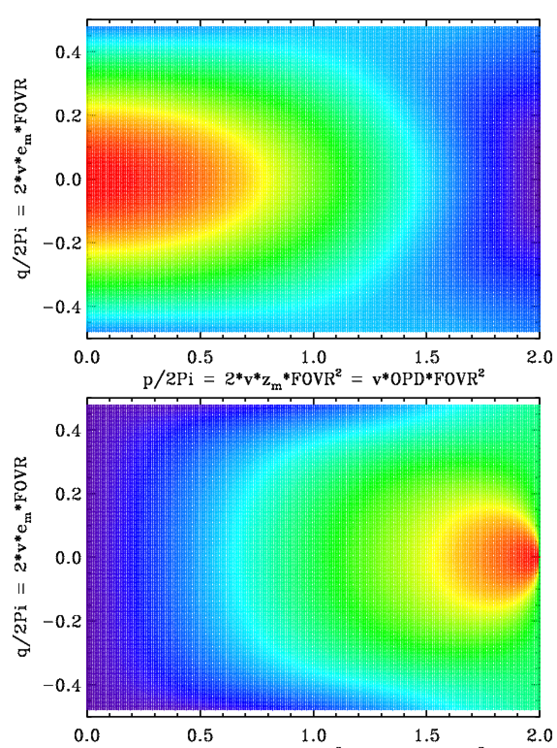
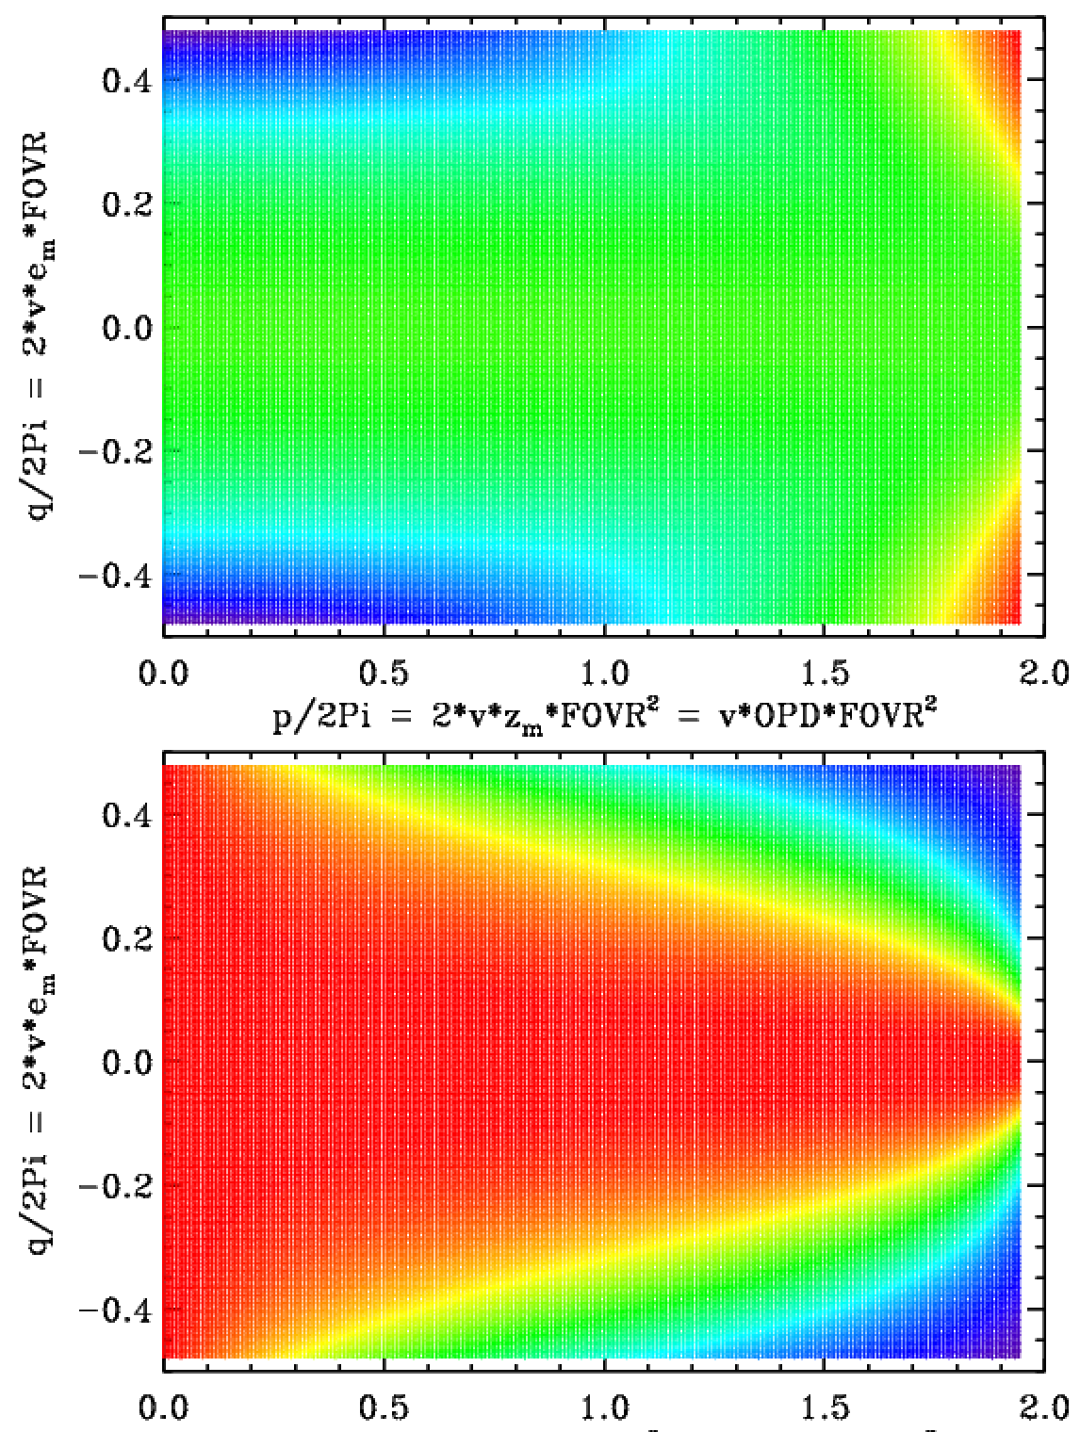
MD
ME(p,q) = MD(p,q)/MD(p,0)
ѱ
ѱ-ѱ₀

Slide 21
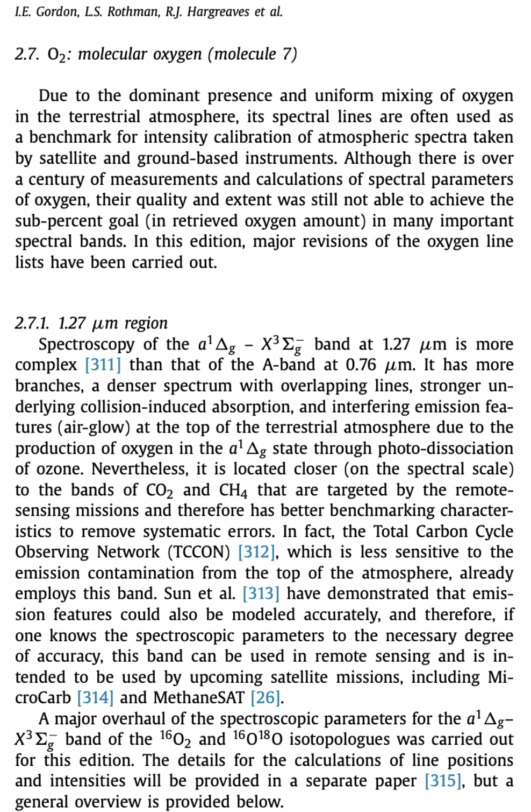
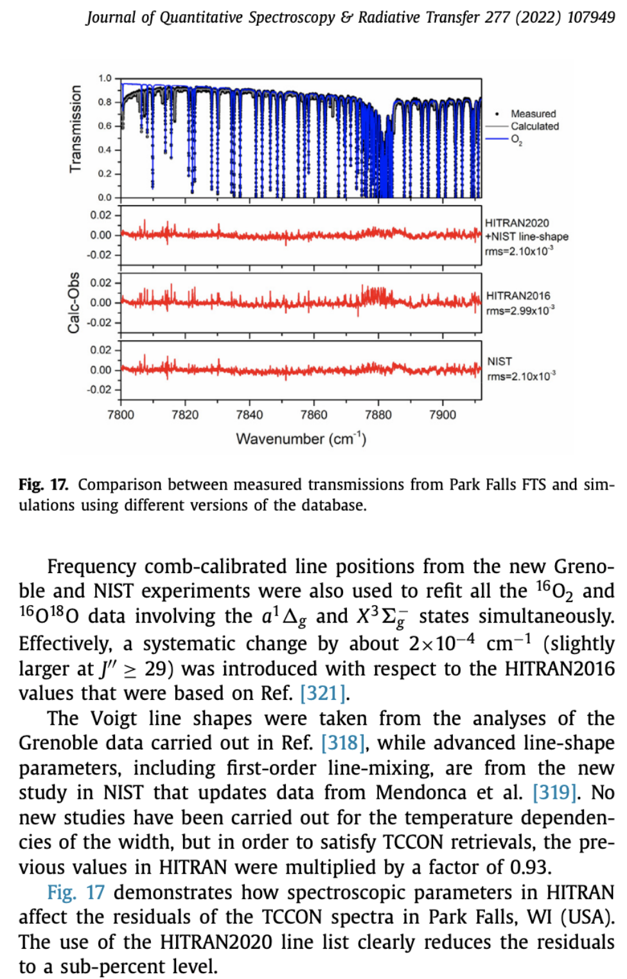
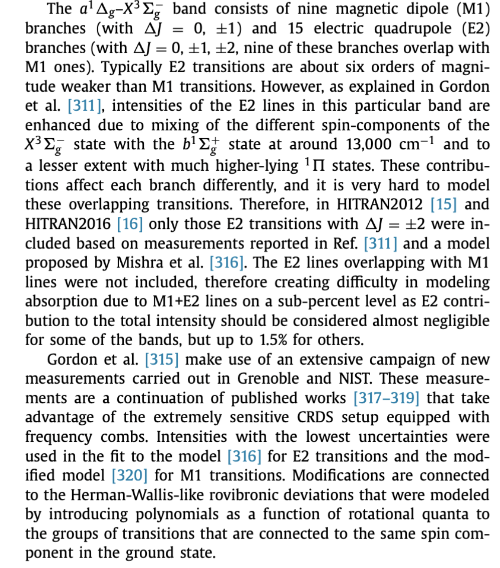
Gordon et al. 2022: O₂ section

Slide 22
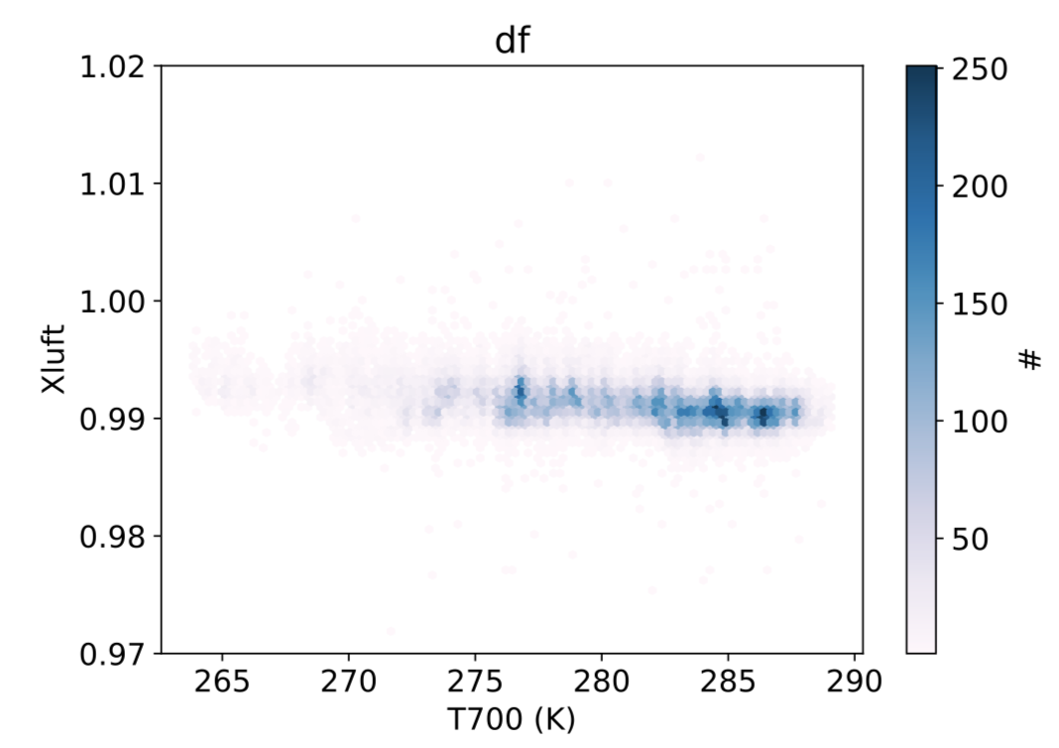
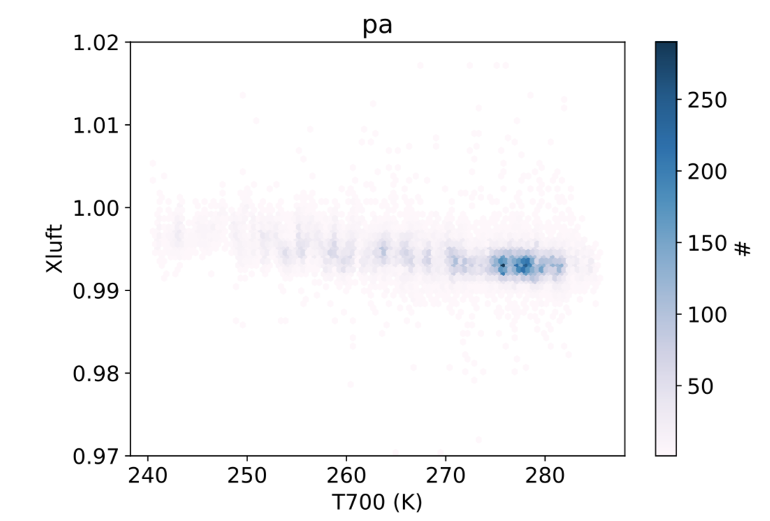
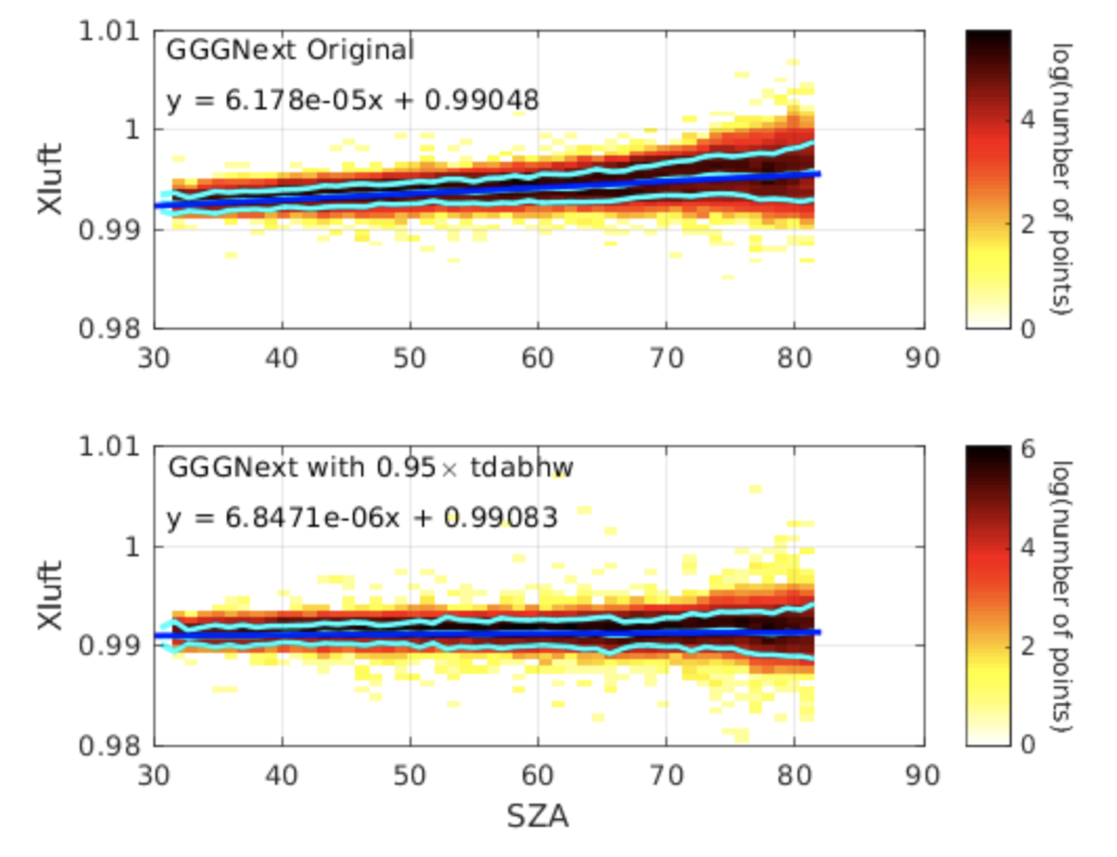
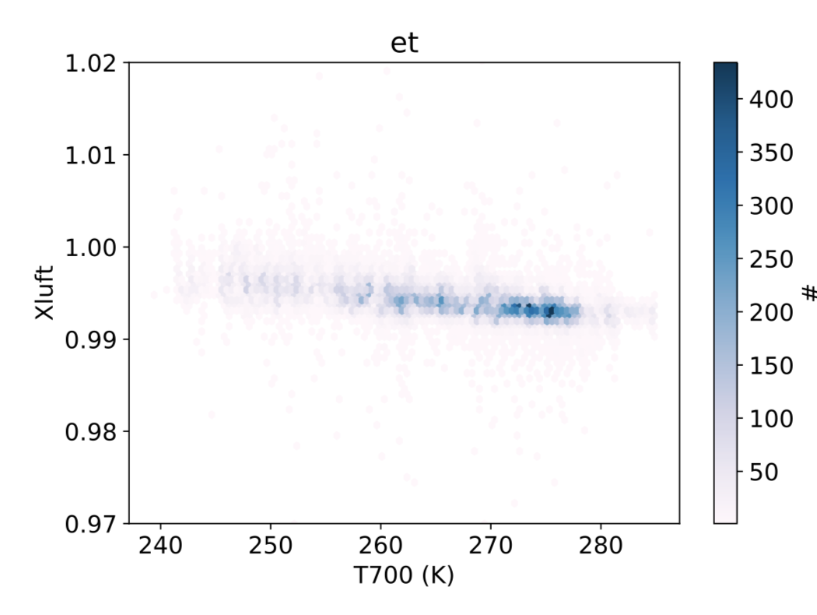
TCCON-motivated adjustments to O₂ 1.27um band spectroscopy
Toon, Laughner, Wunch, Roehl, Roche, Wennberg
2020-06-28
TCCON measurements of O₂ are used to cancel systematic errors (instrumental, atmospheric) in measurements of other gases via Xgas = 0.2095 * Gas_Col / O2_Col .
The O₂-derived Xluft = 0.2095 * Air_Col(Ps) / O2_Col(spectra) is useful diagnostic for QC/QA.
Xluft should always be 1.0 since atmospheric O₂ dry mole fraction varies little from 0.2095.
But TCCON Xluft always been systematically ~1% low as compared to surface pressure.
Additionally, Xluft has small (0.3%) Airmass-, Temperature-, and H₂O-dependences, despite using the Speed-Dependent lineshape and Linelist described in Mendonca (2019).
We investigate the possibility that these issues could be spectroscopic in origin.
Panels upper-right show the downward variation of Xluft = 0.2095*Air_Col(Ps) / O2_Col(spectra) with mean tropospheric temperature (T700) at 3 TCCON sites.
Left: showing the old variation of Xluft with SZA at one site (ET). Although this variation is only 0.3%, it cannot be atmospheric. This artifact will induce a 0.3% airmass-dependent bias to XCO2 (1.2 ppm) which will cause a false latitude dependence, and hence spurious CO₂ source/sink attribution.
SZA

Slide 23
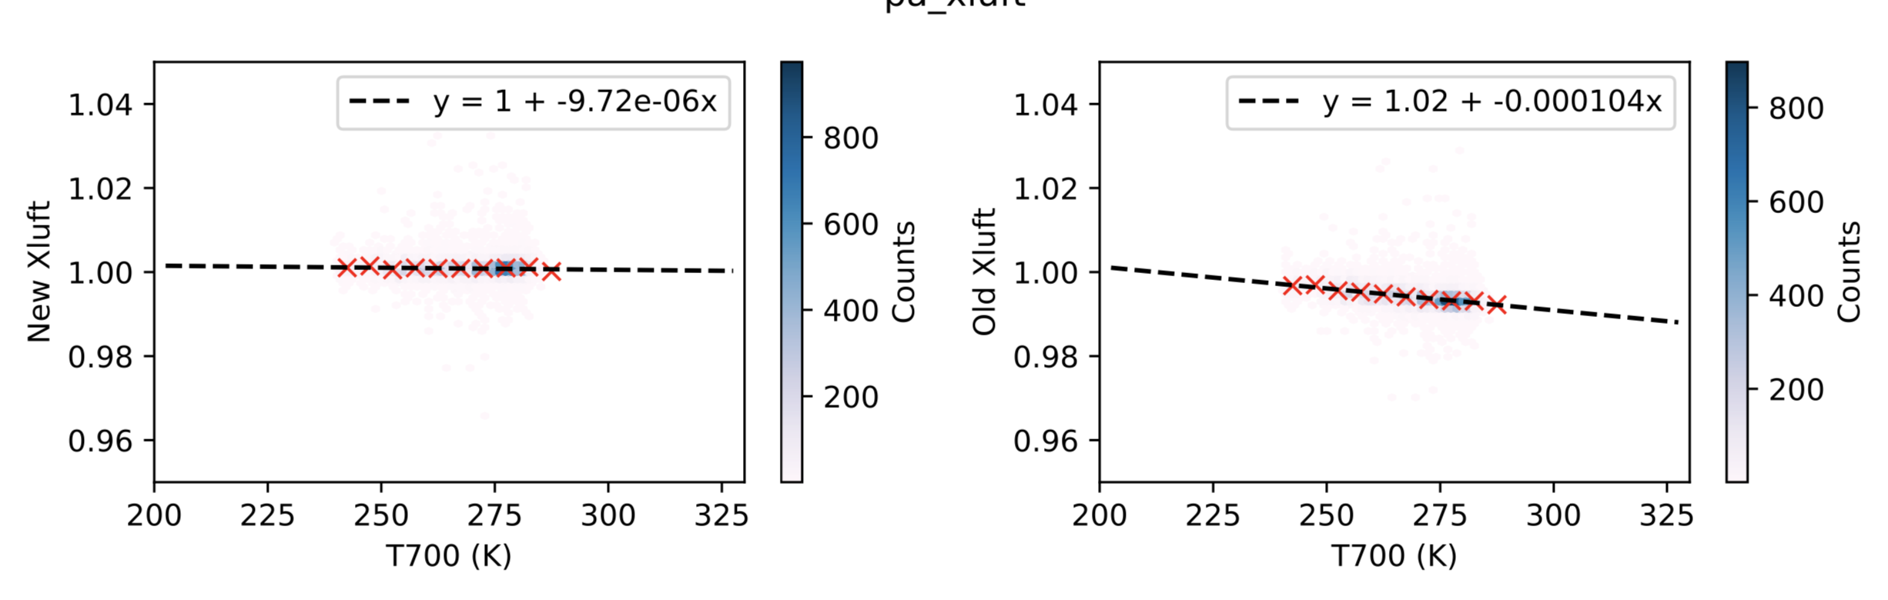
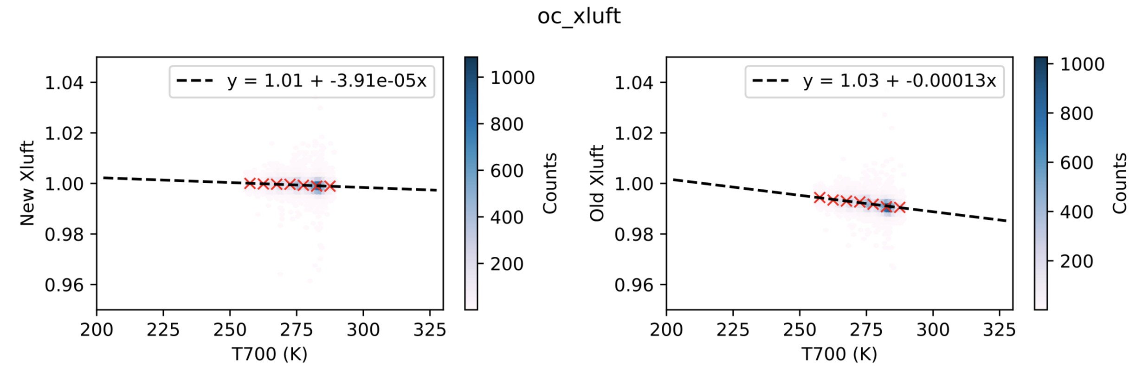
TCCON-motivated adjustments
Temperature
Dependence of
Pressure
Broadened
Half
Width
TDPBHW =
Also termed η
We investigated the sensitivity of the retrieved Xluft to various spectroscopic parameters.
After trying to minimizing the variation of Xluft (O2) with SZA, Temperature, and H₂O, over several sites, we opted for the following spectroscopic changes:
Intensities: x 1.01
Widths: x 1.002
TDPBHW: x 0.93
to the O₂ lines over the 7664-8115 cm⁻¹ region. These changes also slightly reduced the rms fitting residuals, but this was not the primary motivation.
Figures right shows the effect of these changes on the Xluft at the TCCON sites at ParkFalls and Lamont. The right panels show the Mendonca spectroscopy. The left panels show the impact of the changes listed above.

Slide 24
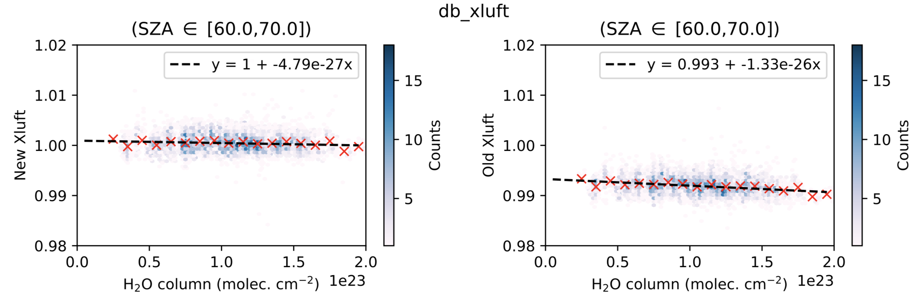
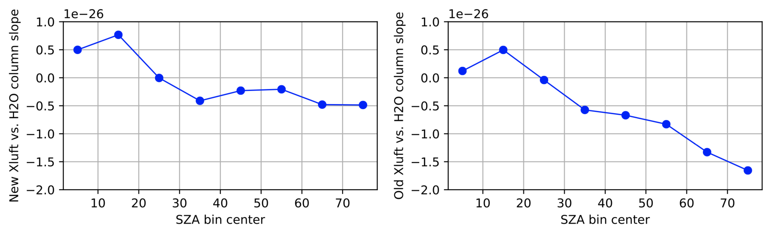
TCCON-based spectroscopy adjustments: H₂O broadening of O₂
We further noticed that after binning for SZA, there was a H2O dependence of the Xluft. We found that by assuming that the H2O-broadening of O₂ was 1.4 times that of the air-broadening, this artifact could be reduced.
Upper-Right: Shows the factor 3-4 reduction in the slope of the H₂O-dependence of retrieved O₂ for 60°<SZA<70° using H₂O-broadening of O2 of 1.4x that of air-broadening, plus the previously-discussed adjustments.
Lower-Right: Summarizing the effect of the change in the H₂O-broadening of O₂ over the full range of SZA. At large SZA, the slopes become less negative.
New Old
New Old

Slide 25
Discussion
Are these changes plausible from a spectroscopic viewpoint? Or are we mis-attributing to spectroscopy problems that originate elsewhere?
1) Look at the HITRAN uncertainty flags, which are “554444” for the stronger O₂ lines in this band
So the intensities are good to 5-10% and the widths and TDPBHW to 10-20%
So our adjustments are well within the HITRAN uncertainties.
2) Look at the lab data on which these spectroscopic parameters are based, and compare with other high-quality lab data.
References:
Joseph Mendonca, Kimberly Strong, Debra Wunch, Geoffrey C. Toon, David A. Long, Joseph T. Hodges, Vincent T. Sironneau, and Jonathan E. Franklin, Using a speed-dependent Voigt line shape to retrieve O₂ from Total Carbon Column Observing Network solar spectra to improve measurements of XCO₂, Atmos. Meas. Tech., 12, 35–50, 2019
https://doi.org/10.5194/amt-12-35-2019
D.D. Tran, H. Tran, S. Vasilchenko, S. Kassi, A. Campargue, D. Mondelain, High sensitivity spectroscopy of the O2 band at 1.27 µm: (II) air-broadened line profile parameters, Journal of Quantitative Spectroscopy and Radiative Transfer, 240, 2020, 106673, ISSN 0022-4073, https://doi.org/10.1016/j.jqsrt.2019.106673.

Slide 26
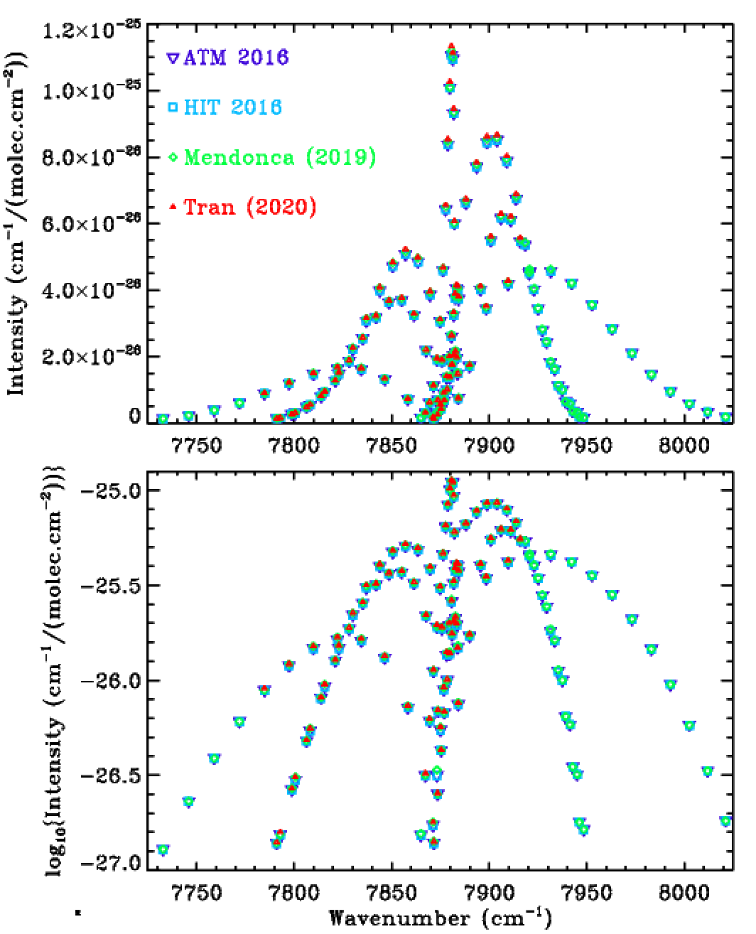
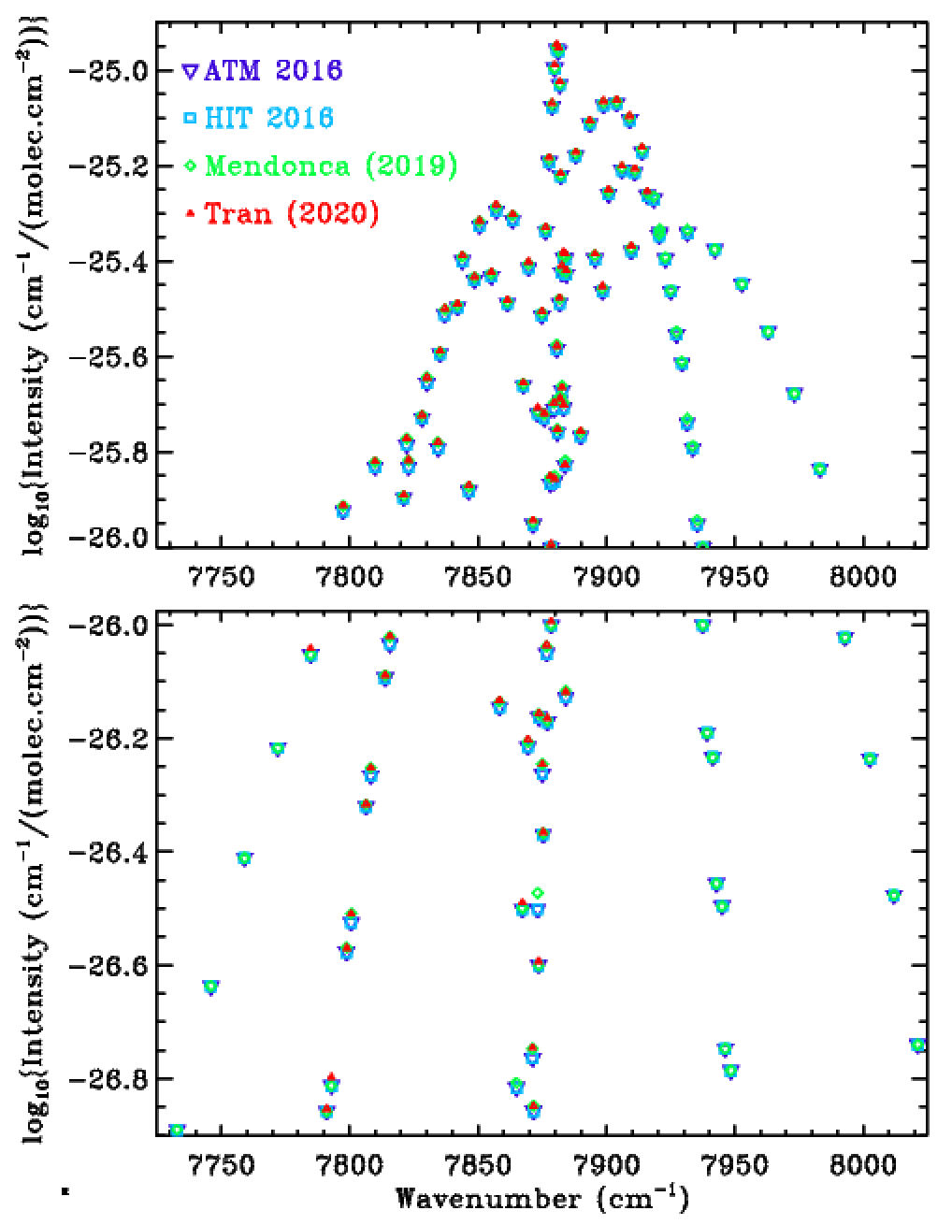
Existing Spectroscopy: Line Intensity comparison of the O₂ 1.27 um band
Upper Left: Tran et al. (2020) intensities seem slightly larger than those of HIT16 or Mendonca(2019),
confirming the plausibility of the 1% increase indicated by the TCCON measurements.
Other Panels: same data with a logarithmic Y-scale for better scrutiny of the weak lines.

Slide 27
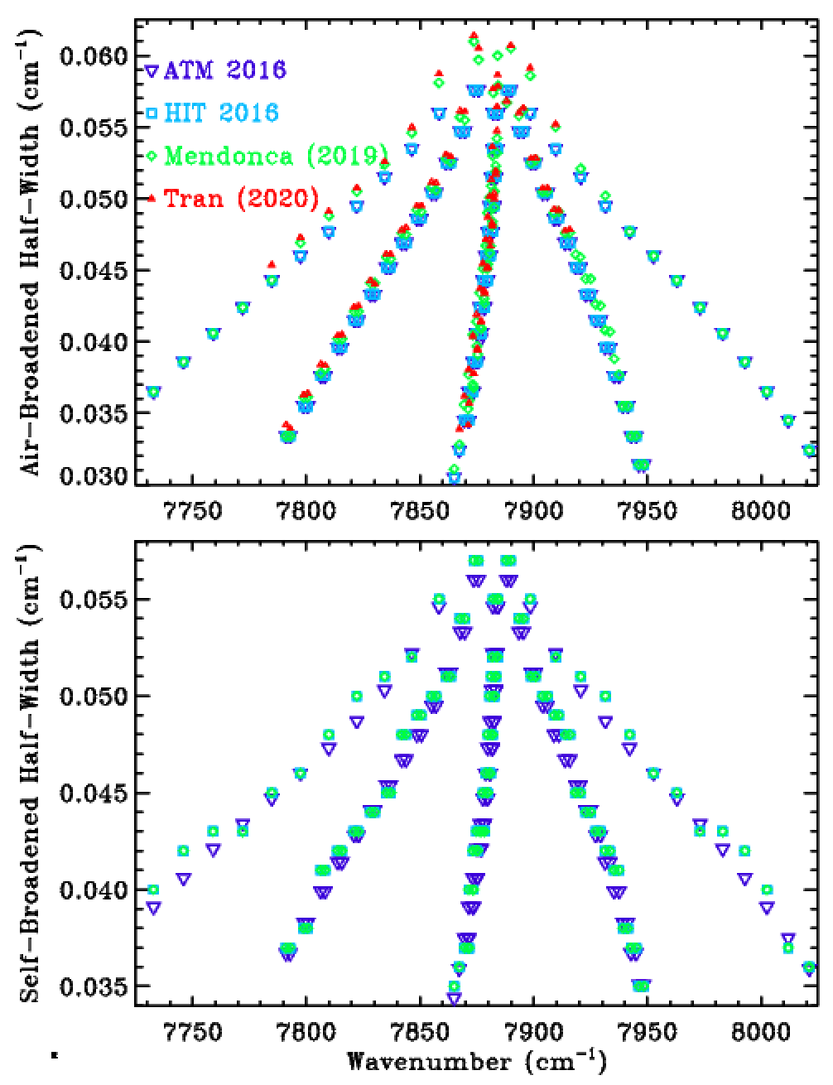
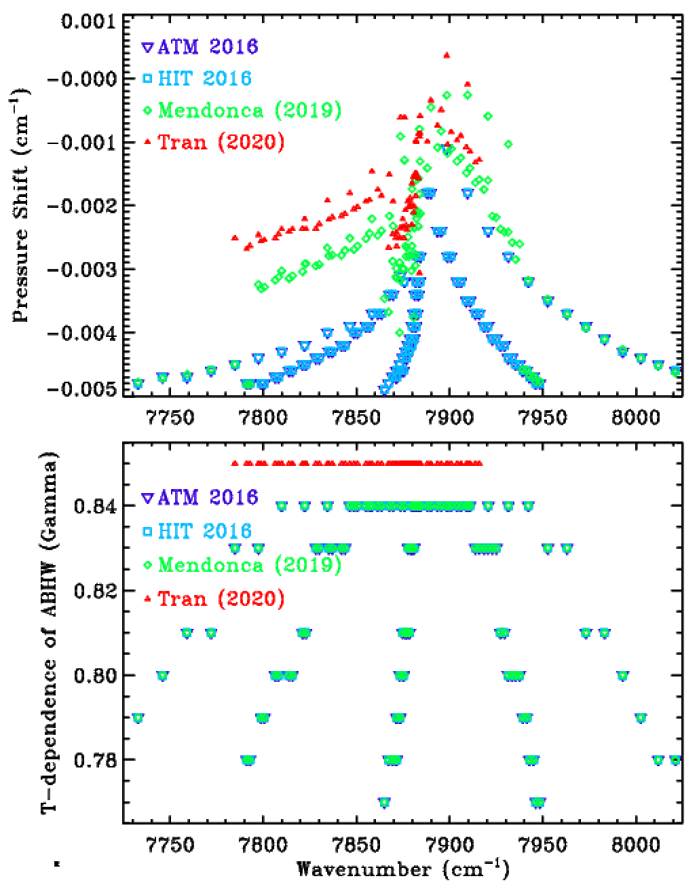
Existing Spectroscopy: Line width and shift comparison of the O₂ 1.27 um band
Upper Left: Tran et al (2020) ABHW are slightly larger than those of HIT16 or Mendonca (2019)
Upper Right: Tran’s pressure shifts are smaller (closer to zero) than those in HIT16 or Mendonca.
Lower-Left: Tran’s (2020) did not measure SBHW, so no red points.
Lower-Right: Tran (2020) measurements were all at room T, so the η-values are irrelevant.

Slide 28
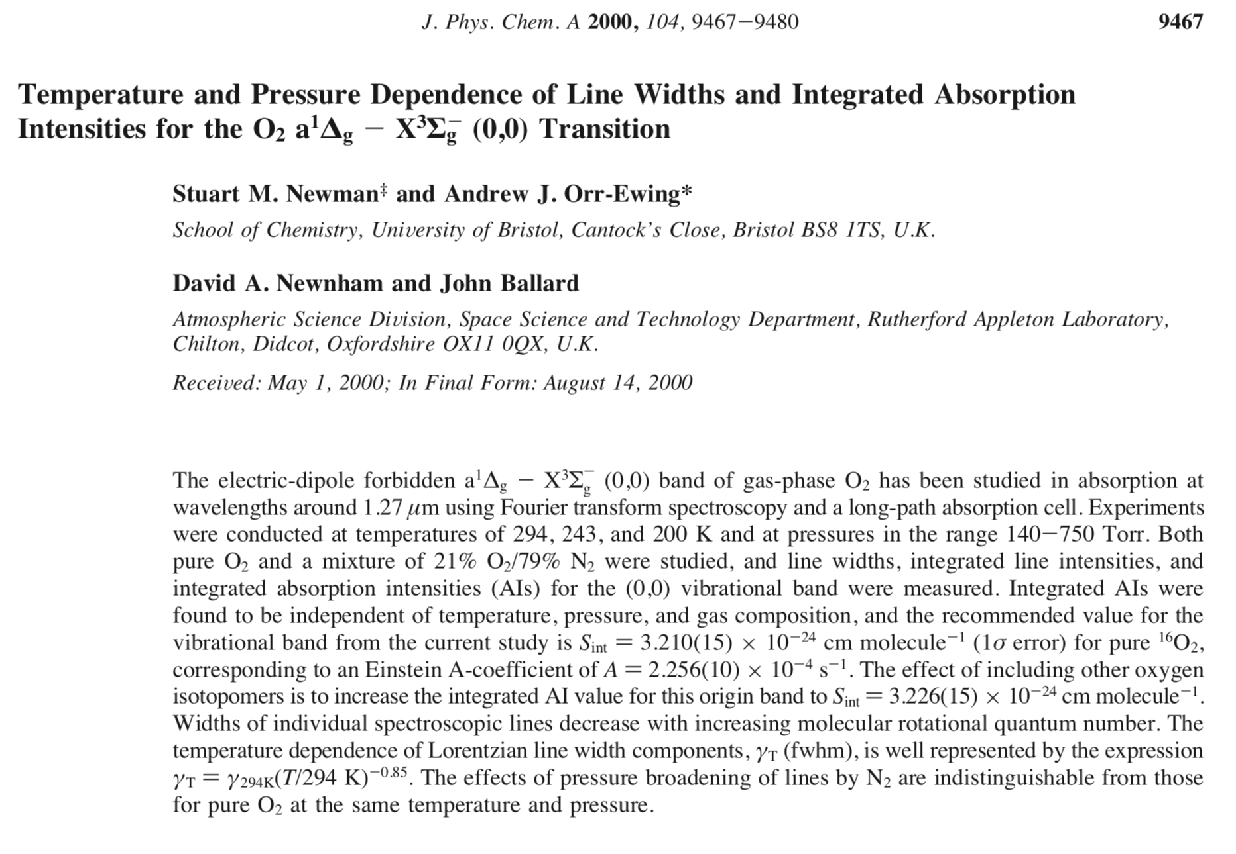
O₂ TDPBHW in the 1.27um band: Newman et al. (2000)
Newman et al.’s measurements of the T-dependence of widths remain the only ones I could find in the 1.27 um band. So this is an important paper.
At the end of the abstract they recommend an exponent of -0.85 for the T-dependence of the widths, which is pretty much what HITRAN has for the stronger lines.
But the data on which this value is based seem to support a lower value, in my opinion, as explained in the next slide.

Slide 29
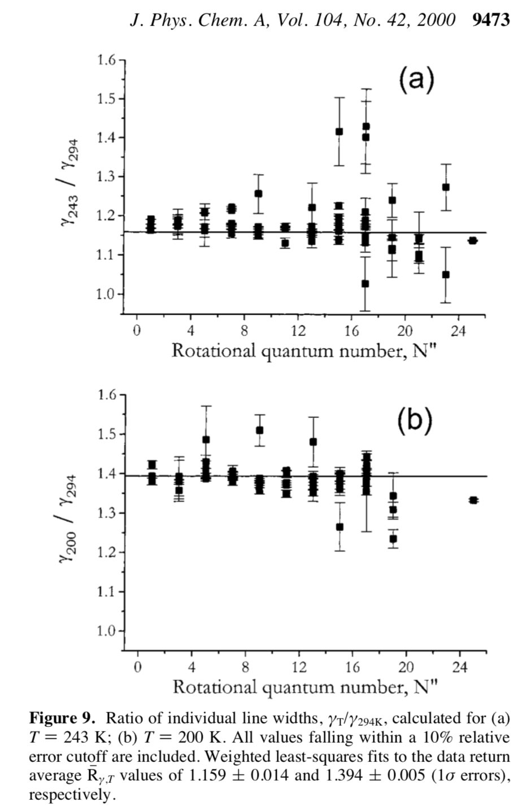
O₂ TDPBHW in the 1.27um band: Newman et al. (2000)
Fig.9a shows a ratio of air-broadened O₂ widths at 234K versus 294K of 1.159 ± 0.014 This implies (294/234)^{η} =1.159 ± 0.014. Hence η = 0.65 ± 0.05
Fig.9b shows a ratio of air-broadened O₂ widths at 200K versus 294K of 1.395 ± 0.005. This implies (294/200)^{η} =1.394 ± 0.005. Hence η = 0.86 ± 0.01
Newman et al. then somehow average these two values (0.65 and 0.86) to get 0.85 ± 0.07
Four comments:
  1) These uncertainties (0.014, 0.005) seem optimistic given the scatter of the points.
  2) The derived η-values are inconsistent: 0.65 ± 0.05 does not overlap 0.86 ± 0.01. This implies a systematic error in the measurements (e.g. temperature) or that the functional form (294/T)^{η} is inappropriate.
  3) The propagated uncertainty in η from fig. 9b (0.05) is 5x smaller than that from 9a (0.01) and so in any weighted average of the two, the data in 9b will have 25x the weight of the data in 9a. [The only way of averaging 0.86 and 0.65 to get 0.85].
  4) The vast majority of atmospheric O₂ is found at temperatures above 250K, so the data in 9b are less relevant than those in 9a, despite their superior precision.
So we disagree with Newman et al’s conclusion that the data in their fig.9 support η=0.85. We would give the 246K & 200K datasets equal weight, arriving at a mean η-value of 0.76.
So the 7% reduction of the average η-value in the new TCCON linelist from 0.83 to 0.77 is more than plausible, it produces a better fit to the data.

Slide 30
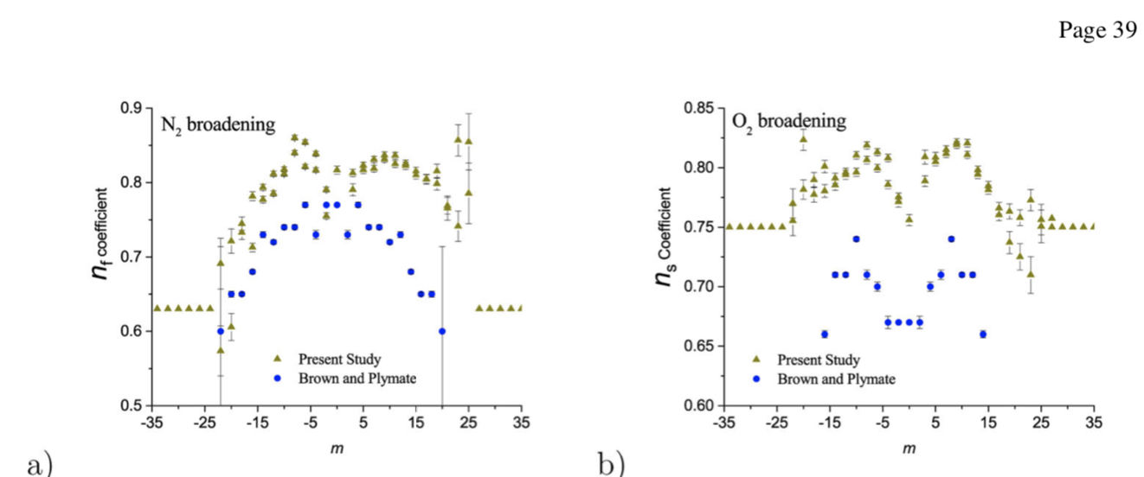
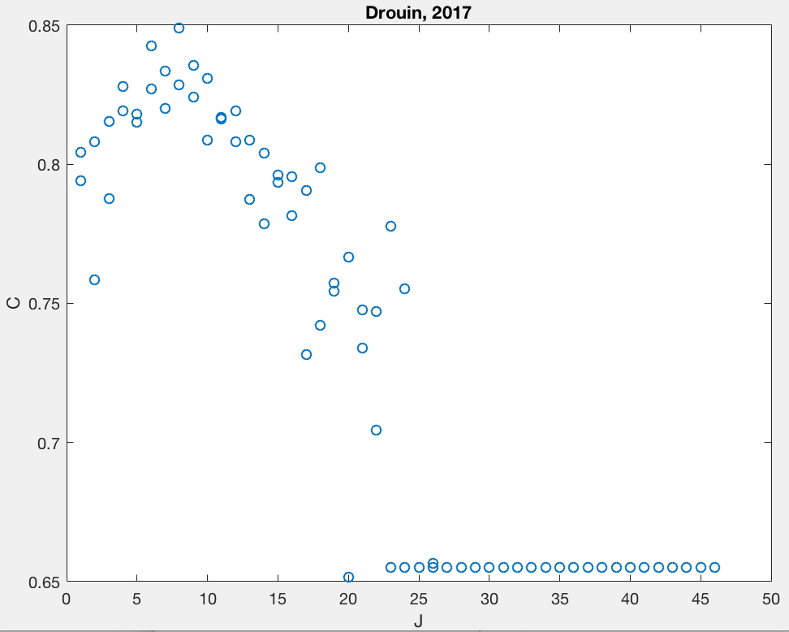
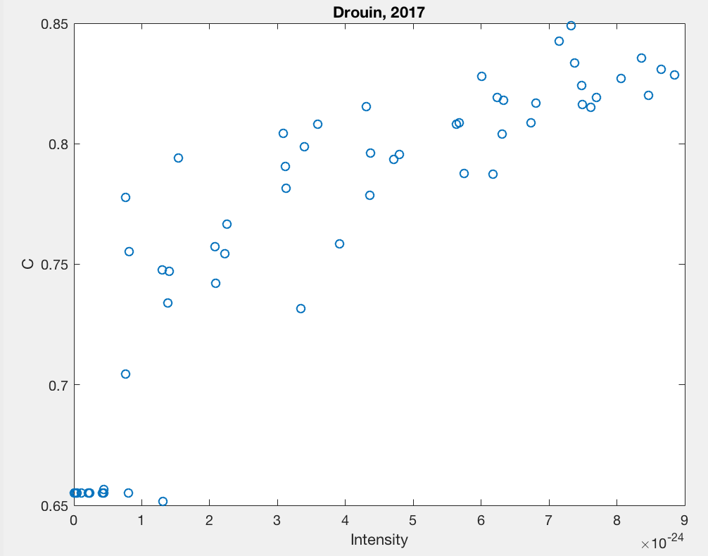
O₂ TDPBHW in the A-band (Drouin (2017)
Air-broadened η-values
Lacking additional cold width data in the 1.27 um band, we looked at Drouin et al.’s measurements of the T-dependence of widths in the A-band. These are 10% higher than those of Brown & Plymate for N₂ broadening, and 15% higher for O₂ broadening.
Drouin sees similar values for N₂ and O₂ (up to 0.85 for the stronger lines) whereas Brown & Plymate report significantly lower values for O₂ than N₂.
Note: Drouin’s values are close to those reported in HITRAN16 for the 1.27 um band.
Brown and Plymate’s N₂ data agree with what we infer (η=0.76) from Newman’s fig.9.
Not clear how well widths obtained in the A-band are applicable to the 1.27 um band.
Air-broadened η-values

