Slide 1
Improvements to the GGG2020 carbonyl sulphide prior profile at the East Trout Lake TCCON station
Liz Cunningham¹, Debra Wunch¹, Josh Laughner², and Geoff Toon²
¹ University of Toronto, ²Jet Propulsion Laboratory, California Institute of Technology
With data from Steve Montzka at NOAA and Kaley Walker and Niall Ryan at University of Toronto.

Slide 2
OCS as a gas of interest
OCS is a gas of interest because it has been shown that atmospheric measurements of OCS can help constrain photosynthesis on ecosystem scales (Whelan 2018)
Why look at TCCON OCS Measurements?
The OCS prior used in GGG2020 currently is the same as that which was used in GGG2014
  There is no seasonal cycle applied to OCS
  There is no latitude gradient applied to OCS
  The value in the troposphere is assumed to always be 500ppt
2

Slide 3
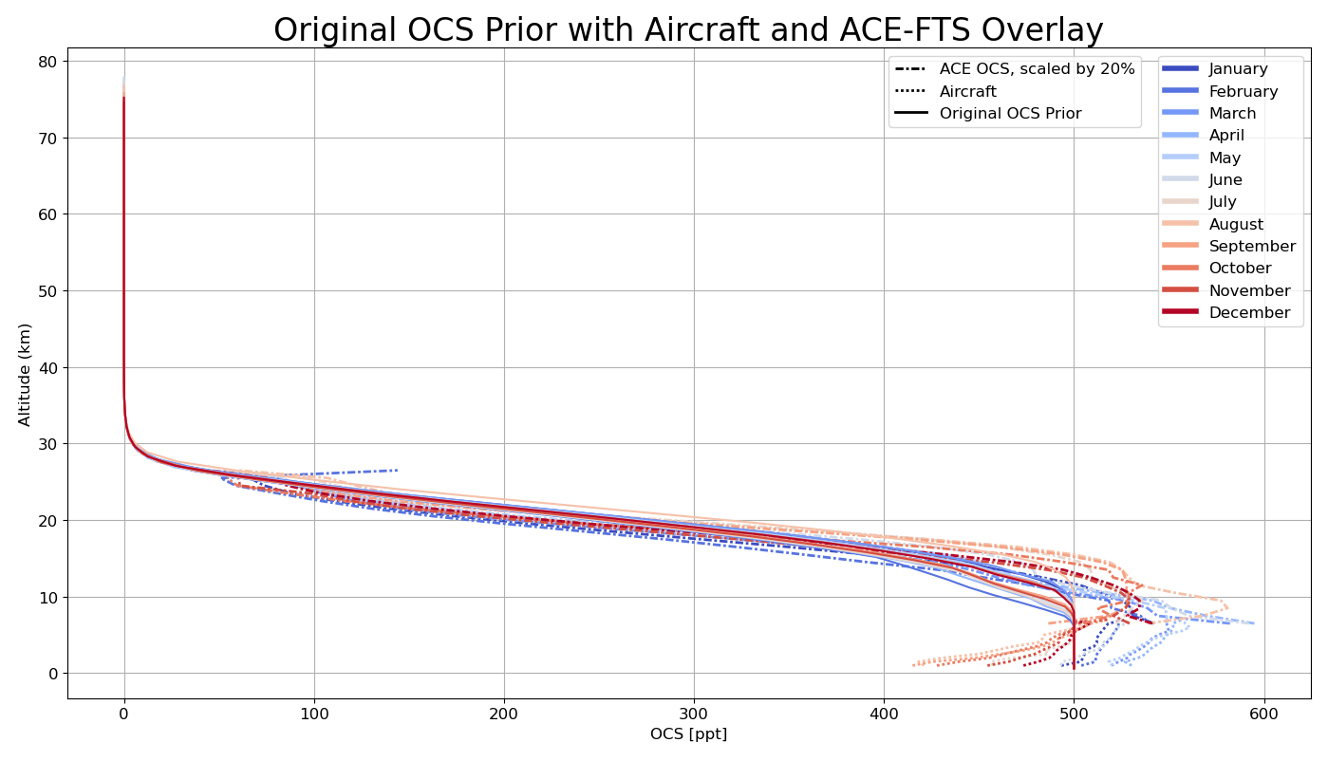
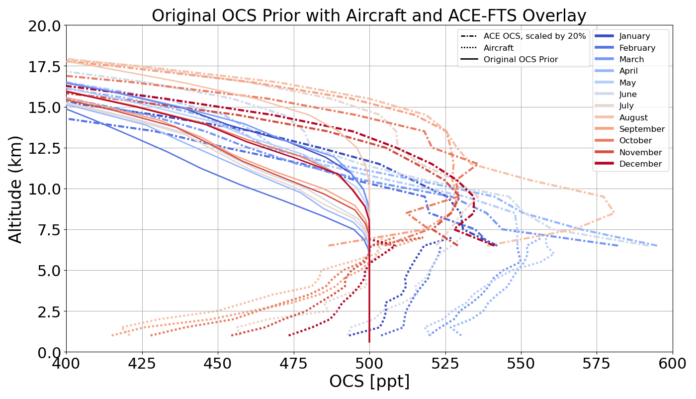
The Original OCS Prior that is used in GGG2020 assumes OCS is 500ppt in the troposphere at all time
In these figures and those to follow I have scaled the ACE-FTS OCS measurements by 20% to align more closely with the in situ aircraft measurements in the upper troposphere
3

Slide 4
Updates to the OCS Prior
Duplicated the method used for CH₄ in the stratosphere
Duplicated the method used for CO₂ in the troposphere
Created a new set of seasonal cycle equations for OCS
Changed extrapolation method for the ML/SMO OCS record to a constant extrapolation
Scaled the stratosphere by 10% to better align the tropopause values with the in situ measurements in the upper troposphere
4

Slide 5
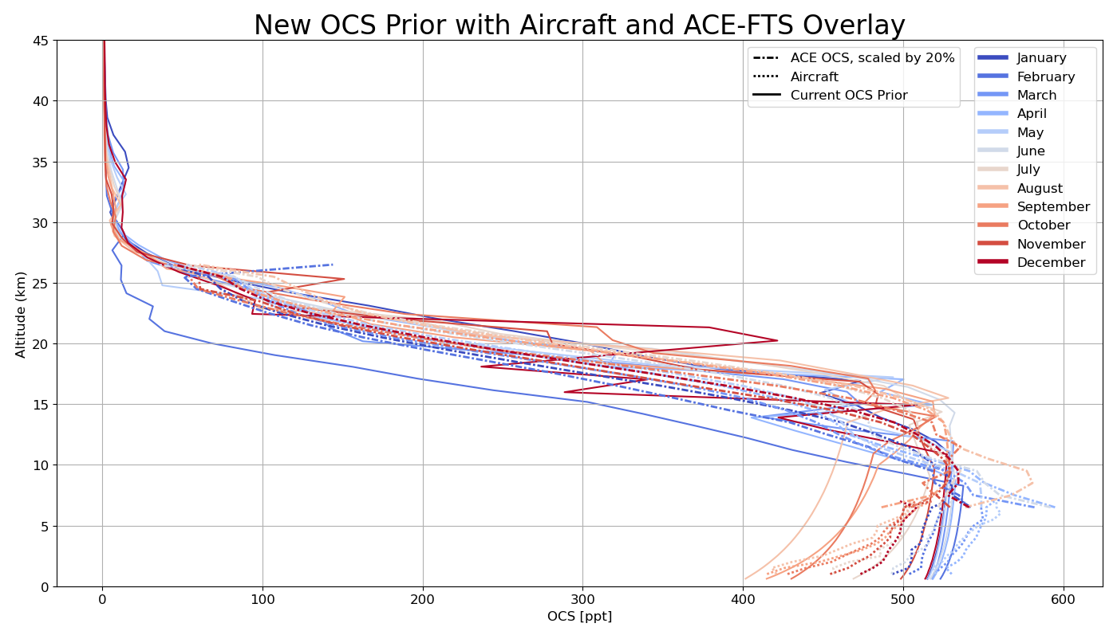
The new priors match aircraft profiles better
5

Slide 6
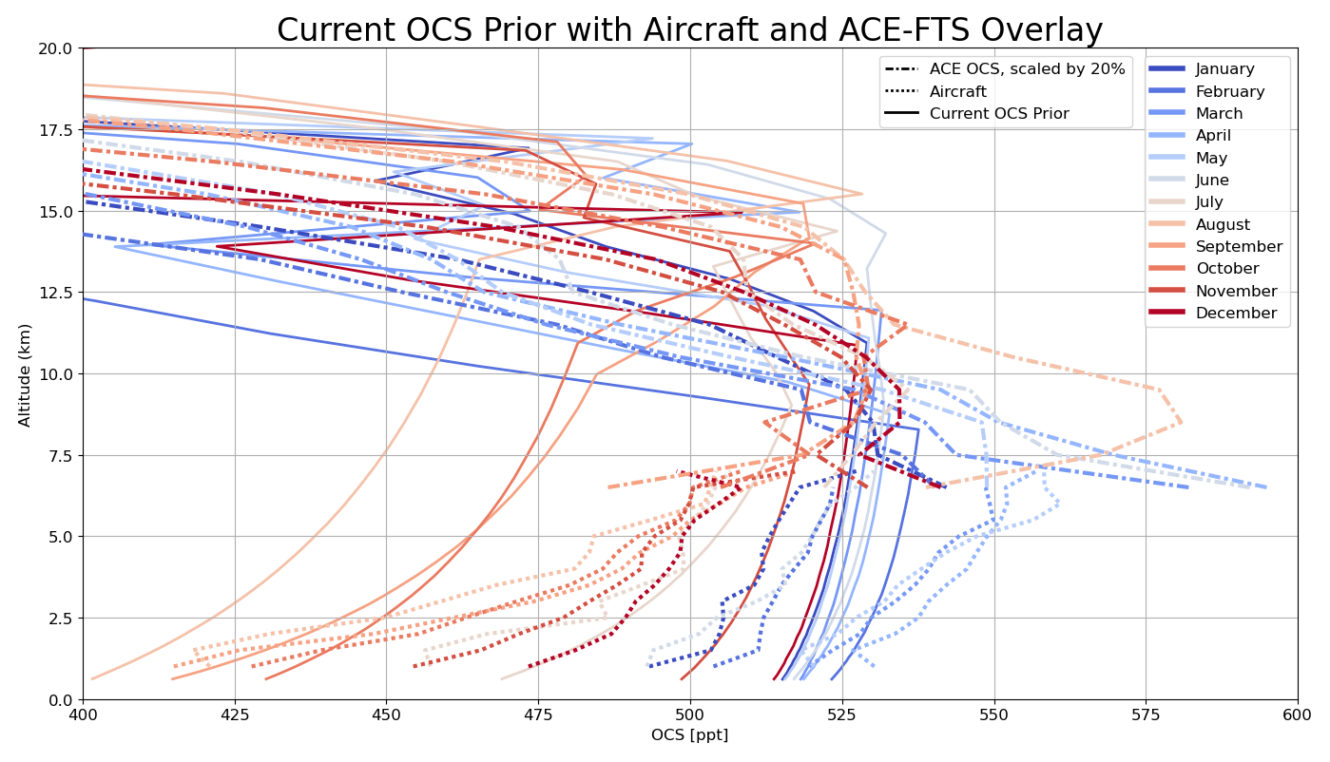
The new priors match aircraft profiles better
6

Slide 7
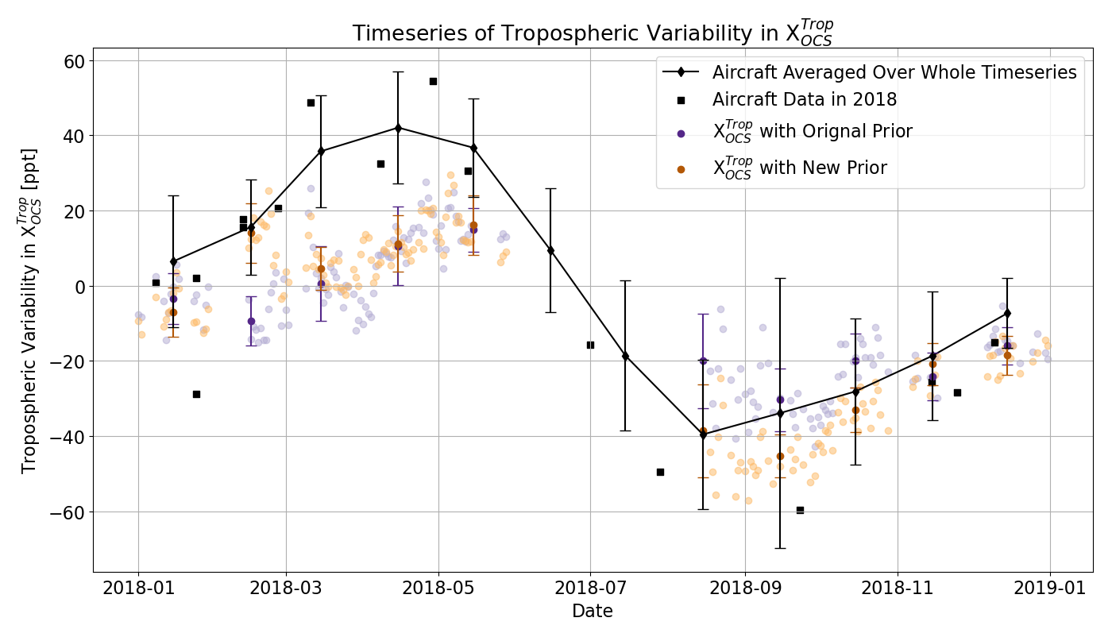
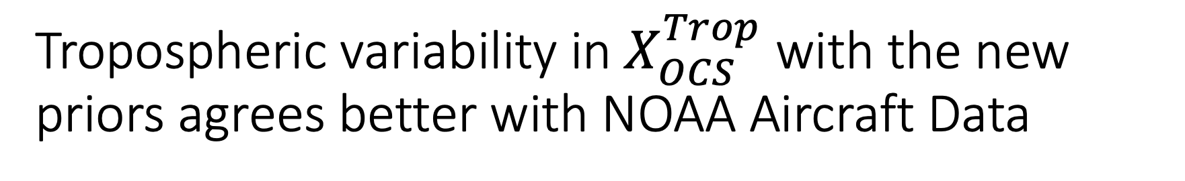
Tropospheric variability in $X_{OCS}^{Trop}$ with the new priors agrees better with NOAA Aircraft Data
Method for extracting tropospheric OCS information from Toon, G. C., et al (2018). Atmospheric carbonyl sulfide (OCS) measured remotely by FTIR solar absorption spectrometry. ACP
7

Slide 8
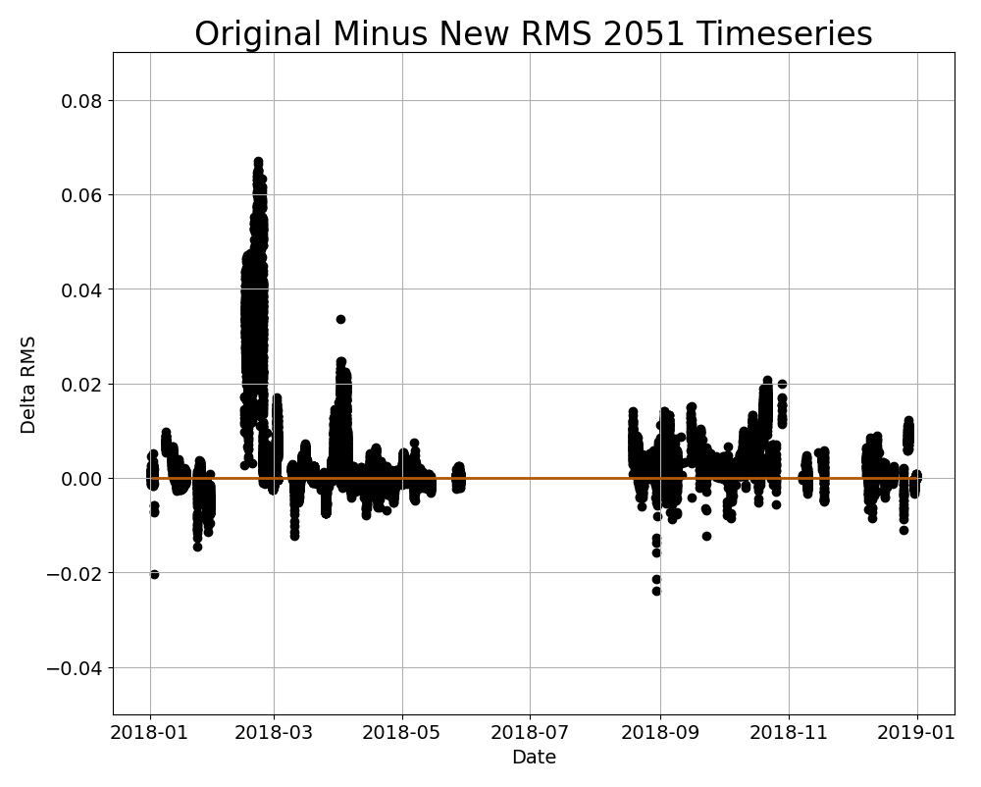
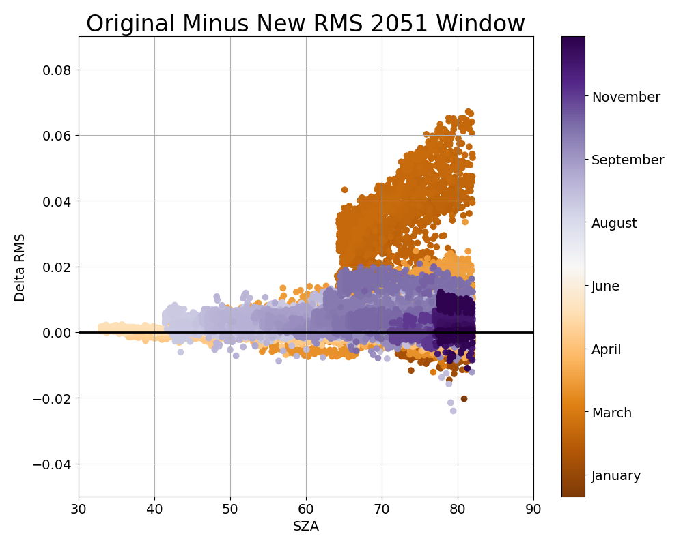
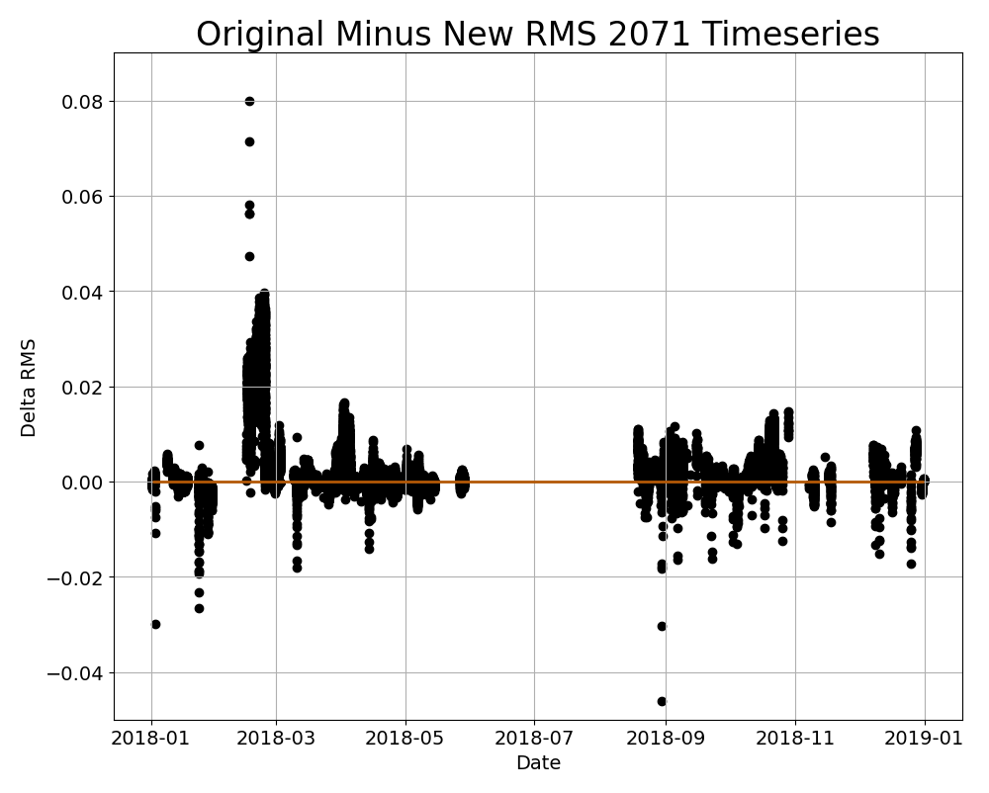
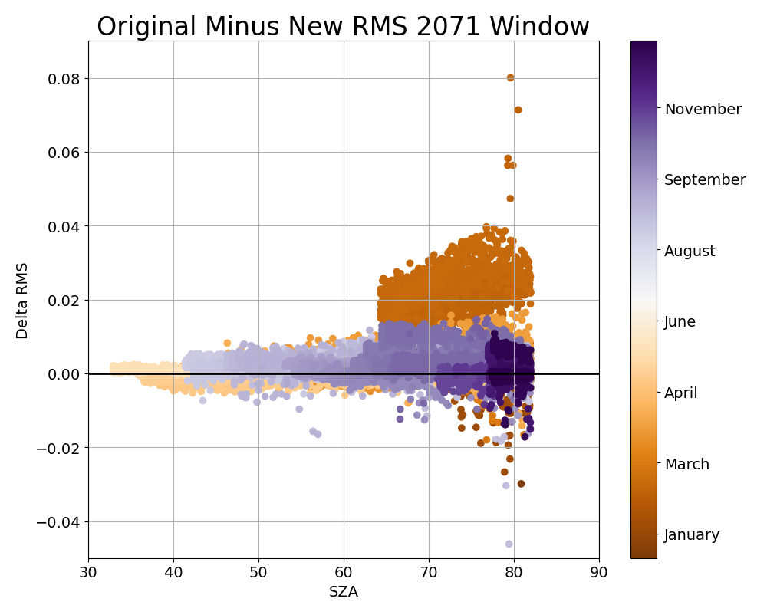
The spectral fits with the new prior are better than those with the original prior
8

Slide 9
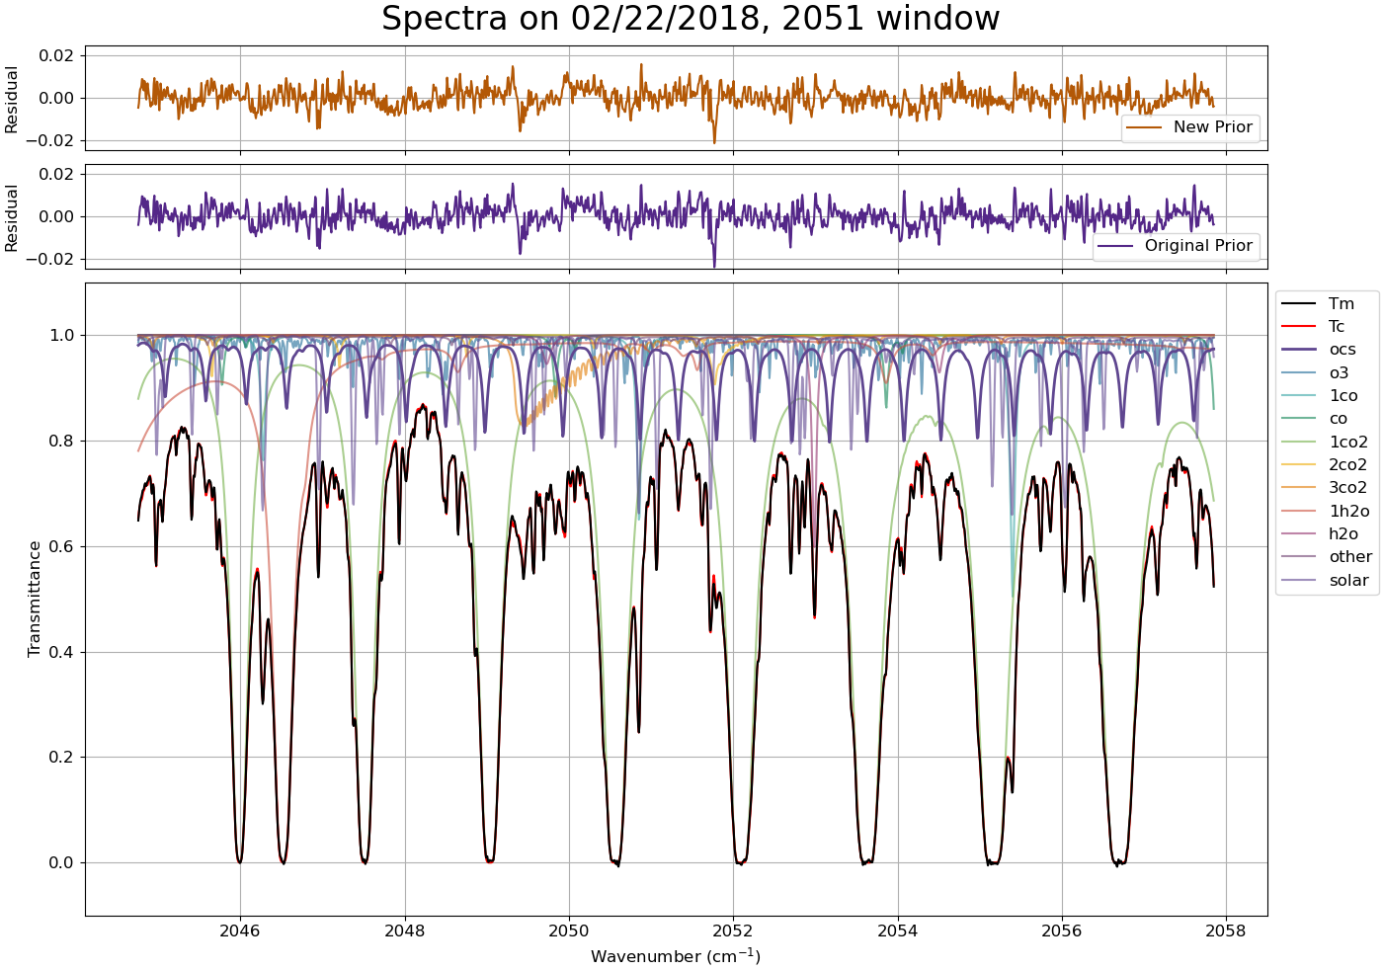
Residuals are smaller in retrievals with new priors
9

Slide 10
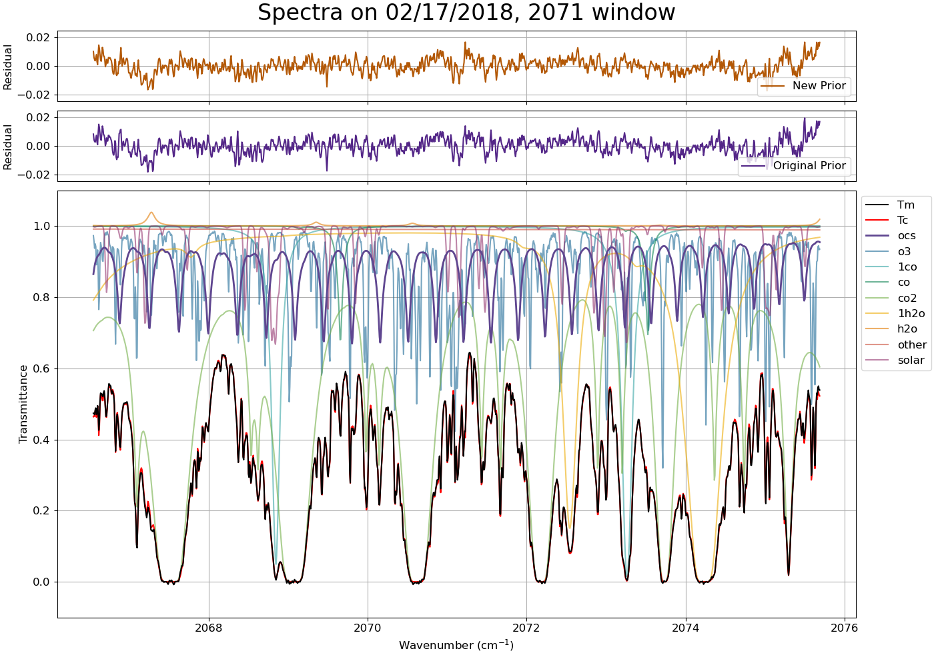
Residuals are smaller in retrievals with new priors
10

Slide 11
Conclusions
We have developed a new prior for OCS at ETL which includes a seasonal cycle and links the OCS prior to the N₂O prior in the stratosphere
This new prior improves spectral fits and the comparison to aircraft data, especially in February
Future work
We will make more changes to the priors to improve the spectral fits for the rest of the year; particularly March, April, May
  One of these changes will be increasing the slope of the priors
Move beyond ETL and create a latitude gradient which can reproduce OCS profiles at sites globally
Tie the TCCON OCS measurements to the aircraft network OCS measurements
11

Slide 12
Acknowledgments
This research was conducted at the University of Toronto with funding provided by the University Corporation for Atmospheric Research’s Next Generation Fellowship Program and NSERC. Part of this research was performed at the Jet Propulsion Laboratory, California Institute of Technology, under contract with NASA. With data from Steve Montzka at NOAA and Kaley Walker and Niall Ryan at University of Toronto.
References
Whelan, M. E. et al. (2018). Reviews and syntheses: Carbonyl sulfide as a multi-scale tracer for carbon and water cycles. Biogeosciences
Toon, G. C., et al (2018). Atmospheric carbonyl sulfide (OCS) measured remotely by FTIR solar absorption spectrometry. ACP
Contact
ecunning@physics.utoronto.ca
12

Slide 13
Supplemental Slides

Slide 14
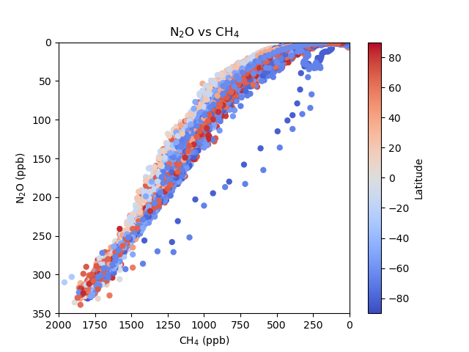
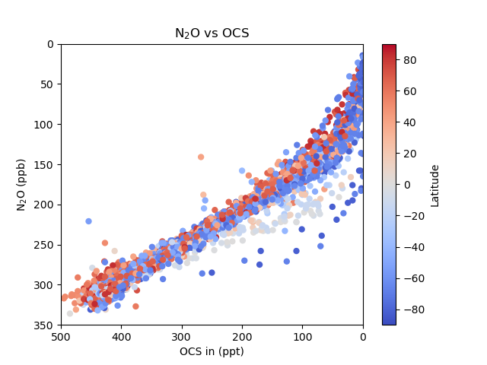
Updates to the OCS Prior - Stratosphere
Duplicated the method used for calculating CH₄ in the stratosphere
  The stratosphere of the CH₄ prior is calculated using the relationship between CH₄ and N₂O
  OCS and CH₄ both have a strong relationship to N₂O in the stratosphere
Created an OCS-N₂O look up table and calculated the OCS stratosphere values based on the fraction remaining of N₂O

Slide 15
Updates to the OCS Prior - Troposphere
Gas_trop_lifetime_yrs = np.inf
  Gets rid of the decrease of OCS with altitude in the troposphere
  In GGG2020, there is the assumption that all emissions happen in the Northern Hemisphere and are transported south. This isn’t true for OCS, emissions are more well distributed globally. By setting trop_lifetime_yrs to infinity this assumption doesn’t apply.
No lat_bias_correction
  Getting rid of the lat_bias_correction doesn’t change the OCS priors
Max_trend_poly_deg = 0
  Extends the ML/SMO data in a sensible way
ML/SMO data linked to most recent ML/SMO data files
Scale the stratosphere by 10%
  This aligns the tropopause values more closely with the aircraft and scaled ACE data
Added a seasonal cycle

Slide 16
Seasonal Cycle Equations
New OCS Seasonal Cycle
  sv = np.sin(2*np.pi*(fyr-0.92))
  svl = np.min([-0.20, sv*(lat/15)/np.sqrt(1+(lat/15)**2)])
  sca = svl*(1-aoa/.25)*2
Seasonal Cycle for other gasses
  sv = np.sin(2*np.pi * (fyr - 0.78)) # basic seasonal variation
  svl = sv * (lat / 15.0) / np.sqrt(1 + (lat / 15.0)**2.0) # latitude dependence
  sca = svl * np.exp(-aoa / 0.85) # altitude dependence
CO2 seasonal cycle equations
  sv = np.sin(2*np.pi *(fyr - 0.834 - aoa))
  svnl = sv + 1.80 * np.exp(-((lat - 74)/41)**2)*(0.5 - sv**2)
  sca = svnl * np.exp(-aoa/0.20)*(1 + 1.33*np.exp(-((lat-76)/48)**2) * (z+6)/(z+1.4))
Return ﻿1 + gas_seas_cyc_coef * sca

Slide 17
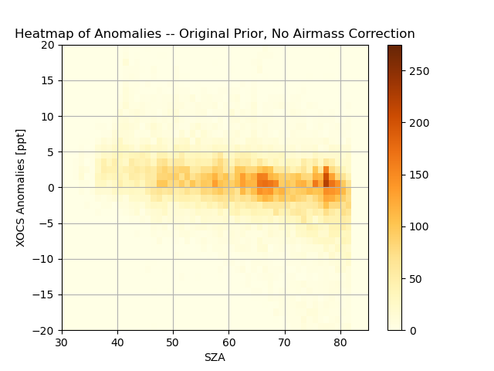

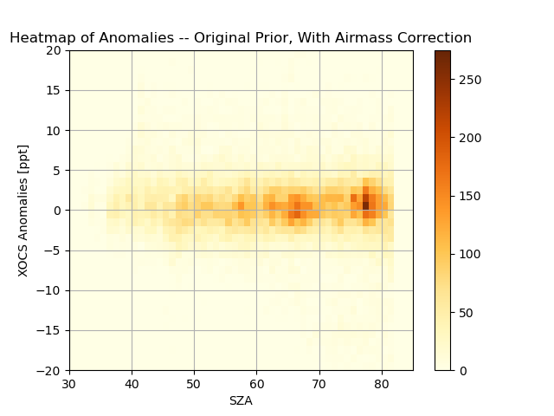
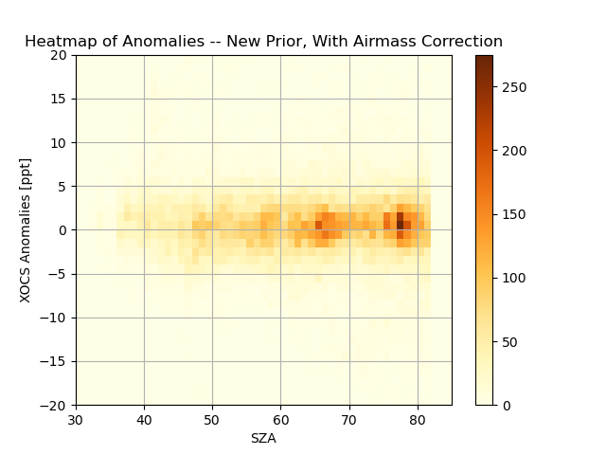
Airmass dependence correction

Slide 18
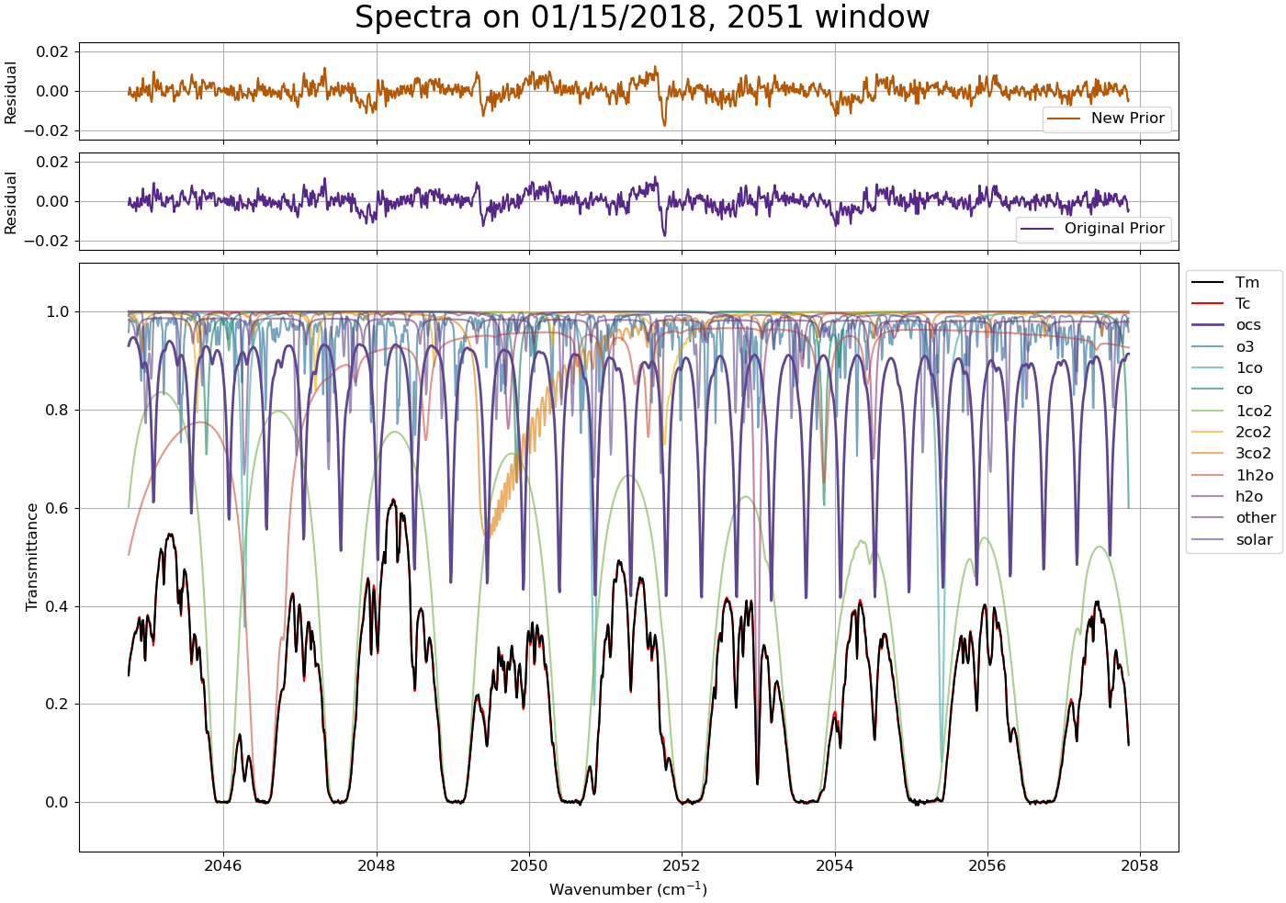

Slide 19
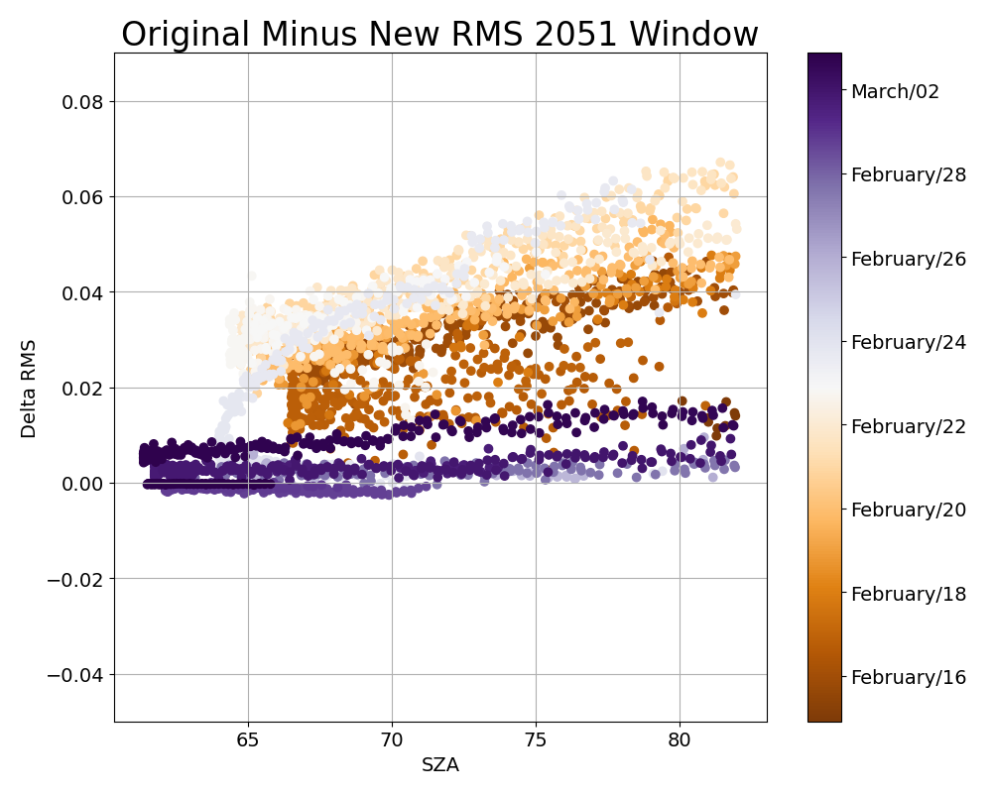
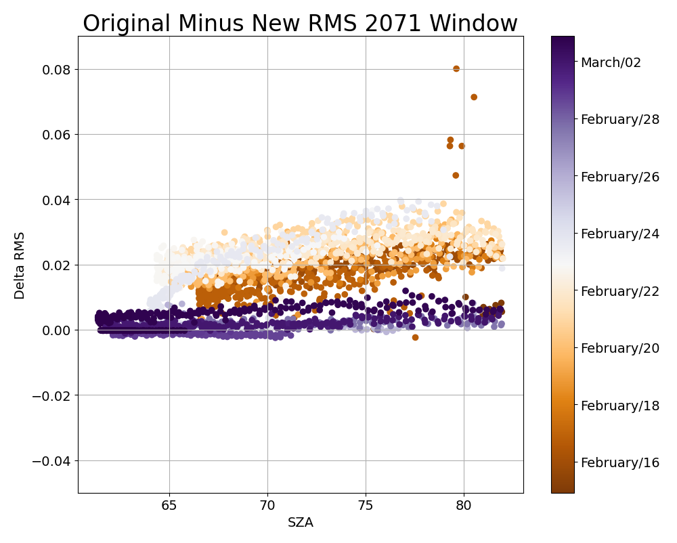
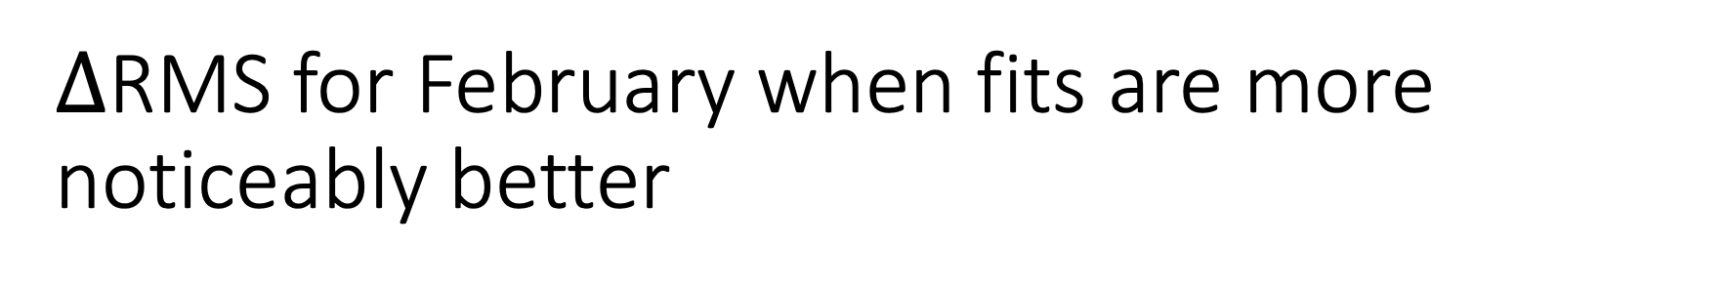
$∆$RMS for February when fits are more noticeably better

Slide 20
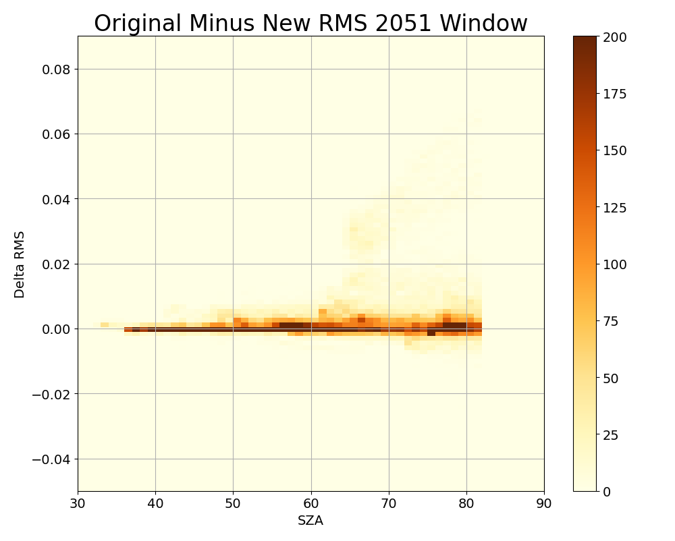
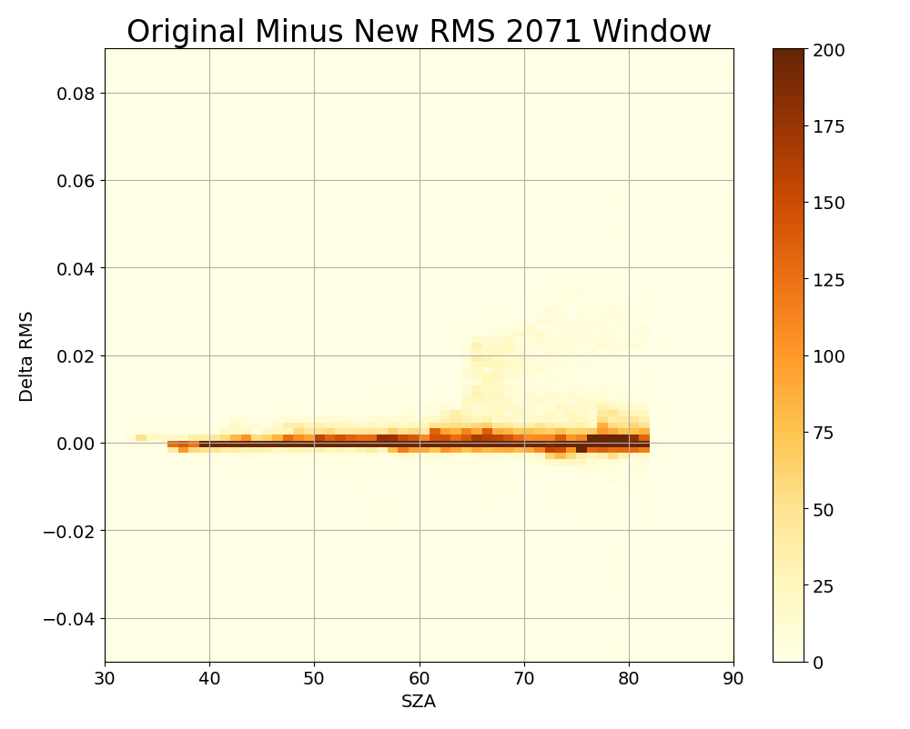
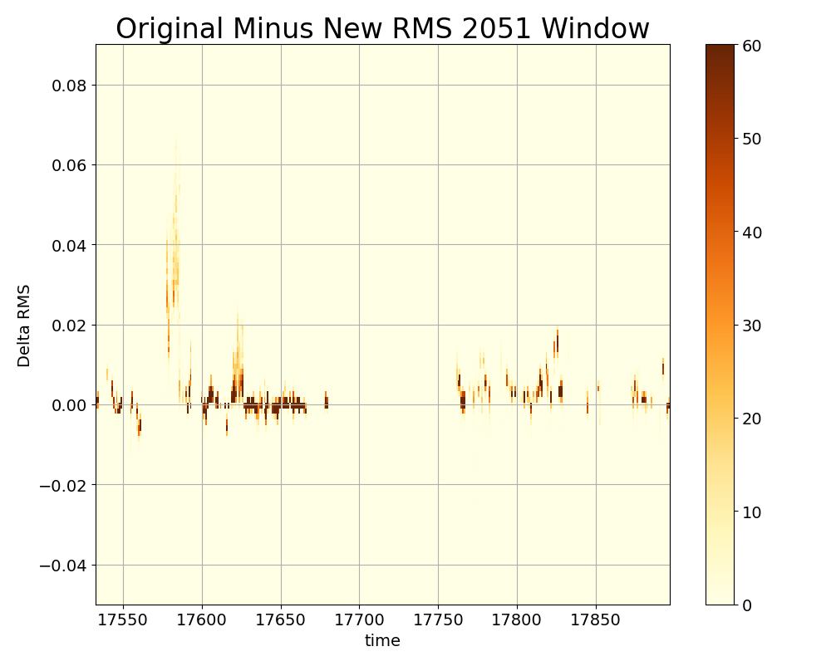

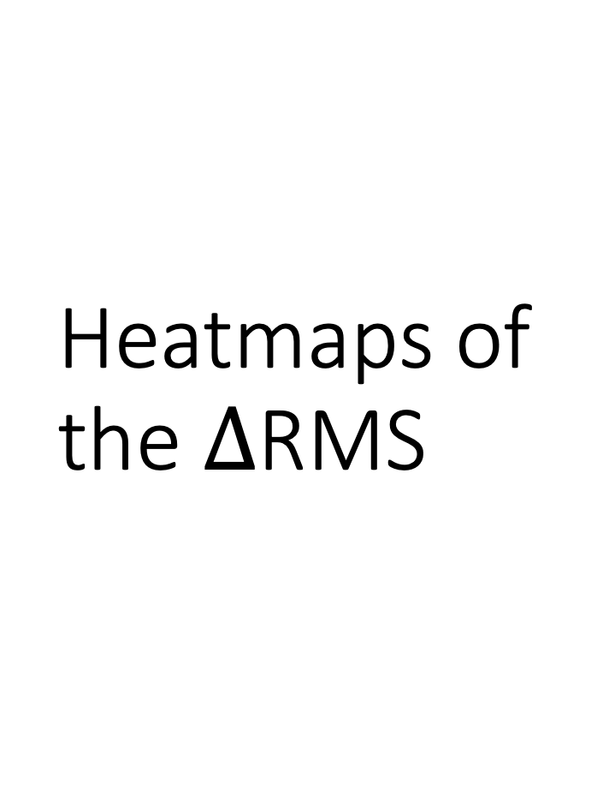
Heatmaps of the $∆$RMS

Slide 21
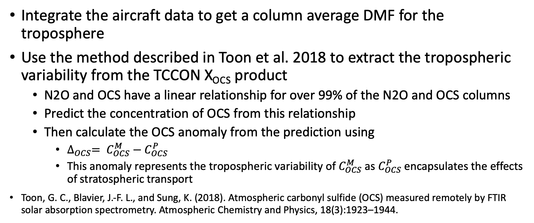
How to compare in situ aircraft measurements with TCCON total columns
Integrate the aircraft data to get a column average DMF for the troposphere
Use the method described in Toon et al. 2018 to extract the tropospheric variability from the TCCON X_{OCS} product
  N2O and OCS have a linear relationship for over 99% of the N2O and OCS columns
  Predict the concentration of OCS from this relationship
  Then calculate the OCS anomaly from the prediction using
    $∆_{OCS}= C_{OCS}^{M}−C_{OCS}^{P}$
    This anomaly represents the tropospheric variability of $C_{OCS}^{M}$ as $C_{OCS}^{P}$ encapsulates the effects of stratospheric transport
Toon, G. C., Blavier, J.-F. L., and Sung, K. (2018). Atmospheric carbonyl sulfide (OCS) measured remotely by FTIR solar absorption spectrometry. Atmospheric Chemistry and Physics, 18(3):1923–1944.

Slide 22
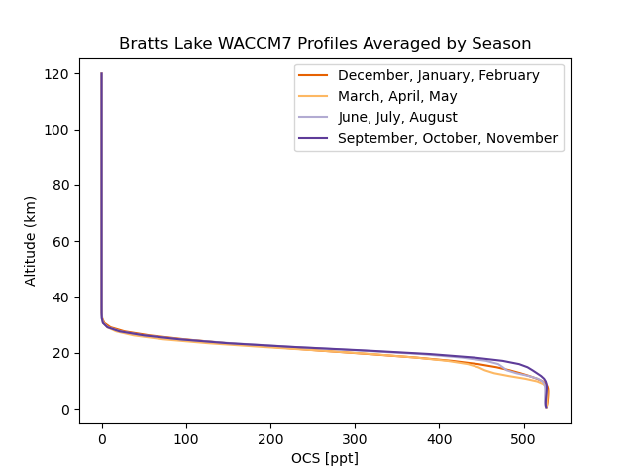
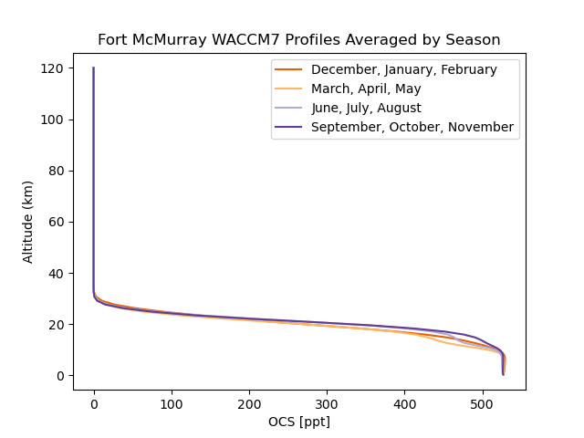
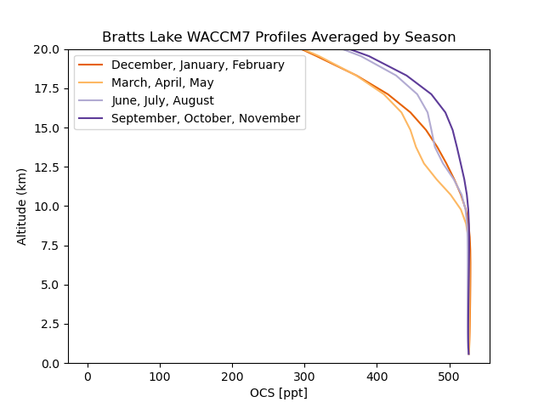
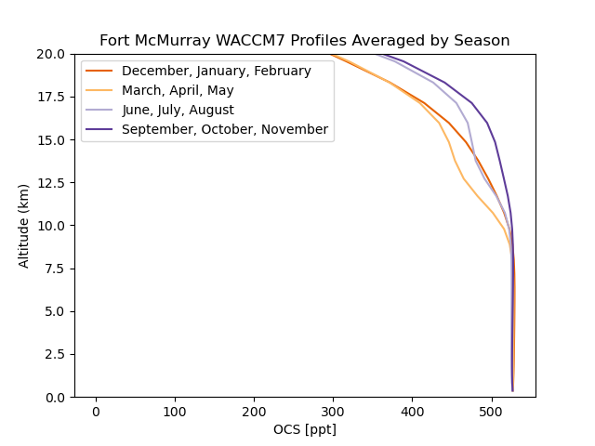
There is no seasonal cycle in WACCM Profiles

Slide 23
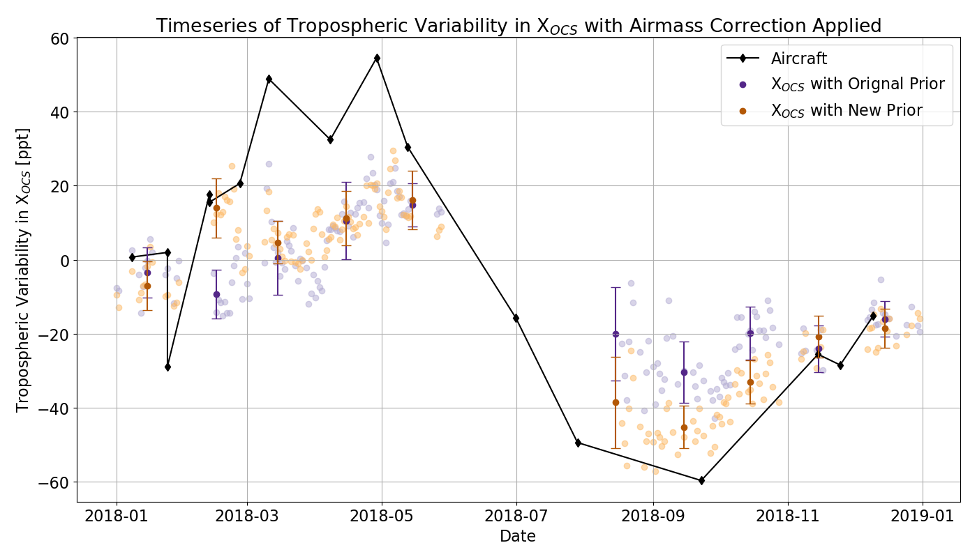
Tropospheric variability in $X_{OCS}^{Trop}$ with the new priors agrees better with NOAA Aircraft Data
Method for extracting tropospheric OCS information from Toon, G. C., et al (2018). Atmospheric carbonyl sulfide (OCS) measured remotely by FTIR solar absorption spectrometry. ACP

