Slide 1
Welcome to the 2023 TCCON Meeting
Co-Chairs: Debra Wunch, Nicholas Deutscher, Thorsten Warneke
Deputies: Coleen Roehl, David Pollard, Dietrich Feist
Algorithm Chair & Deputy: Geoffrey Toon, Joshua Laughner
QA/QC Team: All above, plus Mahesh Kumar Sha, Paul Wennberg, David Griffith, Isamu Morino
Notes:
Hello everyone! Welcome to the 2022 virtual TCCON/COCCON/NDACC joint meeting. I hope you are all keeping safe and well. My name is Debra Wunch, and I will be speaking on behalf of the TCCON co-chairs and deputies to provide you with this year’s network update.

Slide 2
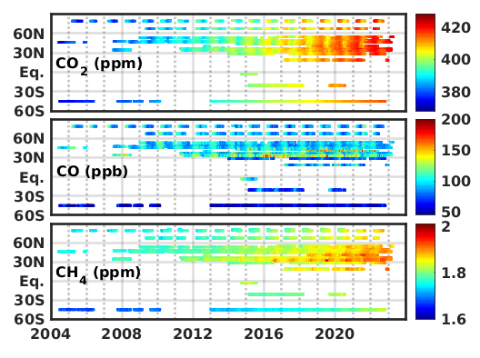
Network Status
COVID-related restrictions significantly impacted our community, but have eased over the past year
Despite these challenges, we’ve still maintained most of our data collection, and contributed significantly to satellite validation, and to the scientific literature
Notes:
COVID-related restrictions have continued to affect us, with delays to new installations and maintenance trips. Despite these challenges, we have still managed to maintain most of our data records throughout the past two years.

Slide 3
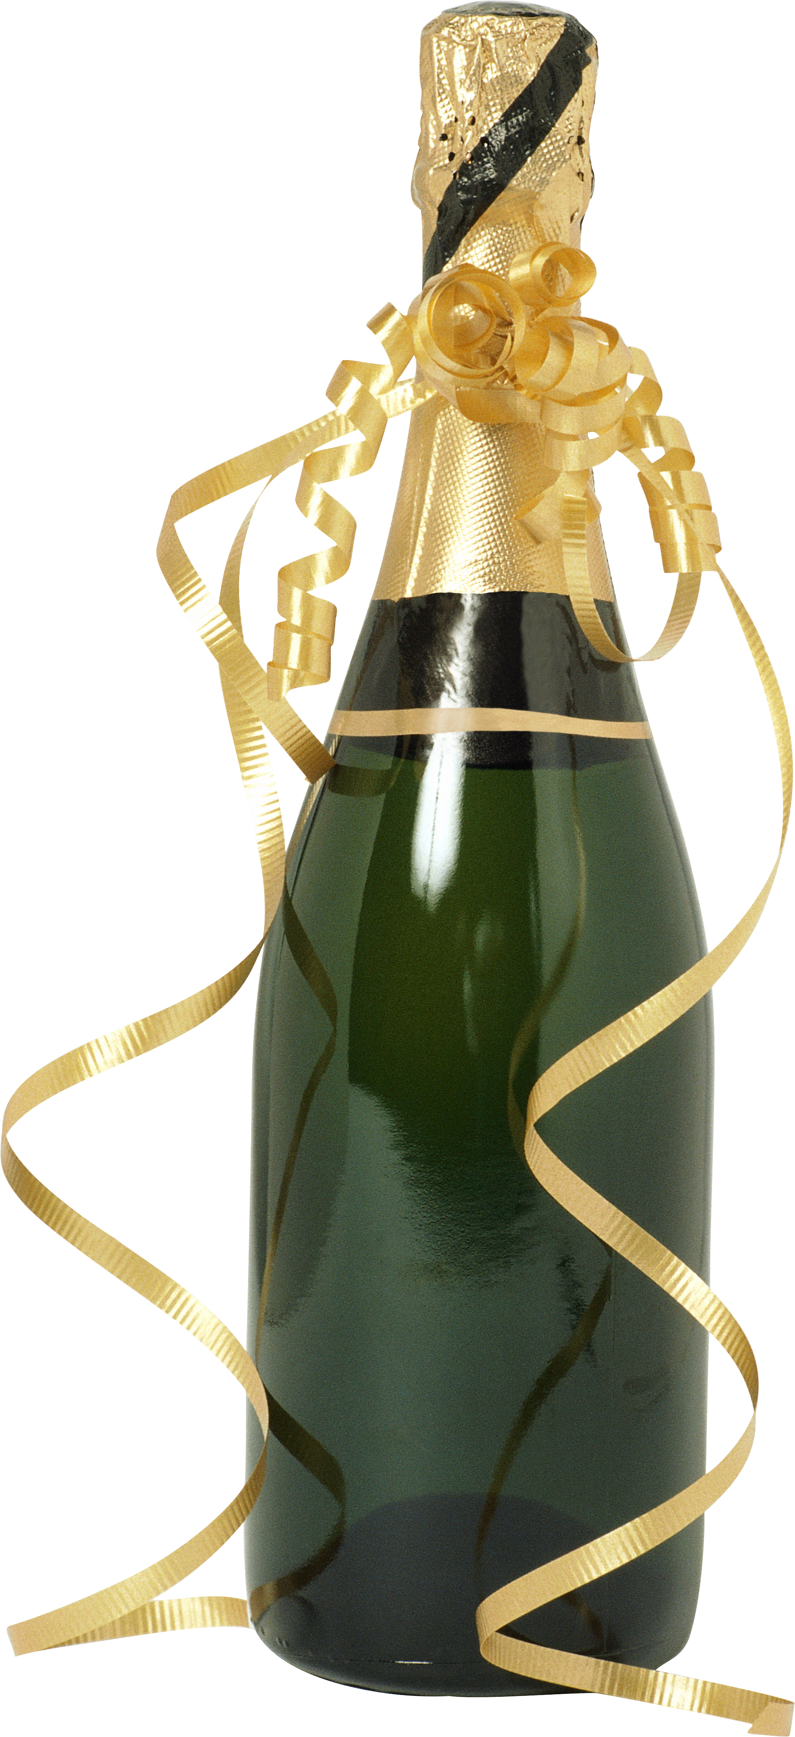
Theses Completed This Year – CONGRATULATIONS!!!!
2022, Isis Frausto-Vicencio: Advances in Atmospheric Trace Gas Monitoring Systems: Quantification of Methane Sources by Solar Column Observations in the San Joaquin Valley of California (University of California, Riverside)
2022, Nasrin Mostafavi Pak: Quantifying Methane Emissions from the Greater Toronto Area (University of Toronto)
2023, Shyno Susan John: Drivers of Variability of Atmospheric Carbon Monoxide in Australia (University of Wollongong)
2023, Harrison Parker: A novel algorithm for inferring the vertical distribution of trace gases using remote sensing measurements (Caltech)
2023, Ariana Tribby: Inference of Global Methane Emissions from Oil and Gas Production (Caltech)
2023, Benedikt Herkommer: Improving the consistency of ground-based remote sensing greenhouse-gas measurements using a portable FTIR-spectrometer (KIT)
Please let us know who is completing theses in your groups – we’d like to keep a list and a copy on the TCCON Wiki!
This Photo by Unknown Author is licensed under CC BY-NC

Slide 4
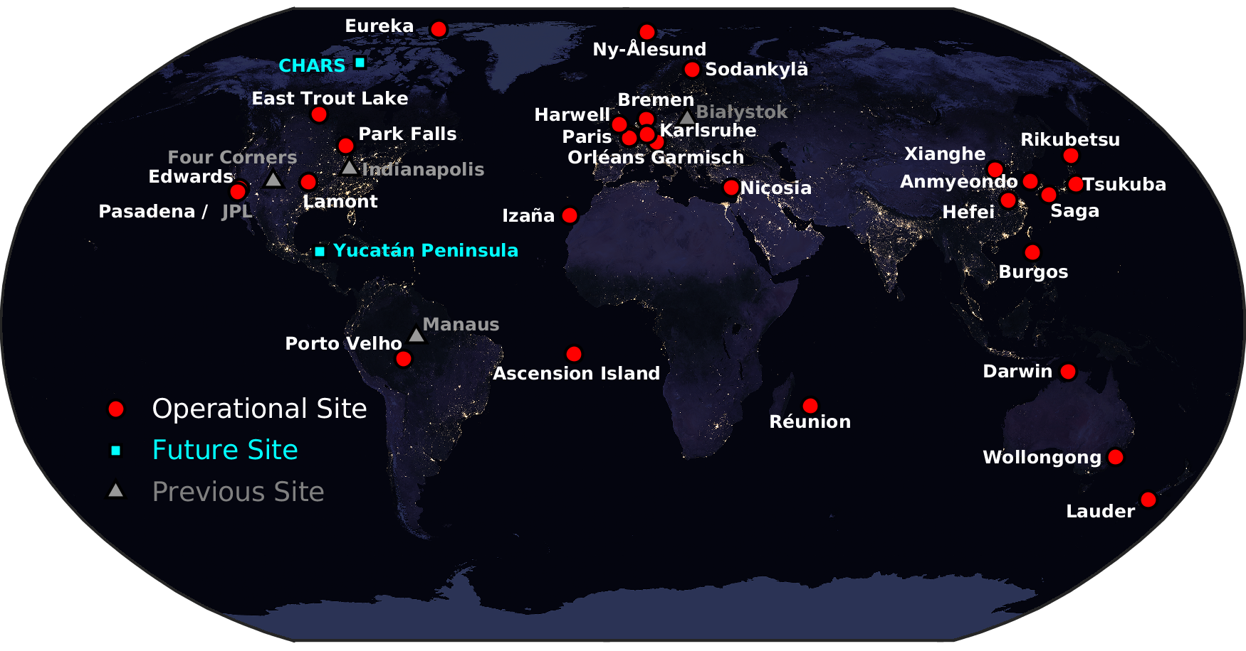
Network Status: Future Sites
Porto Velho – now operational! (De Mazière, Sha) – See Mahesh’s talk
Yucatán Peninsula – planned soon (Gruter, Stremme) – See Michel Grutter’s poster
Canadian High Arctic Research Station (CHARS) – planned for summer 2024 (Strong, Wunch)
Notes:
There are three new TCCON stations planned for installation over the next year: Martine de Mazière and Mahesh Sha have scheduled an installation in Porto Velho in late 2022; Michel Gruter and Wolfgang Stremme are planning to install their Yucatán Peninsula station in late 2022/early 2023; and Kim Strong and I are planning to install a station at the CHARS site in summer 2023. The Harwell instrument was successfully moved locally this year as well.

Slide 5
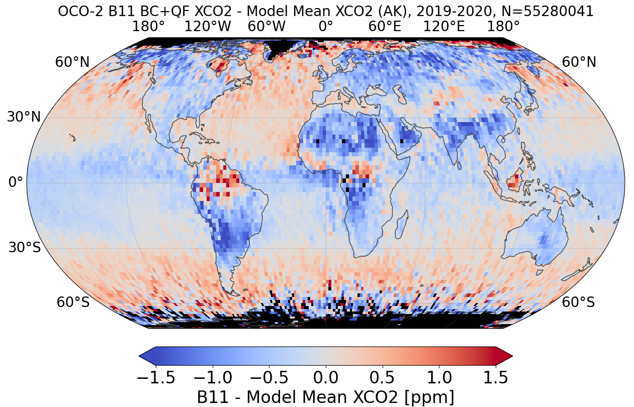
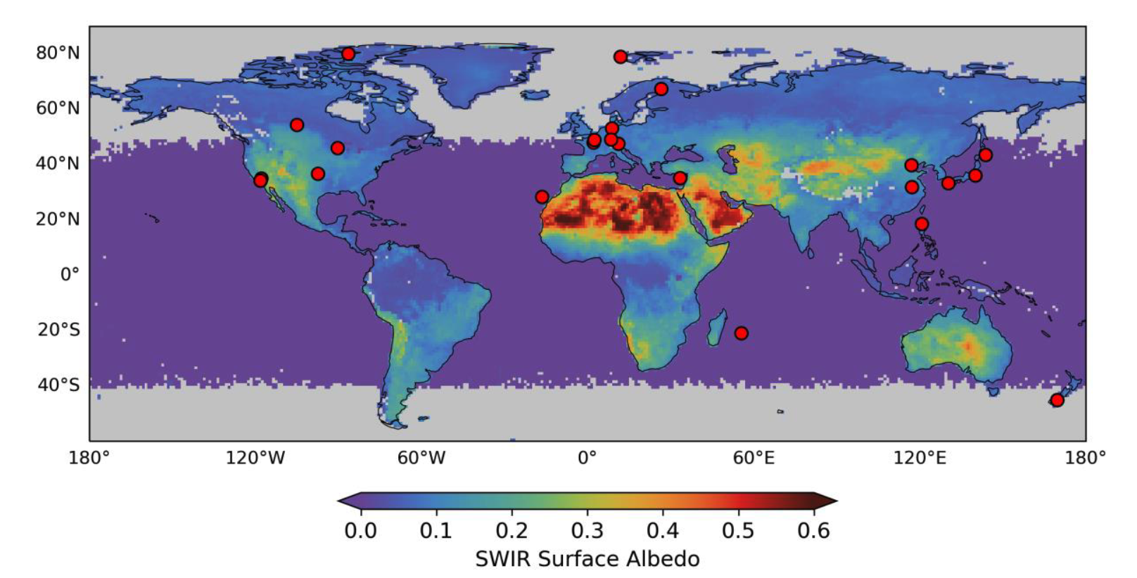
Requests for New TCCON Station Locations
OCO-2 Bias wrt Models
Lacking validation data over high albedo regions
Dryden/Armstrong/Edwards is helpful (up to 0.35), but does not reach albedos of major deserts (>0.6)
“Spectrally less smooth” locations required – Lorente et al., 2023
Lacking validation data over oceans
There was a suggestion to get a TCCON station at SMO and one at Bouvet Island. These are also regions with large biases in OCO-2 data compared with models.
Azores
(Izaña?)
Kiribati
or SMO
Bouvet Island
Rob Nelson, JPL
Lorente, A., Borsdorff, T., Martinez-Velarte, M. C., and Landgraf, J.: Accounting for surface reflectance spectral features in TROPOMI methane retrievals, Atmos. Meas. Tech., 16, 1597–1608, https://doi.org/10.5194/amt-16-1597-2023, 2023.
Balasus, N., et al., A blended TROPOMI+ GOSAT satellite data product for atmospheric methane using machine learning to correct retrieval biases, AMTD, 2023.
Balasus et al., AMTD, 2023

Slide 6
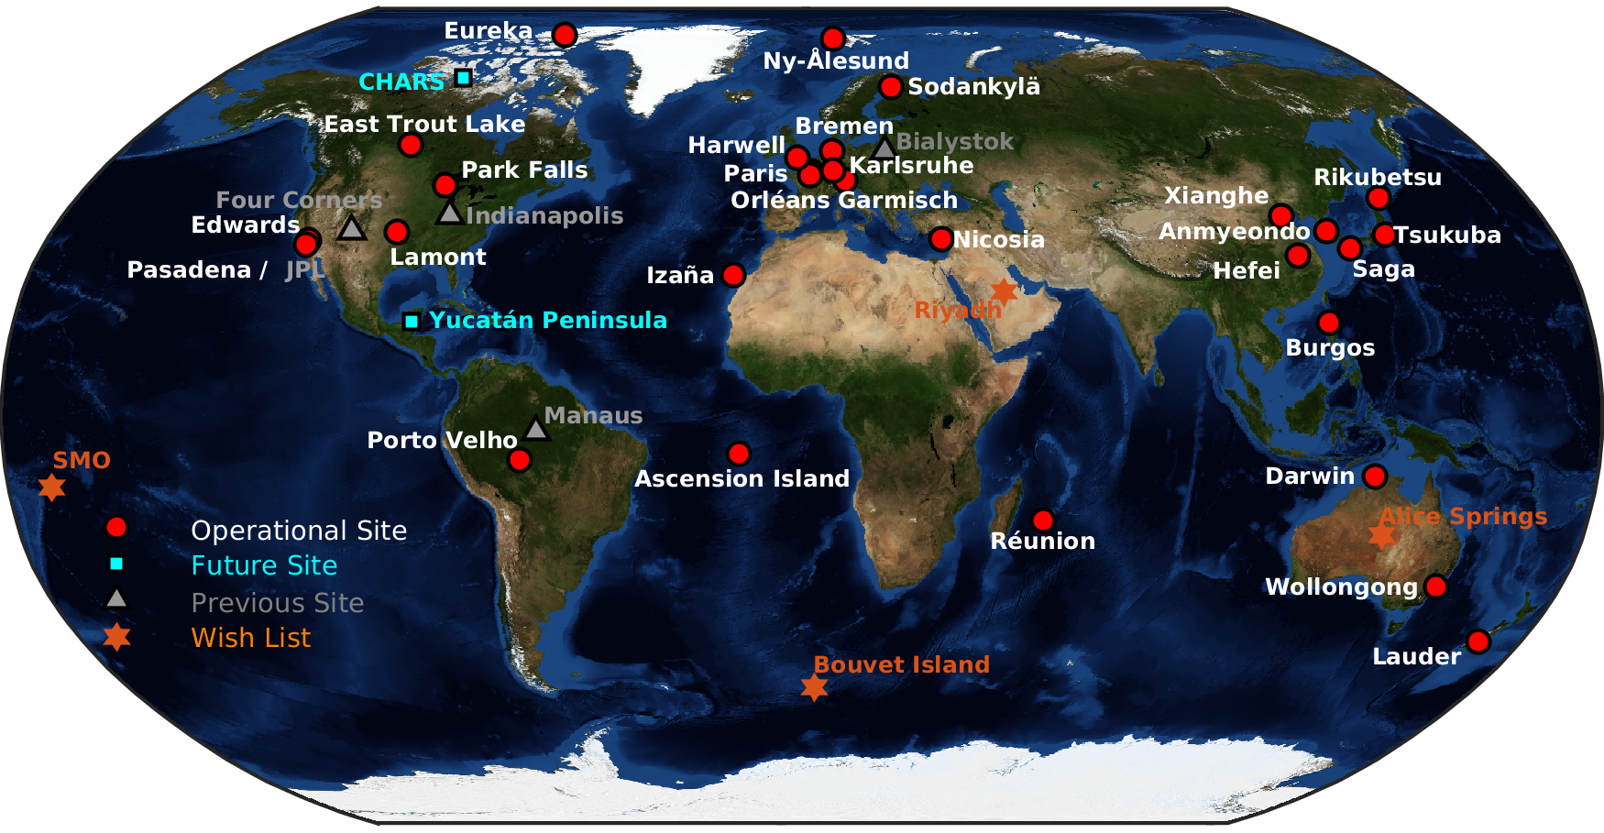
Future TCCON Stations?

Slide 7
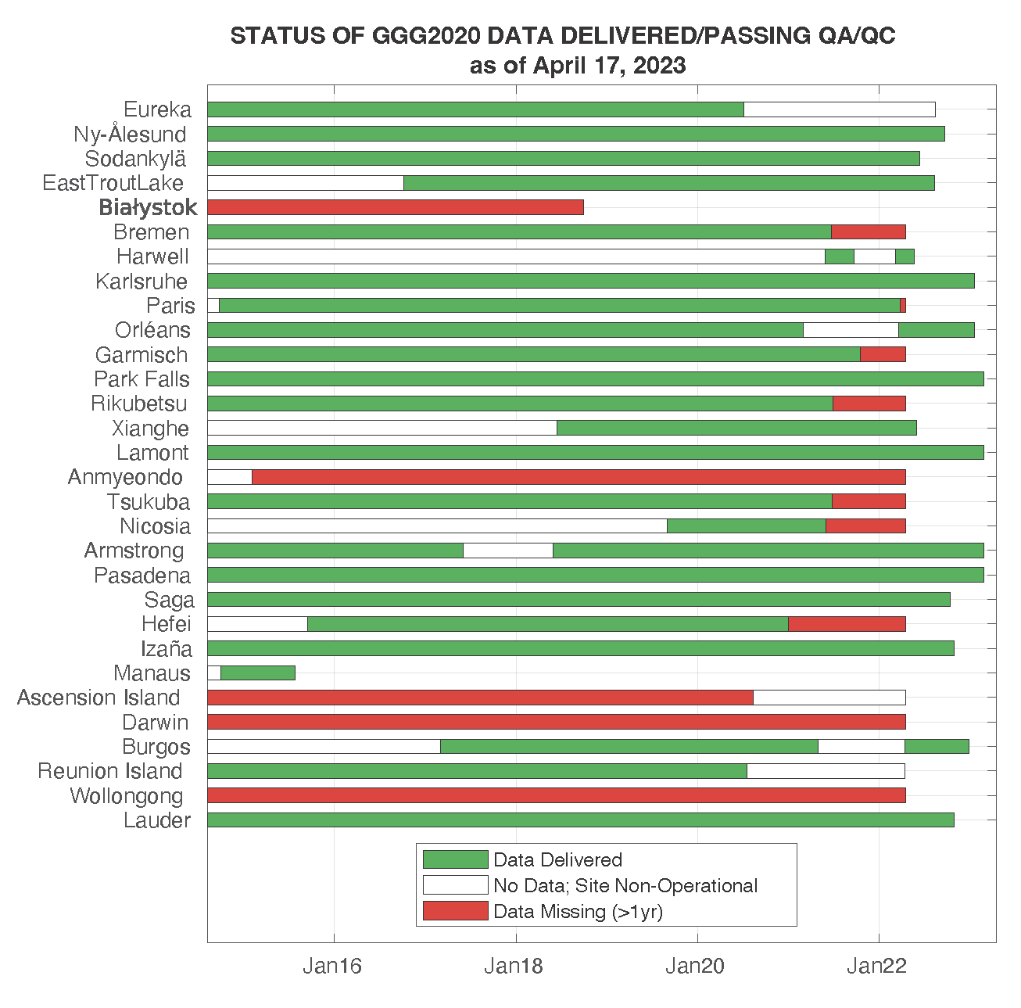
NETWORK Updates: GGG2020 Data Availability
GGG2020 data delivery continues, as does our QA/QC process. Thanks to the QA/QC team for all their time and effort:
Geoffrey Toon, Joshua Laugher, Coleen Roehl, Paul Wennberg, Nick Deutscher, Thorsten Warneke, Mahesh Sha, Dave Griffith, Dave Pollard, Isamu Morino, Dietrich Feist
Any volunteers?
Thanks to all for submitting data in a timely manner and participating in the QA/QC process!
Please continue to deliver your data and collaborate with the QA/QC team.
in QA/QC
in QA/QC
Coleen Roehl
Notes:
This was an exciting year for TCCON, as our GGG2020 software and data product were released. This successful roll-out of the software was due to the efforts of our algorithm team: Geoff Toon, Josh Laughner, and Sébastien Roche, along with Coleen Roehl, and Paul Wennberg. We assembled a large quality assurance team that includes those I’ve just mentioned, plus Nick Deutscher, Thorsten Warneke, Mahesh Sha, Dave Griffith, Isamu Morino, and Dietrich Feist. Our data archive is built and maintained by Tom Morrell at Caltech.
I’d also like to thank all of you who reprocessed your datasets and were fully engaged in the QA/QC process. The archive is nearly complete.
Our public TCCON data archive, provided by the CaltechDATA service, will be mirrored at the European Space Agency’s atmospheric validation data centre (EVDC), both for security and backup purposes, and to reach a broader audience for our datasets. The files will be identical to the public files available on the CaltechData archive, and EVDC will pull the data directly from the archive each month.

Slide 8
Our Goals and Challenges

Slide 9
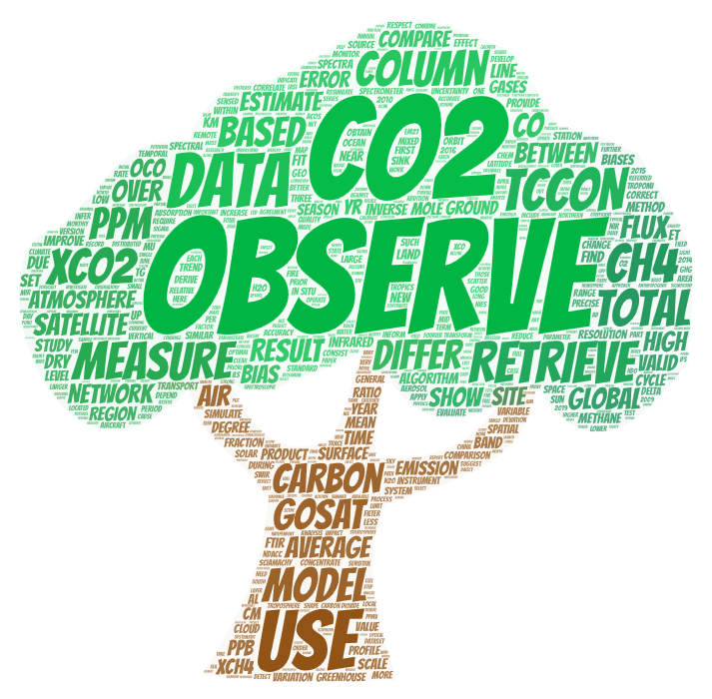
TCCON Accuracy (BIAS) and Precision Goals
Enable carbon cycle science
Remain a useful resource for satellite validation
Work to improve accuracy and precision with new data versions
To tie historical satellites to current and future satellites

Slide 10
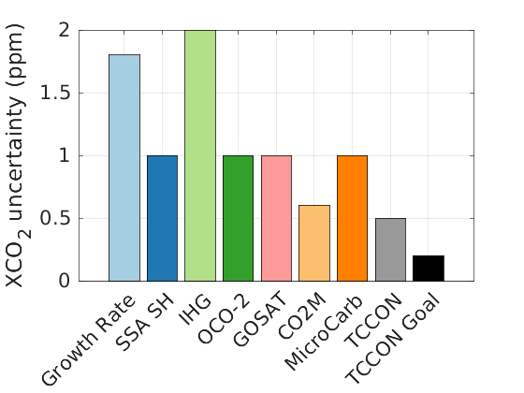
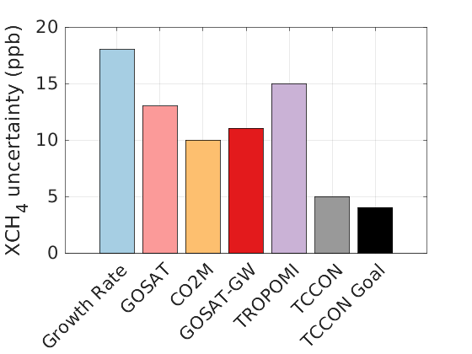
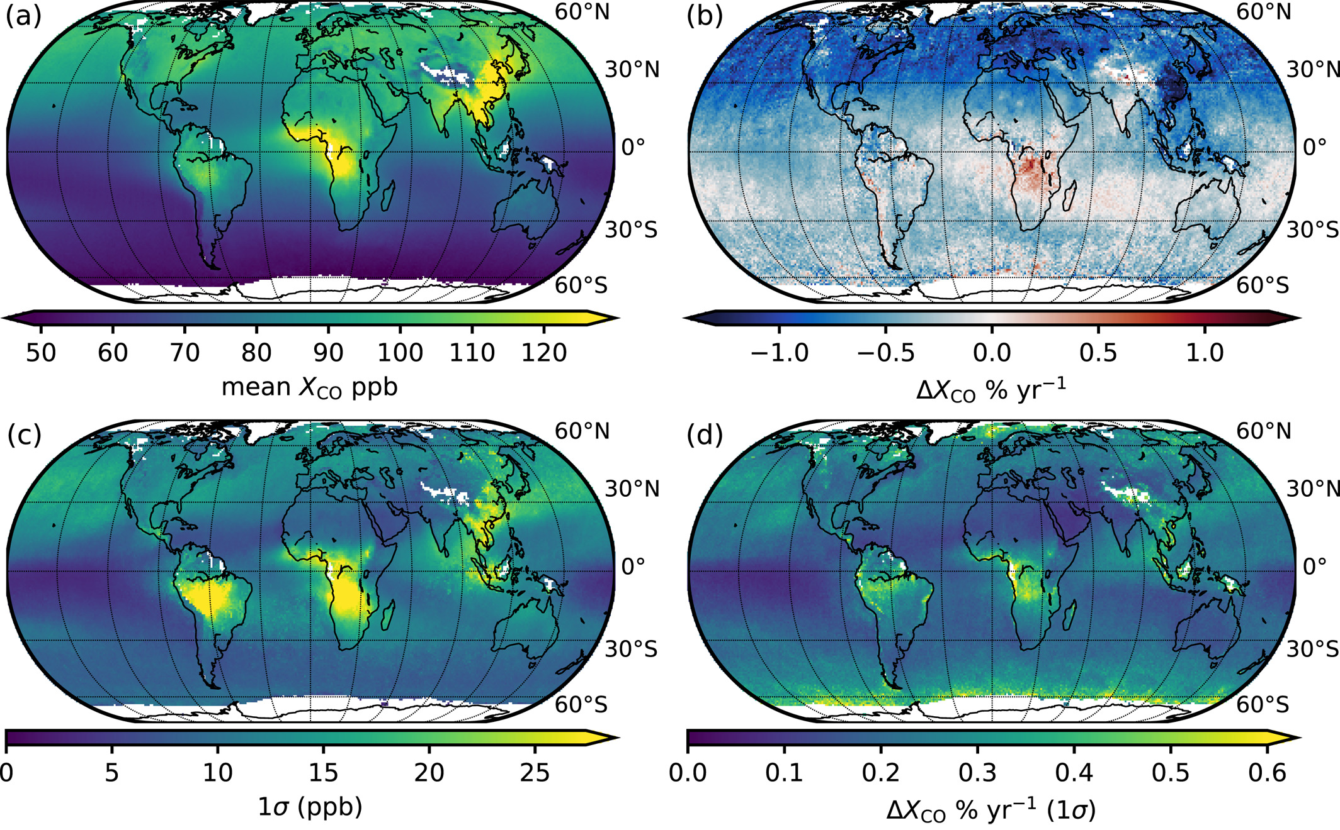
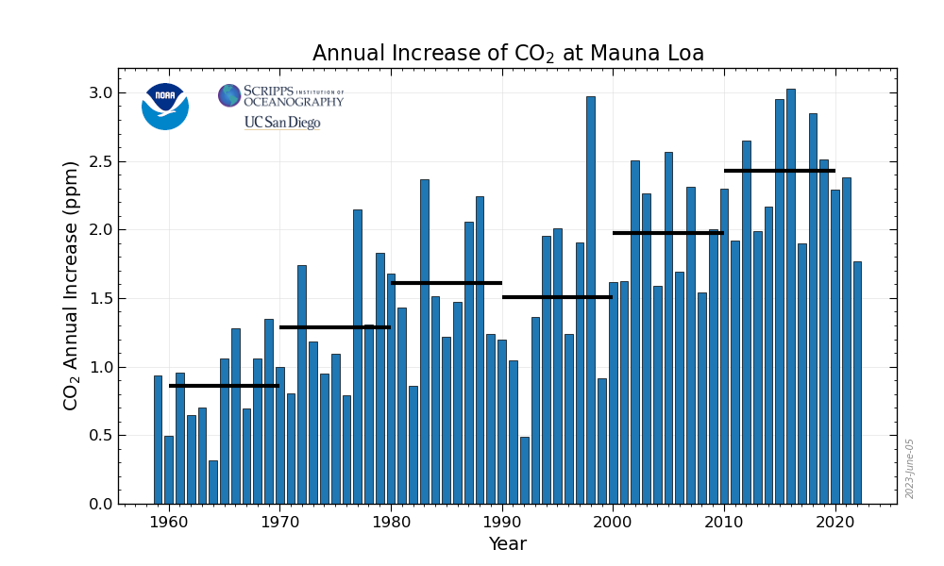
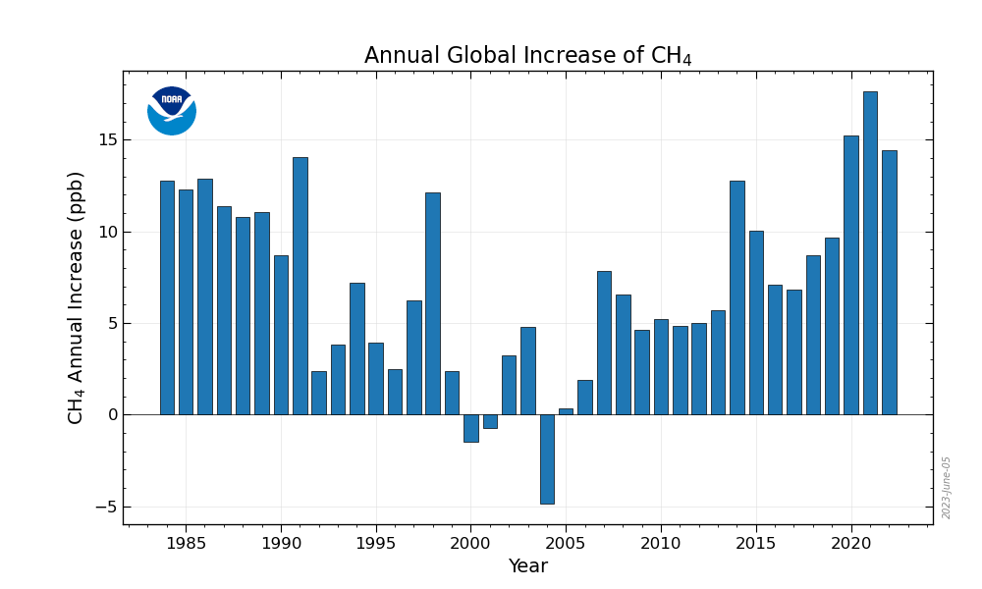
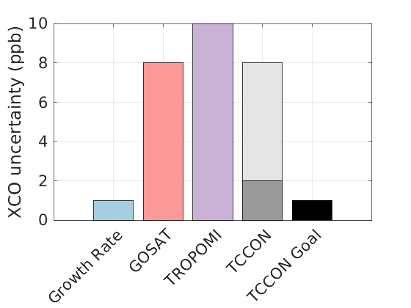
TCCON Bias and Precision Goals for XCO₂, XCH₄, XCO
TCCON requires bias and precision small enough to confidently measure:
Seasonal cycle amplitudes in regions with small seasonal cycles (i.e., SH XCO₂)
Interhemispheric gradients (IHG)
Annual growth rates
Biases in current and future satellite missions
Hedelius et al., JGR, 2021
https://gml.noaa.gov/ccgg/trends_ch4/
https://gml.noaa.gov/ccgg/trends/gr.html

Slide 11
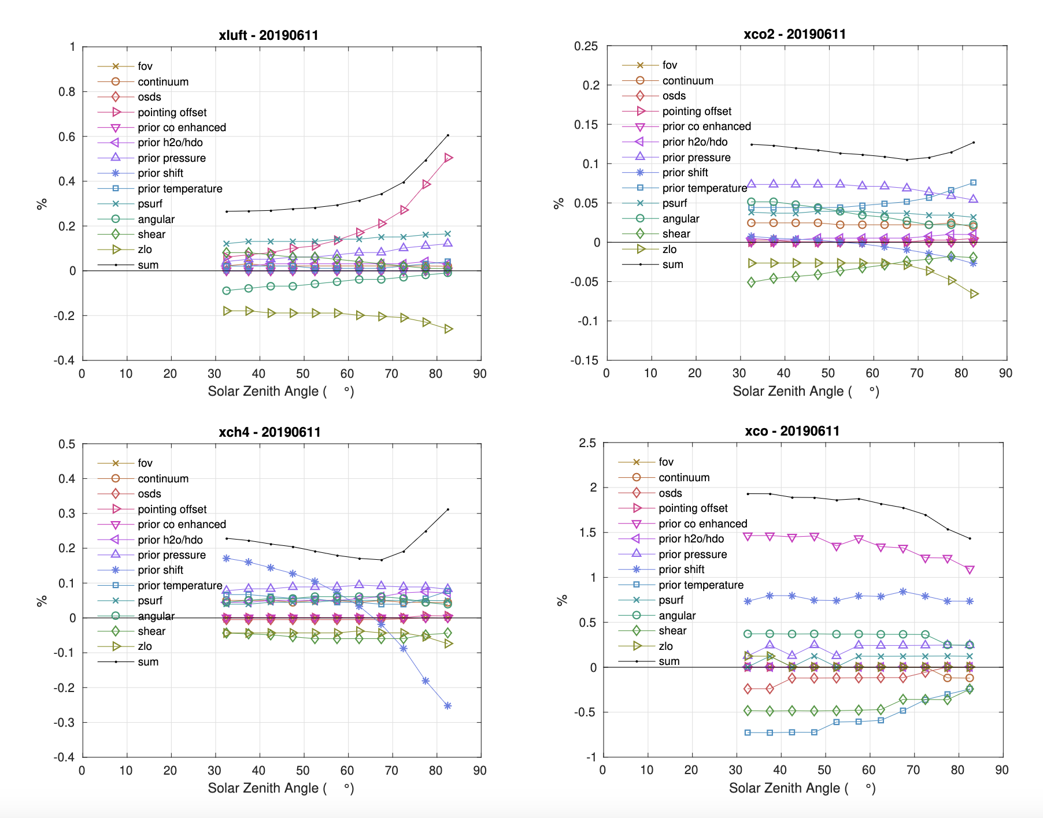
TCCON Precision – Current Error Budget
We are on our way to achieving our precision goals, but haven’t reached them, yet.
Leading order uncertainties: prior temperature, pressure, profile shape, ILS
Geoff Toon is working on implementing a new ILS fitting routine within GFIT – see his talk
This analysis does not explicitly address site-to-site biases or nonlinearity
XCO₂: <0.15%
(0.5 ppm)
XCH₄: <0.3%
(5 ppb)
XCO: <2%
(2 ppb)
Notes:
From this sensitivity analysis, it is clear that for CO2, prior pressure and temperature errors, ILS, and zero level offsets dominate the uncertainty. For methane, the prior shape and prior temperature errors are most important, and for carbon monoxide, the prior shape, prior temperature, and ILS are the most important errors. These results can help us identify which aspects of our data collection and processing procedures need to be refine.
However, these numbers are misleading, because there are still some sources of uncertainty that we cannot estimate using this approach. One of these, which turns out to be potentially larger than what I’ve included here, comes from nonlinearity in our detectors. I’ll spend the next couple of slides describing this problem and some promising solutions.

Slide 12
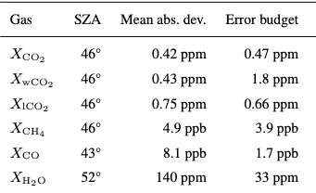
Alternative PRECISION ASSESSMENT
Median abs. deviation = aircraft or AirCore vs. TCCON deviations
Where the two columns agree: the sensitivity analysis captures the variability (XCO₂, XCH₄)
Where they disagree, we’re likely missing something in the sensitivity analysis (XCO, XH₂O, XwCO₂)
Indicates we have not found all the sources of uncertainty in our retrievals for those gases, or that the magnitude of the uncertainties are not properly characterized
Deviation vs. coincident
Aircraft or AirCore
Sensitivity analysis on previous slide
Laughner et al., ESSD (in prep)

Slide 13
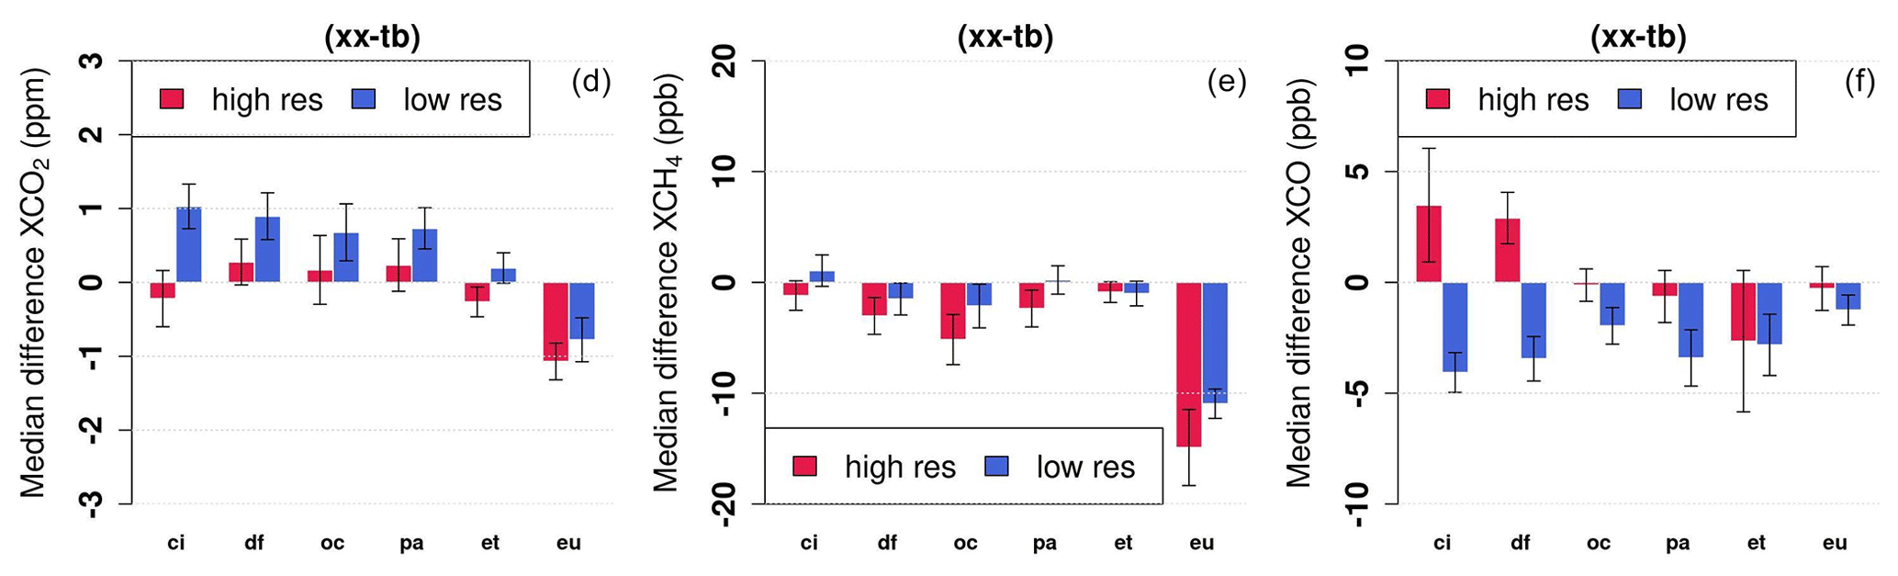
Alternative BIAS Assessments
We need site-to-site bias assessment and removal techniques
See Mostafavi Pak and Herkommer talks tomorrow about traveling EM27/SUNs
See Pollard poster, Griffith presentation, Deutscher talk on AirCores and EM27/SUNs
Mostafavi Pak, N., et al.: Using portable low-resolution spectrometers to evaluate Total Carbon Column Observing Network (TCCON) biases in North America, Atmos. Meas. Tech., 16, 1239–1261, https://doi.org/10.5194/amt-16-1239-2023, 2023.

Slide 14
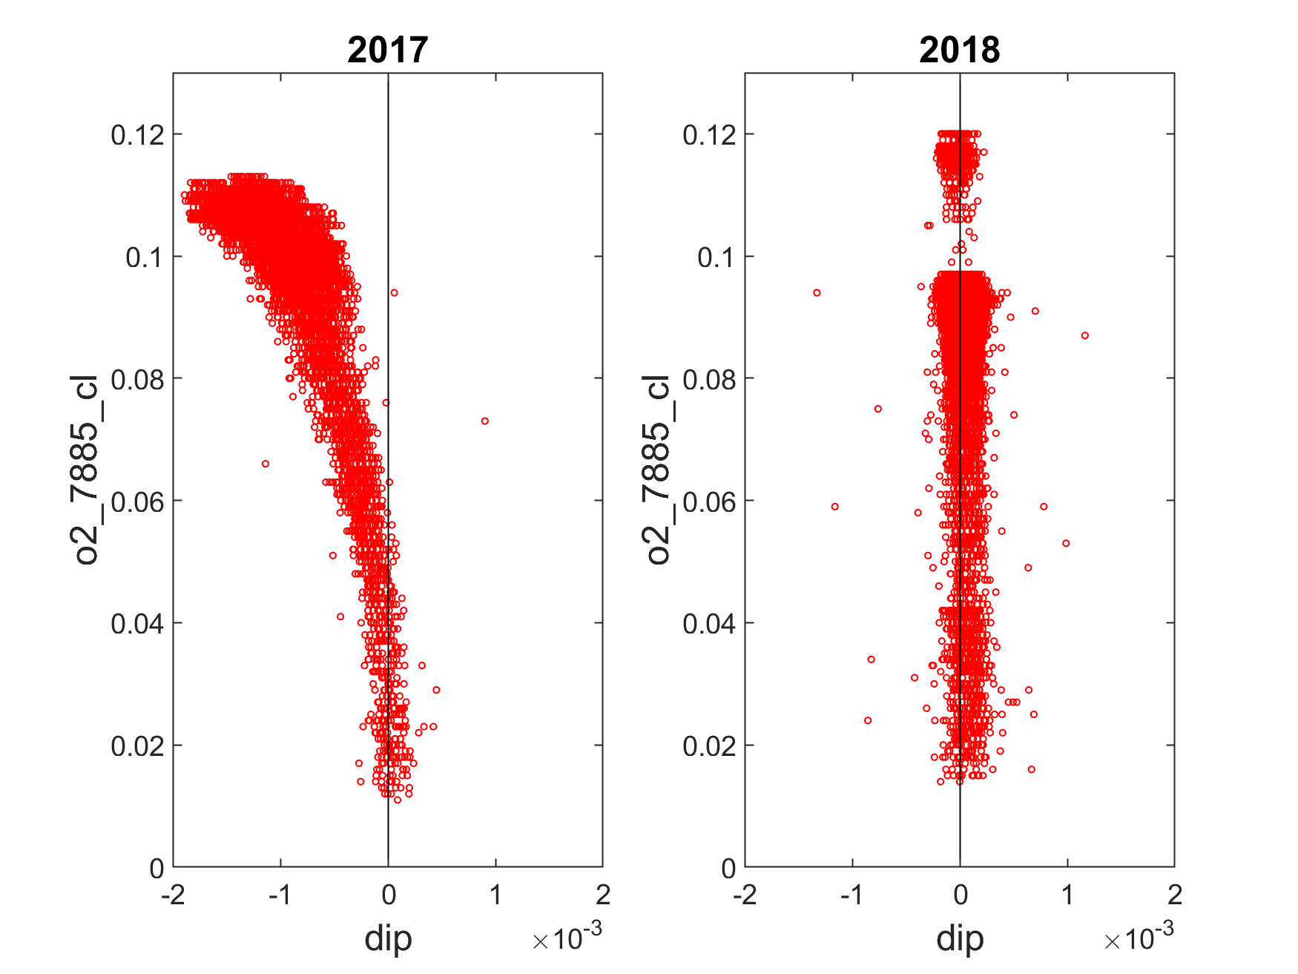
Detector Nonlinearity
Detector nonlinearity occurs when the measured interferogram (I_{OBS}(x), where x is the OPD) is not linearly related to the true interferogram (I(x)). It’s typically modeled using a polynomial:
Nonlinearity can cause the measured interferogram to have an amplitude that is less or larger than the original photon flux
TCCON has a diagnostic of nonlinearity, which we call “DIP” that is calculated in i2s
Sha et al. 2020 (AMT) showed that in 2017 Sodankylä data, nonlinearity caused up to 1 ppm bias in XCO₂. This is twice as large as our current error budget.
Nonlinear period
Linear period
Continuum Level
Rigel Kivi
DIP
DIP
Notes:
Detector nonlinearity occurs when the measured interferogram signal is not linearly related to the number of photons that hit the detector at a given time, as sketched on the figure on the right. Physically, this means that if you double the number of photons, you don’t get exactly twice the voltage. This is also sometimes called “detector saturation.” There’s another potential source of nonlinearity near zero-path difference, which is caused by the very fast change in signal near the centreburst – if the electronics are not able to keep up with the changing signal, this can also cause a nonlinear effect. This is often called the “slew rate” effect.
Detector nonlinearity is often modeled using a polynomial, where the observed interferogram is equal to the true interferogram, modified by second, third, and fourth order terms.

Slide 15
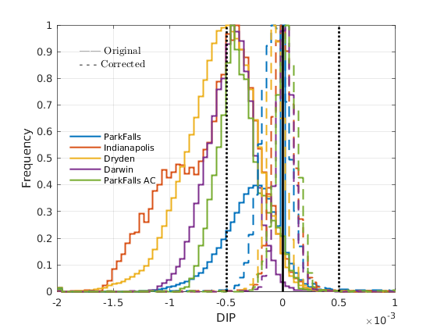
Progress toward Correcting Nonlinearity Biases
Rigel Kivi and Pauli Heikkinen wrote code based on Frank Hase’s implementation of a nonlinearity correction calculation
Calculates coefficients for a 4th order polynomial that returns the interferogram fringes to the correct amplitude
Applied in i2s
Seems to work very well at reducing DIP values
+/- 0.5e⁻³ to limit XCO₂ difference to <0.25 ppm
Max DIP at Sodankylä
Notes:
Based on Frank Hase’s work, Rigel Kivi and Pauli Heikkinen wrote Fortran code to calculate the alpha, beta, and gamma coefficients for a 4th order polynomial correction to the measured interferogram. The code works by minimizing the out-of-band signal calculated from a small section of the interferogram around the ZPD region. Once these coefficients are calculated, they are added to a new section of code within i2s to correct the high-resolution interferograms before calculating the spectra.
I modified their code to read in the Indianapolis data, calculated the coefficients and implemented them into i2s. The results show that their implementation works very well to reduce the dip amplitude of the interferogram.

Slide 16
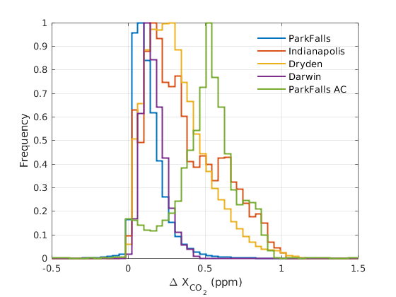
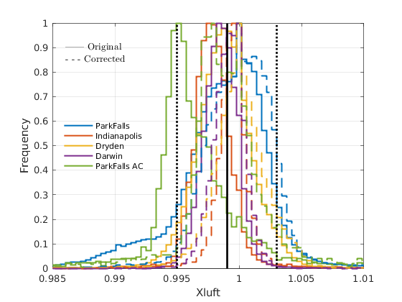
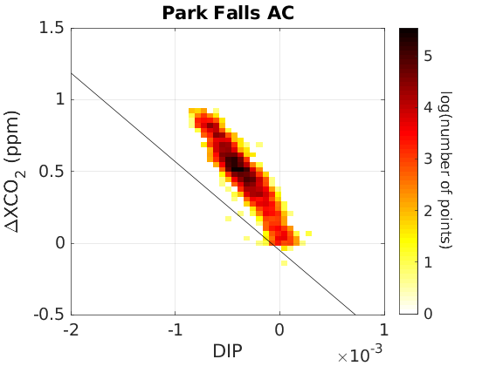
Progress toward Correcting Nonlinearity Biases
Brings Xluft more into family
Changes in XCO₂ can be up to 1 ppm
Park Falls w/AC coupling (<2006) seems to have more sensitivity to DIP than with DC coupling
Best line fit for Indianapolis
Notes:
Based on Frank Hase’s work, Rigel Kivi and Pauli Heikkinen wrote Fortran code to calculate the alpha, beta, and gamma coefficients for a 4th order polynomial correction to the measured interferogram. The code works by minimizing the out-of-band signal calculated from a small section of the interferogram around the ZPD region. Once these coefficients are calculated, they are added to a new section of code within i2s to correct the high-resolution interferograms before calculating the spectra.
I modified their code to read in the Indianapolis data, calculated the coefficients and implemented them into i2s. The results show that their implementation works very well to reduce the dip amplitude of the interferogram.

Slide 17
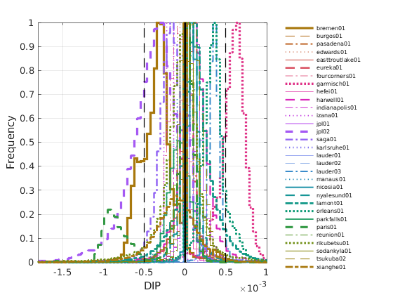
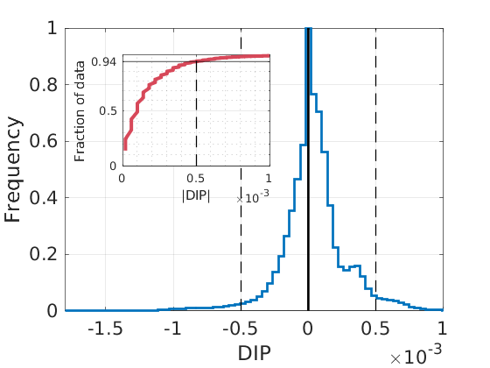
How does the rest of TCCON compare?
JPL02 DIP can be <-1e⁻³
Paris has a period with DIP ~-1e⁻³
Flagged out in public files
Several sites with DIP>0
See Ralf Sussmann’s talk!
Garmisch
Individual site
DIP distribution
Network DIP
Distribution
<6% with
|DIP|>0.5e-3
Notes:
If we expect up to 1 ppm biases with dip amplitudes of -2e-3, then how does the rest of the TCCON compare? This figure shows a histogram of the dip amplitudes for each station that has delivered data to the TCCON archive. Most of the TCCON data shows small dip amplitudes with magnitudes less than 0.5e-3. There are a few notable outliers, and the one I will discuss further is the Indianapolis dataset that is in the dashed pink line.

Slide 18
Summary
The TCCON has been significantly affected by the pandemic, but we’ve done a great job of continuing to collect data.
GGG2020 is a substantial improvement over GGG2014 and was finally released in April 2022!
Inter-network biases remain
First-order problem is nonlinearity, which we know how to fix, but need to continue implementing across the network
Thanks to Rigel and Pauli for the nonlinearity correction coefficient calculation software – now available on GitHub.
ILS should be the next area of focus, along with surface pressure calibration
Continued work to reduce station-to-station biases between TCCON stations will be required to meet our precision and accuracy goals
Notes:
The past couple of years has been particularly challenging for the network, but we have managed to continue most of our measurements and to contribute to the scientific literature. GGG2020 retrievals show a substantial improvement over GGG2014, and I’m excited to see the new science that our new datasets will enable. We still have site-to-site biases within the TCCON that need to be resolved – nonlinearity is probably the first-order of business for affected sites, but it would be ideal to develop and implement a network-wide solution to this problem.

Slide 19
Discussion TOPICS for later Today
Coauthorships
Nonlinearity
Surface pressure calibrations
InSb measurements
Expanding the TCCON
Supporting future satellite measurements with faster data delivery and new products
Funding security for TCCON
Interferogram and spectra backup systems
Formal GGG/PROFFAST comparisons
TCCON budget (internal)
TCCON elections
PLEASE SUBMIT YOUR CHAIR AND DEPUTY NOMINATIONS TO DAVE GRIFFITH OR JUSTUS NOTHOLT BY THE AFTERNOON BREAK!

Slide 20
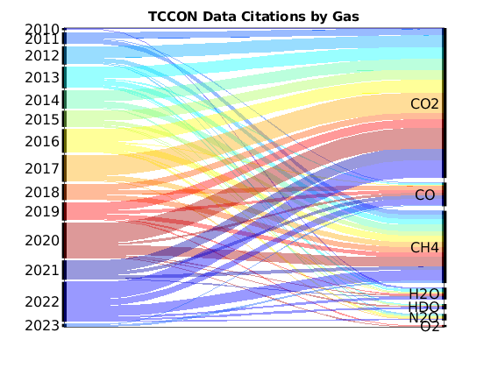
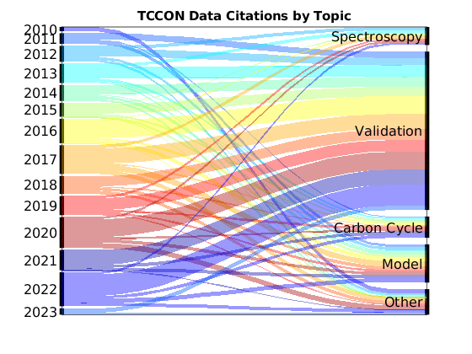
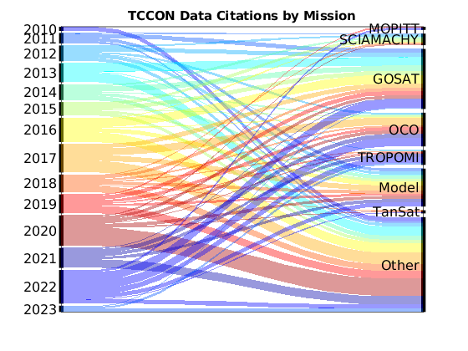
Thank you
431 publications
>3800 citing articles
>11,200 times cited
>25 citations/publication
H-Index = 52
Web of Science: “total carbon column observing network” OR TCCON in all fields
Notes:
Finally, I wanted to thank you all for your diligence and persistence over the past year. I hope the coming year sees fewer restrictions, improved health, and less stress, allowing us to resume in-person joint meetings with our NDACC and COCCON partners. I look forward to seeing you all in person in 2023.

Slide 22
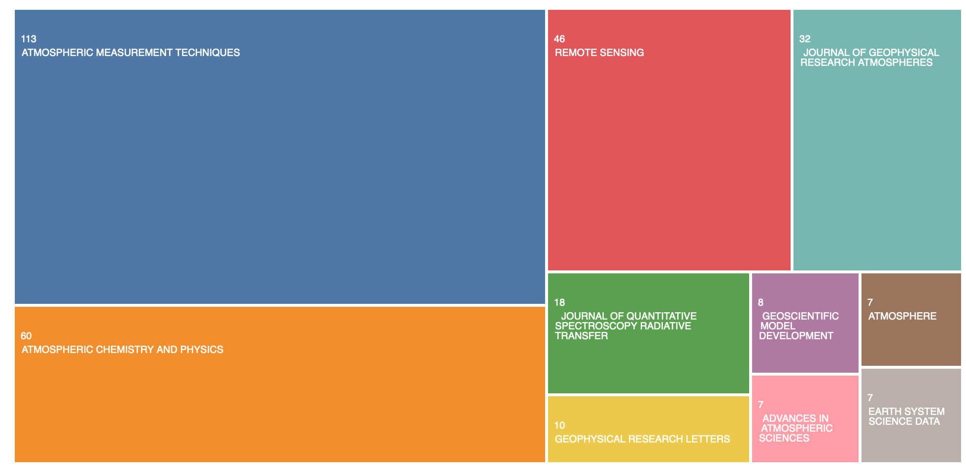
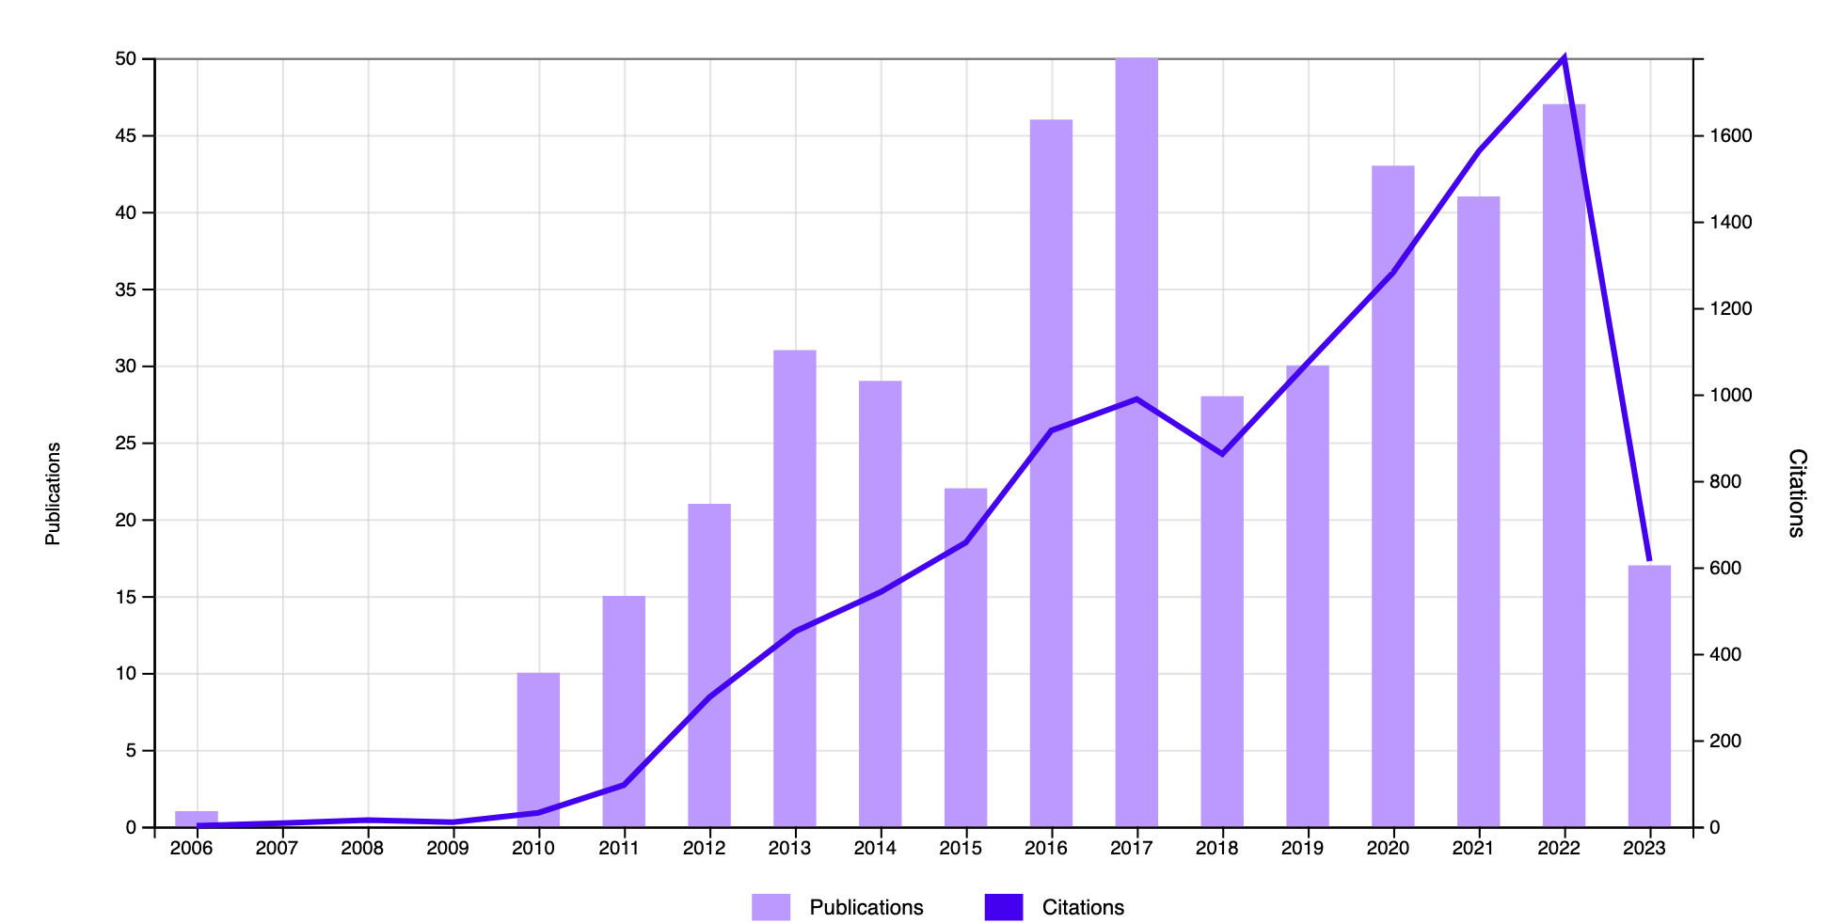
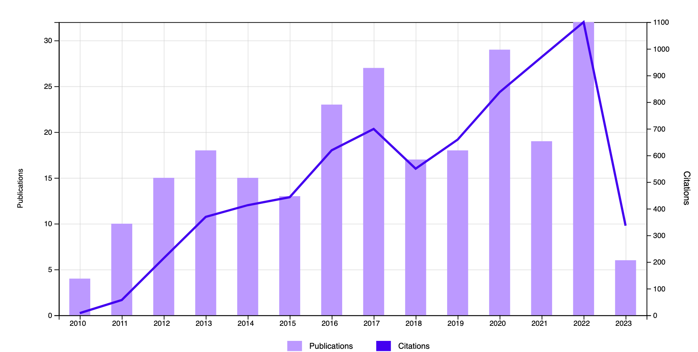
TCCON Data usage by the numbers
431 publications
>3800 citing articles
>11,200 times cited
>25 citations/publication
H-Index = 52
Web of Science: “total carbon column observing network” OR TCCON in all fields
50
1600
Remote Sensing
AMT
JGR-A
Publications
Citations
Atmosphere
JQSRT
GMD
ACP
Adv. in Atmos. Sci.
GRL
ESSD
Web of Science
Notes:
According to the Web of Science, since 2010, there have been 219 publications that mention TCCON, with more than 2000 citing articles. Papers using our data typically appear in high-quality atmospheric science journals such as AMT, ACP, Remote Sensing and JGR, and our paper count has increased over time, albeit non-monotonically.

Slide 23
Data usage – by Gas, by Topic, and By Mission
Notes:
Breaking down these numbers by gas, topic, and mission, it’s clear that even today about 50% of our literature contributions involve our measurements of CO2, with methane accounting for a quarter, and carbon monoxide coming in third. Validation papers of GOSAT and OCO comprise the bulk of these papers, with TROPOMI validation papers starting to contribute significantly. We’ve contributed to model improvements, spectroscopy improvements, and carbon cycle scientific papers as well.

Slide 24
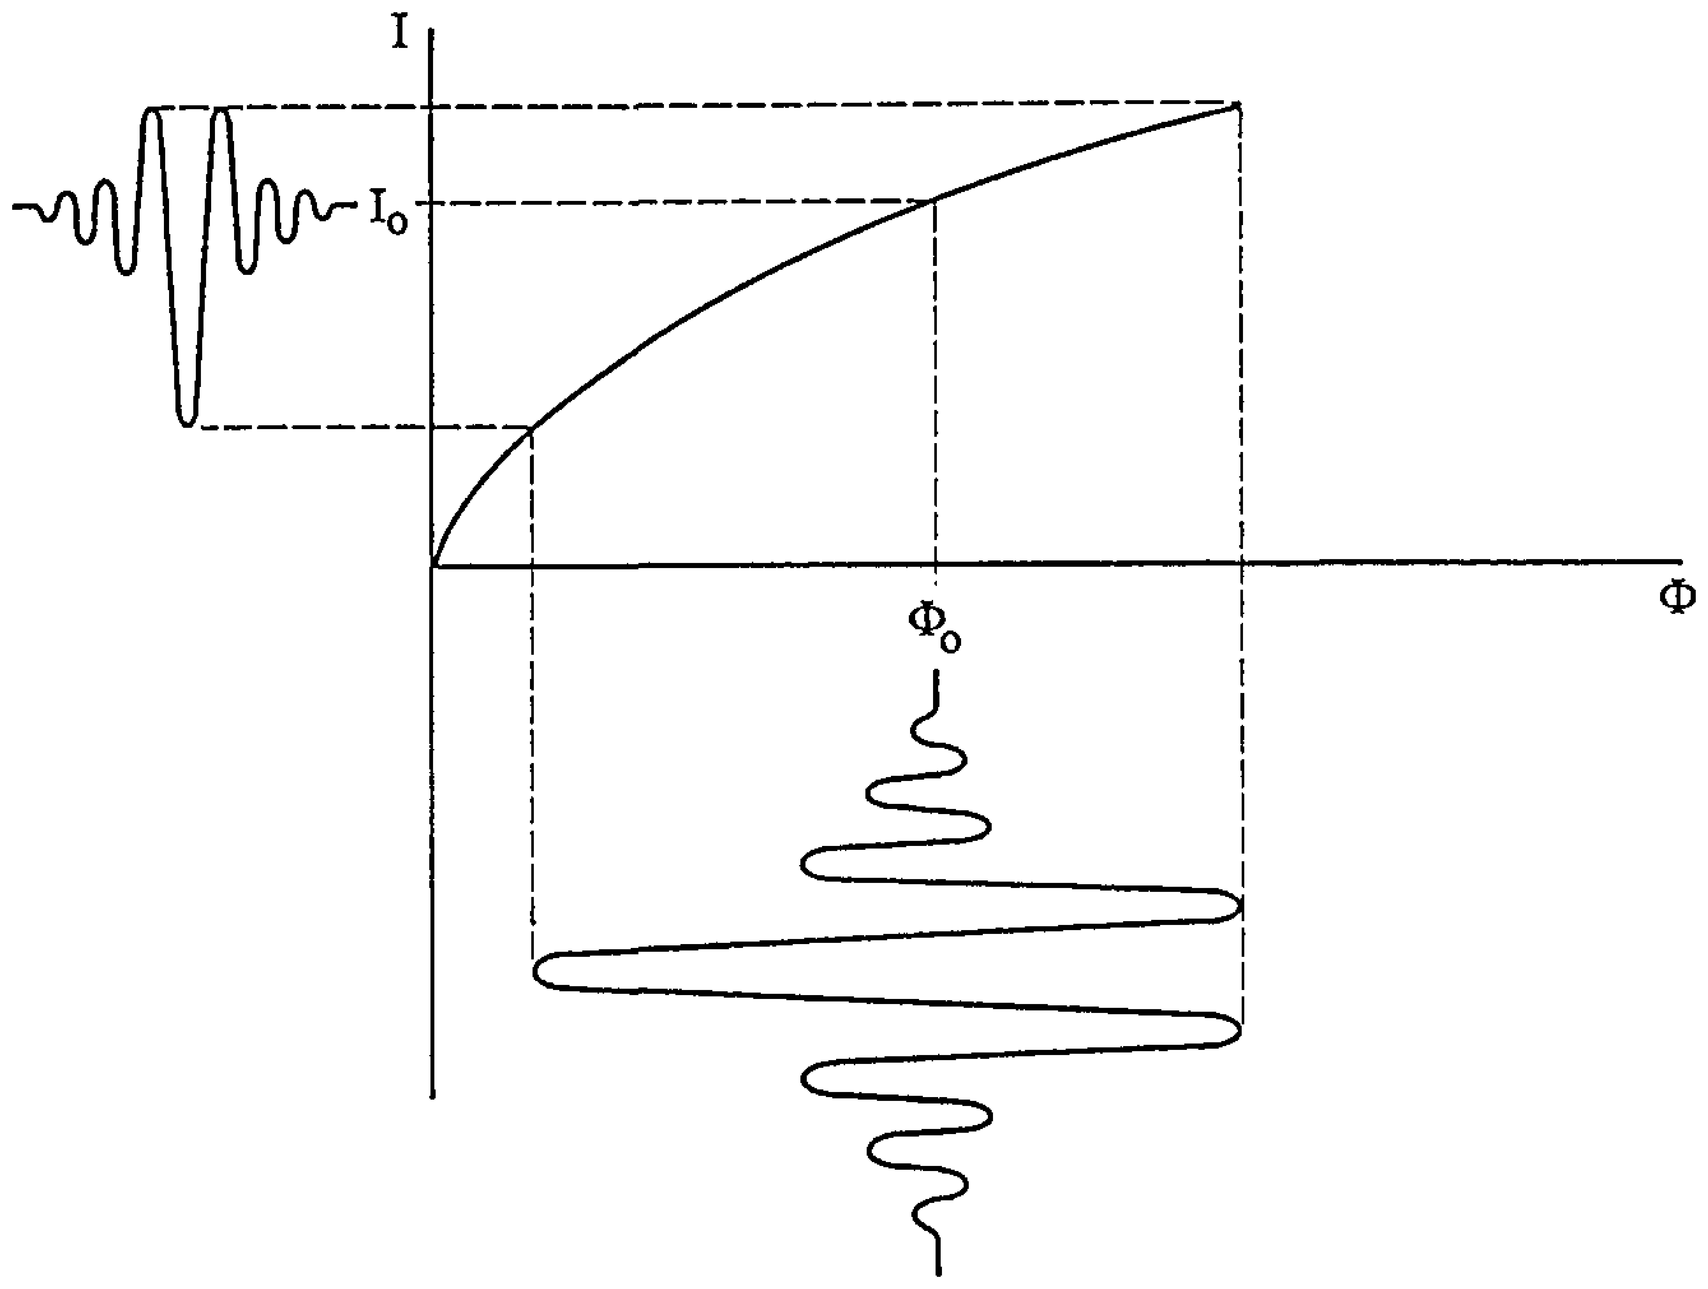
Detector Nonlinearity
Detector nonlinearity occurs when the measured interferogram (I_{OBS}(x), where x is the OPD) is not linearly related to the true interferogram (I(x)). It’s typically modeled using a polynomial:
Physically, this means that when you double the number of photons, you don’t get exactly twice the voltage. This is “detector saturation” and happens when signal levels are high (i.e., near ZPD).
Nonlinearity can cause the measured interferogram to have an amplitude that is less or larger than the original photon flux
Measured DC Signal (interferogram signal)
Linear
Nonlinear
Photon Flux (total number of photons)
Fig 3 from M. C. Abrams, G. C. Toon, and R. A. Schindler, "Practical example of the correction of Fourier-transform spectra for detector nonlinearity," Appl. Opt. 33, 6307-6314 (1994)
Notes:
Detector nonlinearity occurs when the measured interferogram signal is not linearly related to the number of photons that hit the detector at a given time, as sketched on the figure on the right. Physically, this means that if you double the number of photons, you don’t get exactly twice the voltage. This is also sometimes called “detector saturation.” There’s another potential source of nonlinearity near zero-path difference, which is caused by the very fast change in signal near the centreburst – if the electronics are not able to keep up with the changing signal, this can also cause a nonlinear effect. This is often called the “slew rate” effect.
Detector nonlinearity is often modeled using a polynomial, where the observed interferogram is equal to the true interferogram, modified by second, third, and fourth order terms.

Slide 25
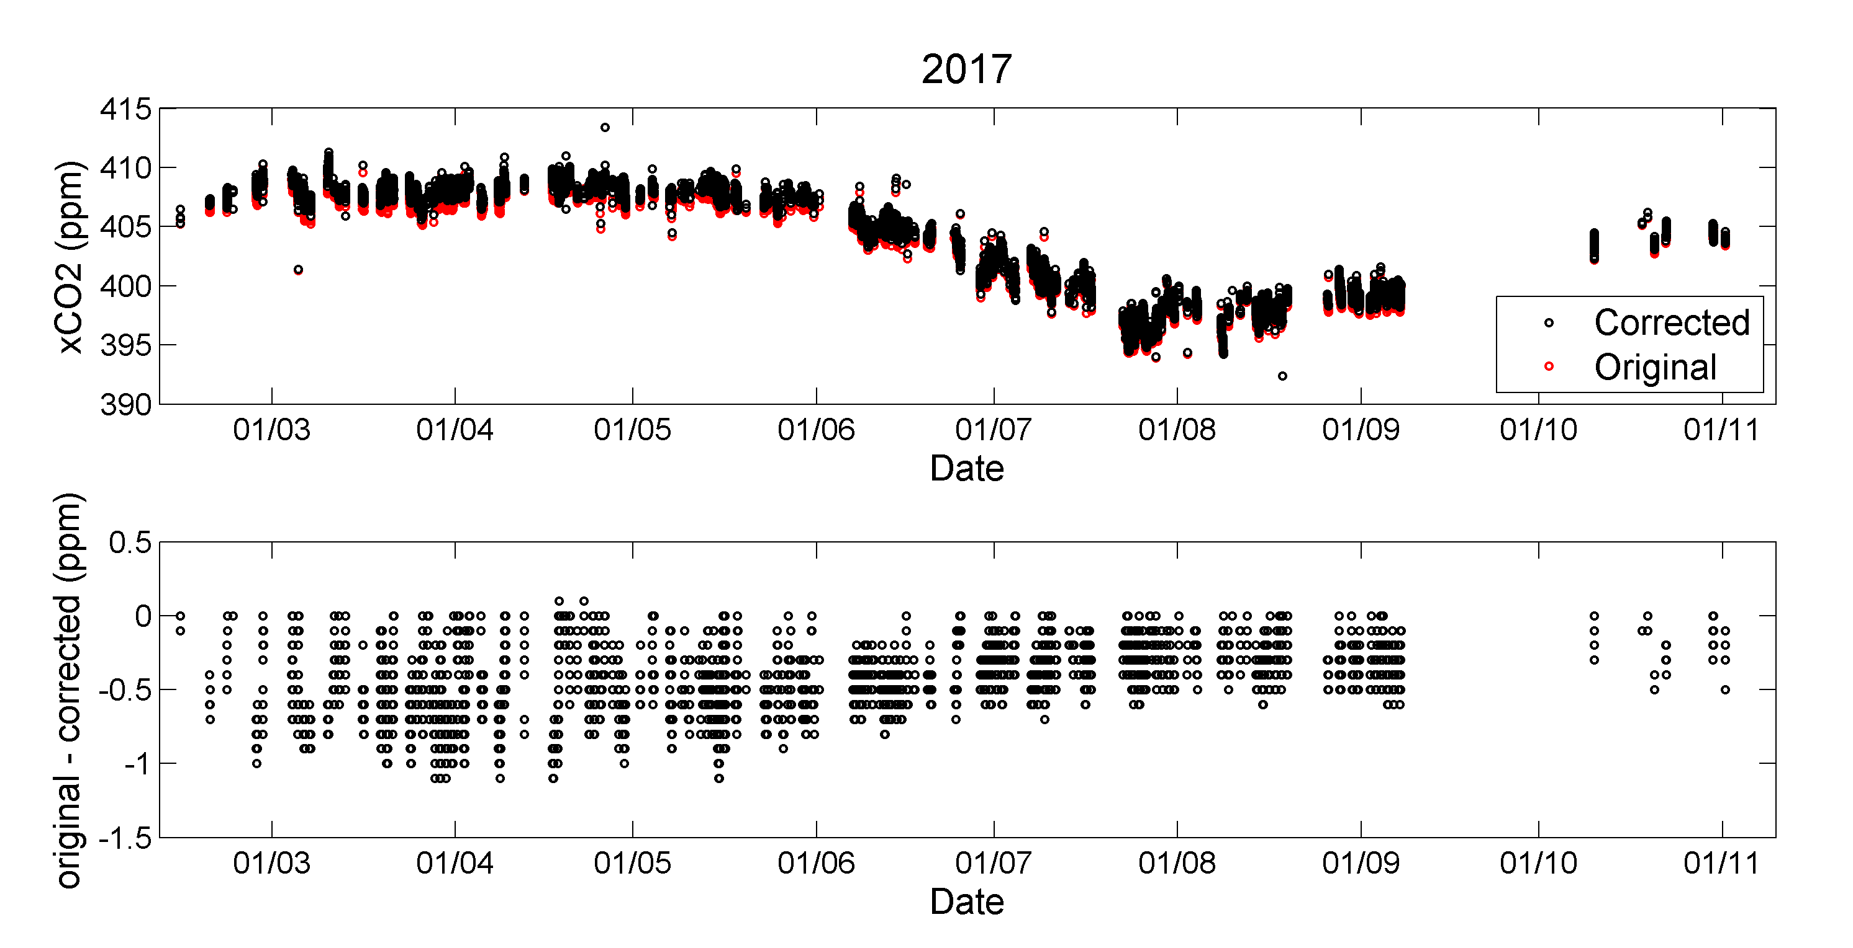
What is the Affect of Nonlinearity on XCO₂?
Sha et al. 2020 (AMT) showed that in 2017 Sodankylä data, nonlinearity caused up to 1 ppm bias in XCO₂. This is almost twice as large as our current error budget.
TCCON has a diagnostic of nonlinearity, which we call “DIP”.
The Sodankylä DIP value in 2017 was as large as ~-2e-3.
Nonlinear period
Linear period
Mahesh Sha
Rigel Kivi
Notes:
So, from now on, I will be using the dip amplitude as a proxy for nonlinearity. First, we want to get a handle on the effect nonlinearity has on XCO2. As part of Mahesh’s intercomparison paper in 2020, they discovered that the Sodankyla data in 2017 had significant detector nonlinearity that caused up to 1 ppm bias in XCO2. This is almost twice as large as our current error budget, so it’s a really important source of error to understand and reduce or eliminate. In 2017, the Sodankyla dip amplitudes were as large as -2e-3. The plot on the left shows the relationship between the dip amplitude and the O2 continuum level during the nonlinear 2017 period, and the subsequent linear 2018 period, after the number of photons reaching the detector was reduced in the instrument. There is a clear relationship between the dip amplitude and the signal level when the detectors were measuring in their nonlinear regime, as expected.

Slide 26
TCCON Bias and precision GOALS for XCO₂
Seasonal cycle amplitude in the SH = ~1 ppm
Interhemispheric gradient = ~2 ppm
Annual growth rate ~= 1.8-3 ppm (since
OCO-2 precision < 1 ppm
GOSAT/-2 precision < 1 ppm
CO2M precision goal = 0.6 ppm
MicroCarb precision goal <1 ppm
Aim for TCCON XCO₂ precision and accuracy of ~0.2 ppm (0.05%)
https://gml.noaa.gov/ccgg/trends/gr.html

Slide 27
TCCON Bias and precision goalS For XCH₄
Annual growth rate < 18 ppb
GOSAT precision = 0.7% (13 ppb)
CO2M and GOSAT-GW precision goal = 0.6% (11 ppb)
TROPOMI precision = 0.8% (15 ppb)
MethaneSAT precision goal = 0.1-0.2% (2-4 ppb for 1-5km binned data)
Aim for TCCON XCH₄ precision and accuracy of ~0.2% (4 ppb)
https://gml.noaa.gov/ccgg/trends_ch4/
Jacob, D. J., et al. Quantifying methane emissions from the global scale down to point sources using satellite observations of atmospheric methane, Atmos. Chem. Phys., 22, 9617–9646, https://doi.org/10.5194/acp-22-9617-2022, 2022.

Slide 28
TCCON Bias and precision goalS For XCO
Annual growth rate ~1% (1 ppb)
GOSAT-2 precision ~8% (8 ppb)
TROPOMI precision < 10% (10 ppb)
Aim for TCCON XCO precision and accuracy of ~1% (1 ppb)
Noël, S., et al.: Retrieval of greenhouse gases from GOSAT and GOSAT-2 using the FOCAL algorithm, Atmos. Meas. Tech., 15, 3401–3437, https://doi.org/10.5194/amt-15-3401-2022, 2022
Landgraf et al.: ATBD for Sentinel-5P: Carbon Monoxide Total Column Retrieval, SRON. SRON-S5P-LEV2-RP-002, 2022
Hedelius et al., JGR, 2021

Slide 30
New Nonlinearity diagnostics in GGG2020: DIP, ZLO
We’ve added two new nonlinearity diagnostic parameters to the private files in GGG2020: DIP and zero level offsets (ZLO)
Both parameters should increase in magnitude when detector nonlinearity is large
ZLO appears to also be sensitive to instrument line shape
zco2_4852a_zo
DIP is calculated as part of i2s
Notes:
In GGG2020, we added two new diagnostics that are sensitive to nonlinearity: a new parameter called “DIP” and the zero level offsets. When detector nonlinearity increases, the magnitude of these two parameters also increases. Zero level offsets are calculated in the new zco2 4852a window, but in addition to its sensitivity to nonlinearity, the zero-level offset calculated in that window seems to also be sensitive to instrument line shape changes. The DIP value is calculated as part of i2s for interferograms recorded in DC mode.

Slide 31
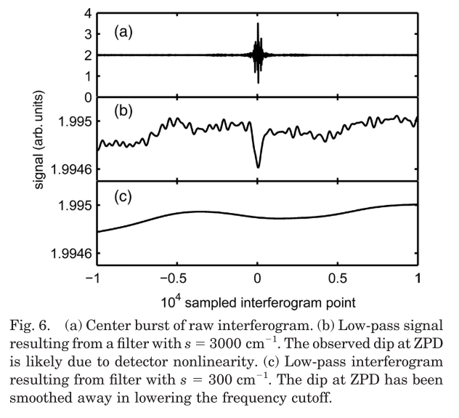
What is DIP?
DIP is calculated as part of the source brightness fluctuation correction (aka, the DC correction)
The smoothed interferogram has a small, negative “dip” near ZPD
Likely related to nonlinearities arising near ZPD
In i2s, the dip is smoothed out before it’s used to correct the high-resolution DC interferogram
The DIP value recorded in the LSE file is the height of the central part of the dip
Gretchen Keppel-Aleks, Geoffrey C. Toon, Paul O. Wennberg, and Nicholas M. Deutscher, "Reducing the impact of source brightness fluctuations on spectra obtained by Fourier-transform spectrometry," Appl. Opt. 46, 4774-4779 (2007)
Notes:
The DIP is calculated during the source brightness fluctuation correction, what we typically call the “DC correction,” that’s used to reduce the impact of high cloud or other small changes in solar intensity during a scan. Gretchen, Geoff, Paul, and Nick noticed that the smoothed interferogram that contains the source brightness fluctuations in panel (b) on this figure had a small, negative “dip” near ZPD that is likely related to nonlinearities arising near ZPD.
In our current implementation of i2s, the dip is smoothed out and removed before correcting the high-resolution DC interferogram, but in the process, we record the amplitude of the dip in the header of each spectrum. That amplitude is then written out in the .lse files we generate with create_runlog.

Slide 32
What is DIP?
It is clear that DIP is related to nonlinearity
It’s not yet clear whether DIP is most sensitive to the large signal level, or to the “slew-rate” of the detector electronics. Or both!
Gretchen Keppel-Aleks, Geoffrey C. Toon, Paul O. Wennberg, and Nicholas M. Deutscher, "Reducing the impact of source brightness fluctuations on spectra obtained by Fourier-transform spectrometry," Appl. Opt. 46, 4774-4779 (2007)
Notes:
It is reasonably clear now that the amplitude of the dip is related to nonlinearity, but we’re not yet sure whether it’s most sensitive to detector saturation effects or the slew rate problem or both.

Slide 33
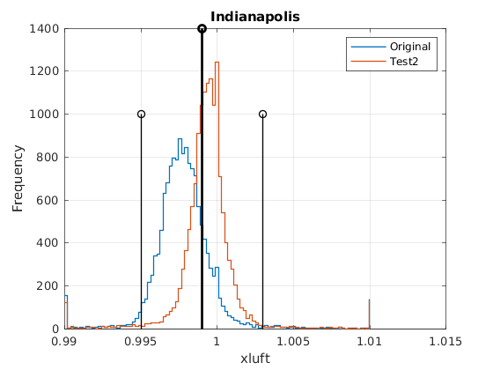
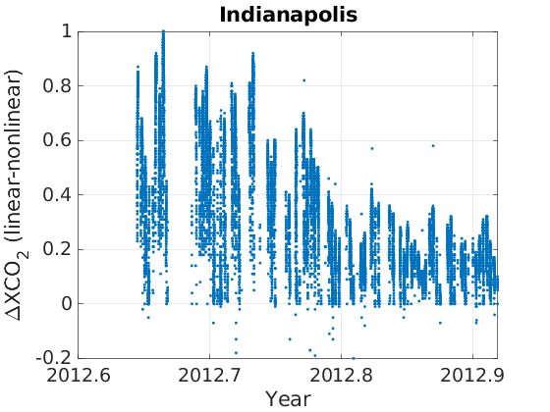
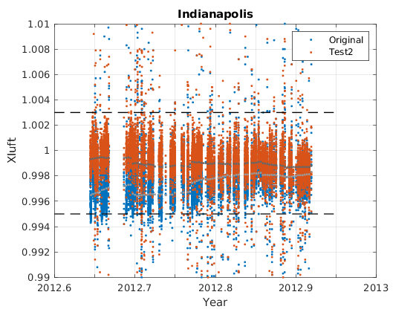
Progress toward Correcting Nonlinearity Biases
After correction, xluft values are closer to the network mean, and have smaller spread
Differences in XCO₂ are up to 1 ppm when the continuum level is largest (near the beginning of the record).
Nonlinear (uncorrected) Linear (corrected)
∆XCO₂
XLUFT
Notes:
After running GFIT on the new spectra, I saw a significant improvement in the precision of the retrieved xluft, and the mean value is more in-line with the TCCON mean, marked in the central figure by the tallest black line. The differences in the XCO2 retrieved from the uncorrected and corrected spectra are up to 1 ppm and depend, as expected, on the signal level. This seems consistent with the results from the Sodankyla data.

Slide 34
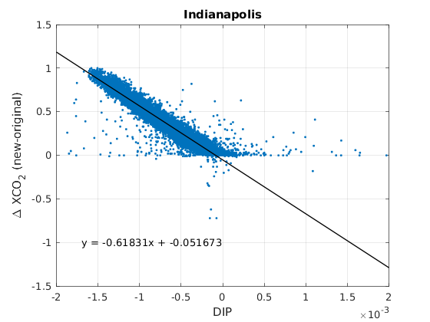
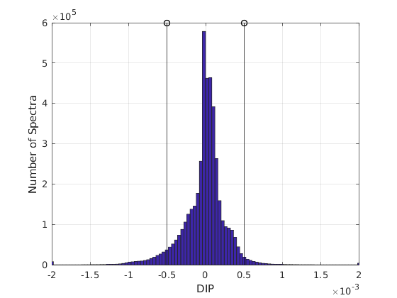
Correcting Nonlinearity Biases
To maintain a 0.25 ppm network-wide accuracy: |DIP|<5e-4
What can we do? Limit incoming photons, and coordinate to correct existing affected data
Limit incoming photons (https://tccon-wiki.caltech.edu/Main/LimitingSignalLevels)
Notes:
Plotting these Indianapolis data another way shows the remarkably linear relationship between the dip amplitude and the difference in XCO2. If we want to maintain a 0.25 ppm network-wide accuracy, then based on this dataset, we need to maintain our IFS systems such that the magnitude of the dip amplitude is less than 0.5e-3.
Around 7% of the TCCON data has a dip amplitude magnitude that is larger than 0.5e-3. We can reduce nonlinearity effects in the instruments by adding an aperture stop or by reducing the field stop diameter on the aperture wheel. But to correct data already collected, I think Rigel, Pauli, and Frank’s approach is a promising one.

Slide 35
Progress toward Correcting Nonlinearity Biases
Changes in XCO₂ can be up to 1 ppm
Park Falls w/AC coupling (<2006) seems to have more sensitivity to DIP than with DC coupling
Best line fit for Indianapolis
Notes:
Based on Frank Hase’s work, Rigel Kivi and Pauli Heikkinen wrote Fortran code to calculate the alpha, beta, and gamma coefficients for a 4th order polynomial correction to the measured interferogram. The code works by minimizing the out-of-band signal calculated from a small section of the interferogram around the ZPD region. Once these coefficients are calculated, they are added to a new section of code within i2s to correct the high-resolution interferograms before calculating the spectra.
I modified their code to read in the Indianapolis data, calculated the coefficients and implemented them into i2s. The results show that their implementation works very well to reduce the dip amplitude of the interferogram.

Slide 36
Paper Abstract Contents
This word cloud was created using all the words in the 431 abstracts of papers that contain “total carbon column observing network” or TCCON in any field

