Slide 1


Temporal Variation of Greenhouse Gases observed by FTIR
at Hefei site, China
Changgong Shan, Wei Wang, Youwen Sun, Cheng Liu
Key Laboratory of Environmental Optics and Technology, AIOFM
cgshan@aiofm.ac.cn
Notes:
My purpose today is to give a detaile of the FTIR observed at Hefei Site

Slide 2
CONTENTS
FTIR system of the Hefei site
Parameter setting
Observed results
EM27 results

Slide 3
01
FTIR system of the Hefei site

Slide 4
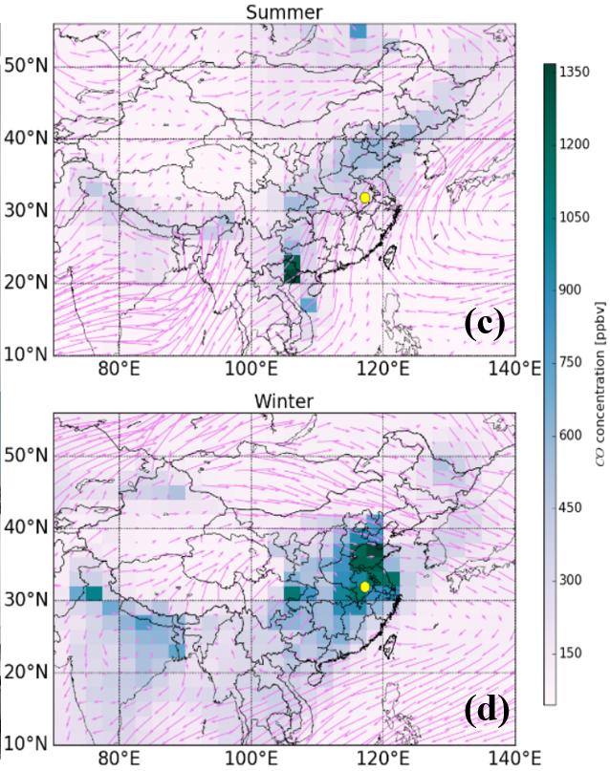
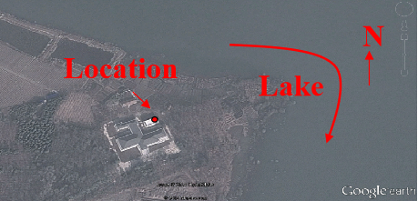
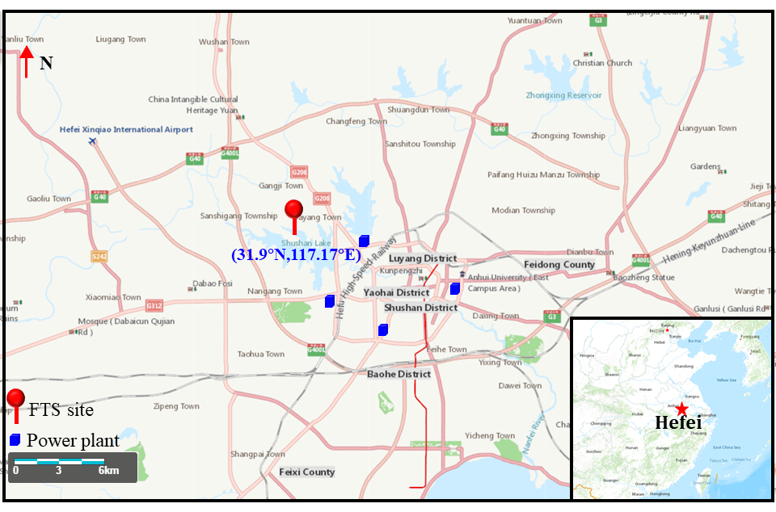
01
FTIR system of the Hefei site
The Hefei site (31.91 N, 117.17 E, 29 m), adjacent to a lake in a flat terrain, is located in the north-western rural area of Hefei city in eastern China
Operated by Key Laboratory of Environmental Optics and Technology, Anhui Institute of Optics and Fine Mechanics

Slide 5
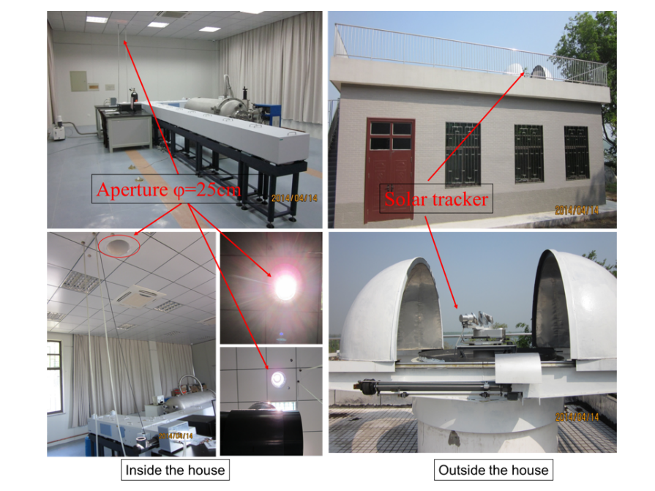
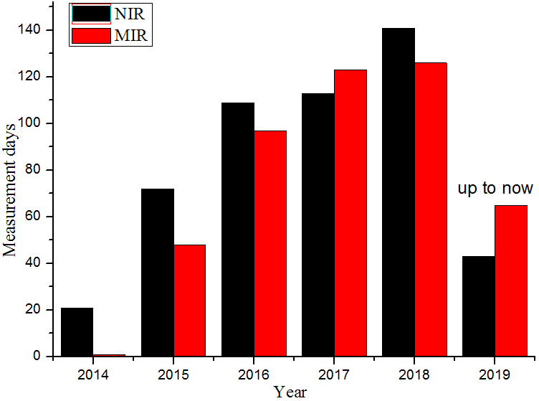
01
FTIR system of the Hefei site
The high-resolution FTIR instrument (Bruker IFS 125HR), and a solar tracker (A547N) on the roof of the lab building, to monitor the atmospheric trace gas profiles and total columns.
Clear sky day:
Alternating
NIR & MIR
Partly cloudy day:
Only NIR or MIR
IFS125HR

Slide 6
02
Parameter setting

Slide 7
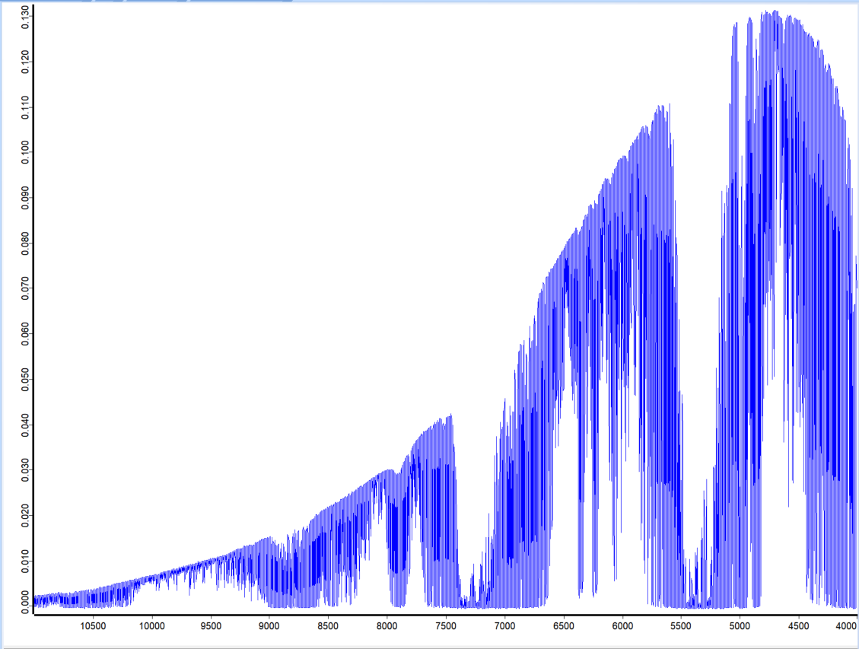
02
Parameter setting
Detector & Beam split
TCCON request
A minimum spectral range of 4000-9000 cm⁻¹.
Maximum OPD >= 45 cm with phase resolution of at least 1 cm⁻¹.
Hefei Site
Spectral range covers 4000–11000 cm⁻¹ using a CaF₂ beam-splitter and an InGaAs detector.
Spectra are recorded at Max OPD = 45 cm. The spectra resolution is 0.02 cm⁻¹.

Slide 8
02
Parameter setting
Sun tracker
TCCON request
FTS sun tracker pointing with an accuracy of 1 mrad (~0.05°, or 3 arcminutes) or better.
Tracker accuracy should be routinely monitored in one dimension using the solar-telluric shift (S-G shift).
Hefei Site
sun tracker pointing with an accuracy of 0.01°
Tracker is pointing directly at the center of the sun.
Notes:
We also using the solar telluric shift that retrieved from O2 window to monitor the tracker accuracy.

Slide 9
02
Parameter setting
Weather parameter
TCCON request
Surface pressure measurements accurate to 0.3 mbar or better.
Surface temperature measurements accurate to better than 1 K.
Hefei Site
The ZENO weather station at Hefei uses a pressure sensor that has an accuracy of +/-0.2mbar.
The ZENO weather station at Hefei uses a HUMITTER 50U/50Y(X) Integrated Humidity and Temperature Transmitter which has a temperature accuracy of ± 0.1°C, and a humidity accuracy of ± 1%.
Notes:
I have checked the weather station logfile and found that the voltage of station battery have been with low voltage and could not be powered properly before 04/29/2020.

Slide 10
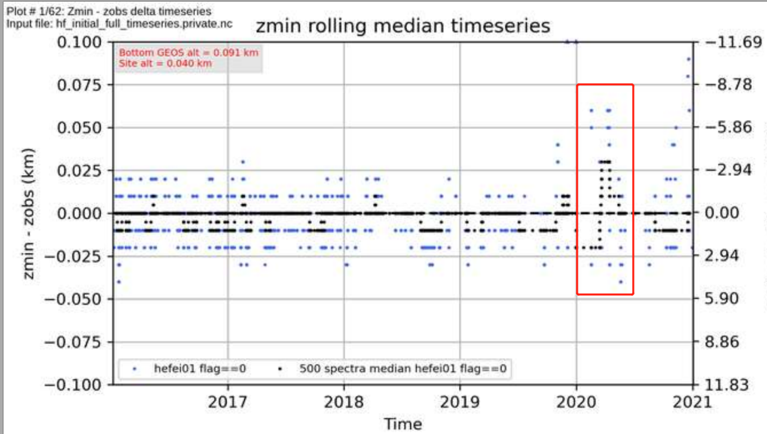
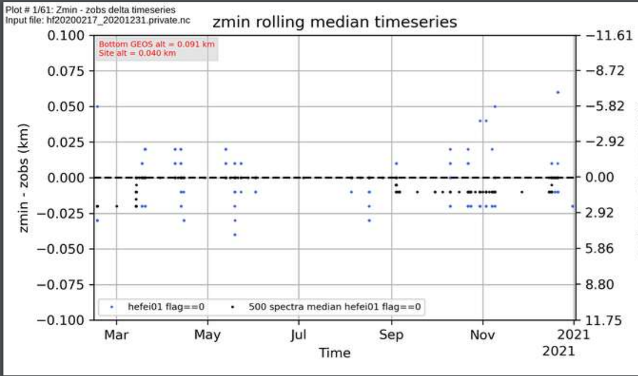
02
Parameter setting
Weather parameter
pout-pmod is outside the 3 hPa limit in 2020.02-2020.05
The voltage of station battery have been with low voltage and could not be powered properly before 04/29/2020
The weather data were corrected by another weather station that nearby the site

Slide 11
02
Parameter setting
Laser sampling errors
TCCON request
Laser sampling errors less than 0.00024 of the sample step.
The corresponding bias in XCO₂ is estimated to be 0.02% or less.
Hefei Site
The instrument uses a ECL03 laser sampling board. The ghost was minimized by adjusting the potentiometer on the board.
A M16 controller is used with the XPM parameter turned on to correct for ghosts while sampling.
Notes:
Additionally, the I2S code is also enabled for the LSE correction.

Slide 12
02
Parameter setting
ILS retrieval results
Routine procedures for monitoring instrument line shape (ILS).
There is an HCl cell that is permanently placed in the path of the solar beam.
Monthly lamp measurements are recorded and processed using LINEFIT 14.5.
The ME is between 1.034 and 0.965, the ME varies less than 5%. and the phase errors are lower than 0.01 rad

Slide 13
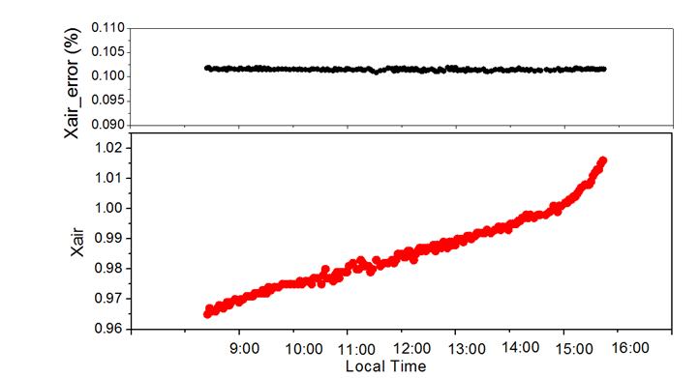
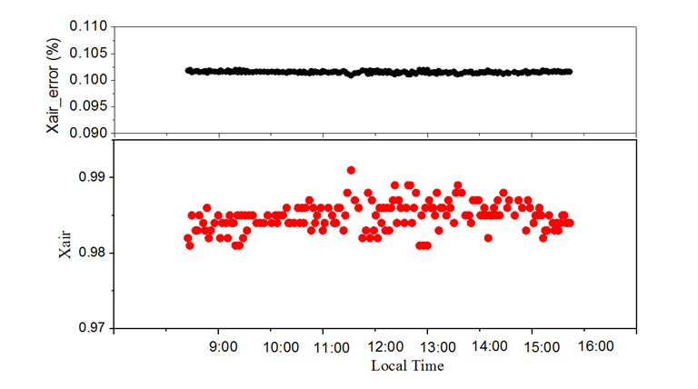
02
Parameter setting
Timing error correct
we corrected the timing error iteratively by adding or subtracting a step value until the diurnal variation of Xair was symmetric and less than 1%
Before the timing error correction is applied, the daily Xair varies more than 4% over a large range from 0.957 to 1.021.
After the correction, with a minus 47s in the retrieval, the daily Xair approaches on 0.983 and varies less than 1%
Notes:
In order to correct timing error-related bias, we assumed a constant
daily timing error and a linear drift from point that the time synchronisation failed until it was discovered.

Slide 14
03
Observed results

Slide 15
03
Observed results
XCH₄
Precision: 0.16%
Annual increase:6.8±0.1 ppb/yr
Seasonal amplitude:35.75±4.97 ppb
XCO
XCO₂
Precision: 1.07%
Annual increase:-3.81±0.88 ppb/yr
Seasonal amplitude:29.26±3.98 ppb
Precision: 0.04%
Annual increase:2.64±0.13 ppm/yr
Seasonal amplitude:7.1±0.98 ppm
Notes:
GGG2020, standed TCCON window

Slide 16
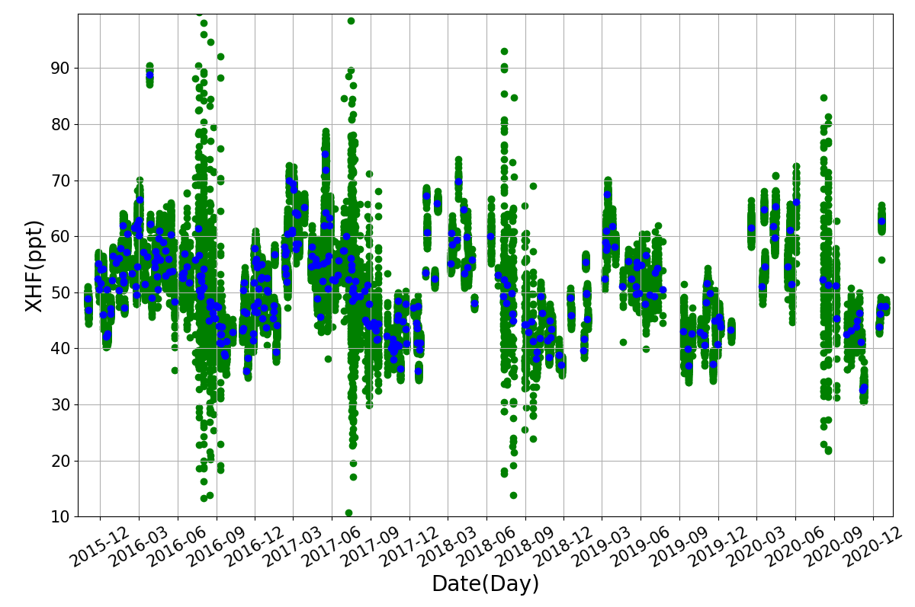
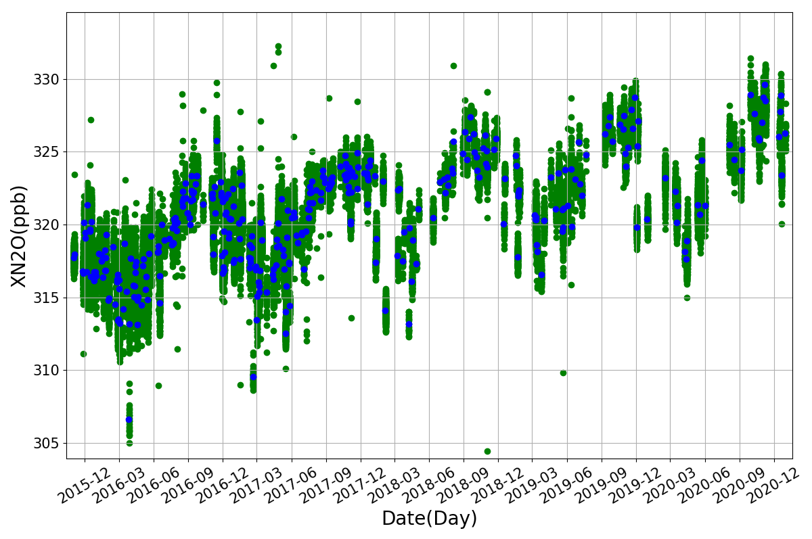
03
Observed results
XN₂O
Precision: 0.20%
Annual increase:1.06±0.4 ppb/yr
Seasonal amplitude:4.64±0.99 ppb
XHF
XH₂O
Precision: 0.04%
Annual increase:-6.90±1.07ppt/yr
Seasonal amplitude:18.9±3.43ppt
Precision: 0.04%
Annual increase: close to 0
Seasonal amplitude:7225.4±103.3ppm
Notes:
基于典型的晴朗天11：00到13：00两个小时内的观测数据，获得反演误差，并根据气体的测量值变化估算气体的观测精度。
With an sunny day select 11:00 to 13:00 two hours data, calculate the data standed deviation and mean value, the ratio of SD and mean value.

Slide 17
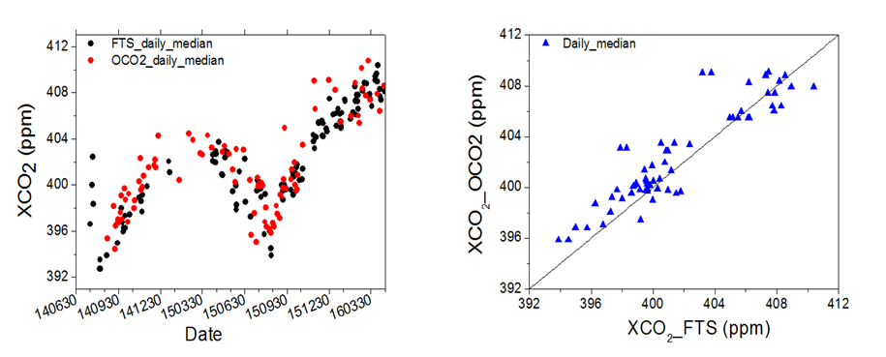
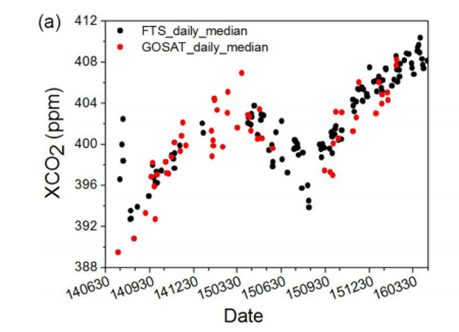
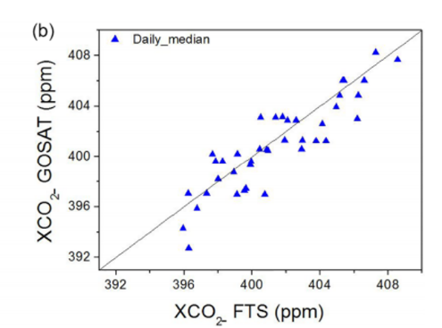
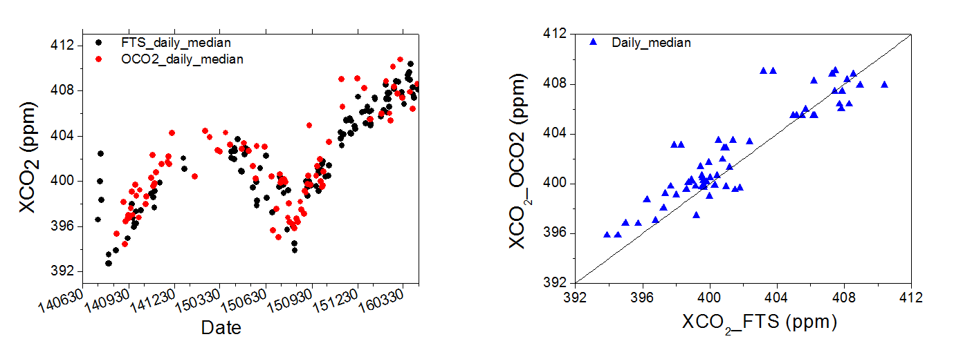
03
Observed results
XCO₂ and XCH₄ comparison with GOSAT
XCO₂ comparison with OCO-2
CO₂
CH₄
CO₂
Bias: -0.52 ±1.63ppm
R² : 0.89
CH₄
Bias: 1.60 ±13.0ppb
R² : 0.77
CO₂
Bias: 0.81±1.73ppm
R² : 0.83

Slide 18
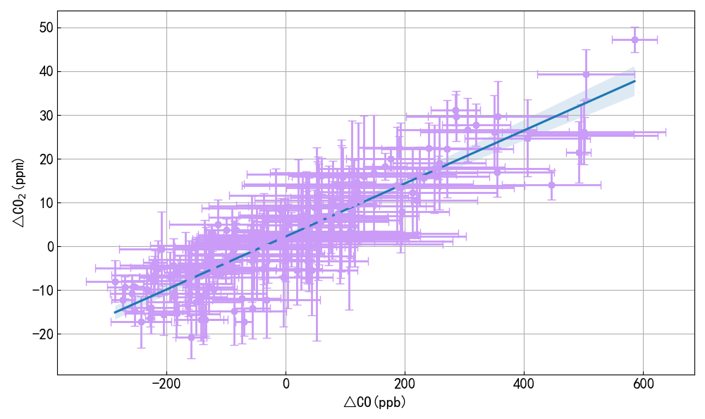
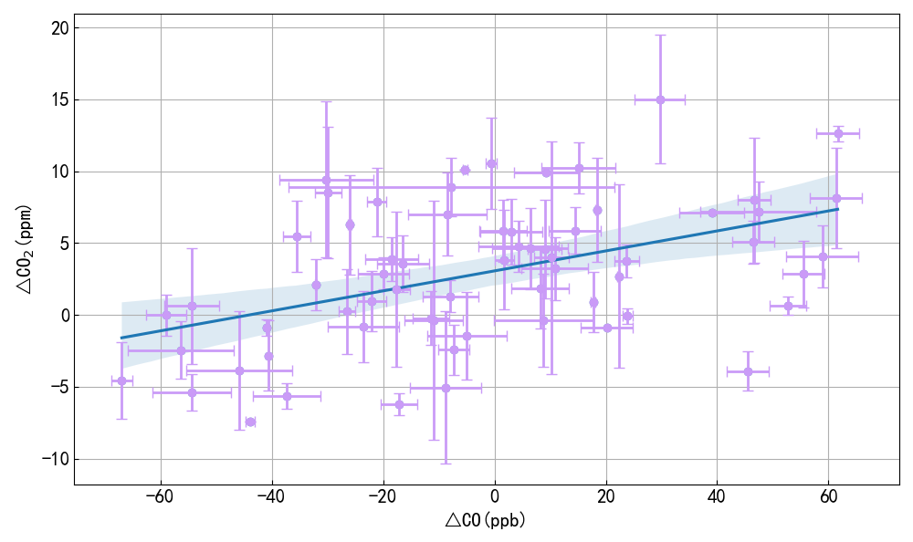
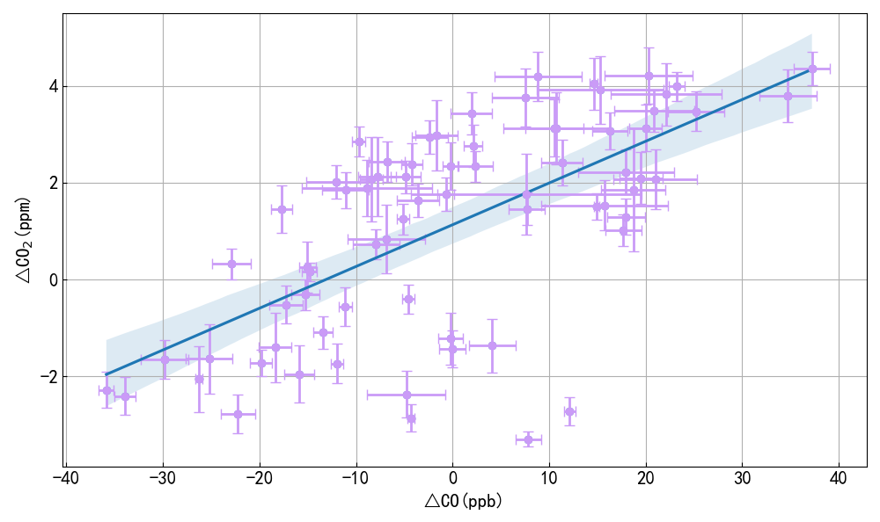
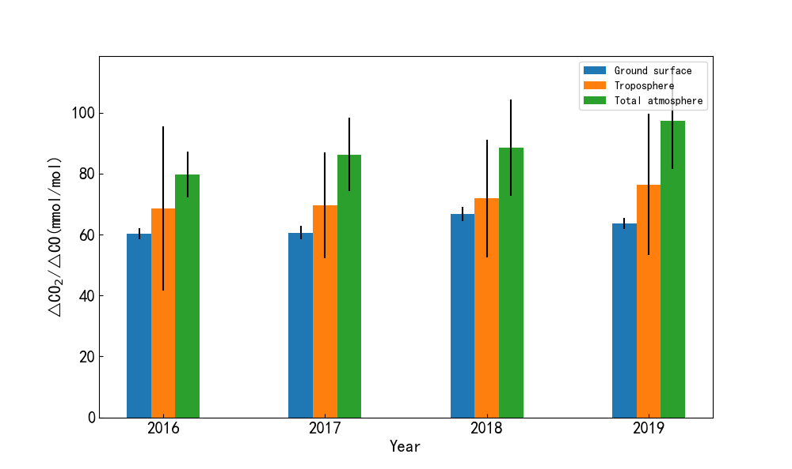
03
Observed results
The enhancement ratio of CO₂ /CO
区域CO排放反演
Surface concentration
Tropospheroc column
Total column
Δ CO₂ /ΔCO ratio in Hefei has been increasing year by year, indicating that combustion efficiency is improving, which is related to the country's promotion of energy conservation and emission reduction;
Surface concentration, tropospheric, and total column ratio show a gradual upward trend, because the average value of the upper layer concentration will dilute the surface concentration results.
Notes:
Using co2 and CO data that observed in surface, troposphere and total column to calculate

Slide 19
04
EM27 results

Slide 20
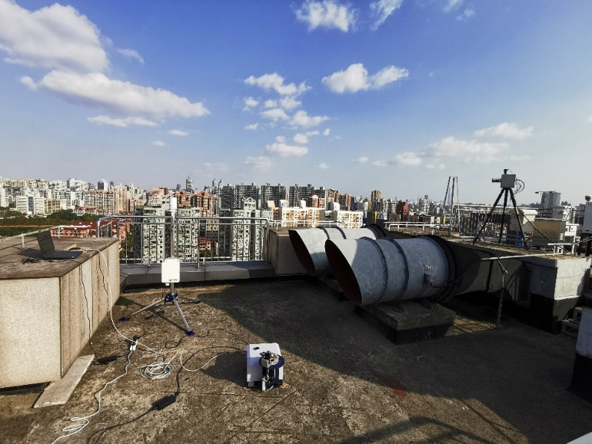
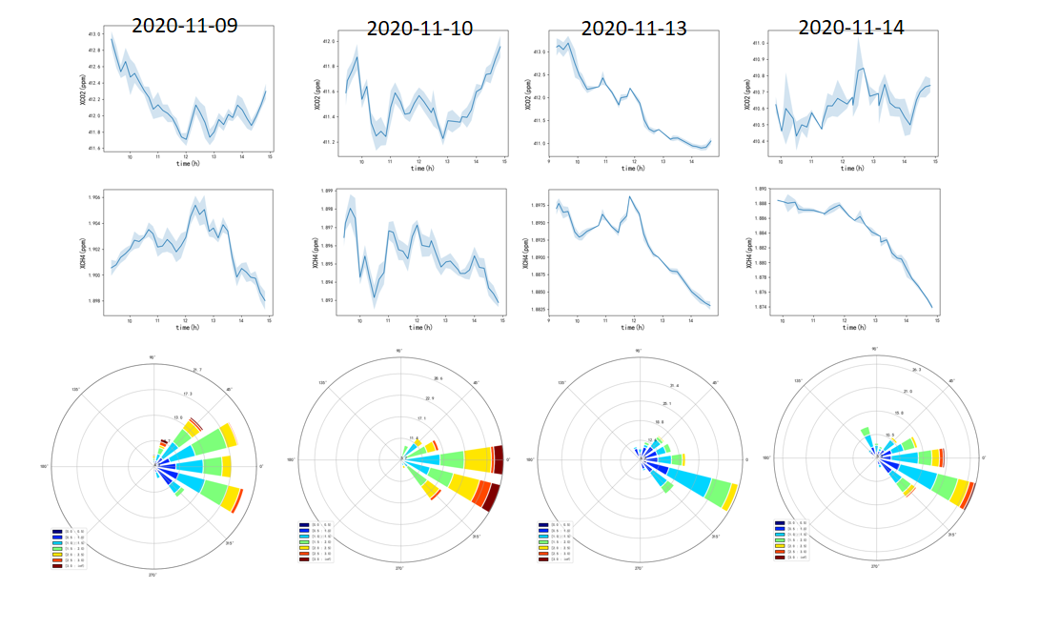
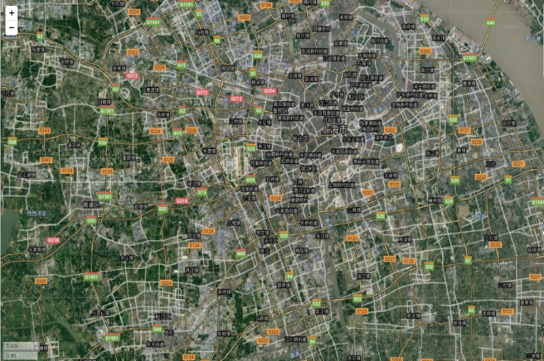
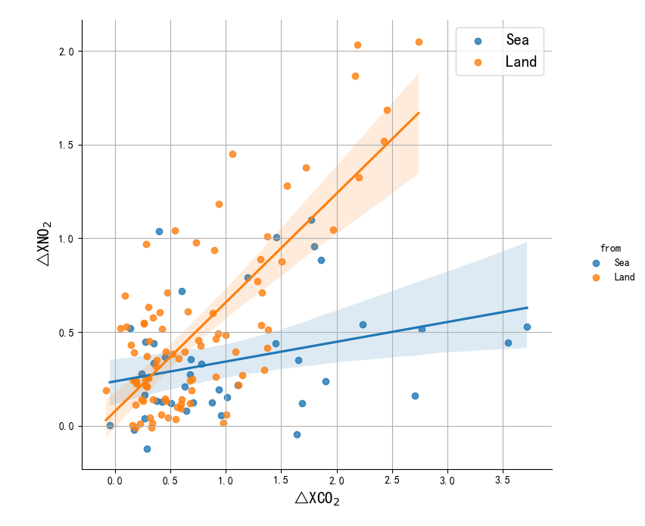
04
EM27 results
Observe in Shanghai
CO₂
CH₄
31.17, 121.43
MAX-DOAS
EM-27
Using NO₂ as a tracer to determine the contribution of different motor vehicle emission sources to CO₂ emissions in Shanghai.
 | Sea | Land
△NO2/△CO2 (ppb/ppm) | 0.11±0.05 | 0.58±0.04
Corr | 0.41 | 0.75
Airmass from land
CO₂ has a peak value in the morning, caused by the morning rush hour traffic;
Concentration of CH₄
and CO₂ both increased at noon, maybe caused by cooking in restaurants, canteens and communities at noon。
The ratio of NO₂ to CO₂ for air masses from land is significantly higher than that of air masses from sea
Airmass from Sea
Notes:
A campaign was conducted for observations of trace gases with EM27/SUN and MAX-DOAS system at Shanghai from October 2020 to December 2020. Atmospheric CO₂ and NO₂ from the land sources show higher correlation, with higher ratio of NO₂ to CO₂ compared to that derived from the gases from the sea sources.

Slide 21
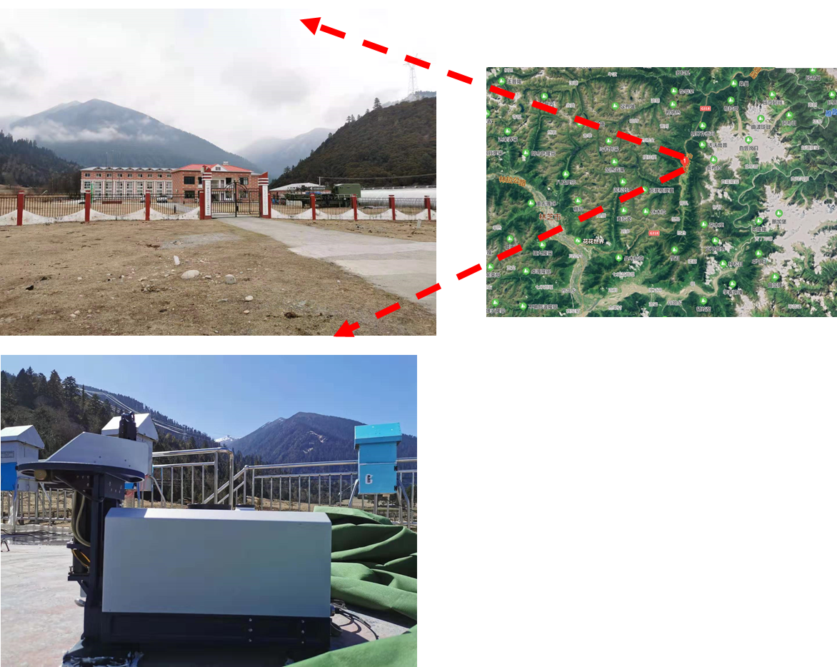
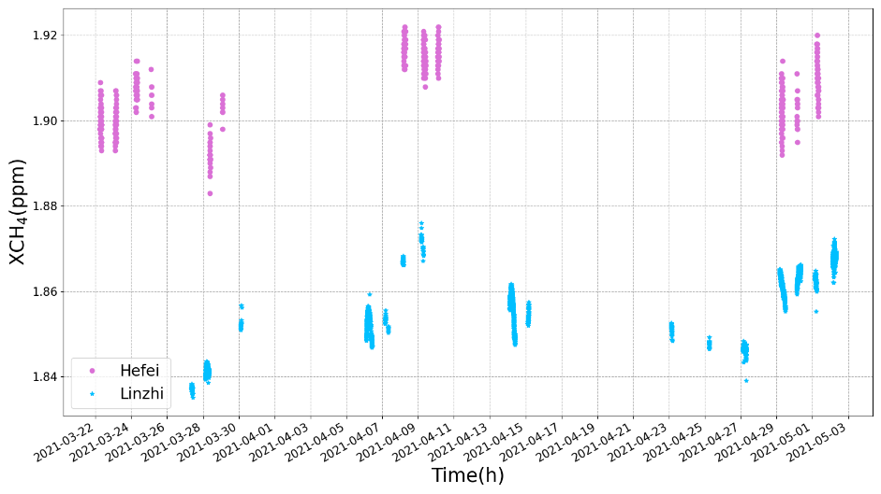
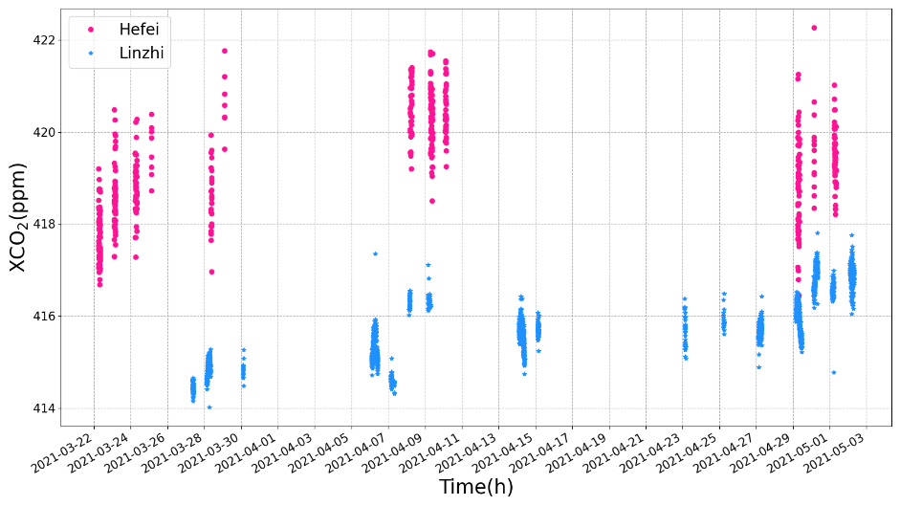
04
EM27 results
Compare with Hefei site
∆XCO₂：2.68±1.08(ppm)
Compare with Hefei site
Linzhi Site
∆XCH₄： 41.09±4.64(ppb)
94.44E，29.46N，ALT 3326m
Notes:
41.09

Slide 22
We Thank
David Grifﬁth，Voltaire Velazco，
Nick Deutscher, David Pollard and Frank Hase
for great assistance

Slide 23
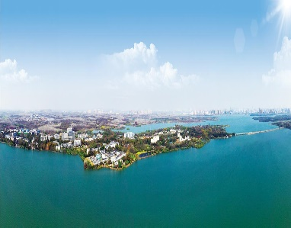
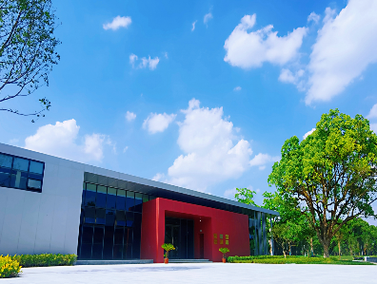
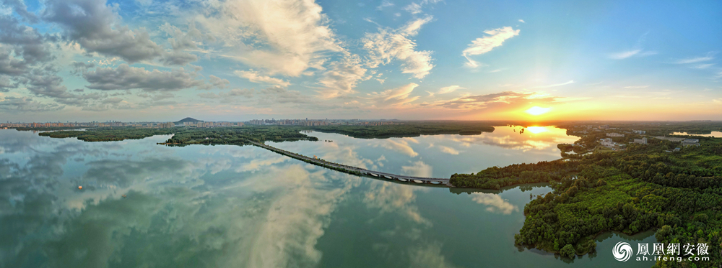
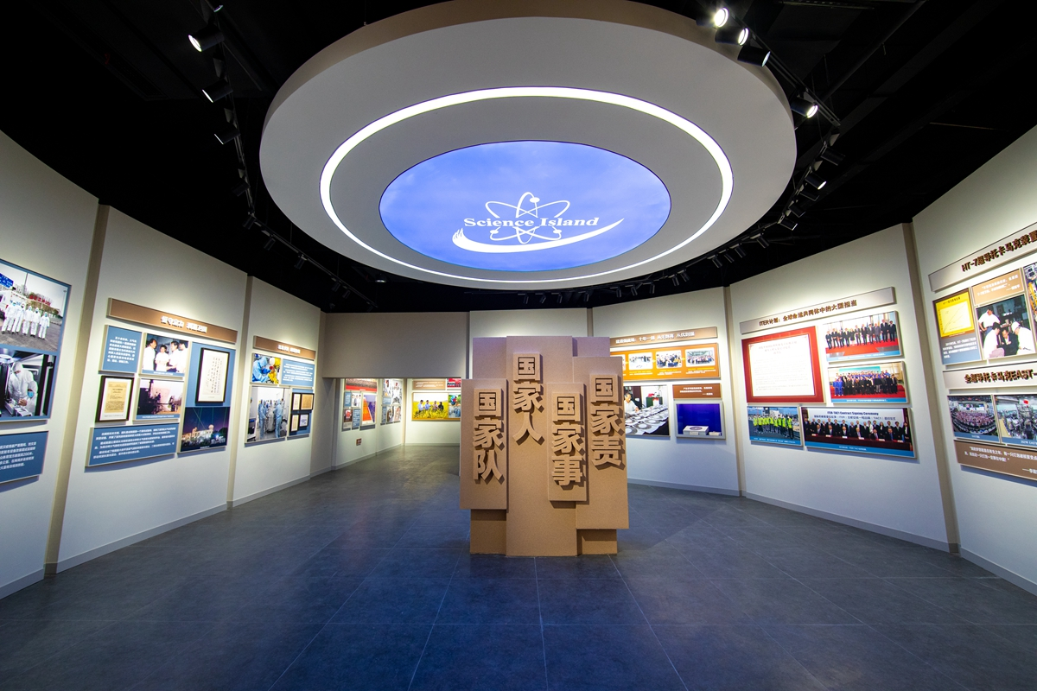
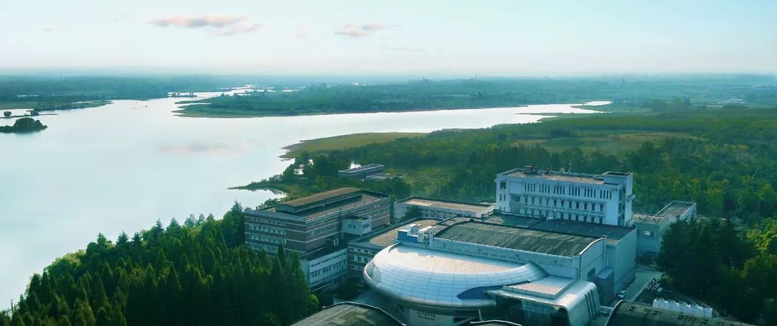
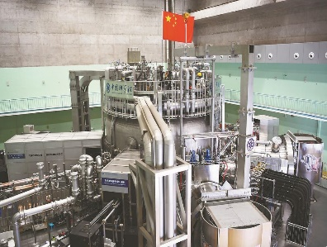
Thank You!
Hefei Institutes of Physical Science, Chinese Academy of Science
www.hf.cas.cn

