Slide 1
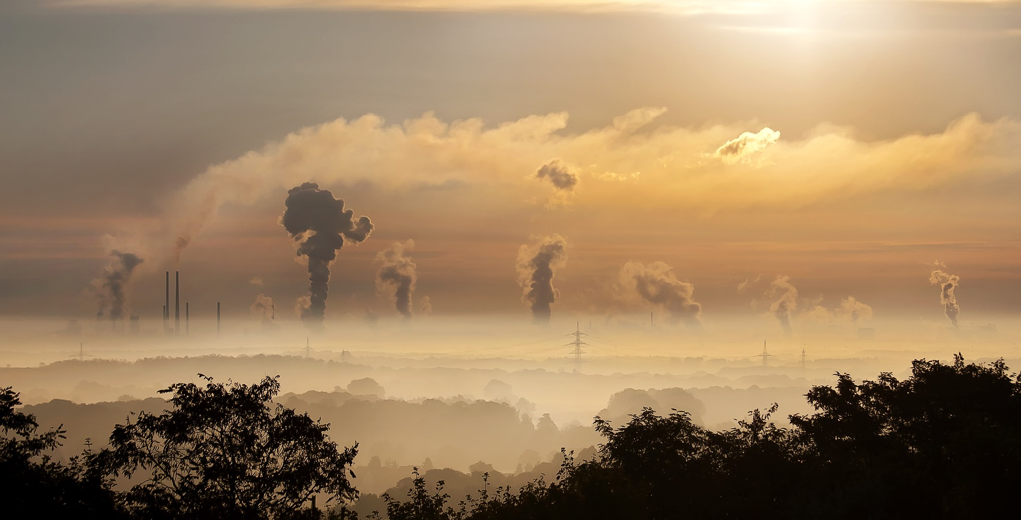



CO₂, CH₄ and CO at Xianghe

Slide 2
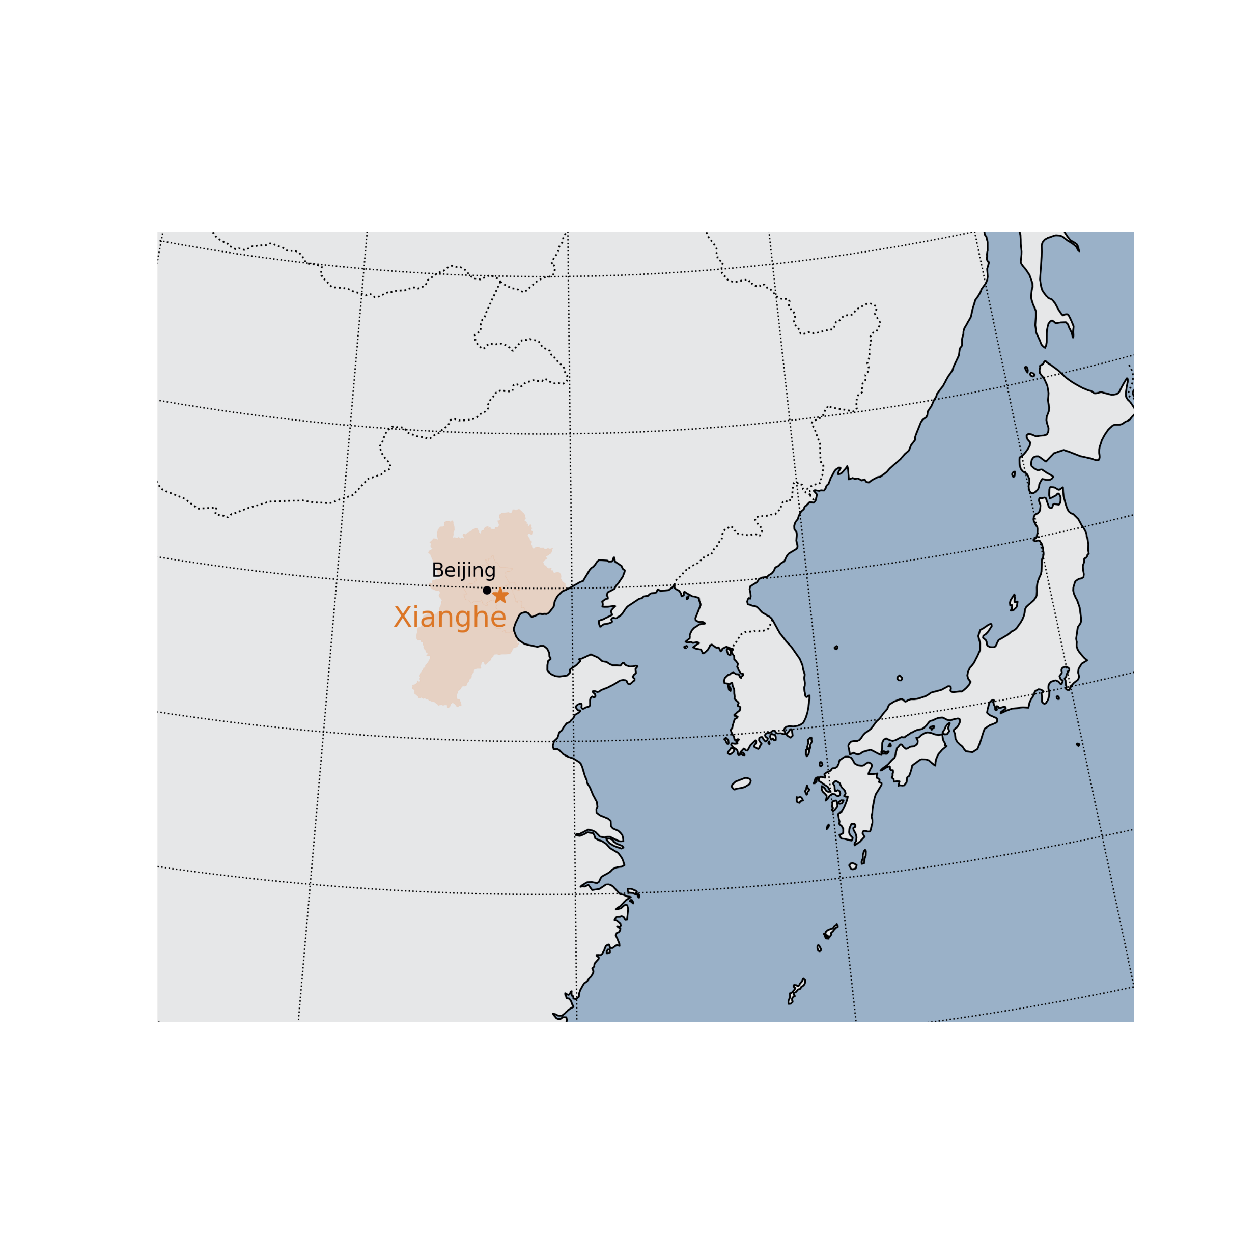
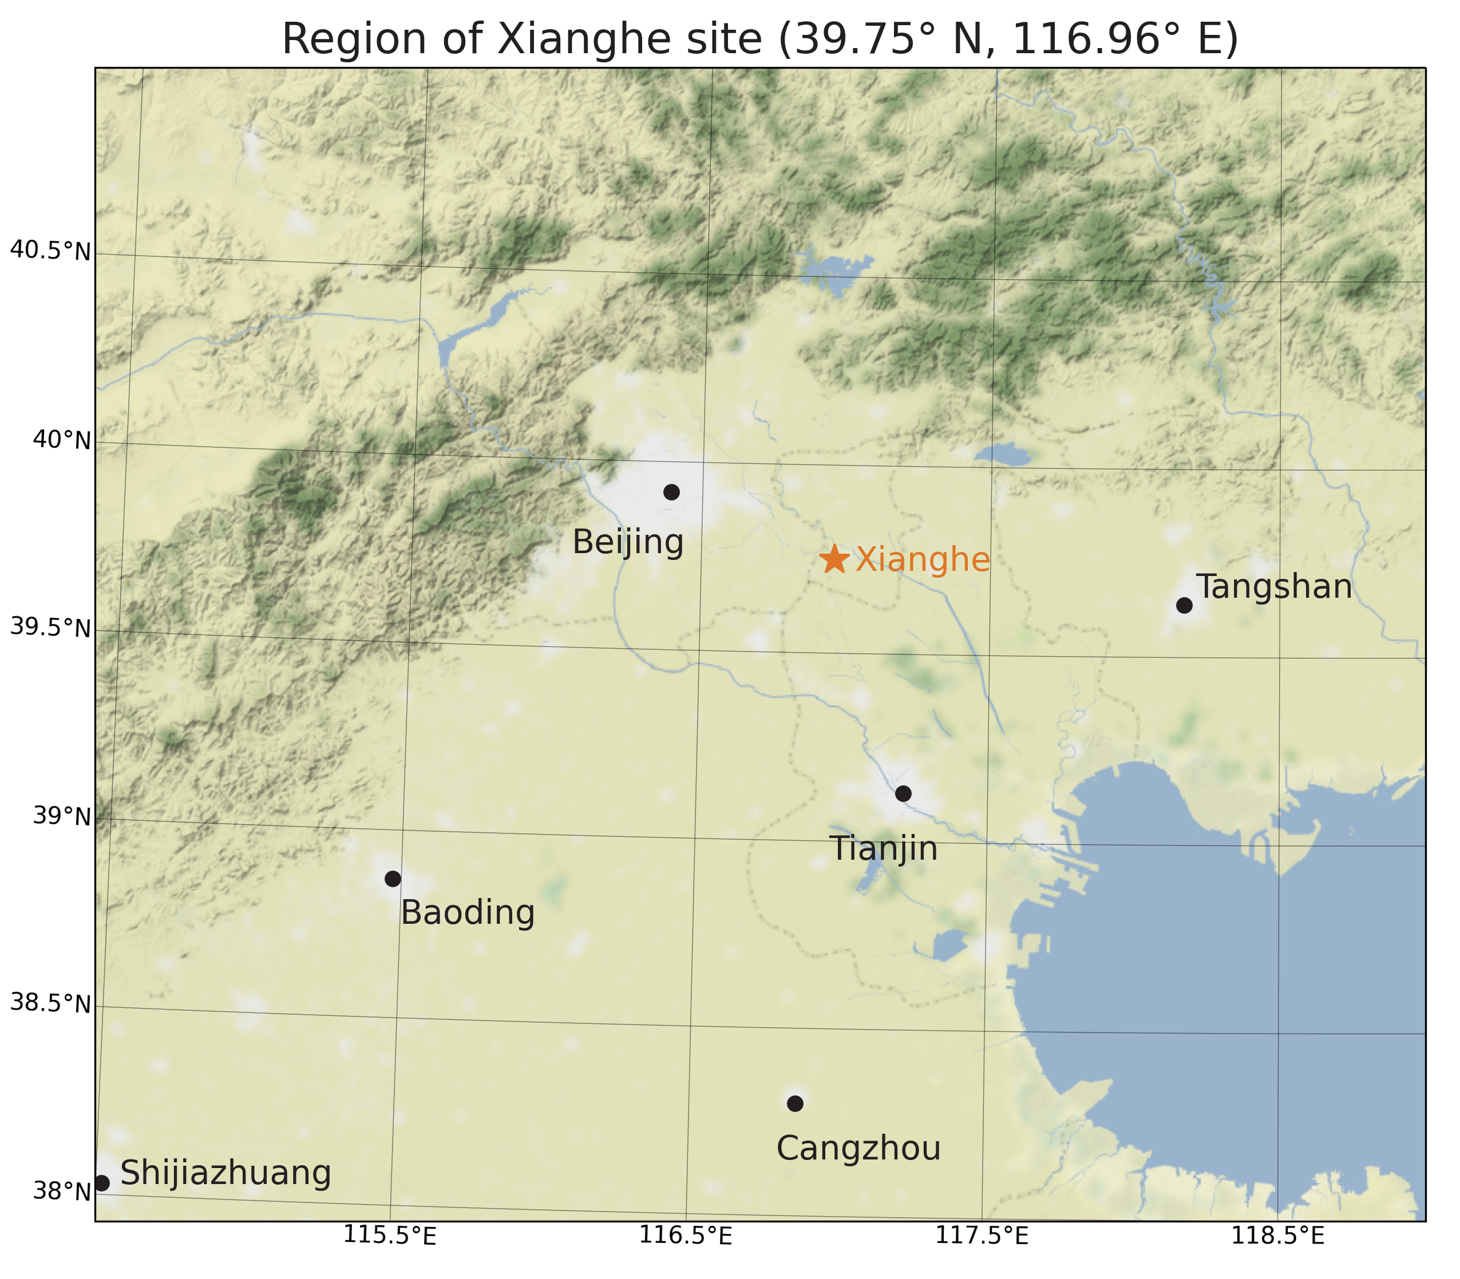
Xianghe site
The Xianghe site (39.75° N, 116.96° E) lies in a suburban area,
~ 50 km southeast of Beijing.
2nd TCCON site in China

Slide 3
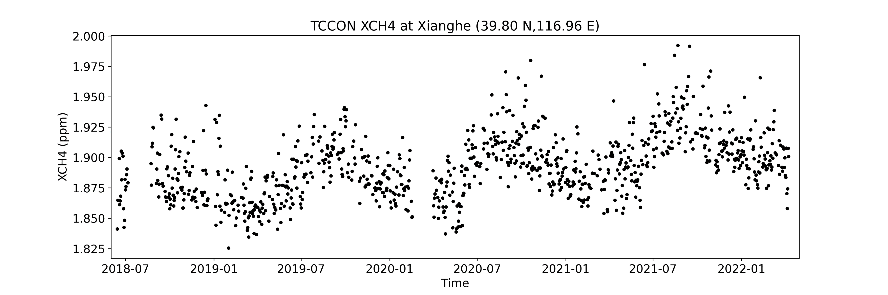

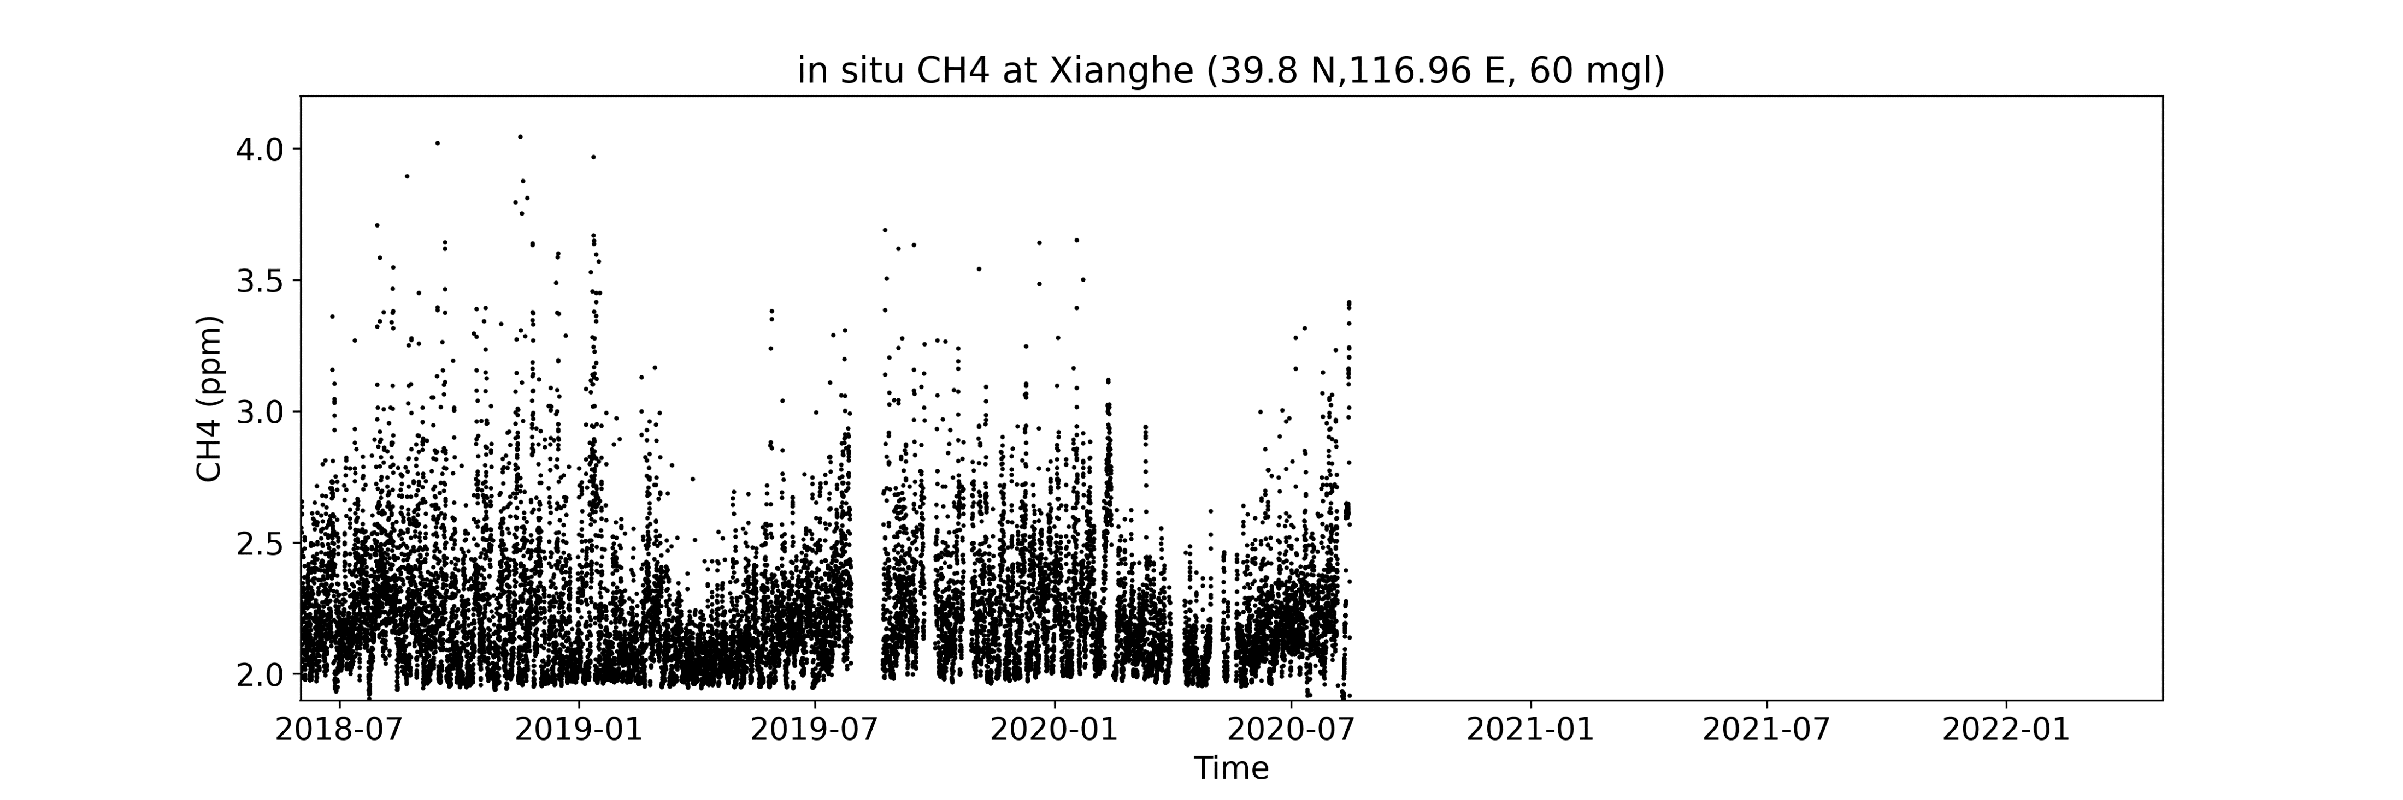
Xianghe observations
Observations carried out in collaboration with the Institute
of Atmospheric Physics of the Chinese Academy of Sciences (IAP-CAS)
Bruker IFS 125 HR spectrometer
XCO_{2,} XCH_{4,} XCO
Since June 2018
Picarro CRDS analyzer G2301
Insitu CO₂ and CH₄
60 m above surface
1 year

Slide 4
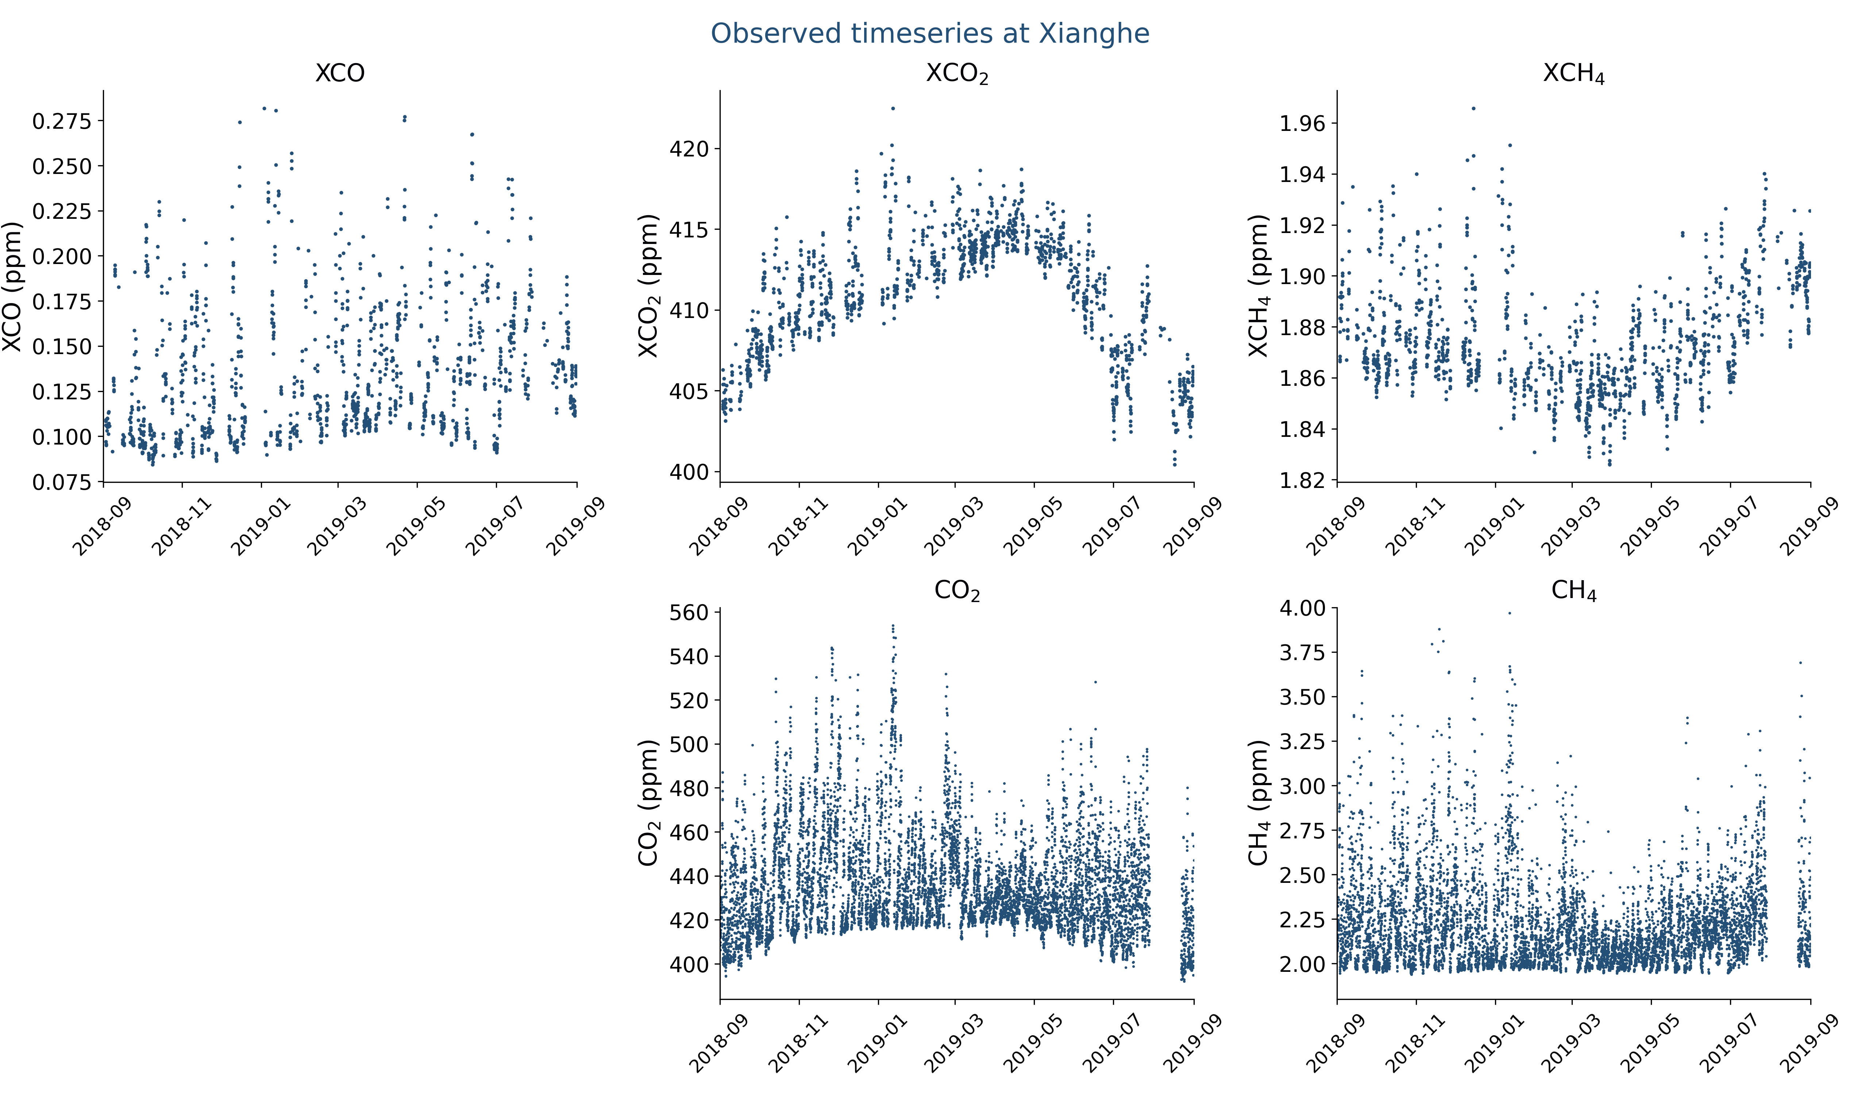
Xianghe observations
Observed timeseries of CO, CO₂ and CH₄ show lots of variability

Slide 5
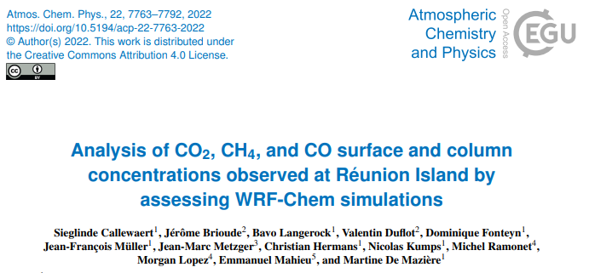
Research questions
How accurate is WRF-GHG in simulating the different observations types of CO₂, CH₄ and CO at Xianghe? What are the model’s strengths and weaknesses?
What are the driving factors behind the observed variabilities?
  What are the different (sector) contributions to the observed concentrations (surface and column)?
Previous case study: TCCON, NDACC and ICOS data at Réunion Island
(Callewaert et al, 2022, ACP)

Slide 6
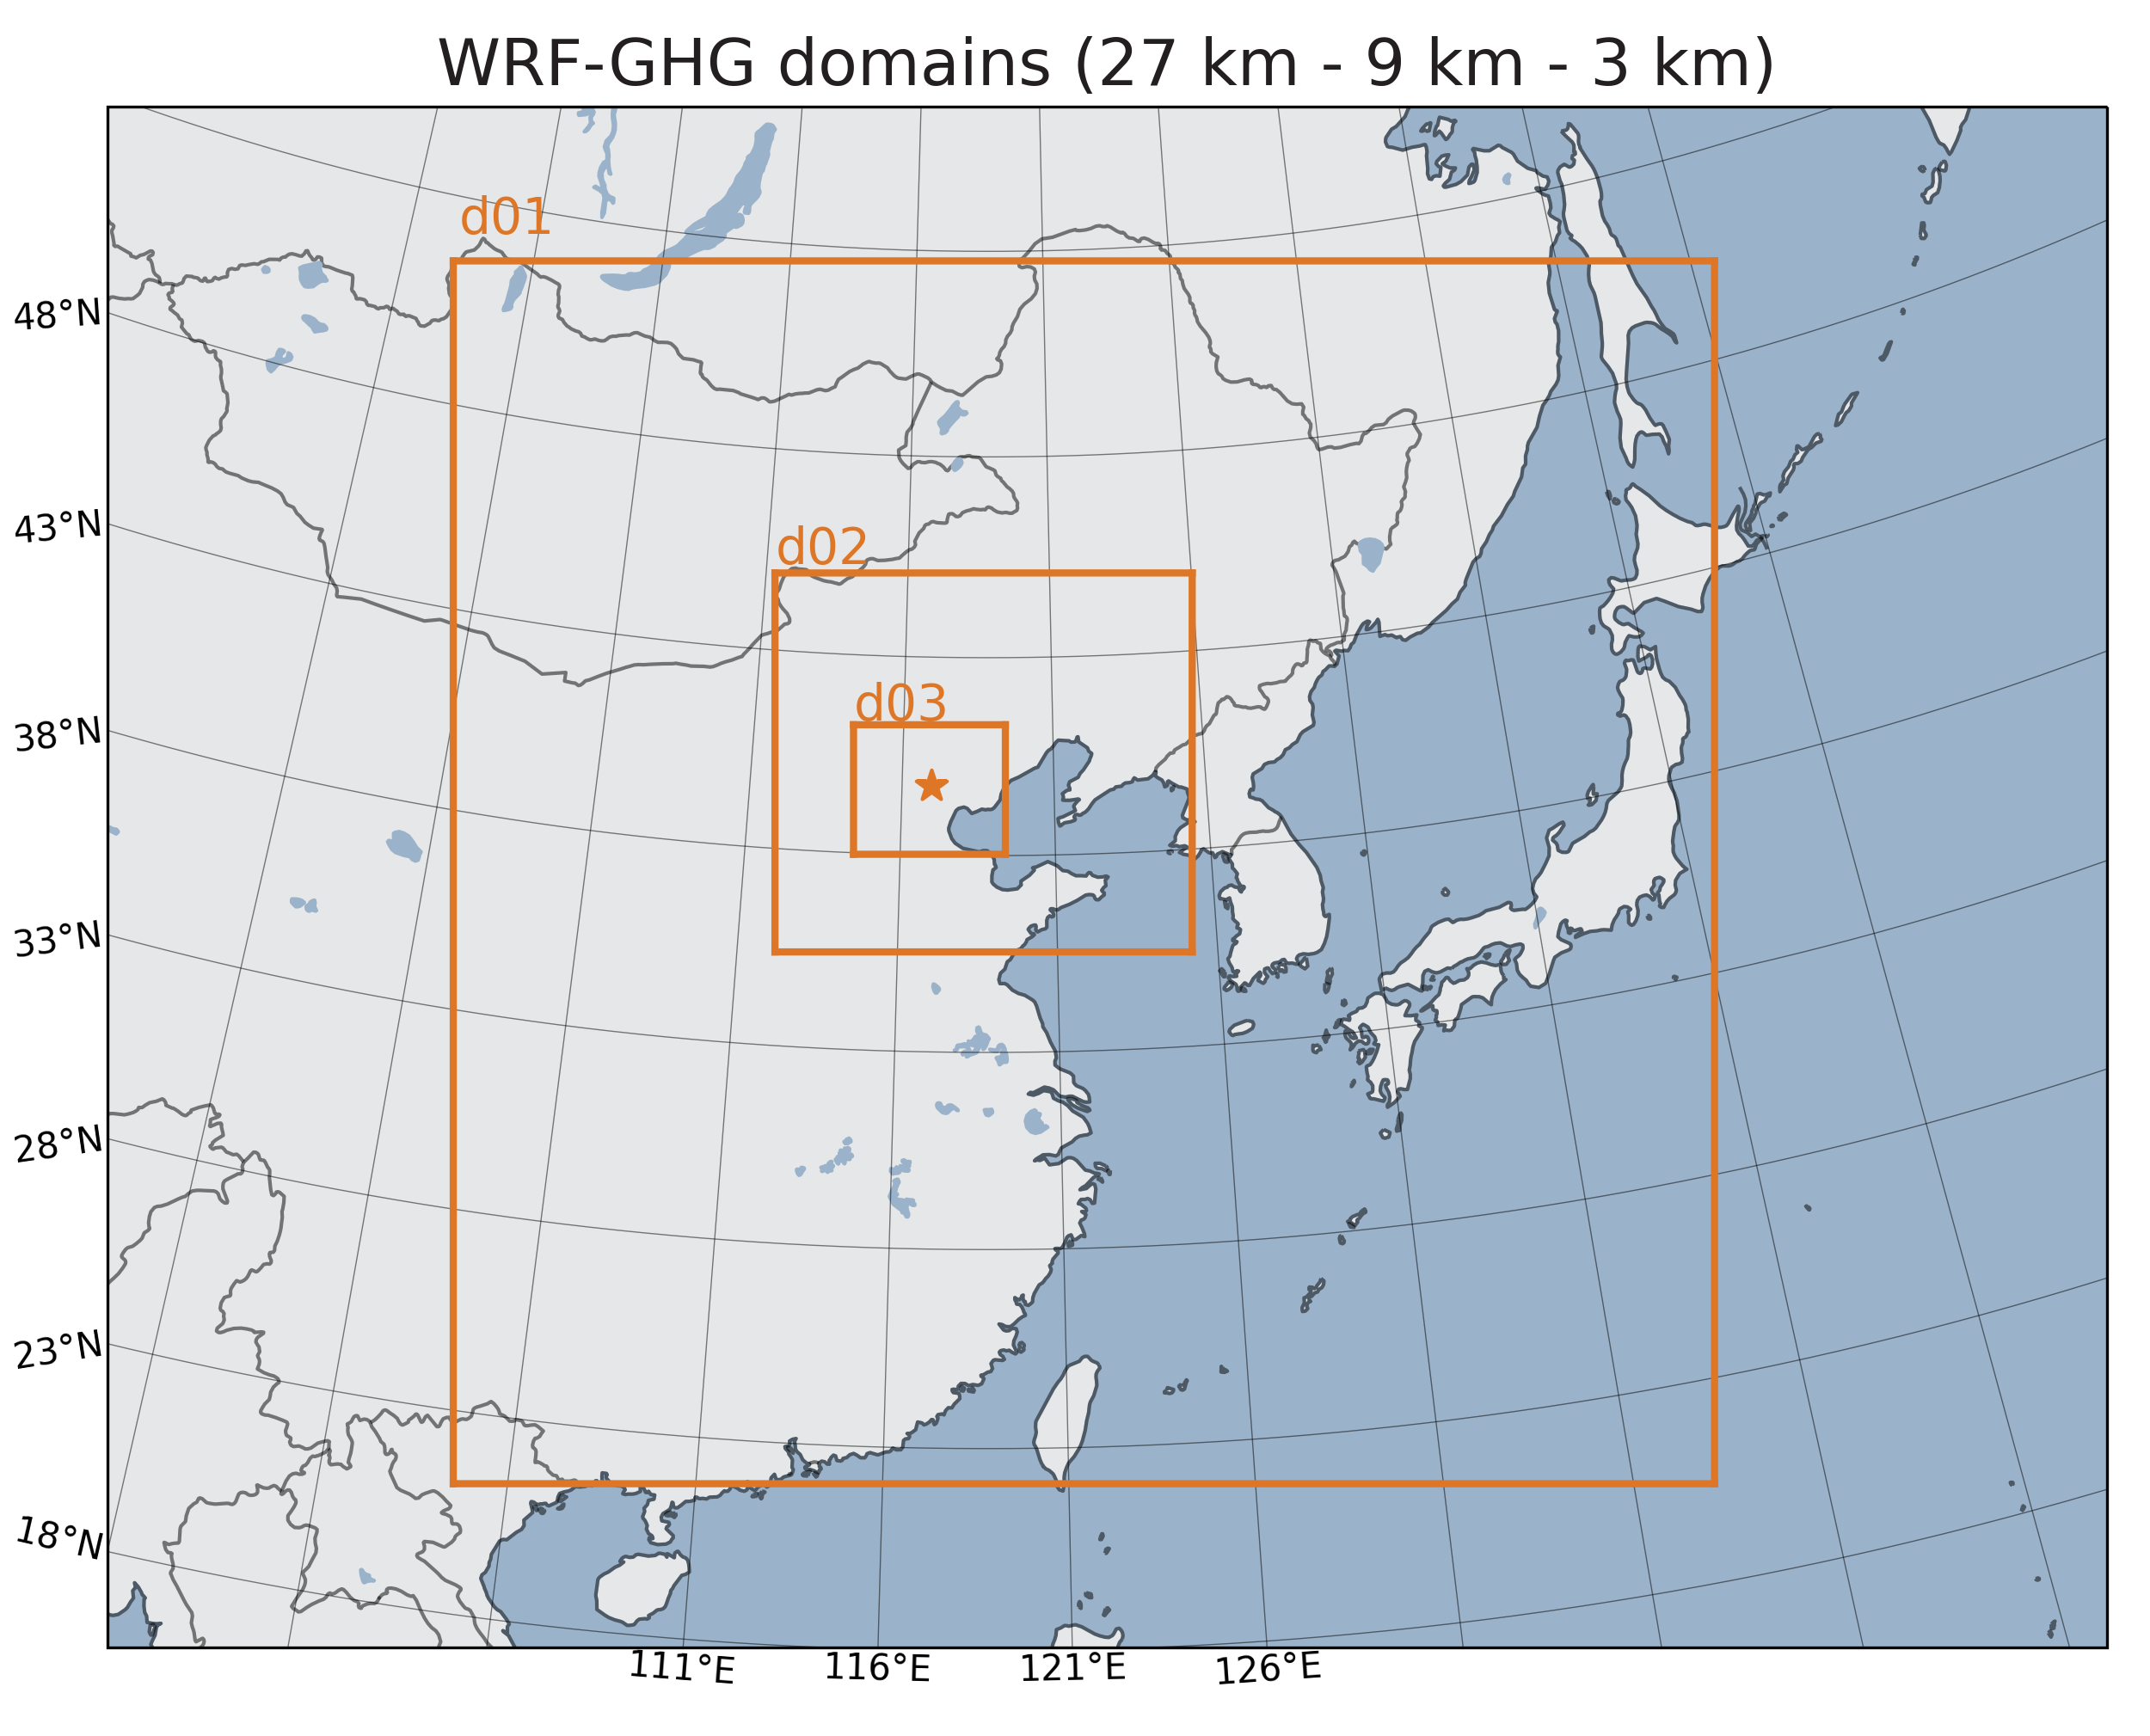
WRF-GHG model
Regional atmospheric transport model
Simulation of 3D meteorological and chemical fields over time
WRF-GHG is WRF-Chem in the passive tracer option: no chemical interactions
Outside domain d01:
Boundary conditions = background
ERA5 and CAMS reanalysis
Inside domain d01:
Surface – atmosphere fluxes (uptake and emissions) from different sources
CAMS-GLOB-ANT
REAS
FINN
WetCHARTs
…

Slide 7
Passive tracers
The simulated concentration of a gas is split up into the contributions of different sources. For example CO₂:
Flux field
Concentration field
Anthropogenic emissions
Anthropogenic tracer
Biomass burning emissions
Biomass burning tracer
Ocean uptake
Ocean tracer
Biosphere fluxes
Biosphere tracer
Initial and boundary conditions
Background tracer
Concentration field
sum
Total simulated CO₂

Slide 8
WRF-GHG model setup
Split anthropogenic tracer into different source sectors
CAMS-GLOB-ANT provides information about 11 sectors
➔ Aggregate into 5 sectors
CAMS-GLOB-ANT sectors | WRF-GHG flux fields
Residential, commercial and other combustion | Residential & Waste
Solid waste and waste water treatment
Industrial processes | Industry
Power generation | Energy
Fugitive emissions from solid fuels
Oil refineries and transformation industry
Agriculture livestock | Agriculture
Agriculture soils
Agricultural waste burning
Non-road transportation | Transportation
Road transport

Slide 9
Results
Model – data comparison

Slide 10
WRF-GHG 1 year simulation
1 September 2018 – 1 September 2019
Comparing hourly model output with observations:
In situ | FTIR
Horizontal grid cell of instrument | Horizontal grid cell of instrument
Model profile interpolated to 60m above model surface | Model profile extended (above 50 hPa) with TCCON a priori + smoothed
Mean of all observations within 15 min of model hour | Mean of up to 5 observations within 20 min of model time

Slide 11
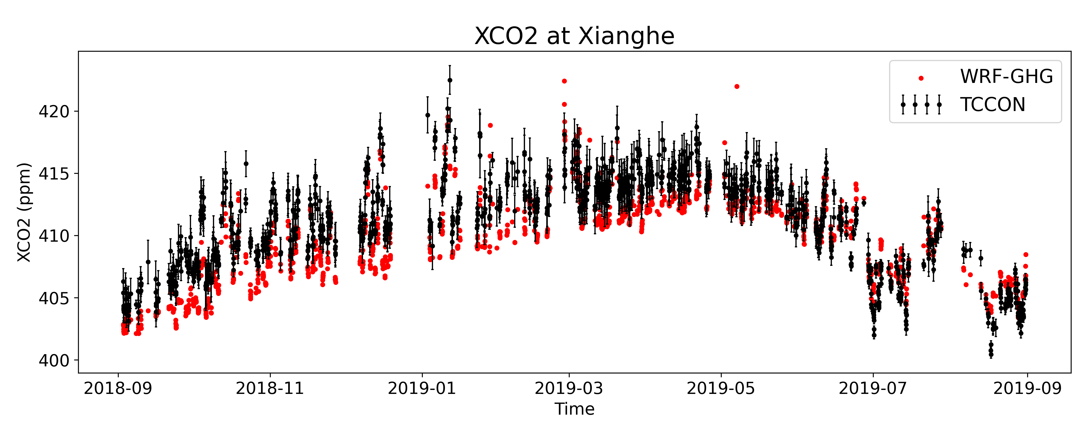
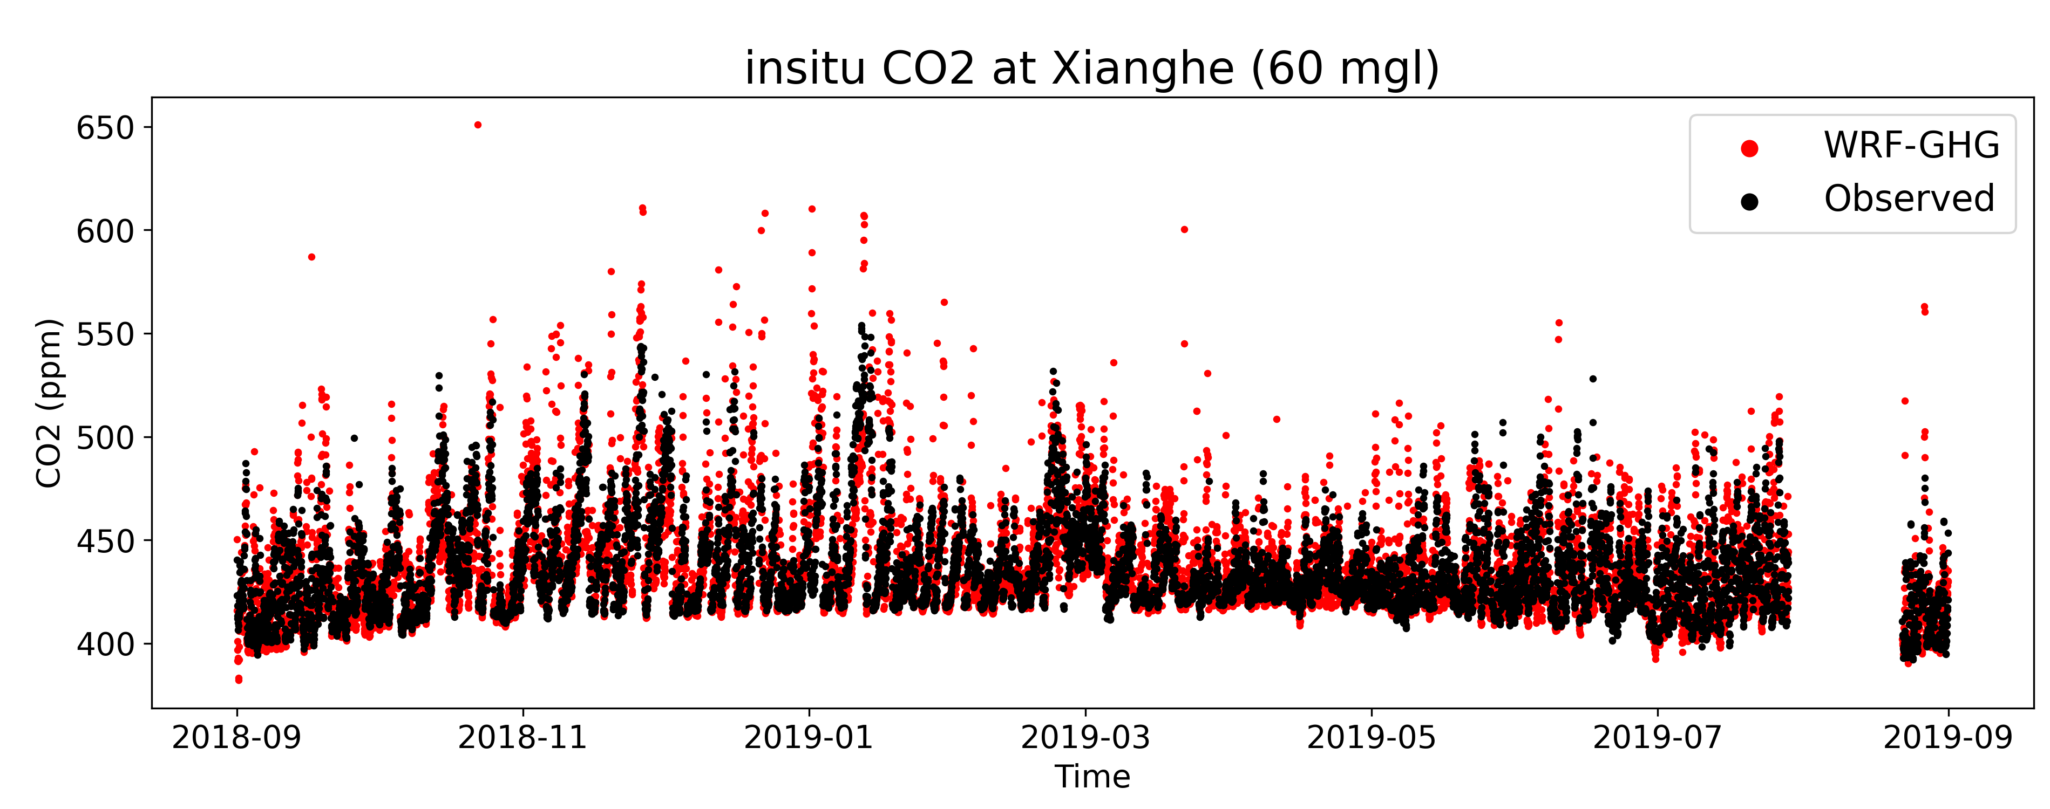
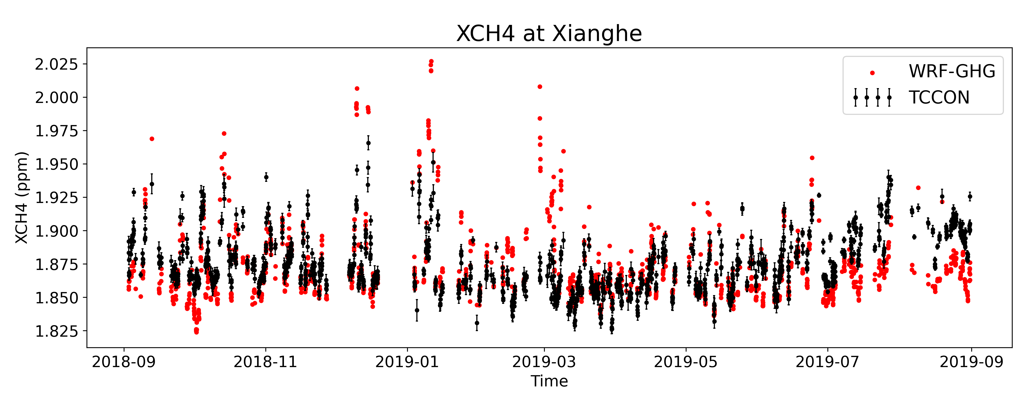
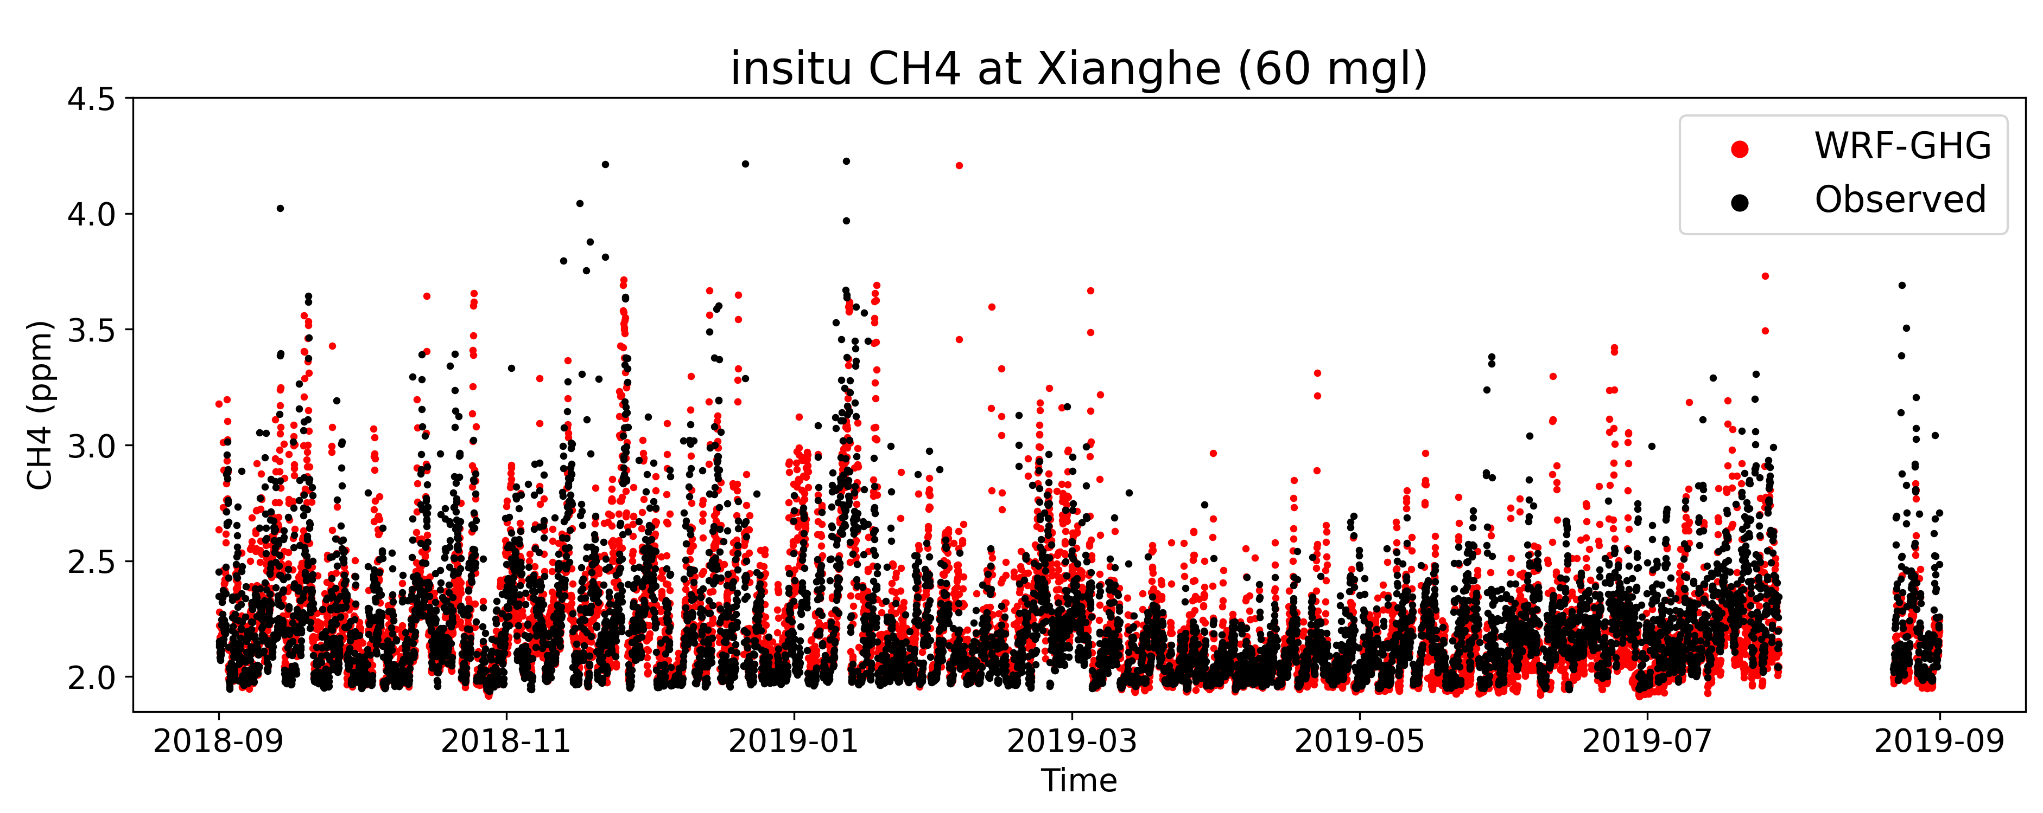
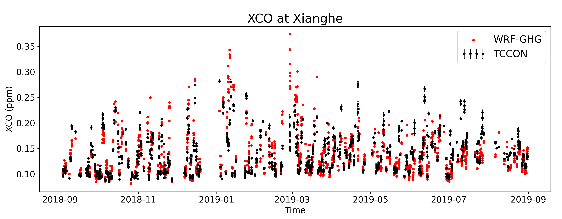
WRF-GHG accuracy?
CORR: 0.85
CORR: 0.68
CORR: 0.56
CORR: 0.56
CORR: 0.69
 | XCO₂ | XCH₄ | XCO
BIAS | -1.41 ppm | -3.31 ppb | 0.35 ppb
RMSE | 2.40 ppm | 23.36 ppb | 31.07 ppb
 | In situ CO2 | In situ CH4
BIAS | 2.52 ppm | 9.43 ppb
RMSE | 20.94 ppm | 251.82 ppb

Slide 12
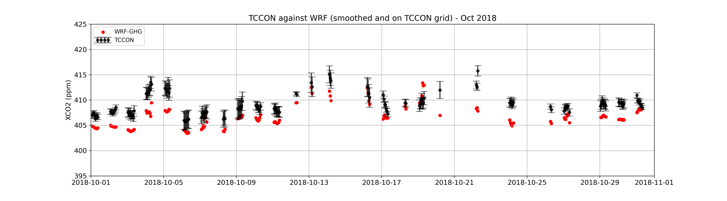
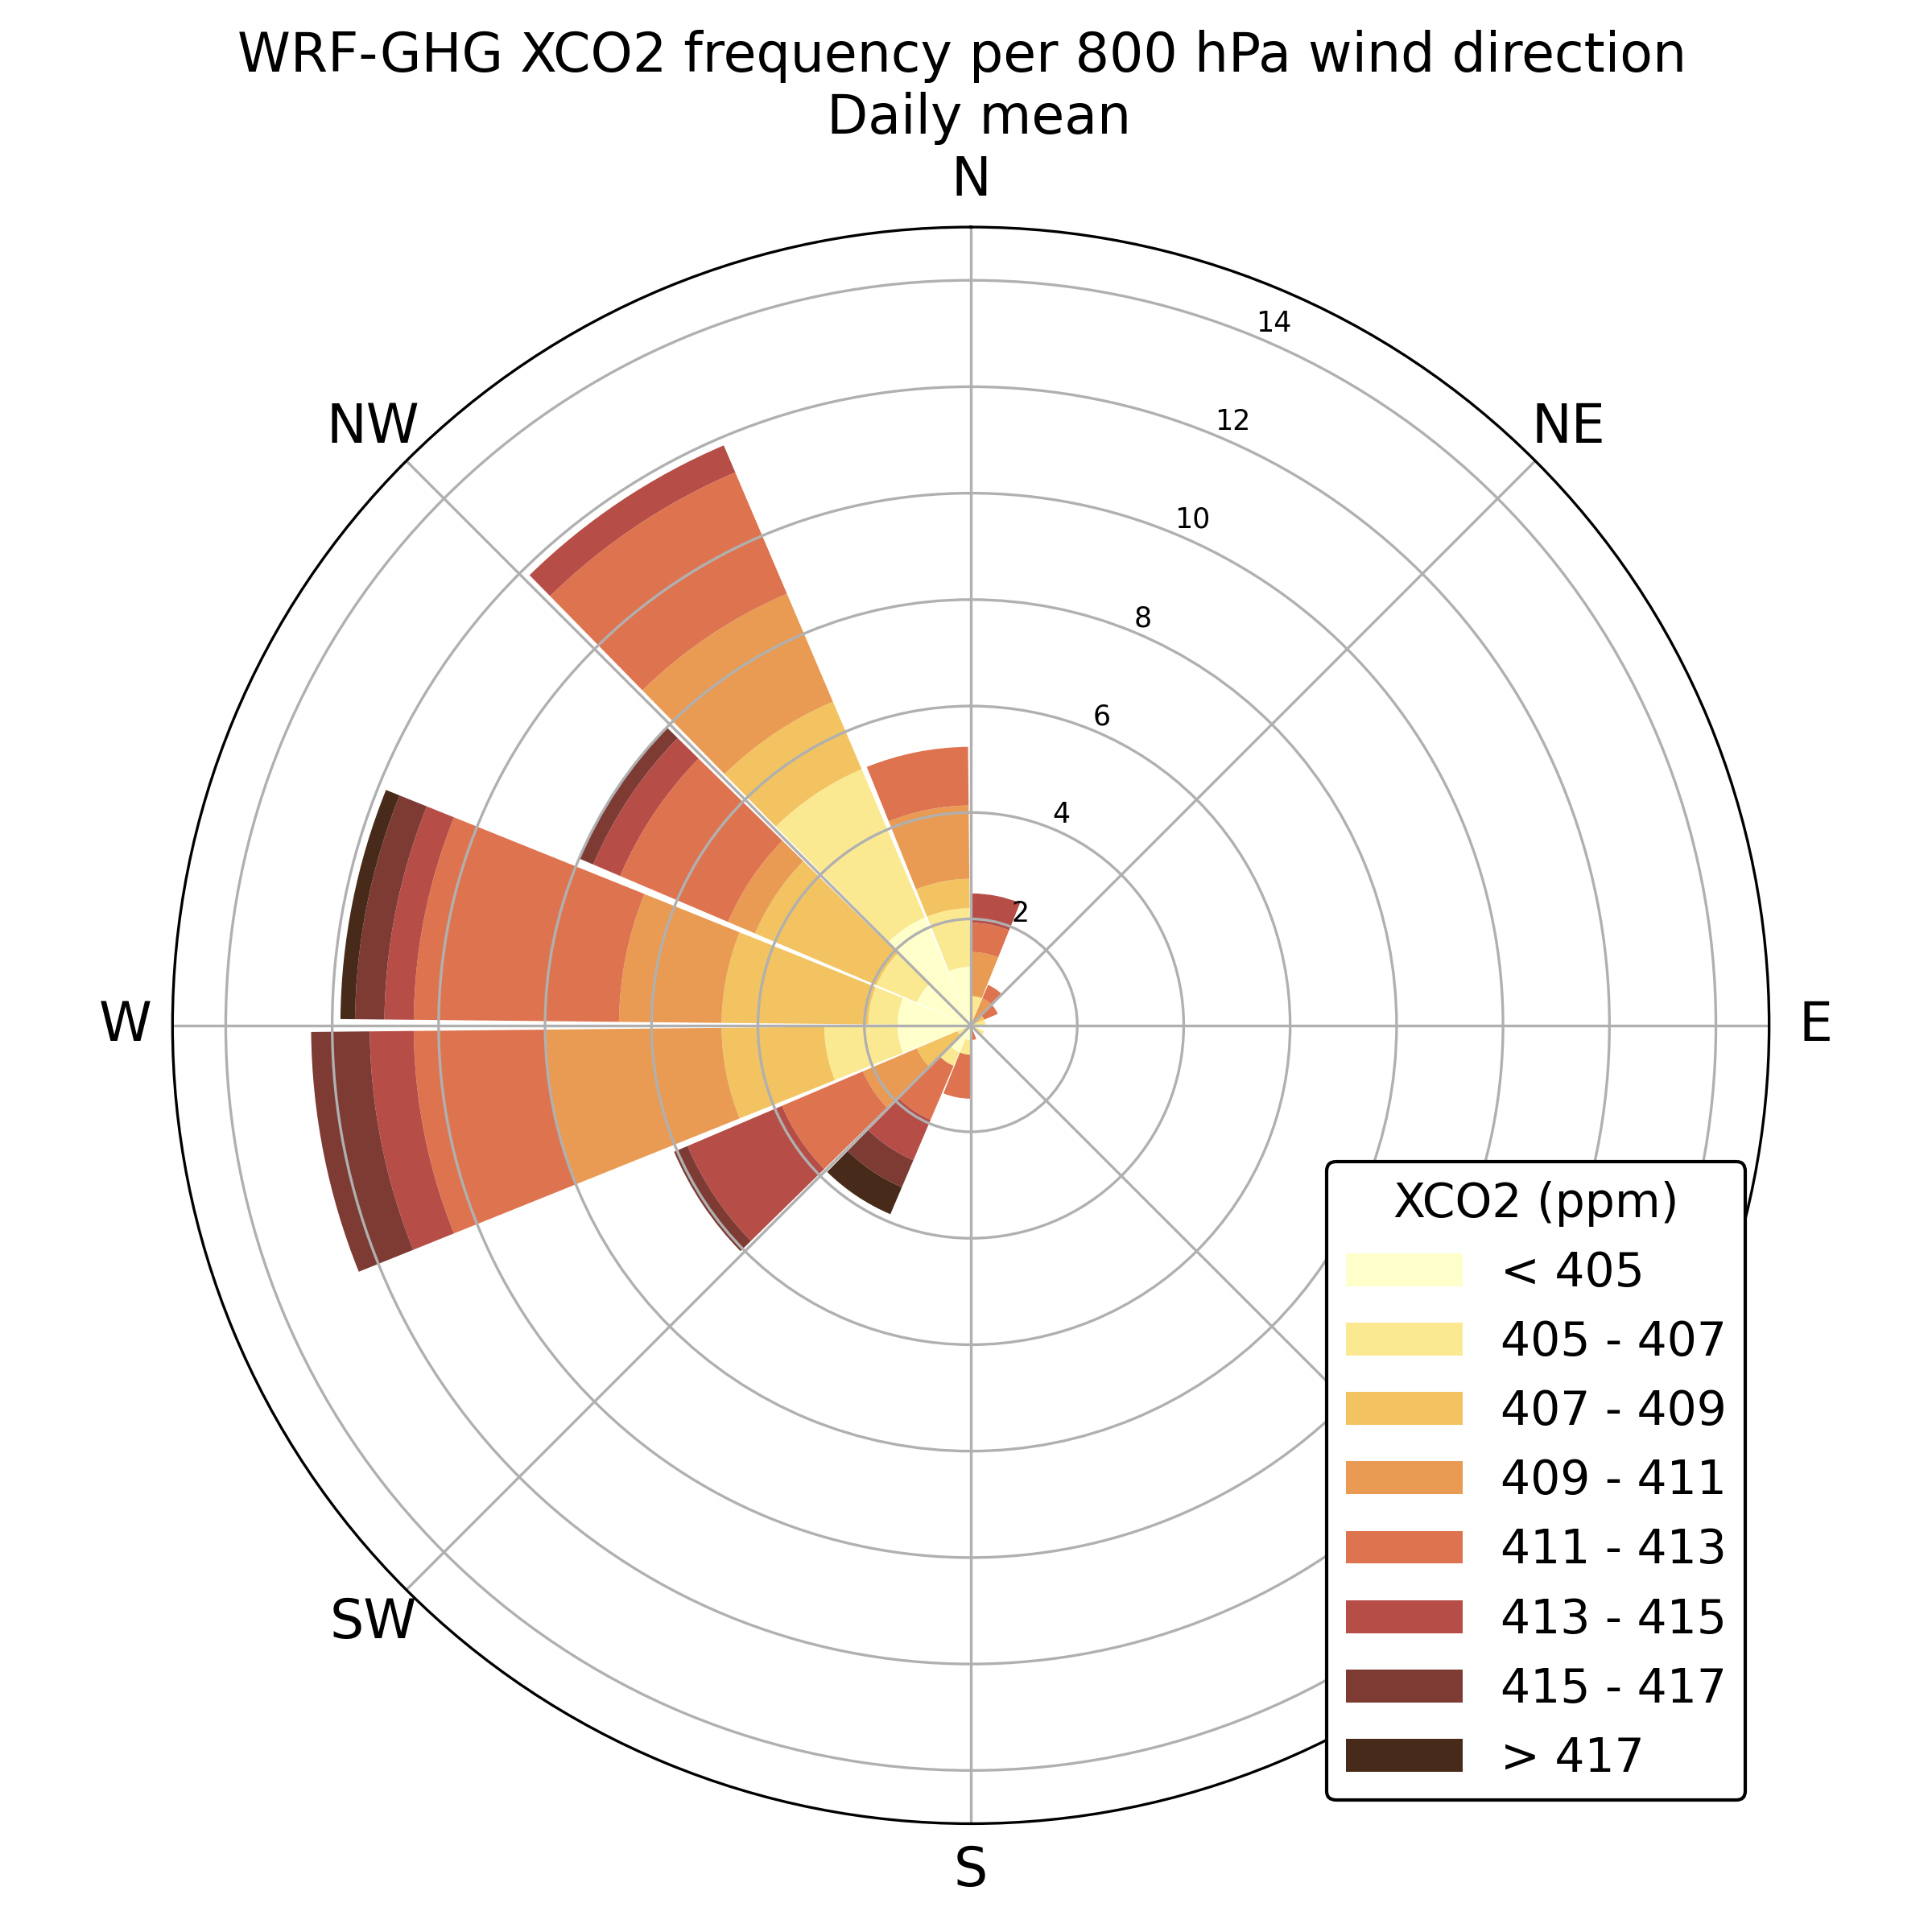
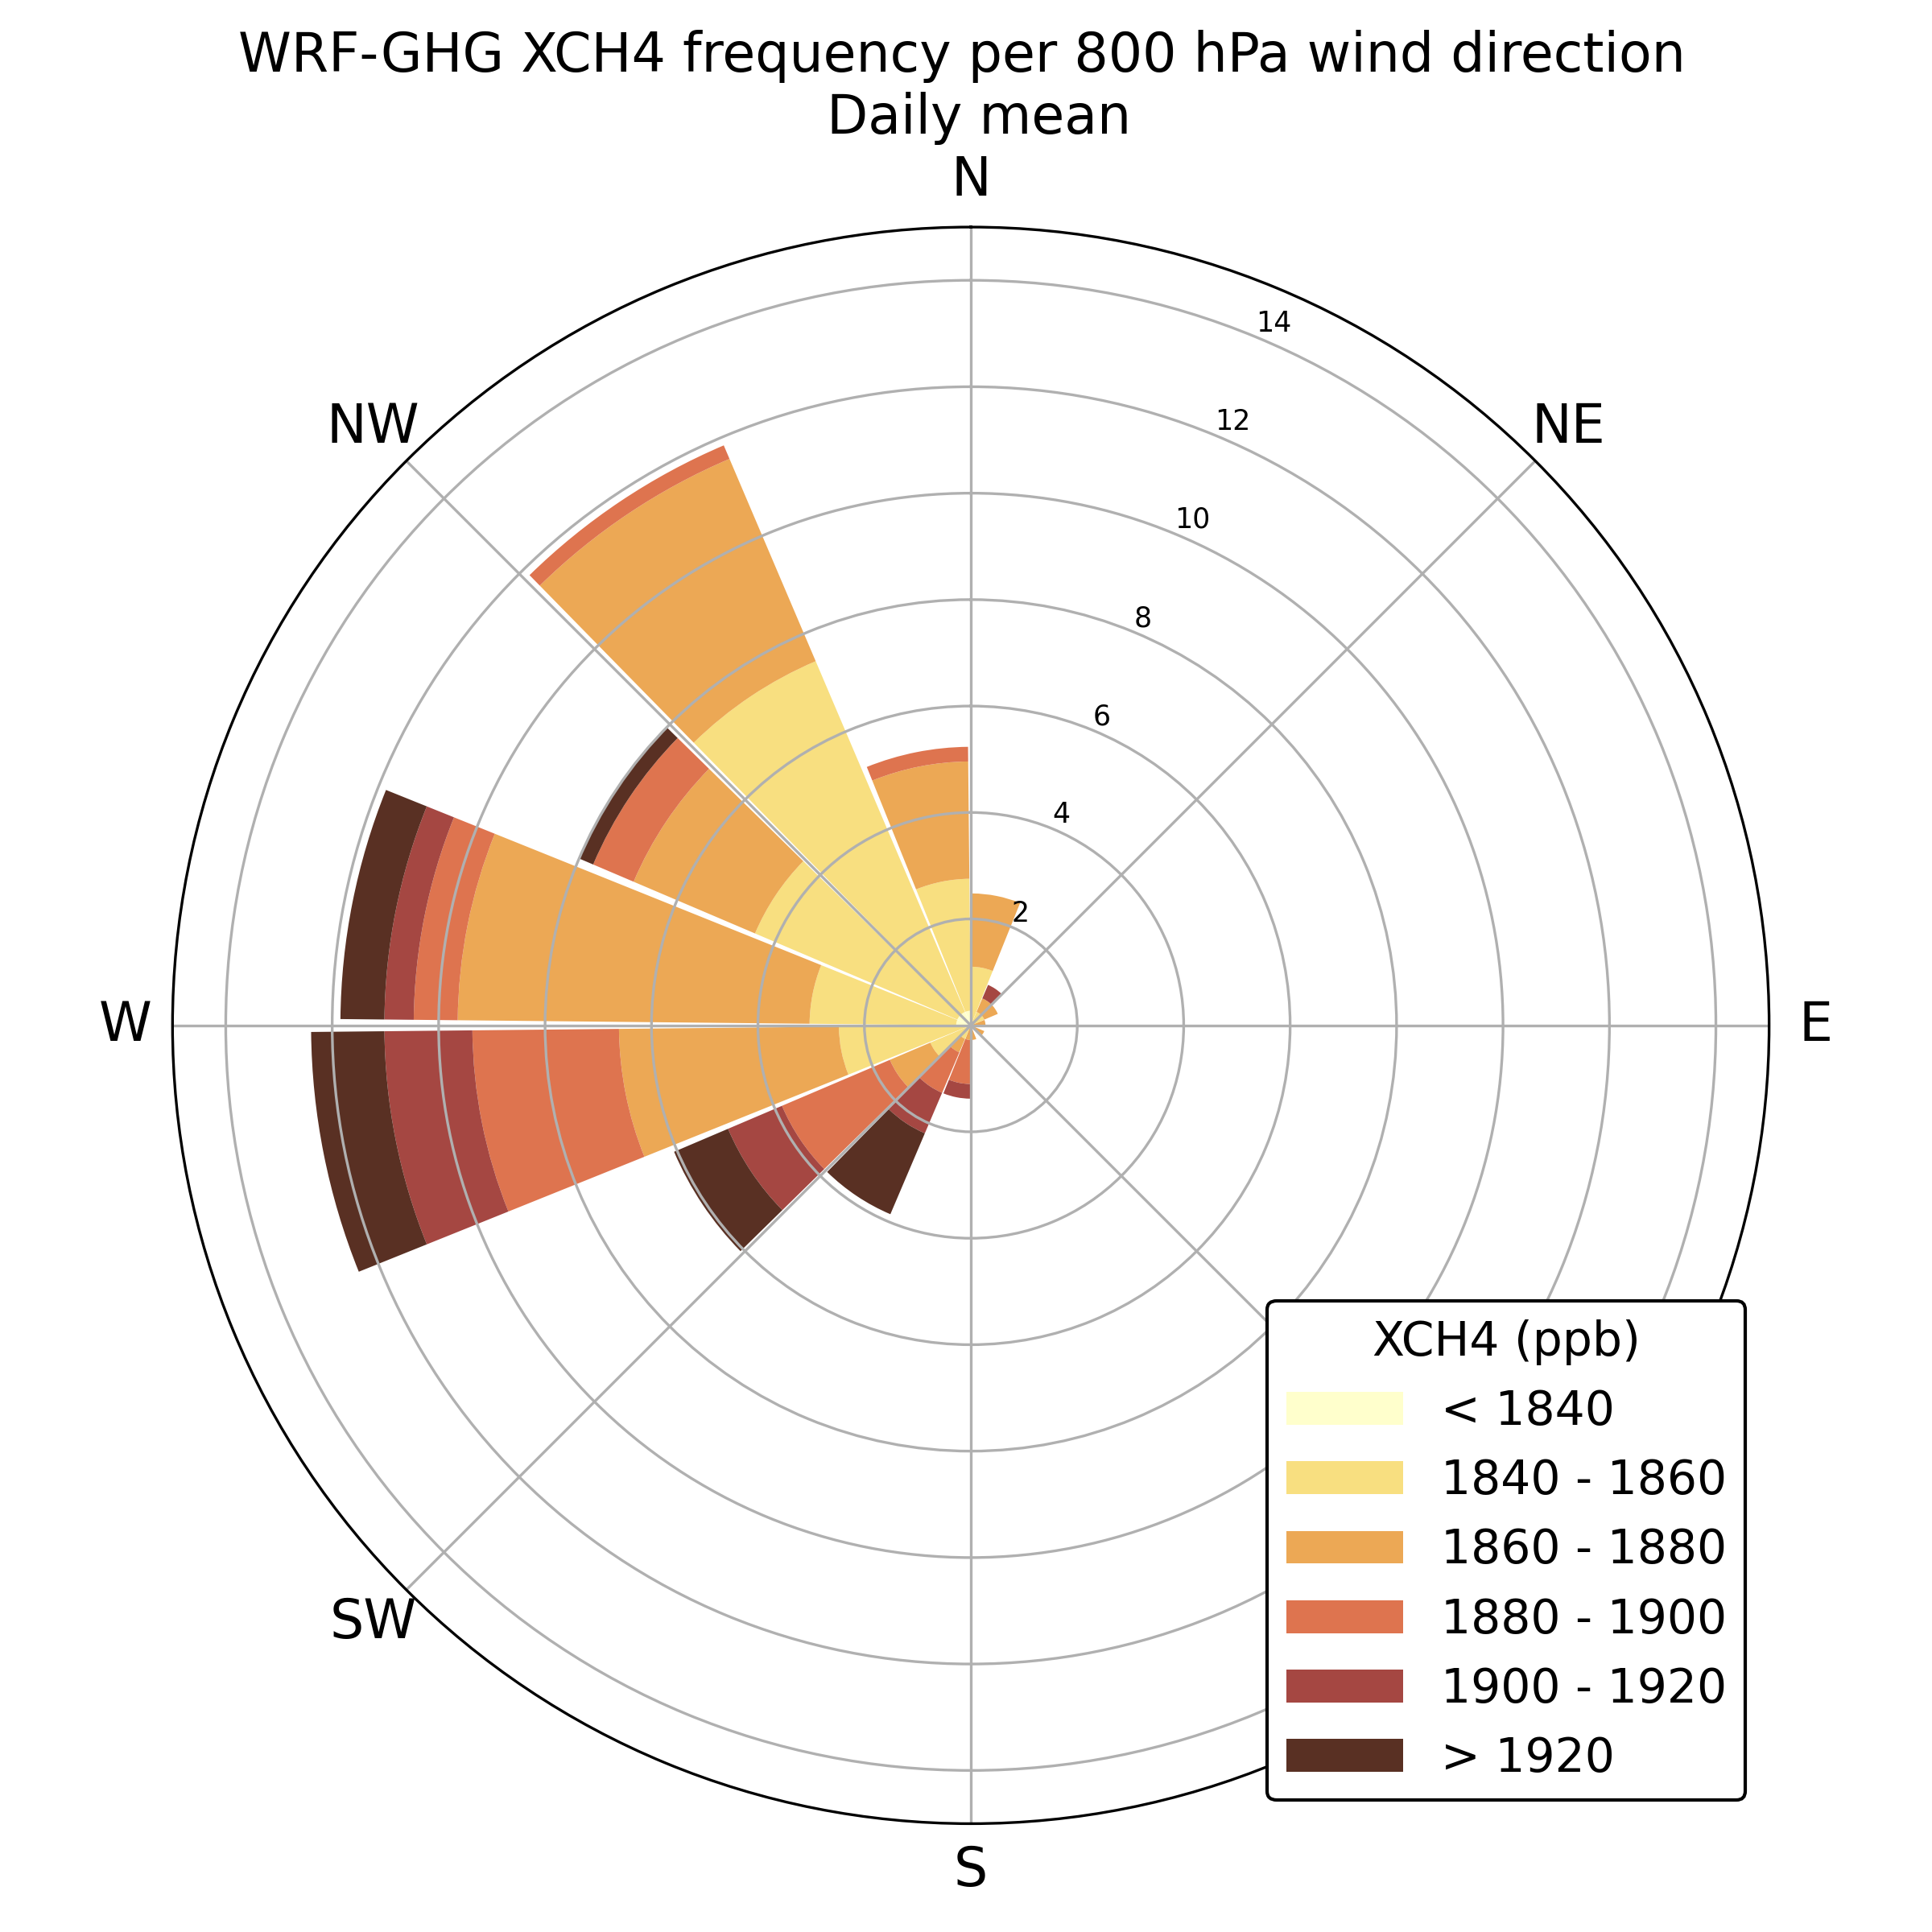
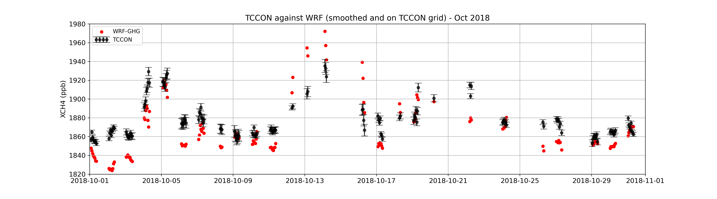
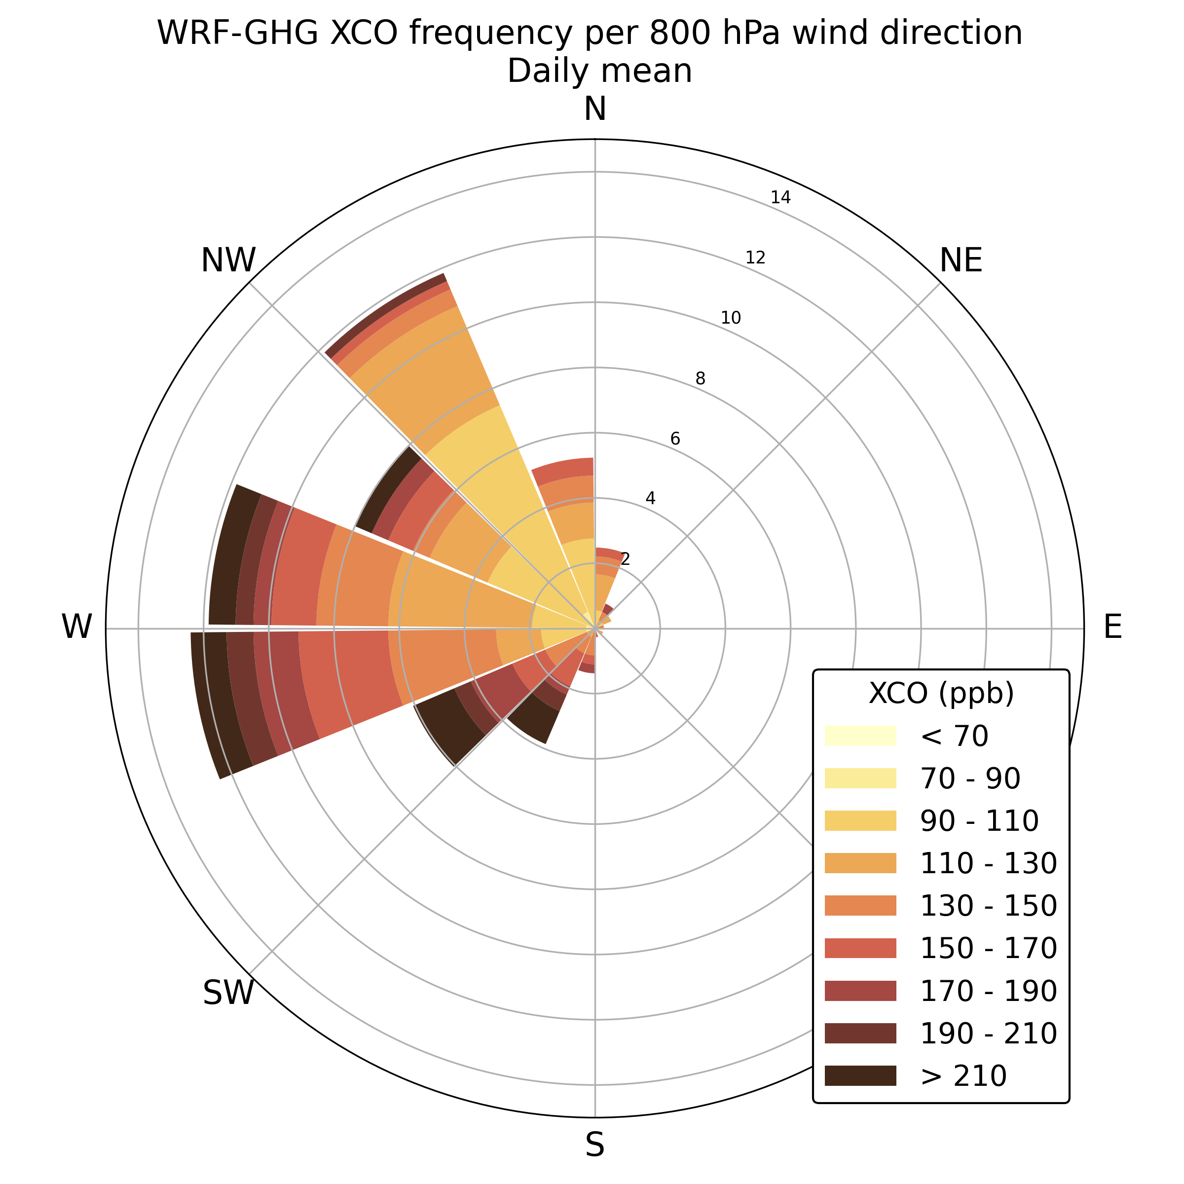
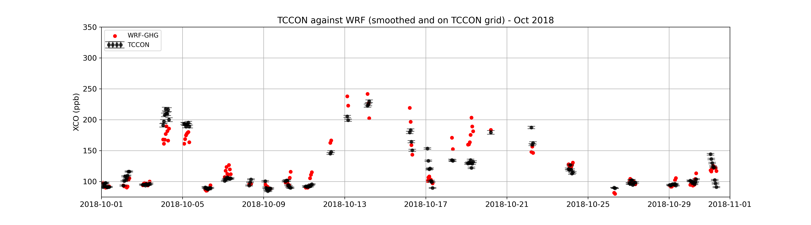
What is driving variability?
XCO₂ – October 2018
All columns increase on same days
These polluted days can be linked with simulated wind direction
XCO₂
XCH₄
XCH₄ – October 2018
XCO
XCO – October 2018
SW: high
(North China Plain pollution)
NW: low

Slide 13
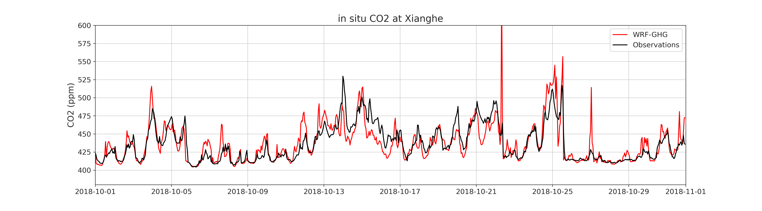
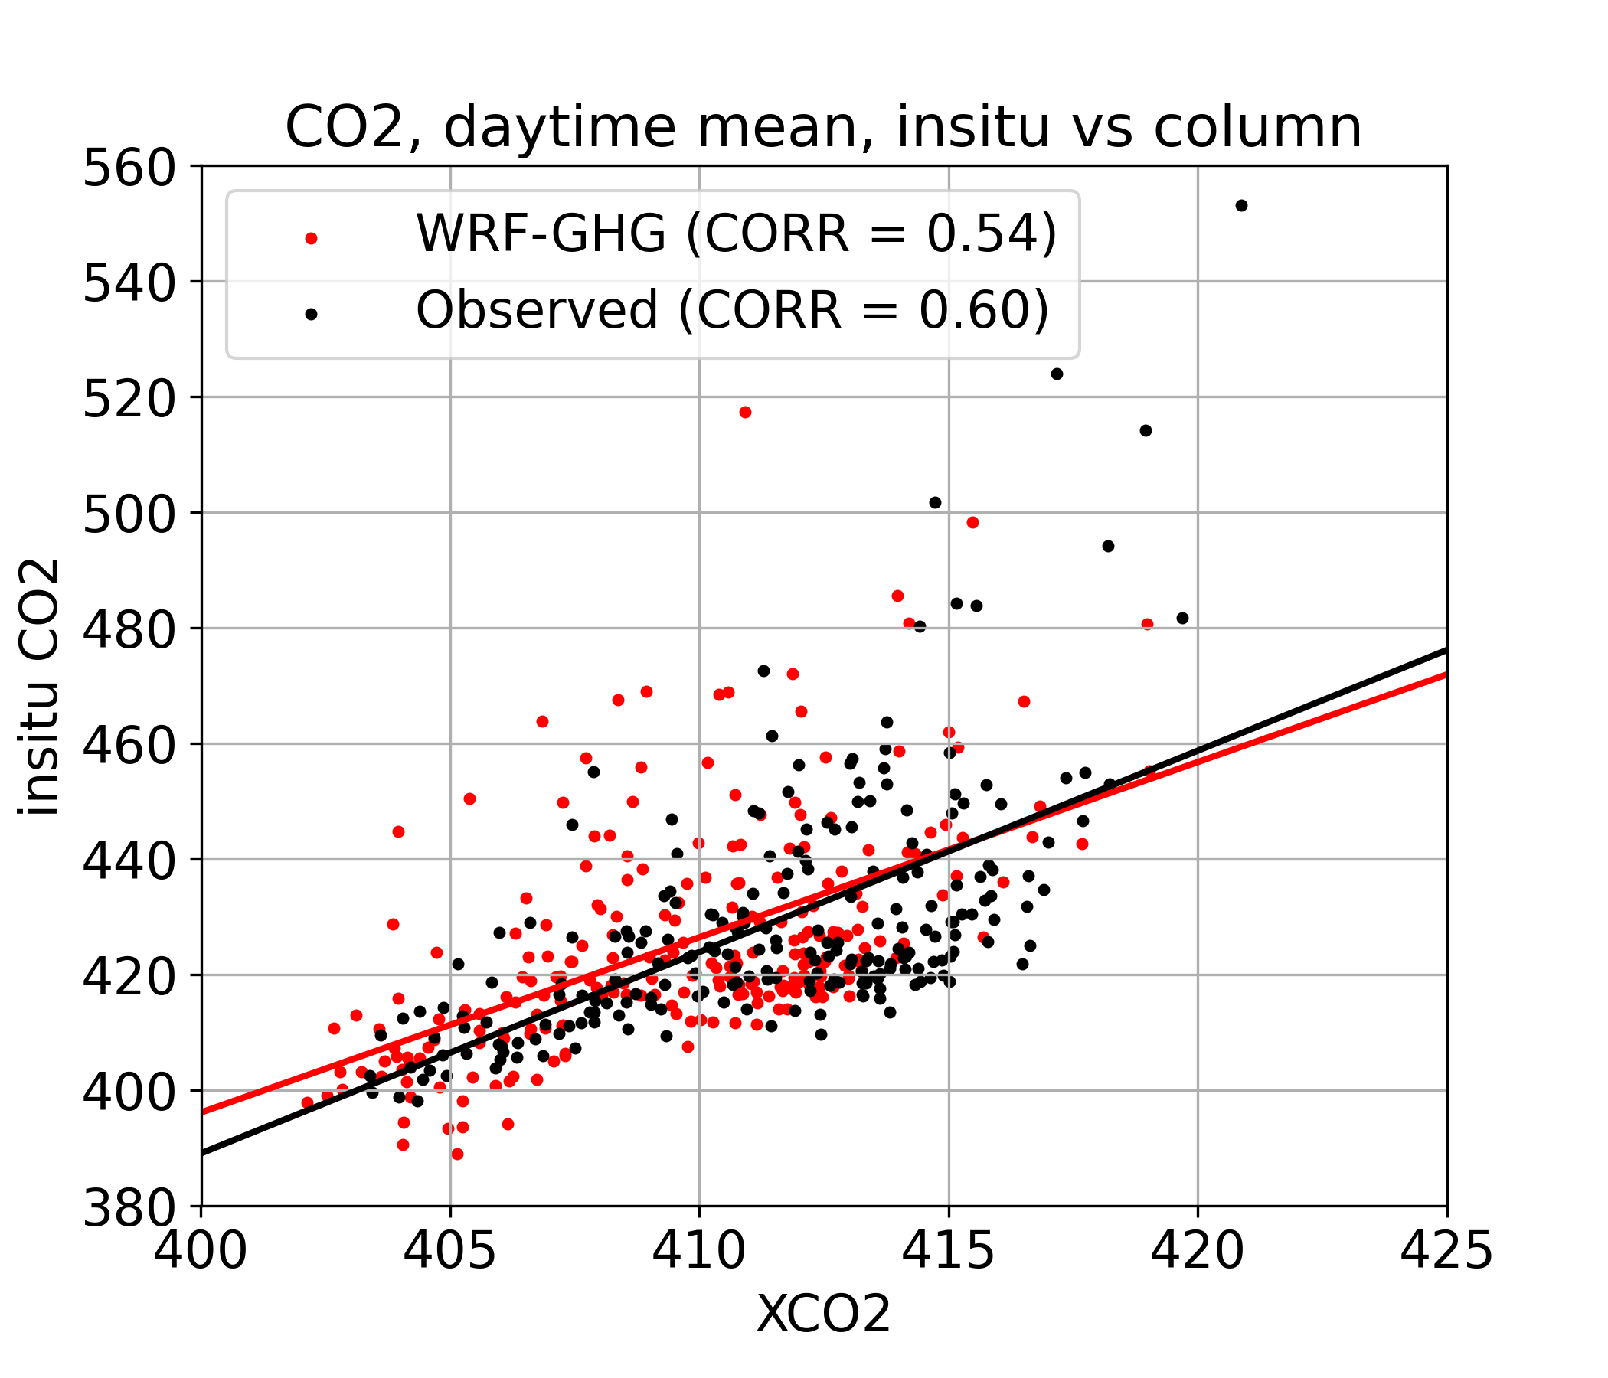
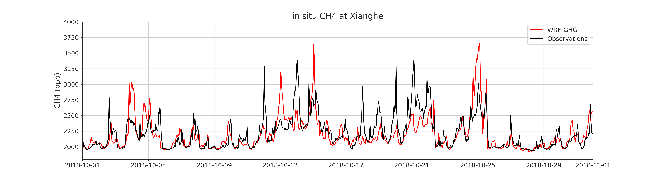
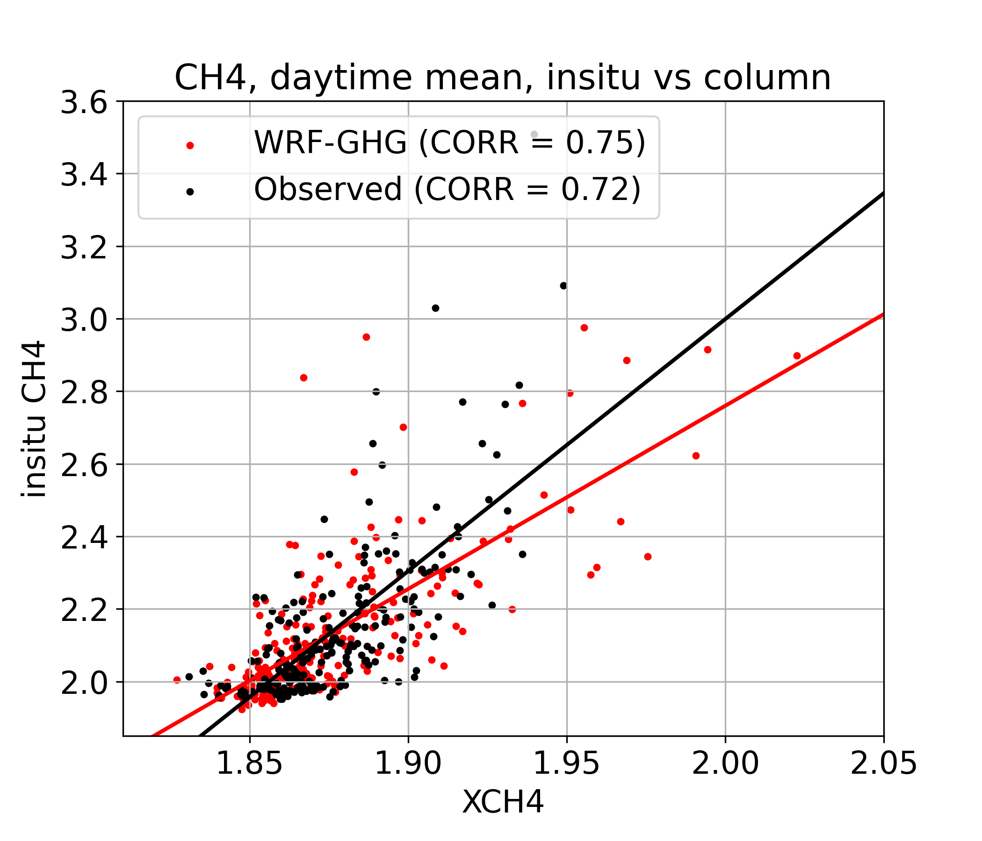
What is driving variability?
Polluted days also visible in timeseries of insitu data
Strong correlation between the daytime mean insitu and column concentrations.
Impact of polluted / clean airmasses is important for both columns and observations near the surface.

Slide 14
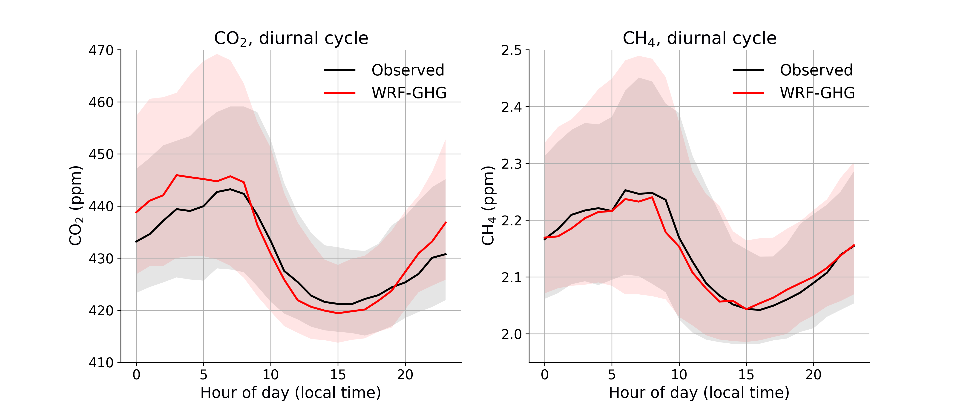
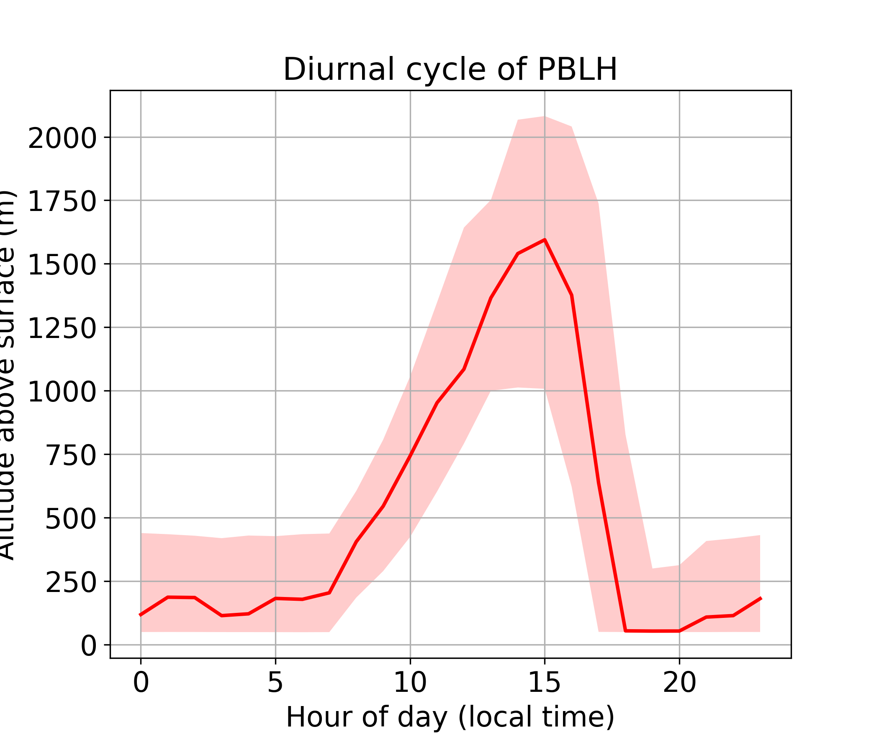
What is driving variability?
For surface observations, daily variation in planetary boundary layer height is also important.
Concentrations peak around 7-8h local time.
Minimum values are found around 15h.
This can be linked to the variation in the PBLH:
Accumulation near the surface at night
Dispersion in the mixing layer during the day

Slide 15
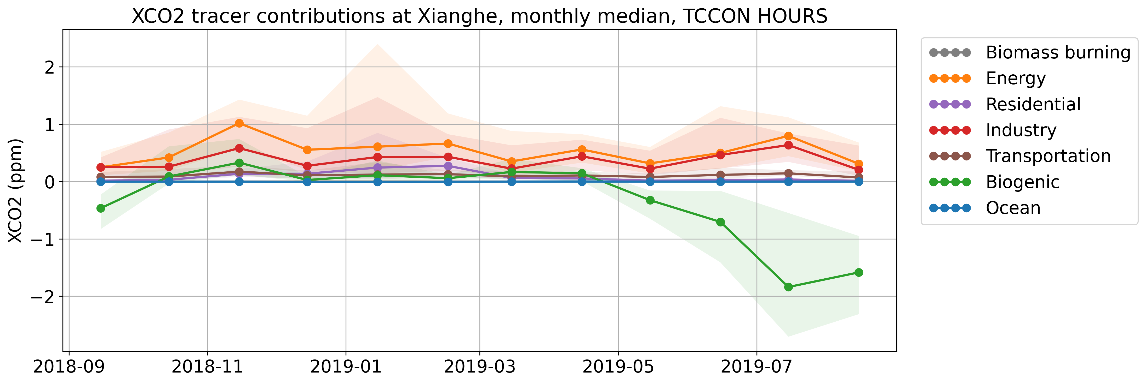



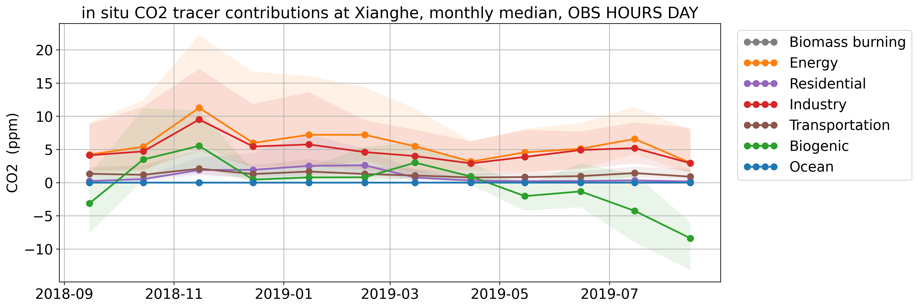


Sector contributions?
Tracer contributions above background for CO₂
Column
Main sectors:
Industry – Energy – Residential – Transportation - Biogenic
Ocean and biomass burning less relevant at Xianghe
Biosphere is a CO₂ source from October until April
Residential emissions are larger in Winter
Insitu

Slide 16
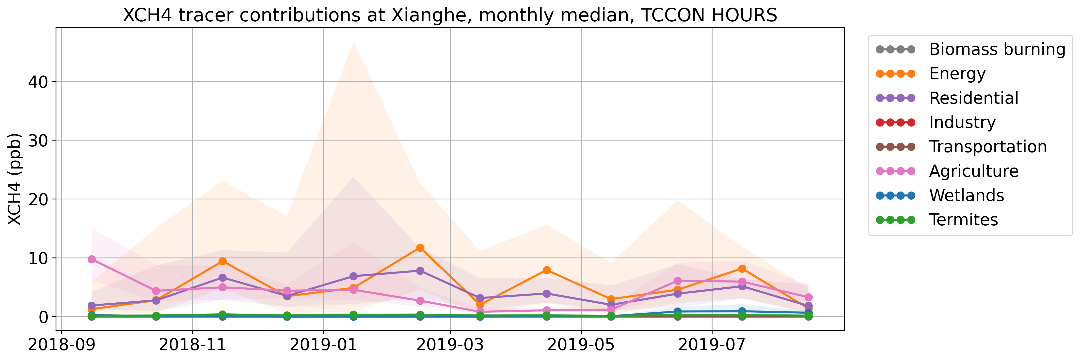



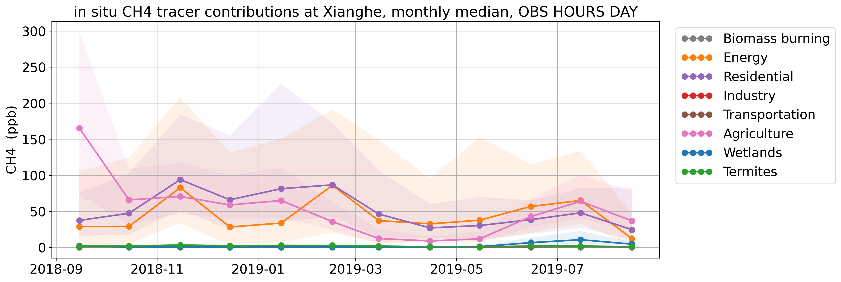
Sector contributions?
Tracer contributions above background for CH₄
Column
Main sectors:
Energy – Residential & Waste – Agriculture
Industry, transportation, wetlands, termites and biomass burning less relevant at Xianghe
Residential emissions are larger in Winter
Insitu

Slide 17
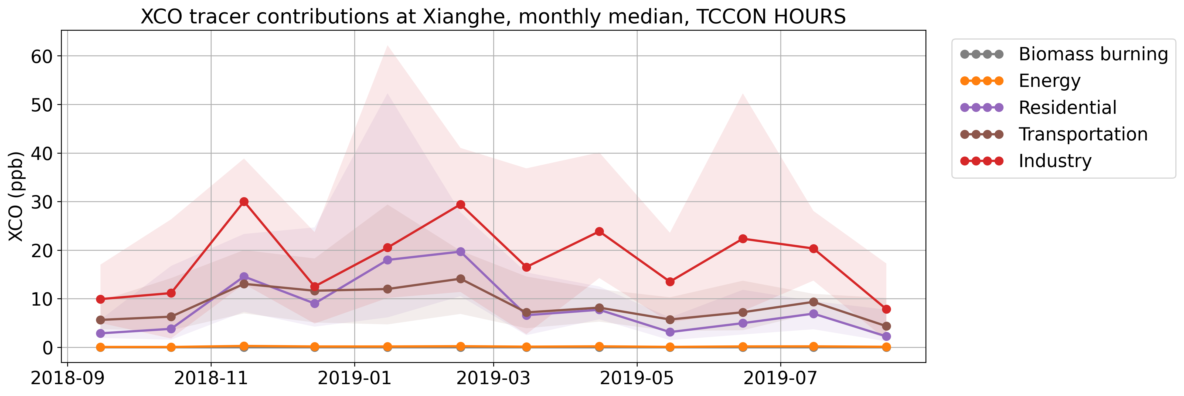
Sector contributions?
Tracer contributions above background for CO
Column
Main sectors:
Industry – Residential – Transportation
Energy and biomass burning less relevant at Xianghe
Residential contributions are larger in Winter

Slide 18






Main conclusions
Variability in timeseries
Column data
Insitu data
polluted/clean airmasses depending on wind direction
PBL height
Local hotspots + wind direction
Polluted/clean airmasses
depending on wind direction
WRF-GHG strengths
Accurate simulated timeseries
Accurate diurnal cycles
Ability to split signal into several tracers
Link between tracer concentrations and meteorology
WRF-GHG weaknesses
Dependence on boundary conditions
Dependence of accurate flux information

Slide 19


thank you!
questions?
sieglinde.callewaert@aeronomie.be

