Slide 1



IRWG C₂H₆: enhancements
Ivan Ortega, Jim Hannigan
IRWG/NDACC virtual meeting (June 2022)

Slide 2
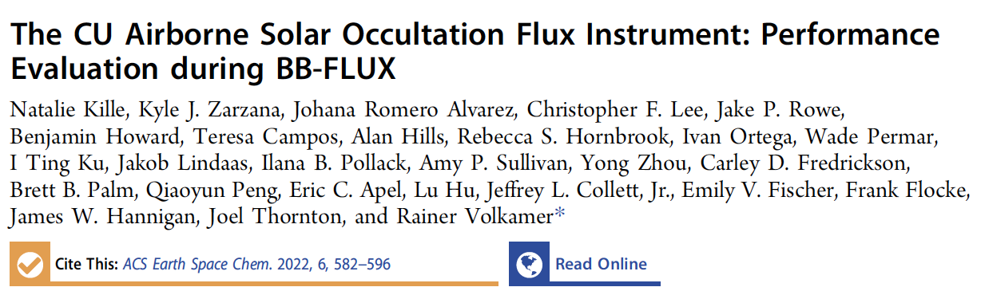
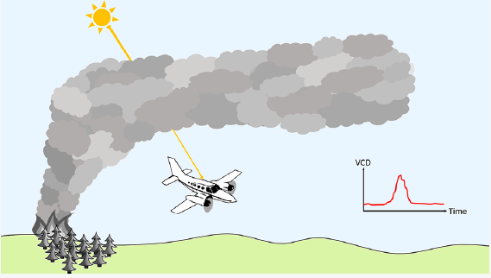
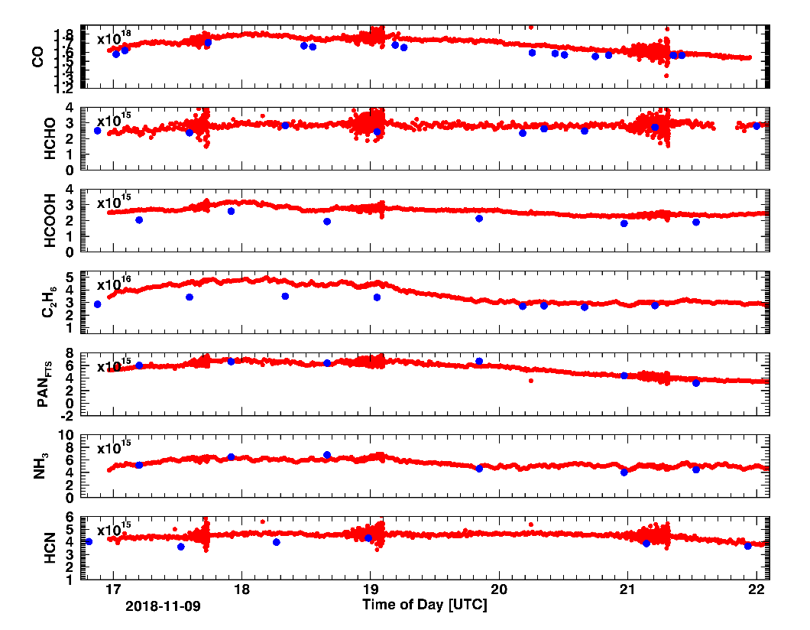
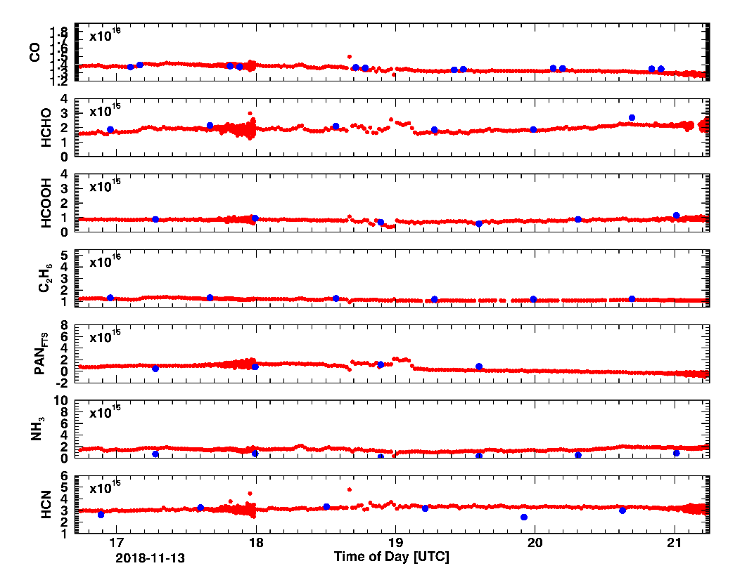
C₂H₆ enhancements identified in a colocated experiment
Blue: FTIR
Red: EM27
Good comparison under low columns.
Not so great when columns are high.

Slide 3
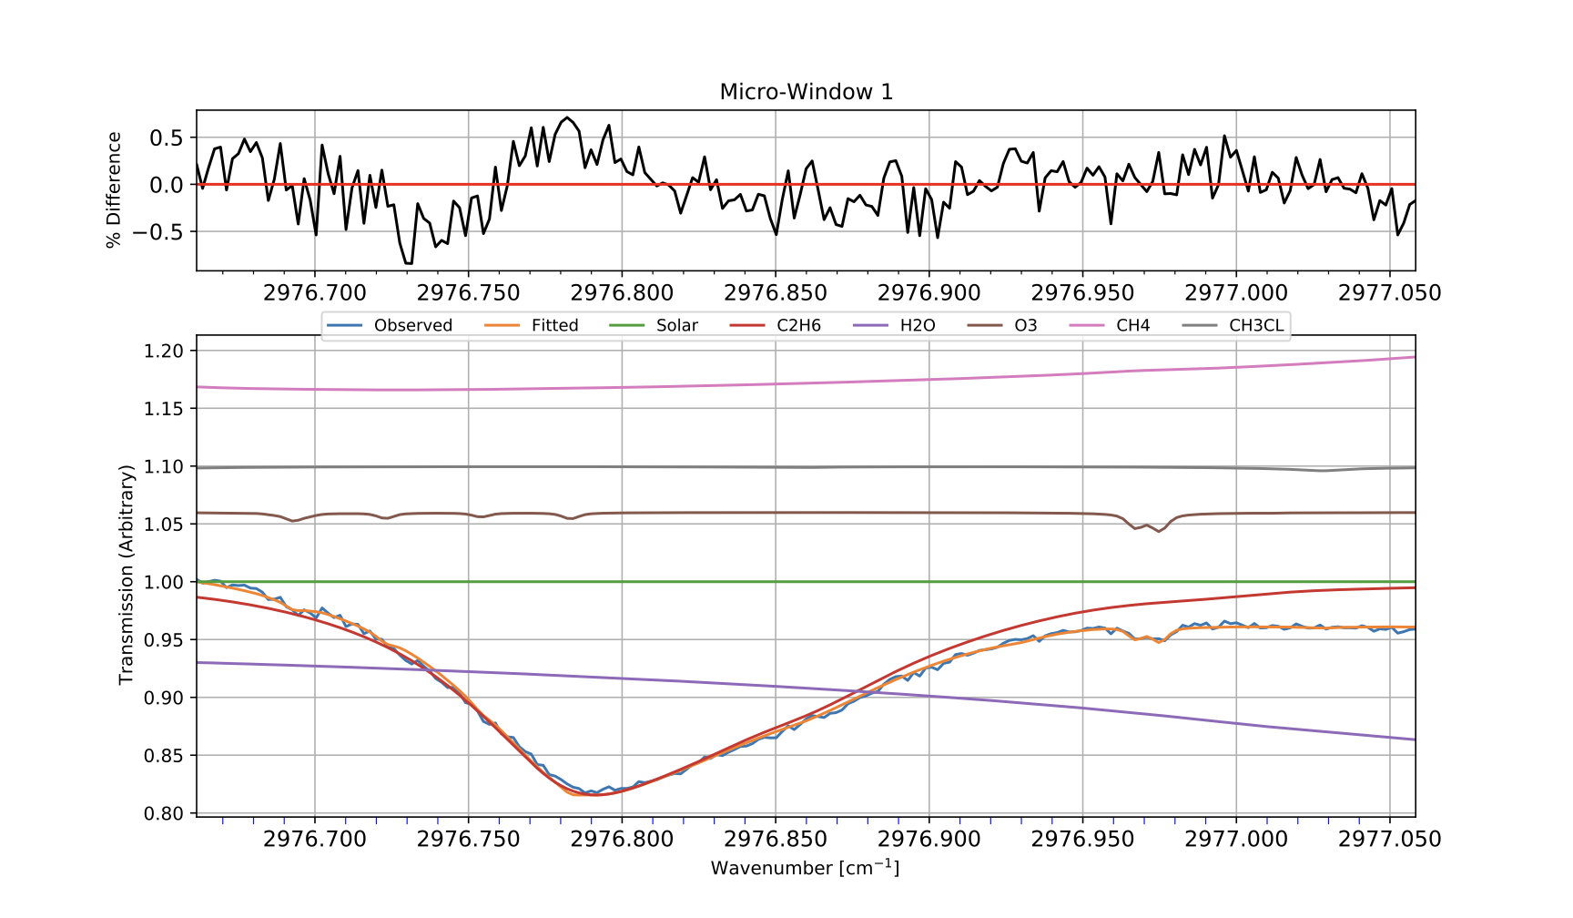
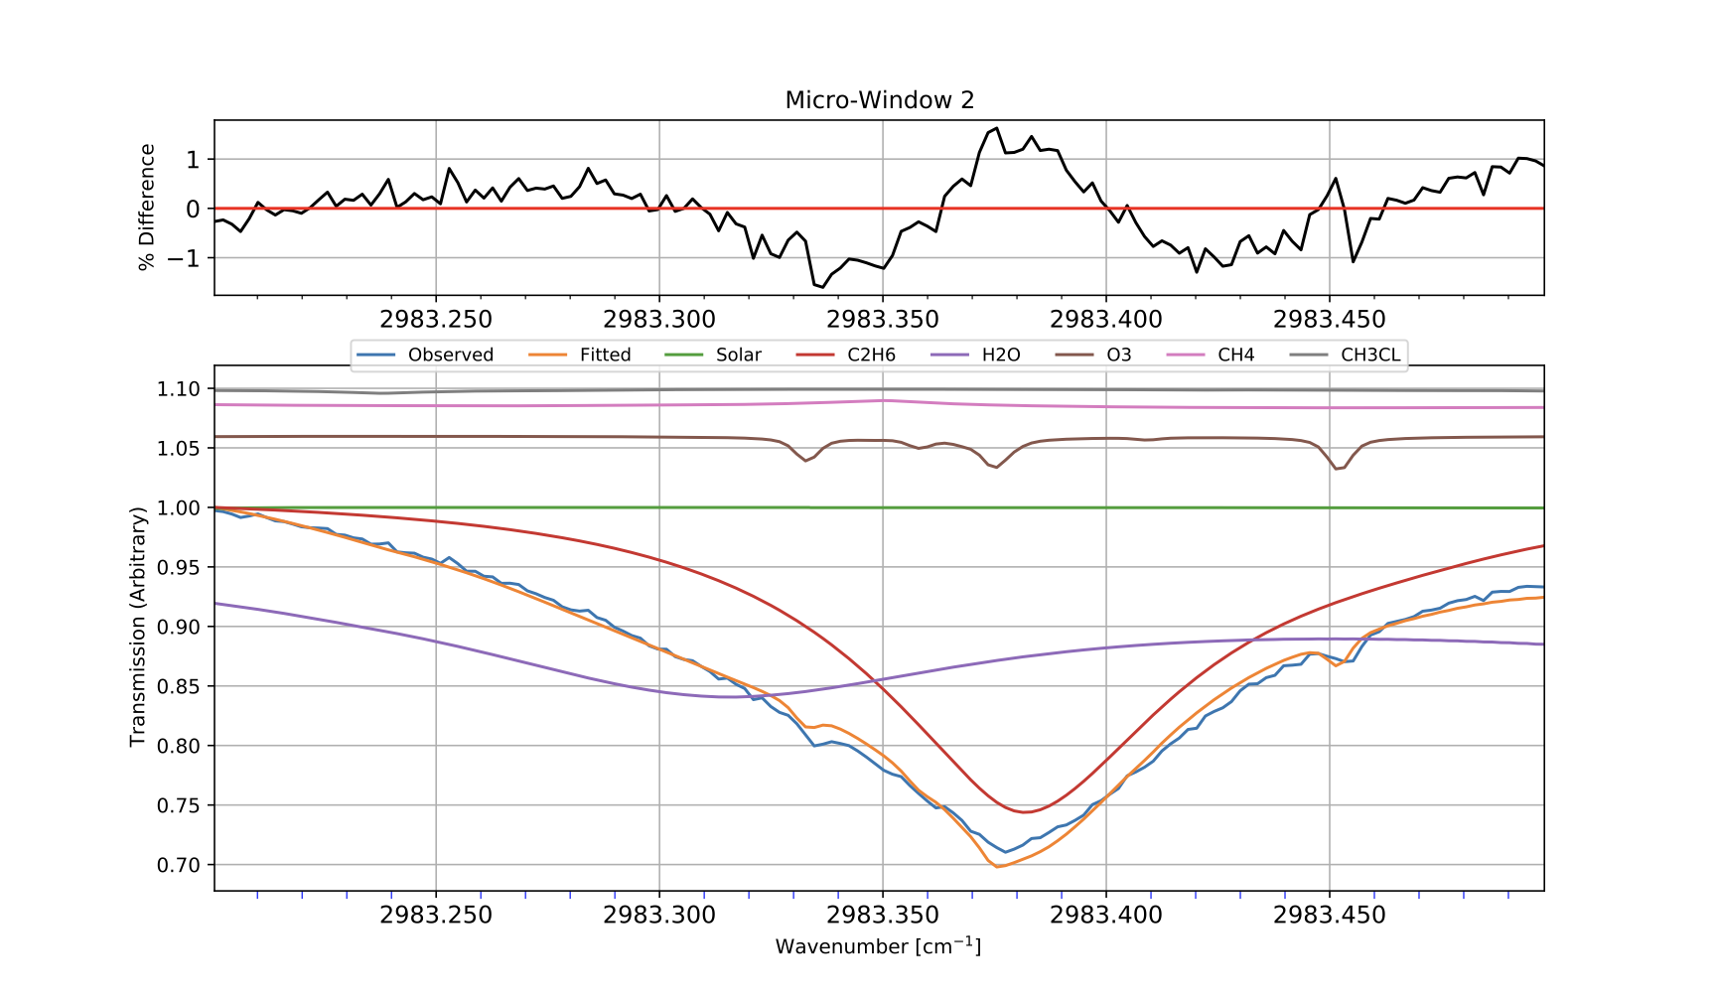
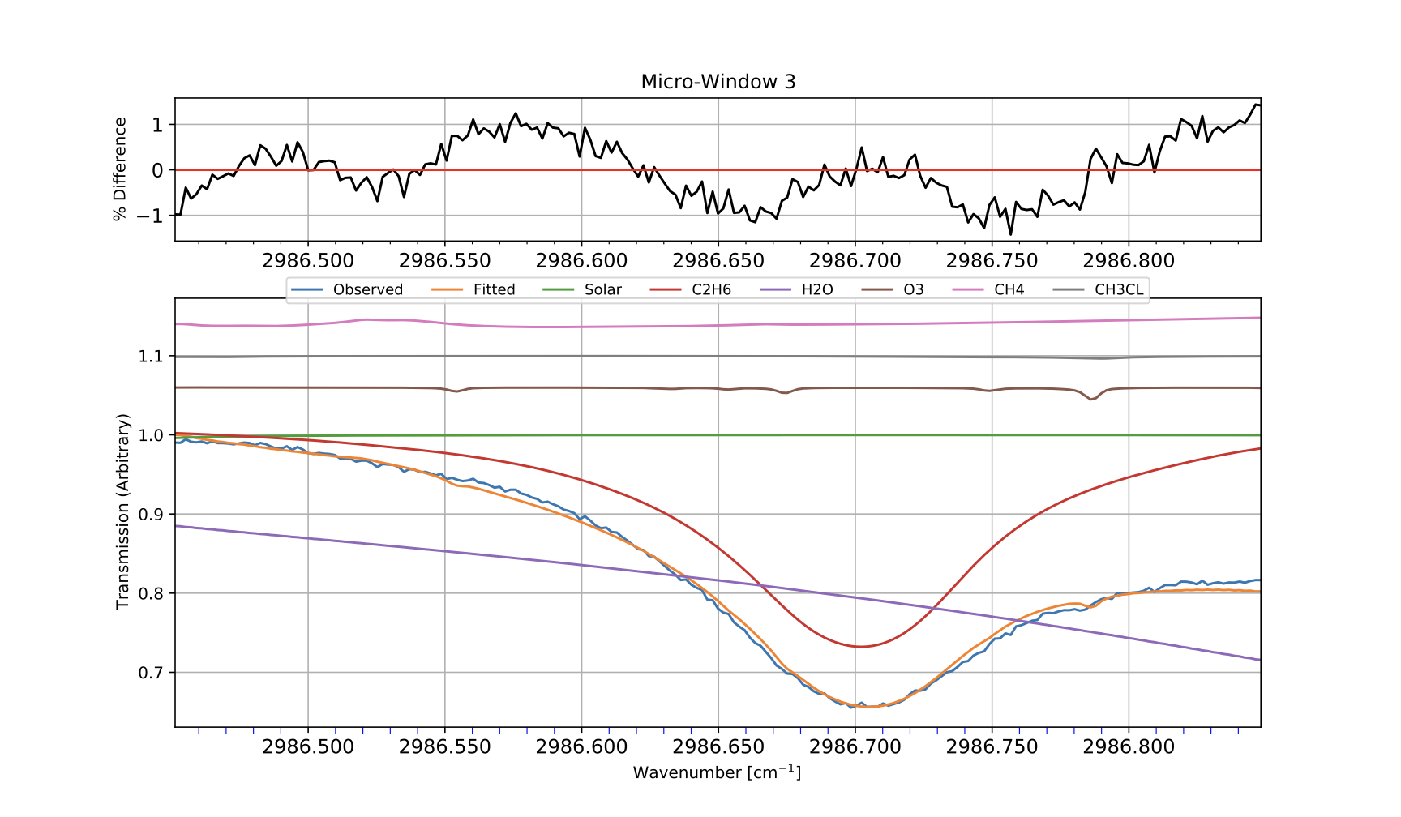
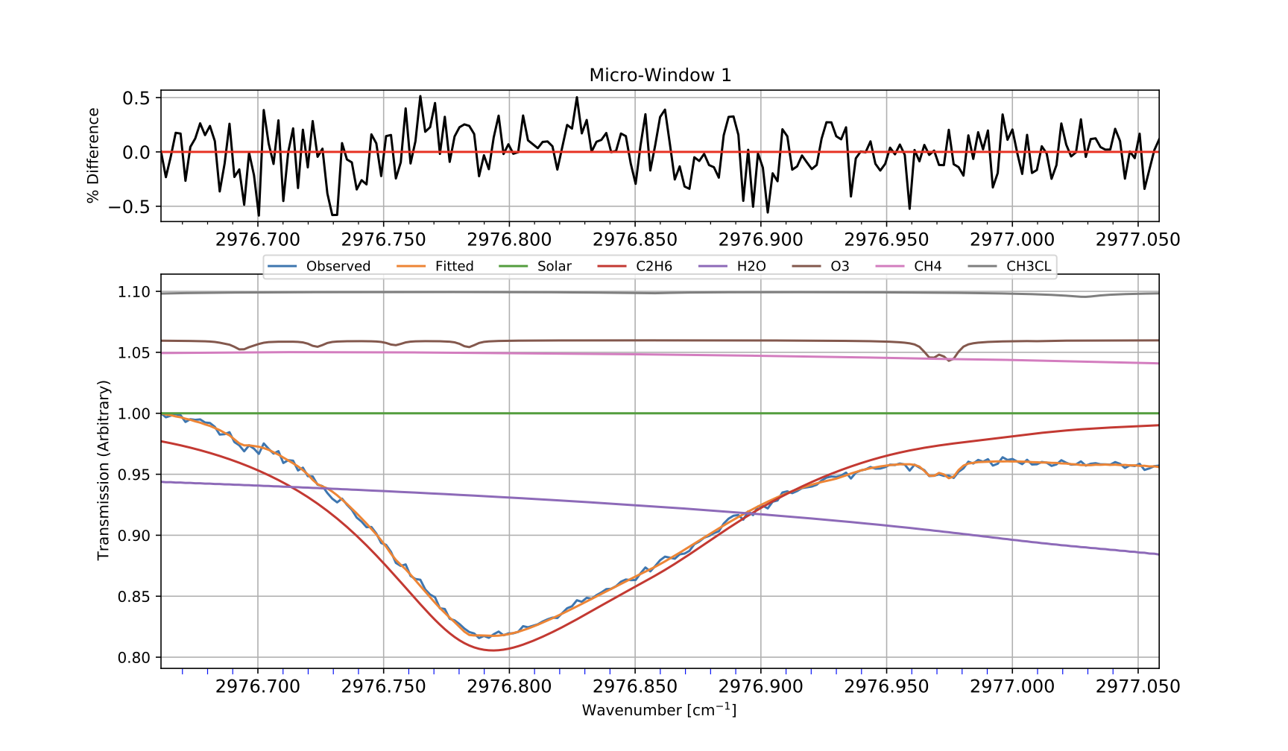
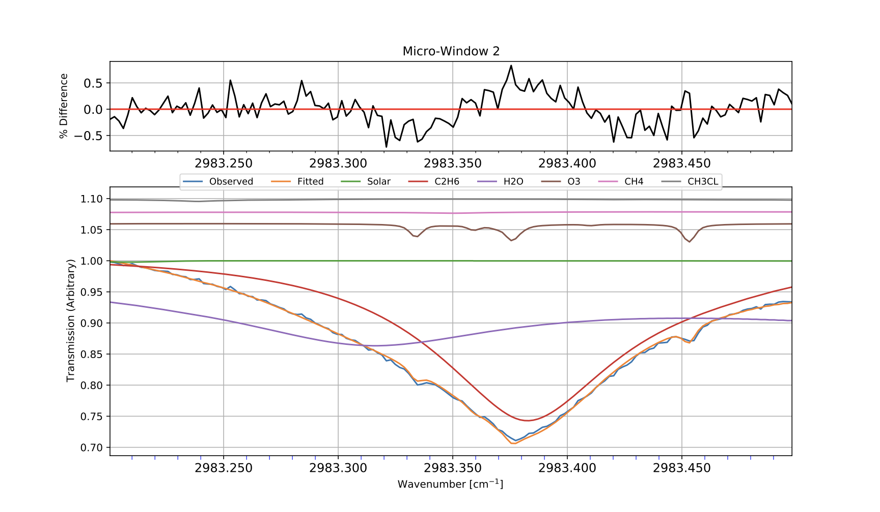
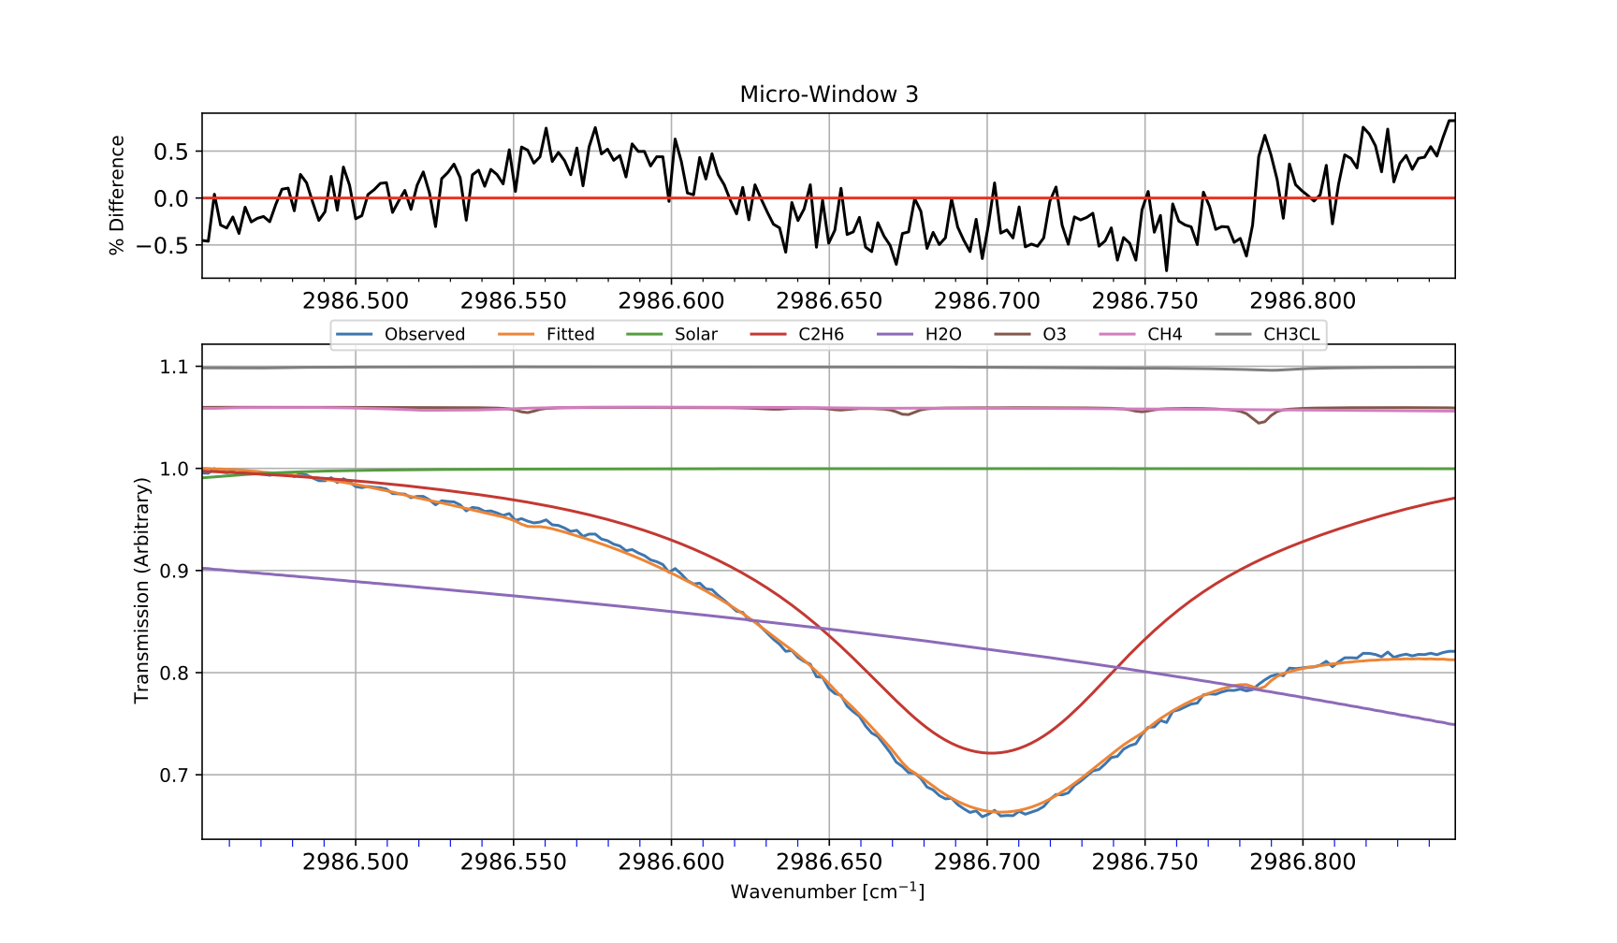
Fit examples
Standard retrieval (RMS = 0.64, DOF = 1.3, TC: 3.25E16)
Standard retrieval but using WACCM v7 (RMS = 0.34, DOF = 1.8, TC: 3.82E16). Further improvement using HIT20

Slide 4
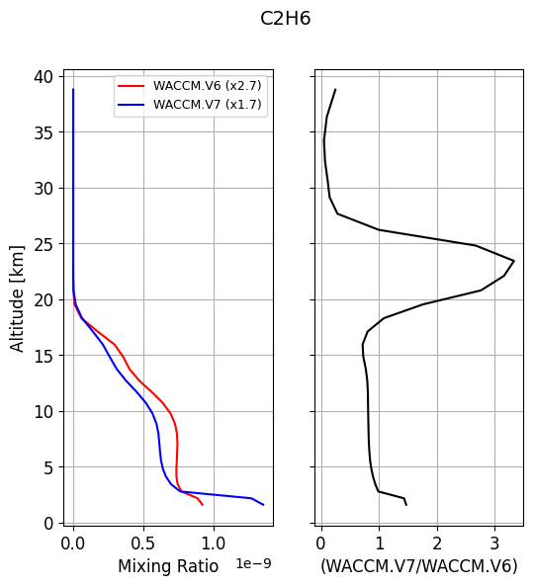
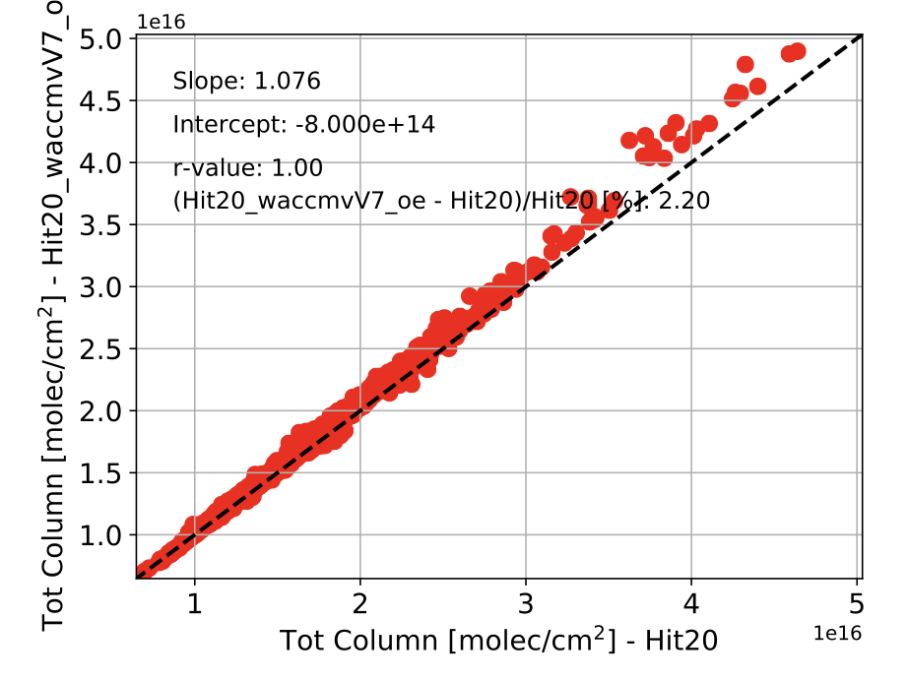
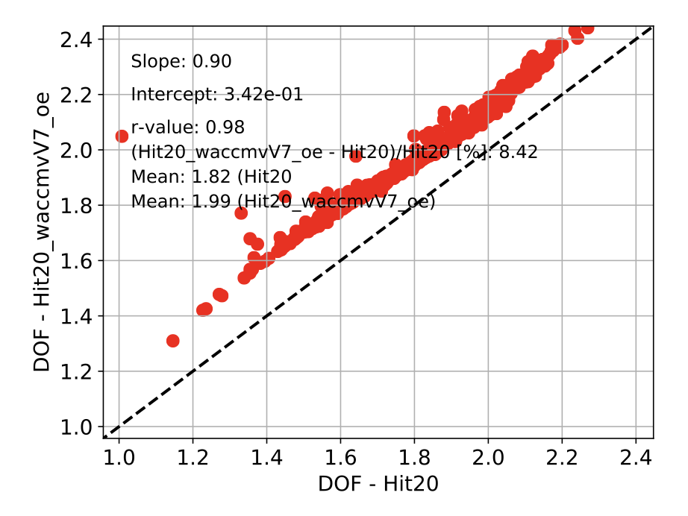
WACCM apriori & 3 years of comparison
Interestingly:
- WACCMv7 x 1.7 improves the retrieval
- WACCMv6 x 2.7, 3.7, 4.7, 5.7 does not improve the retrieval

Slide 5
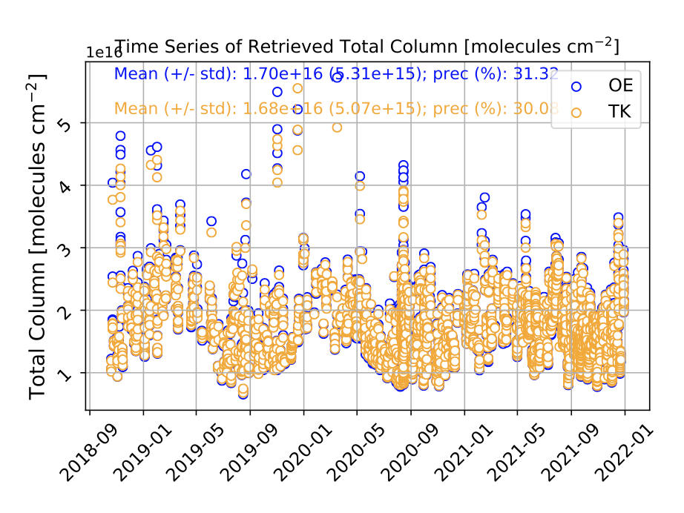
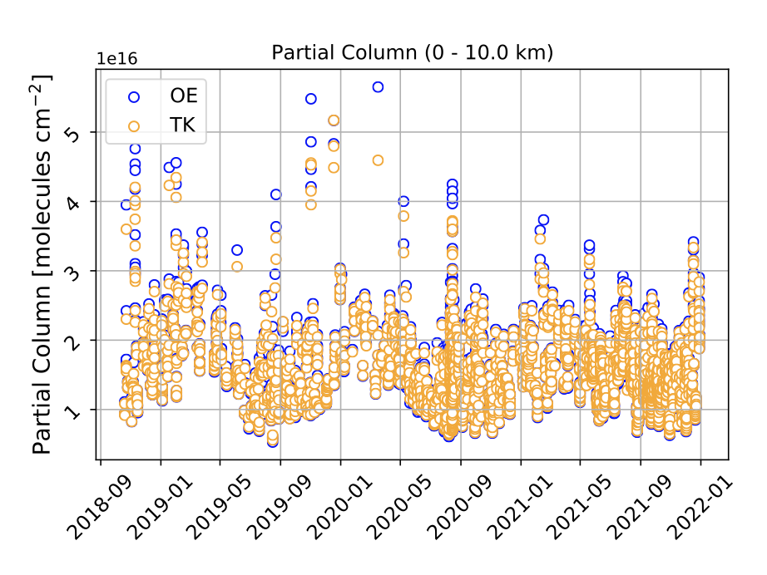
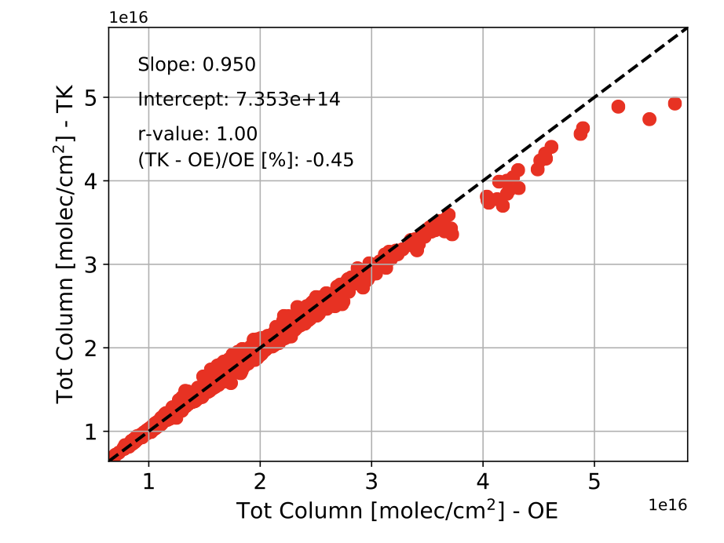
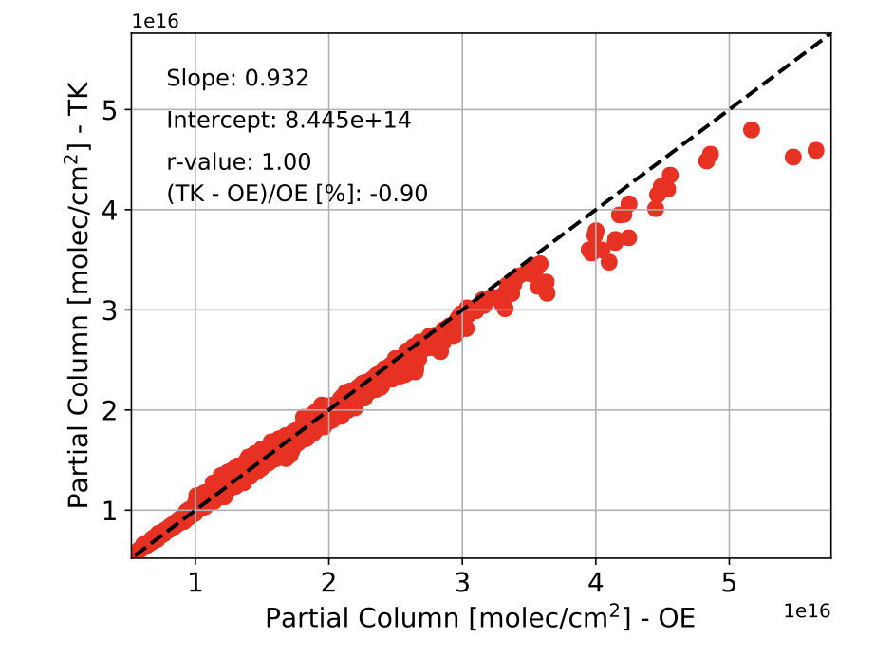
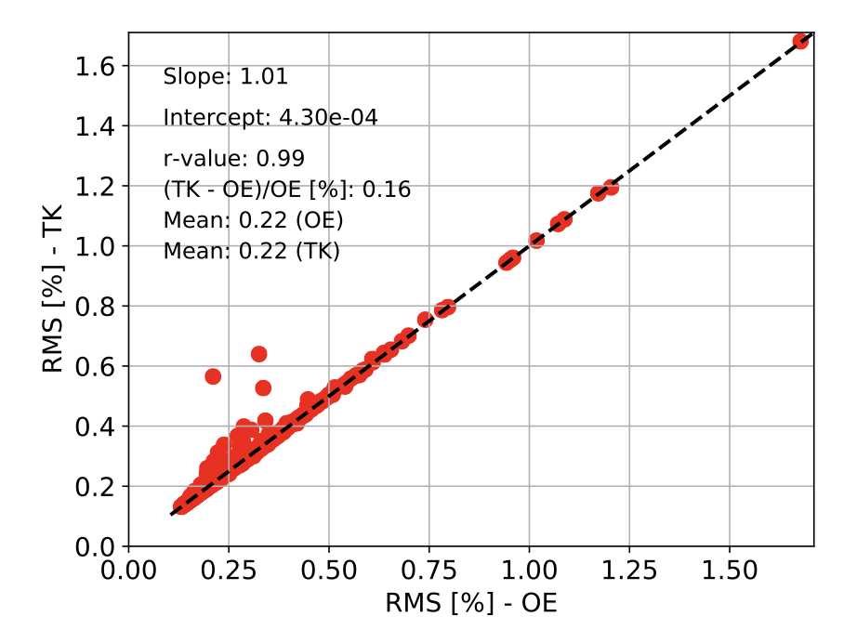
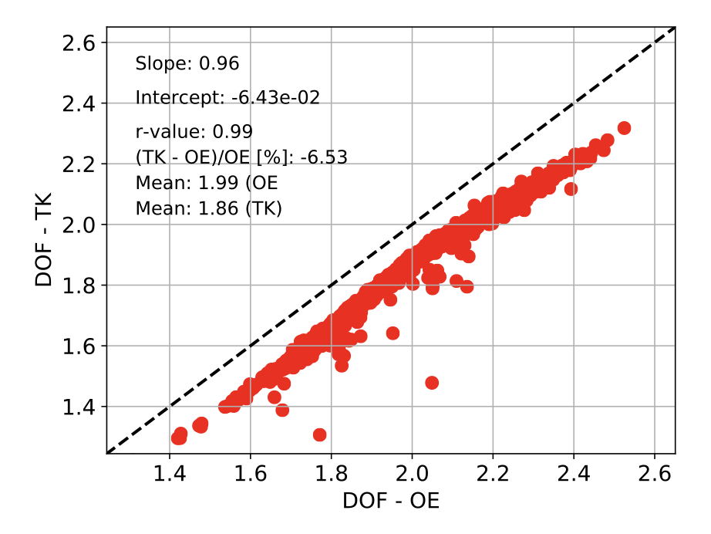
Comparison between OE & Tik (hit20, WACCM v7)

Slide 6
Summary
HIT20 improves the quality of retrievals
WACCM v7 improves the quality of retrievals
HIT20 and WACCM v7 improve further the quality of retrievals
The Tikhonov approach can be used, especially under homogeneous/pristine conditions.
The OE approach captures better enhancements but would be great to test more sites.

Slide 7
C₂H₆ findings from last meeting (Manu’s presentation)
•Based on results from 10 sites (all SFIT4), from pole to pole, spanning various conditions (wet, dry, high-lat, mid-lat, polar, sea level, mountain…)
•Total columns remain close to reference data set (and within the SYS budgets), except for SH, where C2H6 abundances are the lower globally; no seasonal effect for the TOTCOL differences
•Improvement of the fitting residuals with HITRAN20 (combined with C2H6 PLLs) for almost all sites
•DOFS remain mostly unchanged
•Latanzi (2011) spectroscopy for C2H6 (HIT20) leads to clear degradation of the fits; missing secondary features => keep C2H6 PLLs!
•WACCMv7 a priori columns in progress, but still too low overall (example: too low by a factor 2 for JUN) => we might need to keep an a priori pre-scaling if adopting WACCMv7

