Slide 1
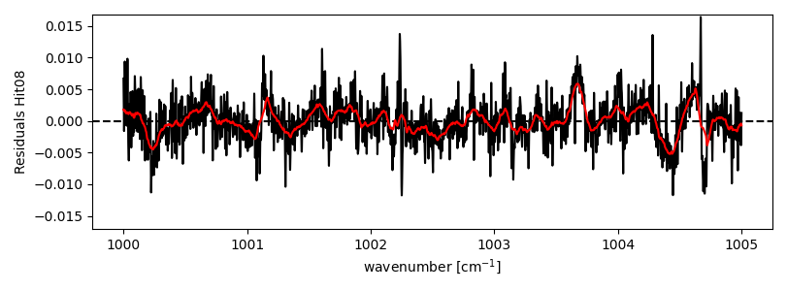
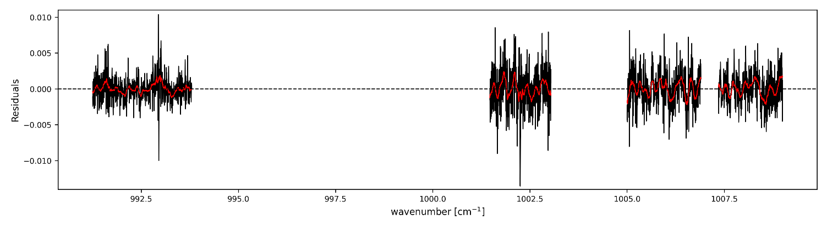
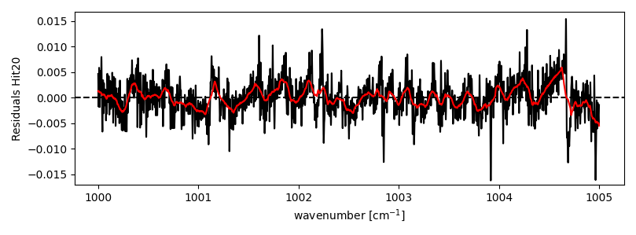
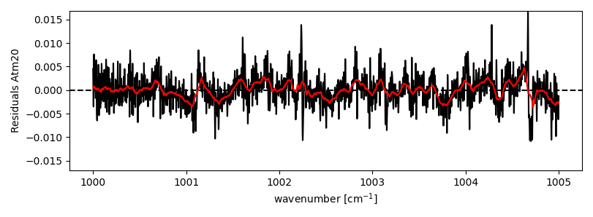
Microwindos and Mean Residuals
Maido
1MW (current)
4MW (Omaira)
Hit08
Hit20
1MW (current) => 1000-1005 cm⁻¹
4MW (Omaira) => 991.25-993.80, 1001.47-1003.04, 1005.00-1006.90, 1007.347-1009.003 cm⁻¹
O. García et al., AMT, 2022
Atm20
Marked most important H₂O lines which have changed. Atm20 gives the lowest residuals for these lines.
(Wavenumbers: 1000.28894, 1003.68917, 1004.44656 cm⁻¹)

Slide 2
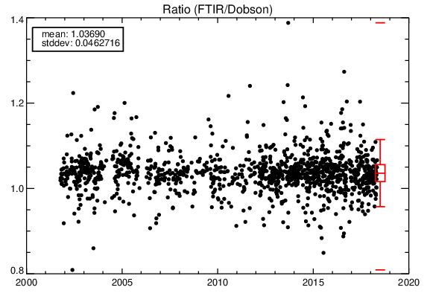
Total Column Comparisons
Lauder: FTIR/Dob72 |  |  | Izaña: FTIR/Brewer
Strategy | Period | Ratio (bias, std) | Strategy | Period | Ratio (bias, std)
Standard hi08 (Vigouroux, ACP, 2015) | 2001-2018 | 1.067 (0.047) | Standard hi08 (1MW, WACCMv6, TIK) | 2018-2020 | 1.032 (0.01035)
 | 2015 | 1.059 (0.049) | Standard hi08 (1MW, WACCMv7, TIK) | 2018-2020 | 1.033 (0.01050)
Standard hi20 (Vigouroux, ACP, 2015) | 2001-2018 | 1.036 (0.047) | Standard hi20 (1MW, WACCMv6, TIK) | 2018-2020 | 1.008 (0.01011)
 | 2015 | 1.035 (0.048) | Standard hi20 (1MW, WACCMv7, TIK) | 2018-2020 | 1.008 (0.01014)
FH5MW hi08 | 2015 | 1.05 (0.049) | FH5MW hi08 | 2018-2020 | On-going
FH5MW hi20 | 2015 | 1.029 (0.045) | FH5MW hi20 | 2018-2020 | On-going
4MW_OPT (hi20,WACCMv7,TIK1000) | 2001-2018 | 1.037 (0.046) | 4MW_OPT (4MW, hi20, WACCMv6, TIK) | 2018-2020 | 1.009 (0.00995)
 |  |  | 4MW_OPT (4MW, hi20, WACCMv7, TIK) | 2018-2020 | 1.009 (0.00998)
Lauder
Regardless of strategy, Hitran2020 provides a better comparison to the Dobson/Brewer.
4MW_OPT (FH5MW) is minimally better than the standard recipe. FH5MW => 4MW (Omaira)+1011.147-1013.553 cm⁻¹
FH5MW: Saturation of the O₃ lines at the greatest wavenumber can actually help in setting/fitting the zerolevel, important for MCT spectra.

