Slide 1
Site: Maido Retrieval code: sfit4 v2 Years: 2018-2020
 | 1MW, Hit20 | 1MW, Hit20 + Atm20 water | 4MW, Hit20 | 4MW, Hit20 + Atm20 water
O3 total column [10¹⁸ molec/cm²] | 7.23 | 7.23 | 7.26 | 7.26
O3 apriori [10¹⁸ molec/cm²] | 7.10 | 7.10 | 7.10 | 7.10
H2O total column [10²¹ molec/cm²] | 19.99 | 19.77 | 40.02 | 33.18
H2O apriori [10²¹ molec/cm²] | 24.17 | 24.29 | 25.41 | 25.44
RMS | 0.468 | 0.465 | 0.403 | 0.404
DOF | 4.72 | 4.79 | 4.57 | 4.57
Random [10¹⁸ molec/cm²] [%] | 0.146 2.02 | 0.145 2.00 | 0.121 1.67 | 0.121 1.66
Systematic [%] | 4.30 | 4.28 | 4.00 | 4.00
Diff60 [10¹⁶ molec/cm²] | 2.87 | 2.84 | 2.73 | 2.73
σ_{daily mean} [10¹⁶ molec/cm²] | 4.97 | 4.69 | 4.46 | 4.46
Mean SNR | 2259.3 | 2258.6 | 2273.8 | 2273.4
Number of spectra | 1143 | 1158 | 1329 | 1329

Slide 2
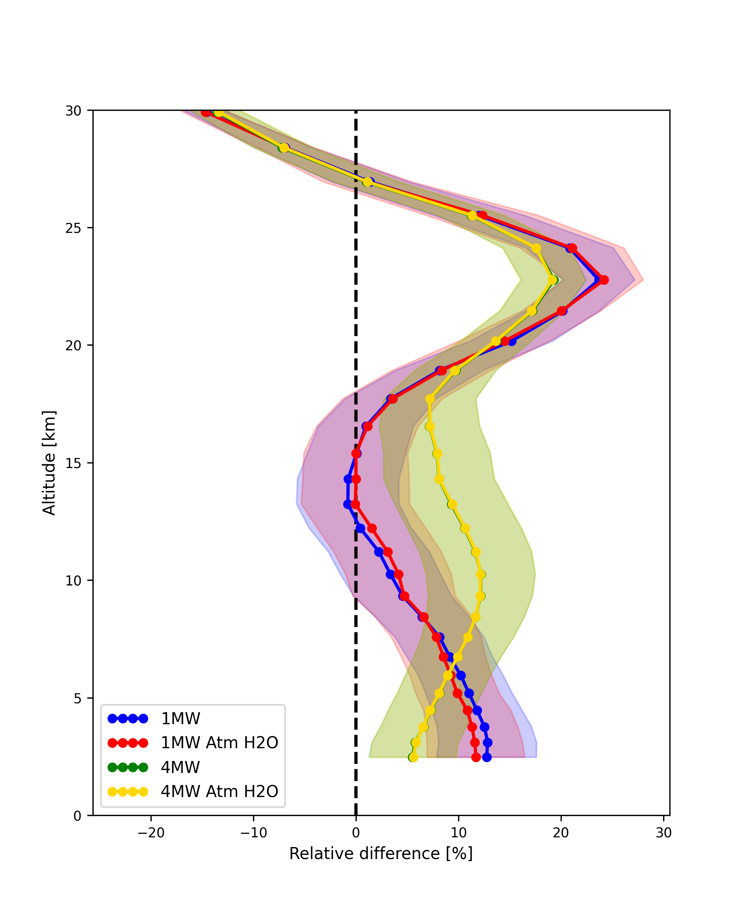
Sonde comparison
Conclusions microwindows:
Using only water as Atm20 in 1MW (rest is Hit20) gives minor improvement
4MW have better statistics over 1MW
Sonde comparison slightly better for 1MW (below 20km)
Using only water as Atm20 in 4MW (rest is Hit20) gives no difference
Suggested: 4MW with Hit20 spectroscopy

Slide 3
Site: Maido Retrieval code: sfit4 v2 Years: 2018-2020
All Hit20
 | 1MW, Tik | 1MW, OE | 4MW, Tik | 4MW, OE
O3 total column [10¹⁸ molec/cm²] | 7.23 | 7.26 | 7.26 | 7.25
O3 apriori [10¹⁸ molec/cm²] | 7.10 | 7.10 | 7.10 | 7.10
H2O total column [10²¹ molec/cm²] | 19.99 | 33.18 | 40.02 | 39.74
H2O apriori [10²¹ molec/cm²] | 24.17 | 25.44 | 25.41 | 25.38
RMS | 0.468 | 0.404 | 0.403 | 0.404
DOF | 4.72 | 4.57 | 4.57 | 4.42
Random [10¹⁸ molec/cm²] [%] | 0.146 2.02 | 0.121 1.66 | 0.121 1.67 | 0.124 1.72
Systematic [%] | 4.30 | 4.00 | 4.00 | 4.07
Diff60 [10¹⁶ molec/cm²] | 2.87 | 2.73 | 2.73 | 2.73
σ_{daily mean} [10¹⁶ molec/cm²] | 4.97 | 4.46 | 4.46 | 4.8
Mean SNR | 2259.3 | 2273.4 | 2273.8 | 2275.5
Number of spectra | 1143 | 1329 | 1329 | 1328

Slide 4
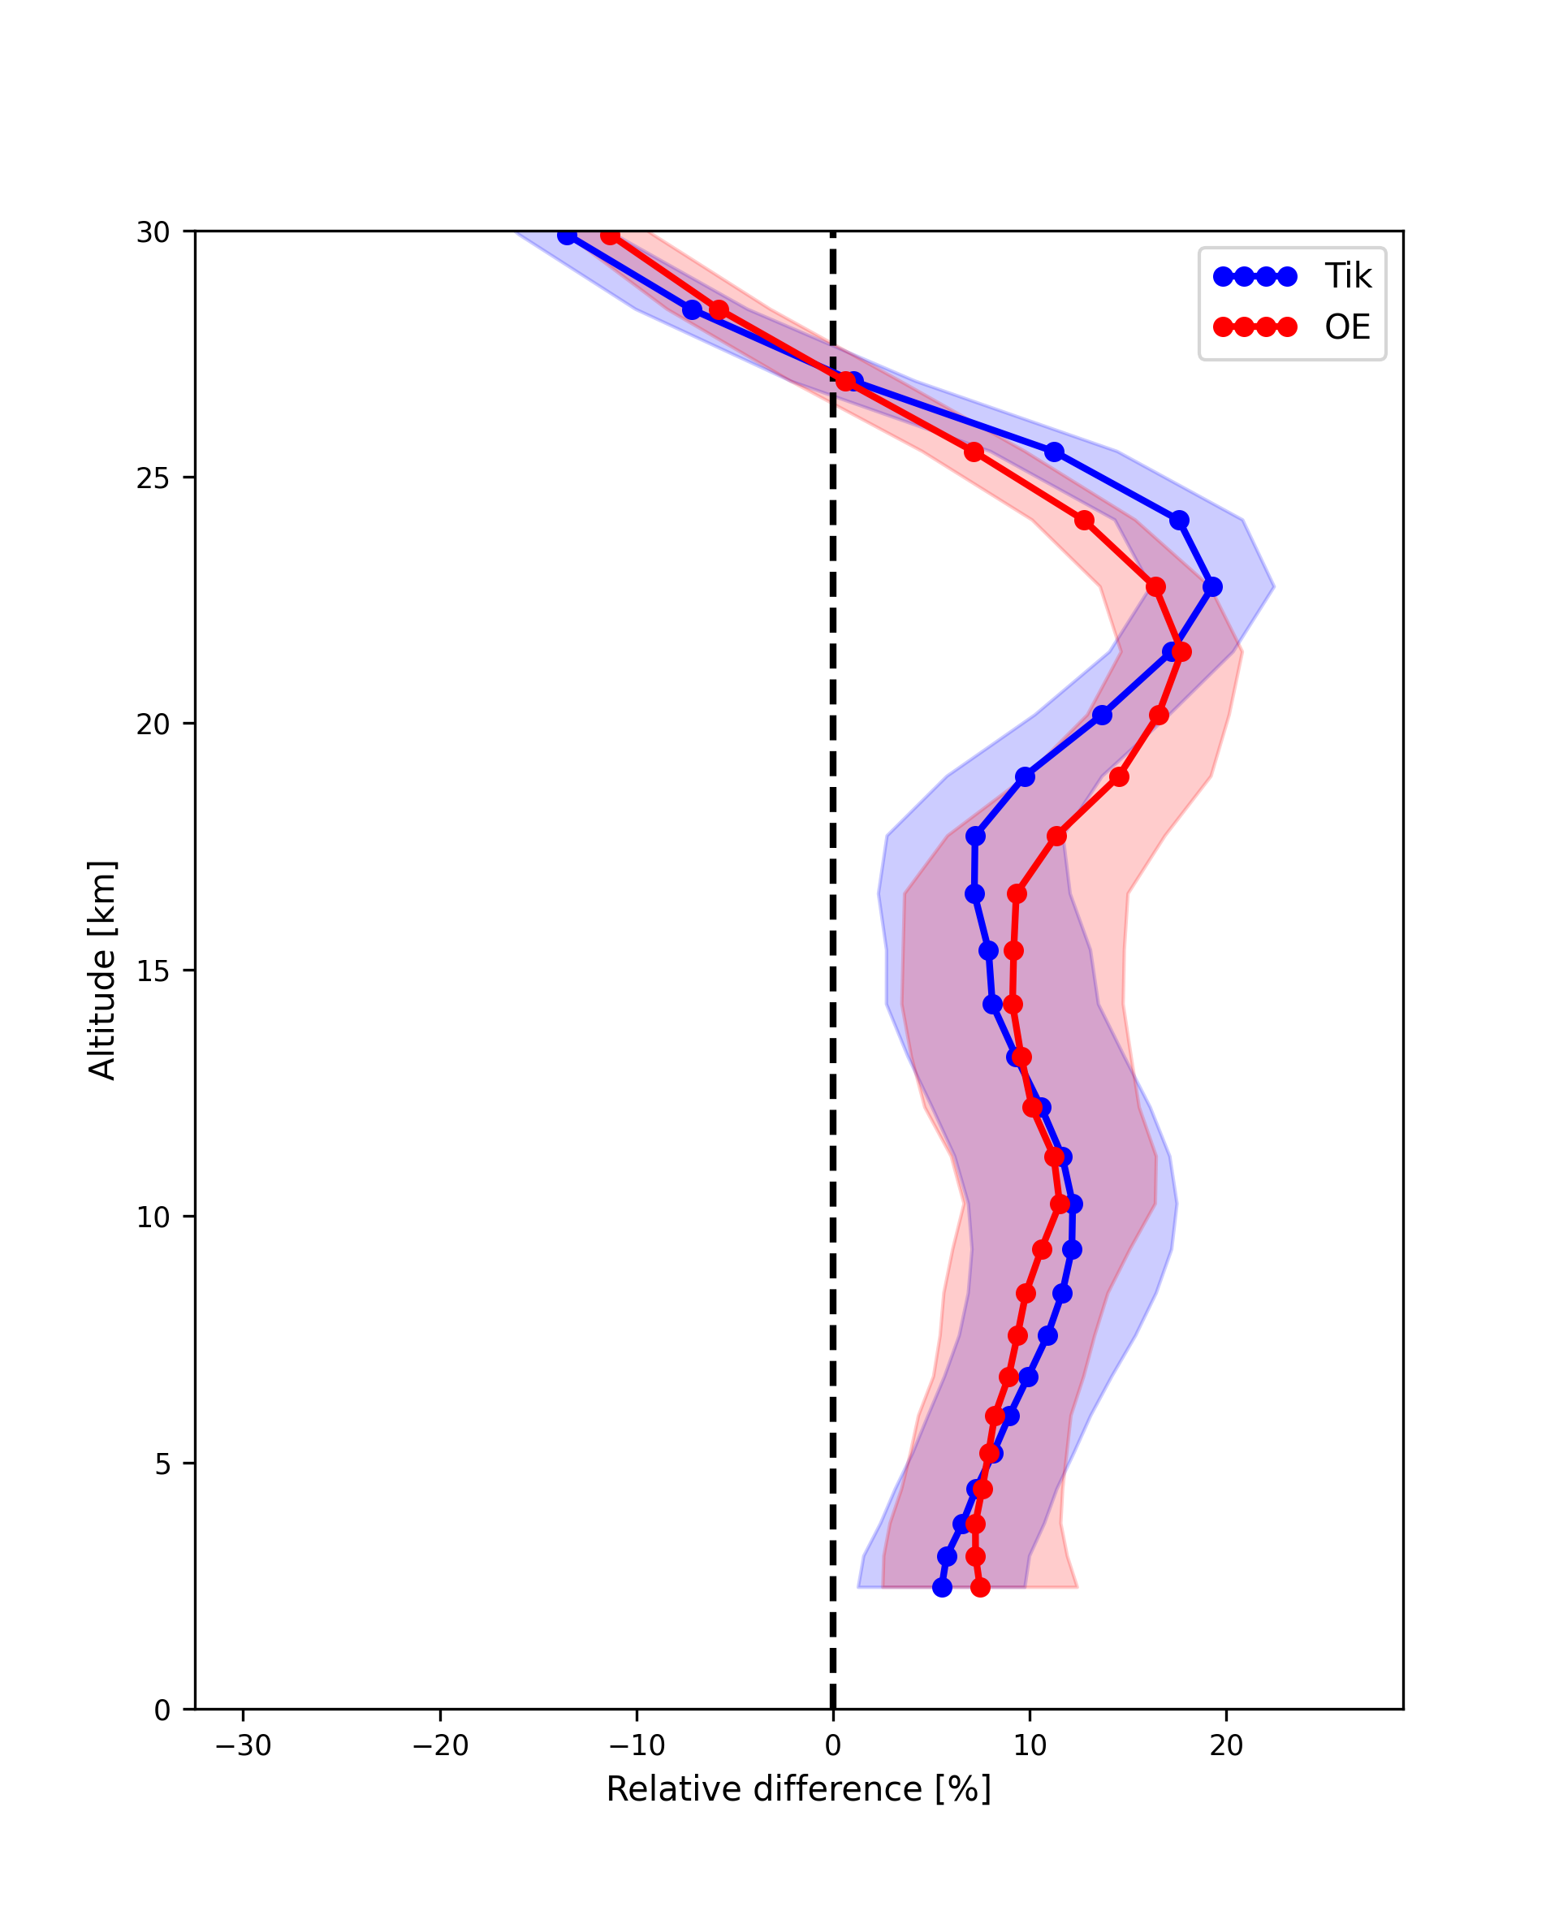
Sonde comparison (using 4MW, Hit20)
Conclusions regularization
For 4 MW: better statistics for Tikhonov over optimal estimation matrix
Very similar sonde comparison
Suggested: Tikhonov retrieval

Slide 5
Site: Maido Retrieval code: sfit4 v2 Years: 2018-2020
All Hit20
 | 1MW, WACCM6 | 1MW, WACCM7 | 4MW, WACCM6 | 4MW, WACCM7
O3 total column [10¹⁸ molec/cm²] | 7.23 | 7.19 | 7.26 | 7.22
O3 apriori [10¹⁸ molec/cm²] | 7.10 | 6.85 | 7.10 | 6.85
H2O total column [10²¹ molec/cm²] | 19.99 | 19.79 | 40.02 | 35.62
H2O apriori [10²¹ molec/cm²] | 24.17 | 23.98 | 25.41 | 25.41
RMS | 0.468 | 0.473 | 0.403 | 0.409
DOF | 4.72 | 4.73 | 4.57 | 4.53
Random [10¹⁸ molec/cm²] [%] | 0.146 2.02 | 0.146 2.03 | 0.121 1.67 | 0.121 1.67
Systematic [%] | 4.30 | 4.28 | 4.00 | 3.99
Diff60 [10¹⁶ molec/cm²] | 2.87 | 2.90 | 2.73 | 2.71
σ_{daily mean} [10¹⁶ molec/cm²] | 4.97 | 4.98 | 4.46 | 4.46
Mean SNR | 2259.3 | 2251.9 | 2273.8 | 2272.2
Number of spectra | 1143 | 1086 | 1329 | 1329

Slide 6
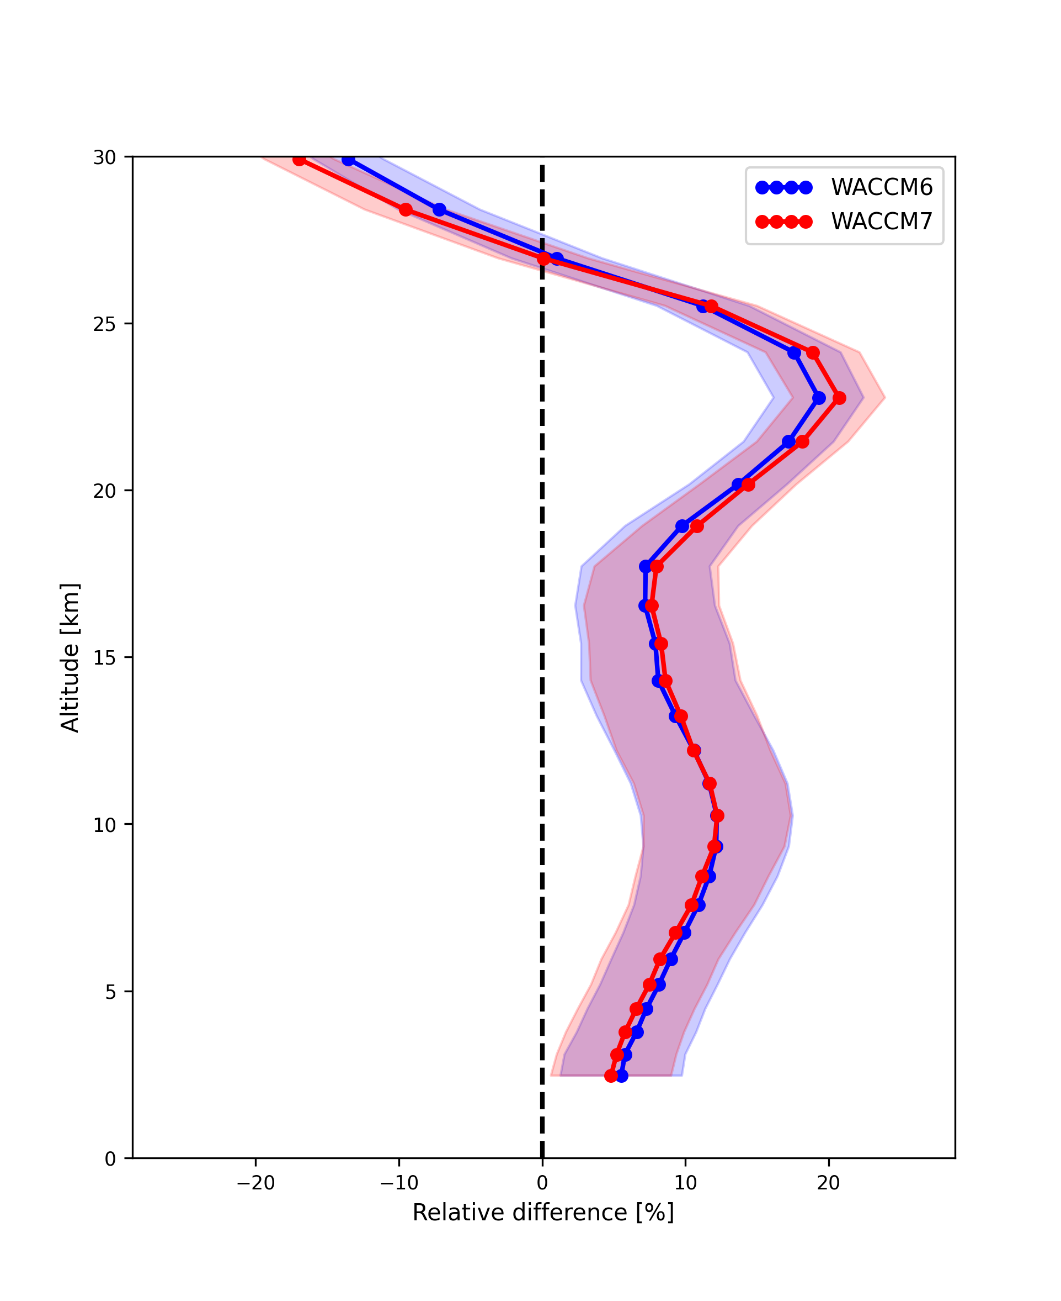
Sonde comparison: (using 4MW, Hit20, Tik)
Conclusions: WACCM
Very similar numbers for WACCM v6 and v7
Very similar comparison to sonde
Both ok to use for O3
Suggested: WACCM v7
(to follow approach of other molecules)

Slide 7
Site: Maido Retrieval code: sfit4 v2 Years: 2018-2020
All Hit20
 | 4MW, linefit | 4MW, ideal | 4MW, retr apod | 4MW, apod+phase
O3 total column [10¹⁸ molec/cm²] | 7.22 | 7.23 | 7.28 | 7.29
O3 apriori [10¹⁸ molec/cm²] | 6.85 | 6.85 | 6.85 | 6.85
H2O total column [10²¹ molec/cm²] | 35.62 | 12.01 | 34.85 | 11.16
H2O apriori [10²¹ molec/cm²] | 25.41 | 25.53 | 25.46 | 26.38
RMS | 0.409 | 0.391 | 0.353 | 0.302
DOF | 4.53 | 4.53 | 4.45 | 4.40
Random [10¹⁸ molec/cm²] [%] | 0.121 1.67 | 0.122 1.69 | 0.103 1.41 | 0.099 1.36
Systematic [%] | 3.99 | 3.99 | 3.79 | 3.76
Diff60 [10¹⁶ molec/cm²] | 2.71 | 2.80 | 1.60 | 1.61
σ_{daily mean} [10¹⁶ molec/cm²] | 4.46 | 4.21 | 2.74 | 2.75
Mean SNR | 2272.2 | 2267.6 | 2232.1 | 2132.6
Number of spectra | 1329 | 1347 | 1425 | 1138

Slide 8
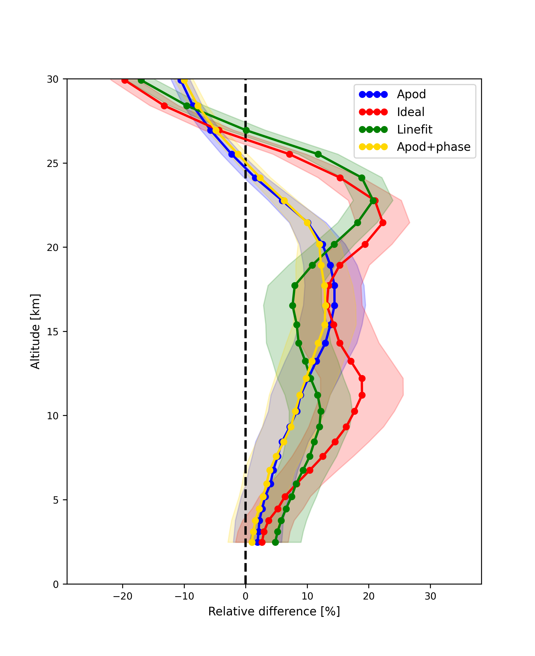
Sonde comparison: (using 4MW, Hit20, Tik, WACCM7)
Conclusions: ILS
Significantly better statistics when retrieving ILS as opposed to using linefit or ideal ILS
Sonde comparison: preference for retrieval of ILS
Best case when retrieving both EAP and phase
Suggested: Retrieve ILS EAP+phase
(using quadratic function)

