Slide 1
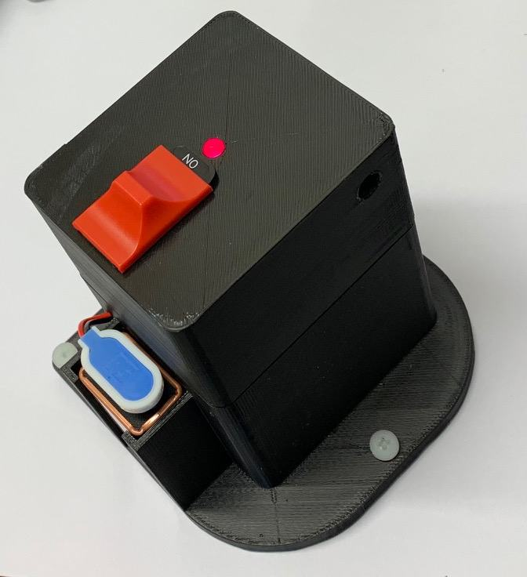
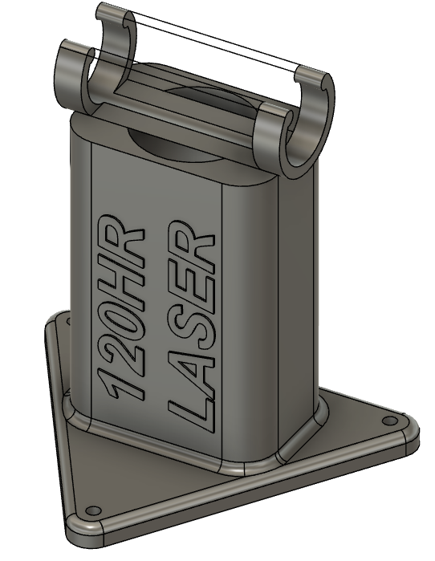
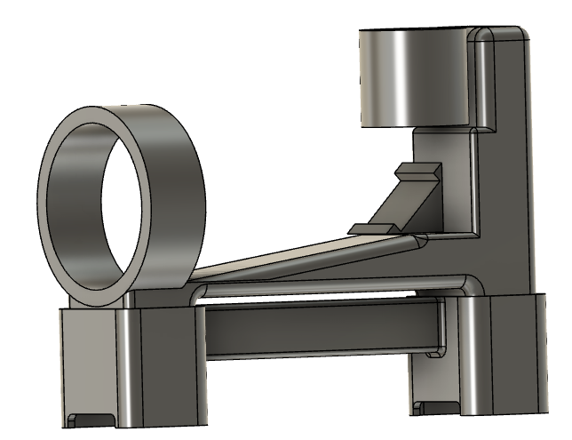
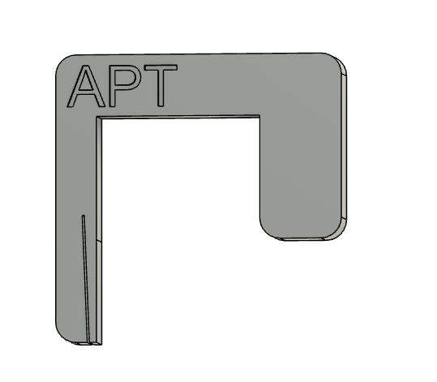
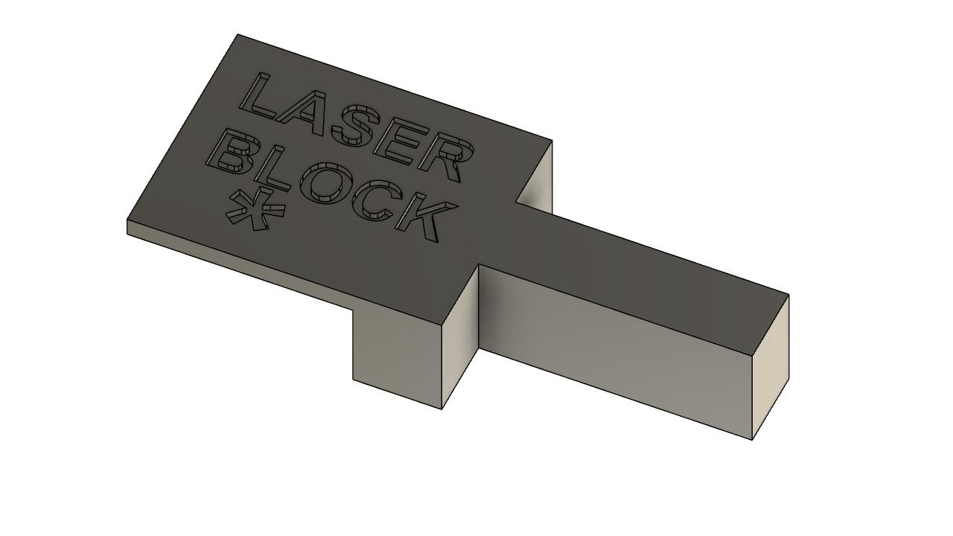
Alignment tool kit
Holder for diffuser paper
Microscope and Telescope
Plus height spacer
120HR Laser holder
Internal laser beam blocker
125HR Laser holder
We assembled a kit of simple, low cost 3D-printed tools for checking alignment of the Bruker FTS. The parts can be left on-site at remote laboratories, or are small enough to travel as carry-on luggage. Standard off-the-shelf optics are used.
The microscope and telescope are identical, so only one is needed, although it is practical to make one of each and optimise the optics for each application (e.g. used preferred eyepiece).
Contact: john.robinson@niwa.co.nz
Alignment docs: https://tccon-wiki.caltech.edu/Main/AlignmentOfThe125HR (under construction)

Slide 2
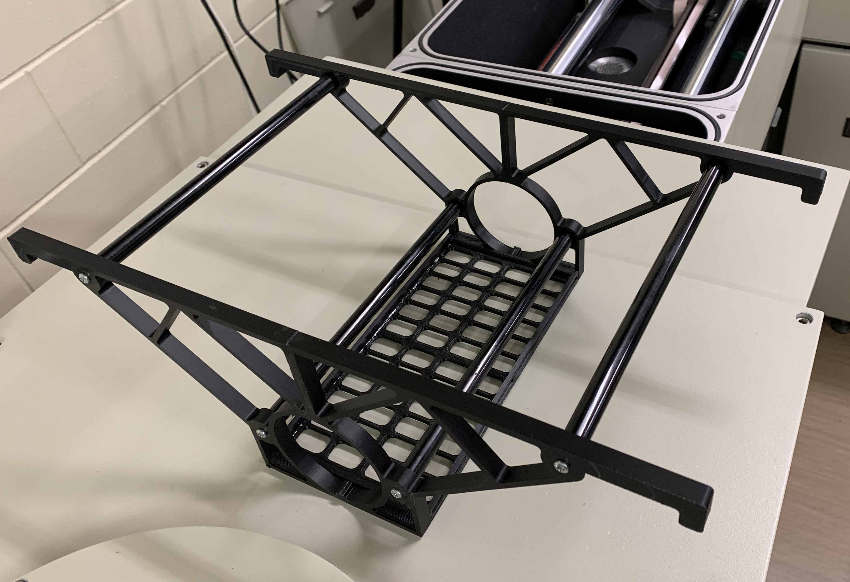
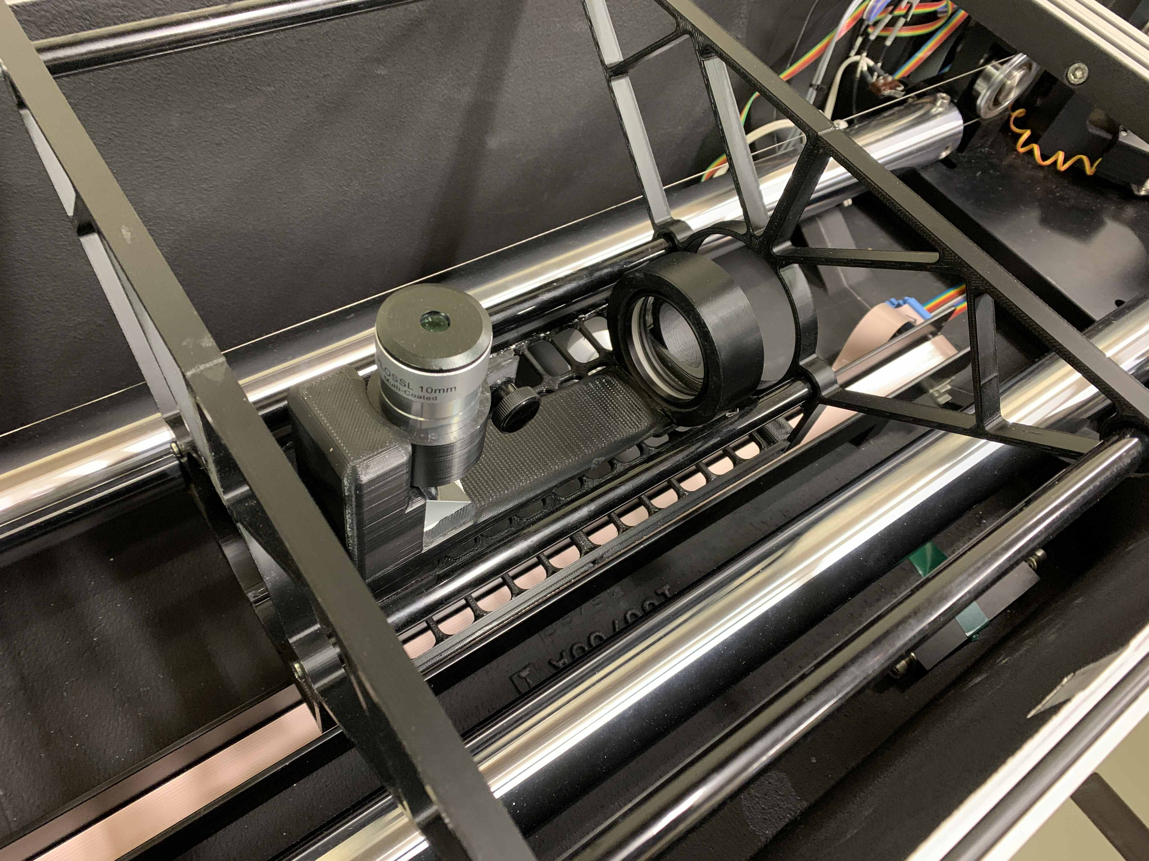
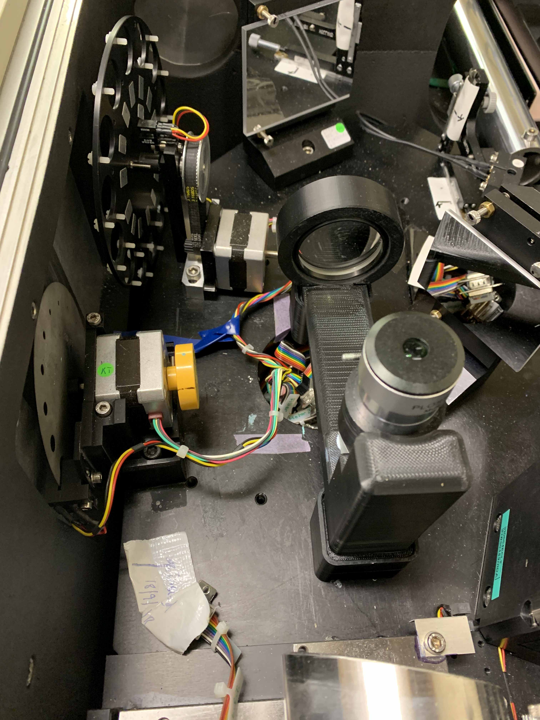
Alignment toolkit
Shelf with Telescope
Telescope shelf
The telescope shelf hangs at the correct height support the telescope to view apertures in the 120 and 125. It folds down flat for travel. The telescope can also be used as a microscope, with a spacer, to view fringes from within the interferometer compartment.
Microscope in interferometer

