Slide 1
Current activities in Paris
Hao FU, Pascal JESECK, Corinne BOURSIER, Christof JANSSEN and Yao TÉ

Slide 2
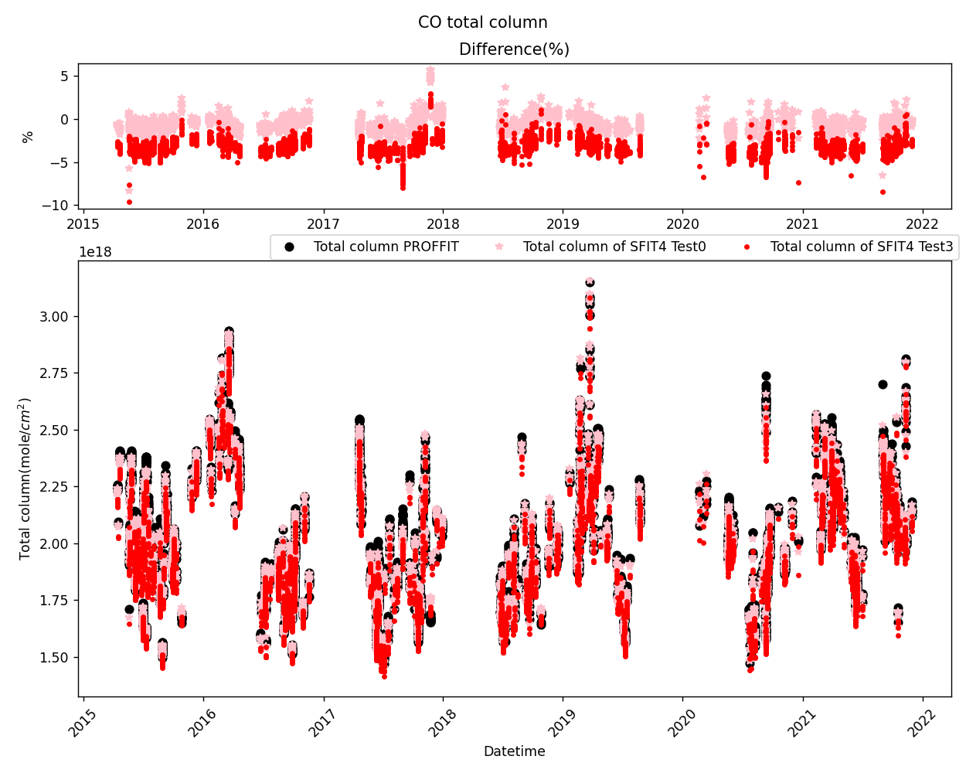
Work on SFIT4
Thanks to Ivan Ortega, Jim Hannigan, Mathias Palm, Jeannette Wild, Victoria Flood and Kim Strong.
CO retrieval previously done using the PROFFIT9 software from April 2015 to November 2021 (Hitran 2008 and WACCM v6 1980-2020)
SFIT4_old using the same set-up than PROFFIT9 (Hitran 2008 and WACCM v6 1980-2020)
• ΔCO (SFIT4_old – PROFFIT9) = -0.82%
• similar to the result from Hase et al. 2004. (PROFFIT9 vs SFIT2 <1%)
SFIT4 using Hitran 2016 and WACCM (v7 1980-2040)
• ΔCO (SFIT4 – PROFFIT9) = -3.3%
• ΔCO (SFIT4_Hit16 – SFIT4_Hit08) = -1.92%
• ΔCO (SFIT4_WAC6 – SFIT4_WAC7) = -0.60%

Slide 3
Future plan
Complete the retrieval result on CO (using the retrieval water vapor profile and the newest hitran, satellite data comparison…)
Retrieval of the other species in NDACC : HCl, N2O, CH4, HF, HCN, H2CO, …
Error analysis to fulfill
Apply ILS measurement in SFIT4 data processing
Fulfill the standard of the NDACC-IRWG
Keep in touch with Corinne Vigouroux, our NDACC-IRWG referee
…

Slide 4
Thank you
Questions?

