Slide 1
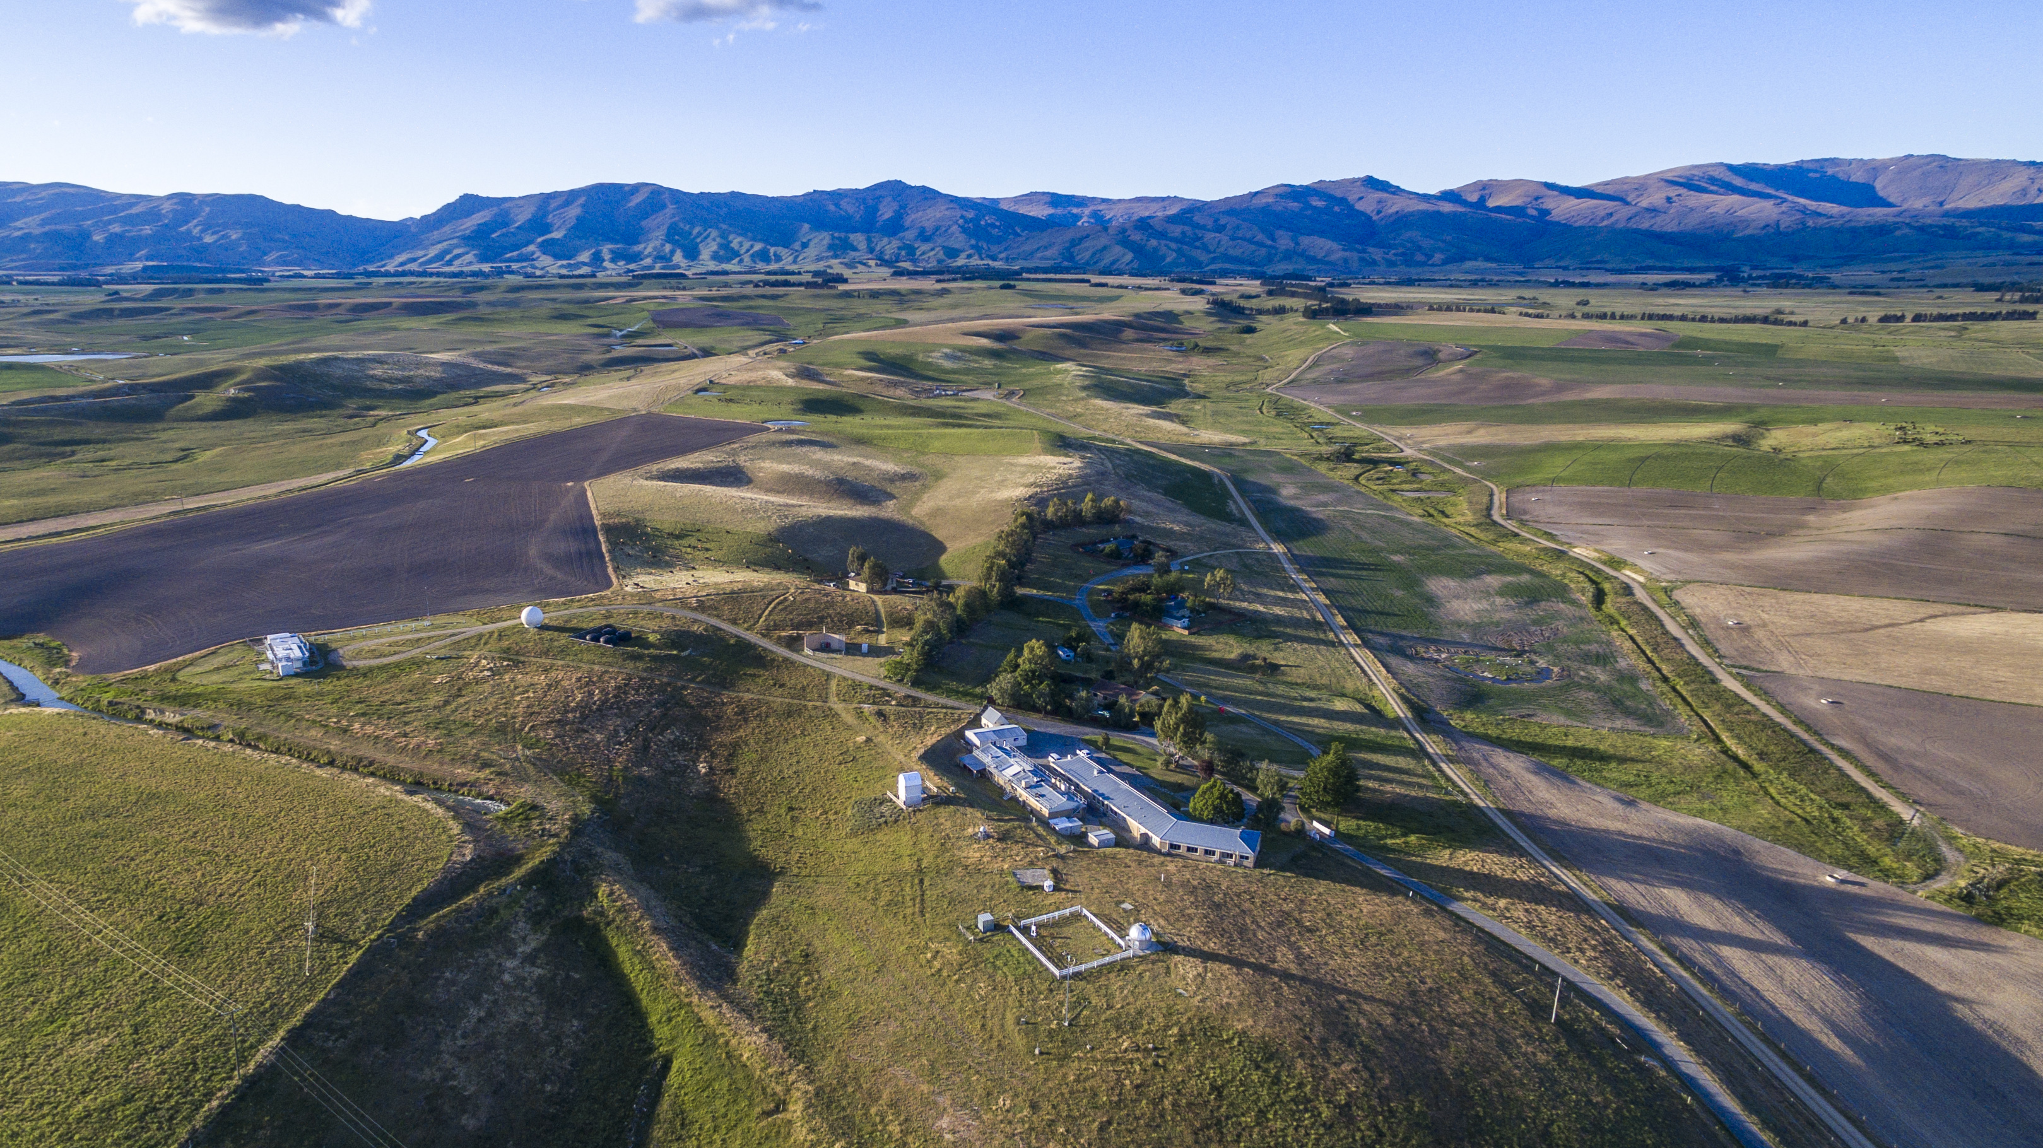
Site visit to Lauder Tomorrow
09:30 Coach departs from Edgewater via the Lake Front car park
11:30 Arrive at Lauder and tours of NIWA Atmospheric Research Station
13:30 Lunch at NIWA
15:00 Depart Lauder
16:40 (at latest) Connect with Ritchies shuttle to Queenstown Airport in Cromwell
17:30 (at latest) Arrive Wanaka

