Slide 1
TES (NASA/Aura Tropospheric Emission Spectrometer) and IASI (MetOp Infrared Atmospheric Sounding Interferometer) Satellite Fourier Transform Spectrometry (FTS)
Free Tropospheric O₃ Zonal Average Time Series
S. Kulawik (BAER, NASA/Ames), J. Neu (JPL/CalTech), C. Wespes (ULB), H. Worden (NCAR)

Slide 2
IGAC – TOAR Tropospheric Ozone Assessment Report
Global metrics for climate change, human health and crop/ecosystem research
Mission: To provide the research community with an up-to-date scientific assessment of tropospheric ozone’s global distribution and trends from the surface to the tropopause.
Goals:
Produce the first tropospheric ozone assessment report based on the peer-reviewed literature and new analyses.
Generate easily accessible, documented data on ozone exposure and dose metrics at hundreds of measurement sites around the world (urban and non-urban), freely accessible for research on the global-scale impact of ozone on climate, human health and crop/ecosystem productivity.
Chair – O. Cooper, NOAA

Slide 3
TOAR chapters – each will be a paper, expected submission in late 2016
1: Trop. ozone sources, sinks, budgets
(leads: Alex Archibald, Yasin Elshorbany)
2: Observations (leads: David Tarsick, Ian Galbally)
3: Metrics (lead: Allen Lefohn)
4: Ozone Distribution/Trends for Human Health
(leads: Zoe Fleming, Ruth Doherty)
5: Ozone Distribution/Trends for Vegetation
(lead: Gina Mills)
6: Ozone Distribution/Trends for Climate and Model Evaluation
(lead: Audrey Gaudel)
7: Global-Scale Model Performance
(leads: Vaishali Naik, Paul Young)
Notes:
Metrics for health are 1-hr, 8-hr, max, avg and #exceedance days
Metrics for vegetation are AOT40 = Accumulated Ozone exposure over a Threshold of 40 ppb in units of ppb-hrs
This chapter also describes appropriate trend diagnostics like Mann-Kendall, etc

Slide 4
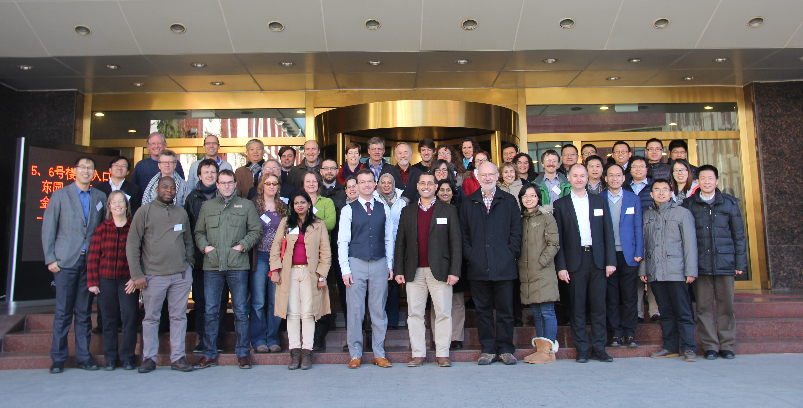
IGAC-TOAR 2nd Workshop, Beijing, January 2016

Slide 5
 | TES | IASI
Launch Date | July 2004 | 2007 (A); 2012 (B)
Orbital Elevation | 705 km | 817 km
Daytime overpass time | 13:45 | 9:30
Spatial Sampling | 8 km x 5 km | 12 km diameter (at nadir)
Spatial Coverage | Sparse (nadir ~180 km apart) 16-day global repeat | Swath (± 48° off-nadir) 2 x global per day
Cloud threshold | Retrieves both clear/cloudy select cloud OD < 0.1 for TOAR | Cloud < 13%
Spectral resolution (apodized) | 0.1 cm⁻¹ | 0.5 cm⁻¹
NESR (9.6 micron) | 50 nW/cm²/sr/cm⁻¹ | 20 nW/cm²/sr/cm⁻¹
Apriori source | MOZART-4 climatology (Emmons et al., 2010) | Global average from McPeters et al., (2007)
Data version used in TOAR | TES L2 v006 | FORLI v20140922
Both TES and IASI measure the the 9.6 micron infrared O₃ band
and are most sensitive from 700-300 hPa

Slide 6
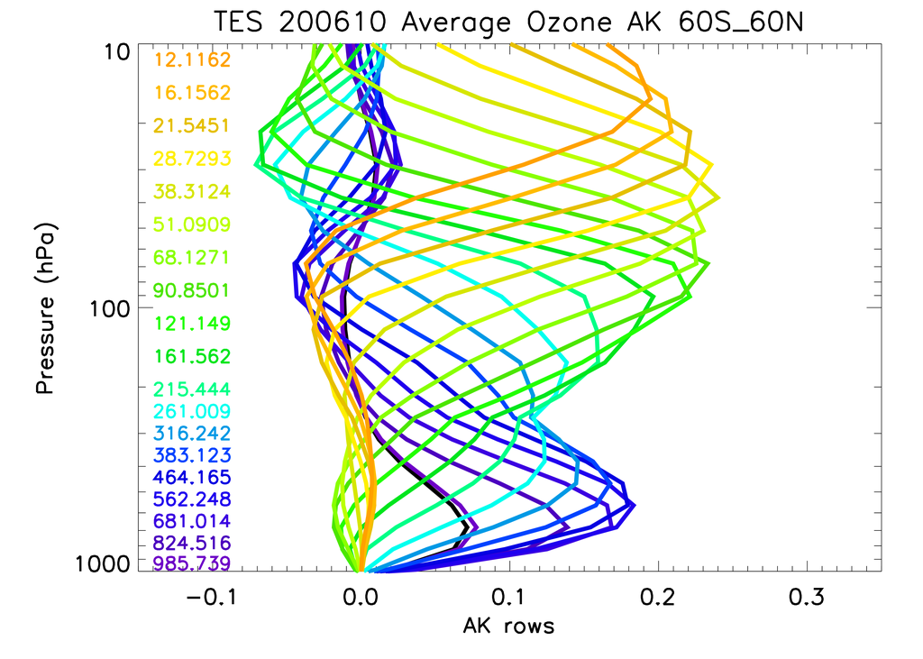
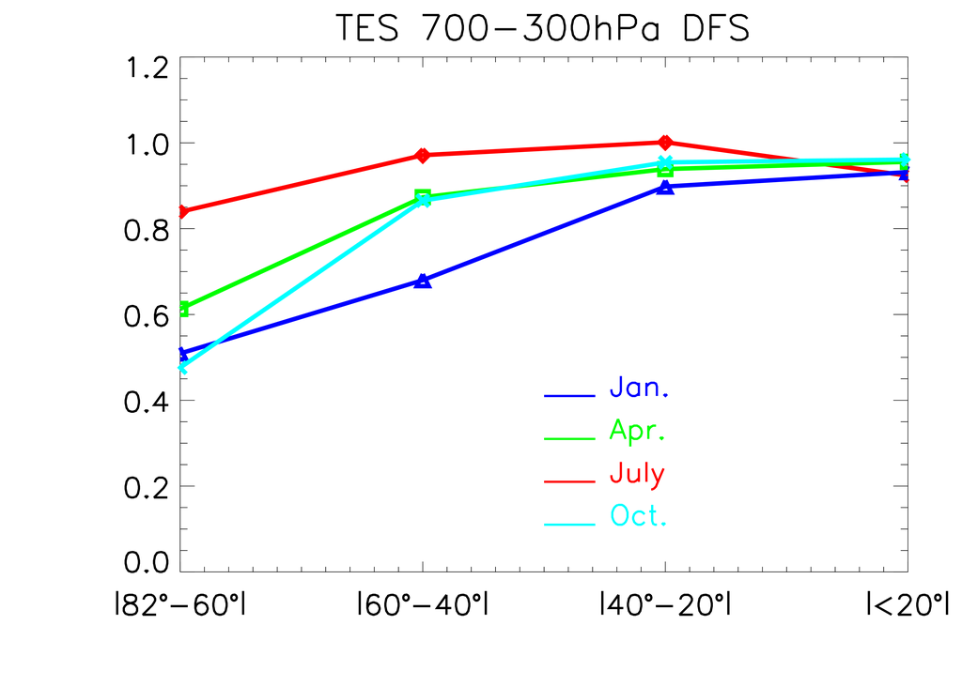
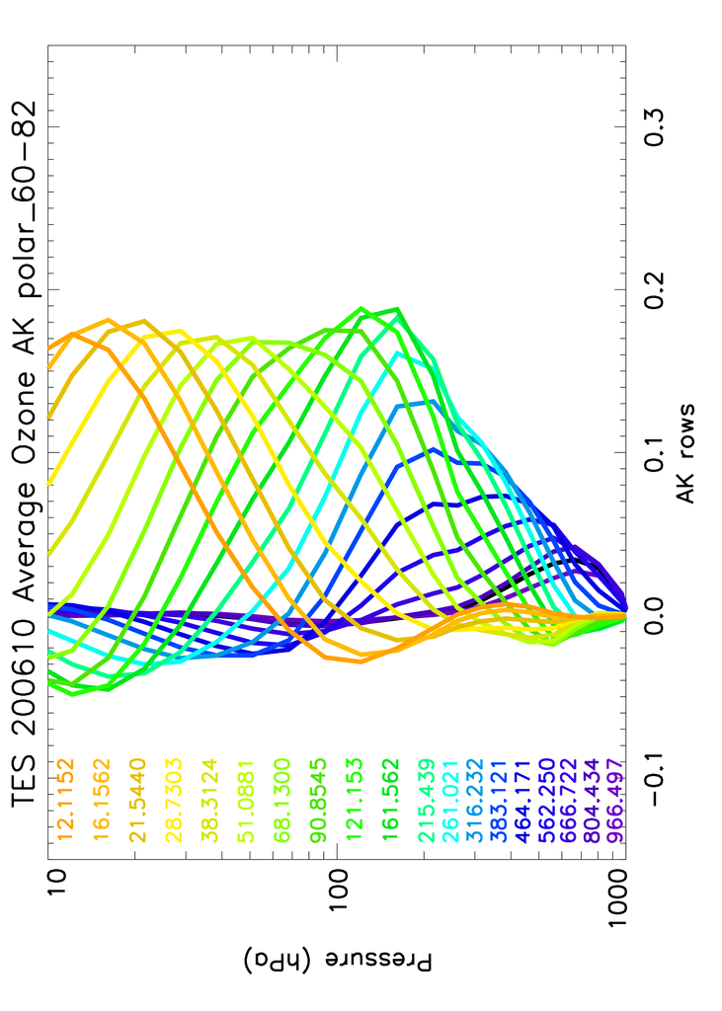
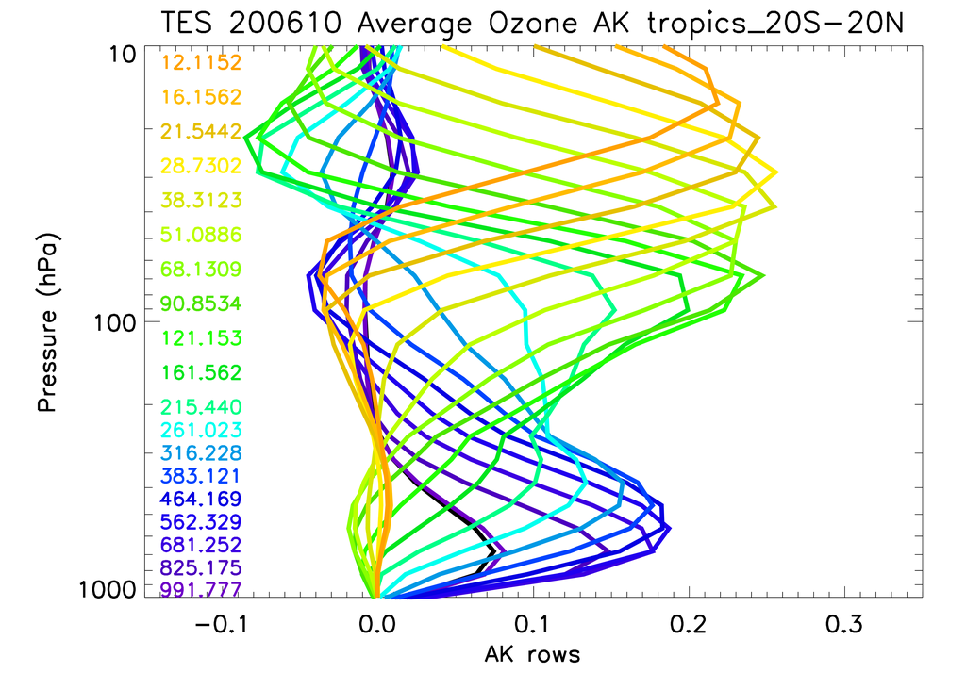
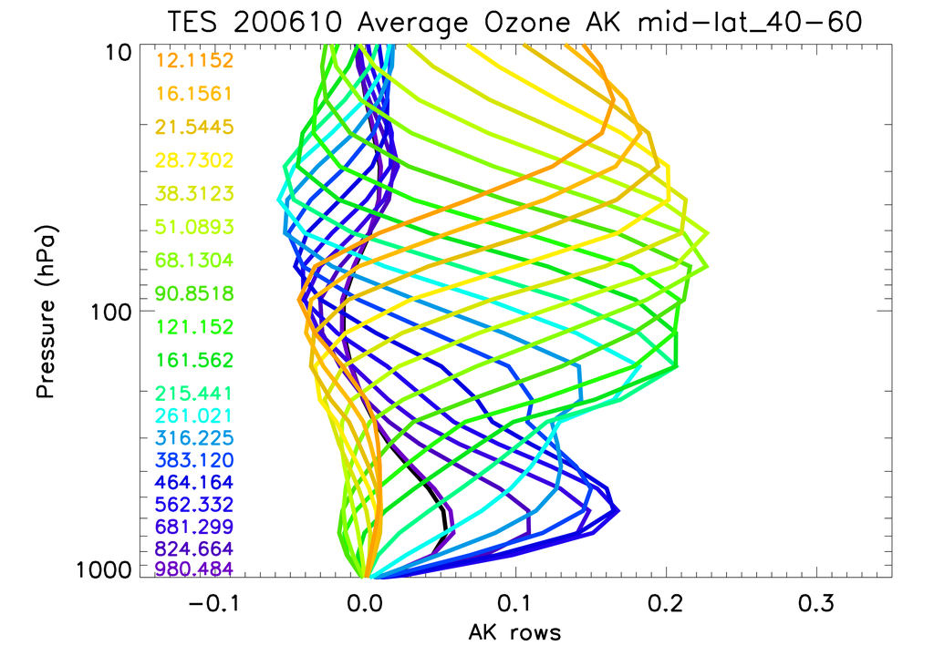
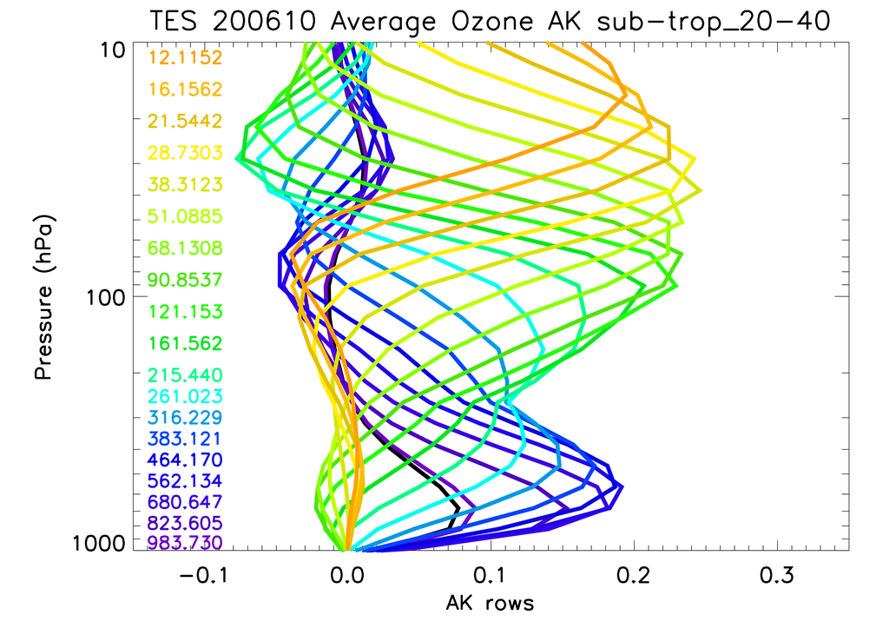
TES Vertical Sensitivity
|60º-40º|
|40º-20º|
POLAR
|<20º|

Slide 7
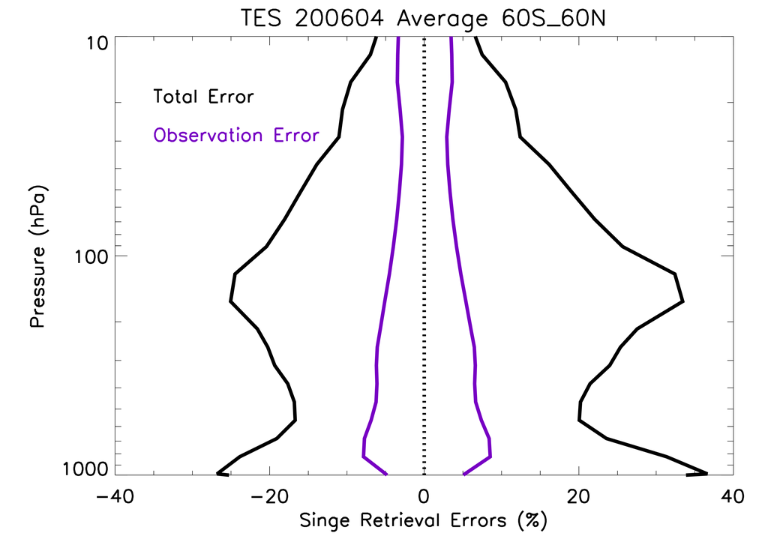
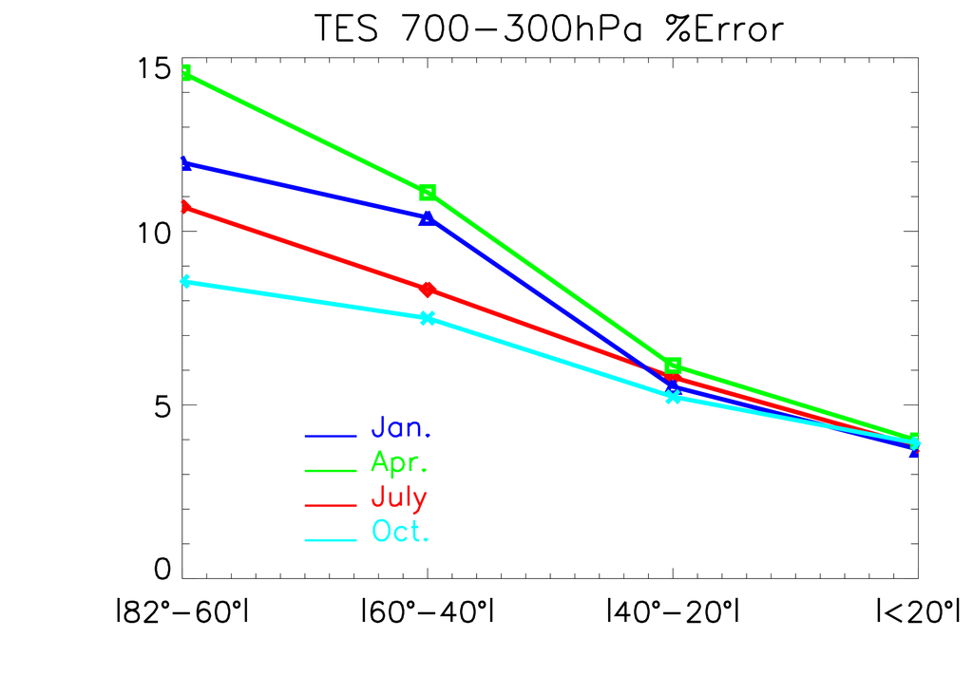
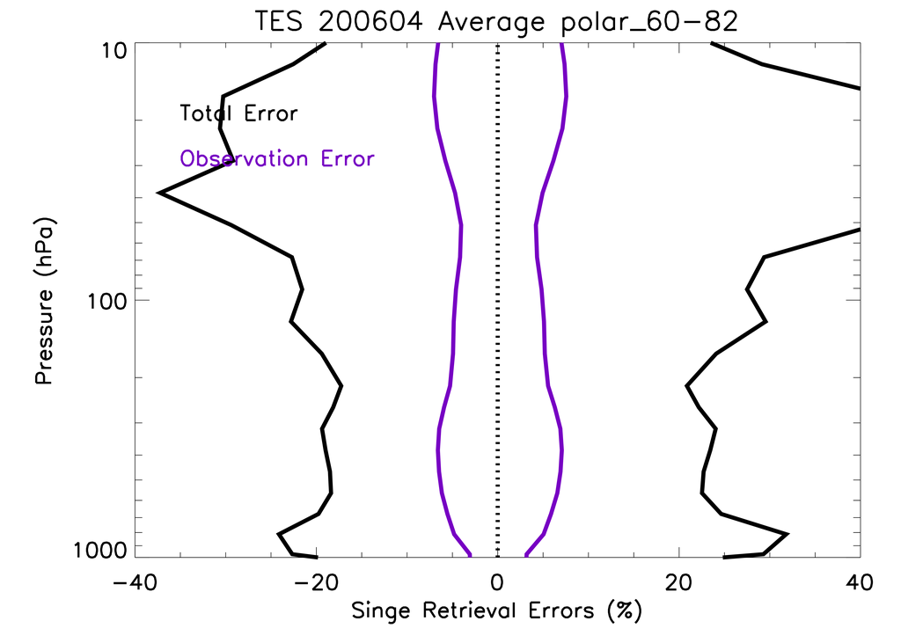
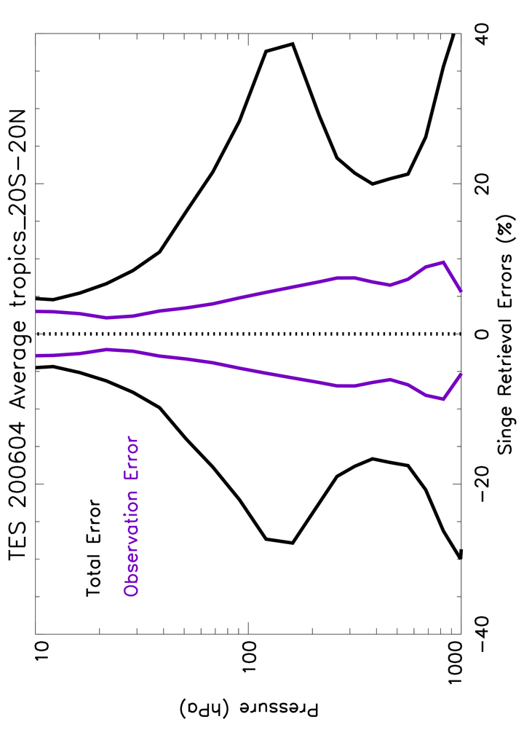
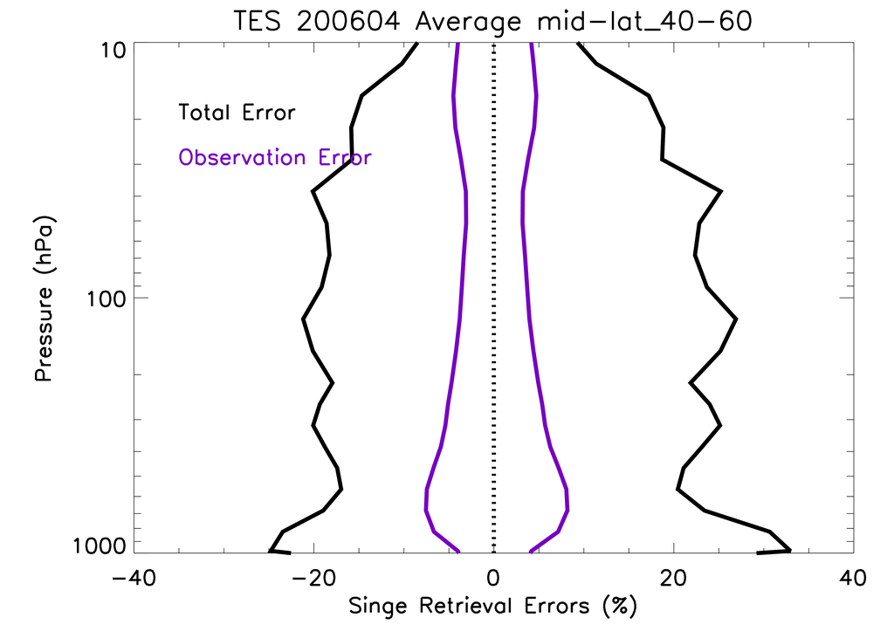
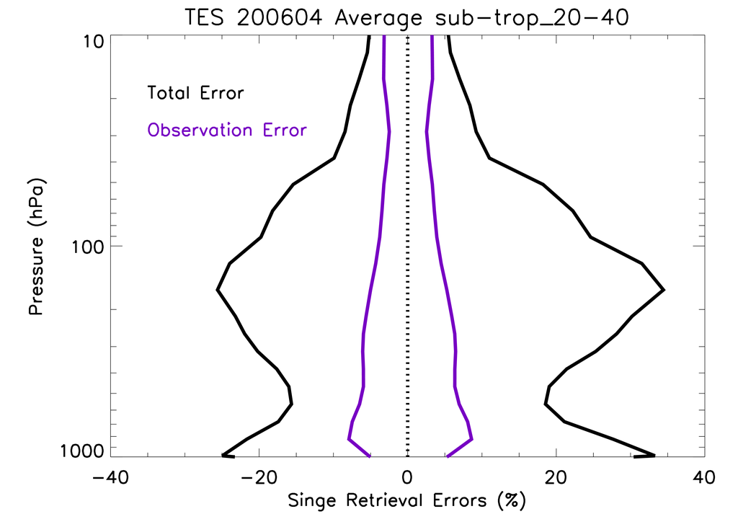
TES single retrieval errors
Uses sub col. variance = h^{T}Ch
Where C is total covariance
h is pressure wt. vector for
700-300 hPa layers
POLAR
|60º-40º|
|40º-20º|
Errors are asymmetric
due to retrieval of logVMR O₃
|<20º|

Slide 8
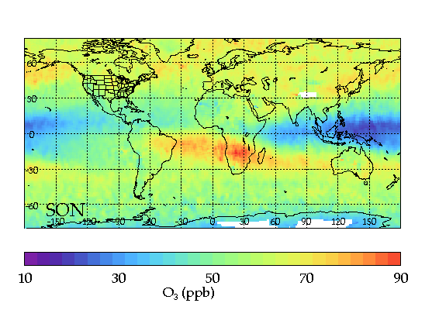
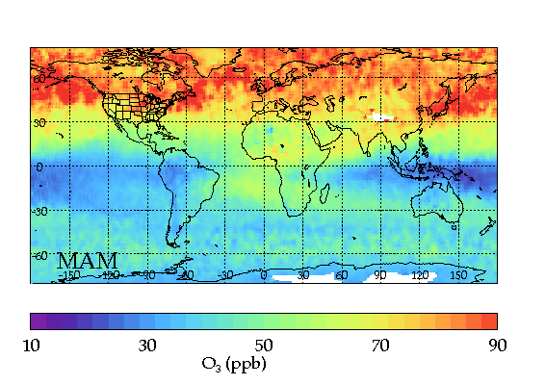
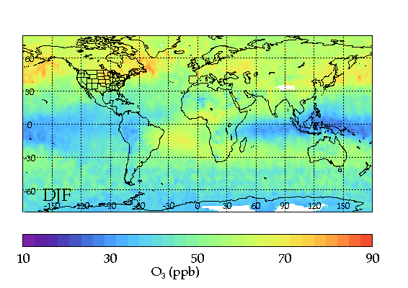
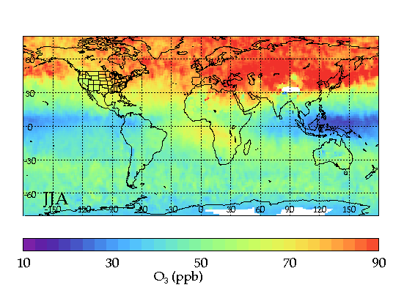
TES Seasonal O₃
SON
MAM
DJF
JJA

Slide 9
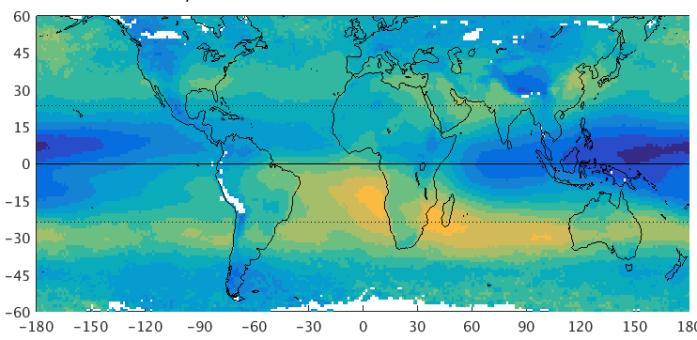
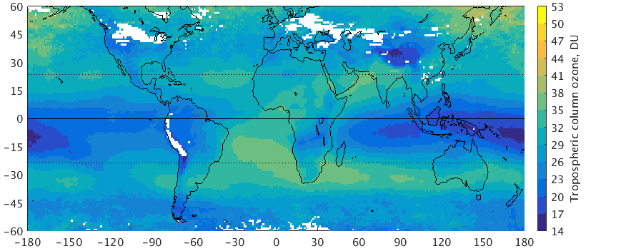
3 Satellite Tropospheric O3 products
SON DJF
TES
200412-200911
700-300 hPa O₃ ppb
IASI
2009-2013
OMI-MLS
2010-
2014

Slide 10
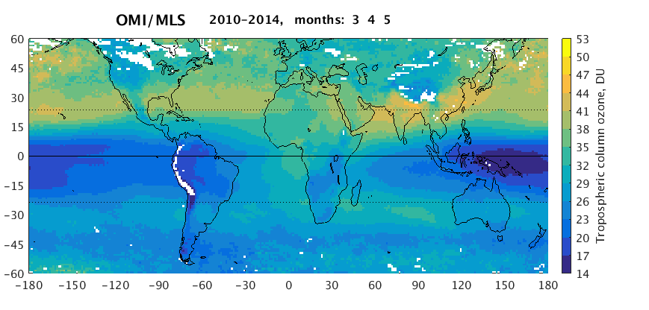
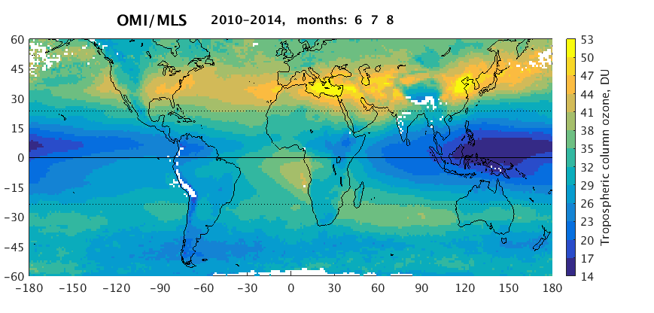
3 Satellite Tropospheric O3 products
MAM JJA
TES
200412-200911
700-300 hPa O₃ ppb
IASI
2009-2013
OMI-MLS
2010-
2014

Slide 11
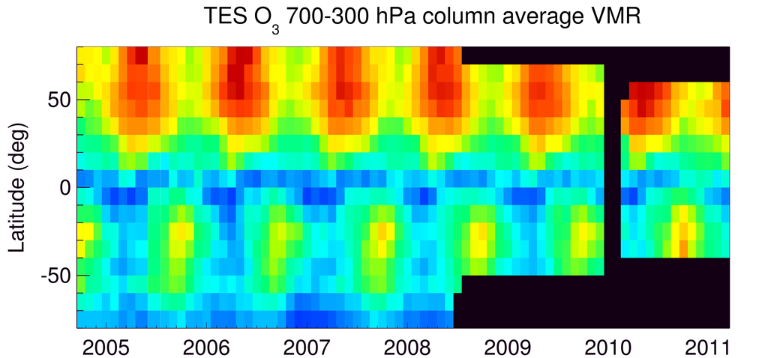
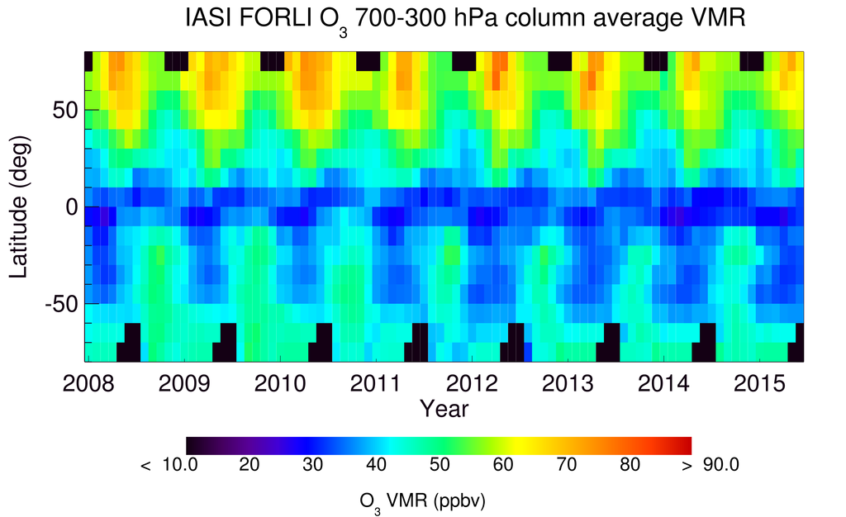
Monthly Mean Values (700-300 hPa)
TES plots reflect changes in
Global Survey latitude ranges
chosen to preserve instrument
life in later years

Slide 12
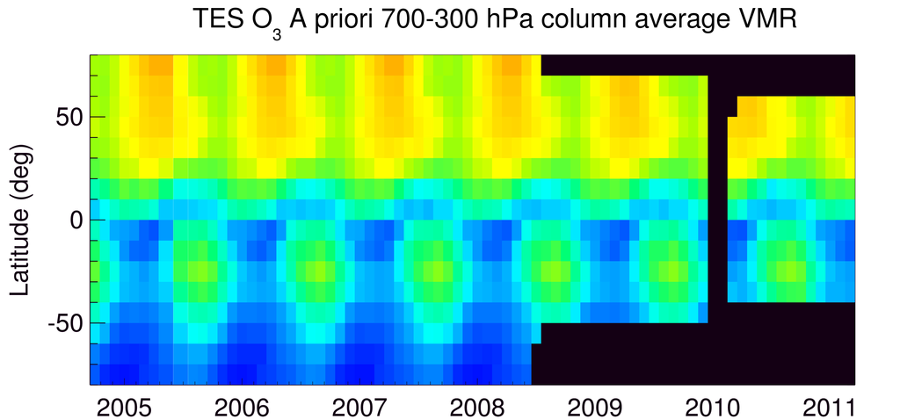
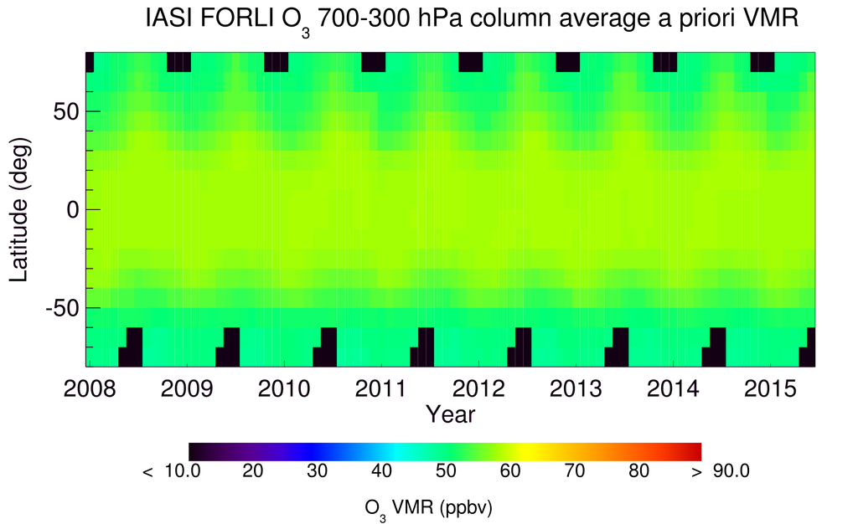
A priori Mean Values

Slide 13
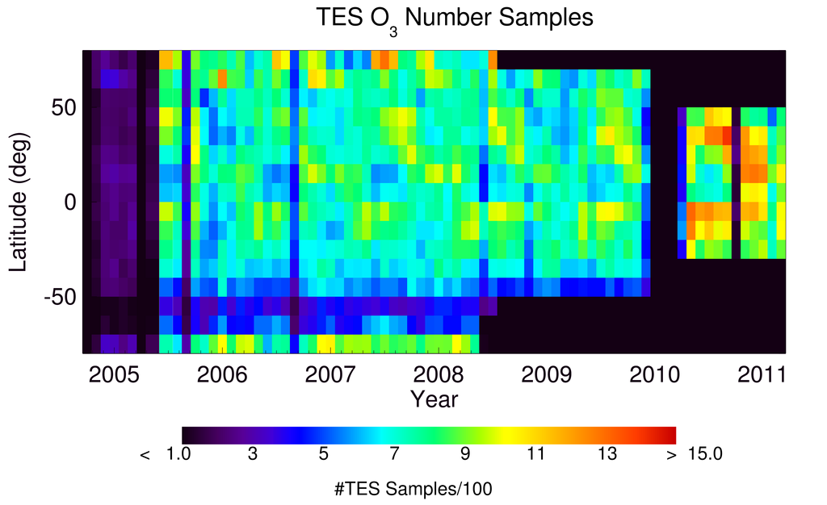
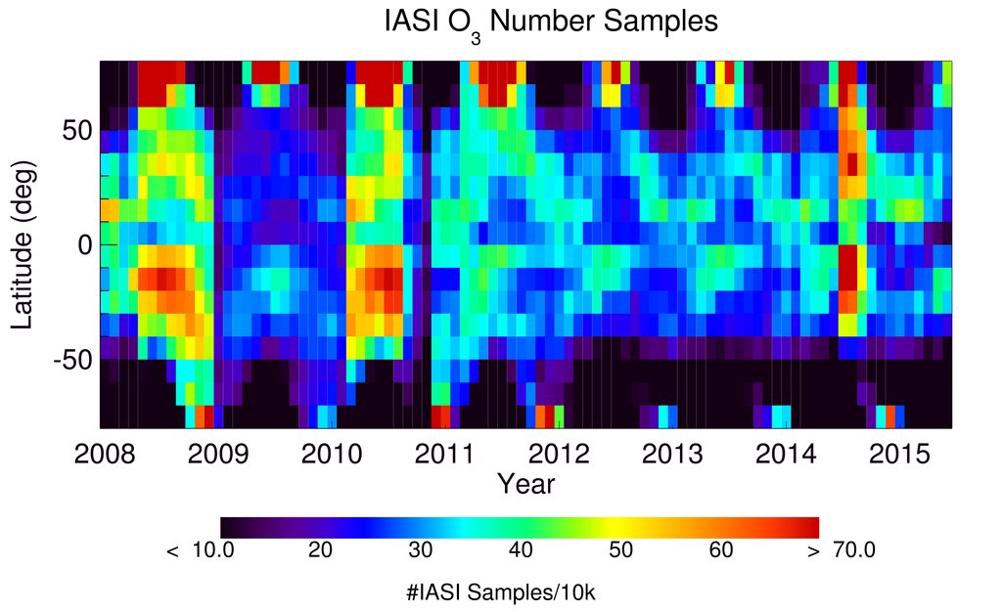
Number of Samples
IASI has ~400 x TES
sampling density

Slide 14
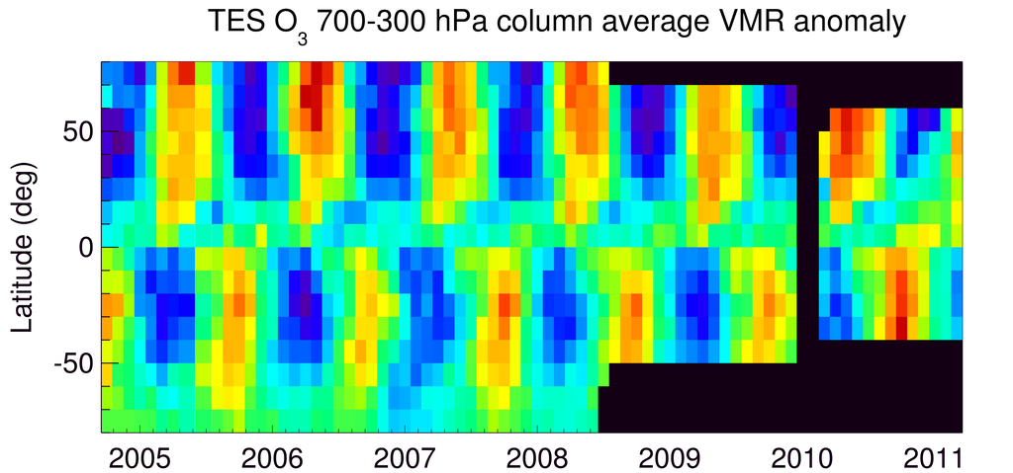
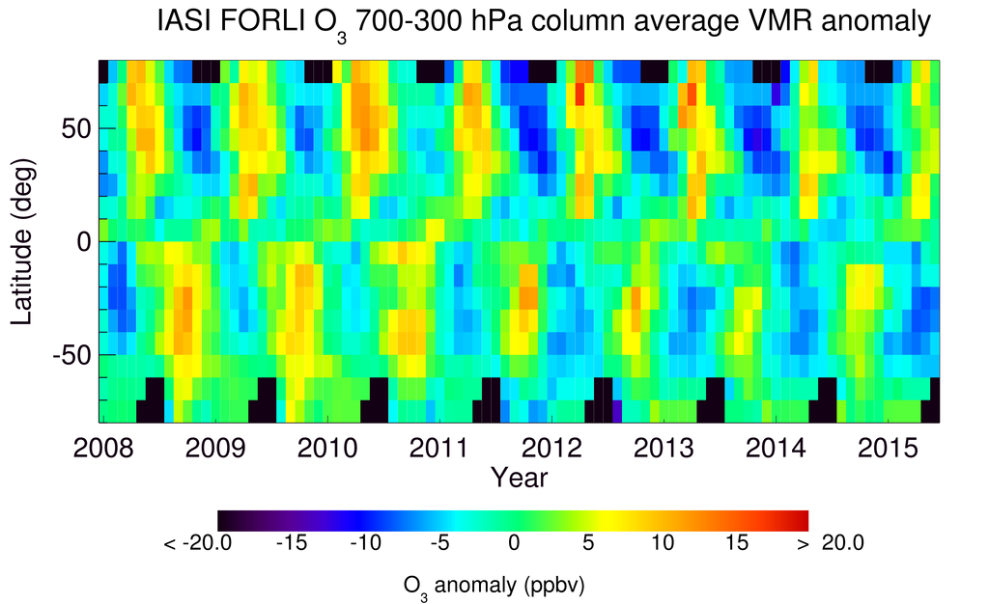
Mean Value Record Anomalies
Anomaly =
x_{month}(lat) –
time mean [x_{all}(lat)]
Removes some effects
of the different a priori
Notes:
Looking at anomalies allows us to remove some of the effects of the prior. For TES and IASI together it looks like mid-latitude (30°-50°) values were rising for both summer and winter till around 2011 and then start to decrease in 2012

Slide 15
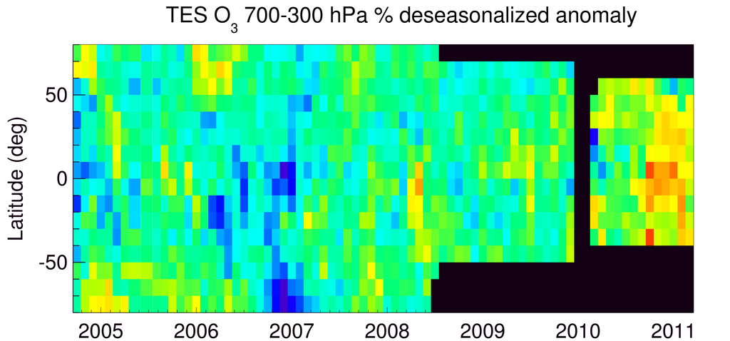
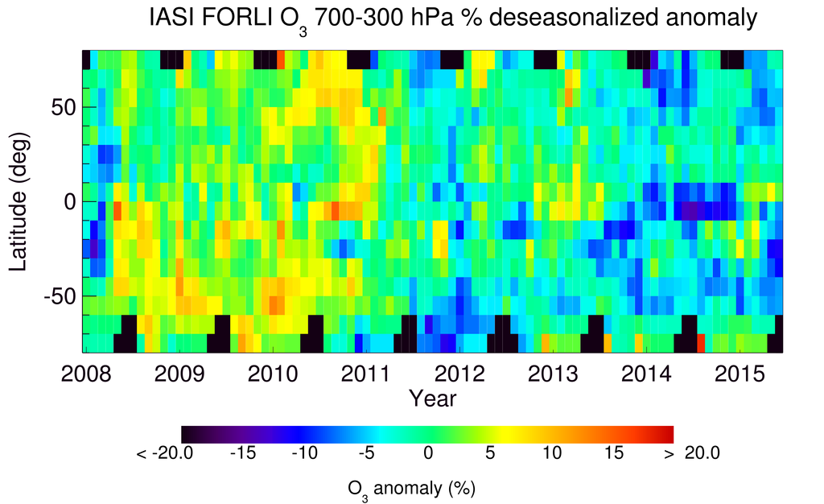
Mean Value Deseasonalized % Anomalies
Anomaly =
100 * (x_{month}(lat) –
time mean [x_{month}(lat)])
/time mean
Tropics and
N. mid-lat reach
highest % anomaly
2010-2011
Notes:
Looking at anomalies allows us to remove some of the effects of the prior. For TES and IASI together it looks like mid-latitude (30°-50°) values were rising for both summer and winter till around 2011 and then start to decrease in 2012

Slide 16
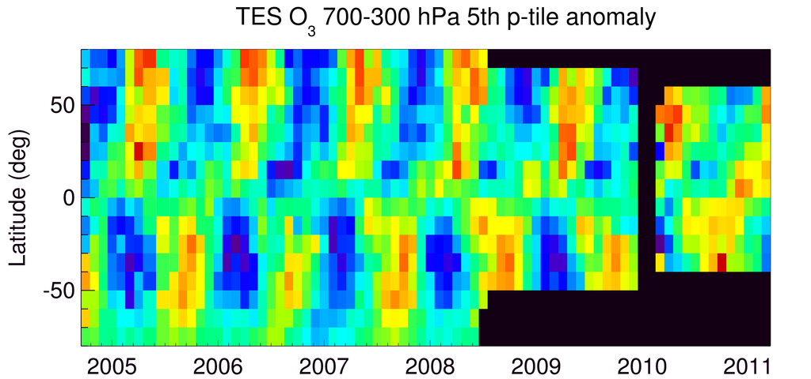
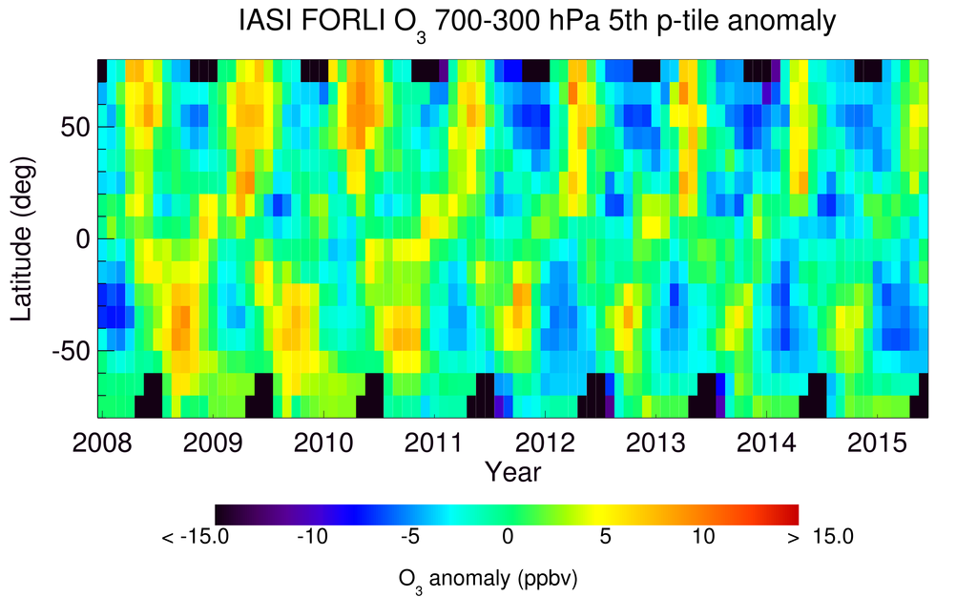
5th %tile Record Anomalies
Anomaly =
x^{5th}_{month}(lat) –
time mean [x^{5th}_{all}(lat)]
2008 2009 2010 2011 2012 2013 2014 2015
Year

Slide 17
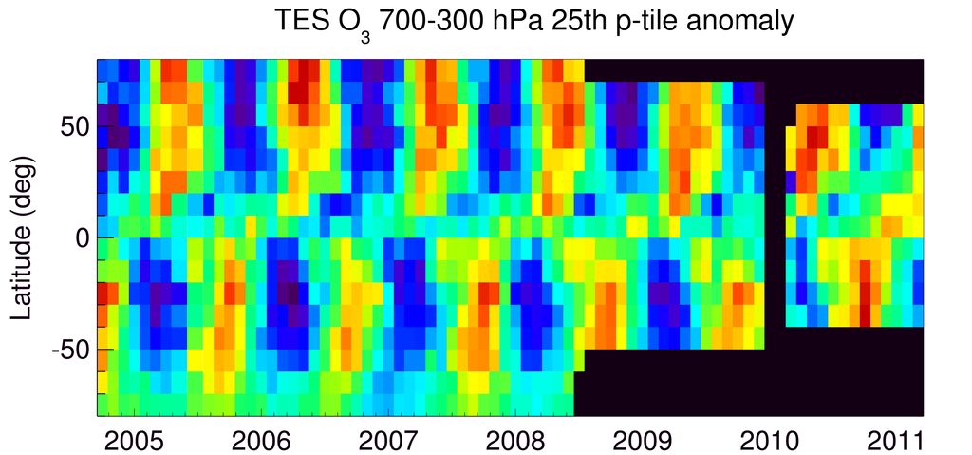
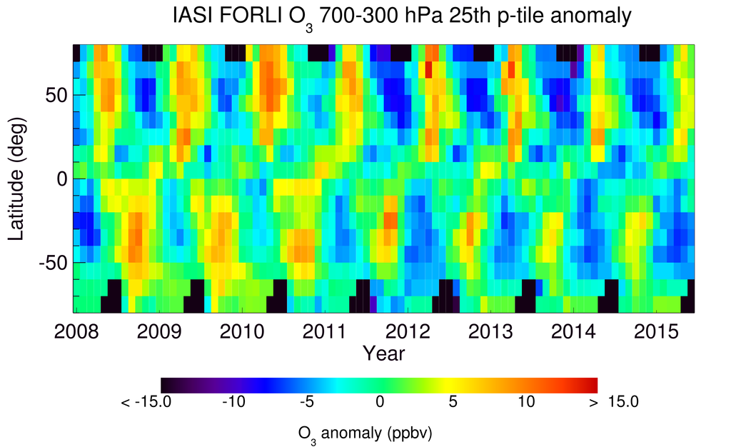
25th %tile Record Anomalies
Anomaly =
x^{25th}_{month}(lat) –
time mean [x^{25th}_{all}(lat)]
2008 2009 2010 2011 2012 2013 2014 2015
Year

Slide 18
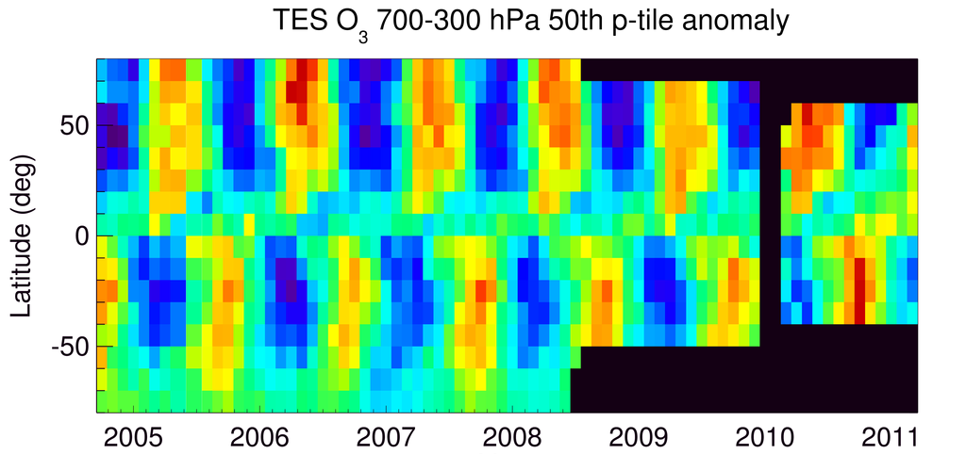
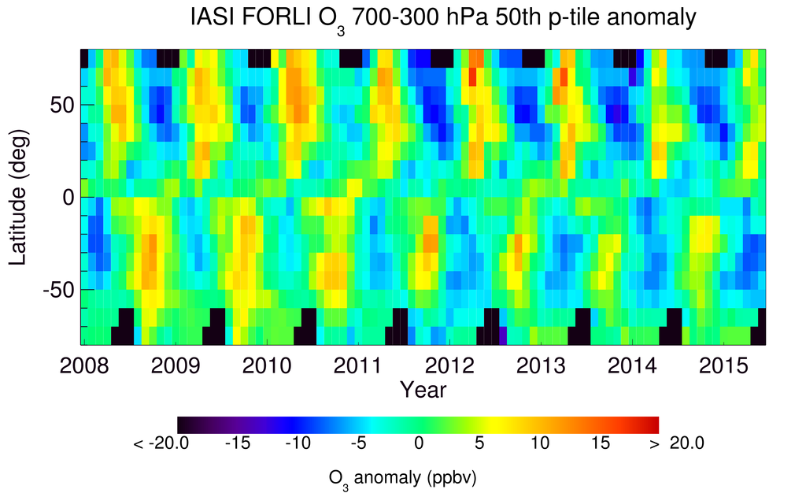
50th %tile Record Anomalies
Anomaly =
x^{50th}_{month}(lat) –
time mean [x^{50th}_{all}(lat)]

Slide 19
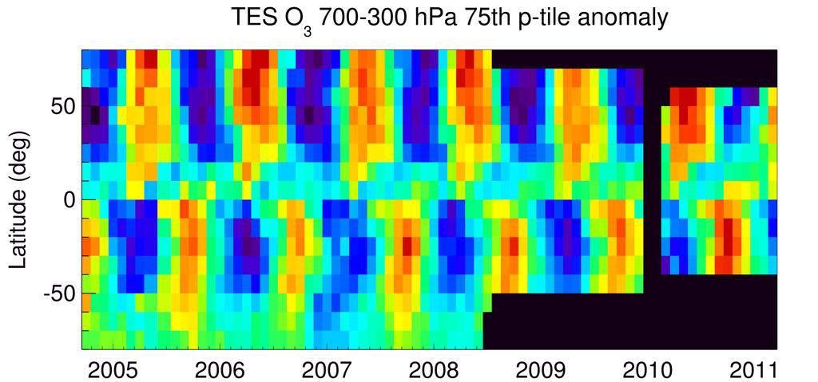
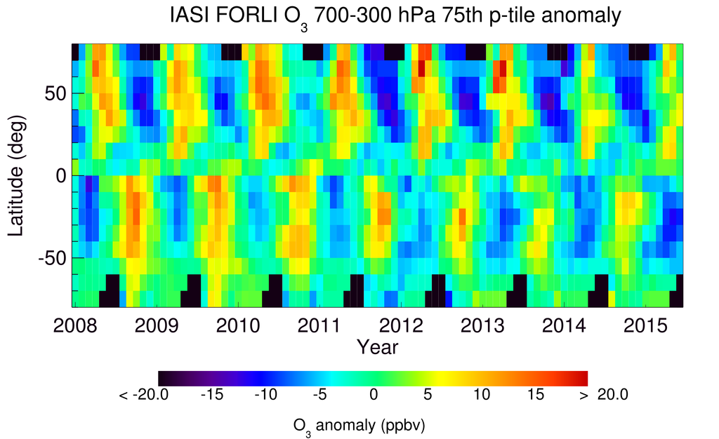
75th %tile Record Anomalies
Anomaly =
x^{75th}_{month}(lat) –
time mean [x^{75th}_{all}(lat)]

Slide 20
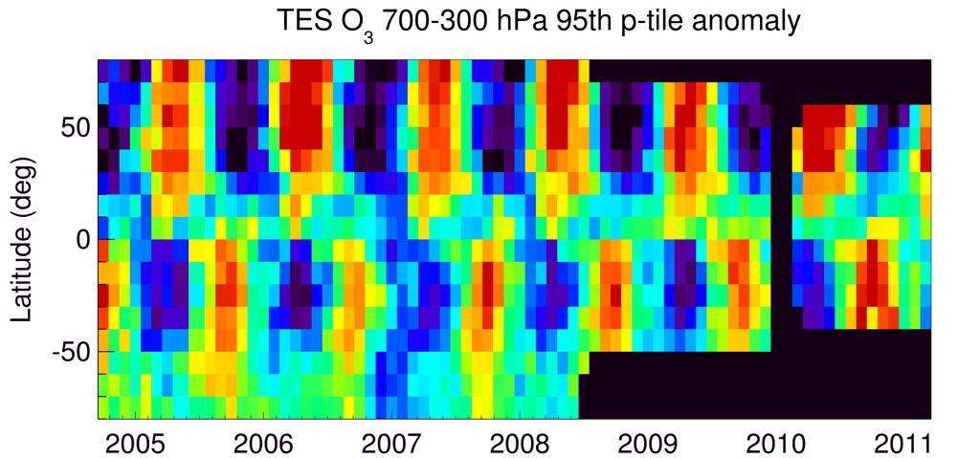
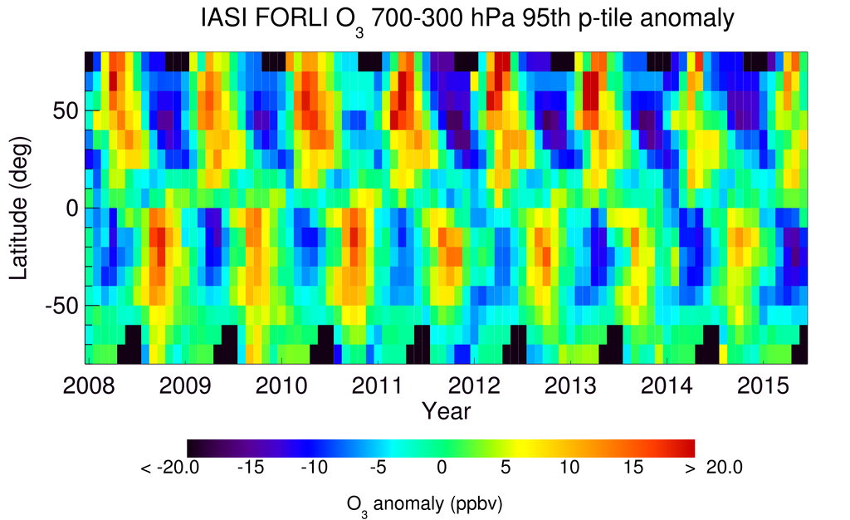
95th %tile Record Anomalies
Anomaly =
x^{95th}_{month}(lat) –
time mean [x^{95th}_{all}(lat)]

Slide 21
TES and IASI with same a priori mean and covariance [Oetjen et al., ACPD 2015]
4 days between Aug. 2008 to May 2009, 50°S to 80°N,
745 TES meas. with 3392 corresponding IASI meas.
Notes:
TES has higher sensitivity due to finer spectral resolution.

Slide 22
Combined TES/IASI 700-300 hPa O₃ [Oetjen et al., ACPD, 2015]
2004-11
2009
2014-07
Notes:
This accounts for sampling differences using representative sampling for IASI to match TES and a residual, constant bias: 3.9 ppb added to IASI

Slide 23
Combined TES/IASI deseasonalized anomaly [Oetjen et al., ACPD, 2015]
Rise in E. Asia free trop. O₃ understood
in terms of O₃ precursor emissions
and strat/trop exchange
(Verstraeten et al.,Nature Geo, 2015)
But not this drop!
2004-11
2011-03
2014-07
Notes:
Note: Gaelle Dufour confirmed that IASI-A and IASI-B see a consistent time record after 2012.

Slide 24
IASI trends for 2008-2013 Wespes et al., ACP, 2016

Slide 25
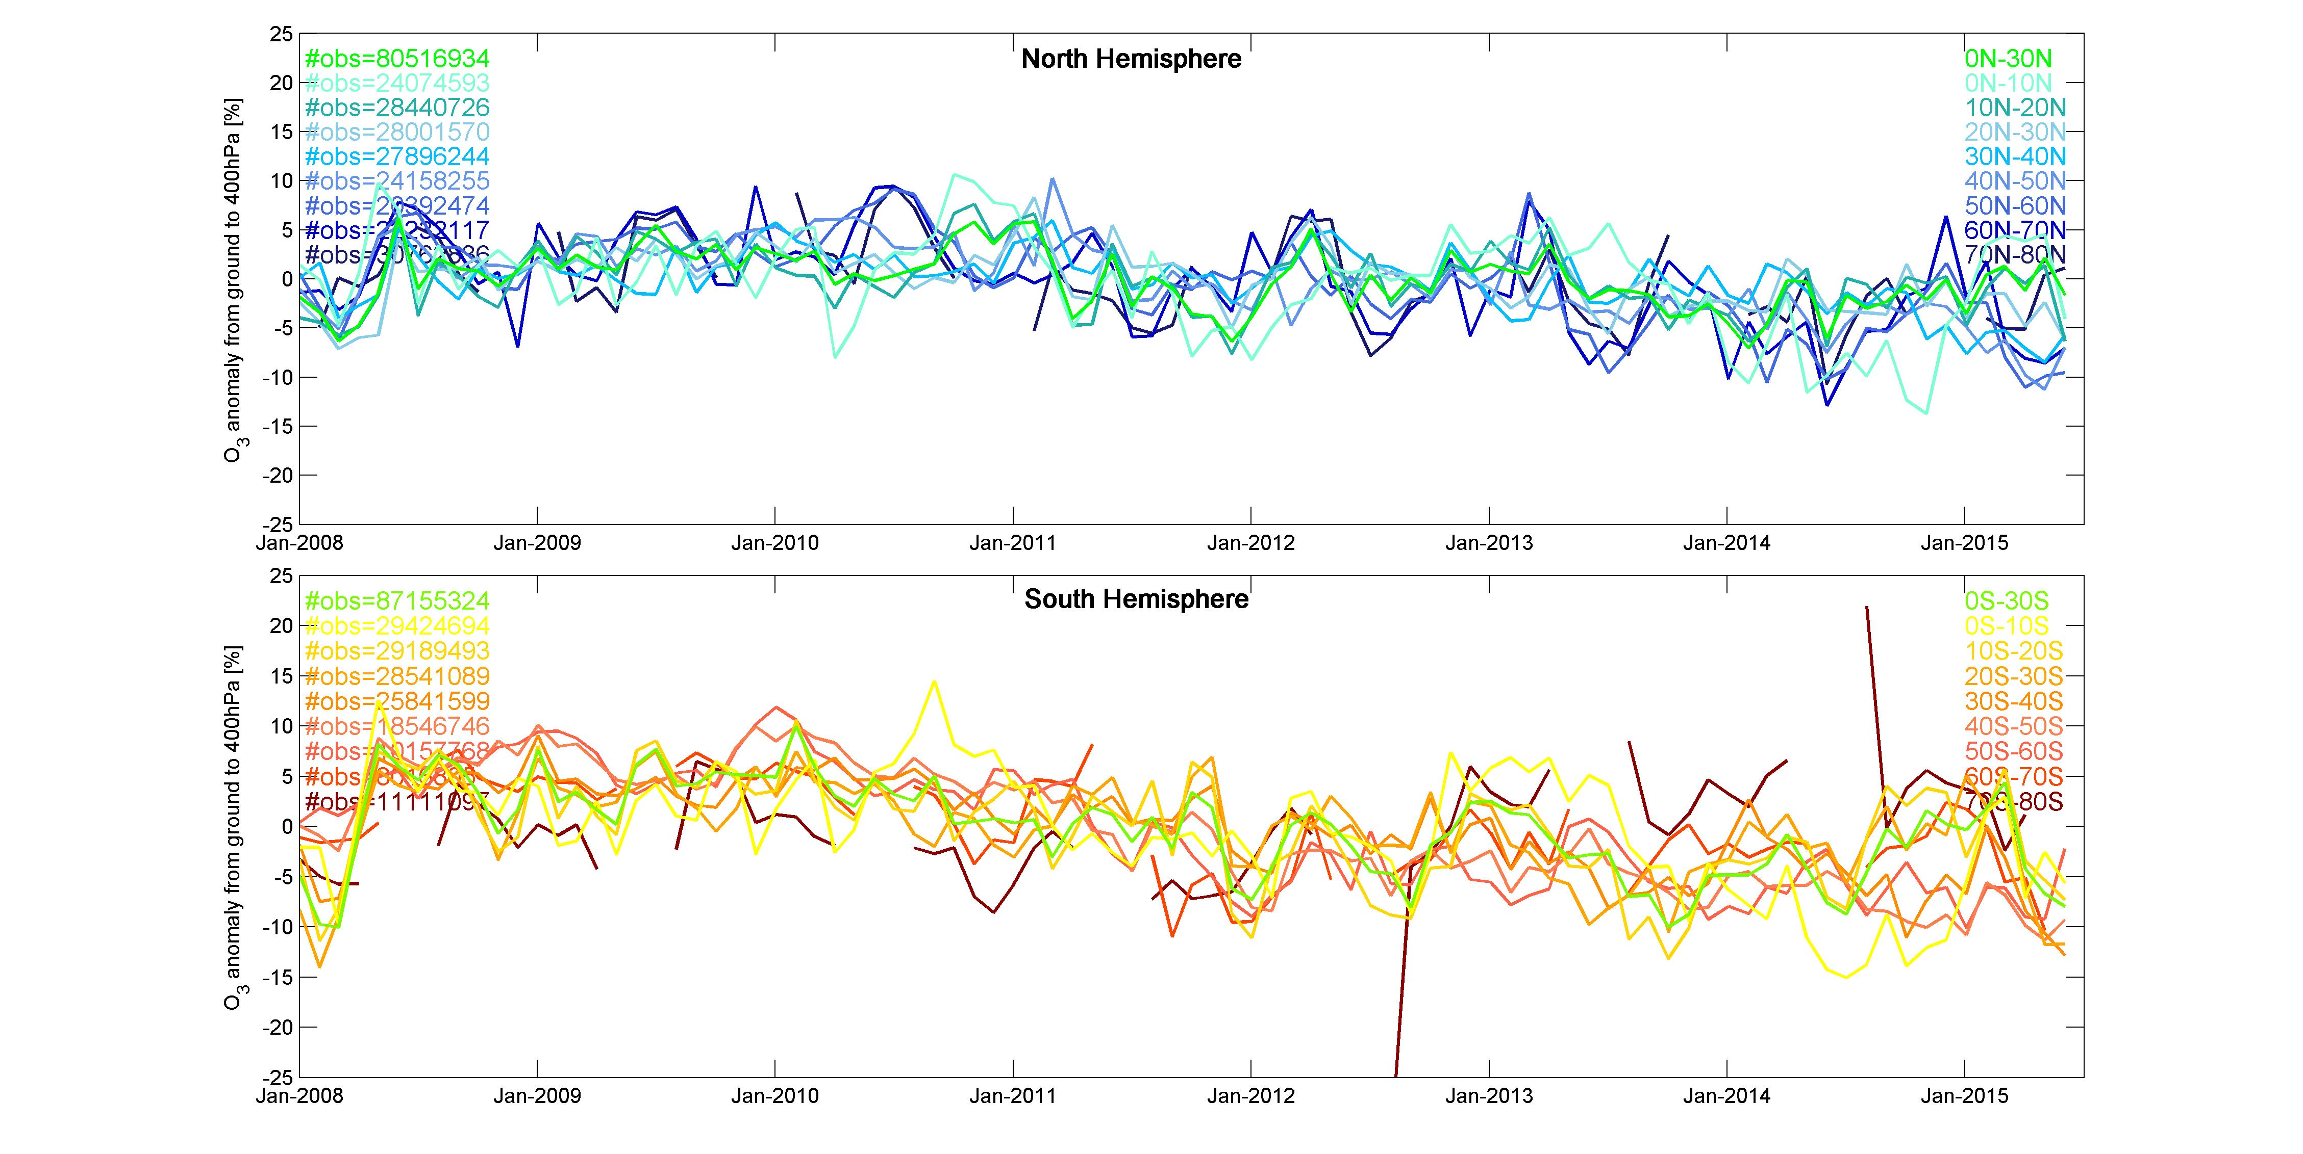
IASI Column Average VMR (surface-400 hPa) Anomaly

Slide 26
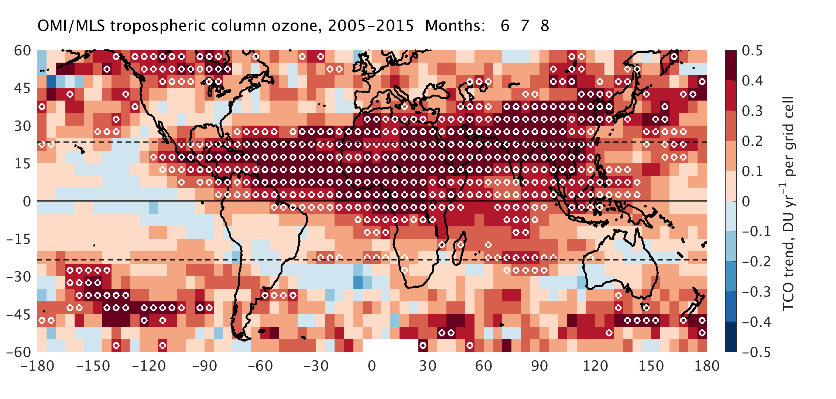
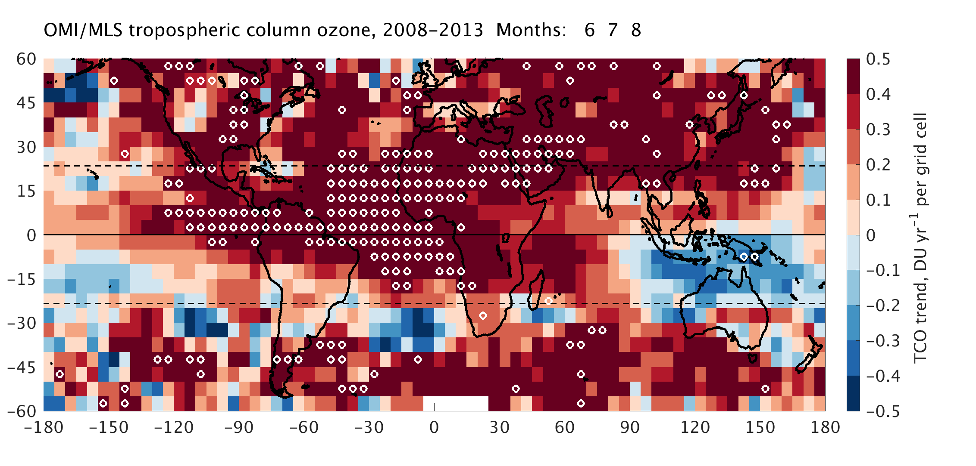
OMI-MLS trends (Owen Cooper et al.)
2005-2015 (JJA)
White dots indicate statistically significant trend
2008-2013 (JJA)
To match IASI record
In Wespes et al., ACP, 2016.

Slide 27
Conclusions
TES has global O₃ data from 2004-2011
IASI has global O₃ data with much higher sampling starting 2008 and into next decade
TES and IASI are most sensitive to tropospheric ozone from 700 to 300 hPa
Anomalies indicate highest values around 2010-2011 for N. Mid-latitudes followed by a decrease, at all percentiles, except summer 95%
Combined TES/IASI record (with common a priori information) shows consistent rise in E. Asia followed by a drop in early 2011.
Sorting out differences in IASI and OMI-MLS will require sensitivity study with known trend in model data to see what trends are detectable by these measurements.

Slide 28
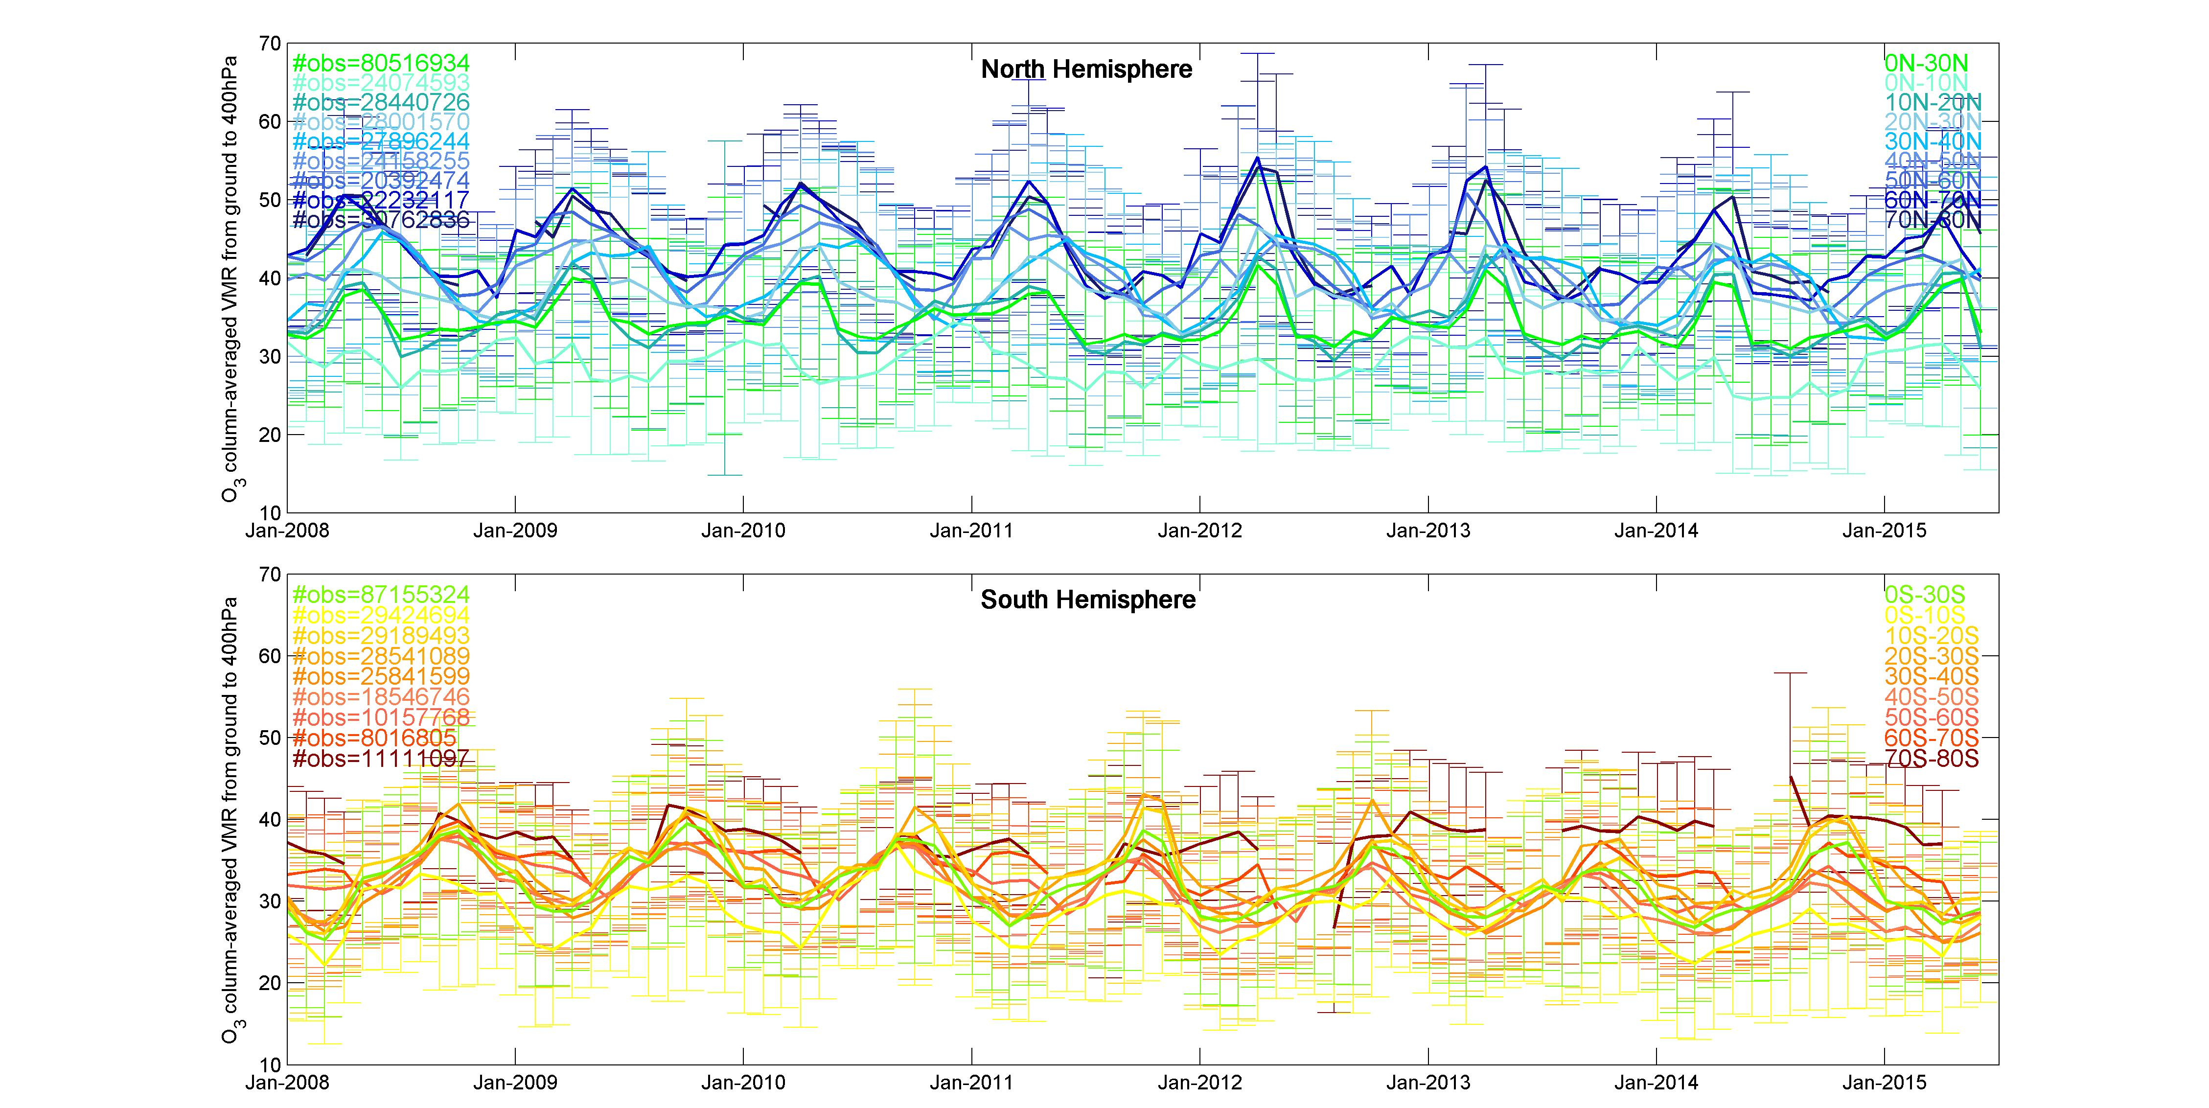
IASI Column Average VMR surface-400 hPa

Slide 29
IGAC-TOAR 2nd Workshop, Beijing, January, 2016

