Slide 1
TES (NASA/Aura Tropospheric Emission Spectrometer) and IASI (MetOp Infrared Atmospheric Sounding Interferometer) Satellite Fourier Transform Spectrometry (FTS)
Free Tropospheric O₃ Zonal Average Time Series
S. Kulawik (BAER, NASA/Ames), J. Neu (JPL/CalTech), C. Wespes (ULB), H. Worden (NCAR)

Slide 2
 | TES | IASI
Launch Date | July 2004 | 2007 (A); 2012 (B)
Orbital Elevation | 705 km | 817 km
Daytime overpass time | 13:45 | 9:30
Spatial Sampling | 8 km x 5 km | 12 km diameter (at nadir)
Spatial Coverage | Sparse (nadir ~180 km apart) 16-day global repeat | Swath (± 48° off-nadir) 2 x global per day
Cloud threshold | Retrieves both clear/cloudy select cloud OD < 0.1 for TOAR | Cloud < 13%
Spectral resolution (apodized) | 0.1 cm⁻¹ | 0.5 cm⁻¹
NESR (9.6 micron) | 50 nW/cm²/sr/cm⁻¹ | 20 nW/cm²/sr/cm⁻¹
Apriori source | MOZART-4 climatology (Emmons et al., 2010) | Global average from McPeters et al., (2007)
Data version used in TOAR | TES L2 v006 | FORLI v20140922
Both TES and IASI measure the the 9.6 micron infrared O₃ band
and are most sensitive from 700-300 hPa

Slide 3
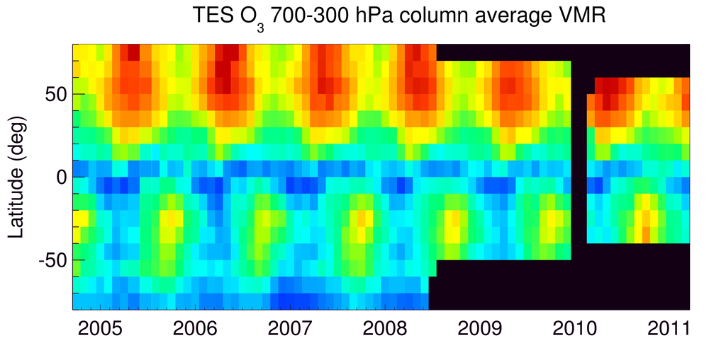
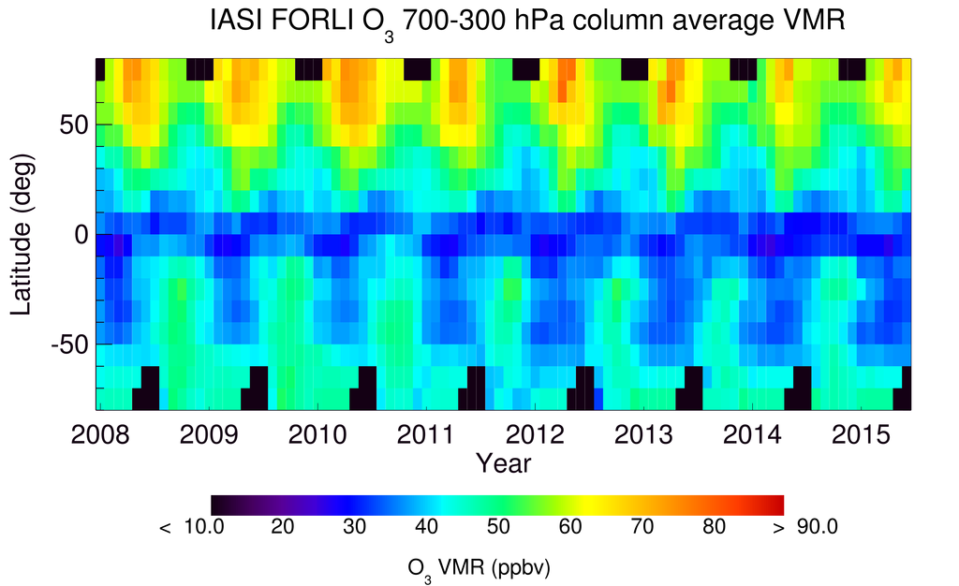
Monthly Mean Values (700-300 hPa)
TES plots reflect changes in
Global Survey latitude ranges
chosen to preserve instrument
life in later years

Slide 4
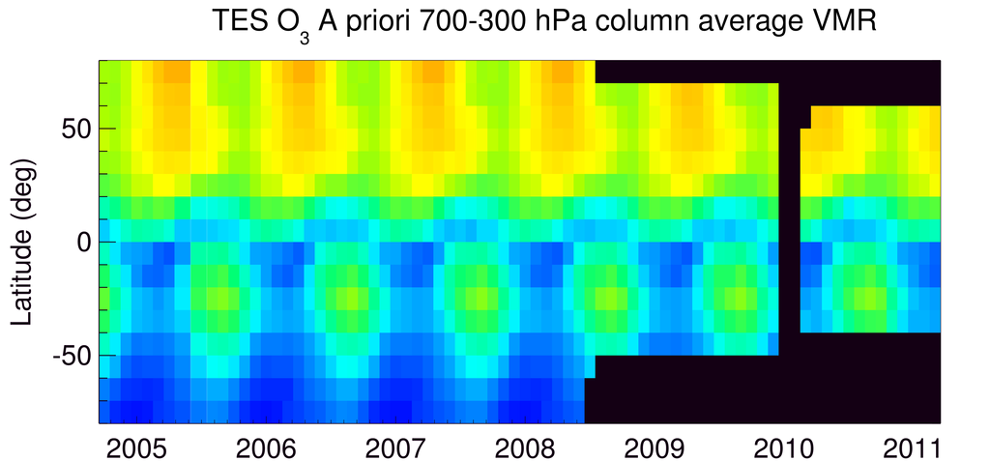
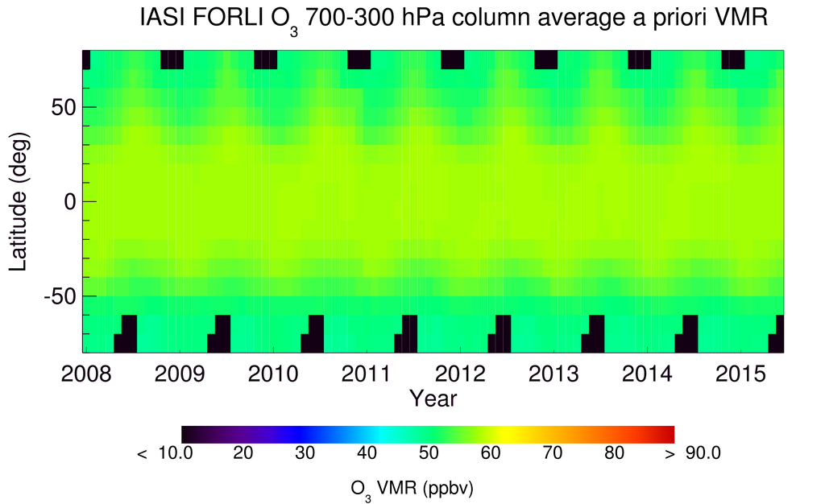
A priori Mean Values

Slide 5
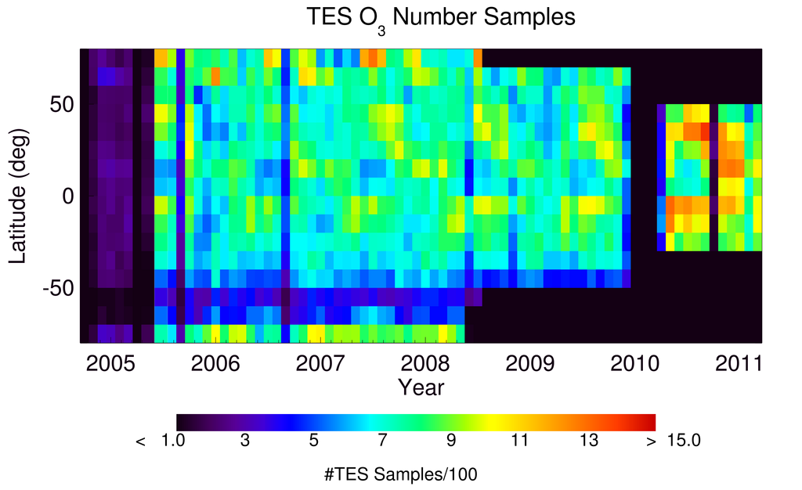
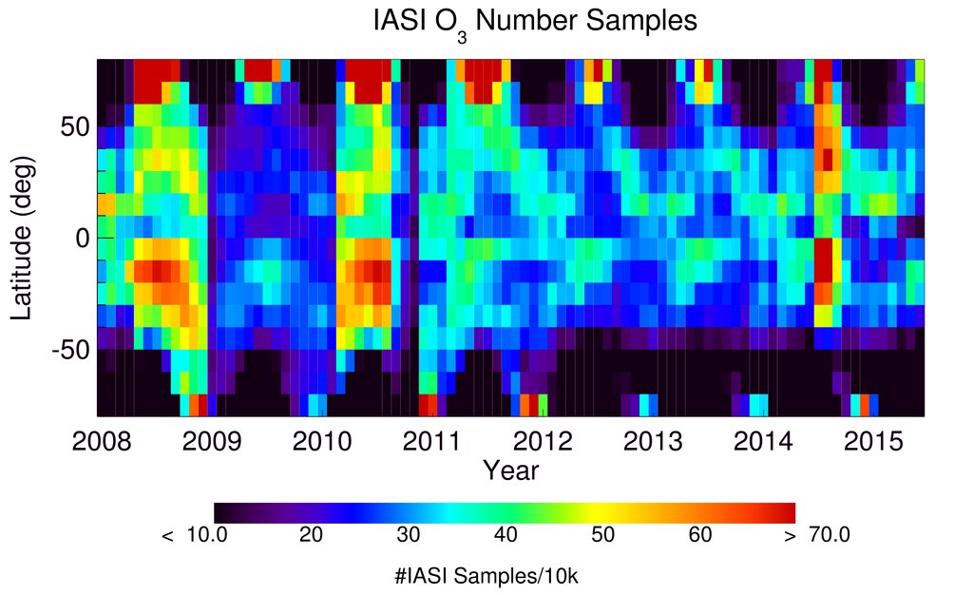
Number of Samples
IASI has ~400 x TES
sampling density

Slide 6
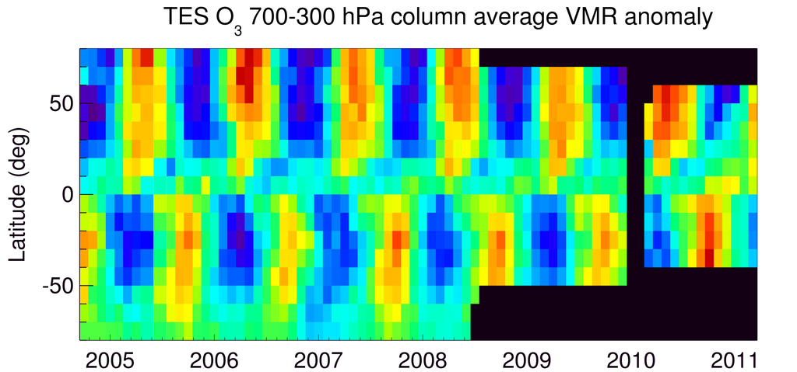
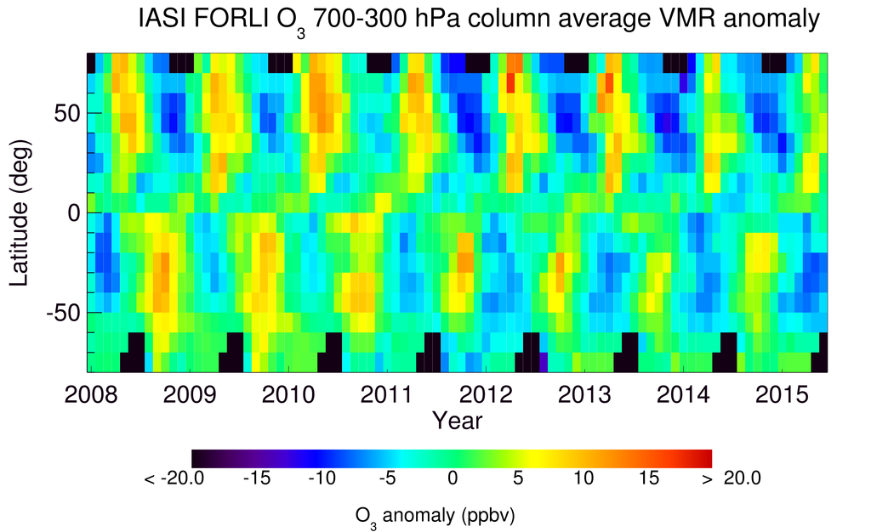
Mean Value Record Anomalies
Anomaly =
x_{month}(lat) –
time mean [x_{all}(lat)]
Removes some effects
of the different a priori
N. mid-lat summer
and winter are
highest 2010-2011
then decrease
Notes:
Looking at anomalies allows us to remove some of the effects of the prior. For TES and IASI together it looks like mid-latitude (30°-50°) values were rising for both summer and winter till around 2011 and then start to decrease in 2012

Slide 7
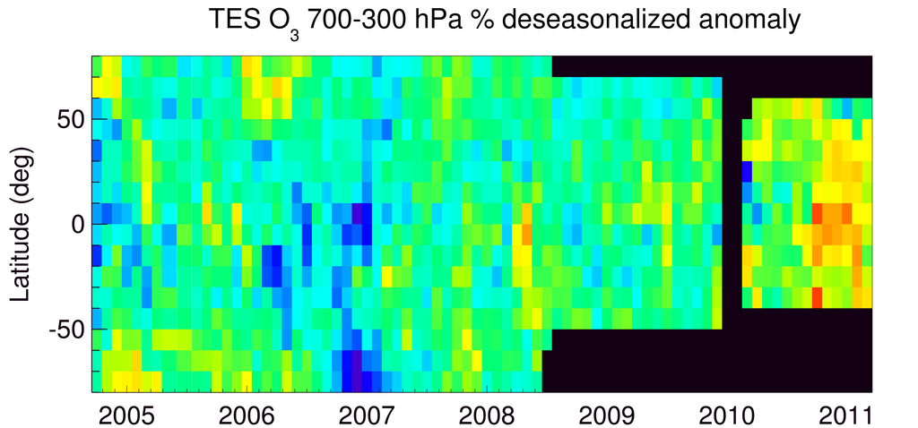
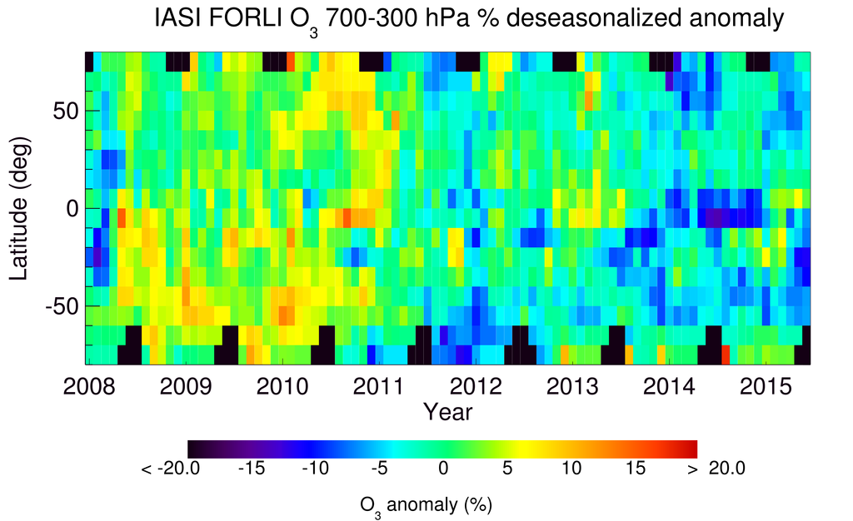
Mean Value Deseasonalized % Anomalies
Anomaly =
100 * (x_{month}(lat) –
time mean [x_{month}(lat)])
/time mean
Tropics and
N. mid-lat reach
highest % anomaly
2010-2011
Notes:
Looking at anomalies allows us to remove some of the effects of the prior. For TES and IASI together it looks like mid-latitude (30°-50°) values were rising for both summer and winter till around 2011 and then start to decrease in 2012

Slide 8
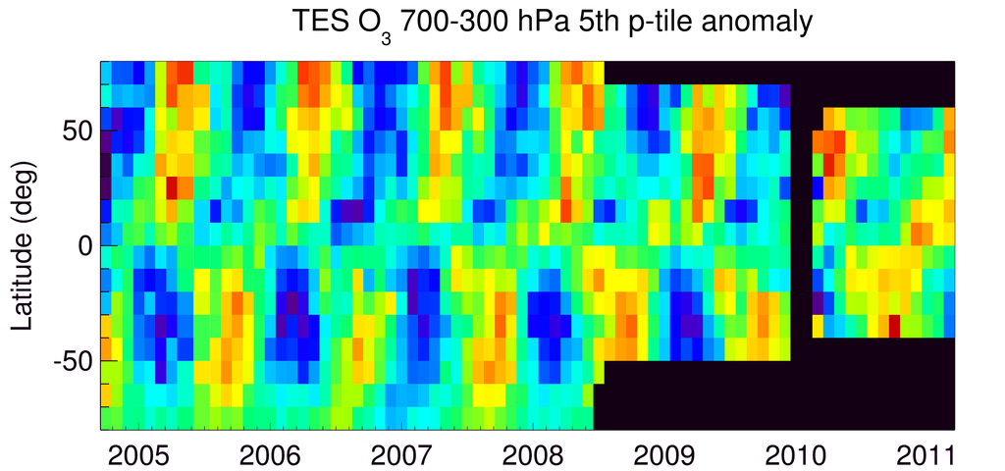
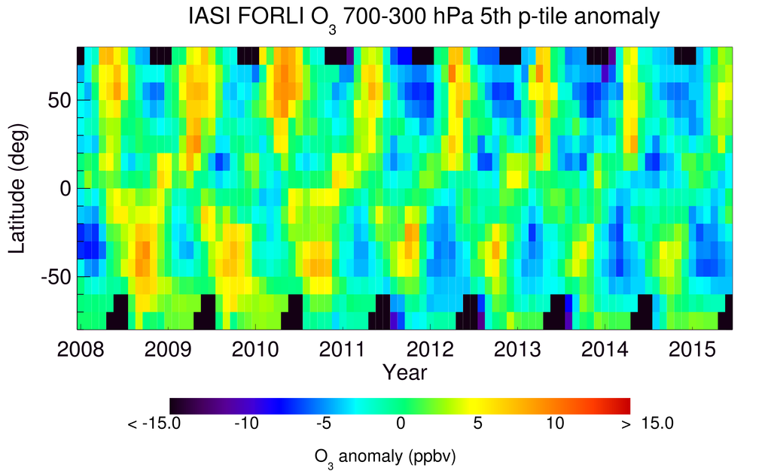
5th %tile Record Anomalies
Anomaly =
x^{5th}_{month}(lat) –
time mean [x^{5th}_{all}(lat)]
2008 2009 2010 2011 2012 2013 2014 2015
Year

Slide 9
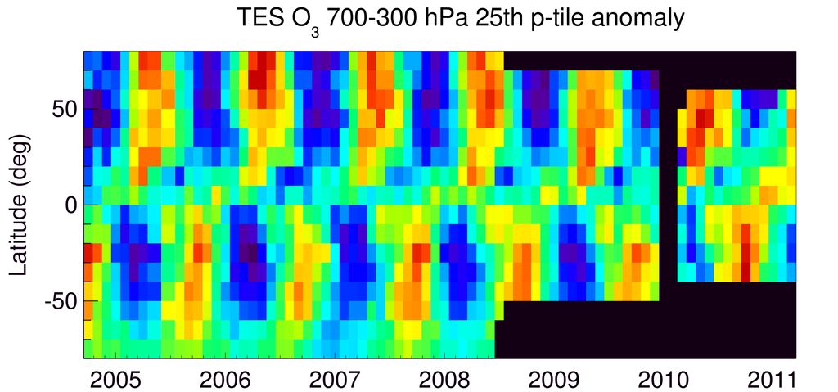
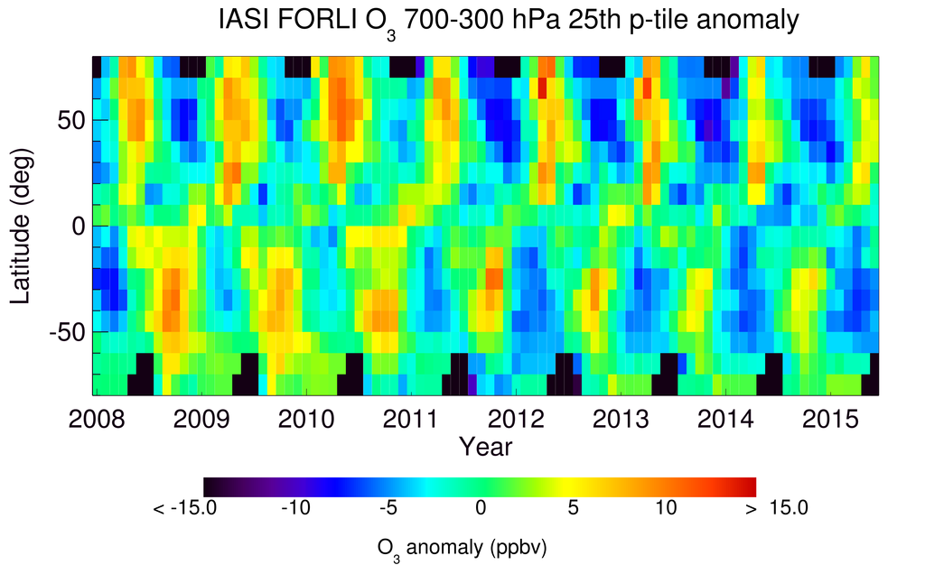
25th %tile Record Anomalies
Anomaly =
x^{25th}_{month}(lat) –
time mean [x^{25th}_{all}(lat)]
2008 2009 2010 2011 2012 2013 2014 2015
Year

Slide 10
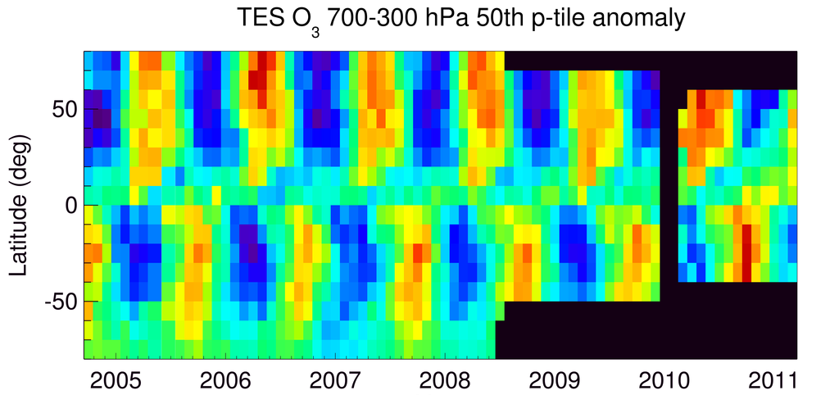
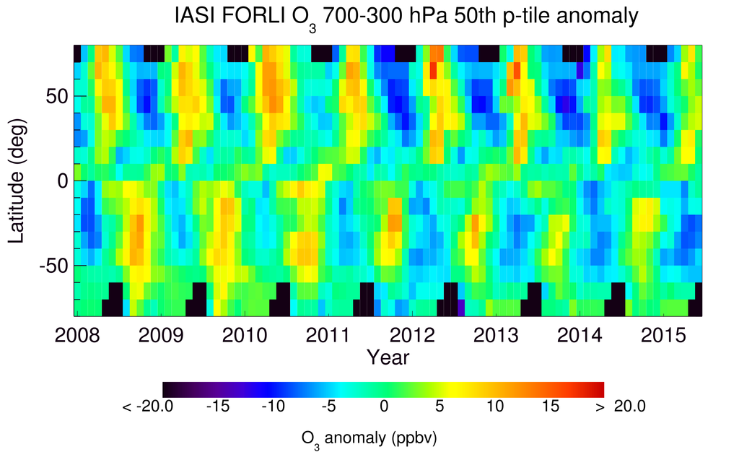
50th %tile Record Anomalies
Anomaly =
x^{50th}_{month}(lat) –
time mean [x^{50th}_{all}(lat)]

Slide 11
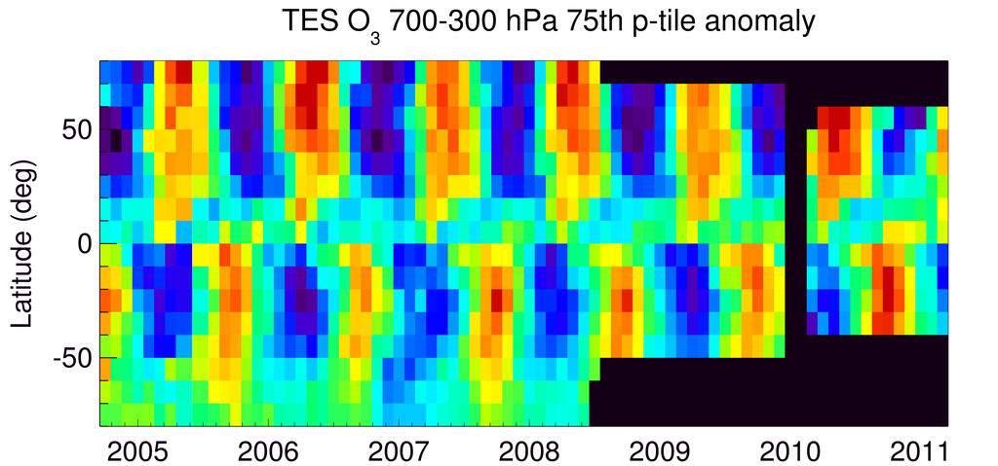
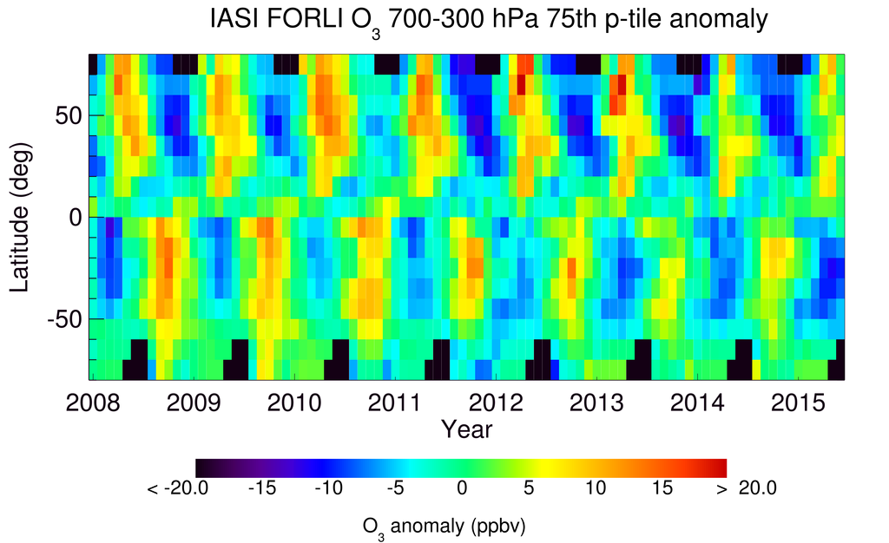
75th %tile Record Anomalies
Anomaly =
x^{75th}_{month}(lat) –
time mean [x^{75th}_{all}(lat)]

Slide 12
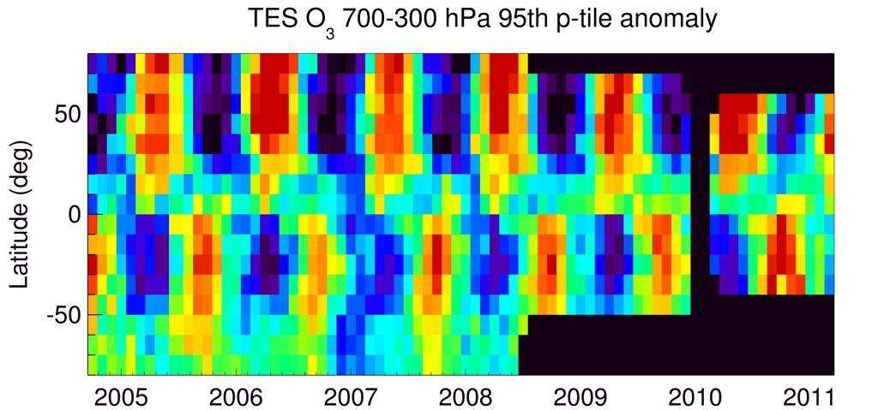
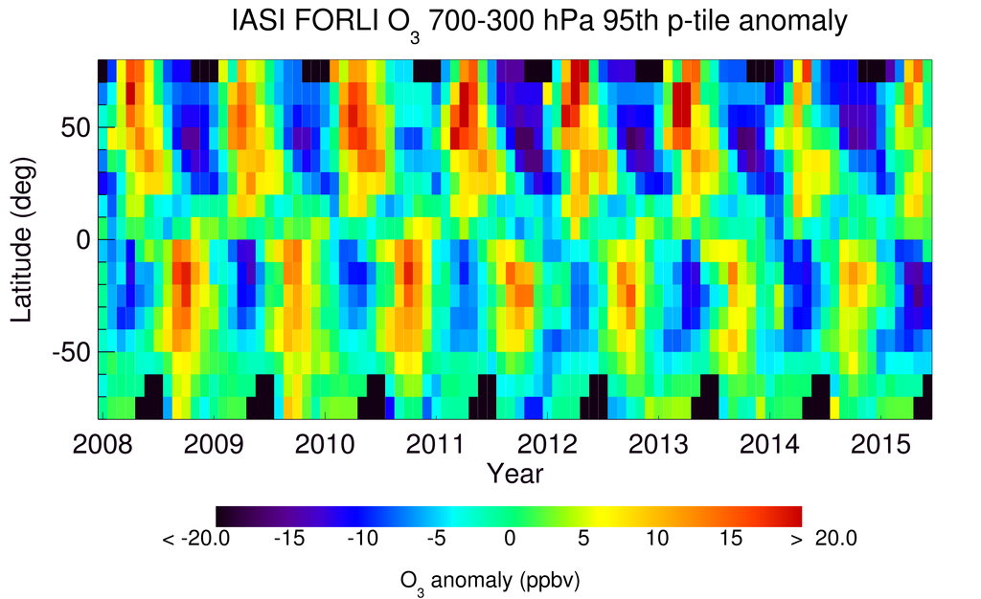
95th %tile Record Anomalies
Anomaly =
x^{95th}_{month}(lat) –
time mean [x^{95th}_{all}(lat)]

Slide 13
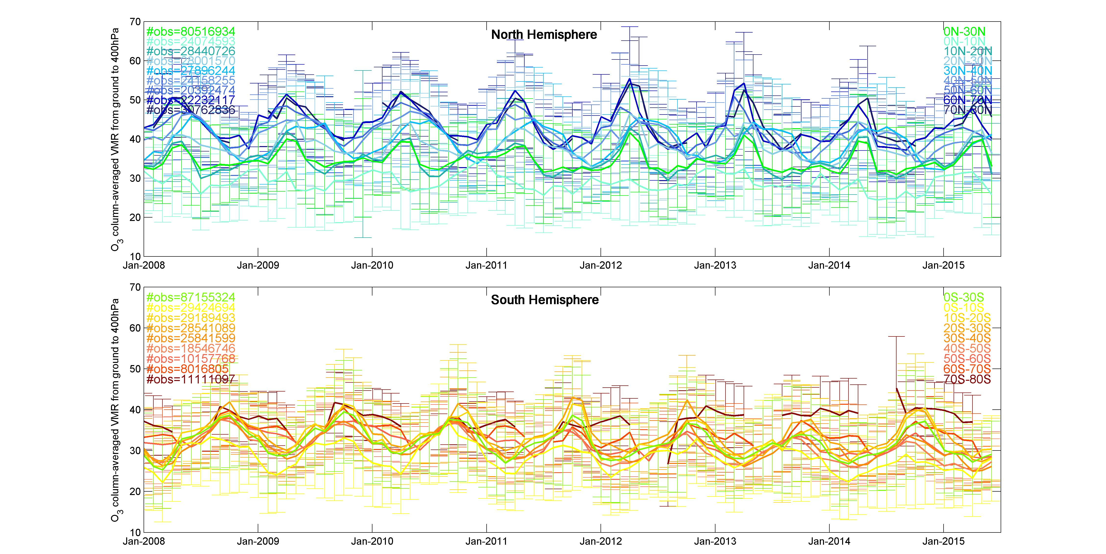
IASI Column Average VMR surface-400 hPa

Slide 14
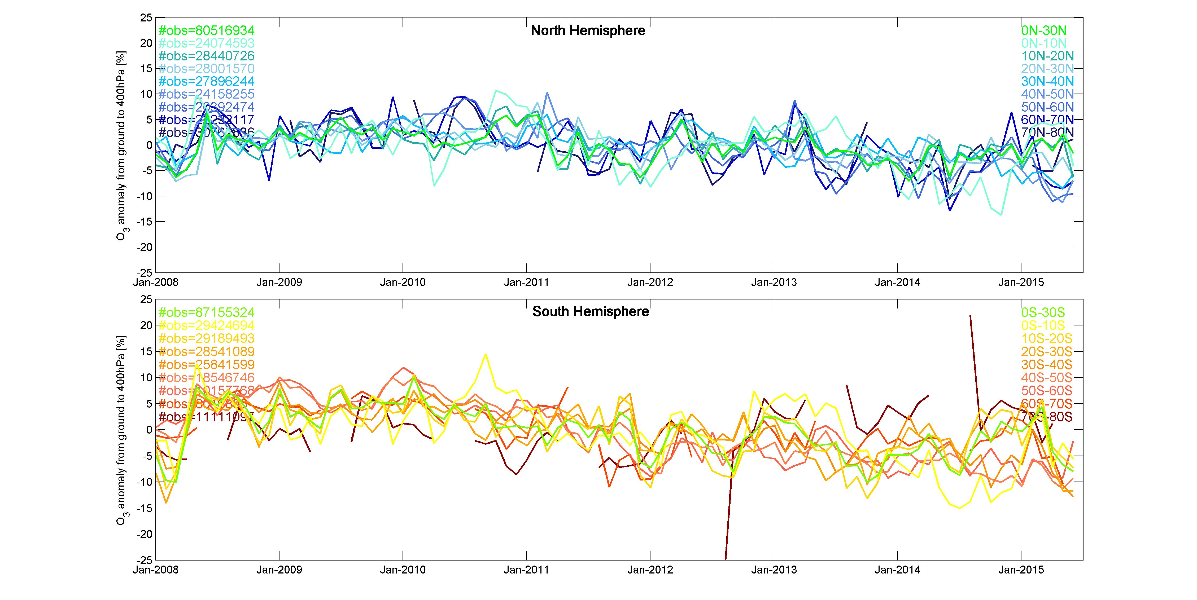
IASI Column Average VMR (surface-400 hPa) Anomaly

Slide 15
TES and IASI with same a priori mean and covariance [Oetjen et al., ACPD 2015]
4 days between Aug. 2008 to May 2009, 50°S to 80°N,
745 TES meas. with 3392 corresponding IASI meas.
Notes:
TES has higher sensitivity due to finer spectral resolution.

Slide 16
Combined TES/IASI 700-300 hPa O₃ [Oetjen et al., ACPD, 2015]
2004-11
2009
2014-07
Notes:
This accounts for sampling differences using representative sampling for IASI to match TES and a residual, constant bias: 3.9 ppb added to IASI

Slide 17
Combined TES/IASI deseasonalized anomaly [Oetjen et al., ACPD, 2015]
Rise in E. Asia free trop. O₃ understood
in terms of O₃ precursor emissions
and strat/trop exchange
(Verstraeten et al.,Nature Geo, 2015)
But not this drop!
2004-11
2011-03
2014-07

Slide 18
Conclusions
TES has global O₃ data from 2004-2011
IASI has global O₃ data with much higher sampling starting 2008 and into next decade
TES and IASI are most sensitive to tropospheric ozone from 700 to 300 hPa
Anomalies indicate highest values around 2010-2011 for N. Mid-latitudes followed by a decrease, at all percentiles, except summer 95%
Combined TES/IASI record (with common a priori information) shows consistent rise in E. Asia followed by a drop in early 2011.

