Slide 1
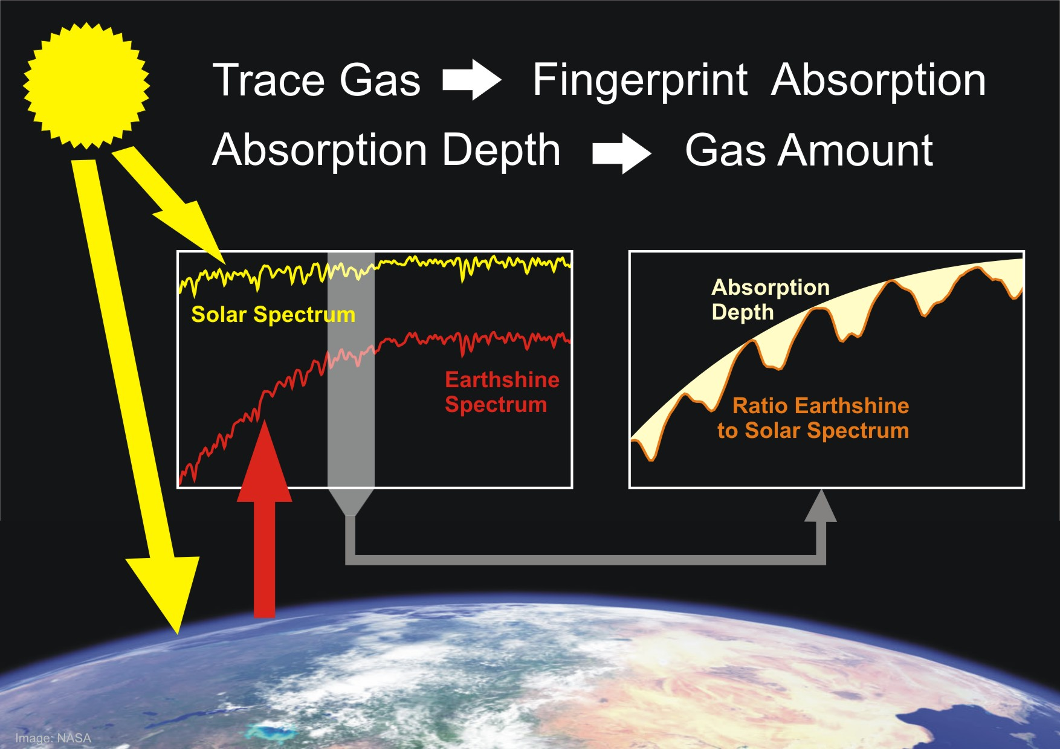
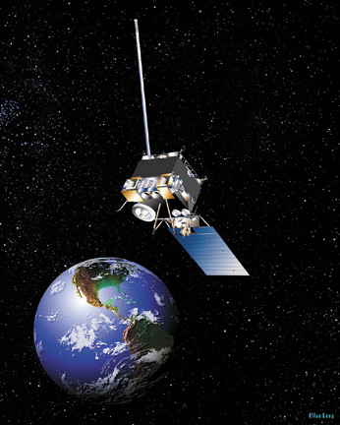
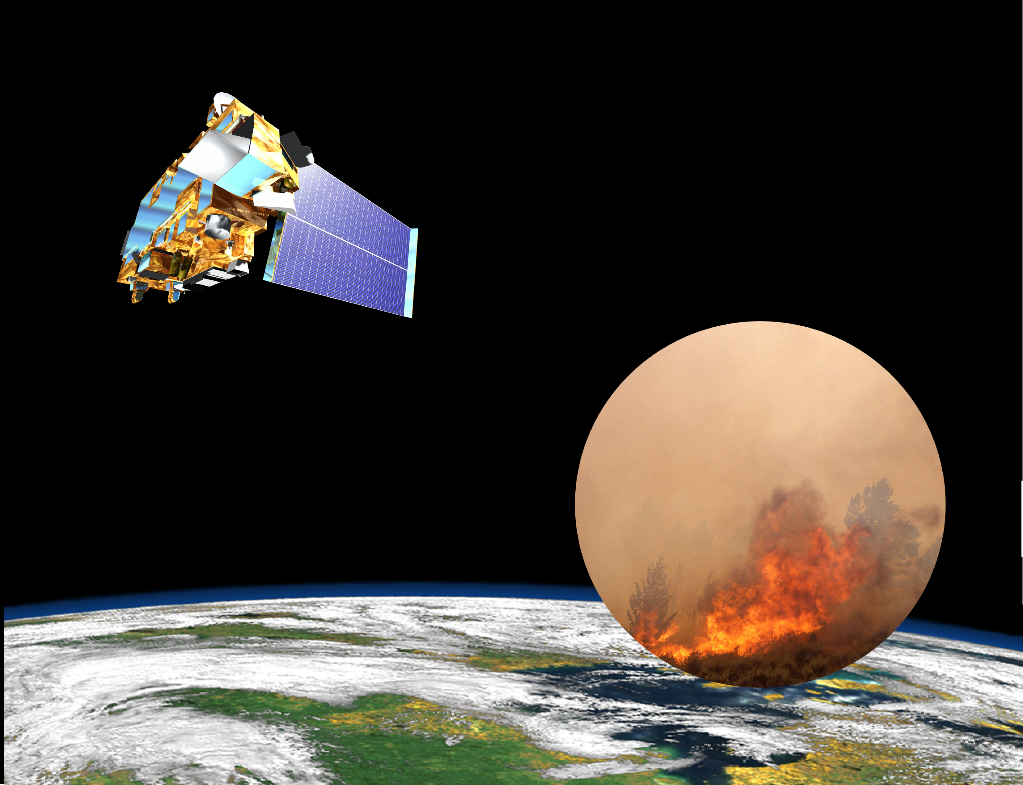
TIR: Provides FT profile information
VIS: Provides column information
UV: Provides partial column information
atmospheric emission
solar backscatter
surface emission
Multi-Spectral Remote Sensing
DOAS UV Retrieval
Notes:
10/17/14
1

Slide 2
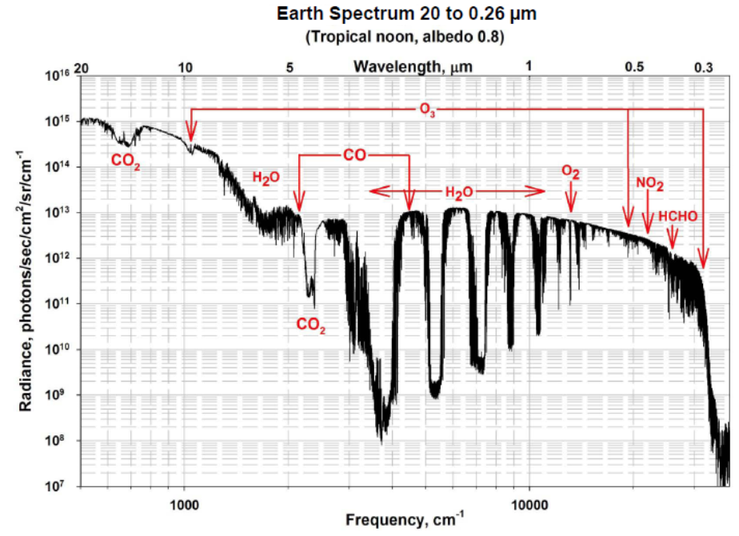
IR and UV O₃ measurements
IR
ATMOS
CLAES
HALOE
IMG
MIPAS
AIRS
ACE-FTS
TES
IASI
CrIS
UV
TOMS
SAGE
SBUV
SOLCE
SCIAMACHY
GOME
OSIRIS
OMI
GOME-2

Slide 3
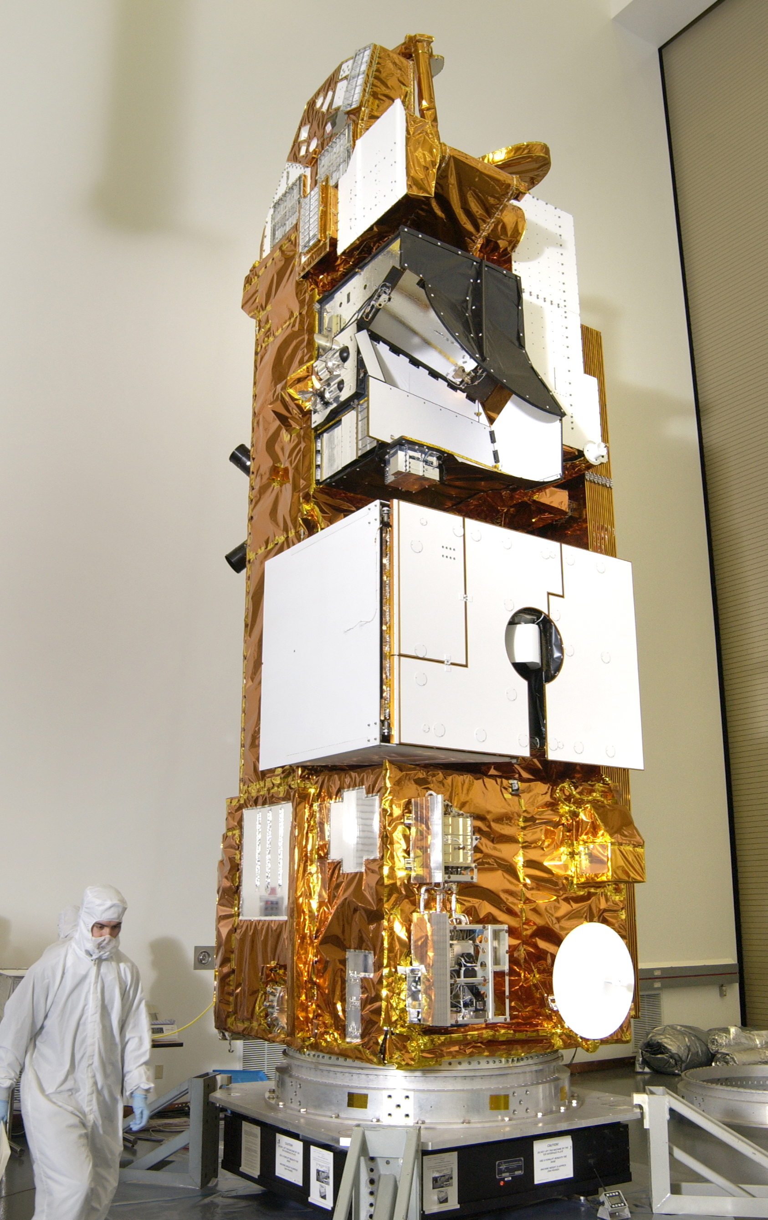
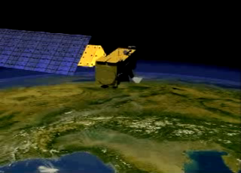
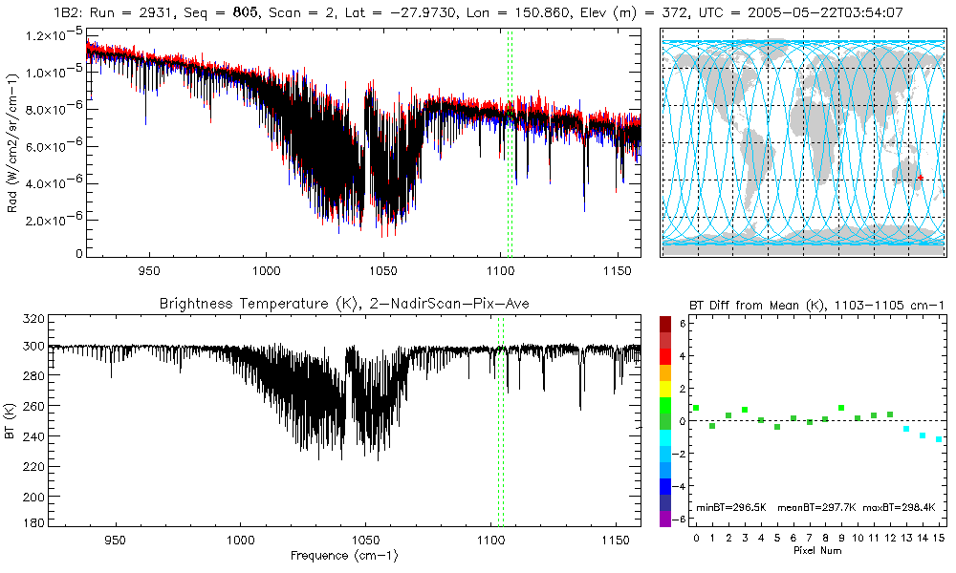
Tropospheric Emission Spectrometer
TES, launched aboard the EOS-Aura spacecraft
in 2004, is a Fourier Transform Spectrometer (FTS)
TES measures infrared spectral radiances from
3.2 to 15.4 μm
Spectral Resolution (unapodized) | 0.06 cm⁻¹ (nadir) 0.015 cm⁻¹ (hi-res)
Spectral Coverage | 650 to 3050 cm⁻¹ (3.2 to 15.4 μm)
Global survey | 1152 – 2048 nadir obs./day (2004-2011)
Spatial Resolution | 0.5 x 5 km (nadir) 2.3 x 23 km (limb)
Nadir NEDT @290K (Noise Equivalent Delta Temperature) | 2B1: 1.08 K 1B2: 0.36 K 2A1: 0.36 K 1A1: 2.07 K
CO₂
O₃
H₂O, N₂O
Unfortunately, TES is having end-of-life issues
Notes:
I have been working on an instrument that is making a vital contribution to our understanding of atmospheric composition, its coupling to climate and the Earth system. It’s called the Tropospheric Emission Spectrometer, launched aboard the Aura spacecraft (shown here to the left) in 2004 a part of NASA’s Earth Observing System. The keyhole at the base of Aura is TES and is suggestive of its two modes of operation: nadir and limb. The nadir mode looks down and has a horizontal footprint of 0.5x5km for each of its 16 detectors. Averaged together, leads to a footprint of 8x5km. The limb mode peers backwards and has a spatial footprint of 2.3x23km.
What does TES measure? Thermal spectral radiation an example of which is shown in the middle figure. The resolution of this spectrum, which we will discuss momentarily, is key to obtaining vertical information about atmospheric constituents.

Slide 4
Using TES and IASI satellite observations to test climate model predictions of ozone radiative forcing
Helen M. Worden
Atmospheric Chemistry Division
NCAR Earth System Laboratory
NCAR (National Center for Atmospheric Research)
Boulder, CO, USA
With special thanks to Kevin Bowman (JPL)
© 2012 California Institute of Technology. Government sponsorship acknowledged

Slide 5
WHAt IS the role of tropospheric ozone in climate?
Notes:
I will assume everyone knows the important role of stratospheric ozone in keeping us safe from UV rays

Slide 6
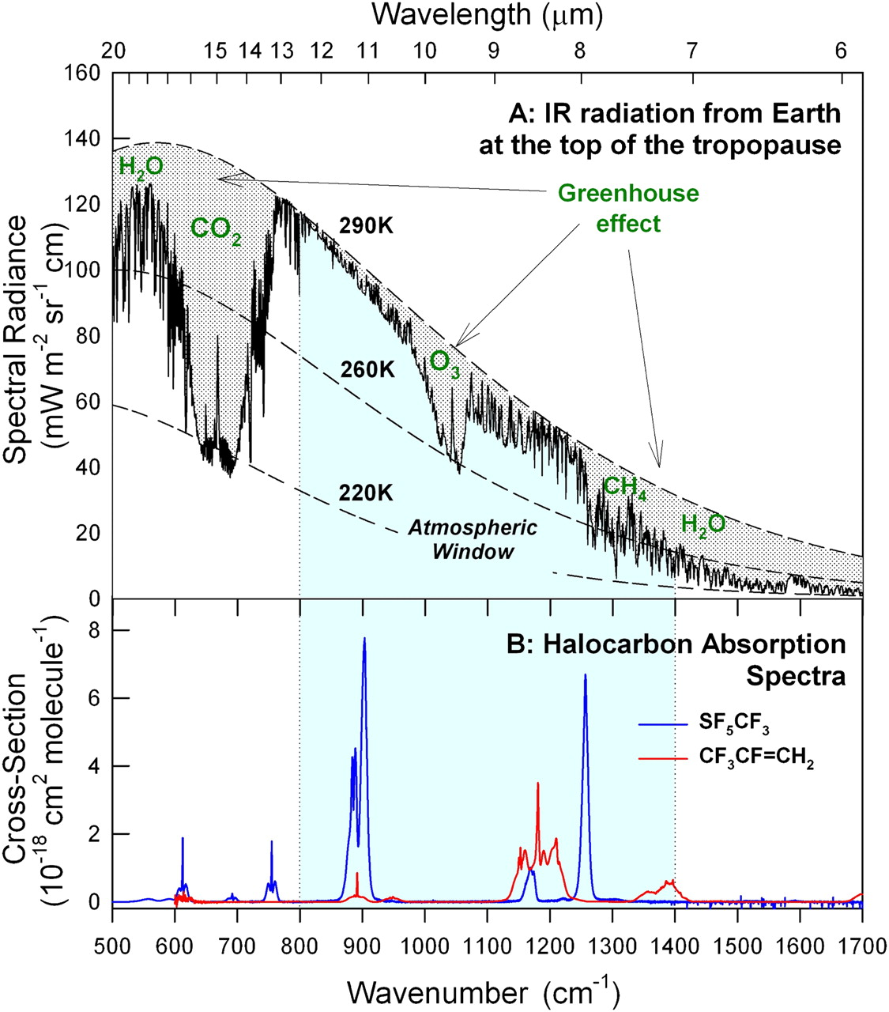
Radiative forcing from atmospheric composition
IPCC AR5
Wallington T J et al. PNAS 2010;107:E178-E179
Carbon dioxide (CO₂), methane (CH₄), and tropospheric ozone (O₃) are the 3 most important greenhouse gases resulting from anthropogenic activities.
As a consequence, the Earth is estimated to absorb 0.58 ± 0.15 watts per square meter more energy from the Sun than it is emitting to space (2005-2010) Hansen et al, 2011, ACP
Notes:
The figure on the left doesn’t show O3 shortwave absorption, which is about 3 times smaller than IR absorption. IPCC AR5 Fig. 8.15. Bar chart for RF (hatched) and ERF (solid).

Slide 7
Radiative forcing definitions
IPCC AR5 Fig. 8.1
Used in <= AR4
+ AR5 (hatched)
Used in
AR5 (solid)
Observational Constraints to RF
Satellite observations can test climate model predictions for present day concentrations
and TOA flux
flux
Natural
background
correction
time
T₀ ε [1850,1855]
T_{p}ε [2005,2010]
Notes:
ERF more realistic since tropopause can change as well (fixed SST) Calculation of ERF requires longer simulations with more complex models than calculation of RF, but the inclusion of the additional rapid adjustments makes ERF a better indicator of the eventual global mean temperature response, especially for aerosols.

Slide 8
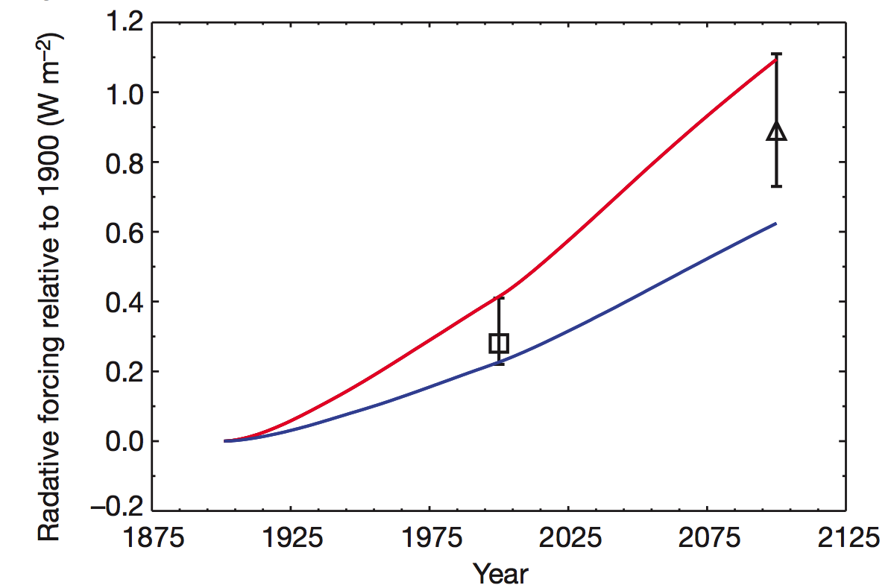
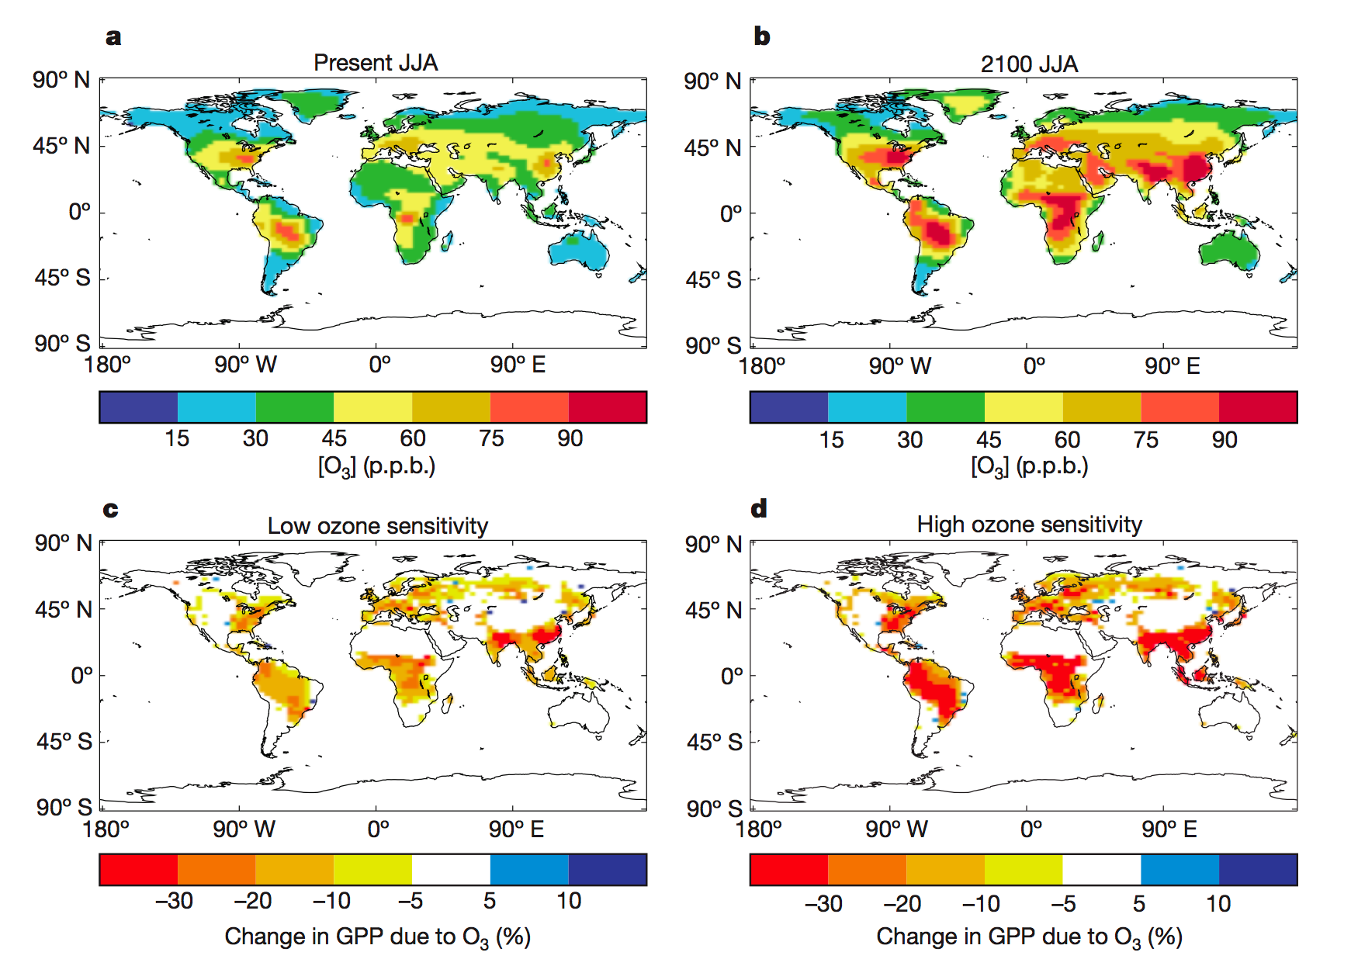
Role of ozone in chemistry-carbon-climate coupling
Direct effect:
Preindustrial-to-present day:
.35 [.25, .65] W/m²
Preindustrial through 21st century:
.89 W/m²
But O₃ RF is also coupled to changes in H₂O
.89 W/m²
Indirect effects:
Suppression of carbon
uptake by ozone damage to
plants could lead to additional
0.62 to 1.09 W/m² CO₂
radiative forcing
Sitch et al,(2007), Nature
Notes:
Ozone plays a critical role in chemistry climate coupling, both in the direct radiative effect (the absorption of outgoing longwave radiation--discussed earlier by Helen Worden)

Slide 9
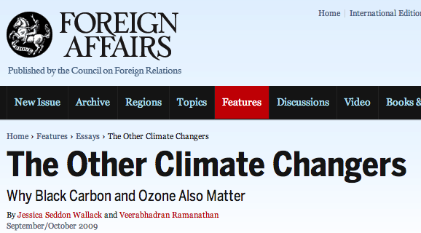
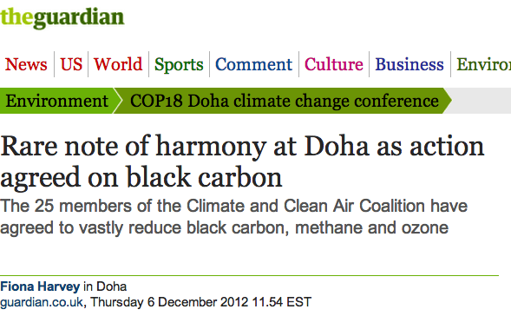

Policy and Science of Short-lived Climate Forcing
The potential of short-lived climate forcing (SLCF) for rapid climate mitigation has received considerable attention.
http://www.unep.org/ccac/

Slide 10
Trade-offs for air-quality controls and climate benefits
IPCC AR5
Need accurate measurements and model assessments
for informed policy decisions

Slide 11
How DO TES (AnD IASI) spectral radiance Measurements address this issue?

Slide 12
Tropospheric Emission Spectrometer
TES, launched aboard the EOS-Aura spacecraft
in 2004, is a Fourier Transform Spectrometer (FTS)
TES measures infrared spectral radiances from
3.2 to 15.4 μm
Spectral Resolution (unapodized) | 0.06 cm⁻¹ (nadir) 0.015 cm⁻¹ (hi-res)
Spectral Coverage | 650 to 3050 cm⁻¹ (3.2 to 15.4 μm)
Global survey | 1152 – 2048 nadir obs./day (2004-2011)
Spatial Resolution | 0.5 x 5 km (nadir) 2.3 x 23 km (limb)
Nadir NEDT @290K (Noise Equivalent Delta Temperature) | 2B1: 1.08 K 1B2: 0.36 K 2A1: 0.36 K 1A1: 2.07 K
CO₂
O₃
H₂O, N₂O
Unfortunately, TES is having end-of-life issues
Notes:
I have been working on an instrument that is making a vital contribution to our understanding of atmospheric composition, its coupling to climate and the Earth system. It’s called the Tropospheric Emission Spectrometer, launched aboard the Aura spacecraft (shown here to the left) in 2004 a part of NASA’s Earth Observing System. The keyhole at the base of Aura is TES and is suggestive of its two modes of operation: nadir and limb. The nadir mode looks down and has a horizontal footprint of 0.5x5km for each of its 16 detectors. Averaged together, leads to a footprint of 8x5km. The limb mode peers backwards and has a spatial footprint of 2.3x23km.
What does TES measure? Thermal spectral radiation an example of which is shown in the middle figure. The resolution of this spectrum, which we will discuss momentarily, is key to obtaining vertical information about atmospheric constituents.

Slide 13
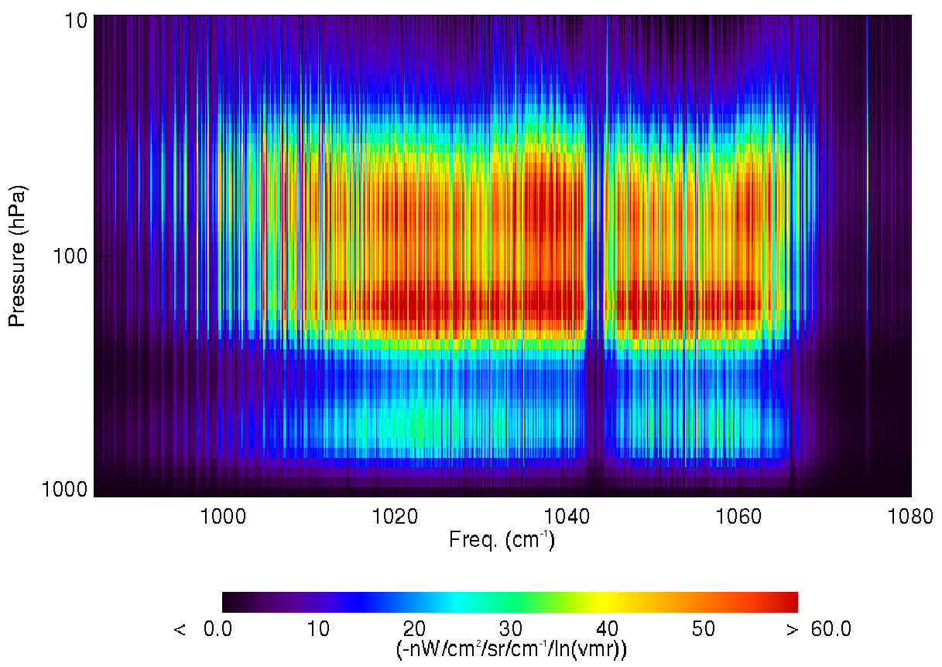
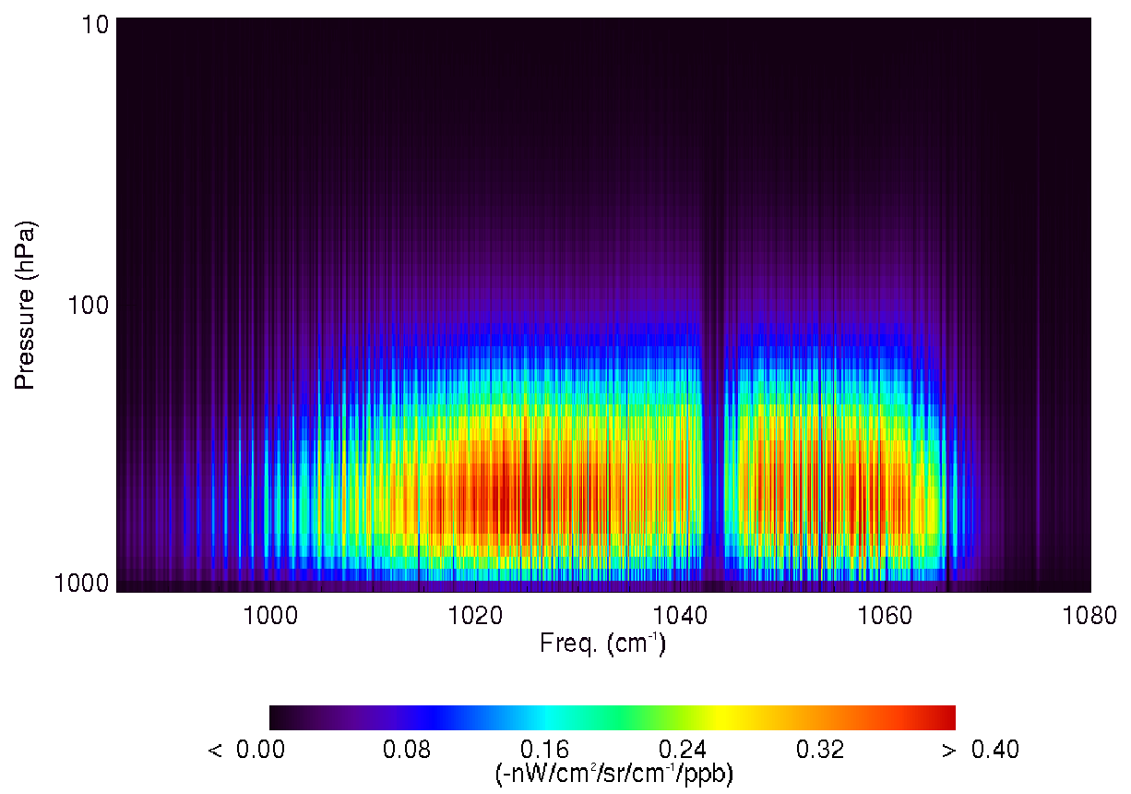
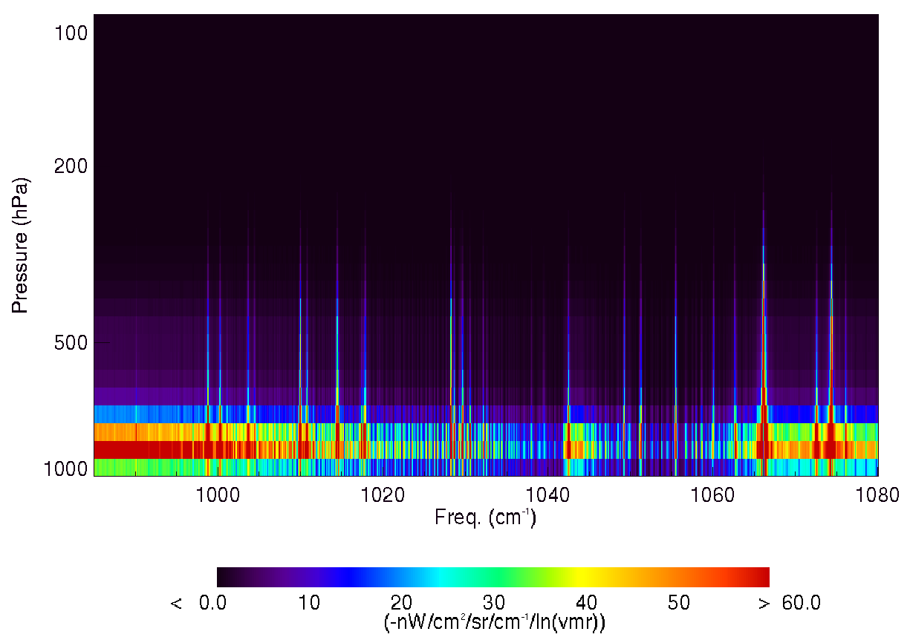
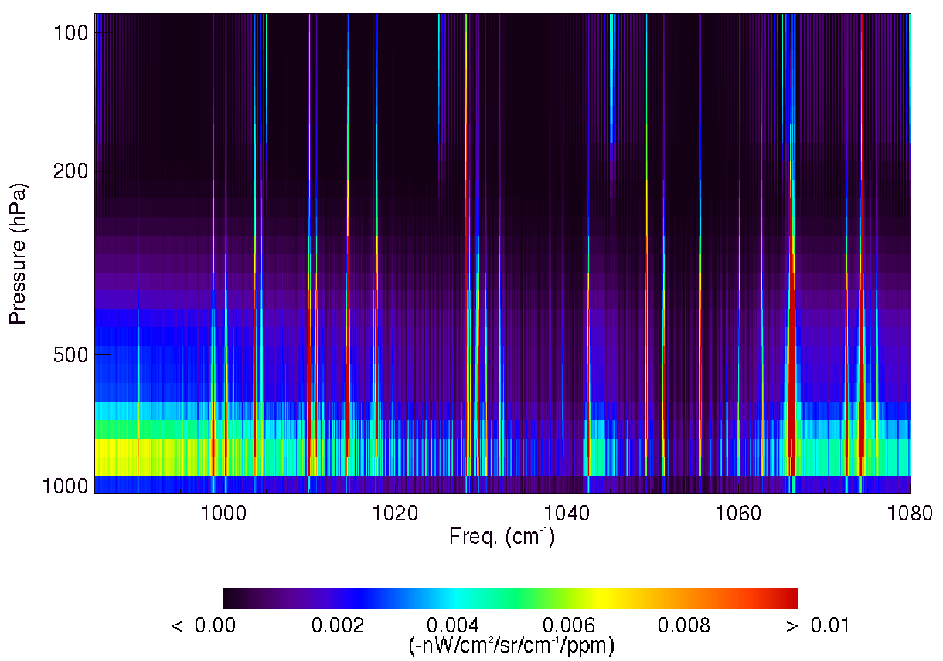
Spectral sensitivity of TOA flux to ozone and water vapor
O₃ (lnVMR) Jacobians
O₃ (ppb) Jacobians
Pressure (hPa)
TES obs. at 65°N, Aug. 2006
Frequency (cm⁻¹)
Frequency (cm⁻¹)
-nW/cm²/sr/cm⁻¹/ln(VMR)
-nW/cm²/sr/cm⁻¹/ppb
H₂O (lnVMR) Jacobians
H₂O (ppm) Jacobians
High spectral resolution is critical for separating O3 and H2O flux variability
Worden et al., JGR, 2011
Pressure (hPa)
Frequency (cm⁻¹)
Frequency (cm⁻¹)
-nW/cm²/sr/cm⁻¹/ln(VMR)
-nW/cm²/sr/cm⁻¹/ppm
Notes:
With spectral resolution, we explicitly account for the effect of water vapor when we integrate over the O3 band Jacobians since the O3 Jacobians are zeroed out when there is a strong H2O line.

Slide 14
Terminology
Jacobian: change in Spectral radiance (L) for VMR q, frequency ν
in each vertical layer l,
in W/cm²/cm⁻¹/sr/ppb
IRK: Instantaneous radiative forcing kernel including anisotropy R(ν)
in W/m²/ppb
LWRE: Longwave Radiative Effect
for tropospheric O3 in W/m²
Forward model based on LBLRTM, Clough et al, IEEE Trans. Geosci. Remote Sens. 2006

Slide 15
TES Ozone and Ozone IRKs
TES Seasonal
All-sky averages (2005-2009)
Seasonal migration of ITCZ
Maximum due to Saharan and Arabian anticyclones
Liu et al., JGR, 2009
SH influenced by biomass burning

Slide 16
IASI LWRE
From S. Doniki, ULB, Belgium

Slide 17
How Can we test climate model predictions of OZONE RF with satellite measurements of present day OZONE concentrations and IRKs?

Slide 18
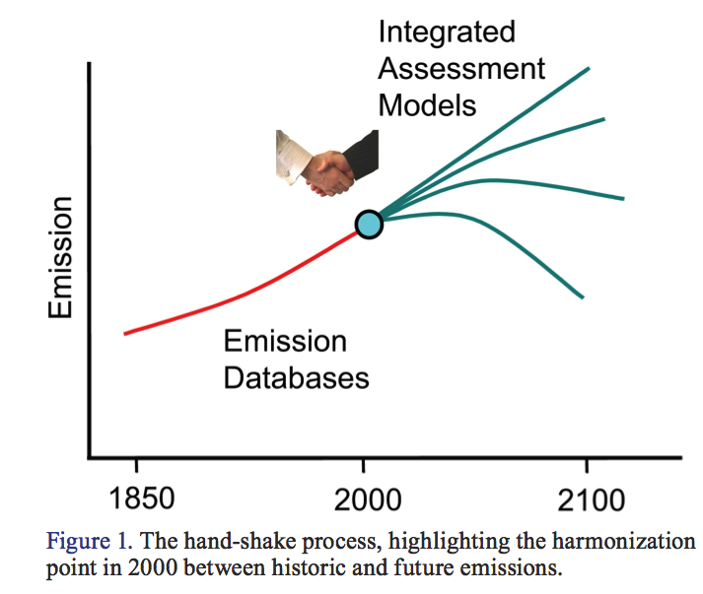
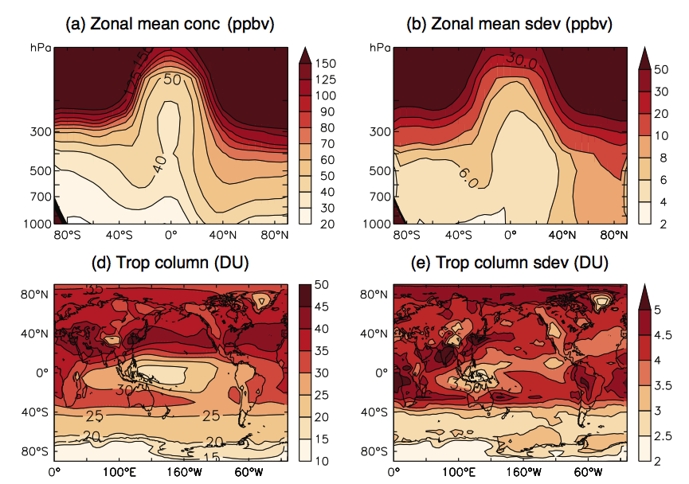
ACCMIP
The Atmospheric Chemistry-Climate Model Intercomparison Project
(ACCMIP) estimated historic radiative forcing (RF) and future response using consistent emissions for the IPCC 5th assessment.
Lamarque et al, ACP, 2010
Young et al, ACP, 2013
Lamarque et al, GMD, 2013
Notes:
Radiative forcing in the CMIP3 20th century simulations as inferred from the geographic distribution of surface temperature change and climate sensitivity/feedbacks of each model (B. Soden, personal communication, 2009). The model and the global mean radiative forcing is given above each plot

Slide 19
ACCMIP-TES comparisons
2005-2011 Average
MOCAGE and GISS are high in the Northern Hemisphere (NMLT) by more than 10ppb
Most CCMs underestimate
ozone in the tropics
ENSEMBLE
Bowman et al, ACP, 2013

Slide 20
What are the radiative implications of ozone differences?

Slide 21
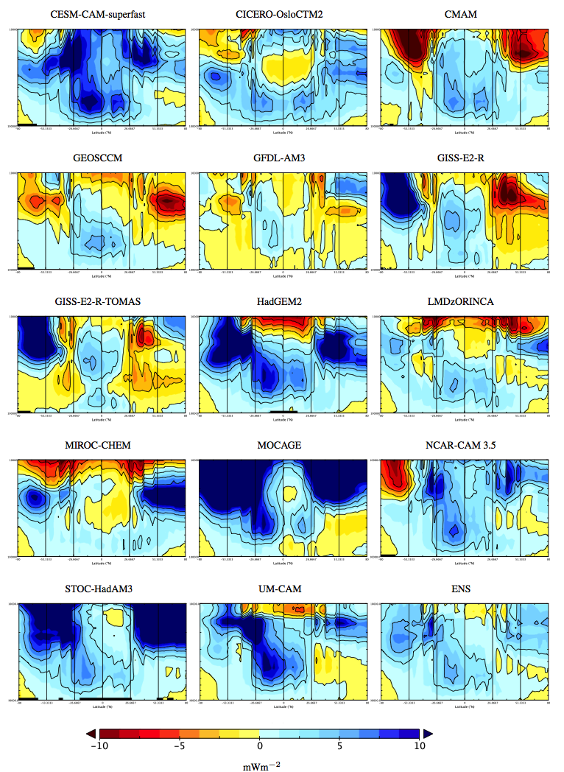
OLR impact
Change in TOA flux from ozone differences at a particular pressure (altitude):
Tropical differences in ozone at pressures greater than 600hPa led to OLR differences exceeding 10mWm⁻²
ENSEMBLE
Notes:
Zonal distribution between the ACCMIP and TES ozone profiles from 2005–2010. The vertical scale is defined
f
i
en
he
M
t
AC
ale
is
fine
s
a
C
an
o
2
de
m
IP
dT
t
n
o
s
r
ES
zon
ep
rofil
d
es
fro
m
00
01
h
er
l sc
100000-10000 Pa discretized to TES pressure levels and the zonal comparison extends from 80S-
a
80N with submarkers at 26.6, ␣␣à␣ about the equator. Positive values indicate a low bias of ␣␣␣␣␣
from 100 000–10 000 Pa discretized to TES pressure levels and the zonal comparison extends
withrespecttoTES.Colorscaleisinvertedtoshowthatalowbiasin␣␣␣␣␣ isamodelunderestimate
◦ ◦ of radiative forcing relative to TES. Ensemble mean bias◦in ␣␣␣␣␣ with respect to TES is denoted by from 80 S–80 N with submarkers at 26.6, 53.3 about the equator. Positive values indicate a
ENS.
low bias of iRFcm with respect to TES. Color scale is inverted to show that a low bias in iRFcm is a model underestimate of radiative forcing relative to TES. Ensemble mean bias in iRFcm with respect to TES is denoted by ENS.

Slide 22
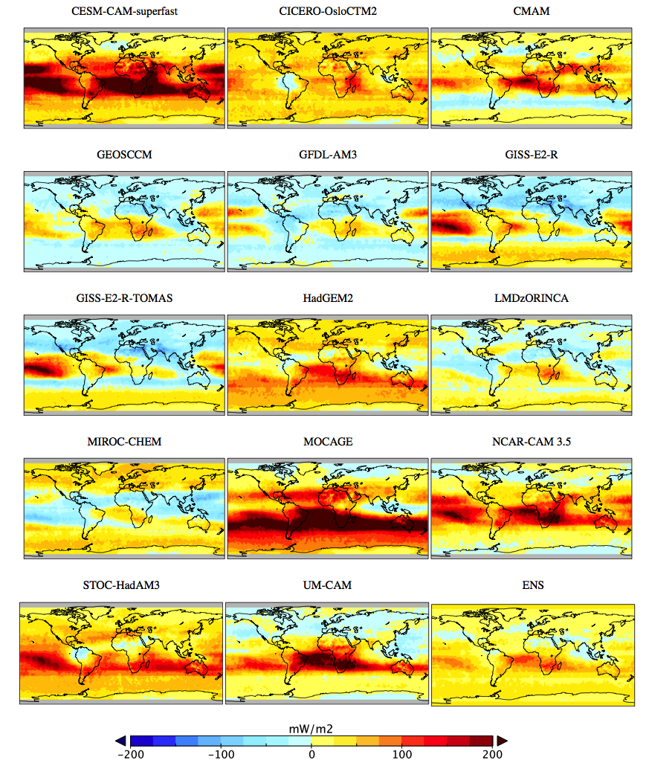
Spatial impact
Tropical Pacific differences vary significantly across ACCMIP models
Ensemble difference shows persistently high values over
100 mWm⁻² in the Tropical Atlantic and South Africa
ENSEMBLE
Notes:
Spatial distribution of iRF between T29ES and ACCMIP averaged from 2005–2010 and m
◦ ◦ limited to 80S-80N. The spatially-resolved instantaneous radiative forcing difference is based on limitedto80 S–80 N.Thespatially-resolvedinstantaneousradiativeforcingdifferenceisbased
a chemical tropopause ␣ à ␣à ppb as diagnosed from TES. ACCMIP ensemble is denoted by ENS. onachemicaltropopPaosiutivsevealuqesin<dic1ate5th0atTpEpSobzonaesradidativaefgorncinogsisehigdhreflraotivmetotTheEmoSde.l.ACCMIPensembleisdenoted by ENS. Positive values indicate that TES ozone radiative forcing is high relative to the model.

Slide 23
Zonally integrated OLR difference
Bowman et al, ACP, 2013
Integrating through the troposphere to the tropopause (q<150 ppb) leads to significant biases relative to TES.
In the tropics, discrepancies lead to over 300 mWm⁻² for individual models and up to 100 mWm⁻² for the ACCMIP ensemble. Mean NH bias is negligible.

Slide 24
Where did ozone radiative forcing come from?

Slide 25
IPCC AR5 RF by Emissions
Ozone doesn’t have direct emissions
Ozone precursor emissions are
NOx, VOCs, CO and CH₄
Interactions through OH and CH₄:
CO increases CH₄ lifetime
NOx decreases CH₄ lifetime

Slide 26
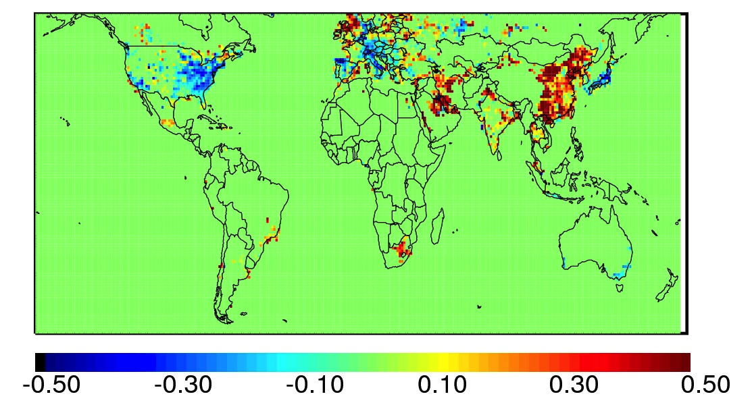
Spatial Evolution of Air Quality
Fractional change in NO2 emissions from 2005-2010 constrained by OMI observations.
From Lamsal et al, GRL, 2011. Taken from
http://fizz.phys.dal.ca/~atmos/martin/
There has been a dramatic shift in the spatial distribution
of pollution. Decreases in the Eastern US and Europe have
been offset by Asia.
What are the implications for global surface ozone (air quality)
And mid-upper tropospheric ozone (climate)?

Slide 27
Connecting TOA O₃ flux to emissions
Sensitivity of TOA at
one location with respect
to precursor emissions
E=[E₁,E₂,…,E_{N}]
Use chain-rule to
link TES Instantaneous
Radiative Kernels to emissions through GEOS-Chem adjoint
GEOS-Chem
adjoint
TES
IRK
(a_{i}/A = normalized model grid cell area)

Slide 28
Attribution of ozone Direct Radiative Forcing (DRF) to NOx emissions
x
Bowman and Henze, GRL, 2012

Slide 29
Attribution of ozone DRF to CO emissions

Slide 30
Radiative Forcing Efficiency
Define a radiative
forcing efficiency to
separate emission strength
versus location

Slide 31
Implications for air quality-climate co-benefits
Define emissions
with equivalent
ozone DRF
mW/m²
27 regions satisfy this criterion.
NOx emissions represent about 64±14% of the total ozone DRF
How do emissions vary intercontinentally and intracontinentally for the same ozone DRF?

Slide 32
Change in absolute emissions
NOx emissions from Atlanta are over a factor of 3 smaller than Chicago but with comparable ozone DRF.
CO emissions from Guatemala City are a factor of 20 smaller than Beijing.
Brunei NMHC emissions are a factor of 5 smaller than Philadelphia
NOx emissions
CO emissions
NMHC emissions
Regional air quality/climate co-benefits can be quantified in terms of ozone direct radiative forcing.
But… Quantification of methane feedbacks necessary for a full air quality-climate co-benefit analysis.

Slide 33
Conclusions
The international consensus to avoid “dangerous” climate change has intensified interest in mitigating climate change through controls of short-lived climate forcers (or short-lived climate pollutants)
Strategies for controlling both air and climate pollutants require accurate measurements, models and assessments
Satellite observations can contribute to this:
TES observations have documented present day biases in ACCMIP OLR and reduced ensemble model spread of ozone radiative forcing
The integration of TES with GEOS-Chem has shown large regional variability of direct ozone radiative forcing from precursor emissions
Proposed work to benchmark satellite – model differences in O₃ band TOA flux and flux sensitivity
Continuing the TES record with IASI data is critical for understanding present day – future changes in O₃ radiative forcing
Next – Multi-spectral O₃ observations for future satellites

Slide 34
TIR: Provides FT profile information
VIS: Provides column information
UV: Provides partial column information
atmospheric emission
solar backscatter
surface emission
O₃ Multi-Spectral Remote Sensing
DOAS UV Retrieval
Notes:
10/20/14
34

Slide 35
Two eyes are better than one: IR and UV
IR
ATMOS
CLAES
HALOE
IMG
MIPAS
TES
AIRS
ACE-FTS
IASI
CrIS
UV
TOMS
SAGE
SBUV
SOLCE
OSIRIS
SCIAMACHY
OMI
GOME
GOME-2
UV and IR measurements provide complimentary sensitivity to ozone. Worden et al, GRL, 2007 and Landgraff and Hasekamp, JGR, 2007 showed the feasibility of estimating boundary layer ozone. Fu et al, ACP, 2013 and Cuesta et al, ACPD, 2013 have demonstrated the potential for TES and IASI.

Slide 36
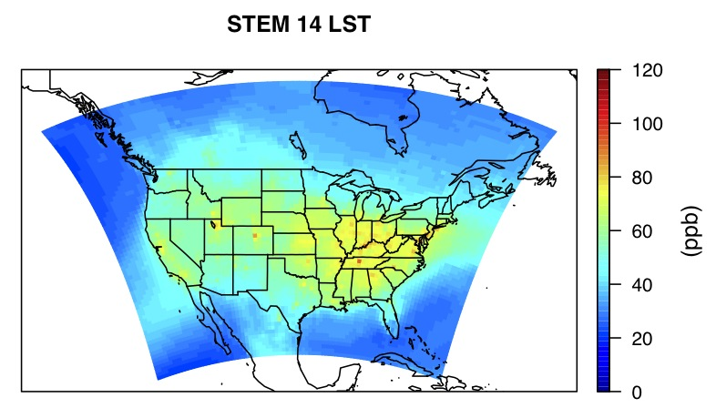
Towards a geostationary perspective: NA
From Min Huang (JPL)
TES+OMI retrievals August 2006
~1500 soundings
High ozone in Southern California
High ozone in Mountain States (Nevada, Wyoming)
Not measured by AQS
WRF-STEM (also in GEOS-Chem) has known high bias in the NE relative to TES+OMI and AQS
Notes:
About 1500 cases passed the quality flag.
The quality flags were defined as following:
abs(Mean spectral residual) <=0.1
RMS(Mean spectral residual) <1.25
Cloud fraction <=30%.
Passed the TES standard CCurve detection algorithm.

Slide 37
Towards a geostationary perspective: NA
R=
R=
Analysis from M. Huang and D. Fu (JPL)
AQS matched to Aura location/time
TES+OMI PBL ozone is highly correlated with surface AQS sites in the West—consistent with sonde comparison
TES+OMI PBL ozone is correlated across all AQS sites—close to WRF-STEM and significantly more correlated than TES or OMI over the US

Slide 38
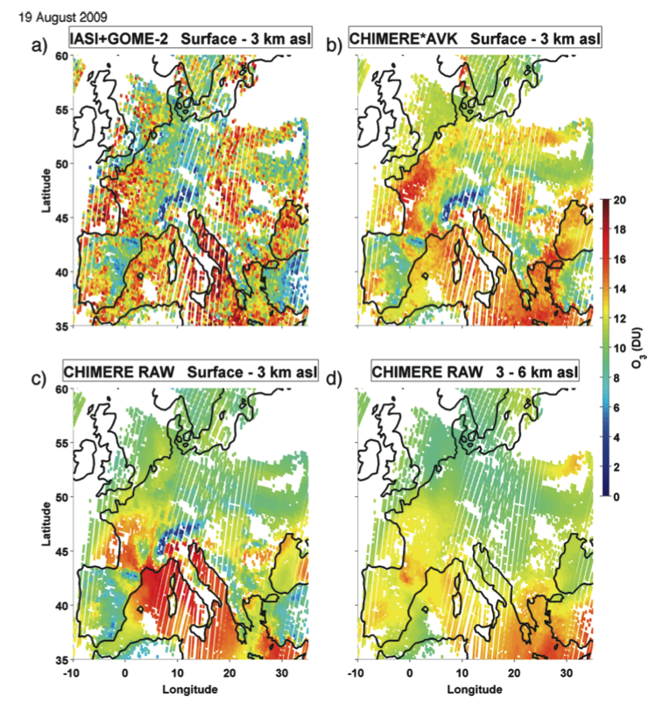
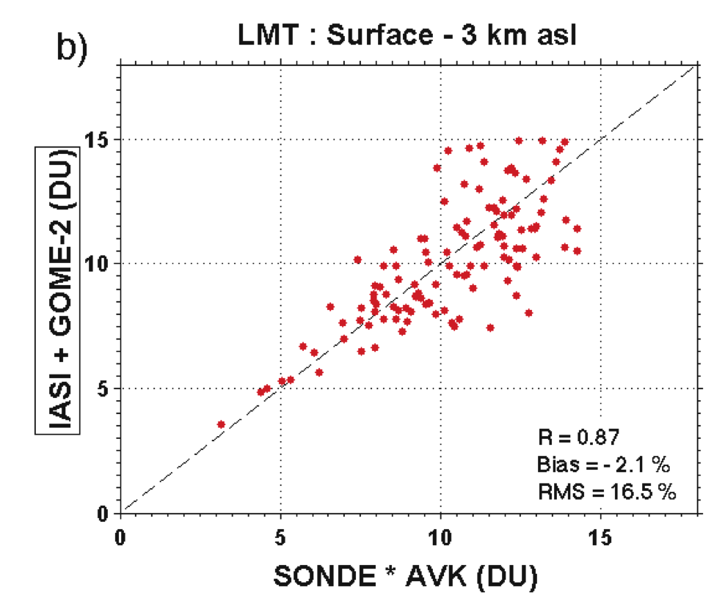
Towards a geostationary view: Europe
Cuesta et al, 2013 show IASI-GOME-2 ozone
retrievals have a strong
spatial correlation with
CHIMERE in the PBL
Strong correlation with ozone sondes in the PBL similar to TES+OMI
Notes:
Fig. 6. Validation of IASI+GOME-2 ozone retrievals in the (a and c) lower troposphere (LT, up to 6 km a.s.l.) and (b and d) lowermost troposphere (LMT, up to 3 km a.s.l.) against ozonesonde measurements over Europe during the summer of 2009 (119 sondes launched from 10 stations during 57 different days). In upper panels (a,b), ozonesonde are smoothed by IASI+GOME-2 AVKs and in lower panels (c,d), raw ozonesonde measurements are considered. Dashed lines are straight lines crossing zero with slope equal to one.

Slide 39
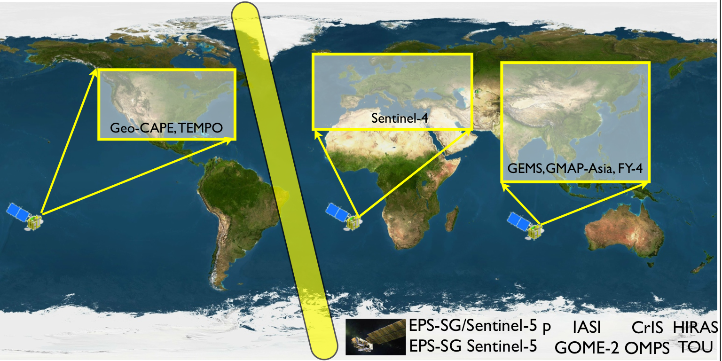
Toward an Air Quality-Climate Constellation
Bowman et al, Atm.Eniv. 2013
IASI+GOME-2 will provide UV+IR ozone products for more than a decade as a part of METOP-(A,B,C).
Continued investments in UV+IR algorithms.
LEO observations to integrate GEO platforms
Opportunity to cross-calibrate observations
Combined UV+IR ozone products from GEO-UVN and GEO-TIR aboard Sentinel 4 (Ingmann et al, 2012 Atm. Env.)

Slide 40
Backup

Slide 41
What other model parameters for ozone rf can we compare to satellite measurements?

Slide 42
Benchmarking climate model top-of-atmosphere radiance in the 9.6μm ozone band compared to TES and IASI observations (NASA ROSES-13 Aura S.T)
Proposal Team
Helen Worden, P.I., NCAR
Kevin Bowman, Co-I., JPL/CalTech
Andrew Conley, Co-I., NCAR
Jean-François Lamarque, Co-I., NCAR
Olga Pechony, Co-I., Columbia University
Drew Shindell, Co-I., NASA-GISS, Columbia Univ.
Cathy Clerbaux, collaborator, LATMOS-IPSL, France
Pierre-François Coheur, collaborator, ULB, Belgium
William Collins, collaborator, Univ. of California, Berkeley
Andrew Lacis, collaborator, NASS-GISS
Steve Massie, collaborator, NCAR
Notes:
This talk presents some of the background and motivation for our recently funded proposal

Slide 43
Resolved Infrared Ozone Spectrum
CO₂
O₃
H₂O, N₂O
Notes:
I have been working on an instrument that is making a vital contribution to our understanding of atmospheric composition, its coupling to climate and the Earth system. It’s called the Tropospheric Emission Spectrometer, launched aboard the Aura spacecraft (shown here to the left) in 2004 a part of NASA’s Earth Observing System. The keyhole at the base of Aura is TES and is suggestive of its two modes of operation: nadir and limb. The nadir mode looks down and has a horizontal footprint of 0.5x5km for each of its 16 detectors. Averaged together, leads to a footprint of 8x5km. The limb mode peers backwards and has a spatial footprint of 2.3x23km.
What does TES measure? Thermal spectral radiation an example of which is shown in the middle figure. The resolution of this spectrum, which we will discuss momentarily, is key to obtaining vertical information about atmospheric constituents.

Slide 44
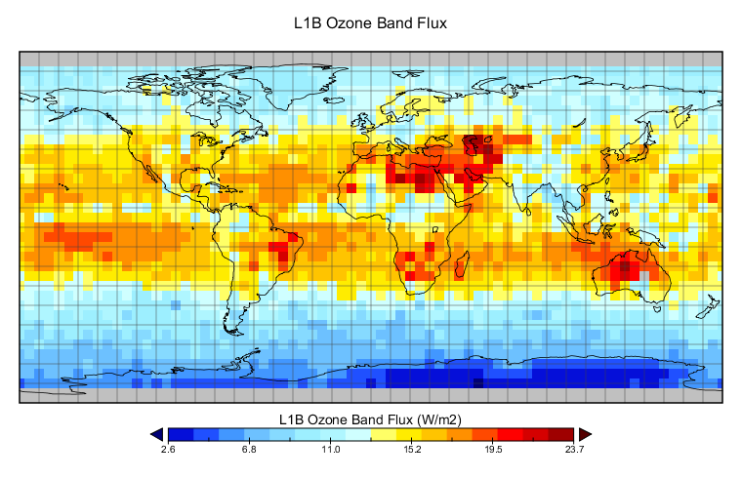
TES TOA O₃ Band Flux
August 2006 Average
This is a fundamental quantity, predicted by climate models, but never tested against observations.

Slide 45
Model-TES IRK Differences
Δ_{LWRE}
Bowman et al., ACPD, 2013
Latitude (deg)
Zonal averages: GISS RTM TOA flux sensitivity
and TES IRKs applied to same model differences

Slide 46
Model-Model LWRE Differences
From A. Conley, NCAR
Same atmosphere and surface conditions
Large differences for both clear and all-sky cases
Notes:
RRTMG is the Rapid Radiative Transfer Model for GCMs from AER

Slide 47
Benchmarking O₃ band TOA flux
The proposal addresses two primary science questions:
What is the bias in IPCC climate model predictions of present day top-of-atmosphere (TOA) flux in the 9.6mm ozone band?
What is the impact of an ozone band TOA flux bias on present day tropospheric ozone flux sensitivity and pre-industrial to present day ozone radiative forcing estimates?
These will be tested with CAM-chem, RRTMG and GISS RT models using TES and IASI TOA flux and IRKs

Slide 48
WHAT are the potential feedbacks to Ozone TOA Flux from changes in Water Vapor?

Slide 49
H₂O and O₃ are radiatively coupled
O₃ (lnVMR) Jacobians
Pressure (hPa)
Pressure (hPa)
Frequency (cm⁻¹)
-nW/cm²/sr/cm⁻¹/ln(VMR)
-nW/cm²/sr/cm⁻¹/ln(VMR)
H₂O (lnVMR) Jacobians
65°N
6.2°N
Pressure (hPa)
Pressure (hPa)
Frequency (cm⁻¹)
-nW/cm²/sr/cm⁻¹/ln(VMR)
-nW/cm²/sr/cm⁻¹/ln(VMR)

Slide 50
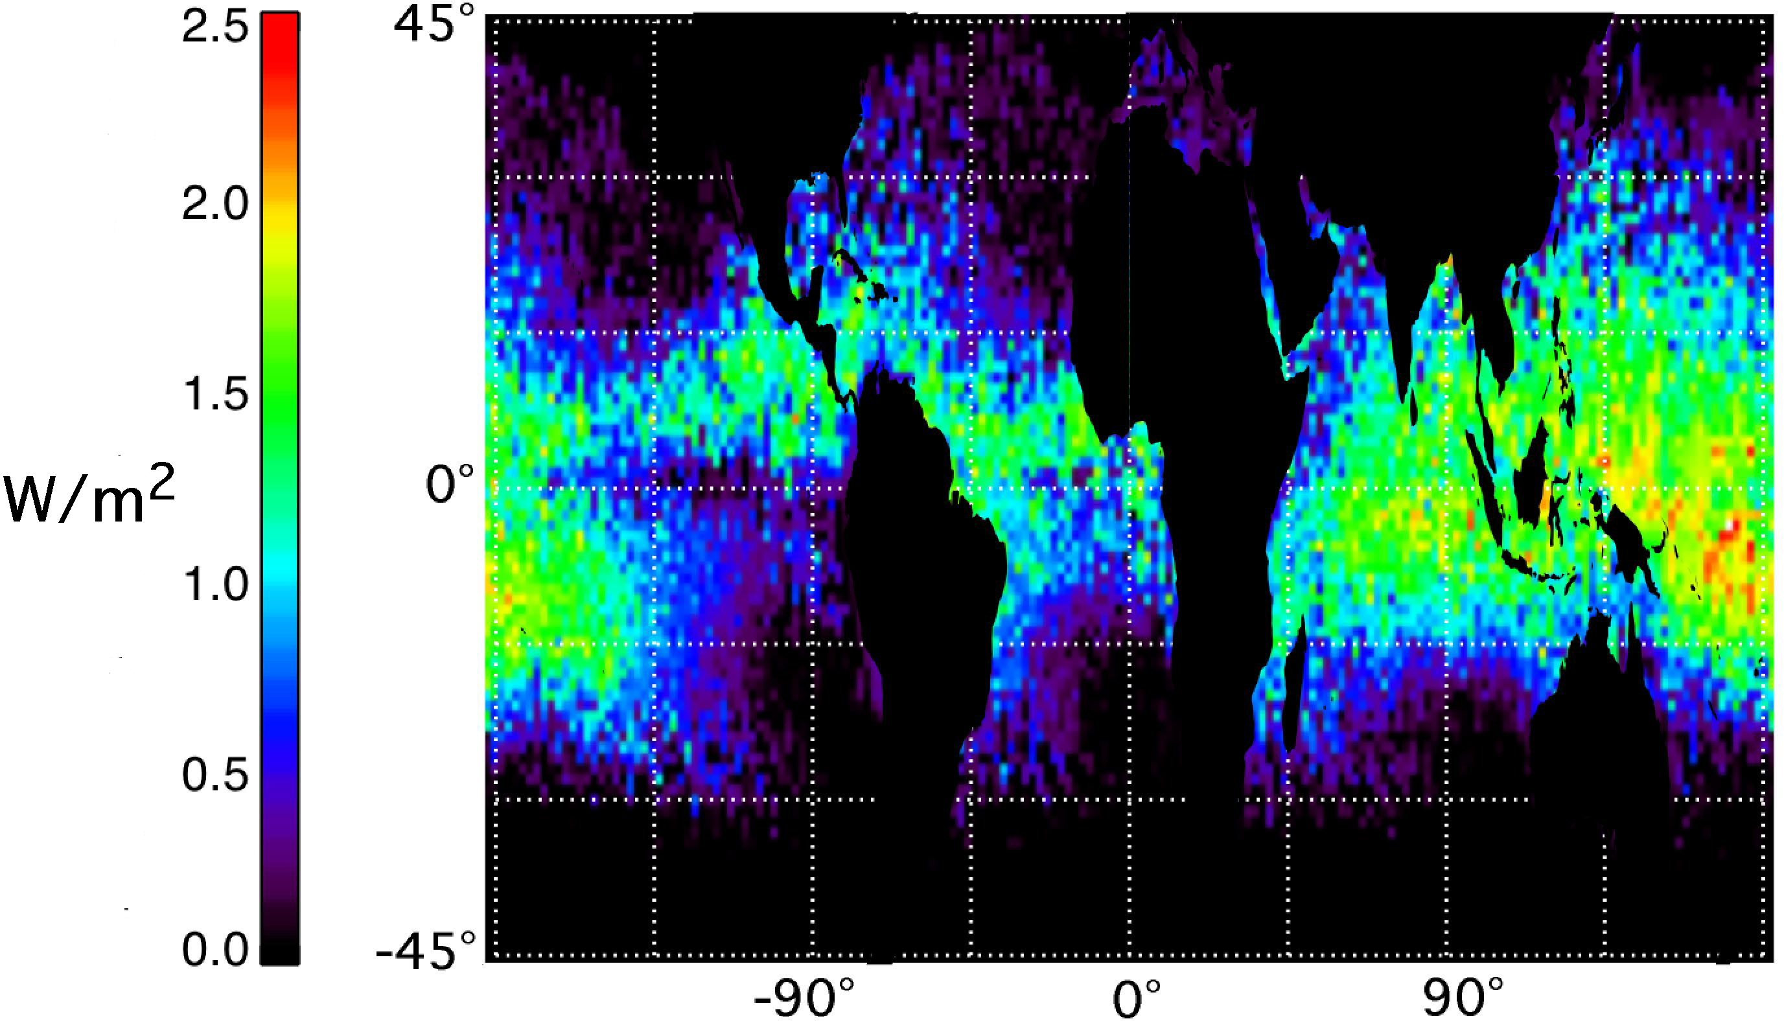
H₂O and O₃ are radiatively coupled
Water vapor LWRE in the IR ozone band
IPCC AR5 FAQ 8.1 Fig. 1: Water cycle
with water vapour feedback ~7%/°C
Worden et al., Nature GEO, 2008
Understanding the feedback of water vapor on ozone RF (more water = less O₃ RF) due to changes in the hydrological cycle from climate change will require the long-term measurements of IASI (A,B,C) and IASI-NG

Slide 51
Flux Estimate and Anisotropy
Flux:
L(θ,φ)
θ
φ
Anisotropy:

Slide 52
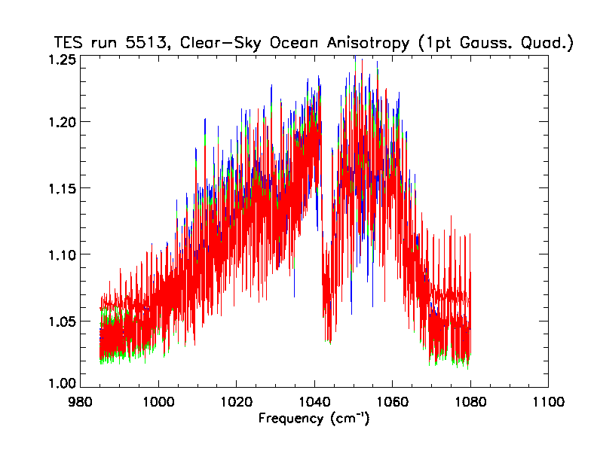
Anisotropy Results
Red = -5°-15°N
Green = 15°-30°N
Blue = 30°-45°N
TES anisotropy spectra
for clear-sky ocean scenes
AIRS clear-sky anisotropy
models: 14 sub-scenes for
prec. wv, T_lapse, T_sur
X. Huang et al., JGR, 2008

Slide 53
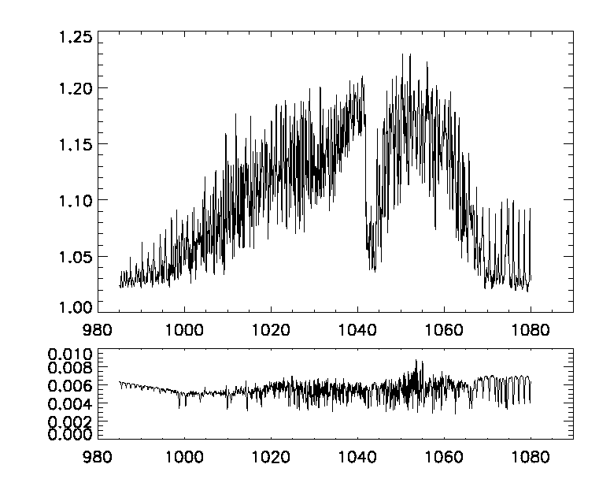
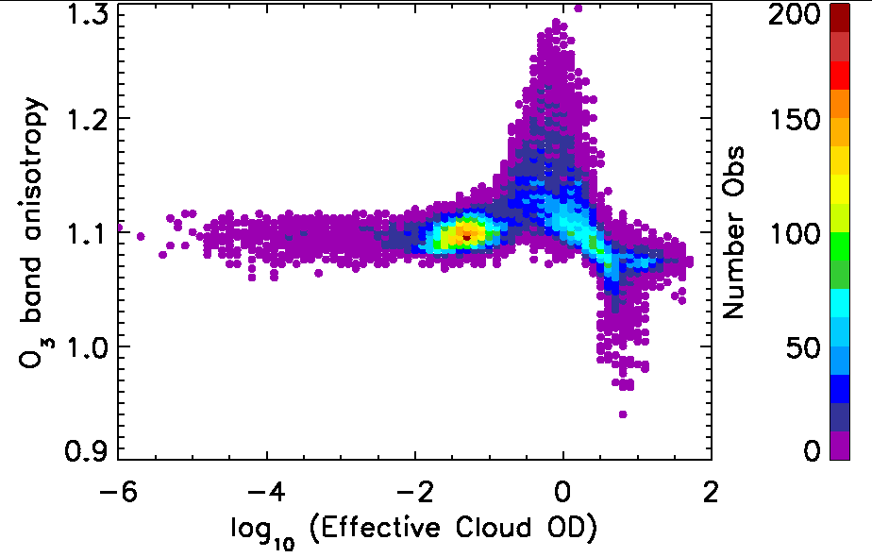
ANISOTROPY ESTIMATE
R spectral dependence
R cloud OD dependence
TES Anisotropy
Worden et al., JGR, 2011

Slide 54
Spectral Anisotropy Estimate
R = anisotropy, F = flux, L = radiance, θ=nadir angle, ν=frequency
(assumes azimuthal symmetry)
Let x = sinθ, then dx = cosθdθ
using Gaussian integration of moments. From Abramowitz & Stegun
for n=1, k=1: x_{i} = 0.666667 and w_{i} = 0.50

Slide 55
What is an air pollutant?
“Because greenhouse gases fit well within the Clean Air Act’s capacious definition of “air pollutant,” we hold that EPA has the statutory authority to regulate the emission of such gases from new motor vehicles.”
MASSACHUSETTS v. EPA
Opinion of the Court, April 2nd, 2007
Justice Stevens
Air pollutants now include Greenhouse Gases (GHG)
Air quality constituents, e.g., ozone and black carbon, are also GHGs
Air quality can effect both human and environmental health, with implications for carbon cycle feedbacks

Slide 56
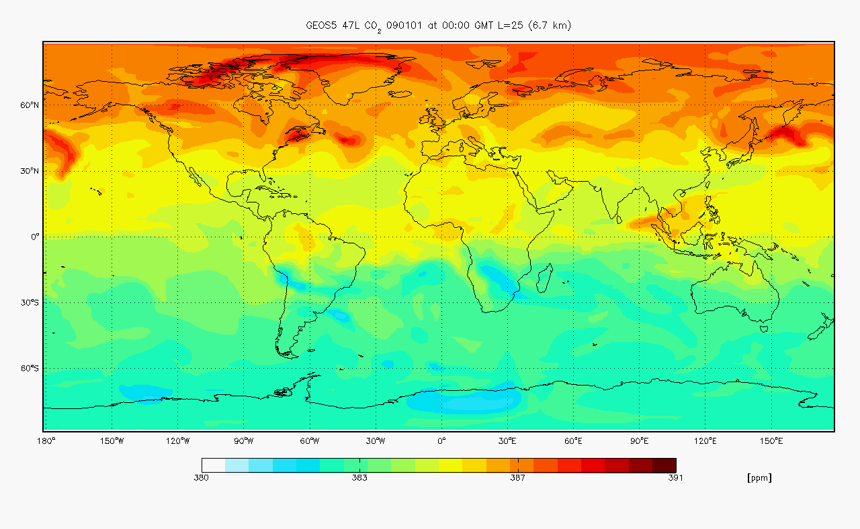
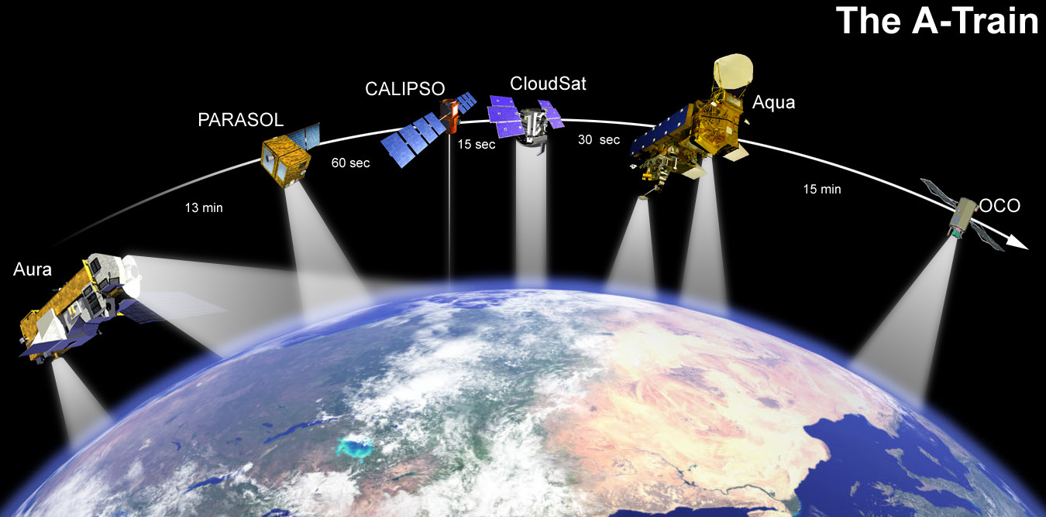
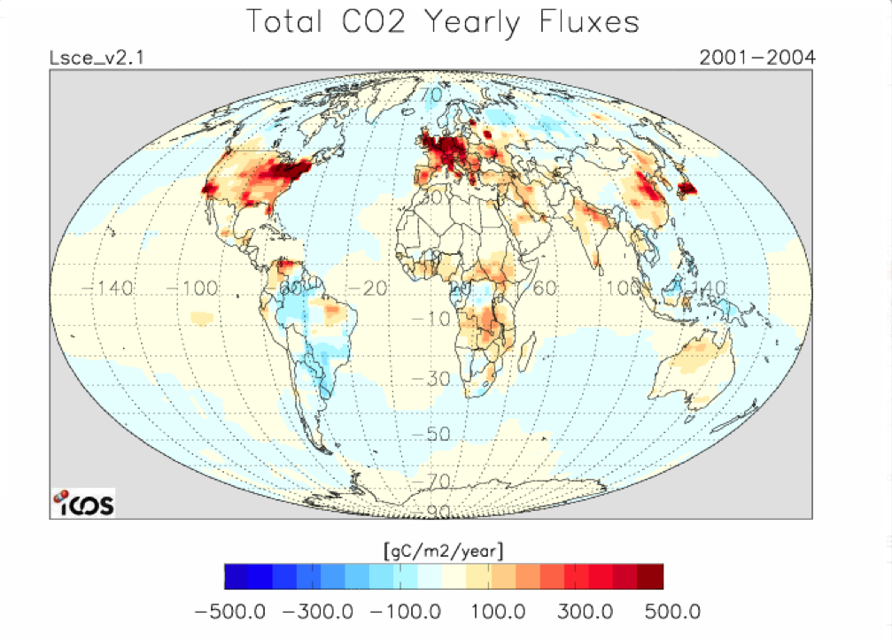
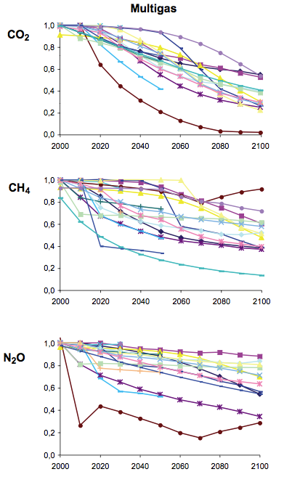
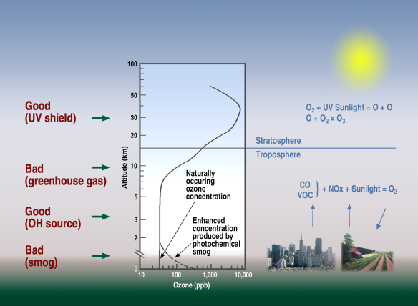
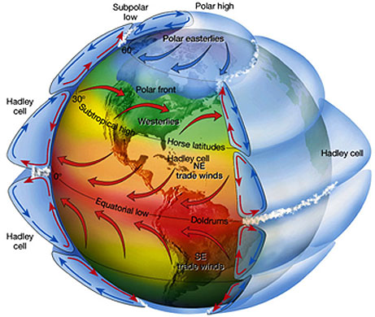
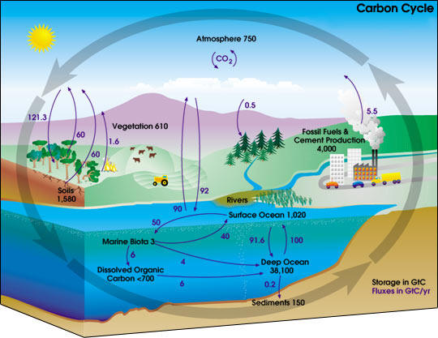
A Climate Forcing Attribution and Mitigation Monitoring System
Composition transport models
Observations
State
Estimation
F
Policy
Earth System models: Feedbacks
Response
Forcing
Impacts: Water availability,
air quality, biodiversity
IPCC AR 4 WG III

Slide 57
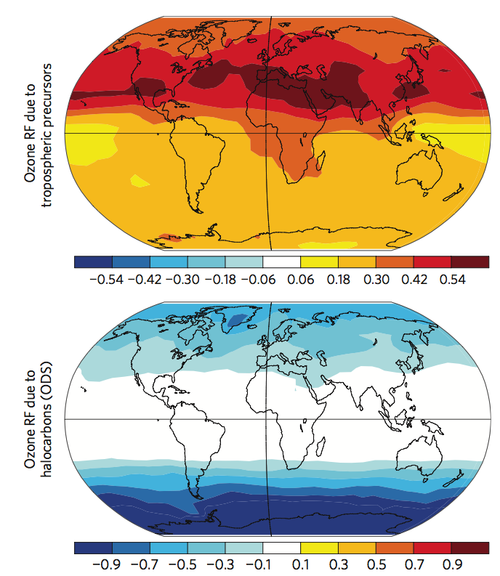
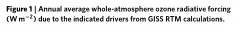
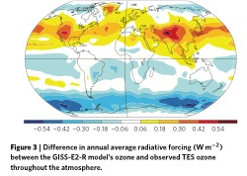
Attribution of historical ozone forcing to anthropogenic emissions
Key Science Facts:
Positive ozone changes lead to positive radiative forcing (RF) in the troposphere or negative RF in the stratosphere.
Ozone depleting substances (ODS), e.g., CFCs, HFCs, remove ozone but are also important greenhouse gases (GHG).
Shindell et al, Nature Climate Change, 2013 used the the GISS chemistry-climate model biased-corrected with TES ozone (~30% reduction in ODS RF) to compute the “whole-atmosphere” ozone radiative forcing from ozone precursor emissions like NO₂ and ODS
The GISS/TES analysis found that
ozone RF from industrial precursor emissions was 0.47 W/m², about 35% higher than reported in the IPCC AR4 (0.35 W/m²).
ozone RF from ODS by reducing both tropospheric and stratospheric ozone was -0.23 W/m², much lower than previous studies
Positive RF from ODS as a GHG (0.32 W/m²) is almost compensated by the ODS as a negative ozone RF

Slide 58
Preindustrial to present day radiative forcing
Natural background
correction
T₀ ε [1850,1855]
T_{p}ε [2005,2010]

Slide 59
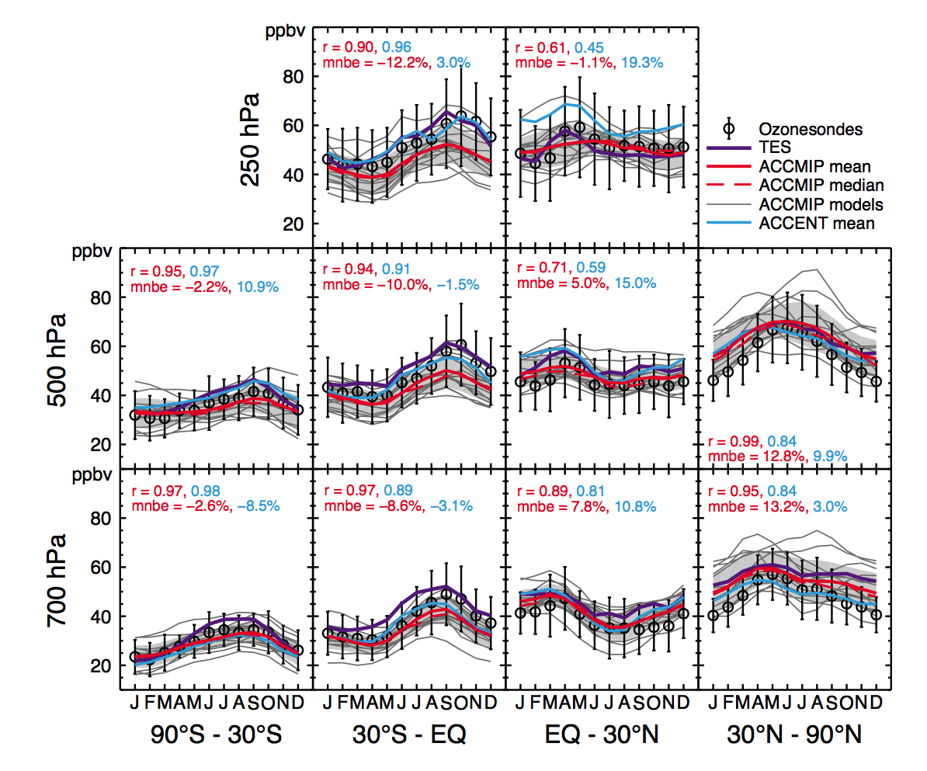
Ozonesondes, TES, and ACCMIP
Overestimate in the Northern Hemisphere
Underestimate
in the southern (sub-)tropics
Young et al, ACP, 2013
Notes:
POINTS: low bias in tropical upper troposphere, TES matches sondes. But sondes are sparse.
Comparison of the annual cycle of ozone, between ozonesonde observations (black circles) and the ACCMIP
ensemble mean (solid red line), ACCMIP ensemble median (dashed red line) and the ACCENT ensemble mean (blue
line) (Stevenson et al., 2006). Ozone concentrations from TES (purple line) are also shown. ACCMIP model data is
from the 2000 time slice mean of the Historical experiment. Model and observational data were grouped into four
latitude bands (90
◦
S to 30
◦
S, 30
◦
S to 0
◦
, 0
◦
to 30
◦
N and 30
◦
N to 90
◦
N) and sampled at three altitudes (700 hPa,
500 hPa and 250 hPa), with the models sampled at the ozonesonde locations before averaging together. The individual
ACCMIP models are represented by the thin grey lines, with the grey shaded area indicating ±1 standard deviation
about the ACCMIP ensemble mean, showing the model spread. Error bars on the observations indicate the average
interannual standard deviation for each group of stations. The correlation (r) and mean normalised bias error (mnbe)
for the ACCMIP (red) and ACCENT (blue) ensemble means versus the observations are also indicated in each panel.
This ﬁgure is an update of of Stevenson et al. (2006).

Slide 60
What are the implications of olr differences on radiative forcing?

Slide 61
Is OLR bias related to ozone RF?

Slide 62
Correlation of OLR bias with ozone RF
Bowman et al, ACP, 2013
Significant correlation for ACCMIP OLR bias and ozone RF (R²=0.59)
Removing MOCAGE and CESM reduces correlation to R²=0.18
Observationally constrained ozone RF = 394 ± 42 mWm⁻²
About 28% reduction in uncertainty compared to 389 ± 60 mWm⁻²

Slide 63
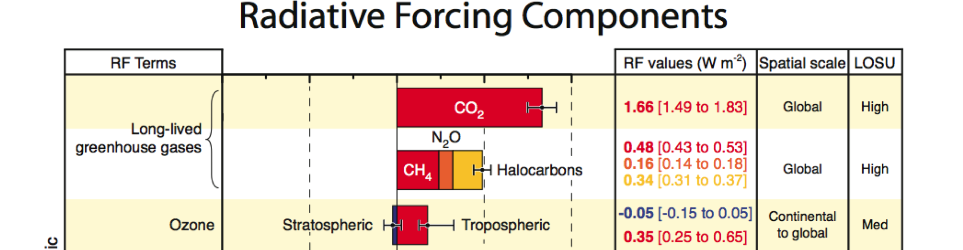
Observational constraint on ozone RF
IPCC AR4: 350 [250 to 650] mWm⁻²
ACCMIP: 389 [329 to 449] mWm⁻²
ACCMIP/TES: 394 [352 to 436] mWm⁻²
FROM IPCC AR5 Ch. 8: “Because we have low confidence in the pre-industrial ozone observations, and these were extremely limited in spatial coverage, it is not possible to calculate a purely observationally based ozone RF. However, modern observations can be used to assess the performance of the chemistry models. Bowman et al. (2013) used satellite retrievals from the TES instrument to constrain the RF from the ACCMIP models. This reduced the inter-model uncertainty by 30%; however, we still maintain overall the (–50% to +50%) 5 to 95% confidence range for AR5.”
Notes:
ACCMIP estimates do not incorporate uncertainties in preindustrial emissions, radiative transfer etc.
For IPCC AR5: The best estimate of tropospheric ozone RF taking into account the ACCMIP models and the Søvde et al. (2011) results (the Skeie et al. (2011a) and Shindell et al. (2013a) models are included in ACCMIP) is 0.40 (0.20–0.60) W m–2. The quantifiable uncertainties come from the inter-model spread, (–0.11 to 0.11 W m–2) and the differences between radiative transfer models (–0.07 to 0.07 W m–2); all 5–95% confidence interval.
Bowman et al. (2013) used satellite retrievals from the TES instrument to constrain the RF from the ACCMIP models. This reduced the inter-model uncertainty by 30%, however we still maintain overall the (–50% to +50%) 5–95% confidence range for AR5.

Slide 64
Attribution of Ozone Direct Radiative Forcing (DRF) to spatially resolved emissions
How can we combine observed TOA fluxes and
attribute their variability to changes in emissions?
Define cost function as global mean outgoing longwave radiation (W/m²)
Define sensitivity of
mean OLR to emissions

Slide 65
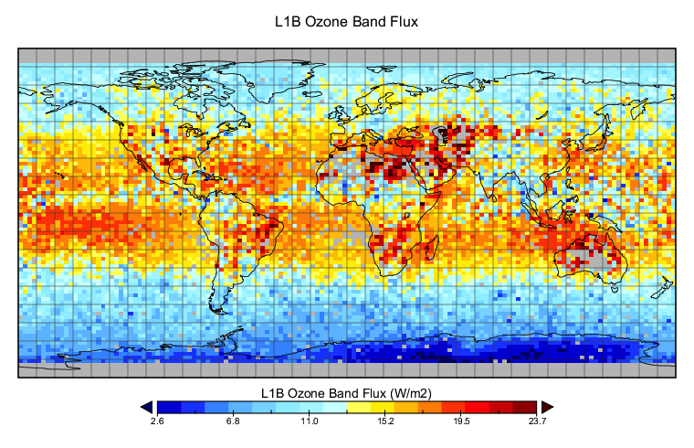
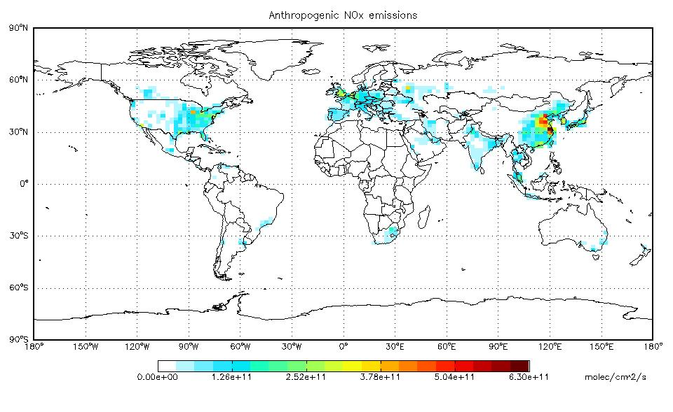
What is the impact of a NOx emission at one location on mean OLR?
J=Mean
δJ(NOx)

Slide 66
H₂O and O₃ are radiatively coupled
Worden et al., JGR, 2011
Tropospheric ozone LWRE has a strong dependence on water vapor in the tropics.
Notes:
different amounts of precipitable water vapor can change the tropical clear-sky LWRE of tropospheric ozone by up to a factor of 5. Regions of high humidity lead to a relatively optically thick atmosphere where ozone variability has little impact on TOA flux variability, i.e., ozone and water vapor are radiatively coupled in the TOA flux. Changes in the spatial distribution of ozone precursor emissions, e.g., increases in Asia, coupled with changes in the hydrological cycle from climate change will lead to different patterns of ozone forcing.

