Slide 1


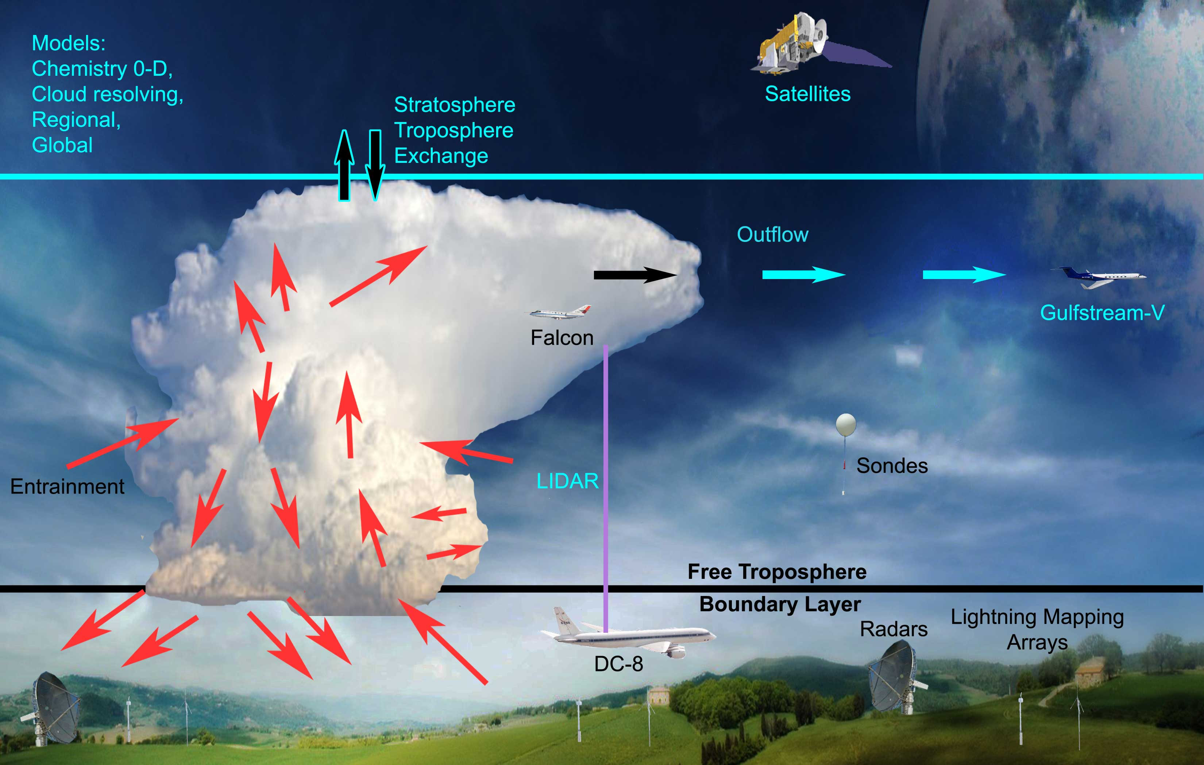
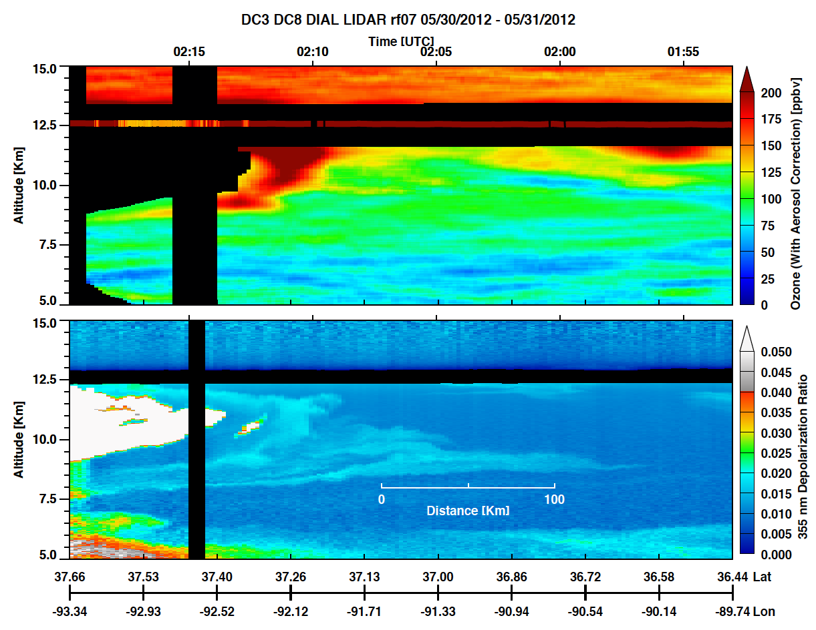
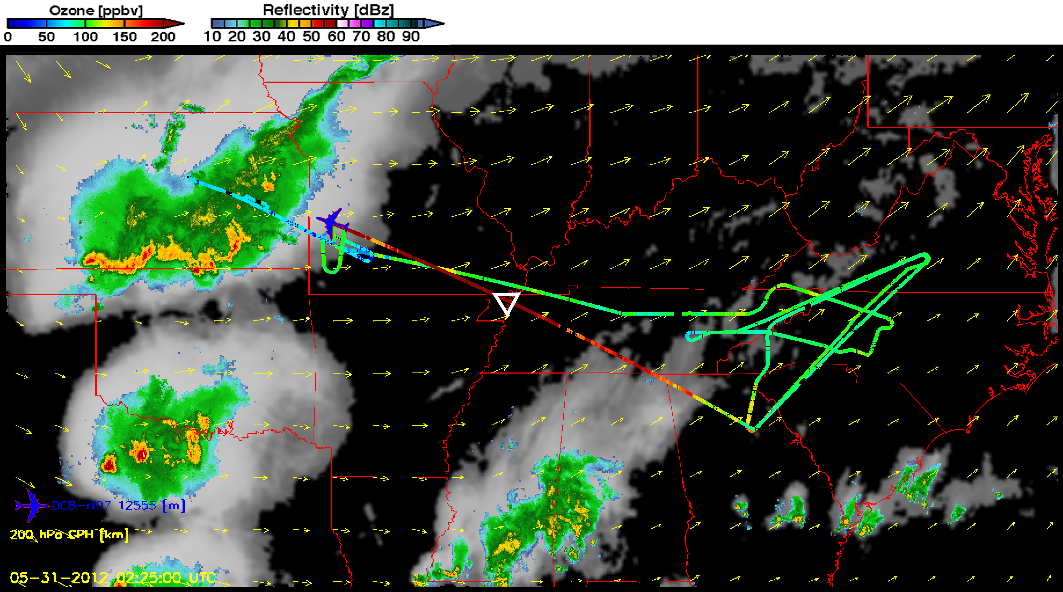
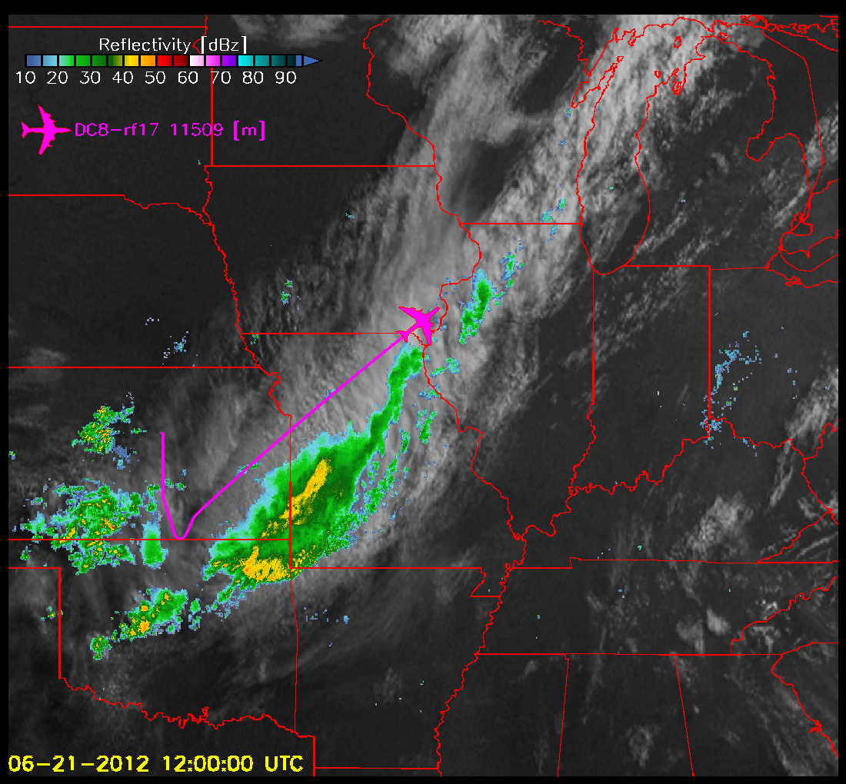
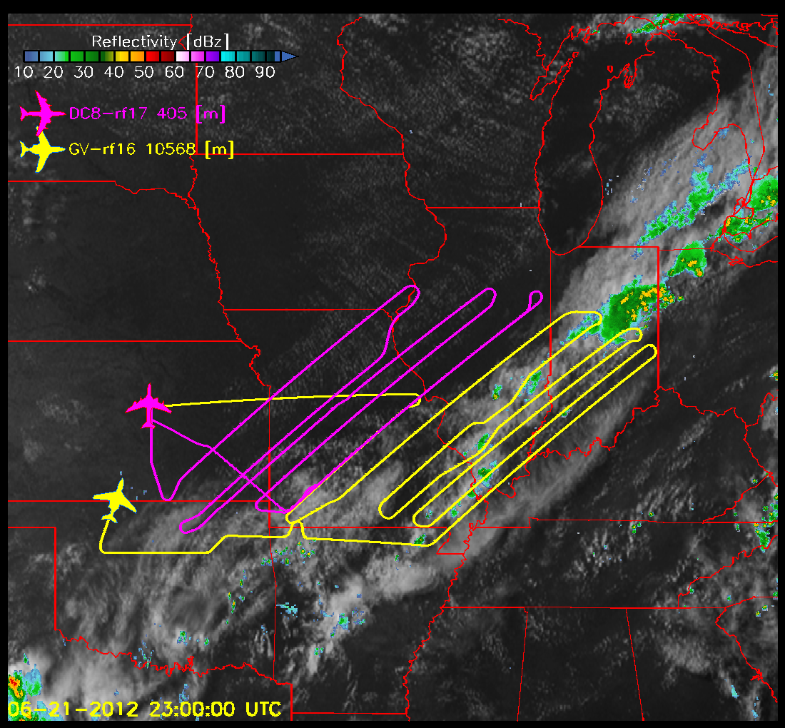
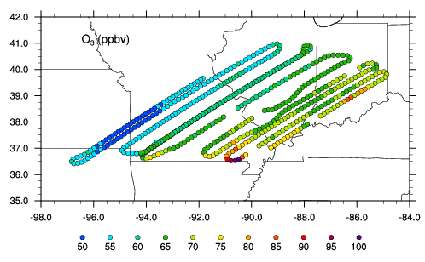
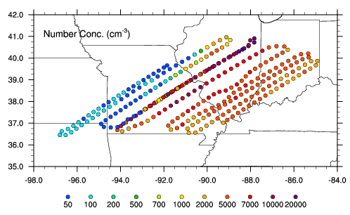
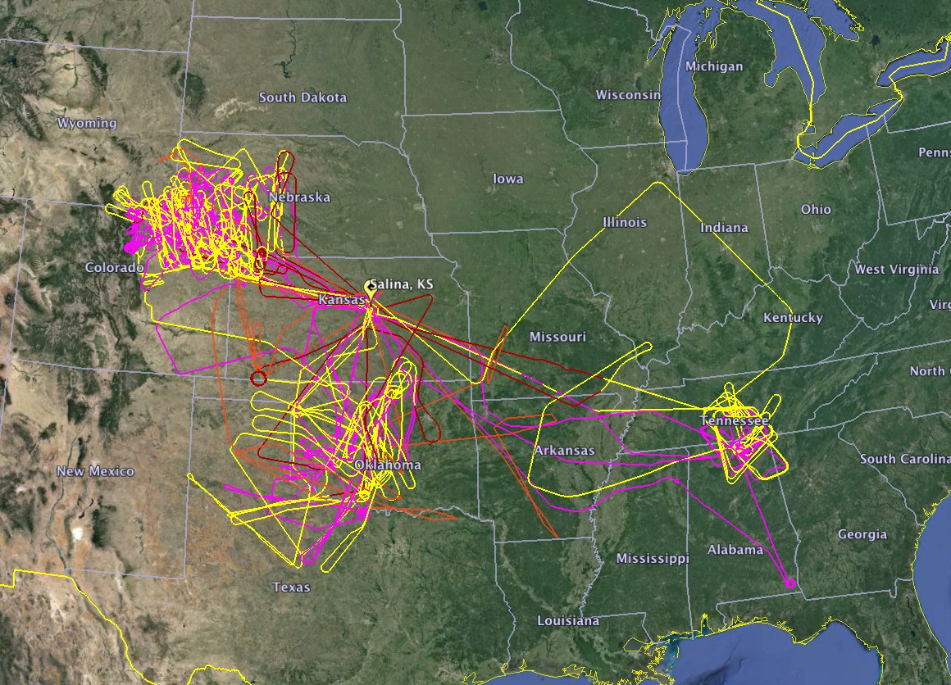
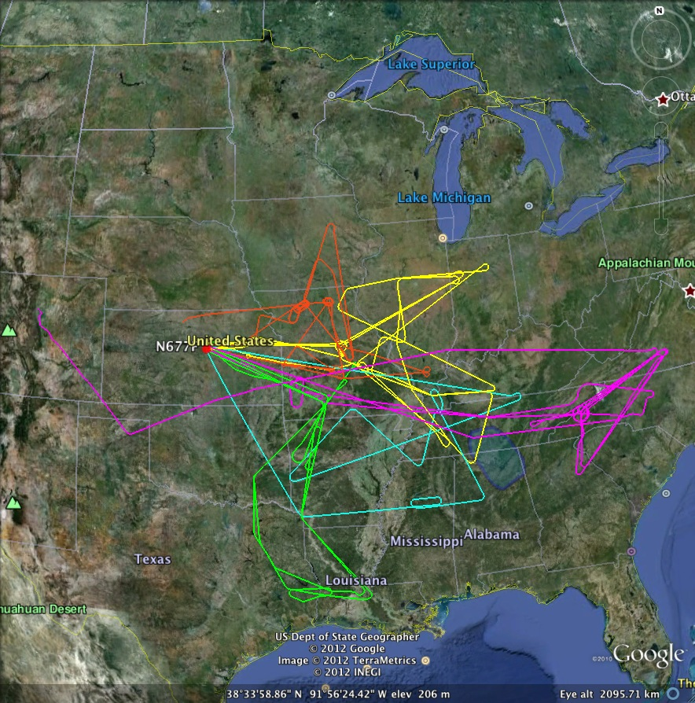

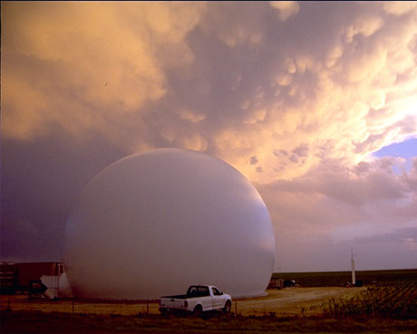
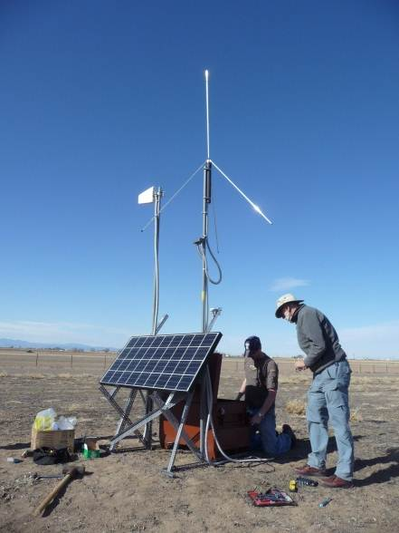
The Deep Convective Clouds and Chemistry (DC3) Field Experiment
A23J-3370
Mary C. Barth (NCAR), W. H. Brune (PSU), C. A. Cantrell (U. Colorado), S. A. Rutledge (CSU), J. H. Crawford (NASA/LaRC), H. Huntrieser (DLR), C. R. Homeyer (U. Oklahoma), B. A. Nault (U. California), R. C. Cohen (U. California), L. L. Pan (NCAR), and L. Ziemba (NASA/LaRC) contact information: barthm@ucar.edu
NCAR is sponsored by the National Science Foundation.
Motivation of the DC3 Field Campaign
What role do thunderstorms have in affecting the upper troposphere – lower stratosphere (UTLS) composition and chemistry?
DC3 Data Analysis Activities
Research includes investigating the transport and dynamics of the storms, scavenging of soluble trace gases and aerosols, production of nitrogen oxides by lightning, relationships between lightning flash rates and storm parameters, and chemistry in the UT that is affected by the convection. Here, we show highlights of studies focused on the UTLS composition.
Goals of the DC3 Field Campaign:
To characterize thunderstorms and quantify how they process chemical compounds that are ingested into the storm
To quantify the changes in chemistry and composition after active convection
Convective transport of water vapor into the lower stratosphere observed during double-tropopause events
Homeyer et al., J. Geophys. Res., 2014.
Key Points
Injected water vapor up to 200 ppm above background lower stratosphere
Convective overshooting up to 4 km above tropopause
Reduced stability from double tropopause may facilitate deep overshooting
Time series of O₃, CO, water vapor, IWC, and altitude of GV aircraft as it sampled convective injection above the tropopause (marked in orange) for 19 May 2012 case.
Composite GOES satellite and NEXRAD radar data for the 19 May 2012 case. Vertical cross-section is located at A-B line. Black lines mark double tropopause.
Scatterplots of O₃ and CO for the 19 May 2012 convective line case. Points are colored by (a) altitude relative to the GFS analysis tropopause, (b) water vapor mixing ratio, and (c) detection of cloud particles.
Thunderstorms Enhance Tropospheric Ozone by Wrapping and Shedding Stratospheric Air
Pan et al., Geophys. Res. Lett., 2014
Key Points
Tropopause-reaching MCSs entrain ozone-rich stratospheric air into troposphere
Airborne lidar measurement is key to revealing this transport mechanism
A missing transport pathway for ozone budget in major global models
Vertical distribution of (a) ozone and (b) depolarization ratio, which indicates the location of the cloud. In-situ ozone is shown along the flight track.
Facilities
Dual-Doppler and polarimetric radars to get storm structure and kinematics
Lightning mapping arrays to get 3-d locations of lightning
Weather balloon soundings before and during storms
Aircraft to measure composition of inflow and outflow of storms and downwind of storms in UT
Composite GOES satellite and NEXRAD radar data showing the MCS in the upper left over Kansas. The DC-8 flight track is colored by the in situ ozone mixing ratio.
May – June 2012 over the Central U.S.
Photochemical Aging and New Particle Formation in the Convective Outflow of a Decaying Mesoscale Convective System (MCS)
Cantrell, Barth, Ziemba, Nault, Cohen and others
Sampled Storms in Colorado, Alabama,
West Texas – Oklahoma
Based in Salina, Kansas
Sampled Convective Outflow in Upper Troposphere 12-36 hours after Active Convection
1400 UTC
1600
1800 UTC
1400 UTC
1600
1800 UTC
May 25, 26
May 29, 30
June 6, 7
June 16, 17
June 22, 23
Composite GOES satellite and NEXRAD radar data at 1200 UTC (left) and 2300 UTC (right) on 21 June 2012. The DC8 (magenta) and GV (yellow) flight tracks are overlaid.
2100
2100
Ozone (left) and particle number concentration (right) for the 21 June 2012 DC3 case along the flight tracks. Both variables are quite low until late morning (1600 UTC) when values increase substantially.
NSF/NCAR Gulfstream V, NASA DC-8, and DLR Falcon aircraft flew 19 thunderstorm cases, > 6 photochemical aging cases
Key Points
Probing the convective outflow region of a decaying MCS is a fruitful way of measuring changes in UTLS composition after active convection
Ozone mixing ratios increase by ~20 ppbv during day
Thousands of new particles are formed beginning in mid-morning
Analysis of total nitric acid and NO_{x} species can constrain UT rate constants and NO_{x}-HO_{x}-O₃ chemistry
In situ measurements of nitric acid plus particulate nitrate increase from early morning to mid day while NO and NO₂ decrease. These data are being analyzed to constrain rate constants for the production of HNO₃ in the UT, including NO₂ + OH → HNO₃ and HO₂ + NO → HNO₃. See poster by Ben Nault et al. A23J-3379 for more details.
NASA DC-8
NSF/NCAR GV
DLR Falcon-20
CSU CHILL Radar
NMT Lightning Antenna
Data available from http://www.eol.ucar.edu/field_projects/dc3
Overview paper: Barth et al., accepted by Bull. Amer. Meteor. Soc.
x10⁴
1320
1400
1500
1600

