Slide 1
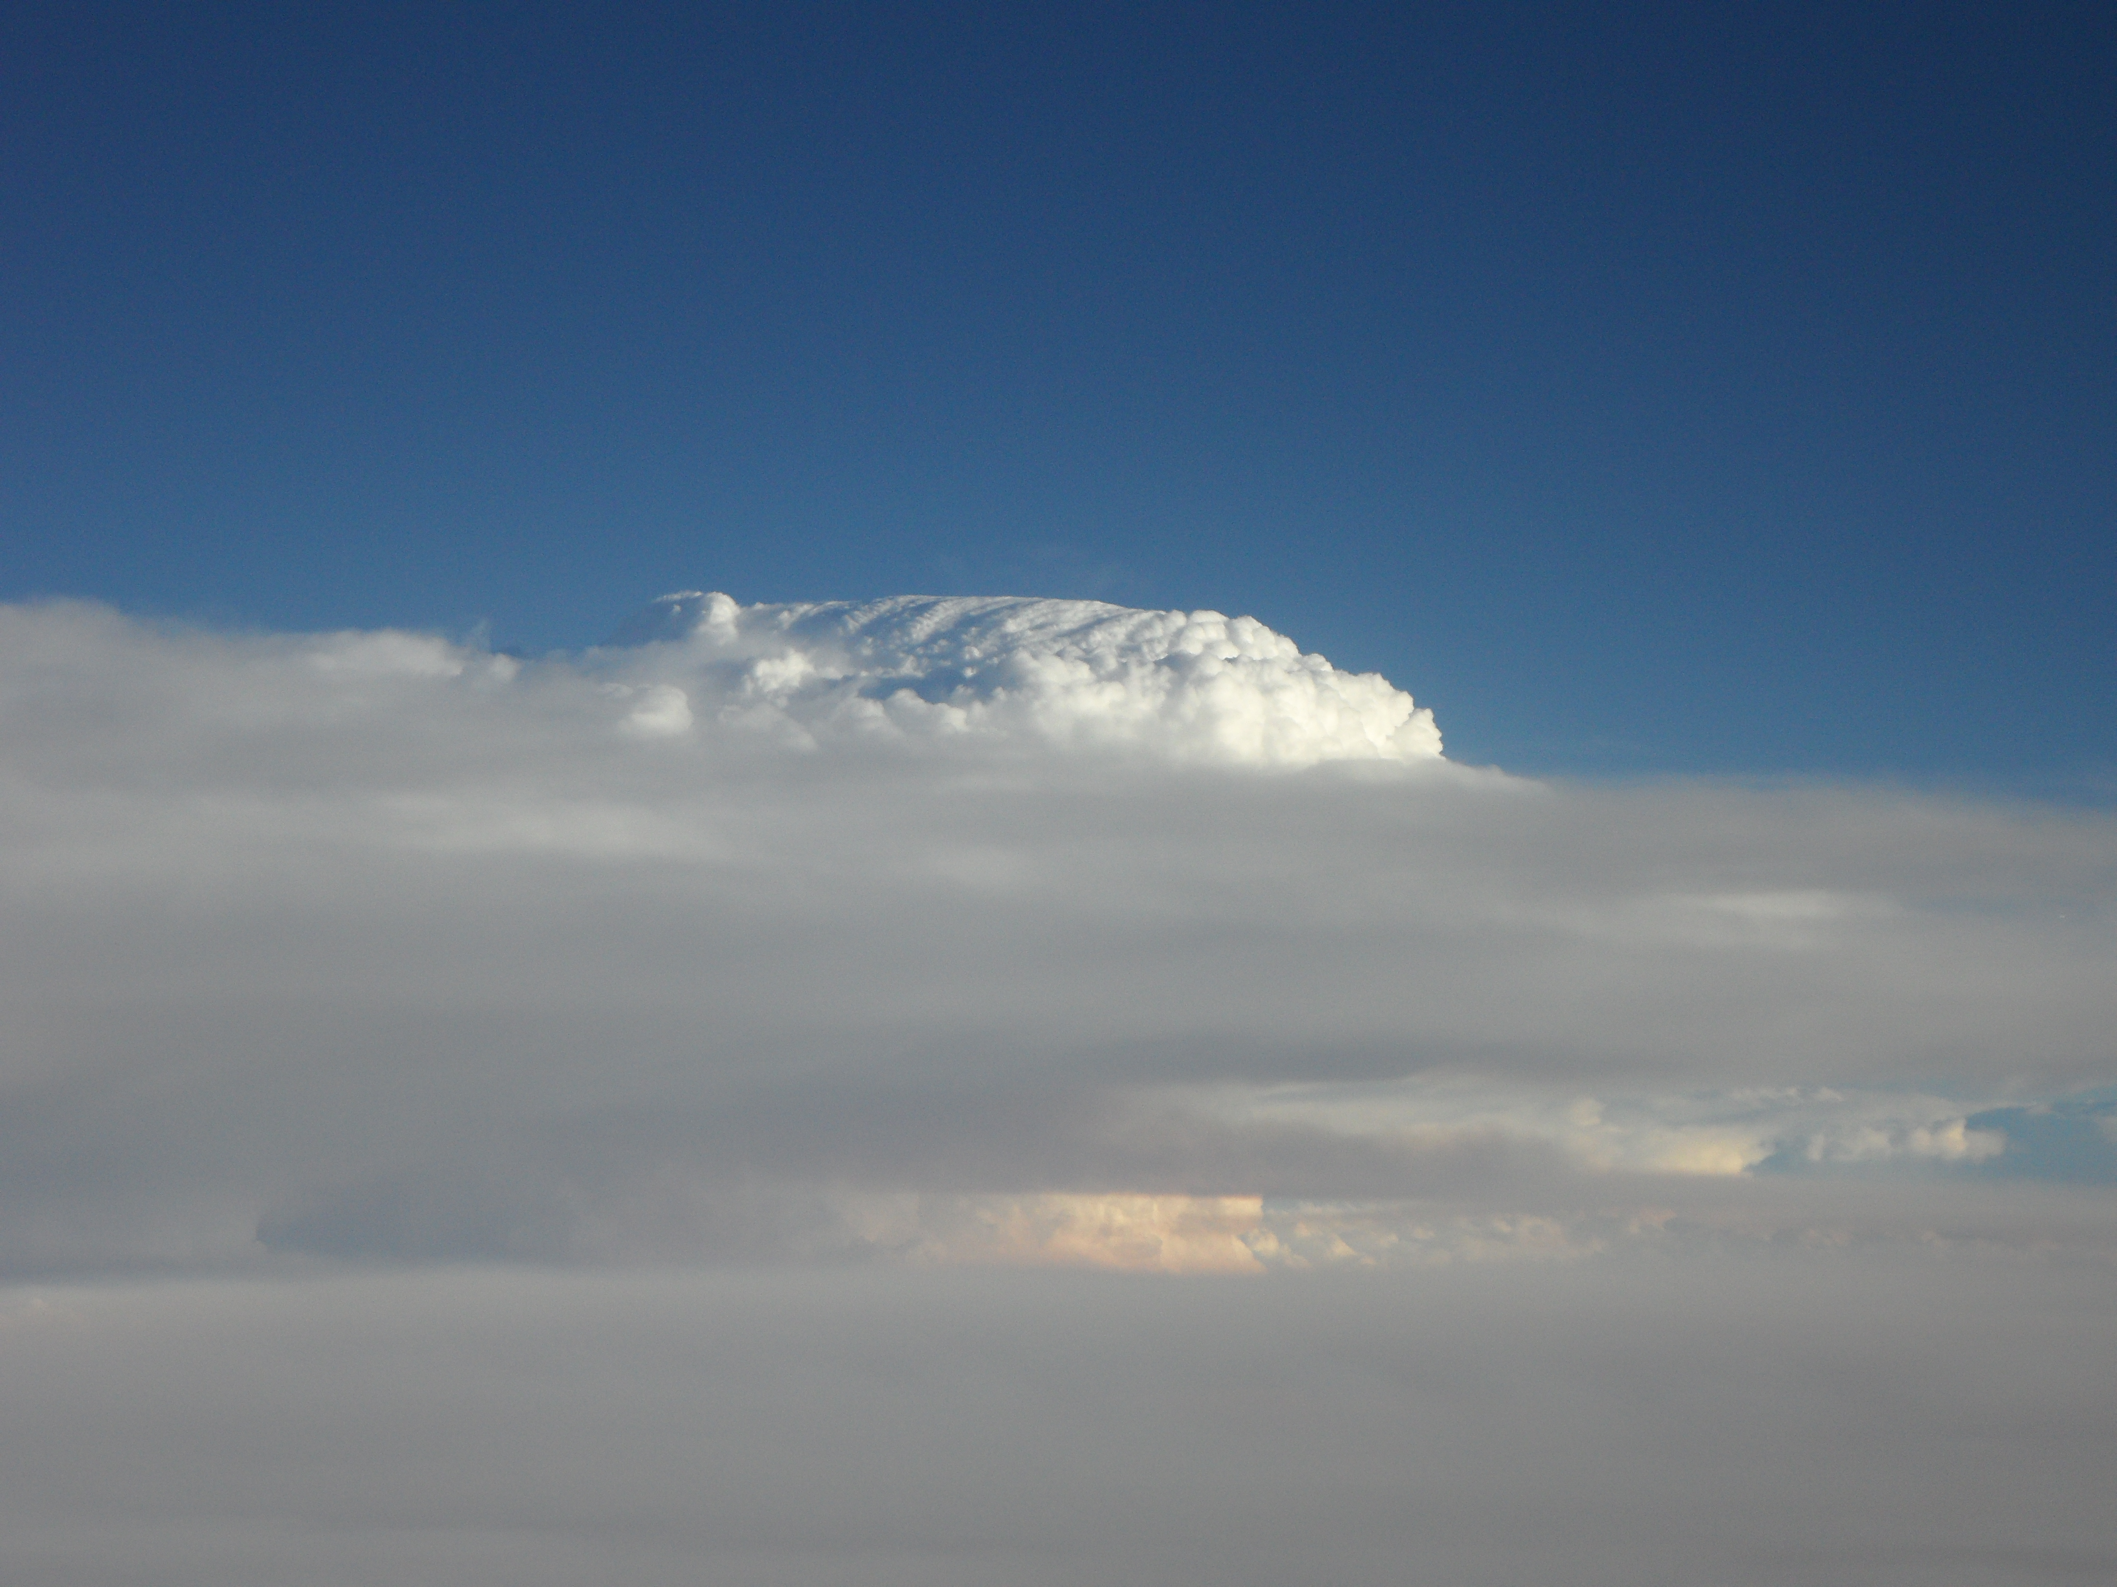
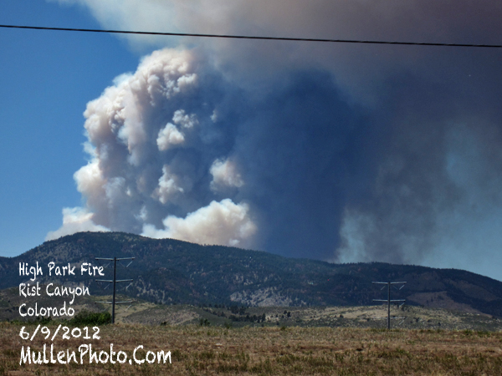
Wildfire Smoke Plume and Thunderstorm
22 June 2012 DC3 Case
Mary Barth (NCAR), Steven Saleeby, Sue van den Heever (Colorado State Univ.)

Slide 2
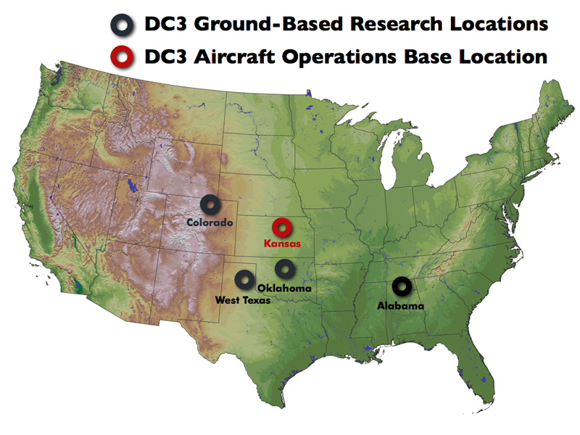
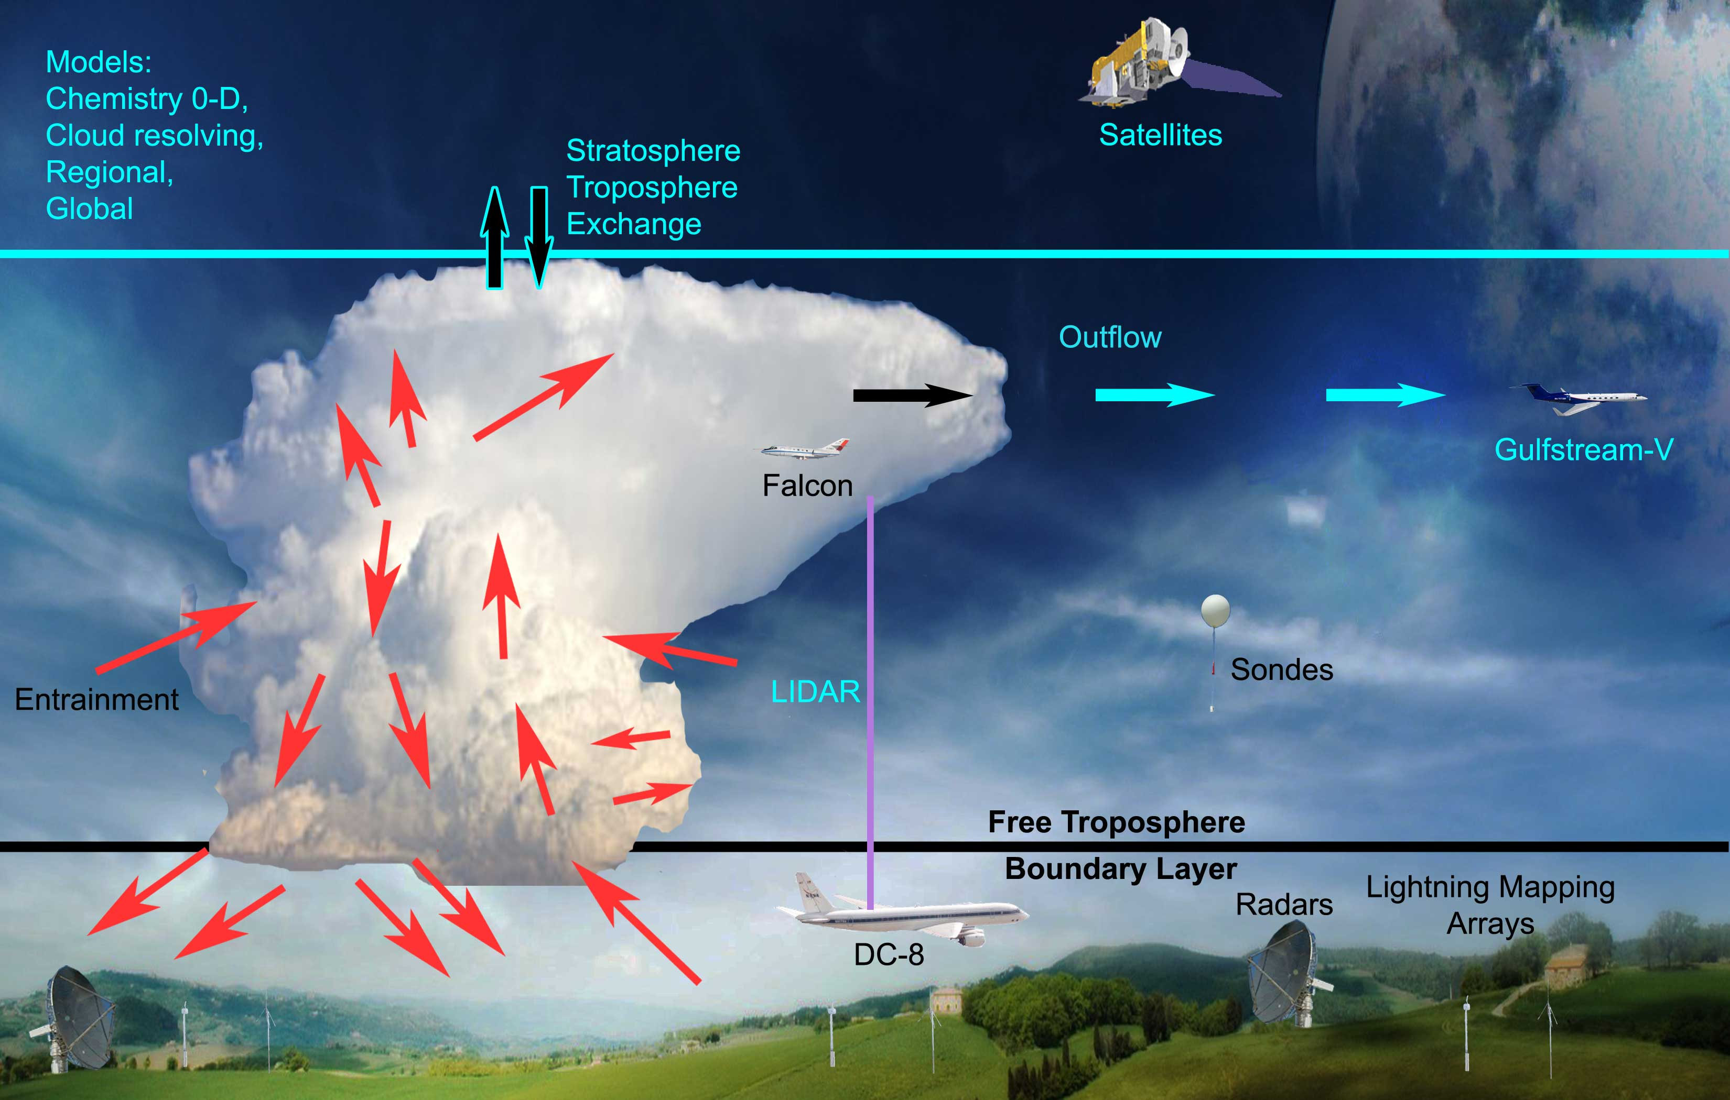
Deep Convective Clouds and Chemistry (DC3)
Field Campaign
When: May – June 2012
Where: Based Salina, Kansas
Sampled storms in NE Colorado, W Texas to central Oklahoma, and N Alabama

Slide 3
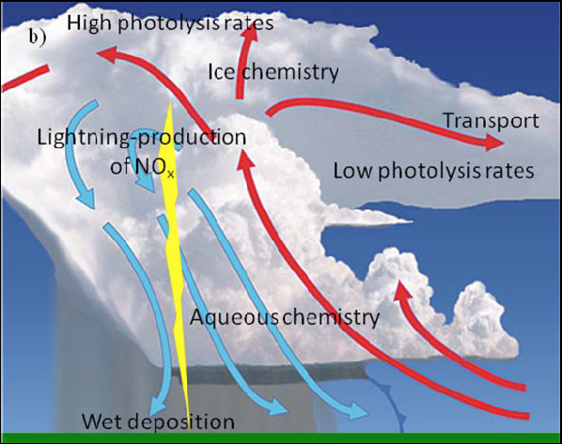
Goals of the Deep Convective Clouds and Chemistry (DC3) Field Campaign
To characterize thunderstorms and how they process chemical compounds that are ingested into the storm (transport, scavenging, lightning, production of NOx from lightning, chemistry)
To learn how the air that exits the storm in the upper troposphere (UT) changes chemically during the next day (chemical aging)

Slide 4
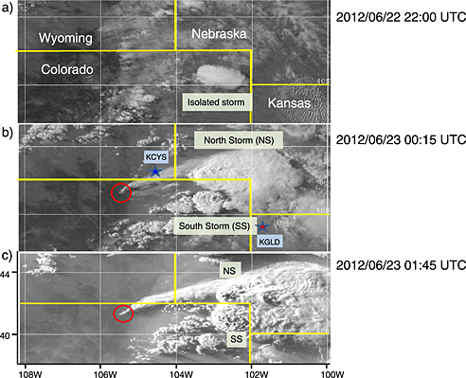
22 June 2012 DC3 Case
22:00 UTC
00:15 UTC
01:45 UTC
7:45 pm LT
From Apel et al. (2015) JGR

Slide 5
22 June 2012 DC3 Case
To see movie of radar reflectivity of this case along with flight tracks of NASA DC-8 and NCAR GV aircraft, go to the following link:
http://catalog.eol.ucar.edu/dc3_2012/research/nexrad/20120622/research.NEXRAD.2012062200.flight_track_movie.mov
DC3 data can be found from the following webpage:
https://www.eol.ucar.edu/field_projects/dc3
Science highlights can be found here:
https://www2.acom.ucar.edu/dc3

Slide 6
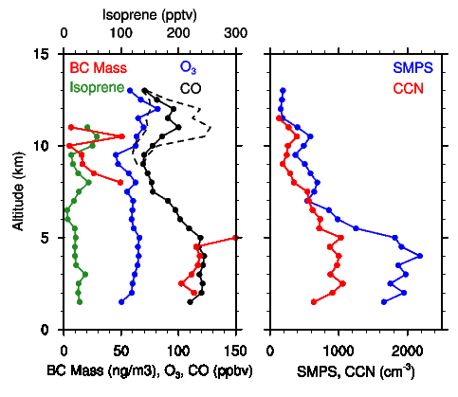
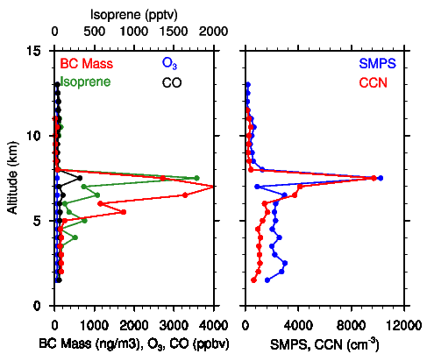
22 June 2012 DC3 Case
Smoke Plumes Removed from Data
Including Smoke Plumes
SMPS measures aerosol concentration in the 10-340 nm size range.
Maximum concentrations ~ 10,000/cm³ at ~7 km MSL.
→ This case provides a unique opportunity to examine the effect of aerosols ingested into a storm at an elevated altitude

Slide 7
Modeling the 22 June 2012 DC3 Case
Objectives of Study
Does model represent storm well?
WRF
RAMS
Does smoky air get into storm?
Where does the outflow air come from?
WRF-Tracer
WRF-Chem
RAMS-smoke
Do aerosols affect storm properties?
One of first times aerosol-cloud interactions will be examined with 2 models addressing the same case

Slide 8
Modeling the 22 June 2012 DC3 Case
WRF, WRF-tracer, WRF-Chem
3-grids: Δx = 15, 3, 1 km
Δz = 50 m stretched to 250 m
Initialization: 12 km NAM at 1200 UTC
Cloud physics: Morrison double moment
Cu parameterization: Grell-Freitas in outer domain only
Nesting: 2-way for WRF and WRF-tracer
1-way for WRF-Chem run
RAMS (S. Saleeby)
3-grids: Δx = 25, 5, 1 km
Δz = 75 m stretched to 500 m
Initialization: 12 km NAM at 1800 UTC
Cloud physics: 2-moment, binned riming
(Saleeby and Cotton 2004; Saleeby and van den Heever 2013)
Cu parameterization: Kain-Fritsch in outer domain only
Nesting: 2-way

Slide 9
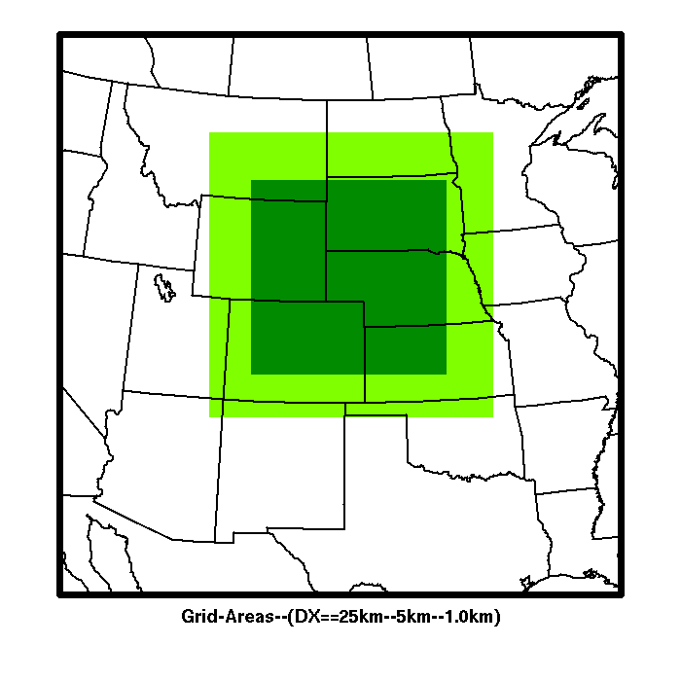
Modeling the 22 June 2012 DC3 Case
WRF, WRF-tracer, WRF-Chem
RAMS (S. Saleeby)
Δx: 15 km, 3 km, 1 km
Δx: 25 km, 5 km, 1 km

Slide 10
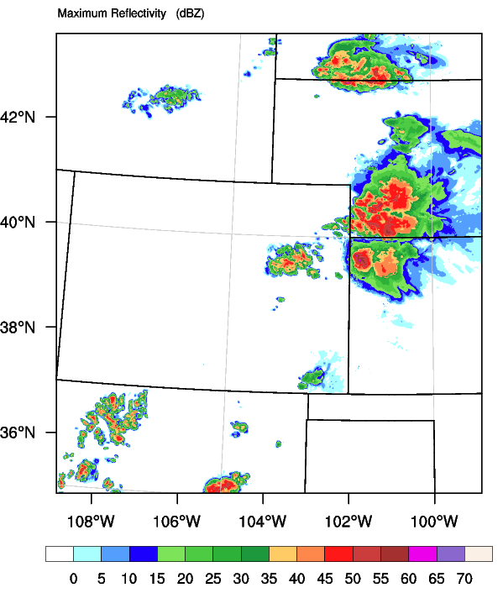
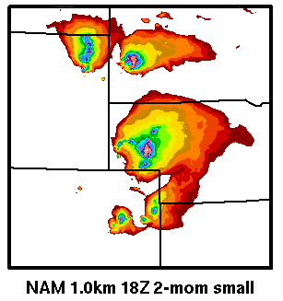
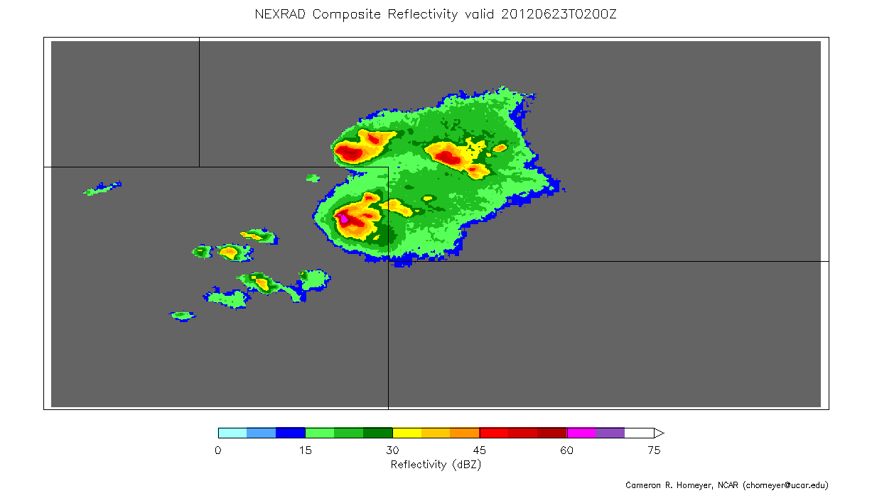
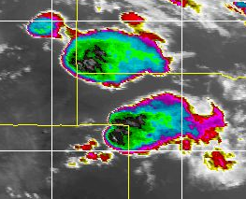
Do WRF and RAMS represent storms well?
WRF Max. Reflectivity
RAMS Total Condensate Path
At 0200 UTC
WRF simulation east of obs, with more convection
RAMS simulation a little north of obs
About as good as we can get
NEXRAD
Thermal IR

Slide 11
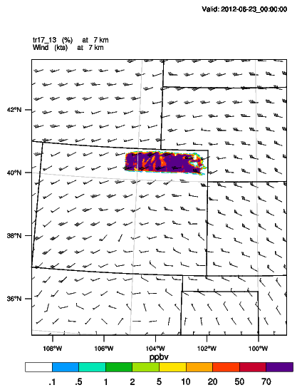
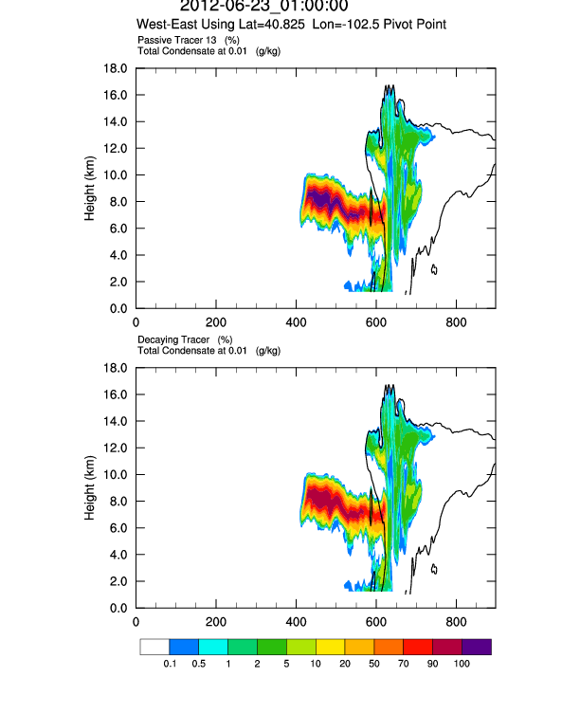
Does smoky air at 7 km get into storm?
00 UTC 23 June
“smoke tracer” at z = 7 km
01 UTC 23 June
Maximum reflectivity
01 UTC 23 June
“smoke tracer”
Total condensate (black contour)
Smoke plume tracer initialized from 2340-2400 UTC
Results shown at 0100 UTC
Smoke plume tracer ingested into and transported to top and bottom of storm

Slide 12
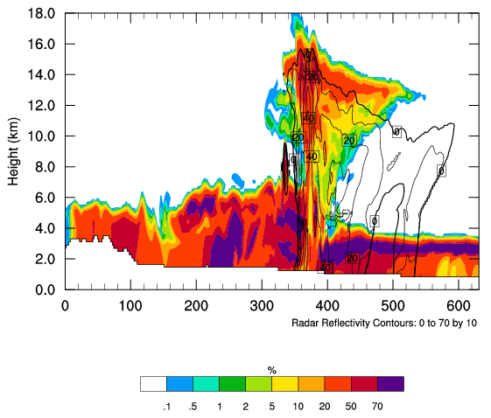
Where does the outflow air come from?
Passive tracers each 1-km altitude
0030 UTC
0030 UTC
“Layer” tracers initialized from 2245-2300 UTC
Results shown at 0030 UTC
Analyze white box region to find how much of each 1-km altitude contributed to outflow region
Most air entrained from below 5 km altitude
0100 UTC shows a little more entrainment from upper troposphere

Slide 13
Simulations with Aerosols
(WRF-Chem and RAMS)
WRF-Chem
MOZART gas chemistry mechanism
MOSAIC aerosol model with 4 bins
EPA anthropogenic emissions
MEGAN biogenic emissions
FINN fire emissions with plumerise
Chemistry is initialized with results from the global chemistry transport model, MOZART
Number of aerosols predicted is a result of emissions and atmospheric processes
Only cloud drop activation affected by aerosols
There are no IN in this configuration
RAMS (S. Saleeby)
Initial CCN = 600 cm⁻³ decreasing exponentially with height
IN = 1 mg⁻¹ decreasing exponentially with height
Fire aerosols added with an ad-hoc emissions method
Results shown are only from RAMS

Slide 14
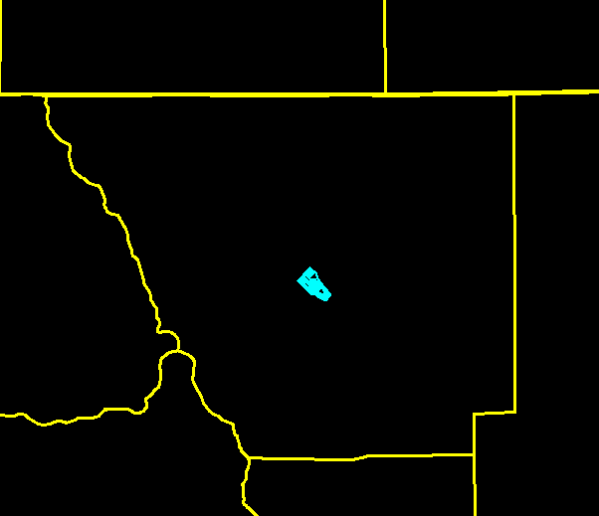
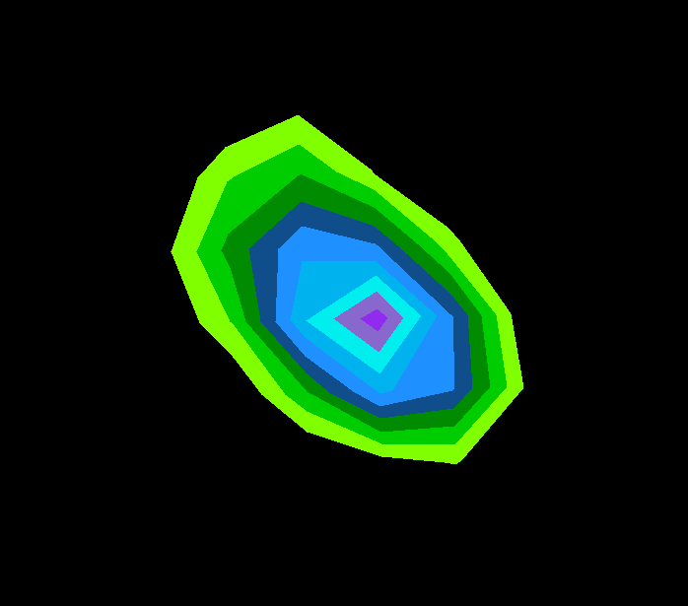
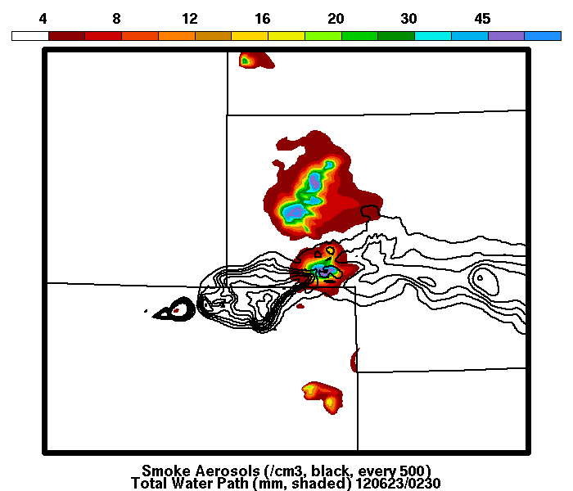
Simulations with Aerosols
(RAMS)
Smoke aerosol number flux
Fire Location
Addition of Wildfire
Surface heat flux ~8 kW/m2
2D varying smoke aerosol flux: 30,000-80,000 #/m2/sec
→ Aerosol plume at 7 km ingested by southern storm
0230 UTC June 23
Smoke
Plume
at ~7km
MSL
Core-2
Fire
Area
Core-1

Slide 15
Simulations with Aerosols
(RAMS)
Two Simulations
1. “Fire” with fire heat flux and with smoke aerosol emissions
2. “NoFire” with fire heat flux and without smoke aerosol emissions
Two Convective Regions Analyzed
“Core-1”: southern storm, impacted by smoke
“Core-2”: northern storm, less impacted by smoke
Cores identified by total water condensate path > 10 mm
0230 UTC June 23
Smoke Plume
at ~7km MSL
Core-2
Fire
Area
Core-1

Slide 16
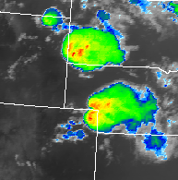
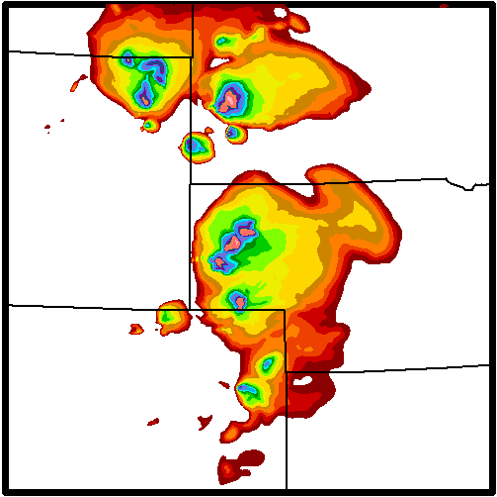
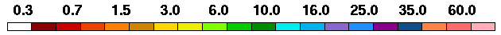
Meteorology agrees well with observations
0200 UTC June 23
RAMS - 12km NAM – 1.0km Integrated Condensate (mm)
GOES – Enhanced IR
Preliminary Results
Do Not Attribute

Slide 17
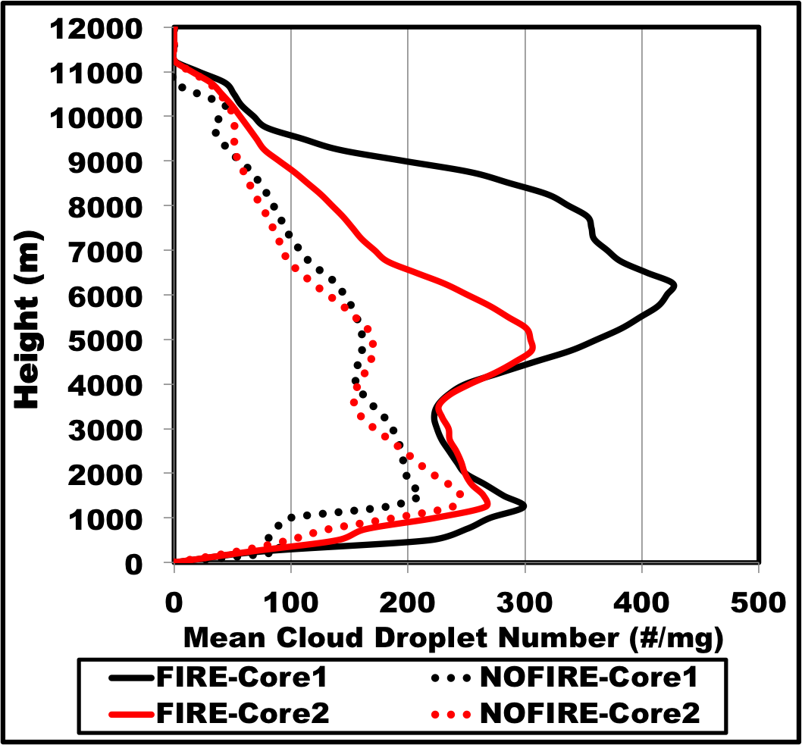
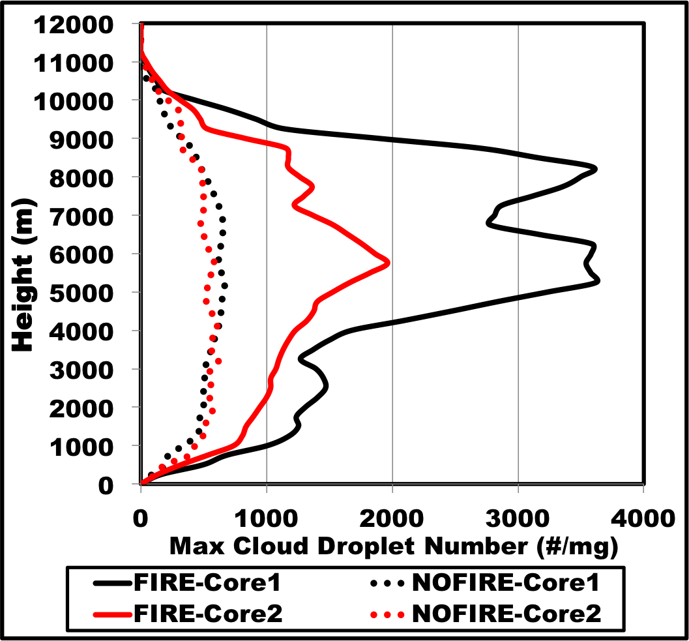
Impact on Cloud Droplet Number
Vertical profiles are averaged temporally over each convective core
AVERAGE Droplet Number
MAXIMUM Droplet Number
Core-2
Core-2
Core-1
Core-1
Preliminary Results
Do Not Attribute
Solid: with fire
Dotted: no fire
Solid: with fire
Dotted: no fire
Solid: with smoke emissions Dashed: no smoke emissions
Both convective cores impacted by smoke aerosols, but the direct impact on Core-1 is significantly greater.
Cloud droplet number concentrations are much greater with smoke plume influence, with maximum impact at mid- to upper-levels where smoke plume is most concentrated.

Slide 18
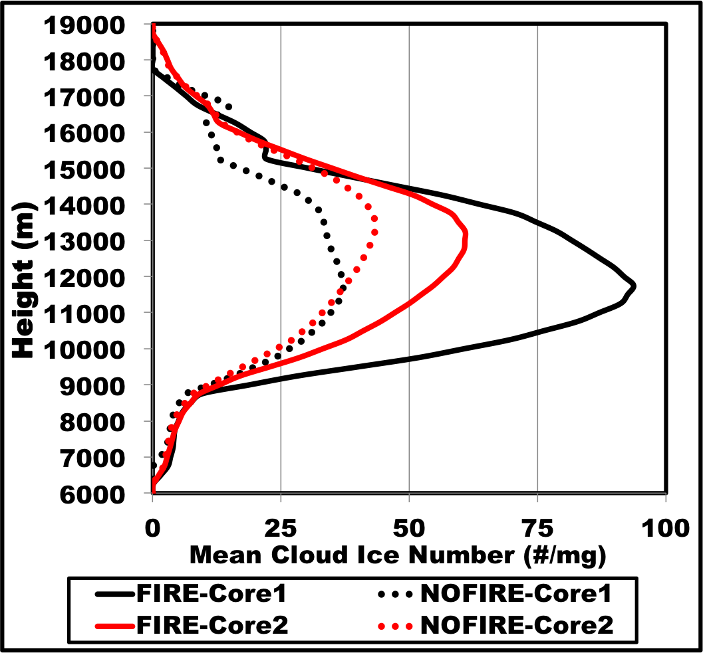
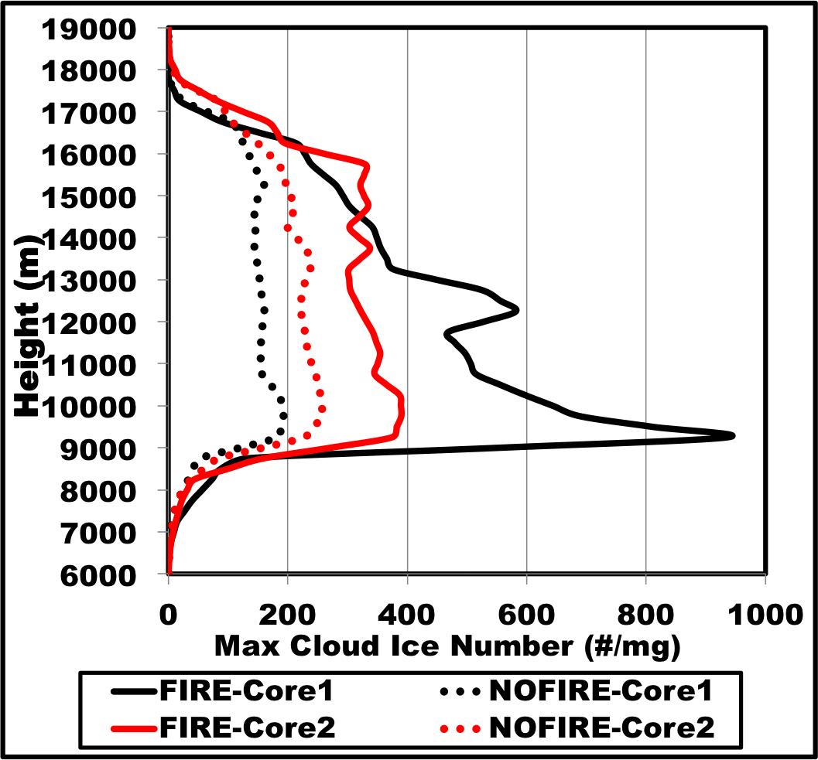
Impact on Cloud Ice Number
Vertical profiles are averaged temporally over each convective core
AVERAGE Cloud Ice Number
MAXIMUM Cloud Ice Number
Core-2
Core-2
Core-1
Core-1
Preliminary Results
Do Not Attribute
Solid: with fire
Dotted: no fire
Solid: with fire
Dotted: no fire
Solid: with smoke emissions Dashed: no smoke emissions
Both convective cores impacted by smoke aerosols, but the direct impact on Core-1 is significantly greater.
Cloud ice number concentrations are much greater with smoke plume influence.

Slide 19
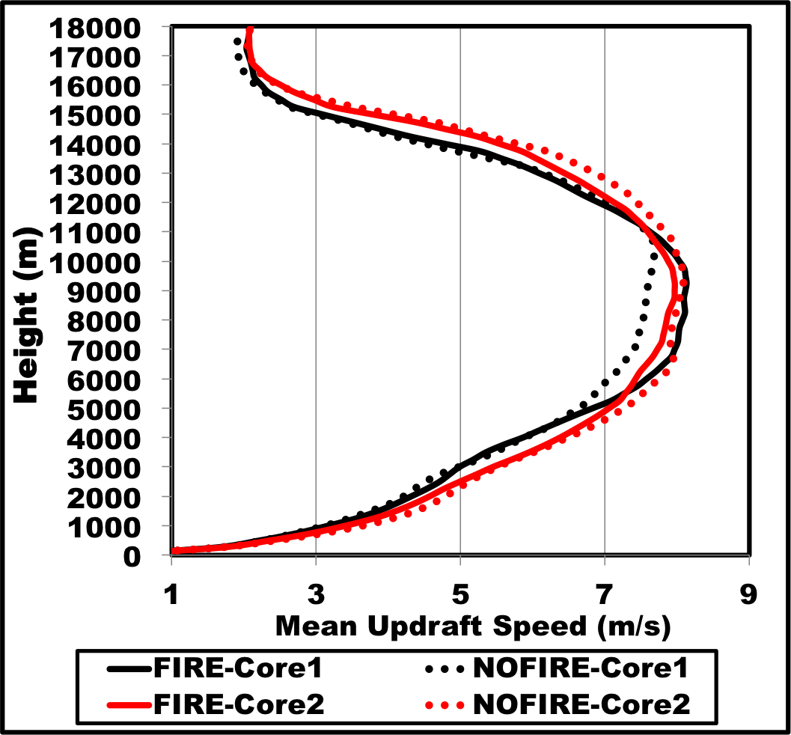
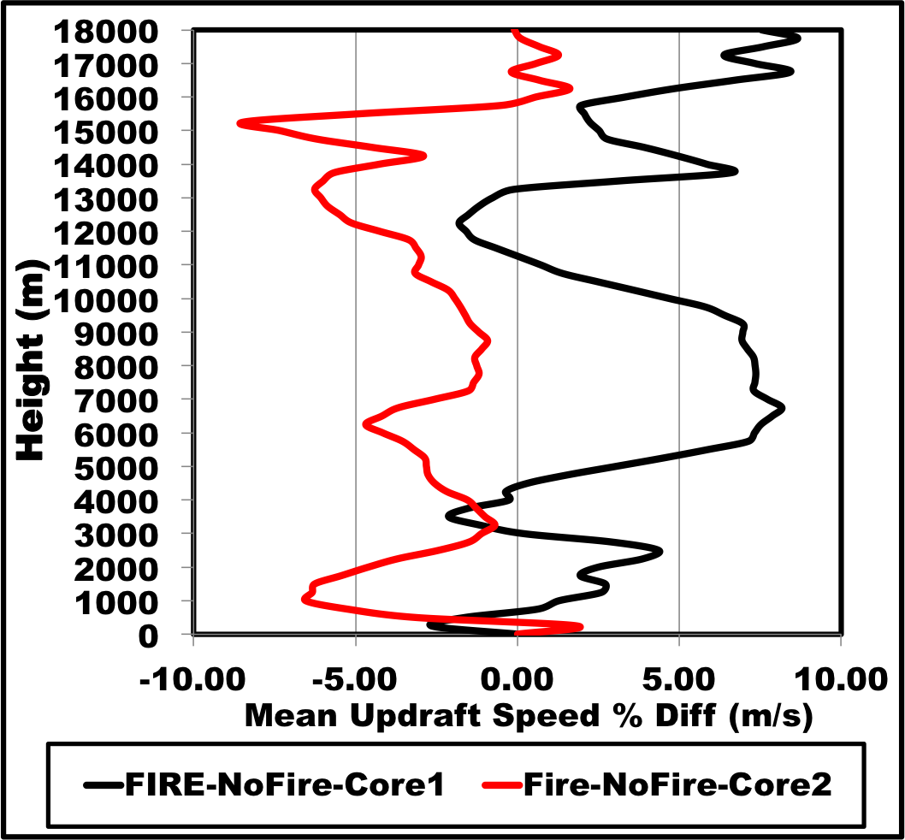
Convective Updrafts
Vertical profiles are averaged temporally over each convective core
AVERAGE Updraft Speed
% Difference (Fire – NoFire)
Core-2
Core-2
Preliminary Results
Do Not Attribute
Core-1
Core-1
Solid: with fire
Dotted: no fire
Stronger updrafts throughout the column in Core-1 (direct smoke core)
Weaker updrafts throughout the column in Core-2 (non-smoke core)

Slide 20
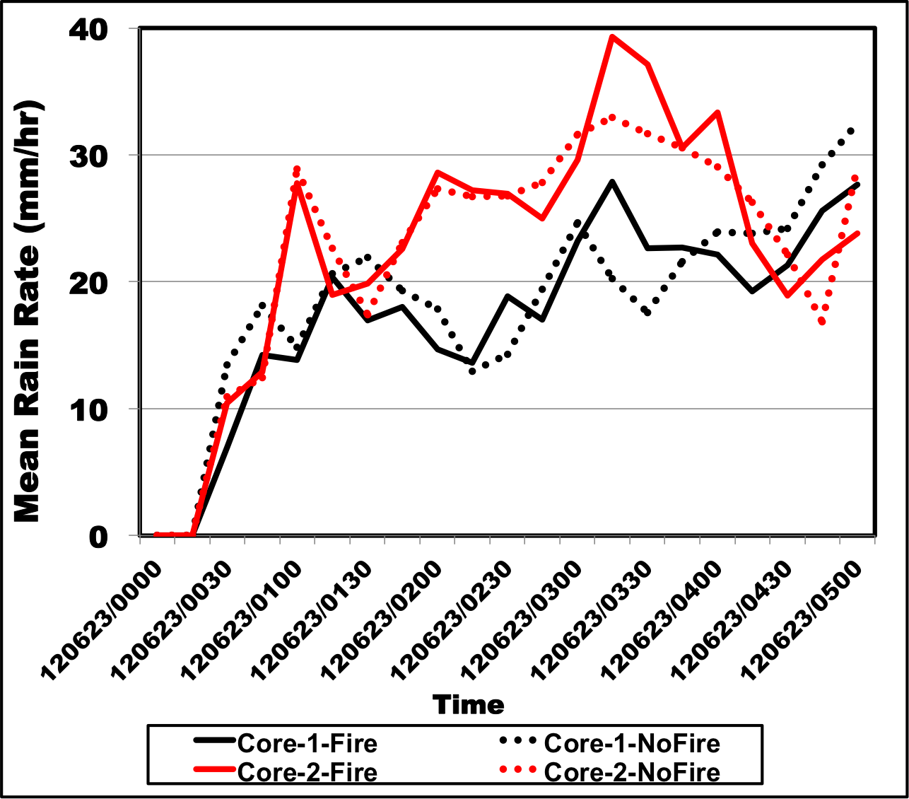
Precipitation Rate
Spatial average over each convective core
Preliminary Results
Do Not Attribute
Core-2
Solid: with smoke emissions
Dashed: no smoke emissions
Core-1
Solid: with fire
Dotted: no fire
Time
No clear trend in fire aerosol impacts on precipitation rate.
I suspect that the increased cloud drop number did not grow large enough drops to be affect the riming process, and therefore precipitation (similar to shallow warm cloud depth)

Slide 21
Summary of DC3 Case Study
WRF-Chem and RAMS model runs of the 22 June 2012 DC3 case where a thunderstorm ingested a smoke plume at ~7 km altitude
Meteorology-only simulations reasonably represent convection
WRF-tracer simulation shows
  “smoke tracer” at 7 km is transported into storm
  Most of air in outflow from altitudes at and below 5 km
RAMS simulations show interaction between smoke and thunderstorm
Storm ingesting smoke plume produced
  more cloud drops, more cloud ice, stronger updrafts, but similar precipitation rate
  compared to simulation without smoke aerosols

