Slide 1
DISCOVER-AQ Forecast Briefings
Meteorology
Forecast maps – NWS surface and NAM upper air; today and the next 3 days
NAM/MOS time series – Denver and Ft. Collins; today and next 3 days;
T, TD, WS, WD, RH, POP, Sky cover
BUFKIT – NAM – time series of cloud amount by altitude, precip, and PBLH
– next 3 days
PBLH from NOAA/ARL WRF-ARW
Wind fields at several sigma levels from NOAA/ARL WRF-ARW
Cloud forecast maps – NAM, GFS, Canadian, GEOS-5
NWS forecaster comments/advice
Fly/no-fly recommendations

Slide 2
DISCOVER-AQ Forecast Briefing
Air Quality
Air quality yesterday – surface station O₃ observations
Air quality forecast maps – NOAA/ARL CMAQ products – O₃, NO₂, HCHO
today and tomorrow
Ozone forecasts from State agency – today, tomorrow, beyond?
Air quality yesterday – surface station PM_{2.5} observations
AERONET and MODIS AOD – yesterday
Air quality forecast maps – NOAA/ARL CMAQ product – surface PM_{2.5}
Air quality forecast maps and time series – GEOS-5 aerosol extinction, AOD,
mass concentrations by aerosol type
PM_{2.5} forecasts from State agency – today, tomorrow, beyond?

Slide 3
DISCOVER-AQ Forecast Products
NAQFC - β Forecasting support (NOAA/ARL)
  Initialized at 00 UTC with 60 hours forecast duration
  WRF-ARW (12km N-America & 4 km CONUS)
  CMAQ 4.7.1 (12km CONUS & 4 km DISCOVER-AQ/FRAPPÉ region)
  Includes Aero5 aerosol mechanism (not in NCEP operational version)
GEOS-5 (NASA/GSFC)
  Global at 25 km;
  5-day chemical forecasts twice daily (00 and 12 UTC)
  Total column O₃, GOCART aerosols, CO, CO₂, SO₂ (simple chemistry)
  QFED fire emissions
  Includes aerosol assimilation (MODIS AOD)
  QFED Fire Emissions (NASA/GSFC)
    Near real time estimates based on MODIS Fire Radiative Power (AQUA/TERRA)

Slide 4

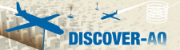

NAQFC-$β \text{f}$orecasting support: Initialized at 00 UTC with 60 hours forecast duration
WRF-ARW | Both North America (12 km) & CONUS (4 km)
Map projection & grid | Lambert Conformal & Arakawa C staggering
Vert. co-ordinate | 42 σ-p unevenly spaced levels
advection | RK3 (Skamarock and Weisman (2008))
SW & LW radiation | RRTMG (Iacono et al. 2008))
PBL Physics | Mellor-Yamada-Janjic (MYJ) level 2.5 closure
Surface layer scheme | Monin-Obukhov Similarity with viscous sub-layer
Land Surface Model | NCEP NOAH
Cloud Microphysics | Thompson et al. (2008)
Cloud convective mixing | Betts-Miller-Janjic Mass adjustment
AForecast: 12 km nested to 4 km
CMAQ4.7.1 | Both CONUS(12 km) & DISCOVER-AQ/FRAPPE (4 km)
Map projection & grid | Lambert Conformal & Arakawa C staggering
Vert. co-ordinate | 42 σ-p unevenly spaced levels
Gas chemistry | Cb05 with 156 reactions
Aerosol chemistry | Aero5 with updated evaporation enthalpy
Anthropogenic emission | 2005NEI as base year, mobile projected using AQS*, area and off-road used CSPR^, point source uses 2012 CEM data
 | WRAP oil and gas emissions data
Biogenic emission | BEIS-3.14
Lateral BC | RAQM (B. Pierce)
42 vertical layers
Air Resources Laboratory/NOAA: DISCOVER-AQ/FRAPPÉ preparation meeting, April 3 2014, Boulder
Notes:
^12 km domain is set a bit large to match National AQ Forecasting Capability for side-by-side verification.

Slide 5
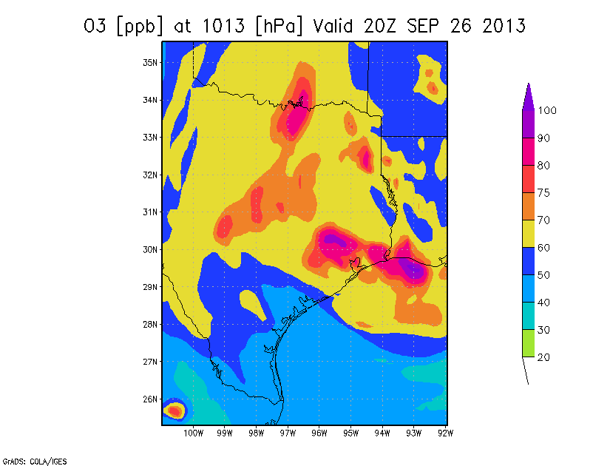
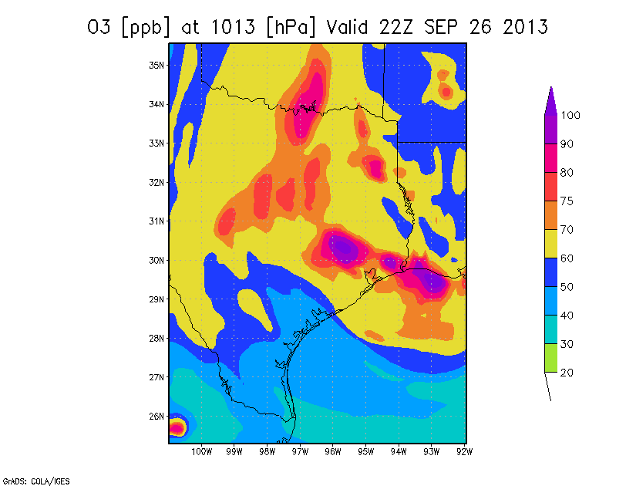
NOAA Experimental CMAQ
Forecast
5 PM
3 PM
Examples

Slide 6
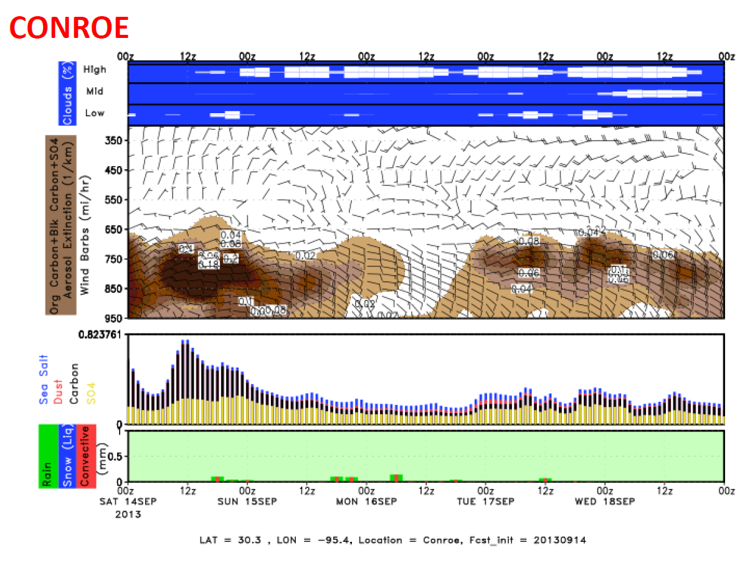
NASA GEOS-5 aerosol forecast
from: 00 UT 14 Sept.
Examples
Cloud cover
Extinction
AOD
GEOS-5 global model at 0.25 deg. resolution;
GOCART aerosols, CO, SO₂; includes assimilation of MODIS AOD
Run by Arlindo da Silva at NASA/GSFC

Slide 7
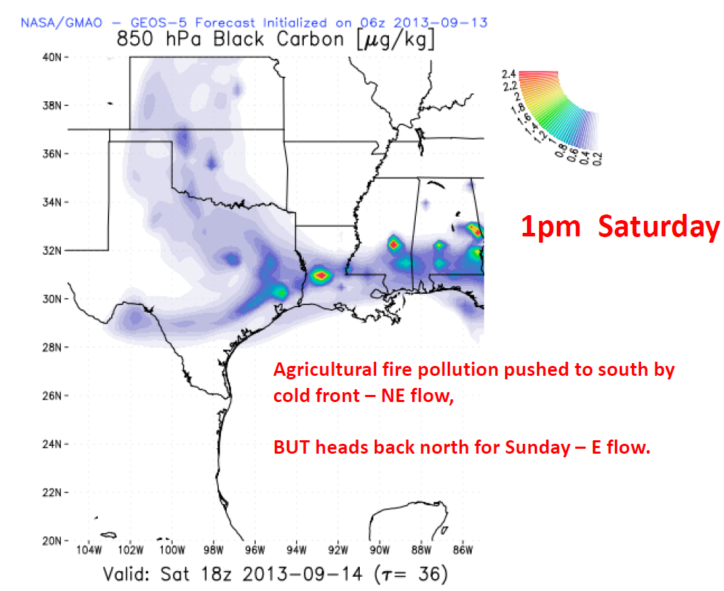
GEOS-5 Aerosol Forecast Maps Examples

Slide 8
FRAPPÉ Forecast Briefings
Jointly with DISCOVER-AQ
Additional Met & Chemistry Products
Short-term forecasts for aircraft and mobile vans
Decisions on Flight Day and Flight Pattern for C-130
up to 3-5 days out, larger CO regions
Flight Objectives: special events (fires, LRT,..), recirculation, emissions, ...
CDPHE/APCD
4 meteorologists will continue to issue statewide and Front Range forecasts for O3 and other pollutants 7 days a week.
Includes 9 AM MDT update, a 24-36 hour forecast by 3 PM MDT, and a multi-day outlook. (see presentation by Patrick Reddy)

Slide 9
FRAPPÉ Forecast Products
Satellite Products
  FINN near-realtime fire emissions (based on MODIS fire counts) (NCAR/ACD)
  MOPITT CO (within 1 day of overpass) (NCAR/ACD)
  IASI CO (~ 4-day delay) (NCAR/ACD)
Met Forecasts
  WRF with assimilation (NCAR-RAL)
    3DVar (no radar DA, 3h UC/12h fcst/1km)
    3DVar (with radar DA, 1h UC/12h fcst)
    4DVar (with radar DA, 3h UC/12h fcst)
    RTFDDA (with radar DA, 3h UC/24h fcst)

Slide 10
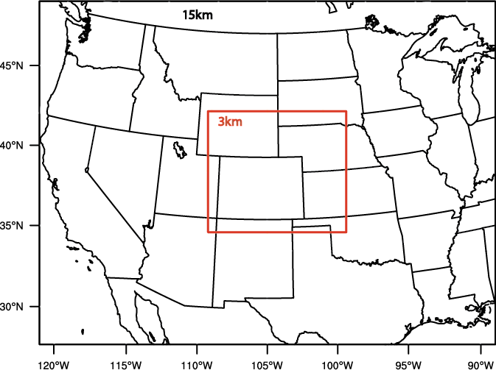
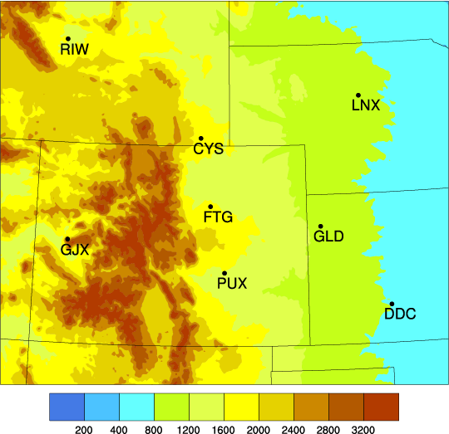
Nested WRF domain
NCAR/RAL STEP - Short Term
Explicit Prediction
Outside systems:
NSSL (3DVar with radar DA, 1h UC*/12h fcst)
GSD/FAB (LAPS with radar DA, 1h UC/12h fcst)
UK MetOffice (UM-WRF, 6h UC/36h fcst)
NCAR systems:
WRF 3DVar (no radar DA, 3h UC/12h fcst/1km)
WRF 3DVar (with radar DA, 1h UC/12h fcst)
WRF 4DVar (with radar DA, 3h UC/12h fcst)
RTFDDA (with radar DA, 3h UC/24h fcst)
* UC – Update Cycle
1km
CHILL
S-Pol
Examples
1km nowcast/hydro domain
3km radar DA domain

Slide 11
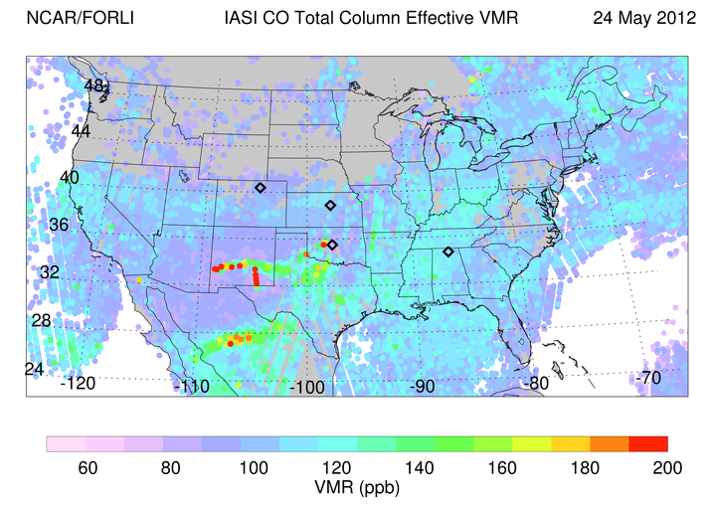
NCAR/ACD MOPITT and IASI CO
MOPITT CO – available within a day of overpass
IASI CO – about 4-day delay, global coverage 2x/day

Slide 12
FRAPPÉ Forecast Products
Chemical/Tracer Forecasts
  MOZART-4 global, 5-day forecast (NCAR)
    Full chemistry at 1.9°x2.5° (possibly assimilation of CO)
    Tracer forecasts at 0.5°x0.5° (CO, isoprene-like, ....)
  RAQMS (NOAA/NESDIS)
    Global 1x1 degree on-line chemical and aerosol assimilation
    and forecasting system
    Assimilation of MODIS AOD, MLS stratospheric O₃ profiles and OMI total O₃
  WRF-Chem (NOAA/ESRL)
    WRF-Chem on RAPid refresh (RAP) 13km domain; 48 hour forecast
  WRF-Chem Tracers (NCAR/ACD) - added to RTFDDA
  FLEXPART (NCAR/ACD): Forward trajectories for defined sources

Slide 13
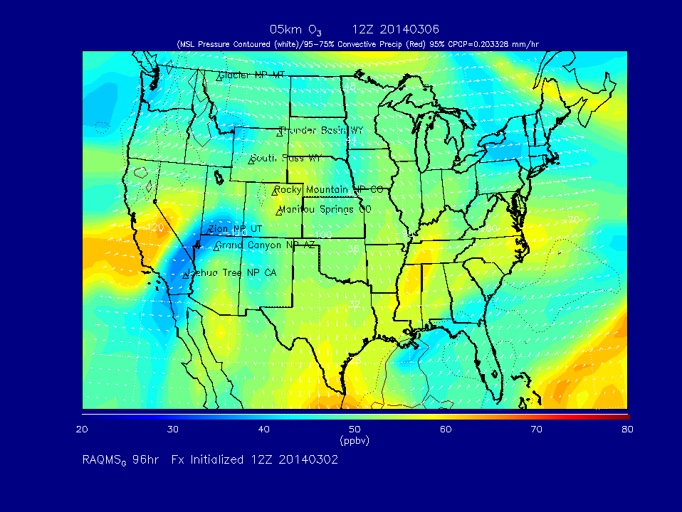
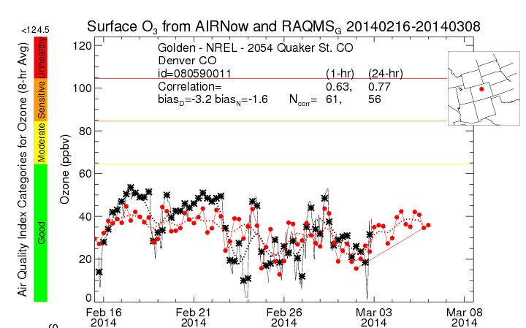
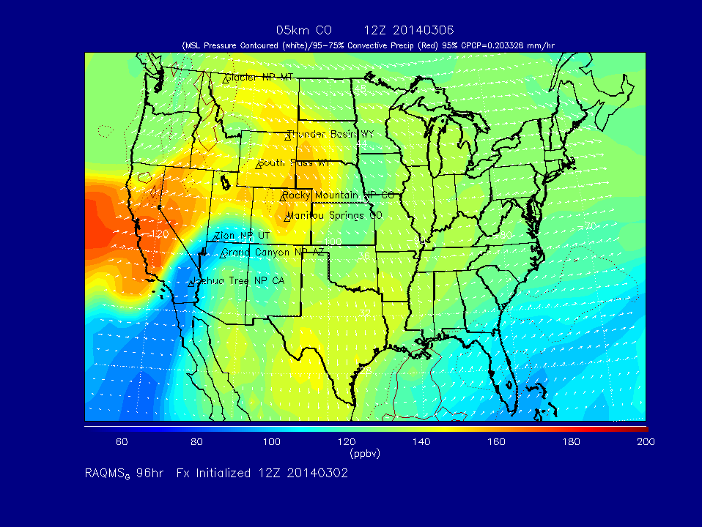
Cooperative Institute for Meteorological Satellite Studies (CIMSS)
Real-time Air Quality Modeling System (RAQMS)
Global 1x1 degree on-line chemical and aerosol assimilation and forecasting system
Assimilation of MODIS aerosol optical depth, MLS stratospheric ozone profiles and OMI cloud cleared total column ozone
MODIS fire detection and Ecosystem/Severity dependent fire emissions
Real-time verification using US EPA AIRNow surface ozone and PM2.5 measurements
Examples

Slide 14
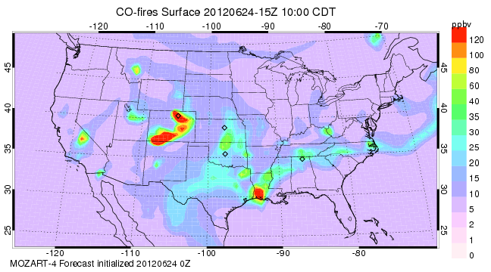
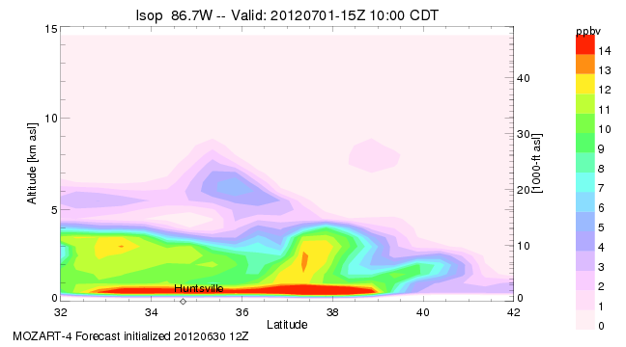
NCAR MOZART-4 Forecasts
Examples
Full chemistry at 1.9°x2.5° http://www.acd.ucar.edu/acresp/forecast/
5-day forecasts, hourly output, currently operational
Forecasts of tracers at 0.5° horizontal resolution
  Isoprene-like tracer based on MEGAN isoprene emissions
  Anthropogenic NOx tracer from individual cities and/or regions
  Fire CO tracer for various regions
  Others for discussion
  Similar to forecasts for DC3, will be run specifically for FRAPPE

Slide 15
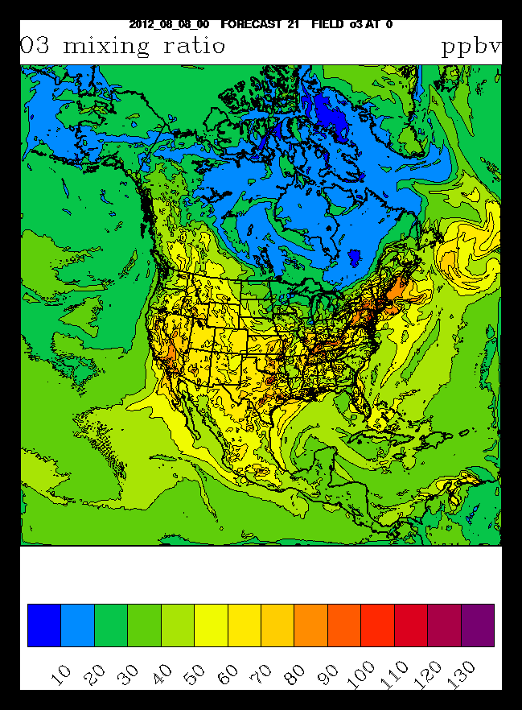
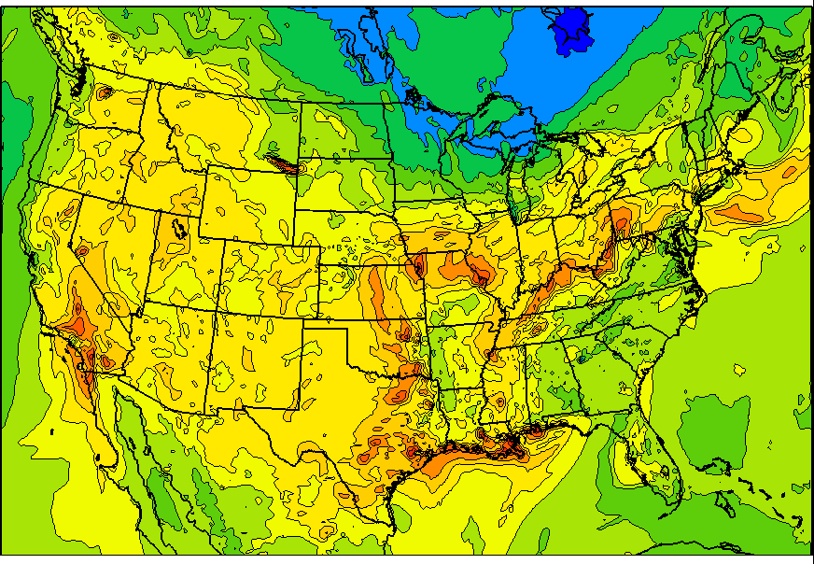
NOAA/ESRL RAP-Chem = WRF-Chem on RAPid refresh (RAP) domain
Dx=13km, RAP (met): operational at NCEP with hourly forecast cycle
Experimental RAP-Chem:
  Includes gas-phase chemistry (O3), aerosols (modal approach), Secondary Organic Aerosols ( SOA, Volatility Basis Set approach)
  Chemical boundary conditions from RAQMS or MACC – still to be decided
  NEI 2011 emissions
  48-hr forecasts
  http://ruc.noaa.gov/wrf/WG11_RT/ -
  different zooms and parameters possible
Examples
O3 (ppbV)

Slide 16
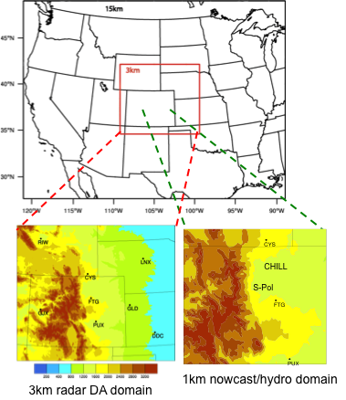
NCAR WRF-Chem with Tracers
Added to 3km STEP Forecast:
Inert tracers with specified lifetime
Suggested tracers:
Anthro tracer (NOx like)
(area, non-road, point sources)
Mobile tracer (NOx like)
Oil & Gas tracer (ethane like)
Agricultural tracer (emissions needed)
Examples

Slide 17
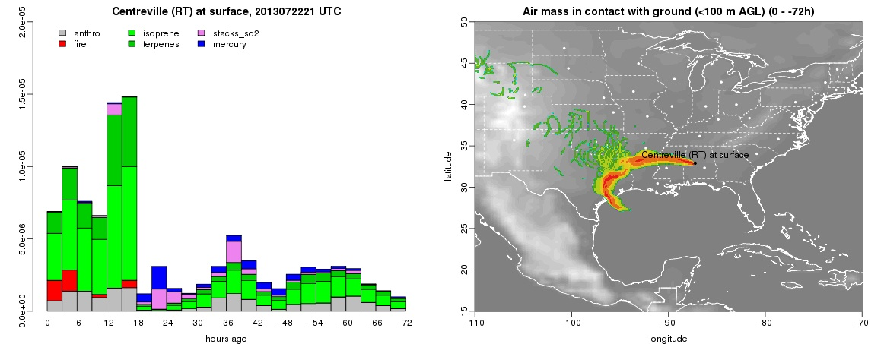
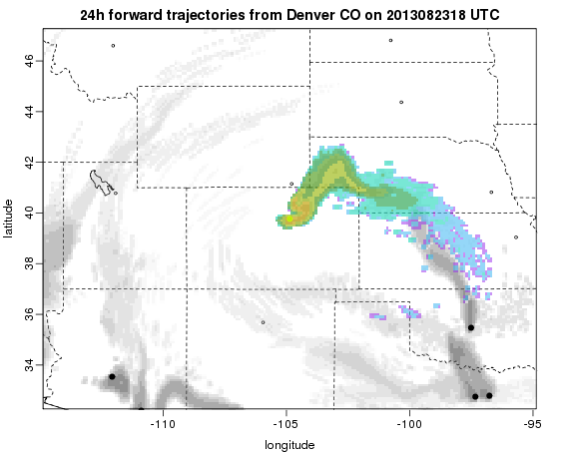
NCAR/ACD: Lagrangian particle dispersion products with FLEXPART
trajectories from ground stations / aircraft paths/ sources
forward and backward in time
based on GFS (global) and WRF (regional) model forecasts / analysis
can be convolved with emissions
provides: airmass history and emissions loading, horizontal and vertical information, deterministic trajectory, trajectory clusters, sensitivity maps
24-hr forward trajectory from Denver
on 2013082318 UTC (during SEC4RS)
Examples

Slide 18
Forecast Schedule
8 - 10 AM Review meteorological and air quality products
10 - 11 AM Consult with NWS forecaster and
CDPHE air quality forecaster
11 AM – 1 PM Prepare/finalize briefing
1 PM Conduct briefing

